Slide 1
HEPS Vacuum System and NEG Coating
Haiyi Dong
Vacuum Group，Accelerator Division，IHEP
July 9, 2026

Slide 2
CONTENT
Brief Introduction
Injector Vacuum
Storage Ring Vacuum
NEG Coating
Summary

Slide 3
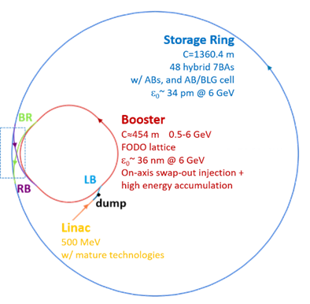
Schematic layout of the HEPS accelerator
HEPS accelerator consists of a linac, a booster, a storage ring, and three transport lines connecting the linac, booster and storage ring.

Slide 4
Brief Introduction
The operating pressure of the HEPS injector needs to be less than 2×10⁻⁶ Pa .
A thin-walled stainless steel chamber with cooling water channels in the booster has been developed to suppress the eddy current effects and dissipate synchrotron radiation power.
A dynamic vacuum level lower than 1.3×10⁻⁷ Pa is required when a beam is circulating in the storage ring. Calculations indicate that the beam lifetime can exceed 100 hours when only beam–gas interaction losses are considered. Meanwhile, low dynamic pressure effectively minimize radiation exposure to insertion devices and beamline personnel.
The chamber wall is designed with gradual profile transitions (taper ≤ 1/10, step ≤ 0.1 mm) to reduce the beam impedance and higher-order mode losses. The overall allowable tolerance of vacuum chambers in vertical and horizontal directions must be lower than 0.3 mm.
Due to very limited pumping conductance of the storage ring vacuum chambers, NEG coating is adopted to suppress electron multipacting and synchrotron radiation-induced pressure rises, as well as to provides distributed pumping.
Sufficient cooling is required to safely dissipate the heat load associated with both synchrotron radiation and higher-order-mode (HOM) losses.

Slide 5
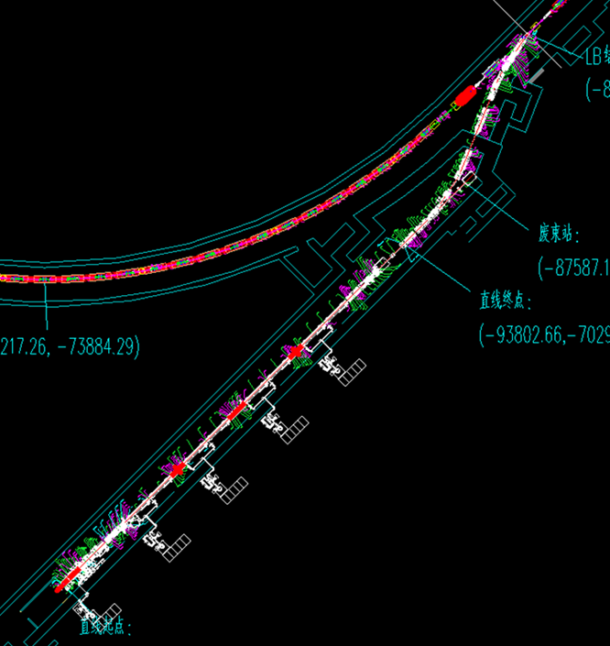
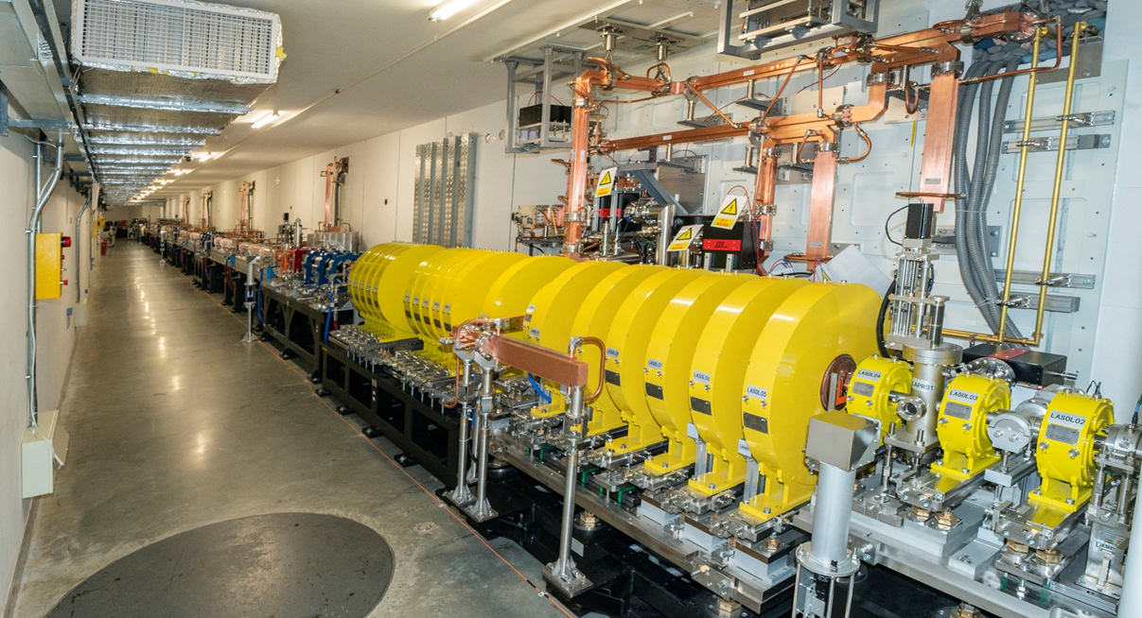
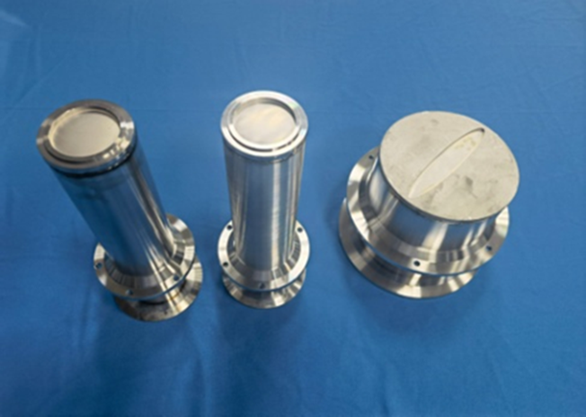
Layout of Vacuum Systems for Linac and Low‑Energy Beam Line
The linac and low-energy transport line (LB) are divided into 8 vacuum sections by eight gate valves.
The vacuum chambers and bellows are made of stainless steel, with a total of 103 components.
Electron Beam Windows are fabricated from 0.1 mm-thick titanium films.

Slide 6
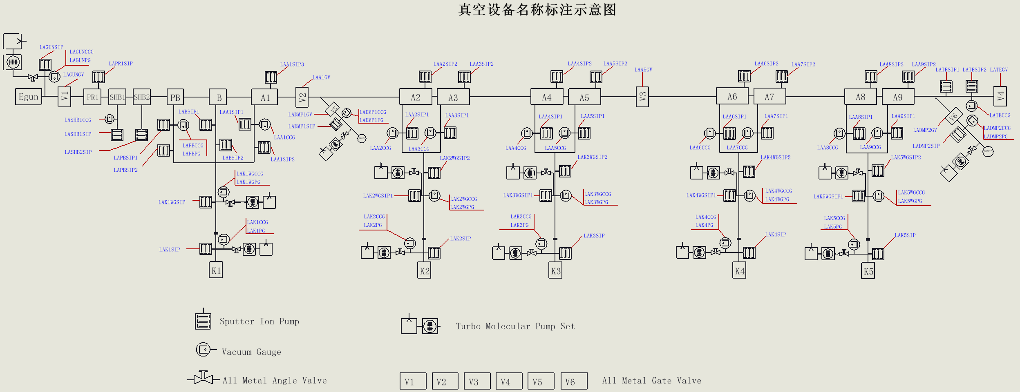
Linac Schematic Diagram of Vacuum Device Distribution
Total 45 ion pumps and 25 cold-cathode gauges.

Slide 7
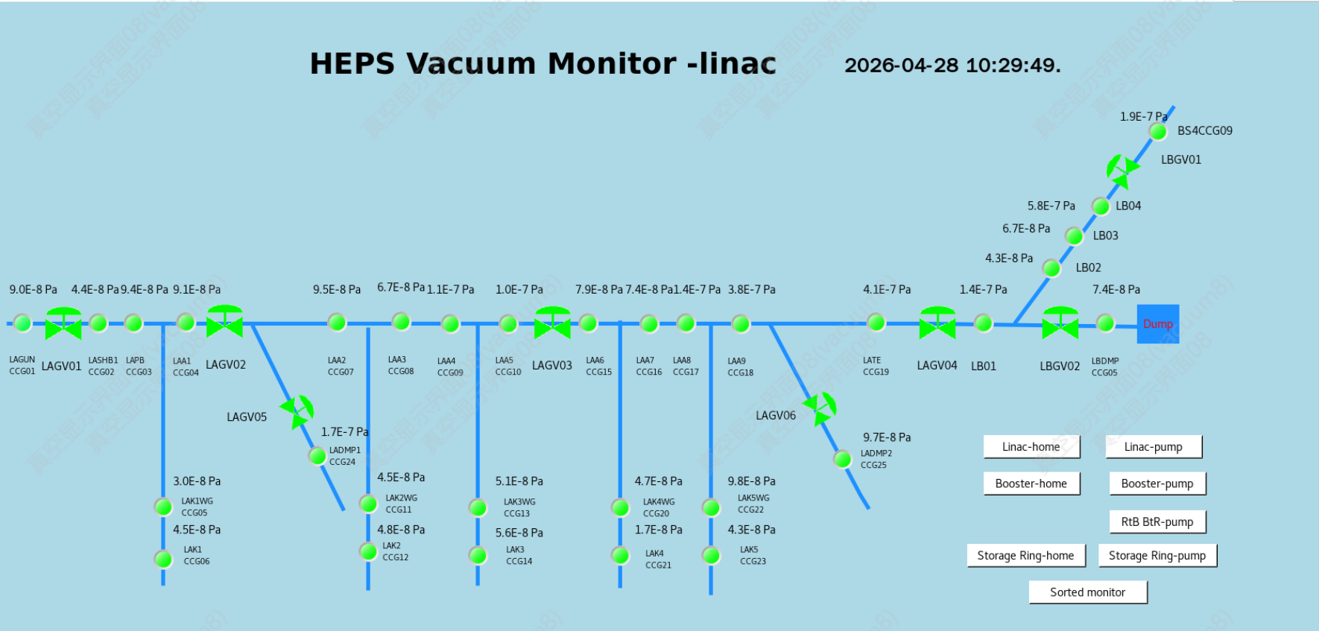
Vacuum Status of Linac and LB
Dynamic Pressure: 5.8E-7 Pa ∼ 3.0E-8 Pa (Design Average Pressure: < 2E-6 Pa )

Slide 8
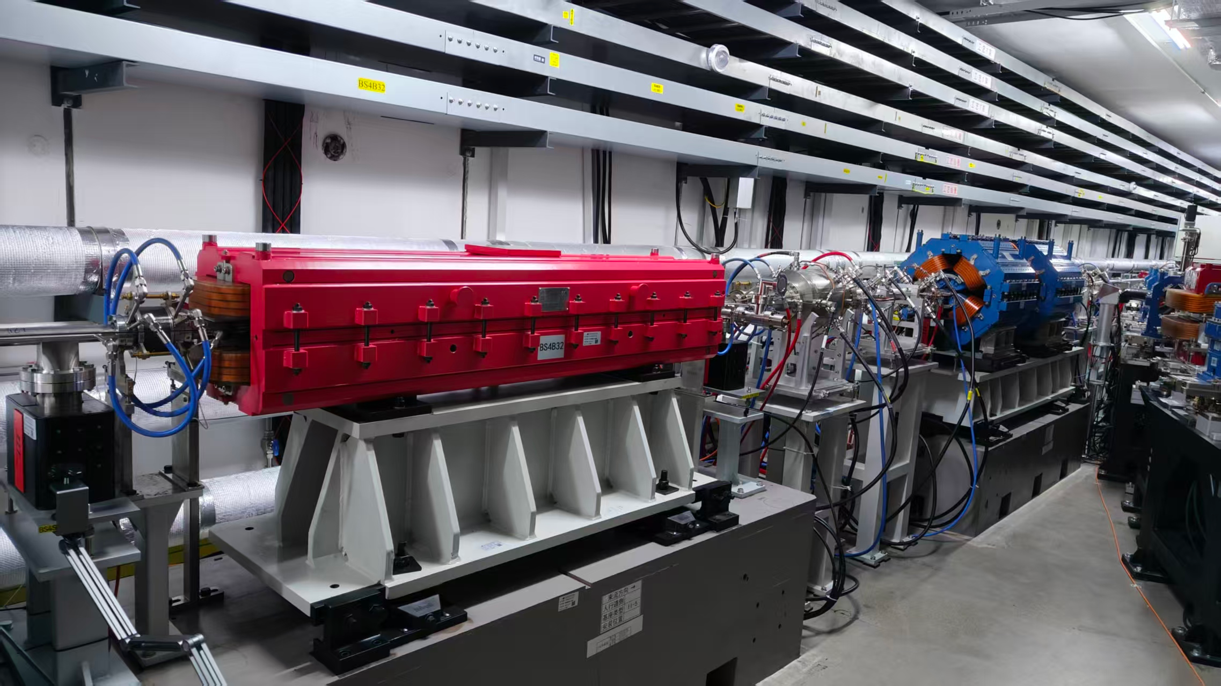
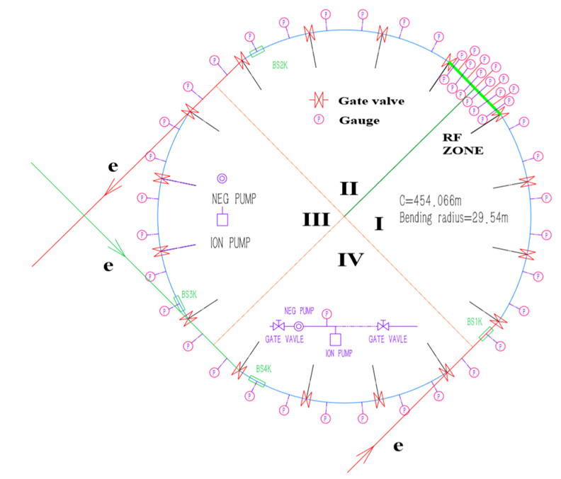
Booster Vacuum System
The booster is divided into 14 sections by RF all-metal gate valves. Each RF cavity is equipped with valves at both ends, giving a total of 26 valves.
There are 407 vacuum chambers in total, covering 83 types.
A total of 160 RF‑shielding bellows of 19 types are installed in the booster.
Total: 145 ion pumps and 39 cold-cathode gauges.

Slide 9
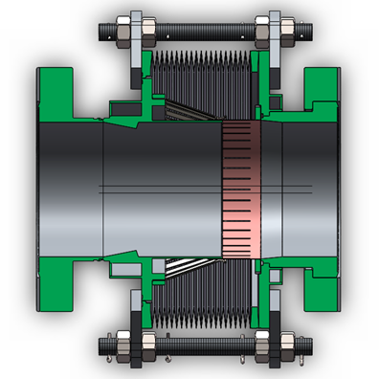
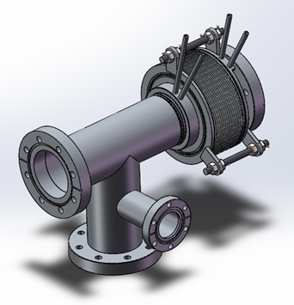
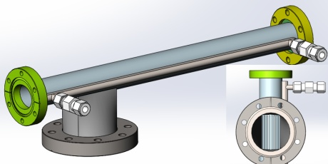
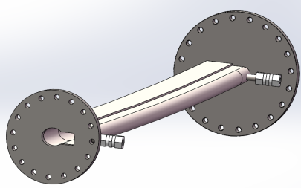
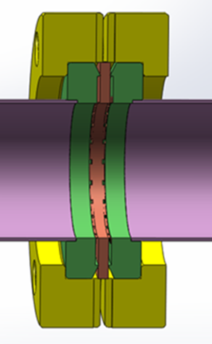
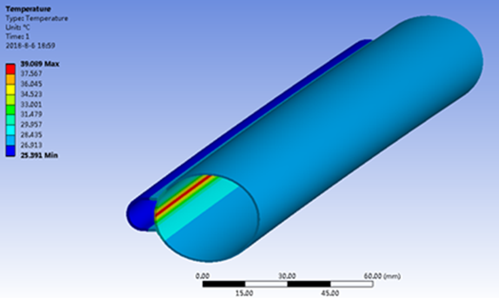
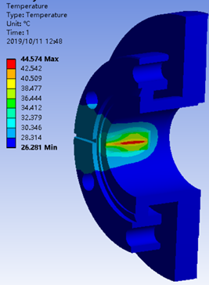
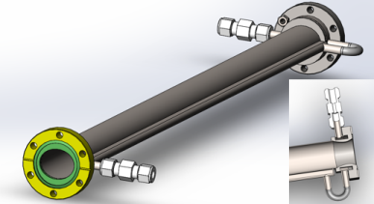

Booster Vacuum Components
The wall thickness of the elliptical vacuum chamber（36 mm × 30 mm H×V) is 0.7 mm, its magnetic permeability ≤ 1.02, perpendicularity ≤ 0.1 mm, and straightness ≤ 0.2 mm.
The RF shielding structure of the bellows consists of multiple contact fingers and spring fingers, with a maximum allowable lateral offset of ±2 mm.

Slide 10
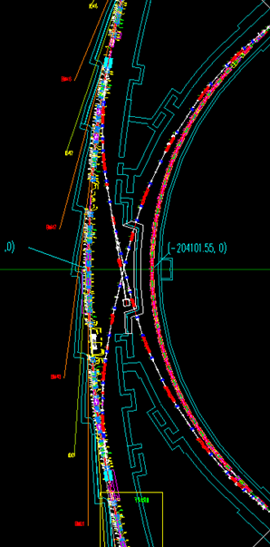
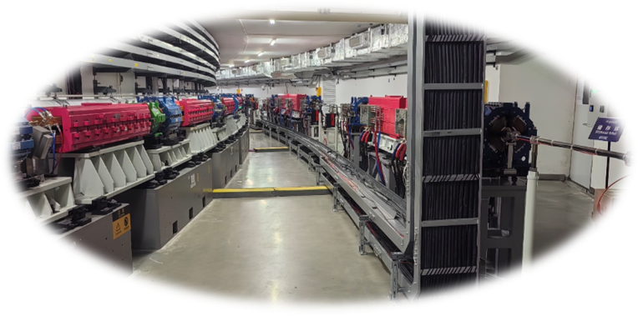
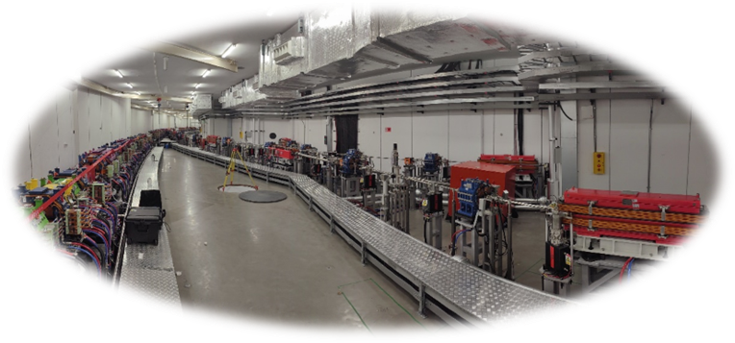
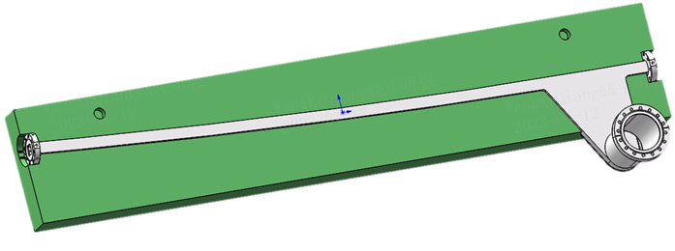
High Energy Transport Line Vacuum System
Ring
BR
RB
Booster
BR & RB consist of two lines with a length of 105 m each and one dump electron beam line of about 18 m long.
Each line is divided into 5 vacuum sections, with a total of 54 ion pumps, 15 cold-cathode gauges, and 6 gate valves.
There are 126 vacuum chambers for the BR line, 129 for the RB line, and 12 for the dump line.
High-precision thin-walled rectangular bending vacuum chambers (26×26) were manufactured.

Slide 11
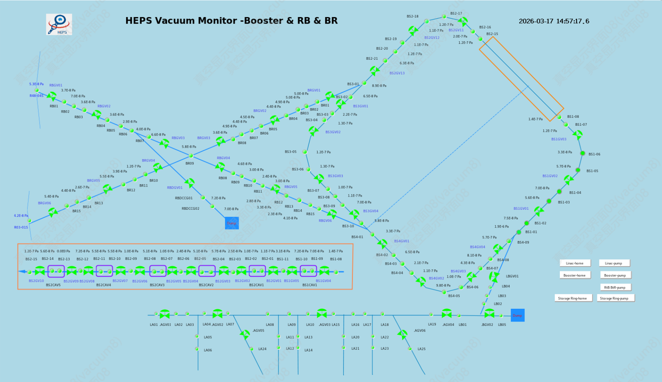
Vacuum Status of Booster and RB &BR
Average Dynamic Pressure is 1.2E-7Pa;
Design Average Pressure: < 2E-6 Pa.

Slide 12
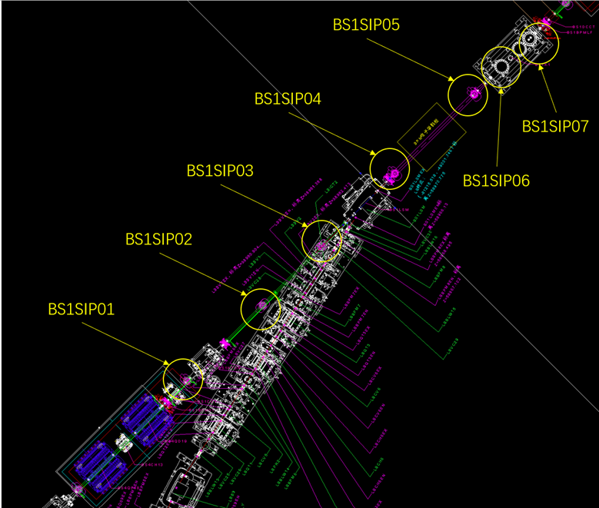
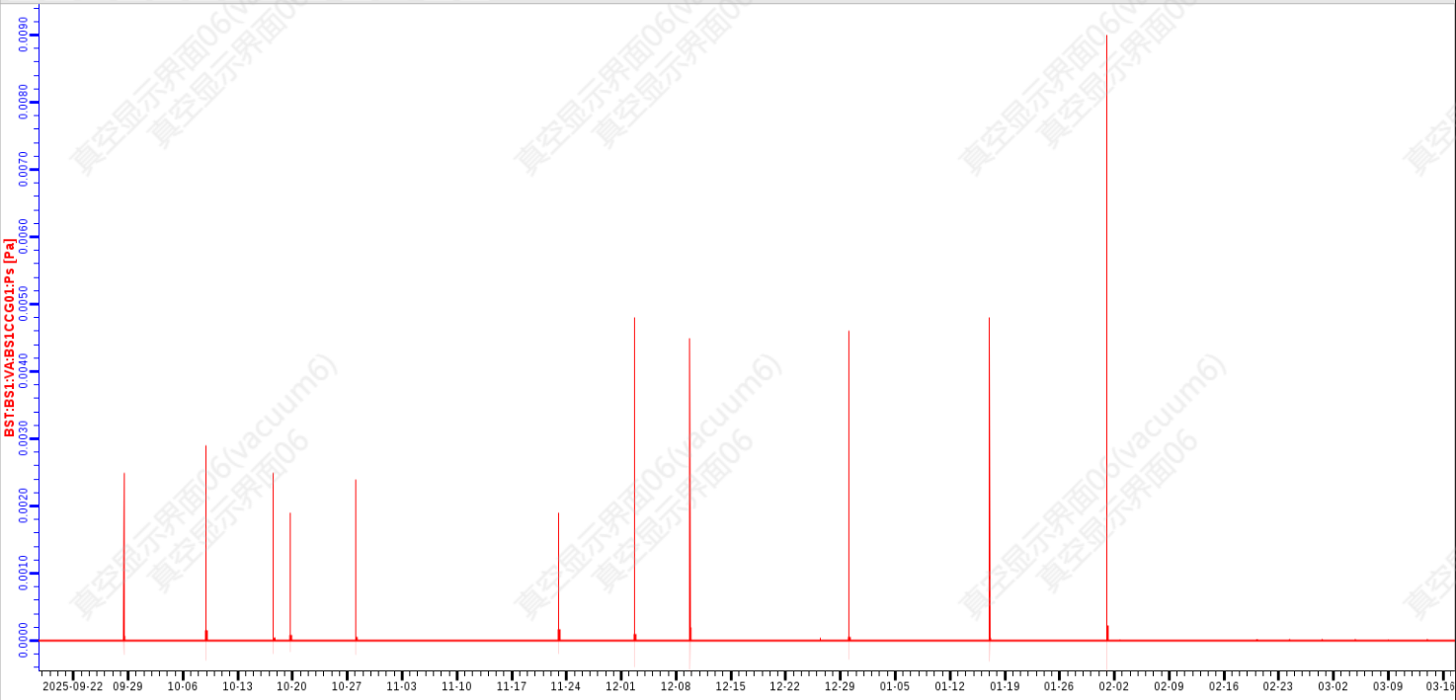
Lessons Learned: Pressure Spikes in the Booster
2025.10.15-2025.12.10
Turn off BS1SIP06 , 07 or 05
2025.12.10-2026.2.12
Turn off BS1SIP04
2026.2.12-
Off SIP04/05/06/07
BS1CCG01
There are periodic pressure spikes in the Booster injection sector. The pressure rise measured by the Cold-Cathode Gauge (BS1CCG01) reaches about 5×10⁻³ Pa and triggers overcurrent protection on the Sputter Ion Pumps (BS1SIP04/05/06/07).
This phenomenon is usually referred to as “argon instability” for diode ion pumps, and the burst gas is mostly Ar.
Whichever pump among BS1SIP04, 05, 06, or 07 is turned off, a pressure spike still remains.
When BS1SIP04/05/06/07 were all turned off, no pressure spike was observed over a one-month period, and the pressure of BS1CCG01 maintained at 1.8 ×10⁻⁶ Pa.
It can be concluded that the pressure spikes were caused by two or more ion pumps.

Slide 13
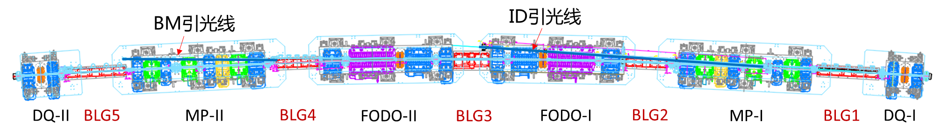
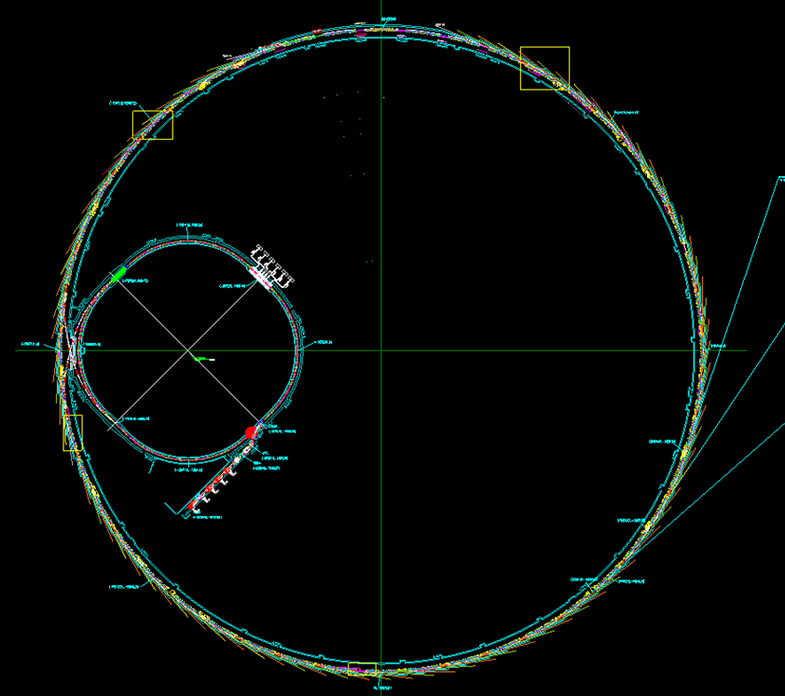
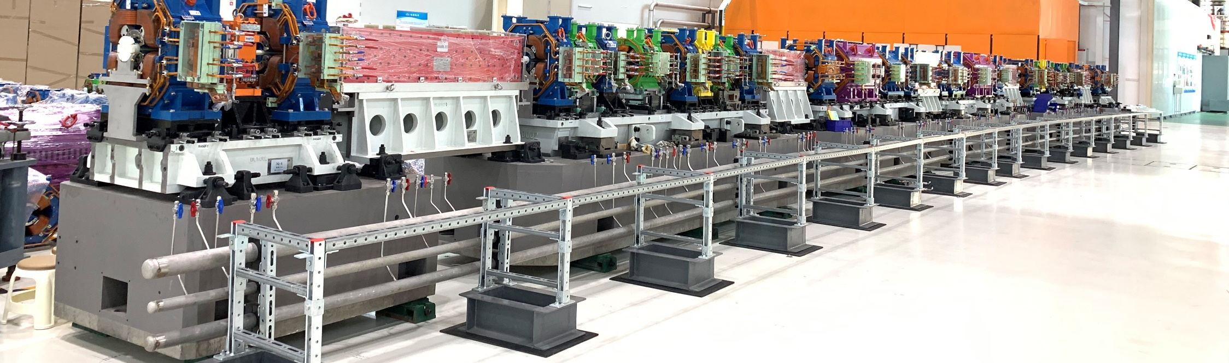
Layout of Storage Ring Vacuum system
R46 Arc Cell
The 6 GeV storage ring has a circumference of 1360.4 m and adopts a 24‑dual‑7BA‑cell achromat lattice.
Among the 48 cells, the long straight sections are located at the beginnings and are mainly used for installing insertion devices, injection and extraction equipment, RF cavities, and other components.
RF all‑metal gate valves are installed at both ends of the long straight sections, dividing the entire ring into 101 vacuum sectors.

Slide 14
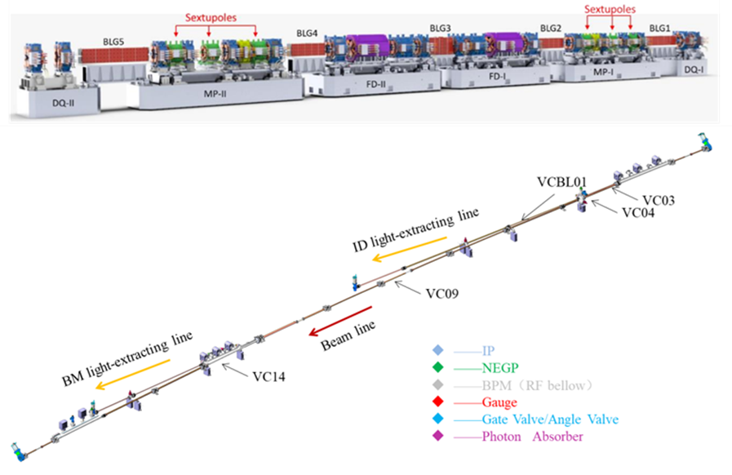
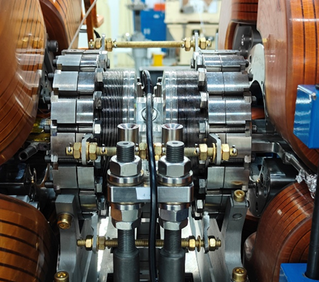
Vacuum Components in an Arc Cell of Storage Ring
One arc cell includes the following components:
Vacuum chambers: 18+6 (Ring + Beamline)
RF shielding bellows: 14
Photon absorbers: 4+2
Ion Pumps (25L/s): 14+2
NEG pumps (Z 400): 3
Cold cathode gauges: 2+2
Residual gas analyzer: 1
All-metal gate valves: 2+2
All-metal angle valves: 2
Transition pipes and bellows: 8

Slide 15
Specifications of the vacuum chambers in an arc cell in the storage ring
No. | Related magnets | Size of cross section（mm） | Material | Length(mm) | Bending（°） | In/Out Flange type
VC1 | QF1-FC1-QD1 | ø22 | C18150&Inconel625 | 956.9/988.3 | 0 | CF63R/CF63
VC2 | BLG1 | In ø22/Out (11+39) Width | 316LN/C18150 | 1587.1 | 1.2373 | CF63R/CF63R
VC3 | QD2-SD1-ABF1 | In (11+53.3) W /Out (11+56) W | C18150 | 1020.3 | -0.0768 | CF63R/CF63
VC4 | - | In (11+56) W/Out (11+13) W | 316LN | 134 | 0 | CF63/CF25R
VC5 | SF1 | In (11+12.8) W/Out ø22 | C18150 | 497 | 0 | CF25/CF40R
VC6 | QF2-OCT1-SD2-QD3 | ø22 | C18150 | 1667.8 | 0 | CF40R/CF63
VC7 | BLG2-QF3 | ø22 | C18150 | 1697.8 | 0.8369 | CF63R/CF63
VC8 | BD1 | ø22 | C18150 | 1202.5 | 1.3676 | CF63R/CF40
VC9 | FC2/ABF2 | In (11+14) W/Out ø22 | C18150&Inconel625 | 930.8 | -0.3081 | CF40R/CF63
VC10 | QD4-BLG3-QD5 | ø22 | C18150 | 1666.8 | 1.3862 | CF63R/CF63
VC11 | ABF3 | In (11+28) W/Out (11+28) W | C18150 | 725.2 | -0.3081 | CF63R/CF40
VC12 | FC3 | In (11+28) W/Out (11+28) W | Inconel625 | 210 | 0 | CF40R/CF40
VC13 | BD2 | In (11+28)/Out (11+48) W | C18150 | 1178.8 | 1.3676 | CF40R/CF125
VC14 | BLG4-QF4 | In (11+55) W/Out ø22 | 316LN | 1808.5 | 0.8369 | CF125R/CF63R
VC15 | QD6-SD3-OCT2-QF5 | ø22 | C18150 | 1555.8 | 0 | CF63R/CF63
VC16 | SF2-ABF4-SD4-QD7 | ø22 | C18150 | 1647.1 | -0.0768 | CF63R/CF25
VC17 | BLG5 | ø22 | 316LN | 1589.1 | 1.2373 | CF25R/CF63R
VC18 | QD8-FC4-QF6 | ø22 | C18150&Inconel625 | 988.3/956.9 | 0 | CF63R/CF63

Slide 16
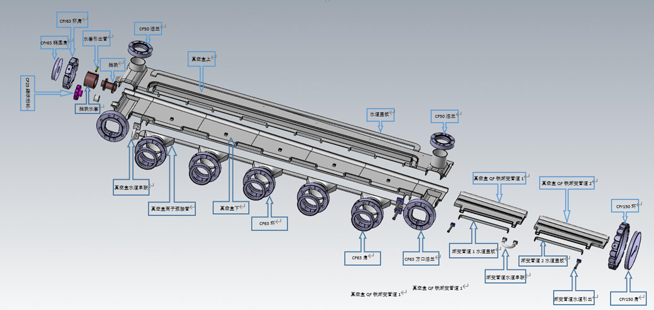
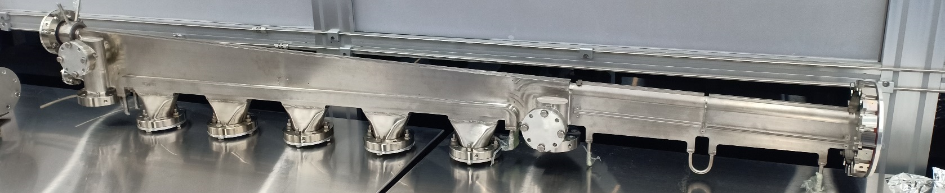
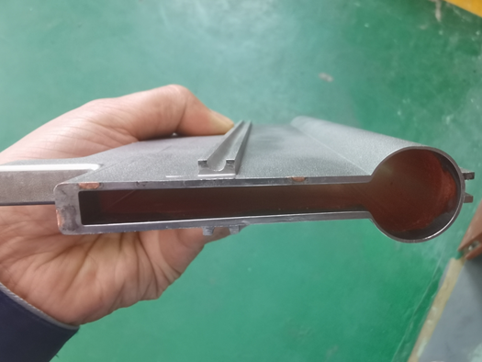
Stainless Steel Vacuum Chamber
VC14（BLG4+QF4)
Multi-channel stainless steel vacuum chambers have been fabricated, allowing vacuum pumps, gauges, valves, and photon absorbers to be installed in the available space.
The welding methods include laser welding, electron beam welding and TIG welding.
The inner surface of the electron beam pipe is copper-plated to a thickness of 20 μm, with a magnetic permeability of less than 1.02.

Slide 17
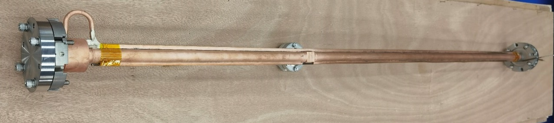
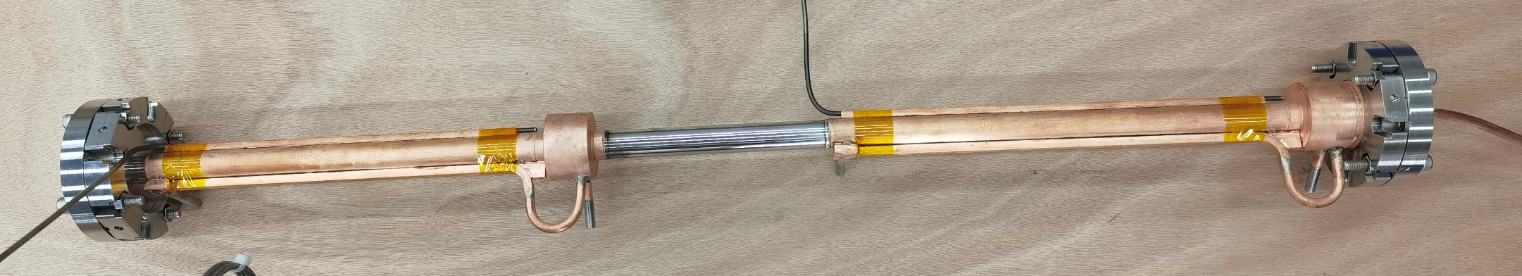
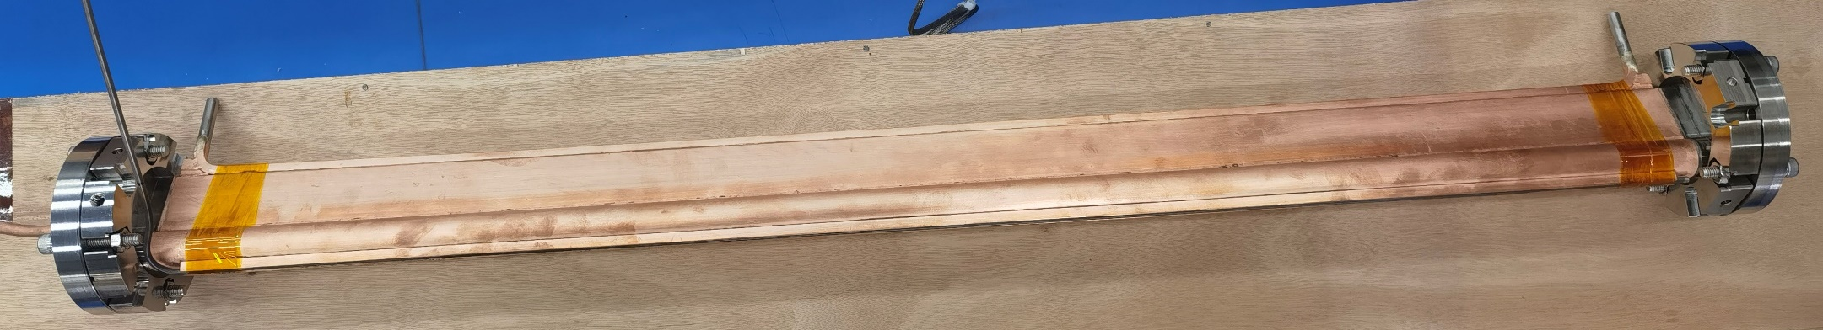
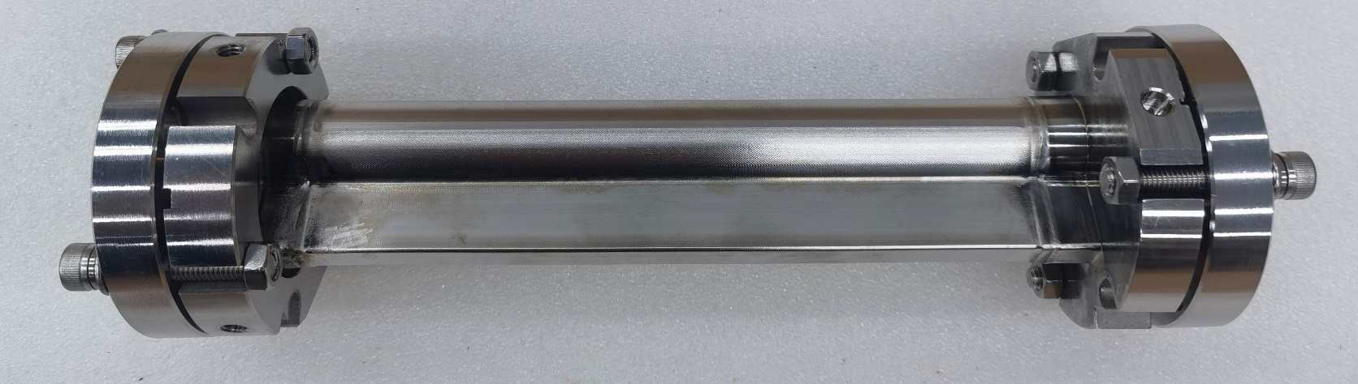
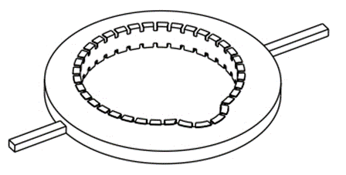
CuCrZr & Inconel Vacuum Chamber
Cu-Cr-Zr (C18150) alloy with higher strength and hardness is extruded and drawn into a specific shape for the HEPS vacuum chamber.
The fast corrector vacuum chamber is made of Inconel with low electrical conductivity and has a wall thickness of 0.5 mm to reduce the eddy current effect.
At the end of the circular vacuum chamber, there is a synchrotron light mask with a cooling water jacket.
Electron beam welding is adopted for vacuum tightness, and low-temperature (>300°C) brazing is used for cooling water pipes and heating wire slots to prevent the Cu-Cr-Zr alloy from softening.
Most of the electron beam pipe has an inner diameter of 22 mm (min. 8 mm) and a wall thickness of 1 mm (min. 0.5 mm). The gap between the magnetic pole and the vacuum chamber is 1 mm (min. 0.5 mm). Therefore, the vacuum chamber is required to have extremely high mechanical precision.
VC01
VC03
VC07
VC12
Gasket with RF shielding

Slide 18
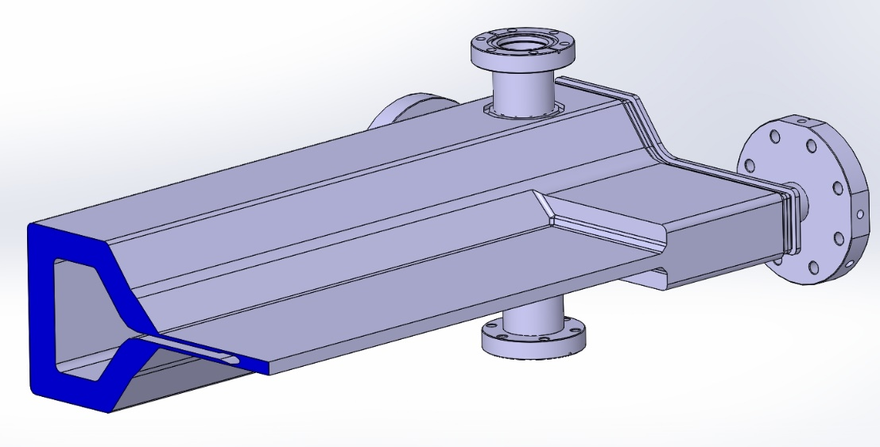
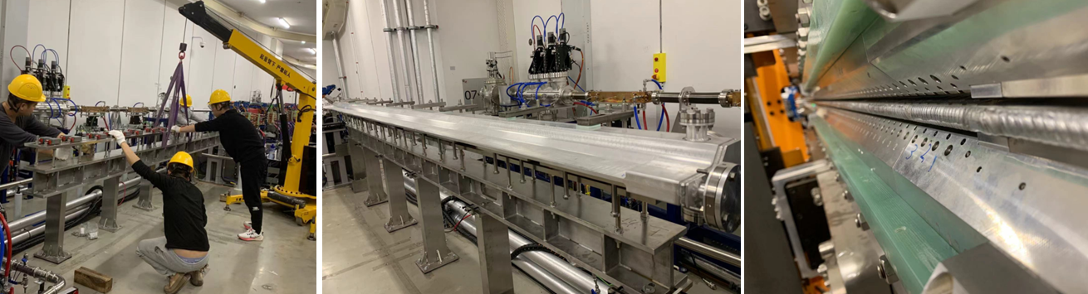
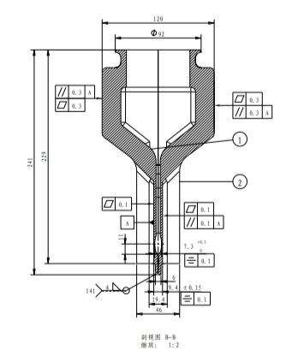
In-Air ID Vacuum Chamber (IAU: 4; IAW: 2; A-K: 1)
The main material of the ID vacuum chamber is aluminum alloy (AL6061-T6), with a total length of about 5.4 meters.
The flange is made of the composite material SUS316L/AL5083-H321.
The electron beam channel has an ellipse cross-section of 7.3×22 mm, a minimum wall thickness of 1 mm, and the gap between permanent magnet poles is only 11mm.
The straightness of the central axis of the beam channel is better than 0.15 mm.
ID chambers are divided into upper and lower halves, which are machined separately by numerical control and then welded together.

Slide 19
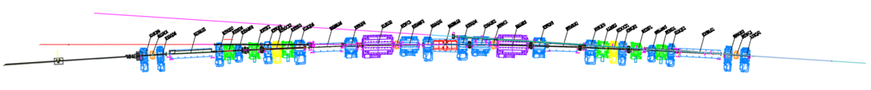
Photon Absorbers
ABF4
ABF3
ABF2
ABF1
ABSR2
ABSR1
ABS5
ABS4
ABS3
ABS2
ABS1
BLG5
BLG4
BLG3
BLG2
BLG1
BD2
BD1
Approximately half of the synchrotron radiation power generated by the bending magnet is deposited onto the photon absorbers (ABS). The power of each arc cell is 12.05 kW (@200 mA).
There are 4 photon absorbers (ABS1-4) in each arc sector, three of which are located at the synchrotron radiation extraction crotch.
Techniques such as CNC machining, slow wire-electrode cutting, and gold-copper brazing are adopted.

Slide 20
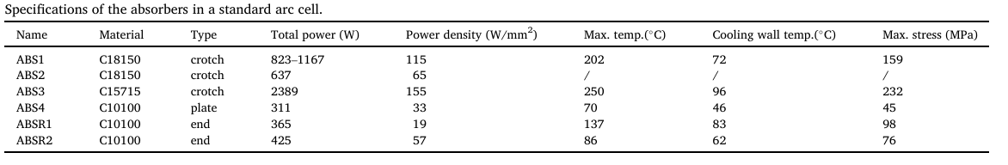
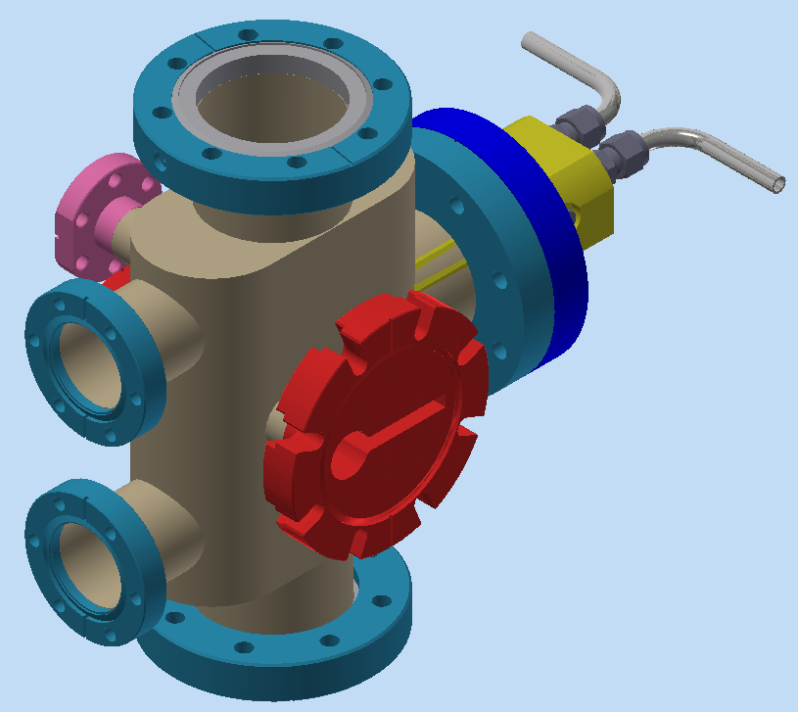
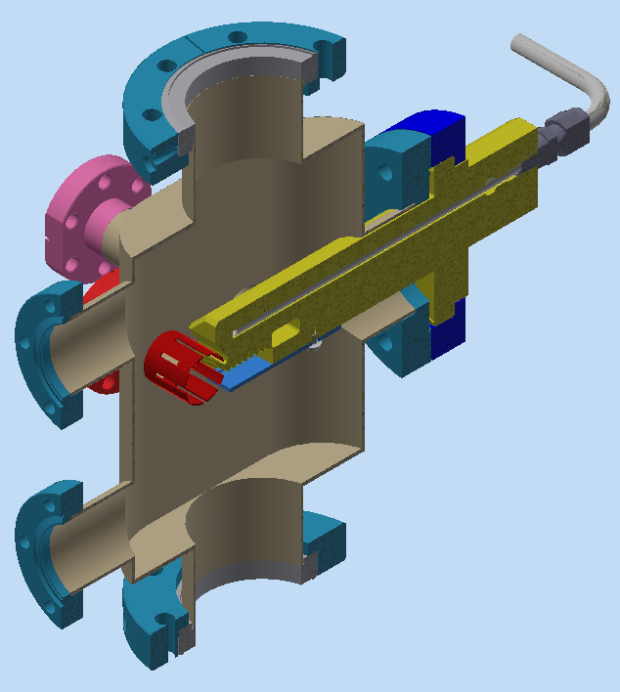
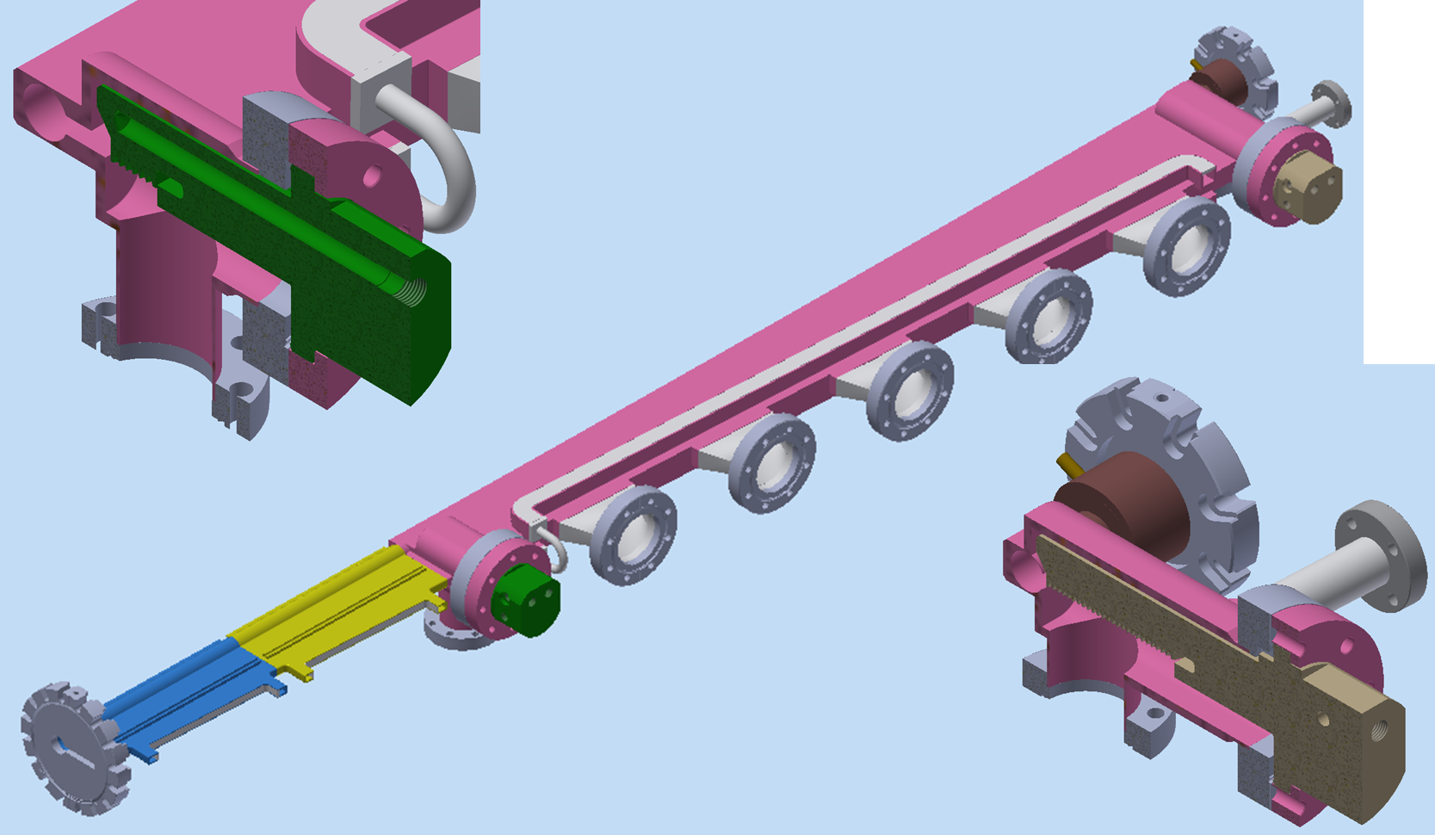
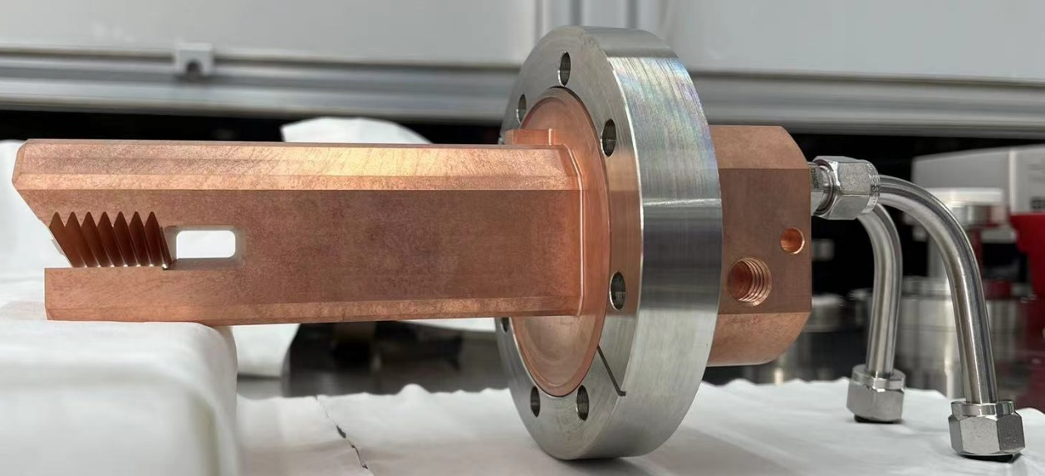
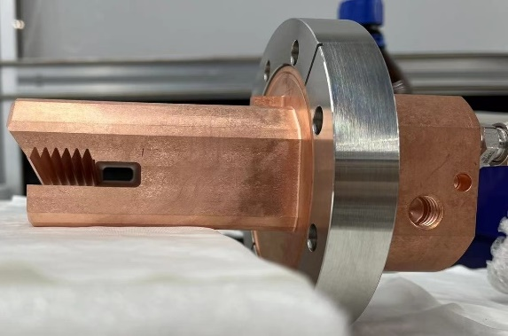
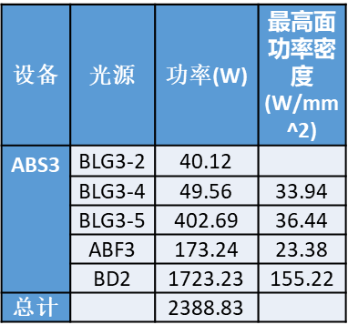
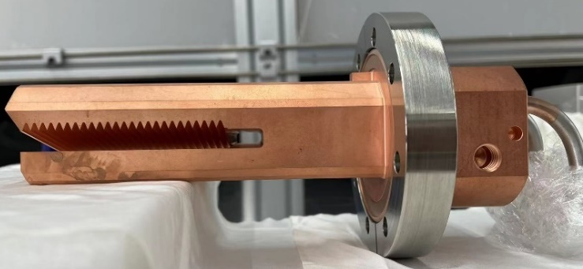
Crotch Photon Absorber
ABS1（CuCrZr）
ABS2（CuCrZr）
ABS3（dispersion-strengthened copper ）(C15715)

Slide 21
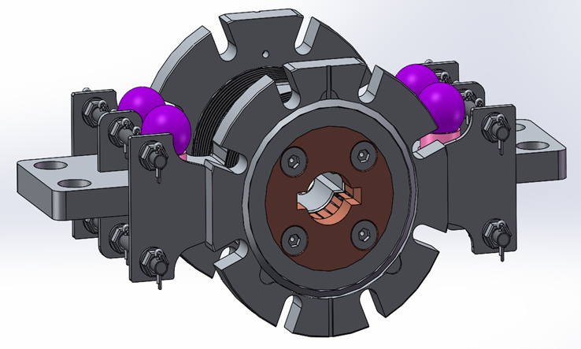
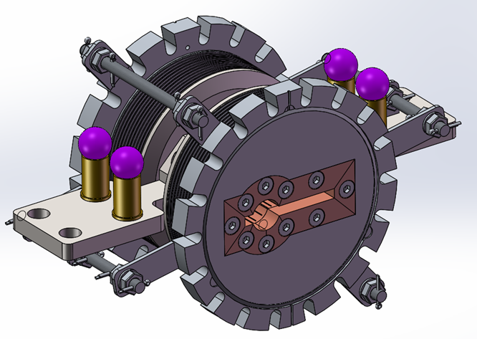







RF Shielding Bellows of Storage Ring

Slide 22







Mass-produced NEG Coating Setups
There sets of coating systems have been built.
There are a total of 918 vacuum chambers in the HEPS storage ring, with a total length of about 1,200 meters, all of which have been coated.
Coating of the 6 mm slit in the 1200 mm-long antechamber has been achieved by means such as applying a multi-segmented solenoidal magnetic field, increasing the magnetic field intensity of the end solenoids, and adjusting the discharge parameters.
A：Circular chamber
B：Antechamber
Clean Room
6 groups of vacuum chambers in parallel
C: Movable Solenoid
Power Supply and Controller

Slide 23



NEG Coating Specifications
Parameter | Design Objective | Achieved Target
Pumping Speed for H₂ L/(s.cm²) | 0.5 | 0.72
Min. Activation Temperature ℃ | ≤180 | 160
Absorbed Capacity for CO mbar·L/cm² | >1.0 ×10⁻⁵ | 1.8 ×10⁻⁵
Thickness of the film | 1 μm ± 30% | 1 μm ± 30%
Ti 钛
Cathode
V 钒
Zr 锆

Slide 24



Results of Mass NEG Coating Tests

Slide 25



Bakeout and NEG Activation of Storage Ring
Thin 0.4 mm polyimide Heating tapes wrapped around the vacuum chambers or jacketed heating wires clamped to the inboard side of vacuum chambers were used in-situ.
Customized heating jackets were employed for complex-shaped vacuum components.
The aluminum layer on the heating tape shields heating radiation and provides uniform temperature distribution.
Total 66 Hrs

Slide 26

Vacuum Status of Storage Ring
@ 6GeV, 100mA
CCG01/02 gauges in the arc cells are located close to photon absorbers with maximum gas desorption.
CCG01S gauges are installed in the straight sectors.
CCG03/04 gauges are installed in the beamlines.
Average Dynamic Pressure is 1.4E-7Pa (Specification: : ≤ 1.3E-7 Pa @200mA)

Slide 27
Normalized Average Pressure as a Function of Integrated Beam Current

Slide 28


Residual Gas Analysis
Static Vacuum (0 mA):
Ion Current Ratio:
H₂/(H₂+H₂O+CO+O₂+Ar+CO₂)
=8.58/(8.58+0.42+1.17+0.03+0.04+0.23)
=81.95％
Dynamic Vacuum (100 mA):
Ion Current Ratio:
H₂/(H₂+H₂O+CO+O₂+Ar+CO₂)
=2.33/(2.33+0.006+0.02+0.0004+0.0006+0.004)
=98.69％

Slide 29




Lessons Learned: Temperature Abnormality
A notably higher temperature was detected on the flange of an RF shielding bellows in the R36 cell when the beam current reached 100 mA;
A deviation of 0.45 mm (allowable tolerance < 0.3) toward the inner ring was found by alignment measurement;
The flange temperature dropped from 62 °C to 43 °C at 100 mA after repositioning the flange;
It is therefore concluded that the temperature rise of the flange resulted from synchrotron radiation.

Slide 30
Summary
The vacuum system runs smoothly during pilot operation, with no failures other than vacuum alarms due to pressure spikes.
The causes of the gas burst in the Booster and the temperature abnormality in the storage ring have been identified.
All types of spare vacuum components in the storage ring have been prepared.
The dynamic pressure of the storage ring is expected to improve further with the increase of accumulated beam dose.

Slide 31


