Slide 1
HEPS-ALBA virtual workshop
ALBA II ID requirements
14th July 2026
Andrea Fontanet on behalf of IDMAFE section

Slide 2
Outline
Portfolio of IDs at ALBA
New IDs for ALBA II

Slide 3
IDs portfolio at ALBA
All IDs installed at ALBA have been outsourced to Industry:
ID # | ID type | Period [mm] | Manufacturer | Year | Technology | Materials
ID24 / ID29 | APPLE-II | 62.36 / 71.36 | Elettra | 2009 | PPM | NdFeB
ID22 | MPW | 80.0 | ADC | 2009 | Hybrid | NdFeB + Permendur
ID04 | SCW | 30.0 | BINP | 2010 | SC coils | NbTi
ID11 / ID13 | IVU | 21.6 | Bruker | 2011 | PPM | Sm₂Co₁₇
ID20 | APPLE-II | 125.0 | KYMA | 2017 | PPM | NdFeB
ID06 | IVU | 19.9 | KYMA + RI | 2020 | Hybrid | NdFeB + Permendur
ID31 | MPW | 54.0 | AVS | 2022 | Hybrid | NdFeB + Permendur
ID15 | IVU | 21.4 | KYMA+AXILON | 2026 | Hybrid | NdFeB + Permendur

Slide 4
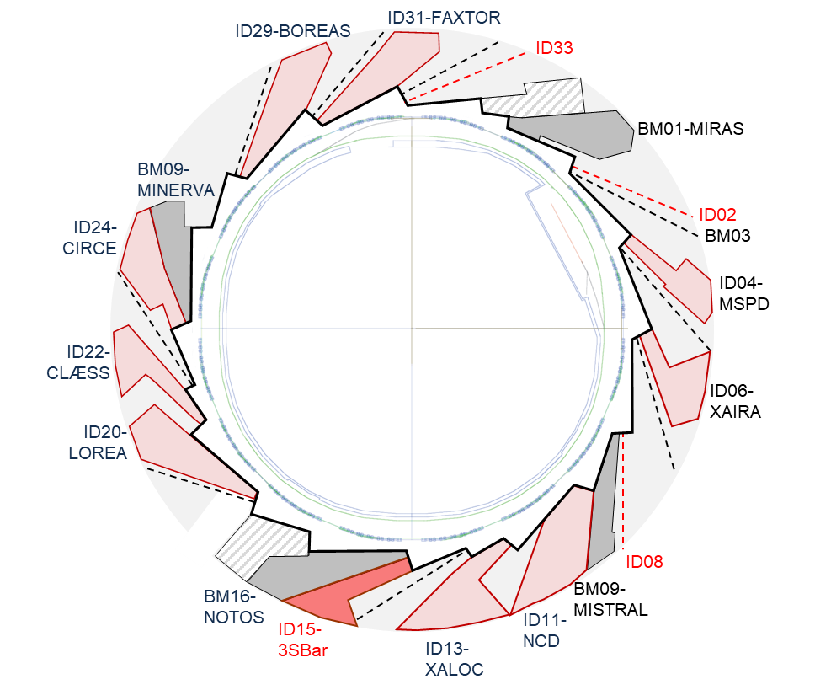
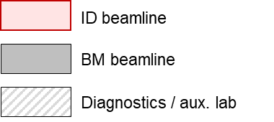
IDs portfolio at ALBA
ALBA has 12 identical 4.2 m-long medium straight sections, which allow to install in-vacuum devices of up to 2.75 m flange-to-flange.
After the installation of ID15-3Sbar, only 2 medium straight sections (ID02 and ID33) remain available for new IDs.
There is one additional ID port available, ID08, but currently it is not of much use because it is linked to a long straight section (8 m) with high beta values (β_{x}=11.3 m and β_{y}=6.75 m).

Slide 5
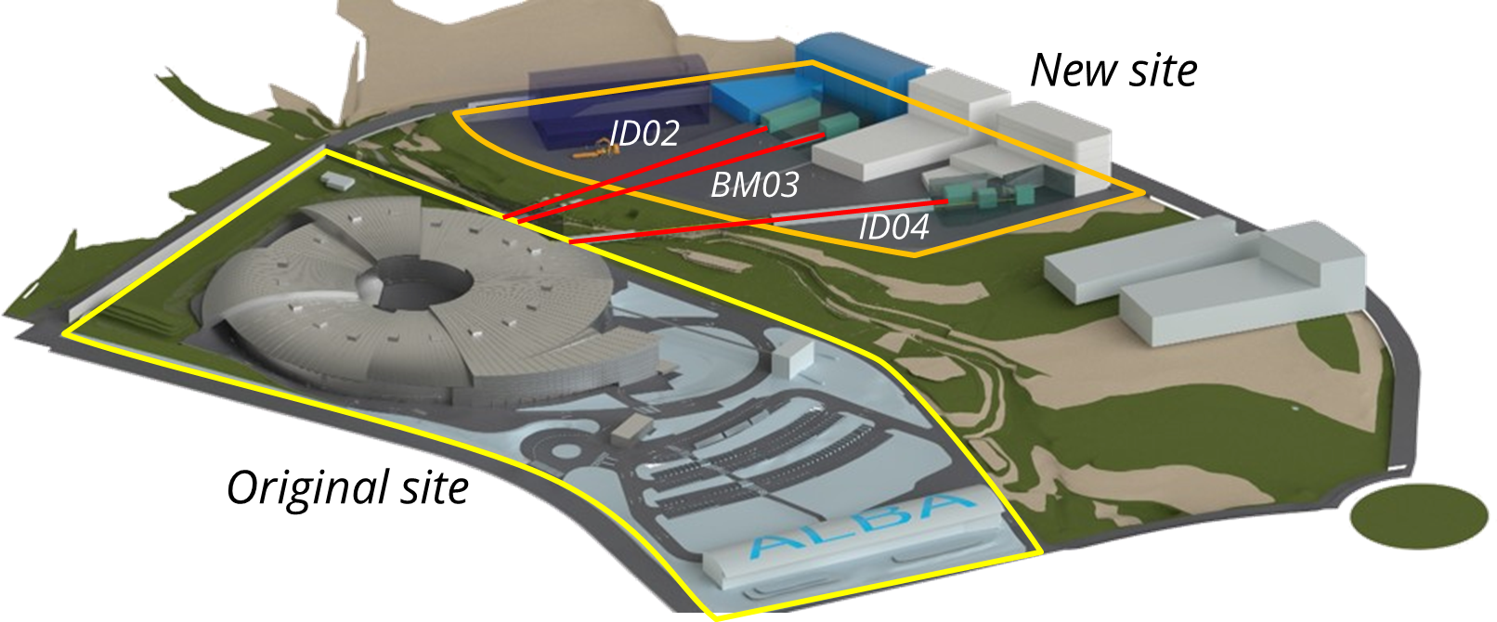
New IDs for ALBA II
The upgrade includes the expansion of the experimental hall onto newly acquired land, which will enable the construction of three extra-long (>250 m) beamlines for nano-probing and coherence based techniques.
One of the ports for those long beamlines (ID04) currently hosts the Material Science and Powder Diffraction (MSPD) beamline, which will not benefit significantly from additional length. Thus, MSPD will be relocated to port ID33 and upgraded to MSPD2, with a new source and optics.

Slide 6
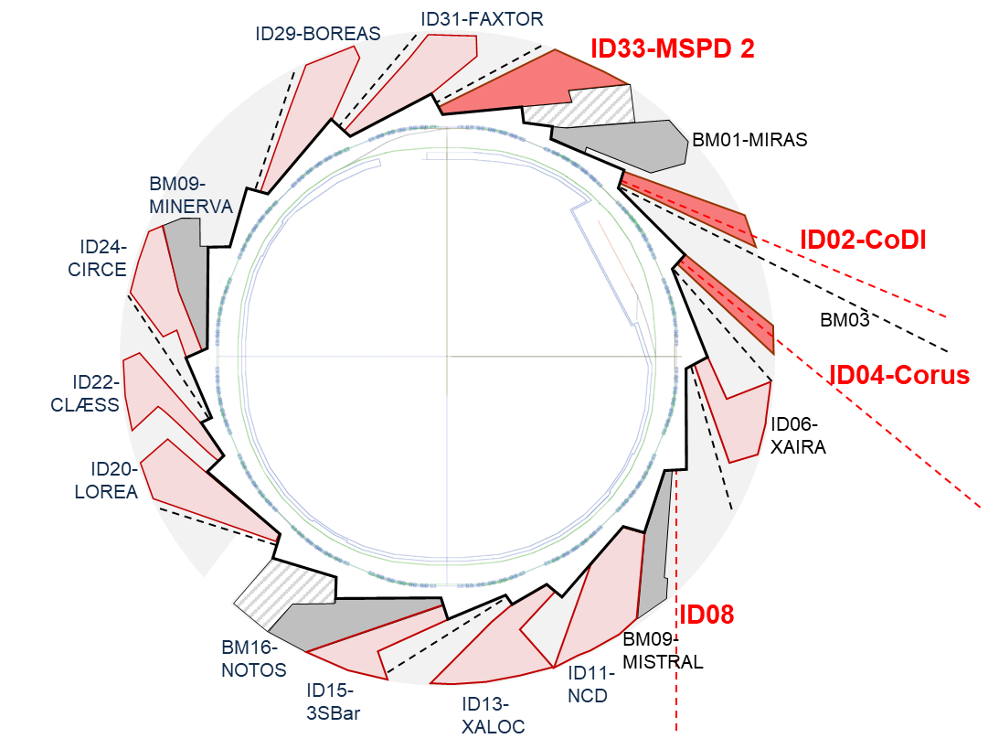
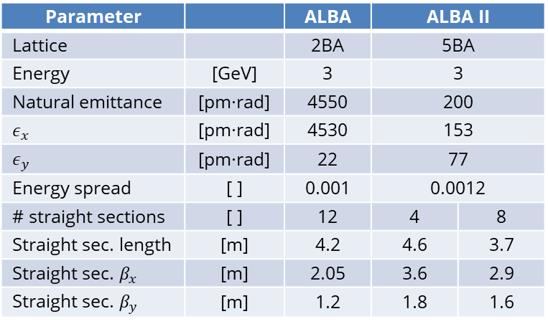
New IDs for ALBA II
The IDs planned for the coming years are:
  ID33 MSPD2: upgrade of Material Science and Powder Diffraction beamline.
  ID02 CoDI: Coherent Diffraction Imaging beamline.
  ID04 Corus: Cryo bio-nano-imaging beamline.
Some of those beamlines will start operating at ALBA, but all of them will be optimized for operation at ALBA II.
Parameter |  | ALBA | ALBA II
Lattice |  | 2BA | 5BA
Energy | [GeV] | 3 | 3
Natural emittance | [pm·rad] | 4550 | 200
$$ε_{x}$$ | [pm·rad] | 4530 | 153
$$ε_{y}$$ | [pm·rad] | 22 | 77
Energy spread | [ ] | 0.001 | 0.0012
# straight sections | [ ] | 12 | 4 | 8
Straight sec. length | [m] | 4.2 | 4.6 | 3.7
Straight sec. $β_{x}$ | [m] | 2.05 | 3.6 | 2.9
Straight sec. $β_{y}$ | [m] | 1.2 | 1.8 | 1.6

Slide 7
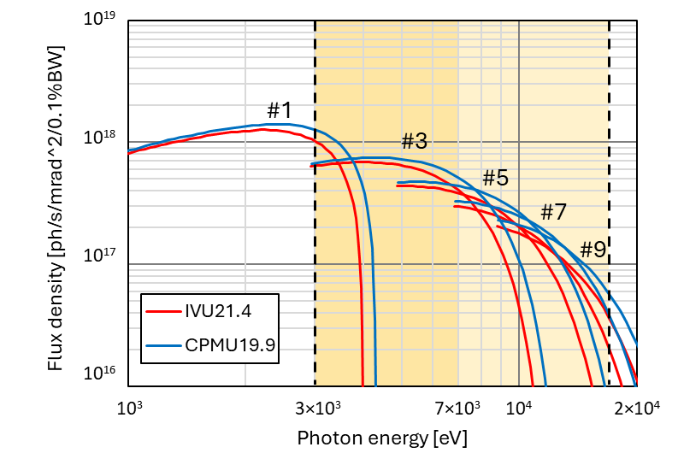
New IDs for ALBA II
Design criteria for ALBA II IDs:
  Technologically simpler and commercially available solutions are preferred (room temperature IVU vs CPMU or SCU).
  Maximum flange-to-flange dimensions equal to ALBA undulators (2.75 m).
  Starting with ID33, we are assuming a reduction of the (magnetic) minimum gap from 5.2 down to 4.2 mm.
Comparison of room-temperature IVU and CPMU technologies performance in the case of ID15-3Sbar

Slide 8
New IDs for ALBA II
The IDs planned for the coming years are:
The contract for the manufacturing of ID33-MSPD2 was awarded to Research Instruments on May 2026. The device is expected to be delivered early 2028.
The specifications for ID02-CoDI and ID04-Corus are still being developed by the corresponding beamline scientists. The CfT for both of them are expected to be published next year.
Port | Beamline | Energy range [keV] | ID type | Period [mm] | Technology | Gap_{min} [mm] | Status
ID33 | MSPD2 | 8-40 | IVU | 15.1 | Hybrid | 4.2 | Manufacturing
ID02 | CoDI | 4-25 | IVU | ~19 | Hybrid | 4.2 | CfT 2027
ID04 | Corus | 4-27 | IVU | ~15 / ~19 | Hybrid | 4.2 | CfT 2027

