Slide 1
HEPS magnet production and magnetic field measurement
CHEN, Fusan
July 13, 2026
ALBA-HEPS joint-workshop · Barcelona & Beijing

Slide 2
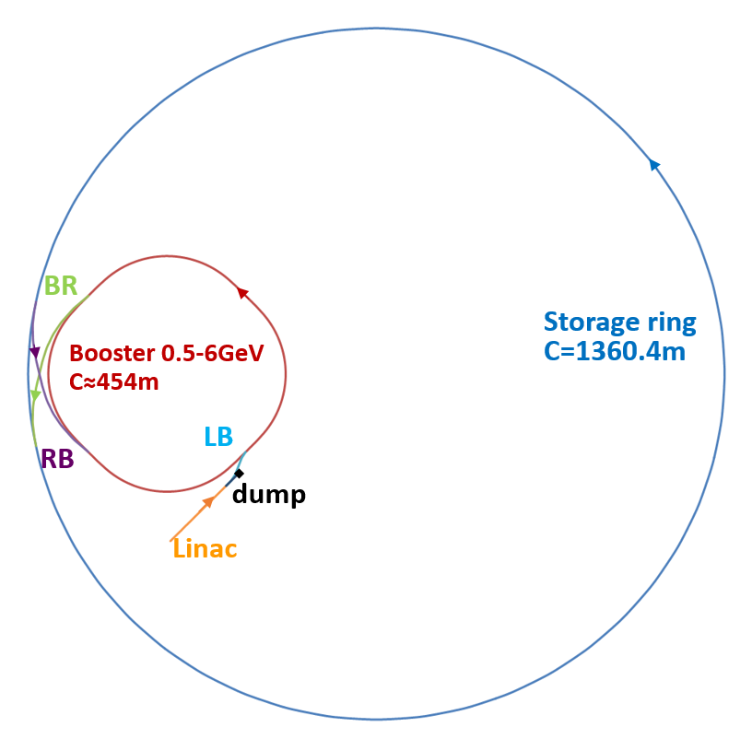
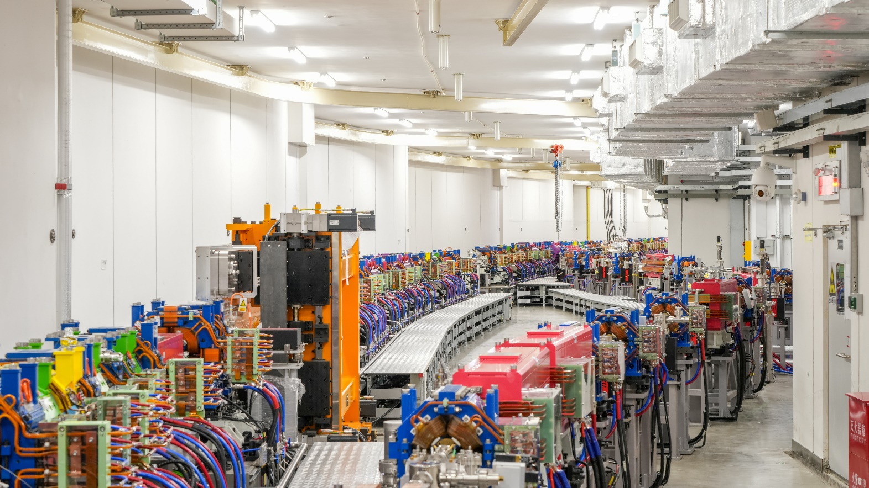
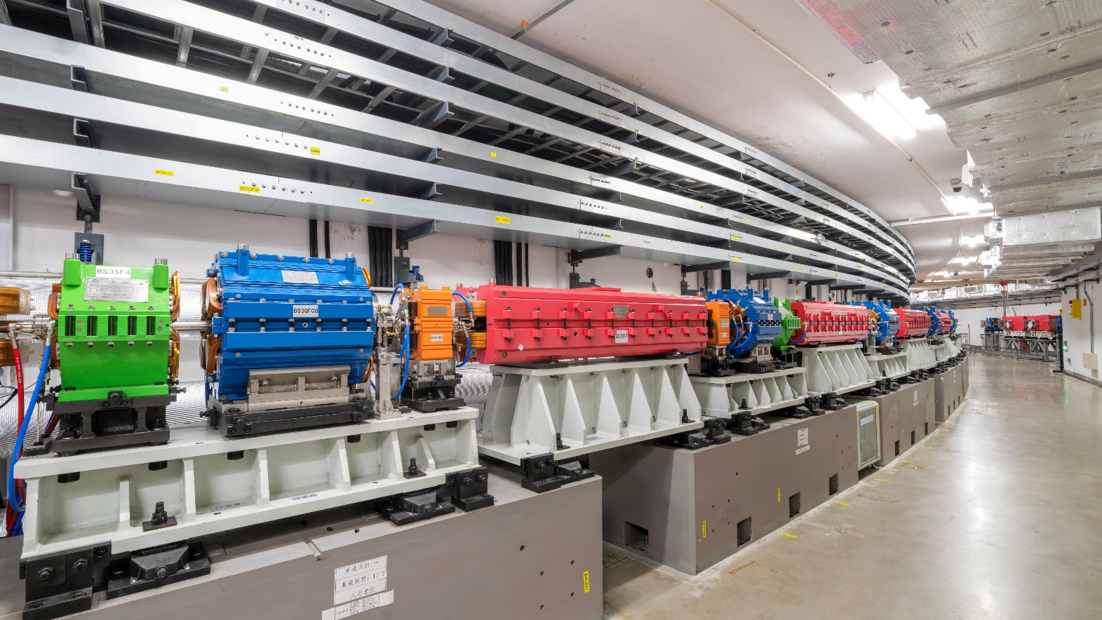
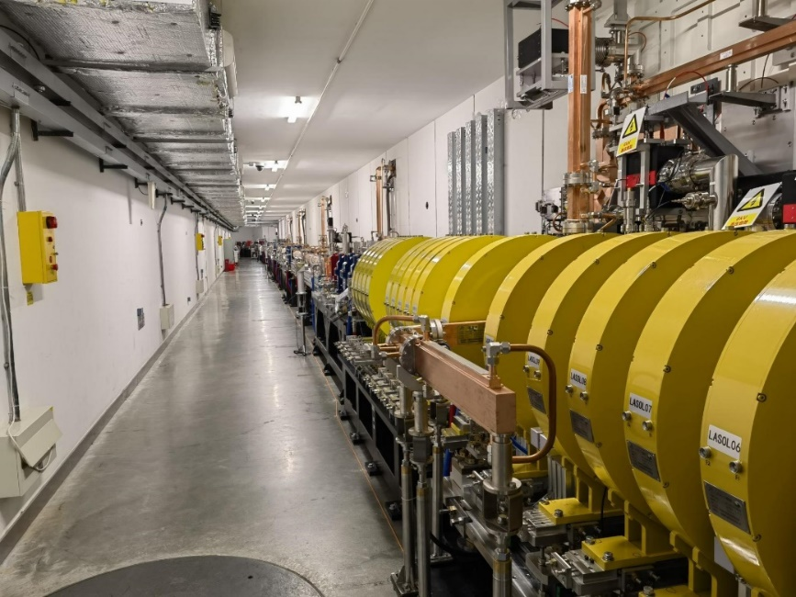
Overview of HEPS magnet system
HEPS has 2389 magnets installed in the tunnels (excl. Lambertson magnets)
Storage ring
Booster
Linac
Location | Quantity
Linac | 55
Low energy trans. line | 30
Booster | 436 + 6
High energy trans. line | 92
Storage ring | 1776 +37

Slide 3
Development schedule & progress
The magnets development time: 4.5 years
About 8 months delayed to the original plan
Contract: 27 months
Reality: 36 months
sorting

Slide 4
Storage ring magnet
One 7BA cell consists of 37 magnets installed on 6 girders.
Magnet type | Symbol | Quantity | Features
Longitudinal gradient dipole | BLG | 5 | Permanent magnet, 5 strength levels along the beam direction.
Dipo./Quad. Combined magnet | BD/ABF | 2/4 | Core saturation, quadrupole installed with horizontal offset
Quadrupole | QF/QD | 6/8 | Core saturation, some magnets have H/V trim coils
Sextupole | SF/SD | 2/4 | Core saturation, SD magnets have H/V trim coils
Octupole | OCT | 2 | Skew quadrupole trim coils
Fast corrector | FC | 4 | H/V combined skew quadrupole, slotted poles

Slide 5
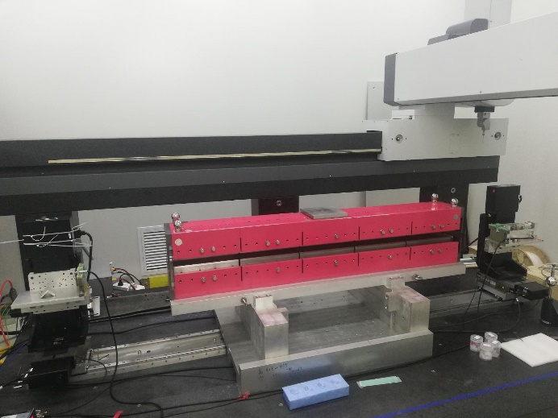
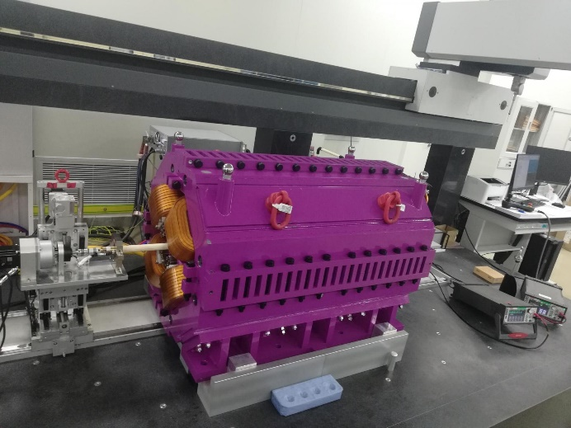
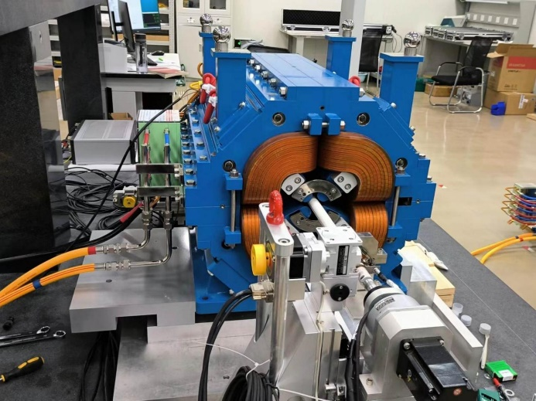
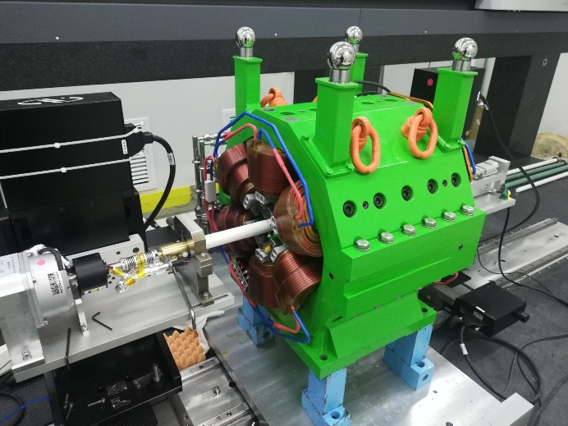
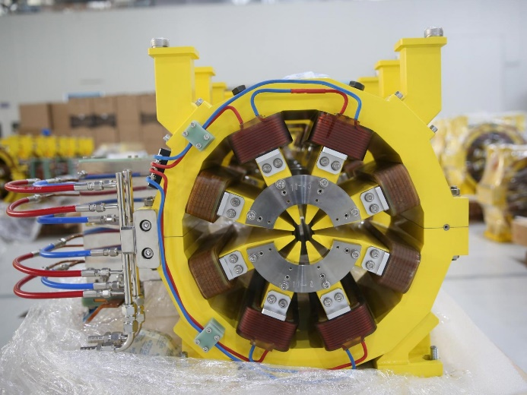
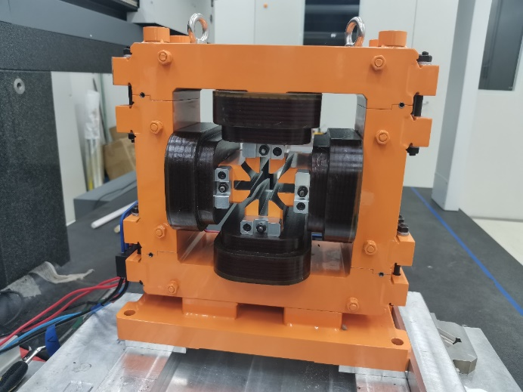
Photos of storage ring magnets
的
Longitudinal gradient dipole BLG1
D/Q combined magnet BD1/2
Anti-bend/Q combined magnet ABF2/3
Sextupole SD1/4
Octupole OCT1/2
Fast corrector FC1/2/3/4

Slide 6
Challenges of storage ring magnet
High magnetic performance for 4th generation light source
  High gradient results in saturation and field harmonics. (G≥80T/m)
  Permanent magnet needs temperature compensation and field tuning. (α<50ppm/°C)
  High precision measurement system (magnetic center to target positioning <10μm)
Complex interface conditions
  Beam injection/extraction and SR light extraction
  Field cross talk between adjacent magnets
Large quantity (1800+ with spares)
  Unqualified magnets improvement method
  In-laboratory field measurement

Slide 7
Measurement system for storage ring magnet
12 sets of field measurement system
  6 sets are self-developed to meet the high performance requirement and improve the efficiency of field measurement.
Measurement system* | Quantity | Usage
Helmholtz coil system | 2 | Permanent magnet block sifting and sorting
NMR | 2 | Perm. magnet temp. comp. and Hall probe calibration
Hall probe system | 2 | Field mapping and rotating coil calibration
Moving coil system | 1 | Integral field uniformity of dipole magnet
Stretched wire system | 1 | Integral field rolling angle of dipole magnet
Rotating coil system | 3 | High order components of quad., sext. and octupole
Picking coil system | 1 | Transient field measurement for fast corrector
* The red system are commercial equipment and the blue system are self-developed system.

Slide 8
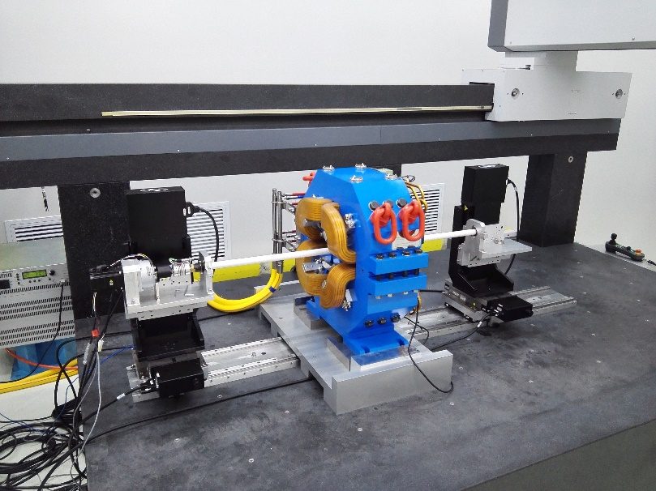
High precision measurement system
Alignment requirement for quad./sext./octupoles
  Magnet-to-magnet on one girder: ≤30μm
  Magnetic center to fiducial target: ≤10μm
Multi-function measurement system
based on coordinate measuring
machine (CMM) is developed
  Mechanical tolerance measurement
  Rotating coil for high order harmonics
  Stretched wire for dipole rolling angle
  Automatic alignment field measurement
Positioning error of the CMM:
3.3 + 3.3*L_{[mm]}/1000 [μm]

Slide 9
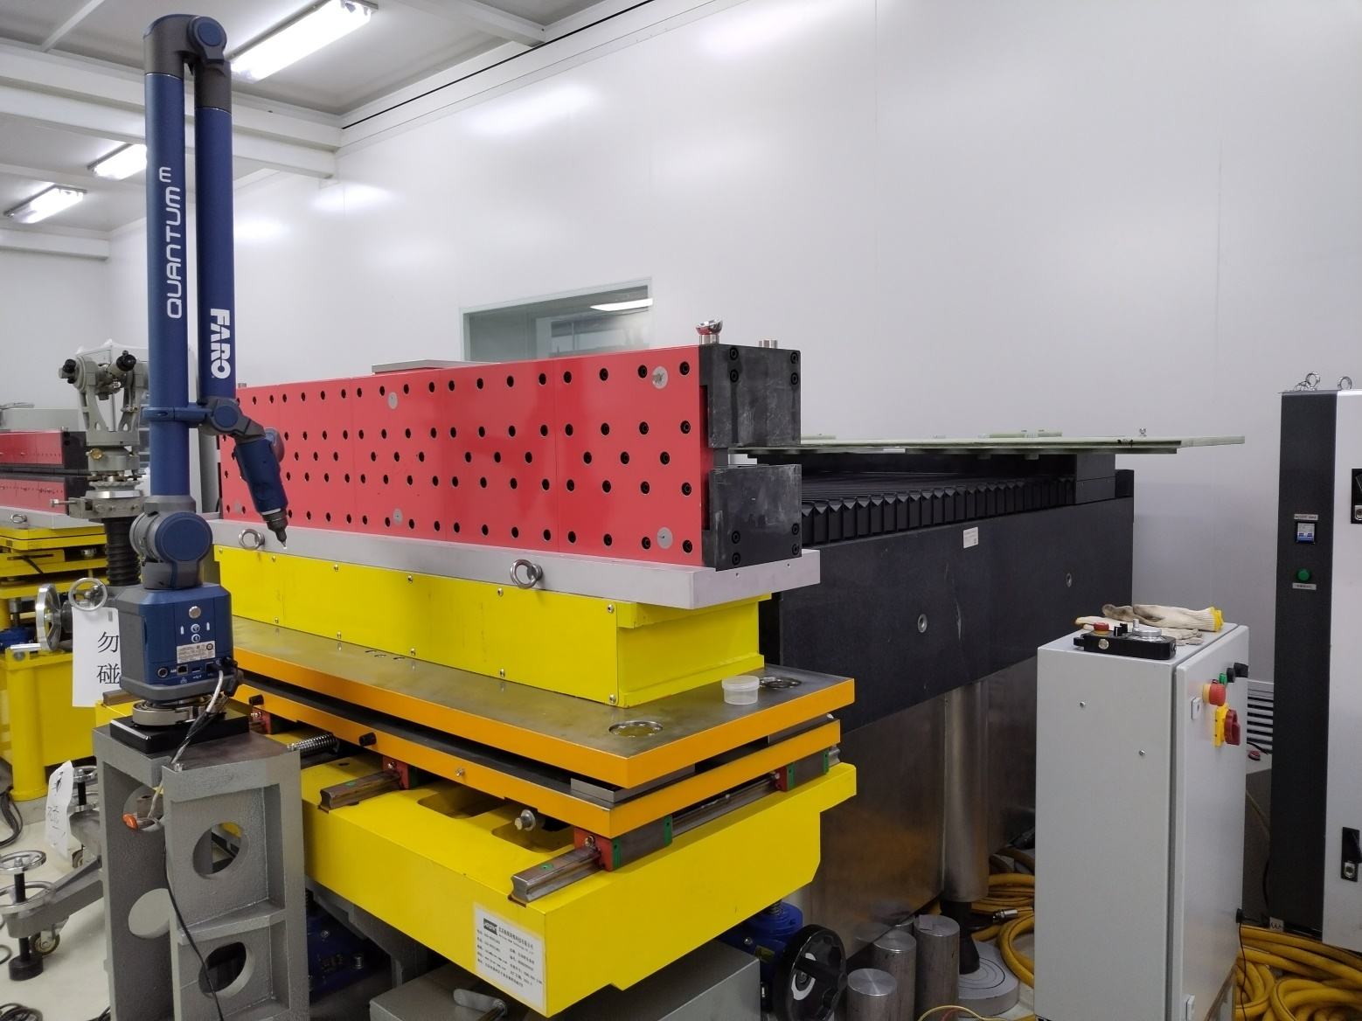
Alignment automation for magnet measurement
Automatic alignment for moving coil system
  Integrated articulated arm CMM and 5d automatic adjustment support.
About 1000 quadrupoles measured in one year

Slide 10
Permanent magnet block sifting and sorting
Purchase quantity of PM blocks is 110% of usage quantity.
  For each block, magnetic moment is measured 6 times with Helmholtz coil
  Blocks which have large deviations are spare for damage
  Block with high moment matches block with low moment

Slide 11
Measurement result – BLG
The field quality of BLG proves the
advantage of the permanent magnet

Slide 12
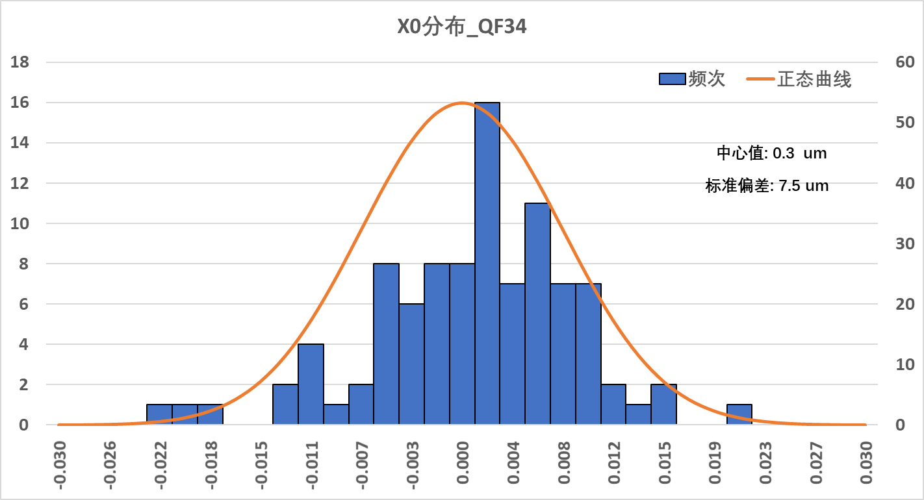
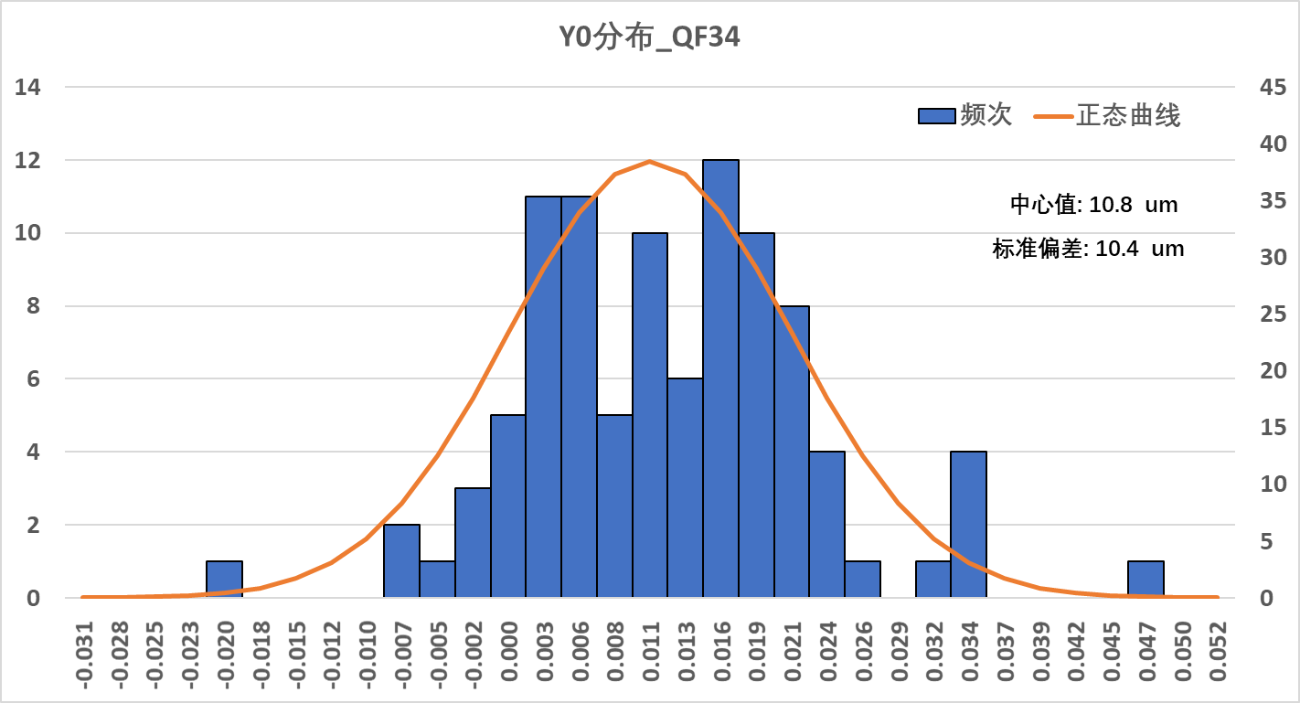
Measurement result – quad. & dipo./quad.
About 12% of quadrupoles need
to reassembly or compensation
  ‘Magic finger’ technology
Deviation of the magnetic center
conforms to normal distribution

Slide 13
Measurement result – sextupole & octupole
Most gap errors are within a
tolerance range of ±30 μm
Sextupoles and octupoles are
sorted and divided into 4
groups

Slide 14
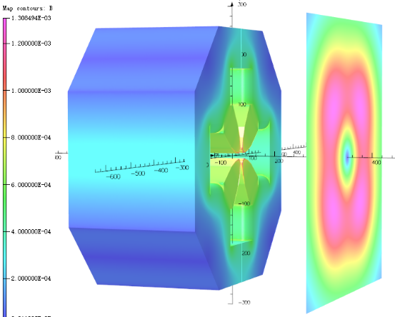
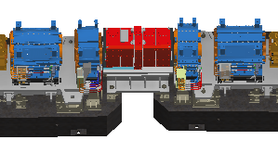
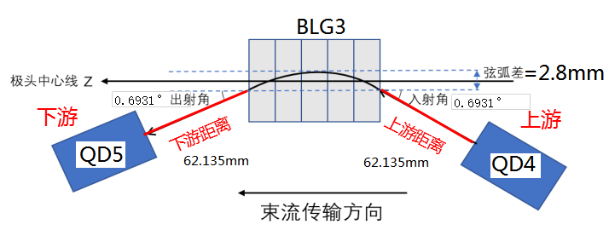
Cross-talk study
240mm
Cross-talk is caused by leakage field
Influence range (leakage field > 10Gs)
Magnet type | BLG3 | BD1/2 | QD5 | SD2/3 | OCT1/2
Magnet aperture[mm] | 26 | 45 | 26 | 26.6 | 30
Influence range [mm] | 30 * | 260 | 240 | 130 | 145
* Leakage field of BLG magnet is suppressed by end shielding plate
QD5
QD4
Iron to Iron distance is ~62mm
BLG3

Slide 15
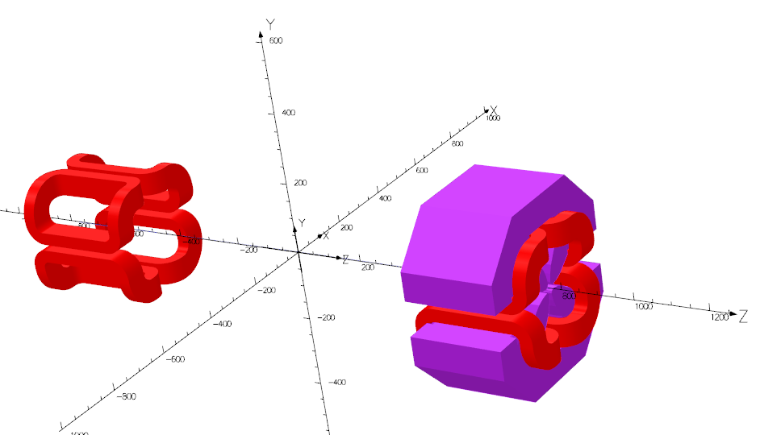
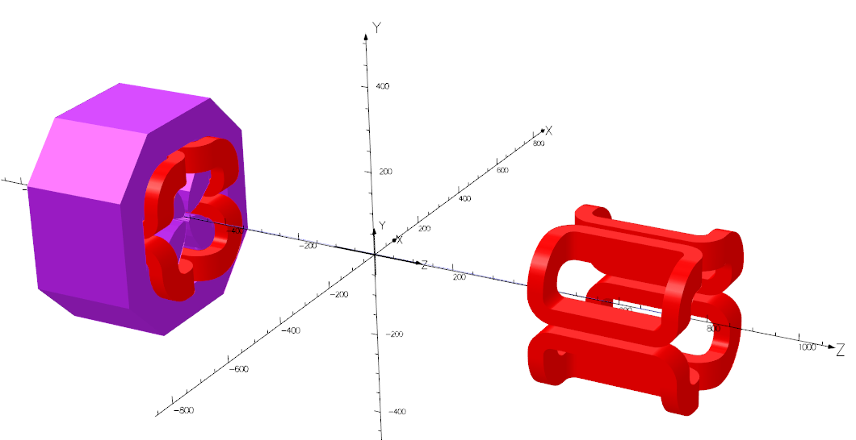
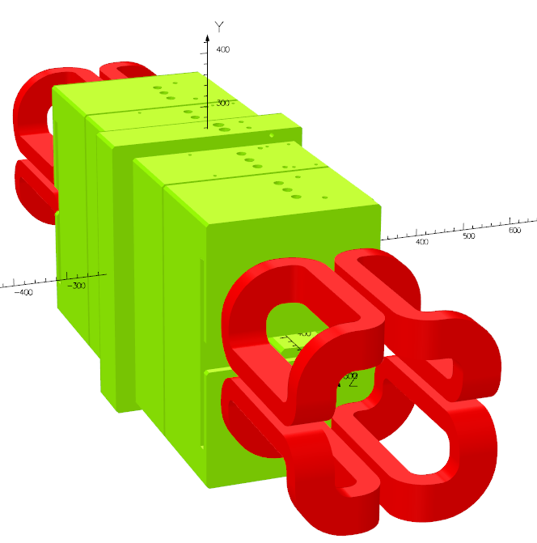
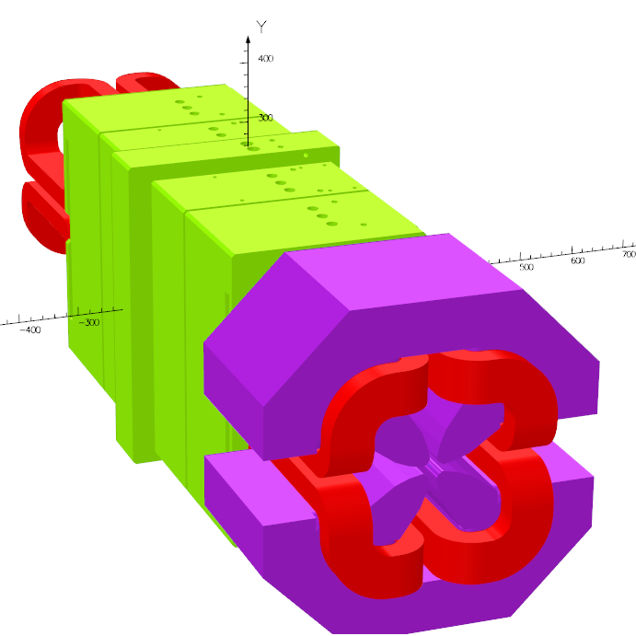
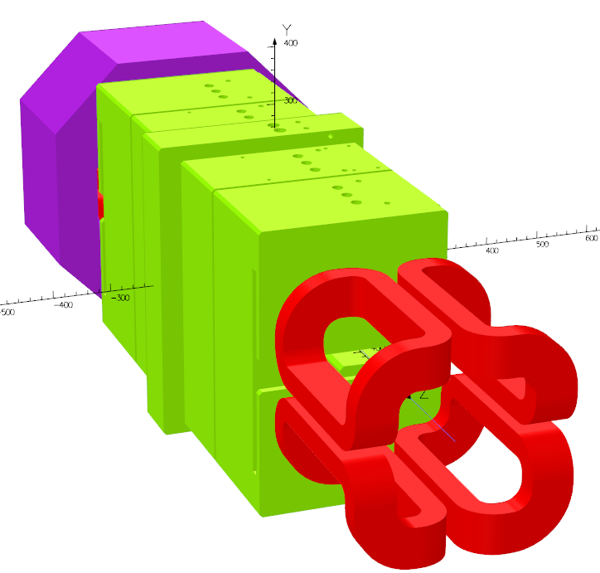
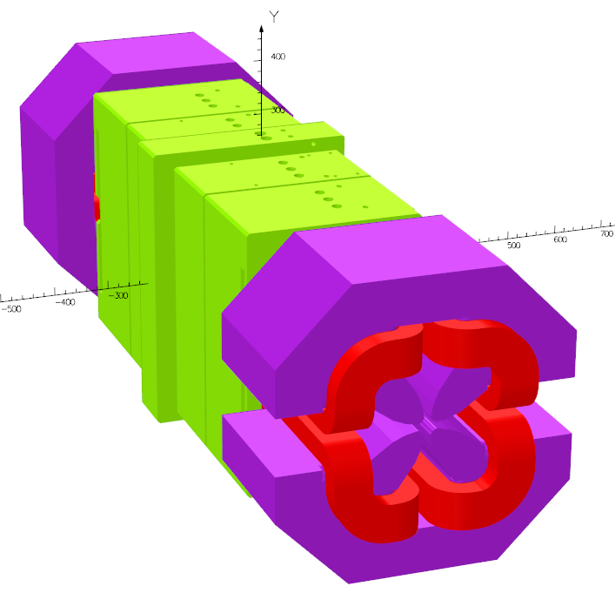
Cross-talk simulation
Modelling for different
situations in OPERA-3d
Calculate the variations of
dipole and quadrupole
along the beam direction
Correct before installation
Dipole component induced by cross-talk
(BLG3+QD4) – (BLG3-only) – (QD4-only)
(BLG3+QD5) – (BLG3-only) – (QD5-only)
(BLG3+QD4+QD5) – (BLG3-only) – (QD4-only) – (QD5-only)
QD4-only
QD5-only
BLG3-only
BLG3+QD4
BLG3+QD5
BLG3+QD4+QD5

Slide 16
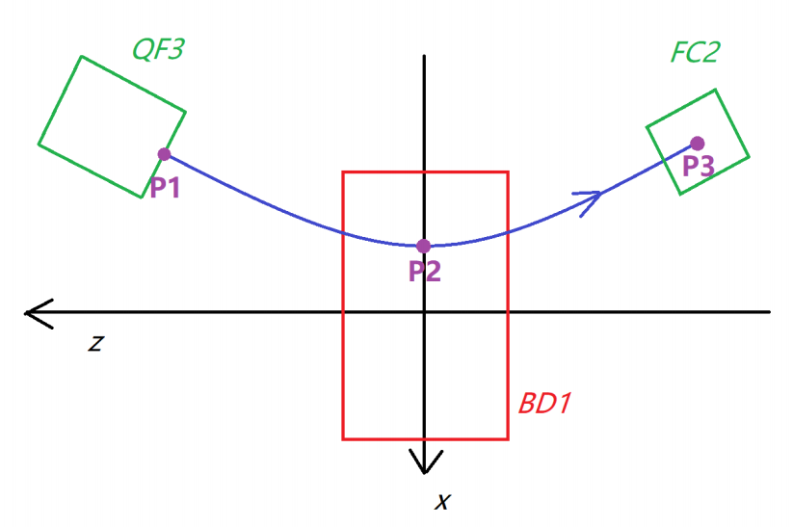
Cross talk compensation
BLG magnet: permanent magnet, need field correction before installtion to compensate the cross-talk.
BD magnet: quadrupole with offset, need offset corrention before installtion to compensate the cross-talk.
integral field correction of BLG magnets
Schematic beam trace of a BD magnet
Offset change: ~150 µm (fringe) ~10µm (cross-talk)
Maximal Incident/exit angle change: ~40 µrad
Maximal integral field change: 4.2E-4 (BLG3)

Slide 17
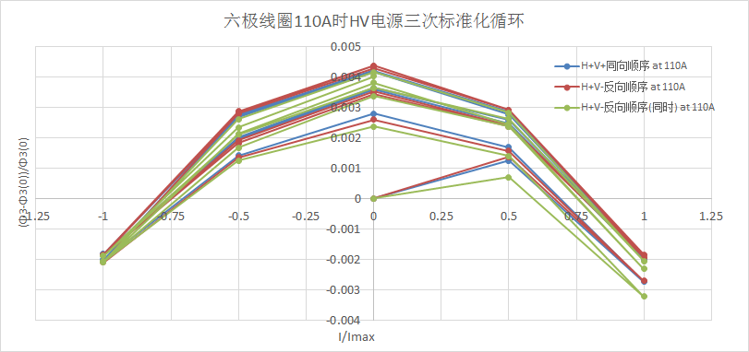
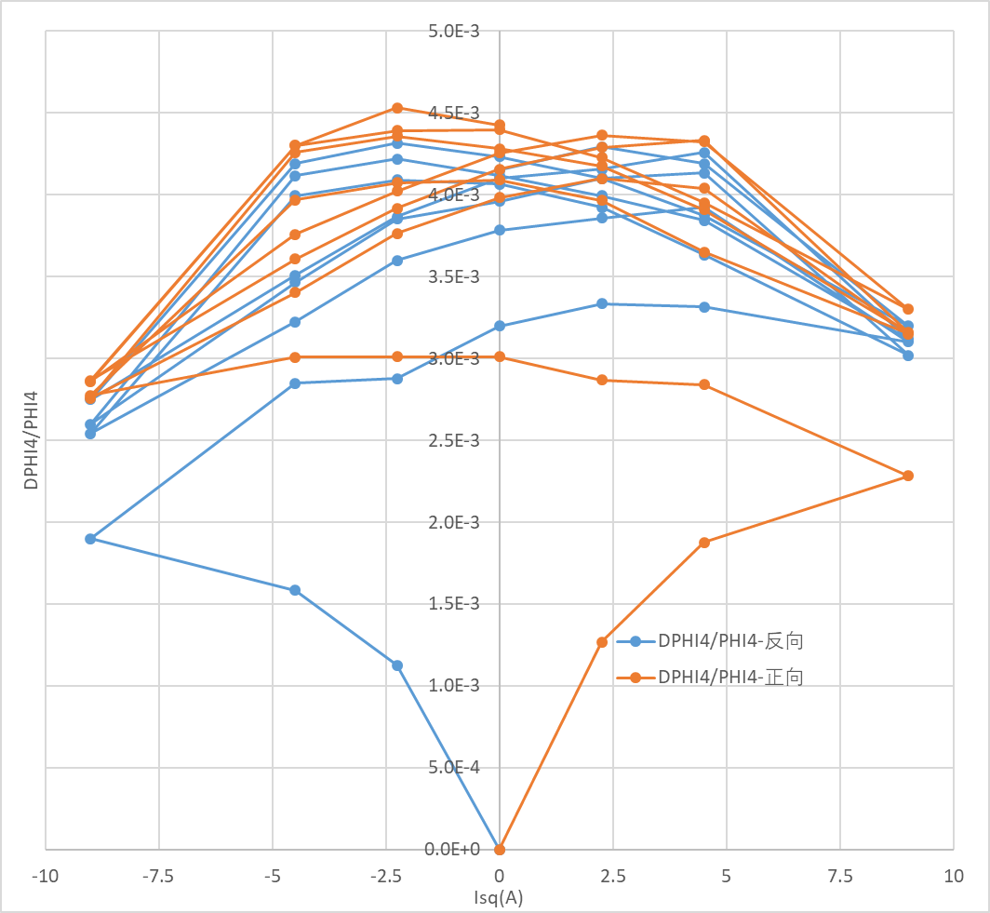
Trim coil effect
More than 1/3 storage ring magnets have trim coils
The main field changes when trim coils are powered.
Magnet type | QD1 | QD8 | QF3/4 | SD1/4 | SD2/3 | OCT1/2 | FC1/2/3/4
Quantity | 48 | 48 | 96 | 96 | 96 | 96 | 192
Trim coil type | H/V | H/V | H/V | H/V | H/V | Skew Q | Skew Q
The change ratio of the main field is up to 0.45% and related to the current of trim coils
Sextupole SD1/4
Octupole OCT1/2

Slide 18
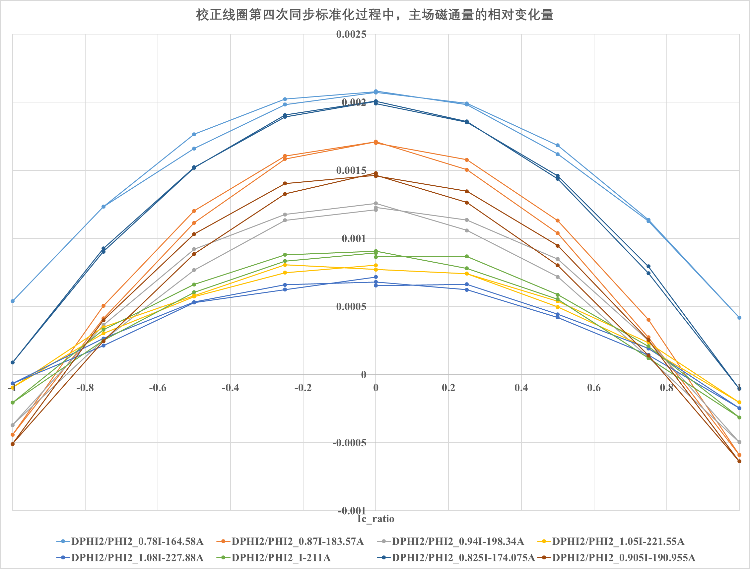

Trim coil effect
The change ratio of main field$δφ$
depends on main coil current (IM)
and trim coil currents (IH/IV).

Slide 19
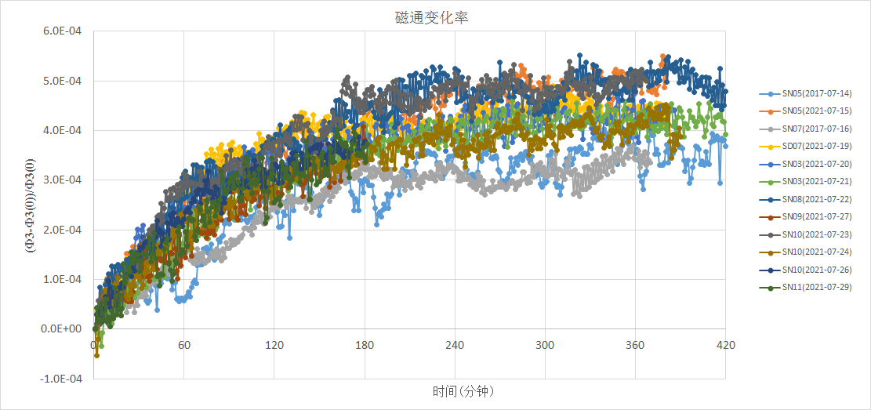
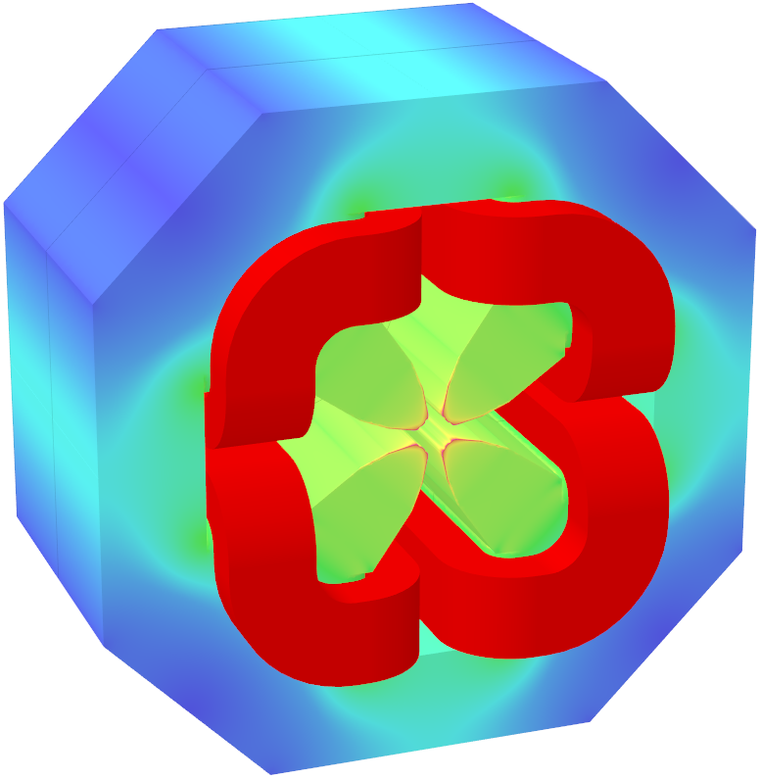
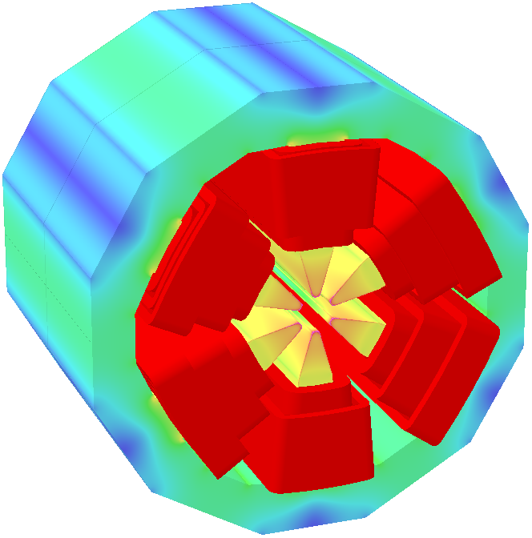
Lesson learnt – warm up before measurement
Sufficient warm up time is need before starting measurement
  Quadrupoles & octupoles: 40min
  Sextupoles: 180min

Slide 20
Lesson learnt – the humidity of the laboratory
The measured value of field has correlation with the humidity of the lab. Situation is improved after sealing the measuring coils (moving/rotating coil ) with epoxy.

Slide 21
Lesson learnt – saturation of solid core magnet
The high order harmonics have different trends at high current
  Magnet with lamination core remains almost unchanged with excitation current
  Magnet with solid core changes obviously with saturation level

Slide 22
Summary
Automation technologies improve the testing efficiency and measurement accuracy, ensuring the magnet developing progress
Studies on some important issues, such as cross-talk and trim coil effect, make us have a better understanding and clearer figure about the magnetic field
The various problems discovered and lessons learnt provide reference for the future development of magnet

