Slide 1
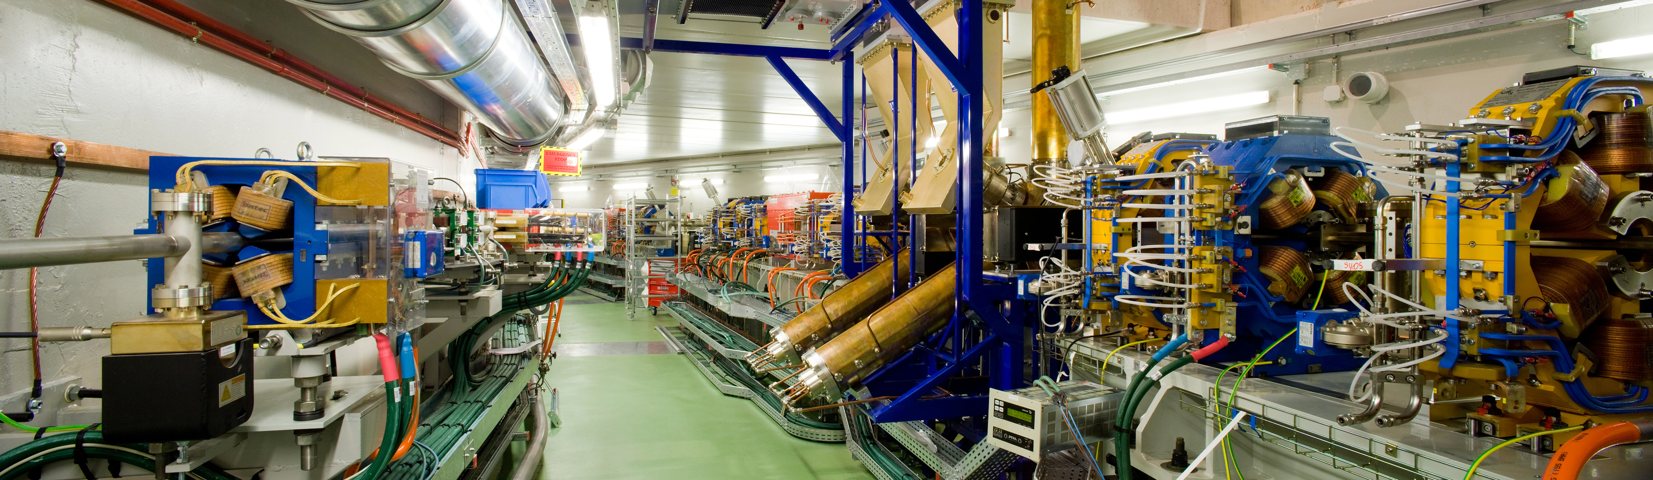
LONGITUDINAL DYNAMICS STUDIES AT ALBA
HEPS-ALBA meeting - 13/07/2026
Ignasi Bellafont

Slide 2
OUTLINE
Introduction: ALBA and ALBA II Light Sources
ALBA II RF system: Overview
Beam stability studies: Tracking simulations, foreseen solutions
Transient beam loading (TBL): Expected impact, foreseen solutions
Trip compensation system (TCS): Simulations and experimental results
Future machine studies
Summary

Slide 3
OUTLINE
Introduction: ALBA and ALBA II Light Sources
ALBA II RF system: Overview
Beam stability studies: Tracking simulations, foreseen solutions
Transient beam loading (TBL): Expected impact, foreseen solutions
Trip compensation system (TCS): Simulations and experimental results
Summary

Slide 4
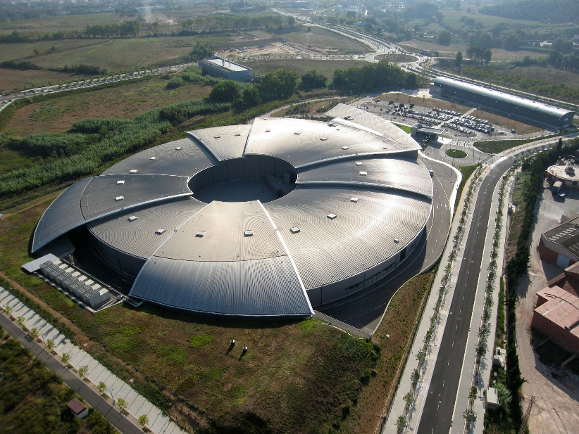
INTRODUCTION - ALBA
ALBA is a 3 GeV, 3rd generation synchrotron light source located near Barcelona, Spain
User operation since 2012
13 beamlines currently in operation, dedicated to life and material science, solid-state physics. 2 more under construction
And upgrade towards 4th generation is planned for 2030, ALBA II
Parameter | Value | Unit
Energy | 3.0 | GeV
Beam current | 250 | mA
Circumference | 268.8 | m
Emittance | 4.5 | nm·rad
Loses per turn (w/o IDs) | 1.02 | MeV
Momentum compaction factor | 8.9·10⁻⁴

Slide 5
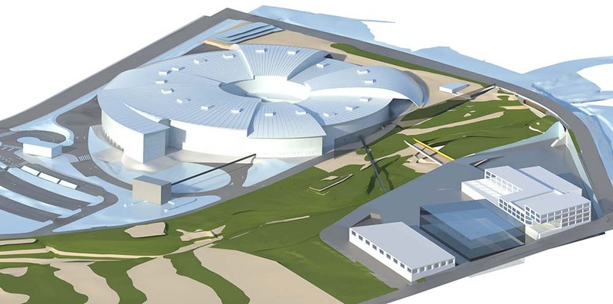
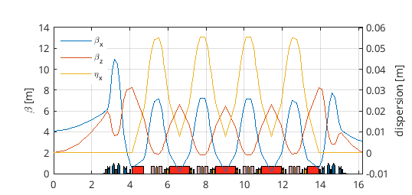
INTRODUCTION - ALBA II
ALBA II will be the upgrade of ALBA, aimed at having a much lower beam emittance (around 22 times lower)
The storage ring will be replaced, while the booster ring and LINAC will remain unchanged
Installation and commissioning planed for 2030, operation expected in 2032
Parameter - A2L007E | Value | Unit
Energy | 3.0 | GeV
Beam current | 300 | mA
Circumference | 268.8 | m
Emittance | 204.4 | pm·rad
Loses per turn (w/o IDs) | 0.93 | MeV
Momentum compaction factor | 1.08·10⁻⁴
Touschek lifetime 0.5 C | 5.4 | h
ALBA II facilities
F. Pérez et al., DOI: 10.18429/JACoW-IPAC2025-MOPS043
Optical functions of a single lattice period

Slide 6
OUTLINE
Introduction: ALBA and ALBA II Light Sources
ALBA II RF system: Overview, new developments
Beam stability studies: Expected instabilities, tracking simulations, Direct RF Feedback
Transient beam loading (TBL): Expected impact, foreseen solutions
Trip compensation system (TCS): Simulations and experimental results
Summary

Slide 7
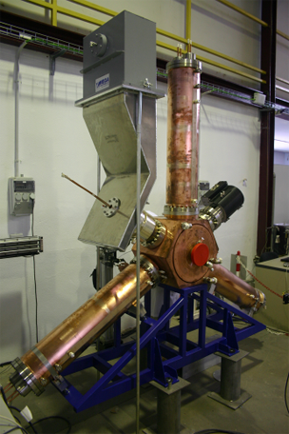
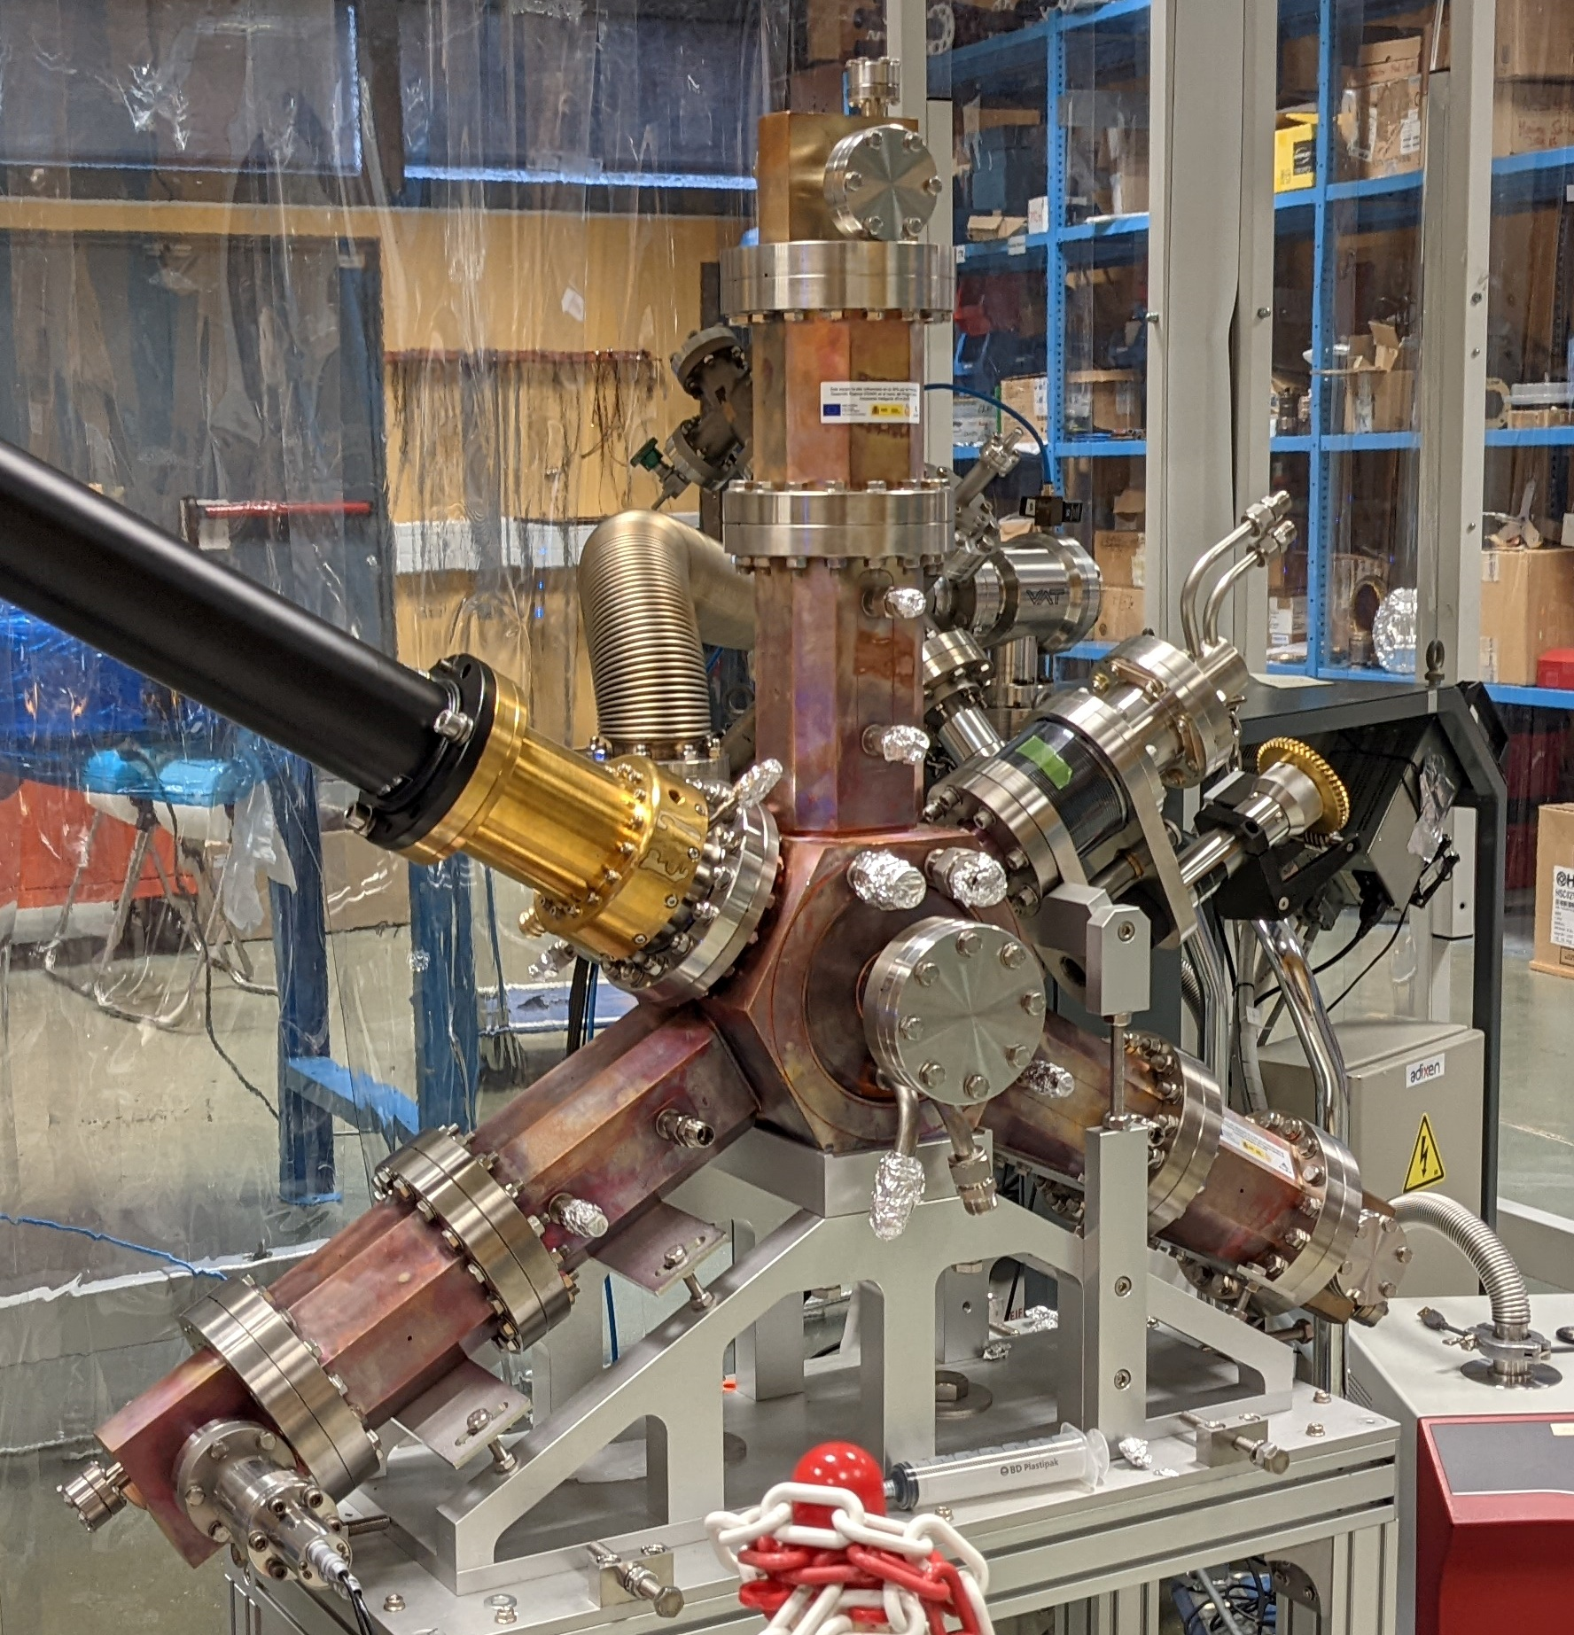
ALBA II RF SYSTEM
Booster RF: Same as in ALBA, 1 x 5-cell PETRA type cavity, fed with a 50 kW BTESA SSPA
Storage Ring: 6 x EU HOM damped NC cavity (same as in ALBA) + 4 x New EU HOM damped NC 3H active cavity. Fed with 130 kW and 20 kW of SSPA power, respectively
Parameter | Value | Unit
Main RF voltage | 2.4 | MV
Harmonic RF voltage | 680 | kV
Number of cavities (MC / HC) | 6 / 4
Main cavity voltage | 400 | kV
Harmonic cavity voltage | 170 | kV
Main RF frequency | 500 | MHz
Harmonic RF frequency | 1500 | MHz
Bunch lengthening HFP | 3.9
Bunch length HFP | 31.7 | ps
4x Harmonic NC active RF cavity prototype
170 kV - 1500 MHz
ALBA II RF system A2L007E
6x Main NC RF cavity
400 kV - 500 MHz

Slide 8
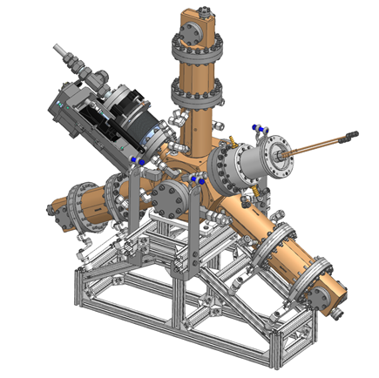
ALBA II RF SYSTEM – 3rd harmonic cavity
In order to increase the beam lifetime of its 4th generation upgrade, ALBA designed a new active, normal conducting, 3rd harmonic cavity, based on the EU HOM Damped 500 MHz cavity
A prototype was tested during 2023-2025 at BESSY II, in a collaboration of three institutions (ALBA, HZB and DESSY)
                Manufacturing of the definitive cavities is completed (5 cavities). The installation will take place this summer. All 2027 will be dedicated to their commissioning and machine studies
                The active feature was chosen in order to i) maximize the lengthening performance of the doble RF system, due to its TBL and PTBL mitigation capabilities and ii) smoother operation, being its voltage and phase independent on the beam current
Harmonic NC active RF cavity
F. Pérez et al., DOI: 10.1016/j.nima.2024.169935
P. Solans et al., DOI: 10.18429/JACoW-IPAC25-WEBD2

Slide 9
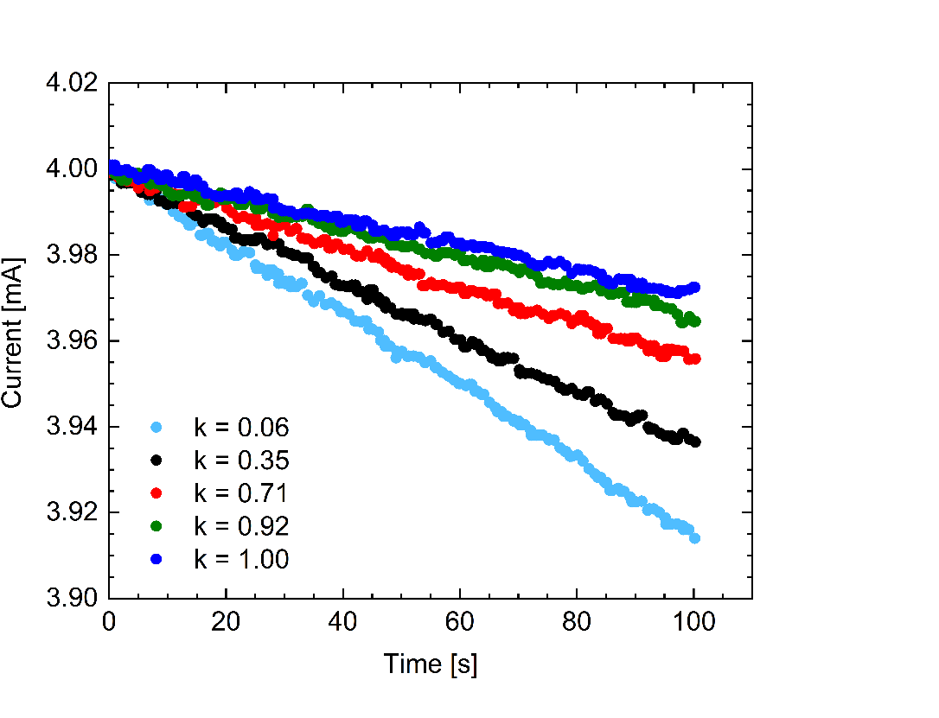
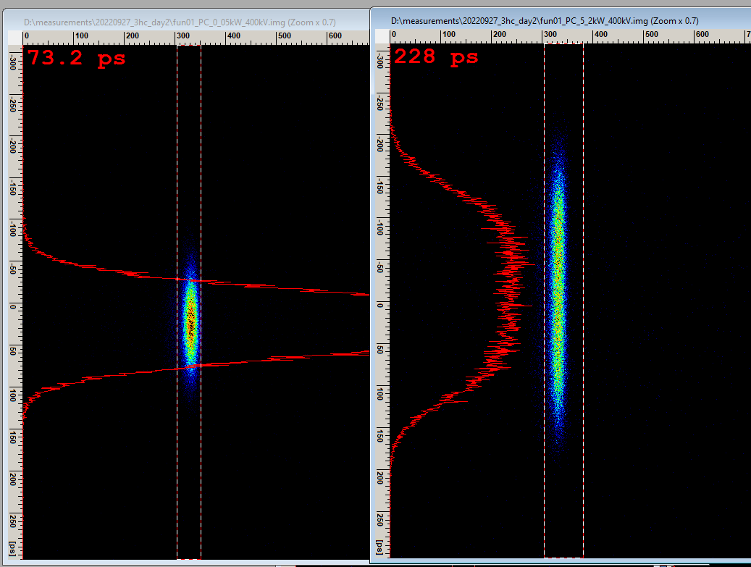
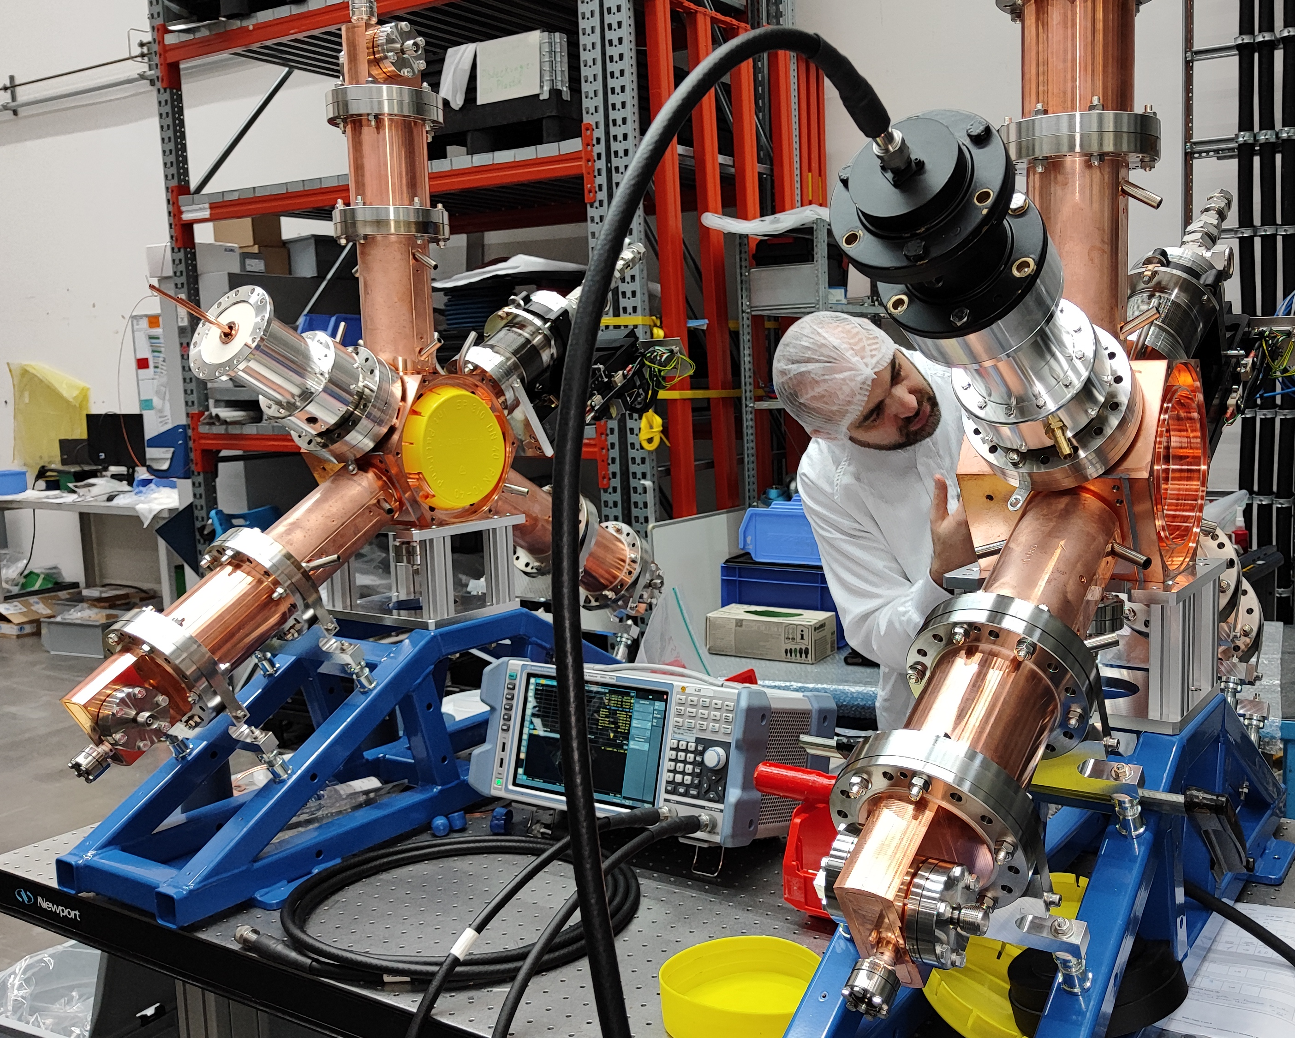
ALBA II RF SYSTEM – 3rd harmonic cavity
Single bunch
τ_{T} =4.31 h
τ_{T} =3.62 h
τ_{T} =2.66 h
τ_{T} =1.79 h
τ_{T} =1.36 h
ALBA-HZB-DESY 3HC commissioning
Lifetime measurements with different ratios of 3HC voltage at BESSY II
1.5 GHz
Main mode
90% reduction
99% reduction
80% reduction
94% reduction
Measurement of cavity voltage spectrum before and after HOM damping activation
3HC Research Instruments factory test

Slide 10
ALBA II RF SYSTEM

Slide 11
ALBA II RF SYSTEM
A2L007E

Slide 12
OUTLINE
Introduction: ALBA and ALBA II Light Sources
ALBA II RF system: Overview, new developments
Beam stability studies: Expected instabilities, tracking simulations, Direct RF Feedback
Transient beam loading (TBL): Expected impact, foreseen solutions
Trip compensation system (TCS): Simulations and experimental results
Summary

Slide 13
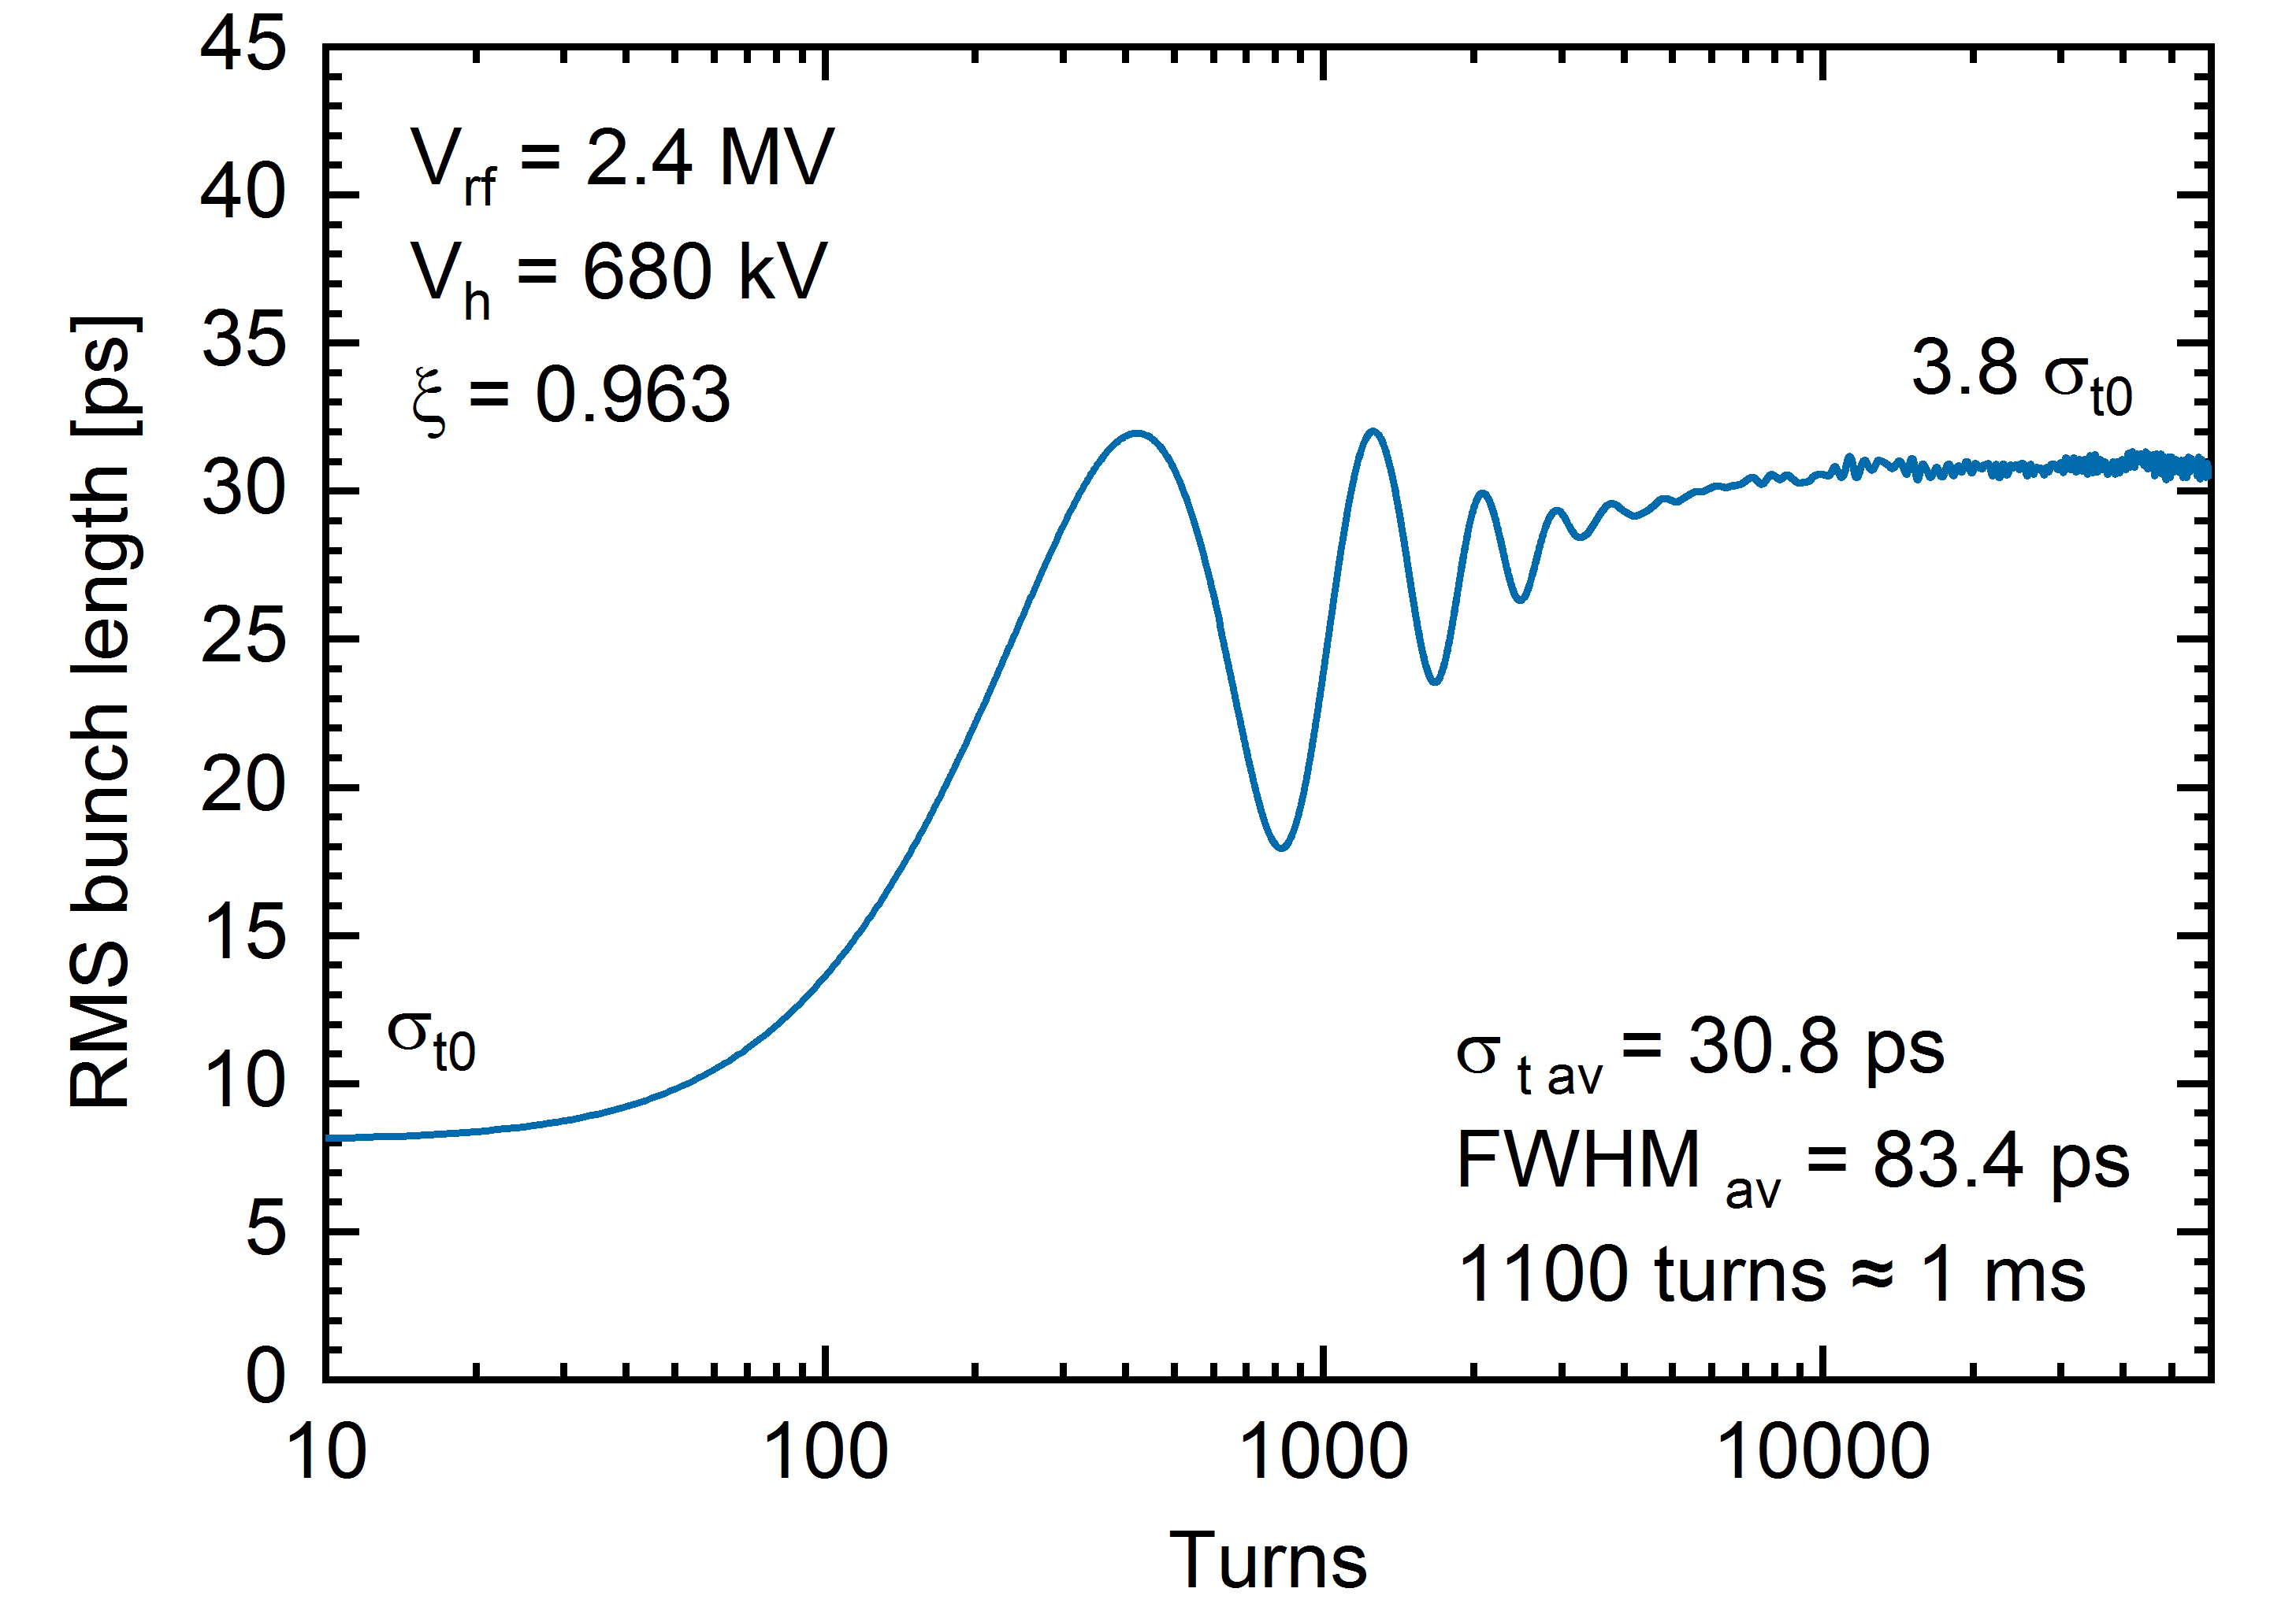
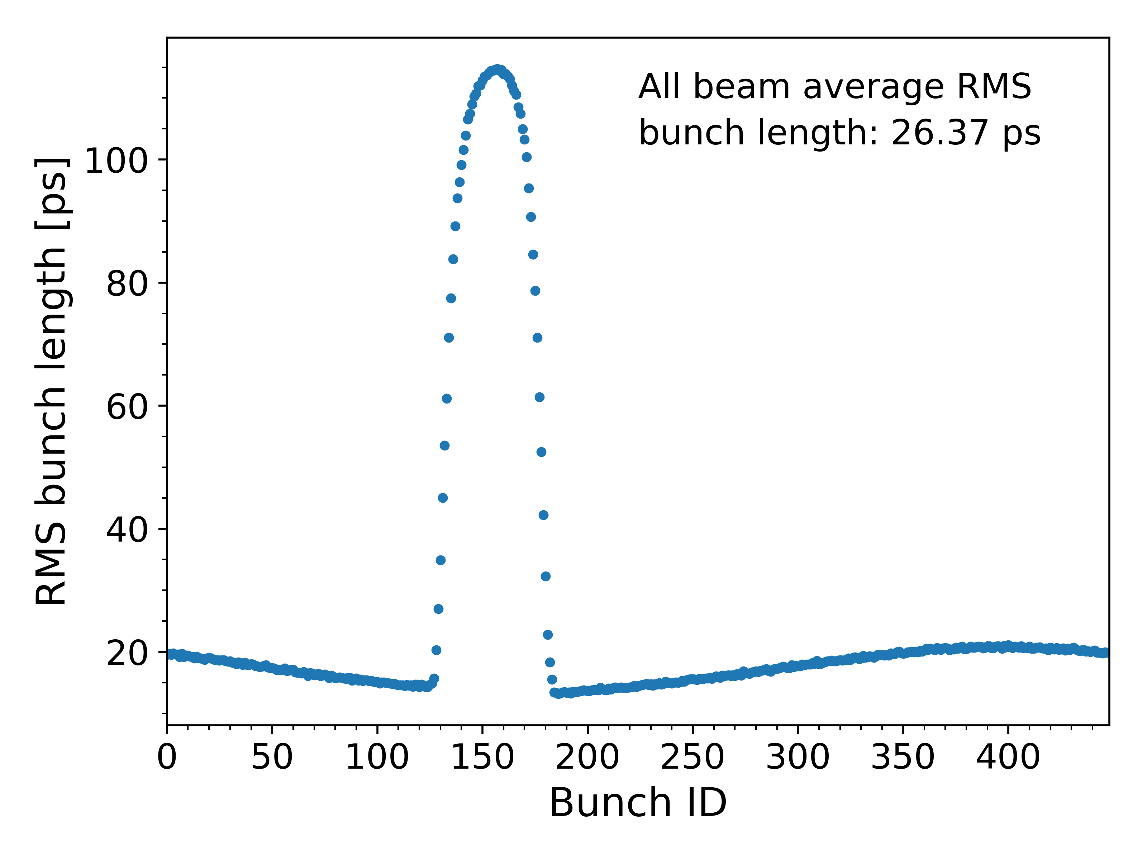
BEAM STABILITY STUDIES – ALBA II
To evaluate the beam stability due to the double RF system in ALBA II, several particle tracking simulations have been carried out using elegant
The simulations include the RF cavities’ impedance, synchrotron radiation damping, a PI control loop, a linear transformation matrix and quantum fluctuations. At this stage, no additional impedance sources are considered
The simulation, the bunch shape and phase, cavity voltage, beam energy, and emittances are monitored and used to assess the overall system stability
The simulations predict the onset of PTBL instabilities for flatness factors above ξ = 0.96. The HC voltage is therefore limited to 680 kV, with 706 kV corresponding to the flat potential (FP) condition
Currently, we have been testing mbtrack2 due to its advanced longitudinal dynamics capabilities, particularly its implementation of coherent synchrotron frequency shift calculations and Direct RF Feedback (DRFF)
A2L006E
Simulation of the bunch length convergence after the HCs are activated
PTBL instabilities example, using FP settings and HFP

Slide 14
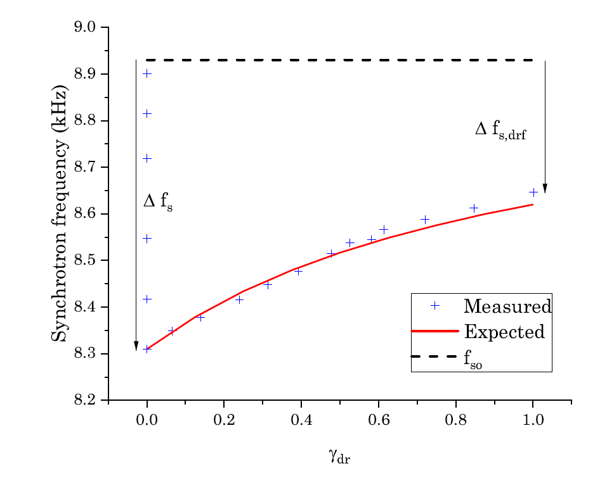
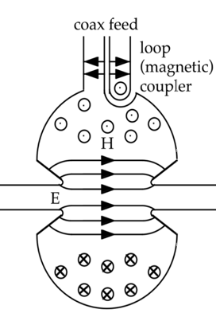



BEAM STABILITY STUDIES – DRFF
DRFF would improve the bunch lengthening performance of the harmonic system in ALBA II, by virtually lowering the R/Q ratio and then mitigate the Periodic Transient Beam Loading (PTBL) instability
DRFF will also allow us to lower the main voltage setting in ALBA II, increasing operation reliability and lowering energy consumption
We have already implemented and tested a digital DRFF in the main cavities achieving virtual R/Q reductions [1]
Voltage setting
$${\tilde{I}}_{g}={\tilde{I}}_{PI}+{\tilde{I}}_{FB}$$
+
$${\tilde{I}}_{PI}$$
PI loop
+
RF amplifier
RF power
-
Error
+
$${\tilde{I}}_{FB}=G_{fb}{\tilde{V}}_{c}$$
(G is complex)
Direct RF Feedback (DRFF)
Cavity voltage reading
1. P. Solans et al., DOI: 10.18429/JACoW-IPAC2024-WEPR76
Feedback and trip compensation diagram

Slide 15
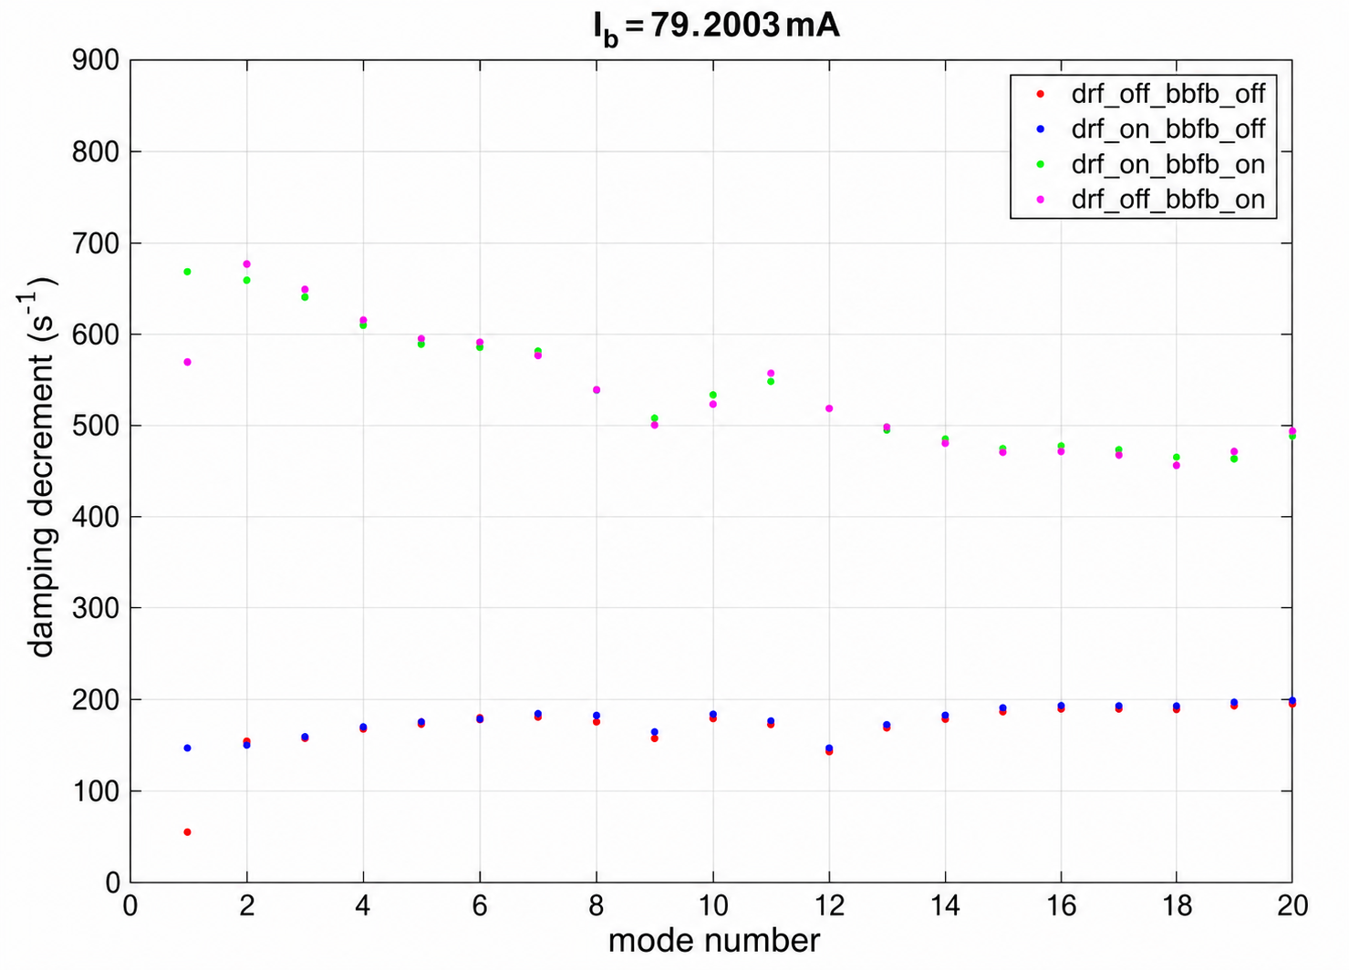
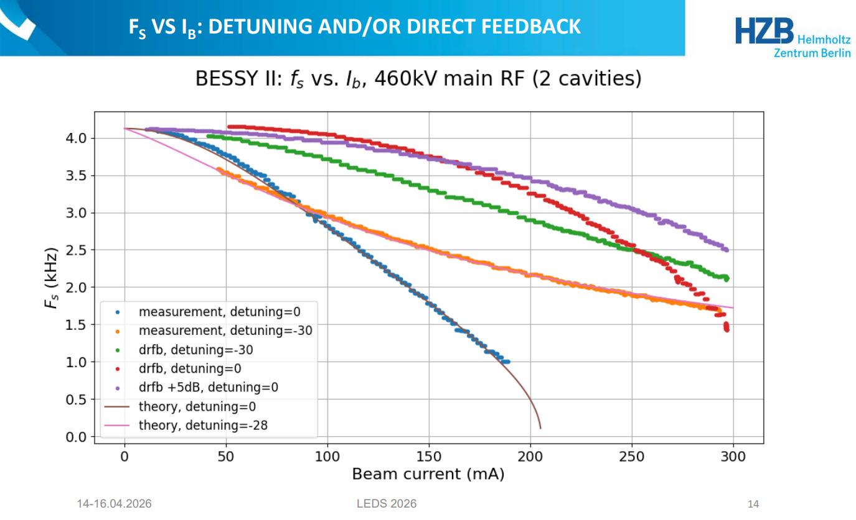
BEAM STABILITY STUDIES – DRFF
DRFF increases damping rate for mode 1 substantially, independently of BbB FB status
DRFF was also tested at BESSY II with good results
Feedback and trip compensation diagram

Slide 16
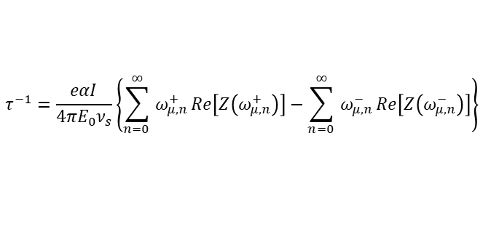

BEAM STABILITY STUDIES
$$τ^{−1}=\frac{eαI}{4πE_{0}ν_{s}}\left\{\sum_{n=0 }^{∞}{ω_{μ,n}^{+}}Re\left[Z\left(ω_{μ,n}^{+}\right)\right]−\sum_{n=0 }^{∞}{ω_{μ,n}^{−}}Re\left[Z\left(ω_{μ,n}^{−}\right)\right]\right\}$$
$$f_{s}=f_{s0} \sqrt{1−\frac{2{(Z}_{i}^{0 }+ {mZ}_{i hc}^{0}){ I}_{sr}}{V_{c}\cos{φ_{s}}}}$$
Coupled bunch (CBI) and Robinson DC instabilities have been also studied analytically for ALBA II. Robinson DC has been cross-checked with experimental studies at ALBA

Slide 17
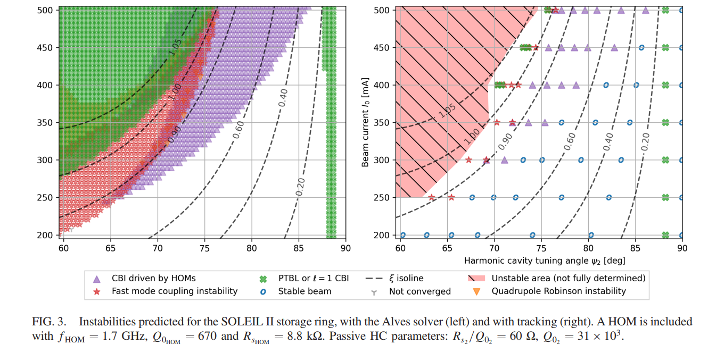
BEAM STABILITY STUDIES
A. Gamelin et al.: DOI: 10.1103/PhysRevAccelBeams.28.054401
As future work, we plan to generate Bosch stability diagrams for the double RF system operation (HC voltage vs current vs stability)

Slide 18
BEAM STABILITY STUDIES – Resulting lifetime
With a homogeneous filling pattern (HFP), and the 4 x 3HCs, we expect to reach a bunch lengthening factor of 3.9, increasing the default 8.2 ps length to approximately 31.7 ps
Under these conditions, and with full filling pattern, the Touschek lifetime would be then raised from 5.4 h to around 21 h
By implementing DRFF, this lifetime enhancement factor could be further improved from 3.9 to close to 4.9, which corresponds to the theoretical maximum
Intra beam scattering (IBS) effect has also been considered in these studies. It increases horizontal emittance, energy spread and bunch length in less than 2%

Slide 19
OUTLINE
Introduction: ALBA and ALBA II Light Sources
ALBA II RF system: Overview, new developments
Beam stability studies: Expected instabilities, tracking simulations, Direct RF Feedback
Transient beam loading (TBL): Expected impact, foreseen solutions
Trip compensation system (TCS): Simulations and experimental results
Summary

Slide 20
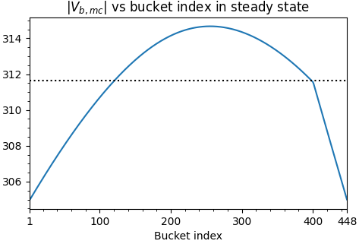
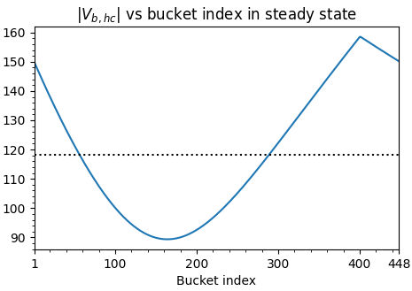

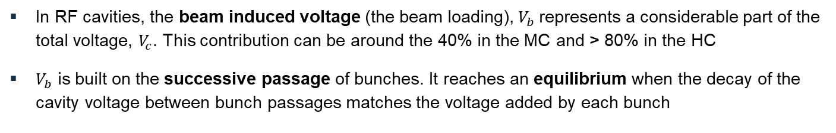
TRANSIENT BEAM LOADING (TBL)
In RF cavities, the beam induced voltage (the beam loading), $V_{b}$represents a considerable part of the total voltage, $V_{c}$. This contribution can be around the 40% in the MC and > 80% in the HC
$V_{b}$ is built on the successive passage of bunches. It reaches an equilibrium when the decay of the cavity voltage between bunch passages matches the voltage added by each bunch
$$V_{b}=−\left(\frac{1}{2} V_{b0}+V_{b1} e^{−\frac{t_{1}}{τ_{f}}} e^{iψ_{1}}+V_{b2} e^{−\frac{t_{2}}{τ_{f}}} e^{iψ_{2}}+…\right)=−\frac{1}{2} V_{b0} − \sum_{l=1}^{N}{{V_{b0} e}^{l(−δ + iψ)}}$$
Uneven charge distribution in the buckets, such as ion clearing gaps, break the homogeneous build-up causing a periodic modulation in the cavity voltage with a period equal to the revolution time
gap
gap
$$|V_{b}| [kV]$$
$$|V_{b}| [kV]$$

Slide 21
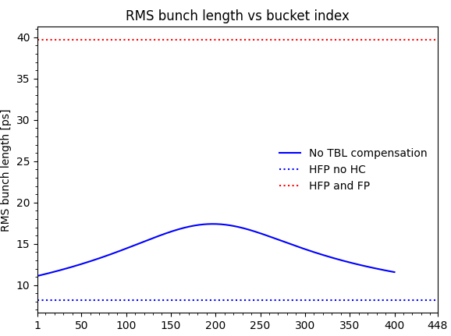




TRANSIENT BEAM LOADING (TBL)
A2L006C
PTBL threshold (680 kV without DRFF)
$$σ_{z} FP= 39.8 ps$$
$σ_{z} no gap= 32.15$ ps
$σ_{z} 11\% gap= 14.5$ ps
No HC
$$σ_{z} no HC= 8.2 ps$$
ALBA II baseline (1.79%)
The different MC and HC voltages seen by the bunches cause different bunch properties (synchrotron frequency, bunch length, phase, etc.) along the bunch train
The bunch length, and thus the Touschek beam lifetime, is specially affected in the case of a double NC RF system tuned to maximize them
Just a 2% gap can lead to Touschek lifetime reductions of about 45%
A proper transient beam loading (TBL) calculation and compensation is therefore highly advised in case a gap in the beam is foreseen in a SR with a double RF system

Slide 22



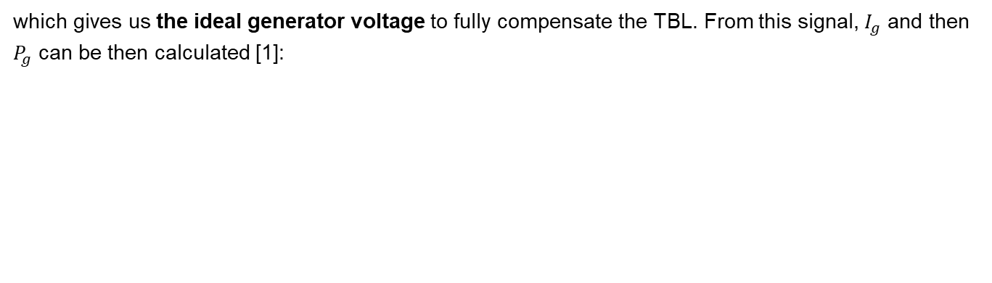
TBL COMPENSATION - METHODOLOGY
Taking advantage of the active HCs, it is possible to modulate the generator induced voltage ${\tilde{V}}_{b}$, to counter the modulation induced by the beam and get a flatter cavity voltage (${\tilde{V}}_{c}$) :
${\tilde{V}}_{c}(t) −{\tilde{V}}_{b}(t)={\tilde{V}}_{g}(t)$
which gives us the ideal generator voltage to fully compensate the TBL. From this signal, $I_{g}$ and then $P_{g}$ can be then calculated [1]:
$${\tilde{I}}_{g}(t)=\frac{1}{k_{l}}\left[\frac{d{\tilde{V}}_{g}(t)}{dt}+\frac{1}{τ_{f}}\left[1−i\tan{ψ_{d}}\right]{ \tilde{V}}_{g}(t)\right]$$
$$P_{g}(t)=\frac{R_{s}{\left|{\tilde{I}}_{g}(t)\right|}^{2}}{8β}$$
However, RF cavities have a narrow bandwidth and do not accept well the high frequency components of the modulated power required to fully compensate the TBL. A very high generator power is required for some buckets, far exceeding the available one, resulting in a high reflected power, as well
Following the strategy proposed by [1], we can filter out most of the high frequency components to effectively mitigate the TBL effects with reasonable amounts of additional generator power
[1] Yamamoto et al., DOI: 10.1103/PhysRevAccelBeams.21.012001

Slide 23
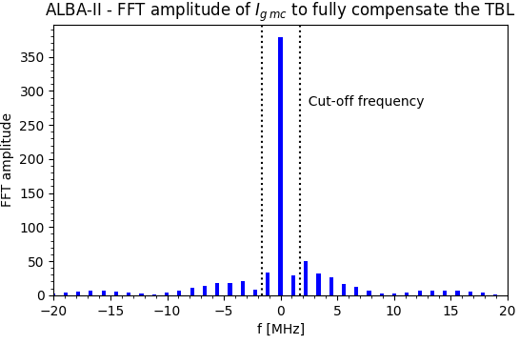
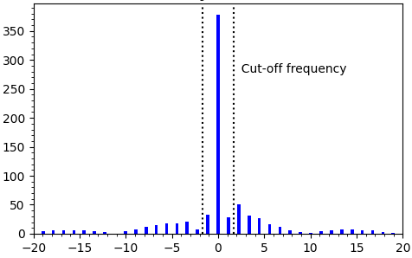
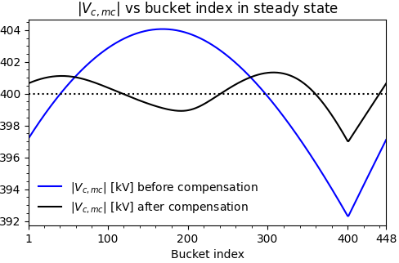
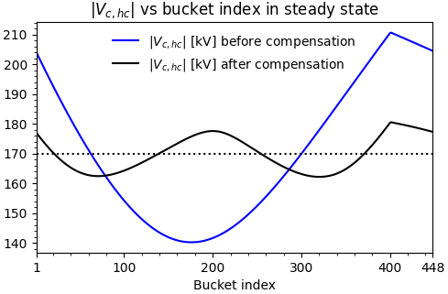
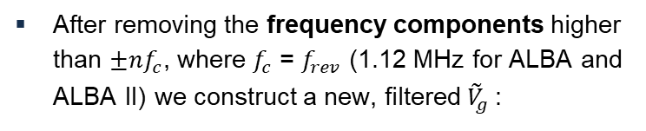
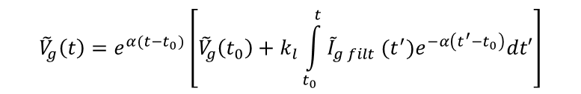
TBL COMPENSATION - METHODOLOGY
After removing the frequency components higher than ${±nf}_{c}$, where $f_{c}$ = $f_{rev}$ (1.12 MHz for ALBA and ALBA II) we construct a new, filtered ${\tilde{V}}_{g}$:
Revolution frequency harmonics
$${\tilde{V}}_{g}\left(t\right)=e^{α(t−t_{0})}\left[{\tilde{V}}_{g}\left(t_{0}\right)+k_{l}\int_{t_{0}}^{t}{{\tilde{I}}_{g filt} (t^{′})e^{−α\left(t^{′}−t_{0}\right)}dt′}\right]$$
The result is a flatter cavity voltage, both in amplitude and phase, for both the MCs and HCs, without requiring an unaffordable amount of RF power:
gap
gap

Slide 24
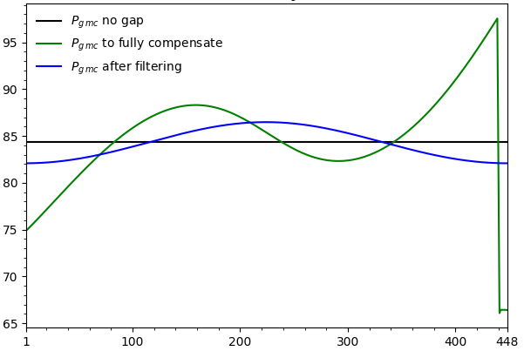
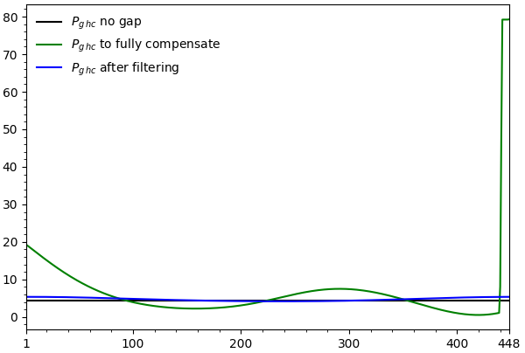


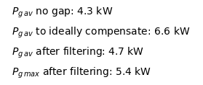
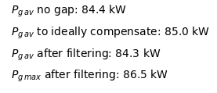
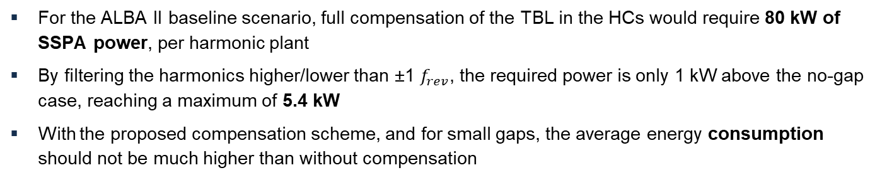
TBL COMPENSATION - ALBA II CASE
For the ALBA II baseline scenario, full compensation of the TBL in the HCs would require 80 kW of SSPA power, per harmonic plant
By filtering the harmonics higher/lower than ±1 $f_{rev}$, the required power is only 1 kW above the no-gap case, reaching a maximum of 5.4 kW
With the proposed compensation scheme, and for small gaps, the average energy consumption should not be much higher than without compensation

Slide 25
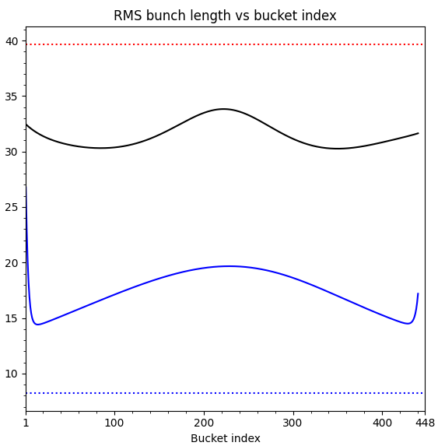
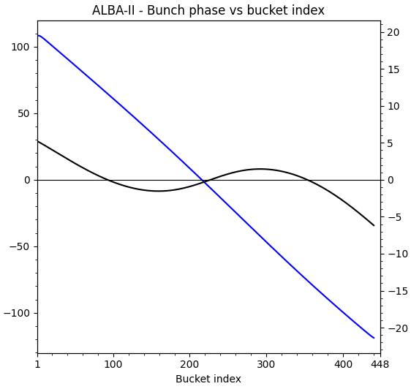

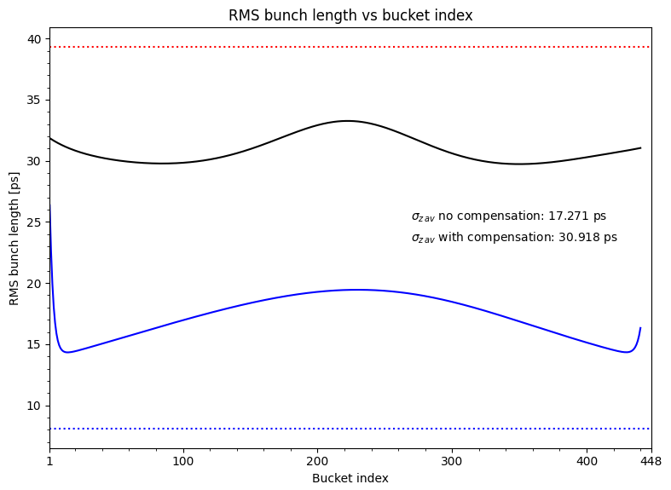

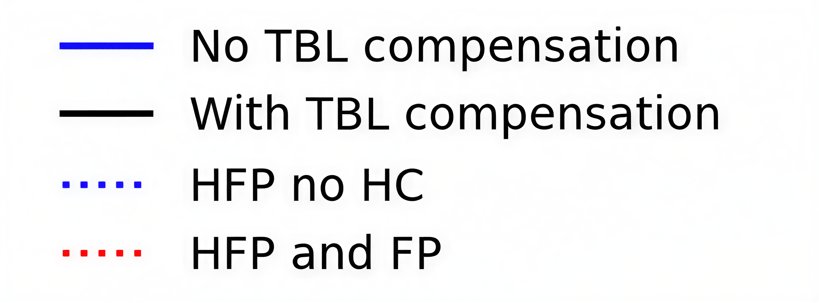
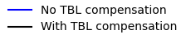



TBL COMPENSATION - ALBA II CASE
In the ALBA II baseline scenario correcting only the 1st revolution harmonic in both MCs and HCs would yield a very high compensation efficacy, with a bunch length around 98% of the no-gap case
With these settings the Touschek lifetime would be improved from 11.5 h to 20.6 h
$σ_{z}$ FP = 39.68 ps
A2L006C
$σ_{z}$ no gap = 32.15 ps
$σ_{z}$ no HC = 8.2 ps
A2L006C

Slide 26
TBL COMPENSATION - ALBA II CASE
Even if the 1.8% of gap has a heavy impact on the average bunch length, further increasing this value does not seem to worsen the impact on the average bunch length much
For gaps < 2%, compensations higher than 90% should be easily achieved
Tracking simulations with power modulation are planned as future work
Flat potential
PTBL threshold (680 kV without DRFF)
x 1.8
No HC
ALBA II baseline (1.79%)

Slide 27
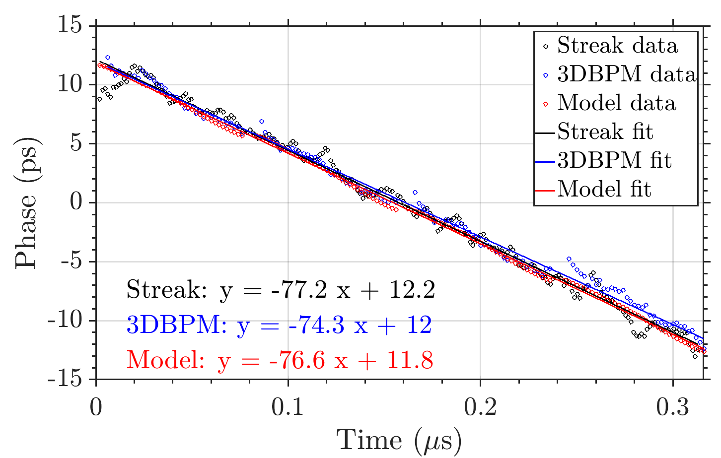
TBL COMPENSATION - ALBA II CASE
The phase offset as a function of bucket index obtained with the developed code has been validated against experimental measurements at ALBA using both the streak camera and the fast oscilloscope acquisition method, showing very good agreement

Slide 28
OUTLINE
Introduction: ALBA and ALBA II Light Sources
ALBA II RF system: Overview, new developments
Beam stability studies: Expected instabilities, tracking simulations, Direct RF Feedback
Transient beam loading (TBL): Expected impact, foreseen solutions
Trip compensation system (TCS): Simulations and experimental results
Summary

Slide 29




ALBA II – Trip compensation system
Good beam availability is an essential goal for ALBA II, as it is for ALBA
The RF system of ALBA currently has around 10 RF interlocks per month. So 10 potential beam losses due to RF
When there is a sudden loss of 400 kV on RF voltage, combined with additional losses from an unexpected parasitic cavity, the beam transitions from one equilibrium phase to another. The resulting oscillation reduces the total voltage due to increased beam loading, which, at sufficiently high currents, can lead to beam loss
At ALBA, we have a dedicated Trip Compensation System (TCS) which raises automatically the RF power and phase delivered to the cavities after a beam loss to counter the large beam oscillations. To mathematically simulate a trip, we have a Simulink model which includes longitudinal dynamics equations and a RLC cavity model. It has been compared with experimental results at ALBA, resulting in a good match
$${\dot{V} }_{r}+\frac{ω}{2 Q_{l}}V_{r}+\left(ω − ω_{rf}\right){ V}_{i}=\frac{ωR_{l}}{2 Q_{l}}{\left( \tilde{I_{g}}+ \tilde{I_{b}}\right)}_{r}$$
$$\frac{d^{2}ψ}{dt^{2}} +2α_{γ}\frac{dψ}{dt}− \frac{Ω_{s0}^{2}}{\cos{φ_{s}}}(\sin{φ −\sin{φ_{s}})}=0$$
$${\dot{V} }_{i}+\frac{ω}{2 Q_{l}}V_{i}−\left(ω − ω_{rf}\right){ V}_{r}=\frac{ωR_{l}}{2 Q_{l}}{\left( \tilde{I_{g}}+ \tilde{I_{b}}\right)}_{i}$$
$$φ=\frac{π}{2}−ψ+{ψ_{V}}_{t}$$

Slide 30
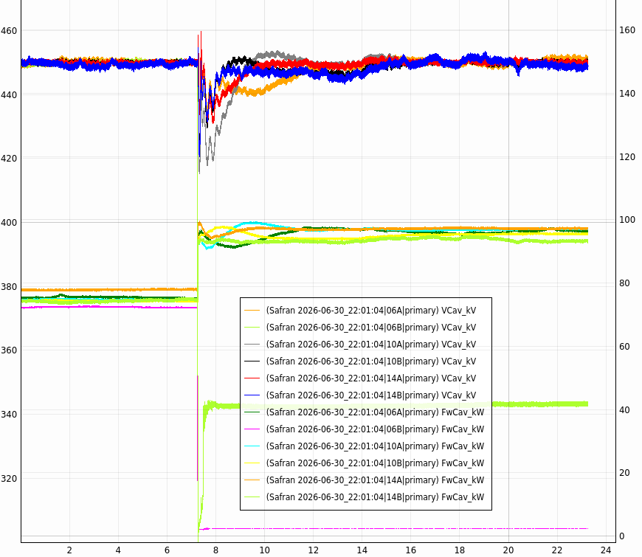
ALBA II – Trip compensation system
06B IOT body current interlock
All 6 RF cavities at 450 kV
Surviving cavities recover their voltage setting thanks to their PI control loop
Feedforward sudden power increase is applied to surviving cavities (they need to compensate for the lost cavity)
Cavity voltage [kV]
Forward power [kW]
Power delivered to the cavities is stable
Tripped cavity has only beam loading voltage
0 kW 06B

Slide 31
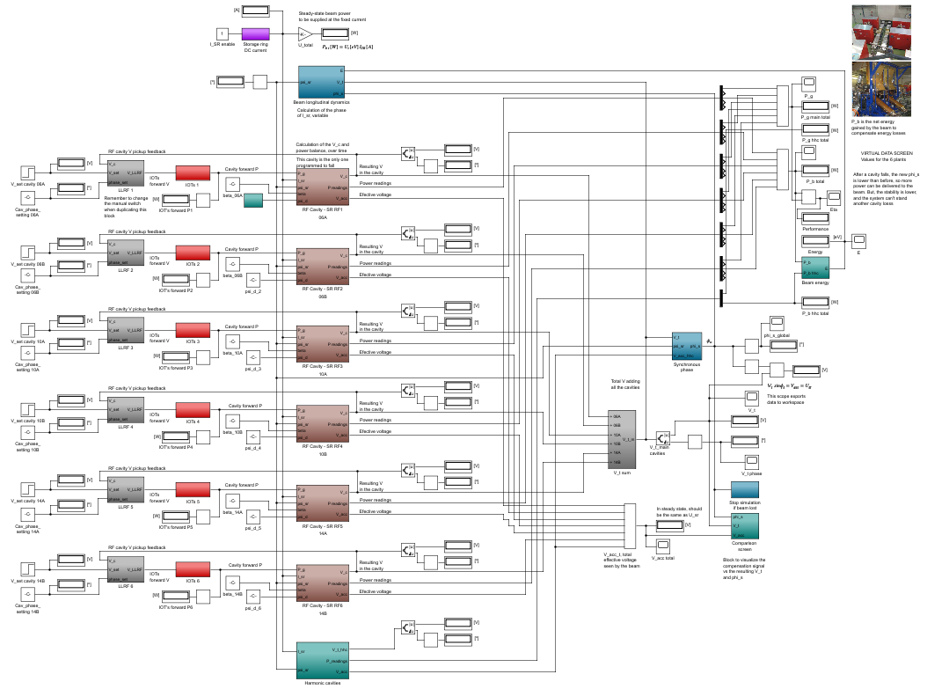
ALBA II – Trip compensation system

Slide 32
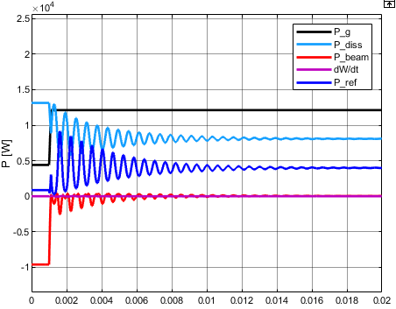
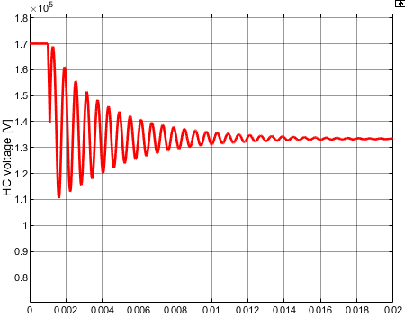
ALBA II – Trip compensation system
With the addition of the 3HCs to the system, surviving a main cavity (MC) trip becomes considerably more difficult:
After a trip, the 3HCs experience increased losses due to the beam phase change, which in turn amplifies the phase shift and further destabilizes the system
If the 3HCs do not change anymore, the previous ratio of V_{HC}/V_{MC} ratio is no longer preserved, leading to a ξ > 1 and the beam becoming unstable
Therefore, we plan to use the generator power to immediately lower the 3HC voltage, countering its beam loading and keeping the system’s below the PTBL threshold
In case Robinson DC instability arises due to the temporarily low MC voltage, DRFF for mode 0 would help to mitigate it
HC power balance after a MC trip
HC voltage amplitude after a MC trip

Slide 33
OUTLINE
Introduction: ALBA and ALBA II Light Sources
ALBA II RF system: Overview, new developments
Beam stability studies: Expected instabilities, tracking simulations, Direct RF Feedback
Transient beam loading (TBL): Expected impact, foreseen solutions
Trip compensation system (TCS): Simulations and experimental results
Summary

Slide 34
GENERAL SUMMARY
Beam stability studies via particle tracking (elegant, mbtrack2) and analytical models are used determine bunch lengthening efficiency of the new 3HC system, both in ALBA and ALBA II
These studies have predicted onset of PTBL instabilities above flatness factor ξ = 0.96, limiting the HC voltage to 680 kV (being the flat potential at 706 kV) and the bunch lengthening factor to 3.9
The use of Direct RF Feedback would improve the bunch lengthening performance of the double RF system and allow a lower main voltage setting in ALBA II.
Transient beam loading due to ion clearing gaps has been studied. It has large impact on the lengthening performance of the double RF system of ALBA II, even for very small gaps, being able to decrease the resulting Touschek lifetime in more than 40%
The calculations indicate that this effect can be effectively mitigated in the ALBA II storage ring by applying a feedforward amplitude modulation of the power delivered to both MCs and HCs at the revolution frequency, without the need of additional hardware, achieving bunch lengthening factors of more than 90% of the full filling pattern case
The trip compensation system studies predict that the current strategy can also be used for ALBA II, allowing the beam to survive when either a main or an harmonic cavity are lost. However, a feedforward signal must be applied on both RF systems

Slide 35
FUTURE MACHINE STUDIES SUMMARY
During 2027 onwards, we will be conducting a series of machine studies to improve the performance of the double RF system, for both ALBA and ALBA II:
Double RF system intrinsic instabilities mitigation (such as PTBL) by means of DRFF
Beam lifetime increase vs flatness factor/HC voltage
3HC passive operation, as a back-up plan in case of a transmitter fail
TBL compensation, by means of forward power modulation
TCS studies, both to guarantee the beam stability after a MC and HC trip and to be able to lower the main MC voltage in ALBA II
Ion effects vs gap size, already under study at ALBA

Slide 37
EXTRA SLIDES

Slide 38
BEAM STABILITY STUDIES – DRFF
DRFF was also tested at BESSY II with good results
Feedback and trip compensation diagram

Slide 39

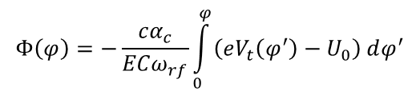


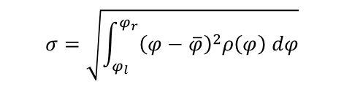


TBL ALGORITHM STEPS
0. HC complex voltage setting calculation. Initially form factor (FF) = 1 and all bunch phases = $Φ_{s}$
1. Beam loading build-up/decay depending on FF and bunch phase
$${\tilde{V}}_{b,i}={\tilde{V}}_{ba, i−1}e^{−δ_{l}+jψ_{t}}−k_{l}{\tilde{F}}_{n,i}q_{i}$$
2. Total cavity voltages along the bunch train. Adjust average generator voltage and tuning. Modulate generator current to compensate TBL
$${\tilde{V}}_{c}\left(t\right)={\tilde{V}}_{g filt}\left(t\right)+{\tilde{V}}_{b}(t)$$
Iterate until convergence
3. RF potential and longitudinal bunch charge distribution along the bunch train
$$Φ\left(φ\right)=−\frac{cα_{c}}{ECω_{rf}}\int_{0}^{φ}{\left(eV_{t}\left(φ^{′}\right)−U_{0}\right) dφ^{′}}$$
$$ρ\left(φ\right)=\overline{ρ}e^{−\frac{Φ(φ)}{α_{c}^{2}σ_{ε}^{2}}}$$
$${\tilde{F}}_{n}=F_{n}e^{jφ_{F,n}}= \frac{\text{ℱ}{\left[ρ\left(t\right)\right]}_{ω=nω_{rf}}}{\left|\text{ℱ}{\left[ρ\left(t\right)\right]}_{ω=0}\right|}$$
4. Complex FF and bunch phase
$$σ=\sqrt{\int_{φ_{l}}^{φ_{r}}{{\left(φ−\overline{φ}\right)}^{2}ρ\left(φ\right) dφ}}$$
5. Individual and average bunch length and Touschek lifetime
$$P_{g}(t)=\frac{R_{s}{\left|{\tilde{I}}_{g}(t)\right|}^{2}}{8β}$$
6. MC/HC Power balance

Slide 40
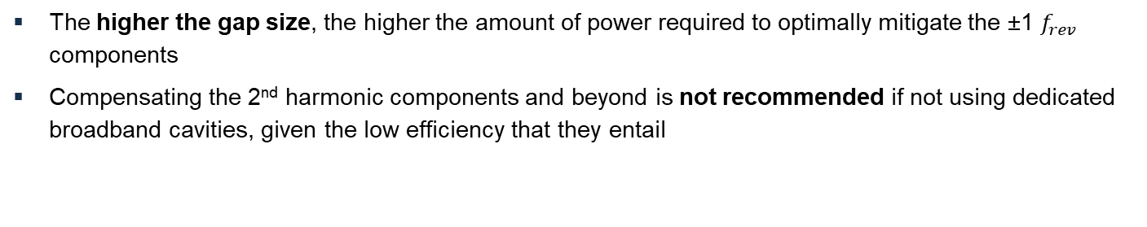
TBL COMPENSATION - ALBA II CASE
The higher the gap size, the higher the amount of power required to optimally mitigate the ±1 $f_{rev}$ components
Compensating the 2nd harmonic components and beyond is not recommended if not using dedicated broadband cavities, given the low efficiency that they entail

Slide 41
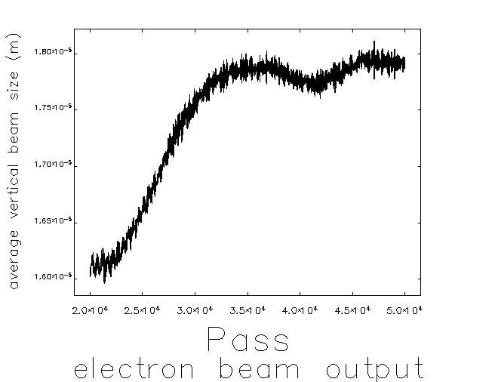
ION EFFECTS STUDIES
Average vertical beam size vs turn number with 1.8% gap in ALBA II
Current ALBA’s gap and expected long term one in ALBA II
12% increase
H₂ constitutes 70-90% of total gas molecules
Heavier, slower species are more difficult to clean
3·10⁻¹⁰ mbar
BbB disabled
100 macroparticles per bunch
Ion generation enabled
To determine the necessary ion clearing gap length for ALBA II, we have been conducting beam-ion instability studies
The main concern is the beam size blow-up caused by accumulated ions, particularly during early commissioning when the synchrotron radiation-induced gas density is high
Early simulation results suggest that a single 1.8% clearing gap combined with a bunch-by-bunch (BbB) feedback system should be sufficient to keep the beam size growth within acceptable limits

Slide 42


ALBA II – Trip compensation system
With the addition of the 3HCs to the system, surviving a main cavity (MC) trip becomes considerably more difficult:
After a trip, the 3HCs experience increased losses due to the beam phase change, which in turn amplifies the phase shift and further destabilizes the system
If the 3HCs do not change anymore, the previous ratio of V_{HC}/V_{MC} ratio is no longer preserved, leading to a ξ > 1 and the beam becoming unstable
Therefore, we plan to use the generator power to immediately lower the 3HC voltage, countering its beam loading and keeping the system’s below the PTBL threshold
In case Robinson DC instability arises due to the temporarily low MC voltage, DRFF for mode 0 would help to mitigate it
Active MC power balance after a MC trip
Active MC voltage amplitude after a MC trip

Slide 43


ALBA II – Trip compensation system
With the addition of the 3HCs to the system, surviving a main cavity (MC) trip becomes considerably more difficult:
After a trip, the 3HCs experience increased losses due to the beam phase change, which in turn amplifies the phase shift and further destabilizes the system
If the 3HCs do not change anymore, the previous ratio of V_{HC}/V_{MC} ratio is no longer preserved, leading to a ξ > 1 and the beam becoming unstable
Therefore, we plan to use the generator power to immediately lower the 3HC voltage, countering its beam loading and keeping the system’s below the PTBL threshold
In case Robinson DC instability arises due to the temporarily low MC voltage, DRFF for mode 0 would help to mitigate it
Flatness factor (ξ) after a MC trip
$$ξ=\frac{{−mV}_{hc}\cos{φ_{s,hc}}}{V_{mc}\cos{φ_{s,mc}}}$$

Slide 44

CONSTANT POWER PHASE LOOP
Taking into account that most of the harmonic cavity voltage content is driven by the beam itself and that the phase must follow the beam, the Constant Power Phase Loop has been implemented in the DLLRF
The loop monitors the amplitude of the cavity and adjust the phase of the drive to compensate, thus resulting in a beam phase control loop

