Slide 1
Beam Instabilities and Longitudinal Dynamics in HEPS
Haisheng Xu
July 13, 2026
ALBA-HEPS Virtual Workshop, July 13-14

Slide 2
CONTENT
Brief Introduction
Studies of Longitudinal Dynamics in HEPS
On-going Studies and Possible Next Step
Summary

Slide 3
Brief Introduction

Slide 4
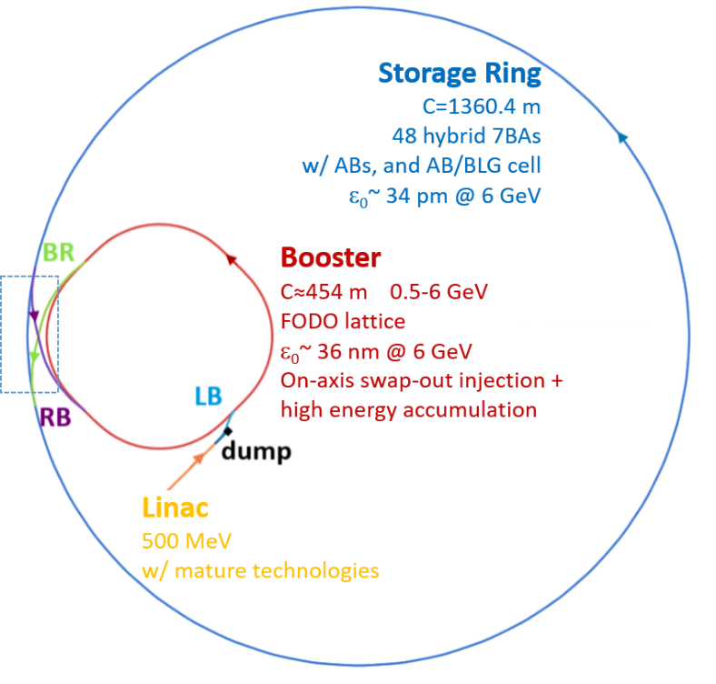
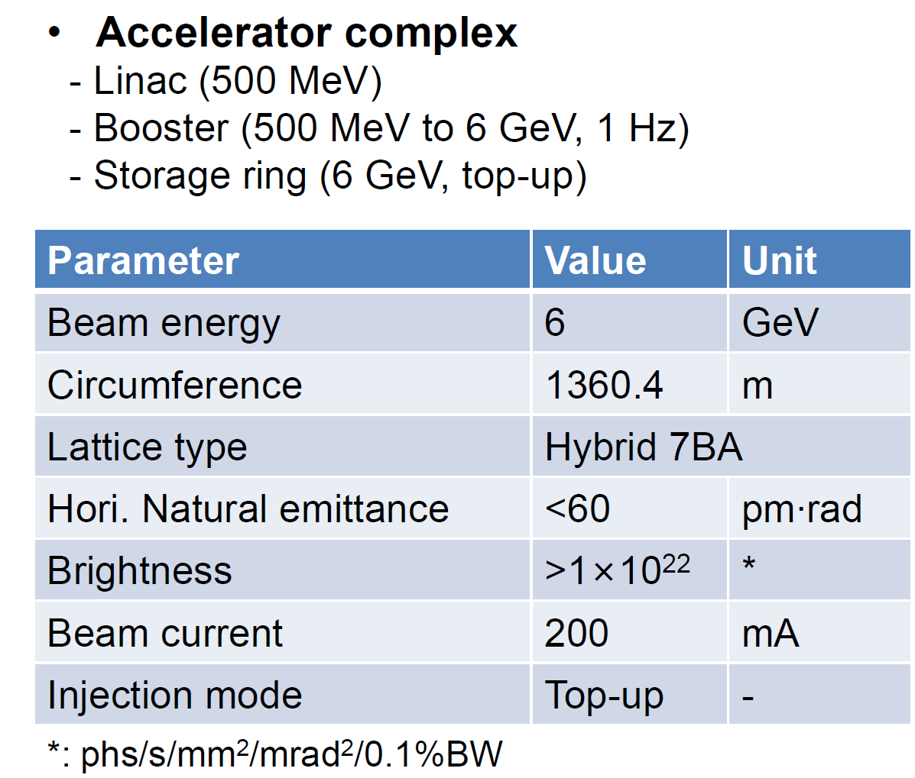

Brief information of HEPS
Challenging!
[1] Y. Jiao et al., J. Synchrotron Rad. 25, 1611–1618 (2018).
[2] Y. Jiao, RDTM 4, 399 (2020).
[3] H. Xu et al., RDTM 7, 279–287 (2023).

Slide 5
Brief information of HEPS
HEPS storage ring
  “high-bunch-charge mode"
    14.4 nC/bunch (200 mA, 63 bunches)
  “high-brightness mode”
    1.33 nC/bunch (200mA, 680 bunches)
  on-axis swap-out injection scheme + high energy accumulation in booster
    “full-charge bunch” injection --- mismatched injected bunch of 14.4 nC / 1.33 nC;
    injection imperfection induced initial transverse offset;
HEPS booster
  need to provide high charge bunch (>14.4 nC) to the storage ring
  ramping from 500 MeV to 6 GeV
High bunch charge!

Slide 6
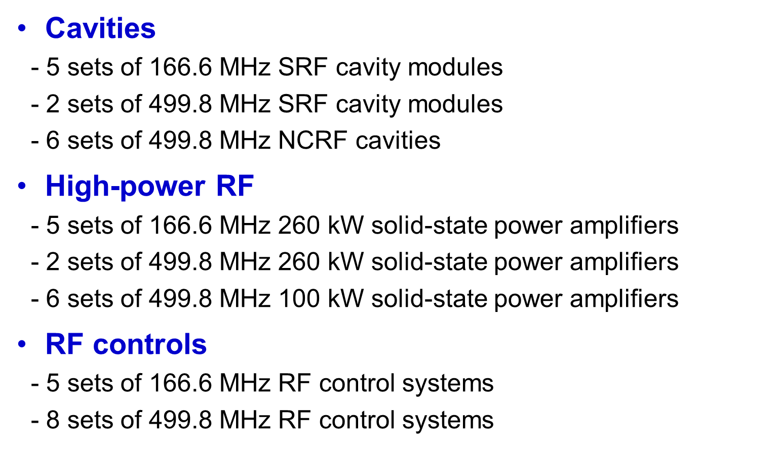
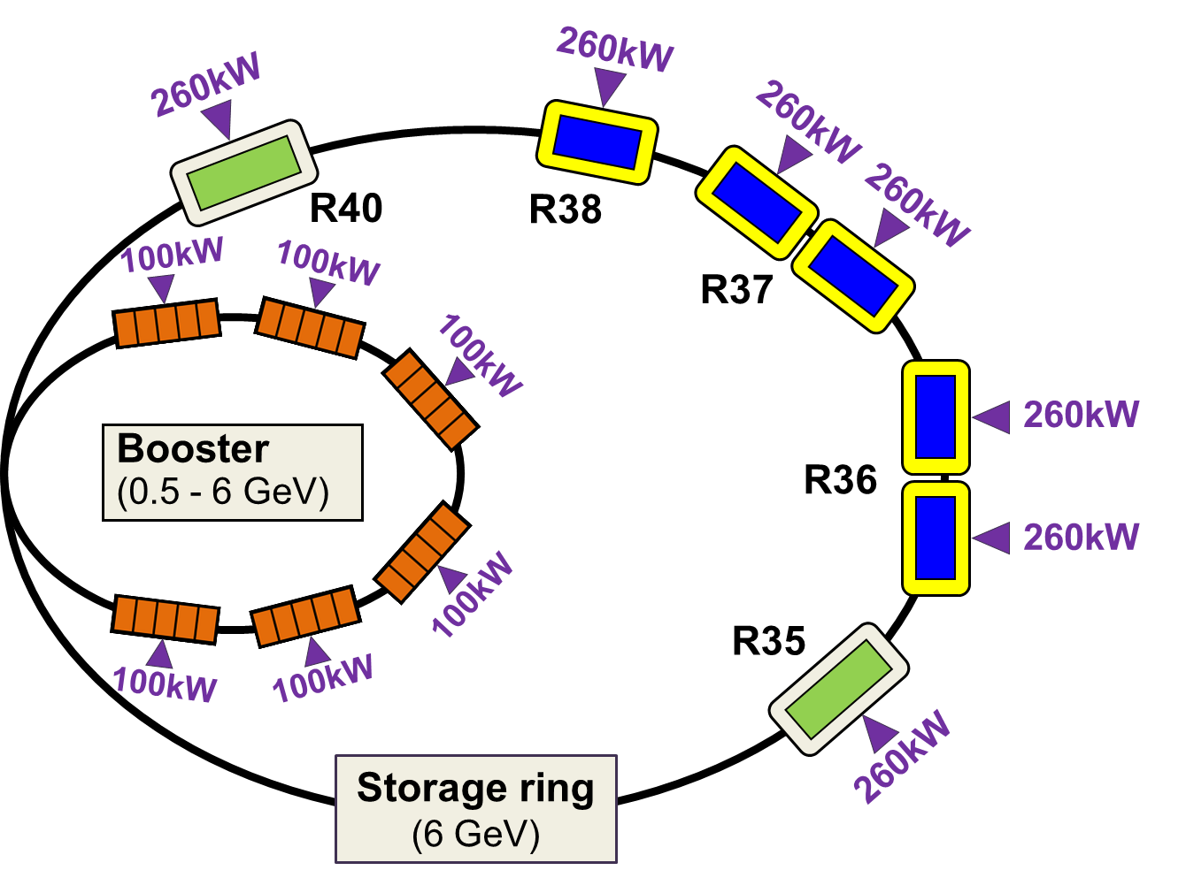
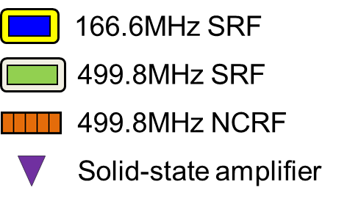
Brief information of HEPS: RF system
Courtesy of Pei Zhang
Active dual-RF system for the storage ring

Slide 7
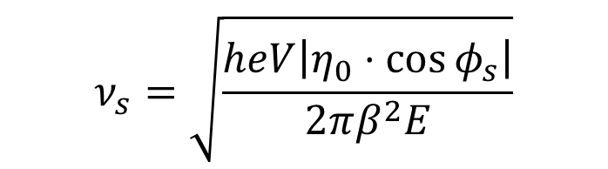
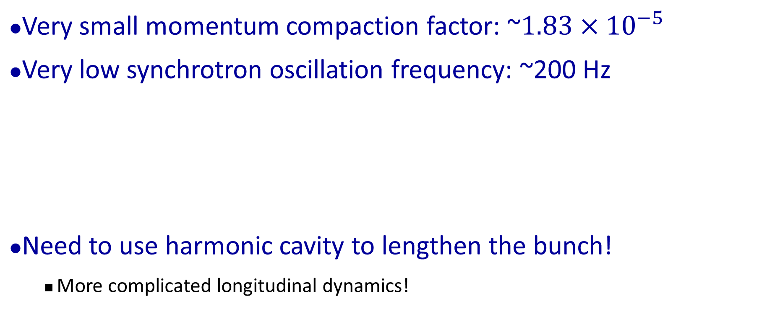

Brief information of HEPS
Slow longitudinal oscillation!
Very small momentum compaction factor: ~$1.83×{10}^{−5}$
Very low synchrotron oscillation frequency: ~200 Hz
Need to use harmonic cavity to lengthen the bunch!
  More complicated longitudinal dynamics!
$$ν_{s}=\sqrt{\frac{heV\left|η_{0}⋅\cos{φ_{s}}\right|}{2πβ^{2}E}}$$
$$α_{p}↓，η_{0}↓，ν_{s}↓$$

Slide 8
More complicated longitudinal dynamics
Double-RF system with active harmonic cavities
  Nonlinear longitudinal motion
  Longitudinal stability when adjusting ID gaps
  Lower synchrotron tune and larger spread
    Synchrotron frequency is in the FOFB bandwidth
High single-bunch charge induced collective effects
  Possible beam induced heating problem
  Bunch distribution distortion because of longitudinal impedance

Slide 9
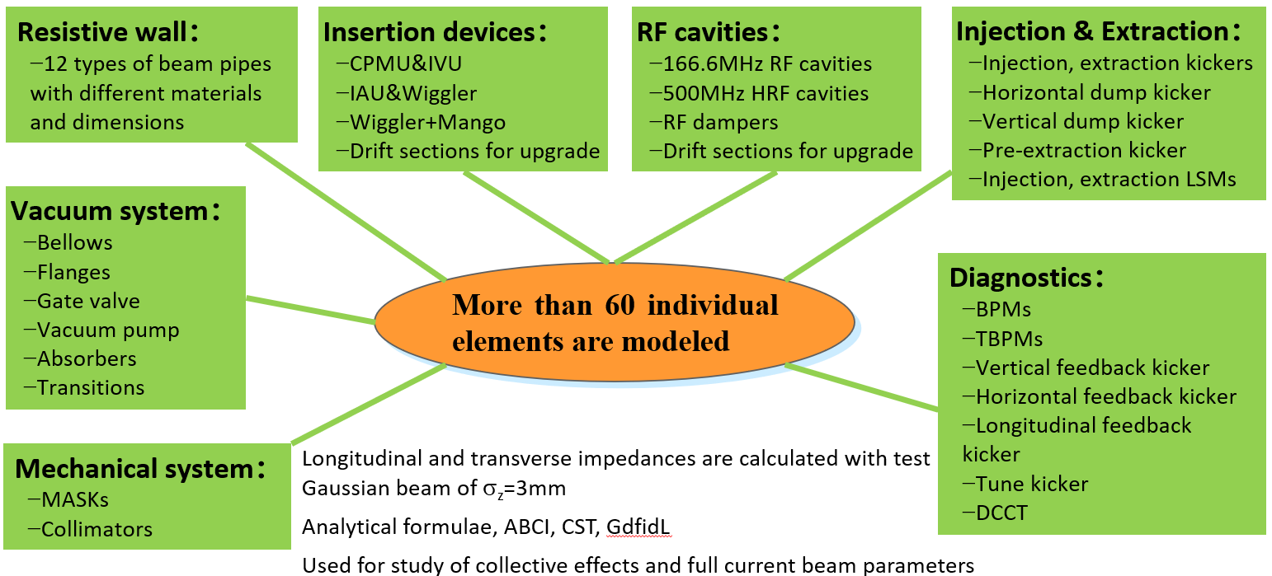
Storage ring impedance modeling
Courtesy of Na Wang
The coupling impedance model of the whole ring was developed based on element-by-element computations with analytical formulae or numerical simulations.

Slide 10
Studies of Longitudinal Dynamics in HEPS

Slide 11
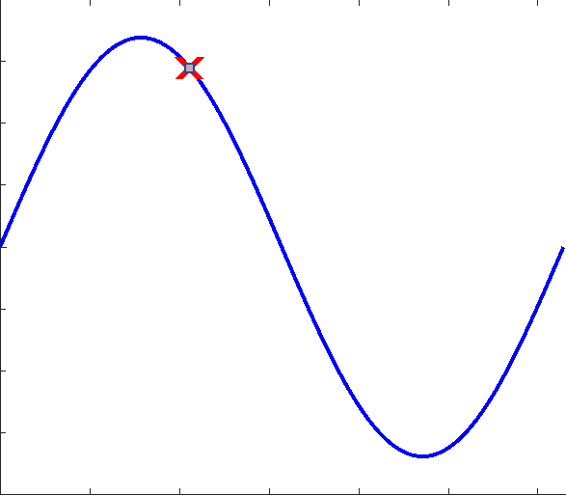
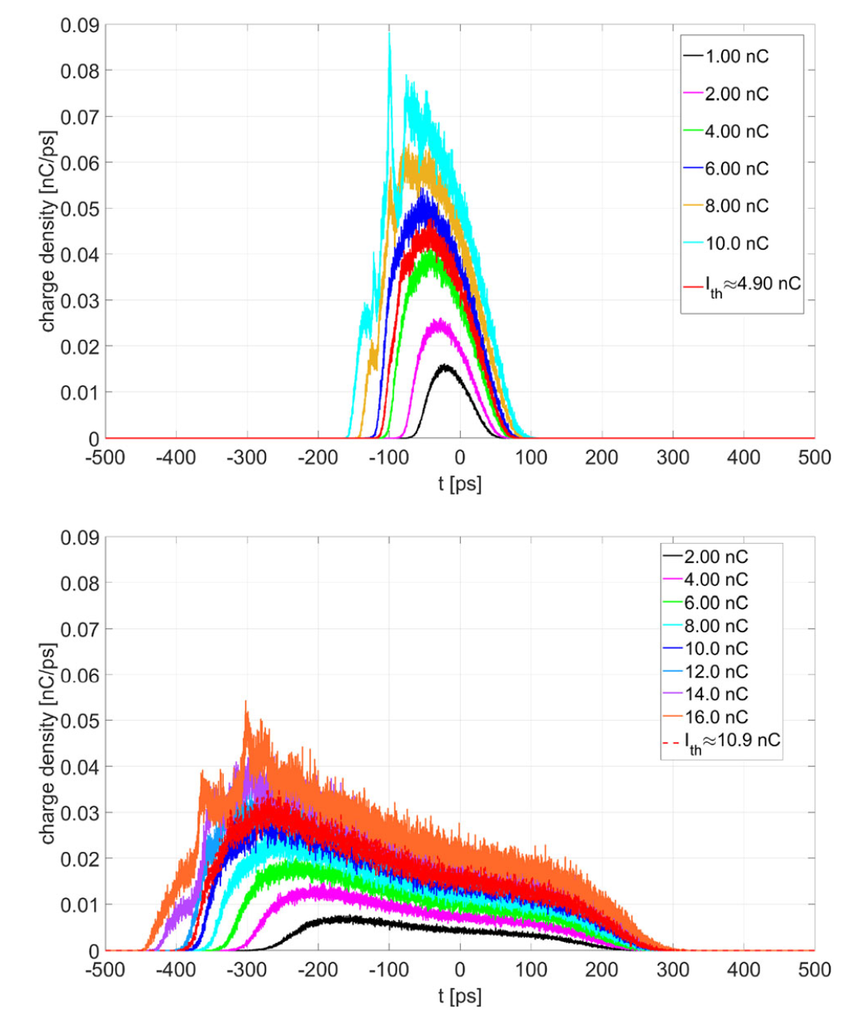
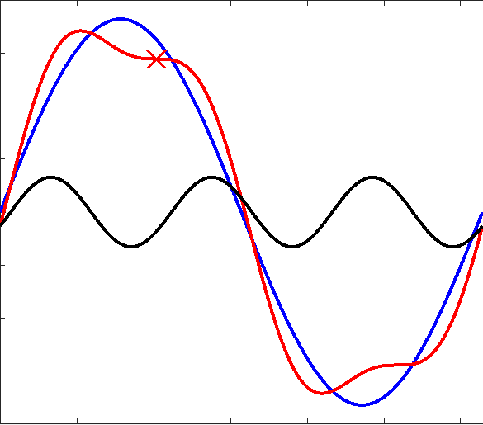
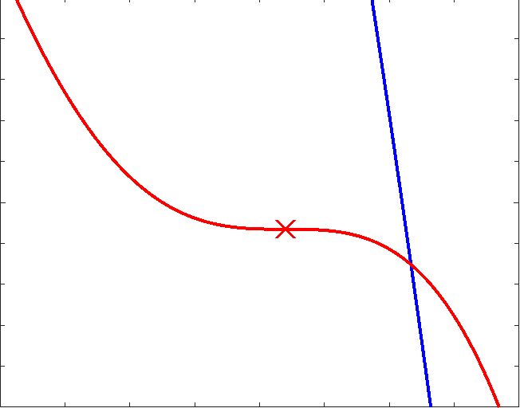
Longitudinal dynamics w/ and w/o HC
w/o HC
RF potential diff
Haissinski solutions diff
Longitudinal motion
  Linear: w/o HC
  Nonlinear: w/ HC
ideal HC

Slide 12
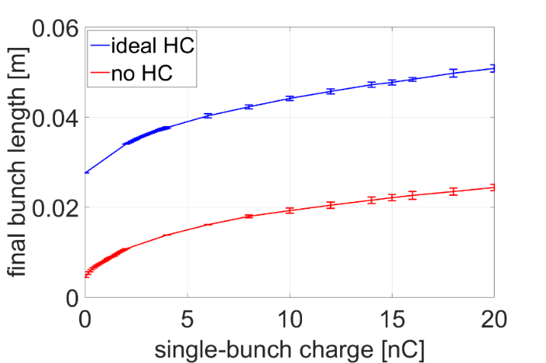
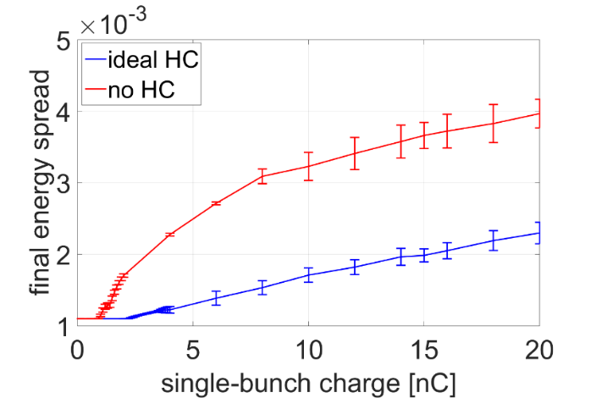
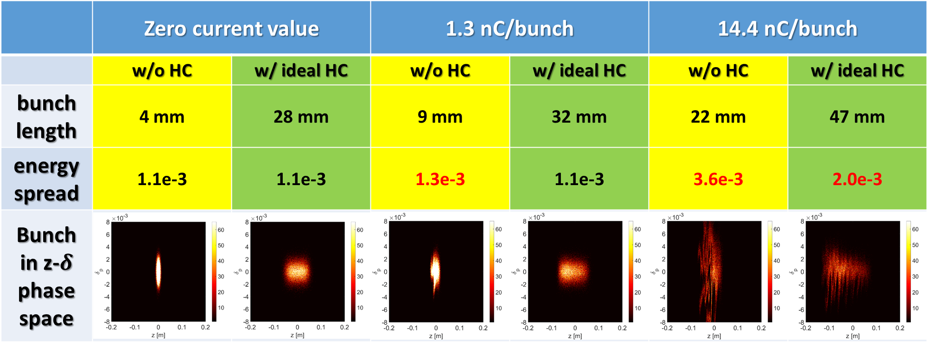
Microwave Instability (simulations)
Bunch Length
Energy Spread

Slide 13
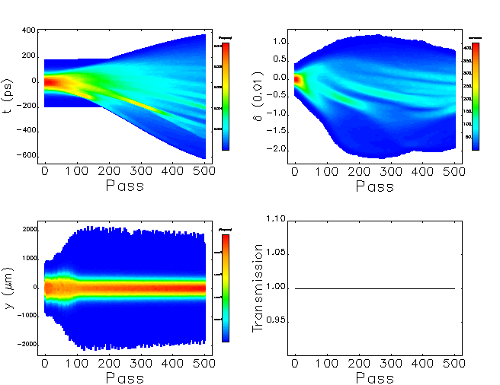
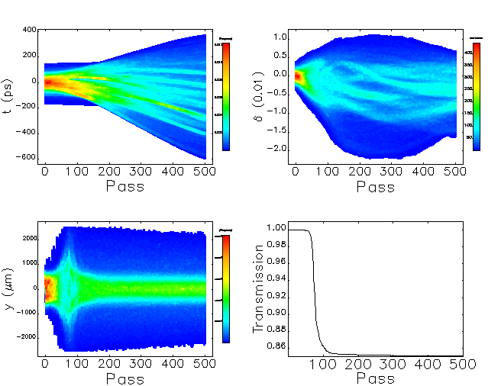
High-Charge Limit in the transient process after injection
Courtesy of Zhe Duan
Single-bunch 15 nC, initial vertical offset $y_{ini}=300μm$, initial bunch length $σ_{t−ini}=40 ps$, initial energy spread $σ_{δ−ini}=0.001$
Linear One-Turn Map
Element-By-Element
8

Slide 14
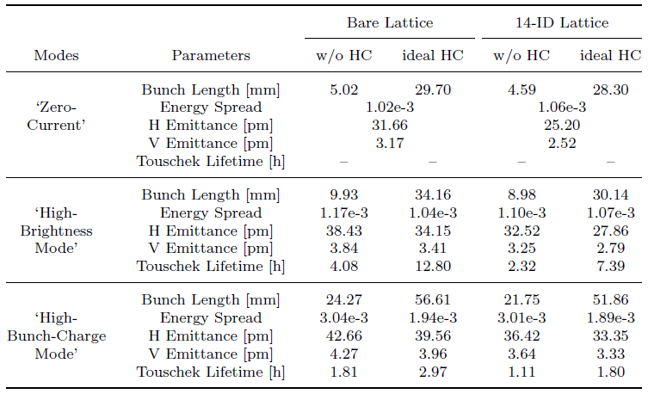
Systematic Study of Collective Effects
Beam parameters at 200 mA design current (including impedance, IBS, etc.)
H. S. Xu, et al., RDTM 7, 279–287 (2023).

Slide 15
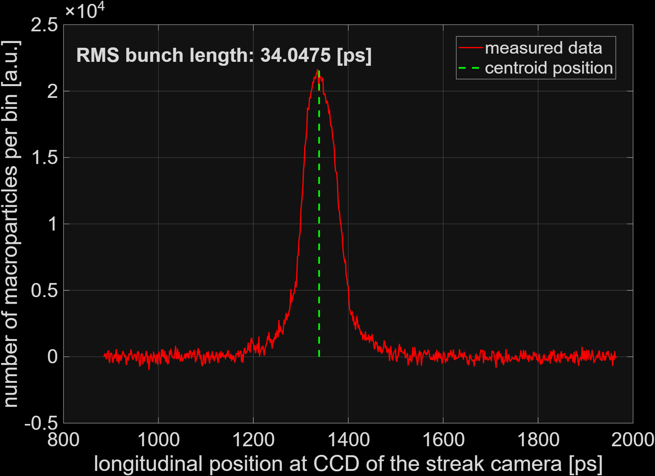
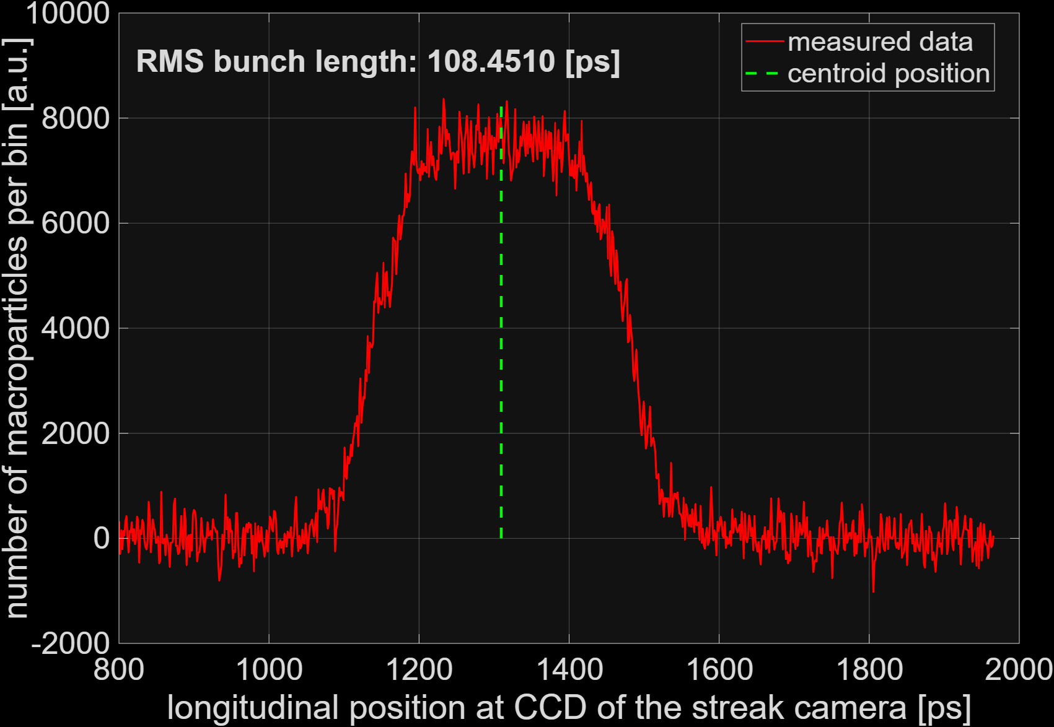
Bunch lengthening commissioning
Manage to reach nearly ideally flat bunch distribution at arbitrary beam current. （~1.2 nC / bunch）~ 3.2 times bunch lengthening
10.21 mm
32.51 mm
Raw data

Slide 16
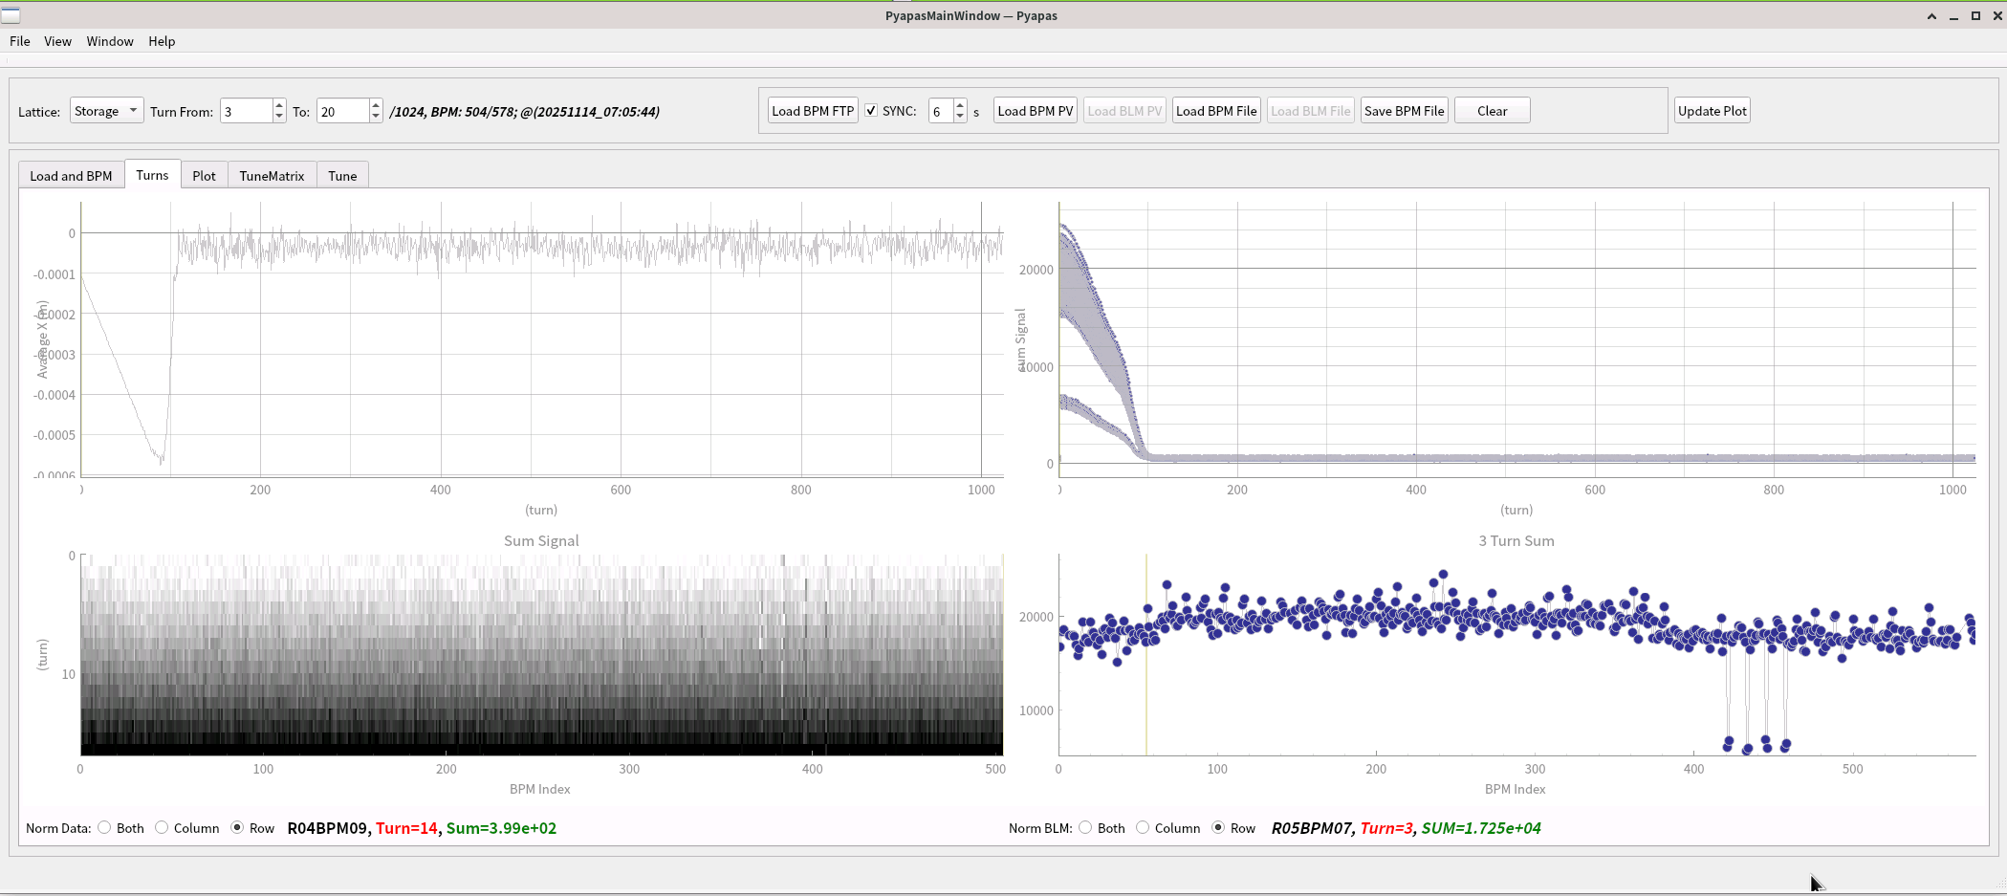
2. Fine tuning of the cavities’ phase
Rough tuning the cavities’ phase, we used the turn-by-turn sum signal of one BPM.
Fine tuning the cavities’ phase, we used the horizontal average orbit (trajectory) from the BPM turn-by-turn data as an indicator to calibrate the phase of RF cavities.
Horizontal average orbit from the BPM turn-by-turn data

Slide 17
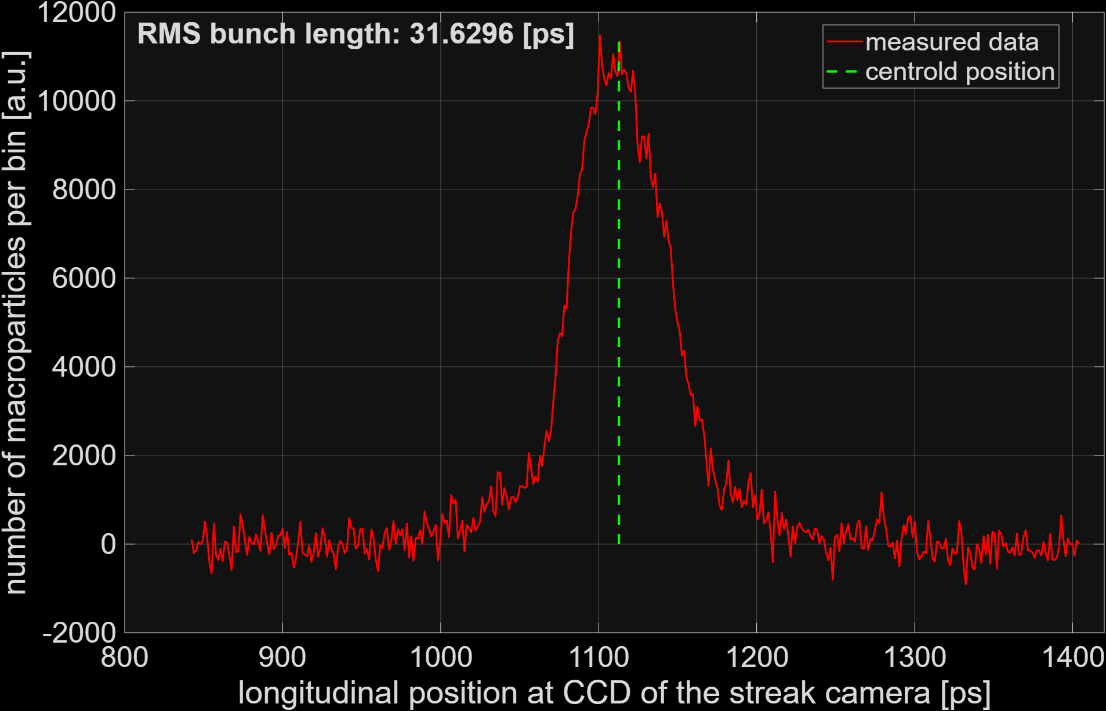
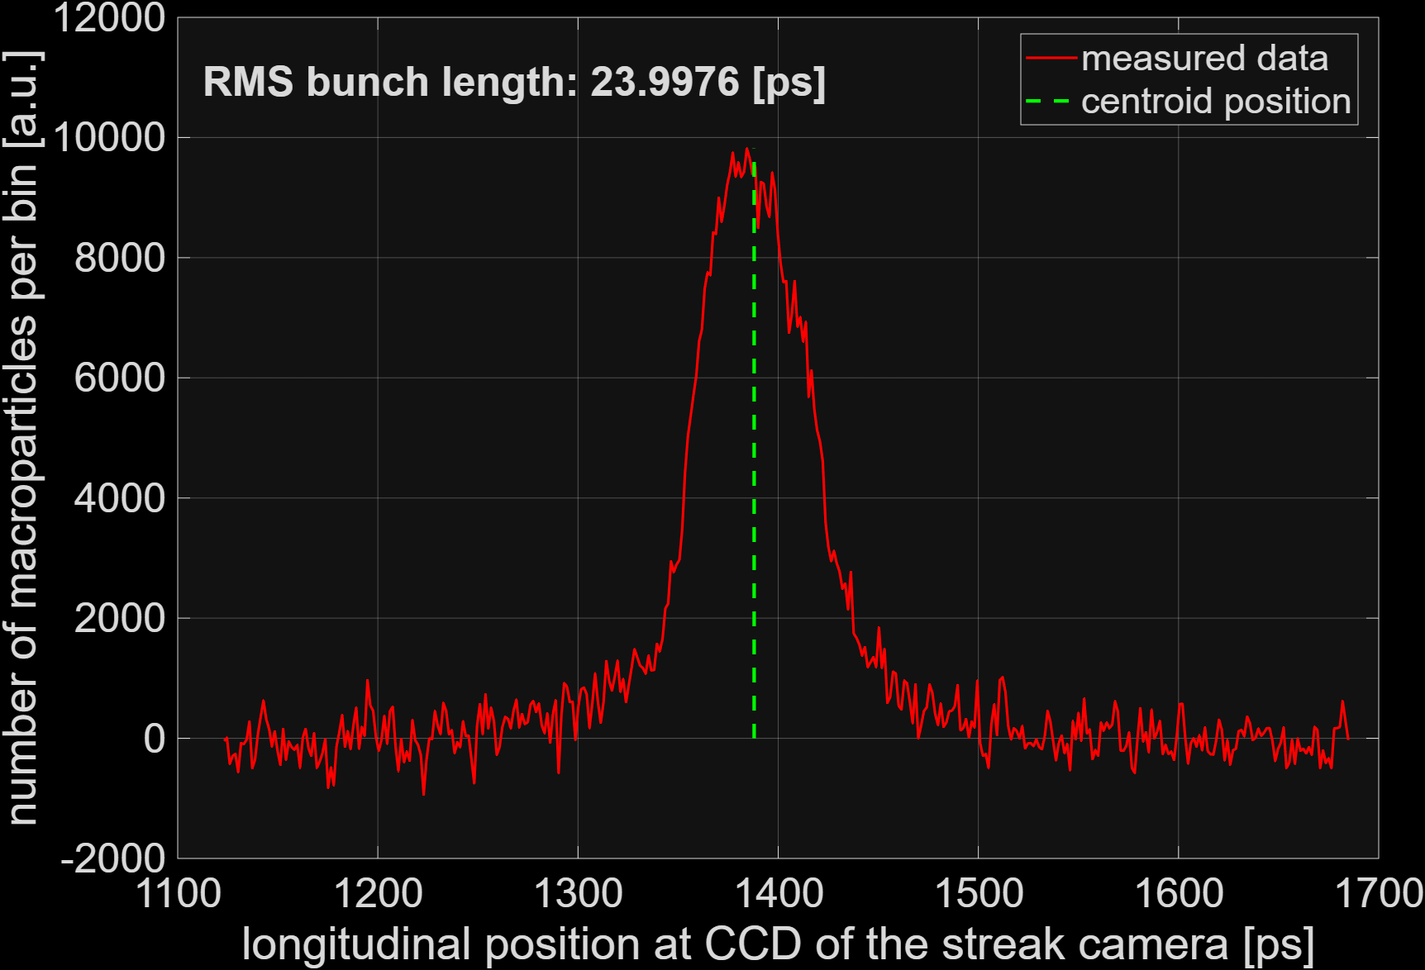
Fine tuning of the cavities’ phase
Rough tuning the cavities’ phase, we used the turn-by-turn sum signal of one BPM.
Fine tuning the cavities’ phase, we used the horizontal average orbit (trajectory) from the BPM turn-by-turn data as an indicator to calibrate the phase of RF cavities.
After calibration, the bunch length (at same single-bunch current) became shorter.
9.48 mm
7.19 mm
before calibration
after calibration

Slide 18
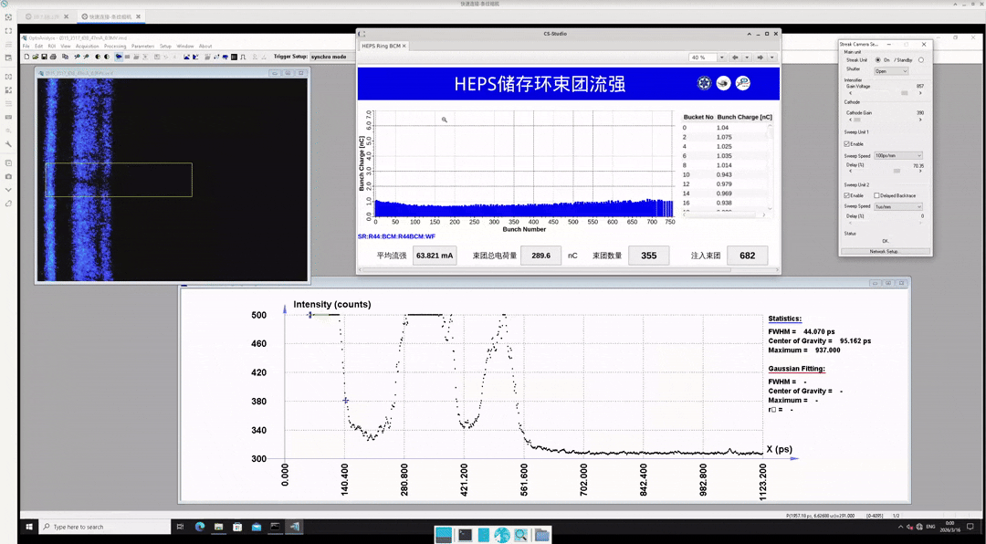
Longitudinal Coupled-Bunch Oscillation (CBM0)
振荡幅度约 168 mm

Slide 19
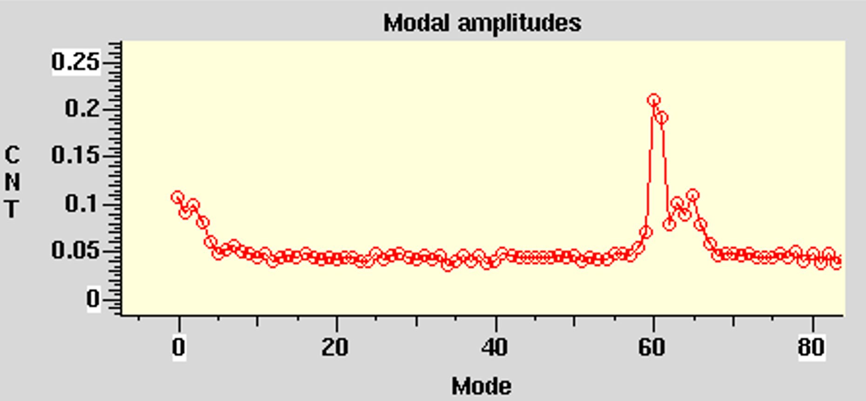
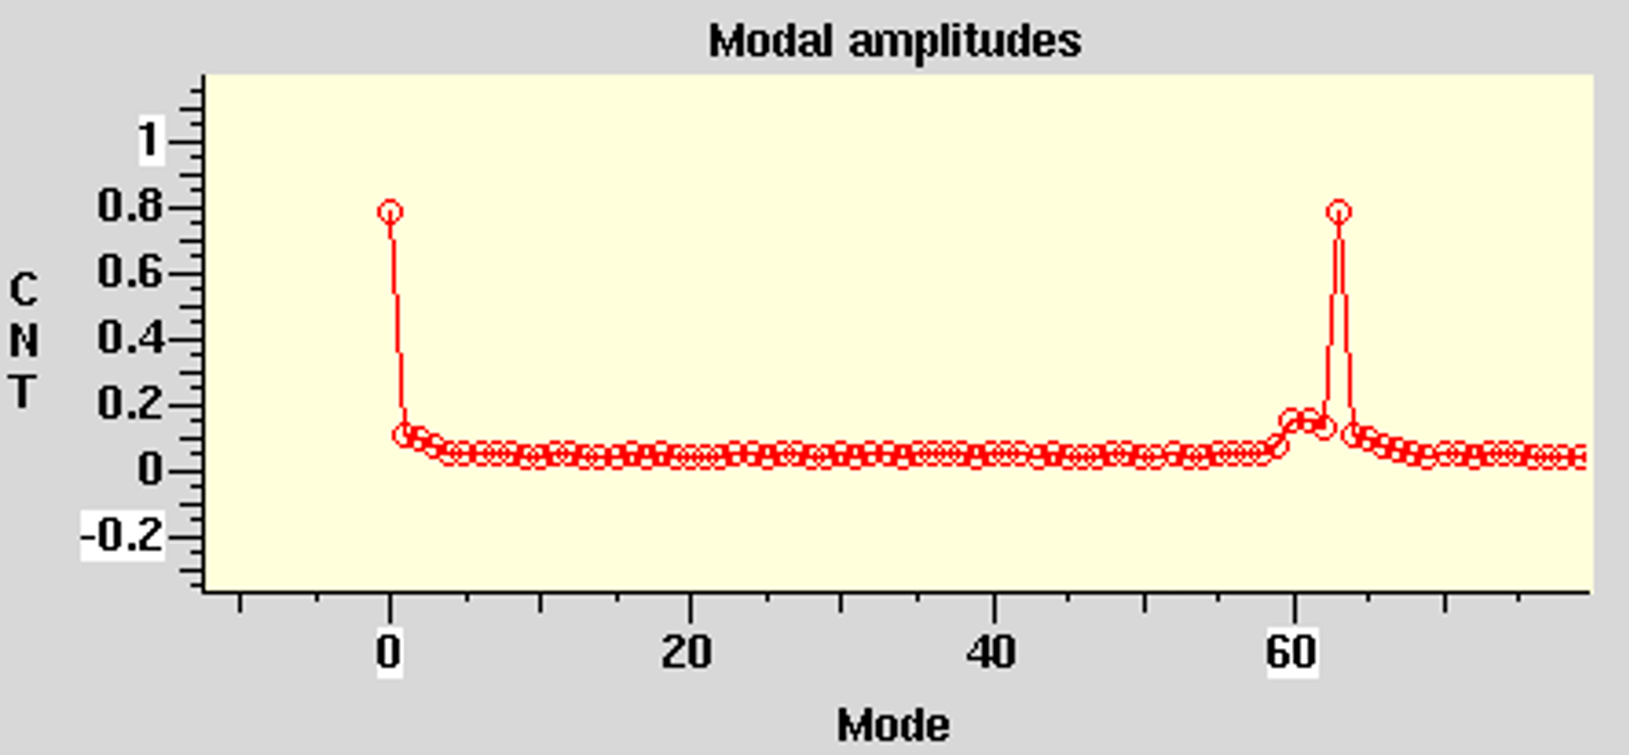
Mode analysis with bunch-by-bunch feedback
Without mode zero instability
  Several modes with much lower amplitude, the mode zero is not dominated
Mode=0
Mode=62
LLRF kp=4 @60mA
With mode zero instability
  Mode zero arises and results in beam current threshold
Mode=0
Mode=62
LLRF kp=1 @56mA

Slide 20
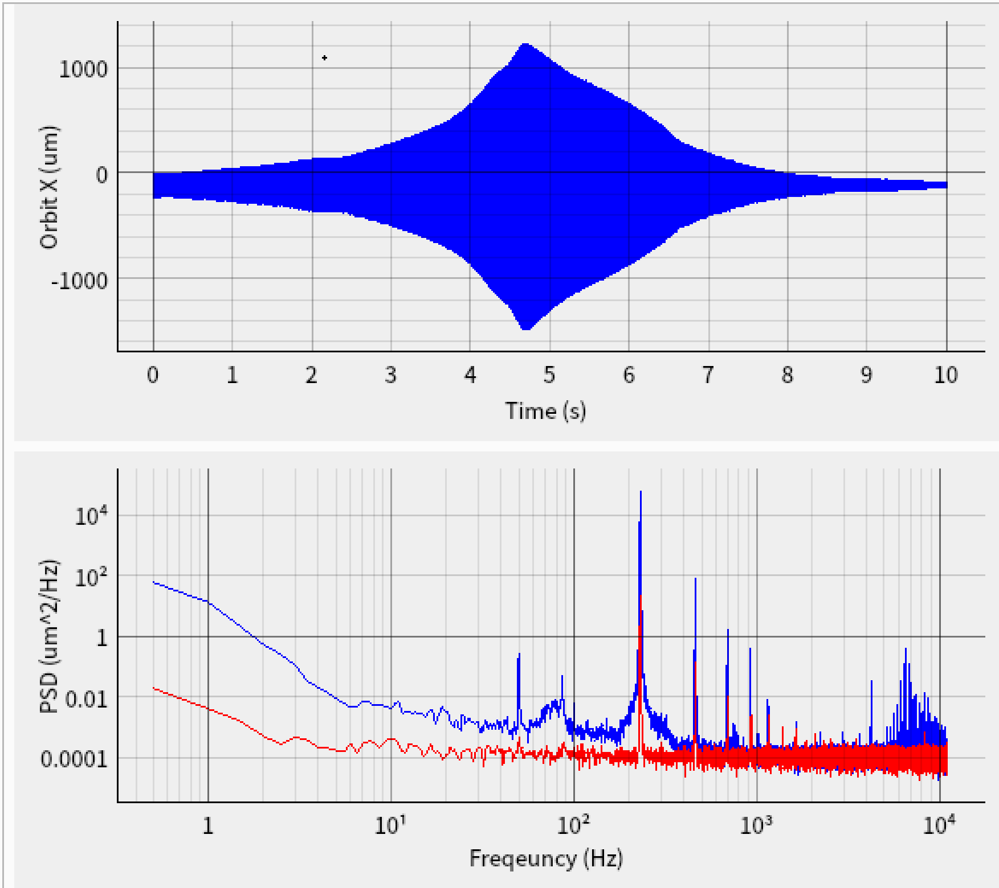
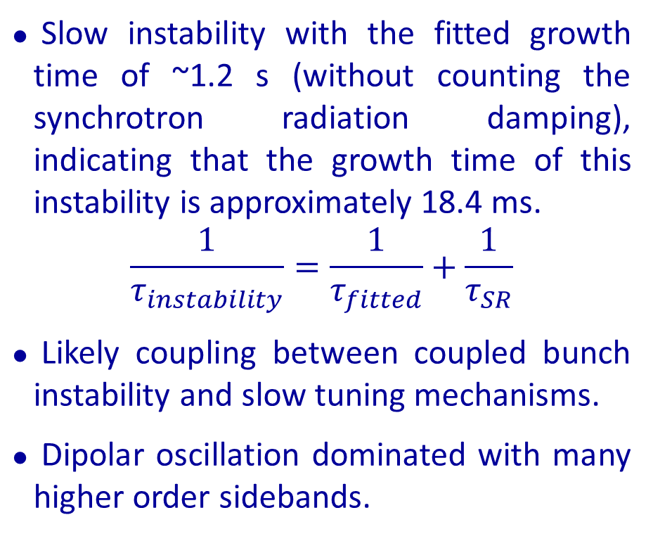
Instability growth time measured from FA data
Beam loss
Fitted growth time ≈ 1.2 s
Slow instability with the fitted growth time of ~1.2 s (without counting the synchrotron radiation damping), indicating that the growth time of this instability is approximately 18.4 ms.
$$\frac{1}{τ_{instability}}=\frac{1}{τ_{fitted}}+\frac{1}{τ_{SR}}$$
Likely coupling between coupled bunch instability and slow tuning mechanisms.
Dipolar oscillation dominated with many higher order sidebands.
Harmonic RF cavities detuned to around 70kHz~100kHz

Slide 21
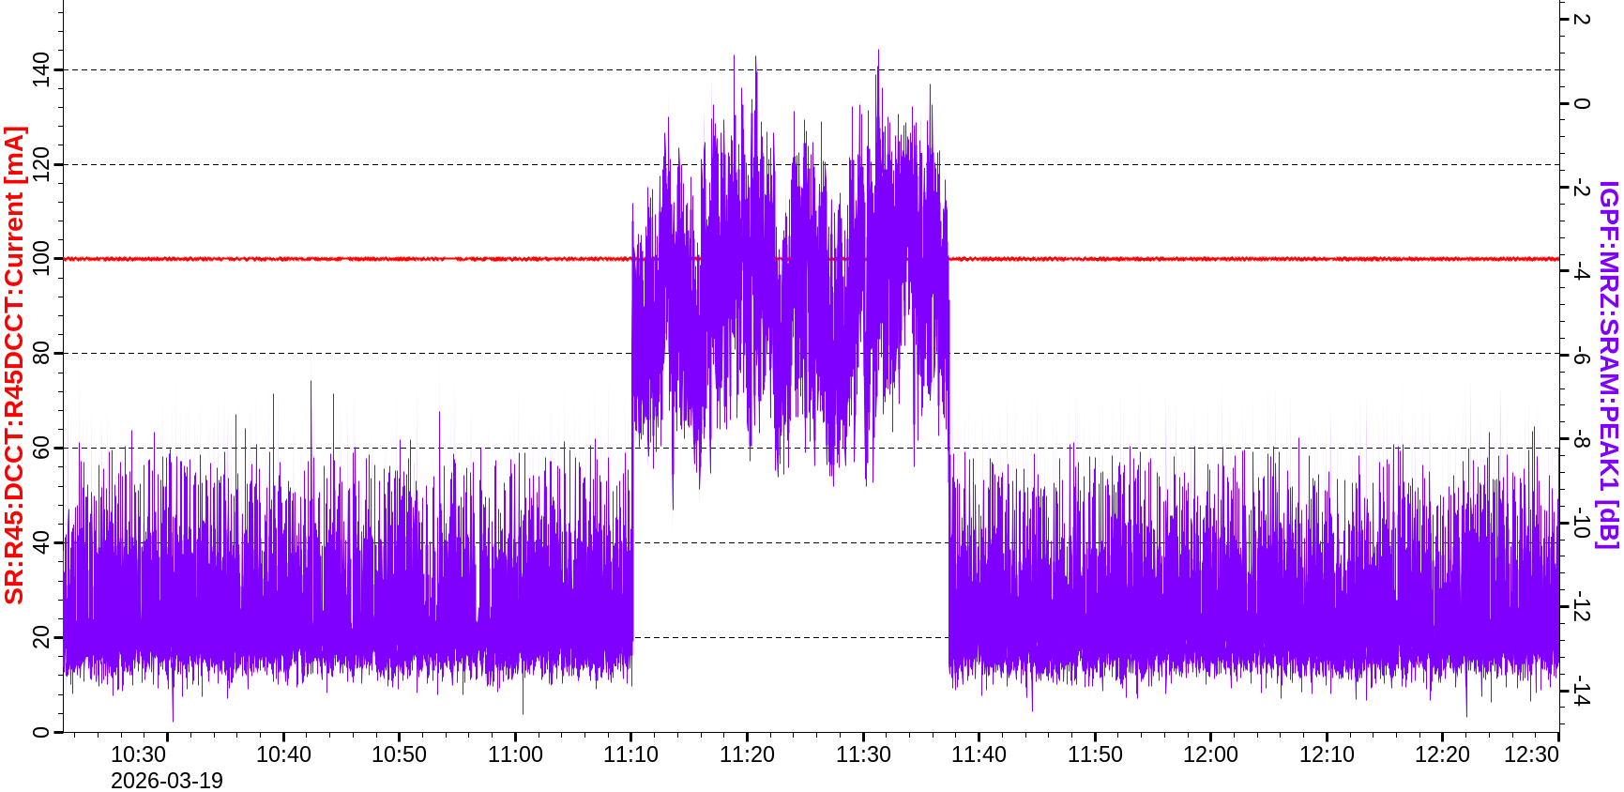
Mitigation strategies
Tuning the kp parameter of the cavity LLRF can damp the mode zero instability
Bunch-by-bunch feedback can provide extra damping to the instability
Since the synchrotron frequency is quite low (less than 100 Hz), FOFB show damping effects on the coupled bunch modes (without zero mode).
FOFB off
Oscillation amplitude with FOFB on

Slide 22
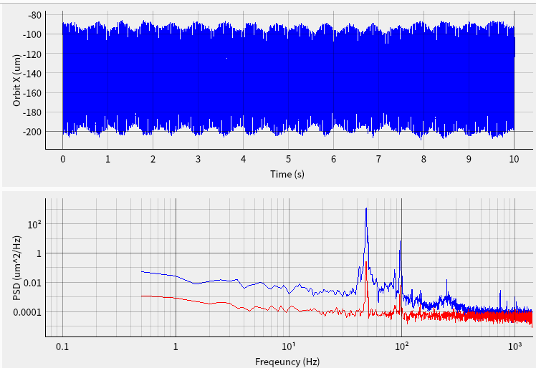
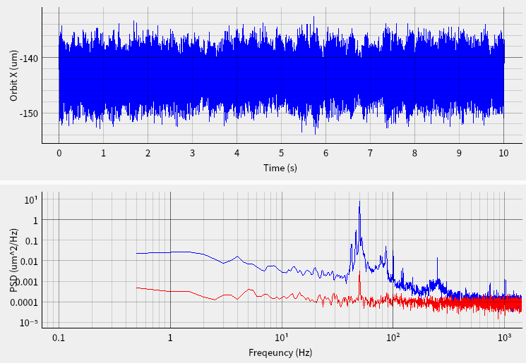
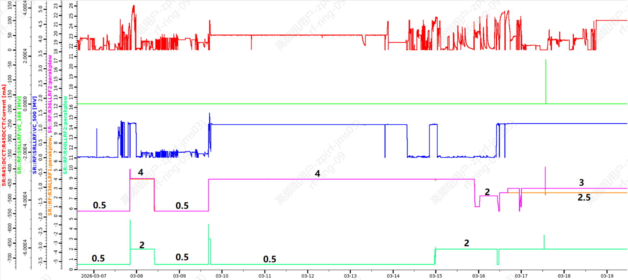




Dedicated beam time for studying the CBM0
95mA, unstable
63mA, stable
Beam current
amp$≈110μm$
amp$≈15μm$
Amplitude of the peak at $ν_{s}$~1000
Amplitude of the peak at $ν_{s}$~10
Kp of 166.6 MHz cavities
Kp of 499.8 MHz cavities

Slide 23
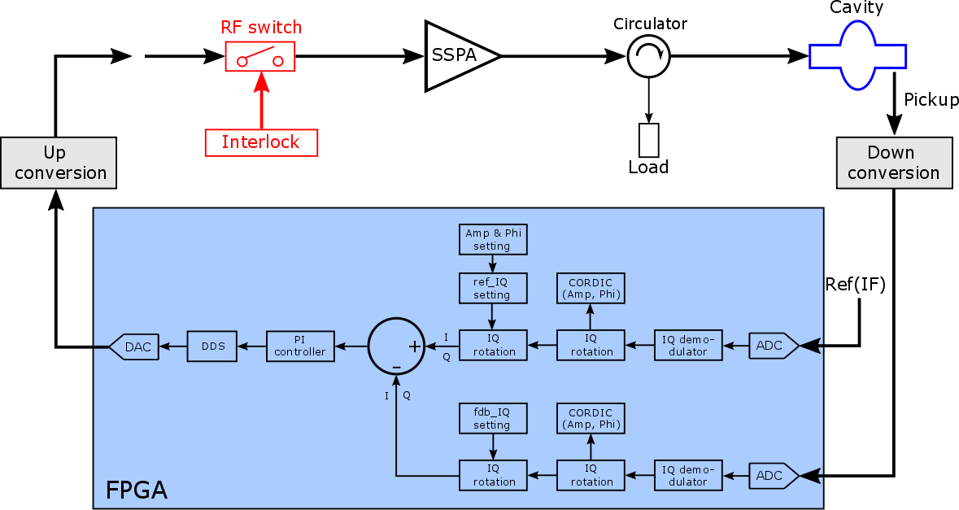
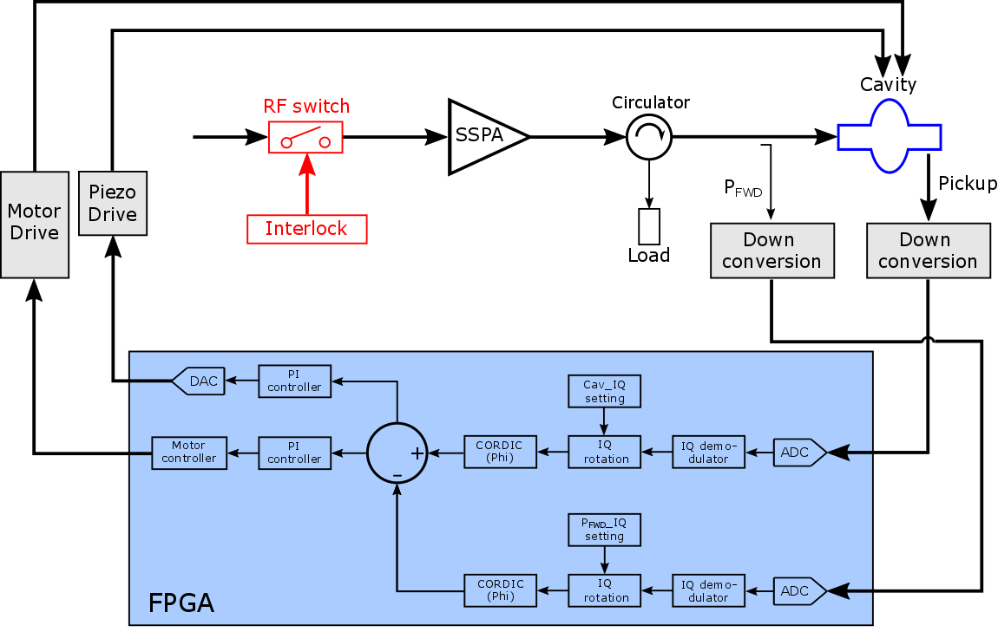
Cavity field & resonance control: I/Q
Courtesy of Qunyao Wang
IQ vector control (field)
- Sample ref. & pickup signals
- Non-IQ demodulate to IQ
- IQ errors to PI controller
- DDS output IF drive signal
IQ vector control (resonance)
- Sample fwd. & pickup signals
- Demodulate to IQ -> phase error
- SC cavity tuner: Motor & Piezo
- NC cavity tuner: Motor

Slide 24
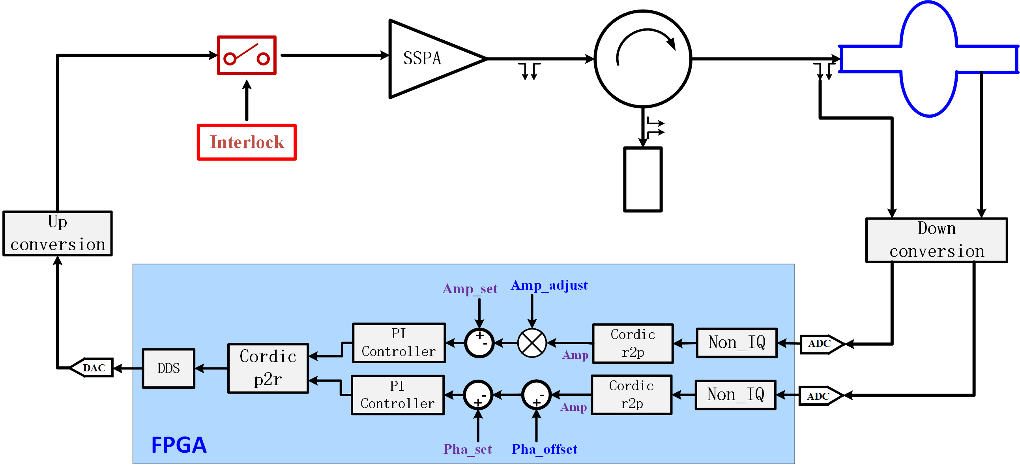
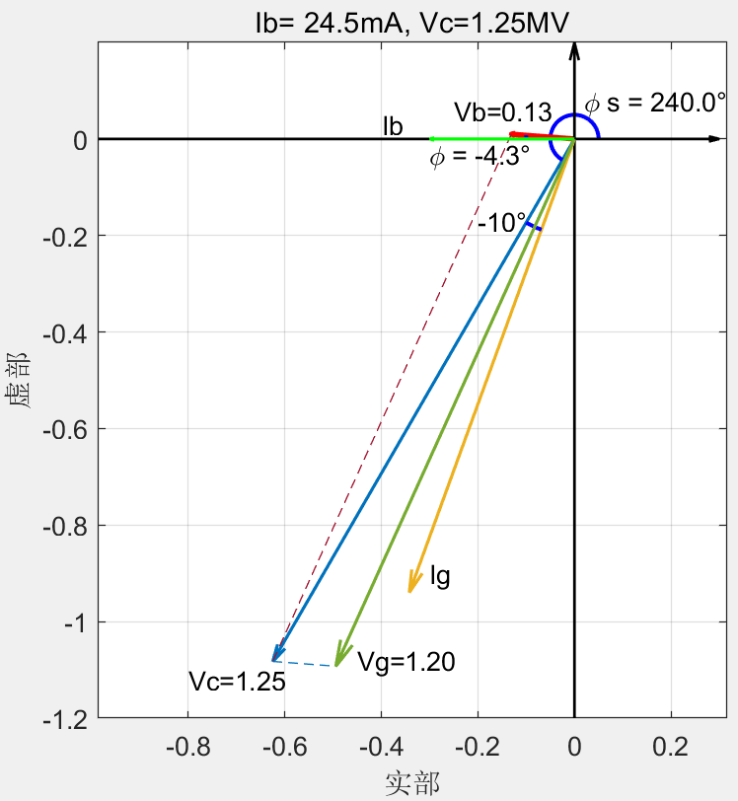
A different LLRF control strategy of the HC
Ib =24.5mA
Pb =-15kW
Vc =1.25MV
Vb =0.13MV
Vg =1.20MV
φ_{s} =240°
This scheme was tested and verified!
More efforts needed to make it operates more stable.
Ignasi Bellafont, talk in the 9th Low Emittance Rings Workshop, CERN, 2024
F. Perez, et al., NIMA, 2025.

Slide 25
On-going studies and possible next step

Slide 26
On-going studies
Control strategy of the HCs at high beam current
Operation strategy when ID gaps changing （U0 feed-forward table）, how to operate two HCs stably；
Trying to find out the physical reason of CBM0;
Cure the mode 0 via algorithm and a mode 0 damper;
Studying the longitudinal coupled-bunch instability;
Carrying out experiments of collective beam instabilities with active harmonic cavities and cure them;
Influences of FOFB on longitudinal collective motions.

Slide 27
Summary

Slide 28
Summary
Systematic studies of longitudinal dynamics were carried out in the design stage of HEPS.
Commissioning of double-RF system were quite smooth at the beginning to reach ideal-lengthening. However, more attention was paid to increase beam current and operate the machine stably (HC setup and ID gaps; stabilize the HC synchronous phase, etc. )
More experimental studies of longitudinal dynamics in HEPS are planned in the future machine shifts.
Possible next step:
  U0 feedforward;
  Keep increasing beam current towards the designed current 200 mA;
  keep stable operation at high current (e.g, find out the physical reason of CBM0);
  mode 0 damper (algorithms is under test and would be tested in the next run);
  experiments of collective beam instabilities with active harmonic cavities;
  ……

Slide 29
Thank you!

