Slide 1
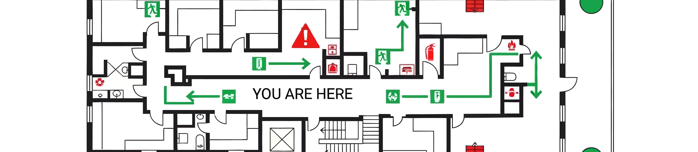
EEC Refresh Session
9/07/2026
Ana Belén Martínez, Josep Maria Roca, Victor Garrido

Slide 2
Index
Objectives of the Session
Updated Emergency Plan (PAU)
EECs’ Duties
Evacuation routes
EECs’ Material
How to act during an evacuation and confinement: differences between Main building and Prisma building
FAQs
Comments or questions
Notes:
Comenzar dejando claro que no soy una experta, que esta sesión pretende ser una puesta en común

Slide 3
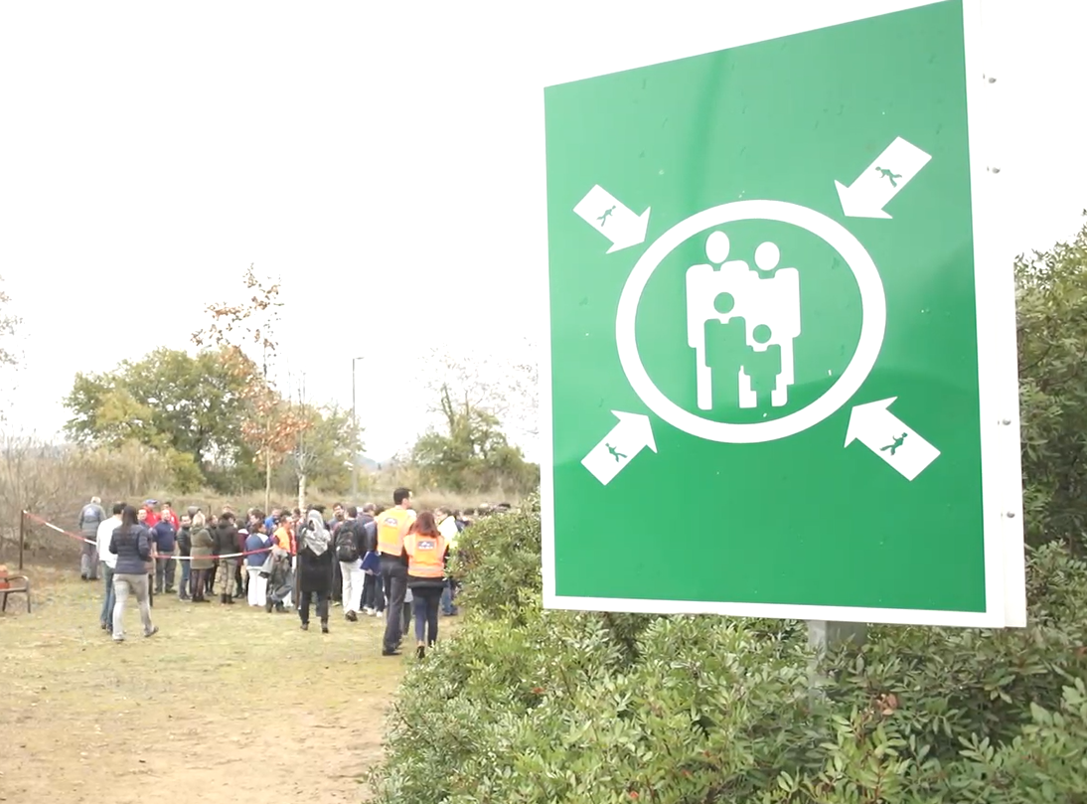
Goals of the session
Check that we have the needed volunteers to cover the different routes
Check that all the routes are clear and well defined
Check that we have the necessary equipment
Propose improvements and clarify how to proceed before the next drill or event

Slide 4
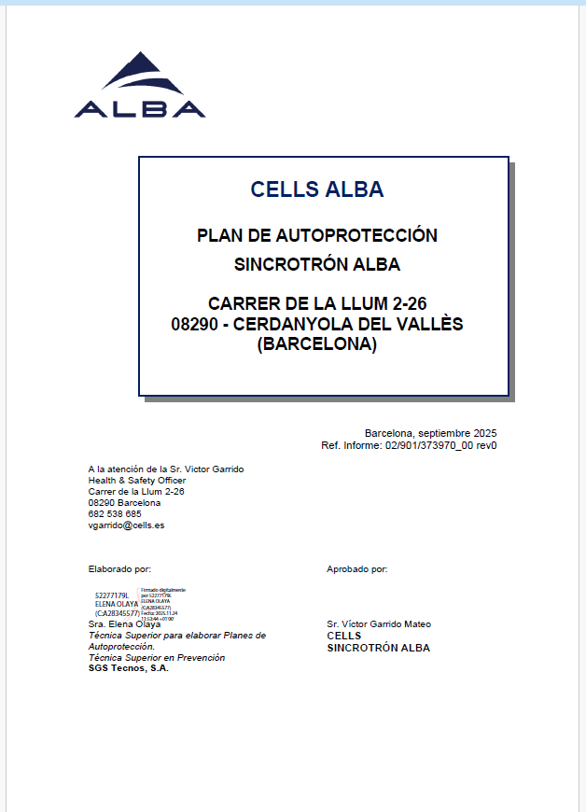
Updated Emergency Plan (PAU)
Last update of the document - end of 2025
Validated by Civil Protection – end of April 2026
Document available in Alfresco
- You must know the document, its sections, possible
scenarios
- Section 1.6.5. Descripción o identificación de las
condiciones de evacuación (page 66)
- Section 3.3.4 Equipo de evacuación y confinamiento
(page 104)
- Specific sheet for EECs (page 202)

Slide 5
EECs’ Duties
As described in 3.3.4 Equipo de evacuación y confinamiento
Ensure the correct evacuation of each zone or route to the Meeting Point, and/or direct personnel to the confinement point, if necessary.
They must know their assigned route.
Report any anomalies that occur in the workplace related to fire protection and fighting equipment and installations, notifying your company's safety officer or the facility's Emergency Manager for repair (doors that are blocked, etc.).
Address any incidents that may occur during the evacuation or confinement, from its beginning to the meeting point and until the end of the emergency situation (injured persons, trapped personnel, etc.).
Report the outcome of the evacuation or confinement process to the JEEC.

Slide 6
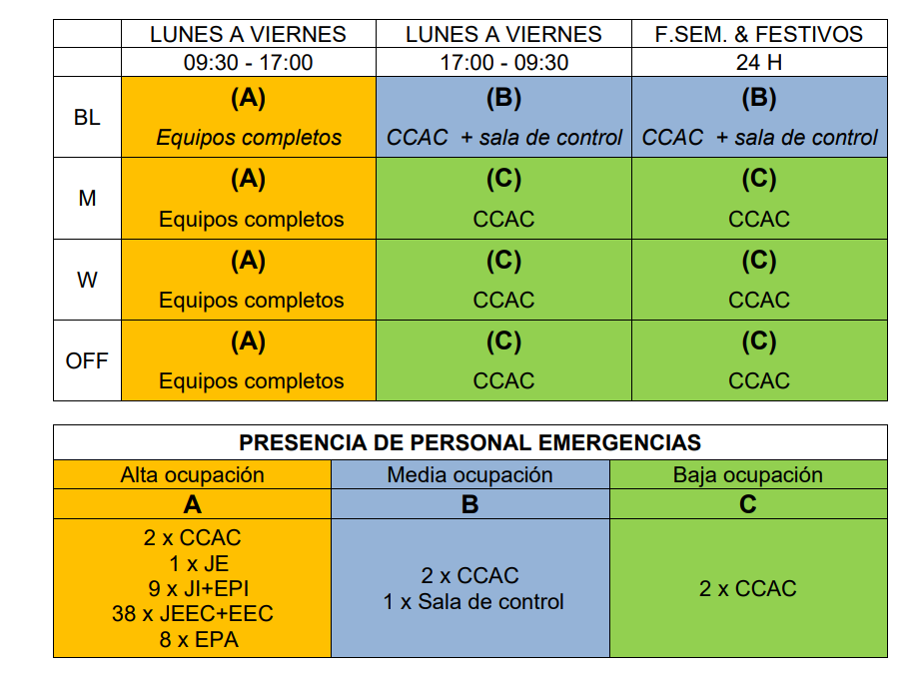
EECs’ Duties
As described in 3.3.4 Equipo de evacuación y confinamiento
In situation B, only two people (floor coordinator + CCAC) are available to carry out the evacuation/confinement, and they will act following the instructions of the Emergency Manager.
In situation C, only one person (CCAC) is available to carry out the evacuation/confinement, and they will act following the instructions of the Emergency Manager.
EEC team only intervenes in situation A

Slide 7
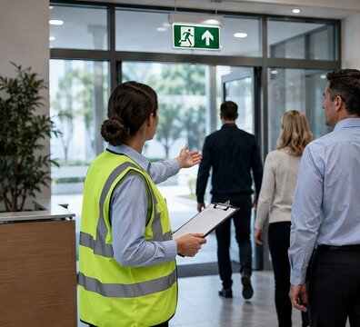
EECs’ Material
Evacuators must have available in the designated areas:
Safety vest
Printed Route assigned
Document holder & pen
Please check that this material is available. Otherwise, open a JIRA ticket to H&S: https://jira.cells.es/servicedesk/customer/portal/1/create/42

Slide 8
How to act during an evacuation
Main Building Evacuation (ALL site except Prisma Building)
The evacuation starts when the fire alarm sounds OR a message is given through the speakers
Each team evacuates its route:
  One team member goes in front evacuating people and directing them to the meeting point through the nearest emergency exit.
  Another team member goes behind the first one (maintain visual contact) checking that nobody is left behind.
  Do not let people go back into the building. If someone doesn’t want to evacuate make a note if it and continue your route.
Go to the meeting point
Inform the EEC head of the result of the route and hand him the revision sheet.
Remain at meeting point until end of emergency is declared
Once you get into the meeting point help the EEC head to perform the counting, please!
These instructions are also in Confluence: https://confluence.cells.es/pages/viewpage.action?spaceKey=EM&title=Evacuation+actions

Slide 9
How to act during confinement
Main Building Evacuation (ALL site except Prisma building)
The evacuation starts when the fire alarm sounds OR a message is given through the speakers
Each team informs the personnel of the confinement points:
  External members. Maxwell Auditorium
  Internal members: Offices
Check and inform that windows must be closed
One member of the route 5 will open the Maxwell Auditorium
Go to the Confinement point and inform the head of EEC

Slide 10
Frequently Asked Questions
Are we modifying the ‘counting’ system? No, for the moment we keep the same ‘counting’ system.
What if one or both of the EEC members are not at ALBA at that moment? The head of the EEC Team will realize that this member is not available and will ask another EEC member to check this route, once he/she has finished his/er own route.
Possible improvement: Identify EEC members and Route Assigned in People Portal and ask CCAA the list of EEC member that are on-site.
Are EEC members taking care of visitors, users or other companies? Yes, EEC members must evacuate or confine all the persons who find in his/her route.
What if someone refuses to evacuate? Inform the EEC head when you reach the Meeting Point.
Shall I meet the EEC head before starting an evacuation / confinement process? No, you must start the evacuation or confinement as described in 8 and 29.

Slide 11
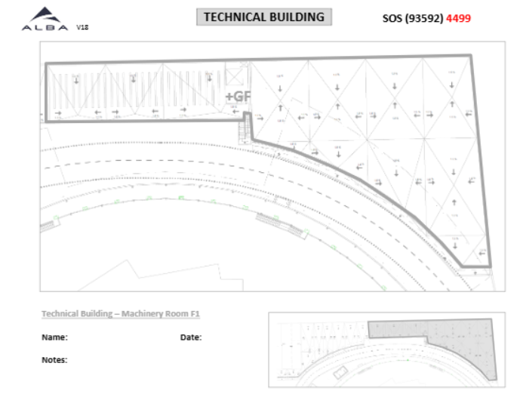
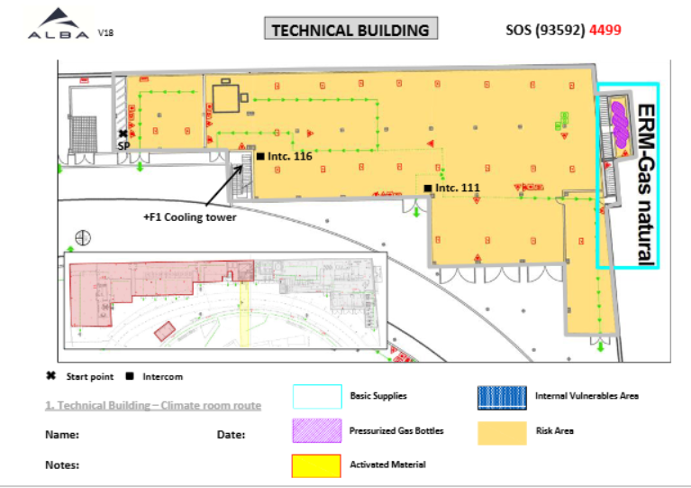
Evacuation routes
# Route | Route name | Map link | Member 1 | Member 2
1 | Edifici Tècnic – Sala de Màquines | https://alfresco.cells.es/share/s/AdZqe5RtR5WeA2vzMNSCaw | Julieta Ferrari | Paco Trujillo
P0
P1

Slide 12
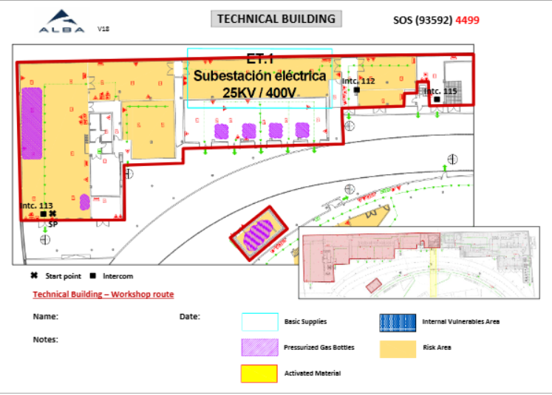
Evacuation routes
# Route | Route name | Map link | Member 1 | Member 2
2 | Edifici Tècnic – Taller | https://alfresco.cells.es/share/s/QCbi7-QwQACwvbgNLkxHqw | Karim Maimouni | Raúl Lorenzo

Slide 13
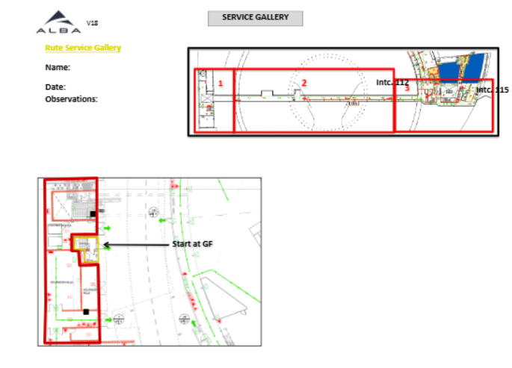
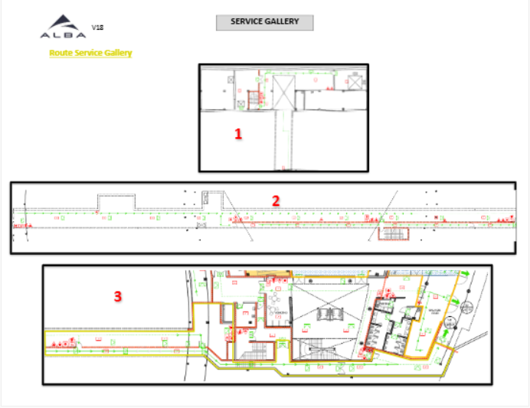
Evacuation routes
# Route | Route name | Map link | Member 1 | Member 2
3 | Galeria de Servei | https://alfresco.cells.es/share/s/kbD4FSkMQSuXUfxZN-YSaQ | Igors Sics | TBD

Slide 14
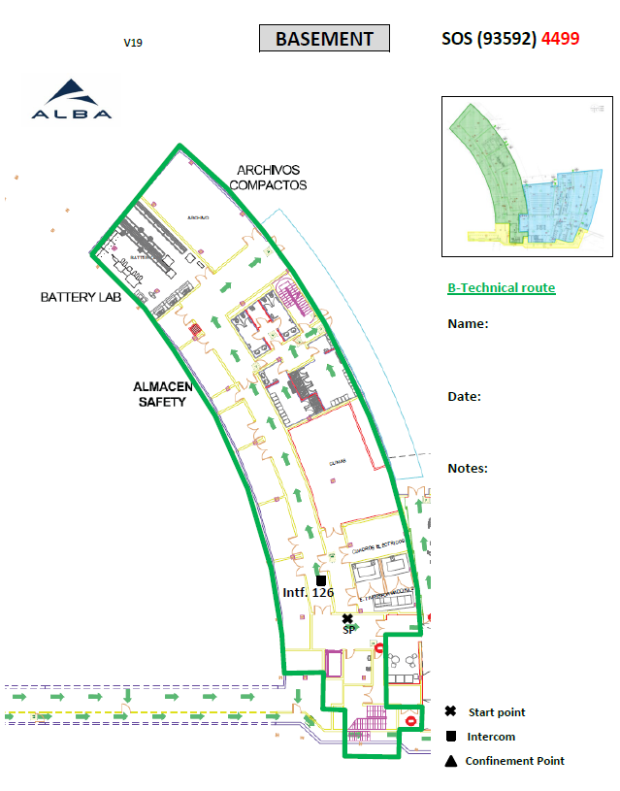
Evacuation routes
# Route | Route name | Map link | Member 1 | Member 2
4 | PS Tècnica | https://alfresco.cells.es/share/s/brrKt2dOStiqbU9jOQtIXQ | José Antonio Alcobendas | Victor Fuentes
Pendent - Actualitzar document a Alfresco

Slide 15
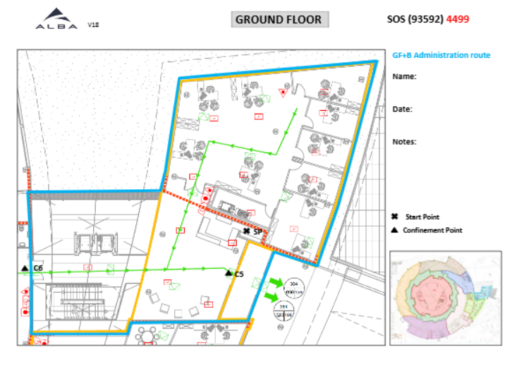
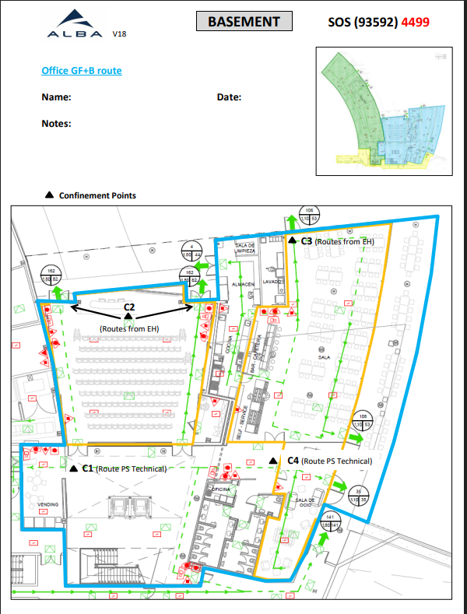
Evacuation routes
# Route | Route name | Map link | Member 1 | Member 2
5 | PS & P0 Administració | https://alfresco.cells.es/share/s/_iL1xetpQLGQlqghvlyAaA | Jose Alañón | Eduardo Moreno

Slide 16
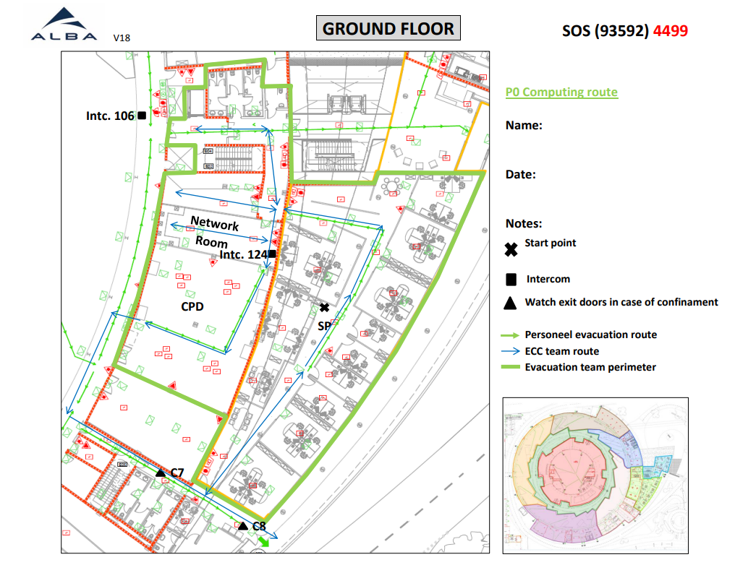
Evacuation routes
# Route | Route name | Map link | Member 1 | Member 2
6 | P0 Computing | https://confluence.cells.es/download/attachments/48529995/Ruta_P0_Computing.pdf | Pau Carnicer | Sergio Vicente

Slide 17
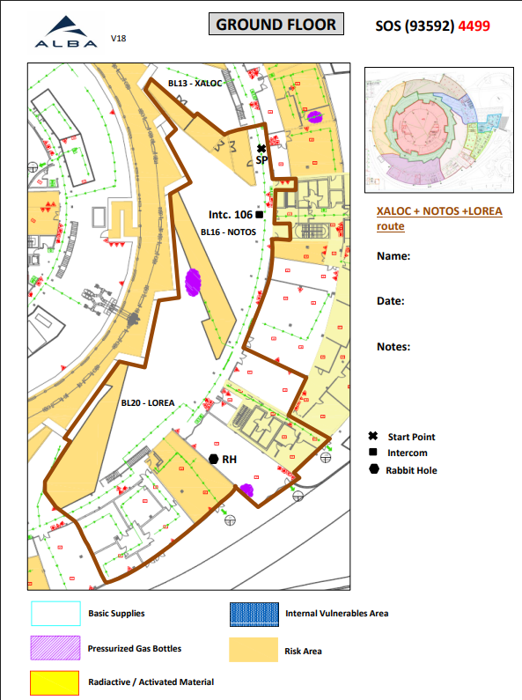
Evacuation routes
# Route | Route name | Map link | Members
7 | Experimental Hall – Ports 13 to 20 | https://alfresco.cells.es/share/s/HwlwysMMSC6_F8K-qhUTjQ | XALOC + NOTOS + 3Sbar + LOREA Local Contact + Technicians
Afegir al mapa 3Sbar + Nanomotion Lab

Slide 18
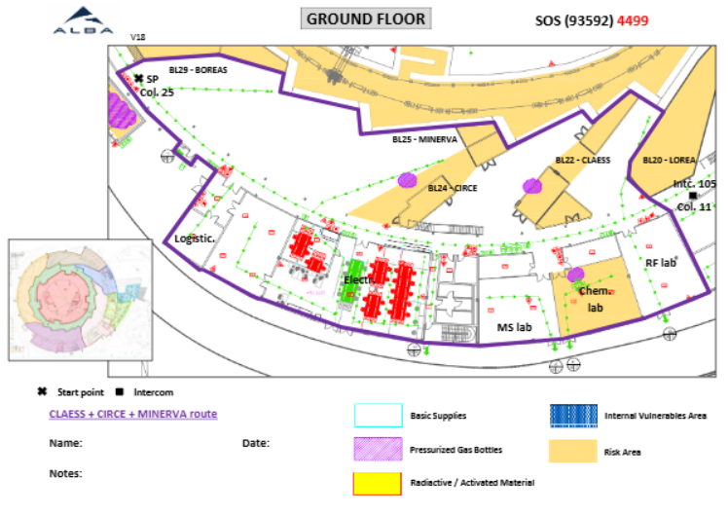
Evacuation routes
# Route | Route name | Map link | Members
8 | Experimental Hall – Ports 21 to 28 | https://alfresco.cells.es/share/s/0gl3iYQqQlu8zi9xj-pxTQ | CLAESS + CIRCE + MINERVA Local Contact + Technicians
Actualitzar Mapa amb MINERVA

Slide 19
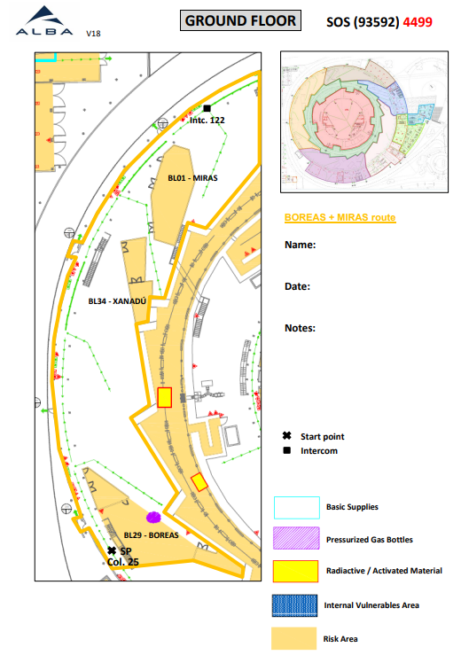
Evacuation routes
# Route | Route name | Map link | Members
9 | Experimental Hall – Ports 29 to 03 | https://alfresco.cells.es/share/s/74GlHQ8iQ5OwrQonb2Klww | BOREAS + FAXTOR + MIRAS Local Contact + Technicians
Actualitzar Mapa amb FAXTOR

Slide 20
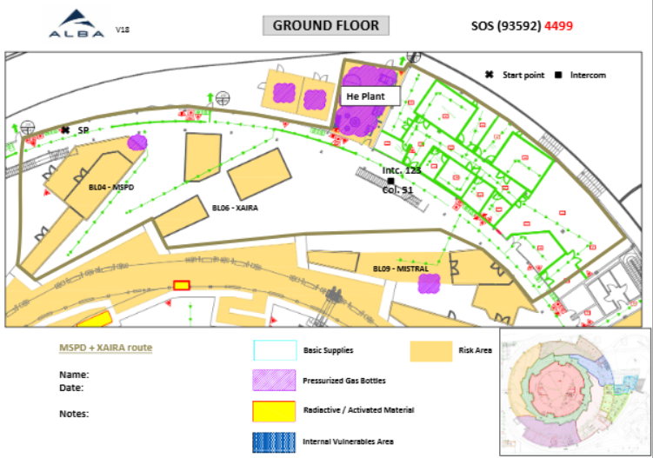
Evacuation routes
# Route | Route name | Map link | Members
10 | Experimental Hall – Ports 04 to 08 | https://alfresco.cells.es/share/s/HyQiT1-AQaa01rOvVylZrw | MSPD + XAIRA Local Contact + Technicians
Actualitzar Mapa sense JEMCA

Slide 21
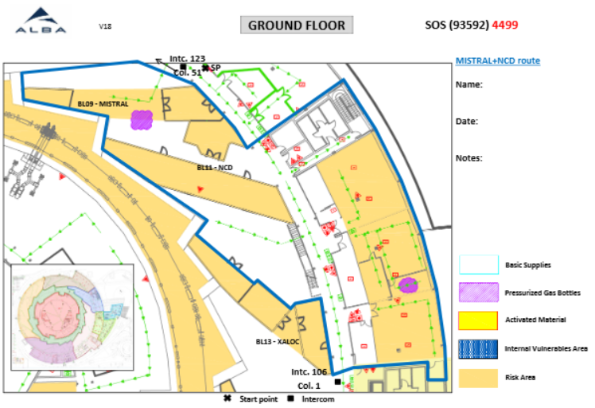
Evacuation routes
# Route | Route name | Map link | Members
11 | Experimental Hall – Ports 09 to 12 | https://alfresco.cells.es/share/s/l9PXwKliT2avQ2qBn1u_DA | MISTRAL + NCD-SWEET Local Contact + Technicians
Actualitzar Mapa amb Fluidrics & alignment + catalysis lab

Slide 22
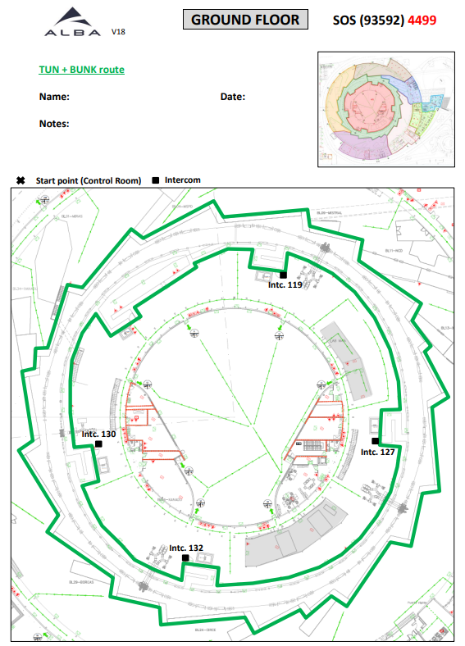
Evacuation routes
# Route | Route name | Map link | Member 1 | Member 2
12 | Túnel + Bunker | https://confluence.cells.es/download/attachments/48529995/Ruta_TUN%2BBUNK.pdf?version=3&modificationDate=1542204079000&api=v2 | Davide Lanaia | Alejandro Sánchez

Slide 23
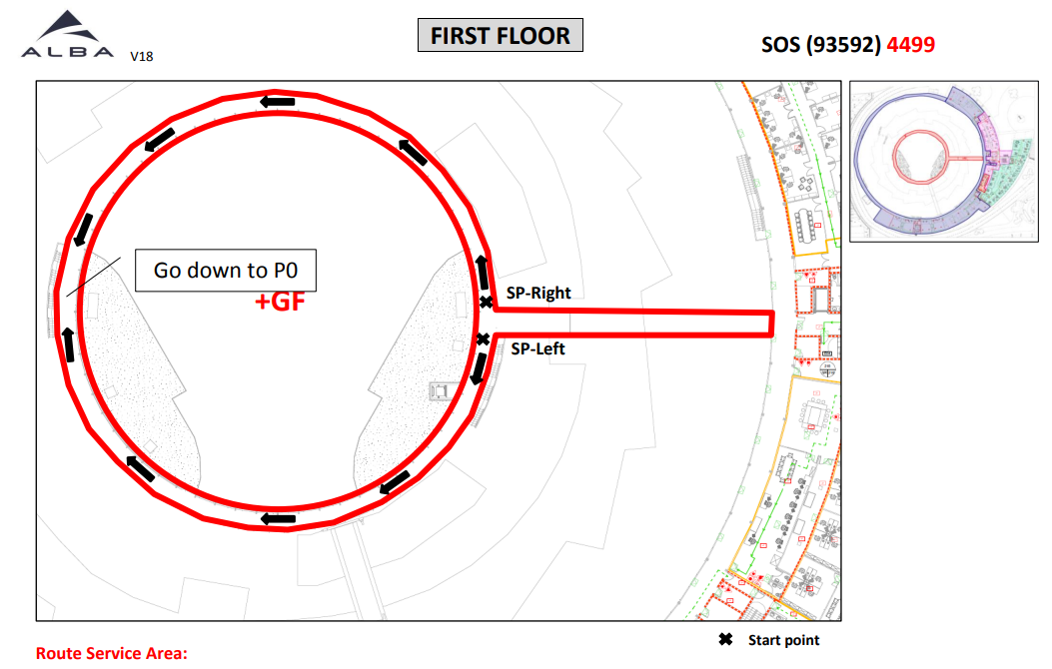
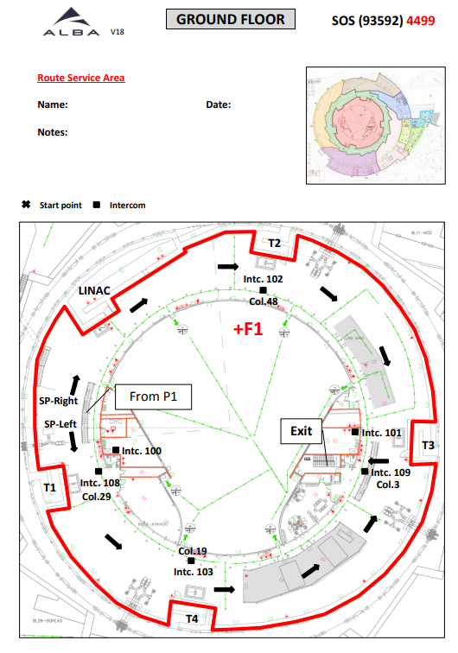
Evacuation routes
# Route | Route name | Map link | Member 1 | Member 2
13 | Service Area | P0 https://confluence.cells.es/download/attachments/48529995/Ruta_SA_P0.pdf?version=2&modificationDate=1542204181000&api=v2 | Valentí Massana | TBD
 |  | P1 https://confluence.cells.es/download/attachments/48529995/Ruta_SA_P1.pdf?version=3&modificationDate=1542204181000&api=v2 | Jon Ladrera | Xevi Serra

Slide 24
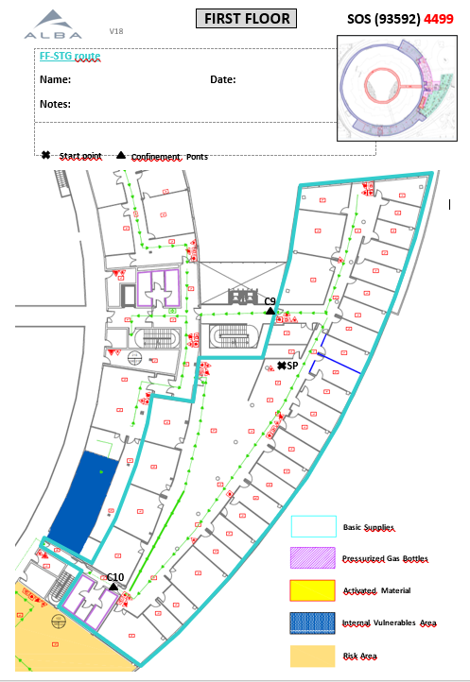
Evacuation routes
# Route | Route name | Map link | Member 1 | Member 2
14 | P1 STG route | https://alfresco.cells.es/share/s/tiMocN_FRtiHcMkOgYu0Qw | Gemma Rosas | Sergi Pusó

Slide 25
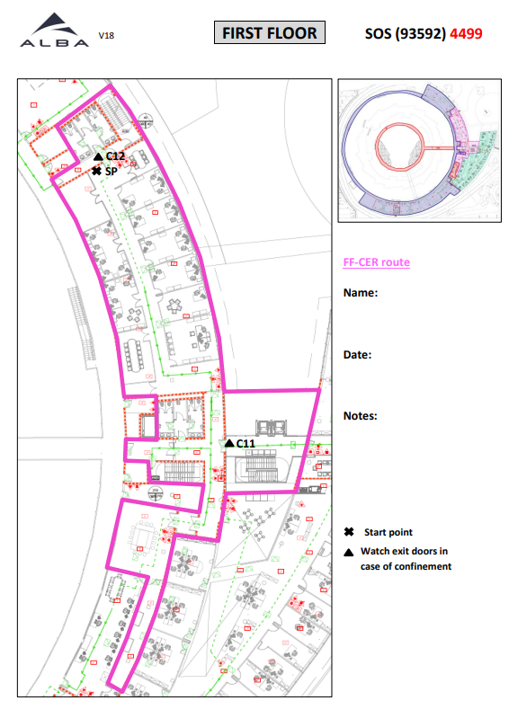
Evacuation routes
# Route | Route name | Map link | Member 1 | Member 2
15 | P1 CER route | https://confluence.cells.es/download/attachments/48529995/Ruta_P1-CER.pdf?version=3&modificationDate=1542371025000&api=v2 | Marta Ávila | Núria Madrid

Slide 26
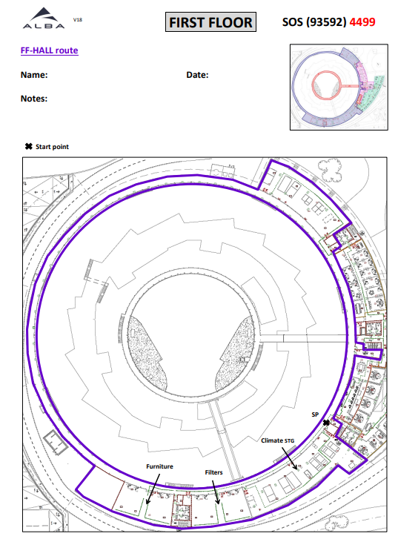
Evacuation routes
# Route | Route name | Map link | Member 1 | Member 2
16 | P1 Experimental hall | https://confluence.cells.es/download/attachments/48529995/Ruta_P1-HALL.pdf?version=2&modificationDate=1542371106000&api=v2 | Toni Camps | David Calderón
Corregir mapa per marcar les noves oficines de Electrònica i Experiments de la Planta 1

Slide 27
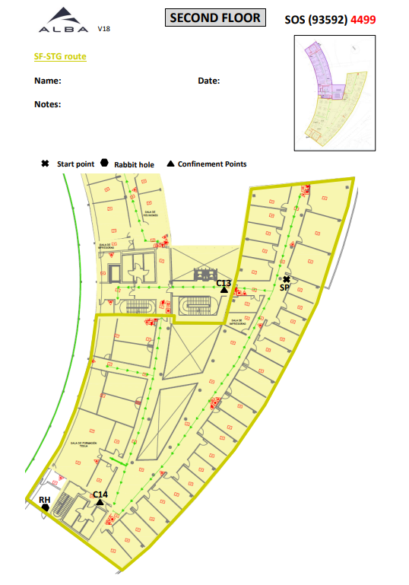
Evacuation routes
# Route | Route name | Map link | Member 1 | Member 2
17 | P2 STG Route | https://alfresco.cells.es/share/s/5zJXIFRPTY61a3gLBhy4nw | Fulvio Becheri | Llibert Ribó

Slide 28
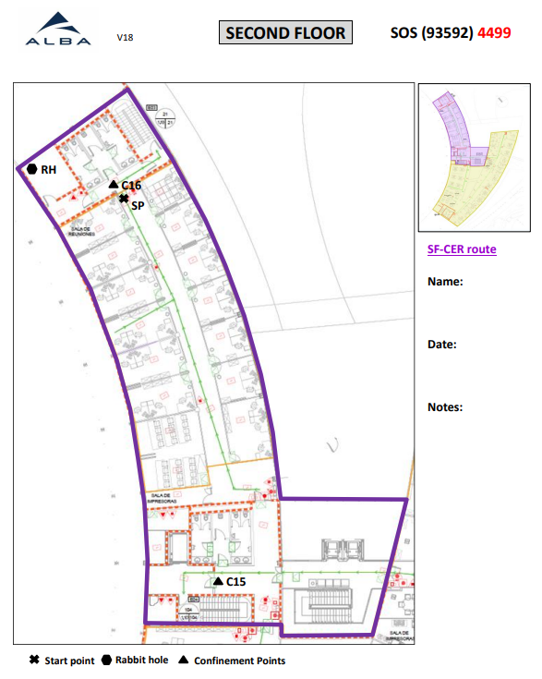
Evacuation routes
# Route | Route name | Map link | Member 1 | Member 2
18 | P2 STG Route | https://alfresco.cells.es/share/s/kFNu-1UdQh-QqoO_HyP_Kg | Núria Martí | TBD

Slide 29
Evacuation routes
# Route | Route name | Map link | Member 1 | Member 2 | Member 3
19 | JEMCA |  | Pablo Guerra | EM02 Scientist | Núria Bagués
Crear mapa d’evacuació

Slide 30
Evacuation routes
# Route | Route name | Map link | Member 1 | Member 2
20 | Prisma Building |  | SPM Lab | RF Lab
Crear mapa d’evacuació

Slide 31
Comments or questions?

