Slide 1
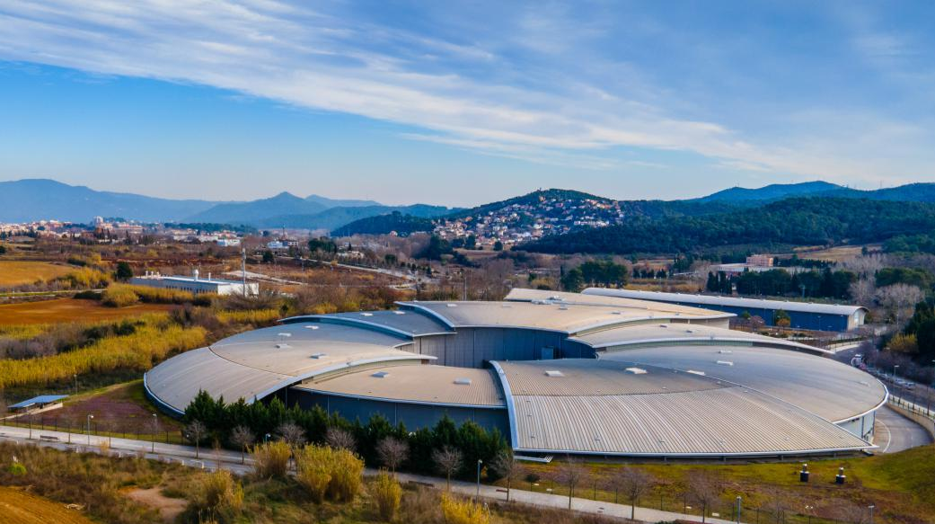



Surface Science Experiments under Ambient Conditions at ALBA Synchrotron
Juan Jesús Velasco Vélez

Slide 2
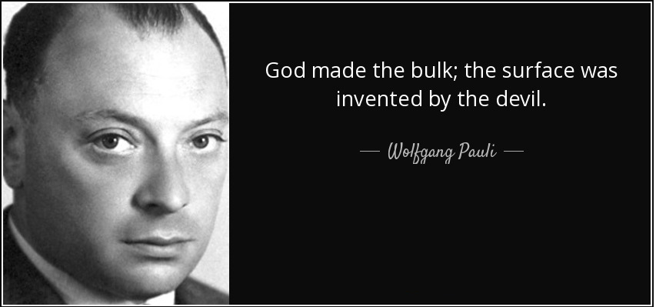
Gaps in material science
Structural complexity
and chemical composition
R. Schlögl, Angew. Chem. Int. Ed. 2015, 54, 2–58
R. Schlögl, Angew. Chem. Int. Ed. 2015, 54, 2–58

Slide 3
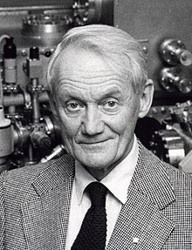
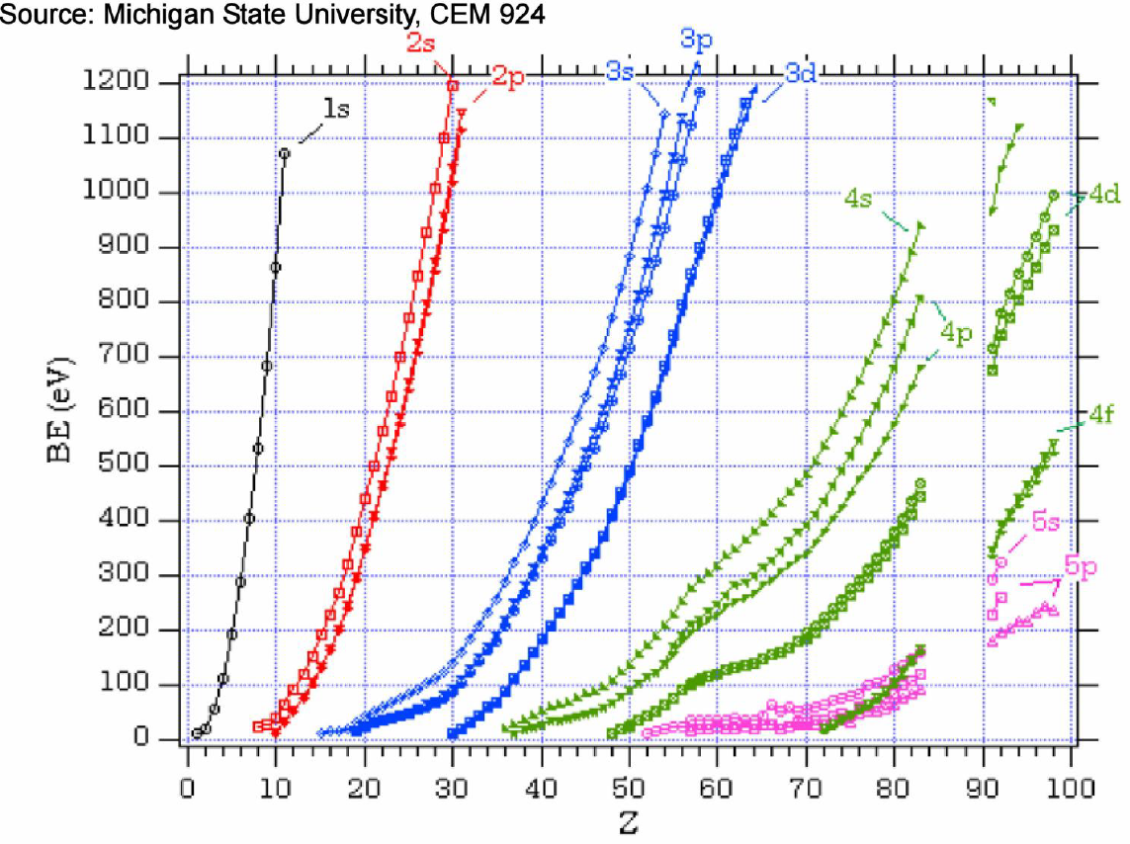
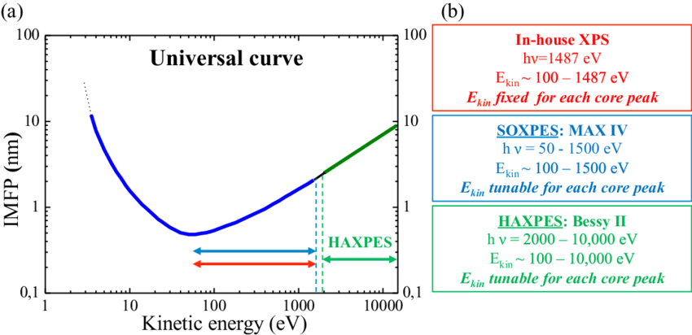
Photoelectron spectroscopy
Kai Siegbahn

Slide 4
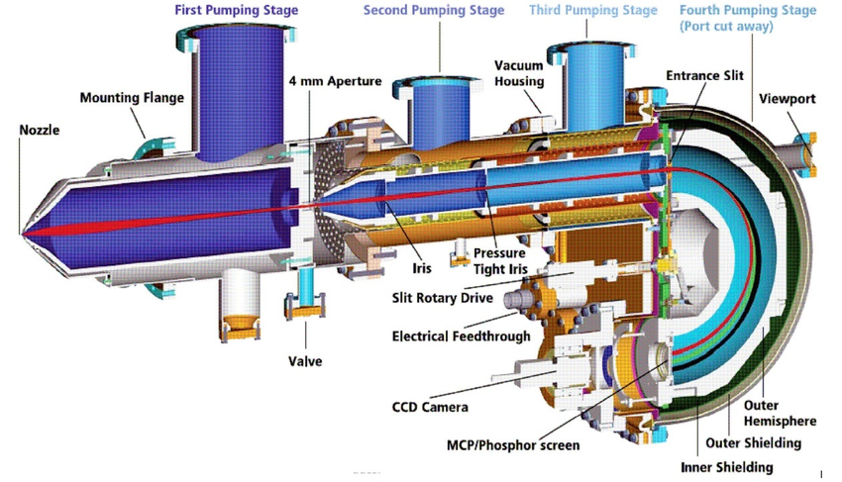
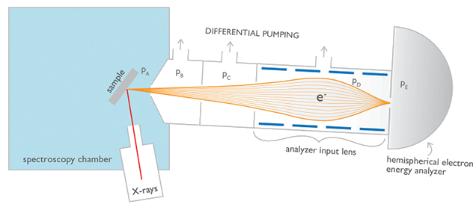
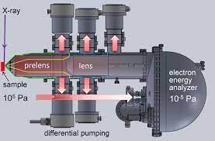
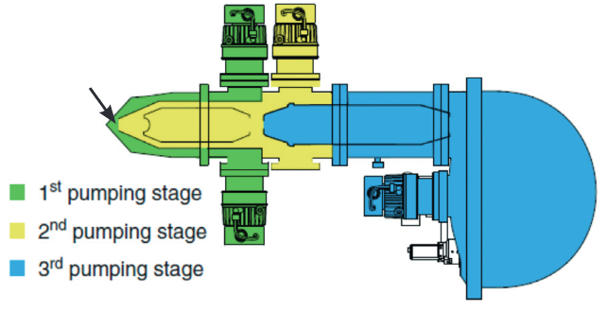
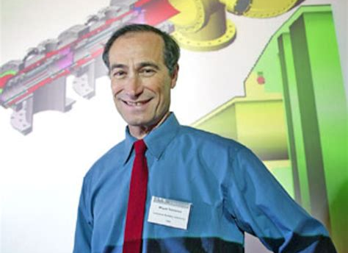
NAP-XPS
PHOIBOS 150 NAP analyzer
Kai Siegbahn
HiPP-3 NAP analyzer
Miquel Salmeron

Slide 5
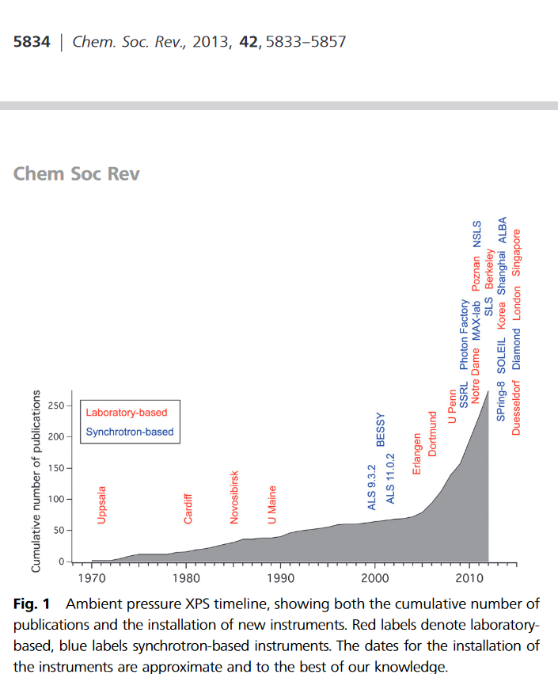
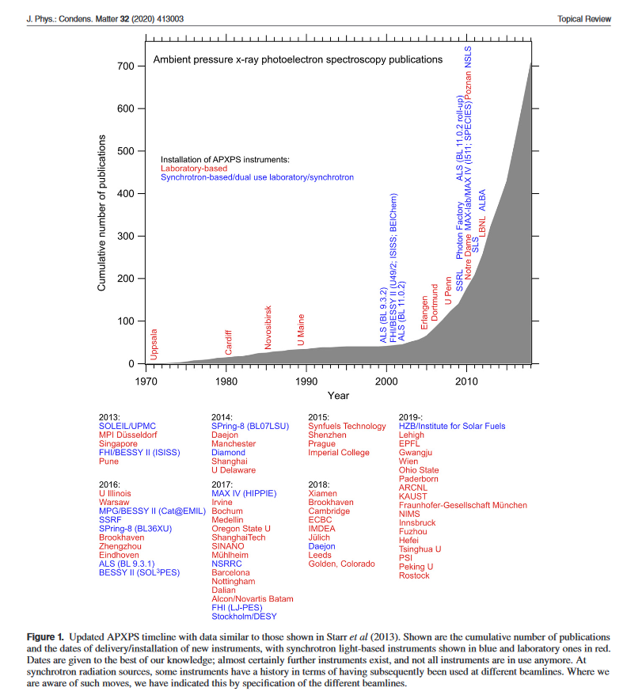
NAP-XPS

Slide 6
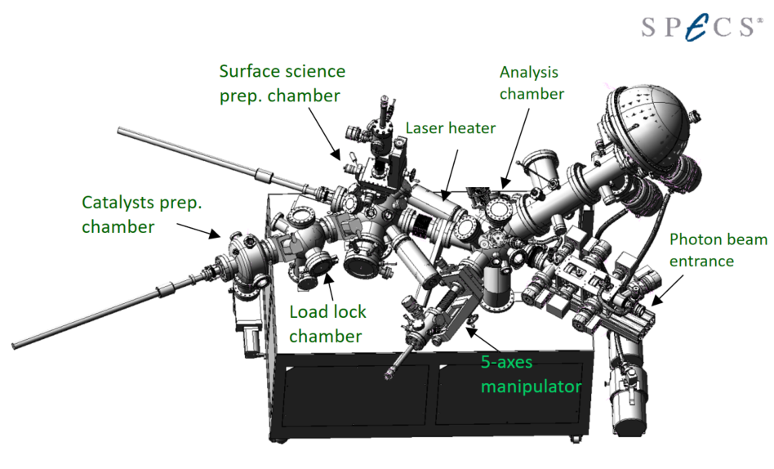
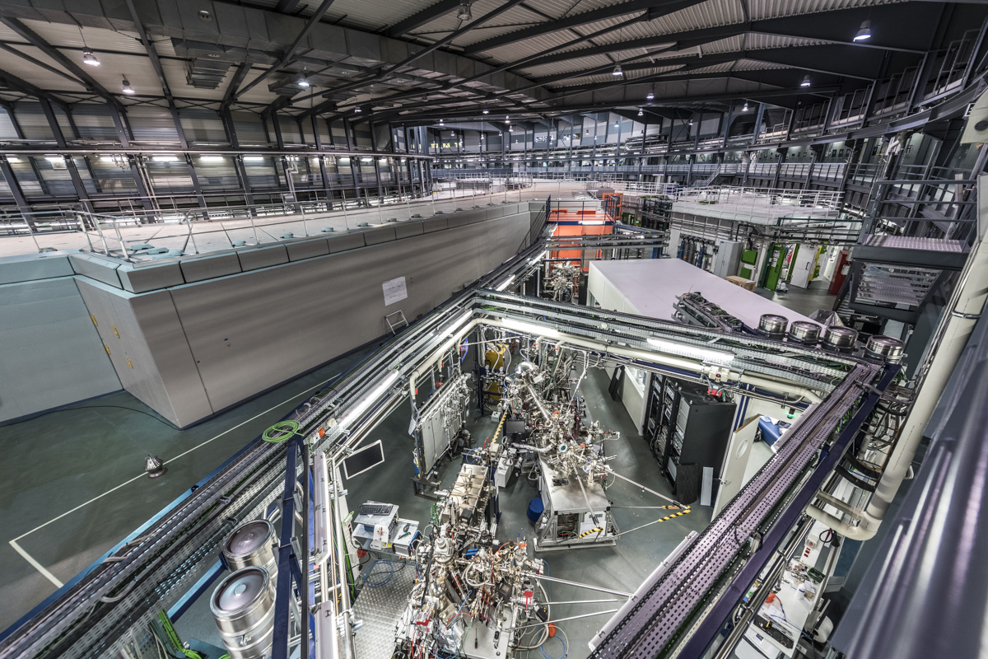
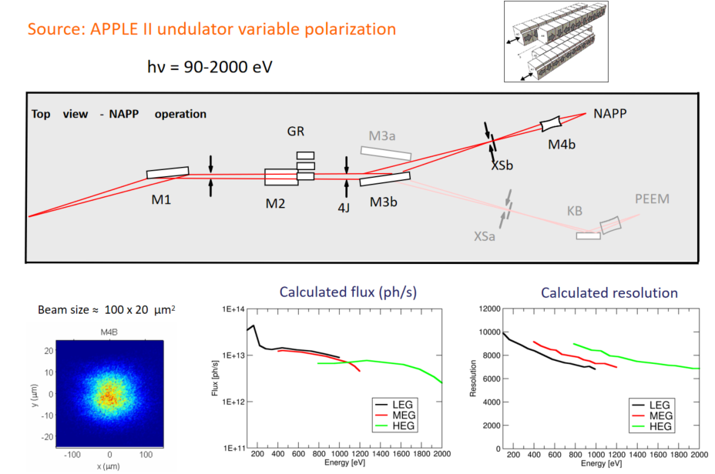
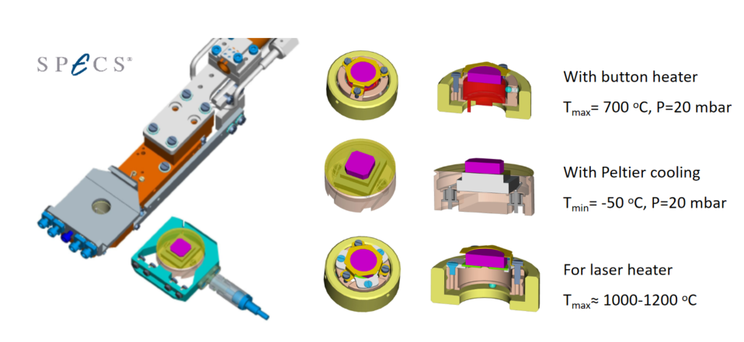
Soft NAP-XPS (CIRCE-NAPP)
*Dr. Ravi Ranjan

Slide 7
Selective hydrogenation Reactions on RAW Pd catalysts
Partial selective hydrogenation
C_{n}H_{2n-2 (gas)}
C_{n}H_{2n (gas)}
Low pressures
Pd
Full unselective
hydrogenation
C_{n}H_{2n-2 (gas)}
C_{n}H_{2n+2 (gas)}
High pressures
Pd

Slide 8
Alkynes hydrogenation (few mbars)
~1 mbar!
PdH_{x}
Pd-C
ChemPhysChem 2019, 20, 1158– 1176
Surface Pd-C phase blocks diffusion of H to the surface
D. Teschner et al. Science 2008, 320(5872), 86-89.
D. Teschner et al. J. of Cat. 2006, 242(1), 26-37.

Slide 9
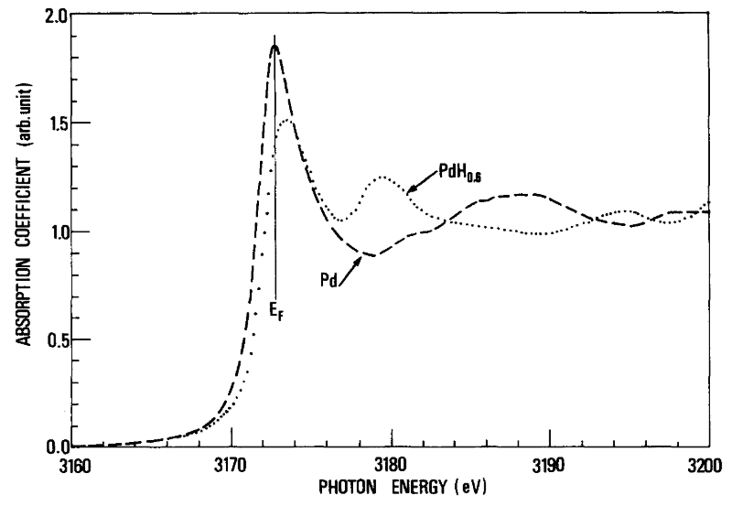
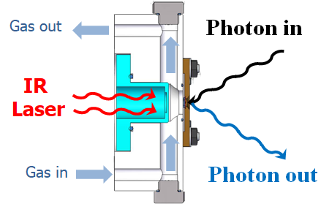
operando NEXAFS - Hydrogenation
Pd @ SiN_{x} membrane; #34305
Hydride peak shape: Tew et al. J. Catal. 283 (2011) 45-54.
with SiN_{x} membrane

Slide 10
operando NEXAFS - Reaction
RT; H₂ : C₂H₂ = 5 : 1
Pd @ SiN_{x} membrane; #34305
Pressure not enough to investigate the selective/unselective hydrogenation reaction of alkynes to alkenes/alkanes

Slide 11
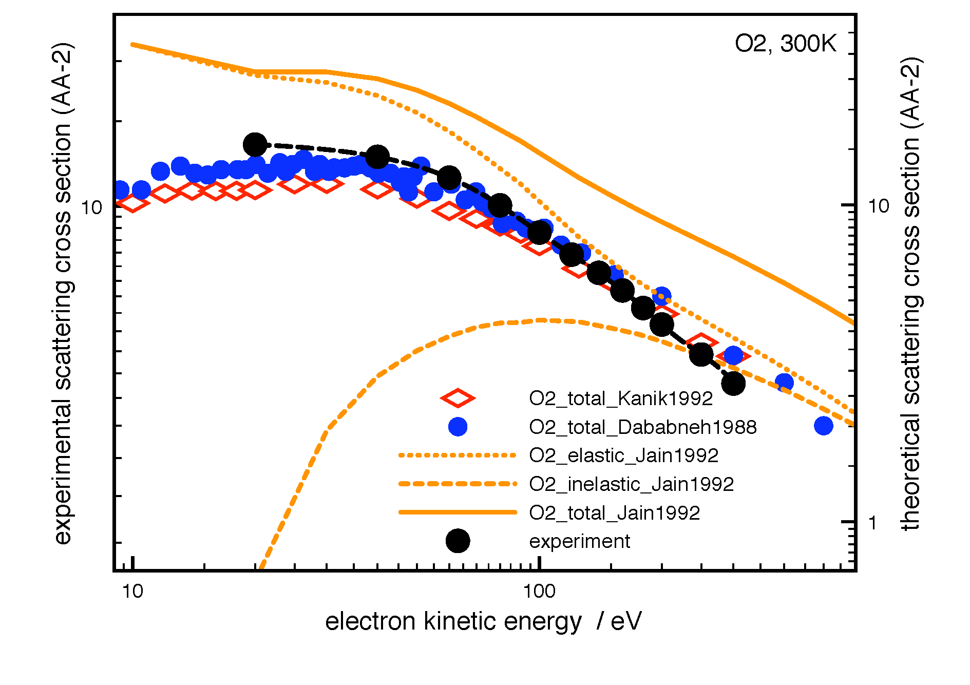
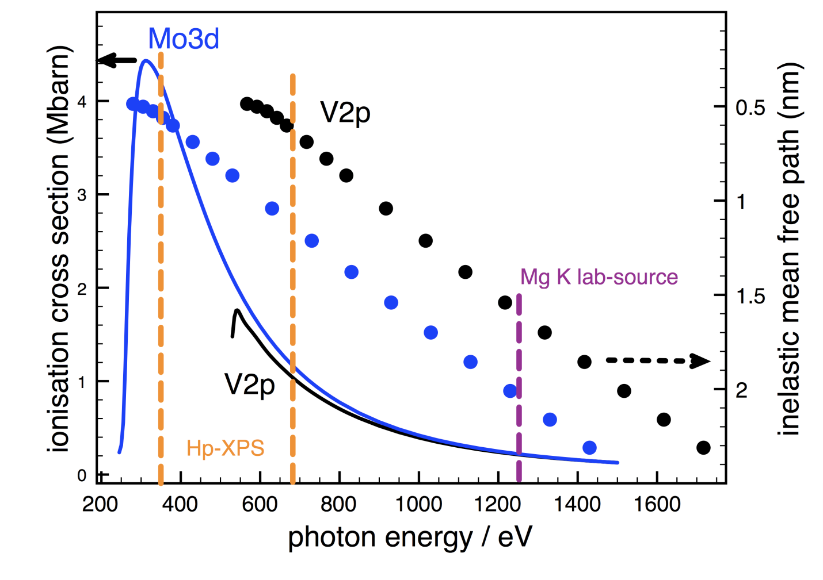
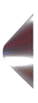
Higher working pressures
Electron scattering in gas phase
Ionisation cross section
IMFP
Reducing
surface
and chemical
sensitivity
X-ray
Ionisation cross section:
J.J. Yeh and I. Lindau, Atomic Data Nucl. Tables 32 (1985) 1.
Inelastic mean free path:
S. Tanuma, J. Powell, D.R. Penn, Surf. Interf. Anal. 21 (1993) 165.
d
e⁻
APXPS
Nozzle
D

Slide 12
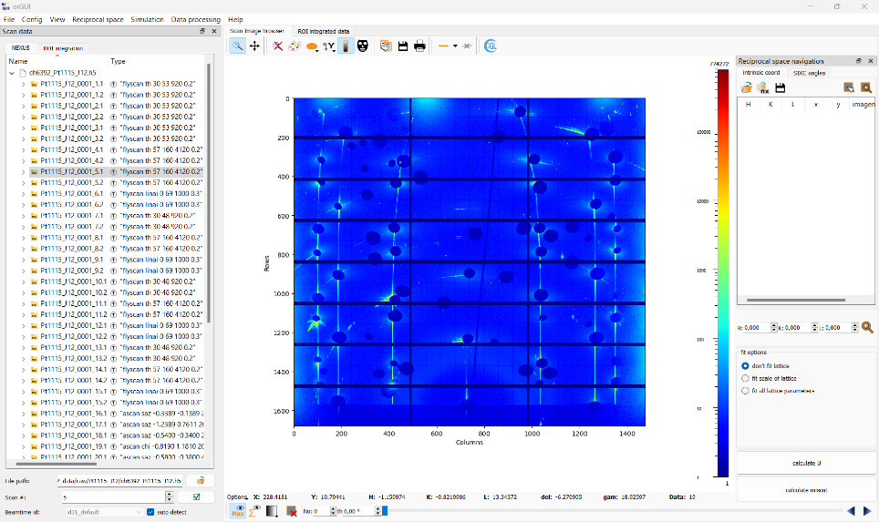
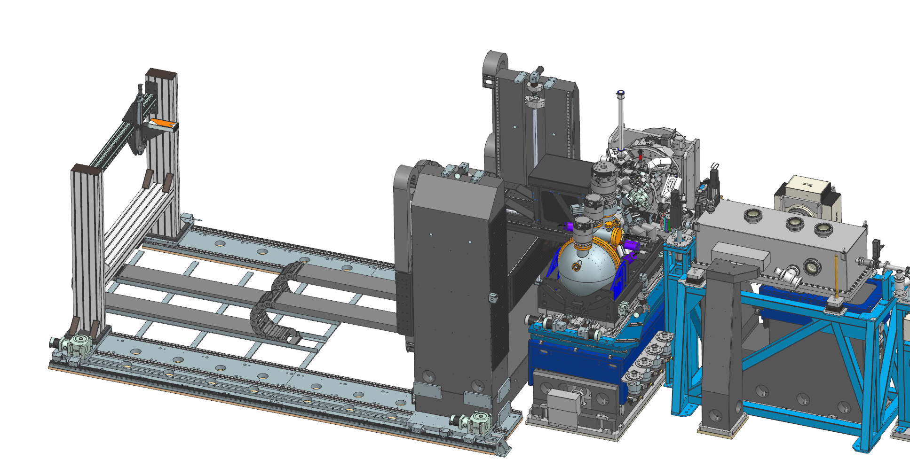
3Sbar: New beamline for surface characterization
3SBar will combine ambient pressure X-ray Photoemission Spectroscopy (AP-XPS) at high pressures(1 bar or more) and surface X-ray diffraction (SXRD) and grazing incidence scattering (GISX) angles (-3° to +15°). First beamline optimized for operate in ALBA II.
BL15 (3Sbar):
Endstation
BL15
X-ray beam
^{Gas flow}
e–
Construction finish during 2026
^{X-Ray}
α_{i}<α_{c}
Evanescent regime
Surface sensitivity
Total external reflection: X-ray depth control
Signal enhancement!

Slide 13
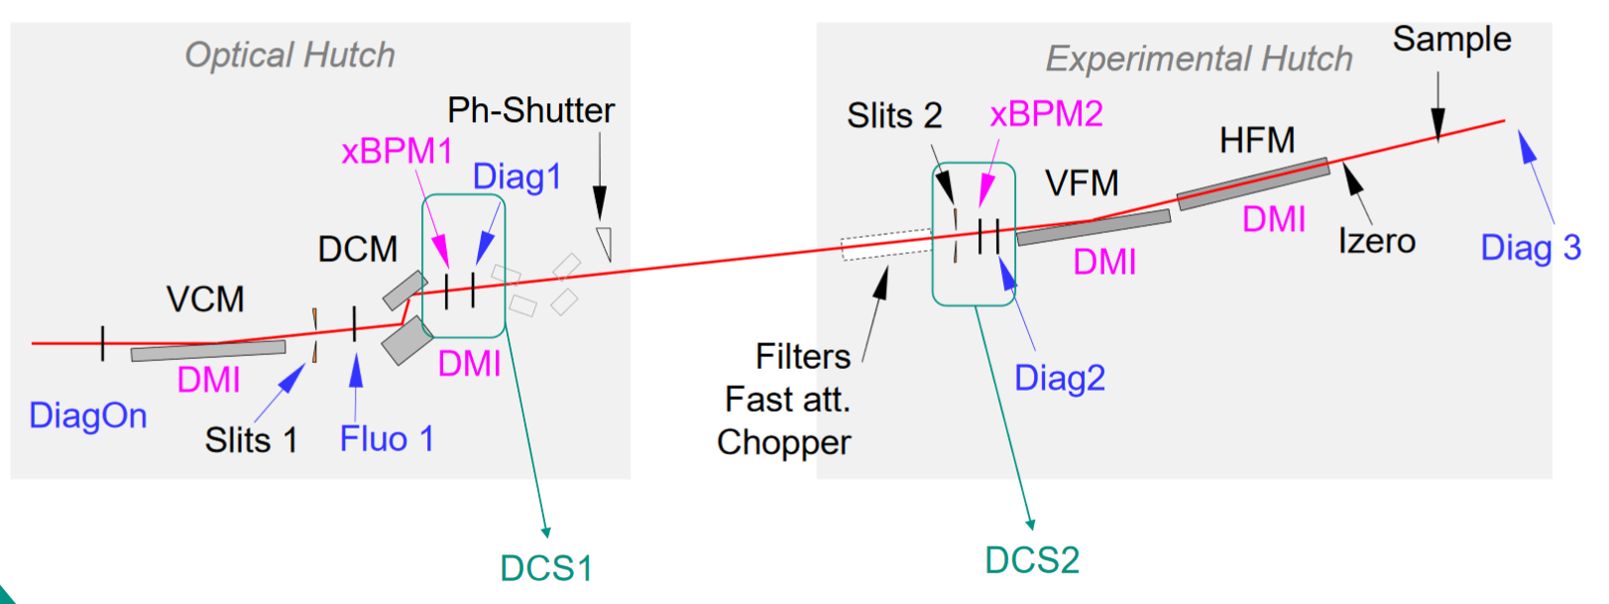
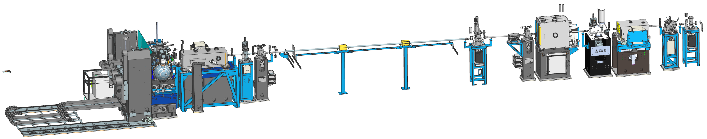
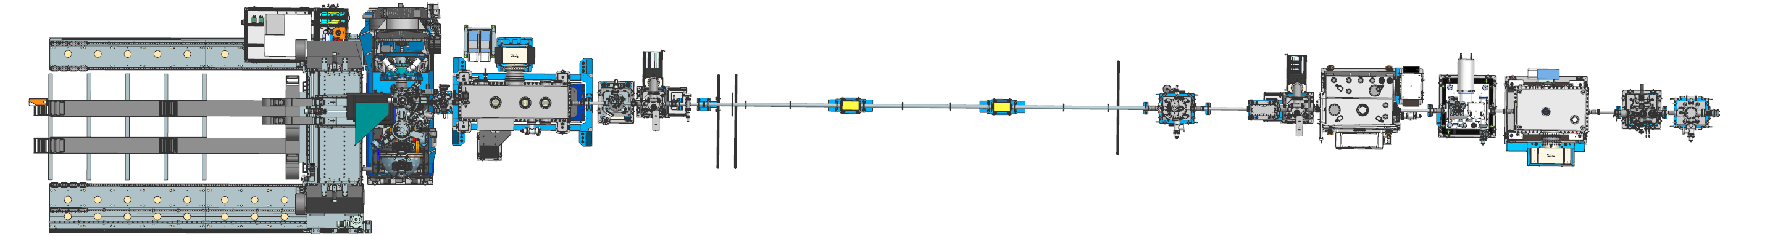
Beamline layout
Parameter | Value | Remark
Energy range | 2.0 keV up to 17.0 keV
Flux at 5 keV | 1.76x10¹³ ph/s | Si(311)
Resolution at 5 keV | 128 meV | Si(311)
Spot size on sample | 1.27 x 3.66 µm² FWHM | ALBA II
Divergence on Sample | 0.76 x 0.30 mrad² FWHM | ALBA II
Slits
Shutter
DCM
DiagOn
VCM
Detector table
KB
Chopper
GISAXS detec. detector
Attern.
Diag1
Diag2
Endstation
*Josep Nicolas

Slide 14
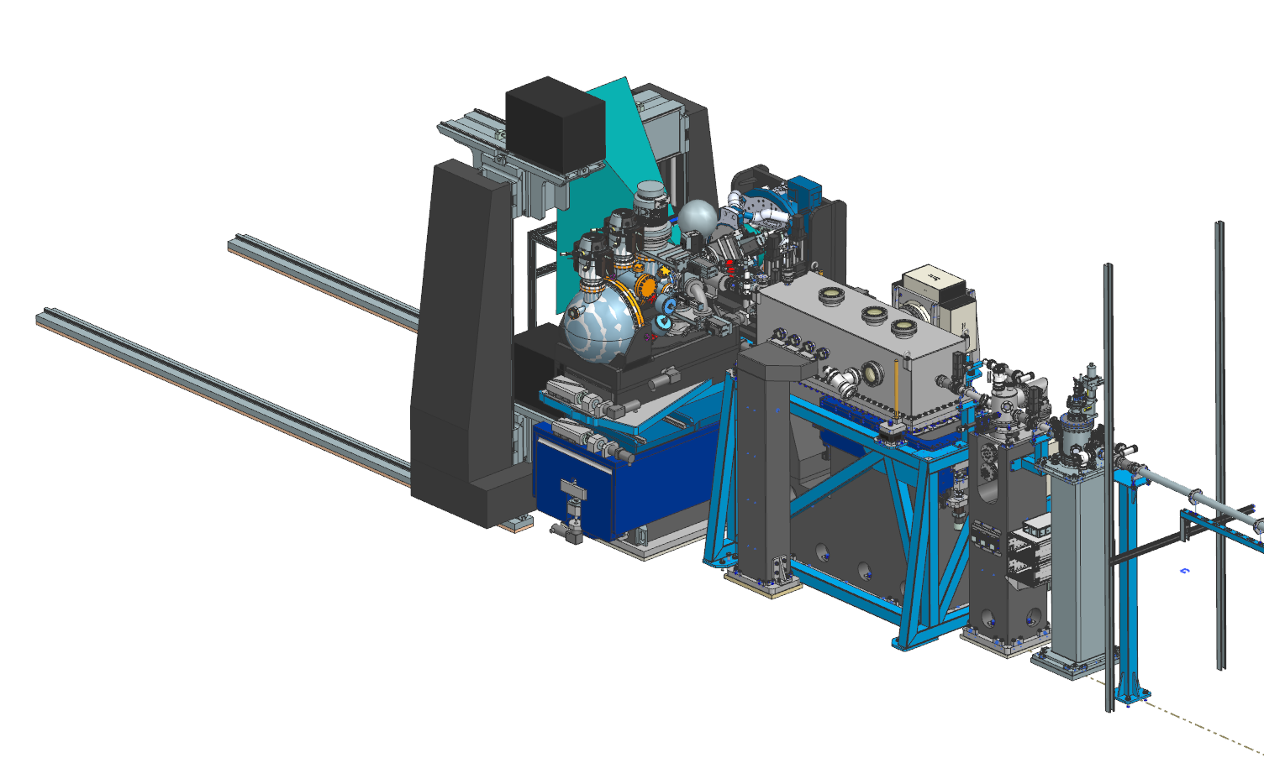
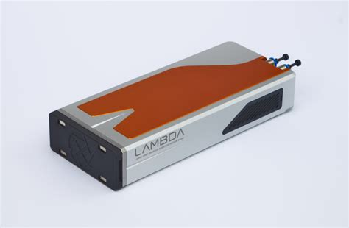
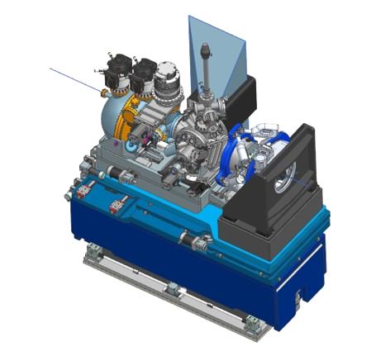
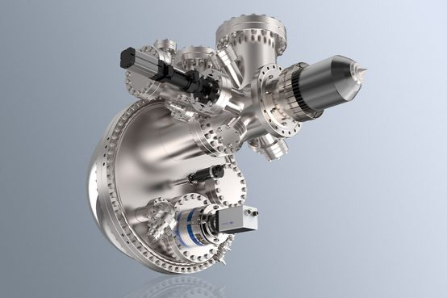
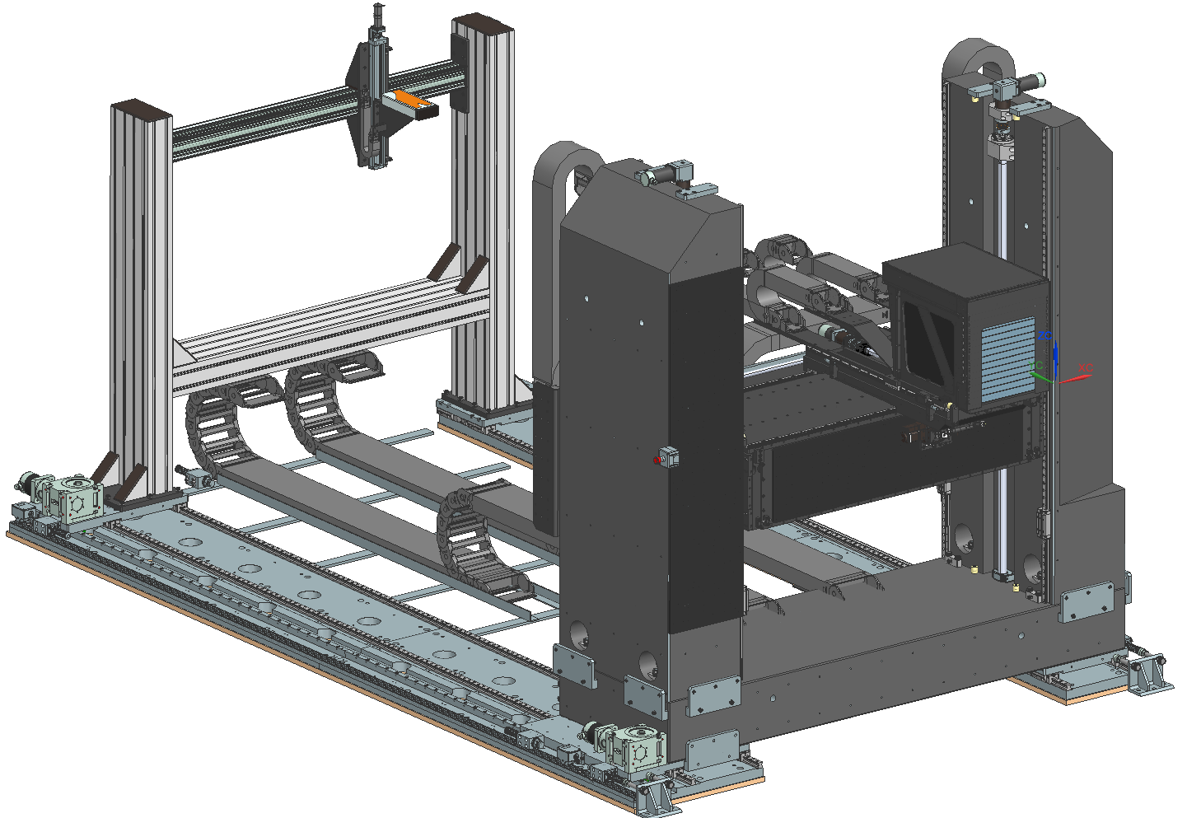
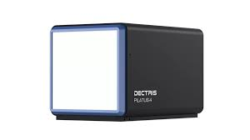
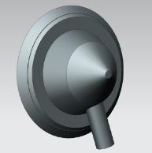
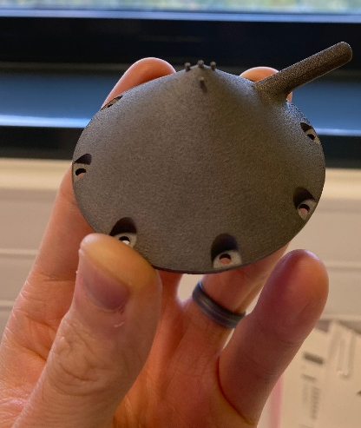
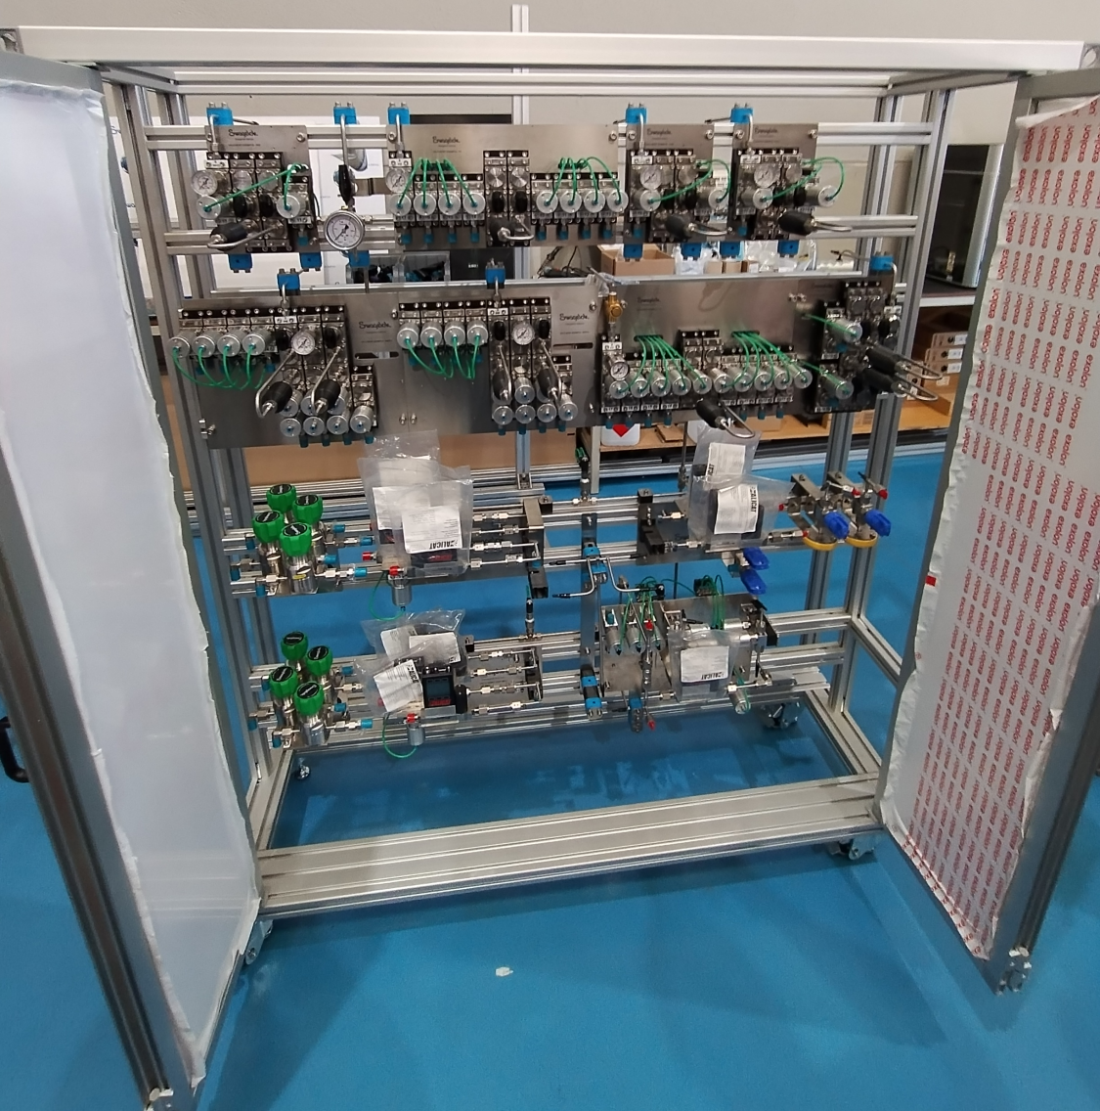
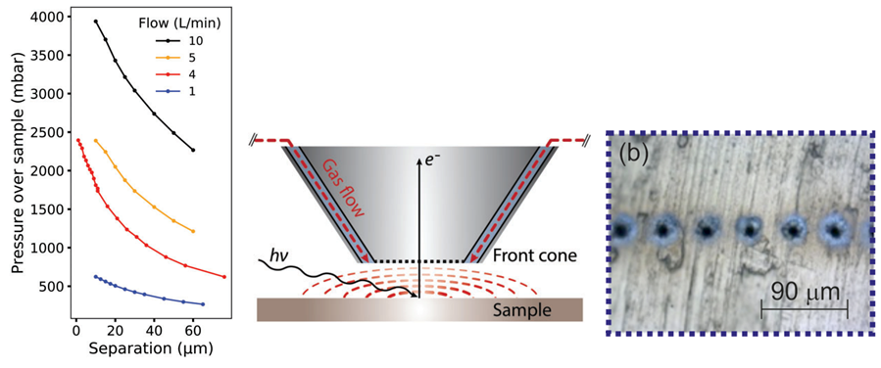
3Sbar detectors and gas environment
AEOLOS 150 AD-CMOS
Lambda 750 (Si)
PILATUS4 2M (Si)
Online gas product analysis:
Gas Chromatography:
SHIMADZU GC-2030N BASIC
2 x QMS:
Edwards WRA200S
Electrochemistry:
Potentiostat:
Biologic SP-300 (2 channels EIS)
Fully automatized gas delivery system:
Two full set of MFCs (ml/min and l/min)
Gases:
He, Ar, N₂
H₂
O₂
CO₂
CO
NH₃
N_{x}O
C_{x}H_{y}
Vapours:
H₂O
Et-OH; Met-OH; etc...
Endstation
Detector table
Gas system

Slide 15
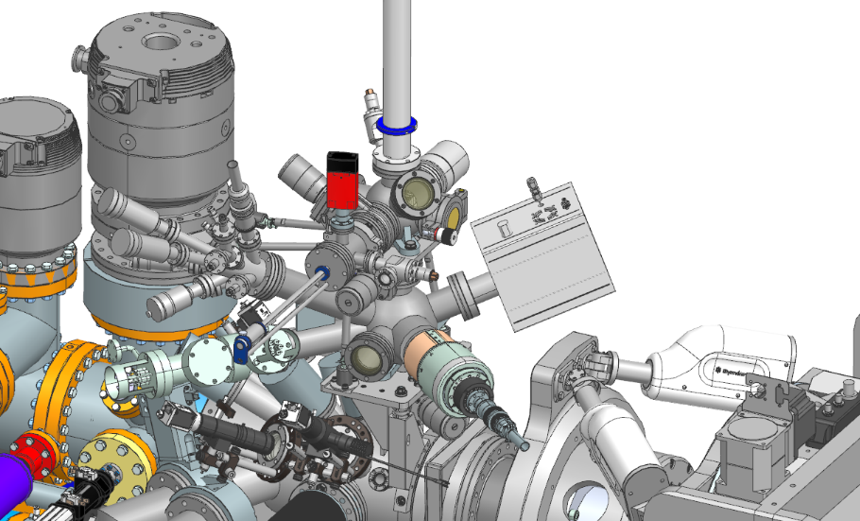
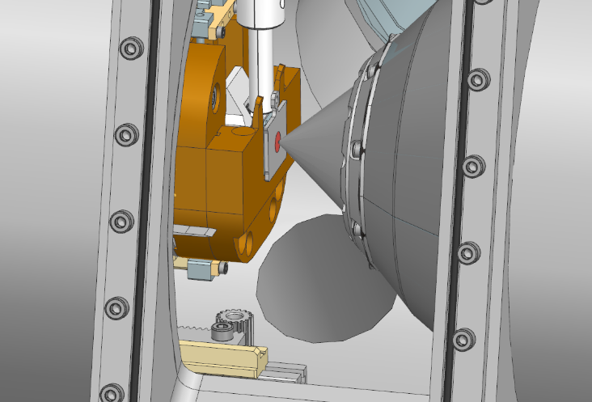
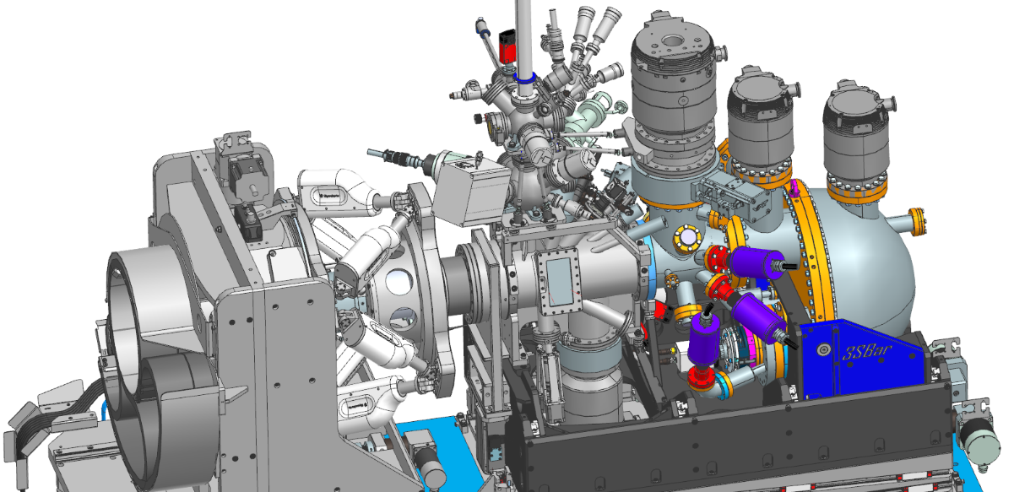
Possible transfer suitcase
Sample preparation
Sputtering
Annealing up to 1400 C
Plasma treatment
PVD
At the sample stage
Laser heater up to 1200 C
Gas delivery system
mass flow controllers from low to high pressure (8 bars)
Mass spectrometry
Gas chromatography
Vapor dosing
*Christopher Goodwin
*Nahikari Gonzalez
*Christopher Goodwin
Omicron plate (adaptable sample holder)
Multiple thermocouples
Gas dosing (possible flow reactor)
6 pins free to use
*Antoni Garcia

Slide 16
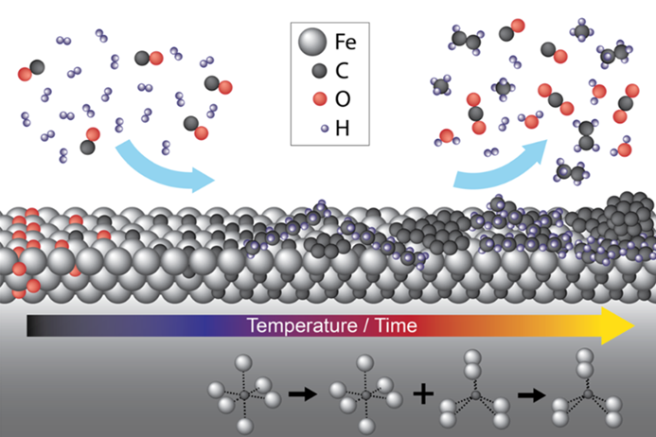
Case study: CO hydrogenation over Fe(110)
Iron is known to make long-chain hydrocarbons
Long chains deactivate the surface
Surface XRD and HP-XPS were performed independently to understand the process
^{Gas flow}
e–
^{X-Ray}
ACS Catal. 2022, 12, 13, 7609

Slide 17
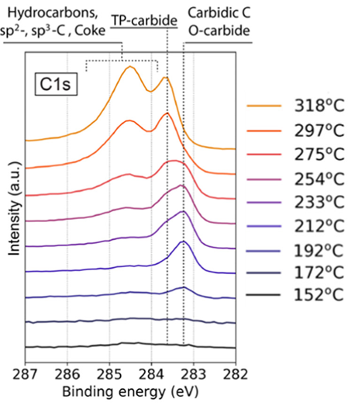
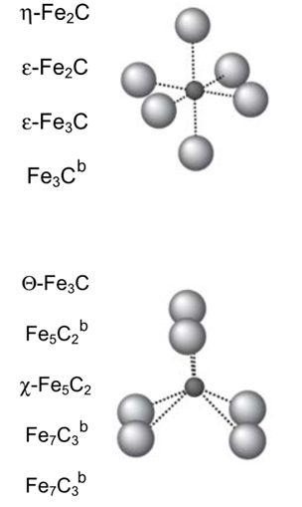
Incomplete information
1:4 CO:H₂, 85 mbar
By XPS, we know there are two ‘types’ of carbide (Octahedral and trigonal-prismatic)
There are many structures that have these ‘types’ of carbide
O-carbide
TP-carbide
ACS Catal. 2022, 12, 13, 7609

Slide 18
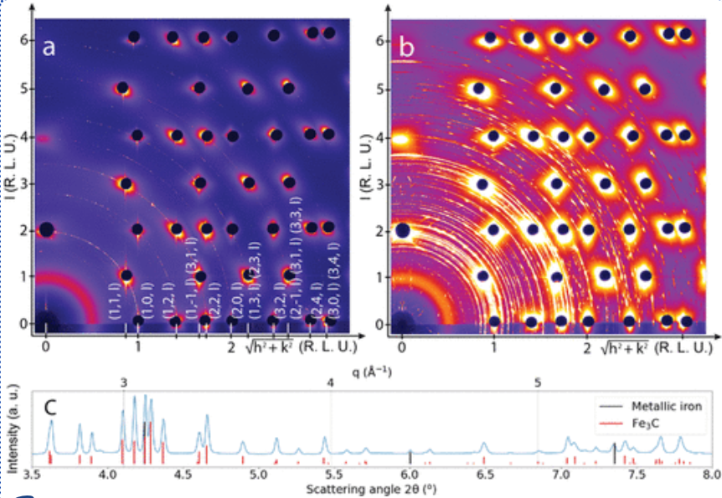
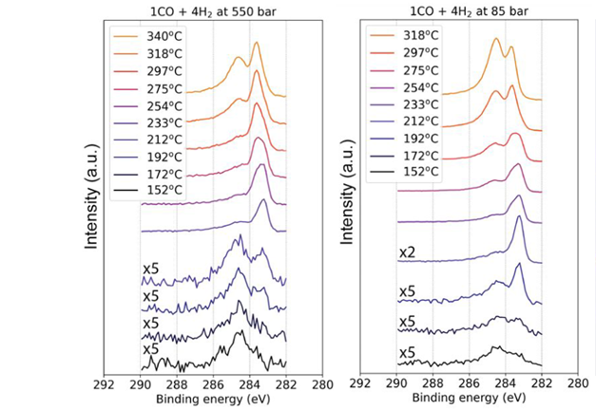
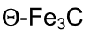
SXRD
1:4 CO:H2, 350C, 150 mbar
1:4 CO:H2, 550 mbar
1:4 CO:H2, 85 mbar
SXRD suggests the only surface structure is θ-Fe₃C
SXRD will only detect crystal phases
O-carbide may not be crystalline
ACS Catal. 2022, 12, 13, 7609

Slide 19
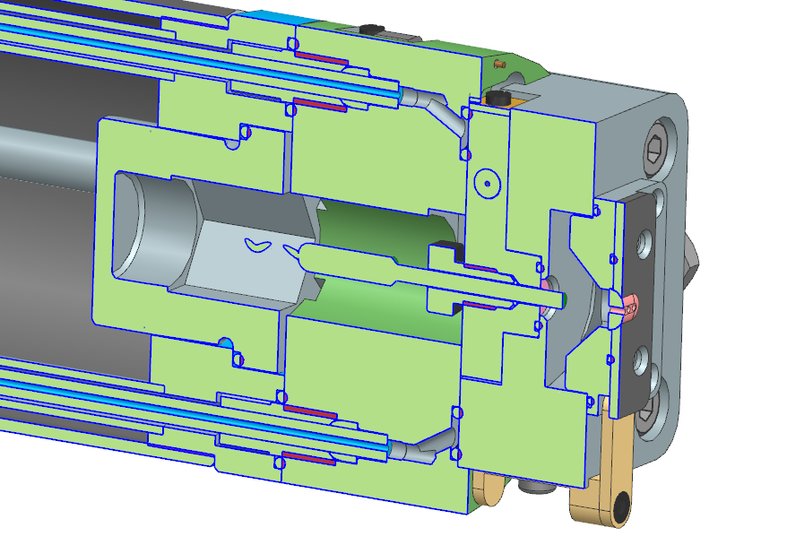
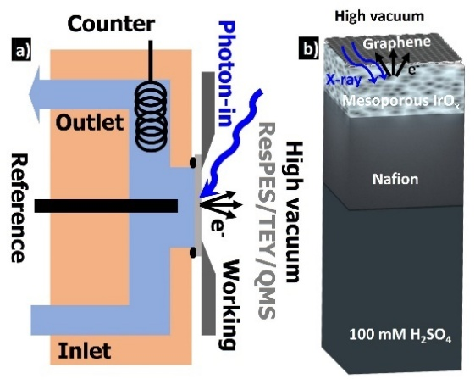
Electrochemical set up
*Andrea Sartori

Slide 20
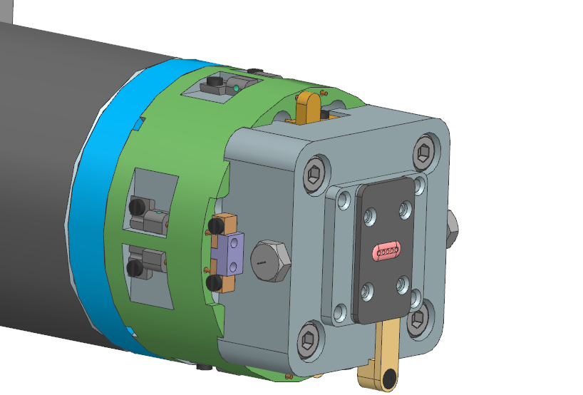
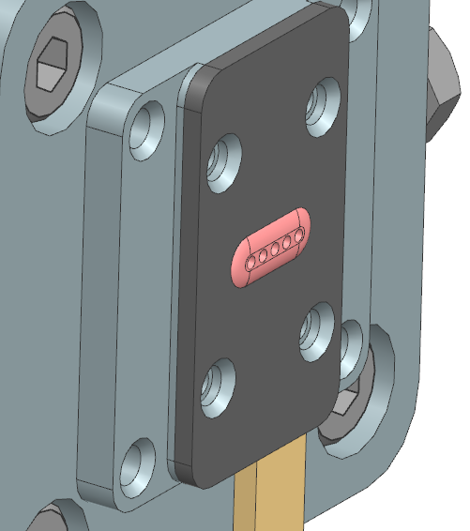
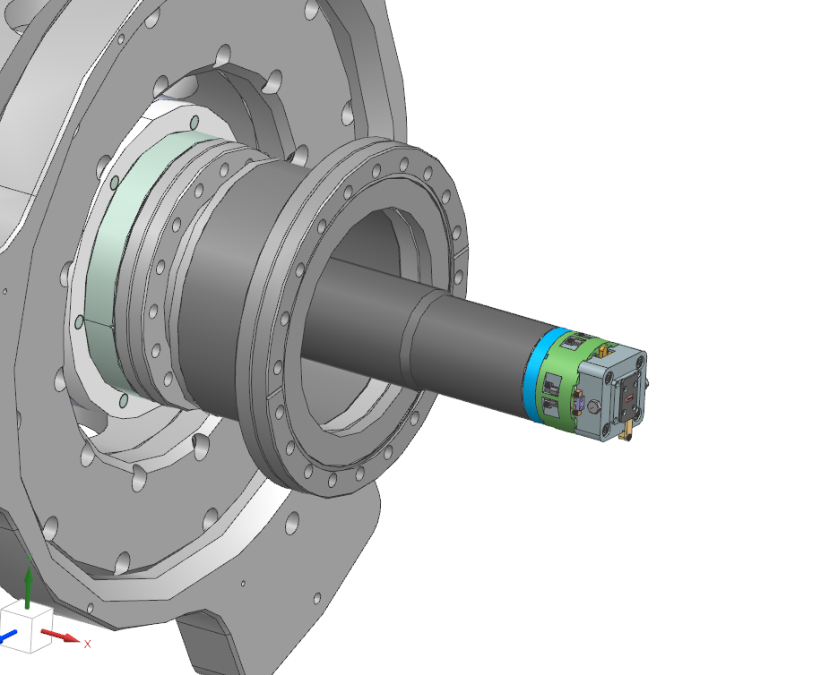

Manipulator modified
Sample modification to allow grazing incidence scattering
beam path
Dome like shape to allow grazing incidence diffraction
Elongated shape to get as much signal as possible
*Andrea Sartori

Slide 21



HER-BiLG/5 nm Pd/FKD (100 mM H₂SO₄)

Slide 22


3SBar
Starting with light 6th of November 2026
Endstation/Exp. Environment
Source/Optics/Diagnostics
In construction
(finish end 2026/begining 2027)
Users first half 2027 (June/July)

Slide 23

Thanks!
3SBar team:
Juan J. Velasco
Christopher Goodwin
Andrea Sartori
WP1(Optics design): Josep Nicolas
WP2 (ID): Jordi Marcos
WP3 (FE): Raquel Monge
WP4 (Optics mechanics): Alejandro Crisol
WP5 (Vacuum): Carles Colldelram/Lizet Carvajal
WP6 (Endstation): Juan J. Velasco
WP7 (Electronics hardware): Albert Miret
WP8 (Electronics infrastructure): Albert Ruz
WP9 (IT system): Adara Carrión
WP10 (Controls): Jordi Aguilar
WP11 (PLCs+PSS): Nil Serra/Jorge Villanueva
WP12 (Radiation shielding): Cristina Orozco
WP13 (Services+control hutch): Núria Martí
WP14 (Cryocooler): Carles Colldelram
WP15 (CNS permit): María José Garcia
WP16 (Gases): Christopher Goodwin
Management :
Caterina Biscari
Josep Nicolás
Klaus Attenkofer
François Fauth
Juan
Velasco
Chris
Goodwin
Andrea
Sartori
Safety :
Victor Garrido
Josep Maria Roca
Manel Pérez
Carolina Gutiérrez
Administration:
Enric Vinyals
Vanesa Faro
Elisenda Sanchis
Ivette Borrás
Clara Reyero
Edgar Eigner

Slide 24
ALBA vs. ALBA II
Parameter | ALBA (Current) | ALBA II (Upgrade)
Generation | 3rd-generation synchrotron | 4th-generation synchrotron
Electron Energy | 3.0 GeV | 3.0 GeV (same)
Circumference | 268.8 m | 268.8 m (same)
Beam Current | ~250 mA | ~300 mA
Horizontal Emittance | ~4.3 nm·rad | ~0.14–0.2 nm·rad (≈140–200 pm·rad)
Vertical Emittance | ~28 pm·rad | <10 pm·rad (design target)
Momentum Compaction (αc) | ~8.9 × 10⁻⁴ | ~8 × 10⁻⁵
Natural Bunch Length | ~15 ps | ~5.5 ps
Energy Loss per Turn | ~1.02 MeV | ~1.09 MeV
Lattice Type | DBA (Double-Bend Achromat) | 6BA (Six-Bend Achromat)
Number of Beamlines | 13 operating | Up to ~26 ports (planned)
Brilliance / Coherence | High | Ultra-high (order-of-magnitude increase)

