Slide 1
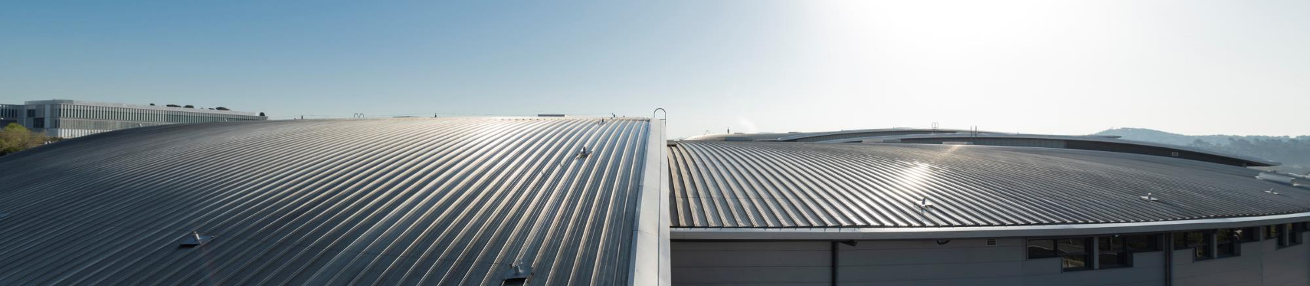
Science and Partnerships at ALBA
By Klaus Attenkofer

Slide 2
Scientific Examples from the Program

Slide 3
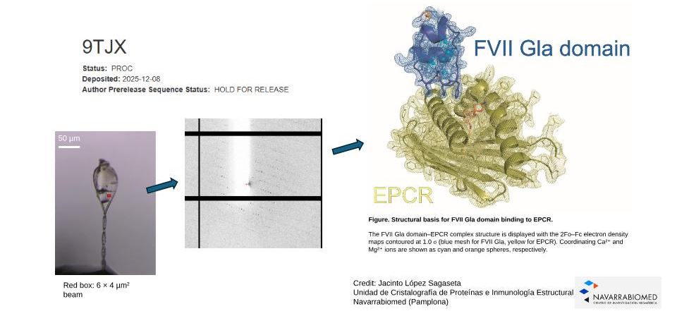
First Deposition of Structure In PDB-Database
Damia Garriga Rigau

Slide 4
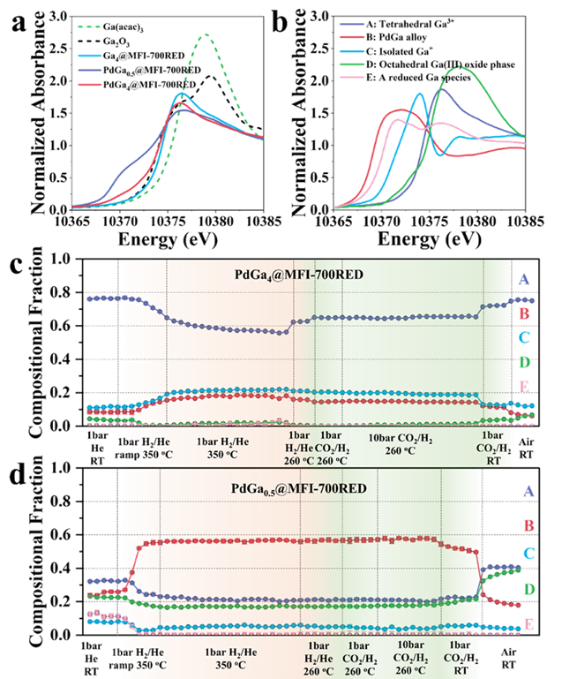
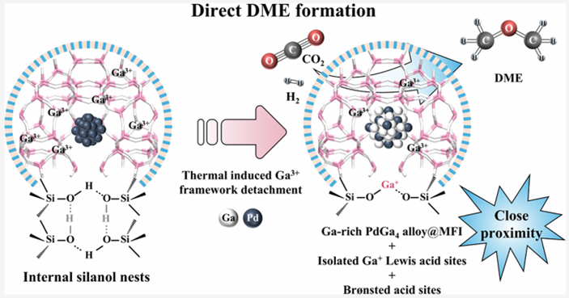
A new catalyst converts CO₂ into green fuel in a single step
Laura Simonelli
Dimethyl Ether (DME)
The novelty of this work lies in bringing both steps together in a single catalytic system, known as a “one-pot” process, based on a zeolite framework.
Thanks to the experiment performed at the CLÆSS beamline the chemical state of each element in the catalyst have been revealed along reaction conditions. The results show that isolated Ga⁺ sites are crucial for controlling the reaction pathway towards DME formation.
J. Am. Chem. Soc. 2026, 148, 6, 6531–6543.

Slide 5
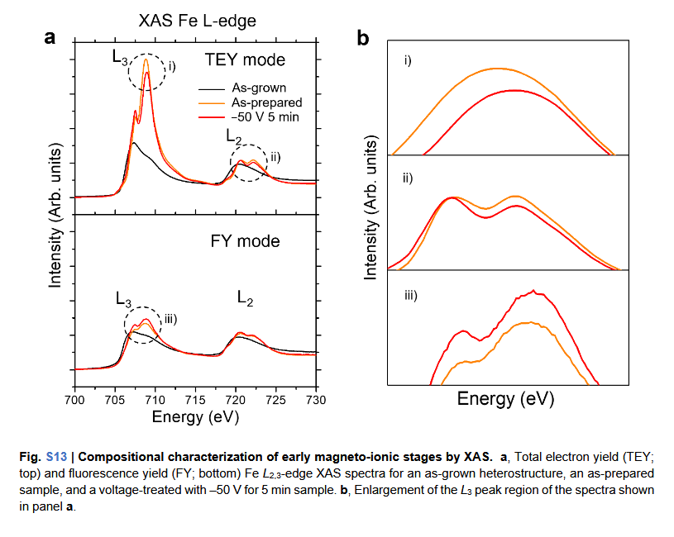
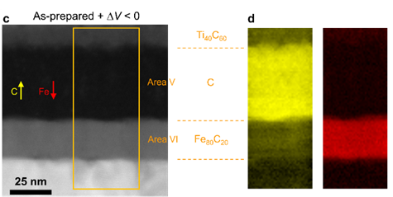
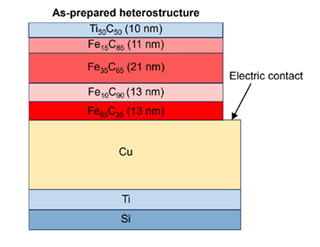
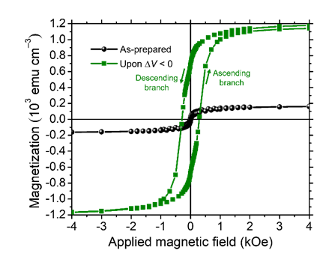
Magneto Ionics: XMCD Answers the Question
A Way to Control Magnetism with a Voltage
Javier Herrero Martin
Applied voltage results in migration of Fe and C in opposite direction, resulting in a ferromagnetic Fe-enriched layer.
Resulting coercivity is different by a factor 10.
Fe acts as cation, C as anion.
Reproducibility was tested Fe/C is an alternative combination to Fe/N
C
Fe
Nat. Commun. 17 (2026) 1568

Slide 6
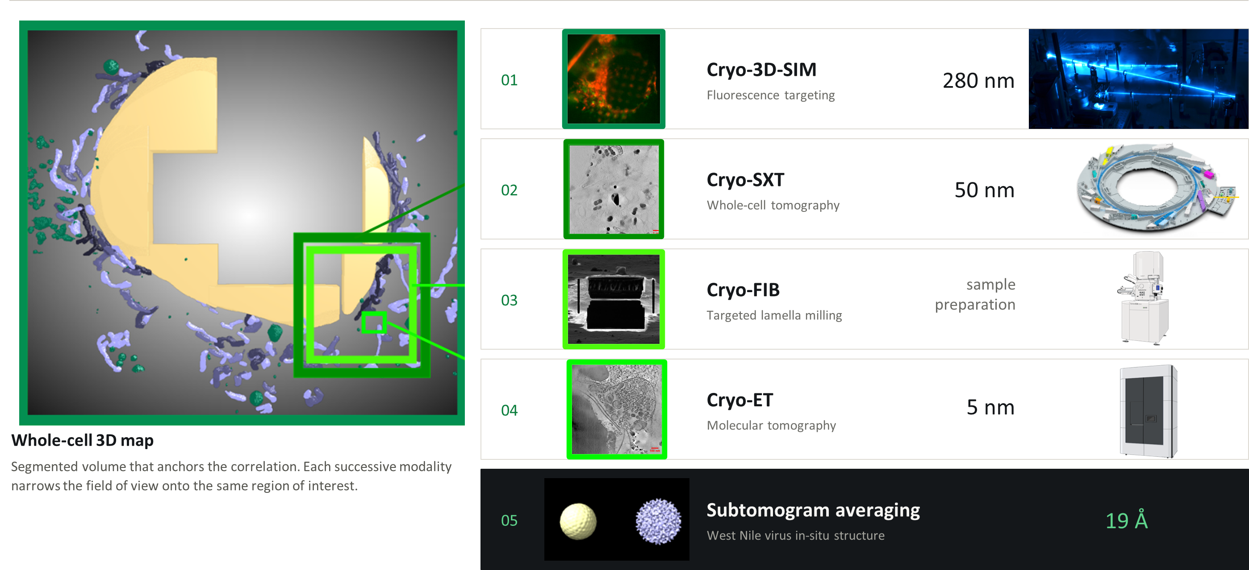
Correlative Cryo-Imaging Pipeline:
From whole cells to molecular structure, across 4-orders of magnitude!
Kevin Mamprin
West Nile virus in-situ structure was identified within cell structure.
    Correlative imagining allows:
                identification of infected cell, finding virus within the cell,
                or measure multiple cells (statistical relevance) and identify cell morphology changes at different virus development stages.
            Three techniques with resolution of 280nm, 50nm, and 5nm can be combined.
            Currently, the developed pipeline is optimized and implemented within integrated framework management system.

Slide 7

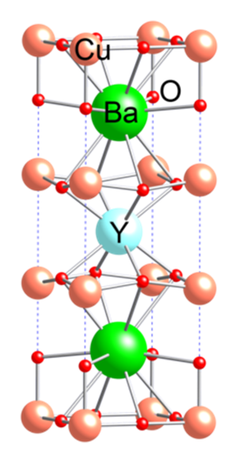
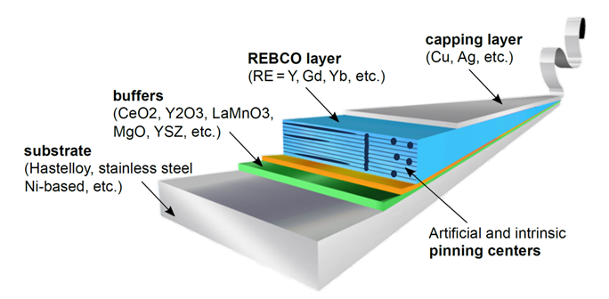
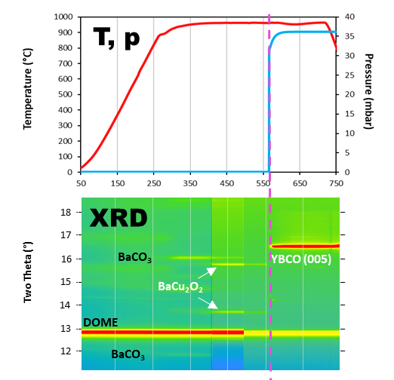
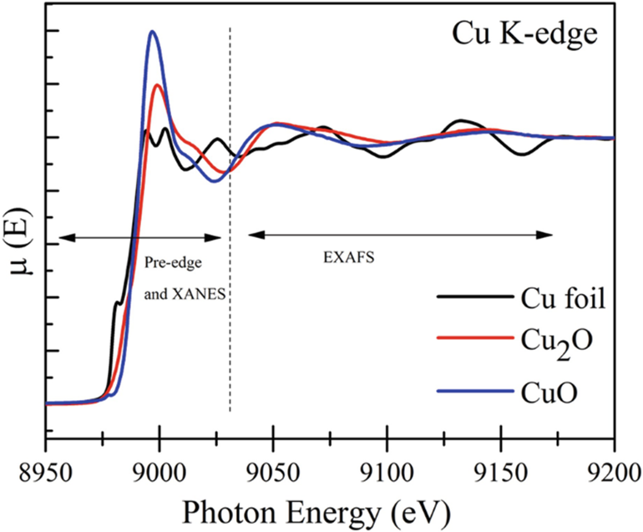




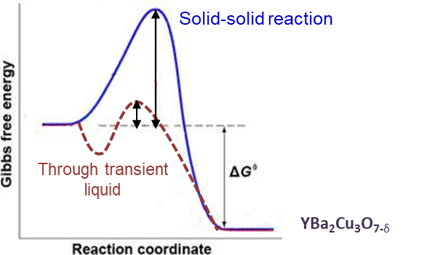
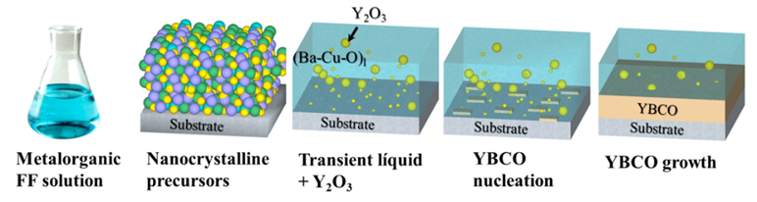

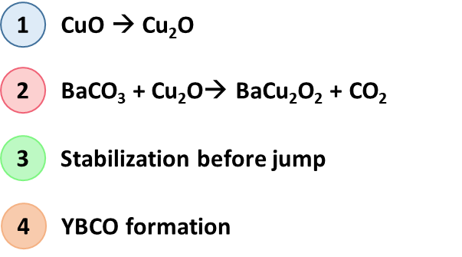
High Tc Superconductors for Cable Production
In-situ characterization of growth: Bridge between basic and applied sciences
Eduardo Solano Minuesa
The Application: Coated Conductor Technology
The Tool:
XAFS & XRD understanding chemical composition
XRD provides development of phases over time.
Cu K edge XAFS provides valance state development (also in liquid form)
T. Puig at al. Nature Reviews Physics 2024, 6, 132-148
The Problem:
Understanding the optimization of non-linear processes
The Result:
transient liquid-assisted growth (TLAG) of REBCO films
*C. Torres, E. Pach et al. to be published
Springer, Cham. https://doi.org/10.1007/978-3-319-92955-2_13

Slide 8
Workflows:
A New Way to Accelerate Your Science
Joaquin Otón Pérez & Methodology group, Sandra Ruiz

Slide 9
From Beamtime to Workflows:
How to solve complex characterization problems in a “short time”
How to characterize the system:
Example: Optimizing Josephson Junctions for Quantum Computing
TEM:
electron diffraction
ELS
X-ray:
GI-WAXS & -SAXS
XAFS
Pol-figures
Microscopy
Interdiffusion creates:
roughness as well as
barriers within the Al-layers
Ultimately resulting in dephasing
Data analytics:
Data analysis (mainly grouping)
Visualizing functional-structural correlations
What is needed:
Pathway to scale from 50 Qubits to 10000 Qubits
One path is developing screening methods (chiplet method)
Another path is optimizing the growth & etching process
New materials combinations (crystalline oxide layer)
Interdiffusion of O into Al
Simulation:
Understanding O interdiffusion
Interdiffusion depends on
Flatness and termination of substrate (saphire)
Crystal structure and roughness of 1. & 2. layer
O-balance and temperature during ALxOy growth
but:
Speed and depth
Cost
Metrology for QA
9

Slide 10
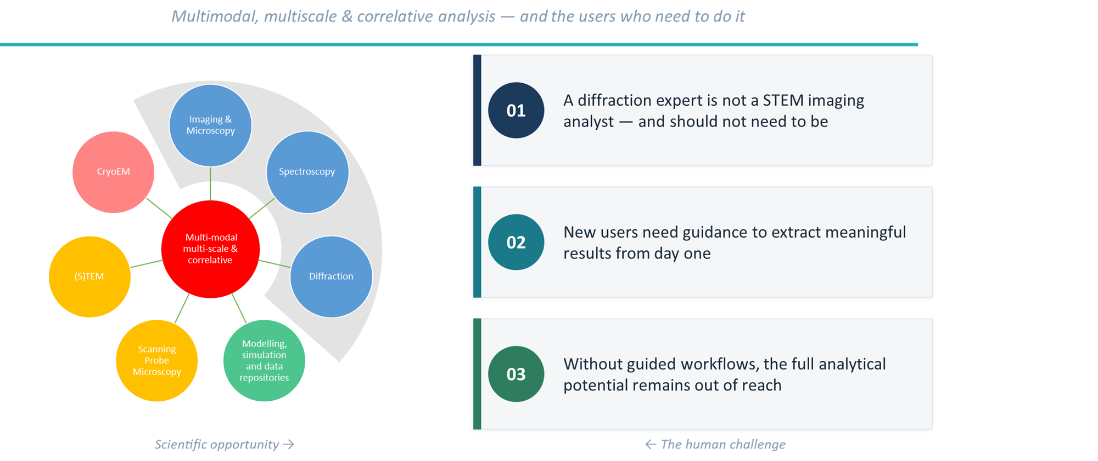
Challenge:
Complexity Beyond a Single Technique

Slide 11
The Workflow:
Methodology, Technical Implementation, Access & Resources
X-ray Diffraction
Incompatible tools
X-ray Imaging
Scientific
&
Industrial
Solutions
Expertise barrier
Spectroscopy
Electron Microscopy
Infrastructure limits
Scanning Probe
No guided workflows
Knowledge & answers
Modelling & Simulation
Complex heterogeneous data
The instruments exist. The data is there. What is missing is the bridge.

Slide 12

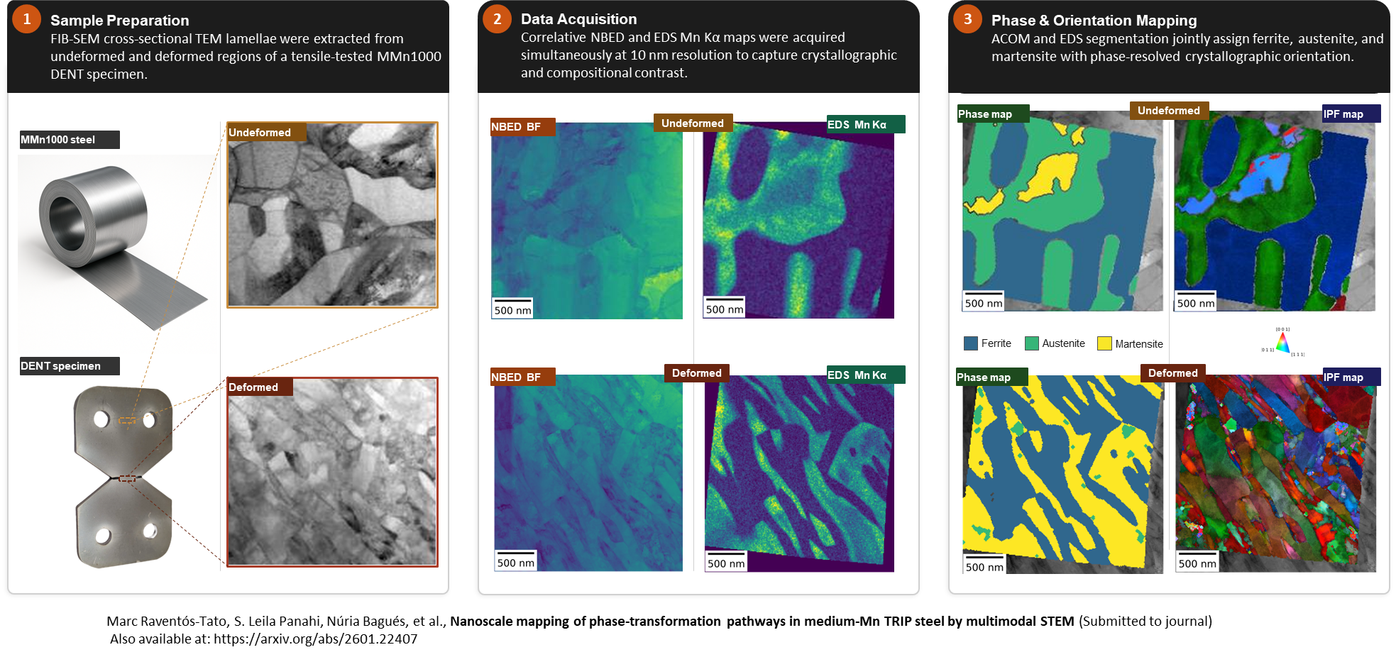
An Example: The POEM Workflow
Phase Identification, Orientation & Elastic Strain Mapping

Slide 13
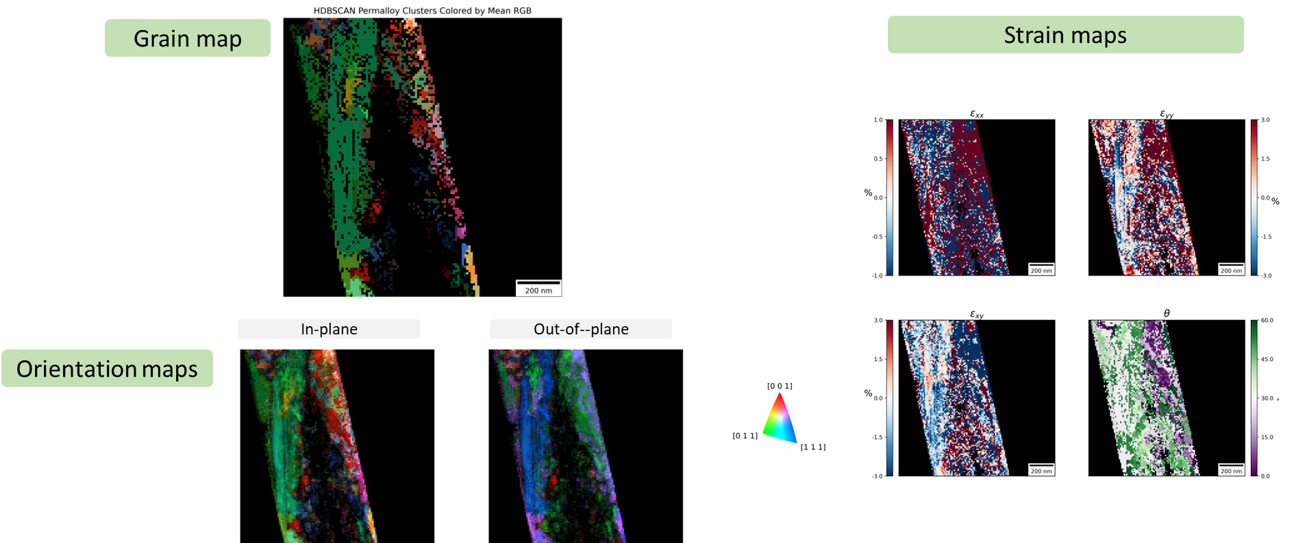
POEM: Crystallography and Morphology
What is POEM and how general is it?
TEM and crystals: POEM workflow
REFERENCES
First workflow available in user program:
Currently preparation of the user portal and documentation.
Support scientist is currently hired.
Originally developed for steel research (industrial background)
CALIBRANT
Background (BG)
SAMPLE
AuPt raw data
Vacuum raw data
Sample raw data
Pipeline 1: Q-Space Calibration
Pipeline 1: Q-Space Calibration
& peakharvest
Q pixel size [Å⁻¹/px]
Calibrated bragg peaks
Refined simple lattice [Å]
Pipeline 2: Orientation Mapping & Strain
IPF Orientation
Maps
HDBSCAN
Grain Maps
Phase Weight
Map
Strain Maps
(exx,eyy,exy,θ)
Workflow is installed and tested; documentation and integration in user portal is currently done.

Slide 14
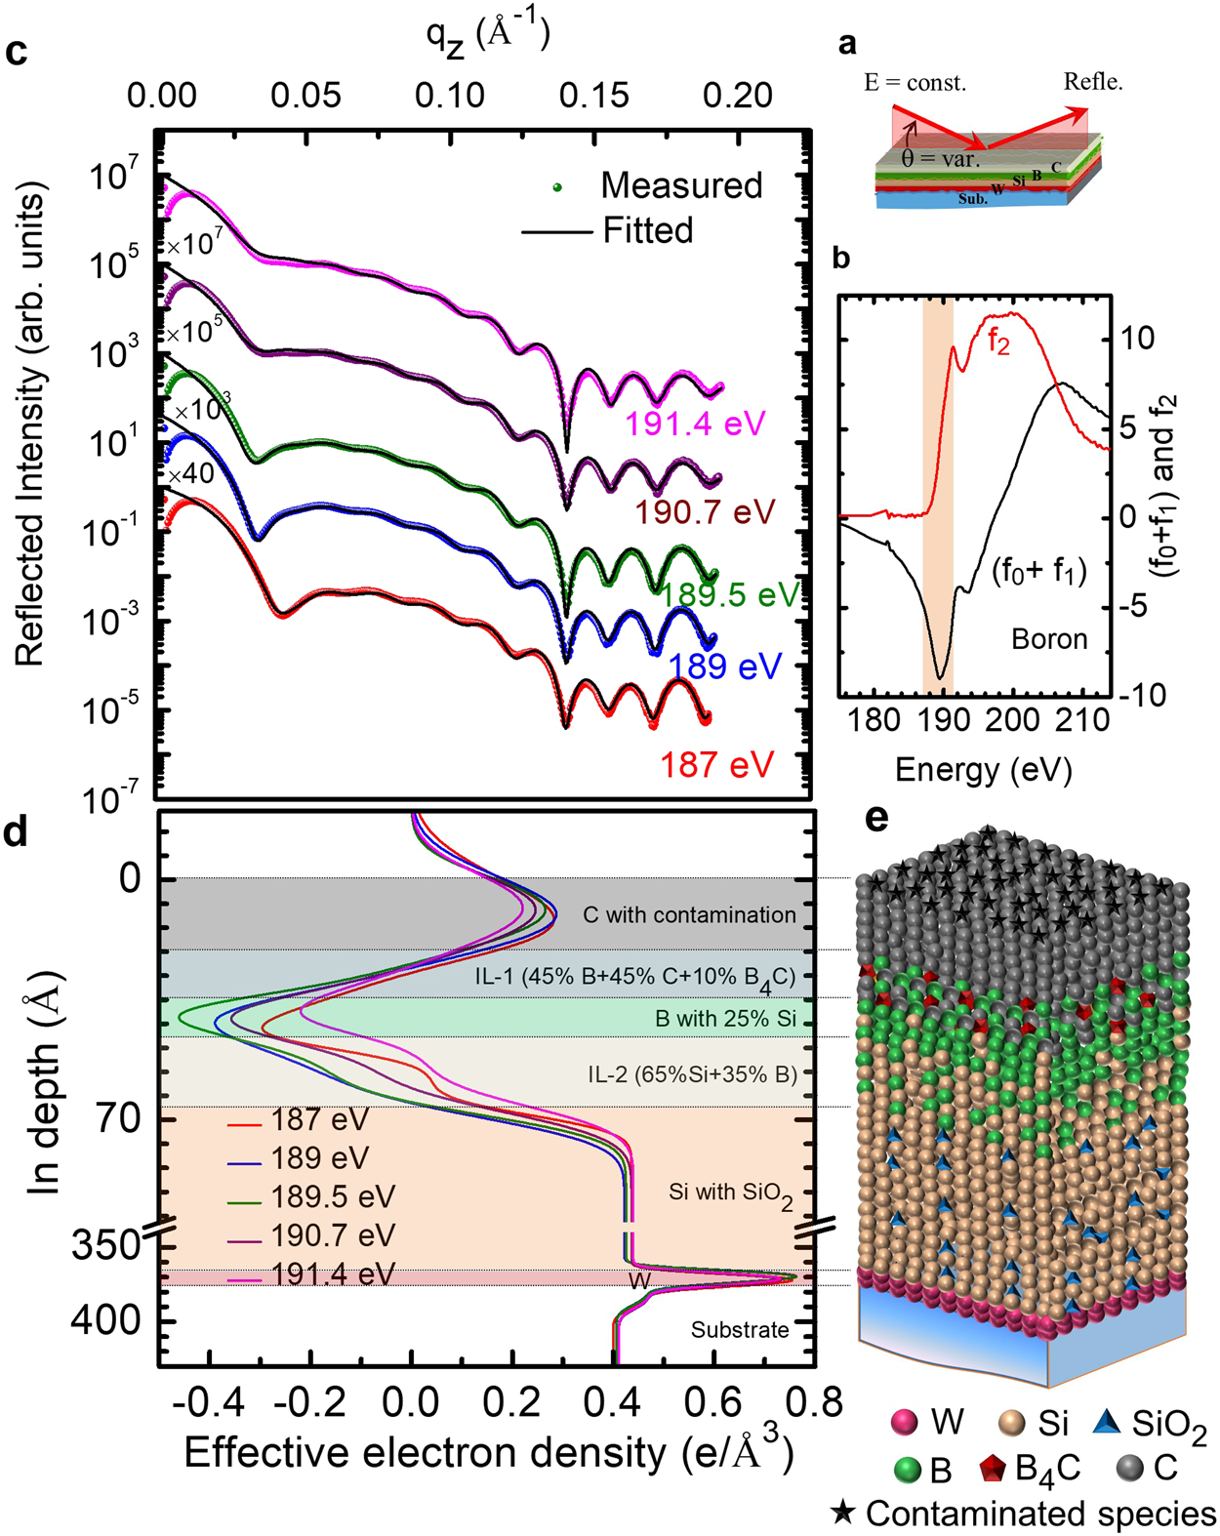
Crystallography and Morphology
Fast and cost-effective measurements of many samples
X-rays and diffraction
X-ray reflectivity
Available as user experiment (NCD)
currently developed to workflow.
Current development of coherent imaging techniques.
Fast
GI-WAXS/SAXS and pole figures
Available as user experiment (NCD).
In-situ (including ALD) capability.
currently developed to workflow.
Current development of coherent imaging techniques.
Model dependent
Compatible with in-line metrology
Experimental setups exist but workflows and analysis pipelines are currently developed
Epitaxial growth of Pt on MgO
J. Appl. Cryst. (2026). 59

Slide 15
Simulation & its Integration in Analysis Pipeline
Carlo Marini
Tested and now integrated within HPC (parallel processing)

Slide 16
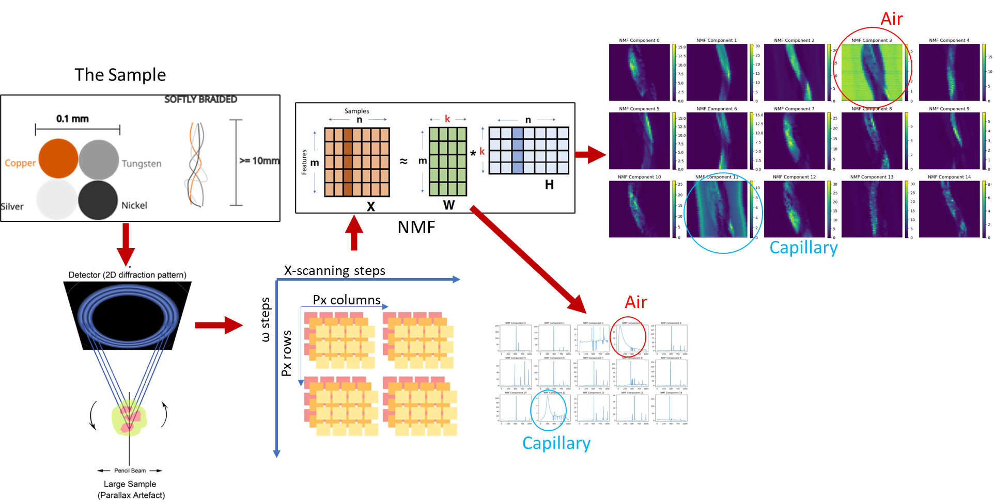
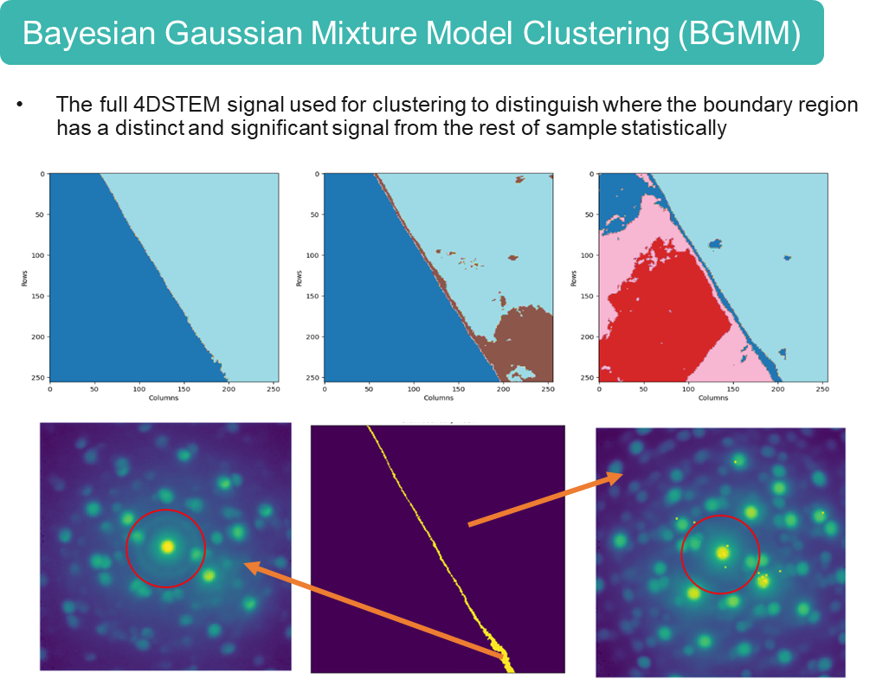
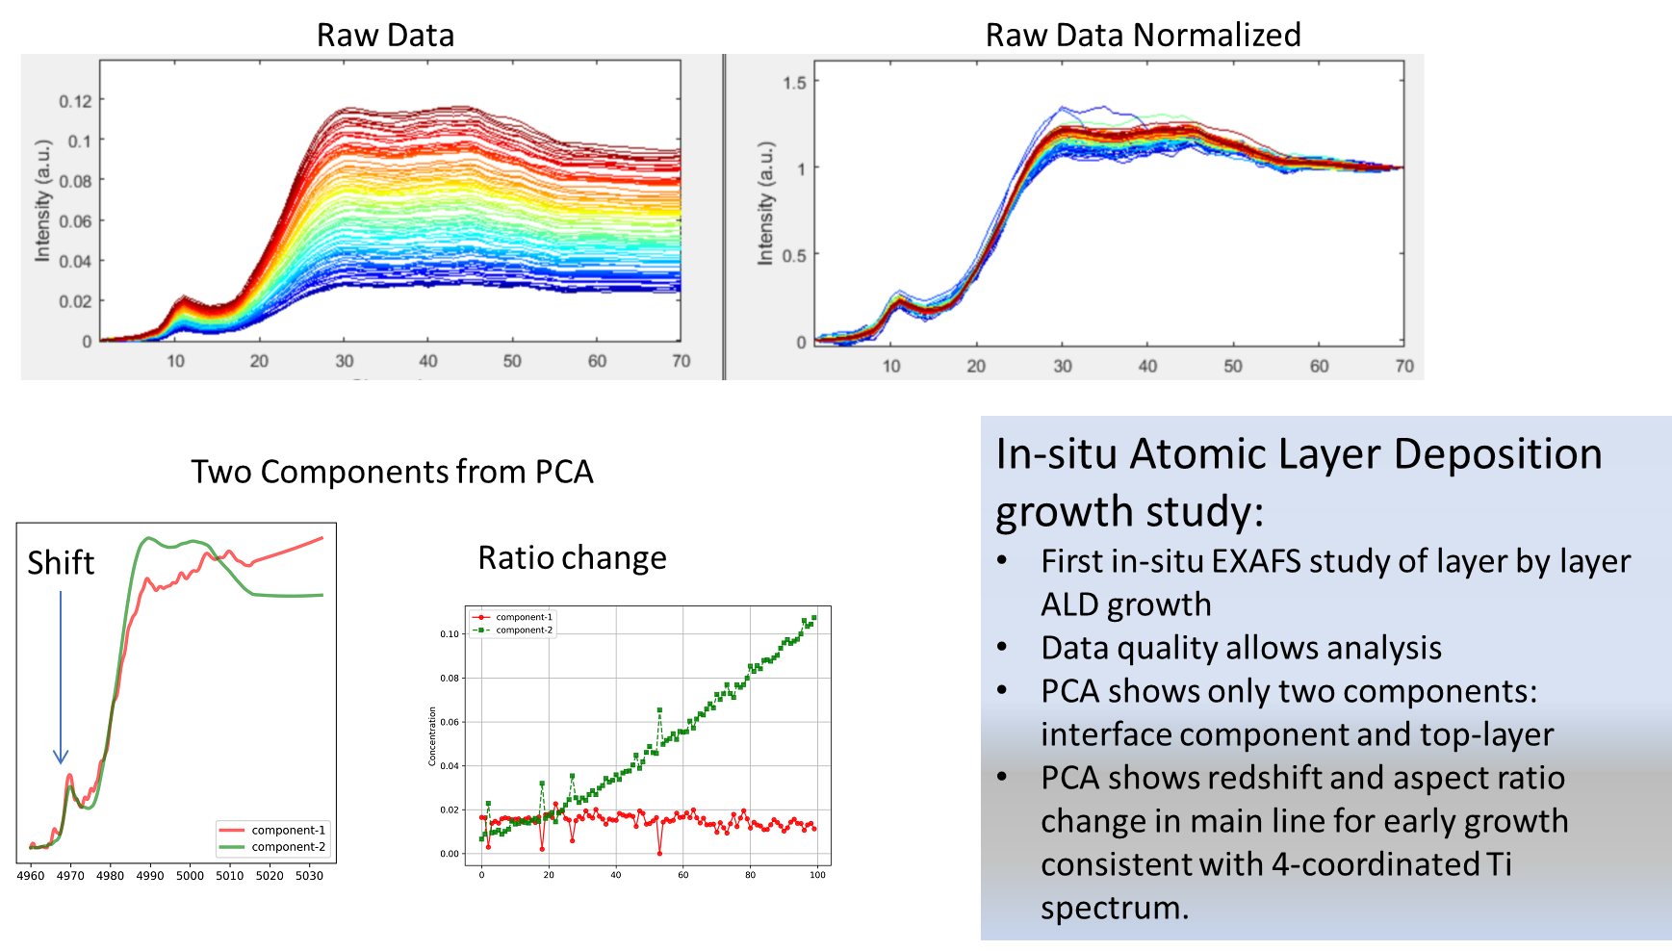
Data Analytics and AI:
Key to Autonomous Pipeline Performance
Data Grouping:
Powder diffraction and imaging:
Electron diffraction:
Spectroscopy and ALD:
Active work on many projects

Slide 17
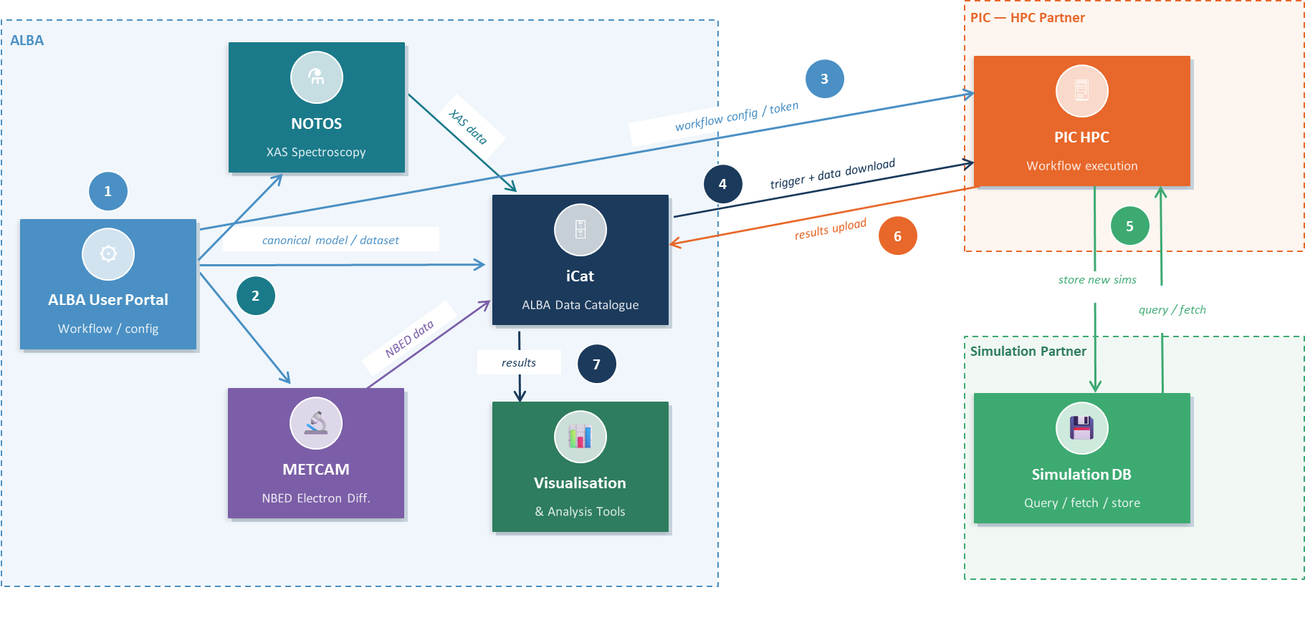
Integrated Framework Management
Fully Unattended, Federated Pipeline Execution
Allows:
Integration of external resources
IP and other rights tracking
Usage of multiple data spaces (shared data spaces)
Currently under development and testing
Examples:
Remote Laboratory
Industrial collaboration

Slide 18
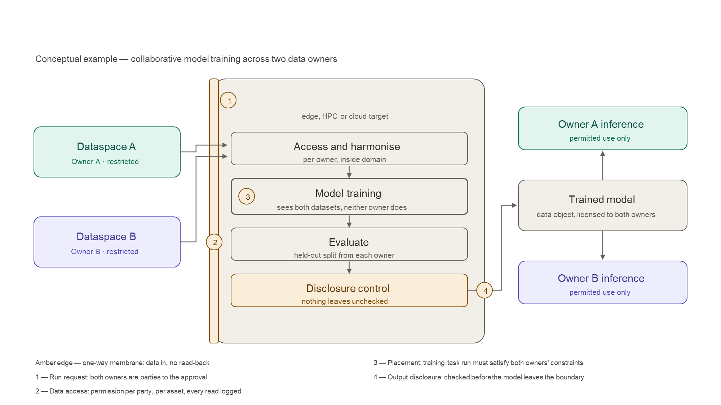
Dataspace connectivity under
IP and access governance

Slide 19
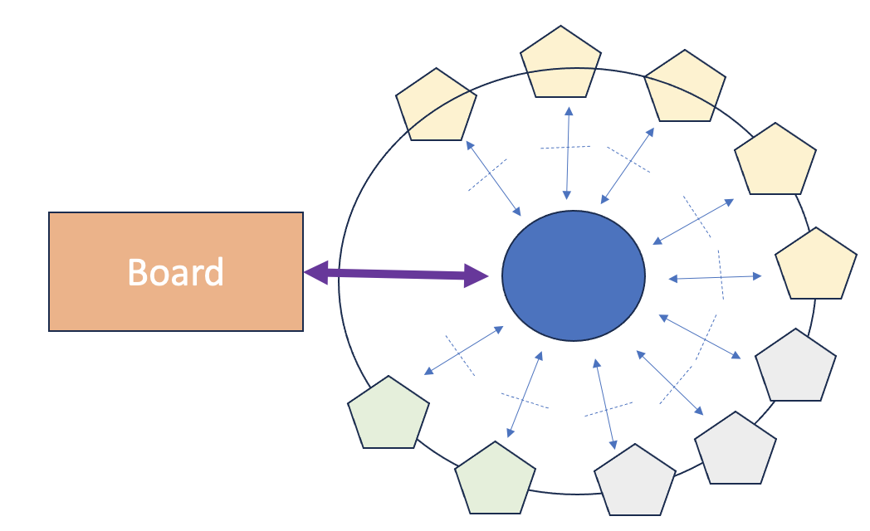

ALBA’s Resources within Innovation Ecosystem
EC
Overview
Tech Challenge1
Database of available workflows
ALBA/user
involvement
Tech Challenge 2
Key features:
Scalable dependent of available resources
IP management is integrated on the lowest development level.
All stakeholders are involved and have ownership (public/private funding, policy maker, investors, scientific community).
Shared dataspace concept with access management system allows the usage of all available European development resources.
Coordination Board
Tech Challenge ….

Slide 20
Partnerships:
The Way To Tackle Grand Challenges

Slide 21























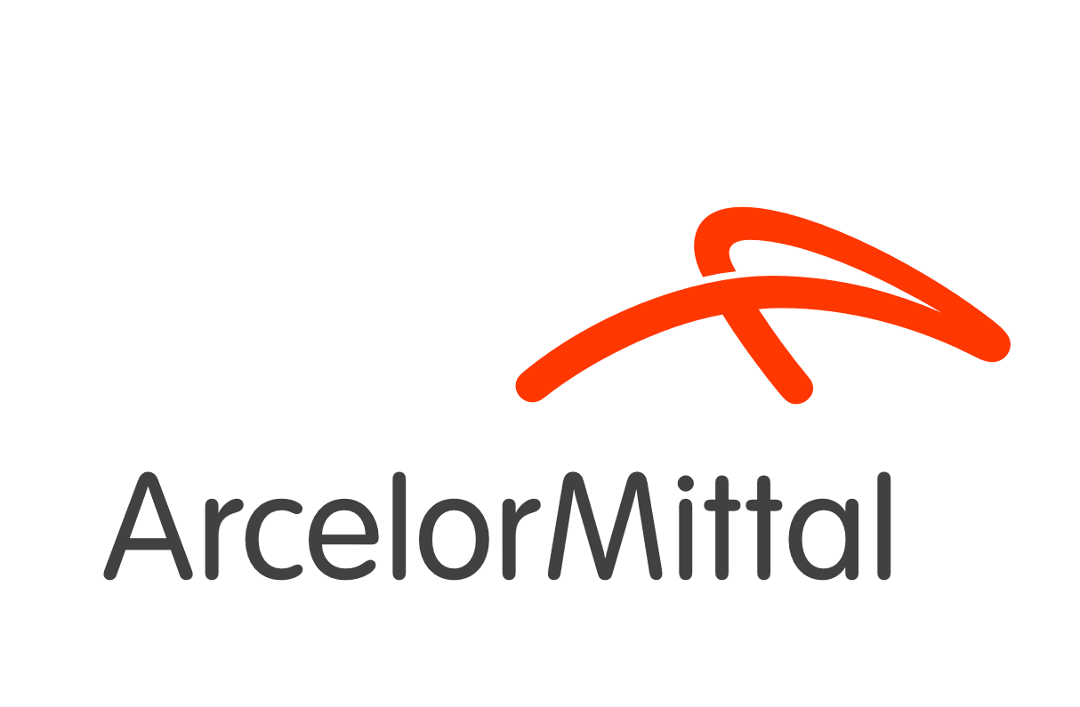








Methodology Development:
Externally Funded Collaboration
Example: POEM workflow development
https://cisma-project.eu/about/
https://eurecat.org/en/portfolio-items/h2form3g/#about
Collaboration partners:
https://eurecat.org/en/portfolio-items/sup3rform/
https://eurecat.org/en/portfolio-items/coophs/

Slide 22

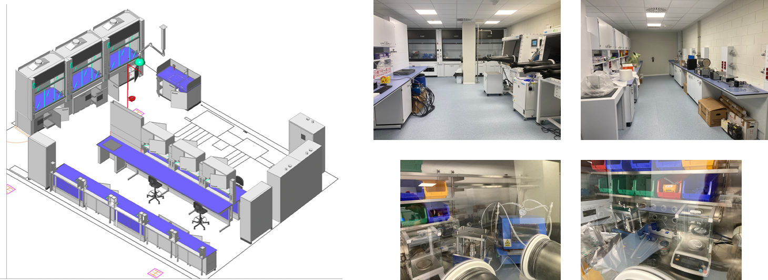
Energy Transition Joint Laboratory
Medium Investment but Long Term Commitment
Lab infrastructure for battery research (coin and pouch cell) and Superconductor growth facility
Available for all users of ALBA
Staffed in collaboration with ICMAB

Slide 23
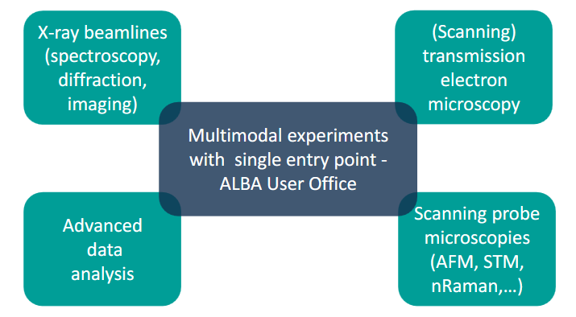
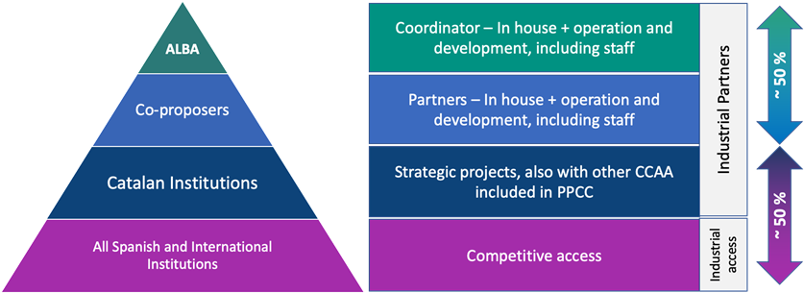

InCAEM: Multi-Institutional & Large Effort
Materials with advanced functionalities for the new technological transformation
Budget 15 M€ (2.4 M€ for personnel). Duration 3+ years (ended with 2025).
See talk of
Ana Arché Núñez

Slide 24
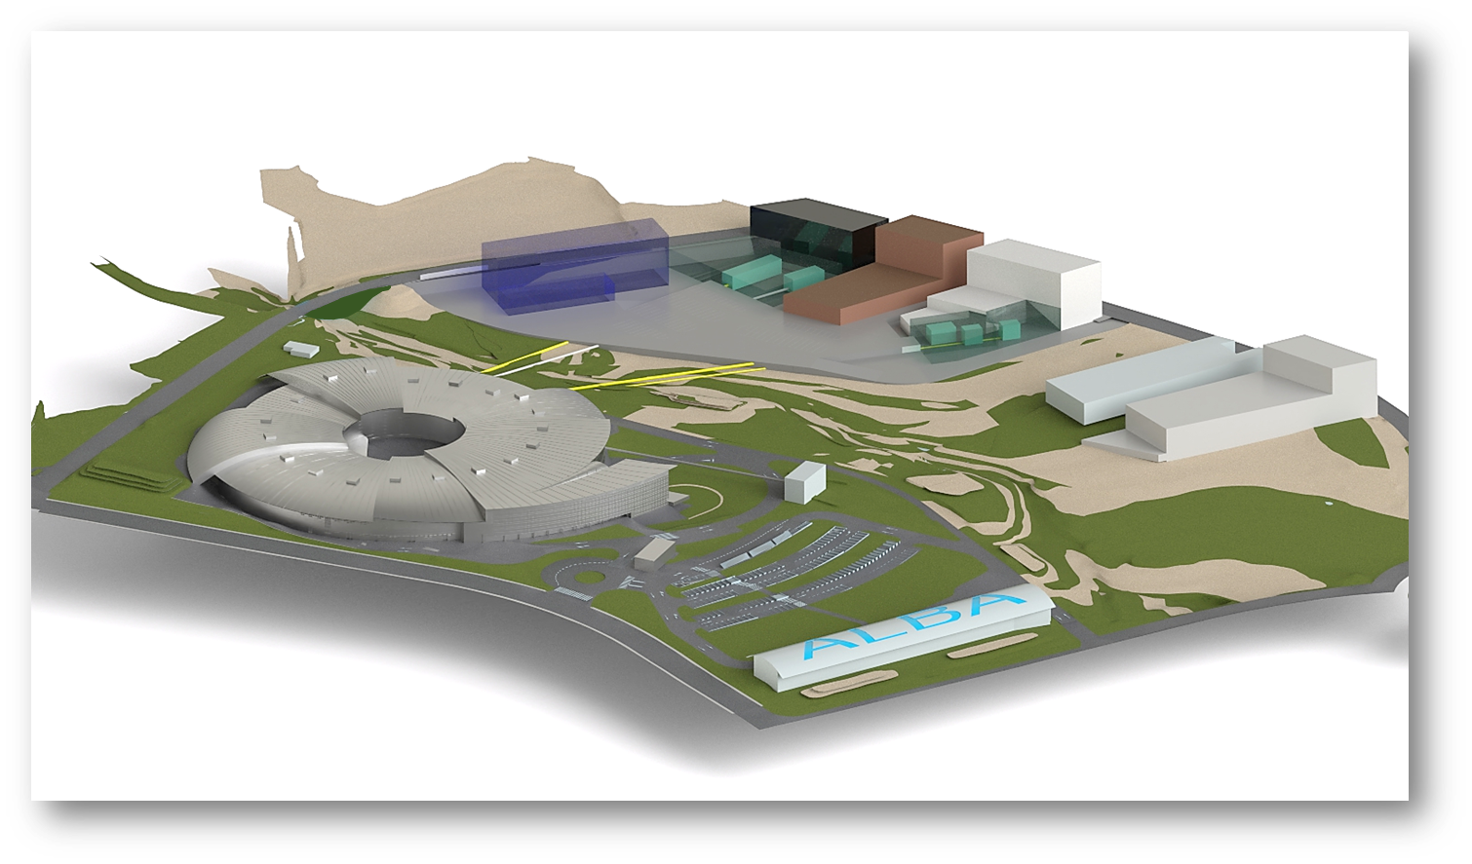







Large Collaborations Tackling Grand Challenges
Resilience to Global Health challenges through the One Health approach – BSL3 connected to CORUS BL
Reach One Health
CODI
INNOFAB
Lab to Fab clean room for microelectronics
for development of semiconductors technologies

Slide 25
The Access Modes

Slide 26

Access Modes and Conditions
Mode | Public/ proprietary | Review (Scientific) | timelines | Comments
Public access | Public | Review panel | 2 calls per year | Most common
Rapid access | Public | Review panel | Continuous | Typically short access; available within 2 month
Proprietary access |  | - | Continuous | As soon as possible
Collaboration based
Collaboration within externally funded projects | Public & Proprietary | Review panel - | 2 calls per year Continuous | May be in exception using in-house or discretionary time
Resident user | Public | SAC review | 2 calls per year | Will be available in Call 2028-I
Strategic large partnerships | Public & proprietary | SAC review | continuous | Conditions depend on funding conditions and collaboration agreement
Example for “Strategic large partnerships”: InCAEM partnership

