Slide 1
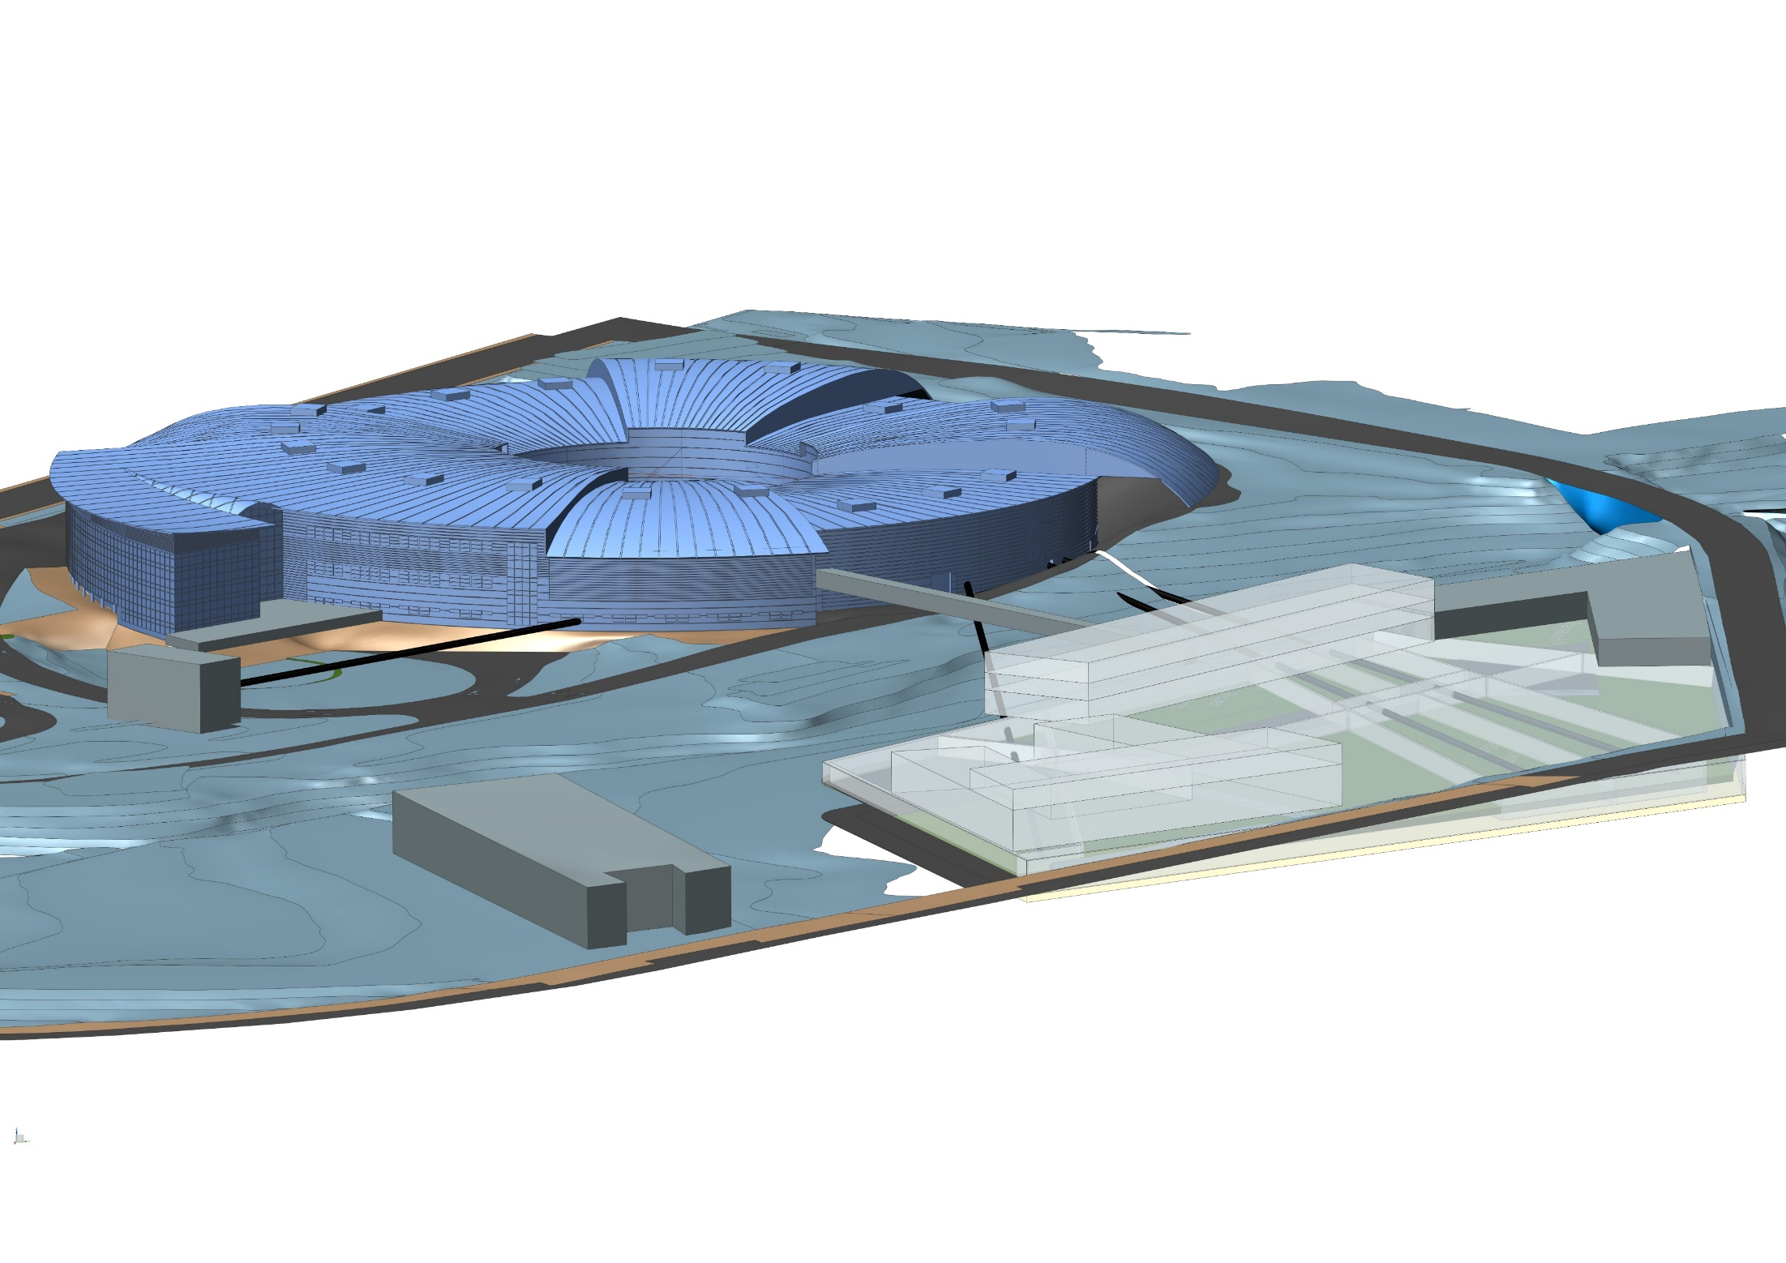
Status of the ALBA II Upgrade
Montse Pont
03/09/2026

Slide 2
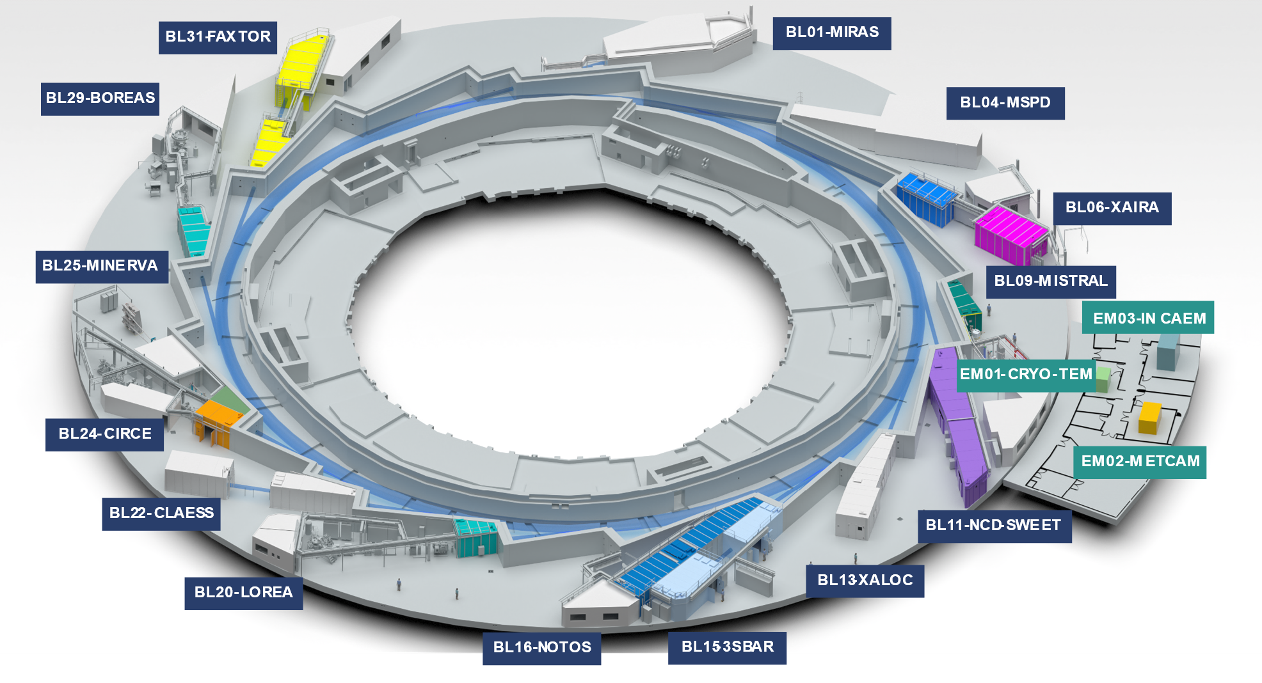
ALBA today
13 BL in operation
1 BL under construction
JEMCA:
2 EM in operation
1 EM under commissioning
5 SPM under commissioning
ALBA
SPM Platform at Prisma Building
JEMCA

Slide 3
ALBA in 2032
BL33 MSPD2
BL02-CoDI
BL04-CORUS
ALBA II
ALBA II:
17 BL in operation
JEMCA:
4 microscopes in operation
5 SPM in operation
EM04 in E6
BLxx CALIMA
SPM Platform at Prisma Building
JEMCA

Slide 4
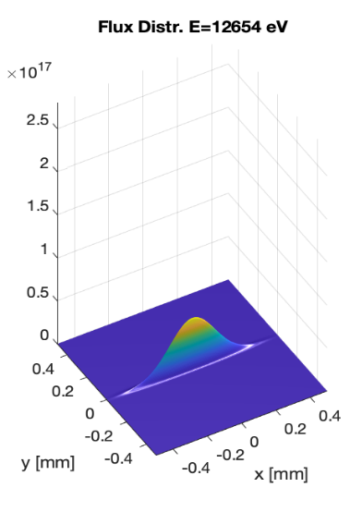
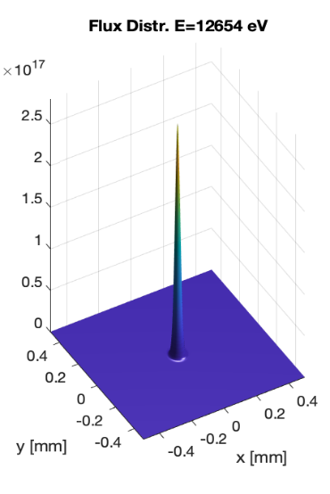
ALBA
ALBA II
2.5·10¹⁷
ph/s/mrad²@0.1%BW
ph/s/mrad²@0.1%BW
0.5·10¹⁷
Increase in Brilliance
Increase in Resolution Power
Increase in Coherence
Increase in Data management capacity

Slide 5
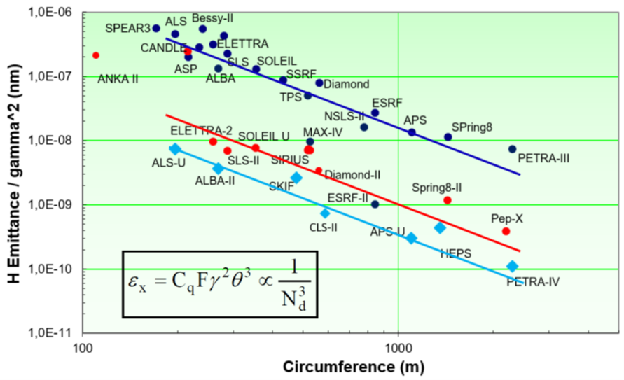
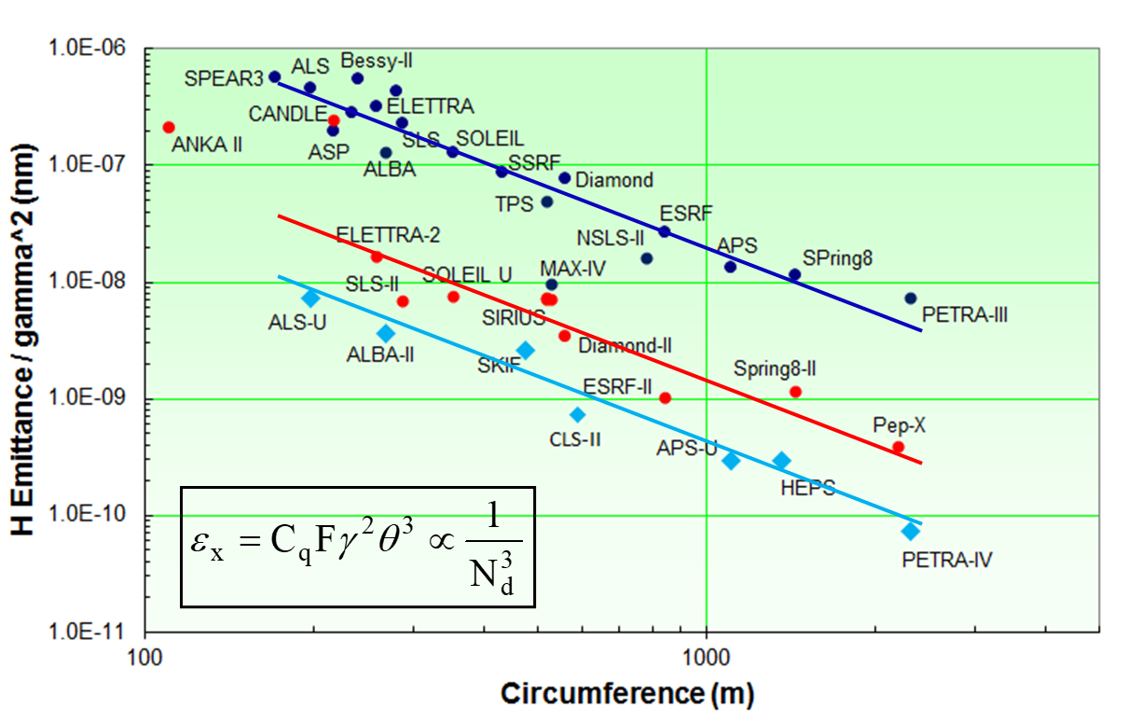
Accelerator
How to achieve it? With a reduction of emittance by a factor 20
4GSR
Reproduced from: R. Bartolini “Overview of ongoing 4th generation light source projects worldwide”, 7th DLSR Workshop (2021)

Slide 6


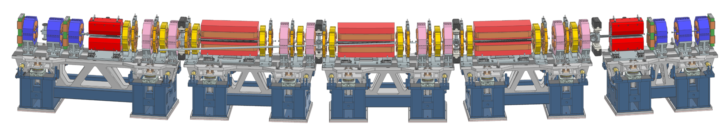
Accelerator
 | ALBA
Energy | 3 GeV
Circumference | 268.8 m
Symmetry | 4-fold
Lattice | 8×2-DBA cells
Emittance | 4.5 nm·rad
Nº of cells | 8 + 8
# of straights | 4 / 12 / 8
Straight length | 7.8 / 4.0 / 2.3m
ALBA II
3 GeV
268.8 m
16-fold
16×6BA cells
200 pm·rad
16
16
4.0 m
÷20
Extremely compact new magnetic lattice

Slide 7
Accelerator
Optimisation parameters
Reduce emittance by more than a factor 20 (∼ 200 pmrad).
Keep the tunnel → SR with similar compact circumference.
Keep beam energy 3 GeV.
Keep existing ID beamlines → preserve 16 cells and source points.
Bending beamlines can be relocated.
Keep injector (present ε_{x}^{booster} = 10 nm∙rad).
Keep infrastructures, as much as possible.

Slide 8
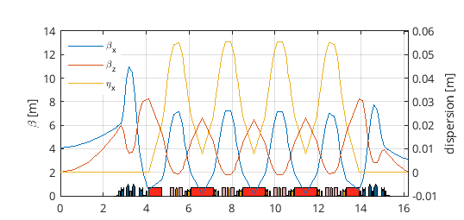
Accelerator
Status of lattice design
Emittance: 200 pm·rad (154 pm·rad)
SS leghts: 5.4 / 4.6 / 3.7 m
β_{x} at SS: 4.1 / 3.6 / 2.9 m
β_{y} at SS: 2.0 / 1.8 / 1.6 m
Lifetime: 11h
5 x girders per sector, total of 80 girders
43 x magnets per sector, total of 688 magnets
> 688 power supplies, when considering additional corrector coils on main magnets

Slide 9
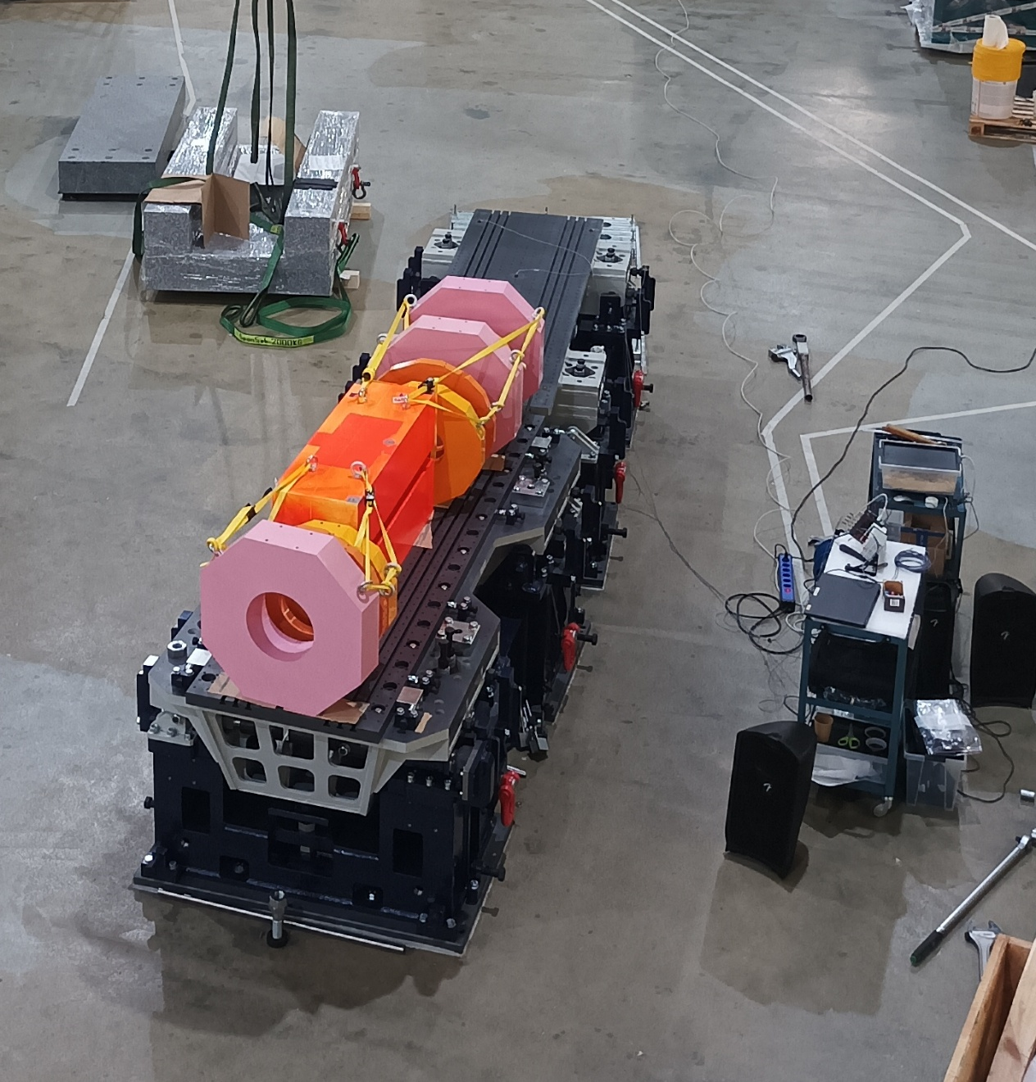
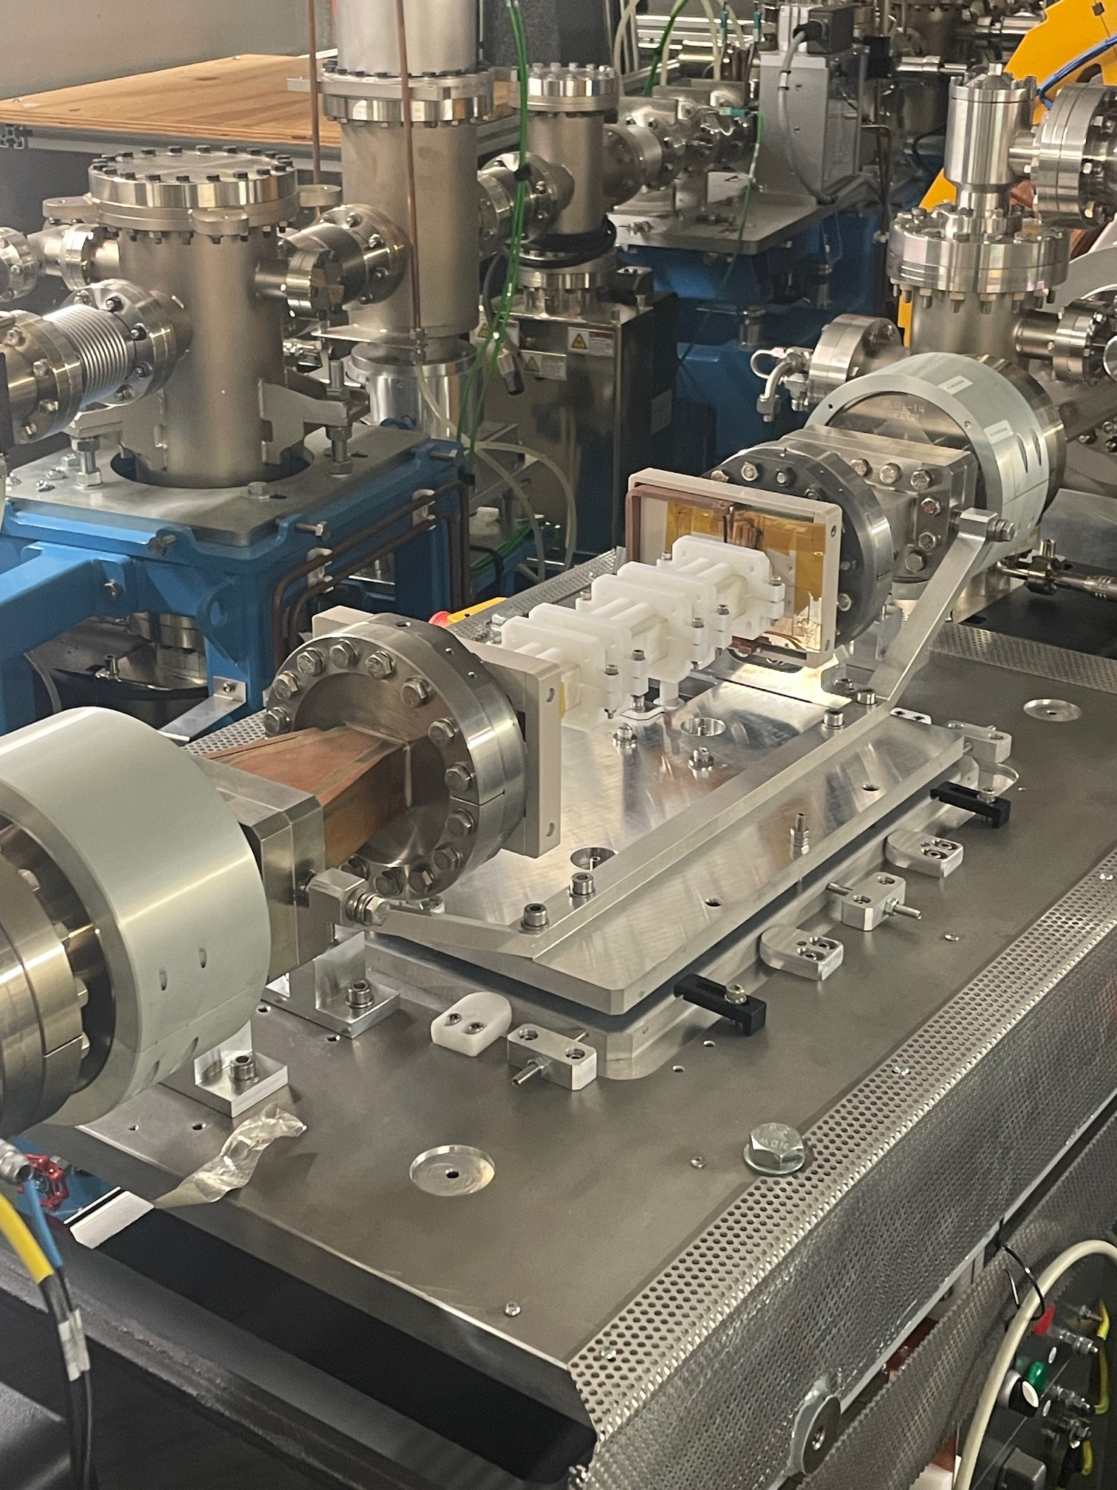
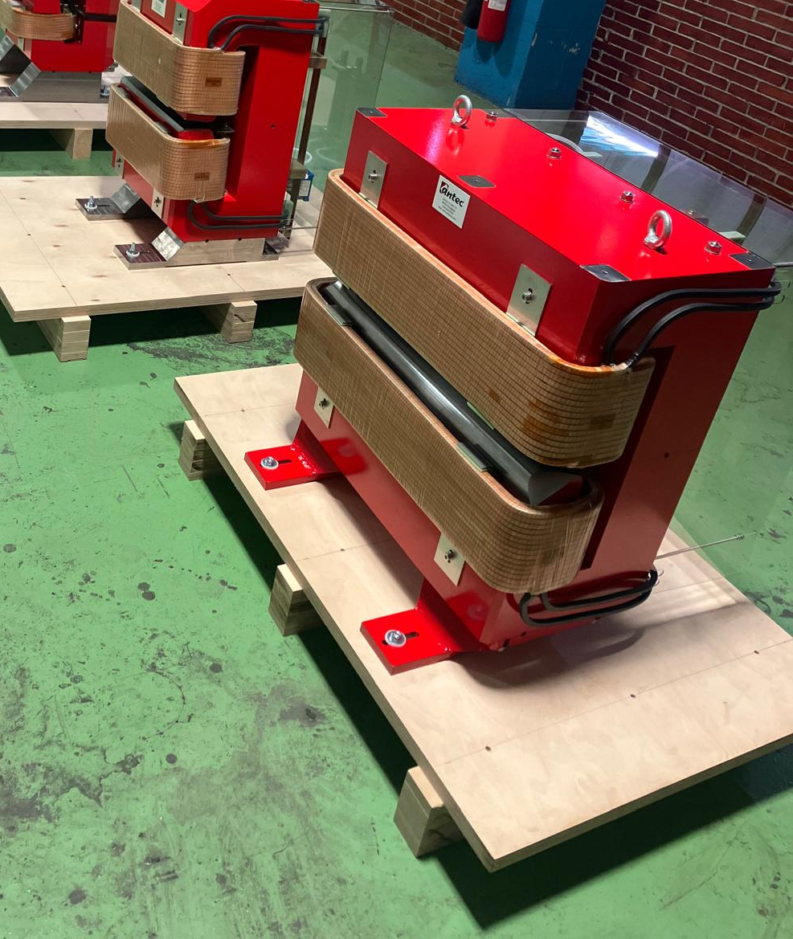
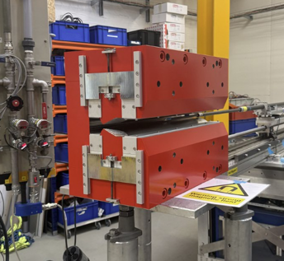
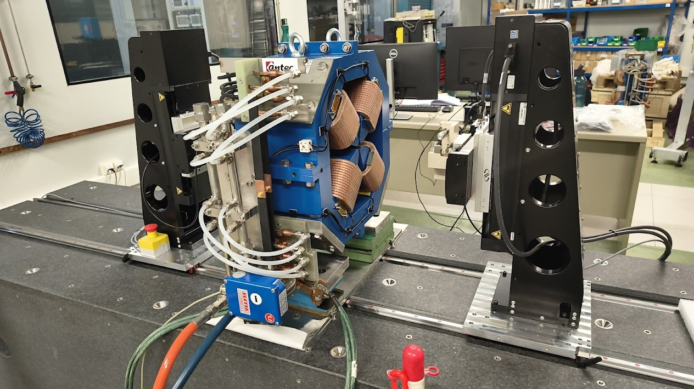
Accelerator
Status of Prototypes
Girders in the EH with dummy magnets
ALBA 01 Prototypes | Expected delivery
Magnets | (final) October 2026
Vacuum Chamber | October 2026
Girders | Delivered
DDK | Delivered. Tested Ok
DDK installed in the tunnel
Magnets Prototypes

Slide 10
Accelerator
Installation of the new SR & Commissioning
DARK PERIOD: 2 years
Before the dark period: Operation of ALBA as usual
After the dark period: Operation of ALBA II
3 months for removal of the SR and the equipment in the SA
10 months for installation of the SR and the equipment in the SA
(Done mostly by external manpower under CELLS supervision)
6 months for Commissioning of the Accelerator
5 months for Commissioning of the BLs
Extensive preparations will be required before the start of the Dark Period.

Slide 11
Experiments
New beamlines in ALBA II
3sbar
Under installation. Commissioning end of 2026
MSPD2
Materials science beamline. Procurement process ongoing
Calima
BioSAXS beamline, design to be started
CoDI
Coherent Diffraction and Nanoprobe for Material Sciences. CDR due in October
Corus
Nanoimaging and nanoSpectroscopy for life sciences. CDR due in October
MSPD2
CoDI
Corus
3sbar
Calima, no port assigned

Slide 12
Experiments
RESTART
PROJECT | Description (Purpose) | PM | PROGRESS
RESTART | Assure all beamlines can re-open after the upgrade of the machine, assuring they are aligned and reach their base performances. | Lucia Aballe | Ray tracing Aug 26 – March 27, at all BLs. Replacement of detectors at selected beamlines has already started.

Slide 13
Experiments
PROJECT | Description (Purpose) | PM | PROGRESS
MISTRAL-U2 | Procurement of a TXM microscope with advanced features for Biology and modify the BL accordingly. | A.J.Pérez | Ongoing. Discussions ongoing with potential bidders, to be able to better defined the specs.
NCD-U1 | Modify the NCD station to allow doing coherent imaging (ptychography) | E.Solano | Ongoing. Under design
BET-OPT | Upgrade the spaces, instruments of the laboratory to assure it can provide the service required to the BLs of ALBAII. | D. Heinis | Design this year, but not yet started.
NOTOS-U1 | -NOTOS Realignment, including HW modiifications - Optics for High Energy - Optics for Harmonic Rejection | C.Marini | Realignment OK. Small change in one of the cable trays. HW modification not started
BET-LABS | Catalysis lab priority 1. | C.Marini | Purchasing of instrumentation for the CatLab
CRYO | Commercial cryocooler for MARES and Lorea. | M.Valvidares | Ongoing. CFT in preparation for the Crycooler of MARES
EM04 | New Cryo EM microscope | J.Juanhuix | Ongoing. Finalise location modification. Working on the specs of the TEM
BET-AI | Provide the EXAFS beamline with advanced AI data analysis, as a pilot project for other beamlines and techniques. | C.Marini | Ramping up
More information on Nico’s talk tomorrow morning

Slide 14
Computing and Data
Computing & Data
Computing Infrastructure
IT strategy
Implementation
Core Data Services
Low Level architecture
Experiments orchestration
Scientific Data Processing and Analysis
Data Processing Workflows
IT Lifecycle
Instrumentation, motion and Synchronisation
Tango, archiving and alarms
User Interfaces
Sustainability and Quality
AI
Data quality assessment and reduction
Data Stewardship

Slide 15
Computing and Data
Computing & Data
Computing Infrastructure
IT strategy
Implementation
Core Data Services
Low Level architecture
Experiments orchestration
Scientific Data Processing and Analysis
Data Processing Workflows
IT Lifecycle
Instrumentation, motion and Synchronisation
Tango, archiving and alarms
User Interfaces
Sustainability and Quality
AI
Data quality assessment and reduction
Data Stewardship
Main task for this year is to collect requirements from all ALBA II Programs to produce a baseline plan & Define upgrades on the Control System

Slide 16
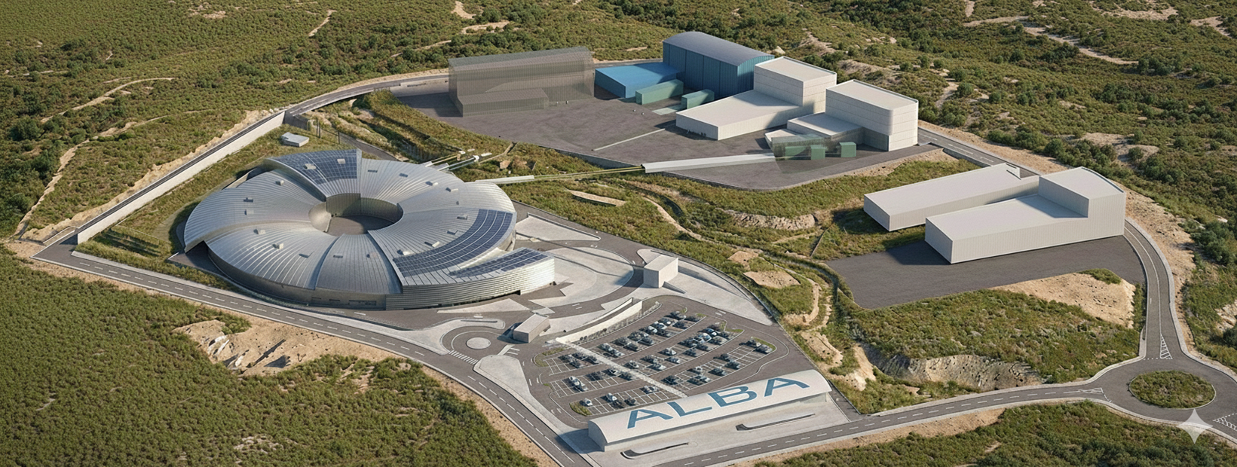
Buildings for the long BLs
Infrastructures, NewBu project
Status
Focus
Existing ALBA building
Orbit
Existing external building
external
Scope of New Bu project
CODI & BL03
external
For the future
Possibilities for external buldings
CORUS
ST4 (thermal energy provider)
(new) CryoEM
InnoFab
Main Building
BL08
Temporary Bu.
Prisma
AI generated, G.Peña

Slide 17
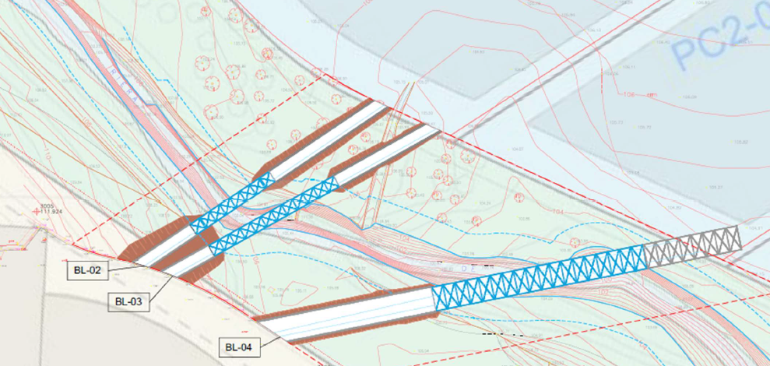
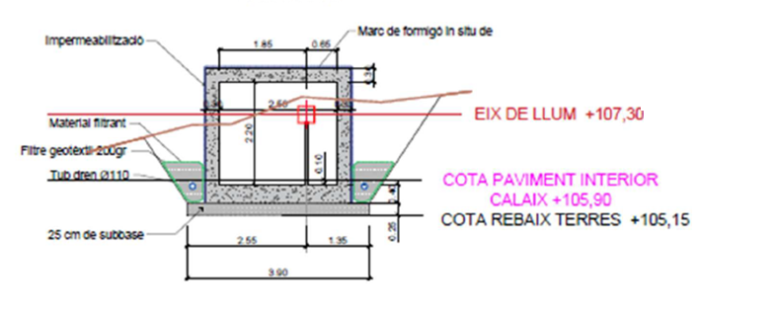
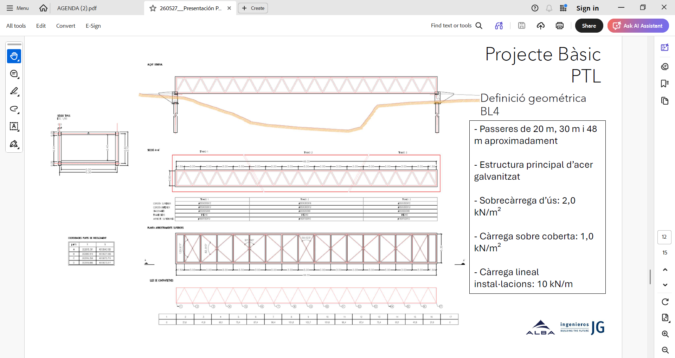
Buildings for the long BLs
Long Photon Transfer Lines
Riera de St.Marçal
Transfer Lines have to cross the Riera de Sant Marçal, which is public area
The course of the stream cannot be changed
Execution to be done by the Parc de l’ALBA

Slide 18
Buildings for the long BLs
Call for ideas
Project Contest and Restricted CFT | Date
Publishing of the Contest | July 2026
Selection of max 6 participants (includes CFT) | Nov 2026
Selection of the winner | March 2027
PB (includes restricted CFT) | Oct 2027
PE | Jan 2028
Start construction | Nov 2028
End construction | Dec 2030

Slide 19
Project Management
ALBA II Project Management
The ALBA II budget was approved by our Administrations in 2025 and published in the BOE on 1/1/26.
More than 50 new staff will join ALBA until 2031 to support ALBA and ALBA II activities.
ALBA will continue operating until the start of the Dark Period.
ALBA II has been organised with a matrix structure around 5 different programs, that have projects and wps:
                - Experiments,
                - Accelerator,
                - Computing&Data,
                - Infrastructure and
                - Implementation
Baseline Schedule is under review, see later.

Slide 20
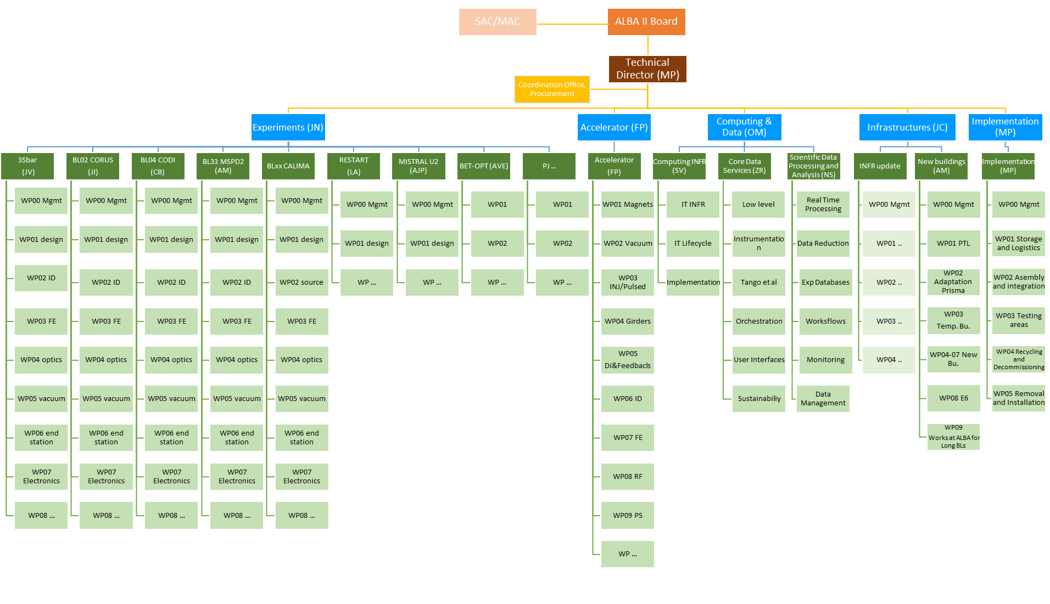
Project Management

Slide 21
ALBA II Schedule (in 2023)
2020 2021 2022 2023 2024 2025 2026 2027 2028 2029 2030 2031 2032 2033
Starting the design
Presenting to funding agencies the ‘pre-White Paper’
ALBA II included in 2021-2024 ALBA Strategy Plan
First funding for prototyping (ALBA01) – 7.5 M€
Funding for 1st ALBA II BL (ALBA05) – 10 M€
New plots assigned for Long BLs extension - 16 M€
White Paper published
Two long BLs pre-design approved
Dark Period

Slide 22
ALBA II Schedule (in 2023)
2020 2021 2022 2023 2024 2025 2026 2027 2028 2029 2030 2031 2032 2033
Budget approval in 2025
Starting the design
Presenting to funding agencies the ‘pre-White Paper’
ALBA II included in 2021-2024 ALBA Strategy Plan
First funding for prototyping (ALBA01) – 7.5 M€
Funding for 1st ALBA II BL (ALBA05) – 10 M€
New plots assigned for Long BLs extension - 16 M€
White Paper published
Two long BLs pre-design approved
Dark Period

Slide 23
ALBA II Schedule (in 2023)
2020 2021 2022 2023 2024 2025 2026 2027 2028 2029 2030 2031 2032 2033
Schedule readjusted. Because design has been advancing, delay of the project of 8 months
Starting the design
Presenting to funding agencies the ‘pre-White Paper’
ALBA II included in 2021-2024 ALBA Strategy Plan
First funding for prototyping (ALBA01) – 7.5 M€
Funding for 1st ALBA II BL (ALBA05) – 10 M€
New plots assigned for Long BLs extension - 16 M€
White Paper published
Two long BLs pre-design approved
Dark Period

Slide 24
ALBA II Programs Roadmap in 2026
Program implementation timeline (2023–2038)
2023
2024
2025
2026
2027
2028
2029
2030
2031
2032
2033
2034
2035
2036
2037
2038
Experiments
Engineering
Computing
Accelerators
Experiments
Pre design
2023-2025
2026-2031
2031-2038
Administration
Accelerators
Engineering
Computing
Experiments
Accelerators
Pre-design
2023–2026
2026-2030
2030-2031
Computing
Experiments
Accelerators
Engineering
Computing&Data
2025-2026
2027–2031
2031-2038
Infrastructure
2023-2025
2025–2029
2029–2033
Engineering
Experiments
Accelerators
Computing
Implementation
2024–2027
2027-2029
2029–2032
Engineering
Experiments
Accelerators
Computing
White Paper
Budget approval
24

Slide 25
Project Management
Requirements to start the Dark Period
            The decision of when to start the Dark Period is driven by the availability of accelerator components. At the start of the dark period:
            All accelerator components must be in house
            At least 80% of the accelerator components must have been tested and at least 12 of the VC arcs completed
            Control system update must be completed
            Infrastructure upgrade must be completed
            Confidence in starting the dark period in June 2030 will be periodically evaluated, with a critical review in June 2029 to give the final go-ahead.

Slide 26
Outlook
  There is good progress across all programmes.
  Procurements for Accelerator components will be published in 2027 for large series and long lead items: magnets, vacuum…
  Next year the detailed design of the buildings for CORUS, CODI and Focus will start.

Slide 27
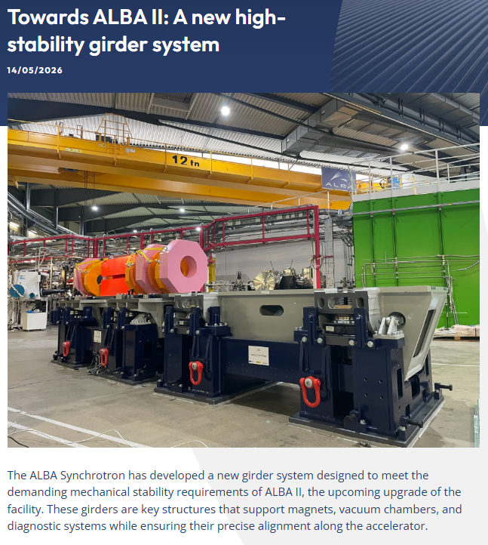
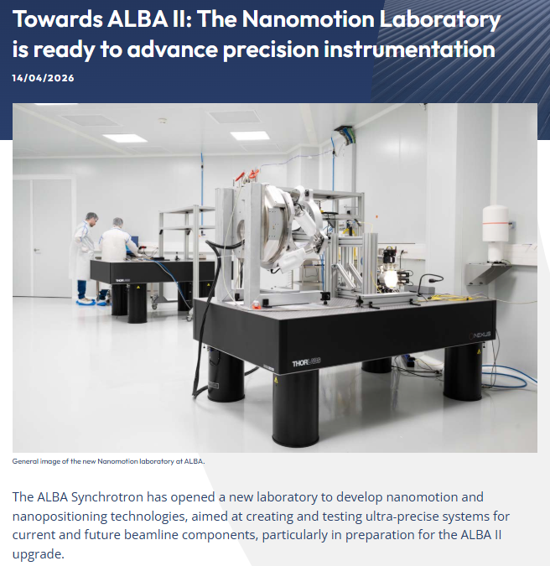
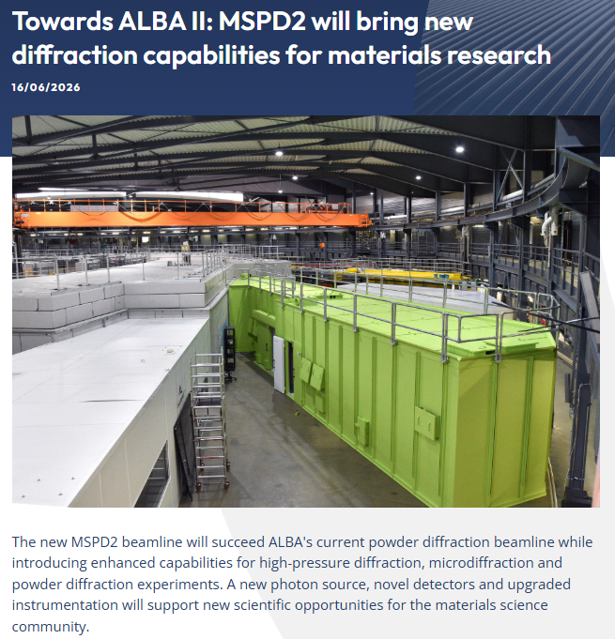
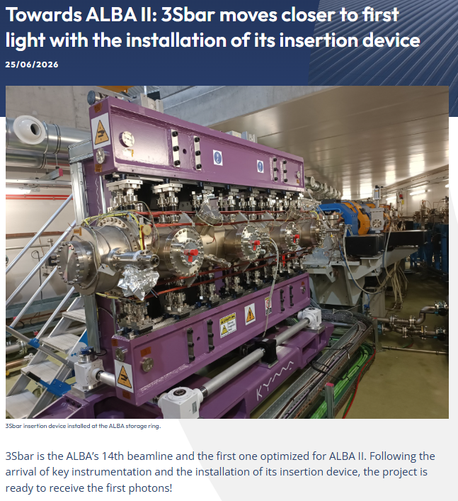
Follow our progress in the social media
Visit us at Instagram, Linkedin, www.cells.es …

