Slide 1
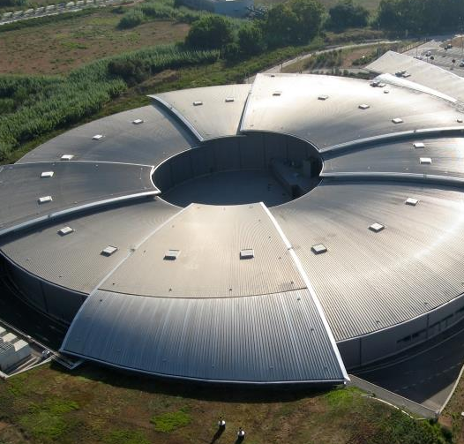
Towards a New Data Policy
Oscar Matilla
Computing Division Head
ALBA Synchrotron
VII ALBA Users’ Meeting
04-09-2026

Slide 2
The new Data Policy is more than an update on the data storage rules. It reflects ALBA's commitment to our users, supports the success of ALBA’s experiments, and serves as the contract connecting the entire scientific data lifecycle.

Slide 3
Timeline
The first ALBA Data Policy was approved in 2017.
Since then, several minor revisions have been introduced.
Current version: https://www.cells.es/en/assets/pdfs/users/data_policy_cells
Our goal is to approve a new Data Policy by the end of 2026, in time for the first call for proposals in 2027.
Initial ideas were presented for feedback at the 42nd Scientific Advisory Committee Meeting; currently gathering input here at the VII ALBA Users’ Meeting.

Slide 4






Key Drivers for the New Policy
Managed Lifecycle
Infrastructure Sustainability
Regulatory Landscape
Transitioning from a basic file custodian and delivery model to a comprehensive scientific data lifecycle with enhanced data services.
To address increasing data volumes and computing needs through intelligent data reduction and computing quotas without compromising scientific value.
To align with EU Legislation 2019/1024, Spanish RD 29/2021, and the Estrategia Nacional de Ciencia Abierta (ENC 2023-2027) guidelines, which mandate that publicly funded research data must be open by default.

Slide 5

The Regulatory Landscape
Open Data Directive
Publicly funded research data* must be open by default to support transparency and further scientific discovery.
European Legislation 2019/1024
Mandating open access to research data across the EU**.
Spanish Legislation RD 29/2021
National alignment for open science integration.
ENCA 2023-2027
National Strategy for Open Science directives.
* Includes publication, data, code and methodologies
** Horizon Europe now strictly requires open metadata

Slide 6
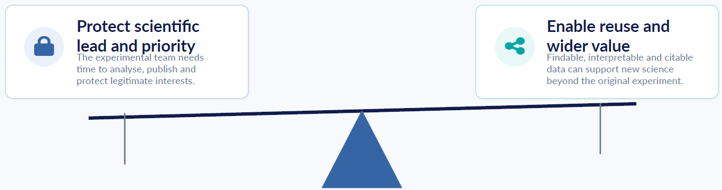
Regulatory Landscape - The Balancing Act
IP
GDPR
Confidentiality
Security
Legitimate commercial interests
“As open as possible, as closed as necessary"

Slide 7
Additional Regulatory Considerations
REGULATION (EU) 2024/1689 · AI ACT
REGULATION (EU) 2016/679 · GDPR
Regulates AI-system risk
Regulates personal-data processing
• Risk-based duties. Rules scale from prohibited practices to transparency, GPAI and high-risk systems.
• Use data lawfully. Identify a lawful basis and meet fairness, transparency and purpose-limitation duties.
• Now enforceable. Transparency requirements and enforcement started 2 Aug 2026; earlier AI-literacy, prohibition and GPAI rules also apply.
• Minimise and protect. Use only necessary data; apply security, retention limits and accountability.
• Assess impacts and rights. Run a DPIA where processing is likely high-risk; safeguard rights in solely automated decisions (Art. 22).
• High-risk phase-in. Annex III duties: 2 Dec 2027. Product-embedded systems: 2 Aug 2028.

Slide 8
Embracing FAIR Principles
Adopting FAIR principles (Findable, Accessible, Interoperable, Reusable) requires understanding what it is not:
FAIR is not strictly "Open" Data can be FAIR while still being restricted to protect legitimate interests.
FAIR is not "Free Anonymous Access" Access requires non-anonymous user registration and attribution (CC-BY).
FAIR does not mean "Store Forever" It involves intelligent data triage, quotas, and defined retention periods to ensure long-term viability.

Slide 9
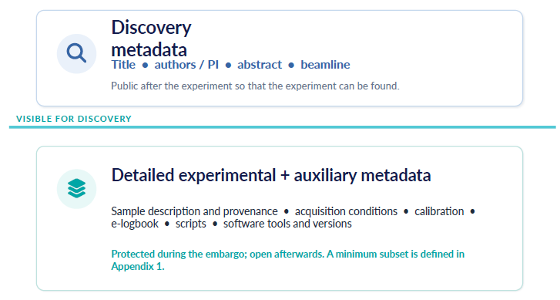
Types of metadata

Slide 10
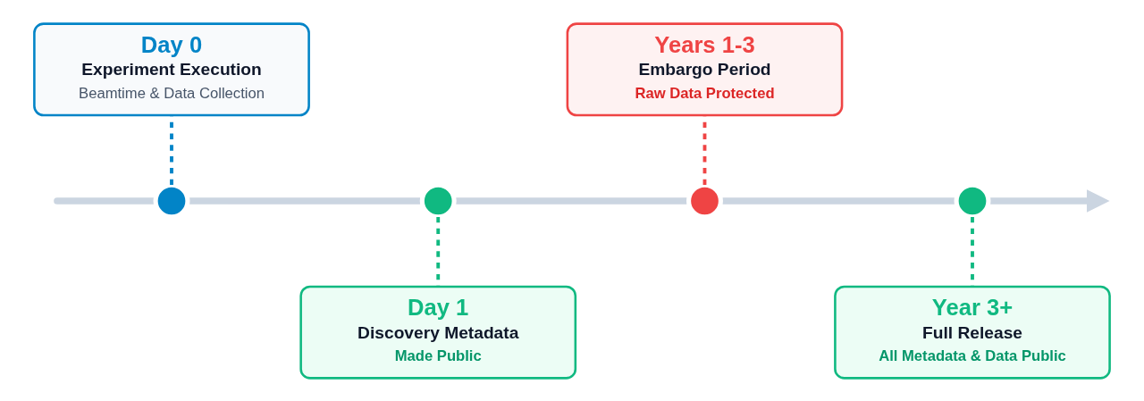
Embargo Period in the current Data Policy

Slide 11
Types of metadata
Since the first Data Policy, Discovery metadata has been public after beamtime ends. Experimental and Auxiliary metadata remain restricted, together to raw data.
Under the new Data Policy, users may request an exception to restrict Discovery Data until the end of the data embargo*.
  We plan to extend the option to request this exception to all users retroactively, including those covered by the current Data Policy.
* Valid exceptions
i. ethical and legal constraints, in particular regarding personal data which cannot be anonymized to a sufficient degree and medical data,
ii. security constraints, including possible code abuse.
iii. ongoing preparation of a patent application,
iv. contractual obligations e.g. to industry partners,
v. intended commercial use of a software linked to a dataset,
vi. intended use of data for commercial purposes or
vii. other special circumstances validated by the CELLS

Slide 12
Types of metadata
Additionally, during the Call, one additional metadata field will be provided to users. This information will be used exclusively by the Scientific Panel for evaluation and will not be available afterward.
Embargo Period Management
The option for users to request an embargo extension beyond three years was included in the previous Data Policy and will remain in the New Data Policy.
Additionally, users will receive automated notifications when the embargo period is nearing its end.

Slide 13
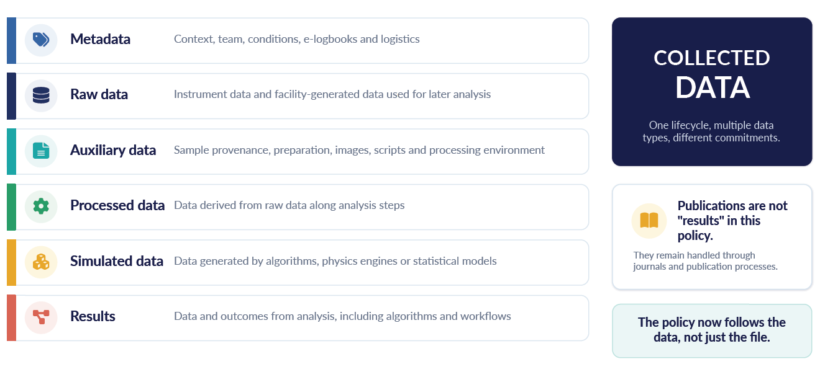
Extending the Scientific Data Lifecycle
Experiment is not finished acquiring raw data. Data Policy will be extended to cover Collected Data which includes processed data. ALBA will allocate resources and make efforts to ensure the successful processing of data and results.

Slide 14
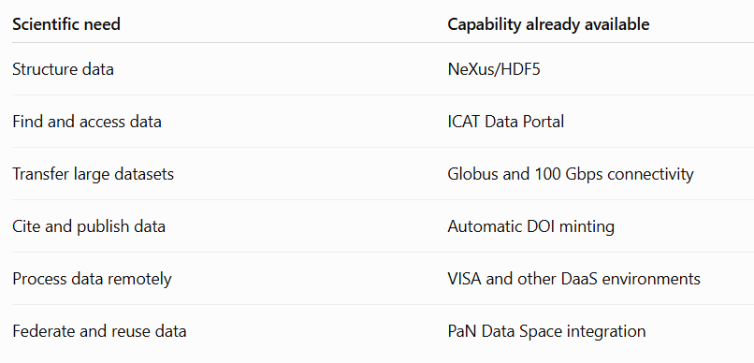
Extending the Scientific Data Lifecycle
From policy to production:
Today, ALBA is actively deploying the tools and services required to manage the modern scientific data lifecycle.

Slide 15
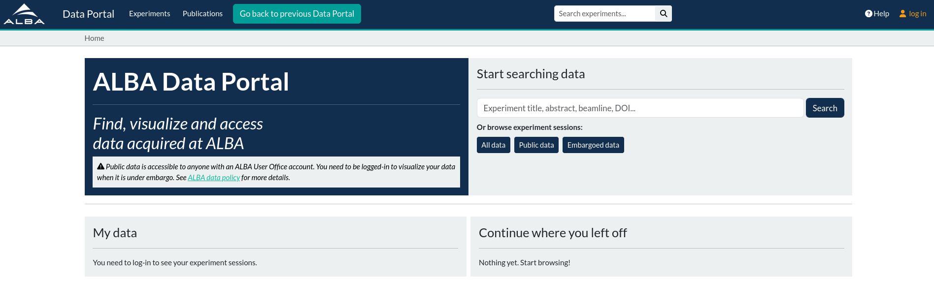
The ALBA Data Portal: ICAT
https://data.cells.es
ICAT is a data catalogue, resulting from a collaboration between different European facilities (DLS, ESRF, HZB, SESAME, STFC and ALBA).
It allows finding, browsing, viewing, downloading and annotating data during and after the experiment.
Current deployment phase:
2023 | BL20-LOREA,
2024 | BL06-XAIRA BL09-MISTRAL BL24-CIRCE_PEEM
2025 | BL11-NCD_SWEET BL22-CLAESS BL29-BOREAS
2026 | BL01-MIRAS BL04-MSPD BL24-CIRCE-NAPP BL31-FAXTOR
The rest of the instruments will follow from 2027 onward

Slide 16
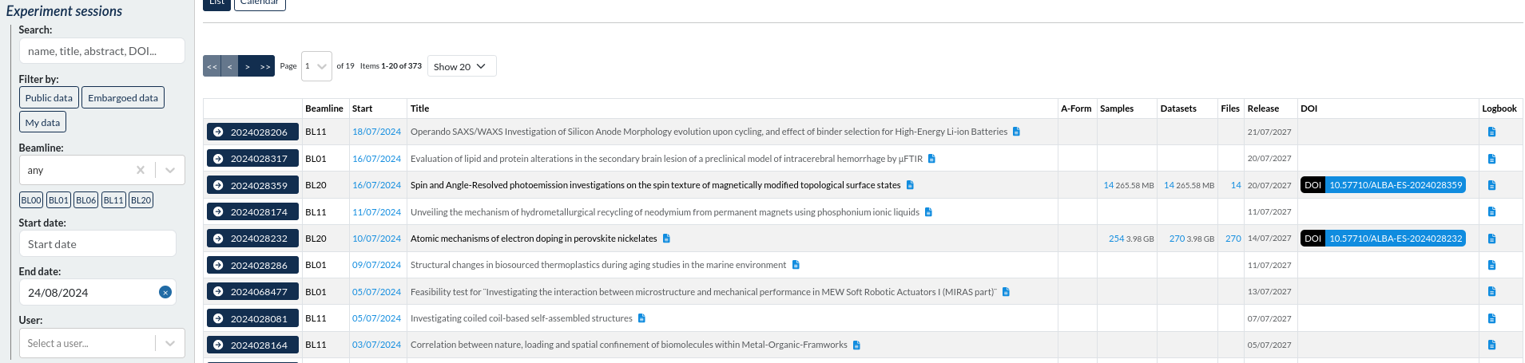
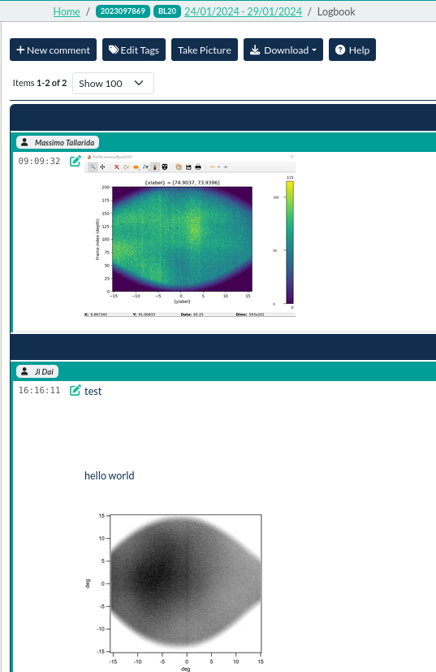
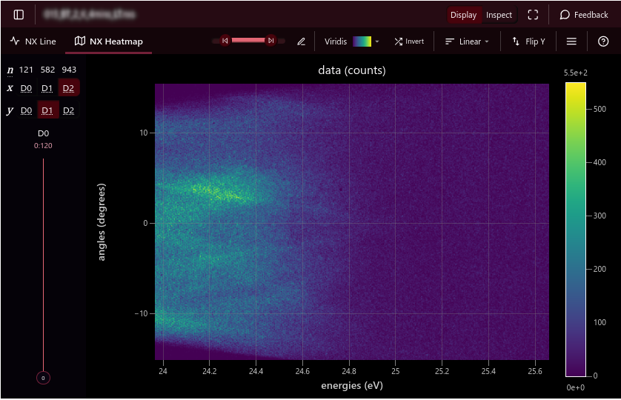
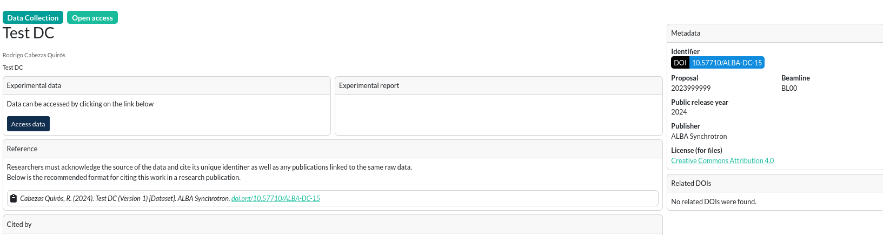
ICAT detailed Features
Browsing, visualizing, annotating and downloading data
before and after the experiment
Integrated NeXus/HDF5 data viewer
Experiment’s landing page
elogbook
Features: DOI minting, integrated elogbook, NeXus/HDF5 data viewer and more.

Slide 17
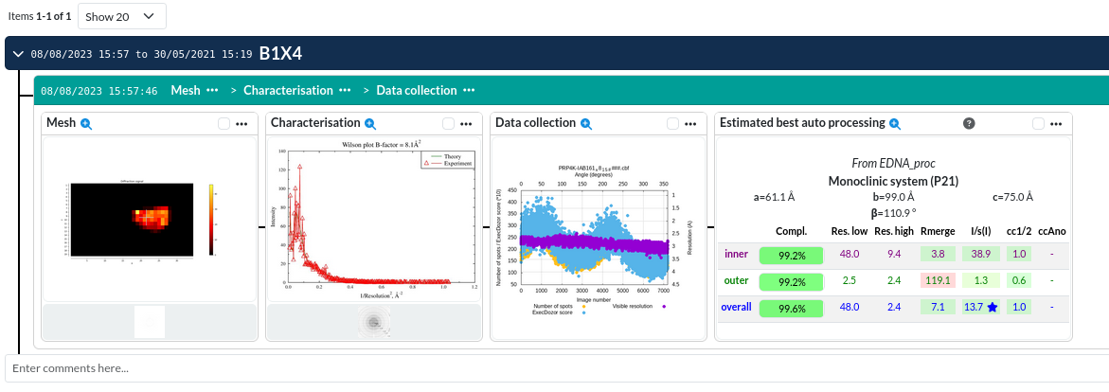
ICAT detailed Features
MX techniques have an integrated Laboratory Management Information System (ICAT-DRAC/ESRF).
More techniques will be included in the future (EM, SAXS, SSX,…).

Slide 18
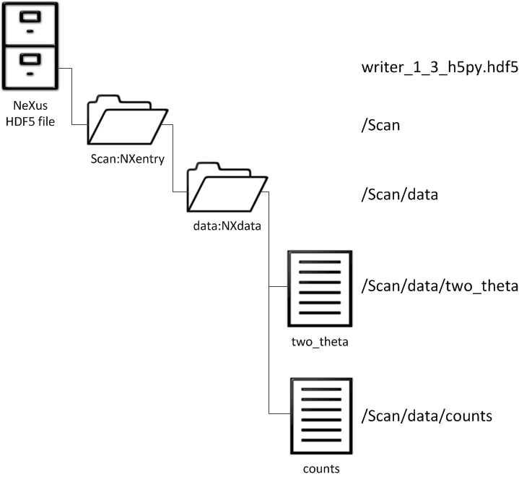
Scientific Data Formats
Embedding data and metadata: the NeXus/HDF5 format
In production:
BL01-MIRAS (NXoptical_spectroscopy)
BL04-MSPD (NXmonopd, NXxrd)
BL06-XAIRA (NXmx)
BL09-MISTRAL (NXtomo)
BL11-NCD (NXsas)
BL20-LOREA (NXarpes)
BL24 CIRCE-PEEM (new NXmpes_peem)
BL24 CIRCE-NAPP (NXsensor_scan, NXxas, NXmpes)
BL29-BOREAS (NXsas based)
WIP:
BL13-XALOC
BL15 3Sbar
BL16-NOTOS
BL22-CLAESS
BL31-FAXTOR (using JPEG2K compression)
Application definitions link

Slide 19
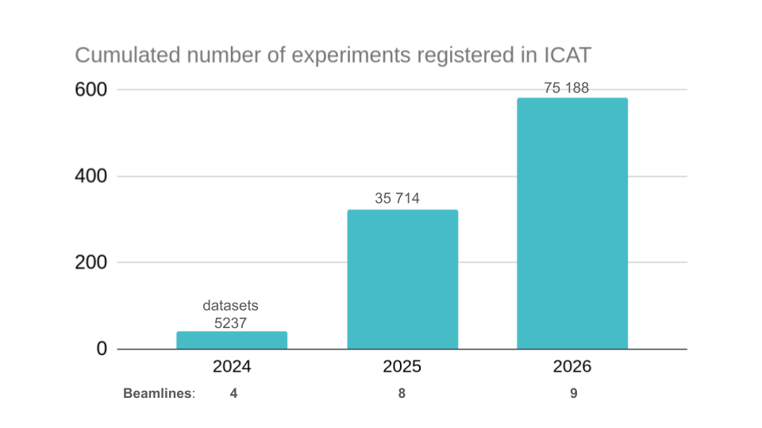
ICAT Usage at ALBA

Slide 20
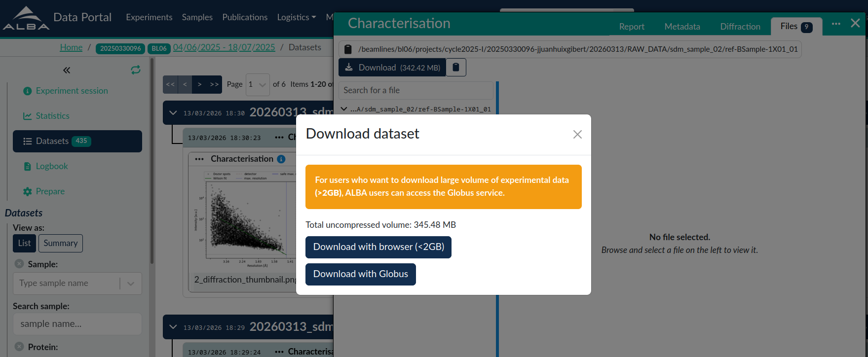
ICAT - Access and Data Transfer
ALBA Data Portal does not allow anonymous access:
Access is restricted to registered users.
Authentication currently relies on ALBA User Office accounts.
We plan to integrate with the broader European federated research identity ecosystem, using GÉANT eduGAIN and MyAccessID. (Early 2027)
Faster Data Transfers for ALBA Users:
Internet connectivity has been upgraded from 10 Gbps to 100 Gbps, with 25 Gbps reserved for Globus.
Globus is now available for high-volume data transfers from BL06-XAIRA, BL13-XALOC, and BL31-FAXTOR, all integrated with ICAT.

Slide 21
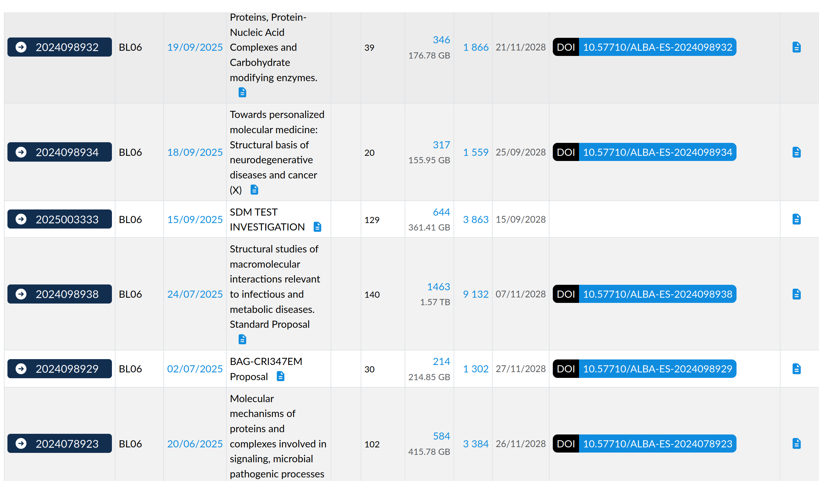
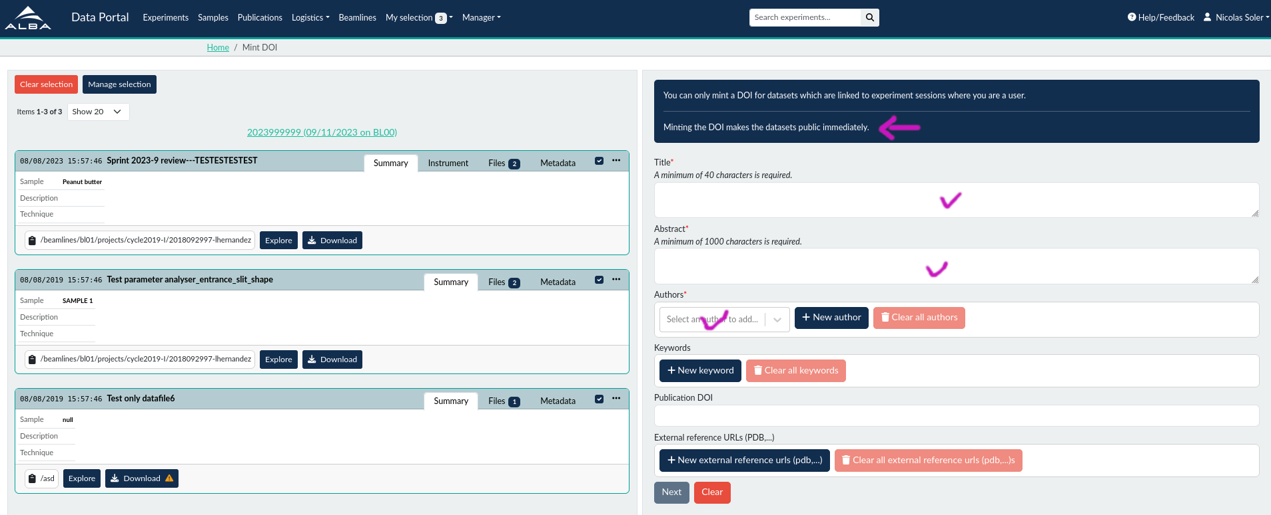
ICAT - DOI minting
DOIs are minted automatically for every experiment
Users can manually mint a DOI to an ensemble of chosen datasets
Each DOI minting leads to the creation of a public landing page

Slide 22
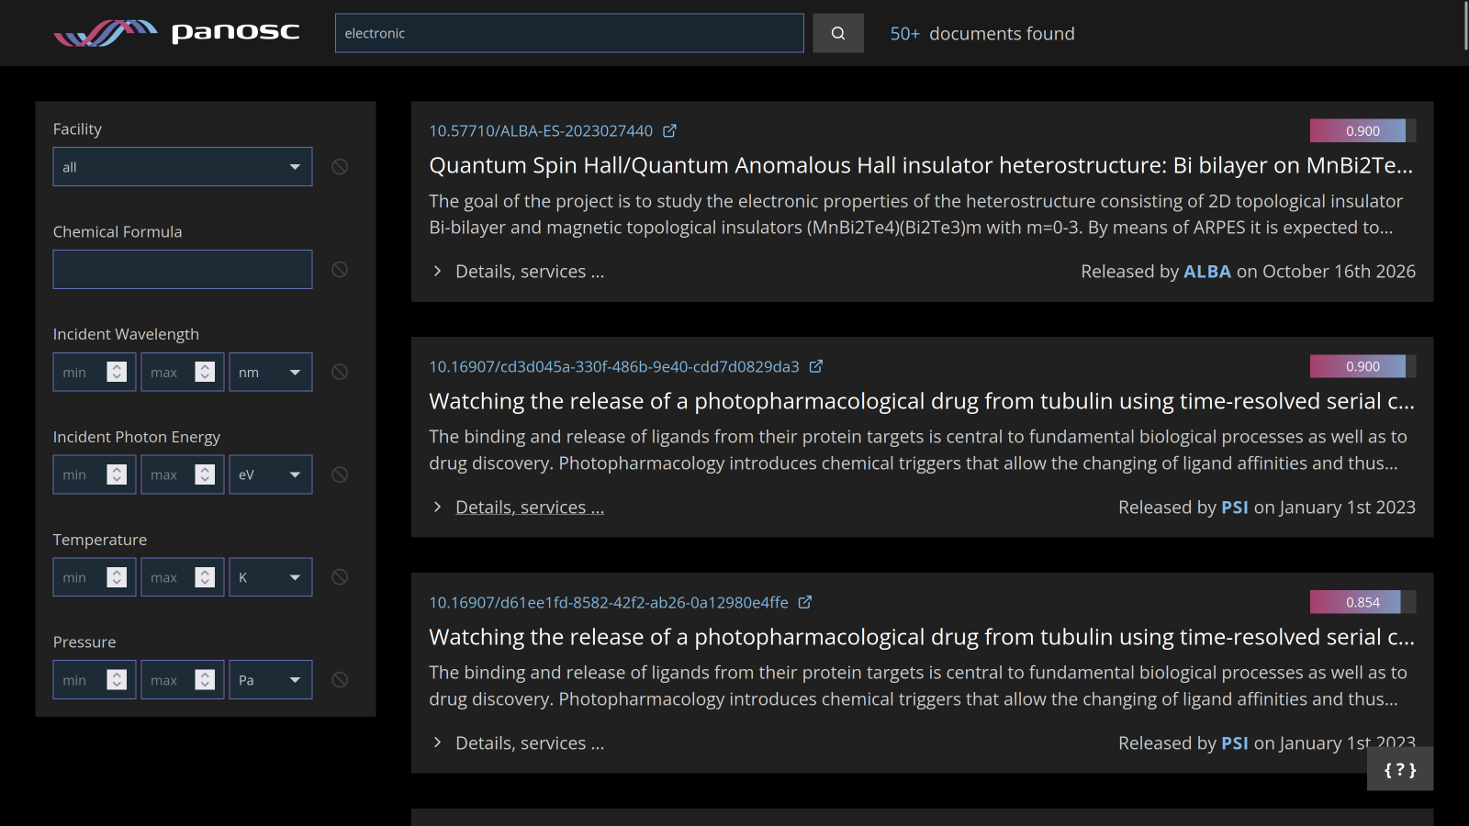
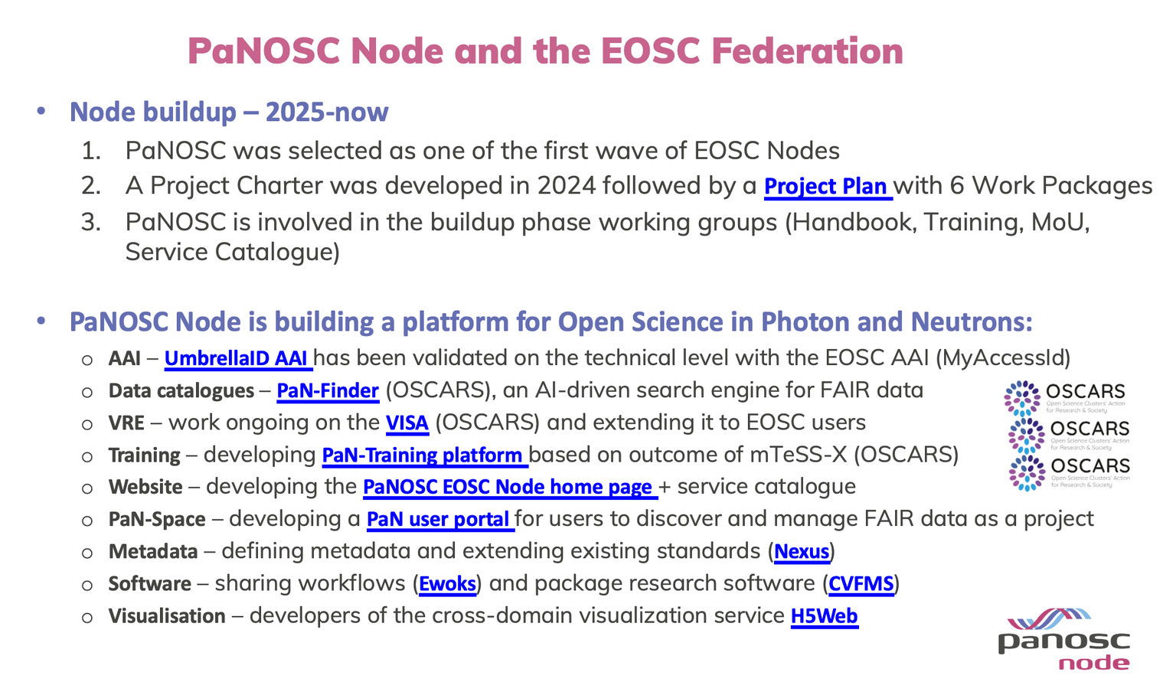
Federated Data Repositories
Federating European facilities
We participate into the creation of a European PaN Data Space and to facilitate Spanish users access to it.
Our data catalogue seamlessly integrates with the PanOSC data catalogue, allowing for easy discovery through general search engines.
https://data.panosc.eu/
https://panosc.eu/

Slide 23
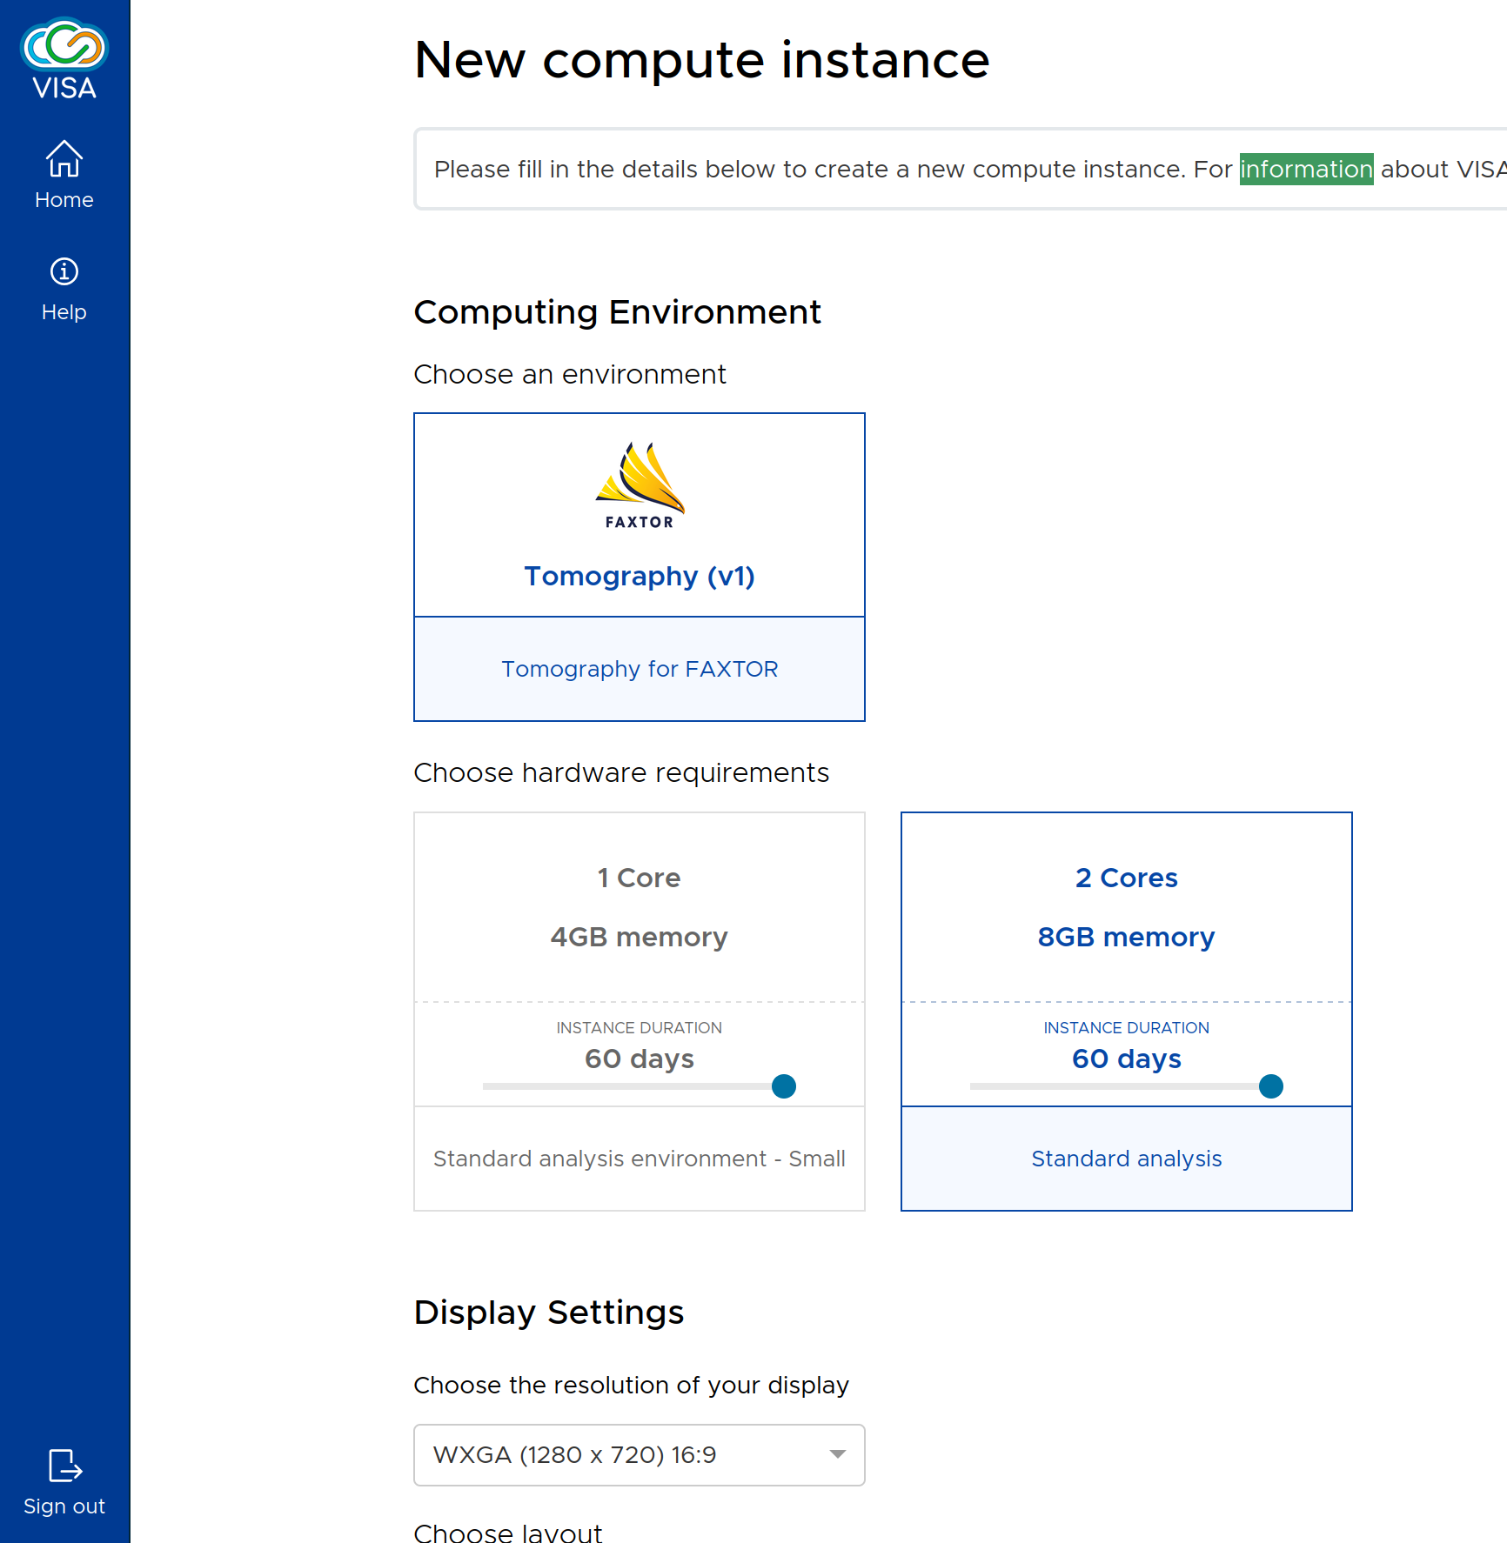
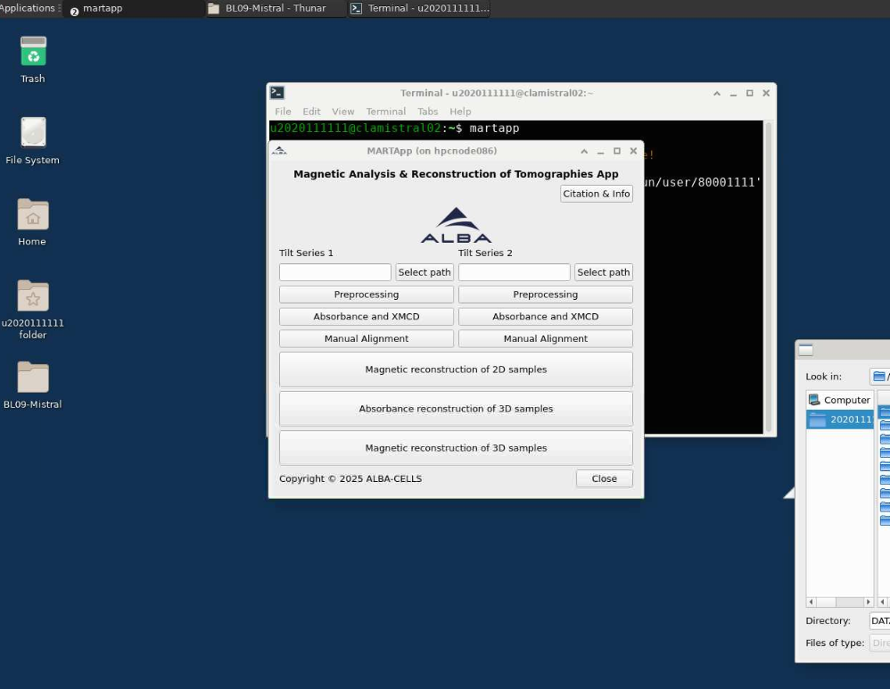
DaaS : VISA & others
VISA deployed at ALBA: images for tomography and MX in test phase, to be deployed in the next weeks.
MISTRAL uses NoMachine for the moment
Possibility to outsource computation to the Barcelona Supercomputing Center (BSC, work in progress).
https://visa.cells.es
Remote processing by MISTRAL users via NoMachine

Slide 24
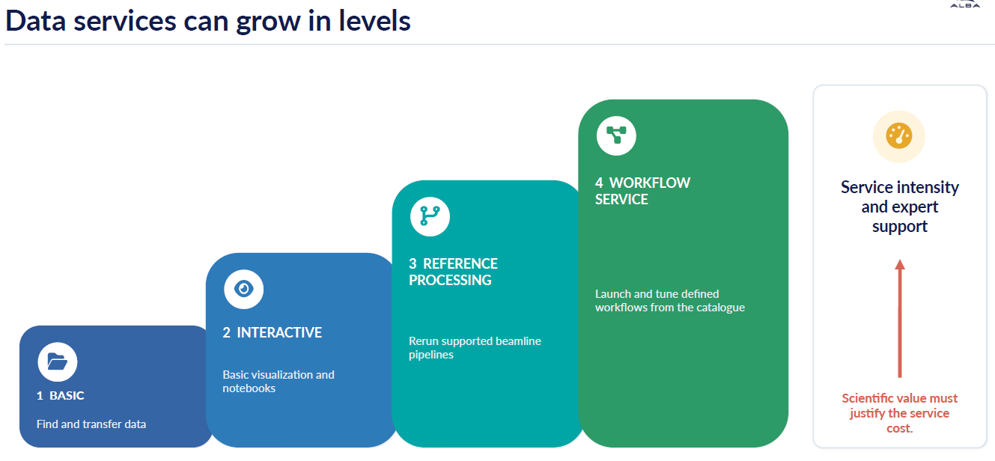
Data Services Sustainability

Slide 25
Sustainability
Evolution of data production at ALBA

Slide 26
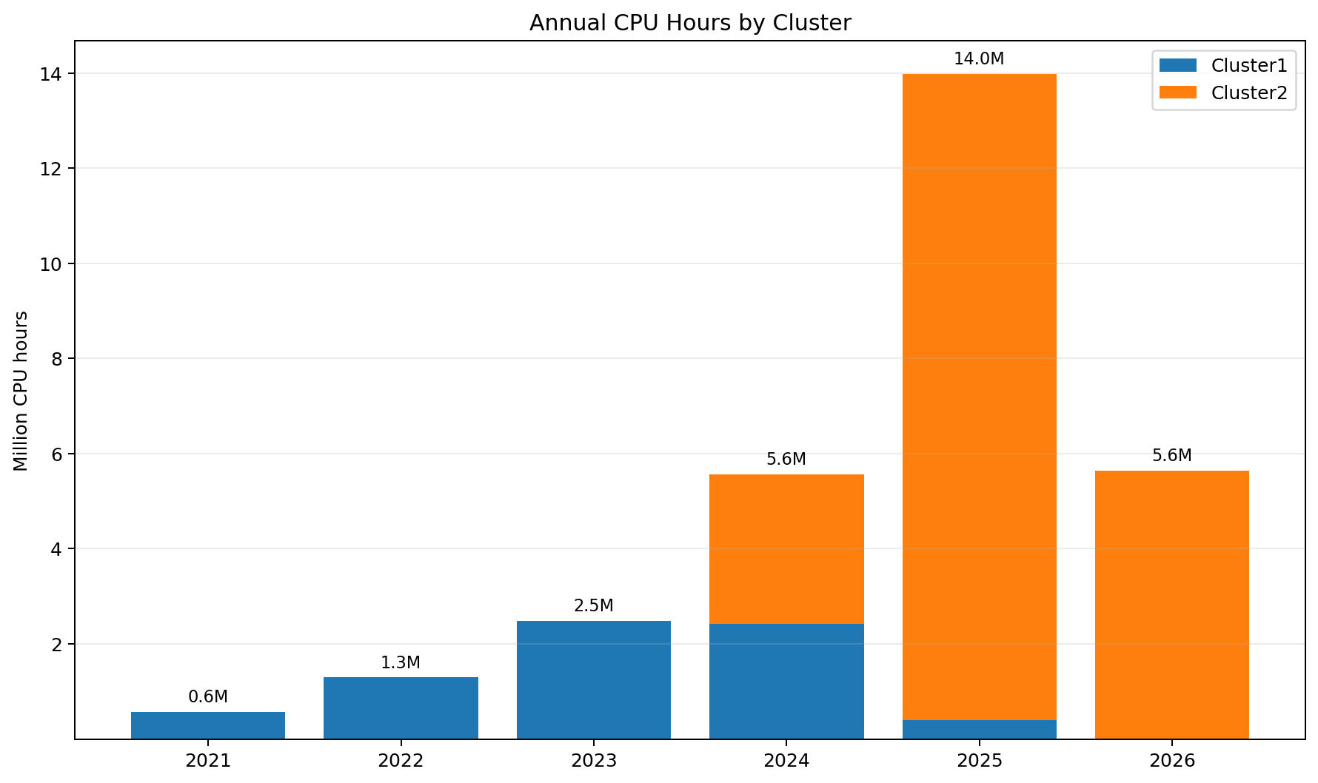
Sustainability
Associated with increased processing needs…

Slide 27
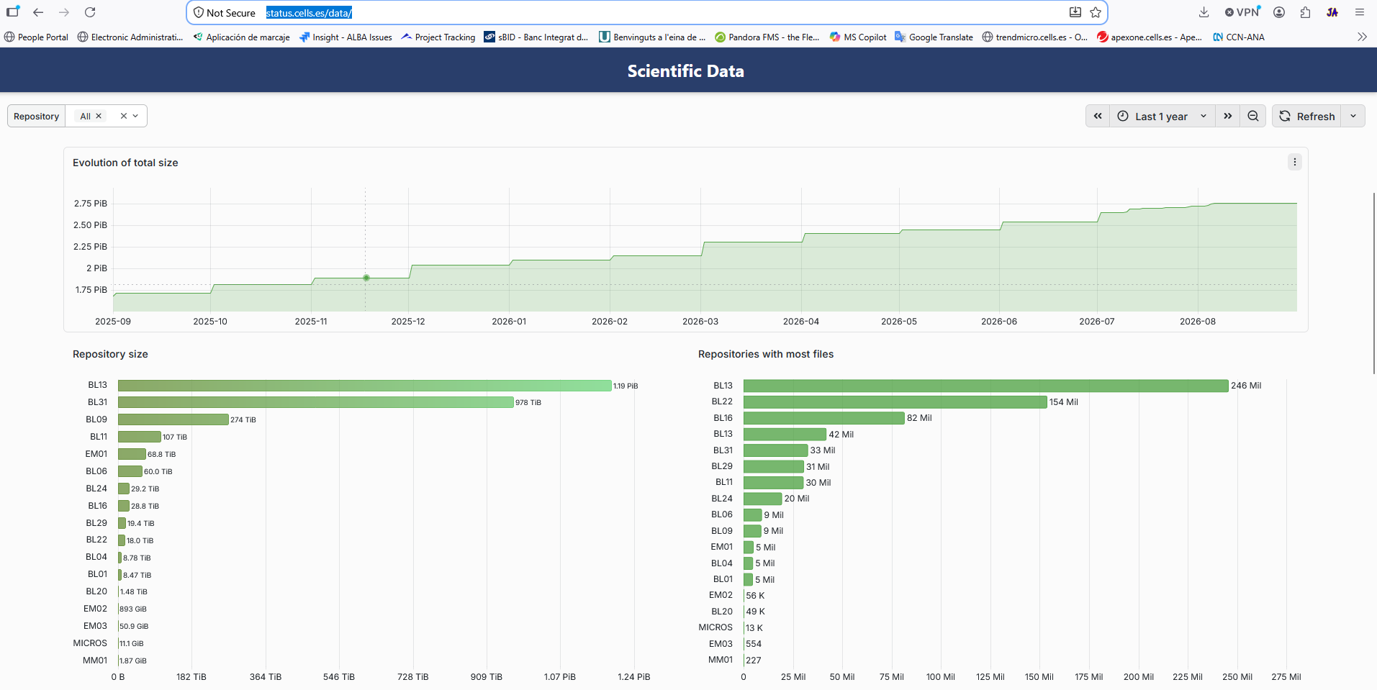
Sustainability
We are implementing strict mechanisms to monitor the use of our IT infrastructure:

Slide 28
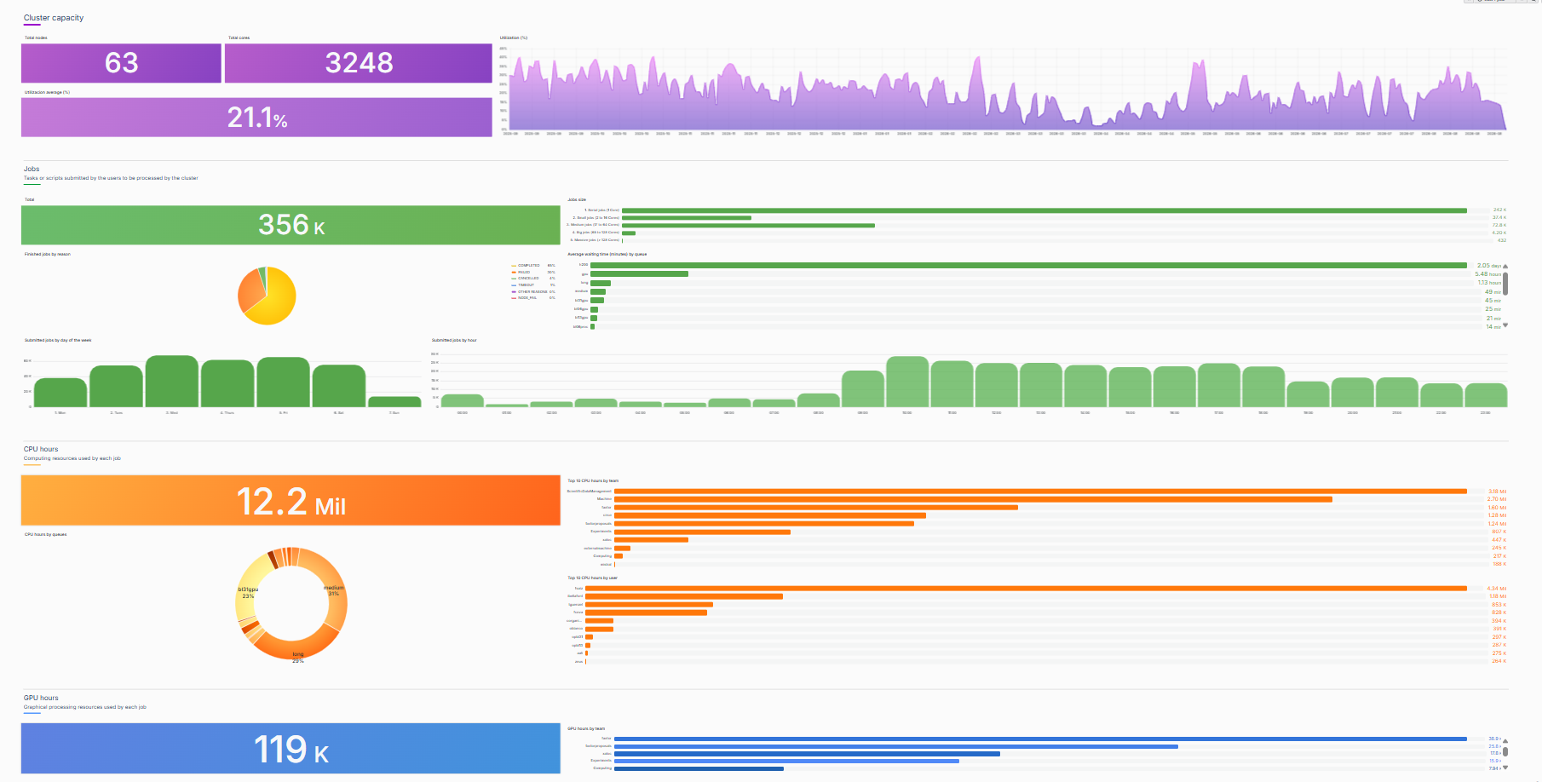
Sustainability

Slide 29
IT Evolution Over the Last Decade
ARITHMETIC THROUGHPUT ≫ DATA TRANSFER
NETWORK WALL
PROCESSING
DATA PATH & STORAGE
IT is becoming structurally unbalanced: computing power is growing faster than our ability to move data.
GPU
×200
NIC bandwidth
×10
NVMe bandwidth
×4
CPU
×20
Rotational Disk bw
×2
Archiving bandwidth
×2
Arithmetic capacity
Maximizing efficiency requires computing closer to data
The gap is architectural, not a single-component issue.

Slide 30
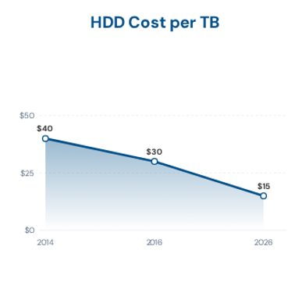
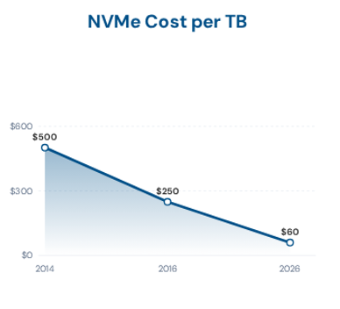
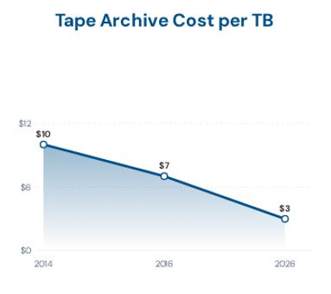
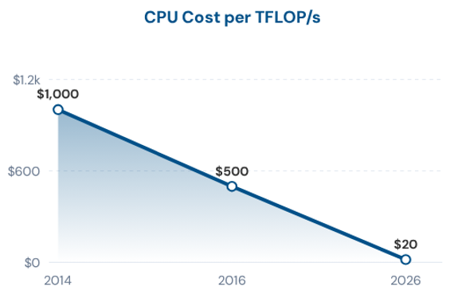
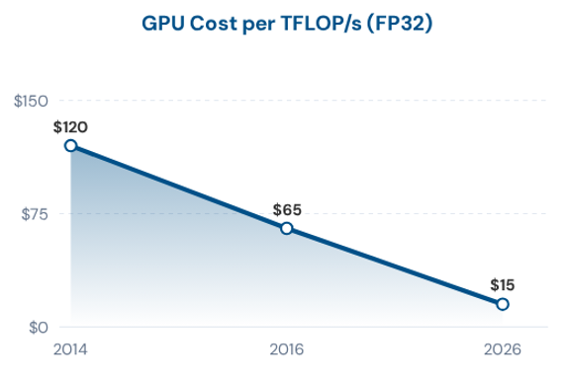
IT Evolution Over the Last Decade
Data volumes are growing exponentially.
Data processing costs are falling rapidly, while storage costs are falling much more gradually.

Slide 31

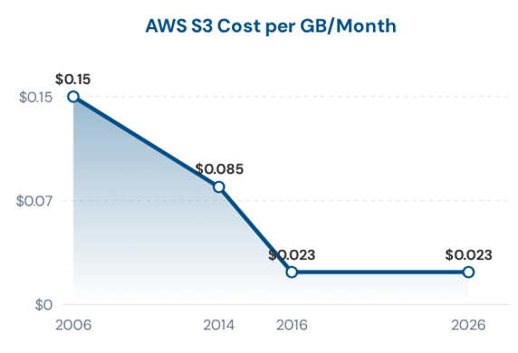
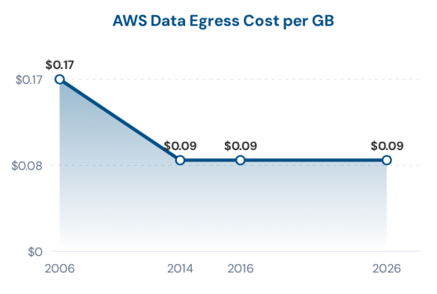
Cloud Computing Alternative
    Public-cloud prices have not followed the declining cost of the underlying hardware.
    Cloud prices have remained relatively flat over the past decade, and some services are now experiencing price increases — sometimes referred to as “cloudflation.”
    Example: storing 100 TB in the public cloud.
    Storage: ~$27.6k/year
    Data transfer: ~$9k/transfer
    Cloud repatriation is becoming increasingly common: more than 40% of U.S. companies relying on cloud solutions have moved workloads back on-premises.

Slide 32
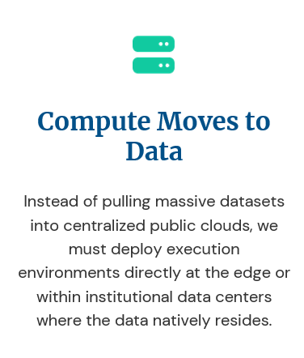
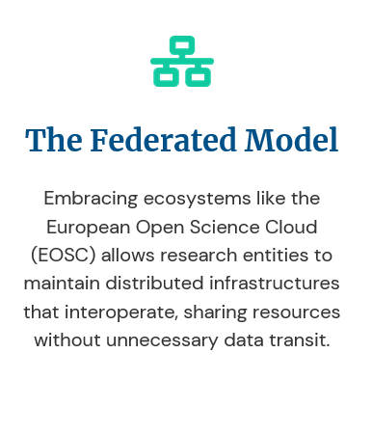
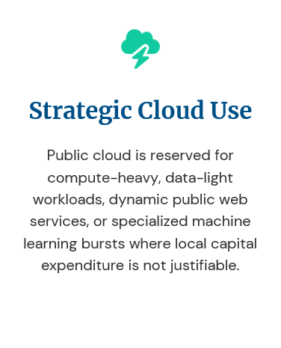
The challenge is shifting from “Can we compute it?” to “Where is the data, and how often must it move?”
Data Gravity

Slide 33
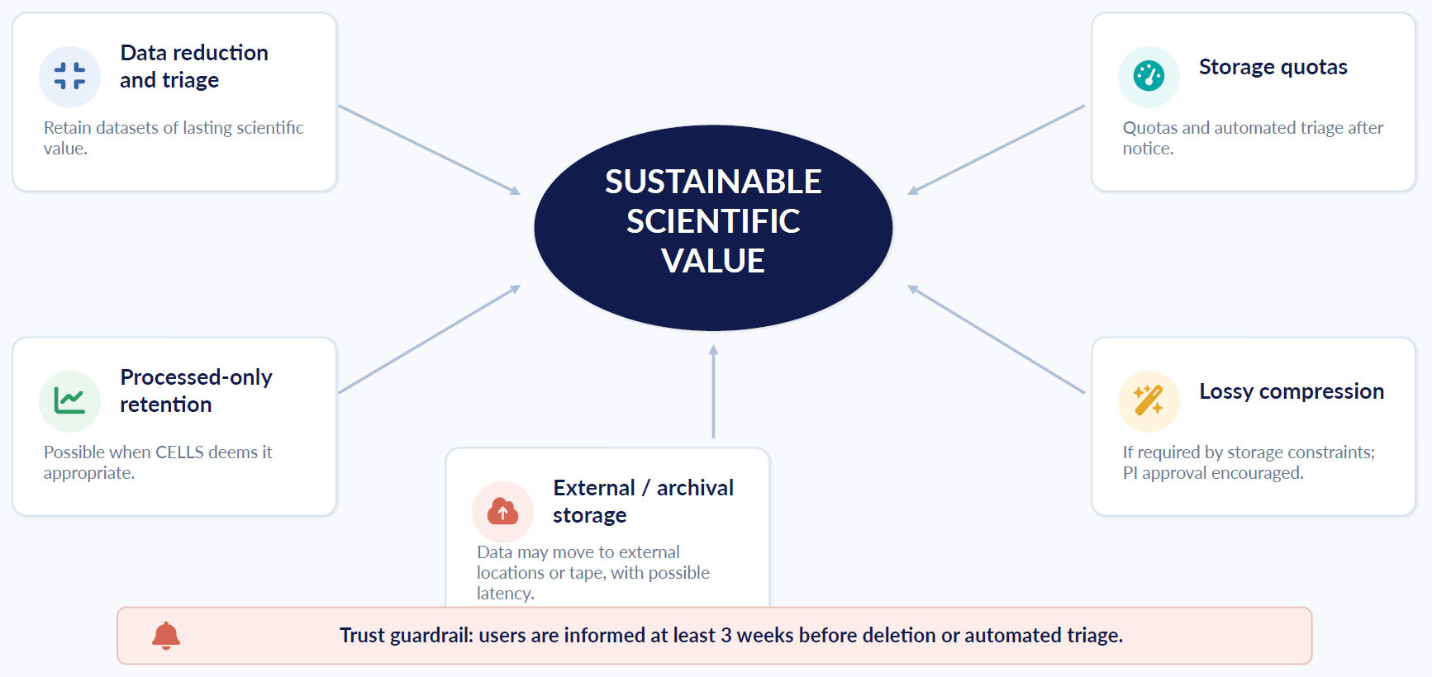
Sustainability Mechanisms in New Data Policy

Slide 34
Conclusions
The new Data Policy, planned for early 2027, is based on the following principles:
Open by default, protected where necessary
Balancing openness with privacy, intellectual property, confidentiality and security.
Covering the complete scientific data lifecycle
From acquisition to processing, publication, reuse and long-term preservation.
Built on services already in production
ICAT, NeXus, Globus, DOI minting, VISA (or other DaaS) and European data federation.
Sustainable by design
Defined retention periods, data reduction and resource monitoring.
Your input is a key part of this process.

Slide 35
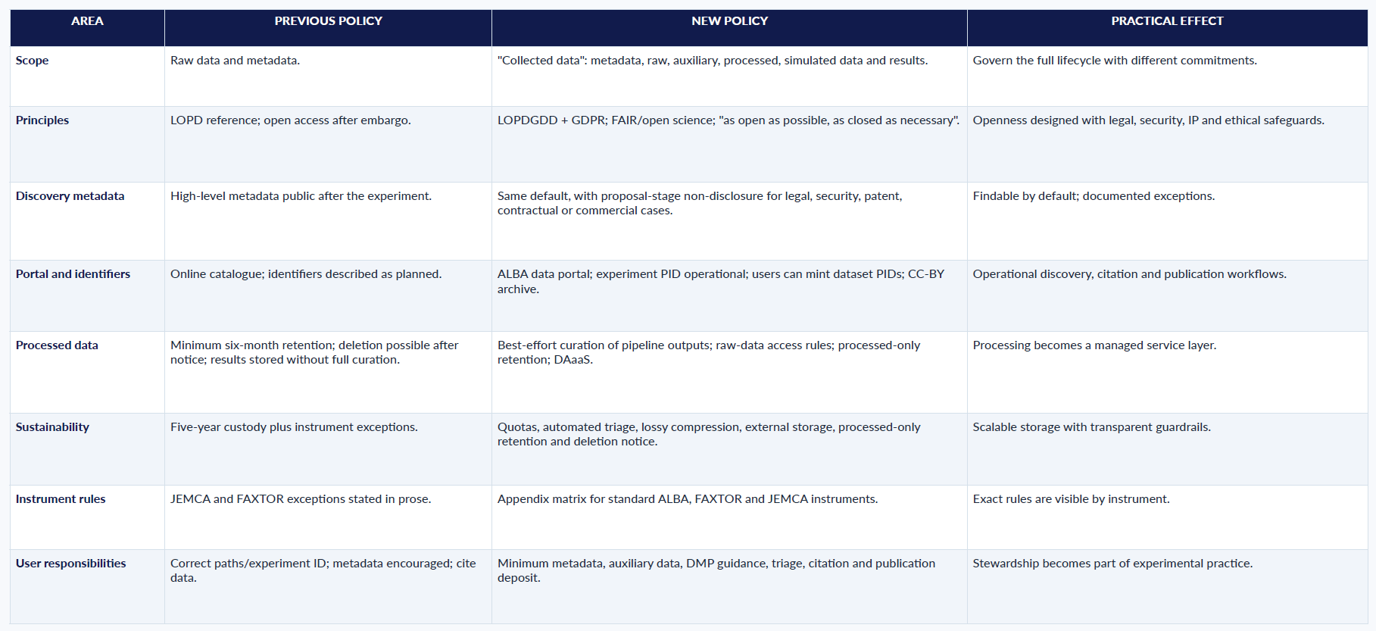
Appendix- detailed policy changes

