Slide 1



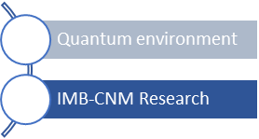

Assessment of thin film superconductivity with
atomic-resolution TEM imaging and analysis in
advanced and innovative materials or heterostructures
Gemma Rius
Institute of Microelectronics of Barcelona, IMB-CNM-CSIC
gemma.rius@csic.es
Superconducting & Hybrid Quantum Chips Research Line qchip.csic.es
1

Slide 2
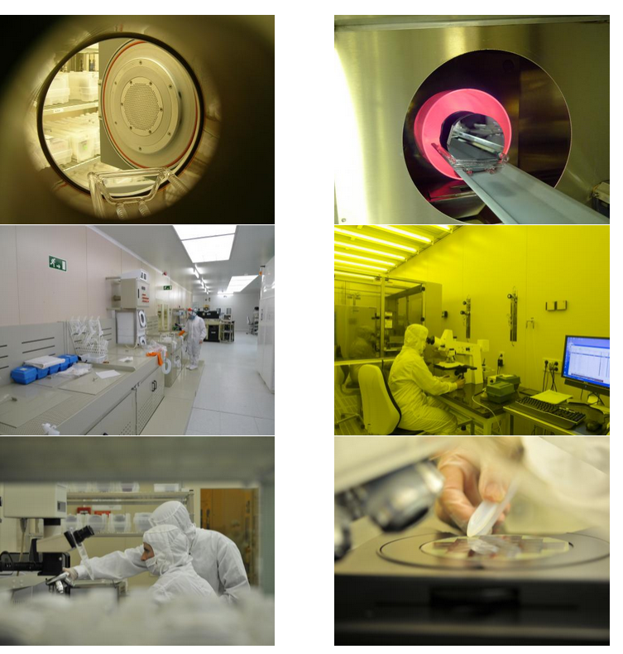
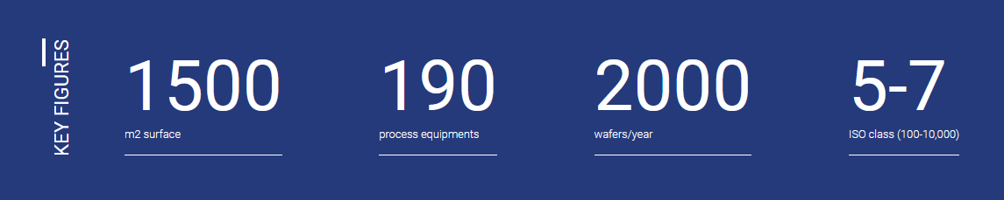
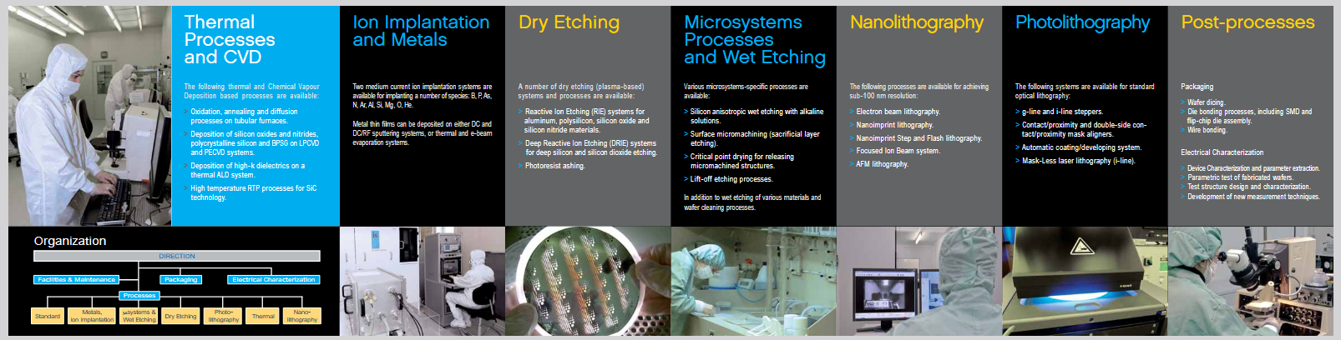
Integrated Clean Room for Micro/Nanotechnologies
www.imb-cnm.csic.es/en/sala-blanca-de-micro-y-nanofabricacion
2

Slide 3
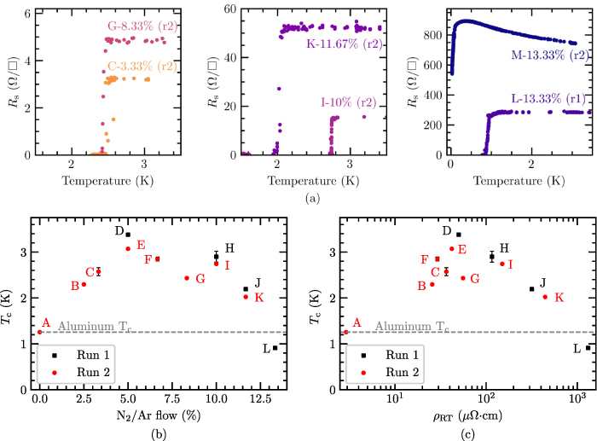
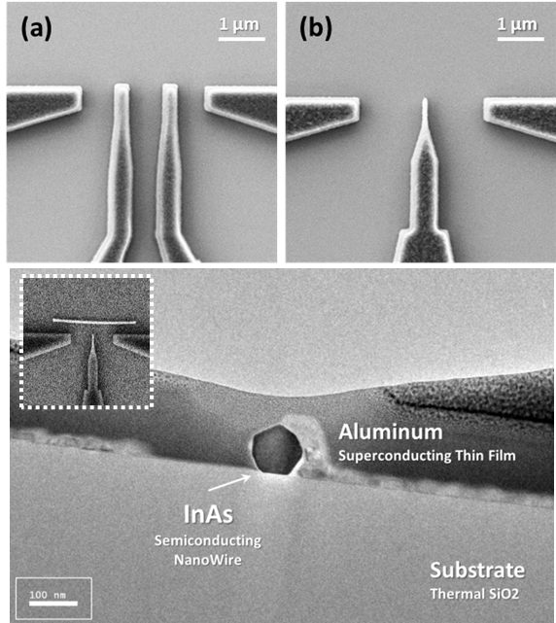
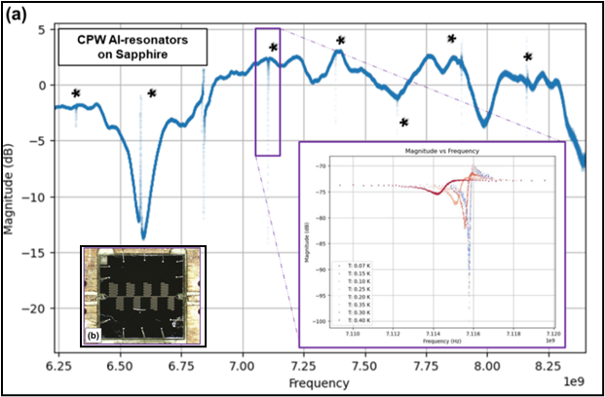
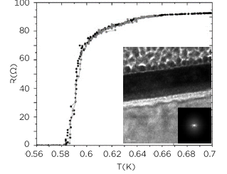
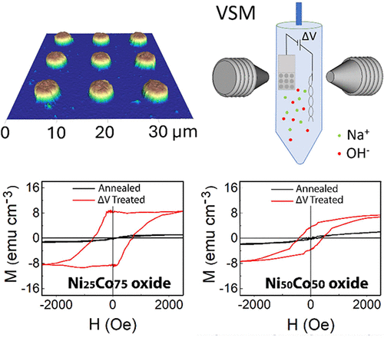
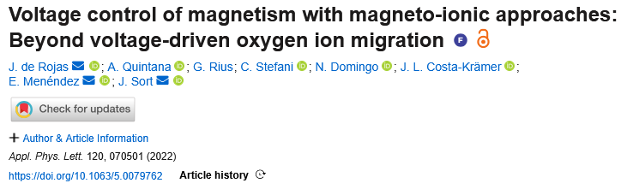
Baseline Superconducting Devices.
Design, Fabrication and Testing
Customized or Advanced
Superconducting Thin films
Hybrid Devices and Unconventional Systems
Baseline Supercond. Thin films & Devices
Nitridized Aluminum
Semiconductor-Superconductor
Material | Tc
Aluminum | 1.2
Tantalum | 4.2-4.4
Niobium | ∼ 4.5
α-Tungsten | < 100mK
2025 Supercond. Sci. Technol. 38 095004
Paper on Ta-Nb to be submitted
2024 Supercond. Sci. Technol. 37 035017
Microwave Resonators, e.g. Al and Ta
2026 J Low Temp Phys 222, 55 doi.org/10.1007/s10909-026-03390-y
Ultrathin Amorphous WSix
Manuscript in Prep.
Quantum Materials Integration
2 Manuscripts under Rev / in Prep.
2026 IEEE Trans. Appl. Superconductivity 36, 5, 1-5 doi.org/10.1109/TASC.2026.3673788
3
Superconducting & Hybrid Quantum Chips Research Line qchip.csic.es
Micro – Nano Technologies for Quantum Materials and Devices gemma.rius@csic.es

Slide 4
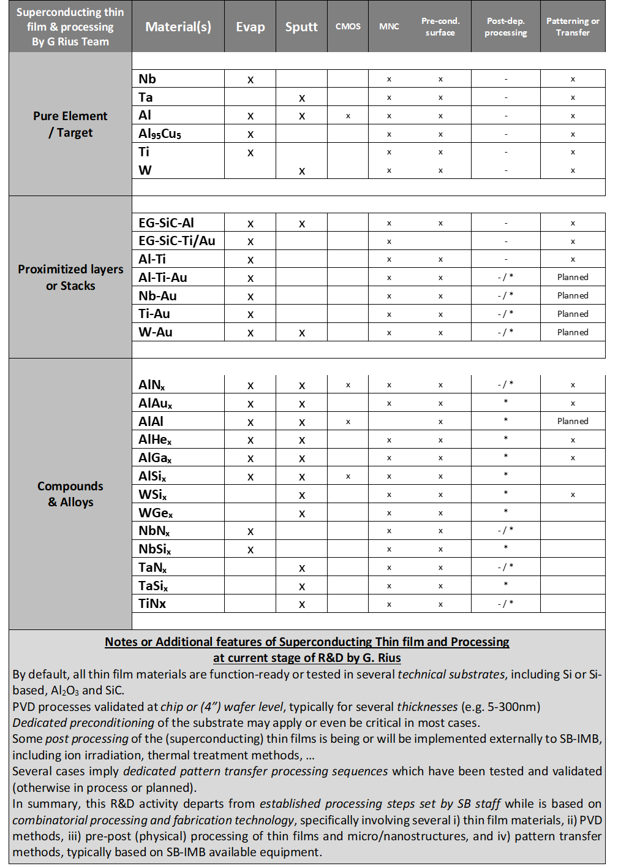
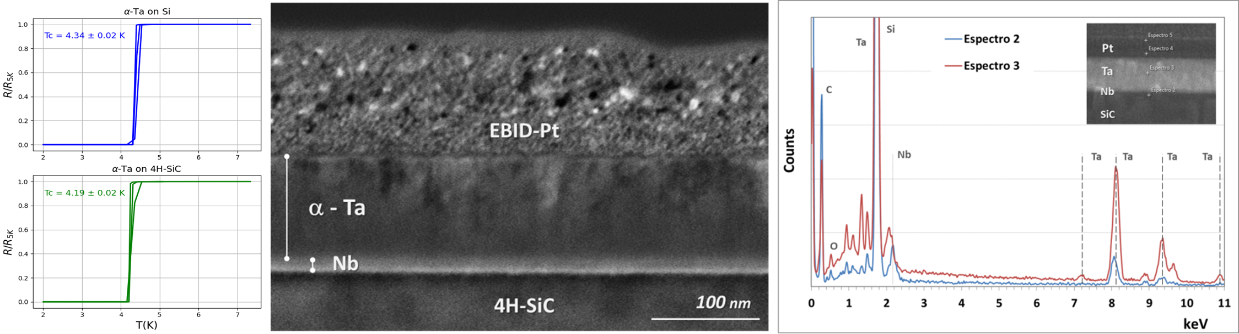
Qualifying existing (metal) thin films
Developing deposition conditions
Fabrication of devices – based on available equipment
and target materials at the ICTS IMB-Clean Roo
Superconducting & Hybrid Quantum Chips Research Line
Material | Tc
Aluminum | 1.2 K
Tantalum | 4.2-4.4 K
Niobium | ∼ 4.5-6 K
α-Tungsten | < 100mK
Titanium | 400 mK
Proximitized films | Tunable
Multilayer stacks | Tunable
2025 Supercond. Sci. Technol. 38 095004
Baseline Superconducting
Thin Films and Devices.
Conventional Methods:
Sputtering
Evaporation
Micro and Nano Patterning
Design, Fabrication and Testing
Intended for both cryogenic electronics and quantum devices
Design fabrication and testing of DC and MW devices & circuits
Resilience of materials and devices to operation, such as B
Paper to be submitted on Nb/Ta Thin films
4
Micro – Nano Technologies for Quantum Materials and Devices gemma.rius@csic.es

Slide 5
Superconducting & Hybrid Quantum Chips Research Line
Baseline Superconducting Devices.
Design, Fabrication and Testing
MINARE Project
LSC-LNGS / IFAE / IMB-CNM
Microwave Resonators, e.g. Al and Ta
Designs of circuits, including arrays of multiplexed resonators
Fabrication of devices and external interfacing (pcbs and sample box)
Analysis of performances upon testing in dilution fridge
(cryo-characterization not on-site)
Modelling and simulations for device and
chip design and performance evaluation:
    Sonnet
    COMSOL
Parametric comprehension of actual characteristics and performances: freq, Ql, power, T, SPR…
Optimization by layout design and fabrication processing
Diagnostic and mitigation of effects and sensitivity or resilience
to environment /off-chip experimental conditions, e.g. ionizing radiation
APL Quantum 3, 020901 (2026)
doi.org/10.1063/5.0319835
Micro – Nano Technologies for Quantum Materials and Devices gemma.rius@csic.es

Slide 6
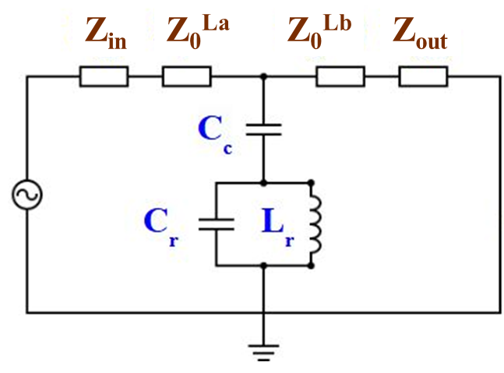
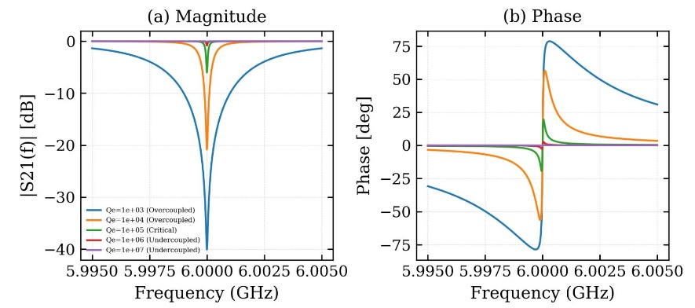
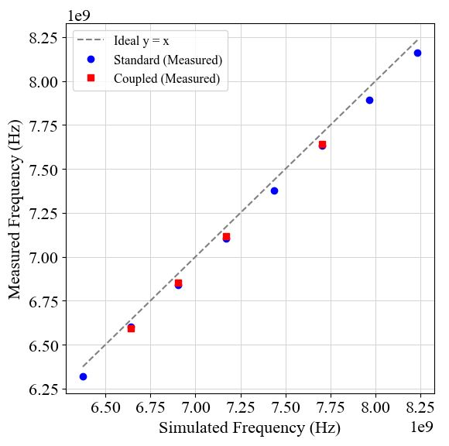
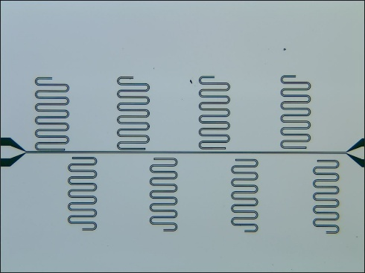
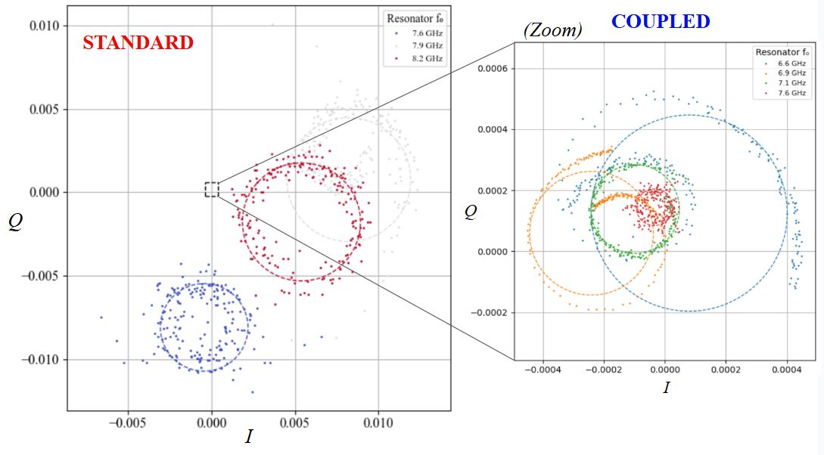
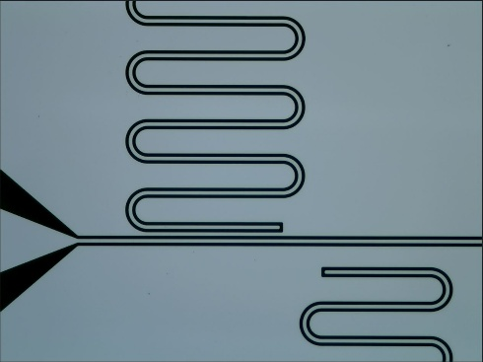
Superconducting & Hybrid Quantum Chips Research Line
Baseline Superconducting Devices.
Design, Fabrication and Testing
Microwave Resonators, e.g. Al on Sapphire
6
Micro – Nano Technologies for Quantum Materials and Devices gemma.rius@csic.es

Slide 7
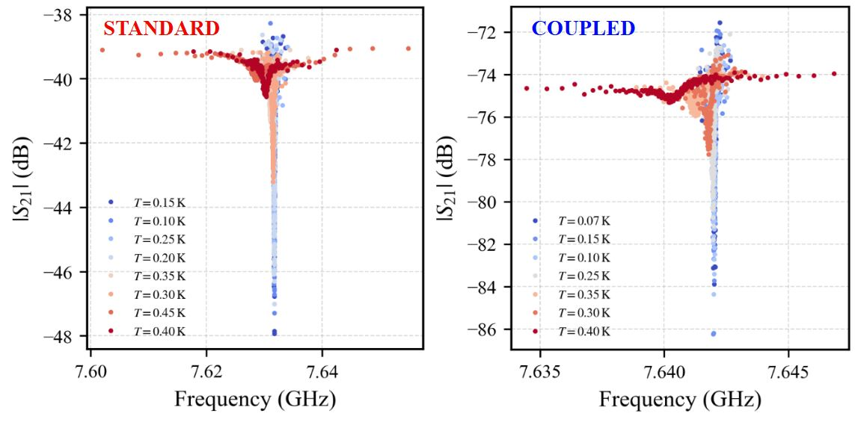
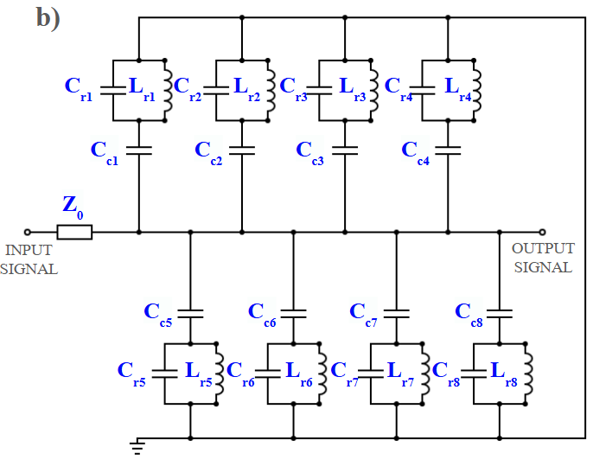
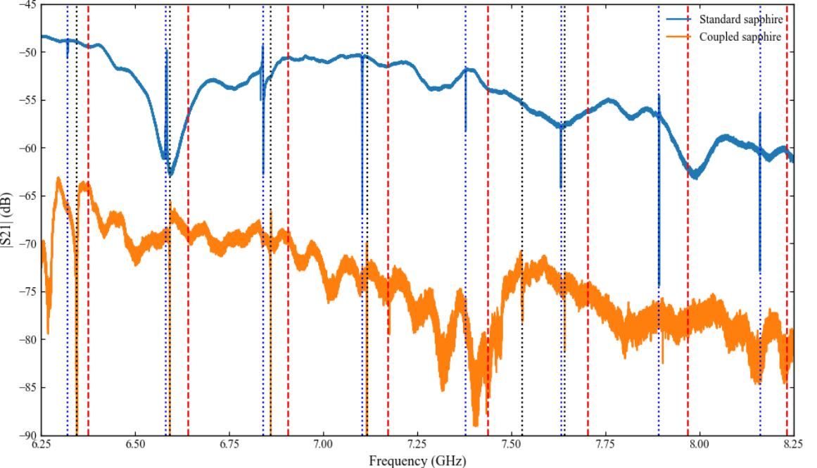
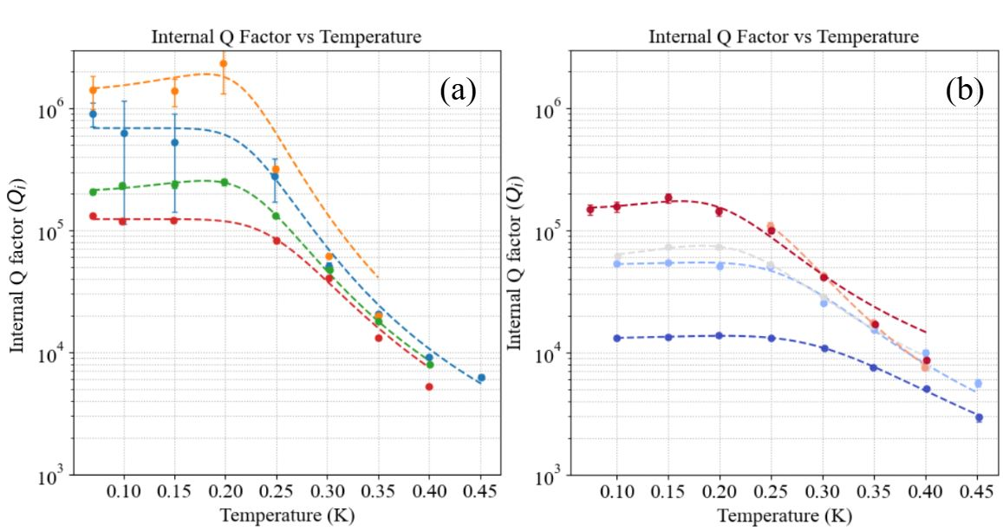

Superconducting & Hybrid Quantum Chips Research Line
Baseline Superconducting Devices.
Design, Fabrication and Testing
Arrays of CPW Microwave Resonators, e.g. Al on Sapphire
7
Micro – Nano Technologies for Quantum Materials and Devices gemma.rius@csic.es

Slide 8
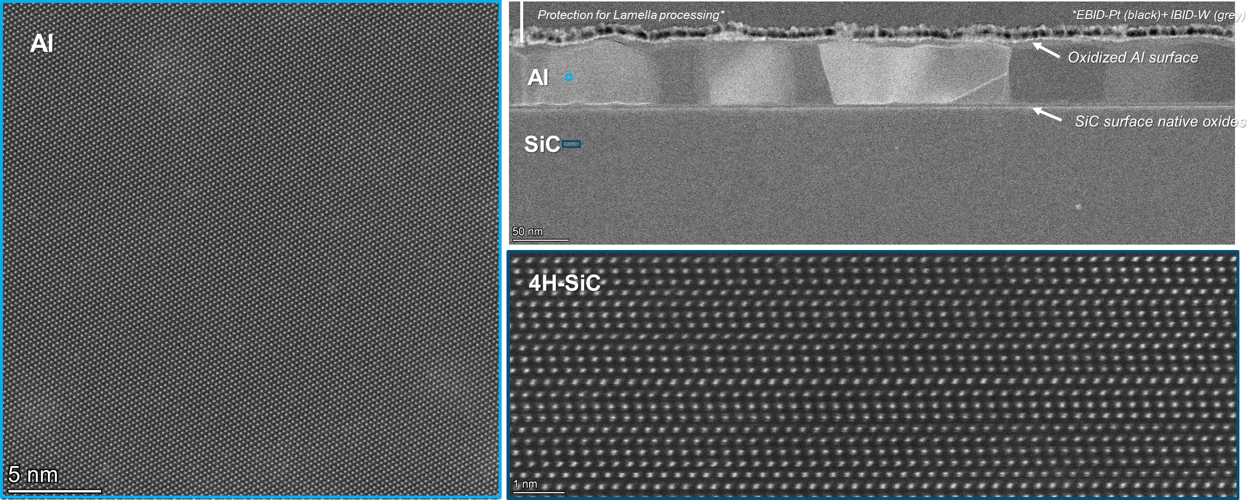
Superconducting & Hybrid Quantum Chips Research Line
Baseline Superconducting Devices.
Design, Fabrication and Testing
Arrays of CPW Microwave Resonators
e.g. Al on SiC
8
Micro – Nano Technologies for Quantum Materials and Devices gemma.rius@csic.es

Slide 9
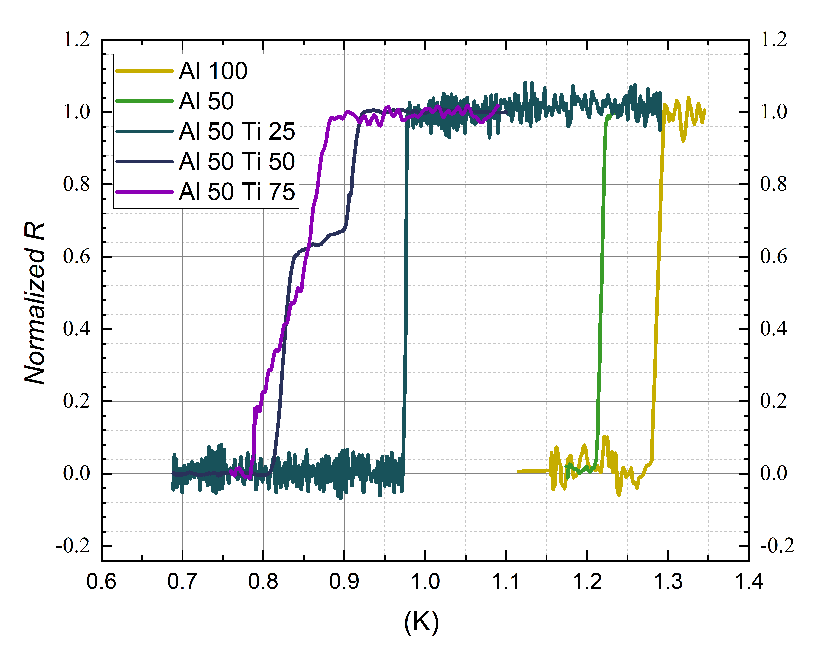
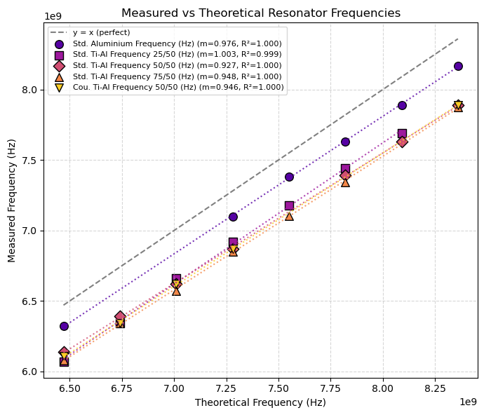
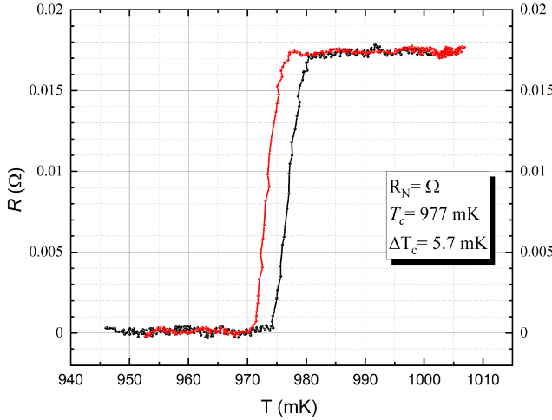
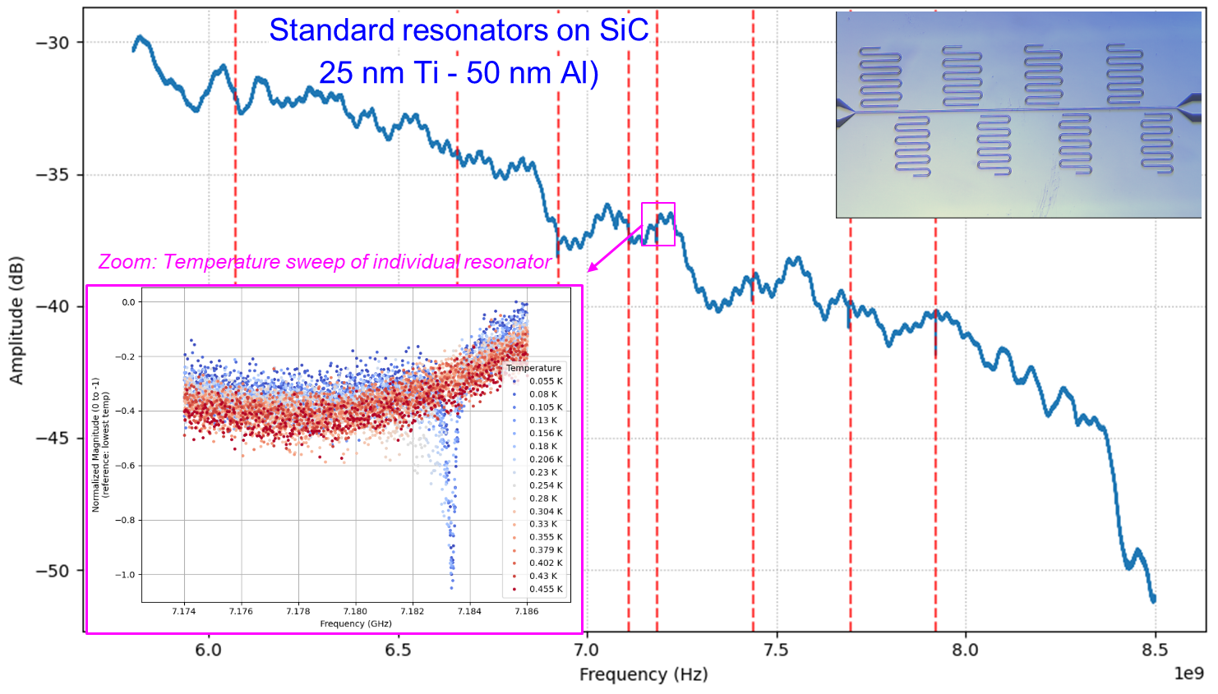
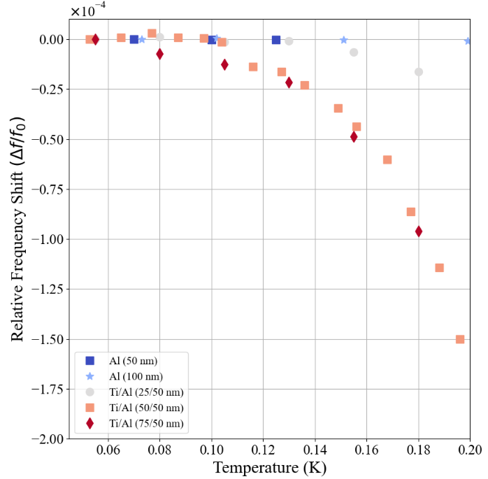
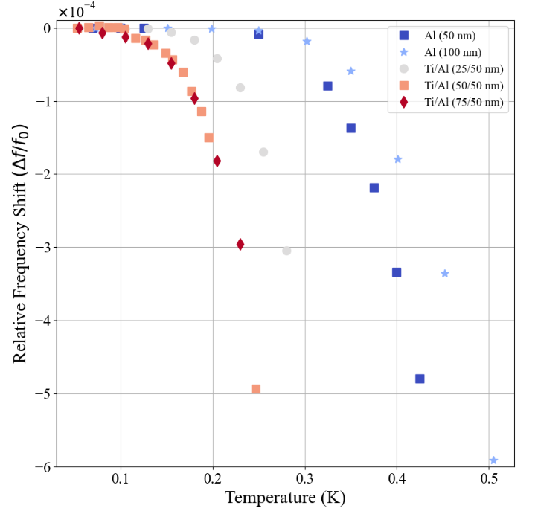
Superconducting & Hybrid Quantum Chips Research Line
Baseline Superconducting Devices.
Design, Fabrication and Testing
+
Enginnering or Advanced Superconducting Thin Films
Microwave Resonator Technology - Pure Metals vs Stacks of Thin films.
Ex. substrate/Ti/Al
9
Micro – Nano Technologies for Quantum Materials and Devices gemma.rius@csic.es

Slide 10
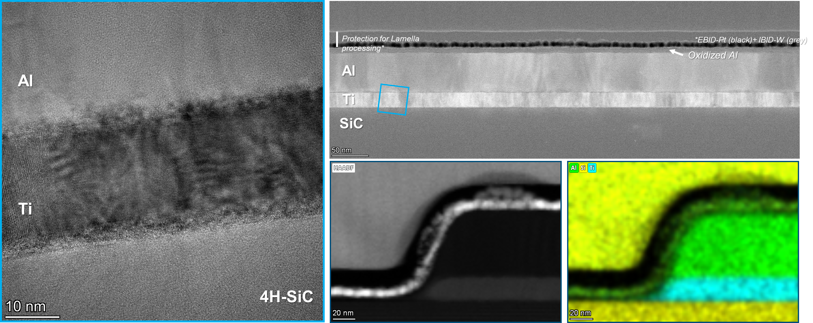
Superconducting & Hybrid Quantum Chips Research Line
Microwave Superconducting Resonator Technology, single metals vs Stacks of Thin films. Ex. substrate/Ti/Al
10
Micro – Nano Technologies for Quantum Materials and Devices gemma.rius@csic.es

Slide 11
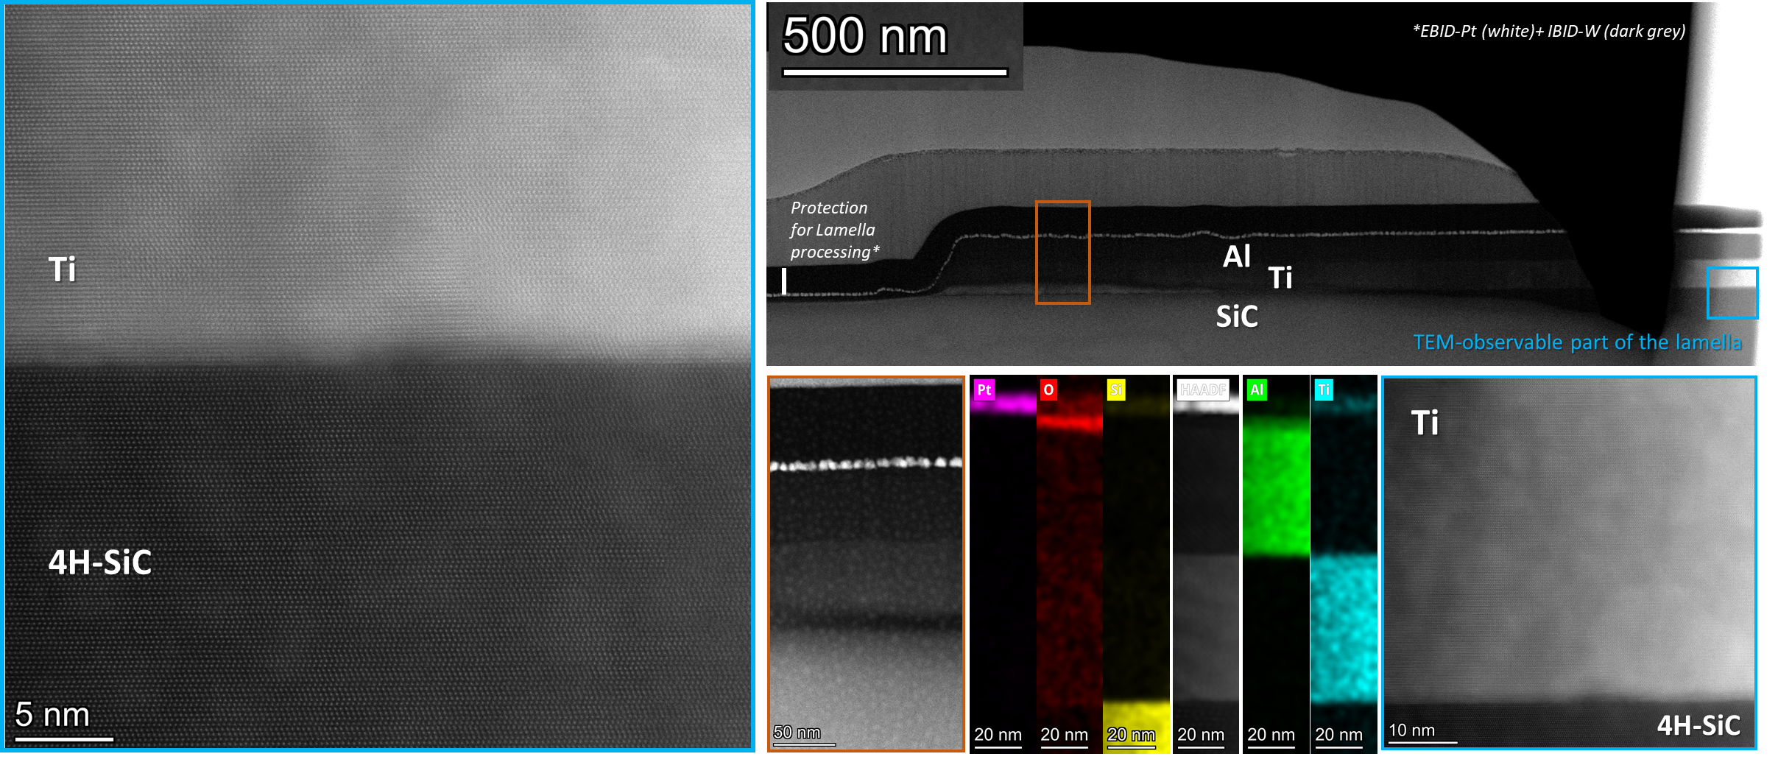
Superconducting & Hybrid Quantum Chips Research Line
Microwave Resonator Technology, single metals vs Stacks of Thin films. Ex. substrate/Ti/Al
11
Micro – Nano Technologies for Quantum Materials and Devices gemma.rius@csic.es

Slide 12
Superconducting & Hybrid Quantum Chips Research Line
Customized or Advanced
Superconducting Thin films
Nitridized Aluminum
Design of tuned or novel superconductivity features
Developing methods and deposition conditions
Fabrication, morphostructural characterization
and functional/operational testing
Tools and Methods:
Sputtering & Evaporation
Ion irradiation (conventional implantation or FIB)
Micro and Nano Patterning of devices
SRIM/TRIM, Tridyn, …
Quantum sensing applications, e.g. direct DM detection
Realization of (ultra) thin films and devices or circuits with specifics in Tc, Lk
Functional/application-oriented design of materials and devices
2024 Supercond. Sci. Technol. 37 035017
2026 J Low Temp Phys 222, 55 doi.org/10.1007/s10909-026-03390-y
Ultrathin Amorphous WSix
2026 IEEE TA Superconductivity 36, 5, 1-5 doi.org/10.1109/TASC.2026.3673788
12
Micro – Nano Technologies for Quantum Materials and Devices gemma.rius@csic.es

Slide 13
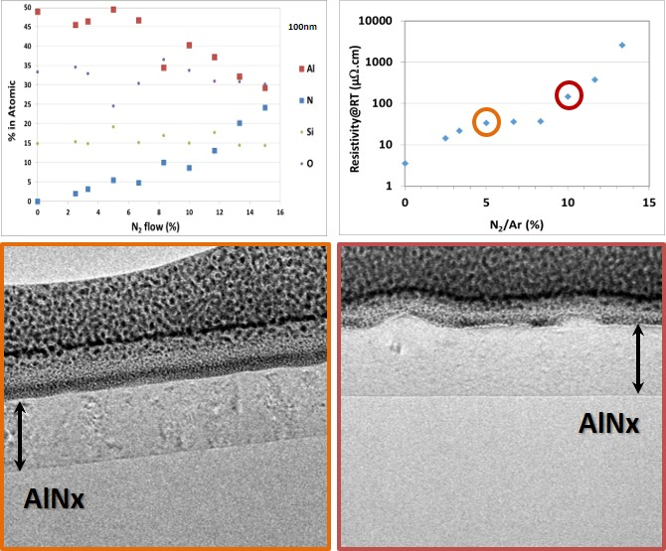
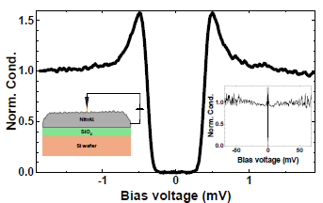
Superconducting & Hybrid Quantum Chips Research Line
Customized or Advanced Superconducting Thin films
Nitridized Aluminum
2024 Supercond. Sci. Technol. 37 035017
2026 J Low Temp Phys 222, 55 doi.org/10.1007/s10909-026-03390-y
13
Micro – Nano Technologies for Quantum Materials and Devices gemma.rius@csic.es

Slide 14
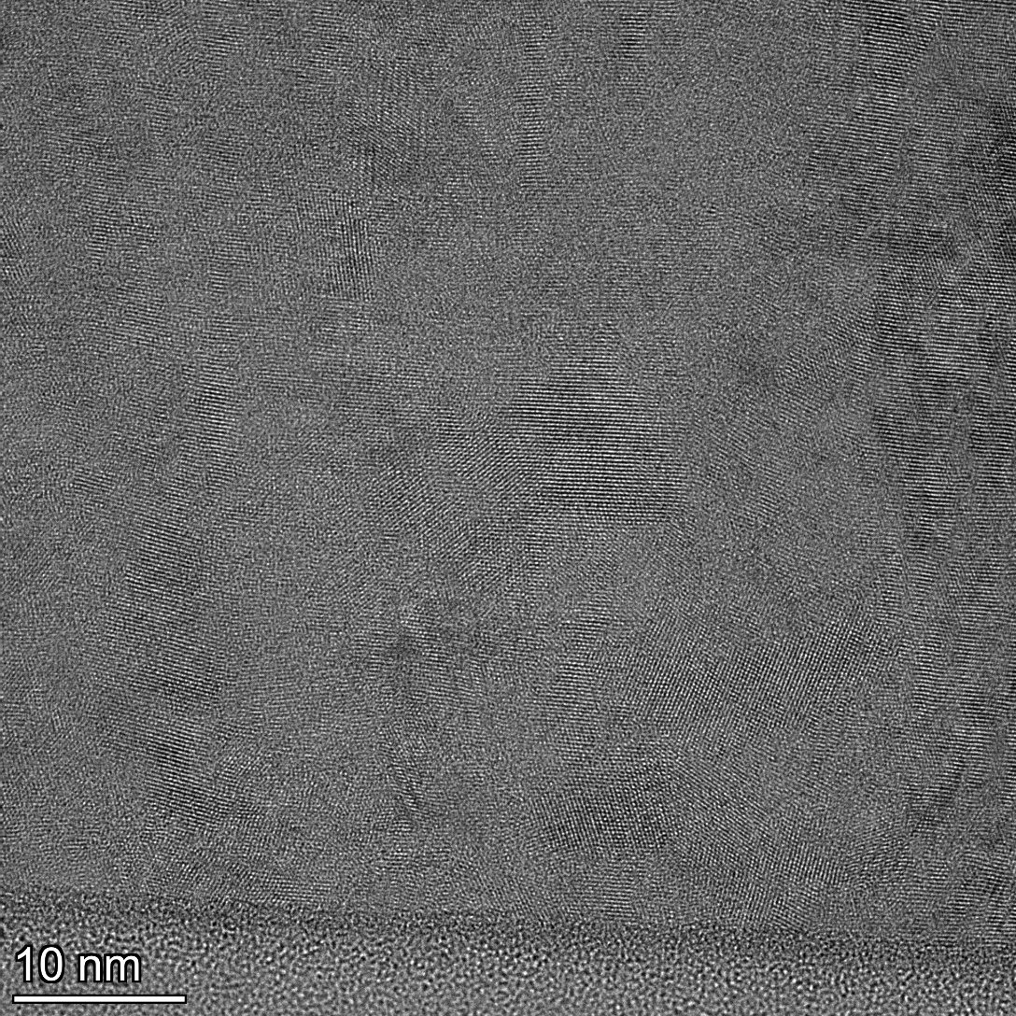
Superconducting & Hybrid Quantum Chips Research Line
14
Micro – Nano Technologies for Quantum Materials and Devices gemma.rius@csic.es

Slide 15
Superconducting & Hybrid Quantum Chips Research Line
Advanced Superconducting Thin films. Nitridized Aluminum by Reactive Sputtering
Property | Sample 3 - lower N% | Sample 6 - higher N% | Difference
Structure | Nanocrystalline/ polycrystalline | Nanocrystalline/ polycrystalline | Same basic class
Characteristic domain size | ~15–25 nm | ~5–12 nm | Smaller
Average representative size | ~20 nm | ~8–10 nm | ~ 2× smaller
Large coherent regions | Relatively common | Less common | Reduced
Grain-boundary density | Moderate/high | High | Increased
Local lattice coherence | Higher | Lower | More disorder
Local orientation variation | Moderate | High | Increased
Internal lattice distortion | Moderate | Moderate–high+ | Increased
Texture | Somewhat more coherent | More isotropic/mixed | More random
Long-range crystalline order | Limited | Very limited | Further reduced
2024 Supercond. Sci. Technol. 37 035017
Sample 3
Al_{0.9}N_{0.1}
Sample 6
Al_{0.75}N_{0.25}
15
Micro – Nano Technologies for Quantum Materials and Devices gemma.rius@csic.es

Slide 16
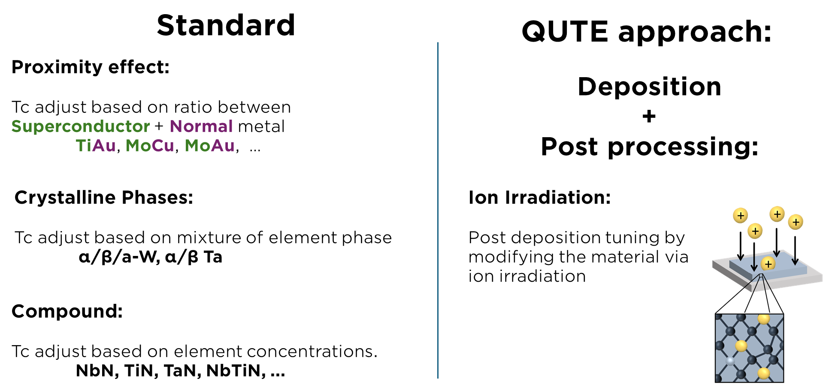
QUTE Project Ref. CNS2023-145234
Ion Irradiation for Advanced Control of Superconductivity in Thin Films
2023 Appl. Phys. Rev. 10, 041311
https://doi.org/10.1063/5.0162597
16
Micro – Nano Technologies for Quantum Materials and Devices gemma.rius@csic.es

Slide 17
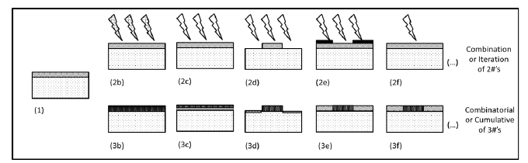
QUTE Project Ref. CNS2023-145234
Ion Irradiation for Advanced Control of Superconductivity in Thin Films
17
Micro – Nano Technologies for Quantum Materials and Devices gemma.rius@csic.es

Slide 18
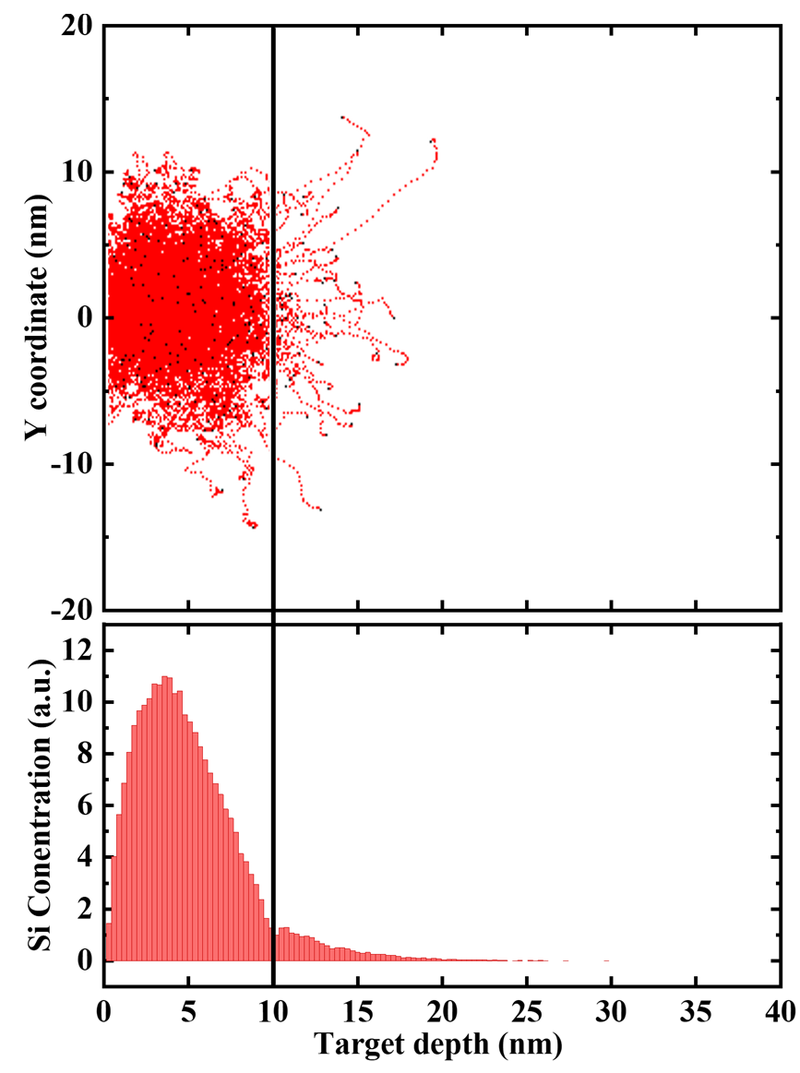
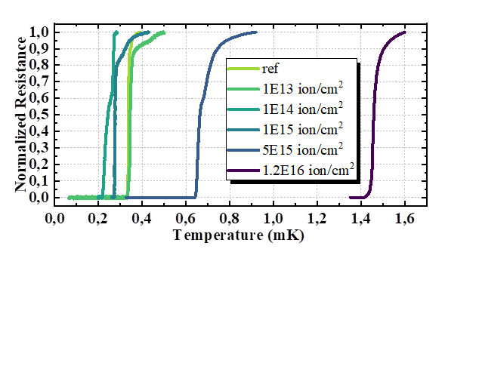
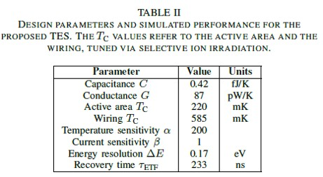
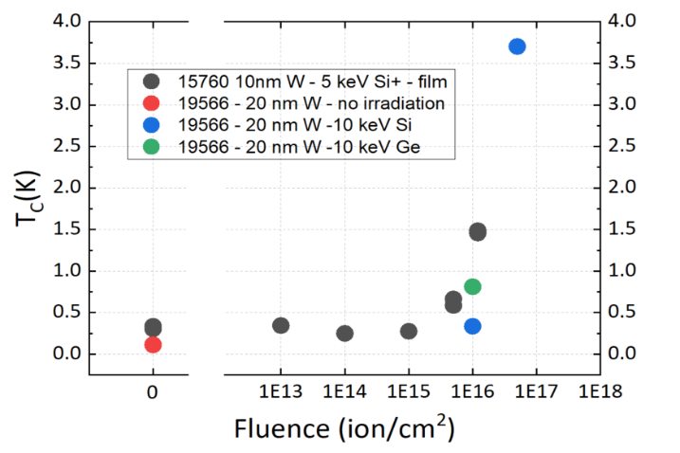
Application of Ion-based SC Thin Films - TES
Ion Irradiation for Advanced Control of Superconductivity
Ultra thin W Tc Tuning via Ion irradiation with semiconductor ions - Si and Ge
2026 IEEE Trans. Appl. Superconductivity 36, 5, 1-5 doi.org/10.1109/TASC.2026.3673788
18
Micro – Nano Technologies for Quantum Materials and Devices gemma.rius@csic.es

Slide 19
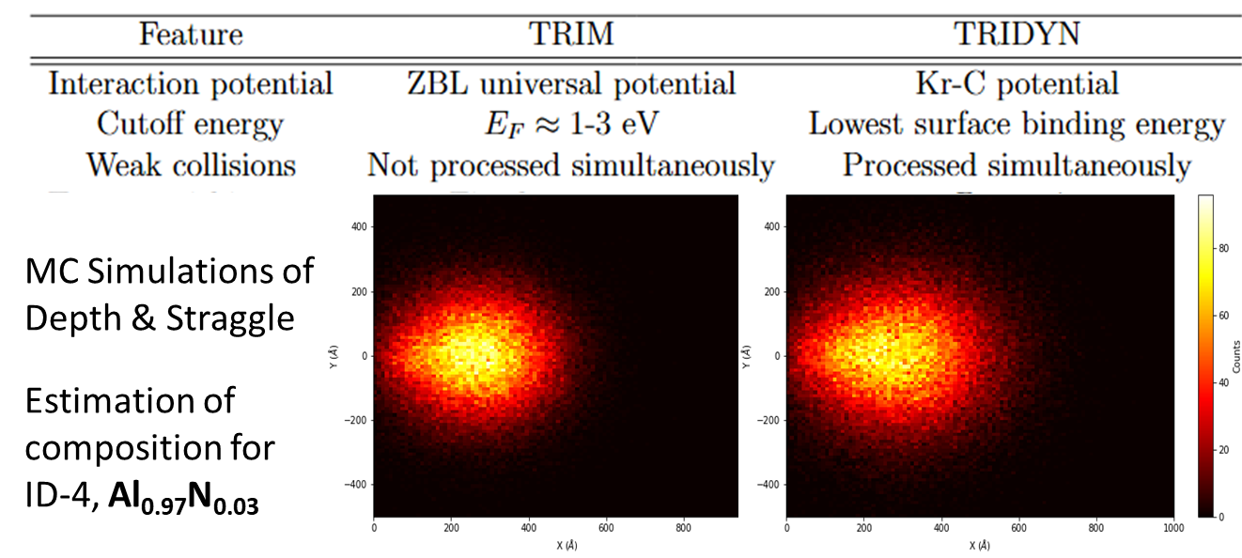
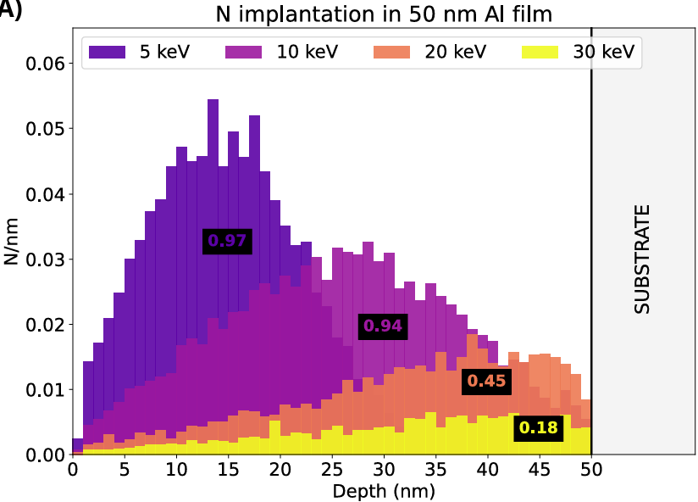
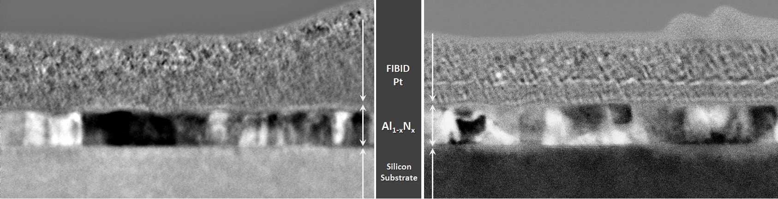
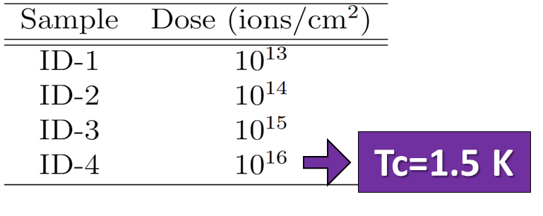
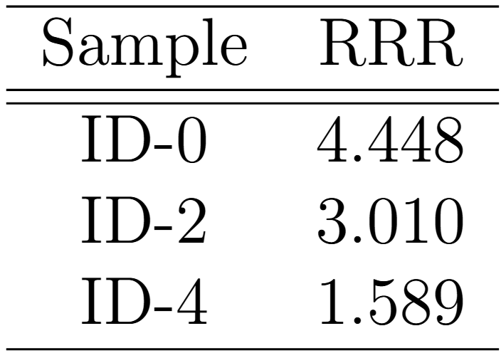
Superconducting & Hybrid Quantum Chips Research Line
Customized or Advanced Superconducting Thin films
Ion Irradiation for Thin Film Tuning AlNx
2.5 K @ 7.5E16
19
Micro – Nano Technologies for Quantum Materials and Devices gemma.rius@csic.es

Slide 20
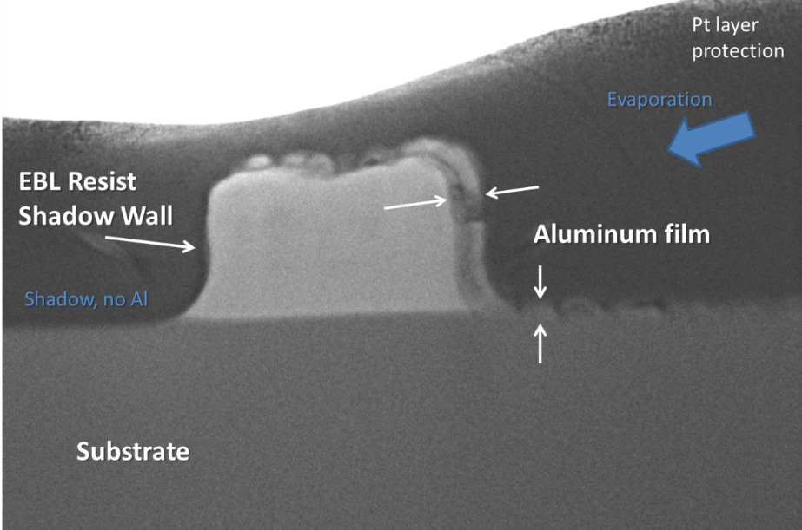
Hybrid Devices and Unconventional Systems
HyFab and IKUR Projects
I-QUMA Project
Semiconductor-Superconductor
Magnetic-Superconductor
Innovative developments of fabrication technology/sequences
Realization of quantum grade interfaces and hybrid integration
Fabrication, morphostructural characterization and functional testing
Methodologies:
Shadow Wall patterning, e.g. single step EBL
Epitaxial NWs, selective materials growth, local patterning, mix and match
Coordinated processing and characterization in multiple sites
Assessment and demonstrators of compatible fabrication sequences and device operation
Realization of (ultra) thin films and devices or circuits with specifics in Tc, Lk
Oriented to quantum physics studies and novel quantum computing/sensing applications
Manuscript in Prep.
Unconventional Approaches and Research on Quantum Technologies
https://doi.org/10.3390/biomimetics10080516
20
Micro – Nano Technologies for Quantum Materials and Devices gemma.rius@csic.es

Slide 21
SUMMARY
Assessment of Thin Film Superconductivity with
Atomic-resolution TEM Imaging and Analysis in
Advanced and Innovative Materials or Heterostructures
Atomic/Nano Scale: crystal phase, mono/poly, disorder, amorphization…
Microscopic Morphology: domain size, grain boundaries, texture…
Elemental Composition: purity, doping, stoichiometry, gradients…
Interfacial Analyses: native oxides, epitaxy, intermixing…
Correlative Evaluation: multi-variable properties/characteristics/functionality
Superconducting & Hybrid Quantum Chips Research Line qchip.csic.es
21

Slide 22


Thank you
CONTACT:
Dr. Gemma Rius gemma.rius@csic.es
Acknowledge ALBA access to METCAM in 2026-I
ALBA METCAM Team
Bernat, Kapil, Belen, Francisco …
Qchip Team at IMB and students
María, Carlo and previous members and students
Nanolitho Area IMB-ICTS Team
Liber, Xevi, Albert…
Clean Room Staff
Leyre, Javi, Nuria, Alberto…

Slide 23
Thank you
CONTACT:
Dr. Gemma Rius gemma.rius@csic.es
Funding Acknowledgements:
QTP2021-03-014; PID2021-122140NB-C32;
TED2021-130292B-C44; CNS2023-145234;
IKUR2025-QT11; Trigger KICKIN; I-QUMA (PID2025)
Main Collaborators and Support:
INRiM, LNGS, CERN, FBK, HZDR, INL
INMA, UAM, CFM-EHU, UV, IFCA-DCOM, ALBA-CELLS, LSC
kiutra, TESCAN

