Slide 1
Precise Node Metalation in a Zirconium Metal-Organic Framework Enables Highly Efficient PFOA Capture via Synergistic Adsorption Sites
Edouardos Loukopoulos
Institute of Catalysis and Petrochemistry, Spanish National Research Council (ICP-CSIC)
VII ALBA Users’ Meeting, 04/09/2026

Slide 2
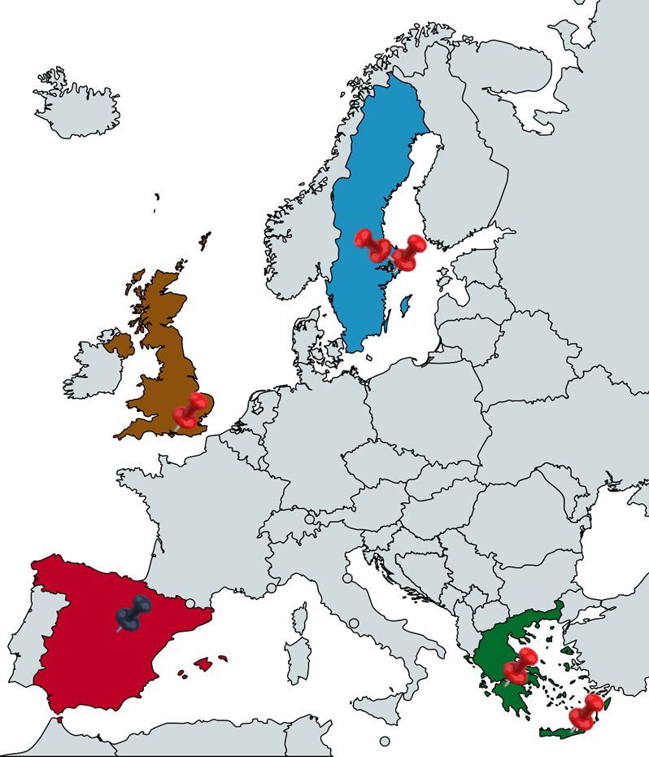

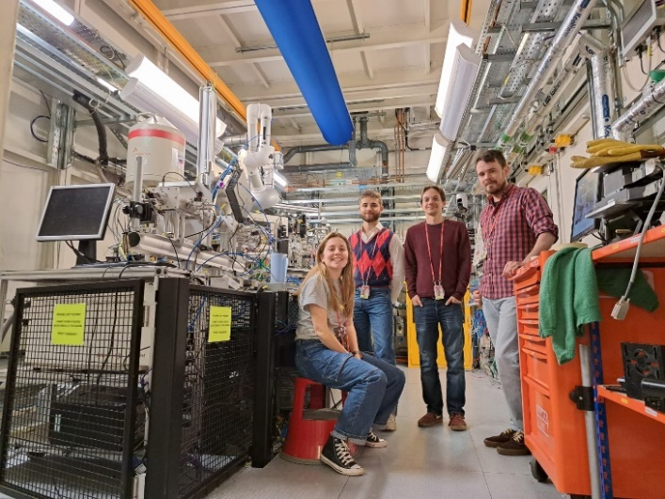
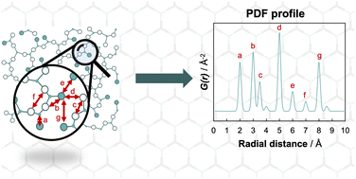
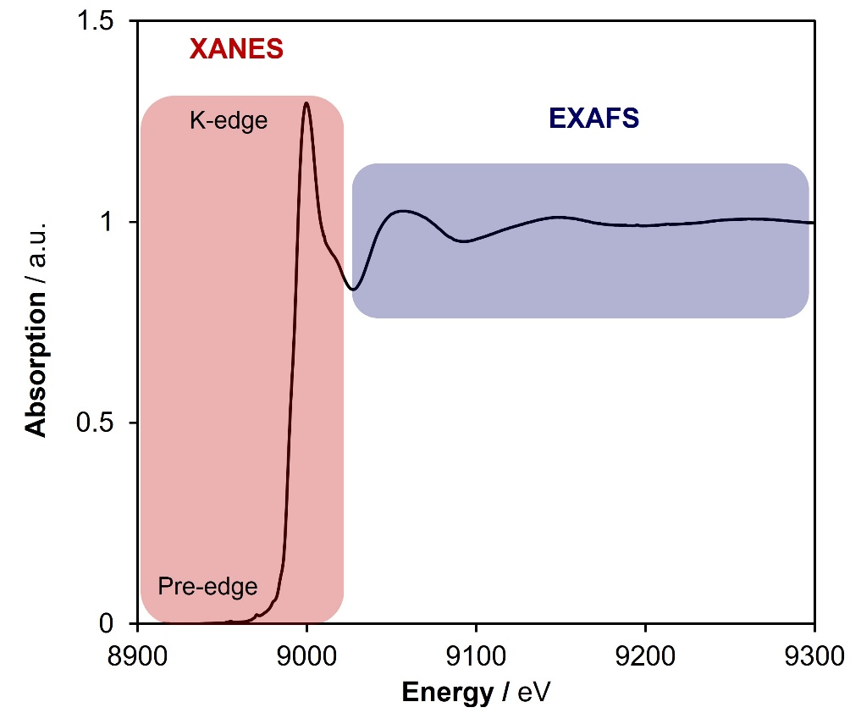
Multiscale Characterization in Catalysis group
(LOCAL-MATER)
Local-/long-range structural analysis in inorganic materials
Identification of structure-property correlations
Synthetic tailoring for optimized sustainability function
César Nombela - Atracción de Talento Fellow (2026)
Synchrotron Characterization to Elucidate Structural Features and Modifications
Chem. Soc. Rev. 2024, 53, 24, 11772
2
Pair Distribution Function analysis
X-ray Absorption Spectroscopy

Slide 3
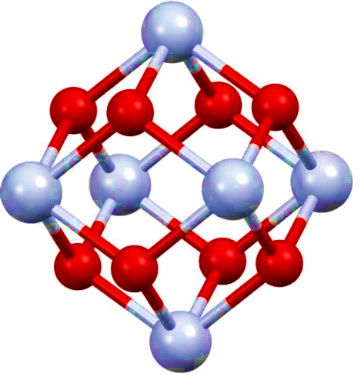
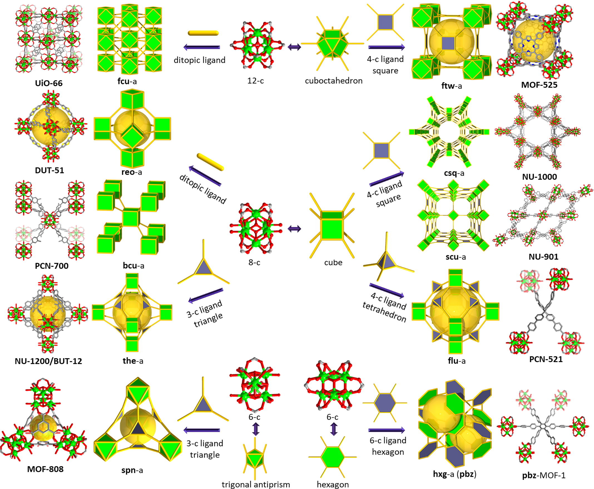
Prototypical porous materials: Metal-Organic Frameworks (MOFs)
+
+
Inorganic
Node
Organic
Linker
Inorganic
Node
Organic
Linker
Diverse porosity features
High stability
Potential for chemical tailoring
Zr₆O₈ cluster node
Saturated, 12-c cluster
Unsaturated, 8-c and 6-c clusters
Most Zr₆-based MOFs
(e.g. UiO-66)
(e.g. MOF-808, NU-1000, PCN-222)

Slide 4

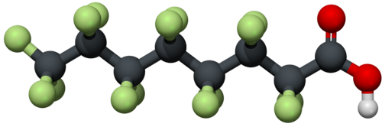

Engineering MOF-based systems for Water Decontamination
The problem: Increasing decline in water quality, further aggravated by new, man-made pollutants with high persistence and toxicity.
Perfluorooctanoic acid (PFOA)
Per-/poly-fluoroalkyl substances (PFAS)
Found extensively in everyday applications
Highly toxic for humans and aquatic organisms
Extremely resistant to common water treatments
Low capacities
Slow kinetics
Low regeneration performance
Limitations of existing PFOA
adsorption-based methods:
UN 2030 Agenda for
Sustainable Development
Solution: Use chemistry-inspired modifications in MOFs to develop target-based sorbents for optimal removal of PFAS from water.

Slide 5
Engineering MOF-based systems for Water Decontamination
Parameters to exploit during MOF design / functionalization:
Tuning of pore features
(size, hydrophobicity)
M – O_{PFAS} coordination
H-bonding
Electrostatic forces
Hydrophobic/F-F interactions
UN 2030 Agenda for
Sustainable Development
Solution: Use chemistry-inspired modifications in MOFs to develop target-based sorbents for optimal removal of PFAS from water.

Slide 6
Engineering MOF-based systems for Water Decontamination
Grafting metal sites to enhance PFAS adsorption via coordination binding – The example of MOF-808
Zr
C
O
High air, water and chemical stability
Large pore size (18 Å)
Based on highly unsaturated 6-connected Zr₆O₈ clusters

Slide 7
Engineering MOF-based systems for Water Decontamination
Grafting metal sites to enhance PFAS adsorption via coordination binding – The example of MOF-808
Zr
C
O
Binding sites for functionalization
High air, water and chemical stability
Large pore size (18 Å)
Based on highly unsaturated 6-connected Zr₆O₈ clusters

Slide 8
Engineering MOF-based systems for Water Decontamination
Grafting metal sites to enhance PFAS adsorption via coordination binding – The example of MOF-808
Zr
C
O
Binding sites for functionalization
Engineering of iron/acetate binuclear species
Fe-MOF-808
J. Am. Chem. Soc. 2026, 148,19, 19672

Slide 9
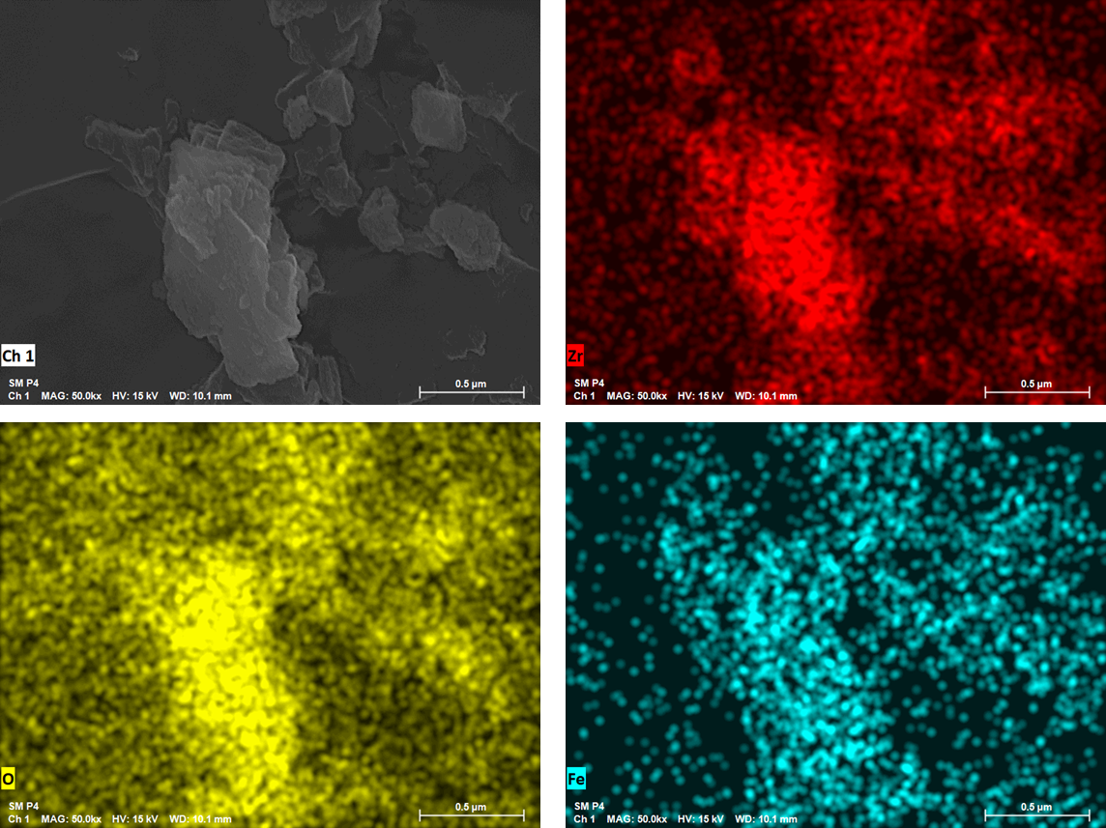
Characterization of Fe-MOF-808
Zr
O
Fe
J. Am. Chem. Soc. 2026, 148,19, 19672

Slide 10

Elucidating the local structure in Fe-MOF-808
DFT model
Pair Distribution Function Analysis
Fe K-edge X-Ray Absorption Spectroscopy

Slide 11


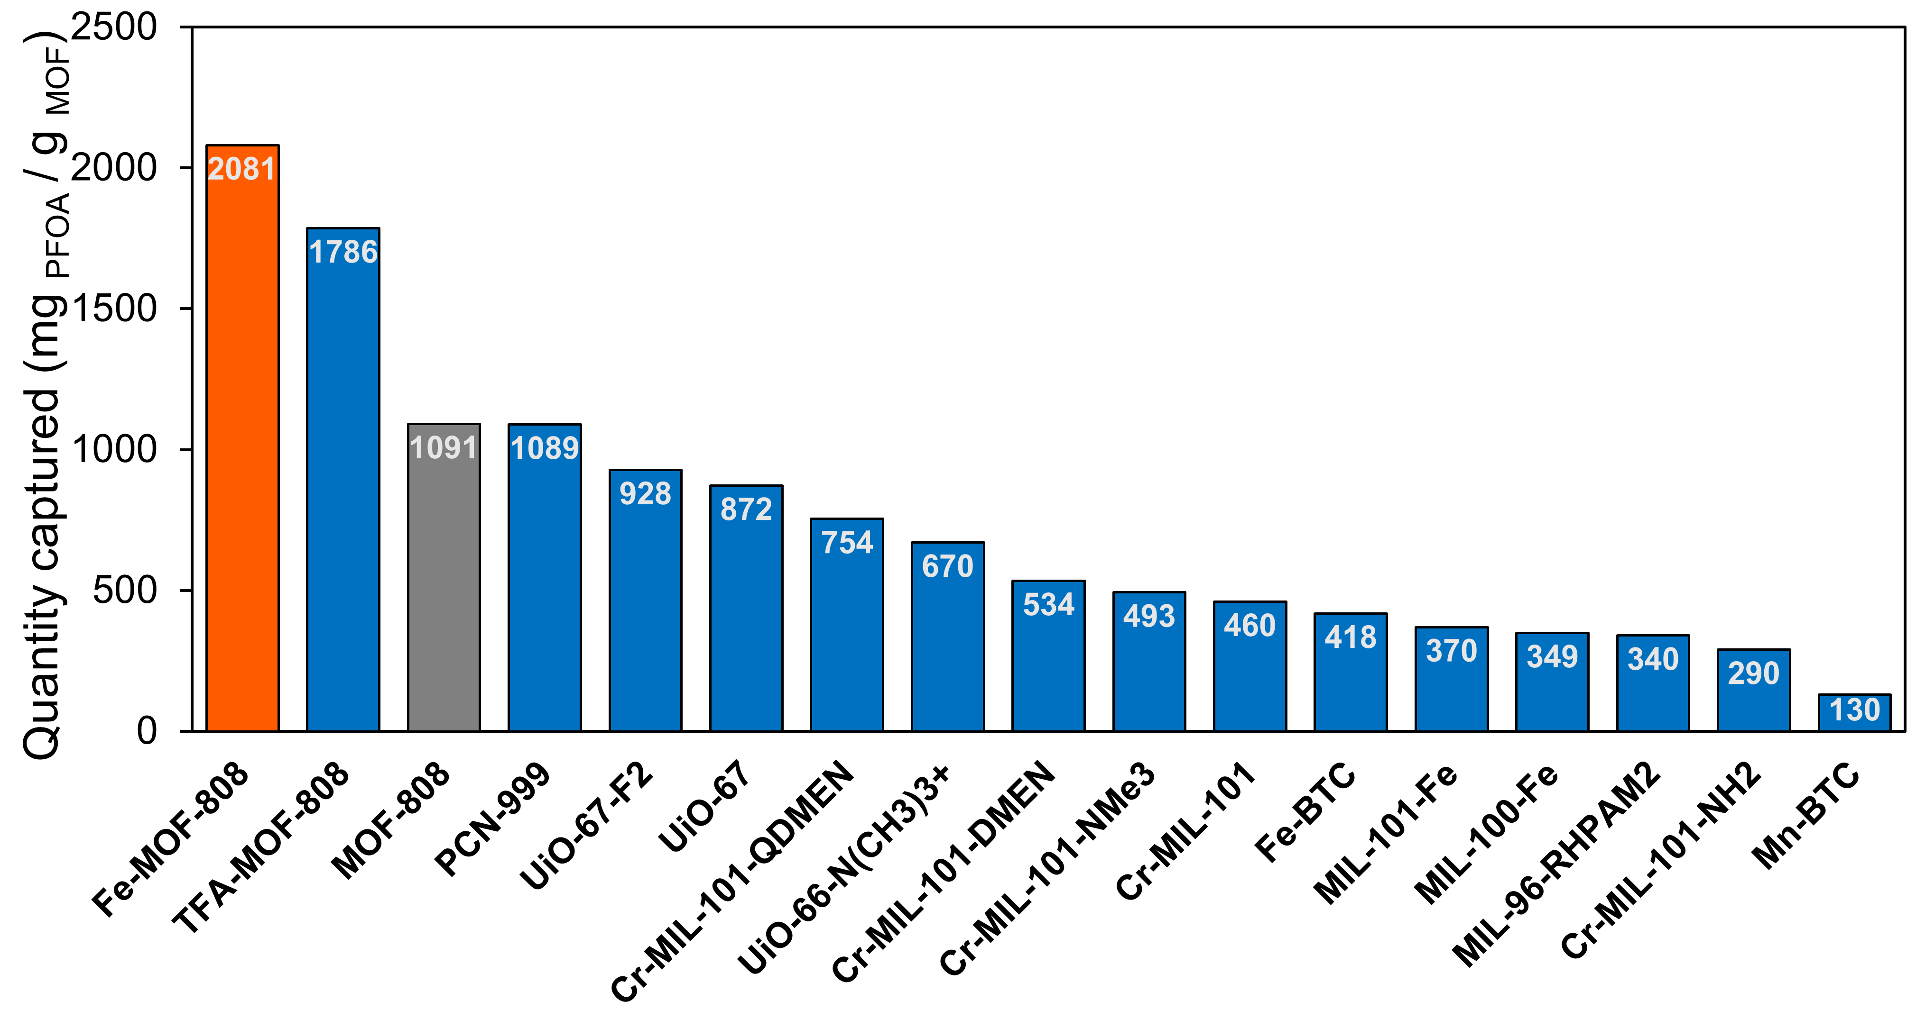
PFOA adsorption performance
S. Marugán-Benito (ICP-CSIC)
Prof. L. Ahrens (SLU, Uppsala)
t₁
C₀
C₁
Fast PFOA adsorption kinetics (C = 100 ppm)
PFOA adsorption capacity at C = 1000 ppm
Fe sites enhance PFOA removal (C = 100 ppm)

Slide 12
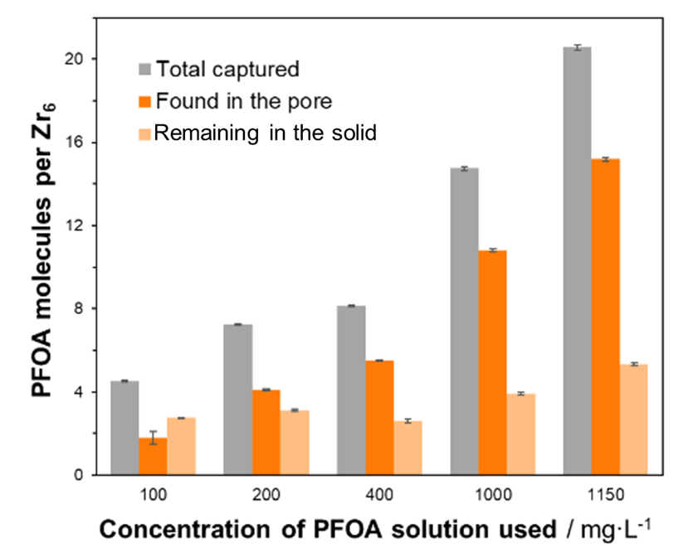
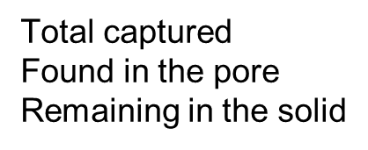
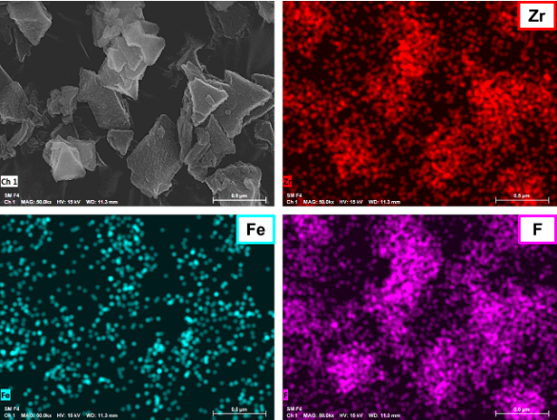
Post-Capture Characterization
While the main structure remains intact, some PFOA remains strongly-bound after capture

Slide 13
Synchrotron-based mechanistic investigations
PDF and dPDF analysis suggest formation of coordination binding and weak PFOA∙∙∙MOF interactions

Slide 14


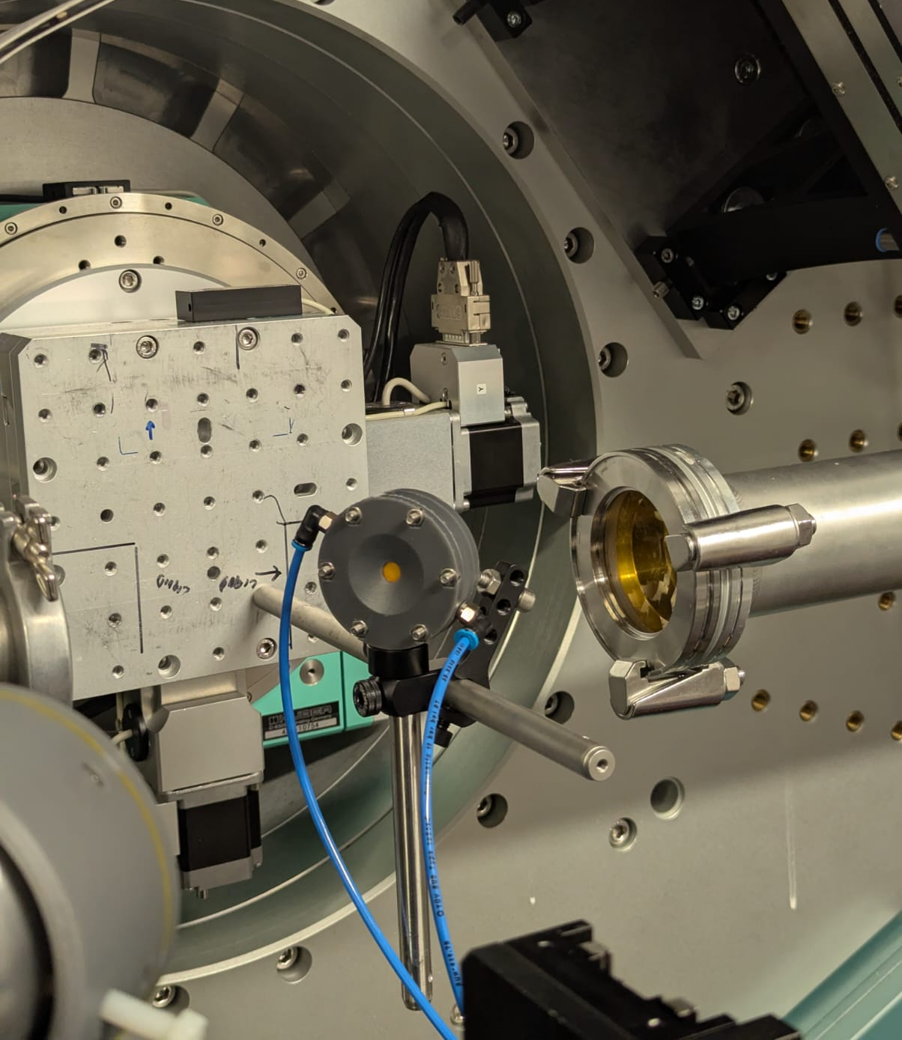
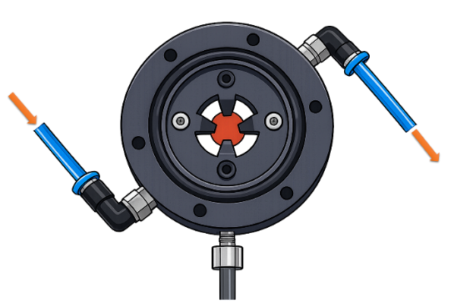
Monitoring the Fe environment through in situ XAS
ALBA BL16 – NOTOS:
C. Marini
J. Prat Albert
flow entrance
flow exit
J. Am. Chem. Soc. 2026, 148,19, 19672

Slide 15
Monitoring the Fe environment through in situ XAS
C. Marini
J. Prat Albert
S. Marugán-Benito
M. Roselló-González
Progressive exchange of coordinated acetates with PFOA alters absorption intensity with no changes in Fe oxidation state
J. Am. Chem. Soc. 2026, 148,19, 19672

Slide 16
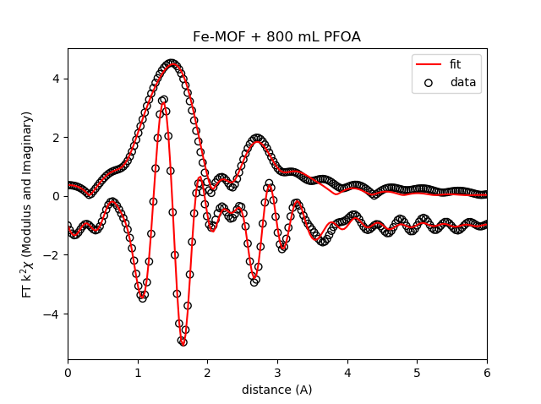
Monitoring the Fe environment through in situ XAS
C. Marini
J. Prat Albert
S. Marugán-Benito
M. Roselló-González
Coordination of PFOA initially expands the Fe octahedron before eventual stabilization
J. Am. Chem. Soc. 2026, 148,19, 19672

Slide 17
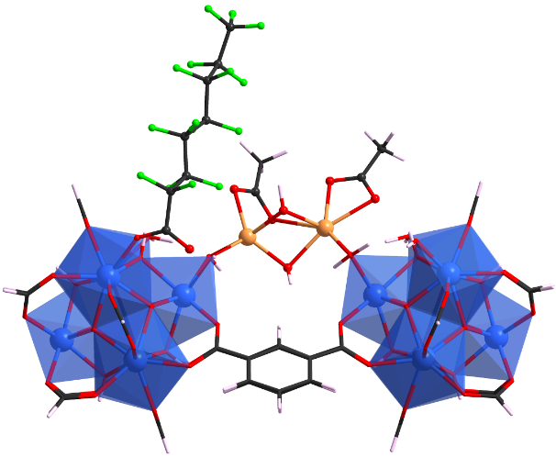
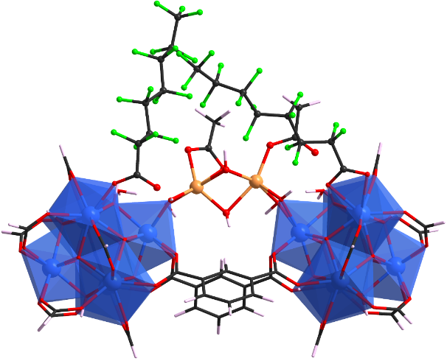
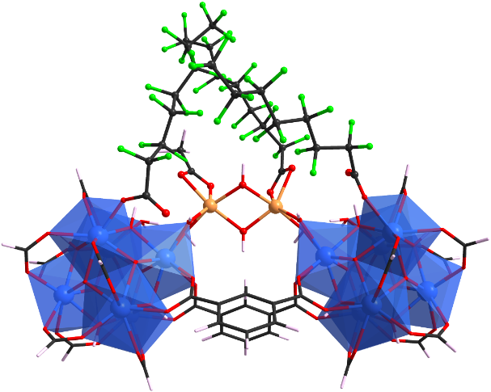
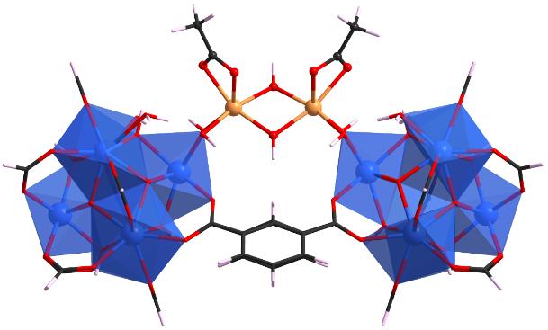
Computational Investigations
A. Mavrantonakis (ICMM-CSIC)
M. Vlachos (ICMM-CSIC)
Theoretical calculations and modelling determine binding site preference
1st PFOA
binds to Zr
2nd PFOA
binds to Zr
3rd PFOA
binds to Fe
Fe-MOF-808
-89.3 kJ/mol
-189.9 kJ/mol
-210.2 kJ/mol
J. Am. Chem. Soc. 2026, 148,19, 19672

Slide 18


Take-home Messages
Node engineering of MOF-808 with secondary Fe centres creates synergistic Zr/Fe binding sites, enabling efficient and rapid PFOA capture.
Binding is further stabilized via electrostatic and hydrophobic interactions.
Synchrotron techniques are essential to determine the local structural environment and extract mechanistic information.
Scan here for the full paper:

Slide 19

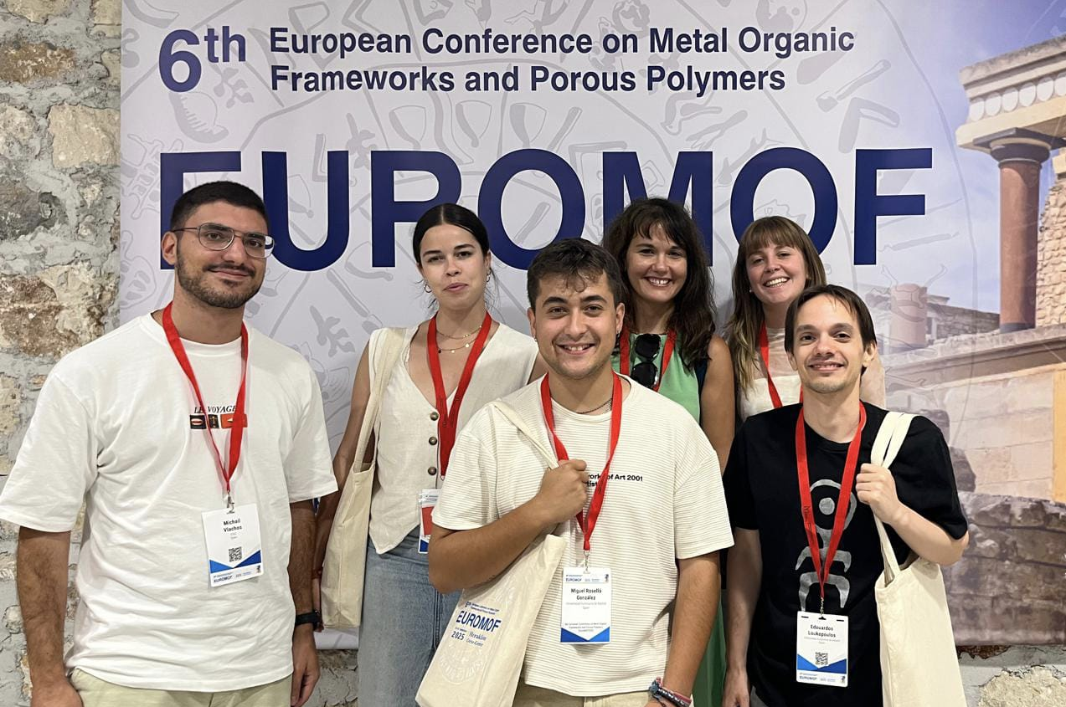



Acknowledgments
LOCAL-MATER members:
Dr. Ana Platero-Prats
Dr. Rodrigo Gil San Millán
Sergio Marugán-Benito
Miguel Roselló González
Michalis Vlachos
Sofía Barragan Soto
2025-T1/ECO-36154
PFAS adsorption studies:
Lutz Ahrens (SLU, Uppsala)
Funded
by the European Union
Theoretical calculations:
Dr. Andreas Mavrandonakis (ICMM – CSIC)
Synchrotron Facilities:
ALBA Synchrotron, BL-16 NOTOS (XAS studies)
Diamond Light Source (PDF studies)
ESRF (PDF studies)

