Slide 1

ML-driven Thermal mapping Using SR-FTIR Spectroscopy
Emigdio Chavez-Angel
E-mail: emigdio.chavez@icn2.cat

Slide 2
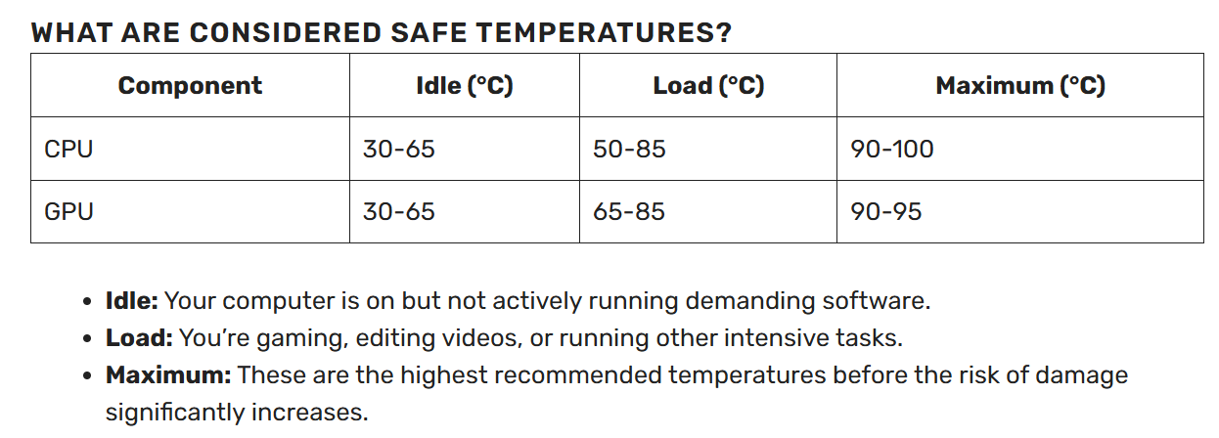
Motivation: Excess of heat: roadblock of ICT
Energy demand in data centers
Cooling
Cisco: Data Center Power and Cooling
White Paper, www.cisco.com
https://shorturl.at/Hp5SX

Slide 3
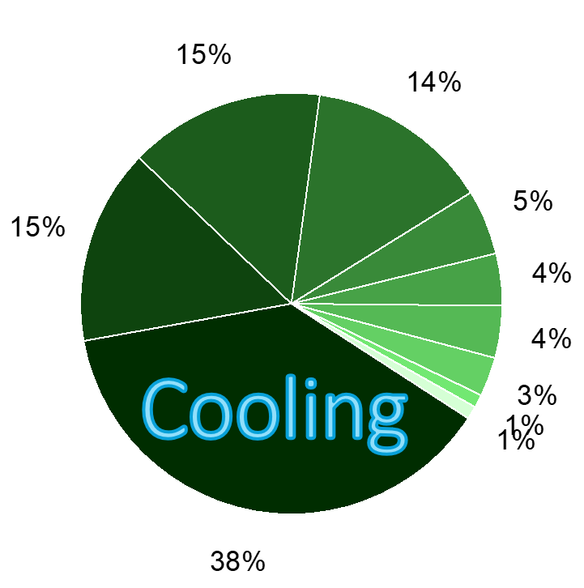
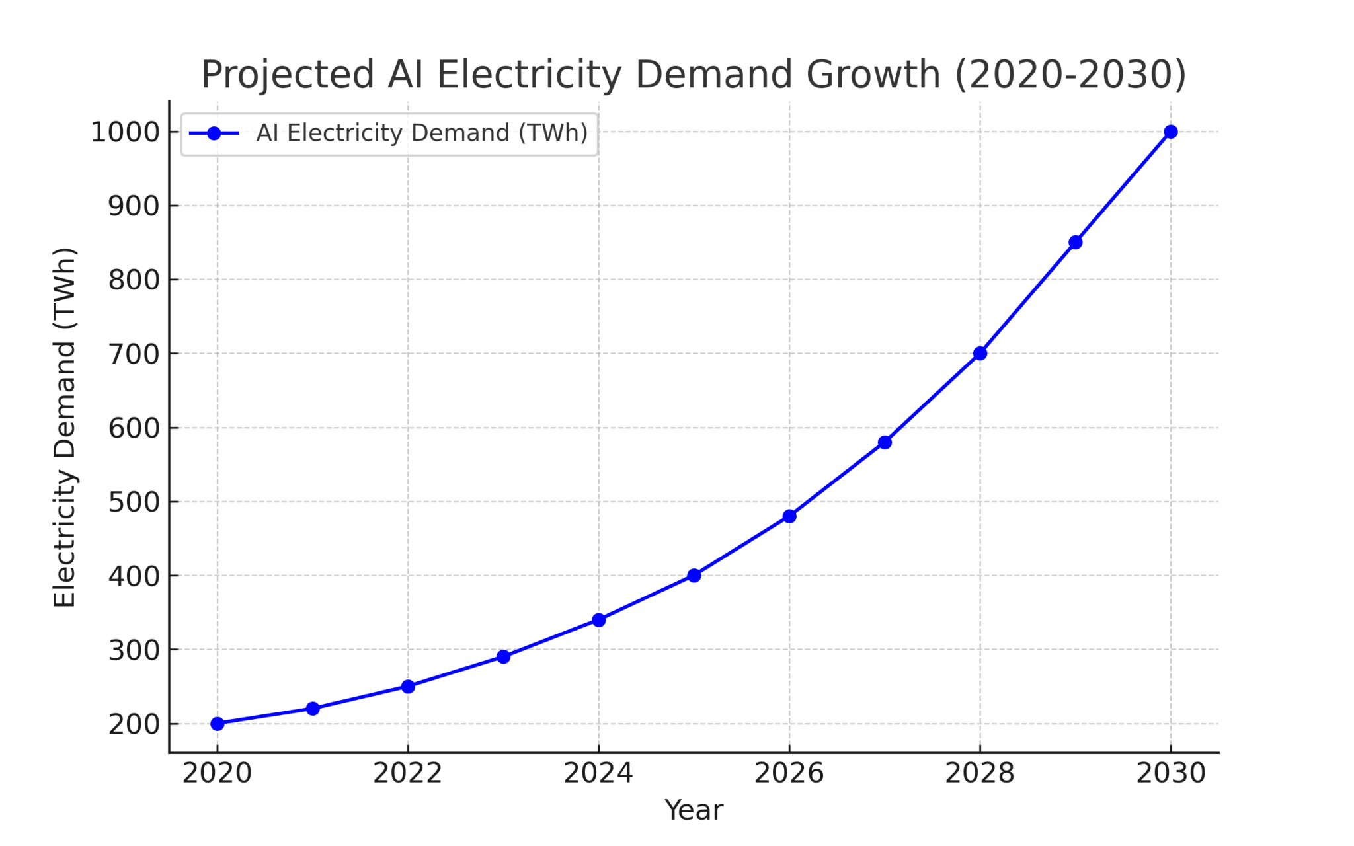
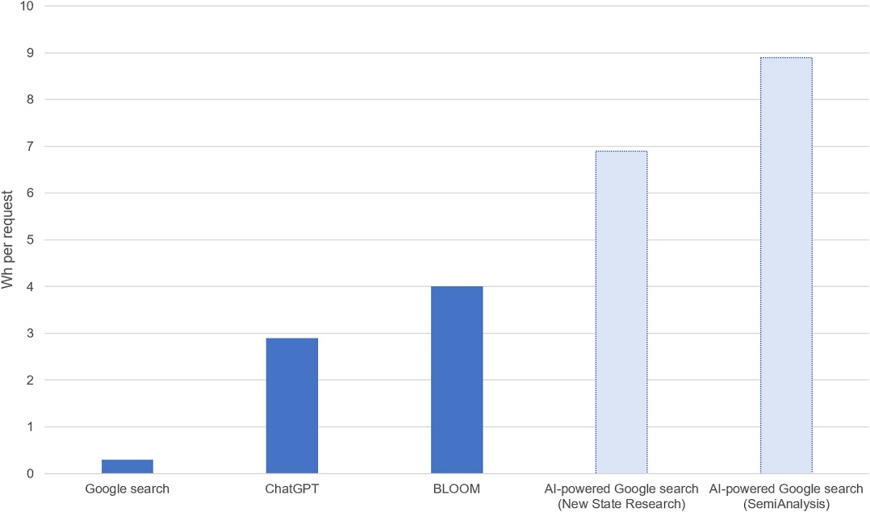
Motivation: Energy consumption of AI
https://evolutionoftheprogress.com/ai-power-consumption-exploding/
Alex de Vries, Joule, 7 (2023), 2191-2194

Slide 4
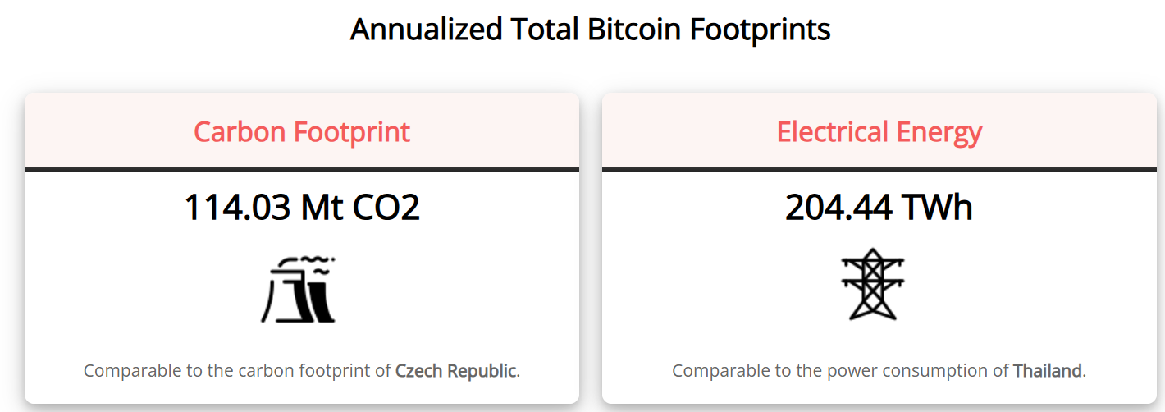
Motivation: Excess of heat: roadblock of ICT
https://digiconomist.net/bitcoin-energy-consumption/

Slide 5
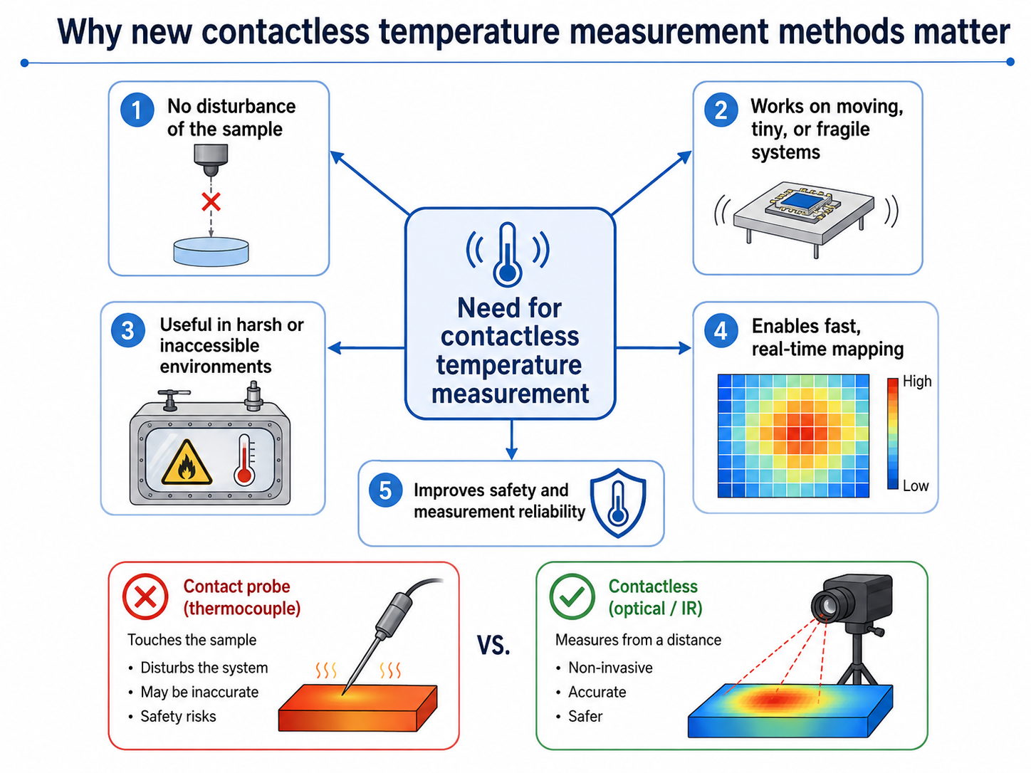

Slide 6
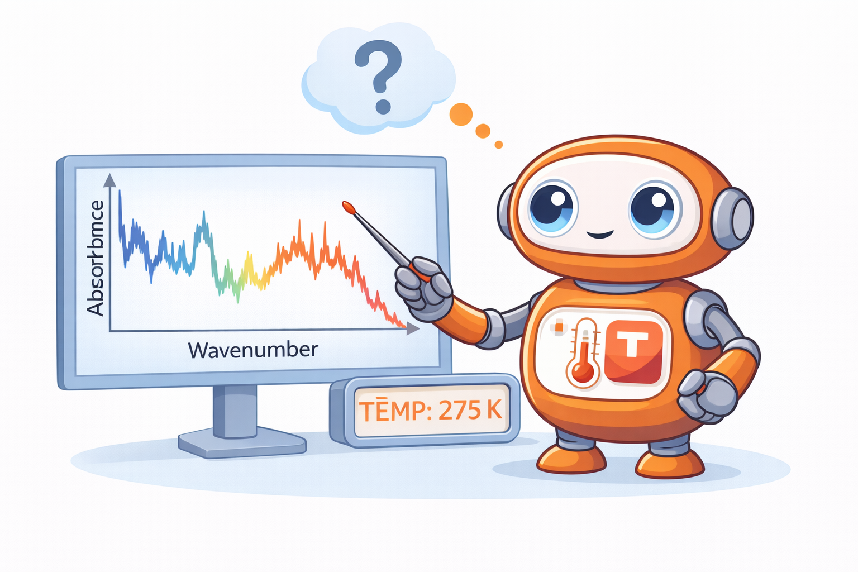
ML-driven Thermal mapping Using SR-FTIR Spectroscopy
Absorbance
We aim to use FTIR signal as contactless thermometer based on the temperature dependence of FTIR signal and analysed using ML tools

Slide 7
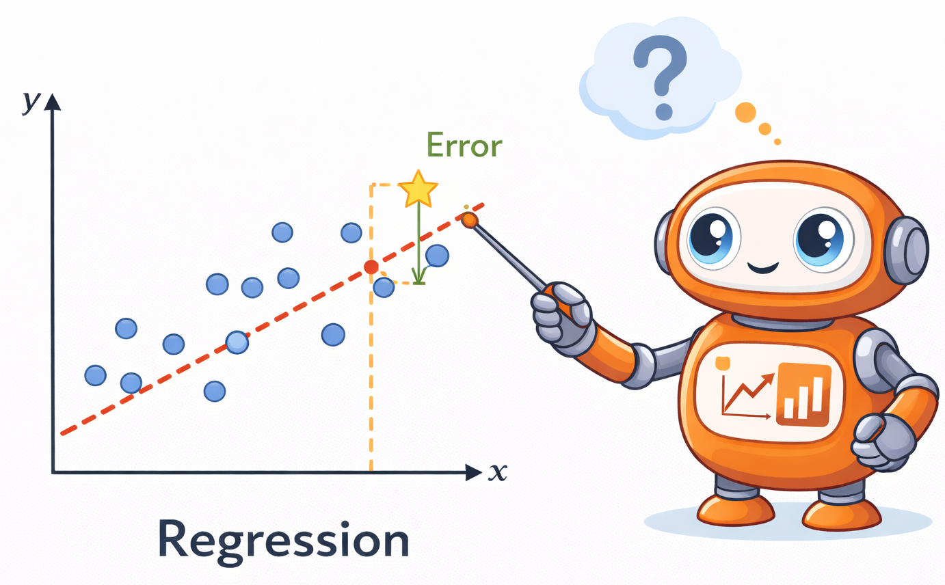
What is Regression?
Regression models the relationship between inputs (x) and outputs (y).
Goal: predict y from x.
Different models make different assumptions about this relationship

Slide 8
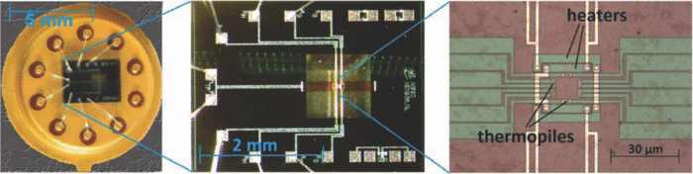
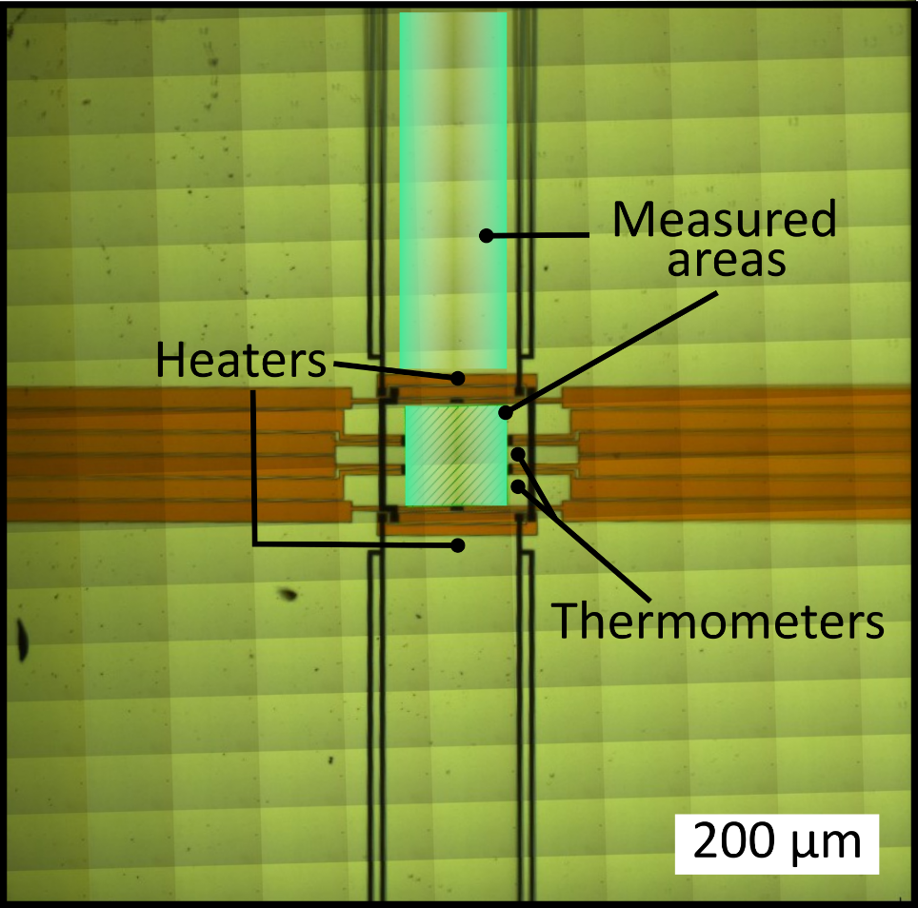
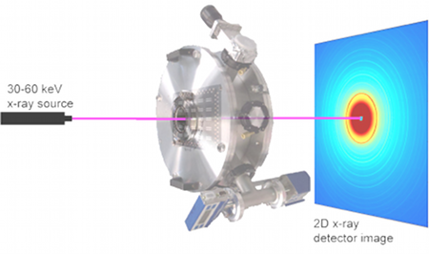
The System: Nanocalorimetric chips

Slide 9
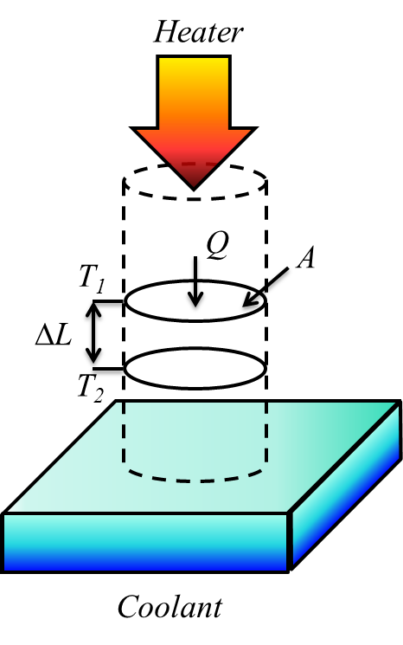
The Theory
The experimental measurement of the thermal conductivity involves two steps:
1.- The introduction of thermal energy into the system (heating)
2.- The detection of the change of temperature (sensing).

Slide 10
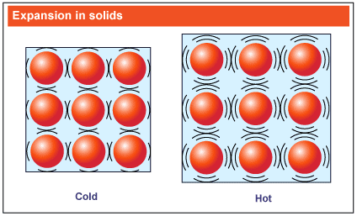
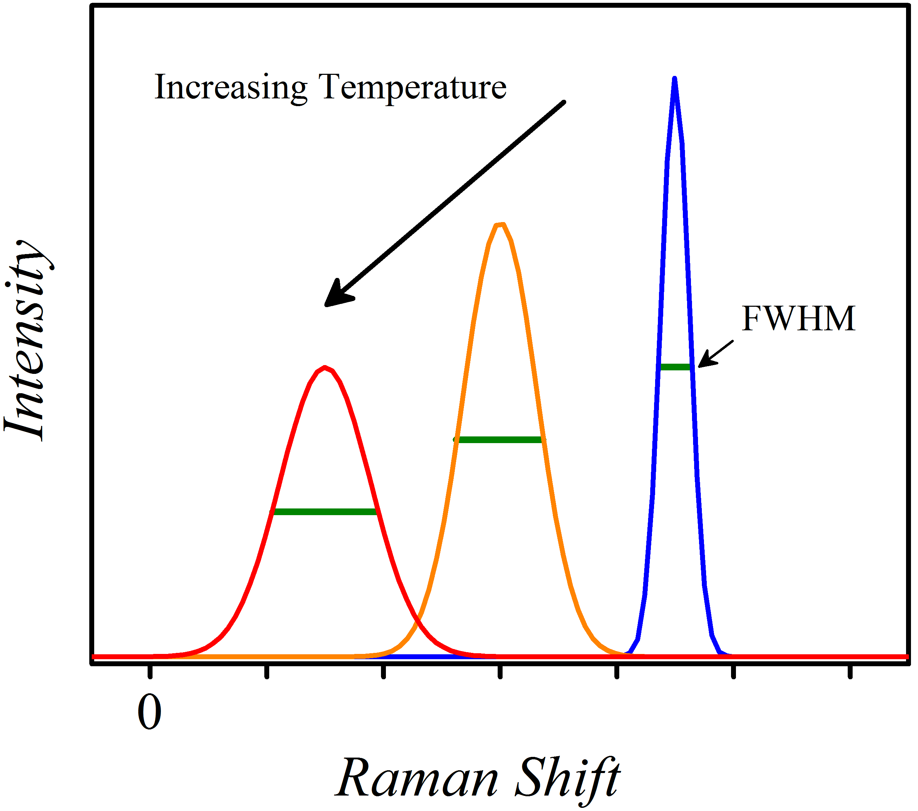
The Theory
Thermal expansion and temperature-dependence of phonon lifetime as thermometer
Change of interatomic forces reflected in Raman signal shift.
Linewidth broadening is consequence of temperature-dependence of phonon lifetime.
Journal of Applied Physics 128, 131101 (2020)

Slide 11
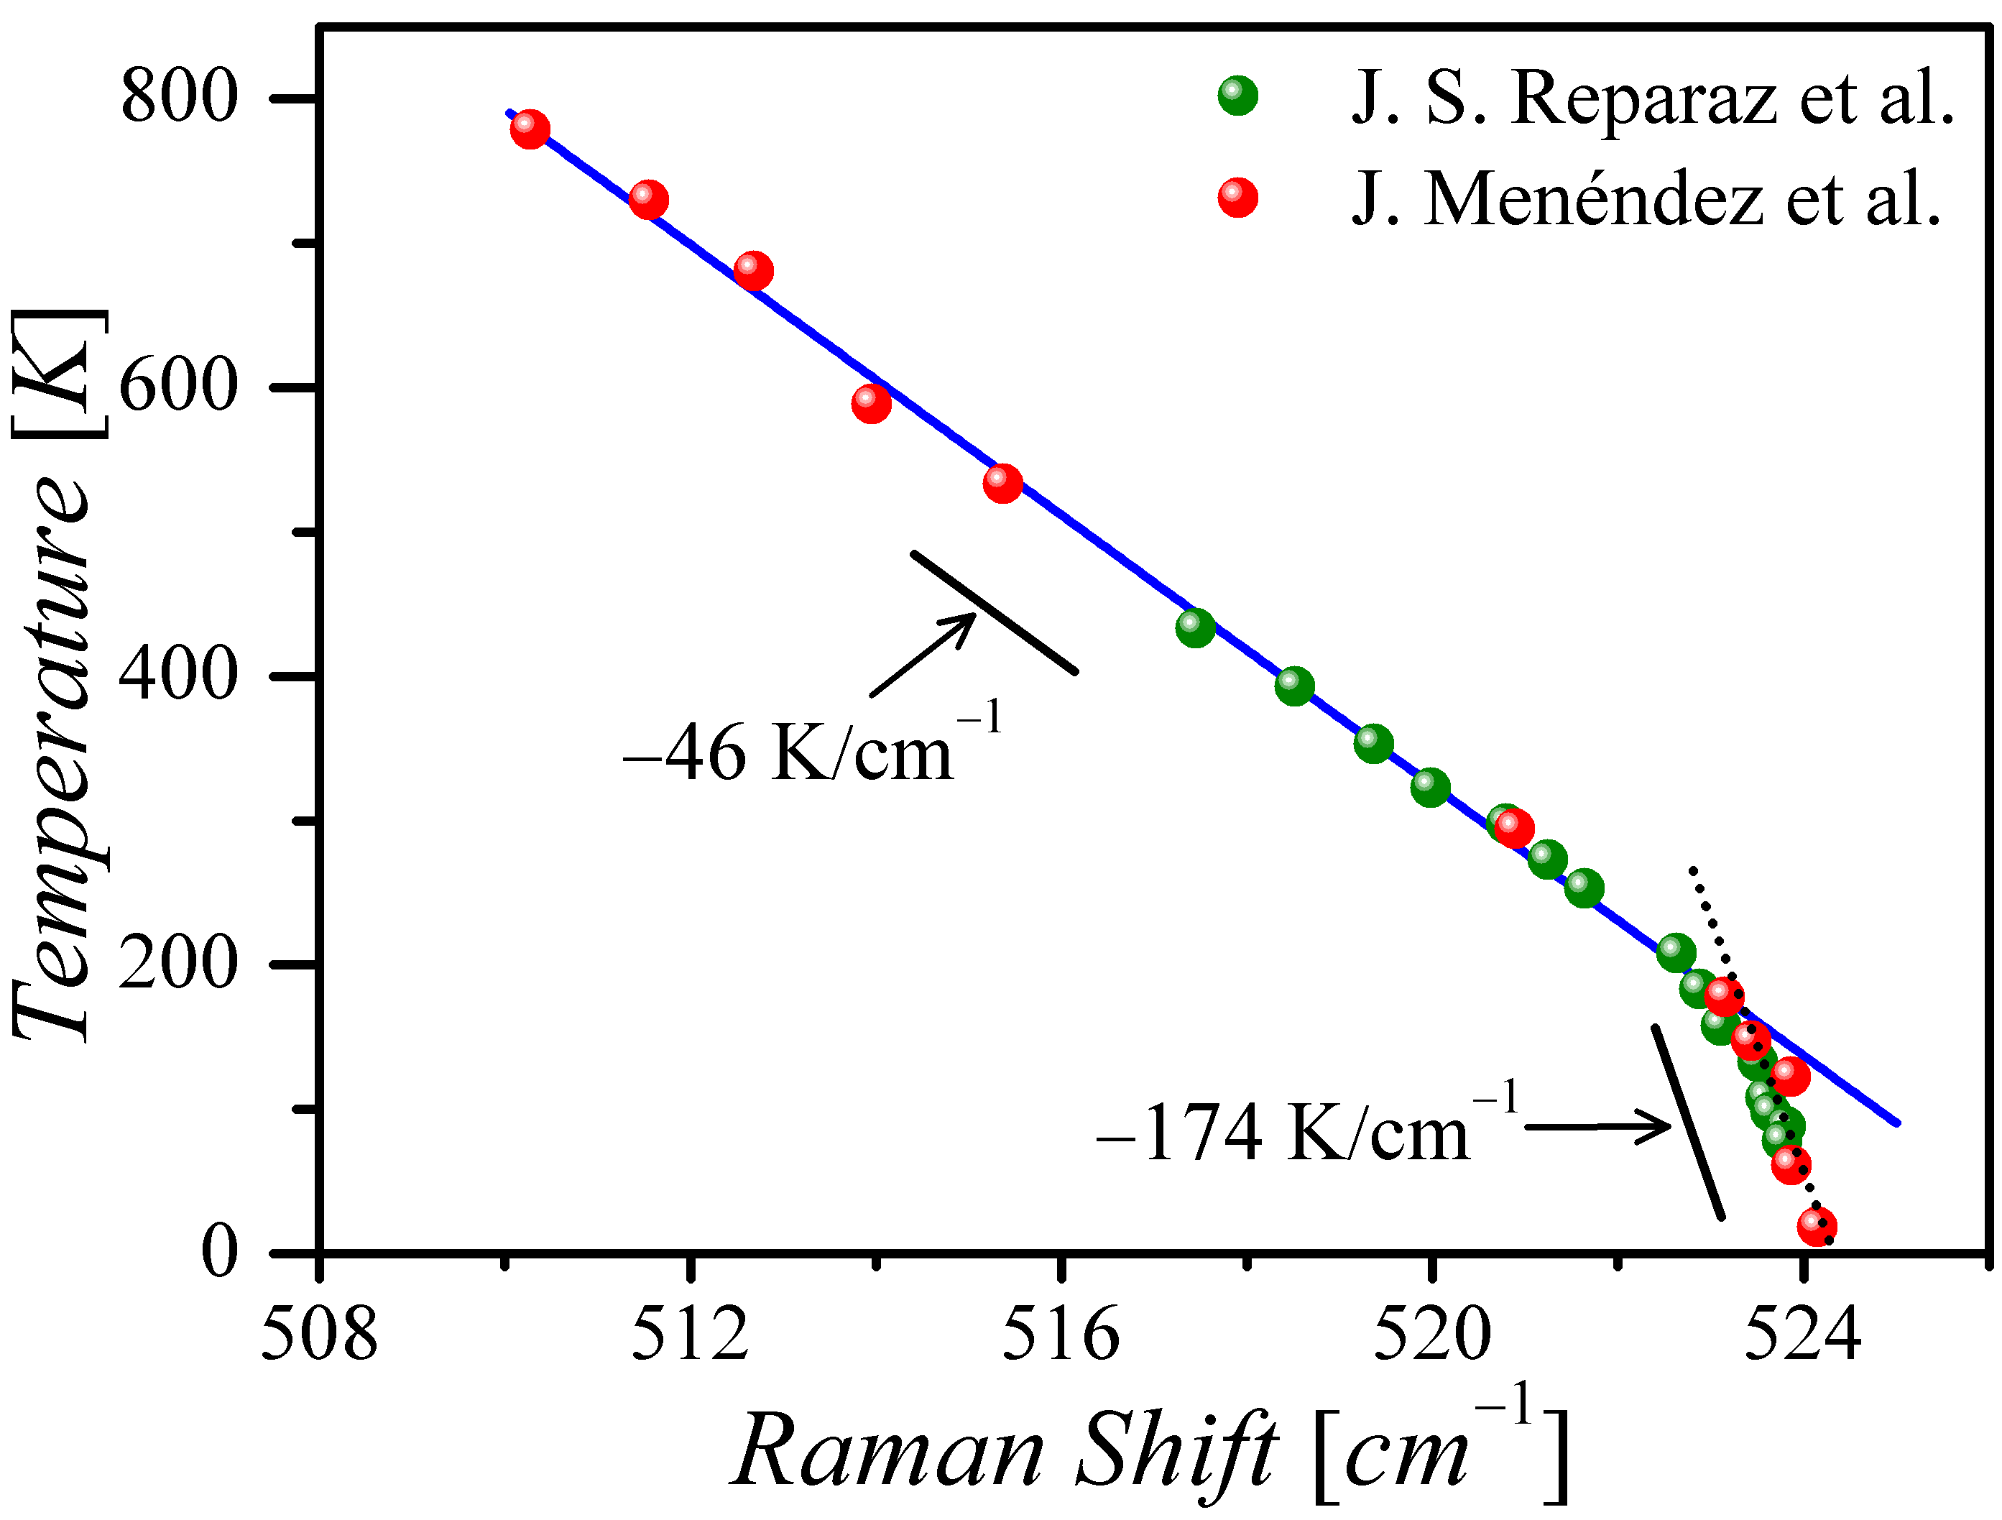
The Theory: Thermal expansion (contraction) effect
LO mode in Silicon
For lower T the solid experiences a thermal contraction
Internal pressure increases
Phonon frequencies increase
Change of energy at constat pressure
α : Compressibility
β : Volume expansion coefficient
Shows how the frequency shifts when pressure is applied at a constant temperature
Energy changes with temperature if the crystal volume is held strictly constant

Slide 12
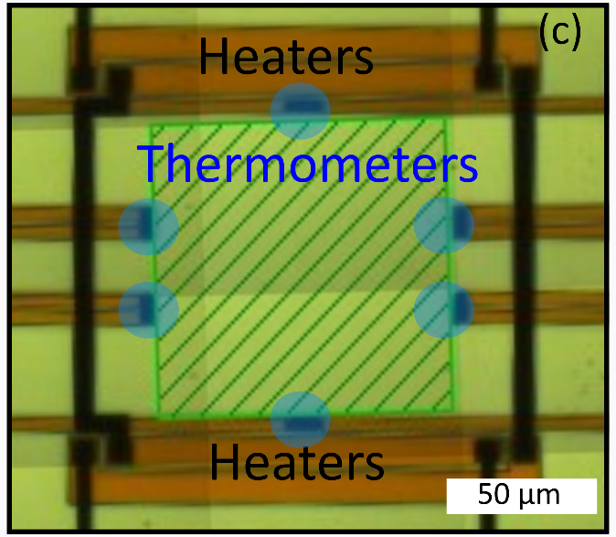

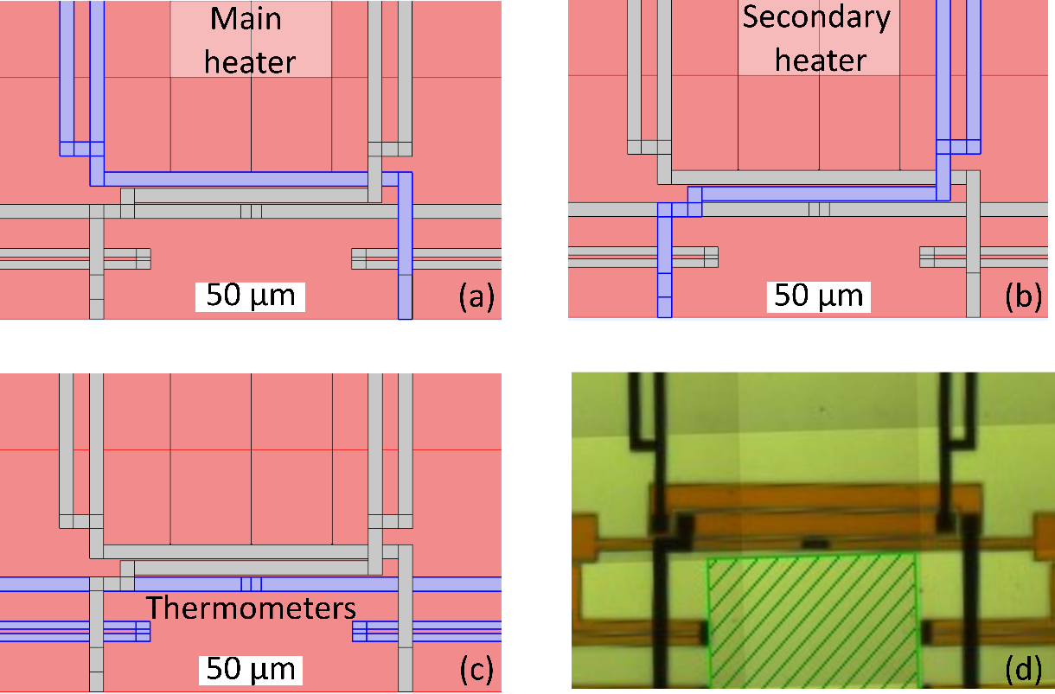
The experiment: Spectra of SiN chip vs T
SiN and heater scheme

Slide 13
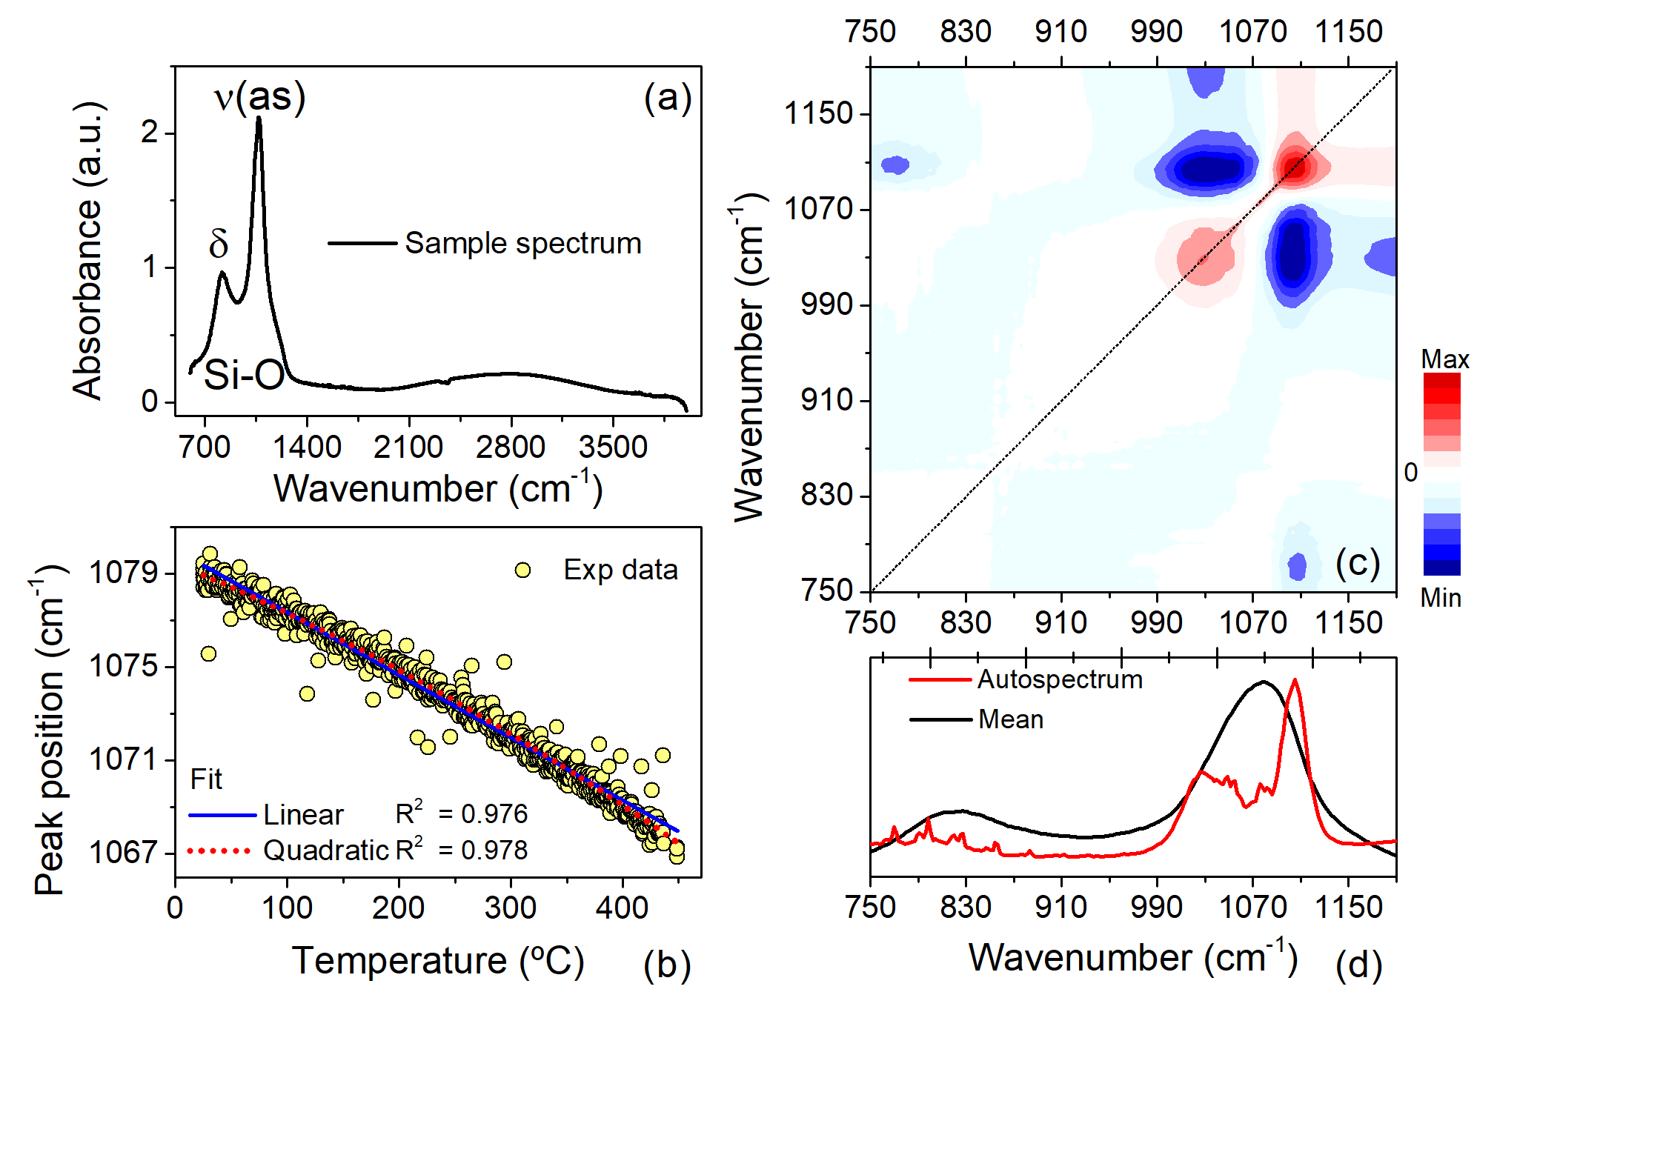
The experiment: Spectra of SiN chip vs T

Slide 14

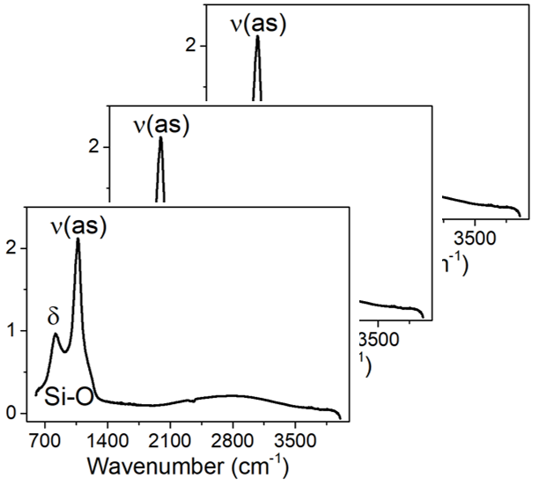

The experiment: Spectra of SiN chip vs T
Steps:
SNV Normalization
Splitting Training/Test (80/20)
Add the map
T1
T2
T3

Slide 15
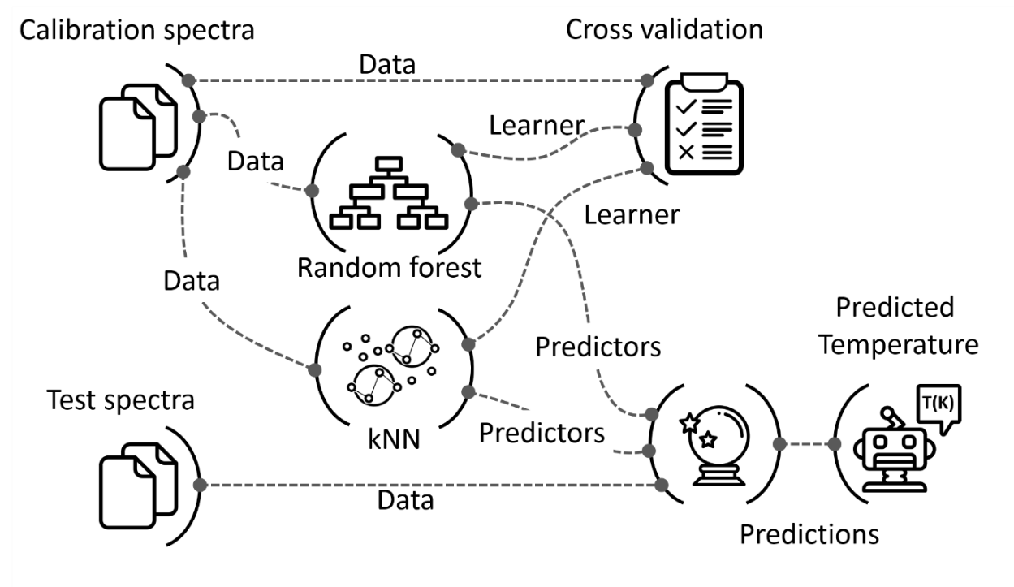
The experiment: pipeline

Slide 16
Results
Table 1 Summary of the machine learning model used in this work
Model | RMSE (ºC) | MAE (ºC) | R²
Linear regression | 9.60 | 5.8 | 0.992
Gaussian Process Regression | 7.10 | 4.2 | 0.996
AdaBoost | 12.16 | 5.9 | 0.988
Random Forest | 12.21 | 5.9 | 0.988
Support Vector Regression | 32.63 | 18.24 | 0.917
Convolutional Neural Networks | 6.53 | 4.13 | 0.997
Fit using peak position

Slide 17
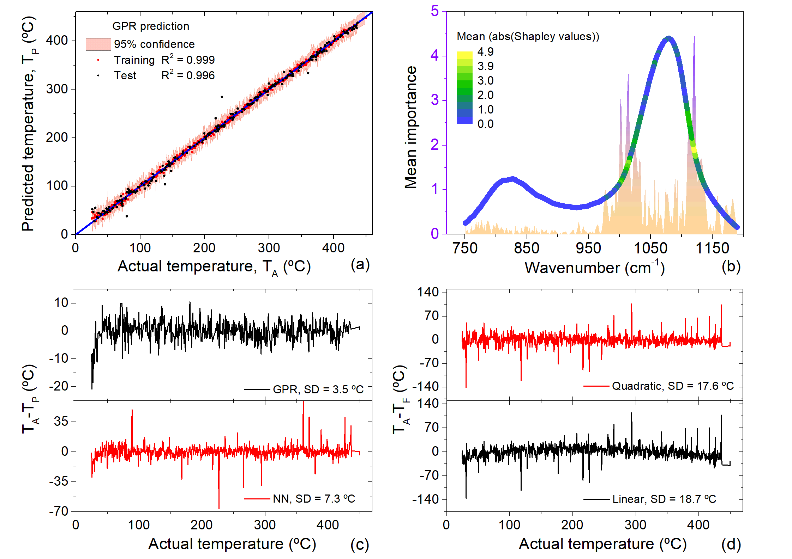
Results

Slide 18
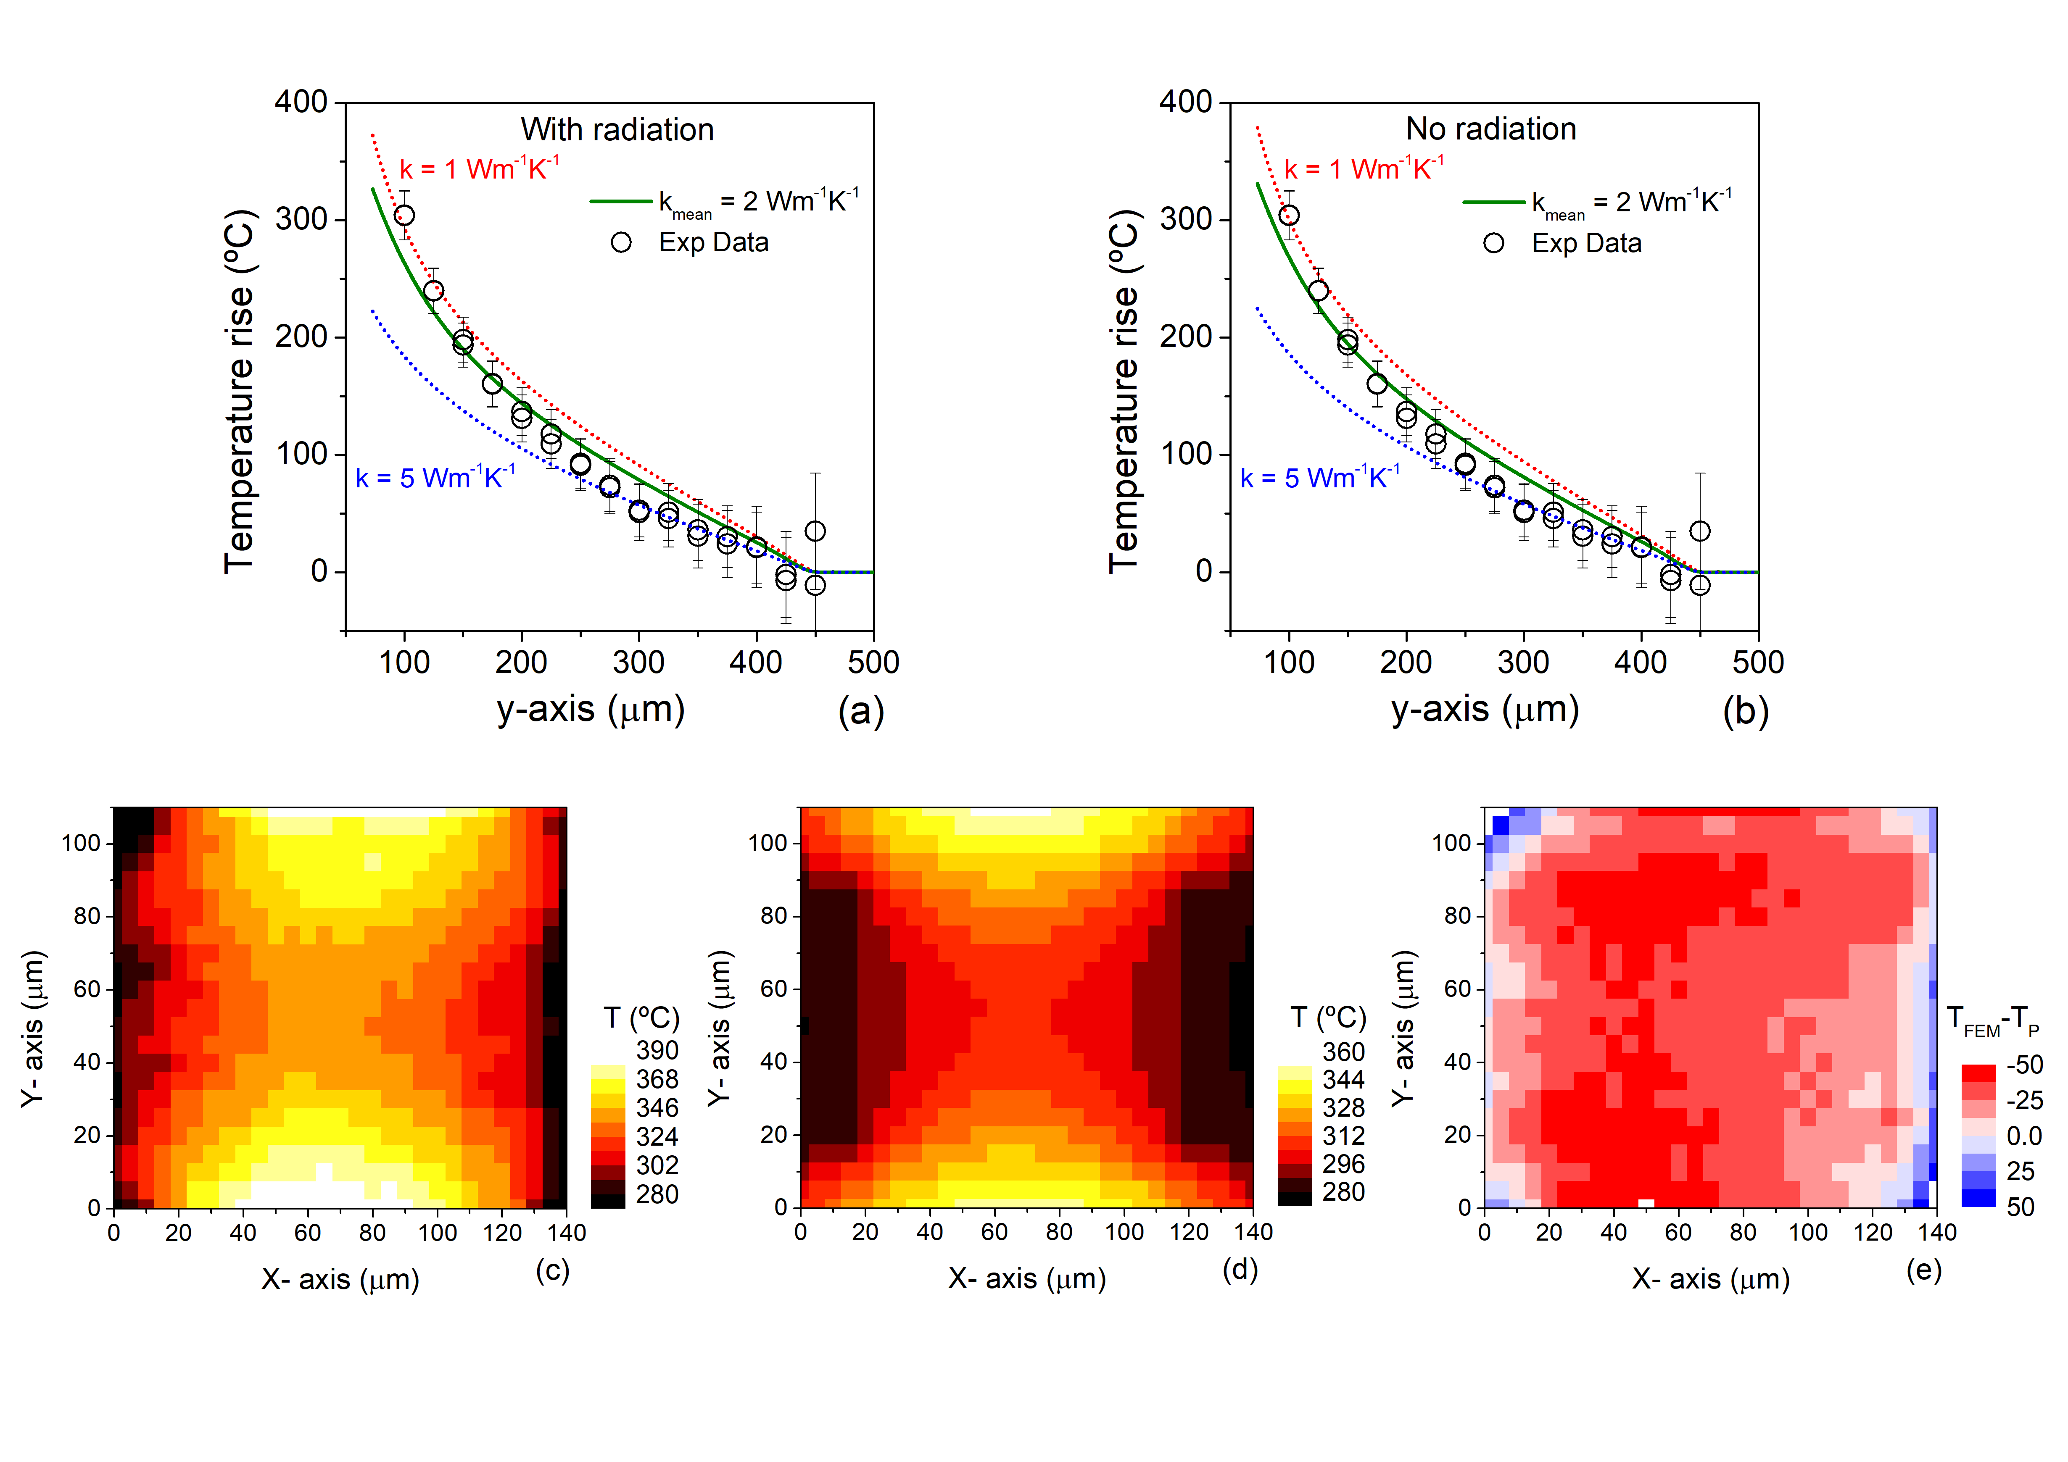
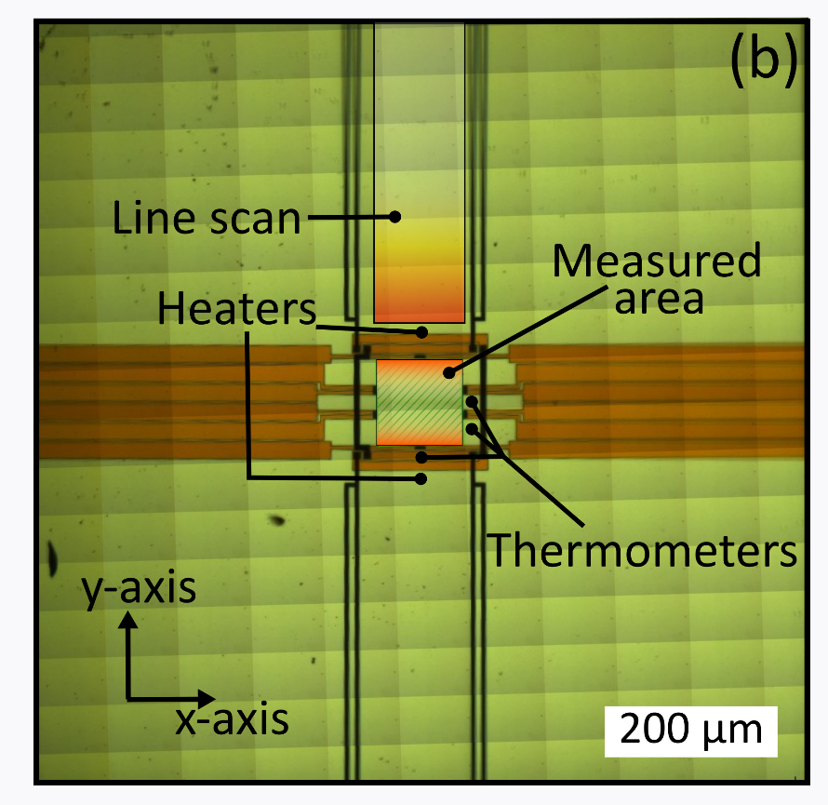
Thermal map of the Chip

Slide 19
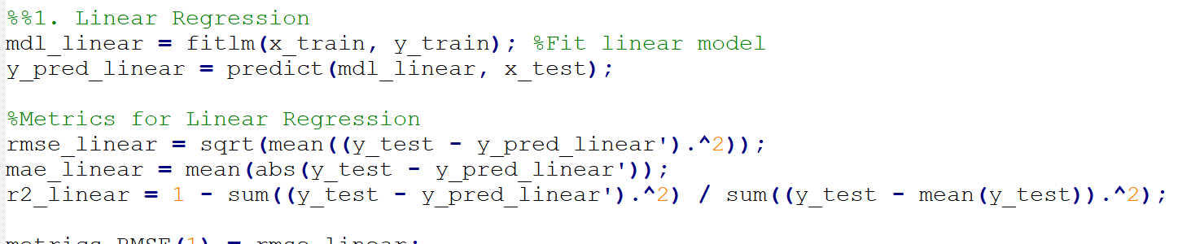
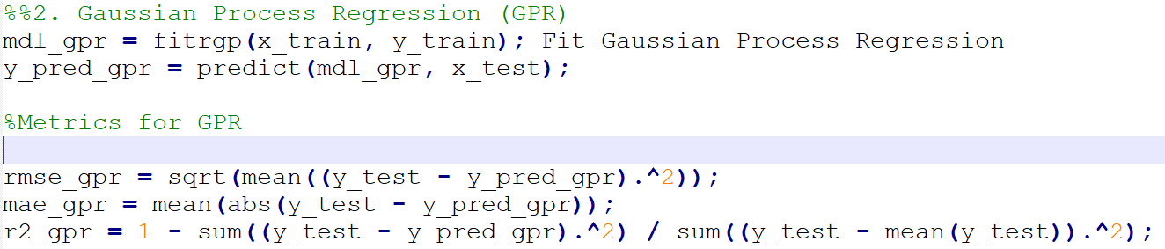
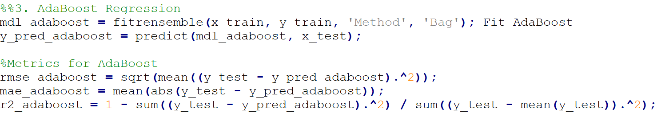
Code

Slide 20
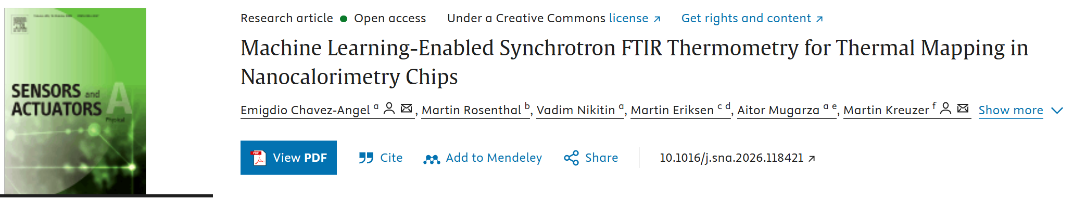
Conclusions
Contactless temperature mapping using SR-FTIR + machine learning
Temperature predicted directly from full IR spectra — no manual peak fitting
GPR offers the best balance of accuracy, robustness, uncertainty estimation and interpretability
ML temperature maps agree well with FEM while capturing local experimental heterogeneity
A scalable approach for automated operando thermometry in synchrotron and microscale devices
DOI: 10.1016/j.sna.2026.118421

Slide 21












Thanks for your attention
Researchers
Vadim Nikitin
Martin Kreuzer
Martin Rosenthal
Martin Eriksen
Aitor Mugarza
RYC2024-048225-I from MICIU/AEI/10.13039/501100011033 and FSE+

Slide 22

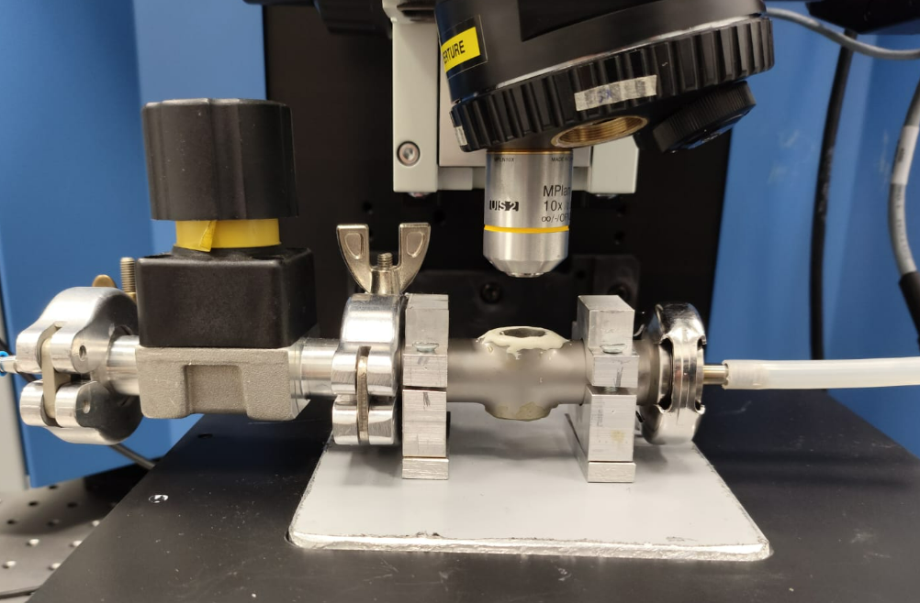
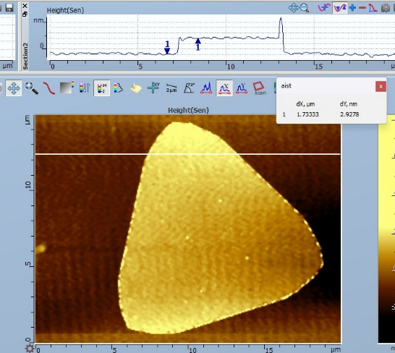
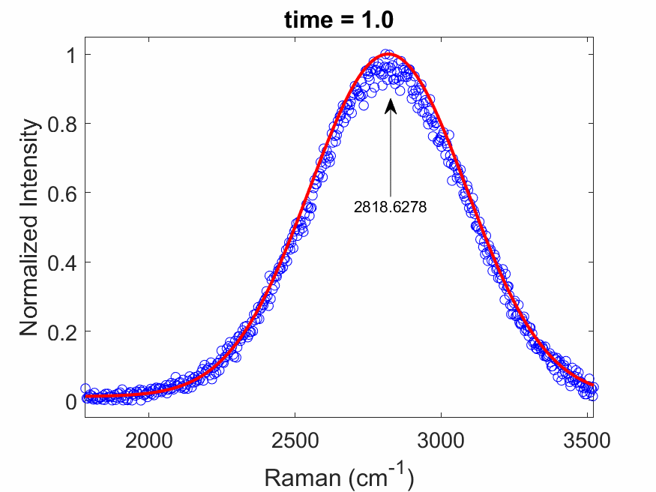
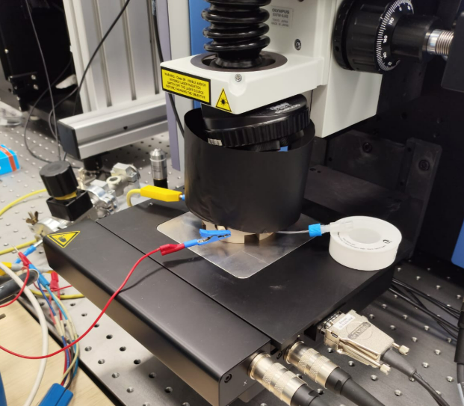
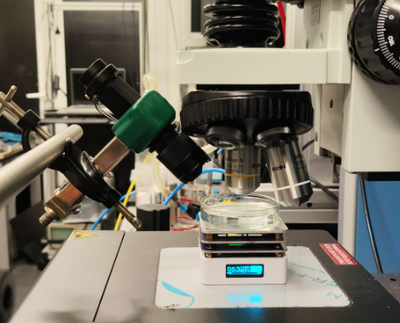
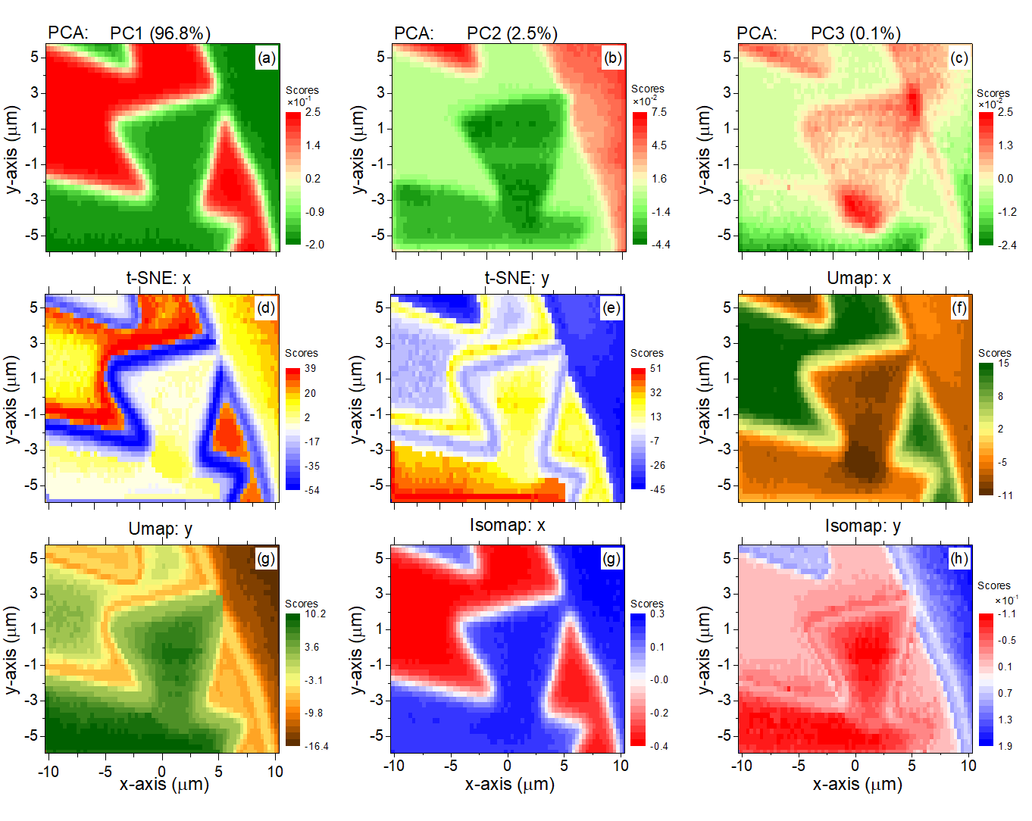
Environmental Photon SPM SM05: Ramen-Lab
μ-Raman/ μ- PL 3 lasers ( 532, 633, 785 nm)
SPM modes (AFM, KPFM, MFM, …)
Tip enhanced modes (TERS/TEPL) < 2 nm
4 grating (300, 600, 1800 & 2400) ≤ 0.2 cm⁻¹
Low temperature (80K, MIRAS)
Polarization kit
EC-Cells (MIRAS and ICN2)
Gas-sensing cell (ICN2)
Strain stage (RT, Miras stage)
Low frequency filters (≤ 4 cm⁻¹)
Chemometric and ML analysis
Custom made scripts for data analysis
Insitu analysis
Gas sensing
Photochemistry
EC Cell

Slide 23

ML-driven Thermal mapping Using SR-FTIR Spectroscopy
Emigdio Chavez-Angel
Aitor Mugarza
E-mail: emigdio.chavez@icn2.cat

