Slide 1
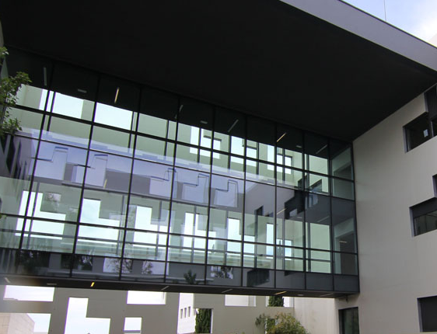





Purifying drinking water with Nafion thin films:
a HAXPES study
J. Fraxedasª, M. J. Esplandiu,ª O. Muntada,^{b} F. Pérez-Murano,^{b} D. Céolin,^{c} J.-P. Rueff^{c}
ªICN2-CSIC-BIST, Campus UAB, 08193 Bellaterra, Barcelona
^{b}IMB-CNM-CSIC, Campus UAB, 08193 Bellaterra, Barcelona
^{c}Synchrotron SOLEIL, L’Orme des Merisiers, 91190 Saint-Aubin, France
jordi.fraxedas@icn2.cat

Slide 2


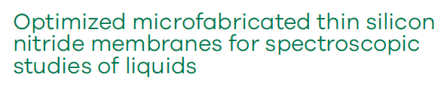
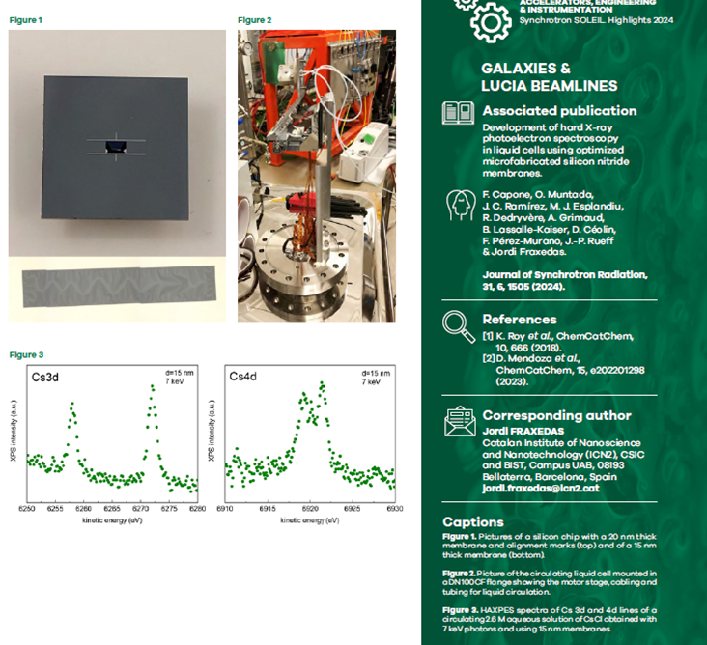

Si3N4 membranes HAXPES
SOLEIL - Highlights 2024

Slide 3
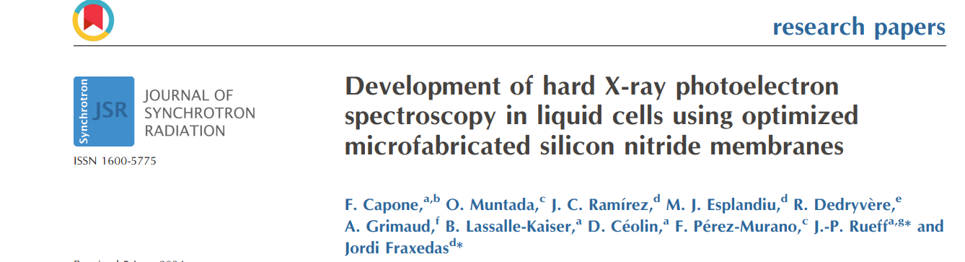
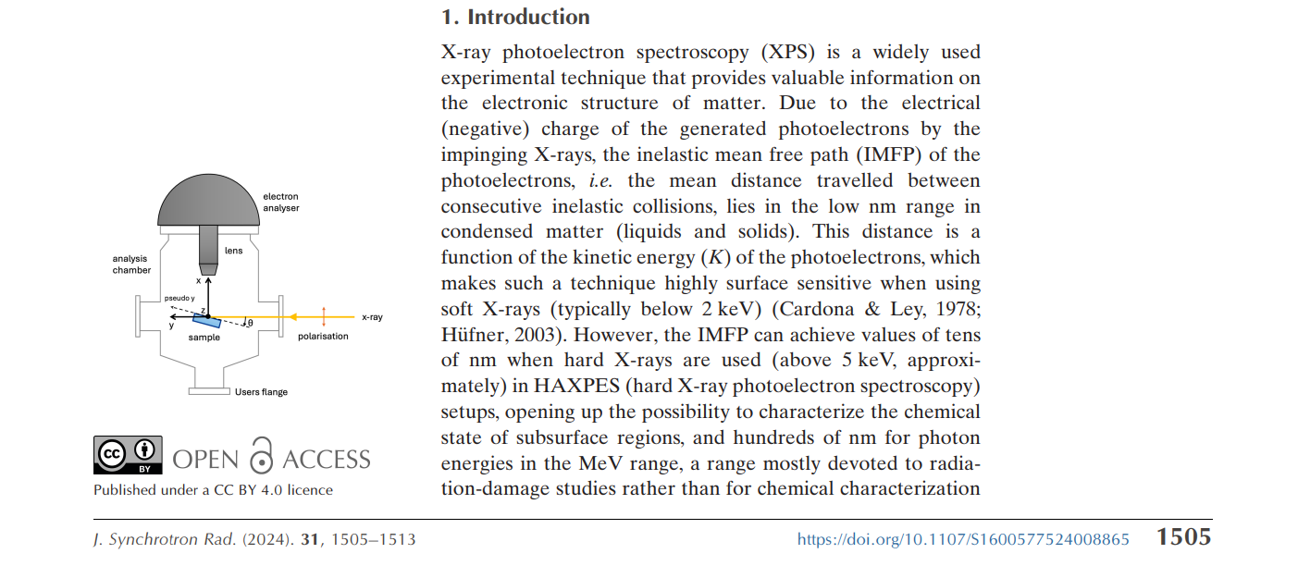

Slide 4
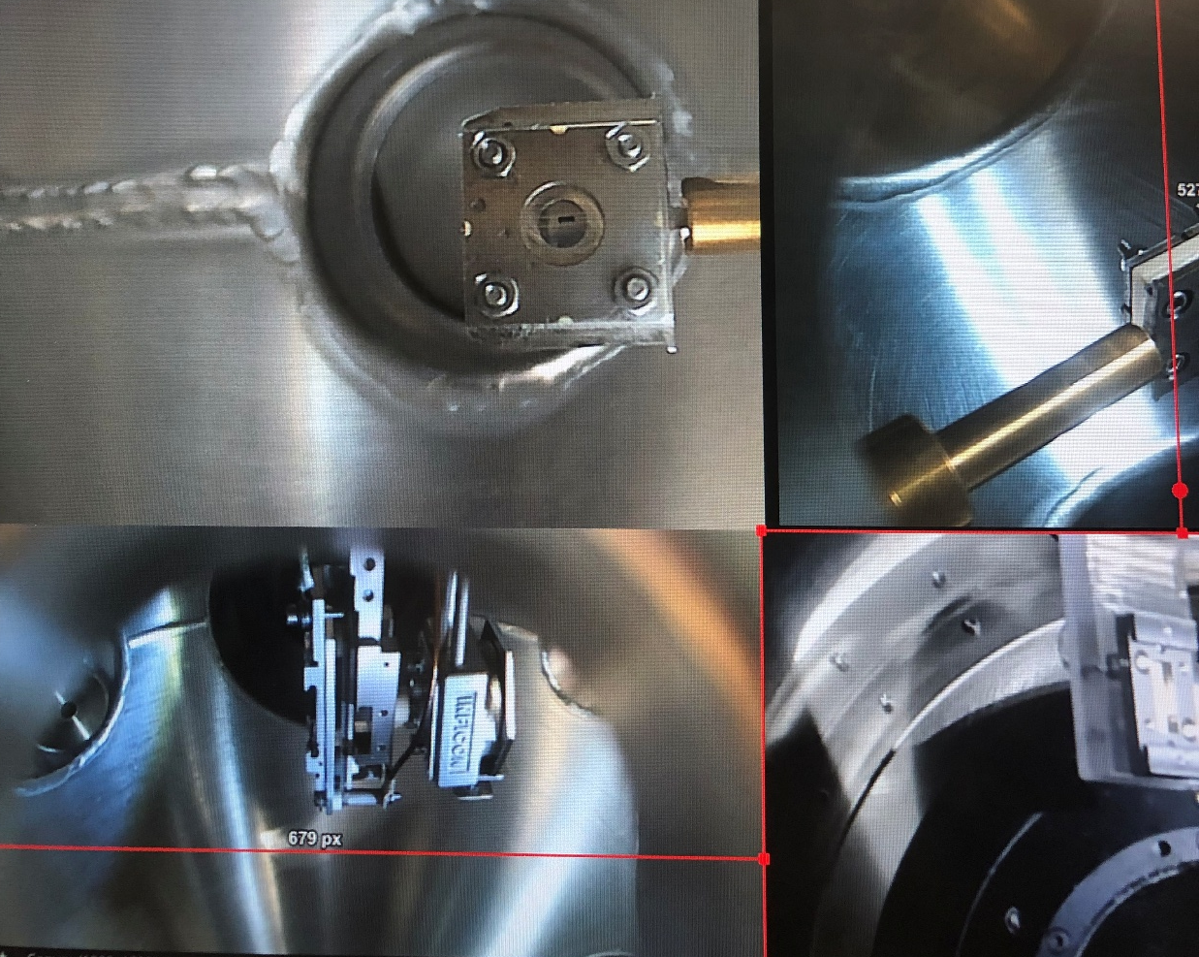
Outline
Objective
Experimental details
XPS & HAXPES results
Conclusions

Slide 5
Objective/Framework
Determining the intrinsic electronic structure of the surfaces of soft materials, typically polymers, that are easily degraded when exposed to X-ray radiation is a crucial matter that must be addressed meticulously. Before any consistent characterization is undertaken, it is mandatory to determine the damage caused by the radiation and set the optimal running parameters of the specific XPS instrument used for the experiments. Here, we propose a systematic method to carry out such a task and apply it to the case of Nafion, a well-known and widely used material, and focus on its ability as thin films to efficiently capture divalent metal cations such as Cd²⁺ and Pb²⁺, two common toxic contaminants of drinking water. Nafion films have the potential for efficient and fast water purification strategies for environmental remediation and requires a detailed analysis to ascertain the ionic-exchange mechanisms involved at the Nafion/water interfaces.

Slide 6
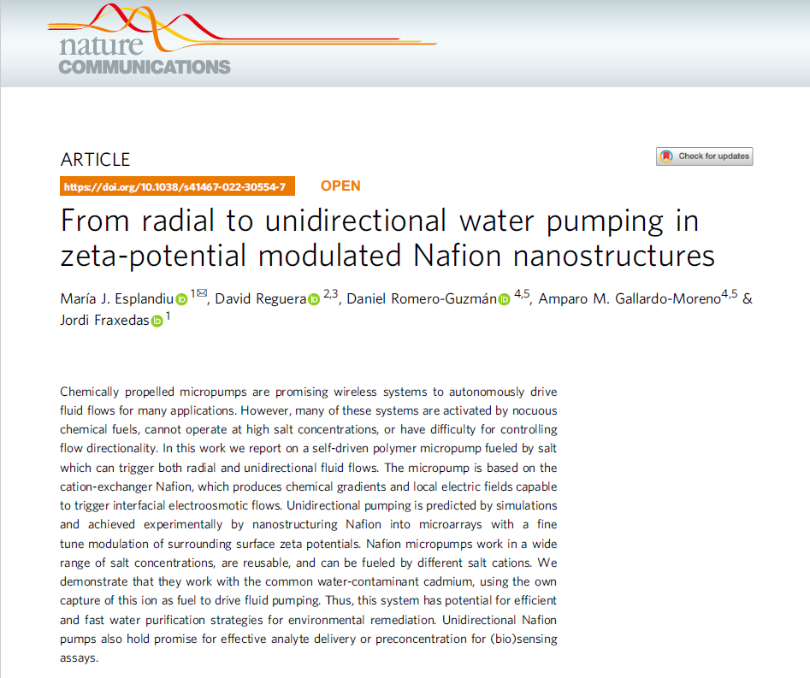
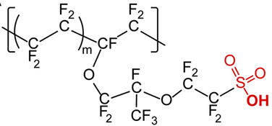
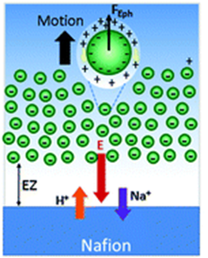
Nafion films
Nat Commun 13, 2812 (2022)
well-known ion-exchange polymer
exclusion zone (100s μm » λ_{D})
water mass flow induced by Nafion

Slide 7
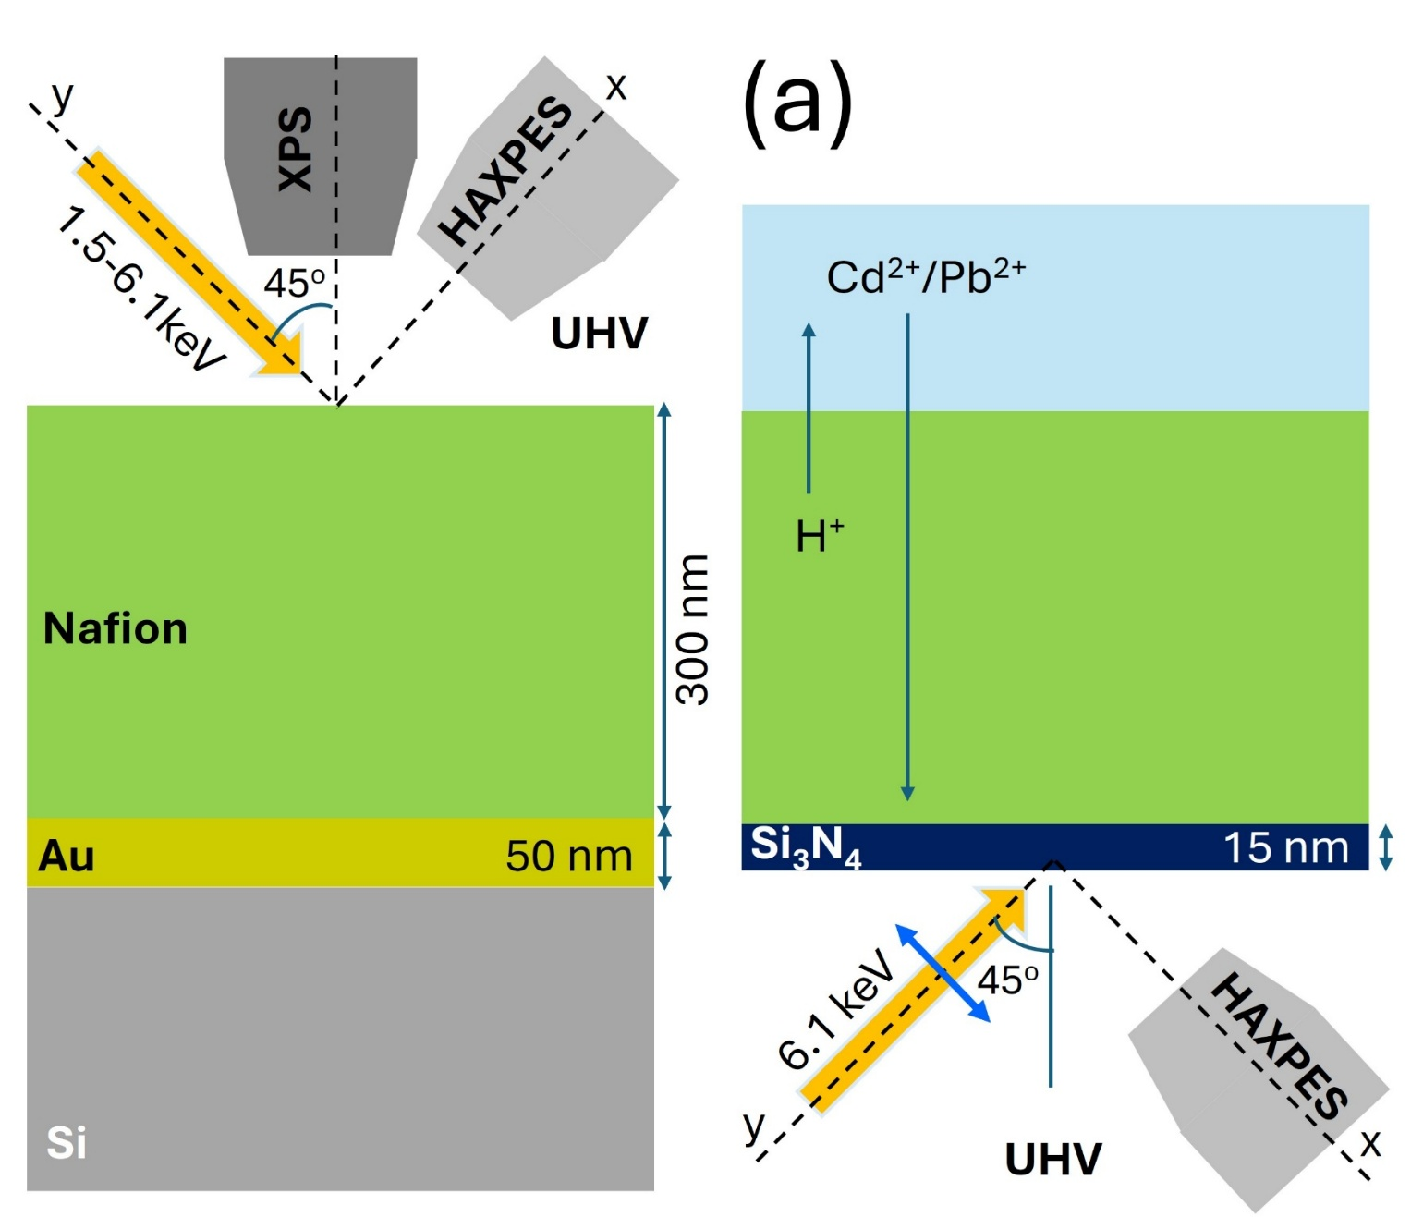
Experimental details
Spin coating

Slide 8
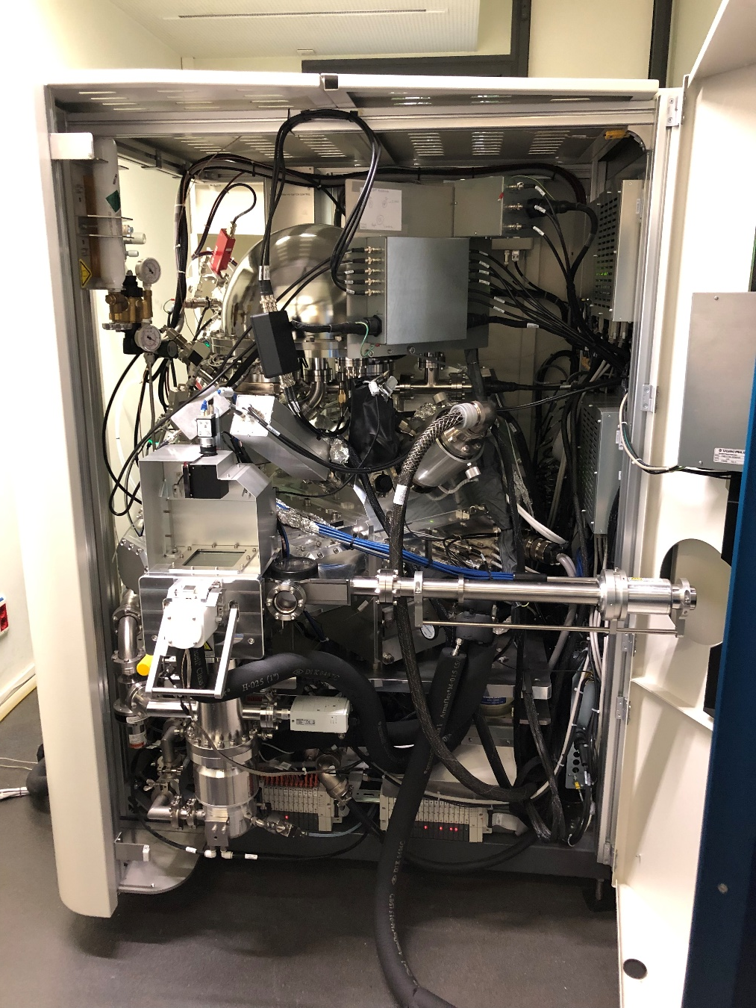
XPS@ICN2
PHI-Genesis system from ULVAC-PHI
Fully Automated Scanning XPS Microprobe
microfocused (φ ≈ 200 um) monochromatic 1486.6 eV source operated at 50 W
surface charging compensation: low-energy electron and argon ion guns (1.0 V, 20.0 μA and 115 eV, 5 mA, respectively).

Slide 9
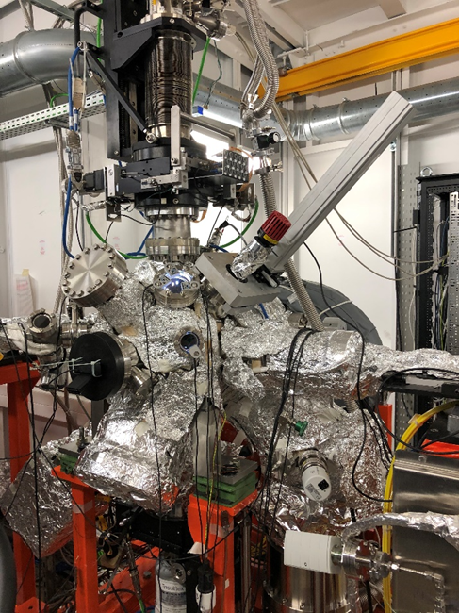
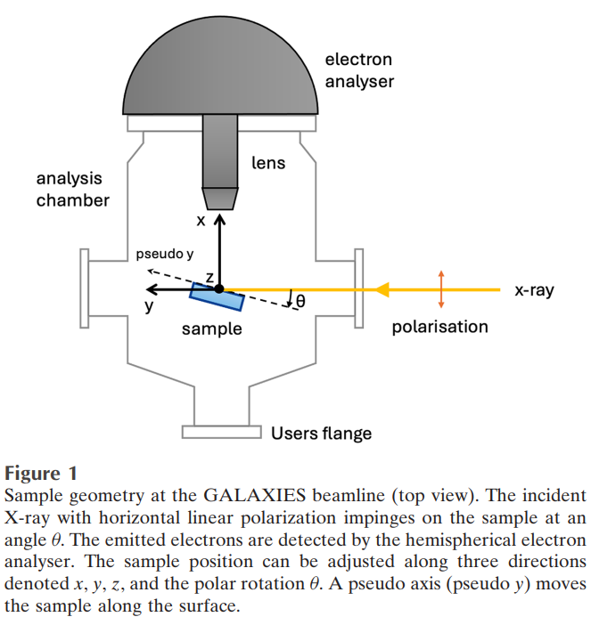
HAXPES@GALAXIES SOLEIL
Scienta EW 4000

Slide 10
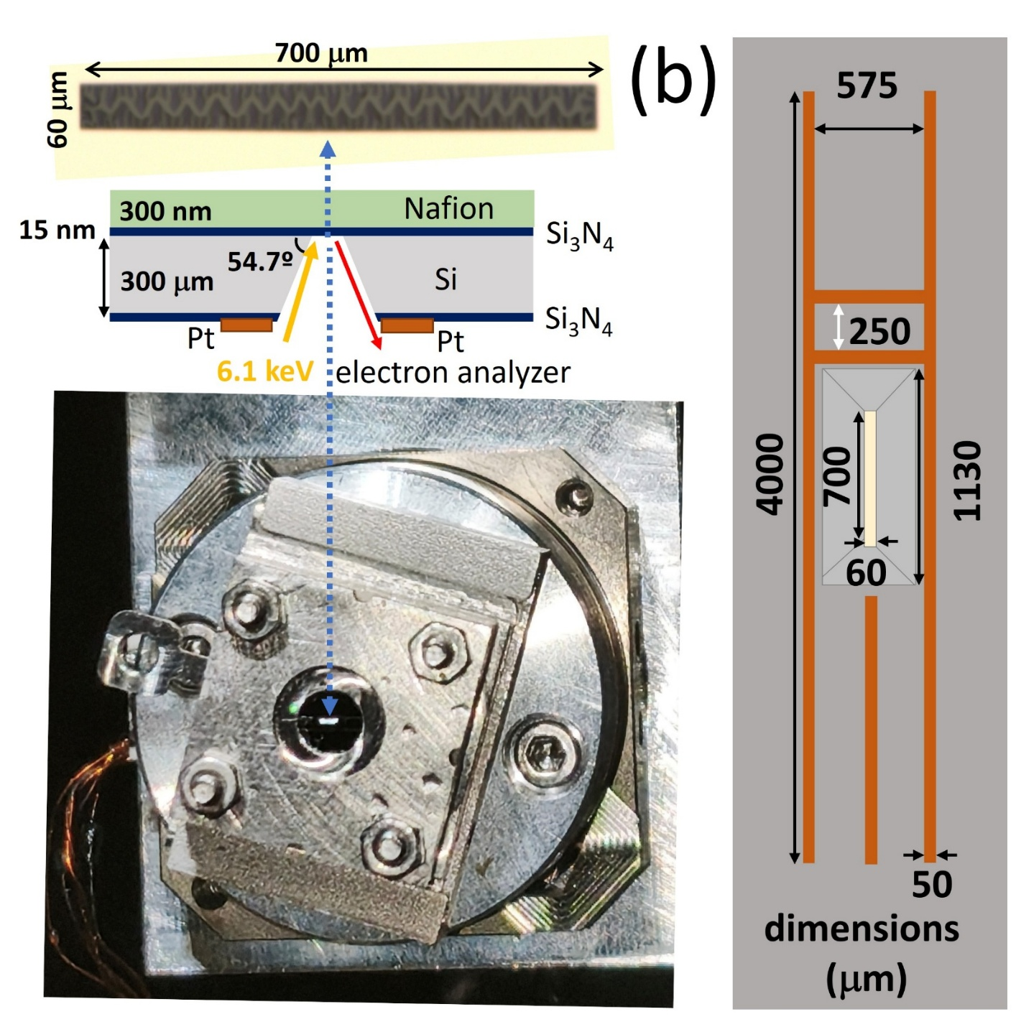
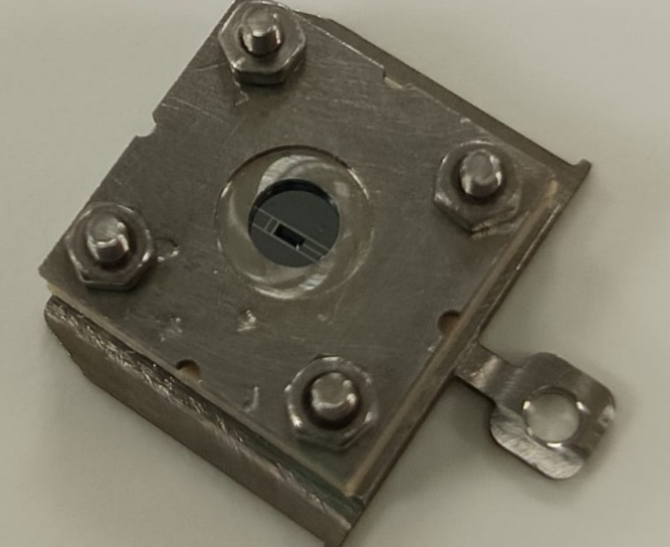
XPS@ICN2

Slide 11
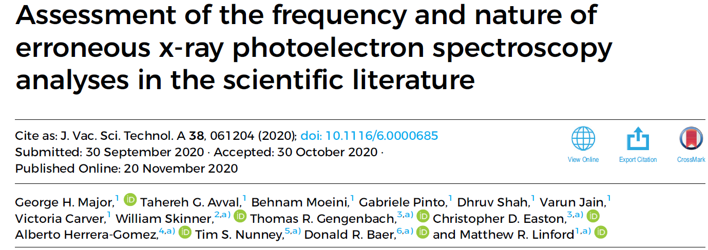
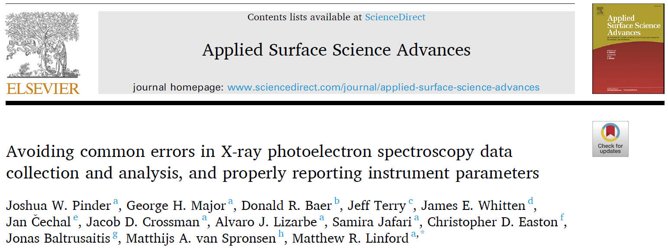
https://doi.org/10.1016/j.apsadv.2023.100534

Slide 12
Experimental results
y
ex situ
XPS
UHV
Cd²⁺/Pb²⁺
10⁻³ M
CdCl₂/ PbCl₂
1h
1.5 keV
45º
Cd²⁺/Pb²⁺
H⁺
Nafion
300 nm
Nafion
300 nm
Au
50 nm
Au
50 nm
Si
Si

Slide 13
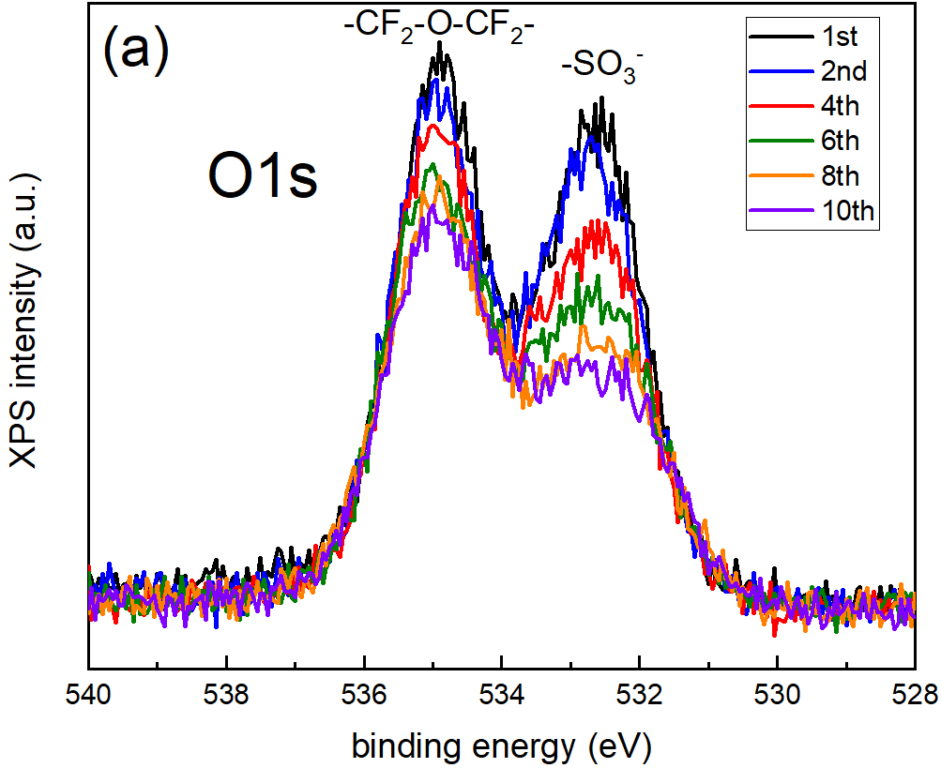
Beam damage
Nafion film soaked in 10⁻³ M HCl (protonated)
Temporal evolution (10 cycles) of the O1s line taken at a fixed point
Charge compensation was used to mitigate surface charging
Scan time is 39 s (scan energy = 12 eV, 0.05 eV/step and 0.16 s dwell time)
Time elapsed between two consecutive spectra is 50 s.

Slide 14
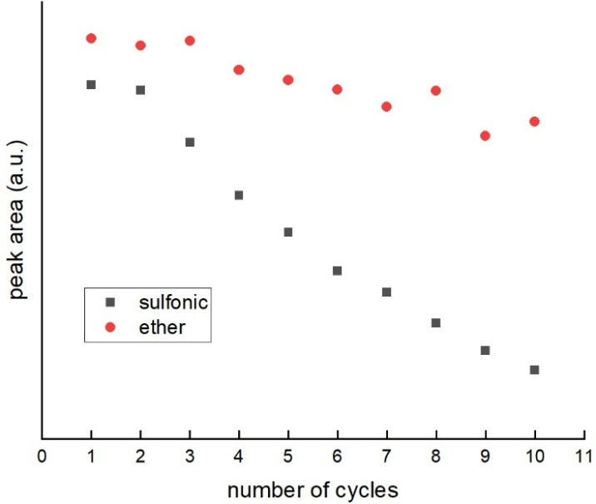
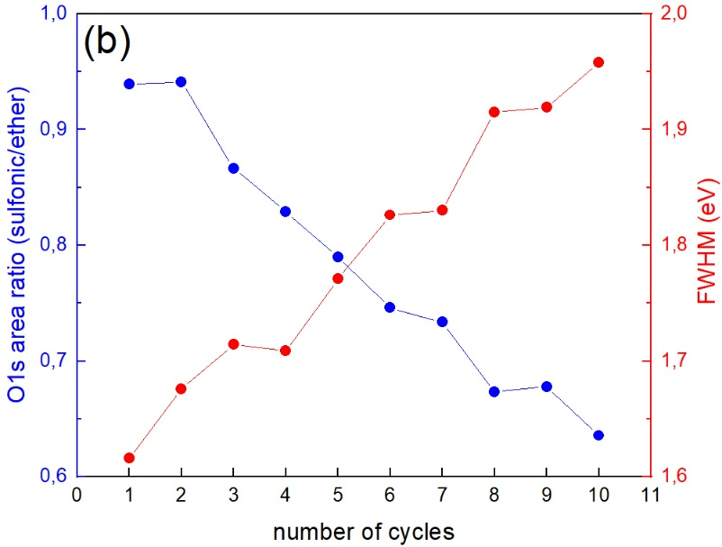
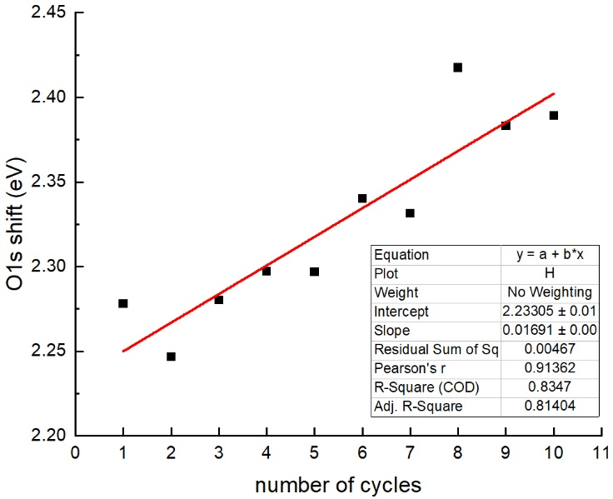
The continuous increase of FWHM is a clear indication of the degradation of the Nafion material exposed to the beam. Thus, for the specific XPS instrument and experimental conditions used in our experiments, the maximum acquisition time should be less than 1 min to obtain reliable results of the intrinsic properties of Nafion (i.e., without degradation).
deprotonation of the sulfonic acid

Slide 15
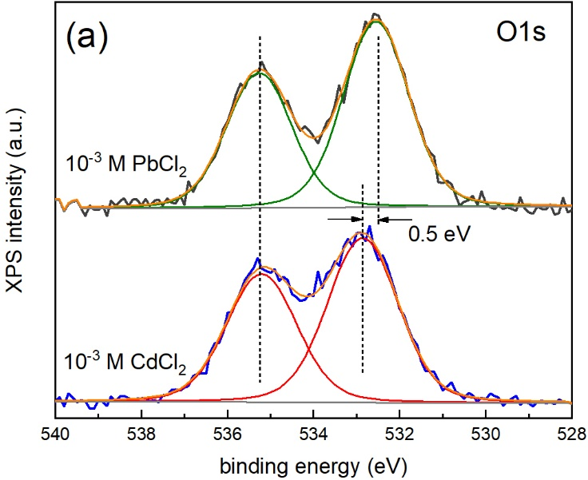
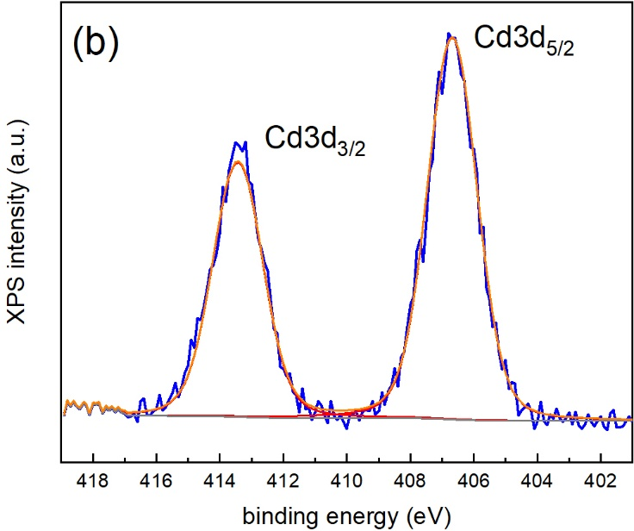
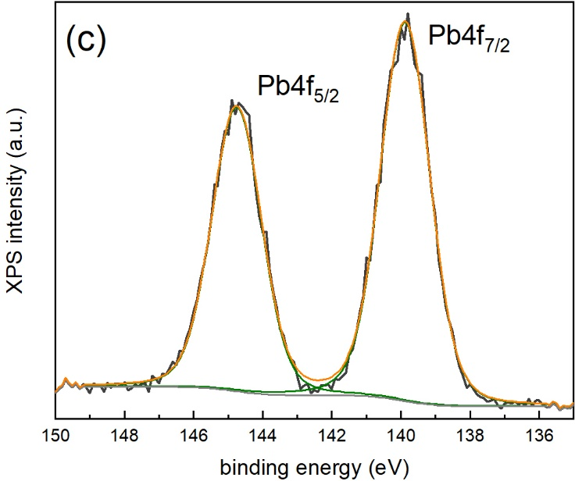
Single scan XPS spectra of the O1s line taken in fresh points of two different Nafion samples after being soaked in 10⁻³ M solutions of PbCl₂ (top) and CdCl₂ (bottom), respectively
Single scan XPS spectra of the Cd3d (31 s) and Pb4f (24 s)

Slide 16
y
x
ex situ
UHV
HAXPES
Cd²⁺/Pb²⁺
10-3 M
CdCl₂/ PbCl₂
1h
6.1 keV
UHV
Cd²⁺/Pb²⁺
H⁺
Nafion
300 nm
Nafion
300 nm
Au
50 nm
Au
50 nm
Si
Si

Slide 17
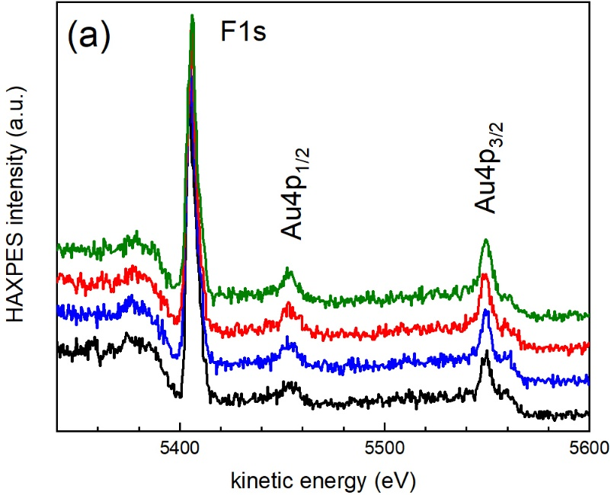
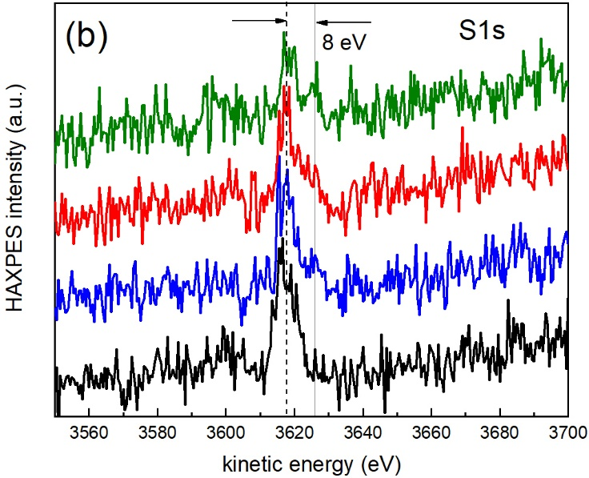
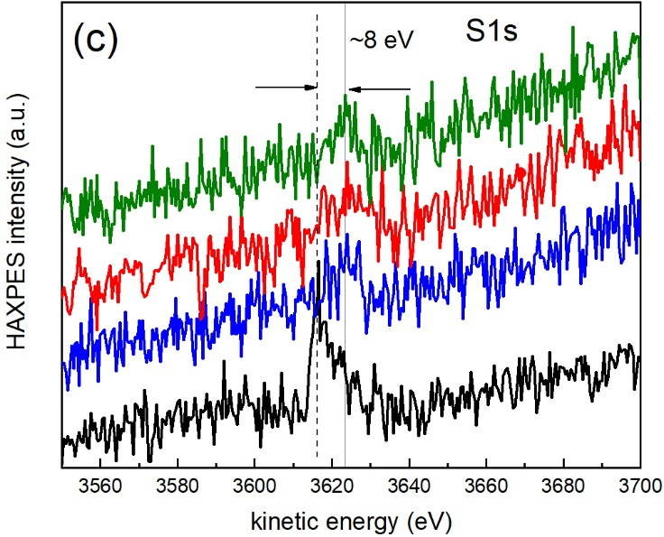
Acquisition time(s)/cycle = 165 s: 120 s (F1s) + 45 s (S1s) = 165 s
Scan times = 93 and 36 s for the F1s and S1s lines, respectively.
Total acquisition time = 660 s (4 cycles).
Total exposure to the beam of 8250 s (50 cycles).
With the used experimental parameters (photon energy, filters, dwell time, step energy, etc.), acquisition time should be less than 165 s when both F1s and S1s are measured but could be significantly less if only one line is explored and the scan width is reduced.

Slide 18
Cd²⁺/Pb²⁺
H⁺
300 nm
Cd²⁺/Pb²⁺ ??
Si₃N₄
15 nm
45º
6.1 keV
HAXPES
y
x
UHV

Slide 19
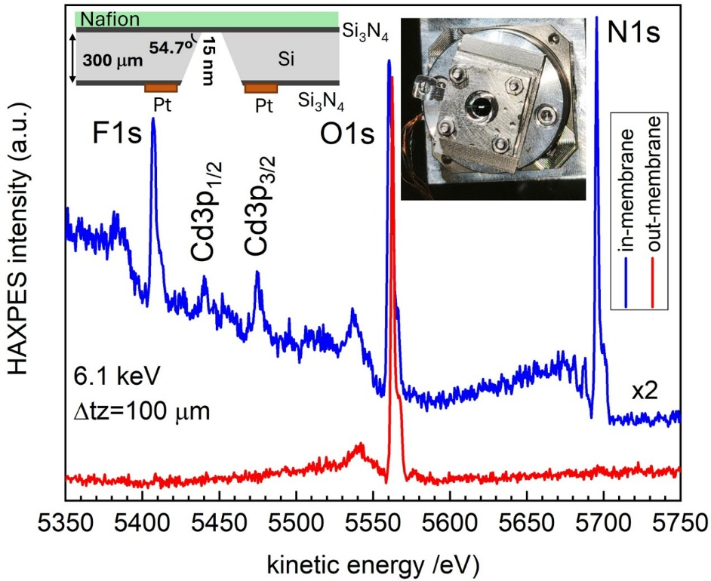
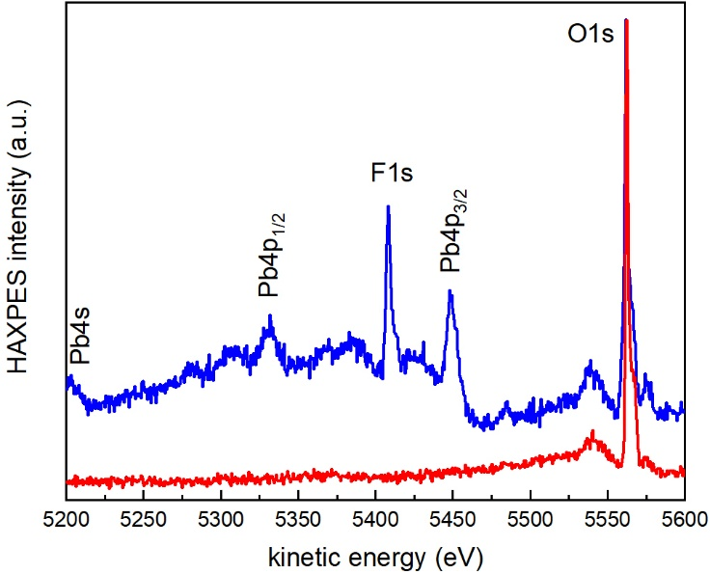
z
100 um
60 um
Step energy is 0.5 eV and scan and acquisition times are 118 and 140 s, respectively.

Slide 20
The inelastic mean free path of electrons in Si₃N₄ is about 9.3 nm for 5.5 keV electrons (Cd3p_{3/2} and Pb4p_{3/2} core levels excited with 6.1 keV)
Since the membranes are 15 nm thick, the signal arises mainly from the membrane/Nafion interface.
R. Dedryvère

Slide 21
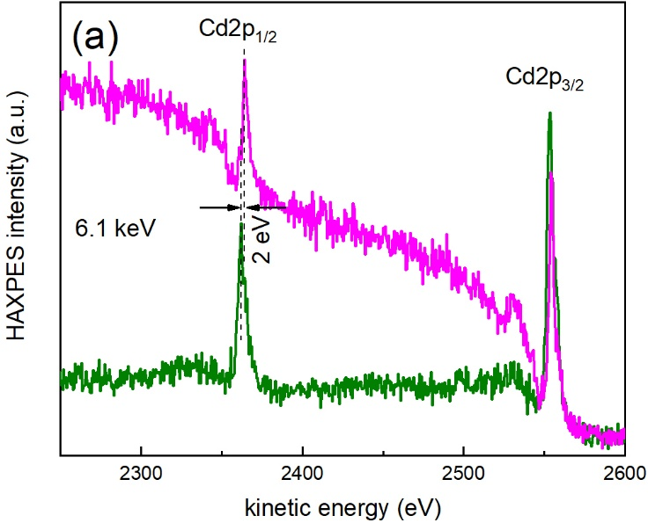
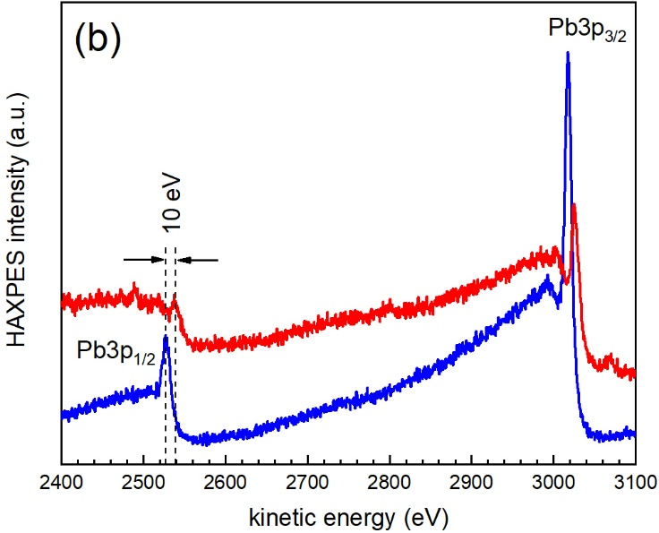
HAXPES spectra of the (a) Cd2p and (b) Pb3p regions obtained with 6.1 keV photons of Nafion thin films deposited on gold (below) and silicon nitride (above), respectively, soaked with the corresponding 10⁻³ M solutions.
Surface charging is not a major problem

Slide 22
Conclusions and Outlook
We have characterized the efficient absorption of cadmium and lead cations by Nafion thin films with XPS and HAXPES upon exposure to aqueous solutions
These cations interact with the sulfonate groups forming ionic salts upon exchange of protons and diffuse all over the bulk of the film
The Nafion films have been prepared by spin coating on gold films and on thin silicon nitride membranes used in environmental liquid cells
Before such study, the optimal experimental conditions were set to reduce beam damage to negligible limits. Thus, despite the high radiation-sensitivity of Nafion, the intrinsic electronic structure can be determined, provided that short single scans (<60s) on fresh points are performed
This unavoidably compromises high-energy resolution experiments
Future experiments using circulating liquid cells are foreseen

Slide 23




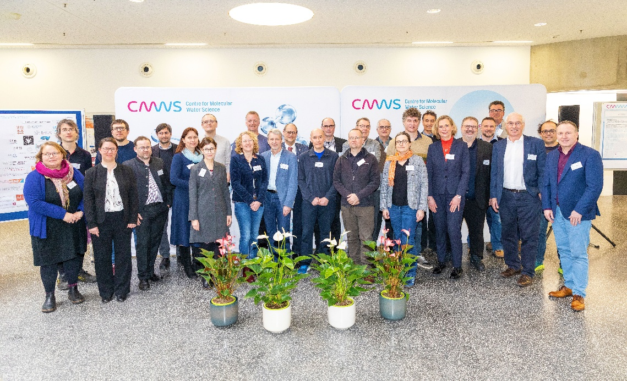

This project has received funding from the European Union’s Horizon 2020 research and innovation programme, under grant agreement No 101007417 NFFA-Europe Pilot and the Spanish Ministry of Science and Innovation (MCIN) under Contract No. PID2024-161974NB-I00.
Founding member

Slide 25
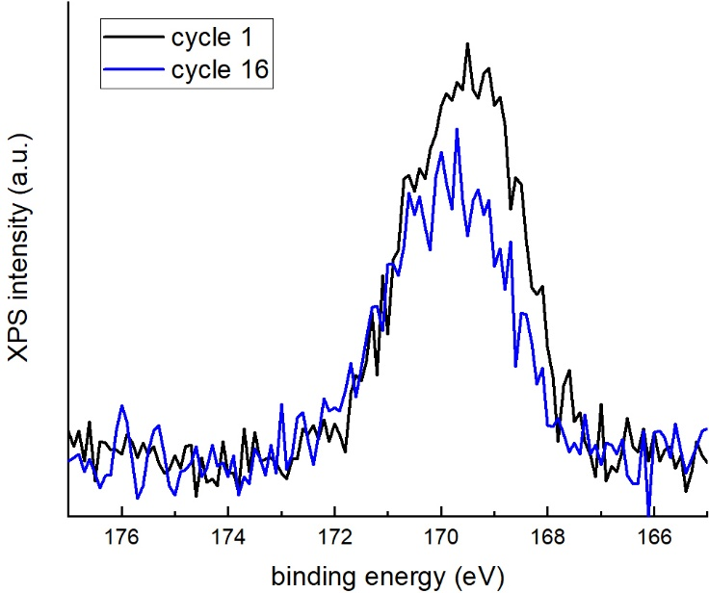
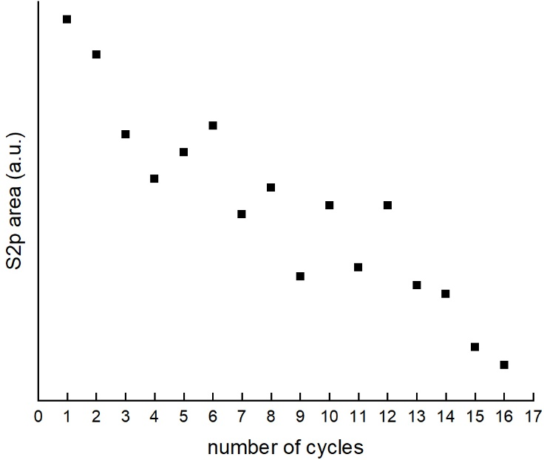
S2p
Temporal evolution over 16 cycles of the S2p line taken at a fixed point of a Nafion film previously soaked in a 10⁻³ M CdCl2 solution with microfocused (ca. 200 um diameter) monochromatic 1486.6 eV photons at 50 W.
Charge compensation was used to mitigate surface charging.
The scan time for each spectrum is 20 s (scan energy = 12 eV, 0.1 eV/step and 0.16 s dwell time).
Time elapsed between two consecutive spectra is ca. 30 s.

Slide 26
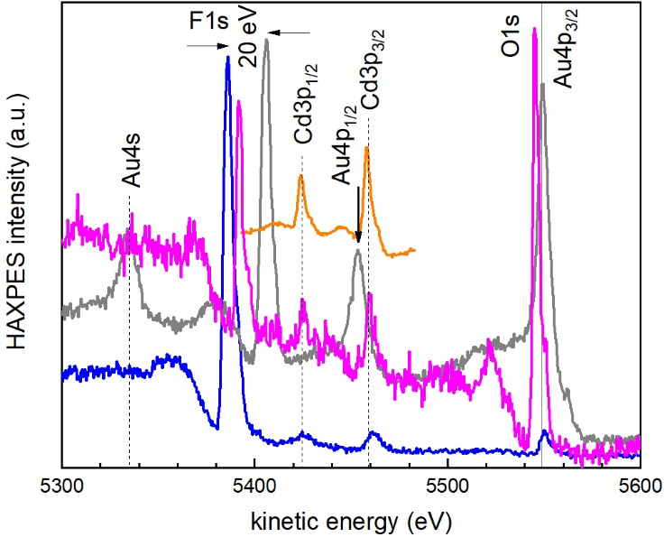
HAXPES spectra of the (a) Cd2p and (b) Pb3p regions obtained with 6.1 keV photons of Nafion thin films deposited on gold (below) and silicon nitride (above), respectively, soaked with the corresponding 10⁻³ M solutions.
Surface charging is not a major problem

Slide 27
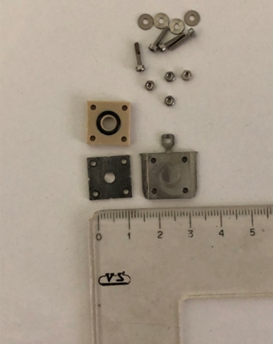
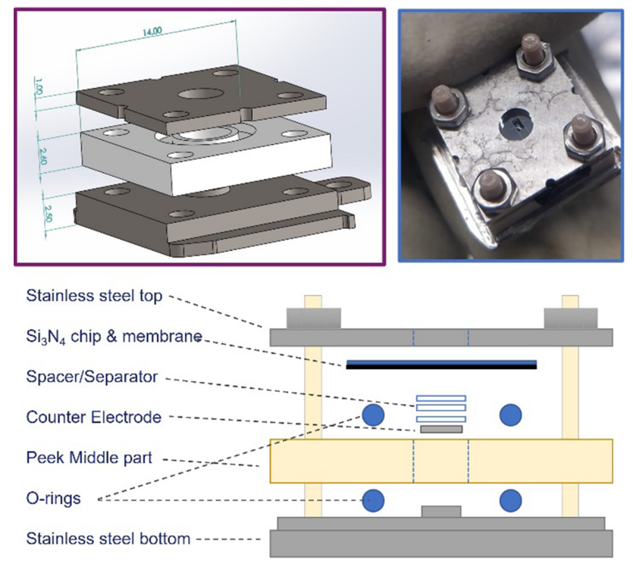

Slide 28


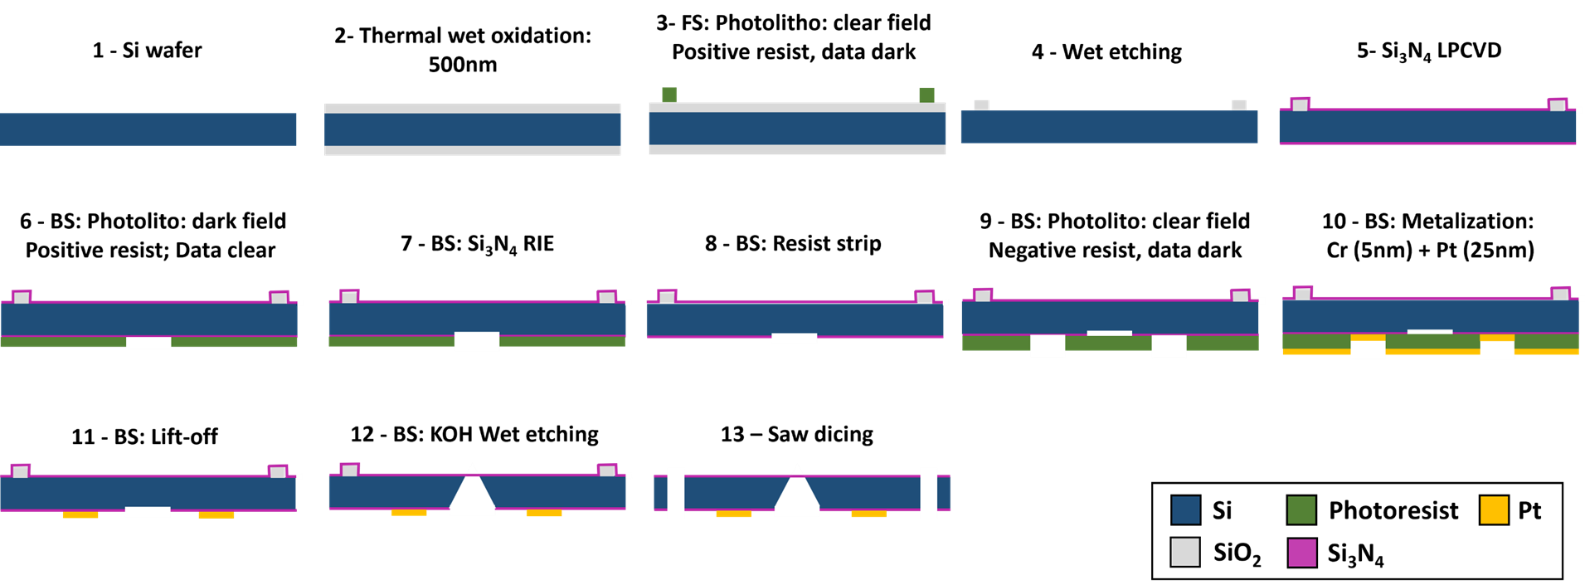
Microfabrication of Si3N4 membranes
Low-stress membranes are fabricated from 100 mm silicon wafers using standard lithography techniques
Silicon nitride membranes microfabricated in silicon chips designed for HAXPES experiments at the GALAXIES beamline
SiNx films deposited by low-pressure chemical vapour deposition (LPCVD) → more stoichiometric material (Si3N4) → enhanced mechanical properties.
Compressive stress around 200 MPa

