Slide 1
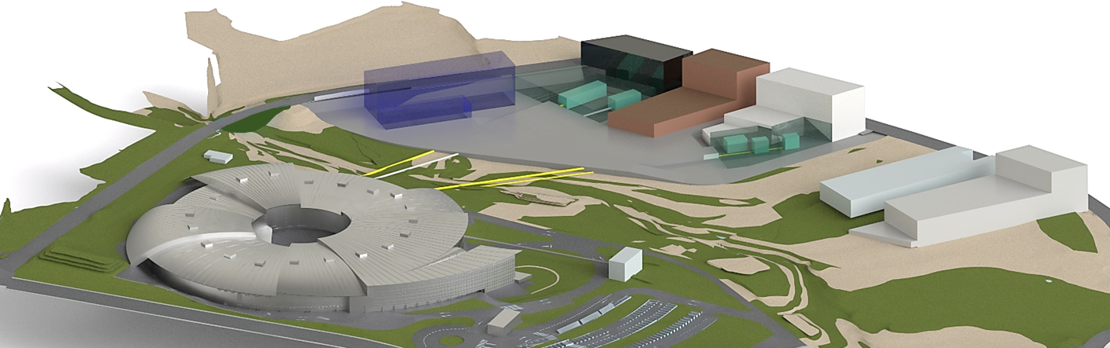
ALBA II Experiments Program
Josep Nicolas

Slide 2
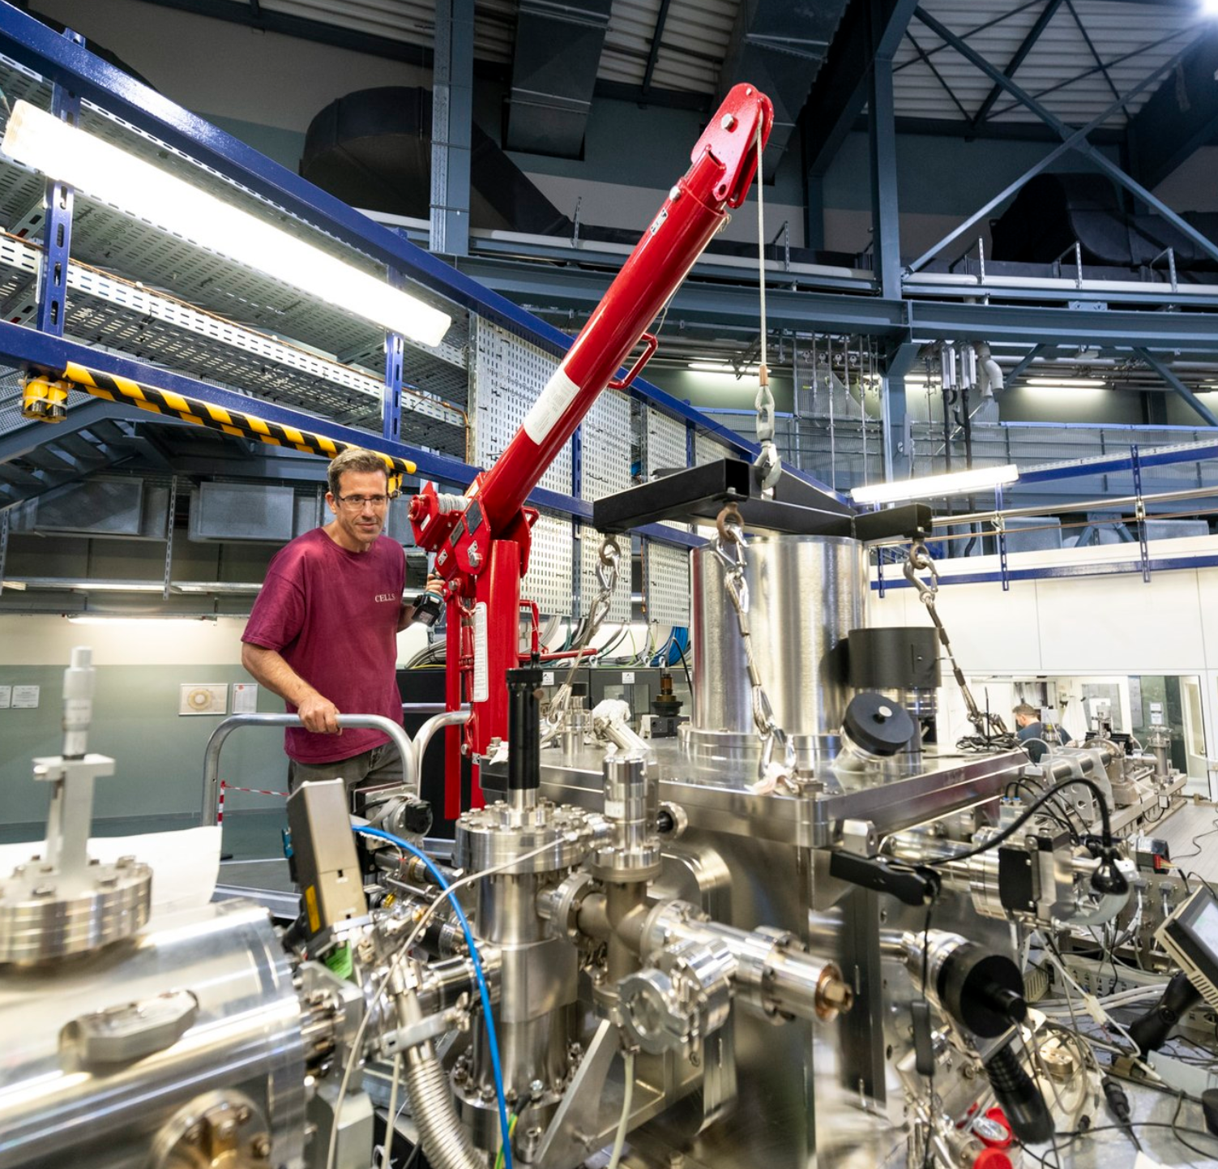
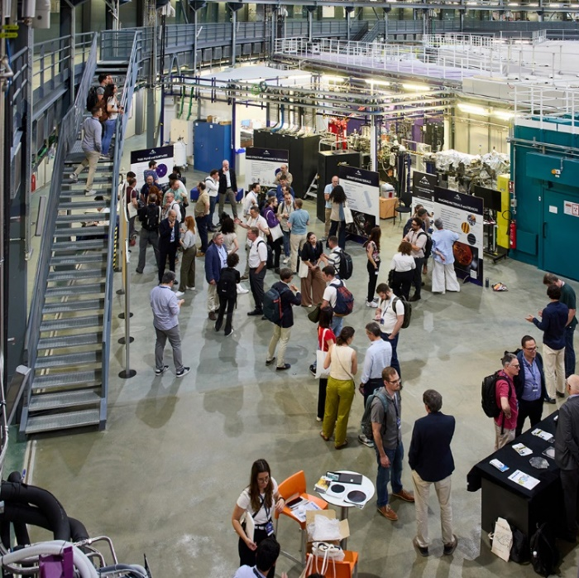
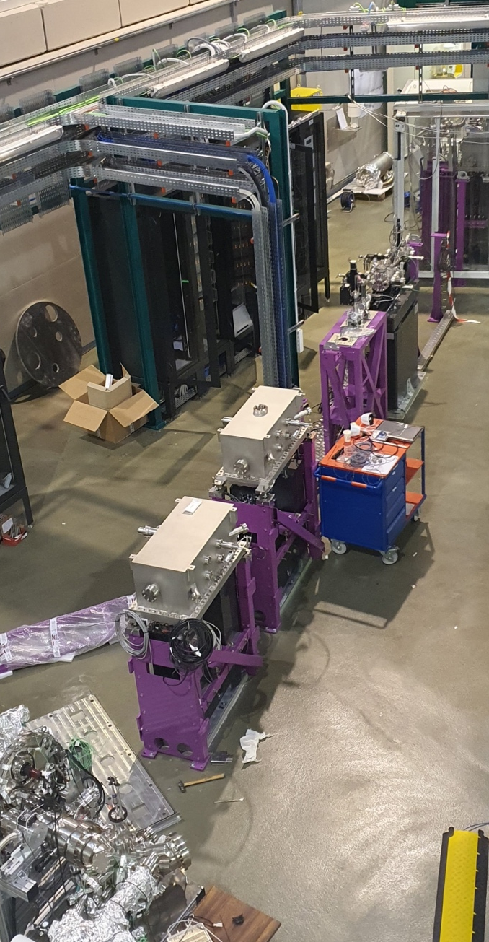
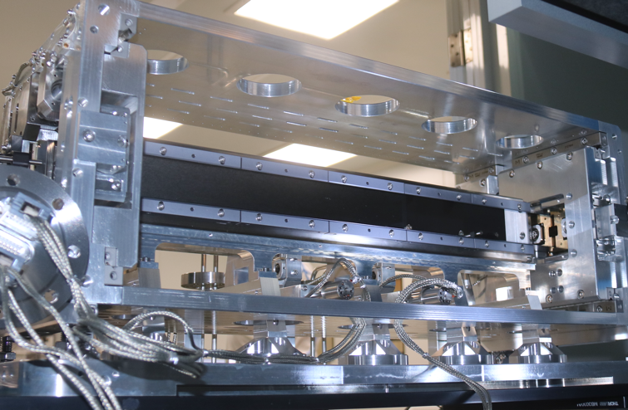
Motivation…
The ALBA II upgrade is a significant investment, and it must be targeted to optimize scientific output.
Currently ALBA operates 13 BL, but it can still host 13 additional beamlines, boosting its scientific production with only a small increase of operational cost.
Some beamlines are ca. 20 yr old, besides aging, in that time there has been big improvements in several technologies: Detectors, Optics, Computing, Accelerator technology.
Research also evolves, now it demands for multimodal and multi-beamtime workflows. ALBA must embrace this.

Slide 3
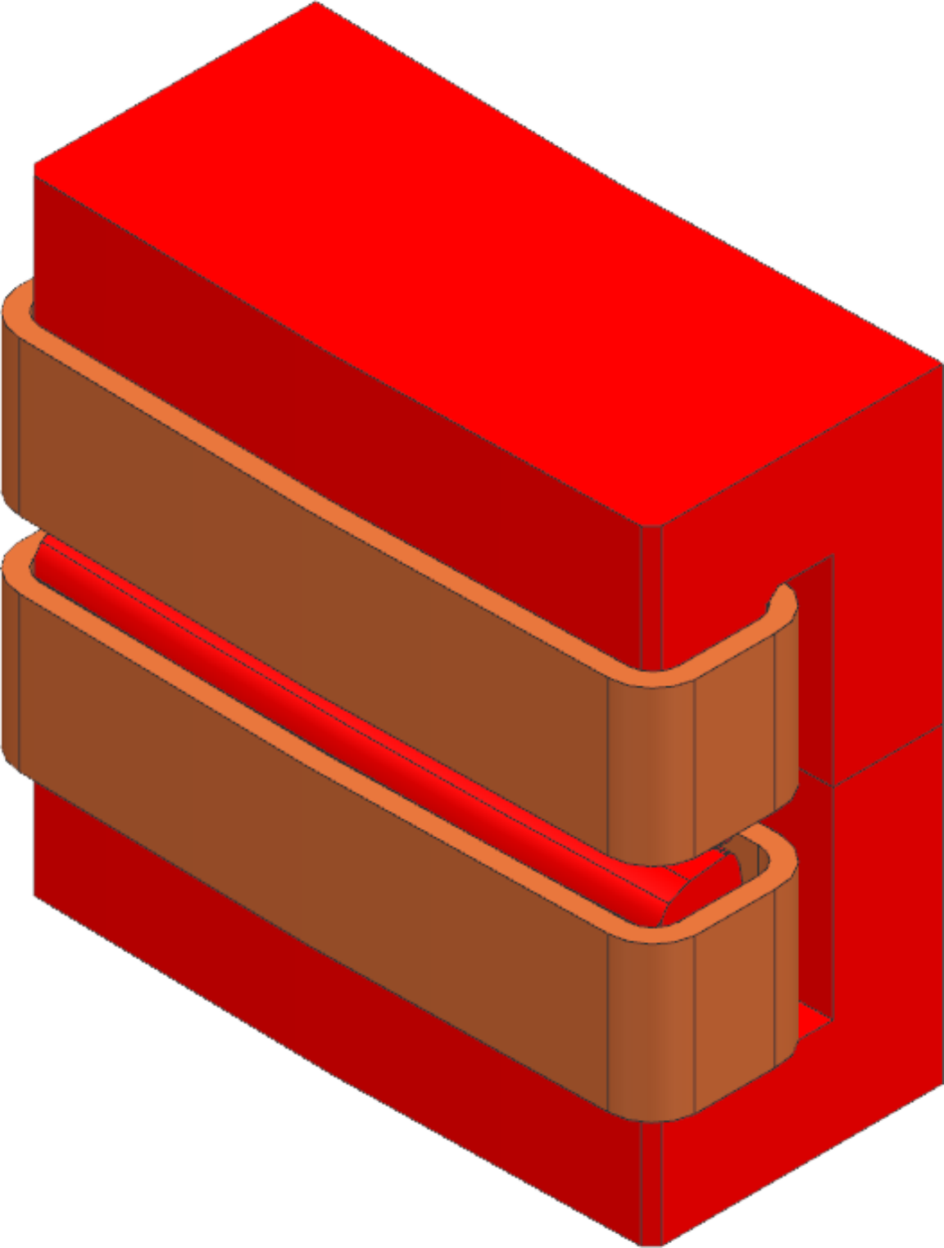
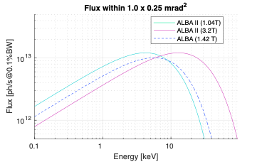
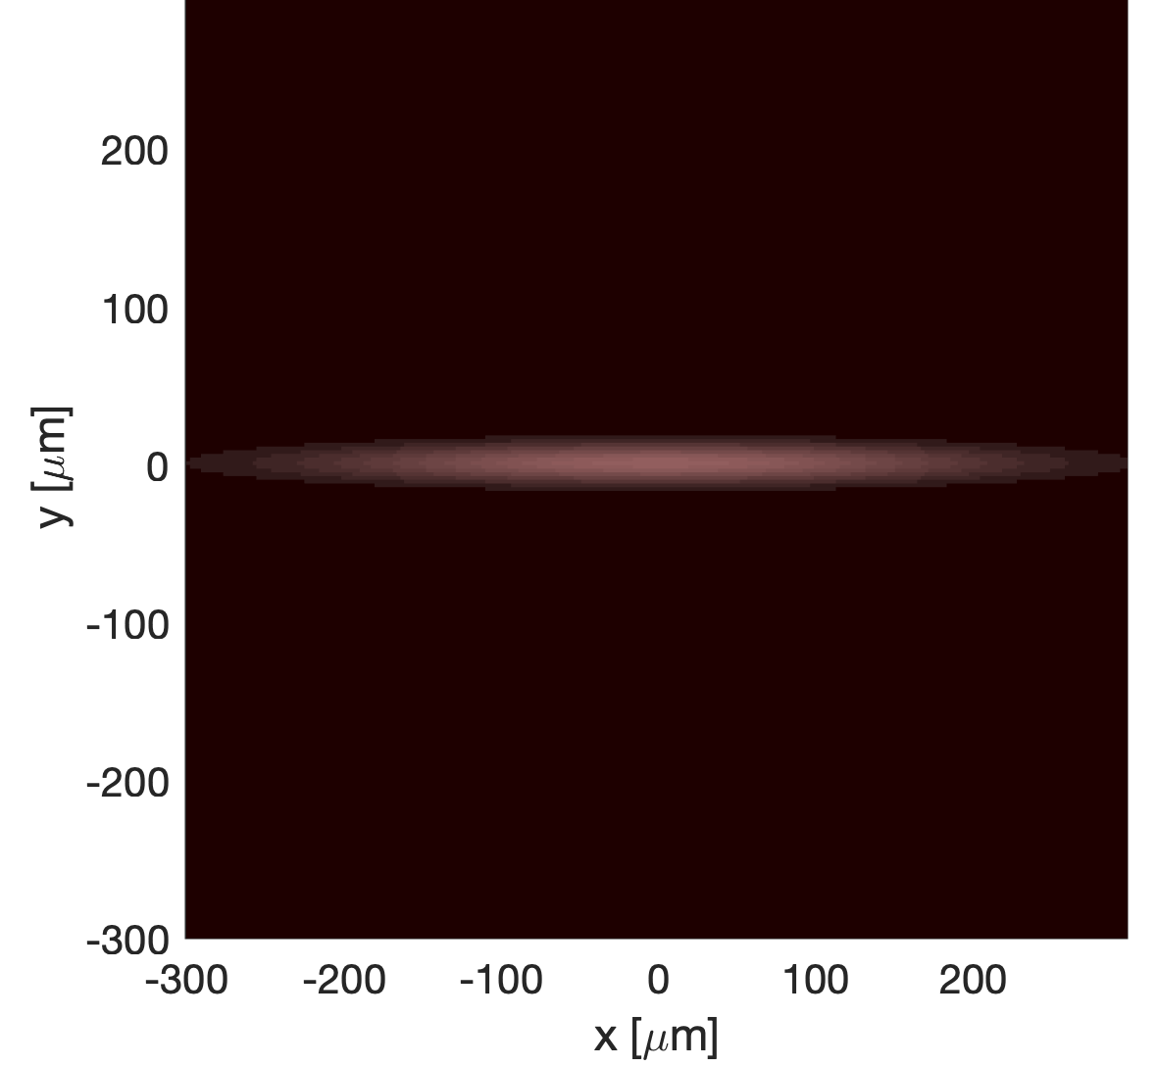
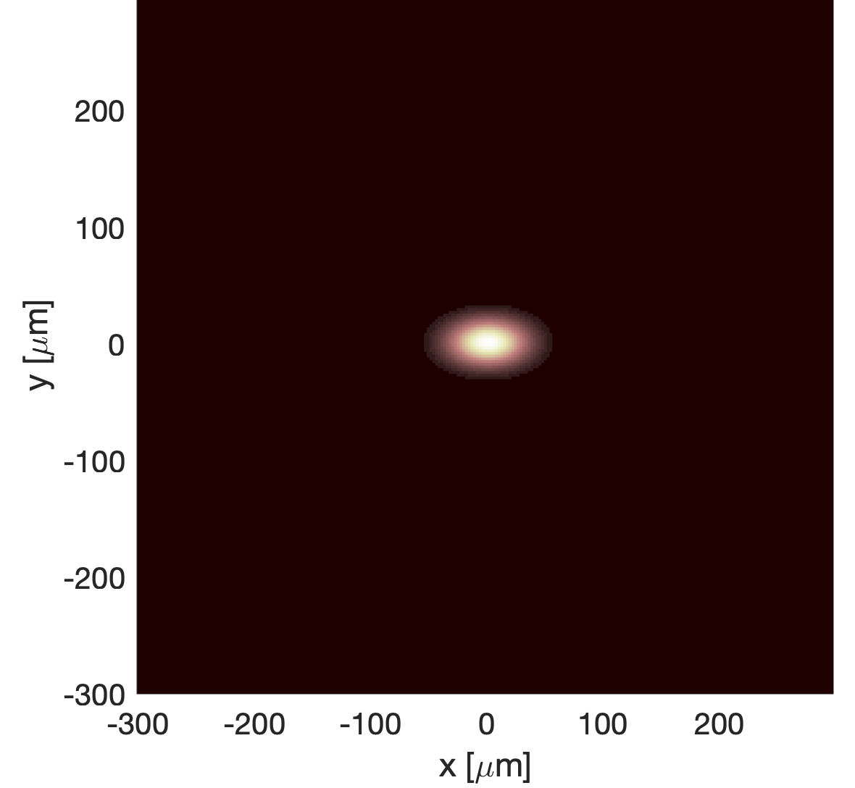
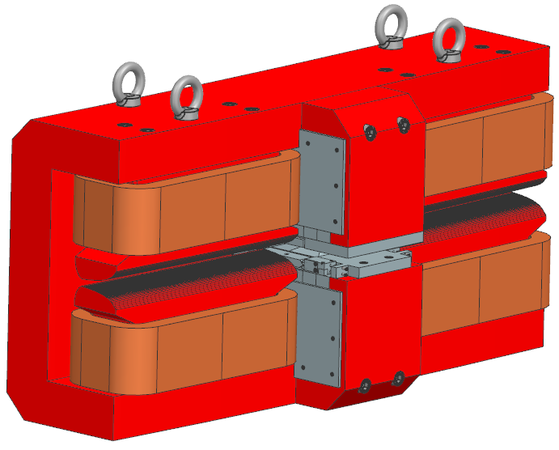
New source, new oportunities
Low Emittance ⬄ High Brilliance
Super bends (high field dipoles)
ALBA
ALBA II
cpl 50%
310 x 18 µm2 fwhm
45 x 27 µm2 fwhm
20 x 14 µrad2 fwhm
  Smaller beam and smaller divergence allow for microfocus, higher flux on sample.
  Faster collection
  Dynamics, High throughput, Diluted simples, in operando, micro-simples.
  Extend the energy range of dipole sources
Parameter | ALBA | ALBA II | ALBA II sBM
Field | 1.40 T | 1.05 T | 3.20 T
Radius | 7.138 m | 9.530 m | 3.127 m
Critical Energy | 8.39 keV | 6.284 keV | 19.15 keV

Slide 4
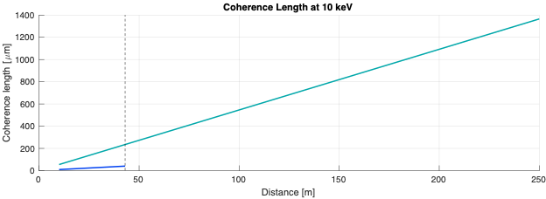
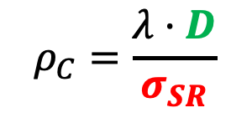


New source, new oportunities
Higher Coherence
Length of Codi/Corus
VanCittert-Zernike Thm.
Max BL length @ALBA
Reasonable acceptance of a KB
$$ρ_{C}=\frac{λ·D}{σ_{SR}}$$
ALBA II
Reasonable acceptance of a FZP
ALBA
The smaller source, and the long distance available for beamlines open the opportunity of Coherent Imaging Techniques.
Focusing optics
Acceptance
$$σ_{SR}$$
Incoherent Source
$$D$$
Coherent beam

Slide 5
Three types of project
The Experiments Program is part of the ALBA II upgrade.
It is in turn organized in 27 projects.
Three types of project:
New Beamlines.
Beamline Upgrades
Enabling Technology
ALBA II board
Technical Direction
Experiments
Accelerators
Infrastructures
Computing and Data
Implementation
3SBAR
RESTART
BET-NANO
BL33-MSPD2
NCD-U1
BET-OPT
BL02-CODI
BET-LABS
MISTRAL-U1
BL02-CORUS
…
--
BLnn-CALIMA
--
BLnn-TXM 2

Slide 6
New beamlines
MSPD2
3sbar
HAXPES and Surface diffraction. Commissioning end of 2026
➔ Yesterday’s presentation by Juan
MSPD2
Powder Diffraction and HPMD
Procurement process in progress
Calima
BioSAXS beamline, kick-off pending
CoDI
Coherent Diffraction and Nanoprobe for Material Sciences. CDR due in October.
Corus
Nanoimaging and nanoSpectroscopy for life sciences. CDR due in October.
CoDI
Corus
3sbar
Calima, no port assigned
BM BL, to allow splitting mistral

Slide 7
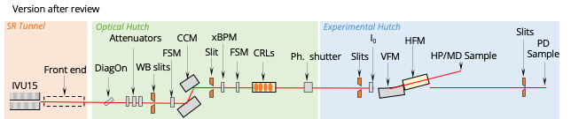
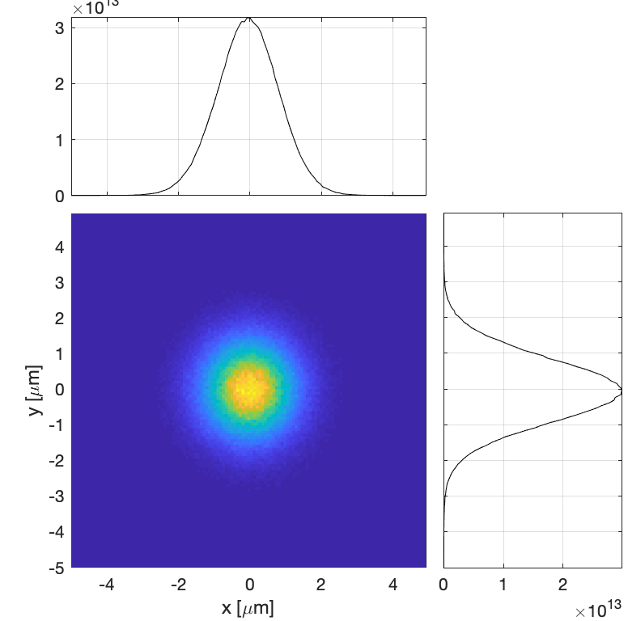
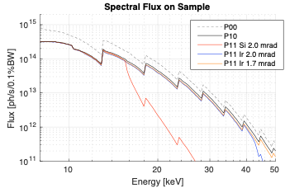
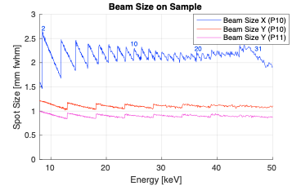
MSPD II: a new port and source
MSPD SCW is aging quickly and compromises the continuity of its operation ➔ Replace source by IVU
MSPD occupies one of the few ports that allow for long beamlines. ➔ Move the BL to port BL33

Slide 8
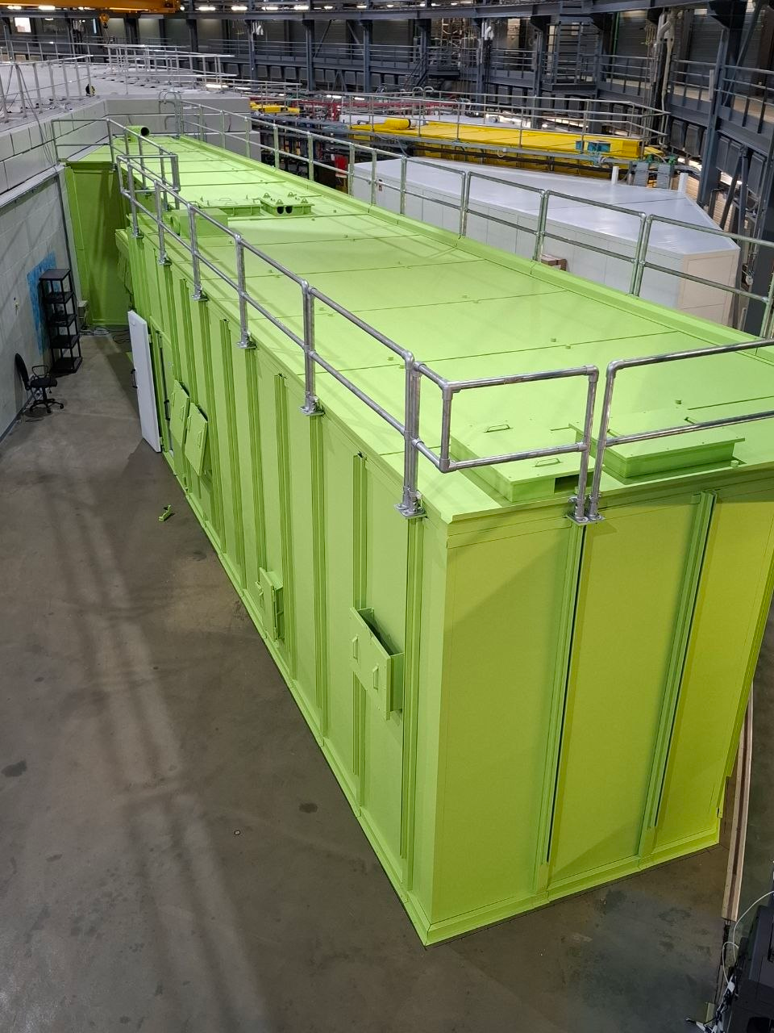
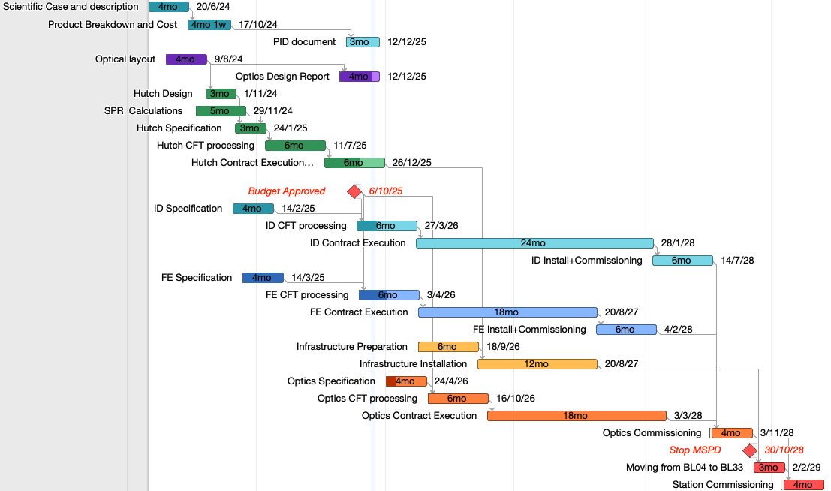
MSPD II: a new port and source
Contracts for the procurement of ID, FE, Hutch and Infrastructure in place
CFTs Optics and Optomechanics in preparation
The BL should be installed within 2028, to allow starting early in 2029

Slide 9
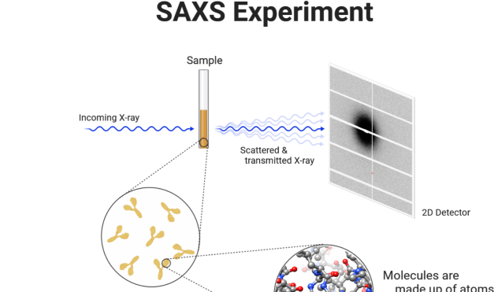
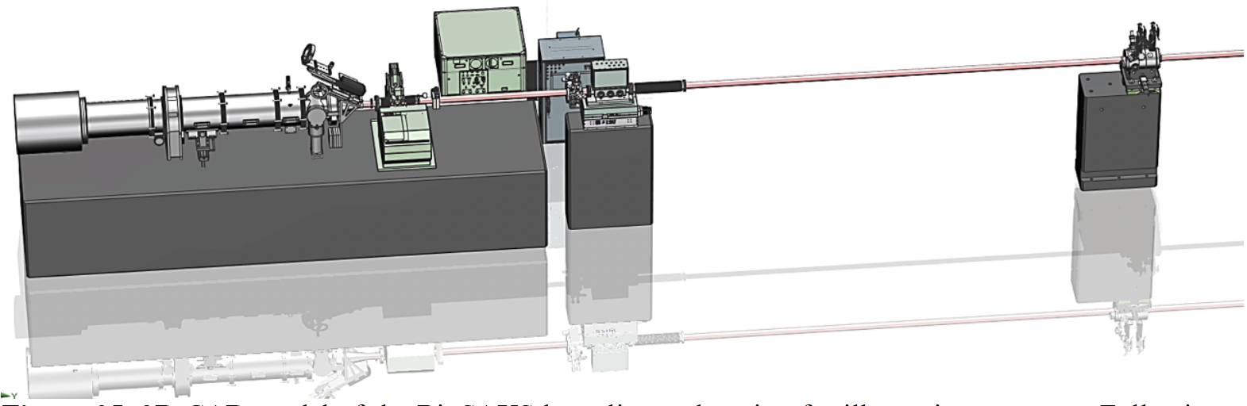
Calima
Calima is a BioSAXS beamline for ALBA for low-resolution structural analysis of samples in solution. Complementary to high-resolution crystallography BLs
SAXS
detector
WAXS
detector
Sample position
Microfocus unit (CRLs)
Sec. Source Slits
(microfocus mode)
Sample mounting robot
The project to build Calima has not yet started, and it will not be operational before the dark period.

Slide 10
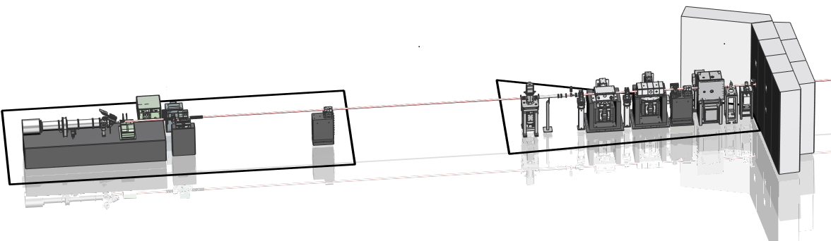
Calima Optics
 | ALBA-II (superbend)
Standard mode (focus at detector)
Spot at sample position | 532×590 um² 175×175 urad² | 532×590 um² 175×175 urad²
Spot at detector position | 23×58 um² | 23×58 um²
Microfocus mode (focus on sample)
Spot at sample position | 5.3×11 um² 428×425 urad² | 5.3×11 um² 428×425 urad²
Spot at detector position | 1.30×1.28 mm² | 1.30×1.28 mm²
The source is a BM
ML monochromator
KB for standard focus
CRL transfocator for microfocus
31

Slide 11
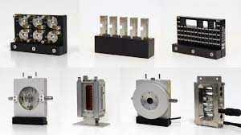
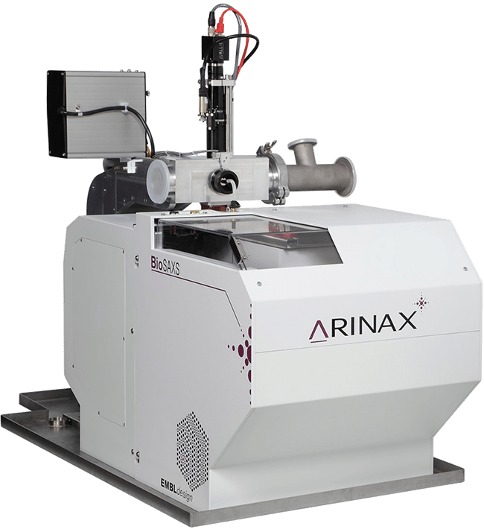
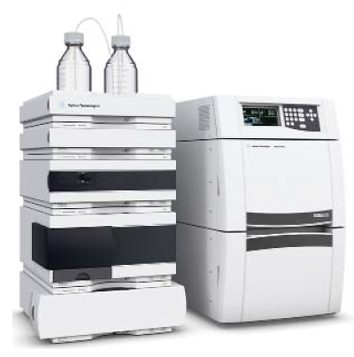
Calima Endstation features
Sample mounting robot (HT-SAXS)
Sample holders
  Capillaries (solution), gels/solid (polymer slice, tissues, pellet), liquids/gels holder, high pressure cell (pressure induce preparation of super crystals) and shear aligning cell (fibre diffraction).
  Temperature-controlled flow cell will be placed in a vacuum chamber.
  Stopped-flow cell
  Novel continuous flow cell for TR-SAXS designed in collaboration with Dr. Ros
  Other cells will also be considered: rheometer, traction cell.
HPLC system for a variety of EC and IEC columns
Laser for photo-activation

Slide 12
Long Beamlines: CoDI + Corus
CoDI and Corus are both very long beamlines, hard x-ray, devoted to imaging techniques and nano-probe techniques, with enough space around the sample
Main building
Far Experimental Hall
BL02-CODI
BL03
BL04-CORUS
Stream course
(not usable)

Slide 13
Long Beamlines: CoDI + Corus
Side View
DCM
VXS
SLIT2
Sample
VFM
M1 (mcyl)
HFM
IVU19
M2 (scyl)
40.3
230.17
19.5
19.8
40.0
230
230.4
2.5 mrad
Top view
MLM
2.8 mrad
3.2 mrad
2.5 mrad
HXS
134
249
17.541
42.560
Tunel
Exp. Hall
Far Exp. Hall
A two-stage magnification optics, with a secondary source, both vertically and horizontally.
All ‘noisy’ optics, stays in the first stage. There is nothing between the XS (intermediate source) and the refocusing KBs (at the endstation)
XS clips the beam spatially, SLIT2 clips the beam angularly. This allows for optimal control of the phase-space acceptance (to control coherence)
Total reflection KBs for refocusing, optimized for different energies.
Our main concerns are.
  Flux (very long beamlines, very small acceptance)
  Stability. Different slabs, how to steer the beam.

Slide 14
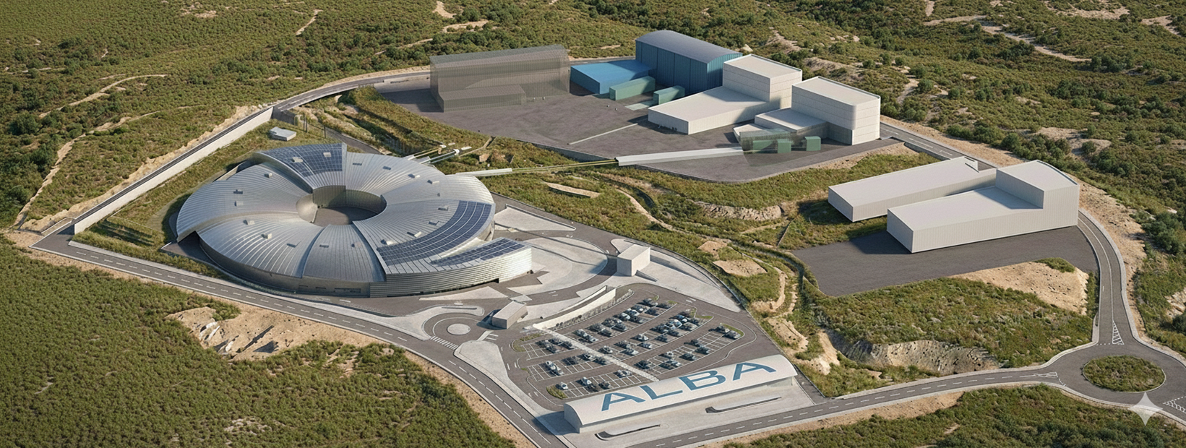
BL02-CODI
BL04-Corus
Transfer lines

Slide 15
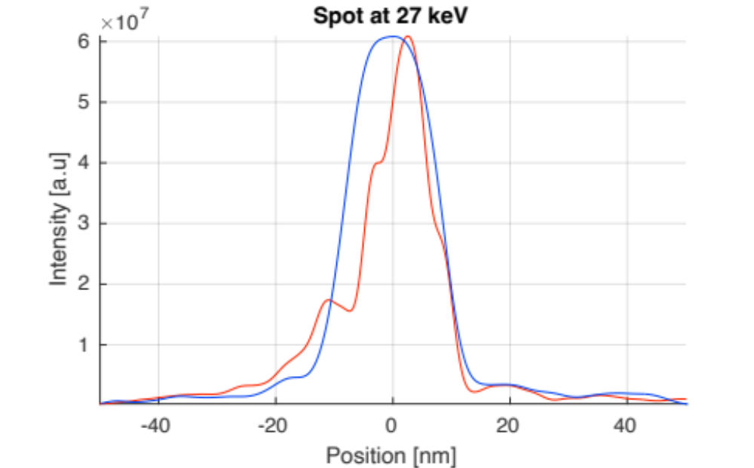
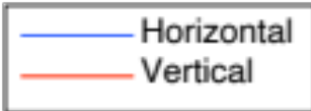
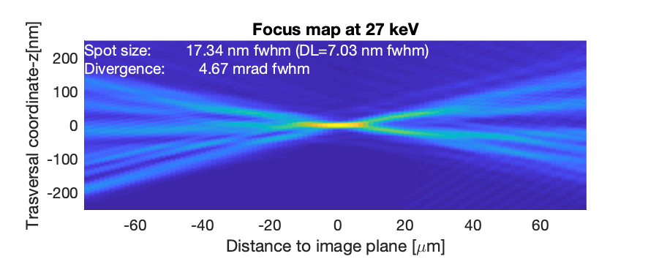
Corus nanoImag
Corus nanoImag works at 3 discrete energies, and can use ML coatings to increase the incidence angle (NA) and reduce the spot size.
HFM
VFM
202.5
122.5
80
17 x 12 nm² fwhm
DL = 7 nm fwhm
80
40
165
120
Parameter | HFM |  |  | VFM
Energy | 10 keV | 19 keV | 27 keV | 10 keV | 19 keV | 27 keV
Length | 165 mm |  |  | 80 mm
Object distance | 233.2 m |  |  | 233.023 m
Image distance | 202.5 mm |  |  | 80 mm
Incidence angle | 1.15º | 0.90º | 0.65º | 1.15º | 0.90º | 0.65º
Coating | ML W/B4C |  |  | ML W/B4C
Period | 3.0 nm | 2.1 nm | 1.9 nm | 3.0 nm | 2.1 nm | 1.9 nm
Working dist. | 120 mm |  |  | 40 mm
Slope Error | <75 nrad rms |  |  | <75 nrad rms
Height error | <0.30 nm rms |  |  | <0.30 nm rms

Slide 16
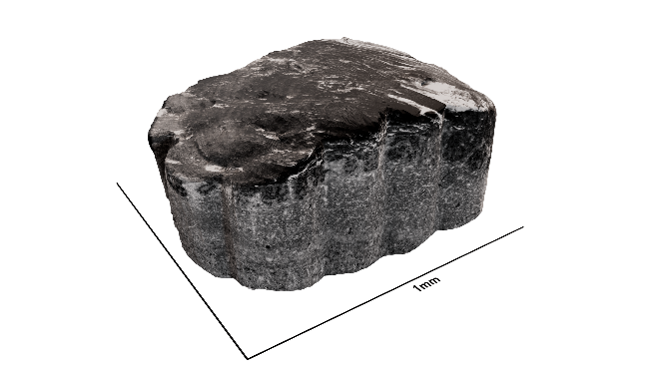
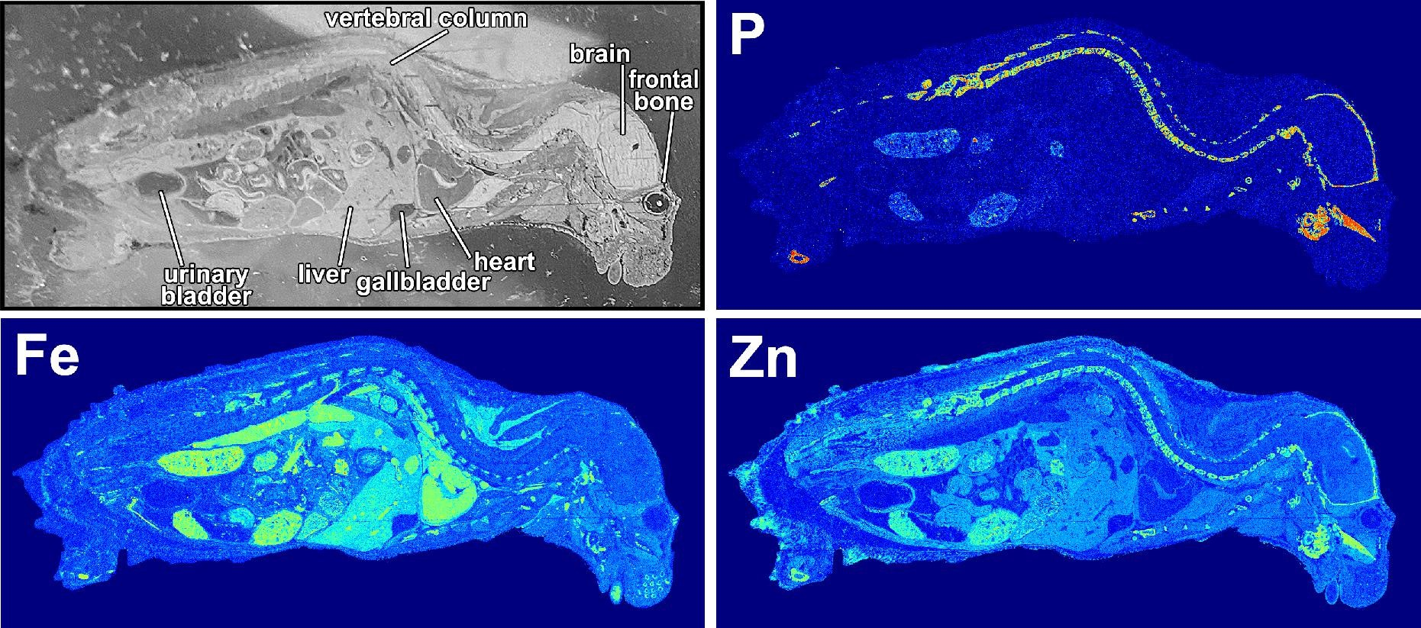
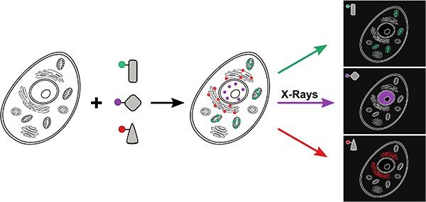
Corus
CORUS will provide nanoimaging, element mapping and chemical speciation capacity in 3D for biological tissue samples of up to 1 mm³ and for cultured cells and organoids.
The beamline will facilitate running correlative multimodal experiments that interrogate the same sample with multiple imaging techniques, either at the same beamline or elsewhere.
Zhang, Bosch, …, Pacureanu, Schaefer. BioRxiv 2025.
https://doi.org/10.1101/2025.04.24.650439
nanoImag @ RT
Tissue-scale systems biology (nanoimaging XNH):
neuroscience, cancer, host-pathogen
KPIs:
target: 1 mm³ connectome, acquisition 1 month
day0: 1/10 mm³ connectome, acquisition 1 week
Flux 7.6 x 10¹¹ ph/s on sample at 27keV
Flux 4.58 x 10¹² ph/s on sample at 19 keV
Bosch et al. Nat. Methods 2025
https://doi.org/10.1038/s41592-025-02891-0
nanoFluoSpec @ cryo
Cell-scale systems biology:
Pharmacokinetics (XFM), pharmacodynamics (XAS)
Pushie et al. Metallomics 2022. https://doi.org/10.1093/mtomcs/mfac032
KPIs:
Flux 2.24 x 10¹³ ph/s on sample at 10 keV
Victor-Lovelace and Miller. Metallomics 2022
https://doi.org/10.1093/mtomcs/mfac093

Slide 17
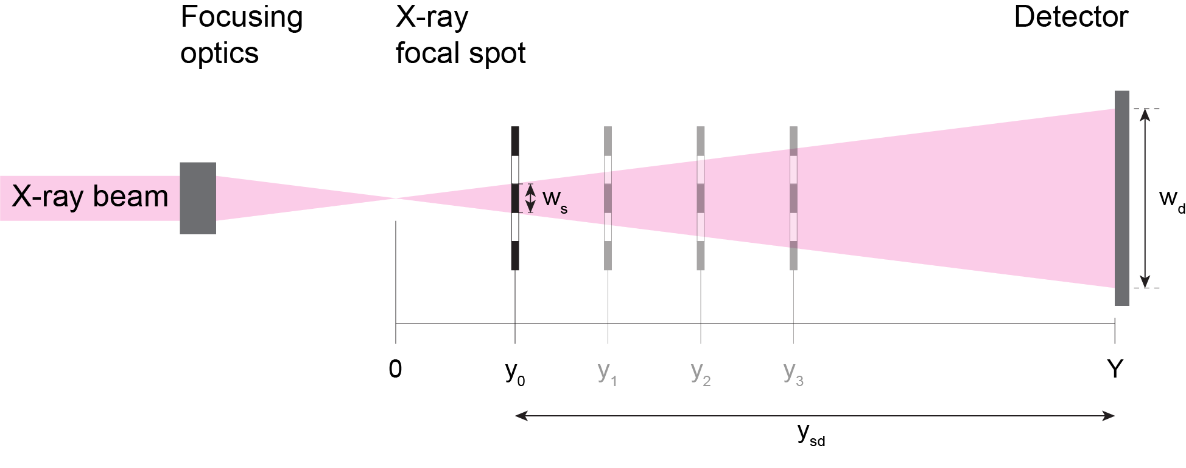
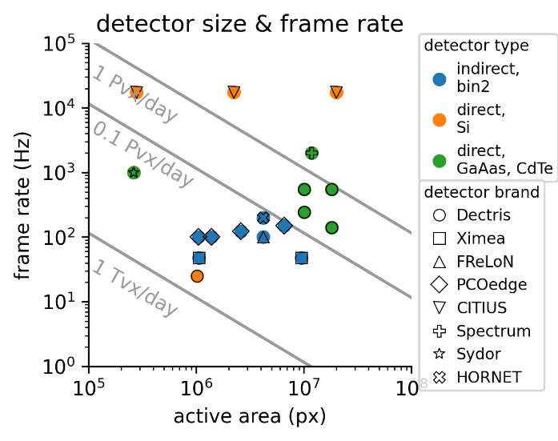
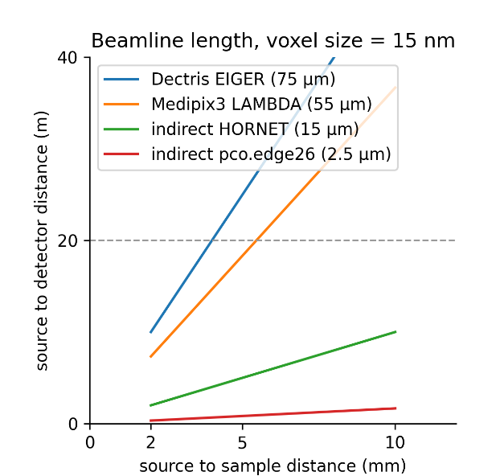
nanoImag Detector
nTiles < 1000
Acquisition < 1 month
E = 27keV
large Area Detector
(>5k width, uncorrelated pixels)
fast frame rates (kHz)
Direct Detection (large pixel)
GaAs,CdTe
Very long Hutch (ca. 20 m)

Slide 18
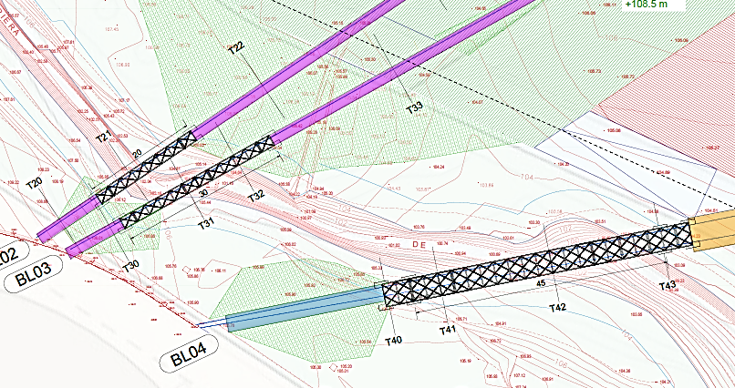
Transfer lines Project in progress
Contract follow up | Date
☑ Contract signed | done
☑ Kick off meeting | done
☑ Basic project | Under evaluation
Executive project | End July 2026
Review by MICIU | 3 months
Handover to Parc de l’ALBA | Oct-Nov 2026
Execution by Parc de l’ALBA | Jan 2028

Slide 19
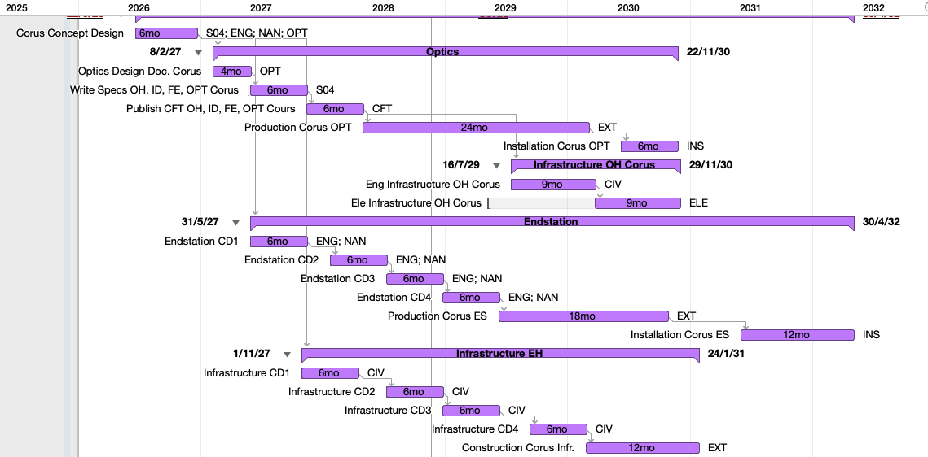
CoDI / Corus Schedule
The schedule of the long beamlines is limited by the delivery of their Buildings (Dec 2030). For Corus we need to decommission MSPD first.
The goal is to start Commissioning CoDi immediately after the dark period.
Corus comes a few months behind.

Slide 20
Beamline Upgrade projects
ALBA does not have personnel to start all projects immediately, so some projects will start later, and the program will spread in time beyond the opening of ALBA II.
The program schedule follows these considerations:
All exp. techniques available on ALBA II day one
We want to assure that all our current beamlines will be able to open immediately after the dark period, in good conditions and adapted to the new machine (even if not optimal). At least all exp. techniques.
This means that also critical upgrades, to allow us continuing operation until the dark period, are also scheduled immediately.
Commitments with User Community
ALBA will honor its commitments with the user community, concerning new beamlines.
Minimize downtime of existing beamlines
We want to avoid shutting down any beamline for more time than the dark period, or at least minimizing their downtime.
Therefore, leaving smaller actuations, that don’t require a long BL shutdown, for later.
MSPD2 | MSPD2 | OPRs
CODI | CODI
CORUS | CORUS
CALIMA | CALIMA
MISTRAL2 | MISTRAL2
MISTRAL | MISTRAL-U2 | MISTRAL-U3
XALOC | RESTART | XALOC-U1
XAIRA |  | XAIRA-U1 | OPRs
3SBAR |  | 3SBAR-U1 | OPRs
MINERVA
CIRCE |  | CIRCE-U1 | CIRCE-U2 | OPRs
FAXTOR |  | FAXTOR-U1 | OPRs
CLAESS |  | CLAESS-U1
LOREA |  | CRYO | LOREA-U1
BOREAS |  |  | BOREAS-U1
NCD |  | NCD-U1 | NCD-U2
NOTOS |  | NOTOS-U1
MIRAS |  | MIRAS-U1
IMM | BET-LABS | BET-OPT | BET-NANO | BET-INT
JEMCA | EM04
Must start soon
Before Dark Period
No BL downtime required
Flexible scheduling

Slide 21
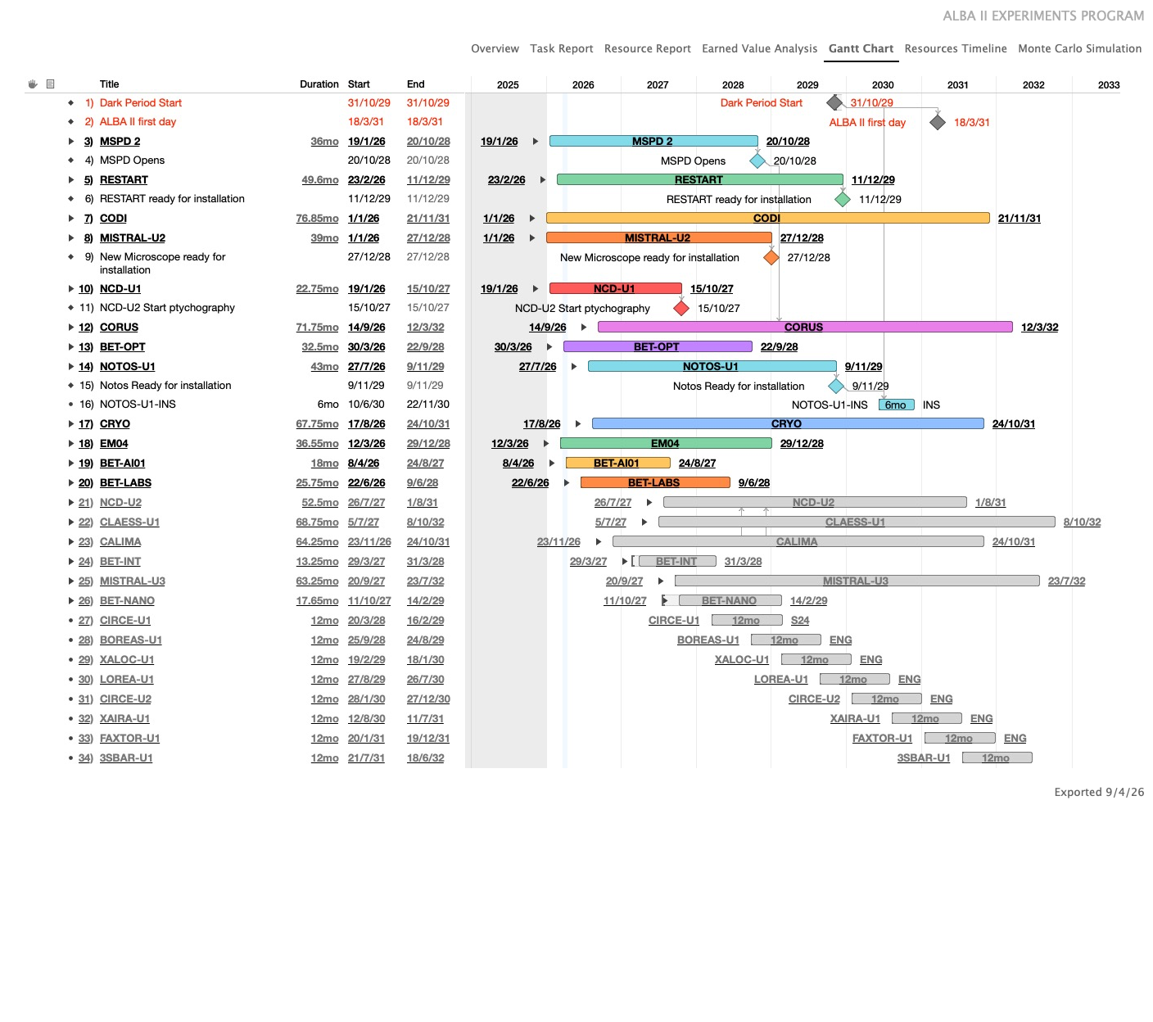
Overall schedule
Only projects starting in 2026 (or early 2027) are scheduled.
We complete MSPD2, RESTART and NOTOS U1 (=all exp-tech available)
We start the long BLs right after the dark period.
The development of the rest of projects will extend beyond the dark period

Slide 22
Projects started in 2026
        Ensure all experimental techniques are available after the dark period, Ensuring BLs reach their base performances at the new machine
Procurement of a new TXM microscope with advanced features for Biology and modify the BL accordingly. Solving reliability issues, and Including a high degree of automation.
RESTART
MISTRAL-U2
NOTOS–U1
Modify the endstation of NCD to allow it doing coherent imaging experiments, as a pilot for CoDi, and Corus.
Realignment of NOTOS to adapt it to the geometry of ALBA II.
Modify the optics to allow operation in an extended energy range
NCD-U1
New CryoTEM for Life science application, including the building to host it.
CRYO
EM04
Cryogen-free cryostat for the MARES and ARPES stations, to guarantee operation in shortage of LHe.
        Instrumentation for the catalysis lab
BET–OPT
BET-LABS
Improvements of the optics metrology instrumentation

Slide 23
RESTART
1. Adapt beamlines to Geometric changes of the source
ID: source position changes only in z (longitudinally)
Beamline | Description | Position change
BL01-Miras | New extraction system is needed. | n.a.
BL04-MSPD | Moved to port BL33. | n.a.
BL06-Xaira | In line, moves upstream | ∆z = –453,20 mm
BL09-Mistral | Source point chosen to point at the center of M2 | ∆z = 0 ∆θ_{M2} = +0.0731º
BL11-NCD | In line, moves downstream | ∆z = +346.20 mm
BL13-Xaloc | In line, moves upstream | ∆z = –107.00 mm
BL15-3Sbar | In line, moves upstream | ∆z =–453,20 mm
BL16-Notos | Source point chosen to be at the center of the bending magnet | ∆x’ = +0.69º ∆x_MAX = 356 mm
BL20-Lorea | Source moves downstream | ∆z = +453,20 mm
BL22-Claess | Source moves upstream | ∆z = –644.83 mm
BL24-Circe | Source moves upstream | ∆z = –453,20 mm
BL25-Minerva | Source point chosen to point at the center of M1 | ∆z =+121.42 mm ∆θ_{M1} =+0.14º
BL29-Boreas | Source moves downstream | ∆z = +453,20 mm
BL31-Faxtor | Source point does not move | ∆z =0
BL33-MSPD2 | Source moves upstream | ∆z = –453,20 mm
BM: (SXR) we select the extraction angle where the beam points to the first mirror of the BL, the rest of the beamline does not need realignment.

Slide 24
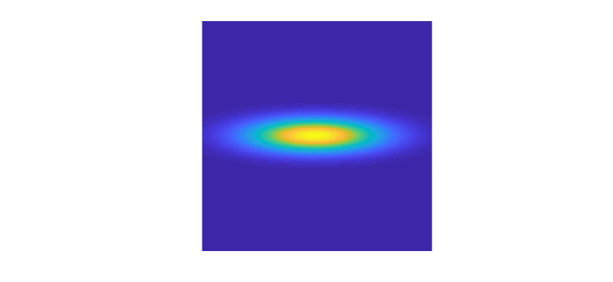
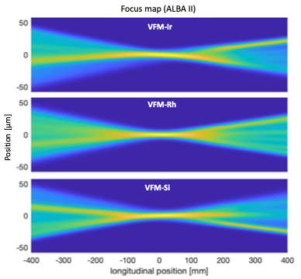
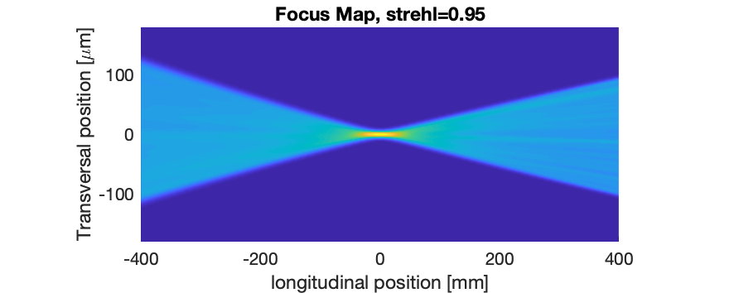
RESTART
Procurement of aging/failing components that risk BL operation
Monochromator (CLAESS)
3 Area Detectors
1 Fluorescence Detector
Slits
Diagnostics
Fast shutters
2 benders
Identification and replacement of obsolete components that would limit the performance in the new machine.
Requirements on mechanical stability become more demanding
Beam heterogeneities at XALOC with the current mirrors
Beam heterogeneities at XALOC with the state of the art mirrors

Slide 25
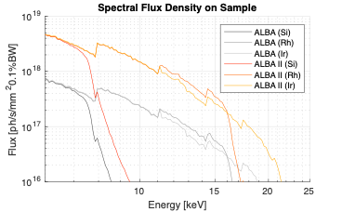
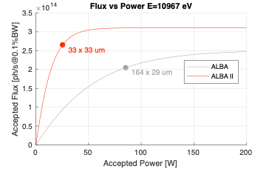
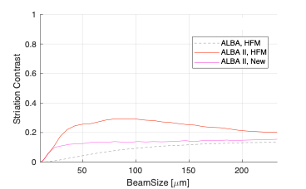
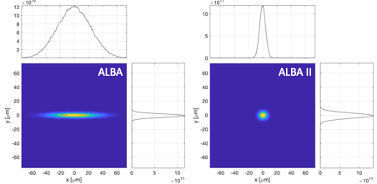
Performance of (some) BLs will be drastically boosted
Higher flux density on sample
Lower power on Optics
More uniform beam for a wider range of beam sizes
Smaller reachable spot size

Slide 26
Beamline Enabling Technology
Xaira@ALBA
Xaira@ALBA II
Xaira@ALBA II
Superpolished mirrors
Spot size on sample for XAIRA, at ALBA, at ALBA II with its current optics, and with state-of-the art optics
1
x14
x48
Beamline performance depends on instrumentation technology.
Better optical quality on mirrors, gratings, lenses
Higher mechanical stability and accuracy
Faster detectors
Faster experiment synchronization.
More automation
Data processing
Advances comes from paradigmatic changes (research and testing)
Adaptive optics, deterministic polishing
Feedback mechanics, parallel robots, complex motion trajectories to simplify mechanics.
Low-level experiment orchestration
AI assisted experiments.

Slide 27
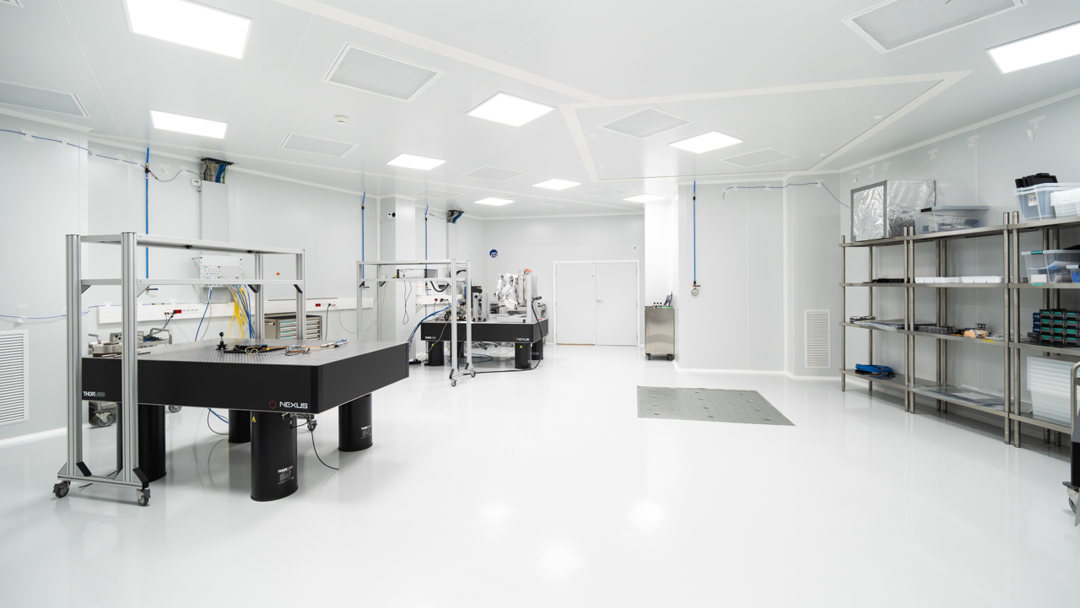
The nanomotion lab
Notes:
Clean room + Superquiet room
Experiment setup inside, electronics outside if posible, route through feedthrough to racks
Experiment control from CR + tests when cleanroom is not required

Slide 28
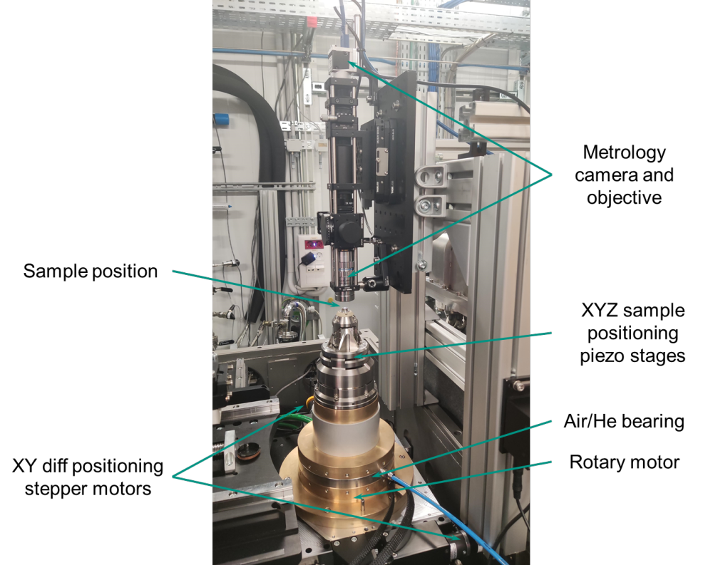

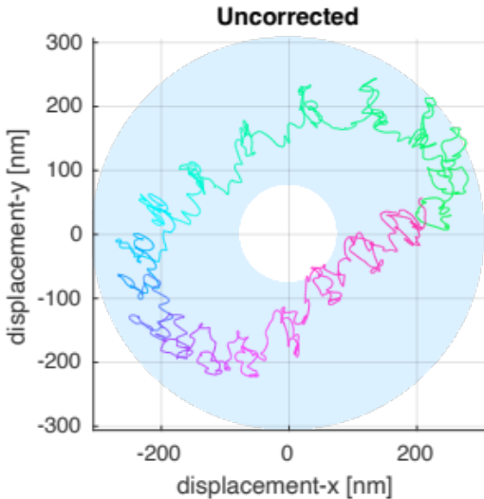
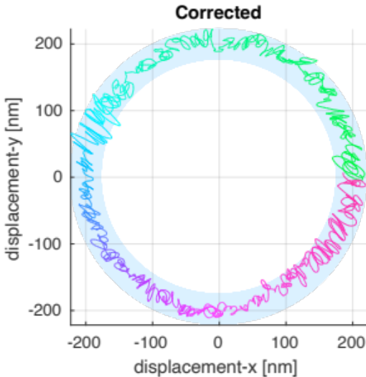
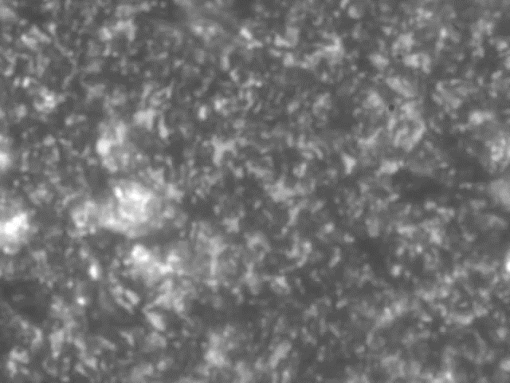
Example 2: Runout control
Nanometric sample spot require rotation with nanometer accuracy. Runout can move the sample out of the beam. .
Ideal trajectory
± 18 nm
± 112 nm
Measured runout uncorrected. Results are used to calculate the necessary XY displacements for correction.
Once the XY displacements are activated, measured runout is considerably reduced.

Slide 29
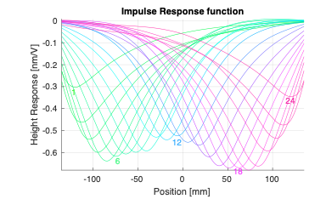


Quality of optics
Facilities need a laboratory capable of setting up optics with surface accuracy below 1nm.
Calibration profiles (unit response per channel)
24 channel superpolished bimorph mirror measured at ALBA.
Final error to the nominal ellipse.
Residual error 67 pm

Slide 30

Final Remarks
The Experiments Program includes new beamlines and upgrades of all existing beamlines.
The process will extend in time, beyond the dark period, but the downtime of experimental techniques will be minimized.
The new source, and state-of-the-art technology bring opportunities for the experimental stations: Faster, In-operando, high-throughput, Diluted, etc.
ALBA will boost its capacities in Coherent Imaging techniques, with a smaller source, longer beamlines, and target upgrades of existing BLs.

