Slide 1
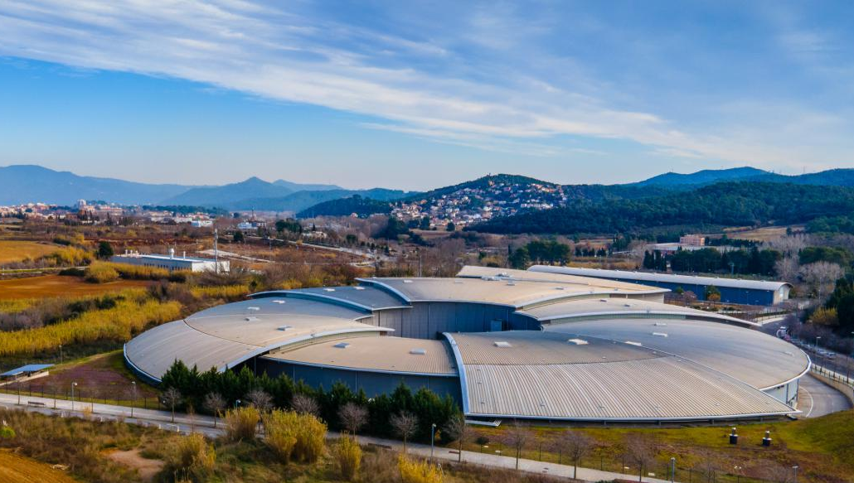


ALBA and its future, ALBA II
Caterina Biscari
3 September 2026
ALBA User Meeting

Slide 2
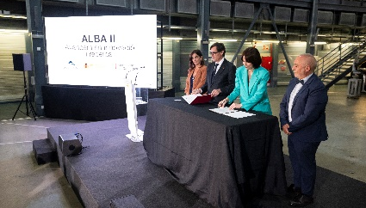
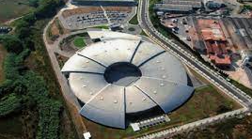
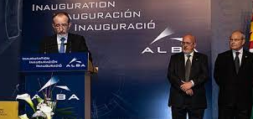
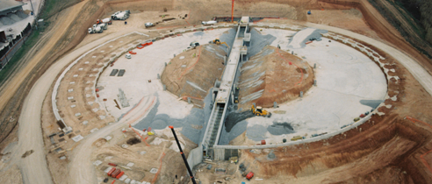
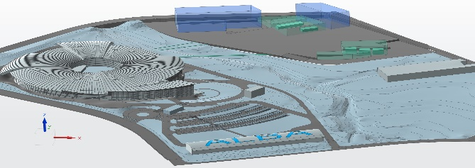
ALBA: past, present and future
2003 – Creation of CELLS Consortium (Spanish Government and regional Catalan Government), and agreement on facility funding for the period 2003 to 2022
2023-24 – Addenda for funding
2003 ALBA Approval
2012
Starting ALBA Operation
2020
Starting ALBA II design
2032
ALBA II Operation
2025
Approval of facility funding for 2025-2038
2006
Starting ALBA construction

Slide 3
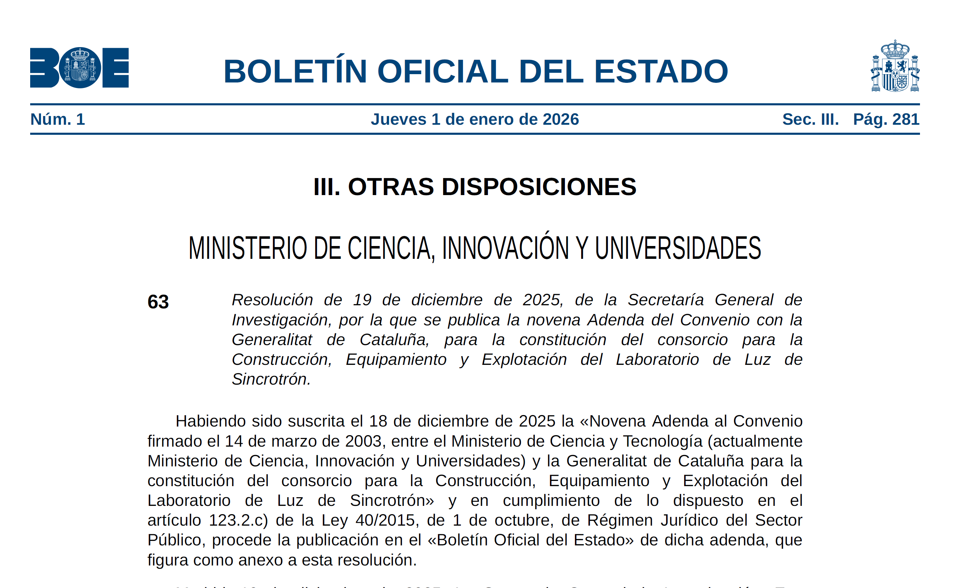
Agreement published on Spain's Official State Gazette (BOE) on 1st January 2026
Adenda 9 – ensuring the future of ALBA
ALBA and its future, ALBA II - 3 Sept 2026

Slide 4
ALBA Priorities today
Build ALBA II
Develop methodologies and services bridging ALBA to ALBA II
Maintain excellence in operation

Slide 5
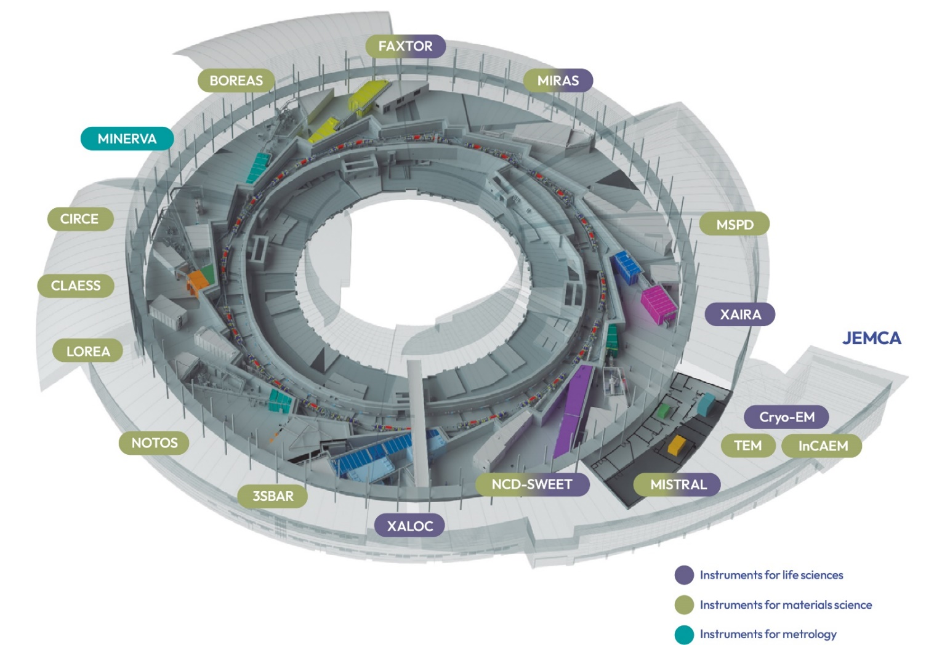
13 operating beamlines + 1 in 2027
3 electron microscopes + SPM & AFM
ALBA 2026
Shared with partners
SPM Platform at Prisma Building

Slide 6
13 operating beamlines + 1 in 2027
3 electron microscopes + SPM & AFM
ALBA 2026
New instruments since Oviedo meeting
Shared with partners
SPM Platform at Prisma Building
See session this afternoon at 15:00

Slide 7
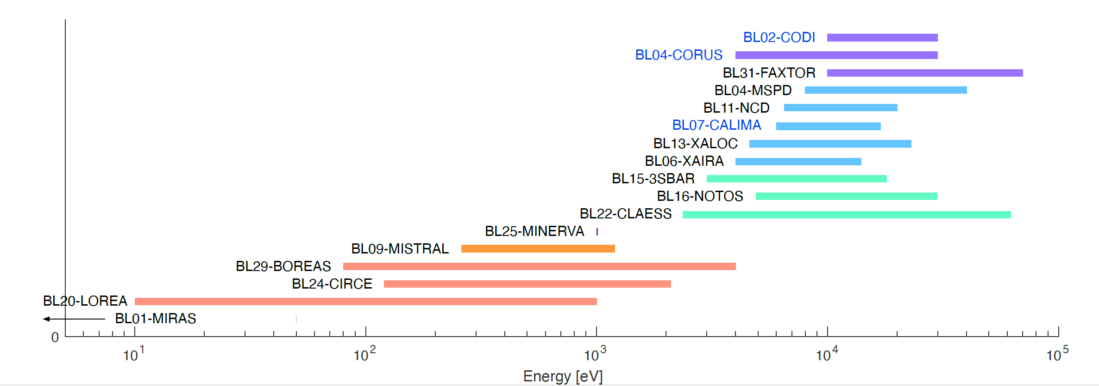
ALBA and ALBA II beamlines
Long BLs
CORUS
Characterization of bio samples down to nanometric resolution
CODI: COherent DIffraction BL
For in-situ and operando experiments and characterization of large samples with nanometric resolution
Absorption and emission spectroscopy, Soft X-ray tomography, IR microscopy, Small and Wide Angle Scattering, HR and HP Powder Diffraction, Crystalline Diffraction, Photoemission, NAPP, ARPES, Resonant Absorption and Scattering, Metrology, Macromolecular crystalline diffraction, Hard X-ray tomography, Surface spectroscopy and ambient pressure photoemission, BioSAXS, Coherent Diffraction, Spectral Imaging and Tomography
In operation – in installation – in design phase

Slide 8
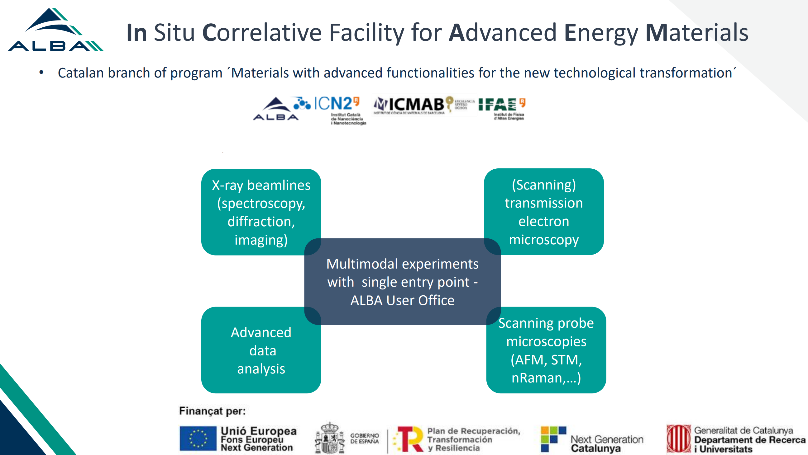
JEMCA model,
with partners co-funding and co-operating instruments, to expand services for all users, has proven to be successful also in developing new opportunities

Slide 9


Developing new data policy, new workflows for data handling, data catalogue
See Klaus talk today
See Oscar talk tomorrow
Working on a proposal for a new platform based on collaboration with BSC
to interconnect the computational and analytical capabilities creating a unique European resource for both facilities’ user communities boosting innovation and science – more next meeting

Slide 10
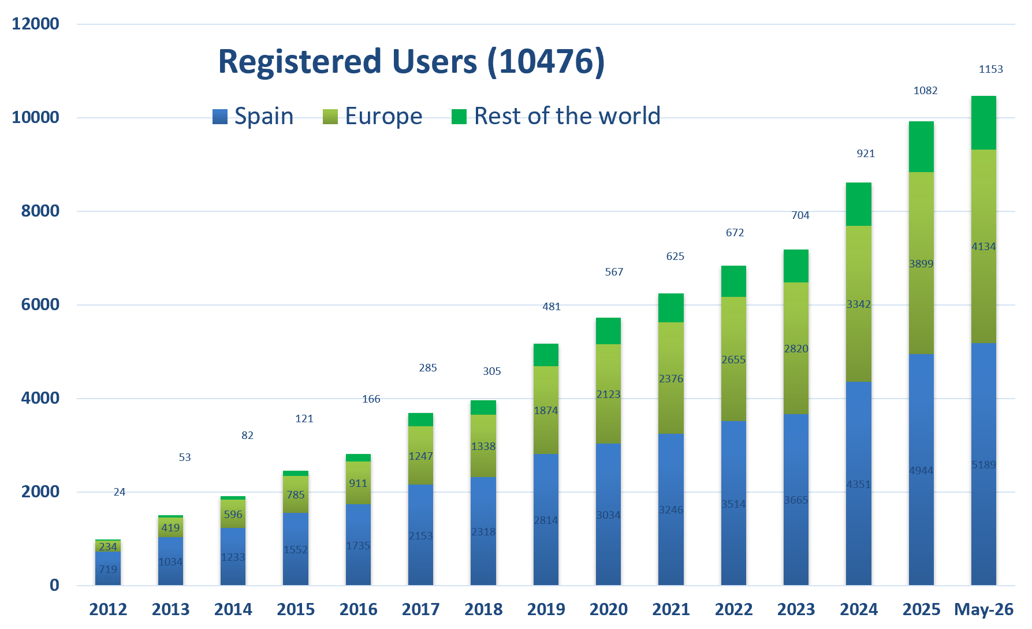
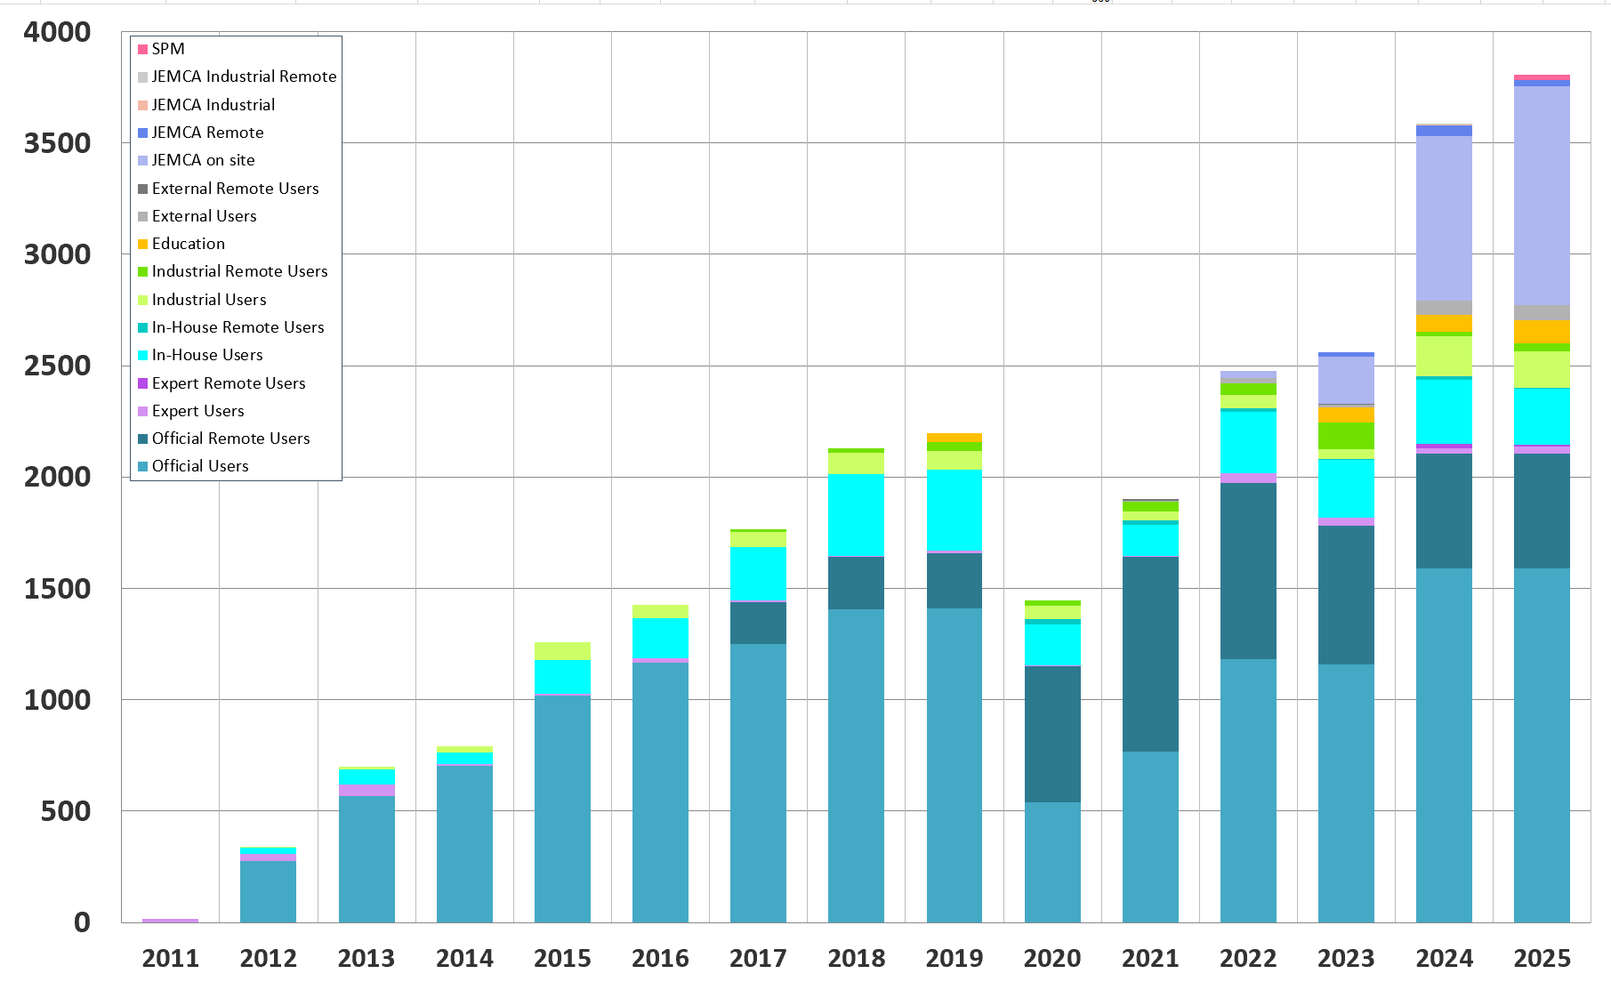
The User Community has grown over 10000 members
Yearly user visits
An increasing number of partner institutions participate to common proposals and projects
During 2025 + 3800 visits
JEMCA visitors make the difference

Slide 11
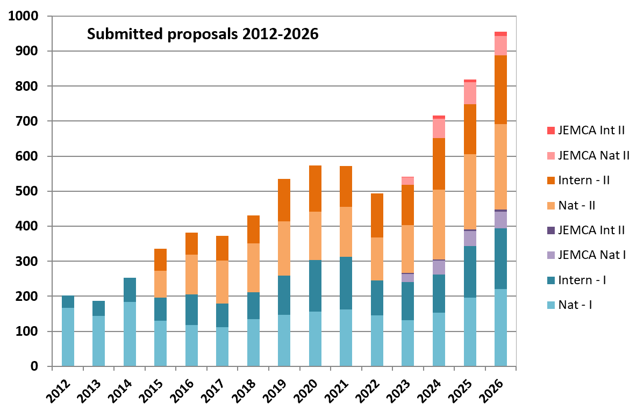
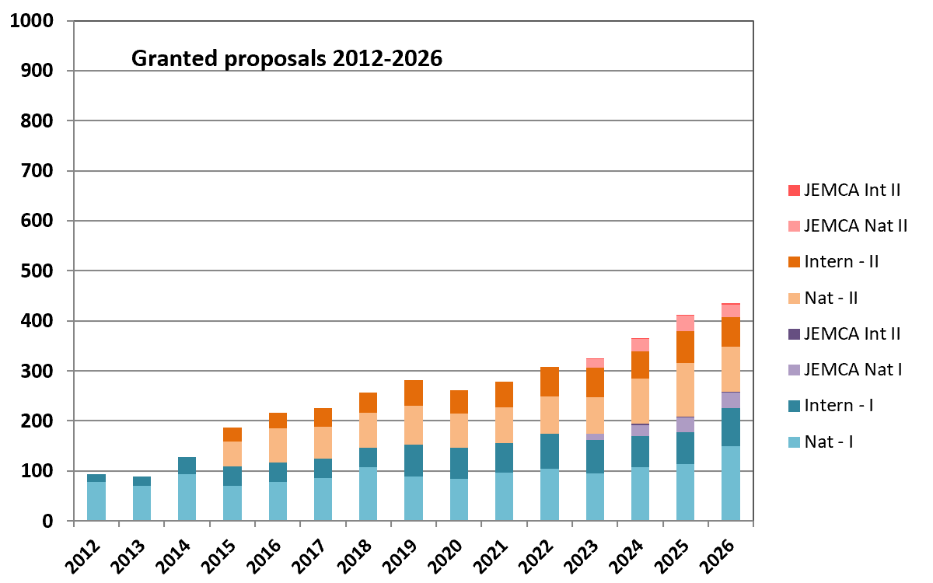
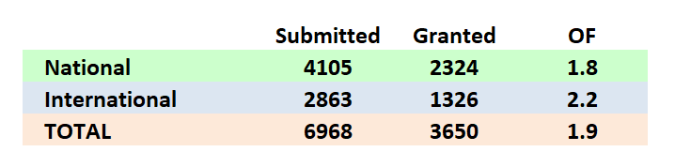
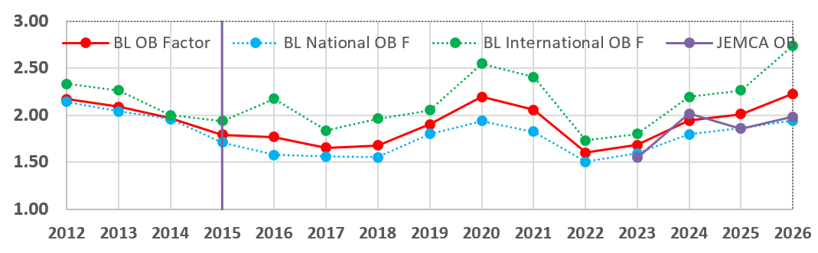
Academic user proposals (including JEMCA)
Call 2027-II open until 7 Sept
BLs only

Slide 12
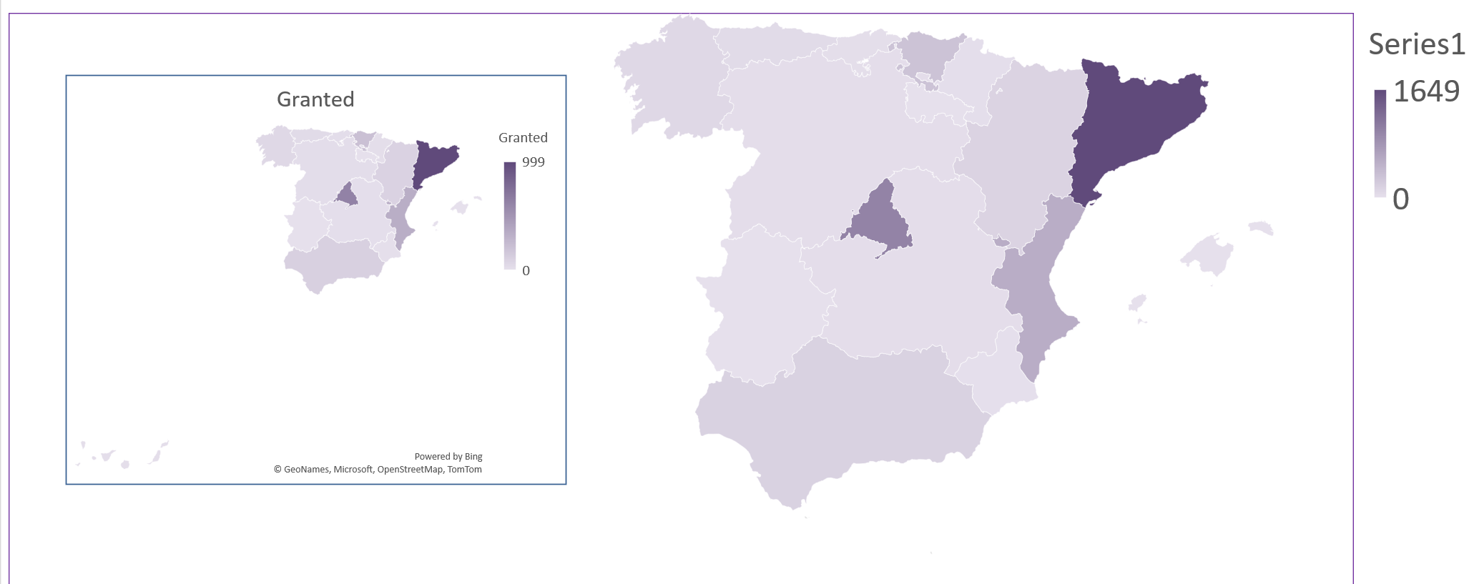

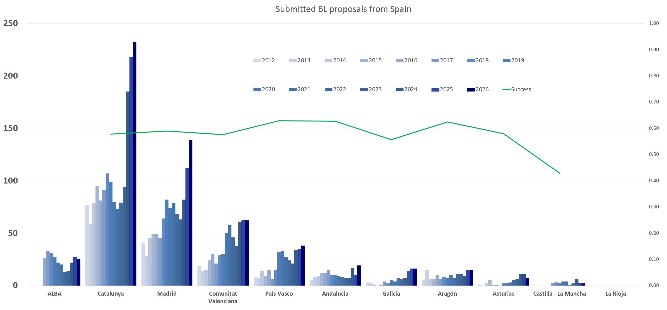
National competitive access
4454 submitted, 2519 granted
Proposals received from almost all CCAA in Spain

Slide 13
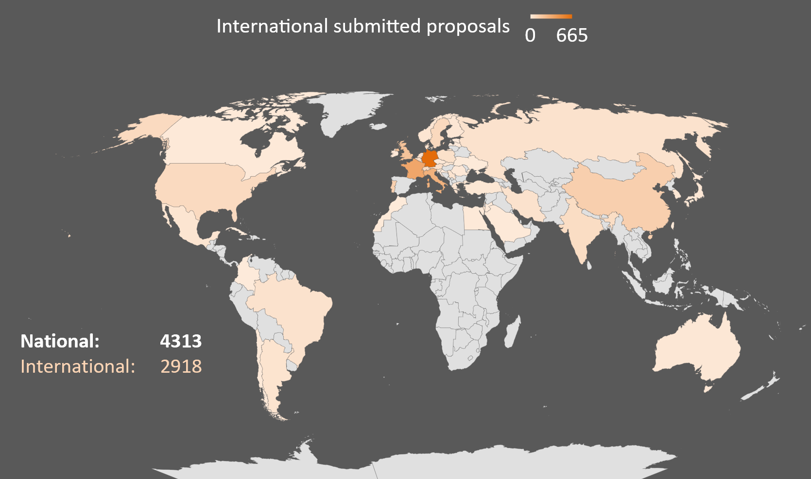
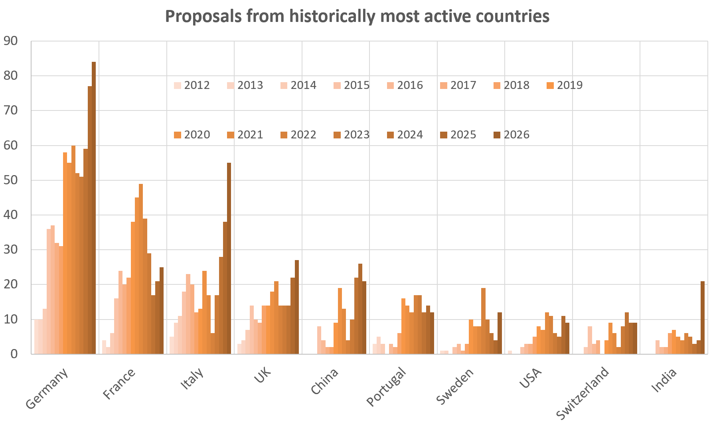
International users – proposals from 50 different countries
National: 4454
International: 2909
1-2 Japan proposals per year
ALBA and its future, ALBA II - 3 Sept 2026

Slide 14
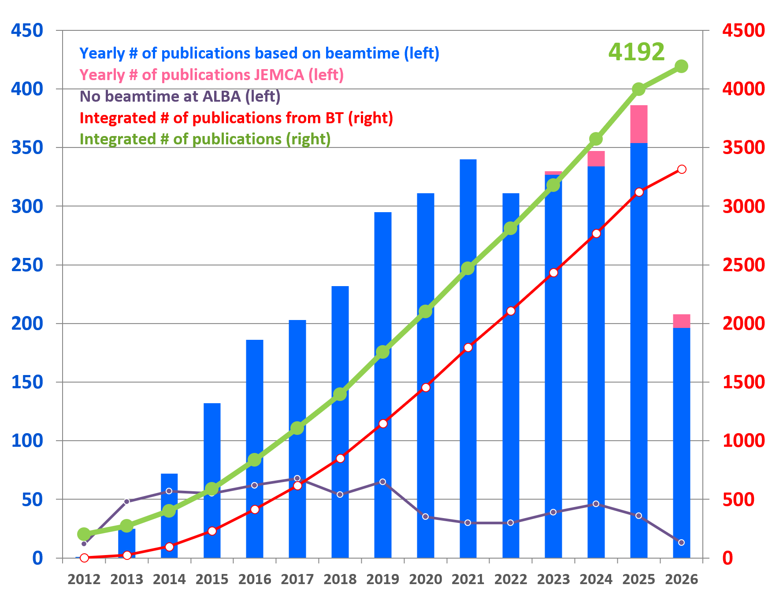
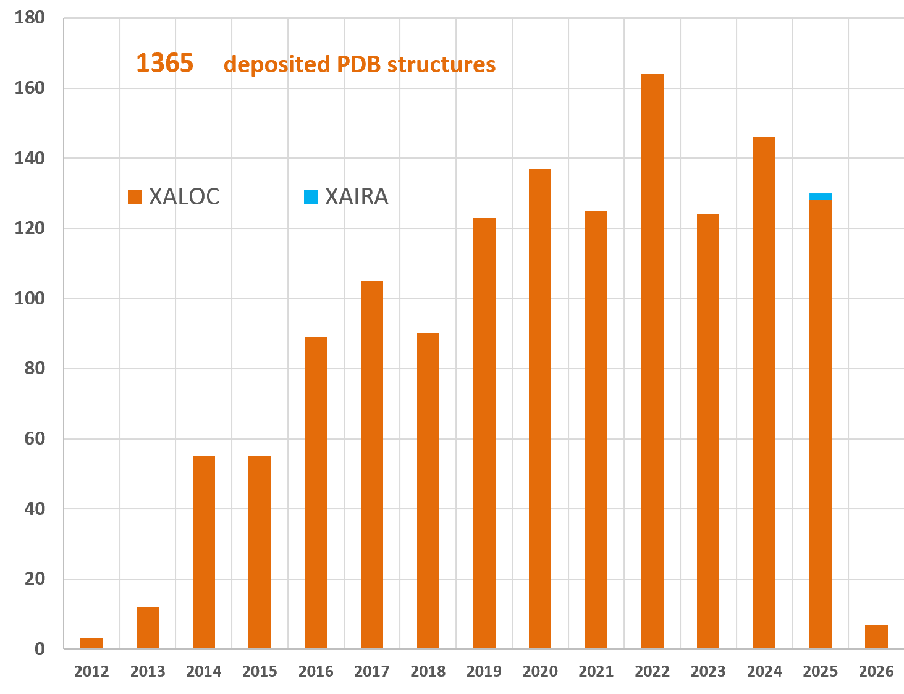
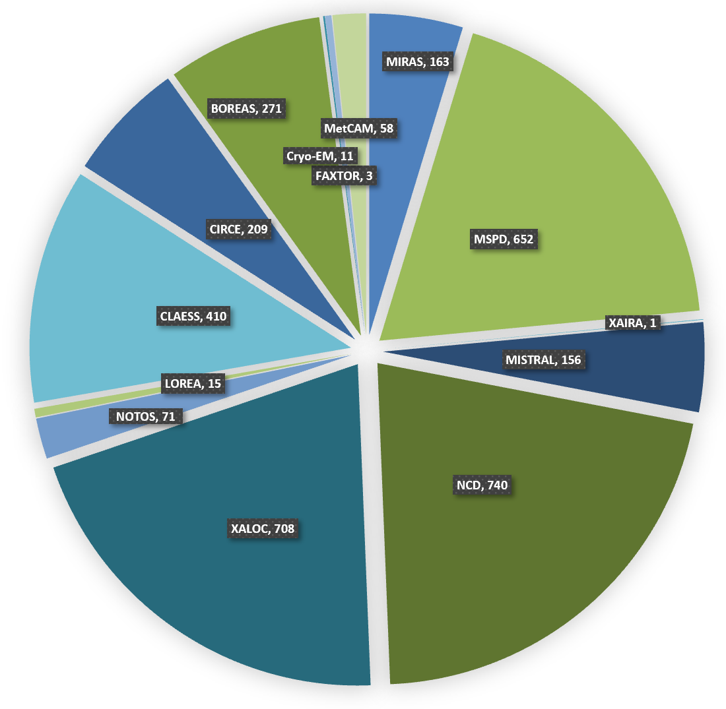
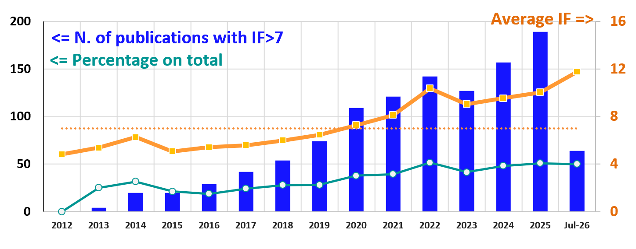
Scientific productivity
Deposited PDB
Xaira has deposited
the first 2 protein structures
See Klaus talk
Publications based on beamtime
2024: <IF> = 8.6; 41% of publications with IF>7
2025: <IF> = 9.6; 46% of publications with IF>7
July 2026: <IF> = 11.8; 50% of publications with IF>7

Slide 15
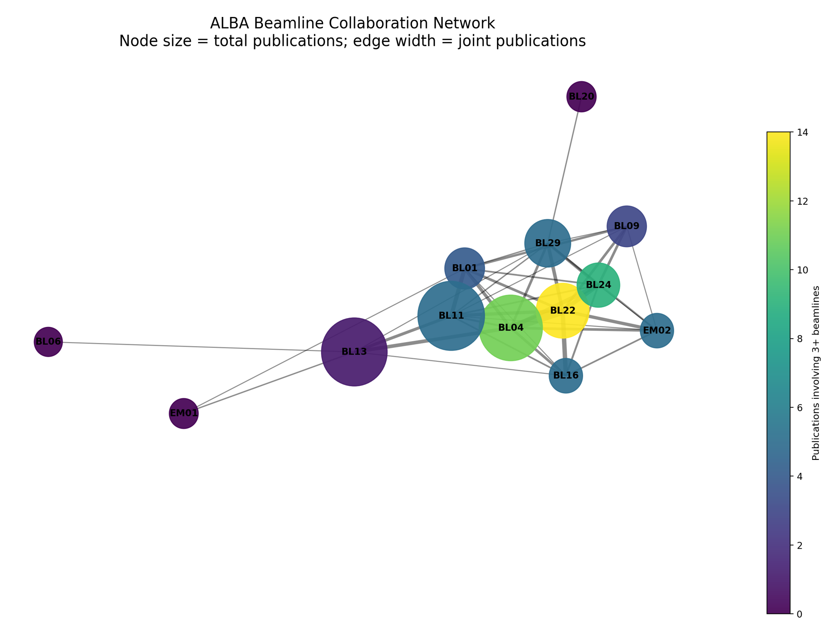
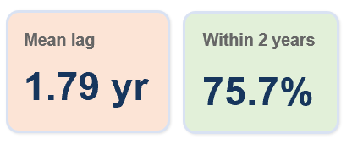
Analysis of publications
Publication timeline

Slide 16
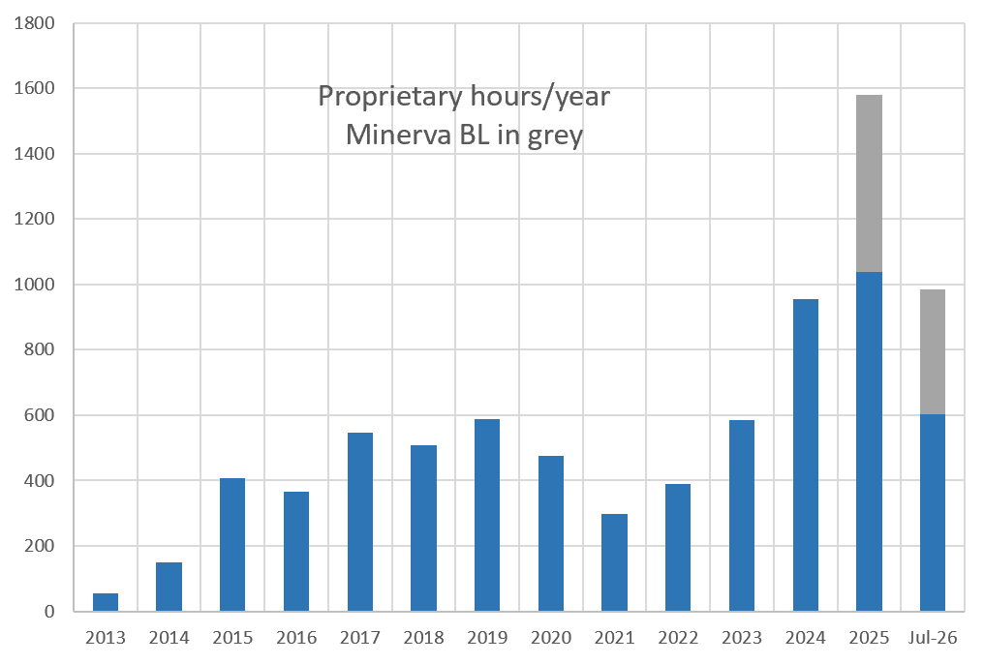
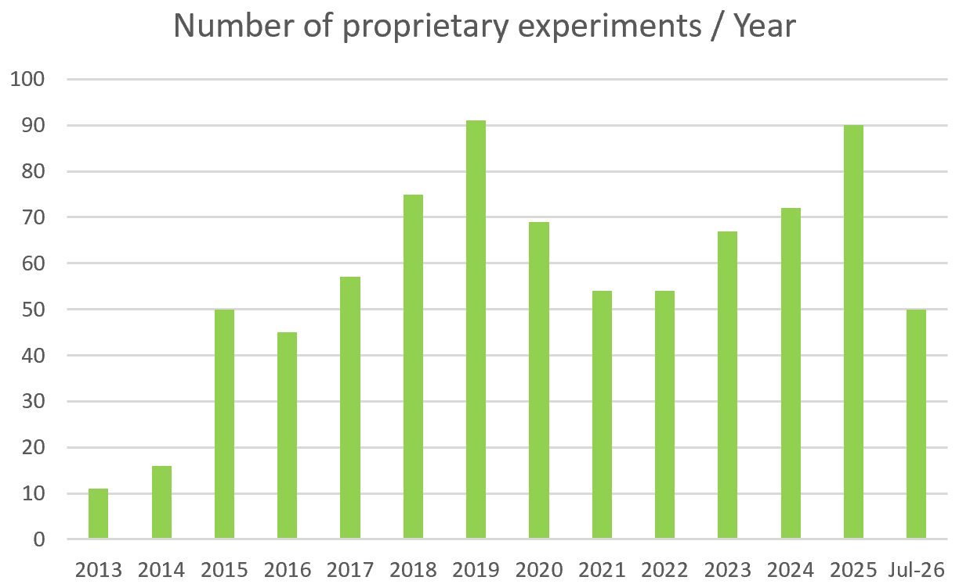
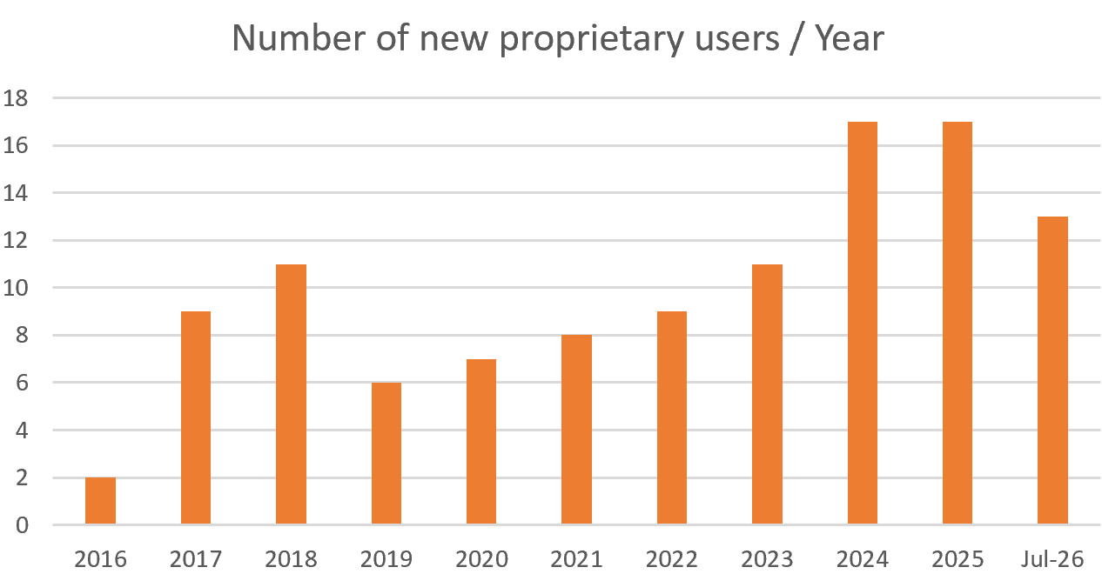
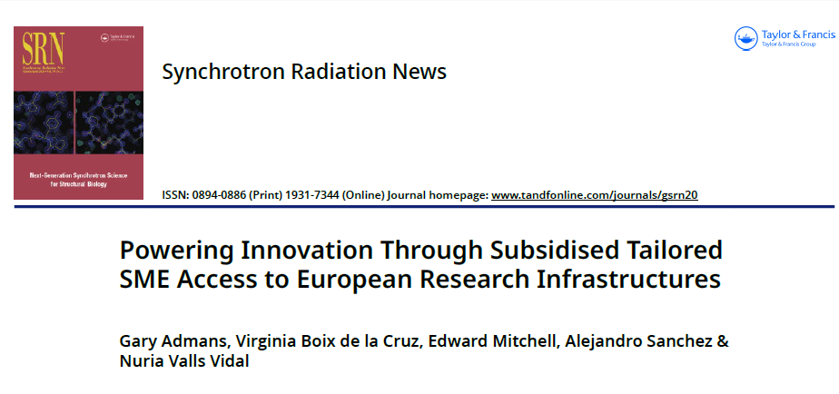
Industrial Beamtime Evolution

Slide 17
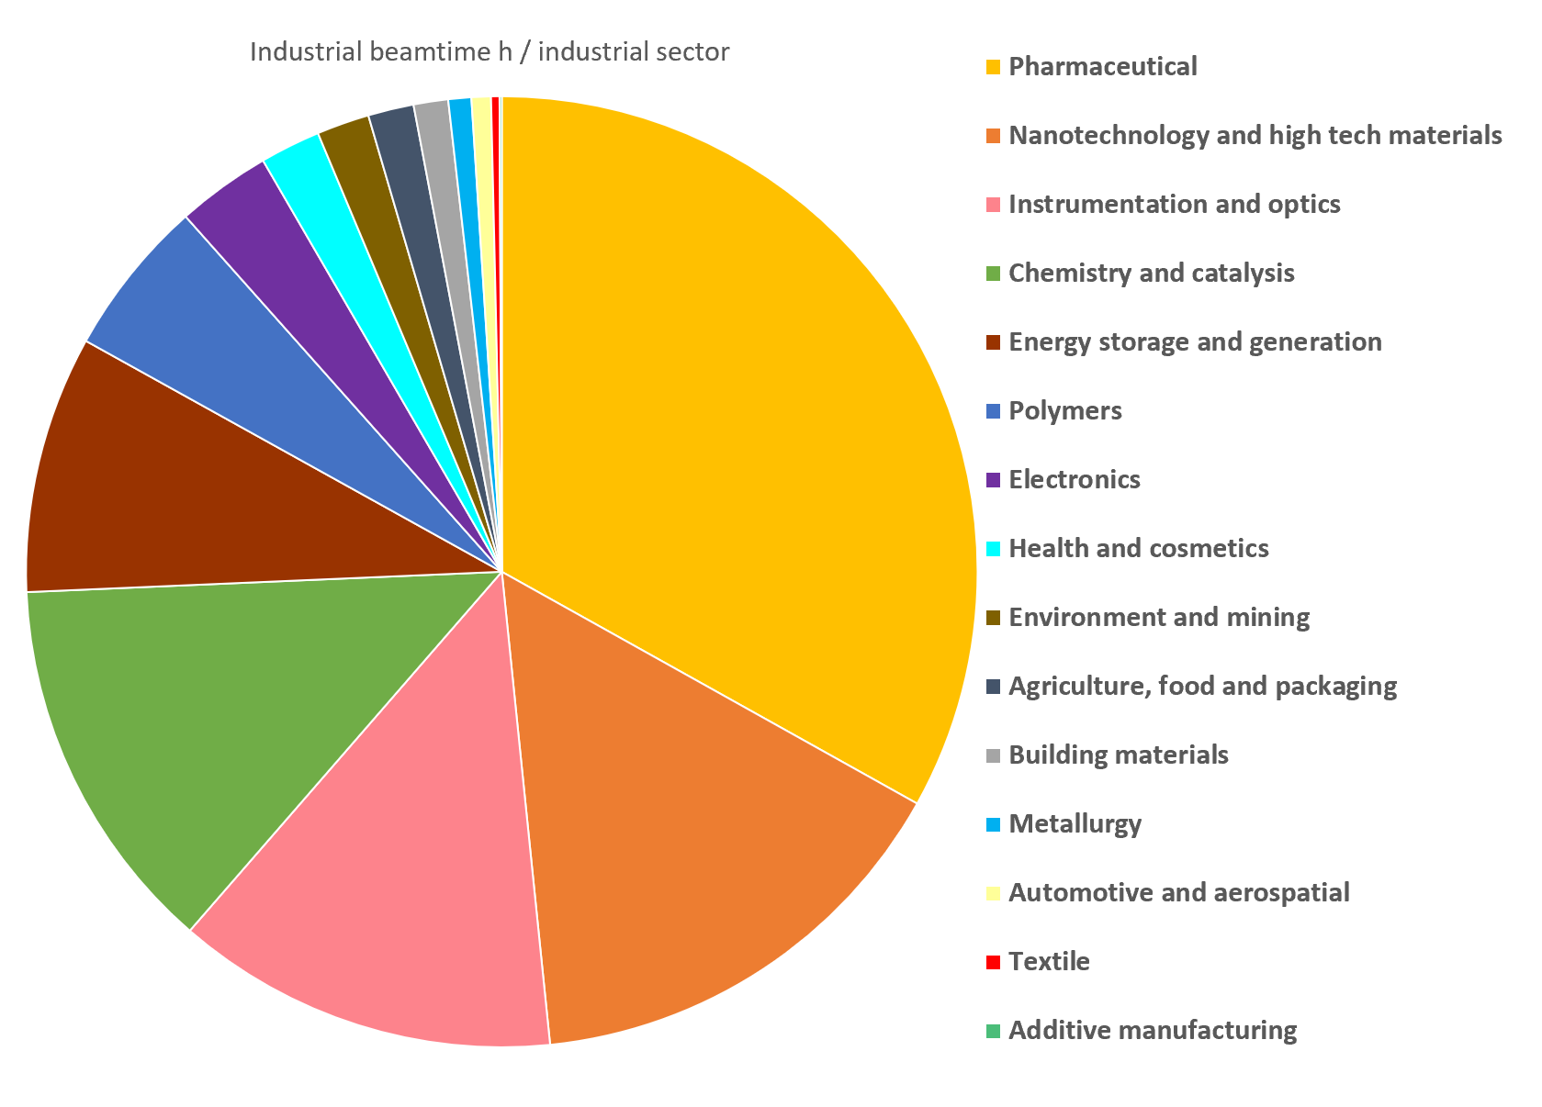
Industrial sectors
801 proprietary services
131 proprietary clients:
  46 % International
  42 % SMEs

Slide 18
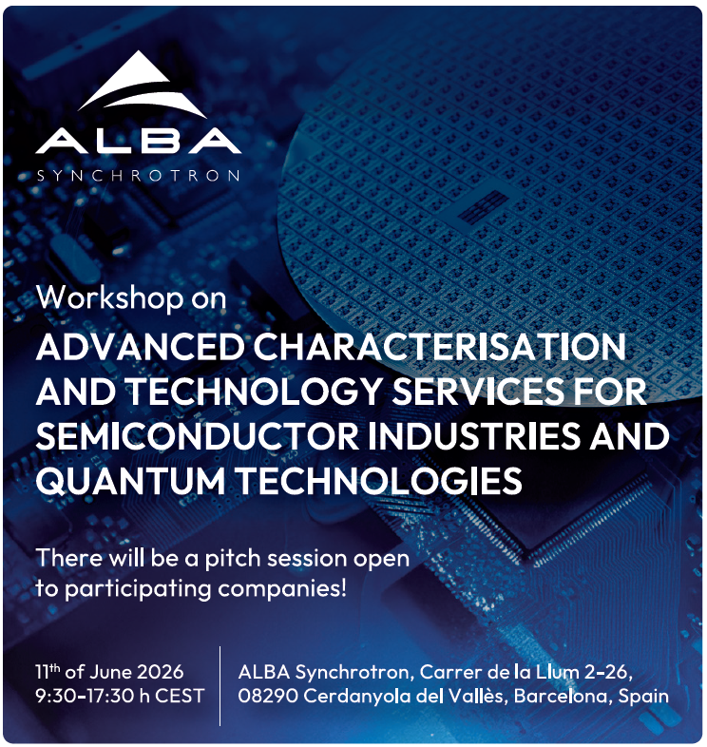
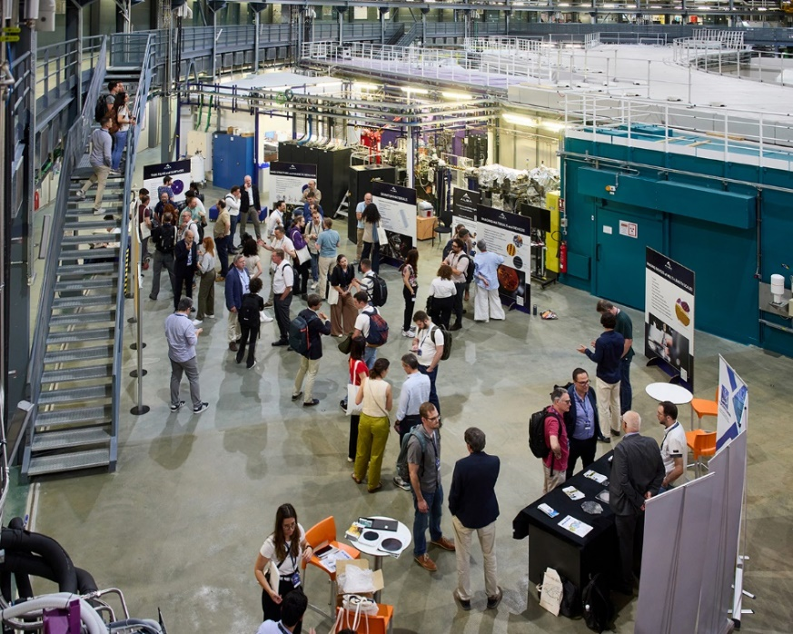
Industry leaders in semiconductors and quantum technologies meet at the ALBA Synchrotron
"This workshop enables companies working in semiconductors to learn first-hand about the advanced scientific capabilities available at ALBA while creating a valuable space for collaboration between the public and private sectors", highlighted Caterina Biscari.
Co-organised with IMEC, CNM and INESC with the collaboration of CDTI and ACCIO
One full day of talks, networking and visit to ALBA
+ 70 participants

Slide 19
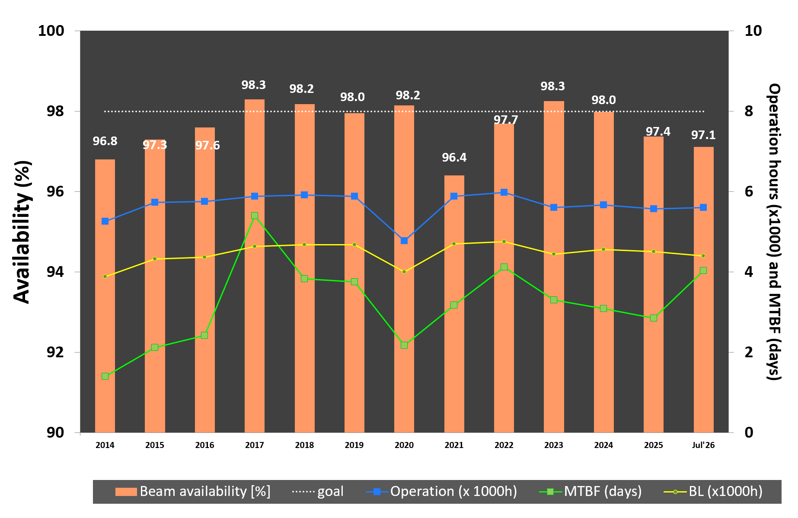
Operation
During 2026 few short interruptions until July. Vacuum incident on 12 July – two days were lost (availability, which was near 99% dropped to 97%)
Operations calendar for 2027
97.1%
176 days for BLs
Time in January to commission the new booster power supply

Slide 20


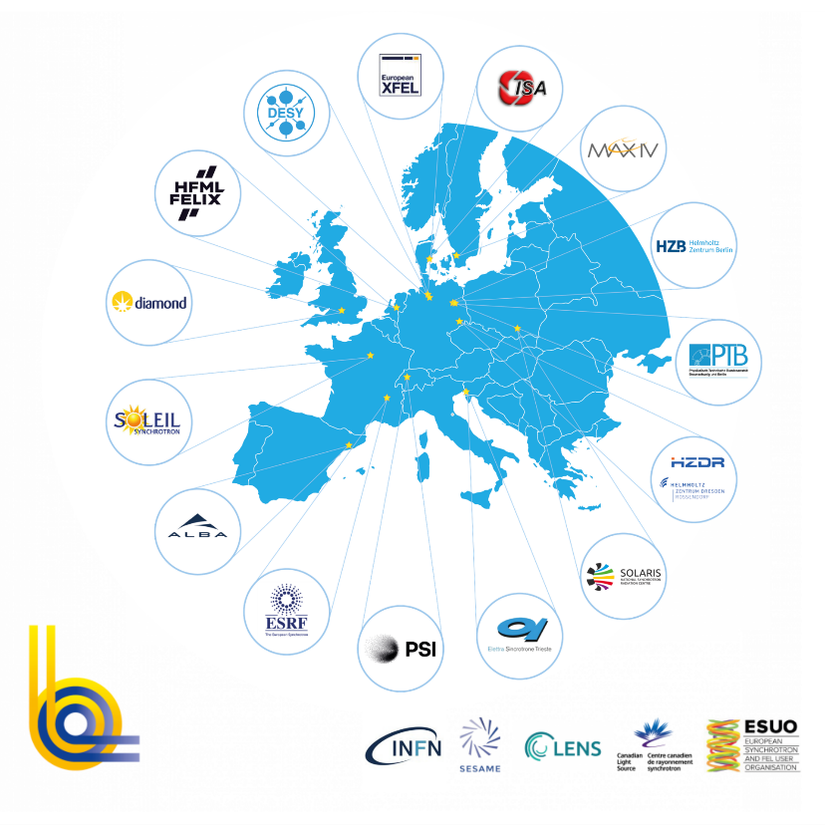
ALBA as a window to European Research centers and RIs
18 facilities - 15 institutions - 10 countries
+35000 users from all EU & beyond
+300 operating End Stations
+25000 publications
In last 5 years
offering
+1M h/year
Associate: SESAME (Jordan)
Partners: ESUO, LENS, CLS, INFN

Slide 21
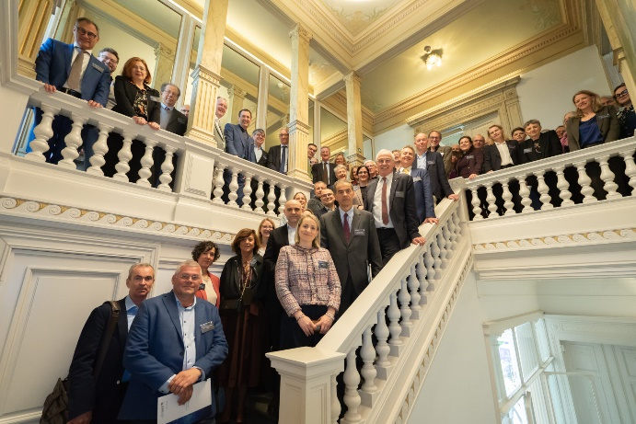
Some of LEAPS activities
LEAPS has become a legal entity: LEAPS AISBL => stronger voice at European level. Possibility of participating in project or partnerships as a whole entity (Example: LEAPS will be member of IAM partnership)
Revision of Mission-Vision on going
2027: Update of 2022 Strategy => producing ESAPS 2027 during next year
Defining participacion in 2027 WP calls as HORIZON-INFRA-2027-TECH-01-01 -> strategic opportunity for LEAPS to implement and test the concepts currently being developed within COORDINA-INNOV project with emphasis on co-creation with industry, start-ups and scale-ups, aligning well with LEAPS ambitions to strengthen innovation and technology transfer
.
22 April 2026 - LEAPS AISBL INAUGURATION IN BRUSSELS
Feedback to EU commission on next WP10

Slide 22







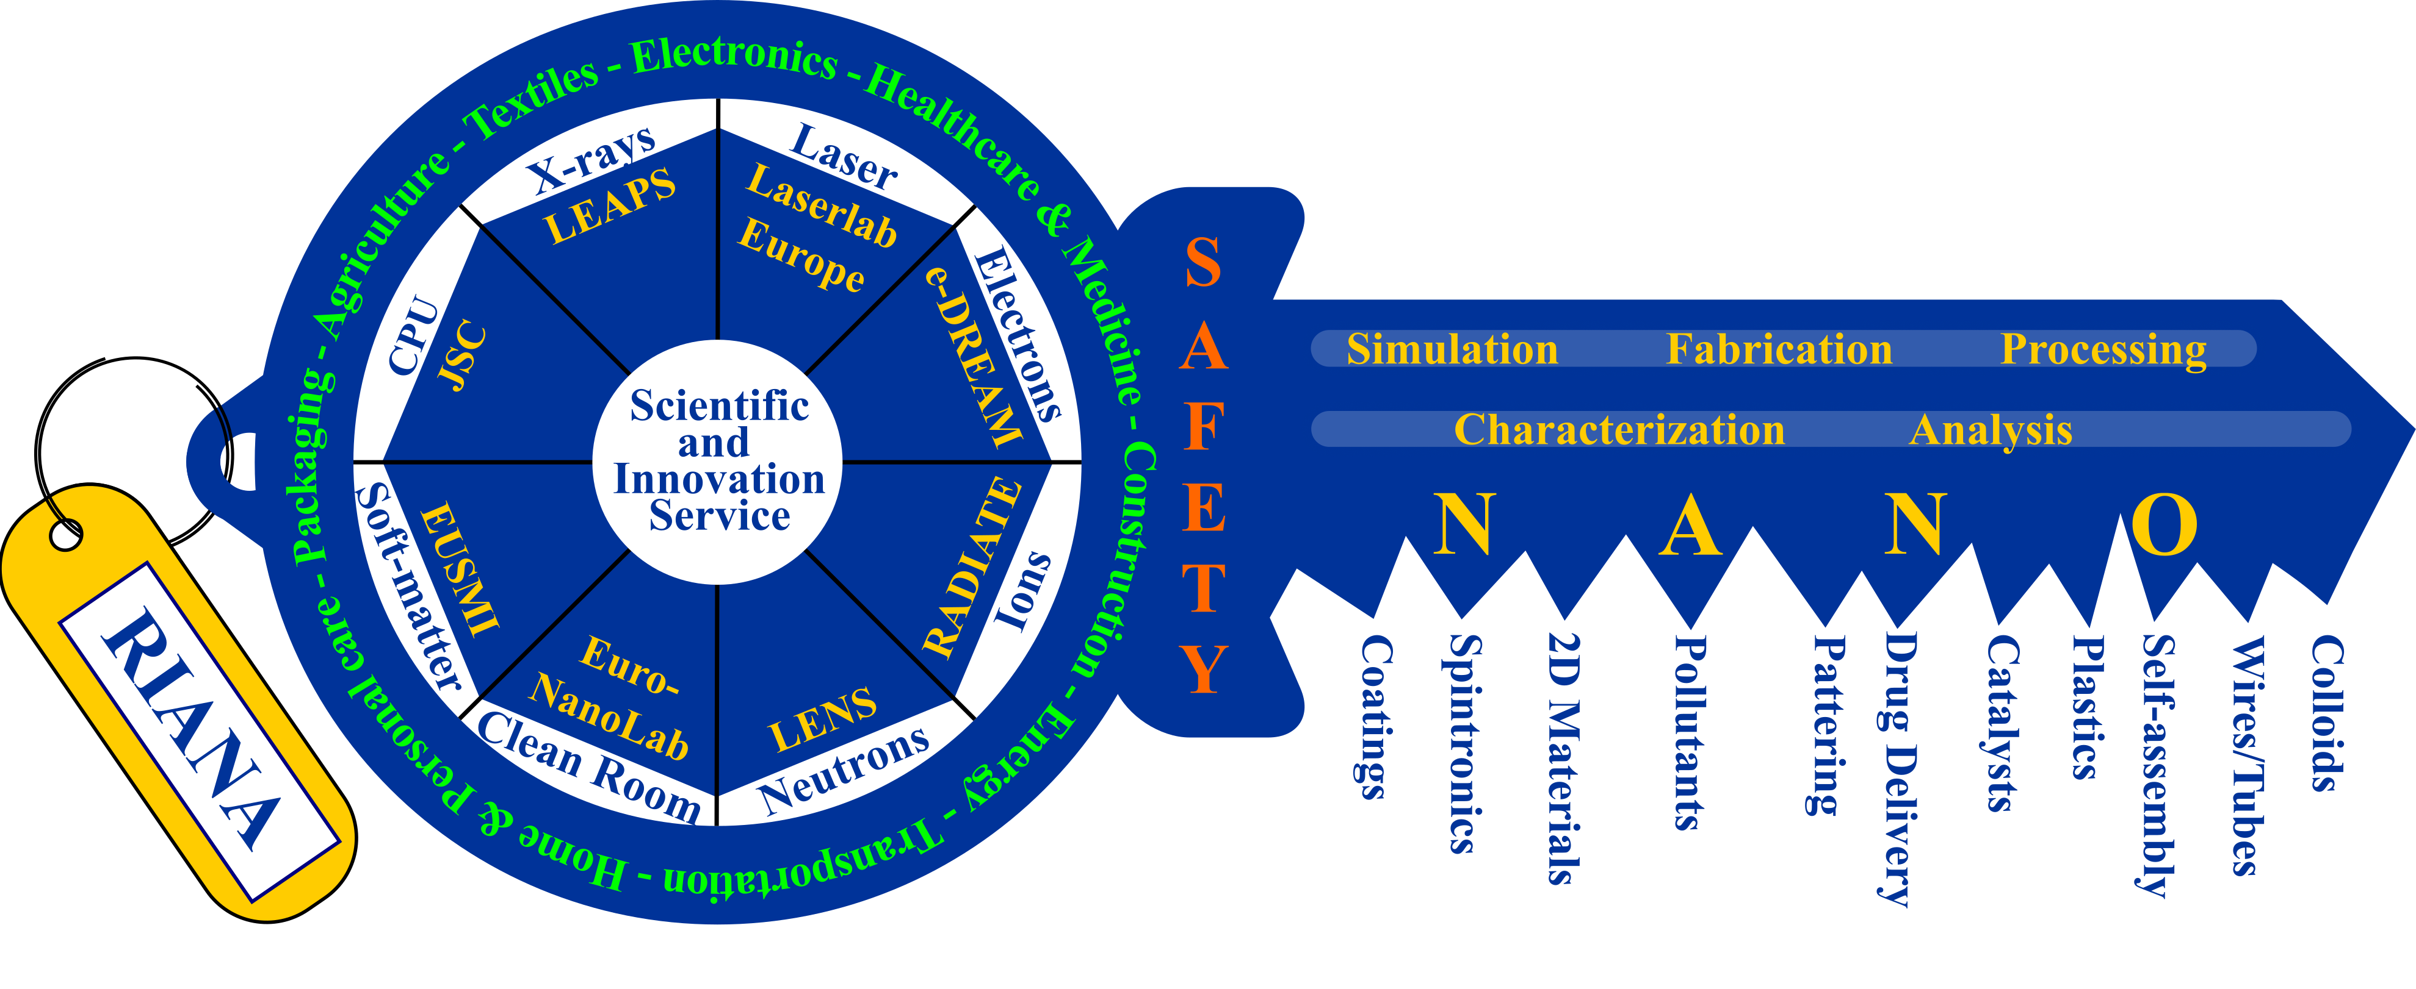
National and International Grants
National Grants include NextGeneration funding, MICIU grants (usually supporting in-house research and with User Community), AGAUR ERDF (Singular)
International are mostly in collaboration with LEAPS, INSTRUCT, INL, Max-Planck Institutes
Some of our direct partners in last years awarded grants
EURECAT, ICMAB, UAM, UCD, ROVALMA, UAB, CSIC, UAL, ICN2, IFAE-PIC
all LEAPS facilities, SESAME, CNR, INFN,
Few examples
Involving companies
X-SeeO2

Slide 23
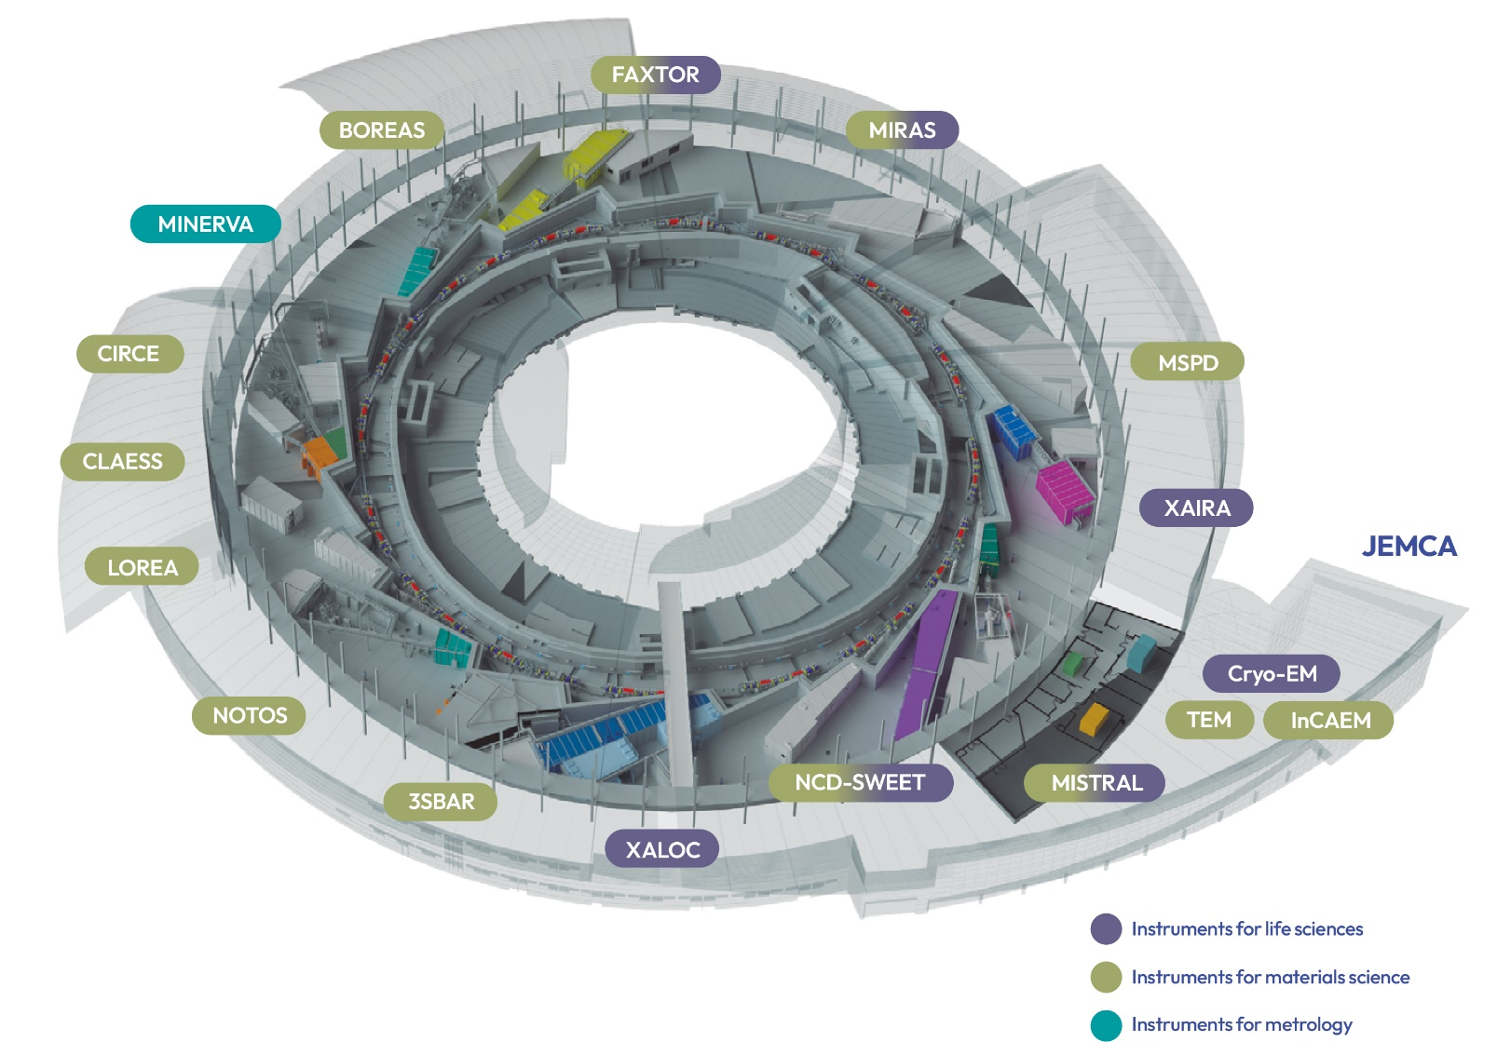
ALBA II in 2032
MSPD2
CODI
CORUS
CALIMA
Shared with partners
SPM Platform at Prisma Building
New storage ring (4th generation)
17 operating beamlines
4 electron microscopes + SPM & AFM
Cryo-EM

Slide 24
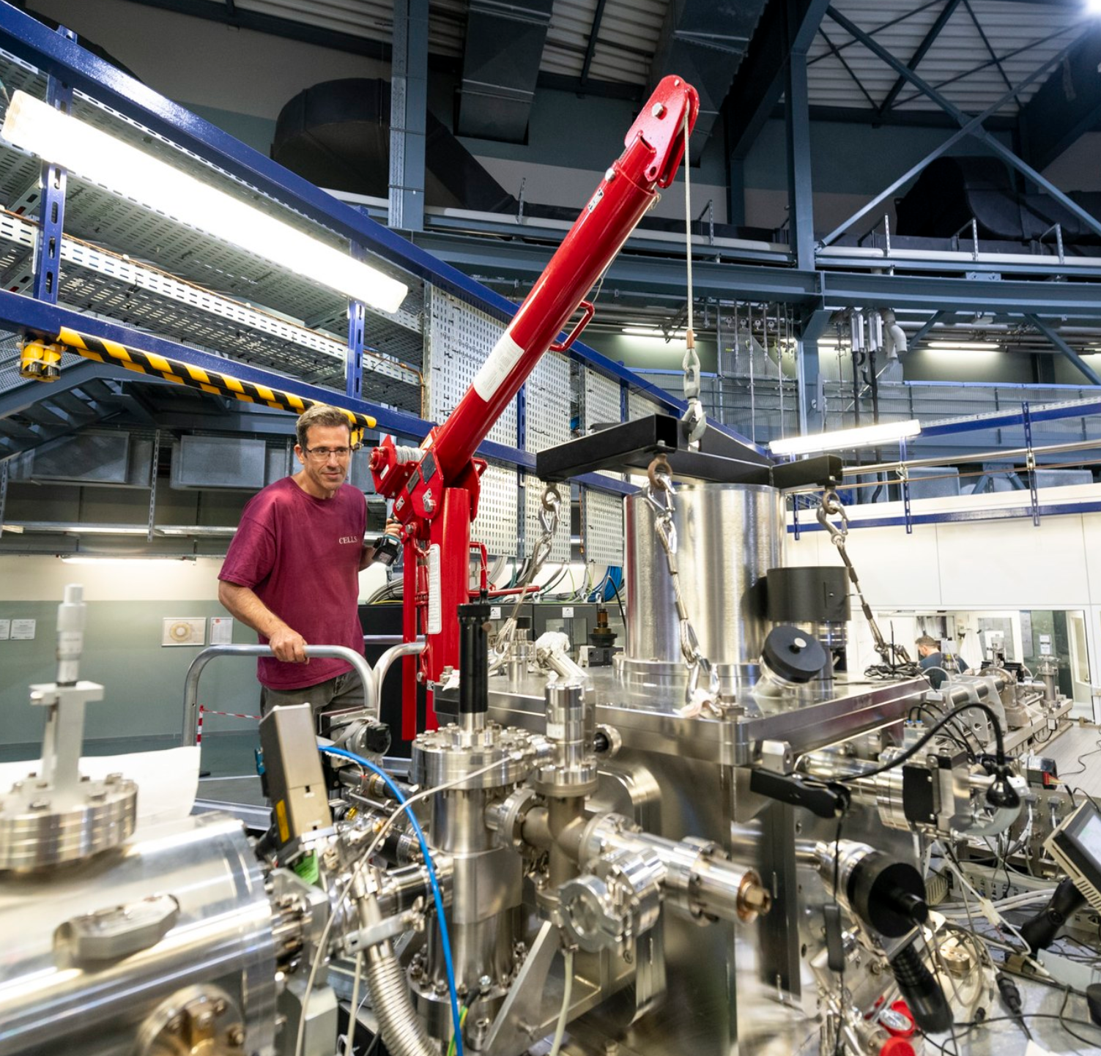
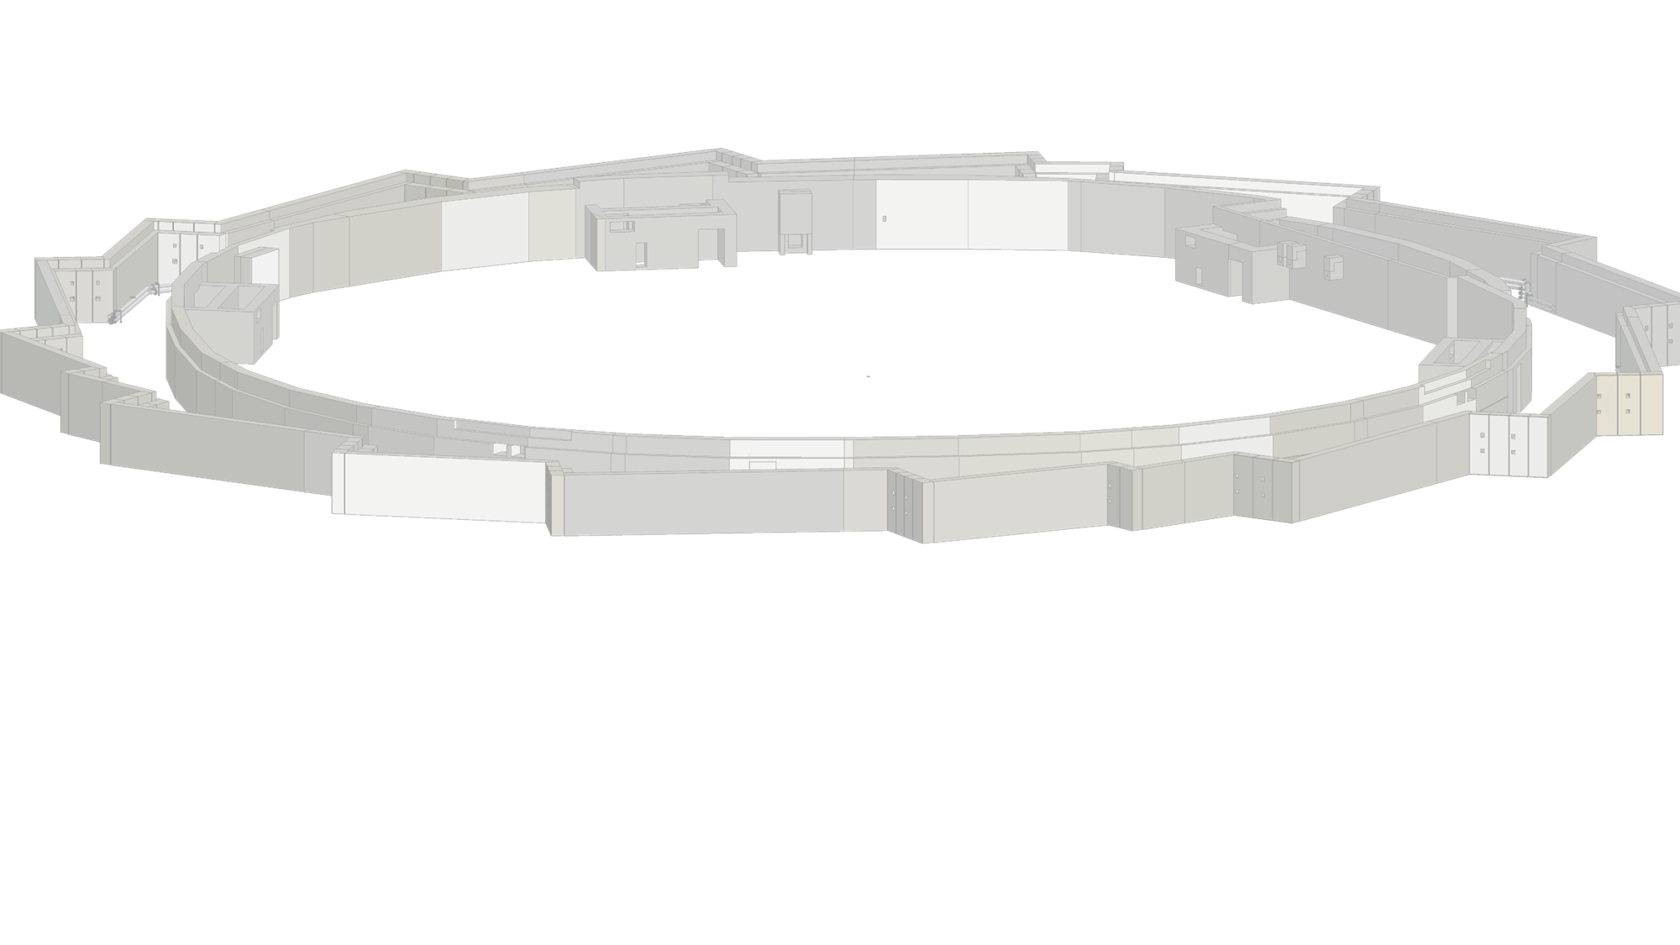
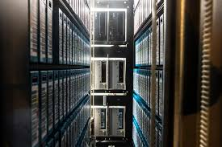
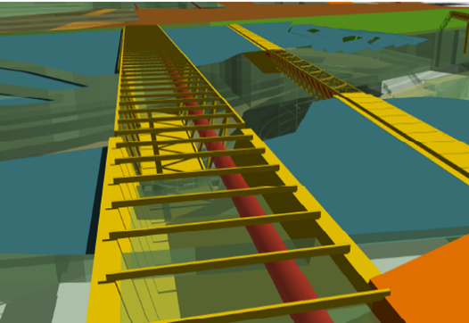
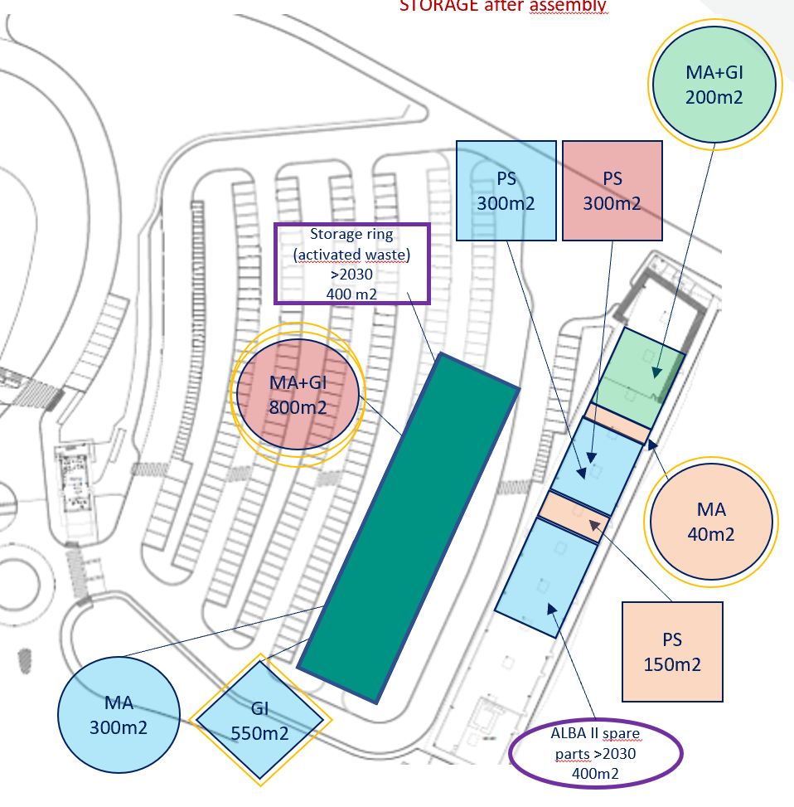
ALBA II – Five Programs
See Montse talk
Program #1
Program #2
Program #3
Program #4
Program #5
Experiments
Accelerators
Computing
& Data
Infrastructure
Implementation

Slide 25
ALBA II Programs Roadmap
Program implementation timeline (2023–2038)
2023
2024
2025
2026
2027
2028
2029
2030
2031
2032
2033
2034
2035
2036
2037
2038
Experiments
Engineering
Computing
Accelerators
Experiments
Pre design
2023-2025
2026-2031
2031-2038
Administration
Accelerators
Engineering
Computing
Experiments
Accelerators
Pre-design
2023–2026
2026-2030
2030-2031
Computing
Experiments
Accelerators
Engineering
Computing&Data
2025-2026
2027–2031
2031-2038
Infrastructure
2023-2025
2025–2029
2029–2033
Engineering
Experiments
Accelerators
Computing
Implementation
2024–2027
2027-2029
2029–2032
Engineering
Experiments
Accelerators
Computing
White Paper
Budget approval
ALBA and its future, ALBA II - 3 Sept 2026

Slide 26
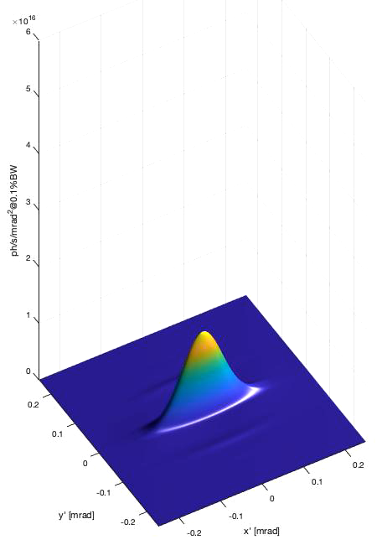
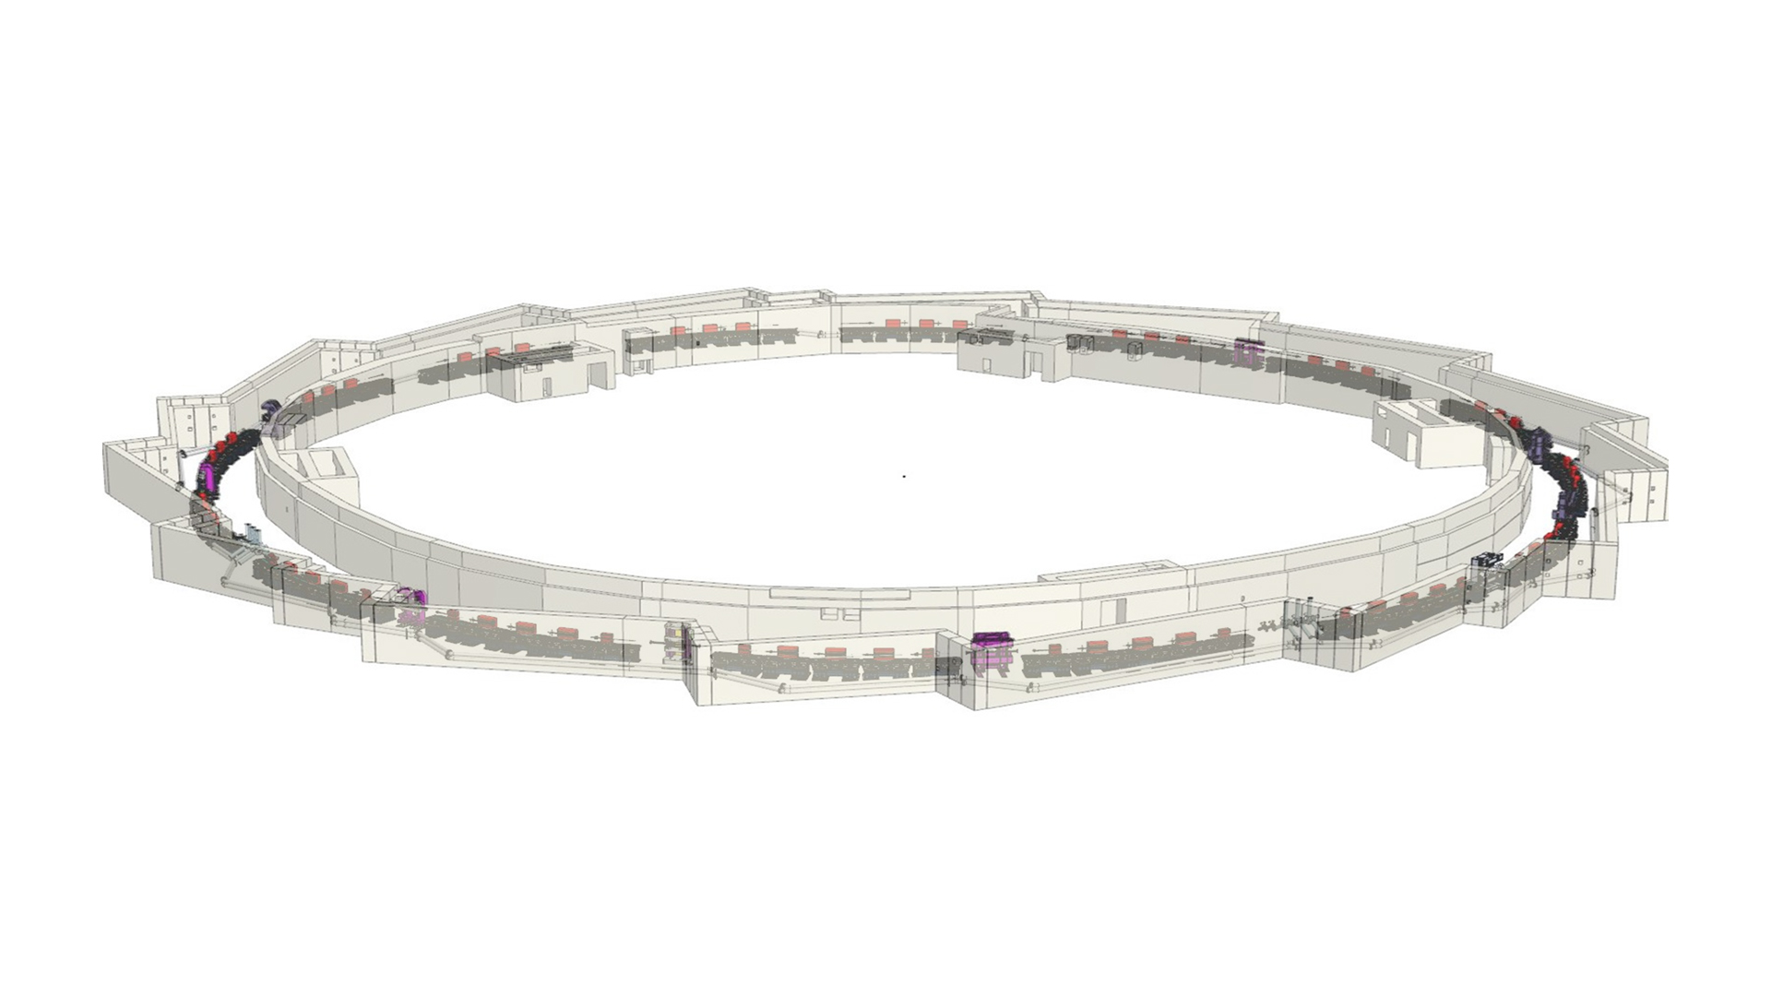
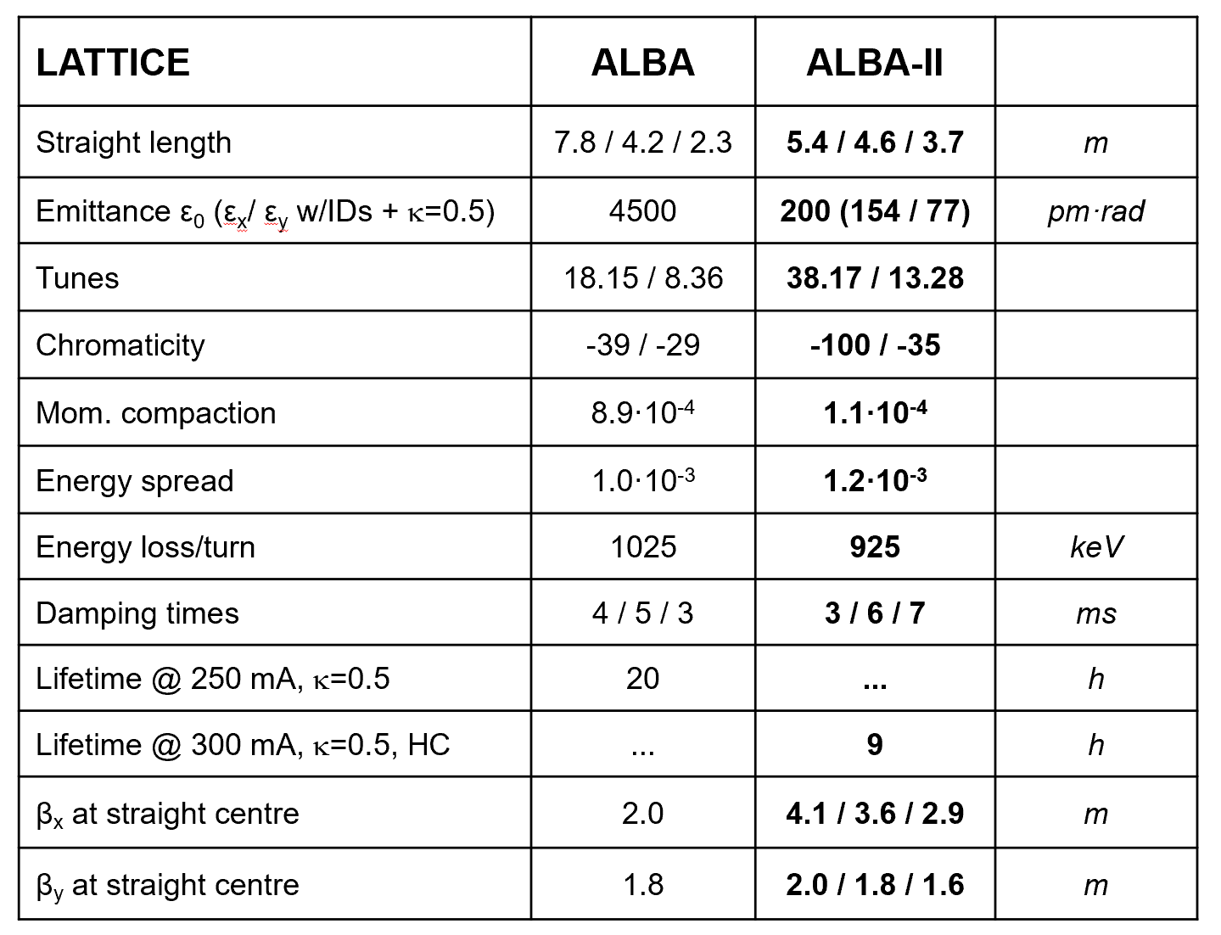
ALBA to ALBA II
Low emittance storage ring (5BA)
Much brighter synchrotron light
ALBA and its future, ALBA II - 3 Sept 2026

Slide 27
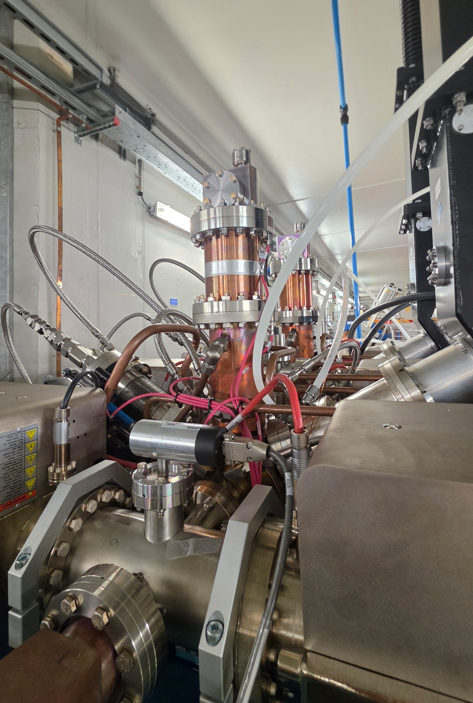
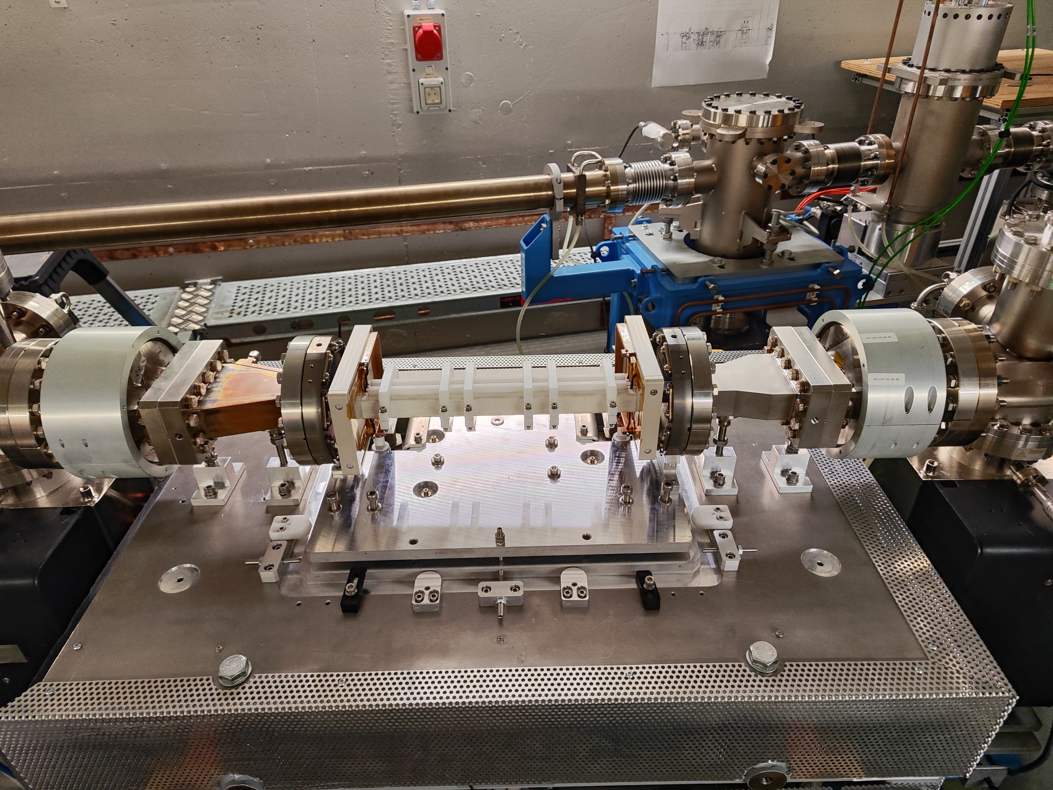
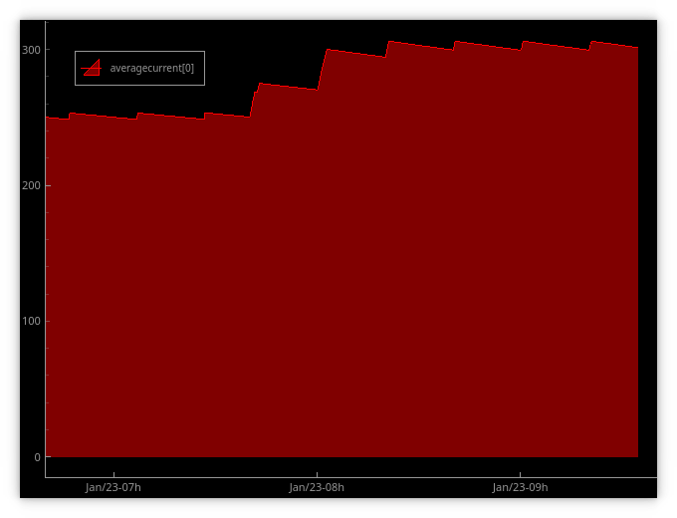
Testing new ALBA II accelerator systems at ALBA
Increasing the current to 300 mA
Tests done at the start-up after the shutdown (Jan 23), storing 300 mA of electrons (+50 mA with respect to normal operation)
300 mA will be the e- current at ALBA II and all systems must be cross-checked to resist the increase of current/radiation/beam losses
3rd Harmonic Cavity
ALBA design, prototype successfully tested in BESSY II
Cavities being installed at ALBA.
Other synchrotrons interested in the design (BESSY II, Sirius, Petra IV,…)
Injection kicker
DDK based on an innovative ALBA design
Built, installed and succesfully tested at ALBA.
Other synchrotrons interested in the design (Sirius, Petra IV,…)
27 July 2026
ALBA and its future, ALBA II - 3 Sept 2026

Slide 28
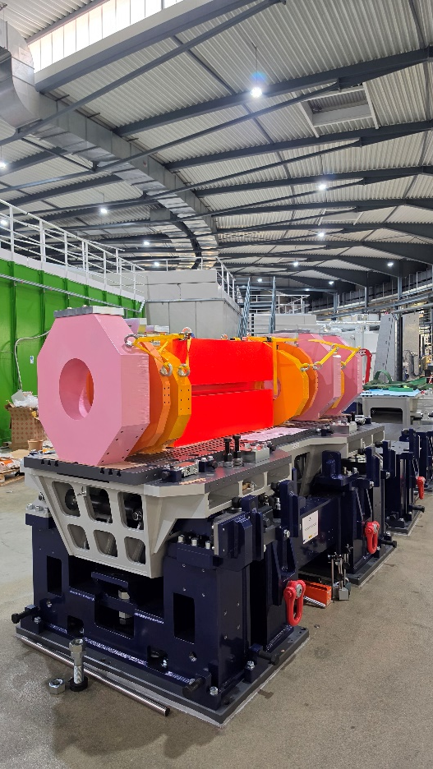


Magnet and girders prototypes being measured
            Girders from Spanish company
            Magnets from Spanish and European companies
ALBA and its future, ALBA II - 3 Sept 2026

Slide 29

ALBA II Flagships Beamlines - Two Long Coherent Imaging nanoprobes
1
BL02 - CoDI
- A single Endstation Beamline
- Focused on multimodal in-situ or operando studies of Functional Material and Environmental Science Samples up to 500 µm in diameter and down to spatial resolution of < 5 nm and acquisition times < 1 minute.
- Main Imaging Modalities:
X-ray Ptychography, Ptychographic Tomography, Bragg-CDI(Ptychography), Holotomography, correlative scanning nanobeam XRD and XRF
2
3
BL04 - CORUS
- A two Endstation Beamline
- NanoImag operating at room temperature:
Focusing on nanotomography of life science specimens (tissues) up to 1mm³ in volume at a spatial resolution of 20 nm within a single beamtime allocation.
Main Imaging Modalities: Holography, Holotomography and Ptychography.
- NanoFluoSpec able to operate under cryogenic and inert conditions:
Focusing on nano spectro-microscopy and tomography of vitrified cellular scale samples (cells), with a spatial resolution down to 50 nm.
Main Imaging Modalities: scanning nanobeam XRF, XAS and Holotomography.
Operational Start-Up : First Light of ALBA II

Slide 30


Infrastructures Program
New Buildings + Infrastructure Upgrades
Status
Existing ALBA building
Focus
Orbit
Existing external building
Scope of New Bu project
external
CODI & BL03
external
For the future
Possibilities for external buldings
CORUS
ST4 (thermal energy provider)
(new) CryoEM
InnoFab
Main Building
BL08
Temporary Bu.
Prisma
AI generated, G.Peña
ALBA and its future, ALBA II - 3 Sept 2026

Slide 31

The Plan
ALBA II
06/2032 – ALBA II Operation
2026
2027
2028
2029 - 05/2030
06/2030 – 06/2032
PG01 Experiments
PG02 Accelerator
PG03 Computing & Data
PG04 Infrastructure
PG05 Implementation
Installation Commissioning
Design CODI Procurement
3SBAR
Design CORUS Procurement
Installation Commissioning
Design & Procurement MSPD2 Installation & Commissioning
Design CALIMA Procurement
Installation Commissioning
Design & Procurement BL Upgrades Installation & Commissioning
Pre-assembly
Installation & Commissioning
Prototypes and Design
CfT & Procurement
Series SAT
COMPUTING Infrastructure
Core DATA Services
Scientific DATA Processing & Analysis
Temporary A and B BUILDINGS
PRISMA LABORATORIES
CODI, CORUS and FOCUS Buildings and Photon Transfer Lines
CDB Created Tooling, Storage, logistics LOGISTICS & STORAGE logistics, controlling execution
Tasks Schedule REMOVAL & INSTALLATION Execution

Slide 32
ALBA Future
ALBA opening new instrument
ALBA developing new tools and services, also with partners
ALBA II upgrade approved – on going
Budget approved up to 2038
Harry Westfahl Jr. director from 1st Nov 2026

Slide 33

Message from Harry
“I am very much looking forward to working with this wonderful community. I am sorry I could not join you at the Users’ Meeting, as we are hosting the X-ray Microscopy Conference at Sirius this week. In fact, I have been very impressed by the quality of the work from ALBA presented here at the conference.
Entering the fourth-generation era is the beginning of an exciting journey, with tremendous new scientific opportunities. I feel honored to join ALBA and its user community for this journey, and I look forward to seeing you all soon and, together, shaping the future”
ALBA and its future, ALBA II - 3 Sept 2026

Slide 34

Thanks to our governing bodies for the support and the trust
Thanks to all ALBA users and collaborators
Thanks to ALBA people

