Slide 1
Property, Plant and Equipment (PPE) register in Infor EAM
Accounting
Julie Falcon
Finance and Administrative Processes Department
Accounting Services - General Accounting

Slide 2
CERN Property Plant and Equipment (PPE) register
Creation of an assets register requested by External Auditors in 2014
Main motivations :
  Increase the number of asset classes
  Split complex assets into components
  Higher level of compliance (IPSAS 17)
  Improvement of disclosed information related to PPE in the financial statements

Slide 3
Various underlying sources
Not all types of equipment at CERN are registered and managed in Infor.
Assets ending in the PPE register are coming from different sources, different databases. For this reason we designed the structure of our register using both Assets and Systems (Infor objects).
Infor
Excel, etc…
Baan
CERN Property, Plant and Equipment register

Slide 4
Structure Objects in Infor EAM
A
Asset is a tangible piece of equipment individually traced with a unique identifier / serial number.
Assets are already in Infor for maintenance purposes. We flag them as “PPE” (Property, Plant and Equipment) and enter depreciation data on them (depreciation start date, depreciation method, useful life, residual value). We then aggregate them into higher Systems.

Slide 5

Structure Objects in Infor EAM
Systems are usually used to group objects into logical groups at various levels.
S
Systems give us the flexibility to group assets according to our pre-defined PPE register structure (following budget and actuals presentation in official financial documents).
We also use Systems for equipment coming from different databases than Infor (or in Infor but with a level of details hardly manageable for PPE register).
Main difference for us is that we have less information to fill in for assets (physical location is already mentioned, responsible organic unit, related facility, etc…). These details have to be loaded via excel uploads for Systems.

Slide 6
PPE
Scientific Installations
LHC Programme
Other Programmes
Non Scientific Installations
General Facilities and Logistics
Informatics
Etc…
Cooling & Ventilation
Vacuum
Etc…
Civil Engineering Tertiary Buildings
Heavy Handling
Etc…
Groups of assets (same nature & useful life)
Groups of assets (same nature & useful life)
S2
S1
A1
A2
Etc…
Etc…
This structure follows the way budget and actuals are reported within our financial documents. Systems gave us this flexibility to group assets accordingly.
Approx. 40’000 assets / systems in the PPE register as of today.

Slide 7
Accounting value attribution
S
Scientific Installations
Value: 200
S
Other Programs
Value: 30
S
LHC Program
Value: 170
S
S
S
Cooling & Ventilation
Value: 50
Vacuum
Value: 50
Etc…
Value: 70
By structuring with systems, the value can easily be aggregated and reported at any level.

Slide 8
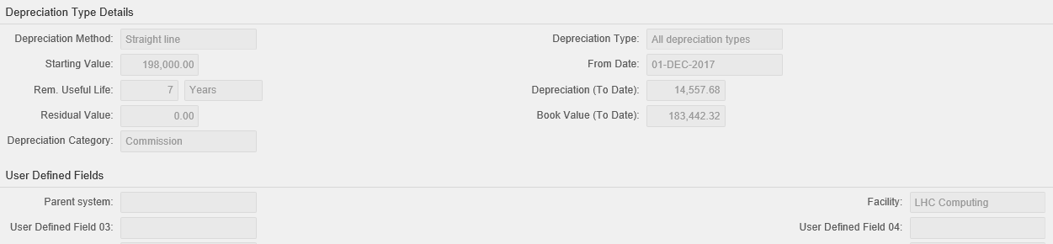
Depreciation functionalities
Data uploaded via Excel files

Slide 9
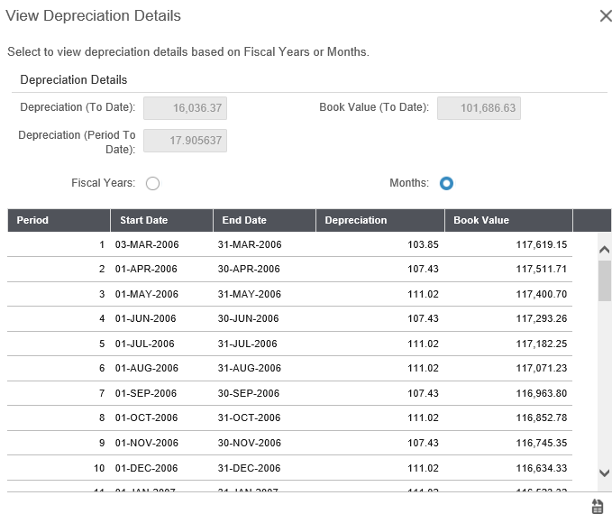
Depreciation functionalities (ctd)
Depreciation details available and exportable to Excel

Slide 10
Depreciation functionalities (ctd)
Increase / decrease value
Early disposal
Increase / decrease life

Slide 11
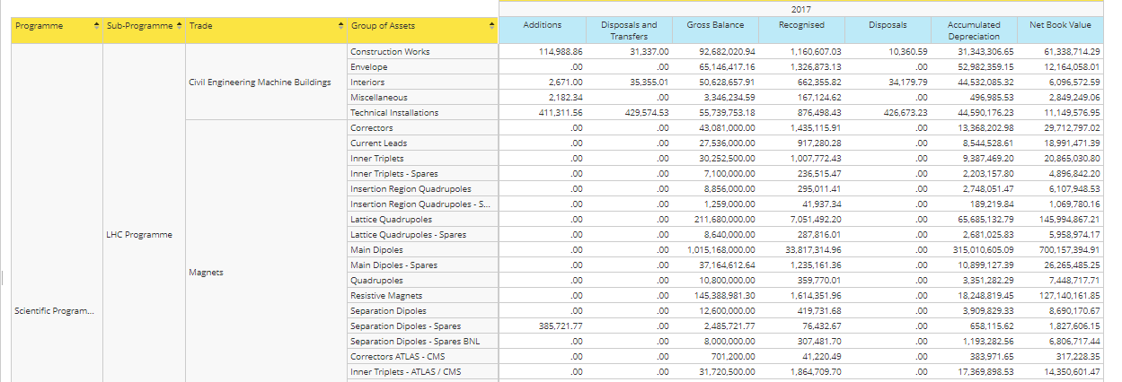
Reporting

Slide 12
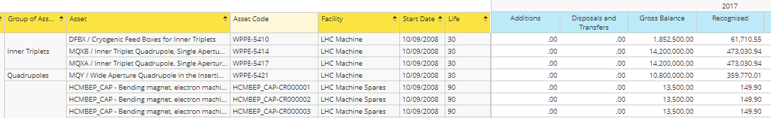
Reporting (ctd)
Assets
Systems

Slide 13
Main remaining challenges
  Process essentially manual and largely relying on technical experts (mouvements of the year, useful life assessment, valuation, etc…). Requires a very good cooperation with the technical groups.
  Very little room for automatization due to high number of persons placing orders at CERN (approx. 50’000 orders per year).
  Infor so far not connected to our accounting system (Qualiac – Cegid). Every mouvement in the PPE register (addition/disposal) is translated by a manual entry in the books.

Slide 14

THANK YOU FOR YOUR ATTENTION

