Slide 1
Adaption of AM Industry Standards in a Scientific Environment
Alexander Frank
Asset Management (AM)
ALBA Synchrotron 27.09.2018

Slide 2
Introduction of EuXFEL

Slide 3
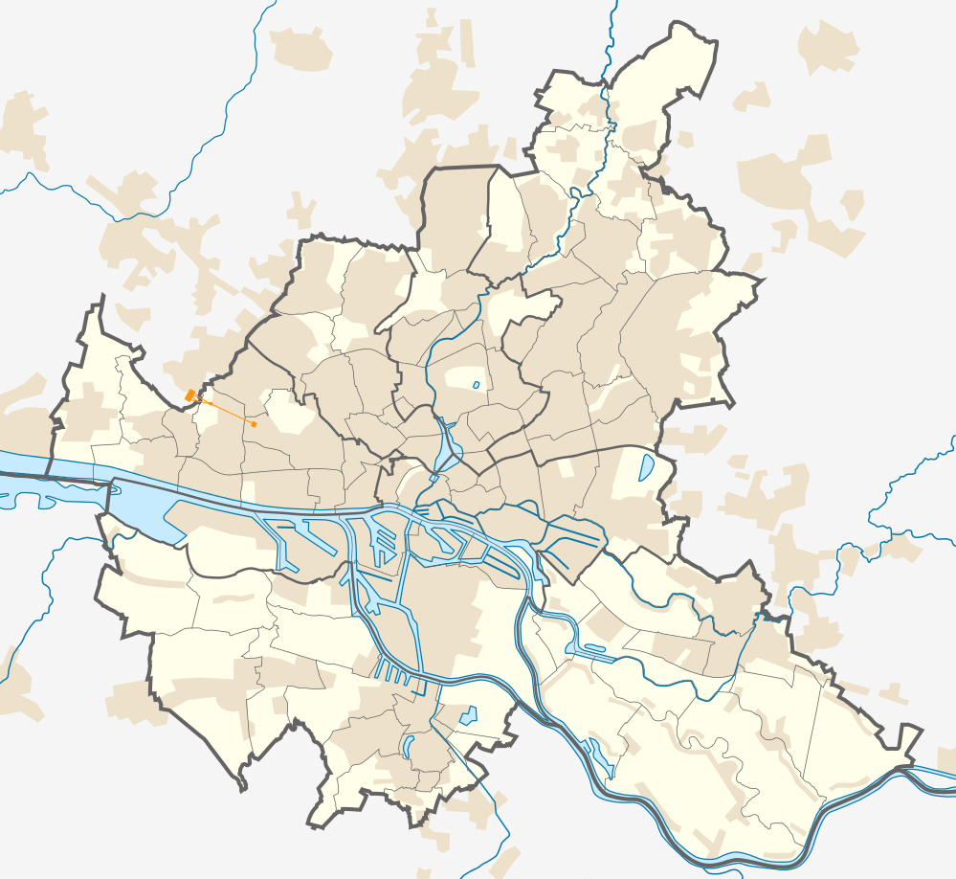
European XFEL—a leading new research facility
NordNordWest / CCA-SA-3.0

Slide 4

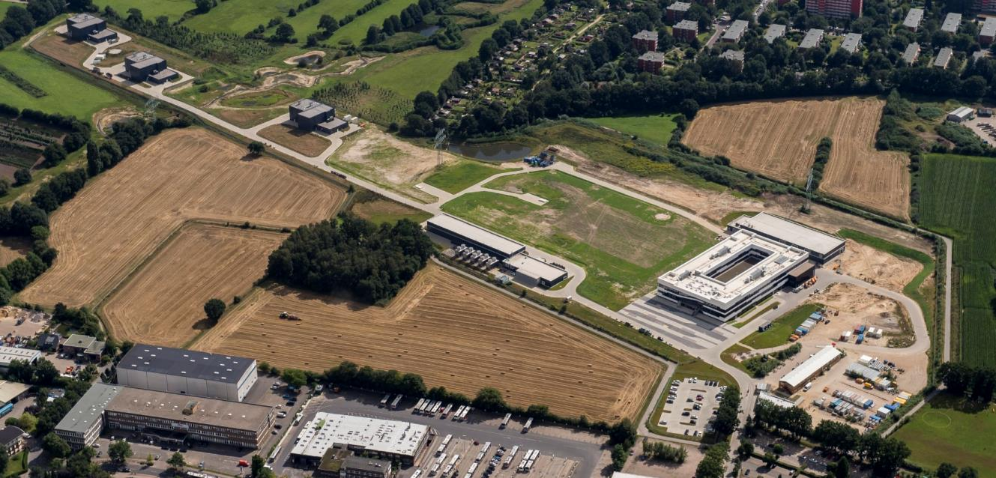
European XFEL—a leading new research facility
The European XFEL is a new research facility that uses high-intensity X-ray light to study the structure of matter.
  User facility with more than 350 employees (+250 from DESY)
  Location: Hamburg and Schenefeld, Germany
  September 2017 start of user operation
Schenefeld research campus on 14 August 2017

Slide 5


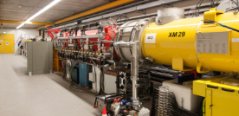
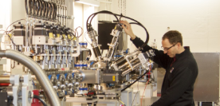
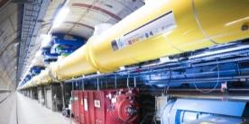
General layout of the European XFEL
Undulator / Photon tunnels
Injector at DESY campus
Scientific instruments in Schenefeld
Superconducting linear accelerator

Slide 6
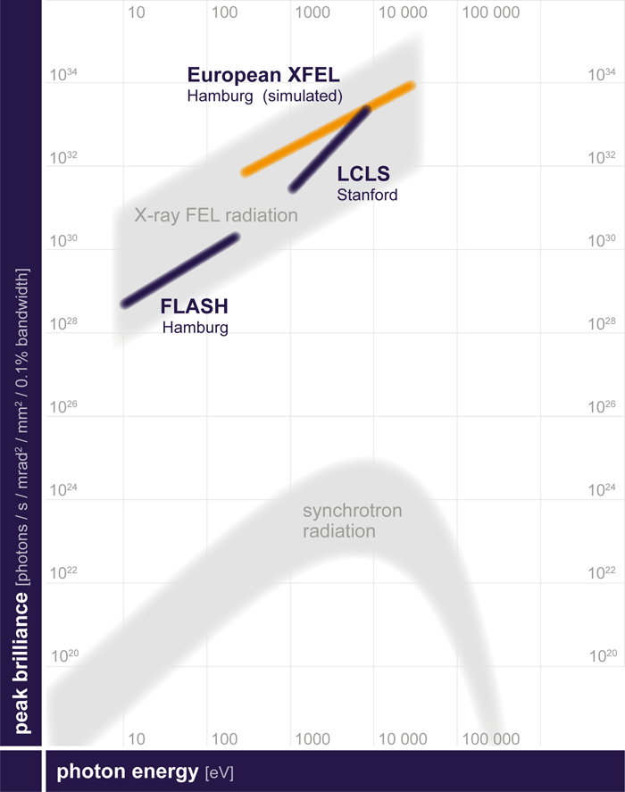
Free-electron lasers worldwide in comparison
The peak brilliance of X-ray free-electron lasers exceeds that of the most modern synchrotron radiation sources by several orders of magnitude
The European XFEL will be capable of generating more pulses per second and more intense X-rays than any other X-ray free-electron laser in the world.

Slide 7

About European XFEL
Organized as a non-profit corporation in 2009 with the mission of design, construction, operation, and development of the free-electron laser
Supported by 12 partner countries
Germany (federal government, city-state of Hamburg, and state of Schleswig-Holstein) covers 57% of the costs; Russia contributes 26%; each of the other international shareholders 1–3%
Total budget for construction (including commissioning)
  1.25 billion € at 2005 prices, about 117 M€ operating budget
  600 M€ contributed in cash, over 550 M€ as in-kind contributions (mainly manufacture of parts for the facility)

Slide 8
The ISO5500x Standards

Slide 9
Asset Management Definition (ISO55000)
Asset Management is “the coordinated activity of an organization to realize value from assets“.
An asset is defined as: "An asset is an item, thing or entity that has potential or actual value to an organization“.
One view of working on the organizational objectives
Make sure everything of value to the organization is properly managed in an efficient and goal targeting way
systematic and integrated approach

Slide 10
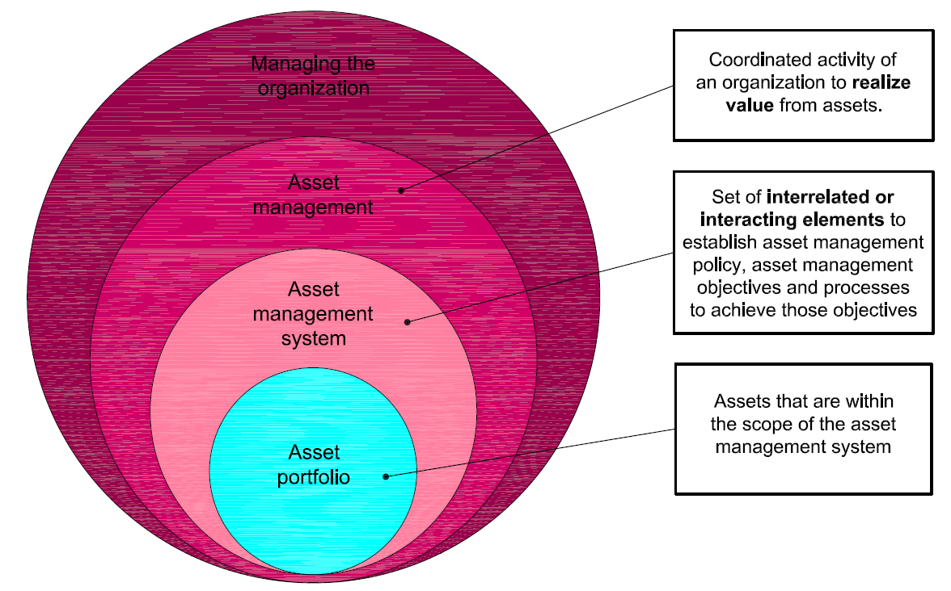
Asset Management System (ISO55000)
Set of elements to establish the Asset management objectives and all processes to reach these objectives
It is not one IT System
© ISO 55000:2014(E)

Slide 11
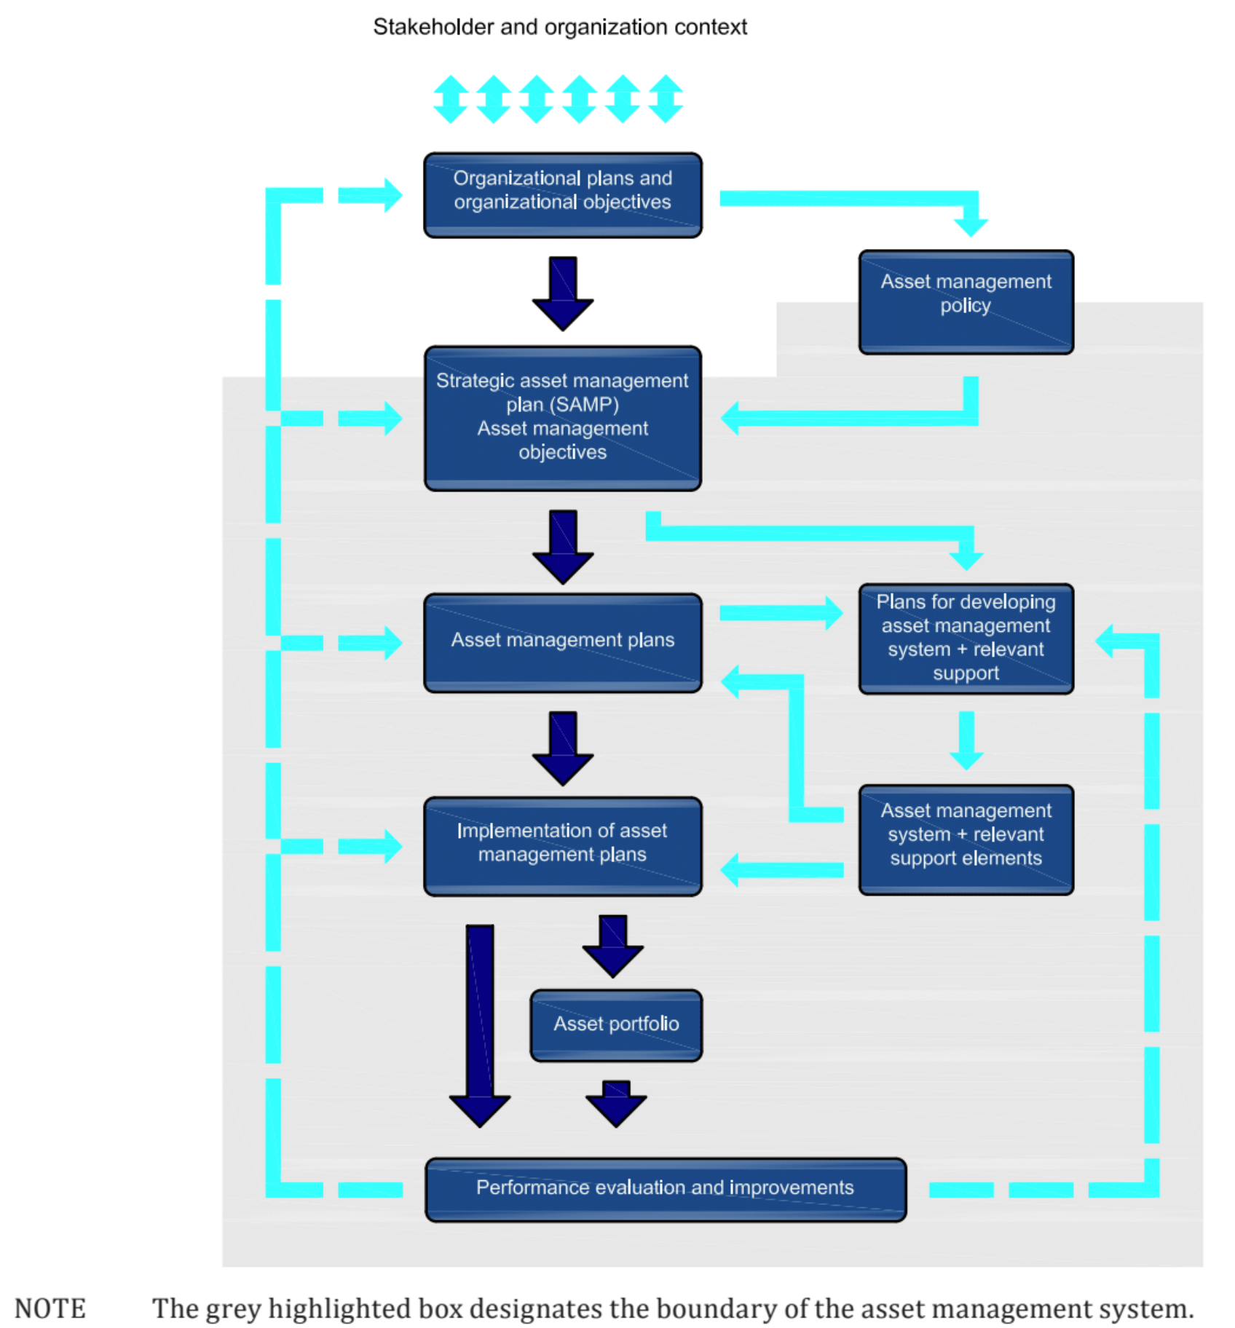
Relationship between key elements of an AM System
ISO55000 AM System as a generic approach
Connect the organizational goals with the operation and maintenance
  → Line of sight
Core elements are
  AM Policy
  SAMP (Strategic AM Plan)
  AM Plans
  Evaluation an improvement
IT-Systems are used and implemented according to your organizational goals.
© ISO 55000:2014(E)

Slide 12
Asset Management at EuXFEL

Slide 13
Asset Management System, Policy and Strategy
AM-System [AM]
  „Set of processes and procedures which govern how Asset management is implemented“
  Plan Do Check Act & Continual Improvement
AM Policy [AM, MB]
  Overarching Asset Management Principles
  Framework for Implementation of the Asset Management
  Meaning and targets of AM for EuXFEL
AM Strategies [AM, Groups]
  Objectives and Priorities in Asset Management
  Criticality / Prioritisation
  Time Scale
  IT Systems, Information Management

Slide 14
Asset Management – AM Tools and Maintenance Planning
Managing & Overviewing the own Assets [Groups, AM, IT]
  Items are identifiable
  Items are locatable
  Maintain Asset Data
AM Plans [Groups, AM]
  Resource Planning and Costs
  Maintenance Planning and Risk Management
  Work Volumes
Find the right tools for the right purpose and let the groups do their jobs.

Slide 15
The AM System at EuXFEL
Stakeholder & organization context
Mission and Vision Statement
AM Policy
AM Report
Group Specific AM Strategies
Plans for developing AM Tools
Group specific planning
Operation of
AM Tools
Implementation of AM Plans
Evaluation and Improvements
© ISO 55000:2014(E)

Slide 16
The AM Policy at EuXFEL - Summary
An asset is everything of value to the EuXFEL. These are usually all items or entities that require a whole-life approach or that are more expensive than a threshold value given by law.
Each group is responsible to inventory its own assets and enable localization and identification of its own parts of value.
Each asset must be identifiable and locatable if this is requested by any involved party.
The AM group is responsible to enable these goals through providing or recommending the required tools.

Slide 17
The AM Strategies – Group Specific AM Report
A periodic AM Report was introduced in order to:
  Define the role of every group in terms of AM
    Scoping / responsibilities
  In the report, every (asset owning) group defined its:
    Assets
    AM tools
    Goals and timescale
    Requirements
  This builds a starting point for future AM efforts
  XFEL-wide requirements analysis

Slide 18
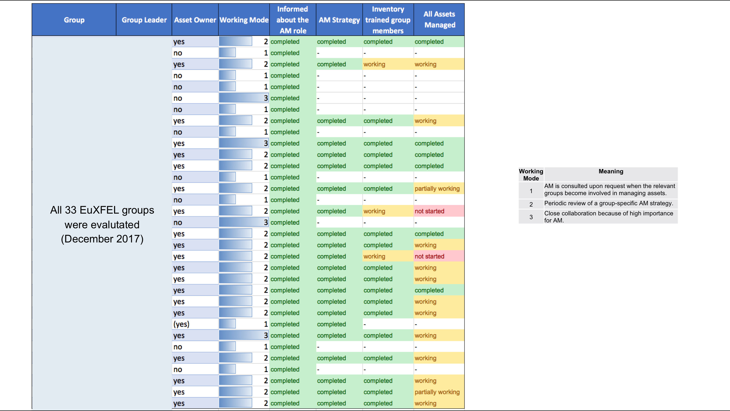

Slide 19
Tools for Managing Assets at EuXFEL
Administrative Groups
Technical Groups
DESY
EDMS
DESY
GISFMS
Pool4Tool
XFEL
ERP
Alfresco
DESY
SE
Sharepoint
DESY
NX Teamcenter
diamant
XFEL
Inventory
XFEL
CMMS

Slide 20
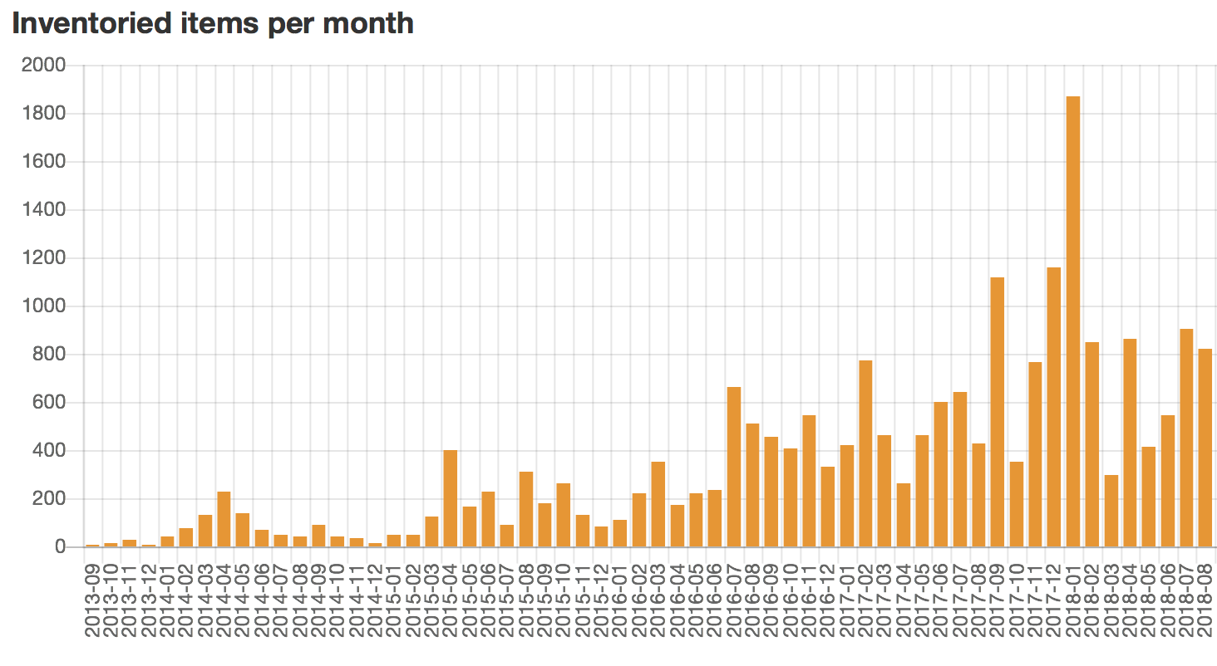
XFEL Inventory Tool

Slide 21
Learnings
AM group introduction in 2016
Groups / Responsible people manage their assets
  If there is no framework given, solutions for operation and maintenance grow within the responsible groups.
  More than 26 tools are supported by IT (not all for AM)
Results of introducing AM 7 years after funding the organization
  Broad landscape of tools
  Time consuming meetings for coordination between groups
The later you introduce a systematic AM the more time consuming a proper introduction will be.
But: The AM Industry standards can help to achieve a systematic and coordinated AM.

Slide 22
Main benefits
Independent from the tool, the AM system makes sure every activity is in ”line of sight” with your organizational goals
Systematic approach to find the areas with the highest need for action
Fulfil compliance with legal obligations
  German Commercial Law (§240 HGB) requires the detailed localization of all assets
  Customs authorities strictly require the tracking of all customs relevant C13 goods
Improve organizational effectiveness
  Avoids double work
  Improves conditions for operation and maintenance
  Find overlooked resources
Improve other disciplines (e.g. risk management)

Slide 23

Thank you for your attention
Questions?

