Slide 1
Towards SOLEIL unique portal
Gwenaëlle Abeillé

Slide 2

My background
Member of the Control System Team, ICA
(Informatique de Contrôle et Acquisition), provides control software for the Machine & 29 Beamlines
Software engineer, at SOLEIL since the beginning (2003):
Developer on control system applications
Manager of developers tool stack (software factory and bug tracker)
Responsible for ICA optimizing team processes the last 5 years

Slide 3
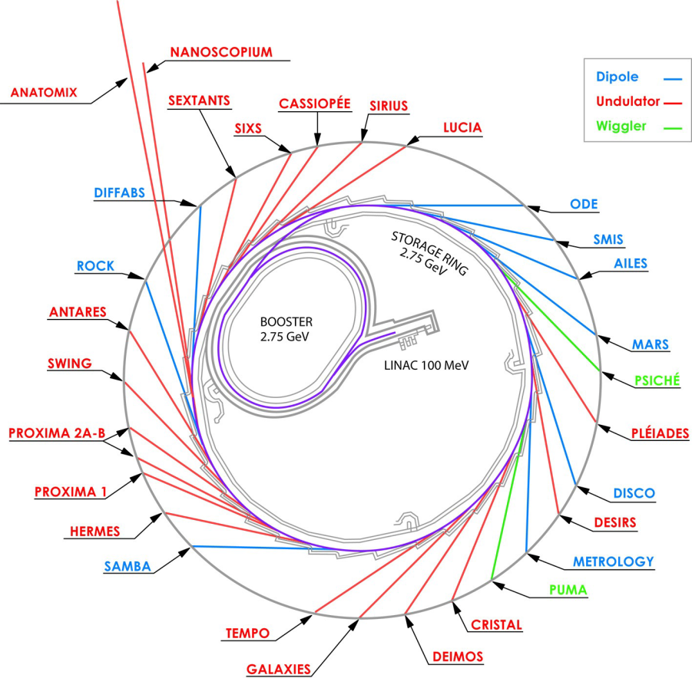
Soleil at a glance
14 engineering teams and 29 beamlines, in operation since 2007
All staff is mainly focused the operation
No time allocated to optimize work processes
Tools selection were made based on each team specificities:
    Maintimedia for CMMS
    Jira for bug tracking
    eLog for accelerators and beamlines operation

Slide 4
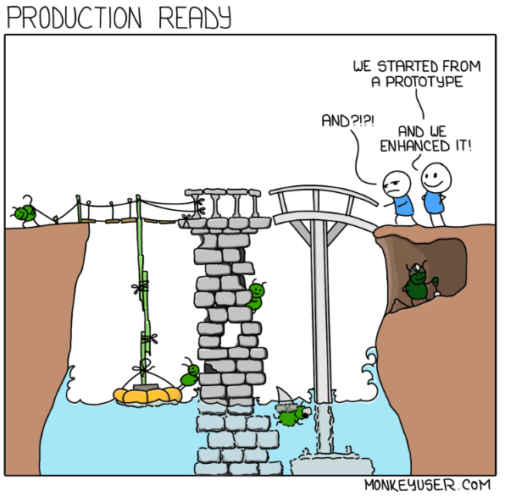
ICA history with operation management
Our core priority was to « Deliver a whole control system » for the Machine & all Beamlines
Focus on deliver new functionalities over quality
Delivered on time but this massive home-made software development leads to defects
Most called team of SOLEIL on support:
Because ICA support activity shifted to 1st level diagnosis support for assigning to others teams
Because we had and limited quality insurance

Slide 5
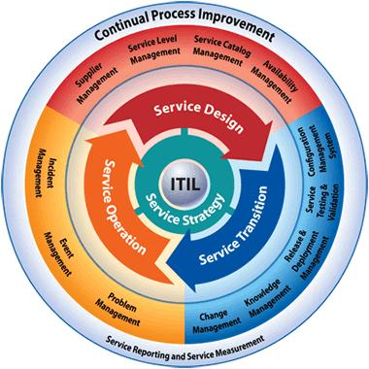
Tackling the ICA problem
We decided to rethink and restructure our processes for ICA operation through ITIL Service Operation processes
ITIL is a set of best pratices to obtain a high IT service quality with focus on customer relationship
We started in 2015 leveraging Jira
for incident and problem management

Slide 6
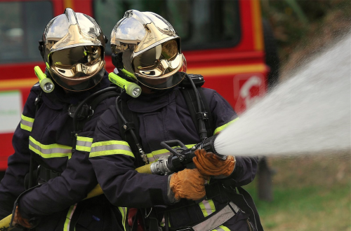

Tackling the ICA problem
Before using ITIL, we were mixing incident and problem management in the same process. The clear separation of these processes help us a lot:
Incidents
An incident is an unplanned disruption or degradation of service
Problems
Find a workaround and then the root cause of incidents
Objective: Restore service as quicky as possible
Objective: Reduce the number and the impact of incidents

Slide 7
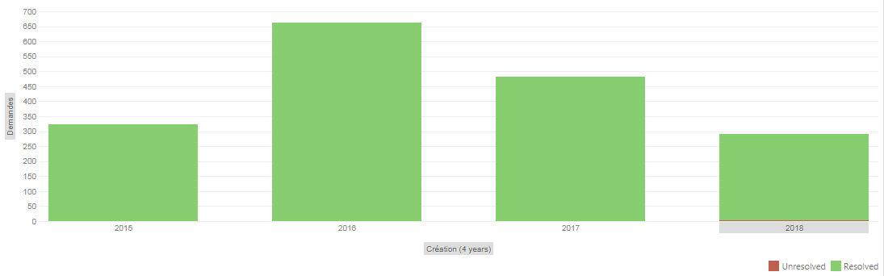
Some ICA Jira reports
Better tracking
Starting improving
ICA incidents numbers since 2015
ICA problems numbers since 2015

Slide 8
Expanding to the Machine
The Machine was keeping track of incidents in eLog:
    difficulties to follow the status of defects
    Incidents and Problems was managed in the same process
    The information was confined to Machine Operators
6 months of preparation were needed with the Machine operation team to define the incident process and test it
Switch to Jira for incidents in beginning 2018, in continuous improvement ever since

Slide 9
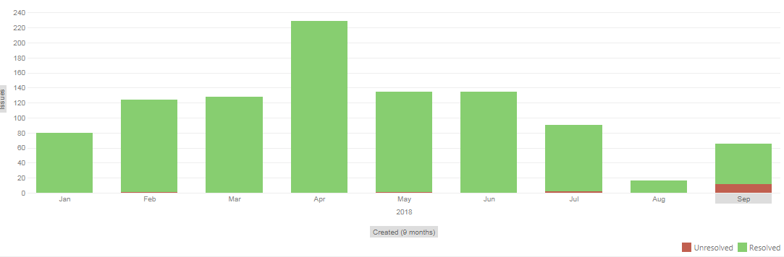
Some Machine results
Machine Operators are accountable for all Machine incidents
The escalation process allows dispatching to teams implied in Machine operations when necessary
(Operators, Vaccum, Power Supplies, RadioFrequence, Diagnosis, Insertions, Security, Machine Physitics, Computing, Electronics…)
Better tracking
Starting improving
Machine incidents numbers since January 2018

Slide 10
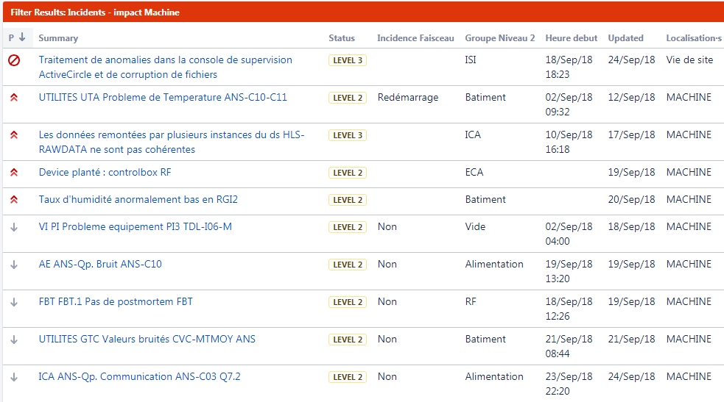
Public incident dashboard
Jira open access
The incidents progress can be followed by all SOLEIL staff since the switch from eLog to Jira

Slide 11
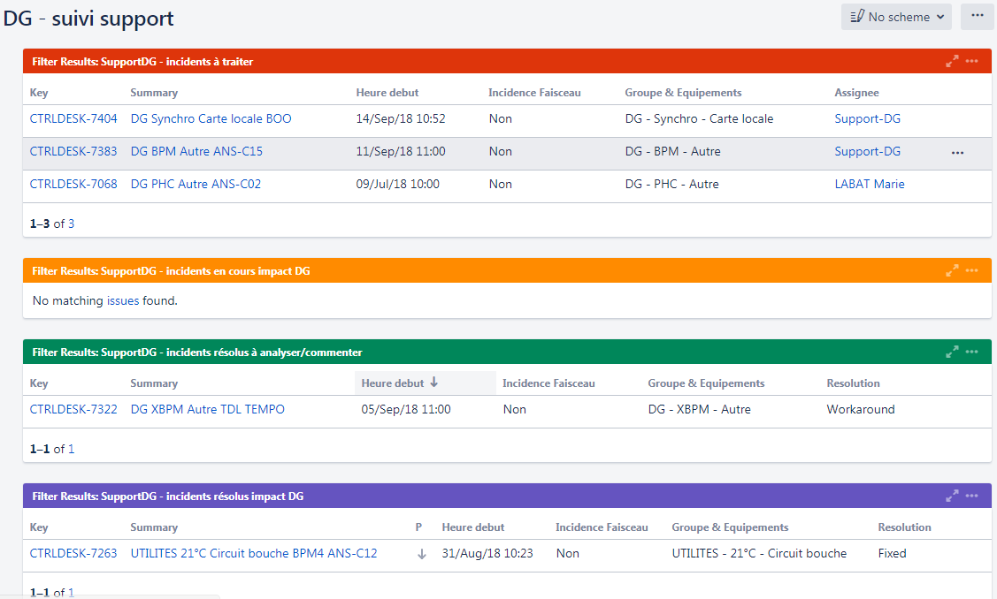
A simplified dispatch of incidents
Jira dashboards help managing the Machine support activities

Slide 12
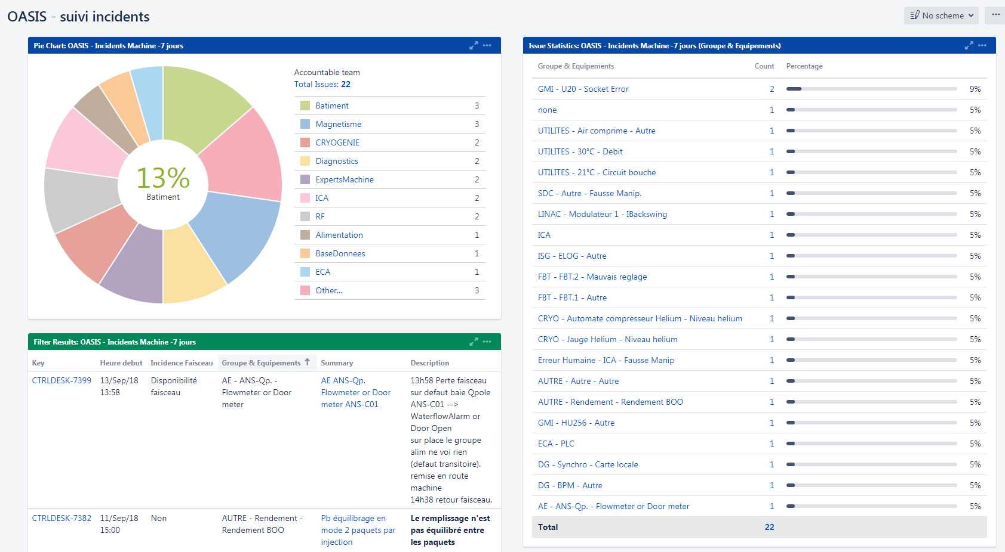
Machine Operation Tracking
The incident governance is coordinated through weekly Machine operation meetings.

Slide 13



Towards a unique portal
Maintain CMMS unique capabilities and ease up the teams interactions via Jira
So we have developed a Jira-CMMS interface:
  Create CMMS requests from Jira
  All CMMS issues are tracked in Jira
  Each Machine incident bookmarks an ELOG entry
Create Intervention Request
Intervention Requests synchronization
Bookmark

Slide 14
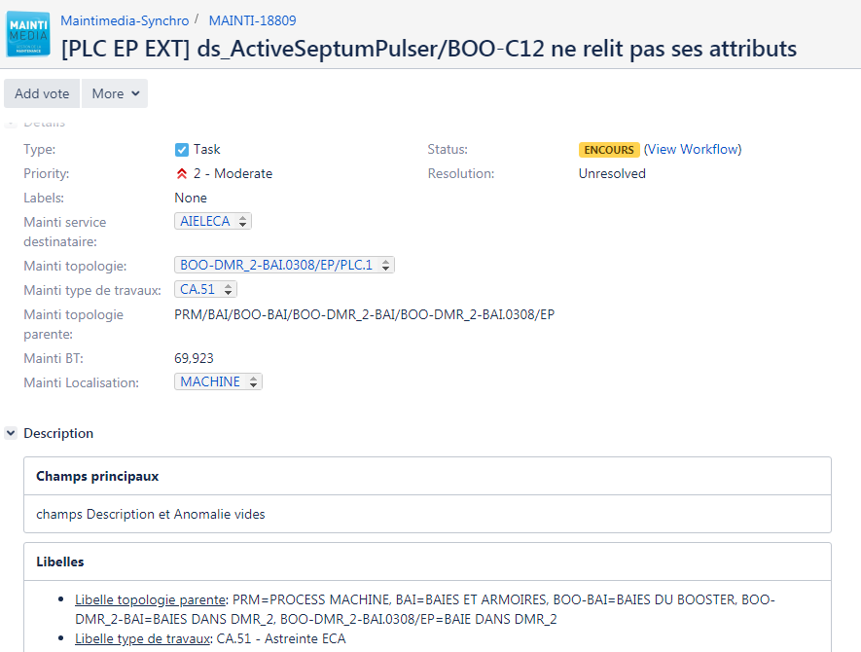
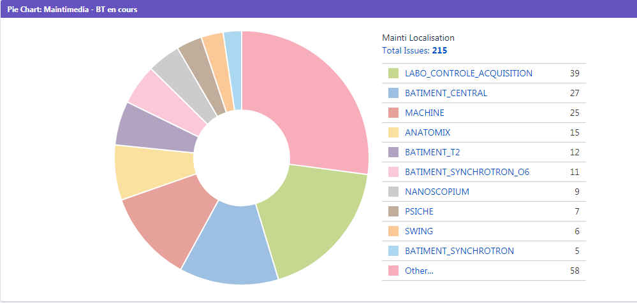
Easy tracking of CMMS Requests
Follow an intervention progress:
View statitics in Jira dashboards:

Slide 15
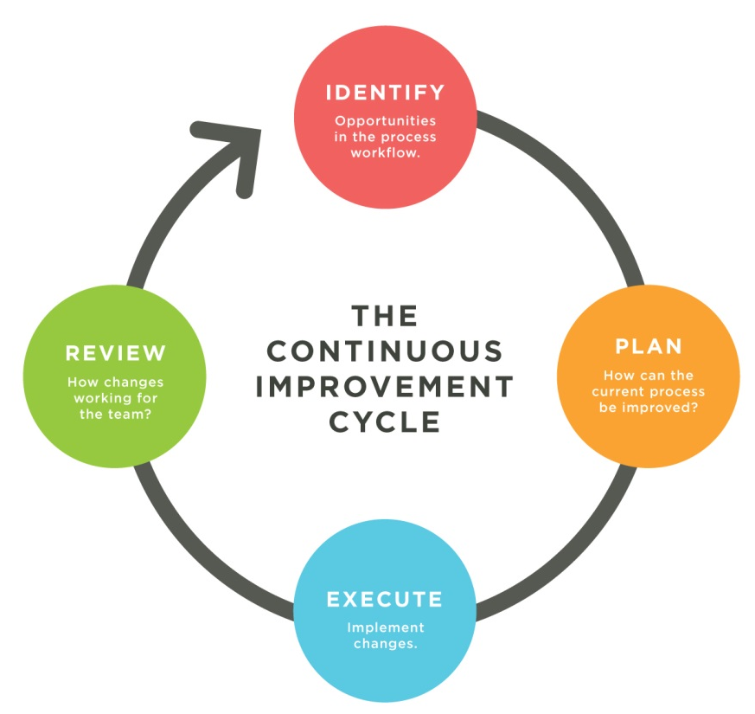
Our results
The ICA teeam is improving our reliability since clear separation between incidents and problems
Continuous improvement is the new motto of the ICA team,
Improving the effectiveness of the Machine incident process.

Slide 16
Next steps under progress
  Extend incident process to beamlines :
  Study group since 2017 leaded by SOLEIL’s director with beamlines scientists, technicians, floor coordinators, technical teams
  Planned switch to Jira beginning 2019
  Implementing problem management for Machine operations

Slide 17
Next steps under progress
Implementing an Incident Knowledge Base with Confluence
Studying how to do easy tracking all interventions (hardware & software) in production under Jira
Extending Jira with « Big Picture » module for the Electronics team, allowing a tracked planification (Gantt)

Slide 18
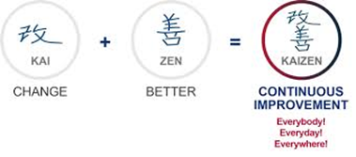
Lessons learned throughout the journey
A bottom-up initiative is efficient and pragmatic as it is based on day-to-day operation feedback
Introducing new processes needs a lot of change management and training for all teams (big challenge as I am not dedicated full-time and not fully accountable)
Top management support is mandatory to extend this initiative to all teams :
  Roll-out a « continuous improvement culture » at SOLEIL
  Share the SOLEIL strategic vision to all SOLEIL staff

Slide 19
Questions?
  Tools currently used at SOLEIL:
  Jira software: https://www.atlassian.com/software/jira
  Maintimedia: https://www.tribofilm.fr/logiciels/gmao-mainti-4/
  eLog: https://elog.psi.ch/elog/
  Tools under installation/test:
  Confluence: https://www.atlassian.com/software/confluence
  Jira Service Desk: https://www.atlassian.com/software/jira/service-desk

