Slide 2
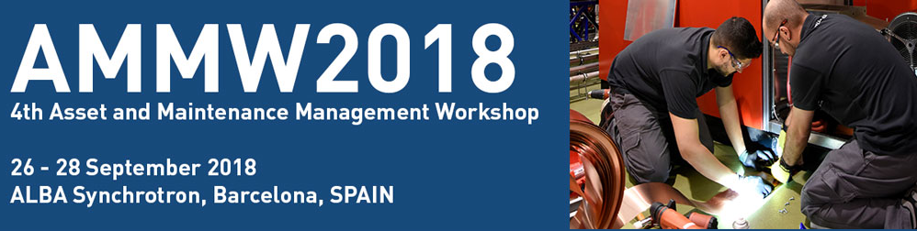
Case management as logbook for the cryogenic installations at CERN
Sigrid Knoops, Nicolas Bonetti, Frederic Ferrand, Philippe Gayet – TE-CRG-ML
Presentation on behalf of Cryogenics Group

Slide 3
Outline
Definition and needs
How are we organised?
Some statistics from former logbook
From existing to new application
New logbook features
Advantages
Statistics since Go Live on March 1st 2018
Improvements

Slide 4
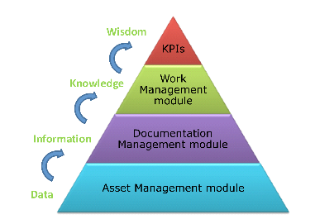
Definition and needs
*
Information
& Knowledge
One of the challenges for the operation and maintenance of the cryogenic installations is to trace as much as possible WHAT-WHEN-HOW *
  The logbook is a tracking tool for the activities occurring at specific time and it is also a common technical interface from operation to the support teams when asking for interventions.
  The logbook is a daily used tool for operators and needs to be easy to use
  The logbook traces and follows up events and proposes an easy way to retrieve information on past events. ALL type of events, not only work requests.
The logbook is the “operation bible” of the installation.
<1996
APEX LHC
and IN, NLHC
2009
2011
Filemaker Pro
1996
Paper logbook
2018
INFOR EAM
2006
Logbook LHC
Local
shared on server
On-line
*AMMW2015: The challenges, methods and results for the maintenance of the cryogenic installations during the first Long Shutdown of LHC

Slide 5
Outline
Definition and needs
How are we organised?
Some statistics from former logbook
From existing to new application
New logbook features
Advantages
Statistics since Go Live on March 1st 2018
Improvements

Slide 6
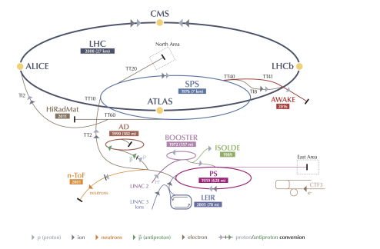
How are we organised?
LHC installations
1 central control room
6 local control rooms
Operation team of 32 staff
Non-LHC installations
2 common control rooms,
each for 3 to 4 areas with 1 or more installations
2 teams of 7 staff
Notes:
Local operators are working on normal working hours
1 x Operator at CCC are working in shifts
Maintenance working on normal working hours + standby duty

Slide 7
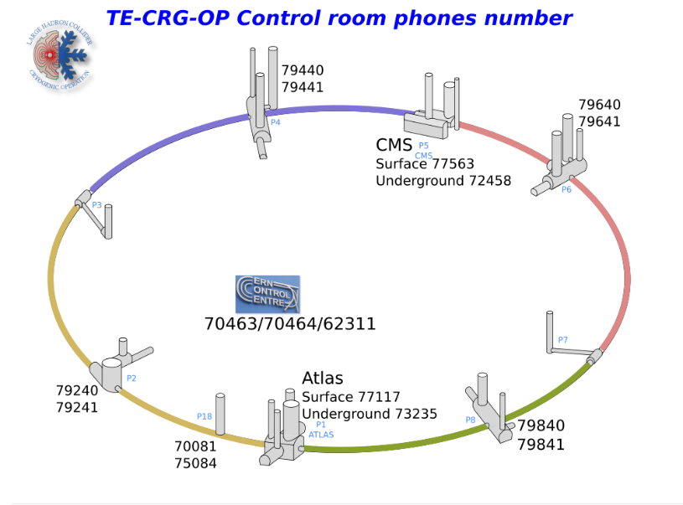




How are we organised?
LHC installations
Local control room P4
Supervision
available
at distance
In offices
Local control room P6
Local control
Room CMS
Number of operators:
P18/P2 | 8
P4 | 7
P6/CMS | 8
P8/ATLAS | 8
Central
control room
Local
control
room
ATLAS
Local control room P8
Local control room P18-P2
Notes:
Local operators are working on normal working hours
1 x Operator at CCC are working in shifts
Maintenance working on normal working hours + standby duty

Slide 8
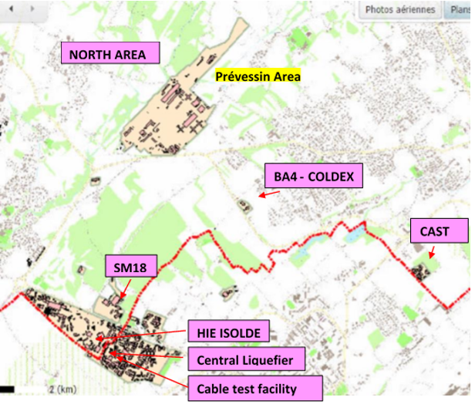
How are we organised?
Non-LHC installations
Control room North Area
(several installations,
local and remotely)
Control room SM18
(several installations,
local and remotely)
WAT
Number of operators: | Number of operators:
7 | 7
Number of Areas to operate | Number of Areas to operate
4 | 3
Supervision
available
remotely
In offices

Slide 9
How are we organised? former logbook
Information Flow for Logbook
Operation activities
Status of the installation
Reporting
-Sharing information to the team members
-History of all operational actions
Work Order
for intervention
Work Request for diagnostics
E-logbook operation
Maintenance Contractor
Mechanical Support team CERN
Instrumentation support team CERN
Electricity – control support team CERN
No feedback on intervention or
diagnostics
INFOR EAM
E-logbook IN
Mail, other
Intervention
And other way around:
No Link from CMMS (EAM) to listed events in logbook for statistics

Slide 10
Outline
Definition and needs
How are we organised?
Some statistics from former logbook
From existing to new application
New logbook features
Advantages
Statistics since Go Live on March 1st 2018
Improvements

Slide 11
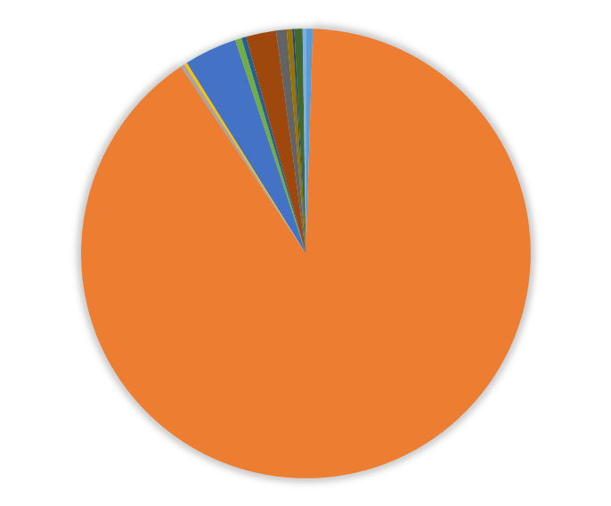
Some statistics from former logbook:
LHC logbook
2017, former logbook results (4500 cases)
Process tuning, 2%
Other failures, 4%
Instrumentation failure, 4%
About 4500 to 5500 cases a year
Statistics on type of event less detailed as no many predefined event types where existing in the former logbook.
General operation, 90%

Slide 12
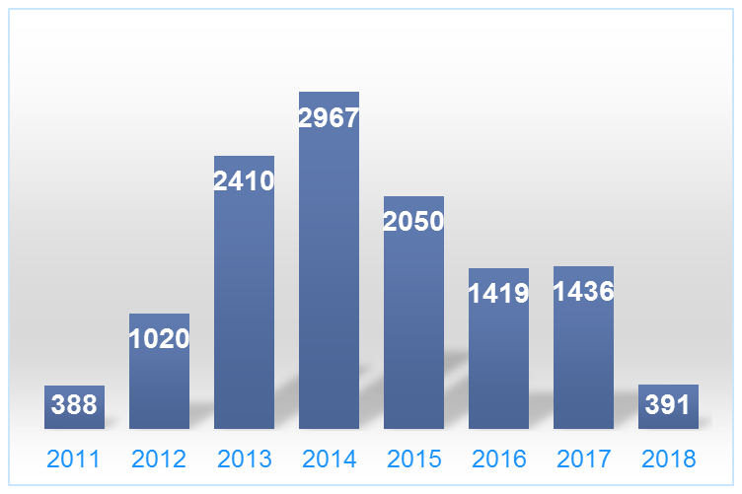
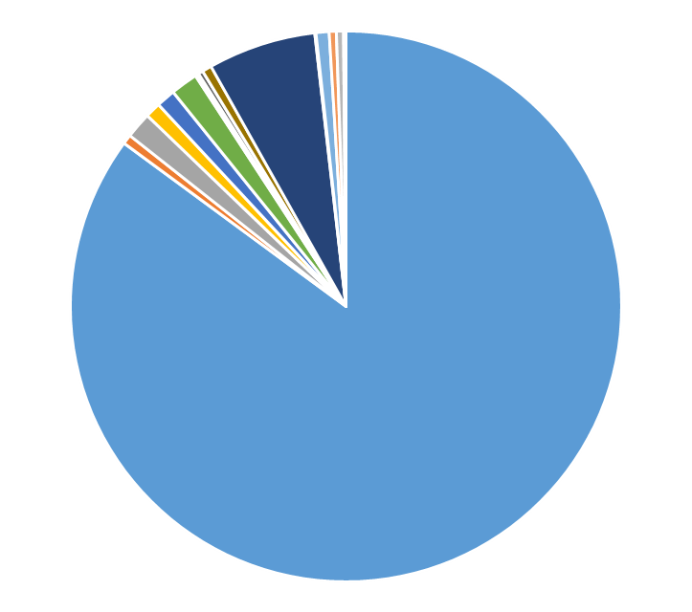
Some statistics from former logbook:
non-LHC logbook
2017, former logbook results (1436 cases)
Other failures, 9%
Report, 6%
Compared to LHC logbook:
Less events
Even less classification of events.
No classification, 85%

Slide 13
Outline
Definition and needs
How are we organised?
Some statistics from former logbook
From existing to new application
New logbook features
Advantages
Statistics since Go Live on March 1st 2018
Improvements

Slide 14
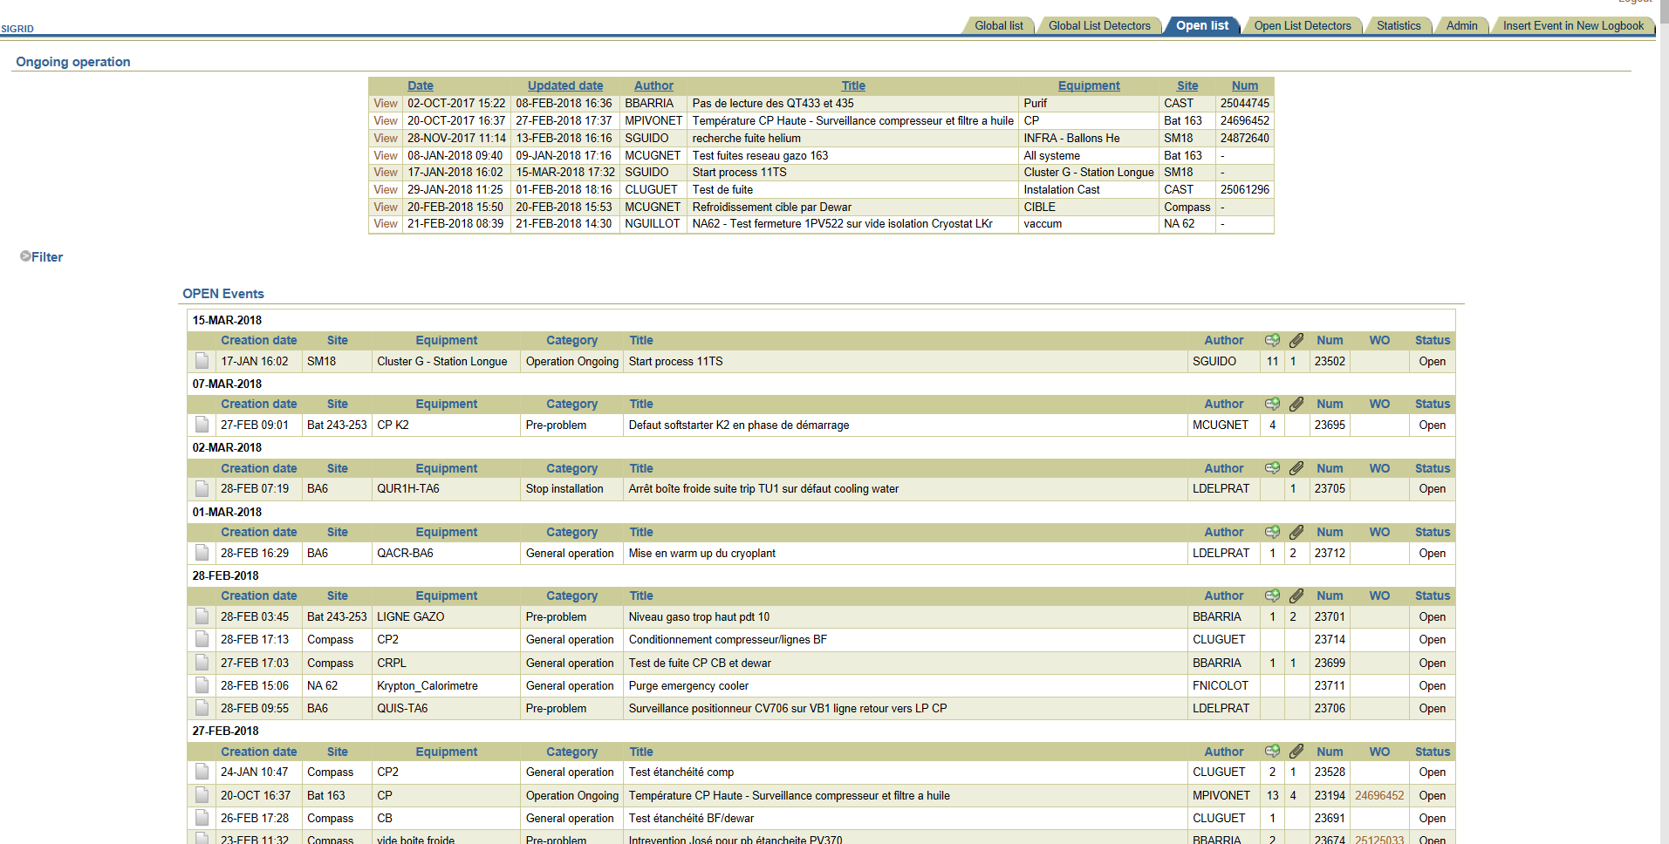
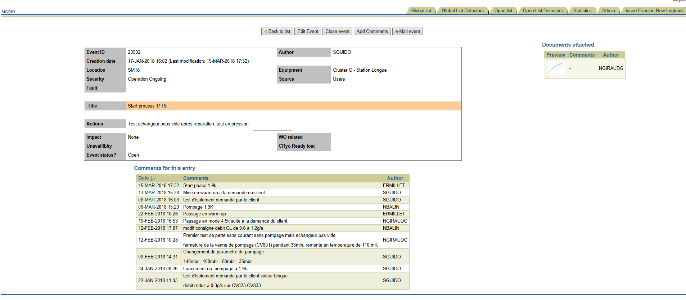
From existing to new application
Predefined lists for equipment and installations, at different levels.
Some predefined lists for categories
Possibility to add document
Link to ONE other logbook for interventions on special instrumentation
Link to EAM Light for creation of work orders
Possibility to add comments
Status Open/Closed for follow-up of actions

Slide 15


From existing to new application
Direct link to other logbook (Tunnel Instrumentation Support Team) for creating a request, direct link to INFOR EAM for creating a work order
Possible to link documents or screenshots from supervision
but
No feedback on intervention or diagnostics from interveners
No link from CMMS (EAM) to logbook events for better diagnostics, statistics
Different applications to be used by the operators and support teams
Several different logbooks in parallel with different layout
No developer support for existing logbook, only maintenance support

Slide 16
From existing to new application
One common approach for all logbooks for the cryogenic installations
Integration in an existing application and therefore developer support by a CERN support group
Linking to other logbooks whenever possible
The operators should trace ALL actions, not only demands for interventions or reporting on faults.
Easy to use and layout adapted to the needs of all operation teams
More predefined lists for better statistics, better analysis
INFOR EAM CASE MANAGEMENT
Creation of this logbook done following the SCRUM method (sprints for developer team and user team)

Slide 17
Outline
Definition and needs
How are we organised?
Some statistics from former logbook
From existing to new application
New logbook features
Advantages
Statistics since Go Live on March 1st 2018
Improvements

Slide 18
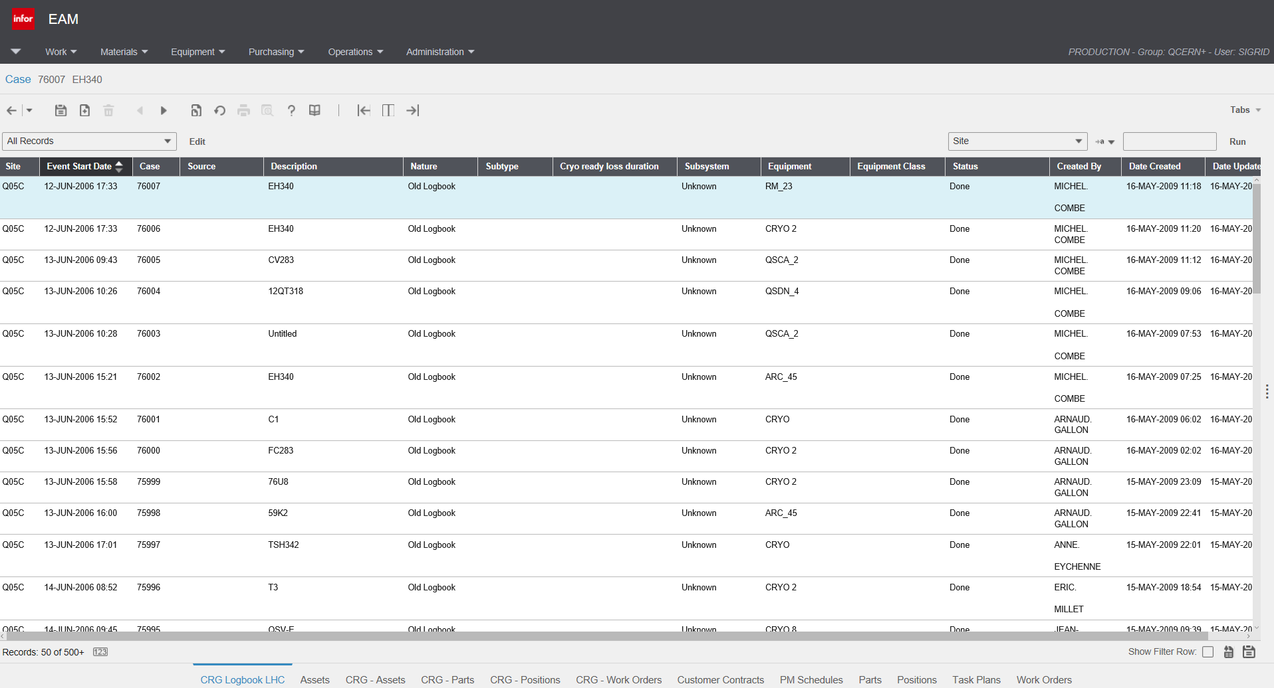
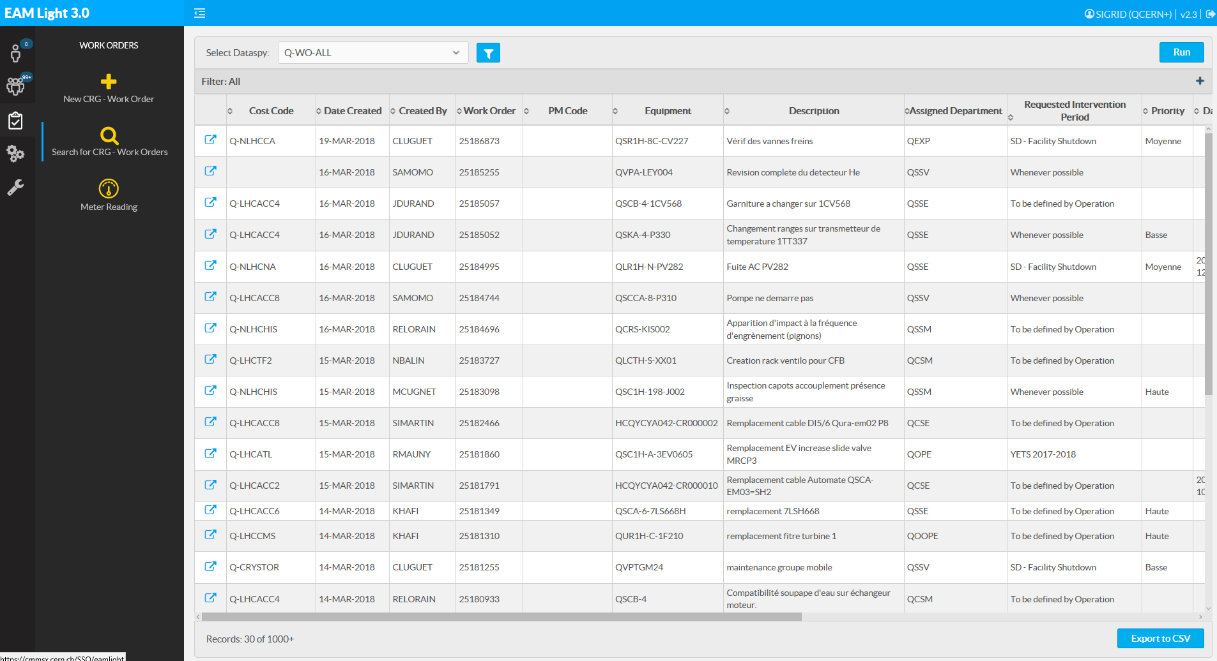
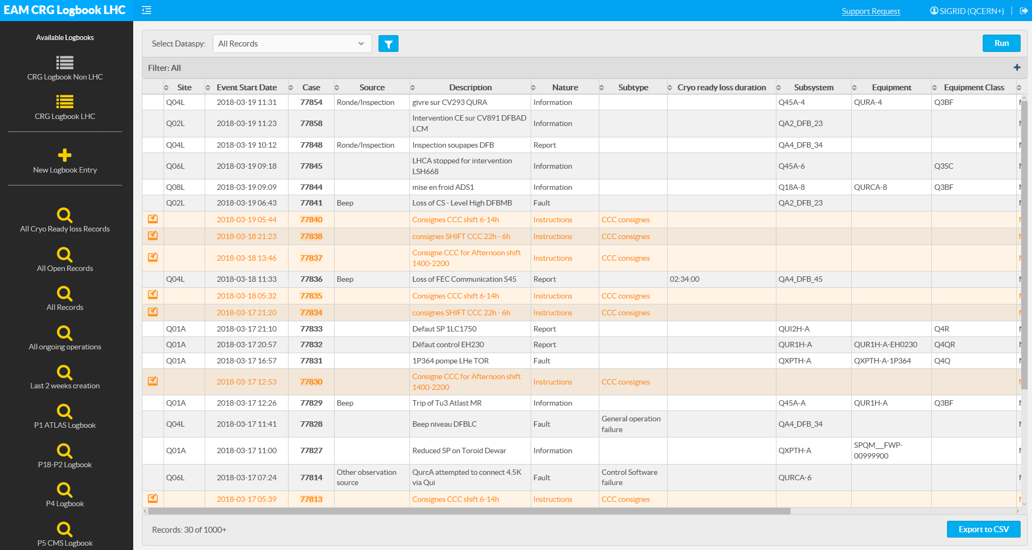
New logbook features:
Presentation of the new application
Operations - CASE
EAM Light – Work Orders
EAM Light – Logbook
In INFOR EAM Extented
not usable as layout,
not adapted to our needs
The new logbook has been created on the same web application as the CERN in-house Light version (EAM Light).
This web application is well suitable for PC screens, tablets and even smartphones

Slide 19
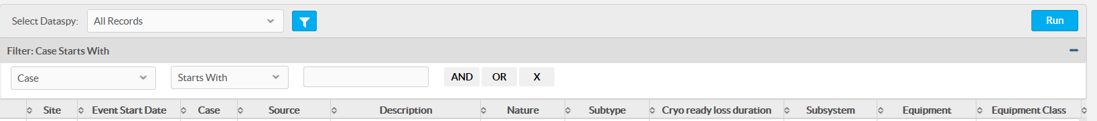
New logbook features:
List view
1
4
5
2
3
6
Link to the 2 logbooks (LHC and non-LHC installations)
Create new event
List of the predefined filters
Opens the filter configuration panel
You can sort the columns by clicking once or twice on the column-head
You can export to Excel the results of the table

Slide 20
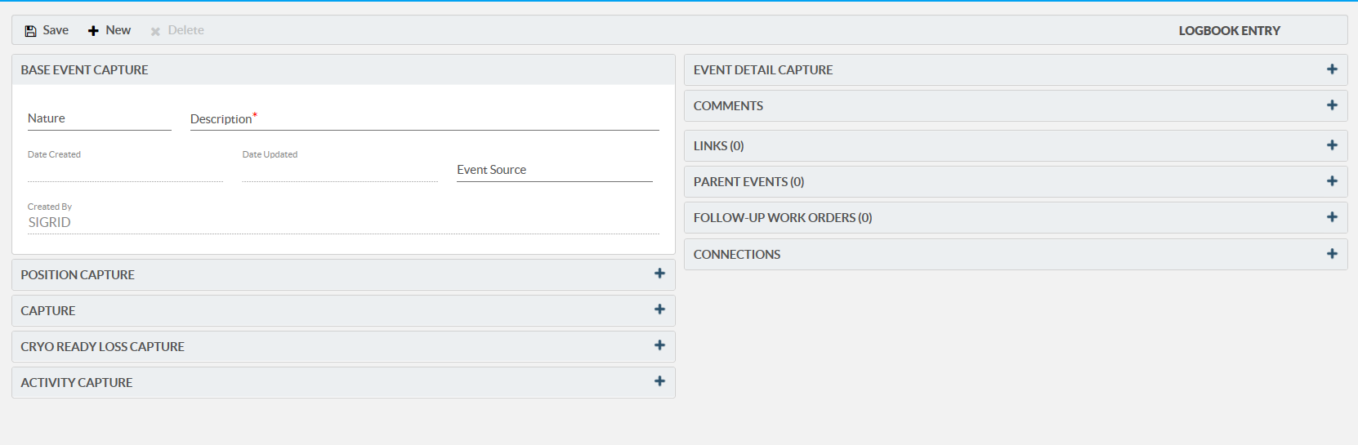
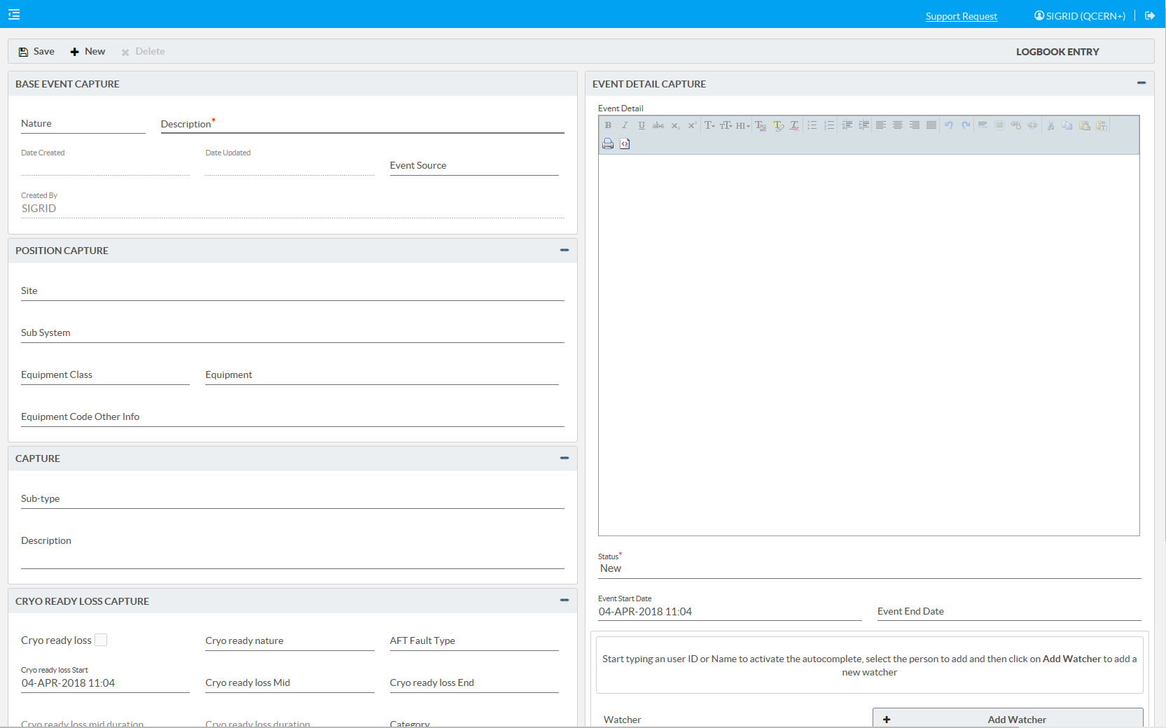
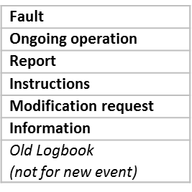
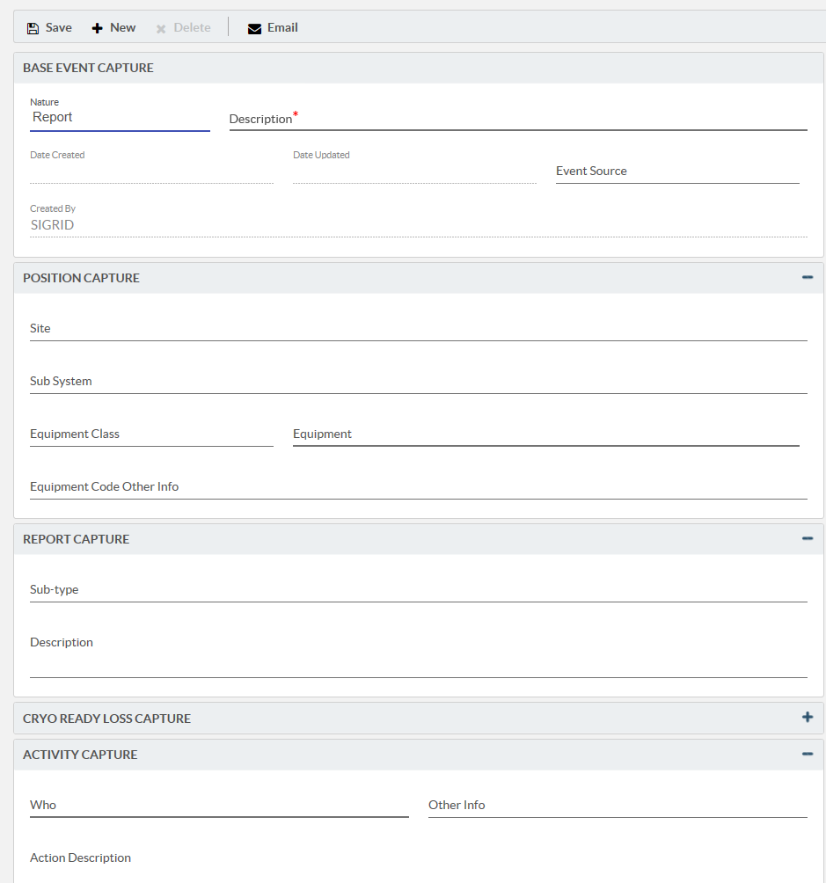
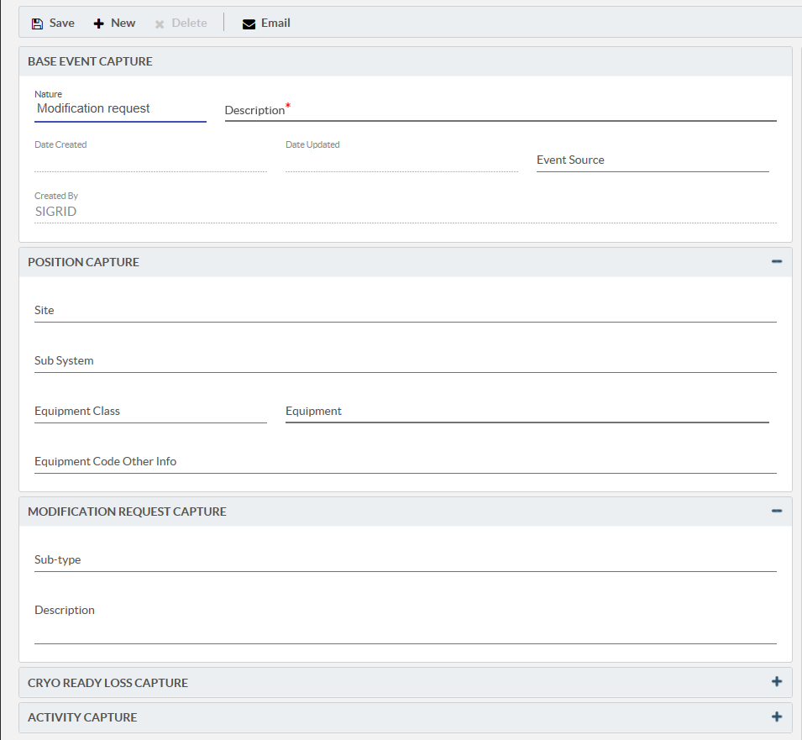
New logbook features:
Record view
The event is divided in different blocks
Depending on the Nature, some blocks are opened, in order to guide the operator in documenting correctly the event.
20

Slide 21
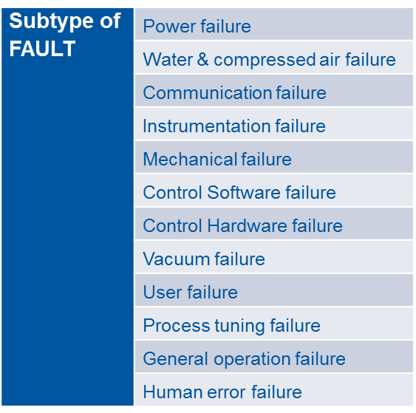
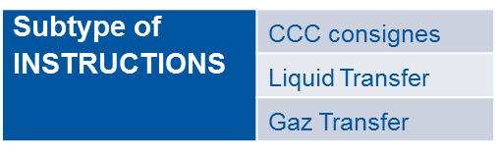
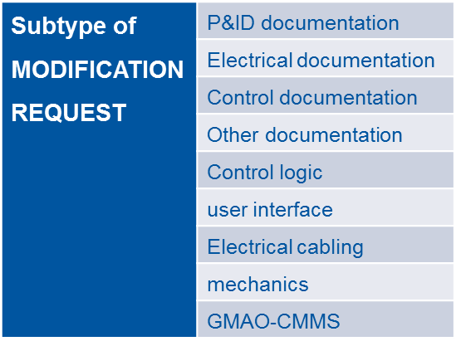
New logbook features:
Increase the number of predefined lists
Predefined lists are important for good statistics
Nature of the event
Fault
Ongoing operation
Report
Instructions
Modification request
Information
Old Logbook (not for new event)
Next step:
Fault will be linked to the EAM problem code, declared on the work request when asking for an intervention.

Slide 22
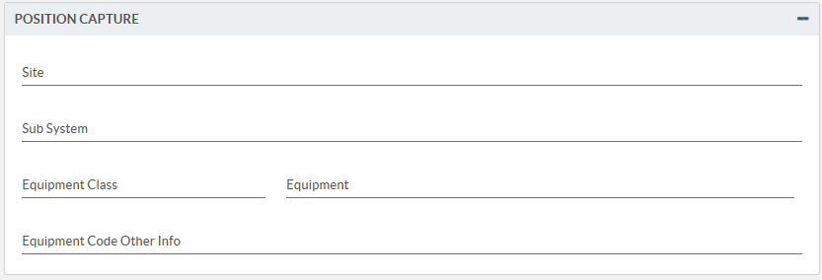
New logbook features:
Link with the existing functional positions of INFOR EAM
Record view:
A CASE (an event) can be attached to:
an existing equipment in the INFOR EAM equipment list
an equipment at a higher level in the structure
or even an equipment not yet existing in the INFOR EAM equipment list

Slide 23
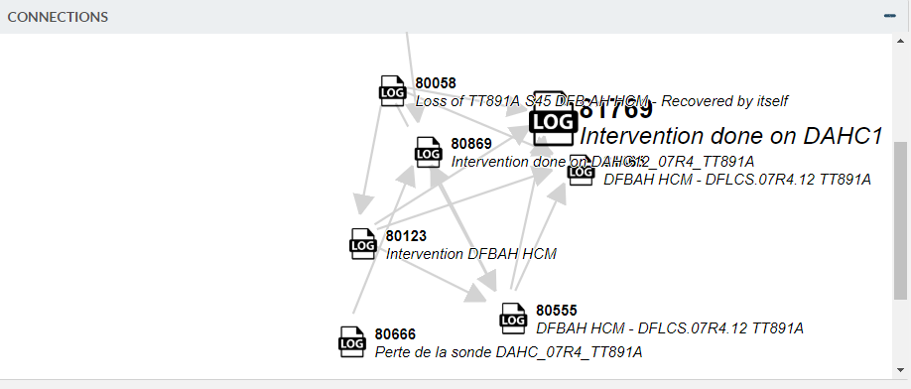
New logbook features:
Link to other information in INFOR or other databases
Record view:
If the event has been linked to other events, work orders or URLs, the connection block is showing all connections in a dynamic way.

Slide 24
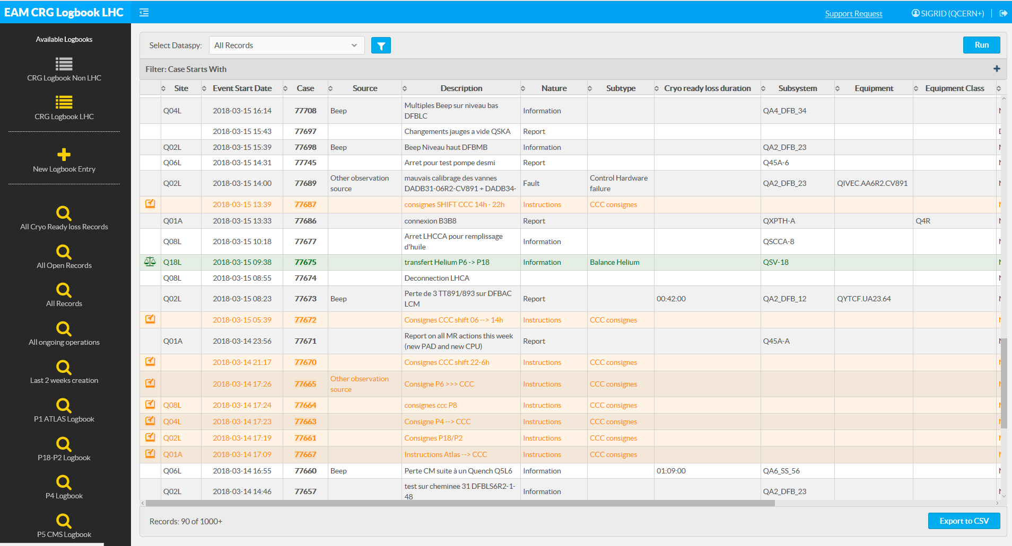
New logbook features:
Use of colours and icons for fast retrieval
List view:
To help operators to find rapidly events of the same “category”, colour coding and small icons are used to complete the visual information.

Slide 25
Outline
Definition and needs
How are we organised?
Some statistics from former logbook
From existing to new application
New logbook features
Advantages
Statistics since Go Live on March 1st 2018
Improvements

Slide 26
Advantages
Events and work orders in the same database | -> better statistics possible
Same logbook approach for all cryogenic installations | -> better comparisons possible
On one equipment, be able to see ALL information: operation actions, parameter changes, work request, intervention reports,… | -> easier for the equipment responsible
long-term developer support | -> efficient and integrated tool
Very easy way to add documents, print screens; even on a tablet or smartphone | -> add as many documentation as needed, stored in the document management database EDMS.
Watcher list on event: creator (+ whom ever is added) for using alert manager from INFOR EAM | -> Notification when changes occur on event or linked work orders

Slide 27
Outline
Definition and needs
How are we organised?
Some statistics from former logbook
From existing to new application
New logbook features
Advantages
Statistics since Go Live on March 1st 2018
Improvements

Slide 28
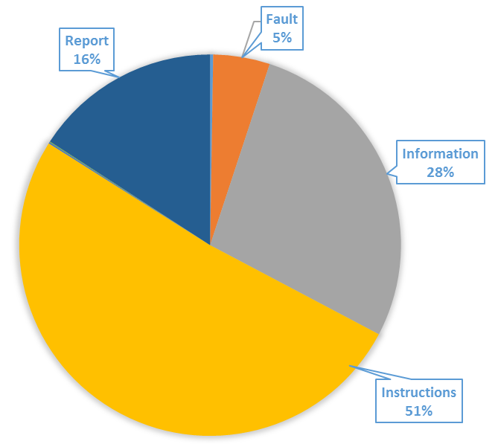
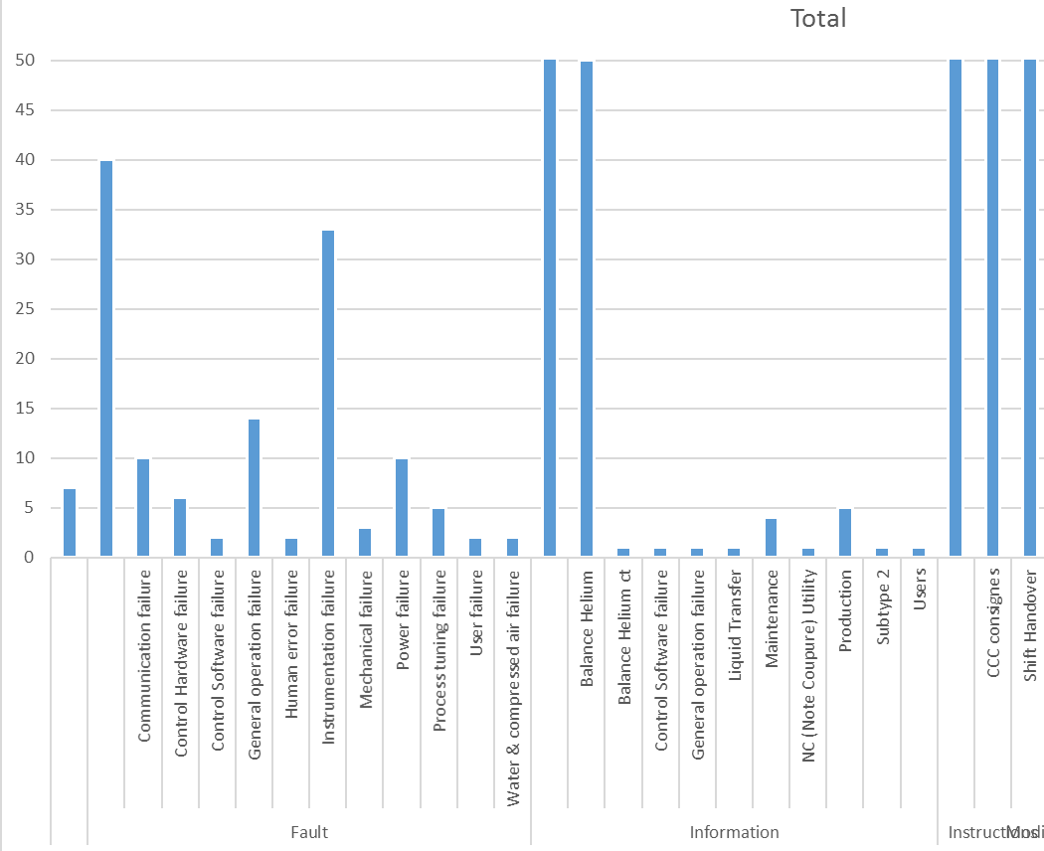
Statistics since Go Live on March 1st 2018
LHC logbook (2700 events, same quantity but better specified)
1 or more times a day; divided in 2 major subcategories
General operation (old) -> Instructions (New)
Shift hand over and CCC consignes 3 times a day -> instructions
Information: starting to subdivide but still many general information
Detailed classification;
Fault cause statistics
678
50
71
475
831
Fault
Information
Instructions

Slide 29
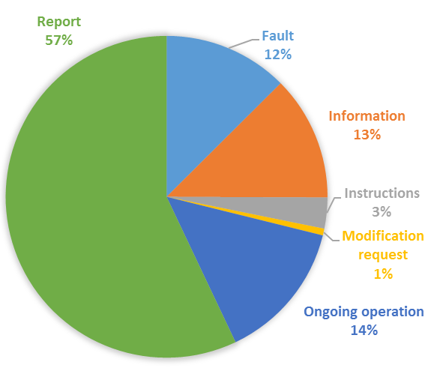
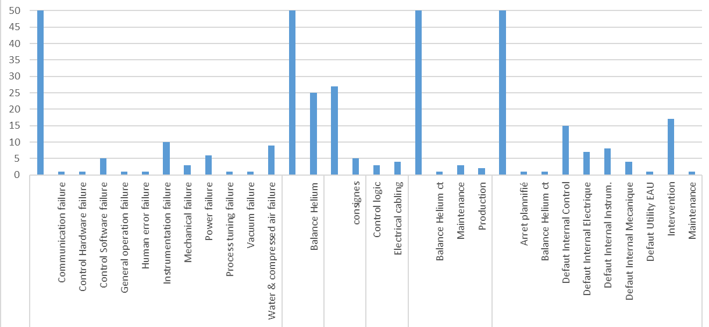
Statistics since Go Live on March 1st 2018
Non-LHC logbook
(1030 events, higher quantity and better specified)
Immediate use of new event types
Test facilities -> ongoing operation
More installations in operation
90
104
139
532
Modification request
Ongoing operation
Instructions
Information
Fault
Report

Slide 30
Outline
Definition and needs
How are we organised?
Some statistics from former logbook
From existing to new application
New logbook features
Advantages
Statistics since Go Live on March 1st 2018
Improvements

Slide 31
Conclusions & Future Improvements
In operation since the 1st of March 2018 – about 6 months.
Training sessions have been held for the operation teams.
We have had a lot of positive feedback and some improvement proposals.
The SCRUM methodology was the right choice for the development of the logbook: create an application fulfilling the needs of the users.
Still to come – next sprint:
Be able to clone an event
Be able to save predefined look-up filters (dataspy)
Open the logbook for read-access to non-INFOR users and review write access.
Integrate the intervention request on LHC special tunnel instrumentation into the same application (now, it is still an APEX based logbook)
Dedicated reports (Pentaho reporting) for statistics
Whenever needed, improve predefined lists for even better statistics and link with closing codes from the maintenance interventions

Slide 32

Questions?
Thanks for listening

