Slide 1
Identification of critical Beamline components for preventive maintenance plans at synchrotron SOLEIL
CHABARD Jules, ROBERT Emmanuel, NICOLAS Christophe, BOZEK John, GOURHANT Patrick, LENER Robin, CHAVAS Leonard M.G., ROZELOT Hélène

Slide 2
OUTLINES:
Introduction
Criticality matrices applied for PLEIADES and PROXIMA1 beamlines
Conclusion and outlooks

Slide 3
Introduction
No dedicated maintenance service.
However, maintenance plans already exist at SOLEIL. Each group is in charge of their own equipment.
If this maintenance “culture” is more formal in the Engineering and Accelerators Division (corrective or preventive), it is not so usual at the level of the beamlines.
But some technical convergences exist through 5 clusters:
29 Beamlines
Hard X-ray spectroscopy (6 BLs)
Soft X-ray spectroscopy / photoemission (5 BLs)
Imagery (6 BLs)
Diffraction (8 BLs)
Gas, liquid, solid spectroscopy (4 BLs)
29 independent laboratories
29 different ways of operation

Slide 4
Introduction
Could we find a unique procedure or tool, which could suite all the beamlines and help them in their maintenance plan?
Apprenticeship of Jules Chabard (2ème année DUT Qualité, Logistique Industrielle et Organisation) under the supervision of H. Rozelot
He interacted with two different beamlines : PLEAIDES and PROXIMA1.
He introduced to the beamline the concept of criticality.
He worked with the beamline teams and helped them build their own criticality matrix .

Slide 5
PROXIMA 1 and PLEIADES Beamlines
PROXIMA 1 (hard X-ray)
PLEAIDES (soft X-ray)
Macromolecular crystallography beamline
Spectroscopy in the diluted phase
“Fixed geometry” with one optical branch and with one experimental endstation
The users bring just their samples
Average users beamtime few hours
Three optical branches with three permanent endstations, with two open ports for users set-ups
Multiple interchangeable sources (gas cell, nanoparticles beam, clusters beam, liquid jet, oven)
Users can bring their set-ups as well
Average users beamtime 5 days or more

Slide 6
Criticality matrix for scientists
To keep it simple (and not scare the scientists), the detection factor is dropped (no calculation of a risk priority number). We will focus only the criticality.
Criticality = Occurrence (O) * Severity (S)
O\S | Minor (1) | Moderate (2) | Critic (3) | Catastrophic (4)
Occurrence d (4) | 4 | 8 | 12 | 16
Occurrence c (3) | 3 | 6 | 9 | 12
Occurrence b (2) | 2 | 4 | 6 | 8
Occurrence a (1) | 1 | 2 | 3 | 4
With Occ. a < Occ. b < Occ. c < Occ. d
Class | equipment | Type of maintenance
3 | Critic | Strong preventive actions
2 | Standard | Preventive action
1 | Ordinary | Corrective action or run to failure

Slide 7
Criticality Matrices
The first step is to list equipment specific to the endstations.
Before the endstations, the support groups (ECA, ICA, Vacuum, etc.) have their own maintenance plans
!! For many beamlines, including PLEIADES, the scientific equipment is not in a database !!
Proposed by Jules
Equipment | Nb | Spare | S | O | Criticality
It is also important to know:
nb of channels
the nb of channels in use
PLEIADES
Spare in stock
Spare belonging to endstations
Time needed for a return to service
weighted criticality

Slide 8
Criticality Matrices
The first step is to list equipment specific to the endstations.
Before the endstations, the support groups (ECA, ICA, Vacuum, etc.) have their own maintenance plans
!! For many beamlines, including PLEIADES, the scientific equipment is not in a database !!
Proposed by Jules
Equipment | Nb | Spare | S | O | Criticality
It is also important to know:
Spare in stock
Spare belonging to support groups
PROXIMA 1
Age of equipment
X
Nb of failures
True Occurrences

Slide 9
Criticality Matrices
O \ S | Minor (1) | Moderate (2) | Critic (3) | Catastrophic (4)
> 2 times / year (4) | 4 | 8 | 12 | 16
1 à 2 times / year (3) | 3 | 6 | 9 | 12
3 à 4 times / 10 years (2) | 2 | 4 | 6 | 8
Unlikely (1) | 1 | 2 | 3 | 4
PLEIADES
O \ S | No influence on the experiment (1) | Downgraded experiment (2) | Very downgraded experiement (3) | Experiement Stoped(4)
[0,75 ; 1 et +] | 4 | 8 | 12 | 16
[0,5 ; 0,75] | 3 | 6 | 9 | 12
[0,25 ; 0,5] | 2 | 4 | 6 | 8
[0 ; 0,25] | 1 | 2 | 3 | 4
PROXIMA 1
The flexibility of the criticality matrix can suit the needs of very different beamlines

Slide 10
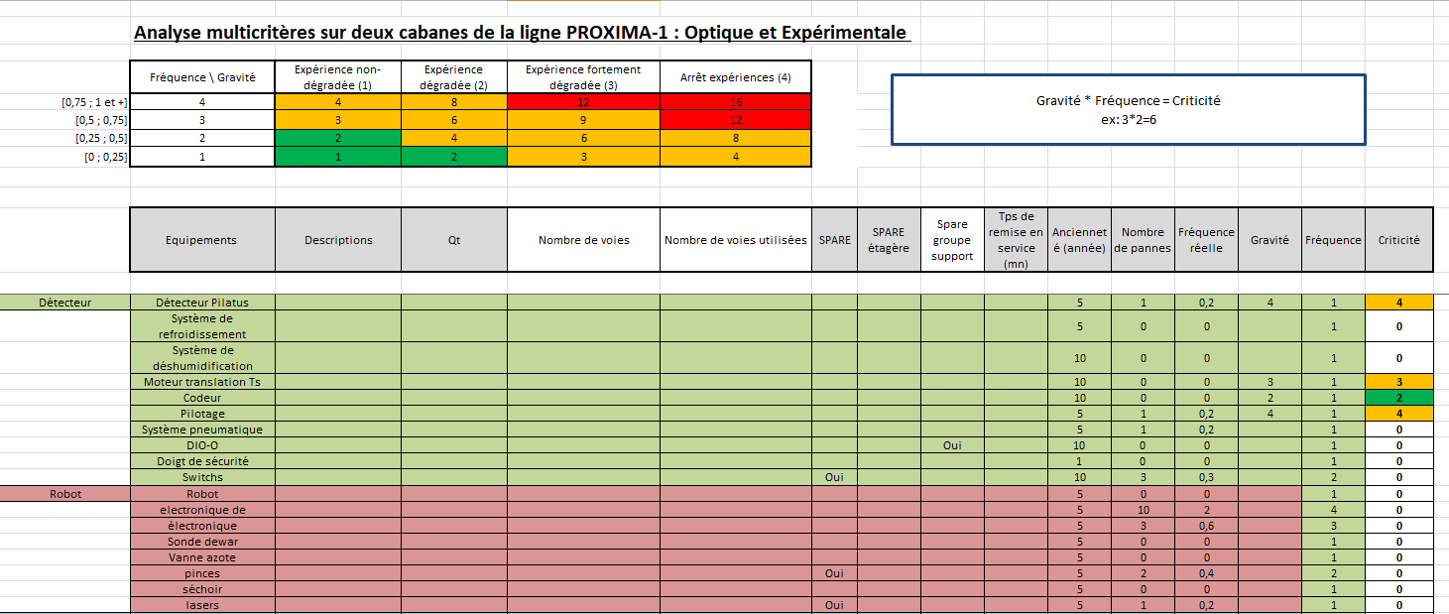
PROXIMA 1 Criticality Matrix

Slide 11
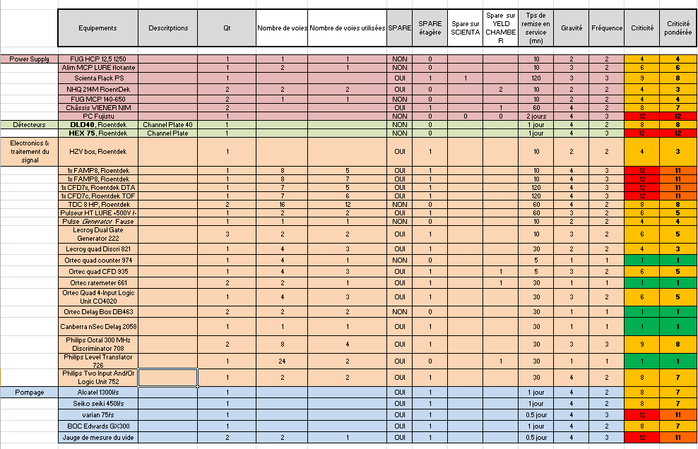
PLEIADES Criticality Matrix
Really helped to formalize where the problems could be.
But still mainly on memories of the staff and feelings!!

Slide 12
Conclusions
Criticality matrices are not scary, even for beamline scientists
They are flexible enough, in their building, to fit the specific requirements of different beamlines
Need to identify and include the equipment in the CMMS software (Manpower)

Slide 13
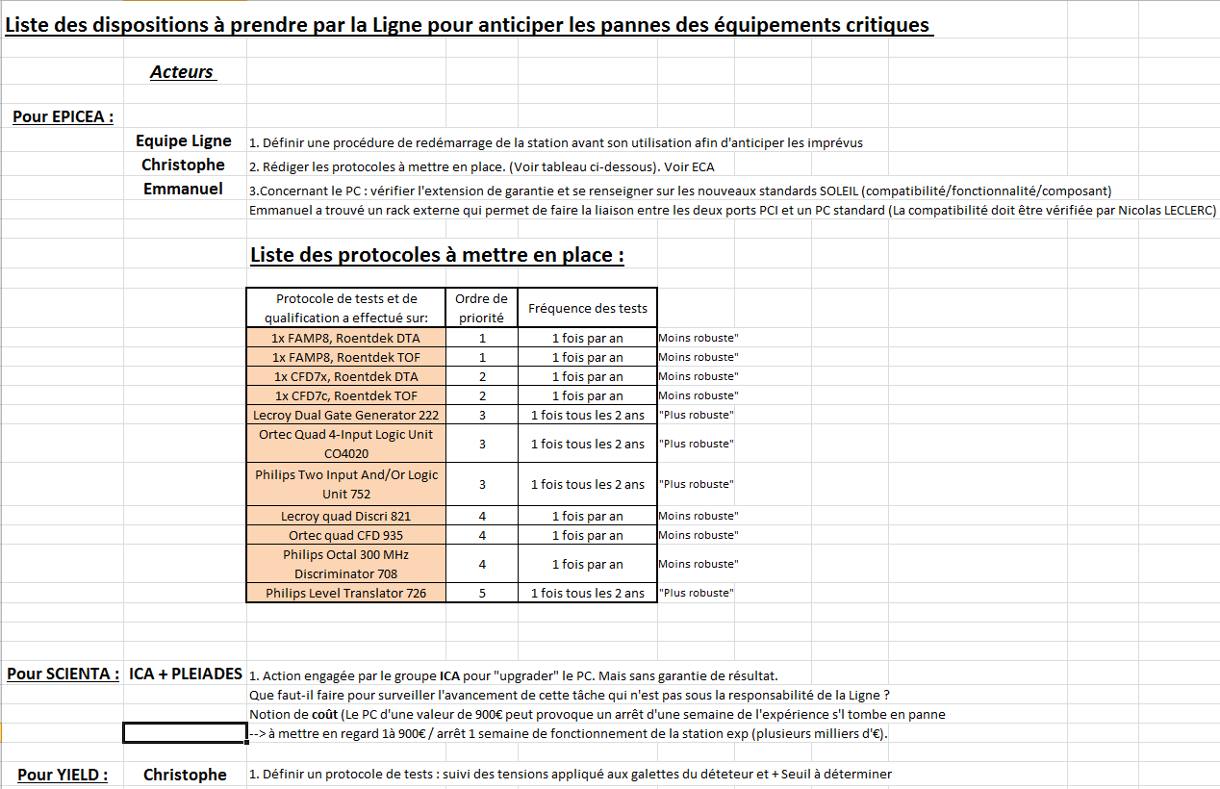
Outlooks
For PLEIADES:
Tests procedures for critical equipment need to be written
Start to work on maintenance plan document

Slide 14
Outlooks
This work was presented to different internal meetings:
  To cluster 5 beamlines
  To the executive coordinators from the EDA
  To the ‘groupe fonctionnement” from the EDA
  To the quality cell of SOLEIL
It has been very well received
Cluster 5: Beamlines are interested, but scared of the work needed to identify and include the equipment in the CMMS software
To evaluate this work, a summer job (1 month) was dedicated to include all the equipment of PLEIADES endstations and sources in the CMMS.
This highlighted two things:
It is very difficult for a non-beamline staff (and even for new beamline staff, who do not know the history of the beamline) to include the equipment, but it is possible and will also benefit the other beamlines (Spares available at SOLEIL).
The homogenization in the definition of equipment gets lost with time (a power supply could have various names, even including the group name: RF_powersupply)

