Slide 1
European Spallation Source
- a new facility approach on system set up for asset management -
Karen Jónsdóttir
PLM & Engineering Programme Manager
www.europeanspallationsource.se
24 September, 2018

Slide 2
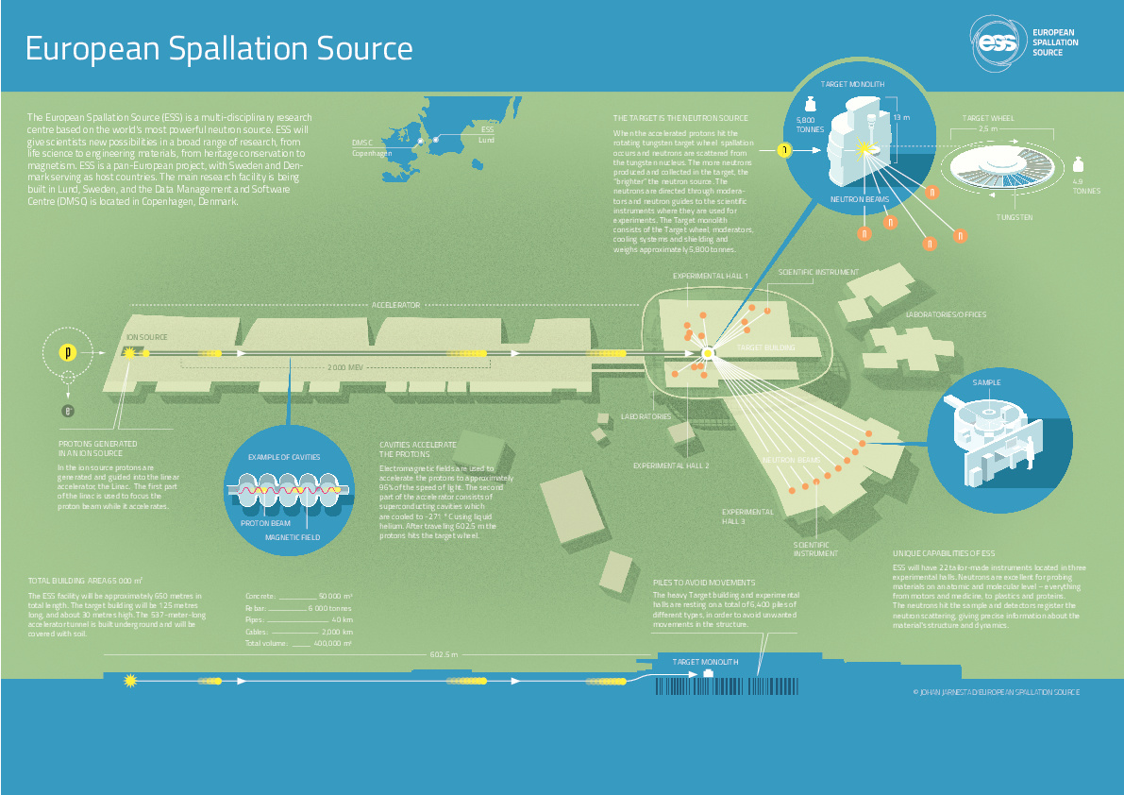
ESS Overview

Slide 3
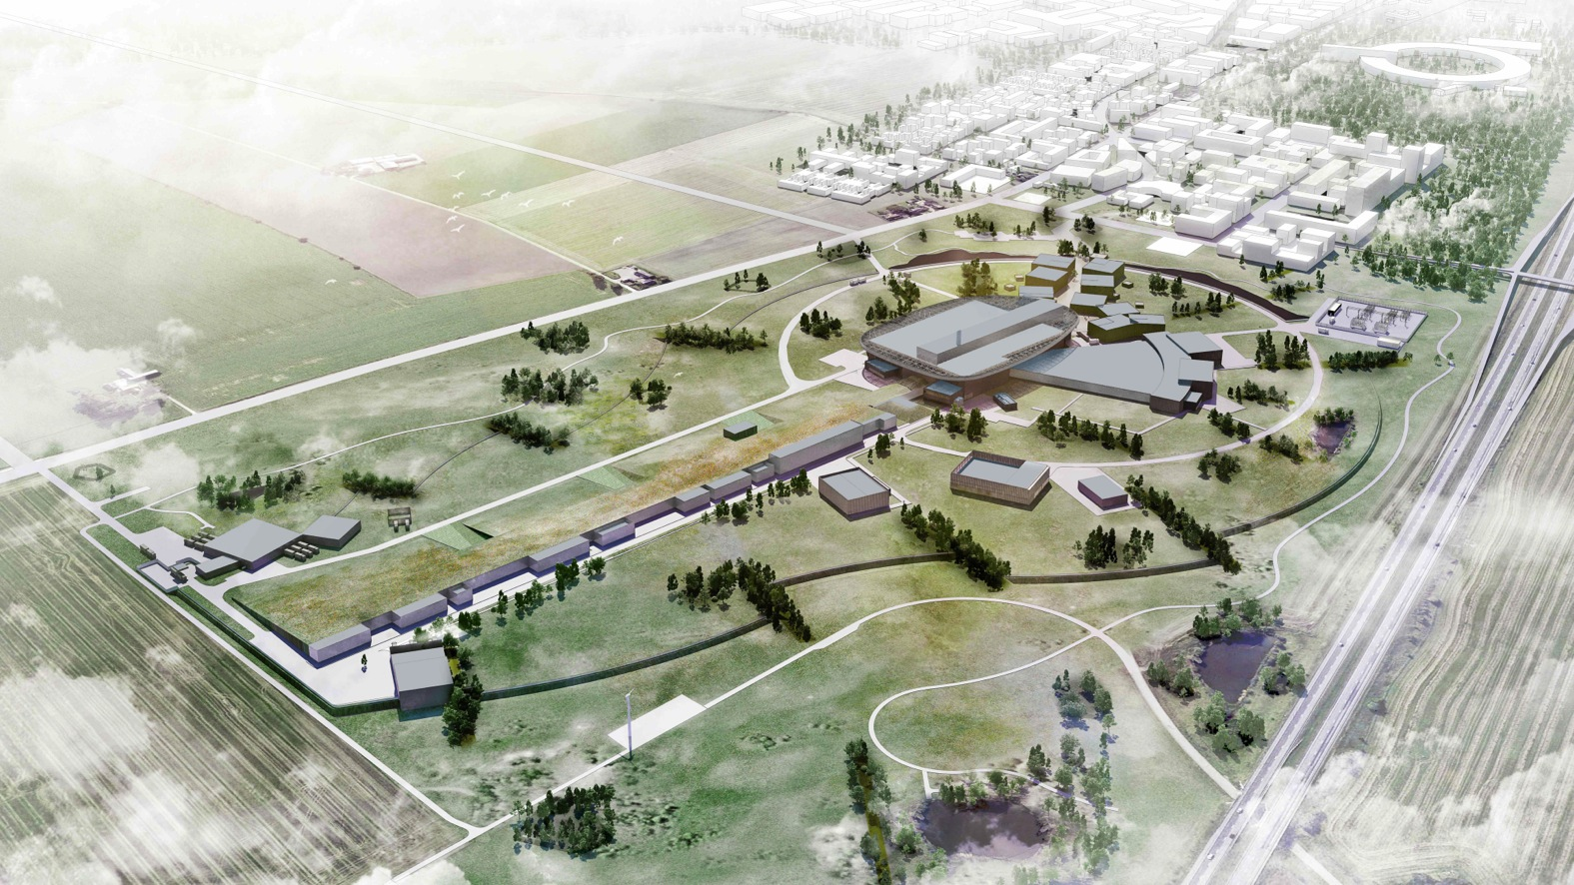
Complete facility

Slide 4
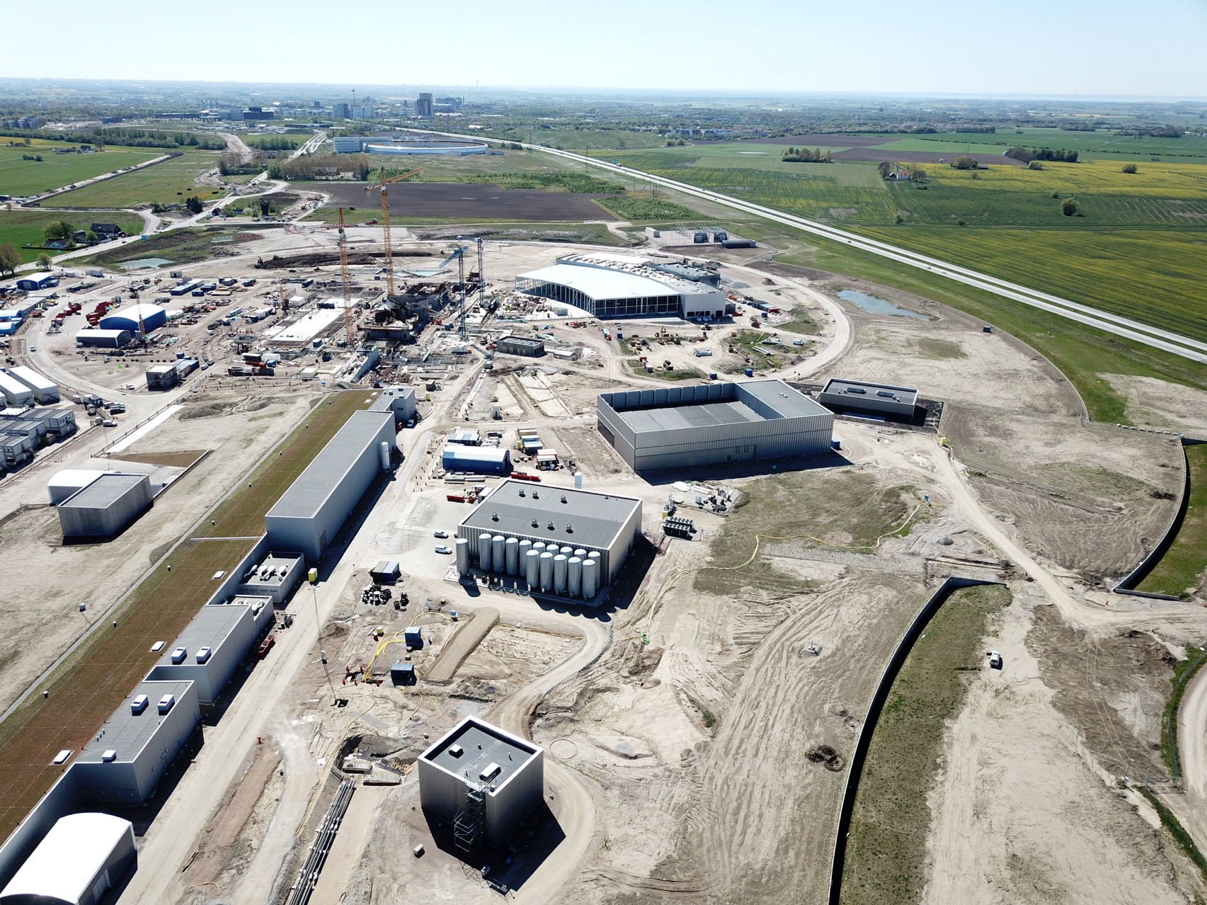
Summer 2018

Slide 5

Neutron science

Slide 6

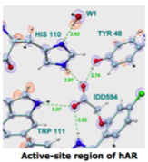
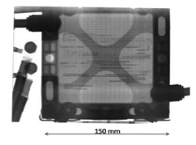
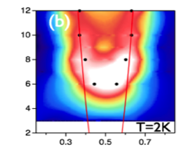

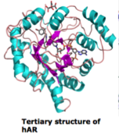

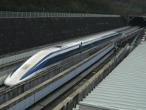

Properties of neutrons for measurements
Charge neutral
Deeply penetrating
Magnetic moment (spin)
Directly probe magnetism
Scattering
Sensitive to light elements
Li motion in fuel cells
High-Tc superconductivity
Actives sites in proteins
Help build electric cars
Efficient high speed trains
Better drugs
Notes:
CP-1 Chicago USA
CP-2 Chicago USA
X-10: Oak Ridge, USA
NRX: Chalk River, USA
MTR: Idaho, USA
LVR: Rez, Czech Republic
HIFAR: Sydney Australia
NRU: Chalk River, USA
HOR Delft Netherlands
SAFARI-1 Pretoria South Africa
HFBR: Brookhaven, USA
HFIR: ORNL, Oak Ridge, USA
NIST: National Inst. for Stds and Tech. Gaithersburg, USA
ILL: Grenoble, France
JEEP II Kjeller Norway
MARIA Swierk Poland
ORPHEE LLB Saclay France
Dhruva: Mumbai, India
RSG: serpong, Indonesia
SINQ: PSI, Switzerland
JRR-3: Tokai, Japan
ES-Salam Algiers Algeria
HANARO: Daejon KAERI, South Chorea
ETERR-2 Cairo Egypt
FRM-II: Munich, Germany
OPAL: Sydney, Australia
CARR: Beijing China
PIK: Gatchina, Russia
ZING-P Argonne USA
WNR Los Alamos USA
KENS Tsukuba Japan
IPNS Argonne USA
IBR-II Dubna Russia
LANSCE Los Alamos USA
ISIS Oxfordshire UK
SNS Oak Ridge USA
JPARC Tokai Japan
CSNS Beijing China
ESS Lund Sweden
More reactor sources exist across the world….

Slide 7
ESS – the machine
The linear accelerator tunnel is 537m where we have a long pulse proton beam.
The beam effect of 2 MW.
Additional space at the warm linac area of the accelerator is left empty in order to facilitate a future upgrade.
The target station uses a helium cooled Tungsten spallation material. Coupled with new type of moderator and reflector we achieve a 100 times higher brightness then ILL – which is ESS reference case.
22 instruments are planned with the current target station and 14 of those + 1 test line have been identified.
User programme is planned to start 2023 with friendly users and a full programme is planned 2026.
ESS supports sustainable science and will be free of charge for users. The facility will not be available for commercial companies.

Slide 8
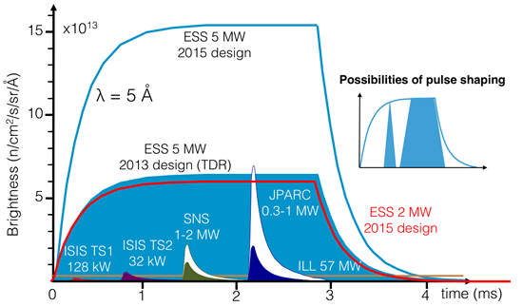
ESS - long pulse with high brightness

Slide 9

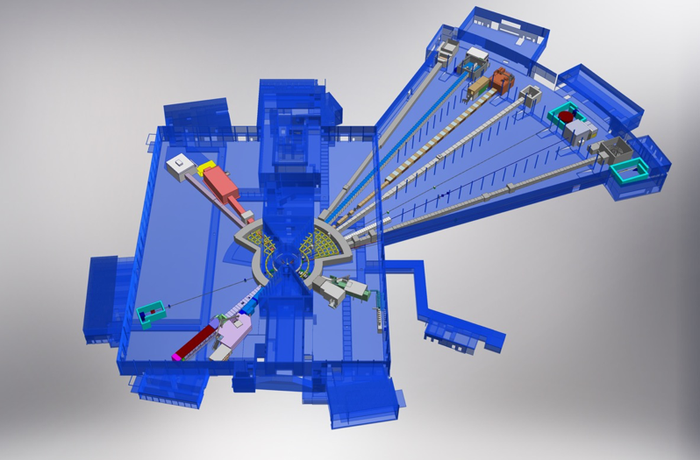











NSS Neutron Instrument positions
ESS Lead Partners for instrument construction
+
Nuclear Physics Institute
NMX
BEER
+
C-SPEC
BIFROST
MIRACLES
MAGIC
ODIN
T-REX
DREAM
HEIMDAL
LoKI
VESPA
FREIA
SKADI
ESTIA
+
ESS In-Kind Partners also collaborate on sample environment, data management systems etc.
ESS Instrument Layout (December 2016)

Slide 10
List of decided instruments
Instrument Class | Instrument | Performance targets (@ 2MW)
Large Scale Structures | LOKI (Broad band SANS) | 5 x D22 & 20 x SANS2D
 | SKADI (General Purpose SANS) (+SONDE funds) | 4 x D22
 | ESTIA (Focusing Reflectometer) | Conventional mode: ~ 100 x D17 High intensity mode: 1cm² samples = seconds
 | FREIA (Liquids Reflectometer) | 30 x FIGARO, INTER
Diffraction | DREAM (Bispectral powder diffractometer) | > 10 x POWGEN or WISH
 | HEIMDAL (Hybrid diffractometer) | ~ 50 x GEM, ~ 8 x new POLARIS
 | MAGIC (magnetism single crystal diffractometer) | Cold: > 100 x worlds best, Thermal: 1mm³ crystals = 10 min
 | NMX (Macromolecular crystallography) | > 10 x LADI & Biodiff
Engineering & Industrial | BEER (Engineering diffractometer) | world leading in strain scanning, unique flexibility
 | ODIN (multi-purpose imaging) | world leading for high resolution, > 10 x best for TOF methods
Spectroscopy | BIFROST (extreme environment spectrometer) | > 10 x THALES & MACS
 | C-SPEC (cold chopper spectrometer) | 100 x IN5 (w RRM)
 | T-REX (bispectral chopper spectrometer) | 3 x 4-SEASONS, 3 x IN5
 | VESPA (vibrational spectroscopy) | 10 x VISION (ΔE = 130 meV)
 | MIRACLES (backscattering spectrometer) | 2 x BASIS and DNA

Slide 11
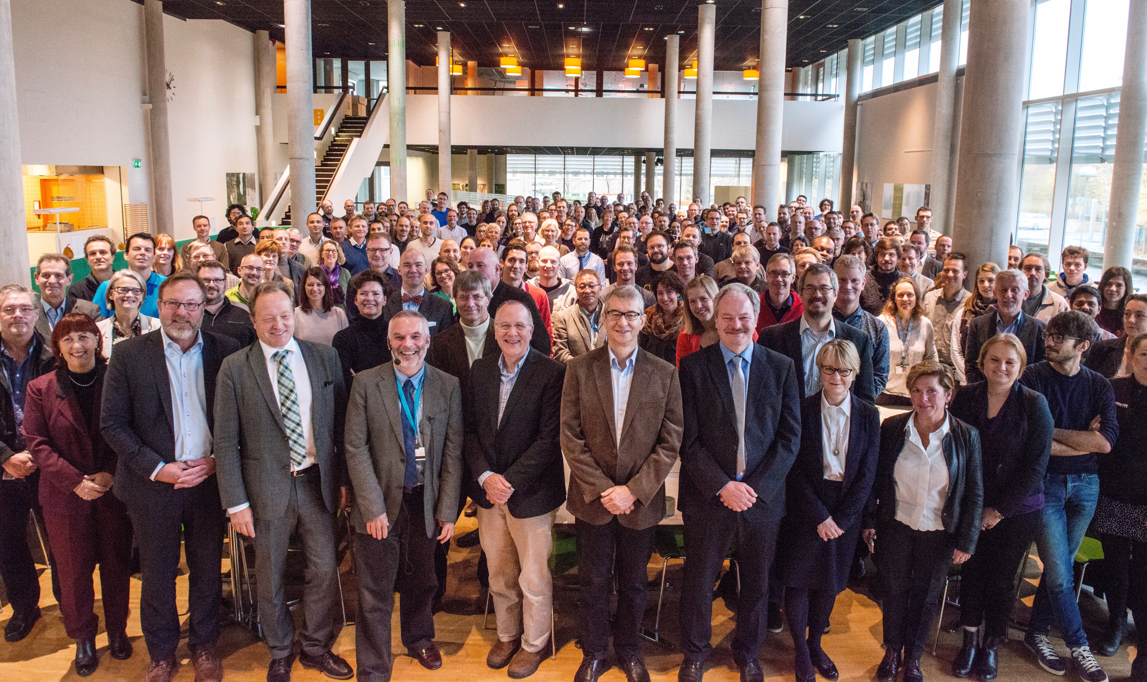


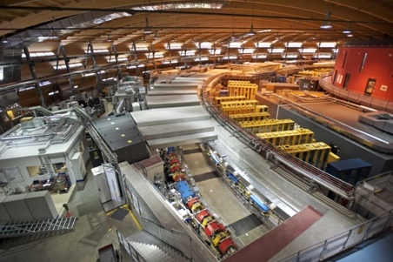
Organization and People
~430
Employees
50
Nationalities
~100
Collaborating Institutions
Notes:
Updated September 2017

Slide 12
ESS In-kind Partners
Rutherford-Appleton Laboratory, Oxford(ISIS)
Kopenhagen University
Laboratoire Léon Brilouin (LLB)
Lund University
Nuclear Physics Institute of the ASCR
Oslo University
Paul Scherrer Institute (PSI)
Polska Grupa Energetyczna - PGE
Roskilde University
Tallinn Technical University
Technical University of Denmark
Technical University Munich
Science and Technology Facilities Council
University of Tartu
Uppsala University
WIGNER Research Centre for Physics
Wroclaw University of technology
Warsaw University of Technology
Zurich University of Applied Sciences (ZHAW)
Aarhus University
Atomki - Institute for Nuclear Research
Bergen University
CEA Saclay, Paris
Centre for Energy Research, Budapest
Centre for Nuclear Research, Poland, (NCBJ)
CNR, Rome
CNRS Orsay, Paris
Cockcroft Institute, Daresbury
Elettra – Sincrotrone Trieste
ESS Bilbao
Forschungszentrum Jülich
Helmholtz-Zentrum Geesthacht
Huddersfield University
IFJ PAN, Krakow
INFN, Catania
INFN, Legnaro
INFN, Milan
Institute for Energy
Research (IFE)

Slide 13
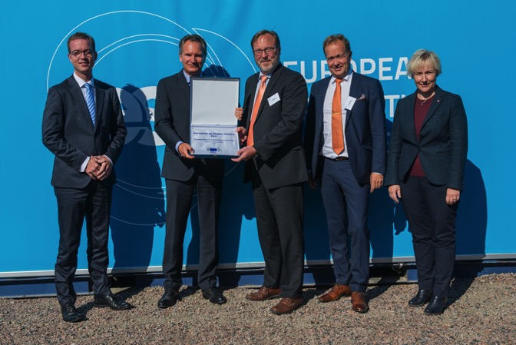
ESS AB transitioned into European Research Infrastructure Consortium (ERIC)
ESS AB
Swedish limited liability corporation
Owned by the Swedish and Danish governments
European Spallation Source ERIC
European Research Infrastructure Consortium
Sole governing body: the European Spallation Source ERIC Council, comprised of representatives from the Member and Observer Countries
transfer of assets,
obligations and
personnel
on Oct 1, 2015

Slide 14


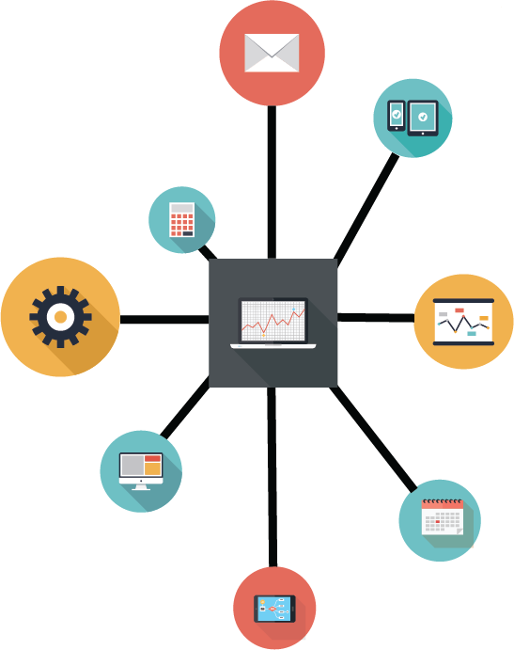





Background
ESS is a greenfield facility and thereby we don’t posses any or little legacy regarding engineering systems.
At ESS the PIM (Product Information Management) group is responsible for all Engineering related systems and facilitating all procedures linked to them.
Our struggle has been that we implement solutions at the same time the project is ongoing and home-built solutions have already been made. This results in continuous change management work.
Our aim is ”Data entry only once!”

Slide 15
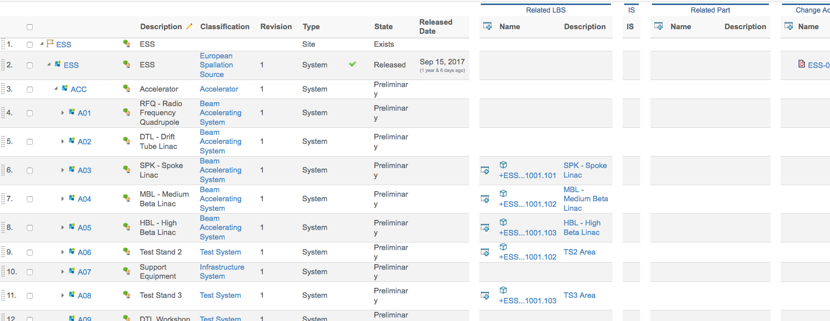
PLM - Enovia
2014 we implemented our PLM system but this was done on the pretences of a documentation system which resulted in several years of struggle of change management to implement the correct functions.
So far, we have implemented the following functions:
  Facility Breakdown Structure (FBS): Function based structure of the facility with all design documentation, location, classification, tags, E-BOM and change order links.
  Location Breakdown Structure (LBS): Location naming structure with links to FBS, conventional design documentation and change orders.
  Requirement Breakdown structure: Req documents and possibility to report compliance including deadlines and actions.
  Engineering Change orders
  Traditional document management
  Quality process and procedure
  E-BOMs
  Classification
  And more…..

Slide 16
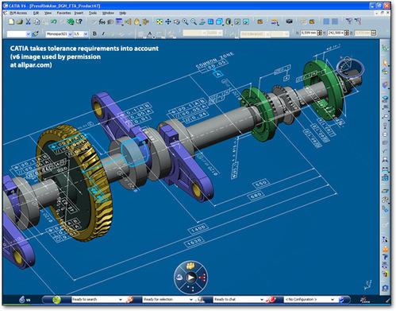
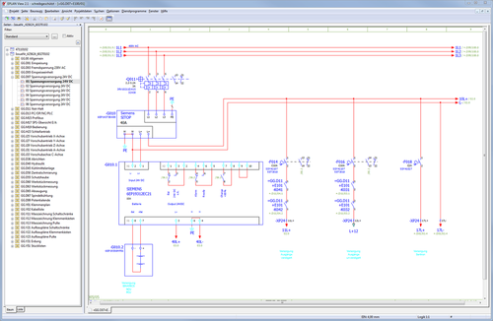
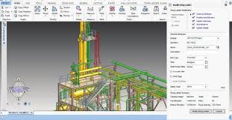
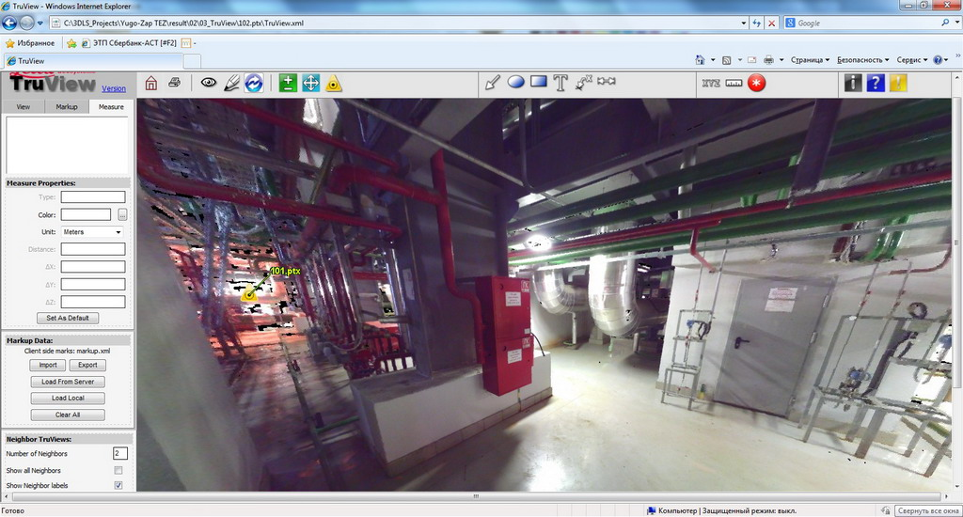
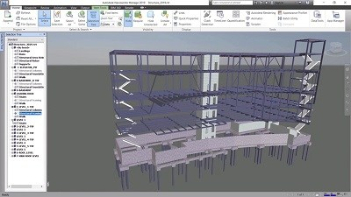
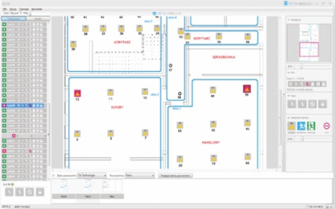
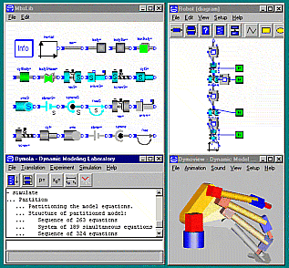
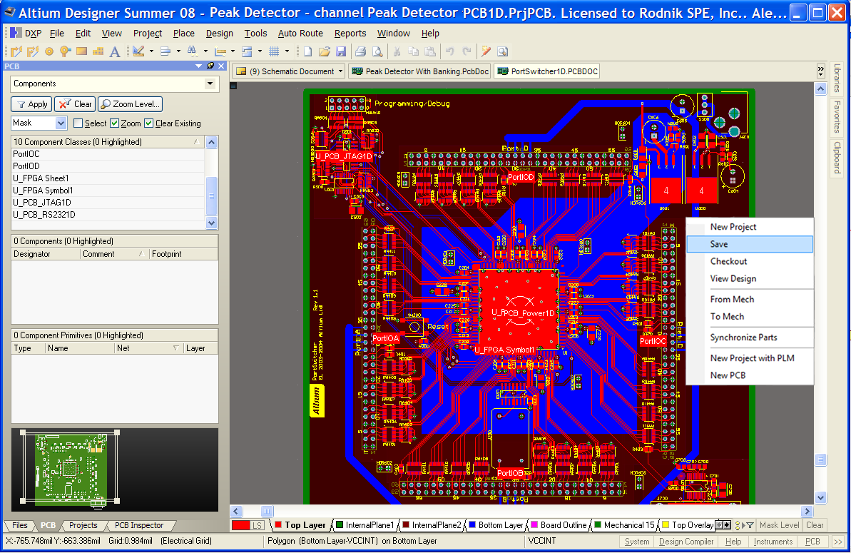
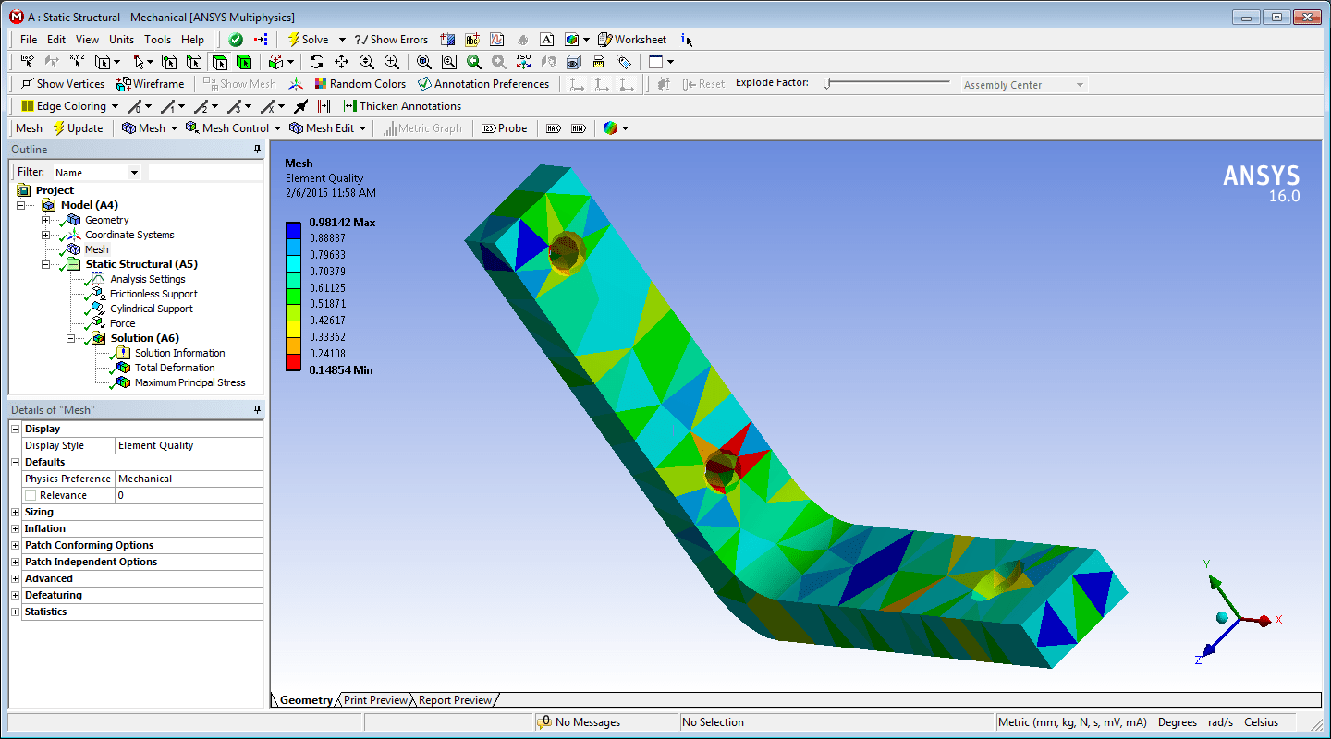
Design tools
At the same time we introduced Enovia we implemented Catia V6 which is the same suite as Enovia and have ready connections. It is our mechanical design tool and contains our main plant layout model.
In 2015/16 we also implemented EPlan for electrical design and Aveva E3D for, primarily, piping design but also for some electrical work.
Our conventional joint venture company uses Revit for their building construction designs.
We have a set of minor assistive tools such as:
  Dymola and Ansys: Modelling and simulations/analyses tools.
  El-vis: Electrical cable dimensioning tool.
  Altium: PCB design tool.
  Truview: Real site scan tool.

Slide 17
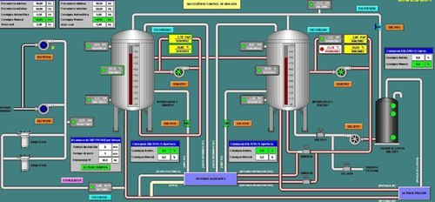
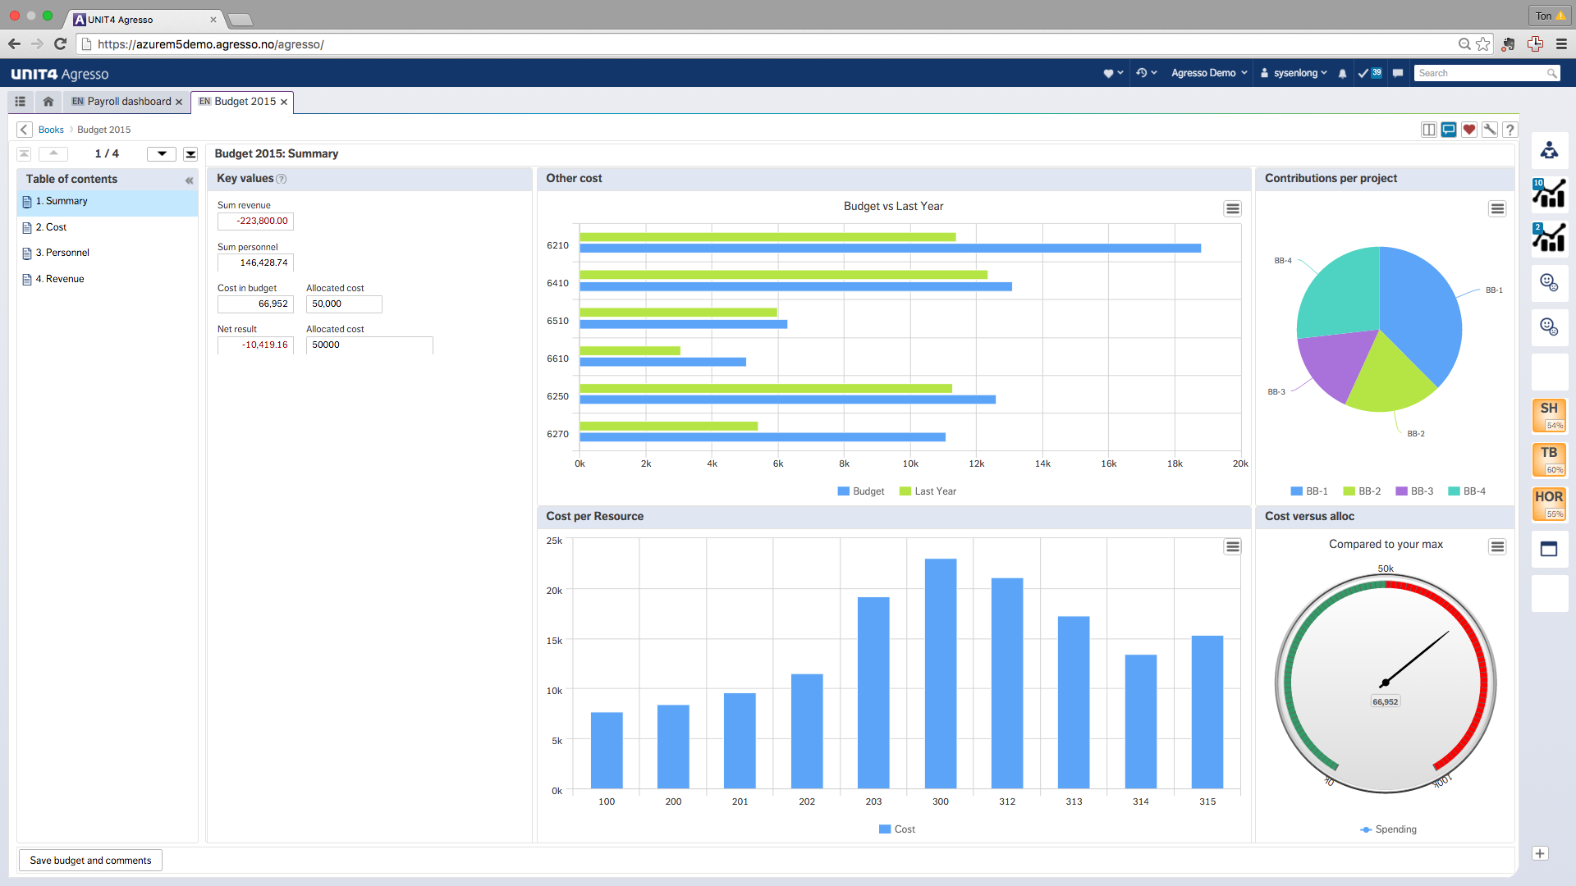
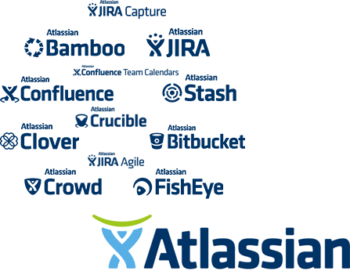
ESS other tools
The ESS integrated control system, is a set of several systems (EPICS, CS Studio, CCdb, etc) containing our control monitoring data.
Unit 4 Agresso is our ERP system with procurement, financial and logistical information.
Atlassian suite is used widely throughout our organisation, using Jira, Confluence, Bitbucket and Insight. This is sometimes used for configurations, design and regulatory information storage and takes a lot of time to resolve what should be stored where, despite already taken decisions.

Slide 18
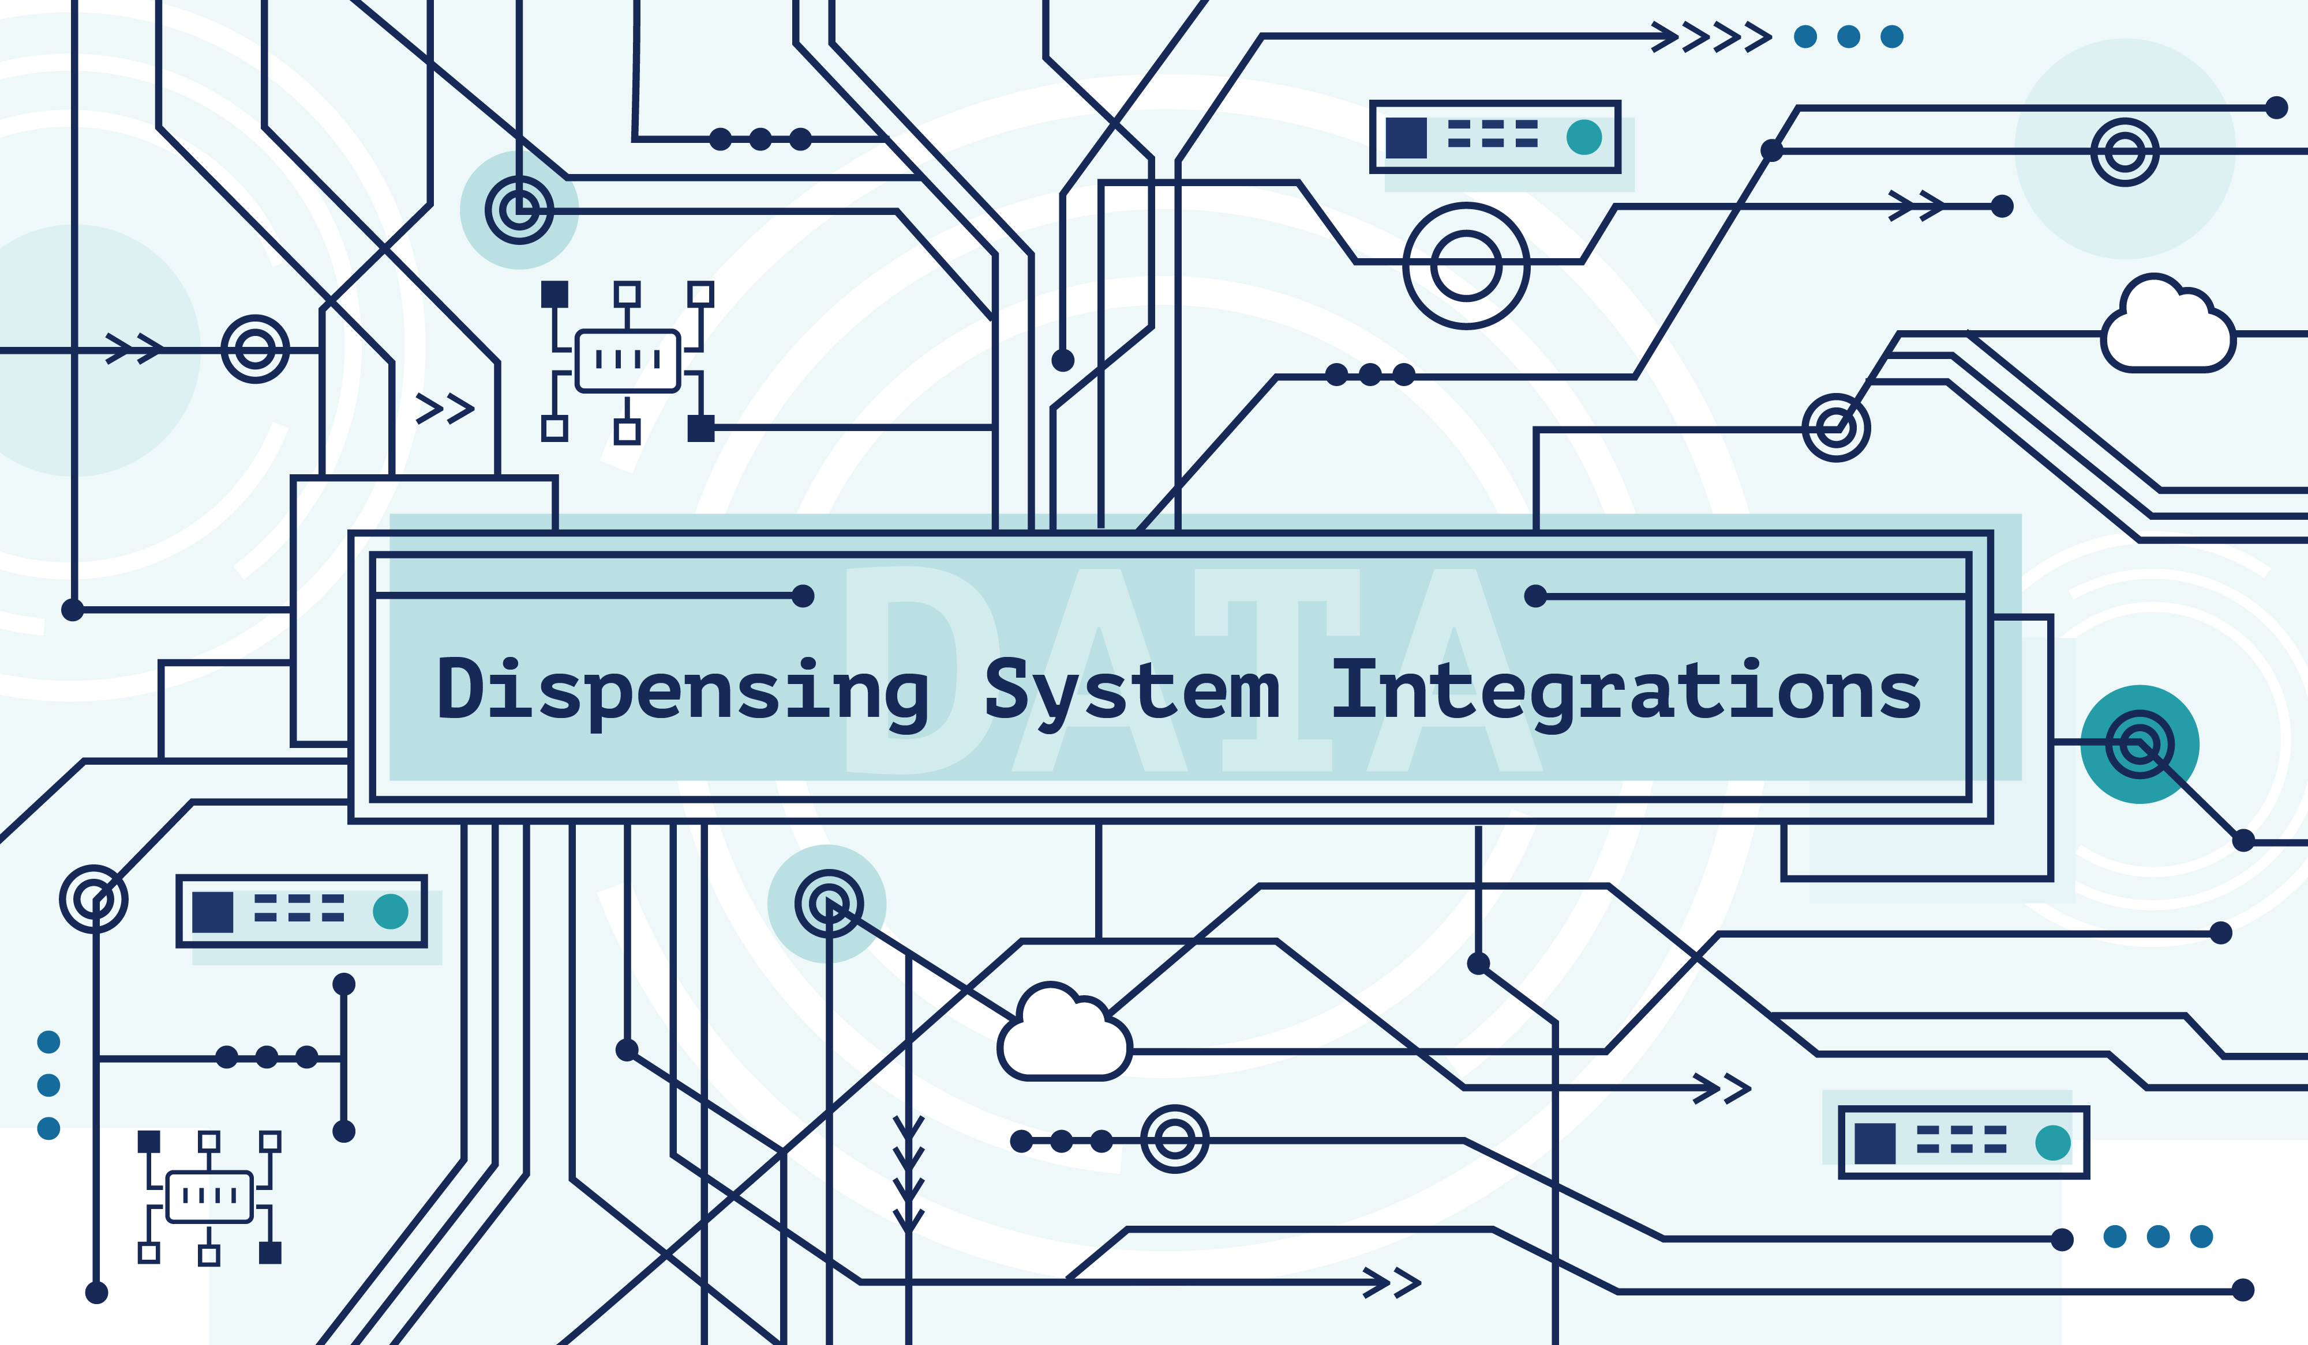
Integrations
ESS aim is to integrate the large systems in order to secure data entry only once thinking.
Integration COTS platform vs home-built solutions?
Integration work is ongoing and the main systems we have or are planning to integrate are:
  CAD system models into Catia
  Design Data into Enovia
  Asset management data and activities into Infor EAM, which includes also predictive maintenance data in the long run.

Slide 19
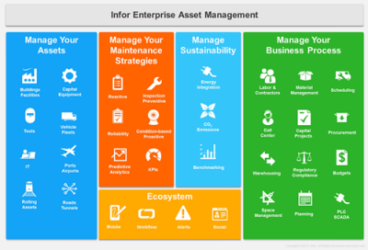
Enterprise Asset Management System
Late 2016 we started to investigate the needs of an EAM system.
In 1H 2017 we conducted a benchmark with several facilities: DESY, CERN, SNS and BNL as well going through the presentations from previous AMMW conferences.
We also conducted a pilot in 2017 that had a positive result.
Beginning of 2018 we installed the EAM system. Currently we have uploaded the FBS and LBS information into the EAM system and are in the process of implementing work orders basic functionality.
Our overall implementation plan of the functionalities we plan to do are:
  Work order basic functionality with approval process
  Work order extended functionalities, including checklists
  Reports
  Asset registration
  Warehouse mangement
  Spare part handling
  Installation planning: Time plan, staff plan, space accessibility
  Tool reservations
  Lock out/Tag out identifications
  Alerts for planned maintenance
  Warranty
  Risk assessment
  Predictive maintenance

Slide 20
System Map – Technical Viewpoint
Atlassian
Jira, Confluence, etc
Ansys
Simulation and Analysis
Revit
Building Design
Altium
PCB Design
El-vis
Cable Dimension
Dymola
Simulation and Analysis
Eplan
Electrical Design
ENOVIA
PLM System
Infor
EAM
System
Agresso
ERP System
Aveva E3D
Process/El Design
Catia V6
Mechanical Design
Integrated
Control System
Truview
Building Scans
CCdb
Planned
Existing

Slide 21
Future?
Implement continuous functions in EAM
Focus on completing planned integrations
Continuing motivating the organisation on the benefit of using these systems and not home made solutions.
Thank you

