Slide 1
SOLEIL: Status of Maintenance Policy
Presented by Hélène Rozelot (helene.rozelot@synchrotron-soleil.fr)
On behalf of SOLEIL teams

Slide 2
Overview
SOLEIL in key figures
SOLEIL Maintenance Management System
From a Maintenance Management System towards a Maintenance Policy
Prospects

Slide 3
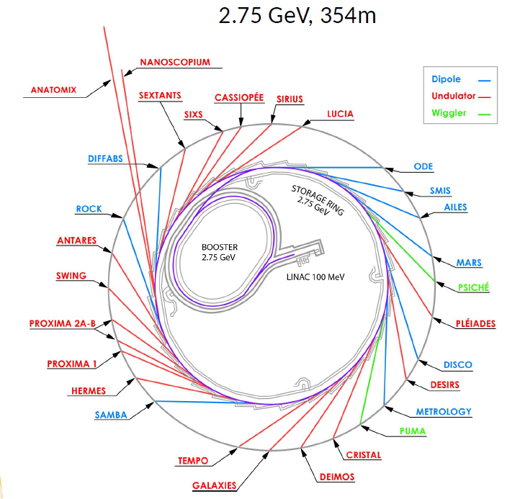
Synchrotron SOLEIL
29 beamlines (10% of BL in Europe)
26 beamlines in 2 phases +3 on project funding
24 beamlines on insertion devices + 5 on bending magnets
Support laboratories in 5 areas :
Biology (2)
Chemistry (2)
Surface science
High pressure
Microfluidics
Notes:
SOLEIL is located near Paris. It is composed of 3 accelerators, plus 29 Beamlines : 3 of them are on project funding

Slide 4
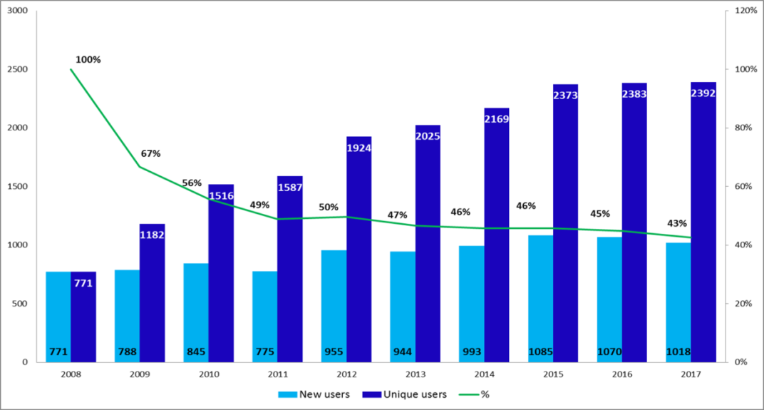
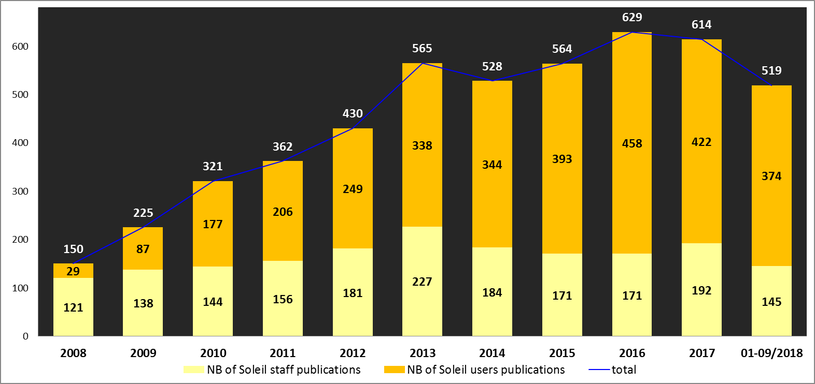
Synchrotron SOLEIL
More than 1200 submitted projects per year
More than 700 accepted projects per year
10000 users from 2200 laboratories since 2008
Notes:
Facts and figures about SOLEIL:
SOLEIL welcomes more than 2000 unique users per year. There is an increasing number of publications (about 500 publications per year)

Slide 5
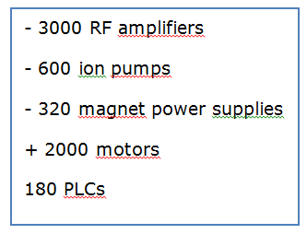
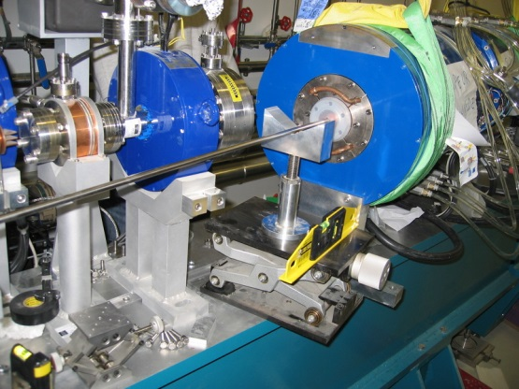
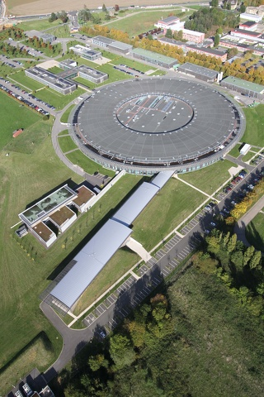
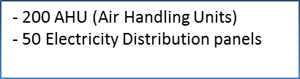
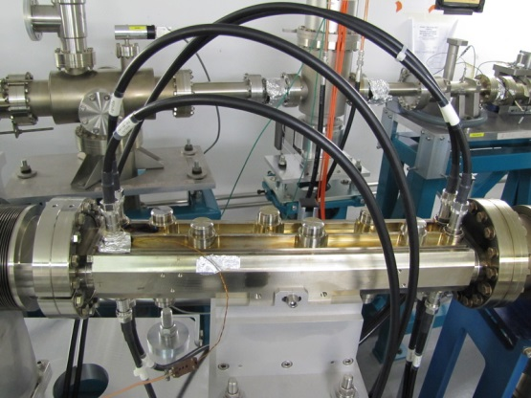
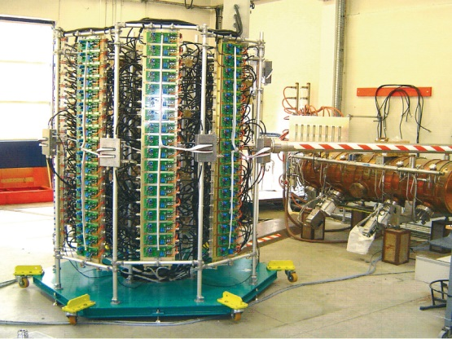
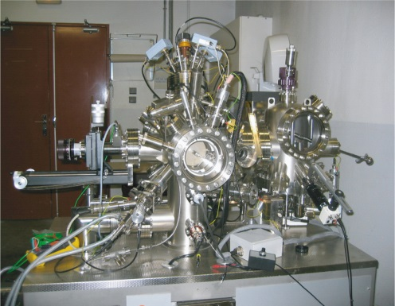
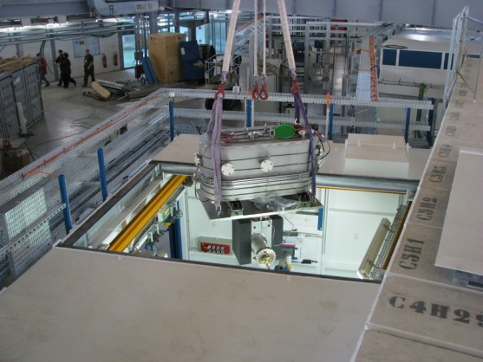
Synchrotron SOLEIL
300 PLCs
+200 equipment on each beamline (x29)
+ equipement in each lab
~ 80000 topologies (branches)
46 000 work orders
70 000 work sheets
40 000 Purchasing requests

Slide 6
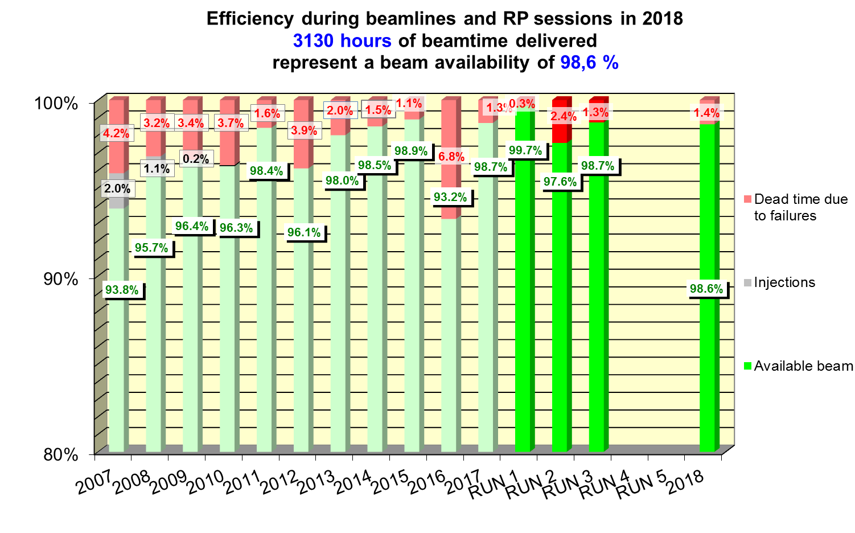
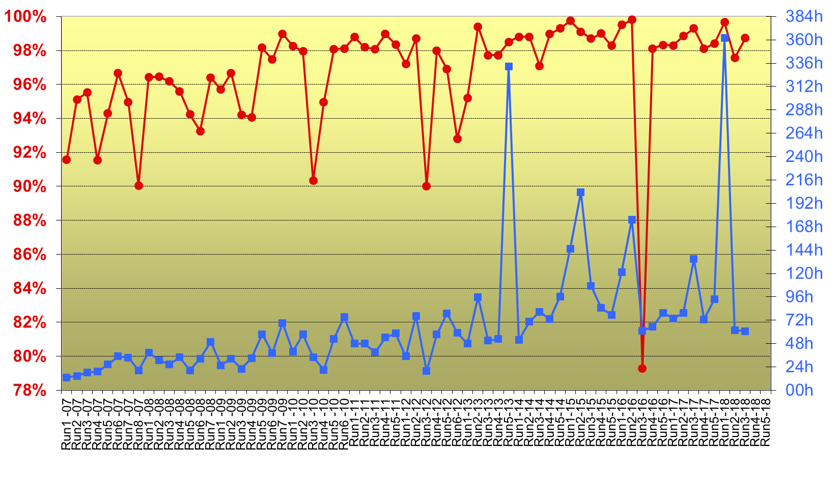
Synchrotron SOLEIL
Beam availability during user sessions
Machine: Availability and mean time between failure
Notes:
An excellent rate of availibility and reliability : 99%. We have now to maintain this rate !...Thanks to the preventive maintenance most of the time.
You can see that the MTBF is increasing since the 1st run in 2007 : about 70 hours. The objective is to reach 100 hours.

Slide 7
Overview
SOLEIL in key figures
SOLEIL Maintenance Management System (status)
From a Maintenance Management System towards a Maintenance Policy
Prospects

Slide 8



Organisation
Maintenance policy (strategy):
Objectives, priorities
Top Management
Executive Coordinators (DAI) &
Coordination Group (Div Exp)
Single
Online
portal
Cluster
CMMS
JIRA
Maintenance plans
Groups (know-how / skills)
ELOG
Notes:
At SOLEIL there is not a unique maintenance service. Each group, in charge of its own equipment, is responsible for the management of its own assets
Staff : 350 people ; ~ 50 groups
Each group imputes its interventions into one of the several software tools available: CMMS, Bug tracker (JIRA), Electronical Logbook, even emails.
This information is then reported and analysed by a "coordination level" (Executive Coordinators & Operation Group for the Accelerator Department; Coordination Group for the Scientific Department) which has the overall view of the operation and failures and therefore of the maintenance activities to be carried out. This coordination level extracts operating indicators and verifies that all lights are green.
Then the coordinators define priorities (taking into account the Beam Schedule with shutdowns) in accordance with the strategic lines defined by Top Management.
All these actions of data analyses and coordination give rise to many meetings.
In order to improve the management system with the objective to increase performance, and also in order to set up common methods, we are defining a global maintenance policy for the whole facility. We are at the beginning of the process.
This policy would mainly consist in defining strategic priorities (preventive maintenance, subcontracting strategy, etc.) and defining common methods and common tools shared by all. Among them: the single online portal (for the service management) and the criticality matrix which allows us to identify critical equipment and actions to be carried on.
This maintenance policy is supported by Executive Coordinators (DAI), clusters (in scientific department) and Quality Unit.
The interface between groups and the level "Coordination" is done by a single channel. The coordination will look for the information in a unique place whatever the tool used by the group. The groups themselves continue to use their own tools.
Note that Each group has its own working methods : corrective maintenance, or preventive maintenance (process sheets for regulatory control), even Failure Mode Effects Analysis (Building & Infrastructures Group).

Slide 9
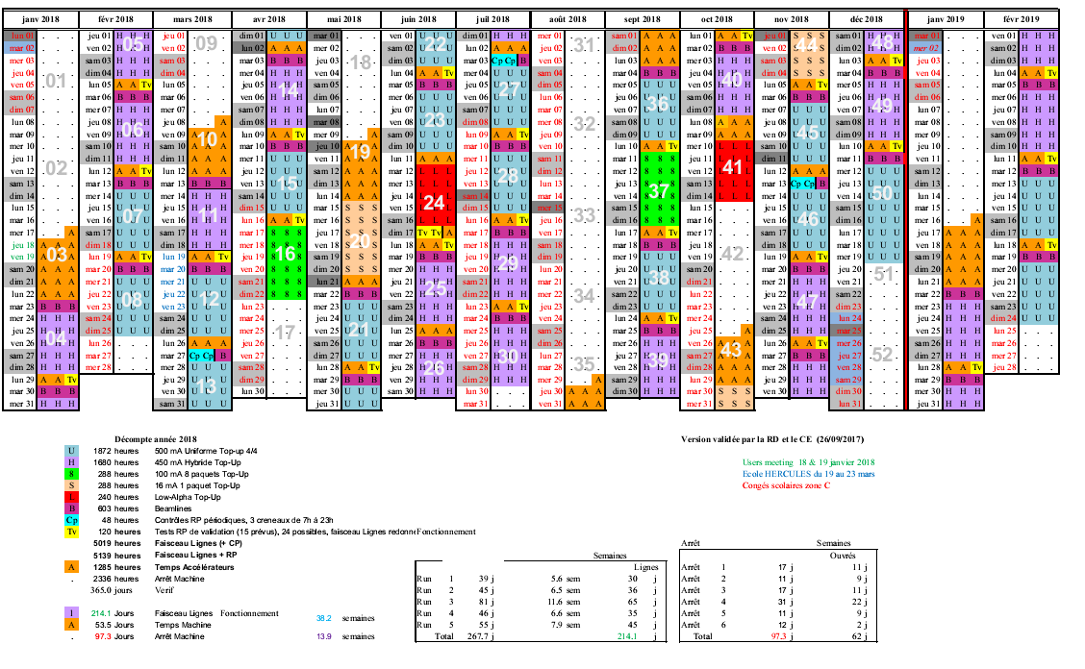
Operation schedule
~ 2330 hours for shutdowns
Notes:
2330 hours dedicated to shutdows, so for maintenance

Slide 10
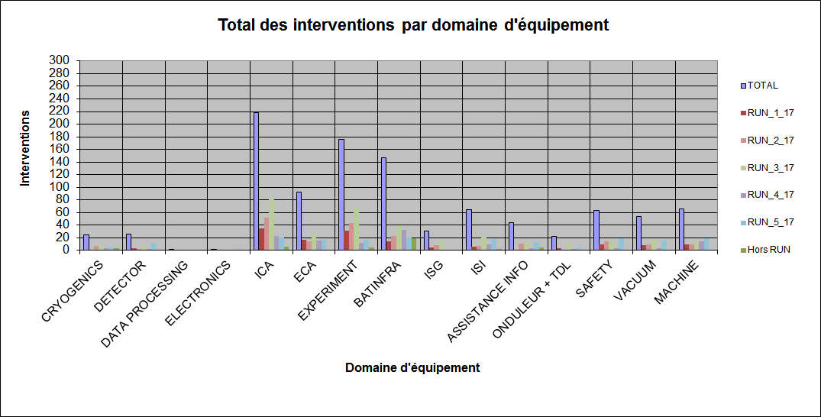
Reporting
Beamlines : Number of interventions per family equipement per run
Notes:
Our maintenance management system allows us to provide various datas, produced by software tools. This is the example of the logbook used by the coordinators in the scientific Division. Il allows to ensure the maintenance of end to end service (from accelerators to beamlines).
You can see for instance that the highest number of interventions concerns the Control System. These are short but recurring failures. The failures can embarasse the users but they can still work on the beam line. La panne n’est pas bloquante.
bilan des interventions e-log pour 2017. Je t’ai mis quelques exemples en dessous sur les interventions qu’il y a eu au niveau informatique.
Par rapport à ta question sur les interventions répertoriées ICA, en général cela correspond à des interventions où les coordinateurs voient qu’il y a une acquisition stoppée sur message d’erreur car il y a un logiciel ICA qui est en erreur (exemple Passerelle, ou Globalscreen, Scanserver, Salsa, Flyscan) ou des devices qui sont en erreurs, ou problème de transfert de données.
Ex : Exemple passerelle message erreur : cause intégration nouveau détecteur eiger dans passerelle
acquisition scan arrêté sur erreur, datarecorder, device attribut, équipements, chargement conf carte xia
Globalscreen bloqué, device serveur en erreur, restart, fichiers de données qui n’apparaissent pas, devices en erreur, problème transfert de fichiers durant l’acquisition sur ruche
Les causes peuvent être d’origine sur des pannes ou erreurs des outils ICA, mais aussi sur des pannes d’outils ISI (Ruche, réseau), matériels (ECA, ou Expériences).
Le classement est fait sur l’origine la plus flagrante au début de l’analyse par le coordinateur lors de l’intervention.
J’espère que pour ta conférence sur la maintenance cela te va.
J’ai extrait les données du bilan annuel des e-logs fait par Rod.

Slide 11
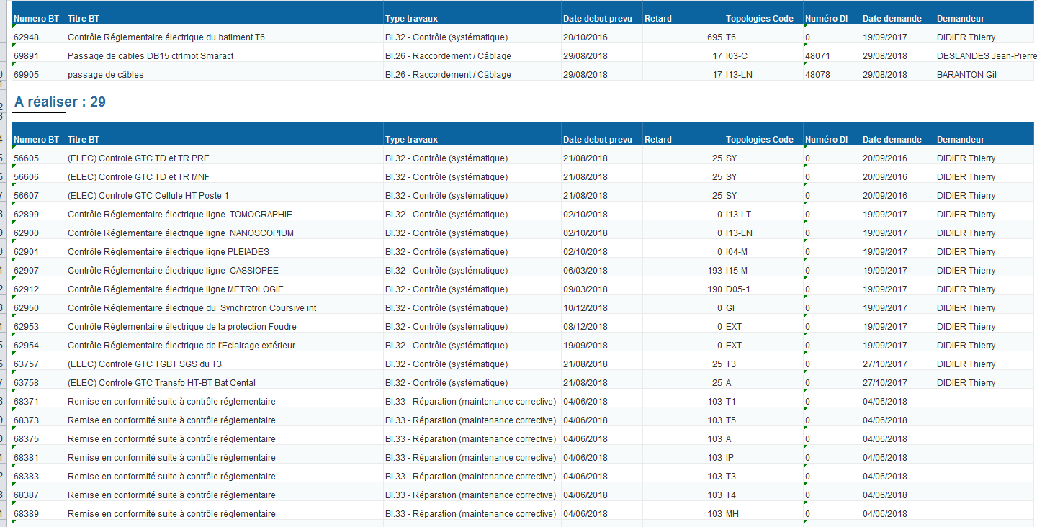
Work sheets of Infrastructures & Building Group
Notes:
Finally let me show you an example of reporting produced by the Infrastructures & Building group.
Exemples of data extracted from the CMMS software (tool) with another tool : Buisines Object (BO) : you can make a list with the work sheets scheduled for each employee.
This exemple concerns compliance with current regulations (Exemple des remises en conformité suite à des contrôles règlementaires).
We try to simplify and to make attractive the work with the CMMS → one unique file with the work sheets

Slide 12
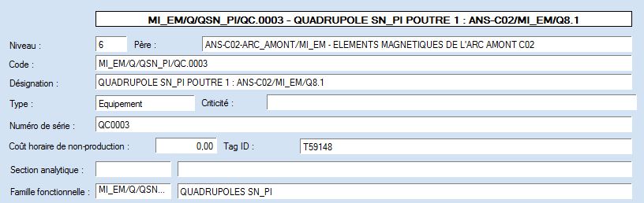
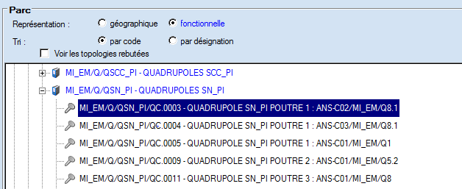
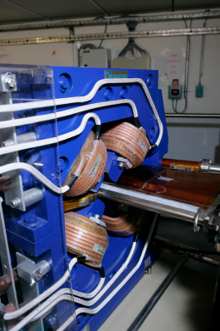
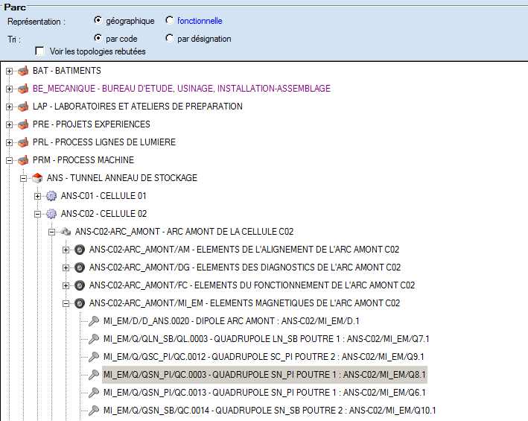
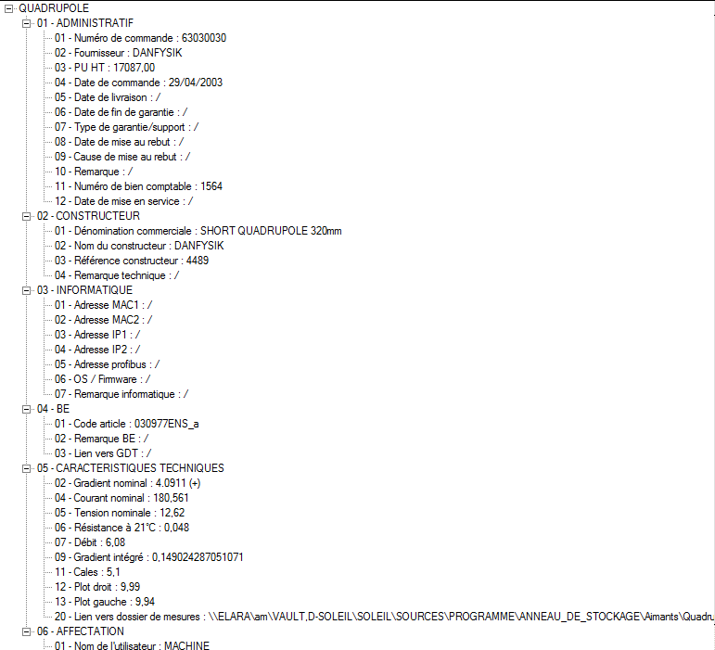
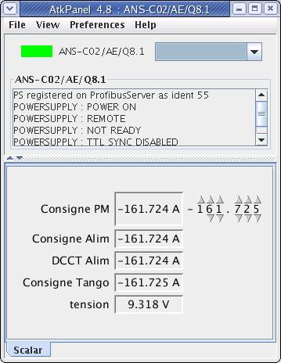
An Integrated Information System
Designation
Functional class
Geographical class
Data sheet
Link towards the procurement database
→ To be implemented
Link towards the drawing database
→To be implemented
Drawing number
Controls Configuration
Service
Magnetic measurement DB
Notes:
At SOLEIL, we try to build this information system. I can give you the exemple of what exists and of the improvements we still have to make…
Let’s take the example of this quadrupole with the serial number 0003. This quadrupole is referenced in our nomenclature as ANS-C02/MI_EM/Q8.1.
With this reference, we can find the asset in each database: CMMS, Control Configuration DB (TANGO) and in the Documentation Database (MERIDIAN)
We could even find it in the procurement DB and in the drawing DB if they were connected (very soon with a “Product Life Management” tool).
In order to facilitate the overall view of the operation, we make the effort to correlate the information beetween each database / software : CMMS, Configuration DB (TANGO control system), Documentation Database (MERIDIAN), Electronical Logbook.
These interfaces are carried out in all the fields of activities.
This same system exists in several other groups (Electronical Group, Vacuum, Chemistry lab).

Slide 13
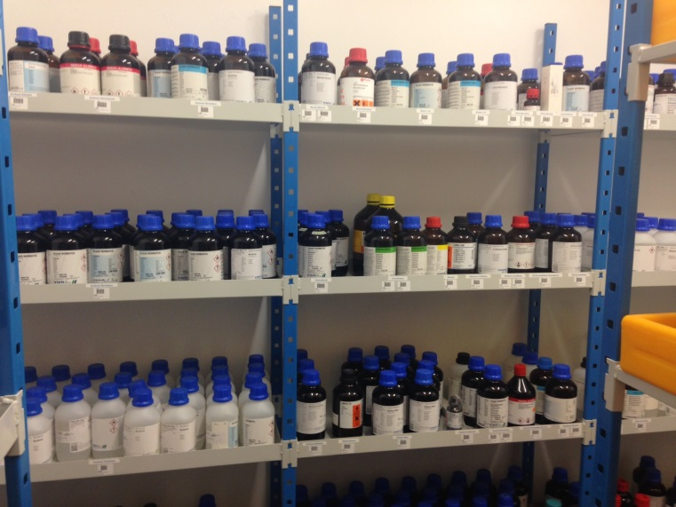
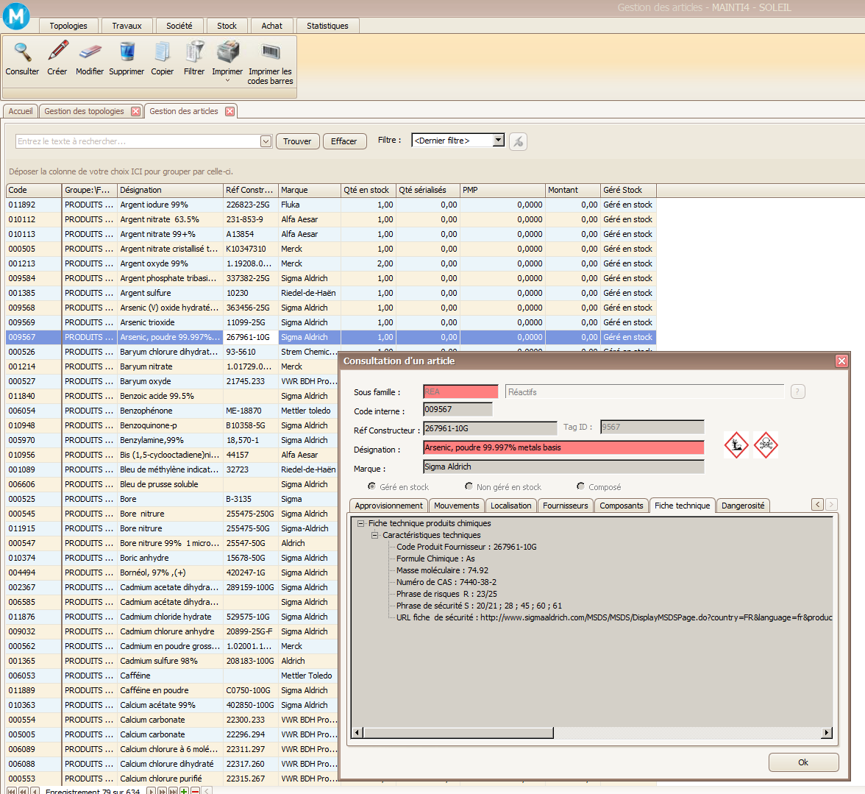
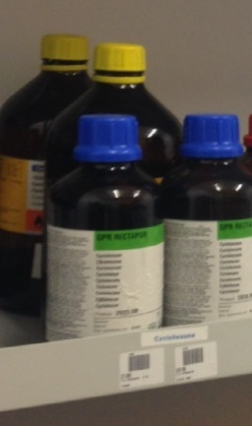
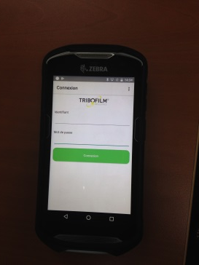
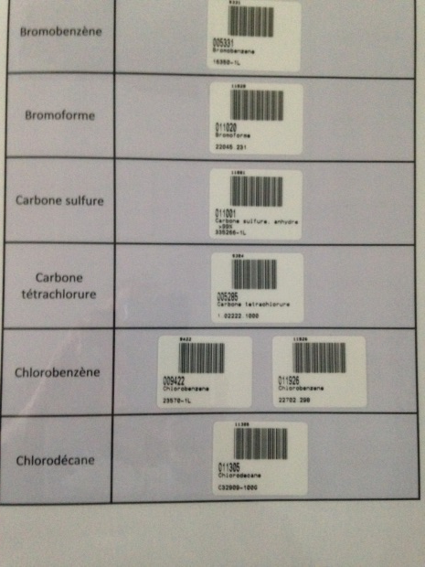
Chemistry lab: stock management
NEW : Quick bar code reader for the stock management of chemicals (more than 500 references)
  Movements and location
  Inventory
Synchronized it with CMMS database
Class of product
Item
Qty
Full web version MAINTI4®
Android application
Technical Data sheet
Risk level and hazard
Link to the Security Data sheet on line
Information accessible by the Security Group at any time
especially for the Fire Department in emergency
(where, which products, qty, dangerousness)
Notes:
An exemple of the way to manage stock in the chemistry lab with Mainti4 Web solution.
- Entrées / sorties (mouvement) à l’aide du lecteur code barre.
Bares codes are especially created in CMMS to manage stock movements (there are not those written on the bottles) : so it is possible to make an inventory.
It’s user’sfriendy, esay to use. We can update the stock at any time.
The staff in the lab stil uses the « thick client » (ancient architecture), via CITRIX our computer server, to find or track information not yet uploaded in the web solution (topologies / branches and technical / data sheets.
The information is available for the Safety department who can know where the dangerous products are located.
→ GMAO : un coutil complet

Slide 14
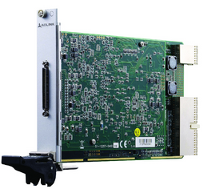
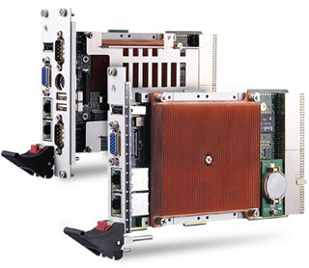
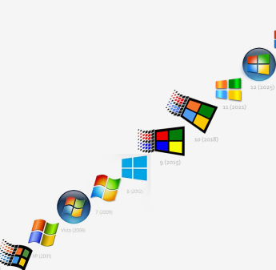
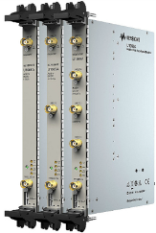
Obsolescence management
Strategy and Methodology to manage obsolescence
  Strategy and principle
    Functionnal segmentation of the control achitecture, allowing changes without breaking the service
    Continuous monitoring of the technology evolution in relation with supplyer
    Continuous monitoring of electronic devices aging over CMMS, HW or SW interface.
    Incidents tracking on control equipments over CMMS
    Maintaining high level performances fully compatible with TANGO Control System
Exemple applied to cPCI CPU
Project to have an homogenous install base.
Studying new DAQ
architecure and technology
Managing CPU
changing
Managing windows
Drivers upgrade
CPU
Innova (W2000)
Obsolescence
Adlink (Win XP)
Obsolescence
Kontron (Win 7)
Win 2000
Support
ending
Win 2000
Windows
Win XP
Support
ending
Win XP
Win 7
Support ending: 2020
Time
2003
2006
2008
2010
2012
2013
2015
2016
Notes:
Exemple for Control System
- Continous process :
A replacement is defined without waiting for a failure
Obsolescence management is made at different levels (hardware but also software)
Now : break with the technological solutions

Slide 15
Overview
SOLEIL in key figures
SOLEIL Maintenance Management System
From a Maintenance Management System towards a Maintenance Policy:
    Inventory review of maintenance practices in SOLEIL facility
    CMMS optimisation
    Single portal development (G. Abeillé)
    Set up of an handling trouble process (or Incident management process) (G. Abeillé)
    Criticality matrix ( C. Nicolas)
Prospects
Notes:
The issues concerning the development of a single portal, the set up of an handling trouble process and the Criticality matrix will be deepened in dedicated presentations, made by my colleagues.
Critically matrix : allows cross referencing between data…

Slide 16
Inventory of maintenance practices
Objectives :
  To have a global and homogeneous view of all our maintenance practices.
  To think about a maintenance policy.
Implementation :
  In 2016/2017.
  Made by an apprentice with several representative groups (Engineering and experimental groups).
Main conclusions :
  High level of expertise and involvement. But also :
  Not enough preventive maintenance compared to corrective maintenance.
  Lack of knowledge within the groups of the impact of the failure of equipment on
  other equipment.
  Lack of indicators.
  High number of tools.
  Risks of a subcontracting policy.
  Difficulties in establishing a global maintenance budget.
  Need improvements to get in inventories and spare parts management.
Notes:
The double objectives for the inventory :
To have a global and homogeneous vision of all the arrangements put in place, which was not always easy (remember that each group defines and leds its own maintenance policy).
To think about a maintenance policy means : to promote (favoriser) corrective maintenance or preventive maintenance ? How to write maintenance plans ? How to define responsibilities ? (between the equipement responsables, the middle management, the “coordinators”, the clusters leaders ?…) ? How to define a subcontracting policy ? How to elaborate the maintenance budget ? How to choose tools ?
Conclusions :
- The professionalism of the groups: they are experts wih many skills even if the maintenance activities are not always very organized...

Slide 17
Replacement of several request management tools
with a single portal
(2015)
CMMS and Bug tracker widely used by support teams
Notes:
At SOLEIL, several tools are used to register requests: CMMS, Bug Tracker and a logbook.
In this slide, you can see that the IT Department uses two main tools, equivalently.
On the opposite, the Machine Department uses 3 tools, and mainly the logbook, which is not exactly the right tool (it is not a data base), but it’s a user friendly tool. The logbook is also used by the Science Division.
That’s the first difficulty: what kind of tool using.
In order to make homogeneous practices, a dedicated working group has been set up to define the interface between CMMS and the bug tracker (JIRA).
JIRA has been chosen as a unique tool for requests

Slide 18
CMMS optimisation : the software
Full web version MAINTI4® made by TRIBOFILM
    https://www.tribofilm.fr
- Web solution implemented in june 2018
- Mobile technologies :
- Barcode reader
- Android Application
- Quick navigation with any type of device : tablets, smartphones
→Responsive design
- Web services
→ Time saving
→ User friendly
Notes:
The web solution is more adapted to suit the resquests

Slide 19
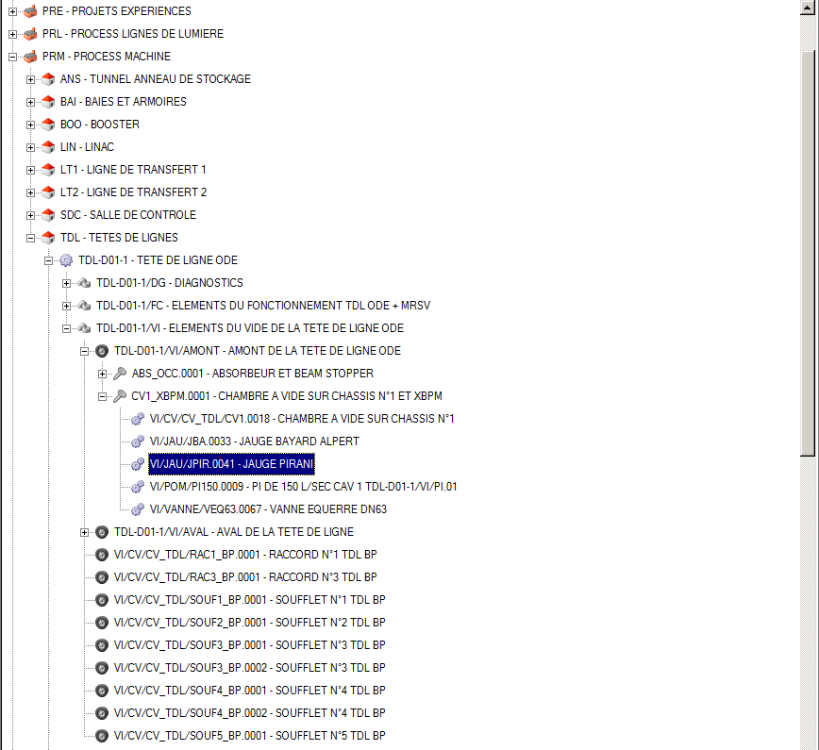
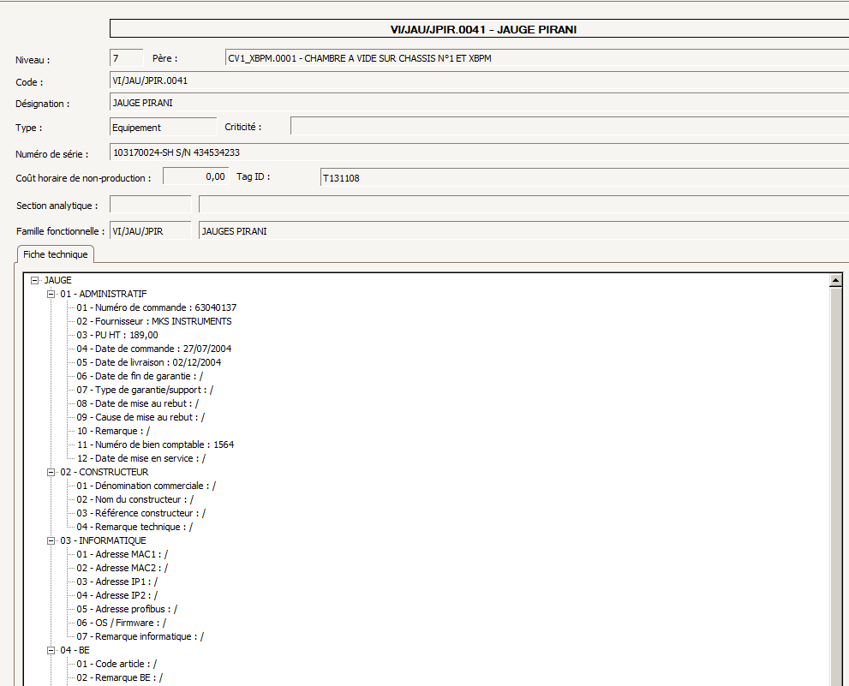
CMMS optimization : visual presentation
Geographical class:

Slide 20
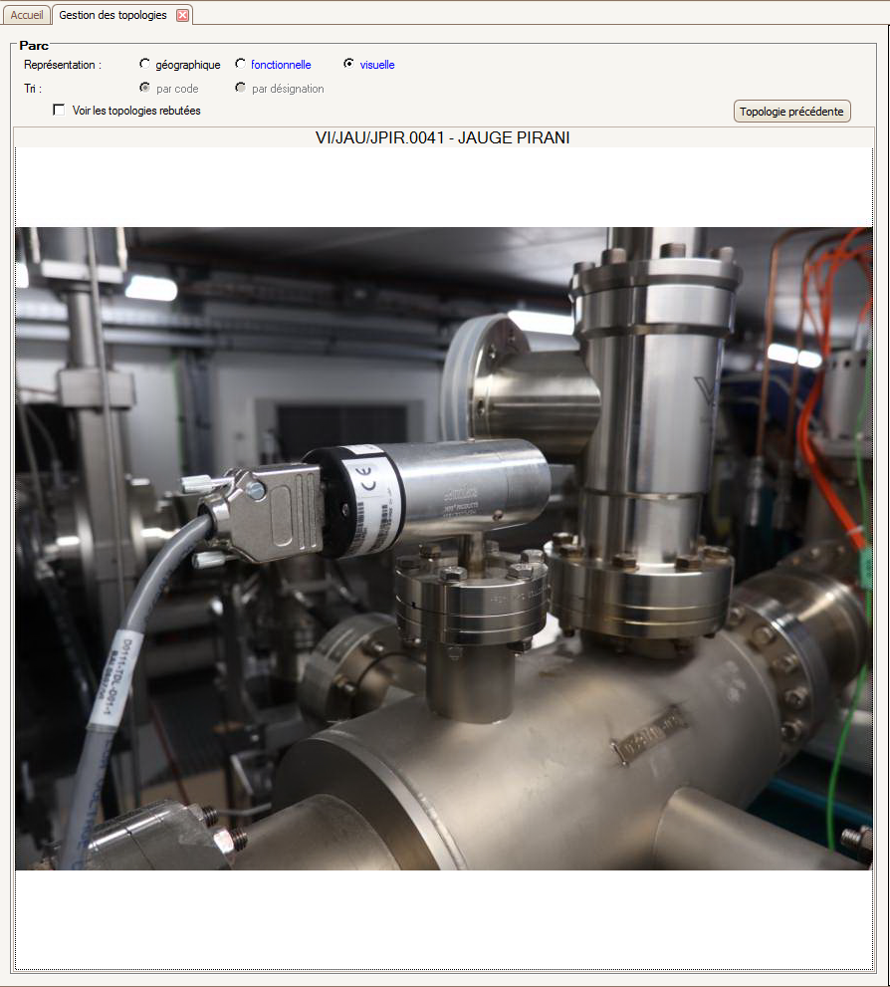
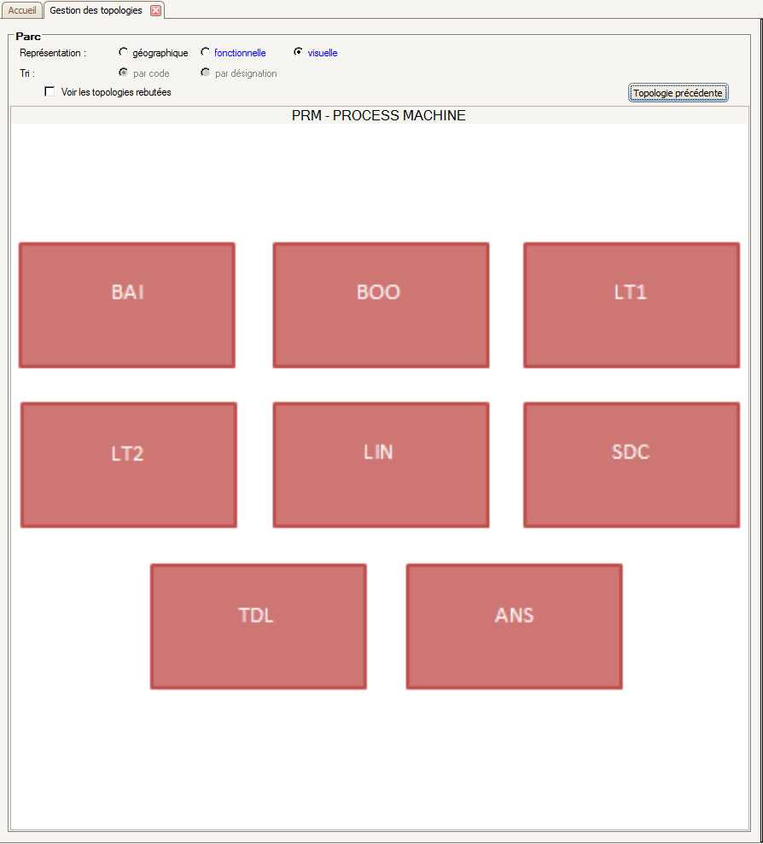
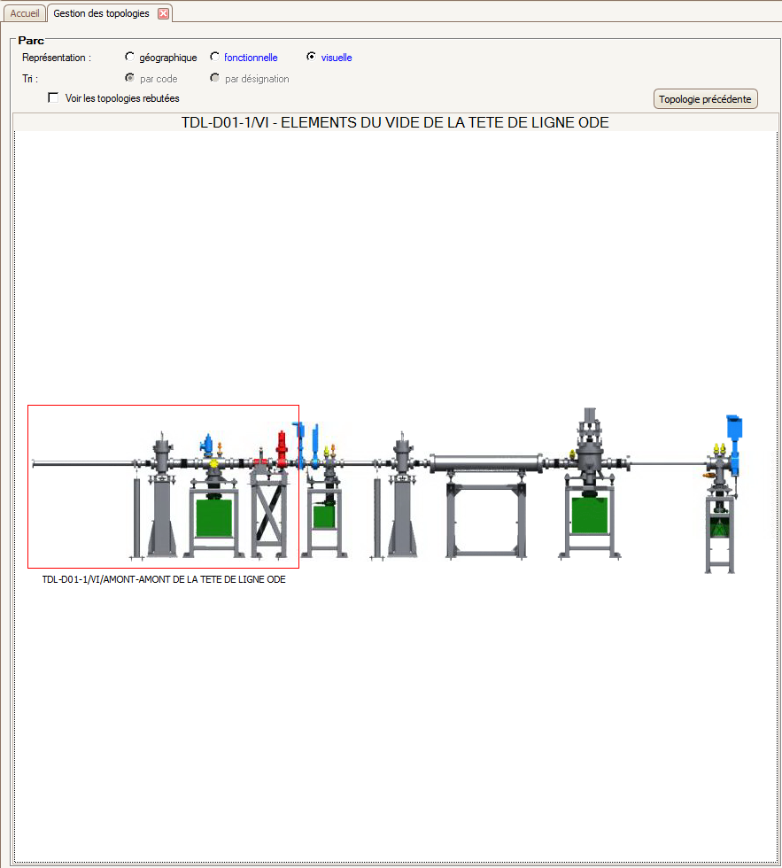
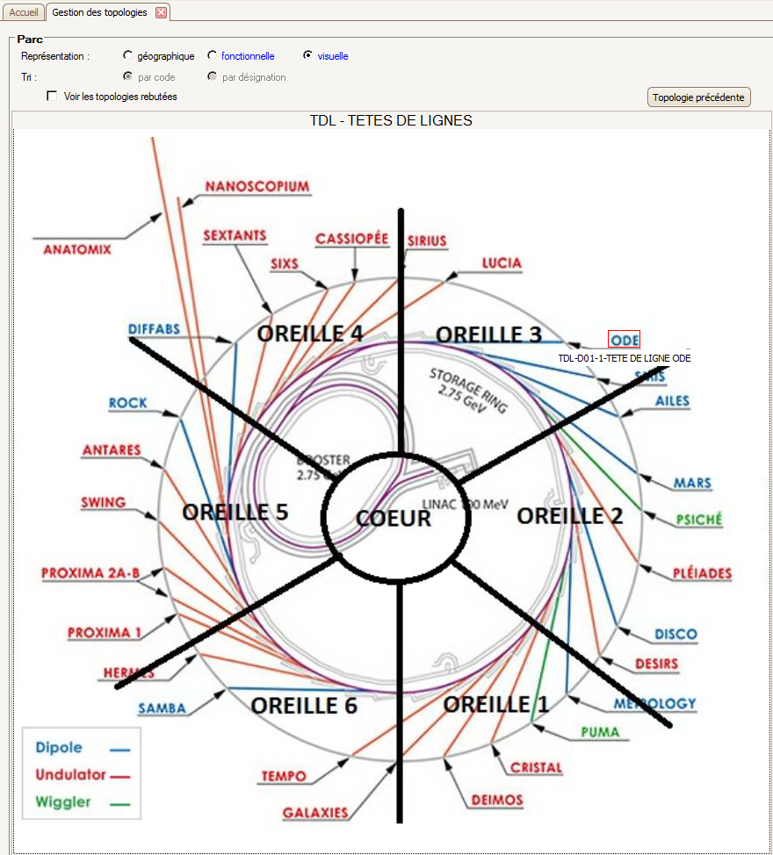
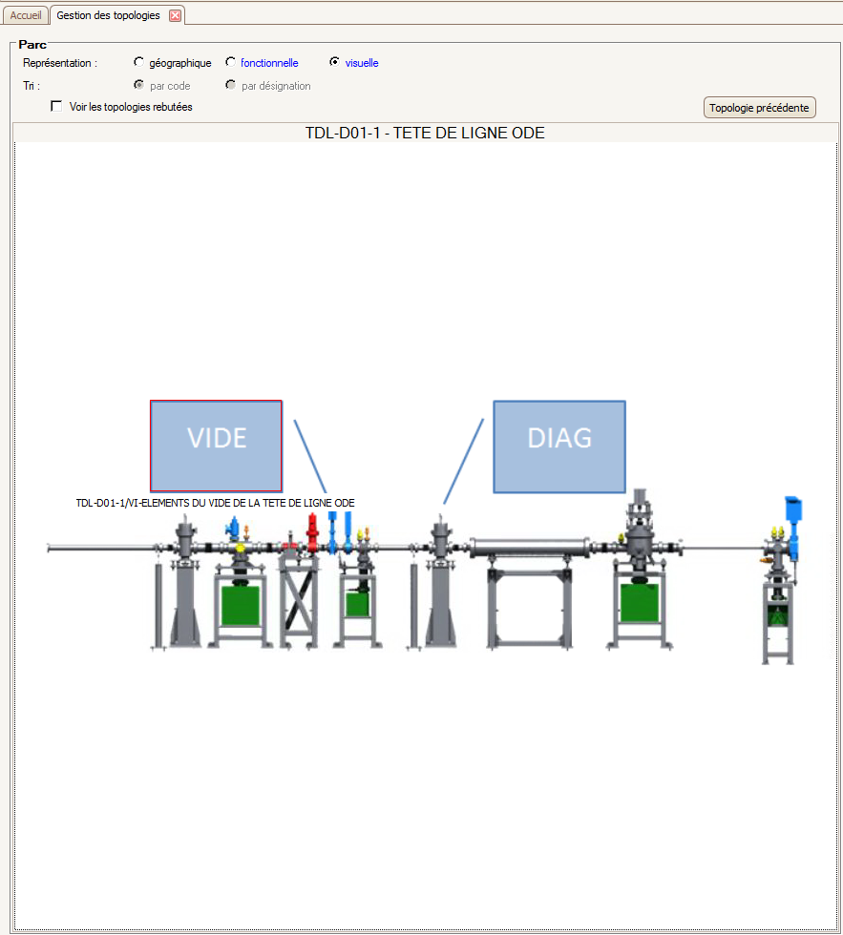
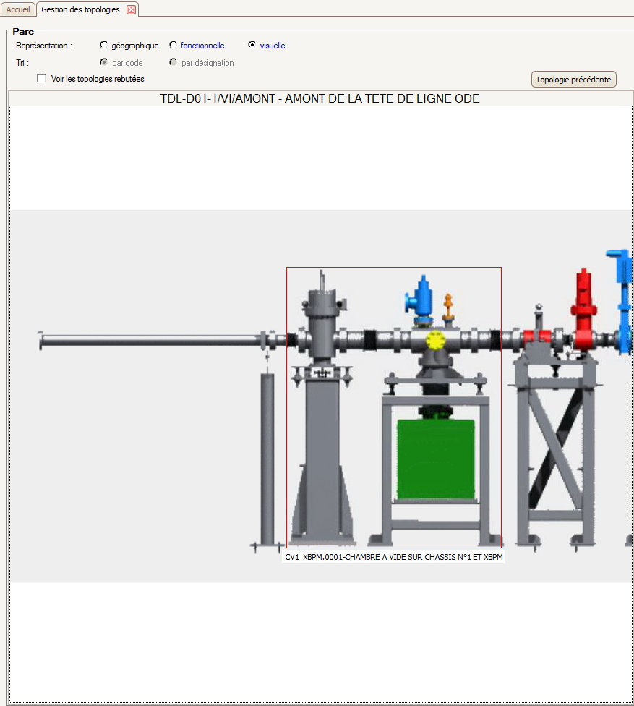
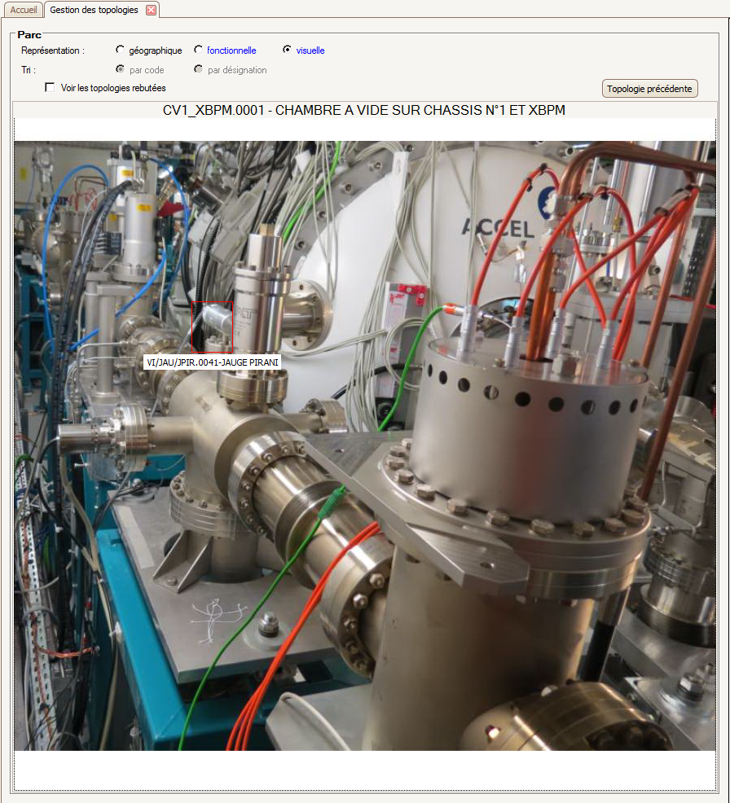
Visual presentation
Visual class
Notes:
The functionality is not yet implemented in the new version.
You need drawings, “areas” and photos.
The advantage is: a more user-friendly way to go through the “branches” (topologies) and to find equipment.

Slide 21
Long road for changes
2003
CMMS implementation
2008-2010
Short-term contract employed to enter all Machine data in the CMMS tool
2011
1st edition of the WS
2012
CMMS was adjusted to allow a better understanding → codification of topologies was improved and simplified.
General quality survey. This has demonstrated:
    The requirement of Asset management tools.
    The necessity of having one single portal.
    The necessity of training people.
2013
Establishment of worksite function for each shutdown to centralize the work on the machine
Scientific Labs are starting to use CMMS for maintenance
2014
External audit on the CMMS to identify areas for improvement
2015
Starting of the single portal development
2016
Apprentice employed
2018
A second apprentice employed.
External audit to check the topologies and stock management.
Notes:
Long road and regular adjustments since the CMMS implementation
For instance :
- the codification of topologies was improved and simplified → Trees schifting in order to simplify geo topologies (push as far as possible “le niveau métier”, the expertise level).
- The worksite functionality (fonction “chantier”). Objective : to look for the interventions (technical actions) and reports made during the shutdowns →it didn’t work )
Difficulty : resistance to change . Cf audit de 2014
On a future installation (Upgrade), the goal is to start with a more optimized use of CMMS.
The idea is to get a good start by having feedbacks about our practices

Slide 22
Overview
SOLEIL in key figures
SOLEIL Maintenance Management System
From a Maintenance Management System towards a Maintenance Policy
Prospects

Slide 23
Prospects
With a new apprentice
Continue the development and implementation of criticality matrix on beamlines.
Write maintenance plans.
Contribute to the implementation of risk analysis for most important equipment.
Identify areas for improvement.
Carry on the definition of a Maintenance policy for the whole facility.
Think about optimizing maintenance costs.
Help in entering the data (equipment and technical sheets) in the CMMS tool.
With a new audit
Reviewing the trees / branches in CMMS : check equipment tagging to comply with the “Nomenclature” (the naming).
Training with the new version.
With the IT Groups
Set up the single portal
Objective:
Share common methods to implement indicators.
Know, for each asset the type of maintenance required, the availability of stock, the maximum time to recovery expected.
Notes:
Nomenclature : naming

Slide 24
Conclusion: a virtuous circle
Strategies
Objectives
Priorities
Maintenance policy
Process
(see above)
Maintenance management
Organisation
Schedule
Information system
Methods
…
Improvement Maintenance Management
User availibility rate
UPGRADE of the Synchrotron
Facility reliability
→ Excellence
Notes:
All these elements will contribute to define a Maintenance Policy for the whole synchrotron
On espère que toute cette exp va nous servir pour la prochaine machine : Integrate the maintenance issues at the very beginning of the « Upgrade » Project

Slide 25
Thank you for your attention

Slide 26
Infractuctures & Building Group : maintenance management workflow
1
Définition des activités de maintenance : type de maintenance, ressources estimées,…
2
Planification du travail : liste ordonnée du travail
3
Programmation du travail : date de début et fin, affectation des ressources
4
5
Emission et attribution du Bon de Travail
Exécution du travail
6
7
Clôture du Bon de travail
Production de rapports
8
Analyse de rapports

