Slide 1
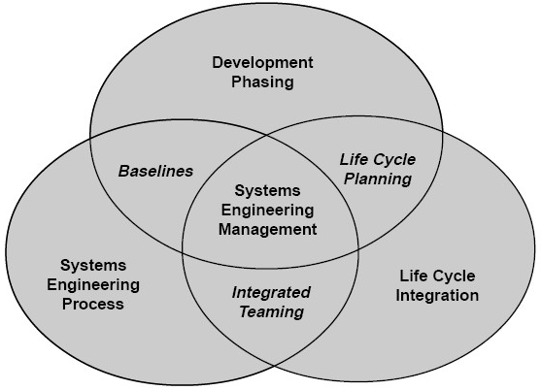
Requirements Control Process (RCP)
Event: AMMW2018 – 4th Assets Maintenance and
Management Workshop
Authors:
Viktor Fedosov – SE and Planning Group Leader; Quality Manager
Aleksei Kuzmenko – Systems Engineer
Organization: Institute of Physics AV CR, v. v. i./ ELI Beamlines Facility

Slide 2
Outline
ELI Beamlines Project Introduction
  ELI project overview
  ELI Beamlines Facility scheme
  ELI Beamlines Facility structure
ELI Beamlines PLM platform
  ELI PLM challenges & solutions – TEAMCENTER
  Tools in use associated with PLM
ELI Requirements Control Process (RCP)
  Overview of ELI RCP
  Project management documentation – ELI RCP directive
  ELI RCP basic principles
  Examples of ELI RCP documentations
  ELI Verification Process in RCP - Planning & Execution
  RCP statistics

Slide 3

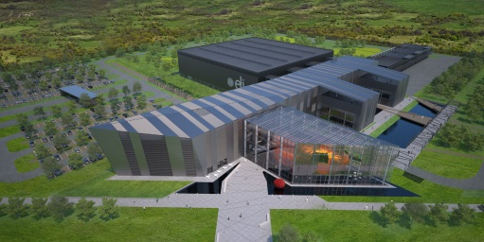
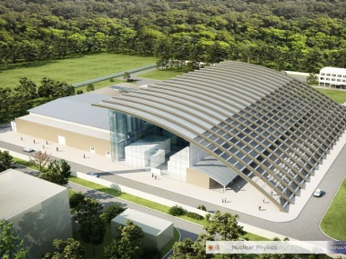
ELI project(s)
ELI - Extreme Light Infrastructure
ELI Beamlines is part of a European plan to build a new generation of large research facilities selected by the European Strategy Forum for Research Infrastructures (ESFRI).
3 PILLARS
ELI Beamlines (Czech Republic) - Study of laser technologies and secondary sources
ELI ALPS (Hungary) - Attosecond Light Pulse Source
ELI NP (Romania) - Nuclear Physics

Slide 4
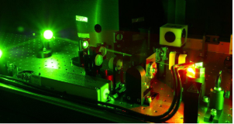
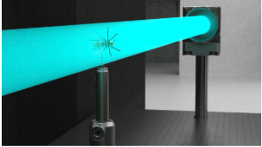

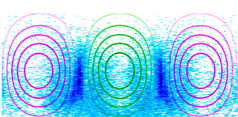




ELI Beamlines project (nearby Prague, the Czech Republic)
Research
Laser Technology - development of new laser technologies
X-Ray Sources driven by Ultrashort Laser Pulses
Particle Acceleration by Lasers
Plasma and High Energy Density Physics
Secondary sources for interdisciplinary applications in physics medicine, biology and material sciences
Ultrahigh Intensity Interactions
Theoretical physics and simulations by using ELI Beamlines Cluster

Slide 5
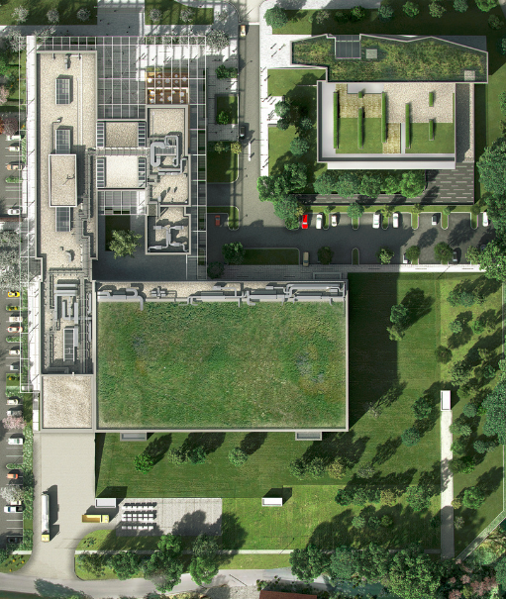
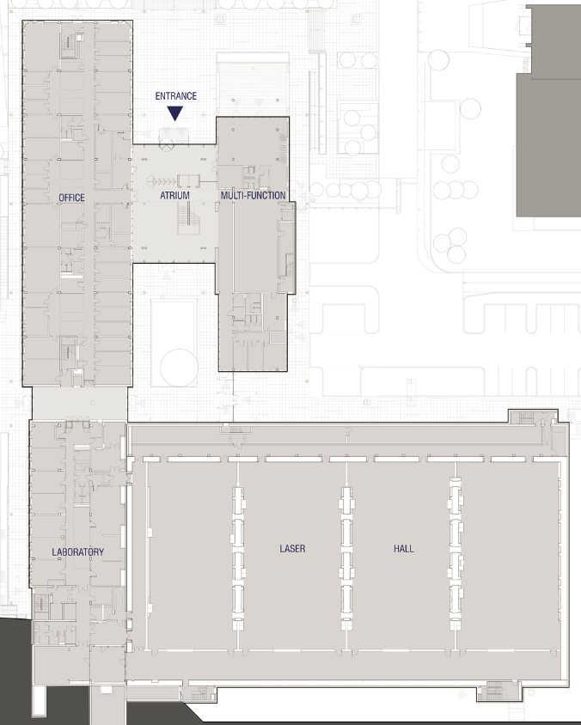


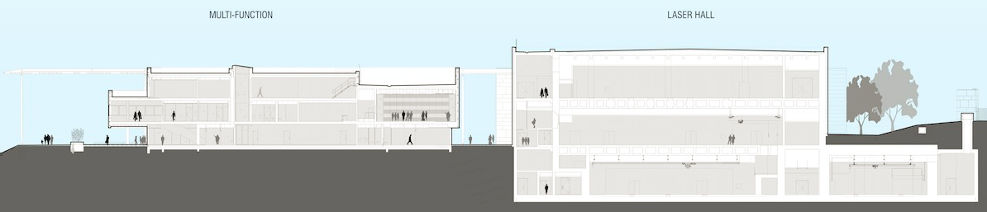
ELI Beamlines Facility

Slide 6
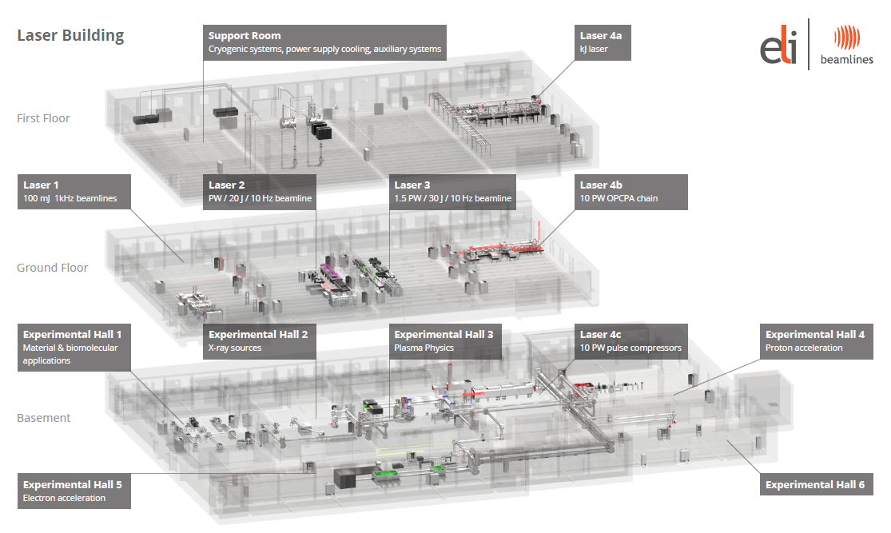
ELI Beamlines Facility
Technology & Building & Team Structure
LASER TECHNOLOGY
LASER TECHNOLOGY
BEAM TRANSPORT
CONTROL SYSTEMS
STAKEHOLDERS
REQUIREMENTS AUTHORS
EXPERIMENTAL TECHNOLOGY
BEAM TRANSPORT
CONTROL SYSTEMS
ENGINEERING
SYSTEMS ENGINEERS
REQUIREMENTS ADMINISTRATORS
EXPERIMENTAL TECHNOLOGY

Slide 7
ELI Beamlines PLM platform – TEAMCENTER
Challenges & Solutions
ELI Beamlines – scientific project (mainly for fundamental research)
Challenges
Specifics of R&D environment - different from business and industry standards
Turbulent processes of development in world of science
3D CAD is not fully established as a common tool
Negative attitude to database as the primary source of information
Difficulties with implementation of systems engineering standards
Need for project management tools
Solutions
Not only document management tool, looking for PLM platform (relational database) with maximum of additional functionalities
Flexible tool easy to use, Possibility of revisions, Workflow processes
Graphical interface for all members of ELI team (all in one SW, mainly 2D drawings and 3D models)
MultiCAD environment
Re-engineering of ELI Building
Systems engineering environment
Project management tool allowing access to relevant existing project data (including scheduling and reporting)

Slide 8
ELI Beamlines PLM platform – TEAMCENTER
Tools in use
Document & Data management
System managing all project data on ELI Beamlines project (including technical and non-technical data; single source of information)
Connected to CAD Management Functionalities
User and access rights management
TC database objects (including document) statuses –level of relevancy
MS Office (word, excel, power point) integration with TC
Workflow & Processes
Technical and Project Documentation Review & Approval (Release) processes
Requirements Capturing, Review & Approval processes
Key user processes – Metrology, Nonconformance, Risk and change management processes
Job Request – Workflow process to manage tasks from scientific to engineering team
CAD Management
multiCAD environment – direct integration of 2 different ED CAD SW into TC
Workflows related to CAD management solution (Concept Released – part, assembly)
Autodesk Inventor (small 3D assemblies, low cost 3D CAD SW)
NX (huge 3D assemblies, e.g. Building and Laser technology, high degree of 3D SW stability)
TC Visualization (2D & 3D)
Link to Job Request process
Systems Engineering tool
Requirements management
Requirements Control Process
Active Workspace
User friendly thin client (web browser) for TC application
intended for all members of ELI Beamlines project team

Slide 9
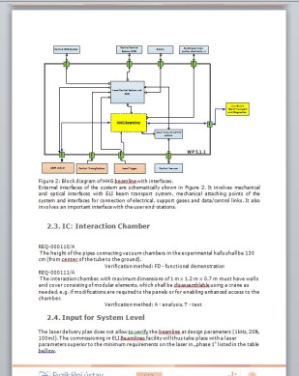
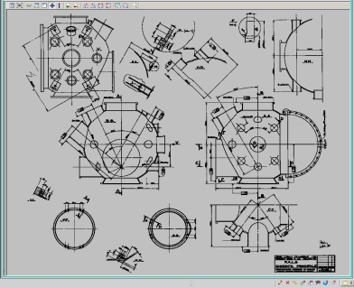
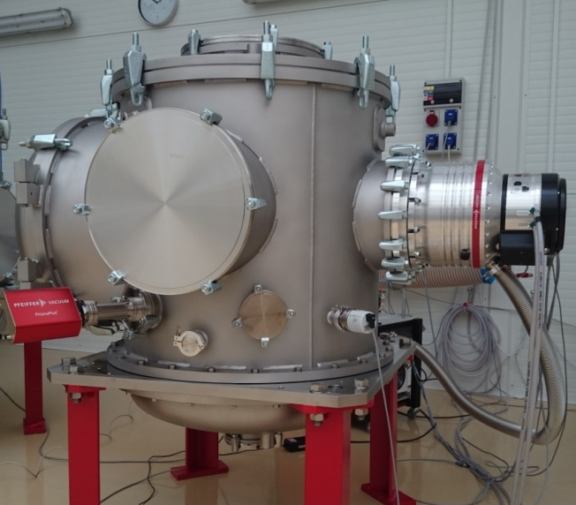
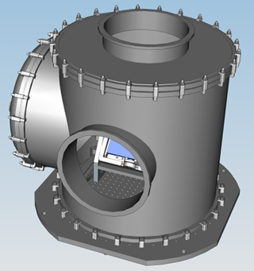
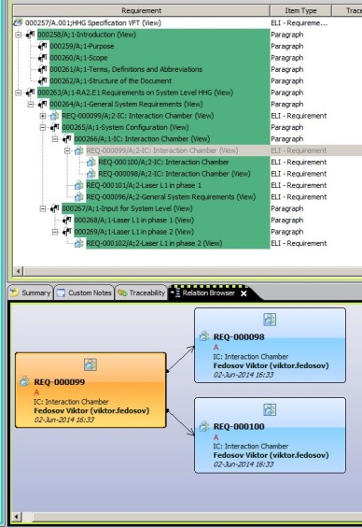
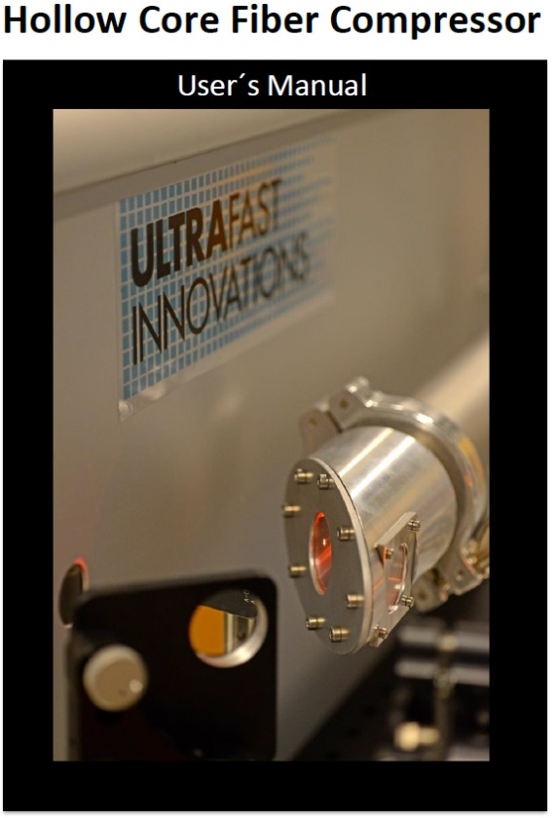
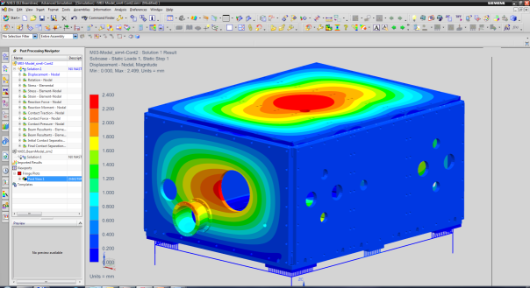
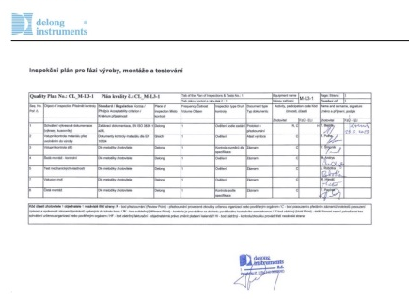
ELI Requirements Control Process (RCP)
Why do we need RCP?
USER EXPECTATIONS,
REQUIREMENTS
DESIGN, DEVELOPMENT
MANUFACTURING
DELIVERY,
OPERATION
RCP
is intended to establish processes for control of lifecycle of all ELI requirements
covers capturing, documenting, reviewing, issuing, baselining, monitoring and control of requirements for each science-based technology and their verification in line with a technology lifecycle
provides traceability between the various technologies and documentation levels
ensures safe storage and backup of all information in the project database
allows stakeholders to recognize deliverables, to share information and experience
excludes duplication of information

Slide 10
Overview of ELI RCP
TIME-SAVING
STATUS REPORTING
DATA & DOCUMENTS CONTROL
INFORMATION ACROSS ELI TEAM
LEVEL OF RELEVANCY
Requirements Control Process
CONCEPT
FUNCTIONAL
&
PERFORMANCE
REQUIREMENTS
TECHNICAL SPECIFICATION
=
RSD
Requirements Specification Document
ACCEPTANCE
VERIFICATION
START WITH FACILITY OPERATION
INTEGRATION
CAPTURING REQUIREMENTS
VALIDATION
COMMISSIONNING
BEST PRACTICE & LESSONS LEARNED APPROACH
SHARING EXPERIENCE
REQUIREMENTS CATEGORIES AND STANDARDIZATION
FORMAL REVIEW & APPROVAL PROCESS
RSD BASED ON DATABASE STRUCTURE
(relations, predefined outputs)

Slide 11
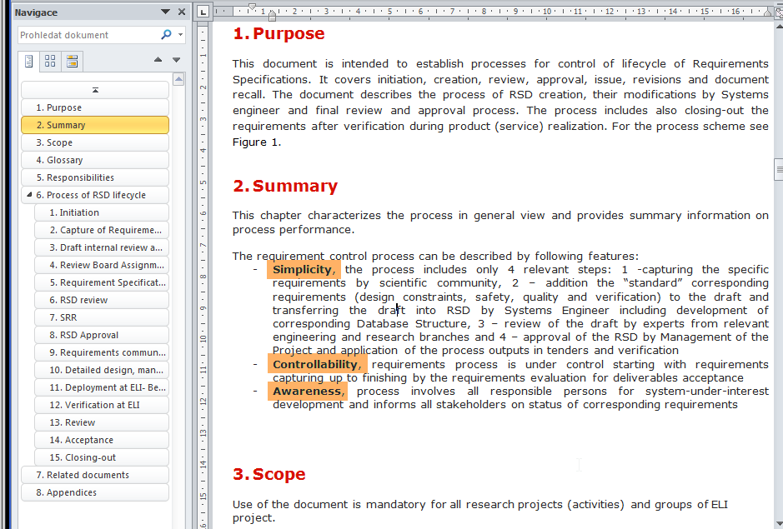
Requirements Control Directive S28 - TC ID 00106311/A
TC ID (00106311) A - S28 Requirements Control
  Guiding Principles
  SIMPLICITY
  CONTROLLABILITY
  AWARENESS
Not new or unknown process!
  We just do it:
  Better,
  Quicker,
  And in the common way

Slide 12
Process Summary of RCP (4 steps)
STEP №1
FUNCTIONAL & PERFORMANCE & SPECIFIC REQUIREMENTS
STAKEHOLDER
(OWNER)
capturing the specific requirements by scientific community
STEP №2
ADDITION OF “STANDARD” CORRESPONDING REQUIREMENTS
STAKEHOLDER
(OWNER)
design constraints, safety, quality and verification to the draft and transferring the draft into RSD by Systems Engineer including development of corresponding Database Structure
SYSTEMS
ENGINEER
STEP №3
REVIEW OF THE RSD DRAFT BY EXPERTS
STAKEHOLDER
(OWNER)
experts from relevant engineering and research groups
SYSTEMS
ENGINEER
APPROVAL OF THE RSD BY APPROVAL AUTHORITY
STEP №4
Approval & Application of the process outputs in tenders and verification

Slide 13
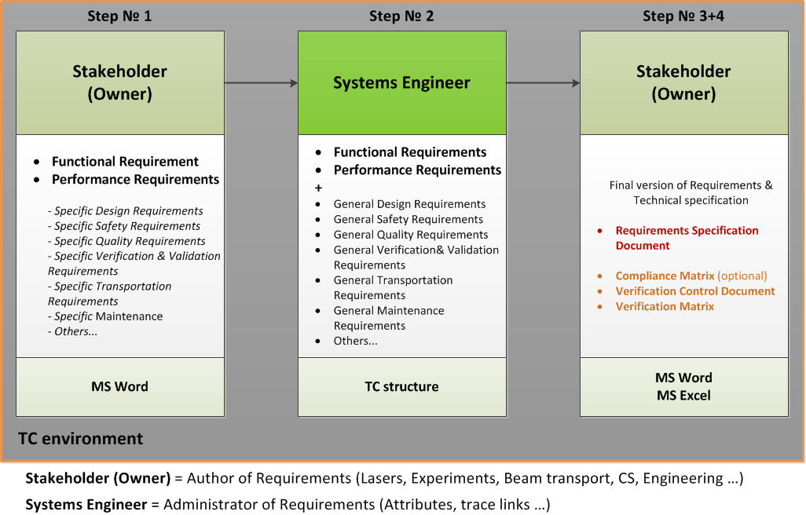
Requirements Collection – basic scheme

Slide 14
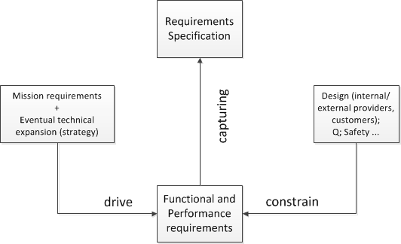
Requirements Capturing & Collection
General requirements describe the programme objectives (mission profile), architecture of the system and it location in the technology building, and sets main specifications in relation to the system operation.
Functional requirements specify the necessary tasks, functions and actions to conform the programme statement (mission objectives).
Performance requirements define the extent to which a mission or function must be executed; generally measured in terms of quantity, quality, coverage, timeliness or readiness.
Operational requirements include operational profiles and events to which the system shall respond (e.g. autonomy, control and contingency, preparation of experiment, experiment execution and etc.).

Slide 15
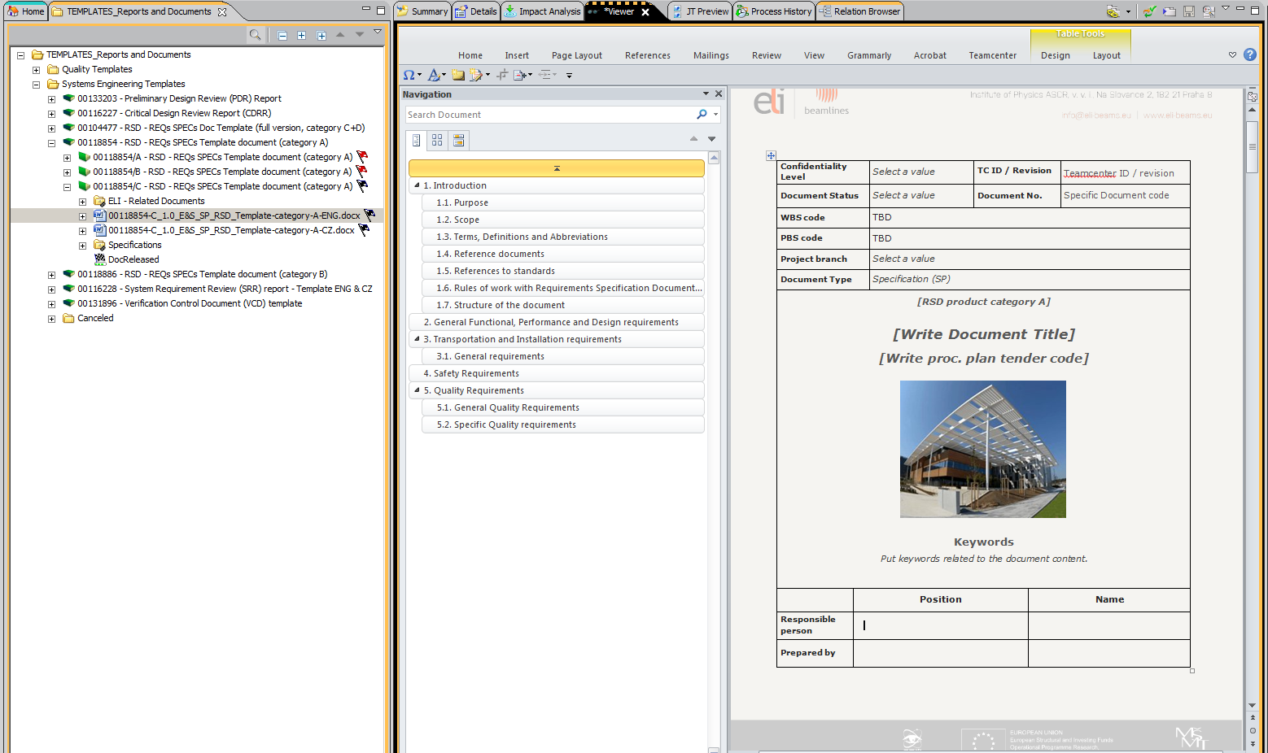
Requirement Specification Document (RSD)
Template – TC ID 00104477
All types of ELI project documentation templates, including RSD templates for different categories of products, are available in the TC.
Stakeholder’s (owner’s) RSD draft the first of all should contain such requirements as: functional, performance and specific ones.

Slide 16
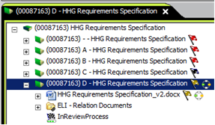
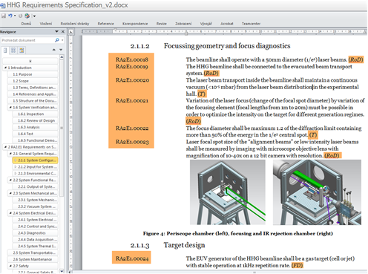
RCP: Capturing Requirements (step №1)
Stakeholder’s (owner’s) RSD draft the first of all should contain such requirements as: FUNCTIONAL, PERFORMANCE AND SPECIFIC ONES.
  Using RSD Templates
Enables Sharing experience
Enables standardization of selected requirements
Allows time-saving on the side of stakeholder (reqs. owner) as well on the side of SE (Systems Engineer)
Allows systems engineering approach
Enables simple and quick upload into Database Structure
STAKEHOLDER
(OWNER) INPUT

Slide 17
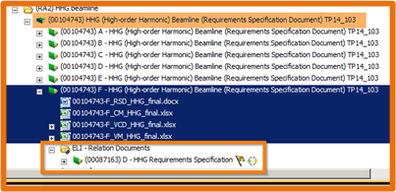
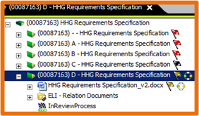
Adding of General Requirements + Upload into Database Structure (step № 2)
SYSTEMS ENGINEER (SE) JOB:
Editor (not owner!) of RSD
Addition of general requirements
Ensuring formal review of draft (such as engineering wording)
Ensuring appointment and coordination of review board
Import of RSD into Database Structure
Creating and maintaining of documentation supporting verification process
SE OUTPUT
STAKEHOLDER
(OWNER) INPUT
SE OUTPUT

Slide 18
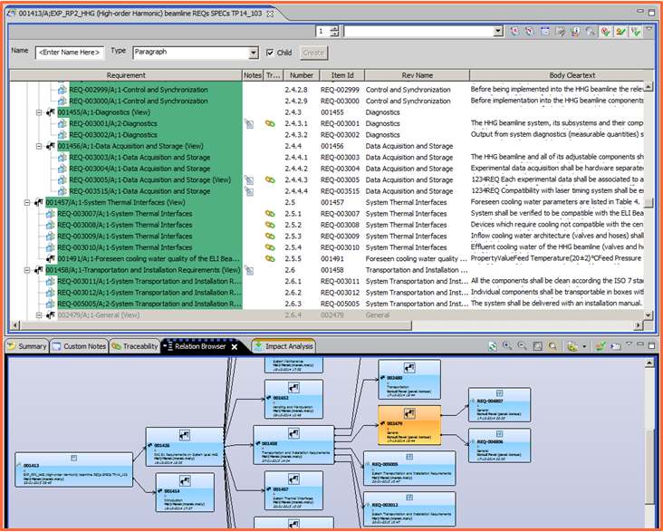
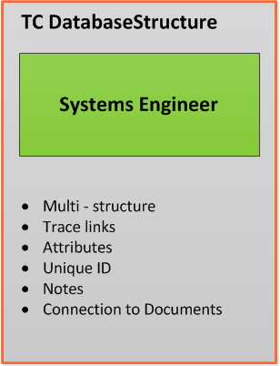
Adding requirements + Upload into Database Structure (step №2)

Slide 19
RCP: Standard requirements and their categories
Use of standardized general requirements
simplify the communication between technical (scientists, engineers, installation) and non-technical team members (quality, safety, legal, transport & installation, procurement)
Enable time-saving when issuing RSD (technical specs for tender)
Category A - Catalog product
Off-the-shelf product without any modification
E.g.: Oscillator, commercially available optomechanics or optics, etc.
Category B - Catalog product with defined level of customization (e.g., product performance) that does not require any design modifications.
E.g.: Customized detectors, gratings and others…
Category C - Customized Product is based on existing design which could be adapted to ELI conditions/requirements.
E.g.: HHG, UHV chambers, OAP mirrors
Category D - Completely new Product
Product must be designed and manufactured according to ELI Beamlines RSD and conceptual design.
E.g.: L1, BDS, L3, L4 systems

Slide 20
RCP Directive: Roles assignment Matrix
Review Board members (“Reviewer”) & Approval Authority (“Approver”) | Disciplines | Role in Requirements Process | role in ELI BL organization | Reviewer Nominated by
Approval authority | laser, experiment, beam distribution | Approver | Chief Scientist RA1 or RA2-6 or Chief Engineer | mandatory assigned as approver
Stakeholder(s) | laser, experiment, beam distribution | Reviewer | Scientists and Lead Scientists (research team leaders) | Chief Scientist RA1 and RA2-6 and Chief Engineer
Engineering disciplines | electrical, mechanical, optomechanical, vacuum, technology/ manufacturing | Reviewer | Engineering Team - Group Leaders | Chief Engineer
 | alignment, optics, electronics, control systems (SW/HW) | Reviewer | Beam Distribution Control Systems Team - Group & Team Leaders | Beam Distribution Control Systems Manager
Building | Building | Reviewer | Building team manager | mandatory assigned
Safety | Safety | Reviewer | Safety Manager | mandatory assigned
Quality | Quality | Reviewer | Quality Manager | mandatory assigned
Installation & Integration | System deployment | Reviewer | Manager of Installation of Technology | mandatory assigned

Slide 21
Goals of Roles assignment
„RSD Review and Approval board “ matrix represents proposal of minimal effort that will:
Ensure RSD review by experts and stakeholders
Provide information of technical parameters about what will be procured across the team
Enable common experience leading to the maximum level of technical requirements standardization
Result in timesaving when preparing and issuing RSD
Represents the way hot ensure to RSD (in other words to technical specification for tender) the level of relevancy that is expected by Approval authority

Slide 22
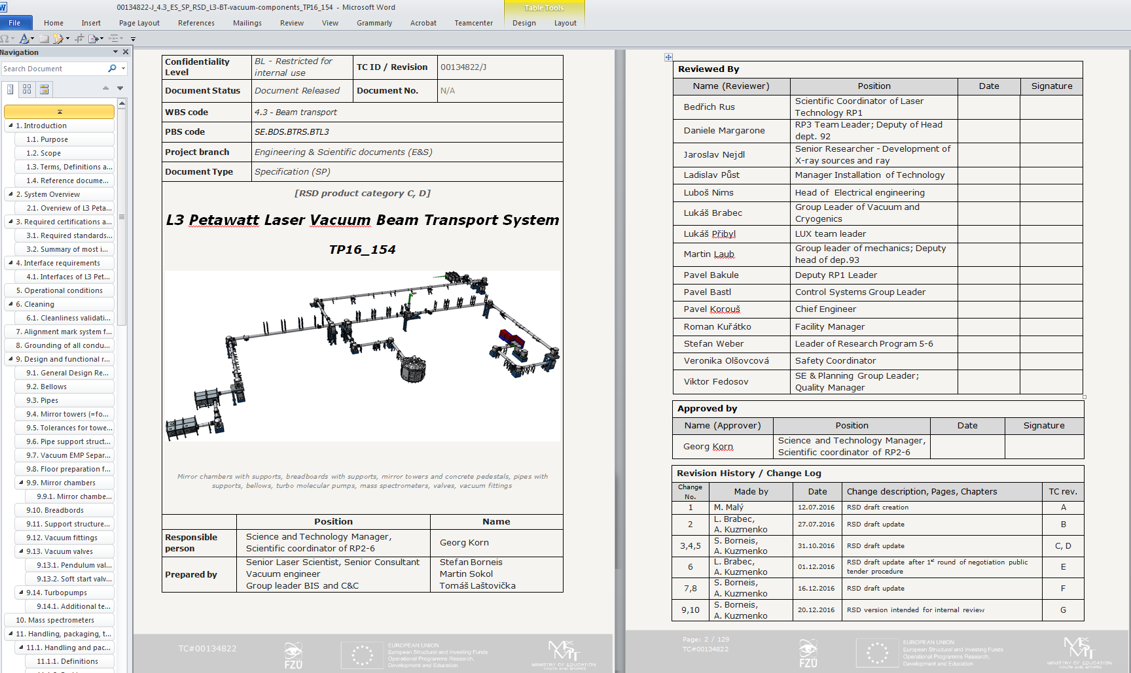
Requirements Control Documentation - RSD
RSD – Requirements Specification Document
RSD = set of Requirements, technical specifications for tender
RSD is mandatory attachment of the contract

Slide 23
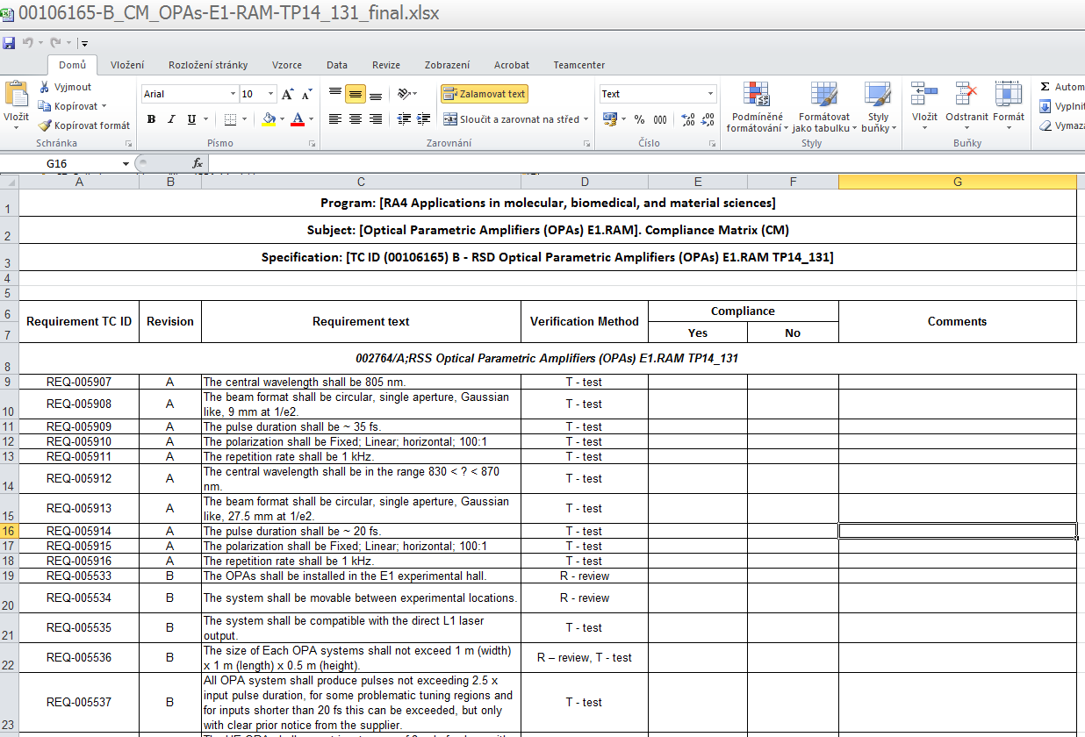
Requirements Control Documentation -
Compliance Matrix (CM)
Requirements text confirmation
– Negotiation procedure
Internal checklist of requirements, formal acceptance from supplier side
During negotiation procedure – CM represents a formal tool of communication between the potential suppliers and ELI side (official record); potential suppliers confirm compliance with presented requirements from ELI or potential suppliers can comment these requirements and make also the proposal of their modification during negotiation procedure.

Slide 24
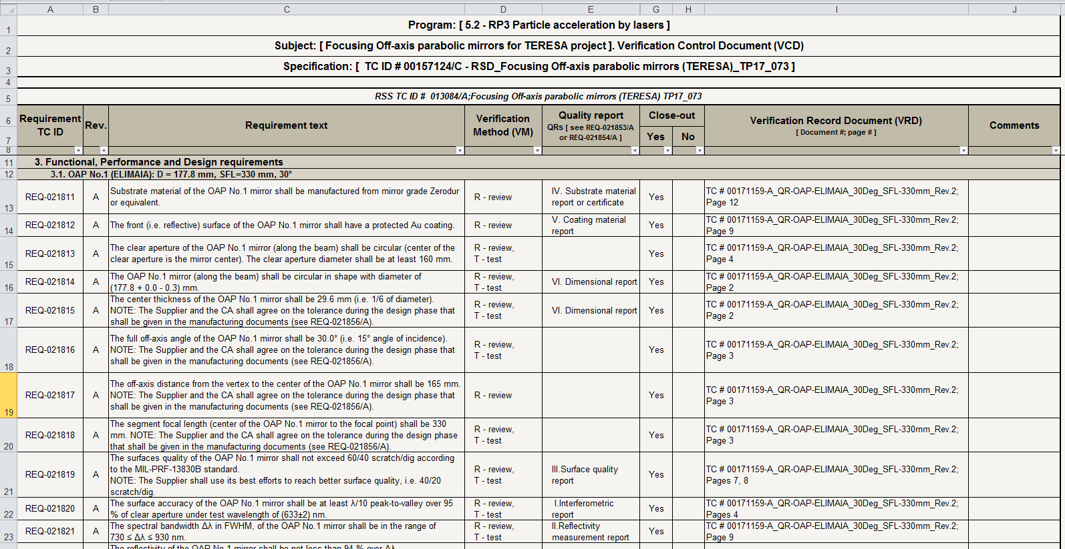
Requirements Control Documentation -
Verification Control Document (VCD)
Requirements status reporting
The VCD represents a formal tool of communication between the supplier and ELI side (official record) and is intended to report on requirements close-out status in different phases of the contract delivery (e.g. design, production, delivery, installation, verification & validation and etc.).
The VCD in simplified form can also be used as Verification Matrix (VM) that confirms use of selected verification methods related to the requirements and action takes place (at the latest) after signature of contract.

Slide 25
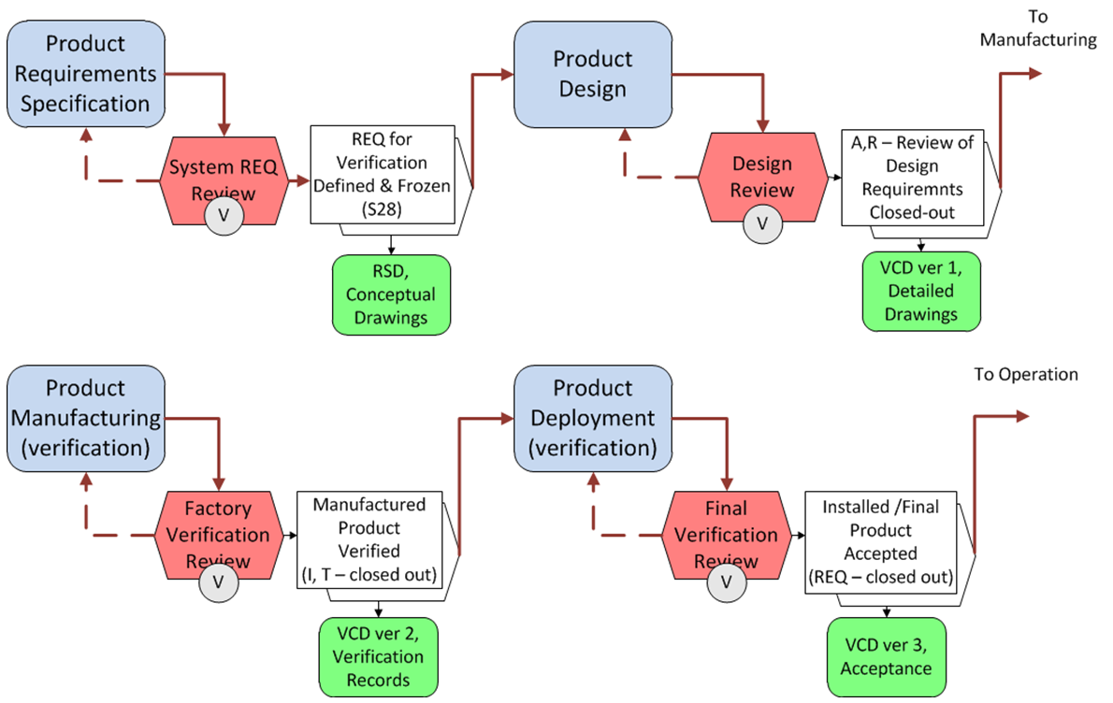
Part of simplified product life-cycle

Slide 26
RSDs preparation, according to the procurement plan

Slide 27
Thank you for your attention!
Viktor Fedosov Aleksei Kuzmenko
Leader of SE & Planning Group Systems Engineer of SE & Planning Group
Viktor.Fedosov@eli-beams.eu Aleksei.Kuzmenko@eli-beams.eu
+420 266 051 278 / +420 702 004 859 +420 266 051 347 / +420 607 087 720

