Slide 1
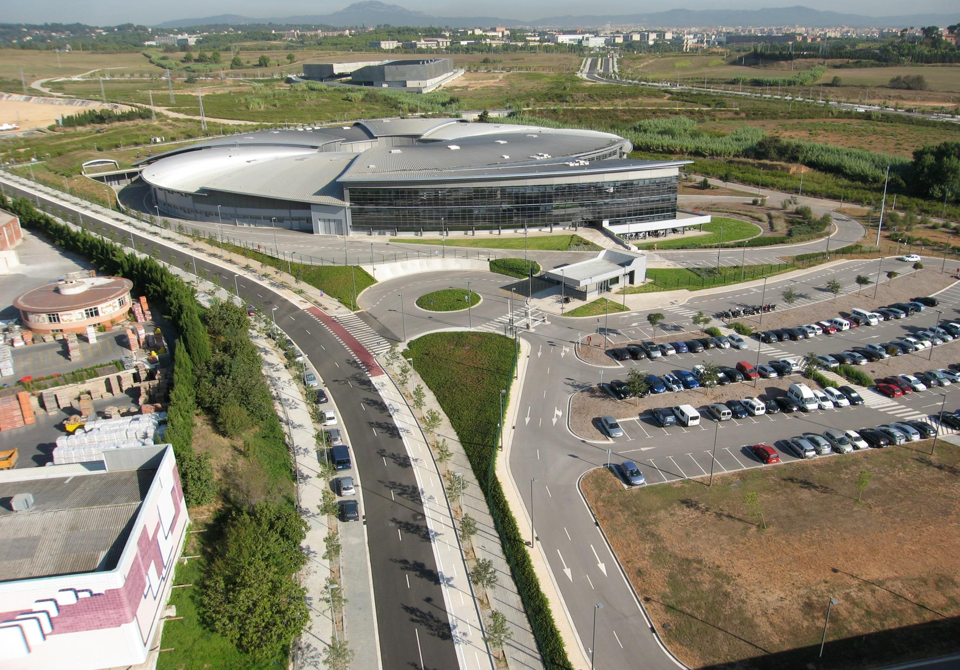
MAINTENANCE from the CONTROL ROOM
Montse Pont

Slide 2
Outline
Introduction to ALBA accelerators
ALBA operation & performance
Maintenance
Summary

Slide 3
Accelerators layout
Parameter | Value
Energy | 3 GeV
Circumference | 268.8 m
Emittance | 4.5 nm·rad
Current | 250 mA
RF frequency | 500 MHz
# cavities | 6
Long straights | 4 (8 m)
Medium straights | 12 (4 m)
LINAC
100 MeV
BOOSTER
100 MeV ->
3 GeV
STORAGE RING
3 GeV

Slide 4
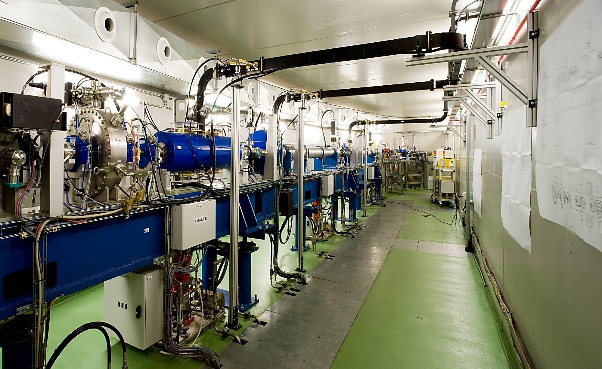
100 MeV LINAC
Linac
LINAC @ 100 MeV
Charge: 1 nC
Rep rate 3.125 Hz
Flexible e-gun: flexible filling patterns

Slide 5
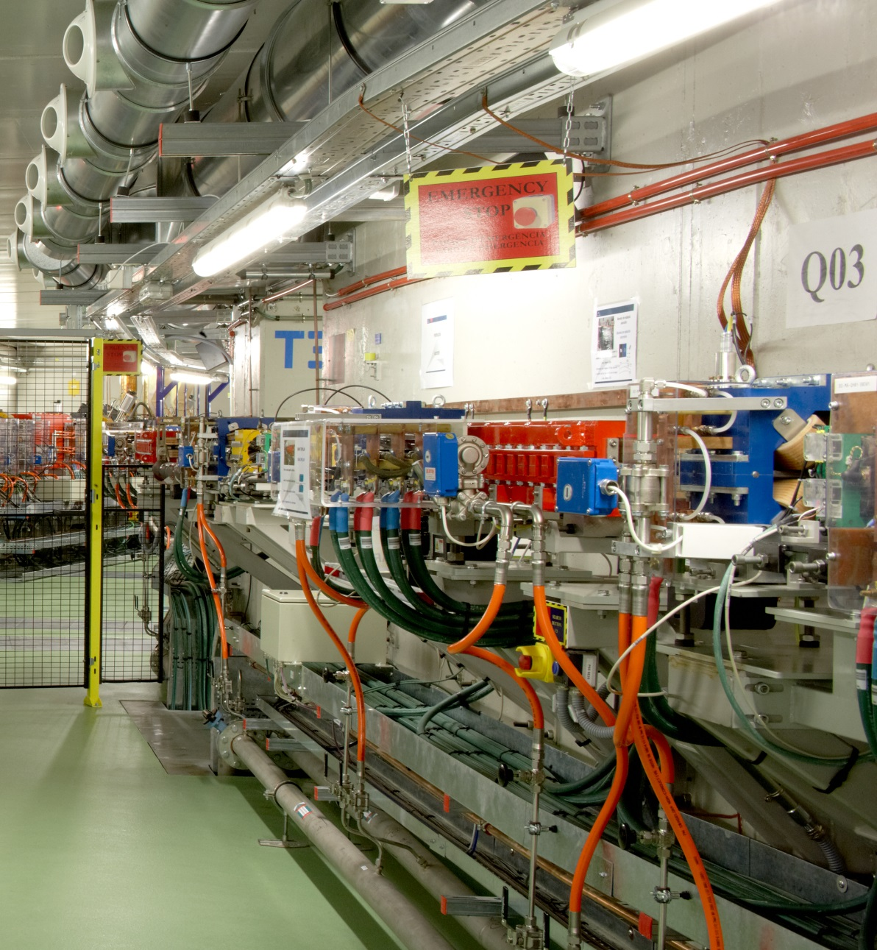
BOOSTER
Booster
Parameter | Value
Nominal inj E | 100 MeV
Minimum inj E | 60 MeV
Nominal ext E | 3 GeV
Circumference | 249.6 m
Emittance | 10 nm·rad
Nominal Current | 1 mA
Rf frequency | 500 MHz
# cavities | 1
In the same tunnel as the SR
Extraction

Slide 6
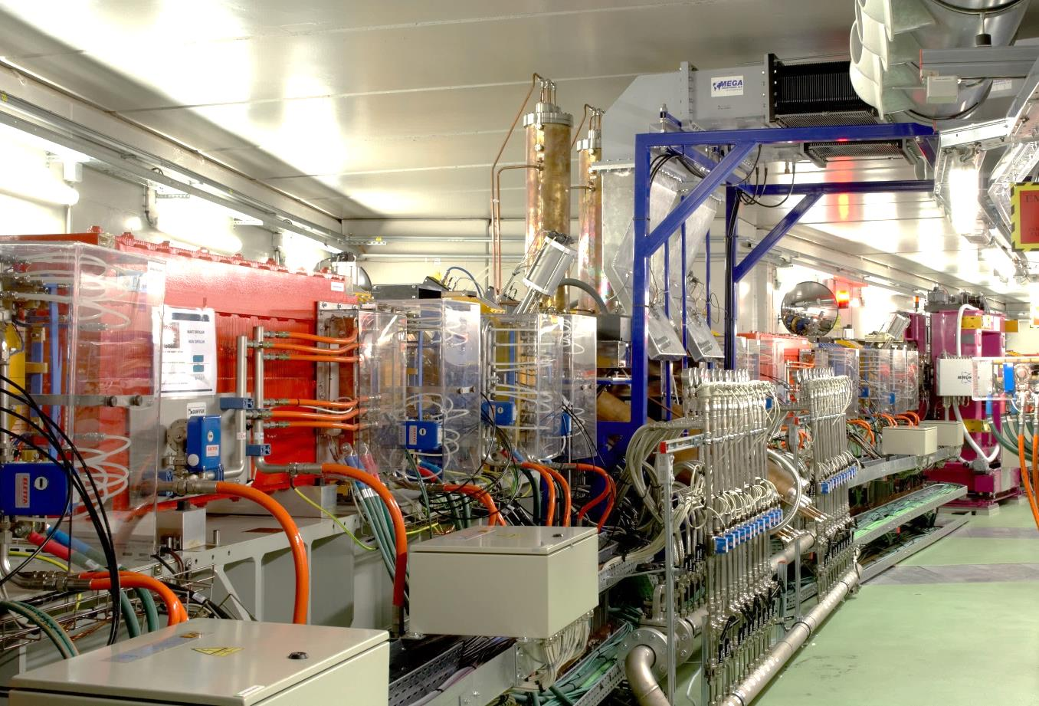
STORAGE RING
Storage Ring
Parameter | Value
Energy | 3 GeV
Circumference | 269.9 m
Emittance | 4.5 nm·rad
Nominal Current | 250 mA
Rf frequency | 500 MHz
# cavities | 6
Long straights | 4 (8 m)
Medium straights | 12 (4 m)
Short straights | 8 (2 m)

Slide 7
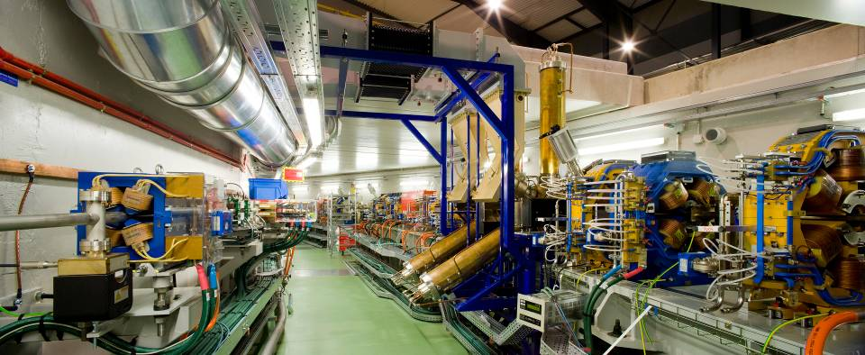
BO & SR
BO and SR share the same tunnel
Normal conducting magnets & cavities
2xIVU, 1xMPW, 1xSCW, 2xAPPLE-II, (1xAPPLE-II, 1xIVU, 1 x MPW)

Slide 8
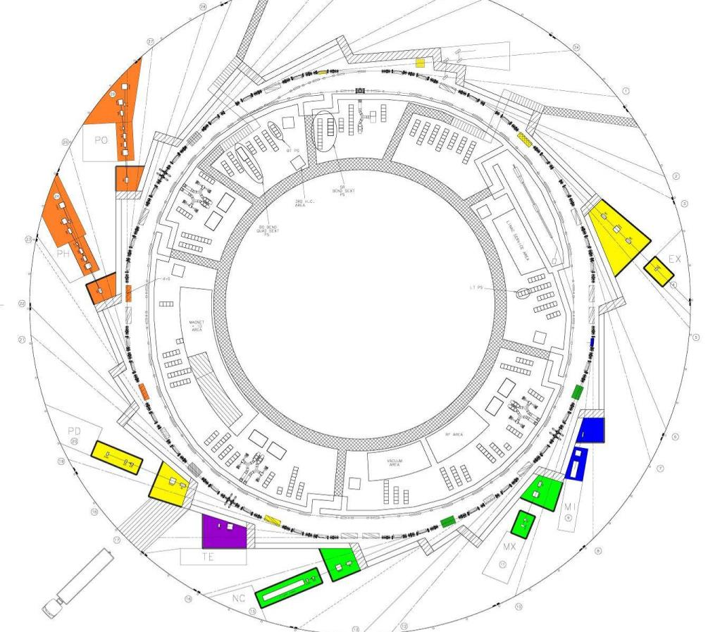
Beamlines
BL29: BOREAS
EU71– (0.08-3 keV)
Resonant Absorption
and Scattering
Bending: e⁻ Diagnostics
BL01: MIRAS
Bending – (0.4-100 µm)
IR Spectroscopy
BL24: CIRCE
EU62– (0.1-2 keV)
Photoemission
spectroscopies
BL04: MSPD
SCW31 – (8-50 keV)
HP/HR
Powder Diffraction
BLXX: FaxTor
ID: 3 pole wiggler
Hard x-ray tomography
In operation (8)
In construction (4)
BL06: XAIRA
IVUXX (~5-25 keV)
Macromolecular Cristallography
BL22: CLÆSS
MPW80– (2-63 keV)
Absorption &
Emission Spectroscopies
BL09: MISTRAL
Bending– (0.27-2.6 keV)
X ray Microscopy
BL20: LOREA
EU125 – (10-450 eV)
ARPES
BL11: NCD
IVU21– (6-13 keV)
Non Cristalline Diffraction
SAXS/WAXS
BL16: NOTOS
Bending
Metrology, XAS
BL13: XALOC
IVU21 – (5-22 keV)
Macromolecular Cristallography

Slide 9
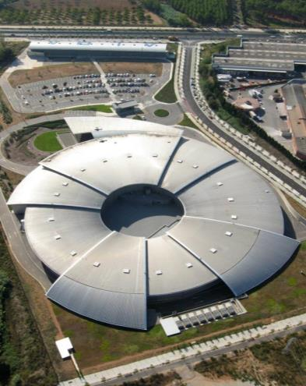
Operation
&
Performance

Slide 10
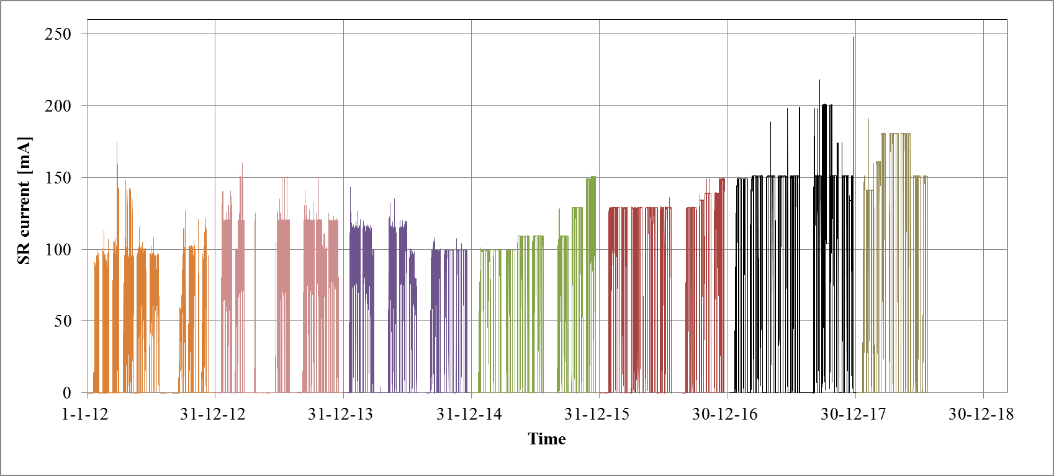
Beam current since 2012
I_{nom}

Slide 11
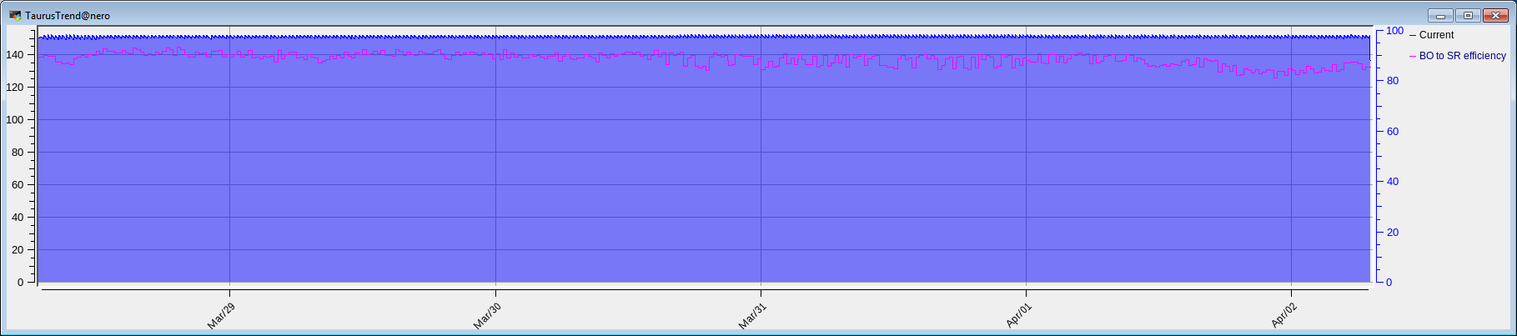
Top-up operation
Top-up operation since 2014
Re-injection every 20 min (ΔI = 2.0 %)
Injection efficiency around 90%
Gating to blank injections is available. IR BL uses it

Slide 12
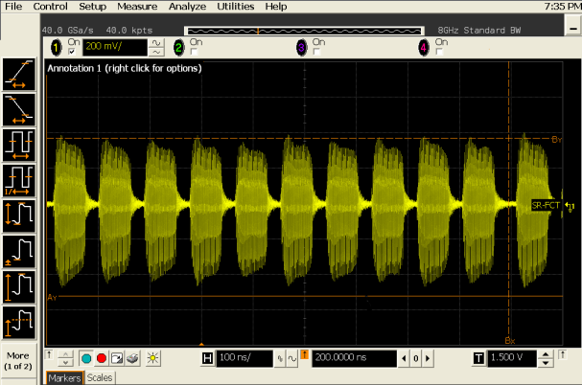
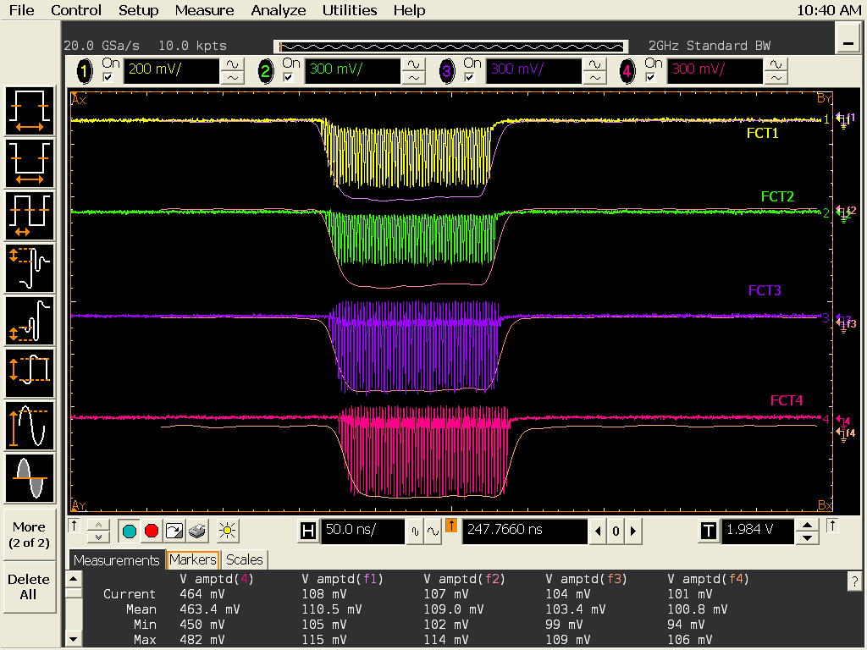
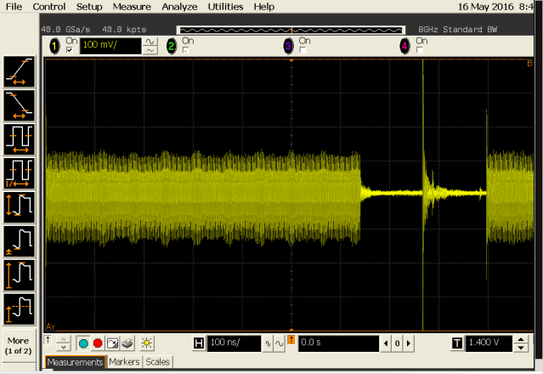
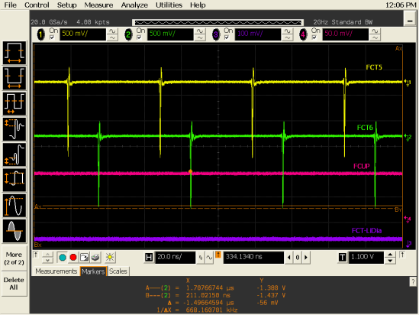
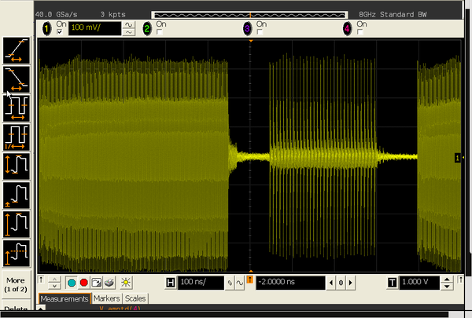
Filling pattern
LINAC MBM pulse
Usual 8-10 (MBM) trains
Hybrid with 1 SB
LINAC SB pulse
For BL24_PEEM
MBM + n x SB
Michael Foerster et al. Nature Communications (2017)

Slide 13
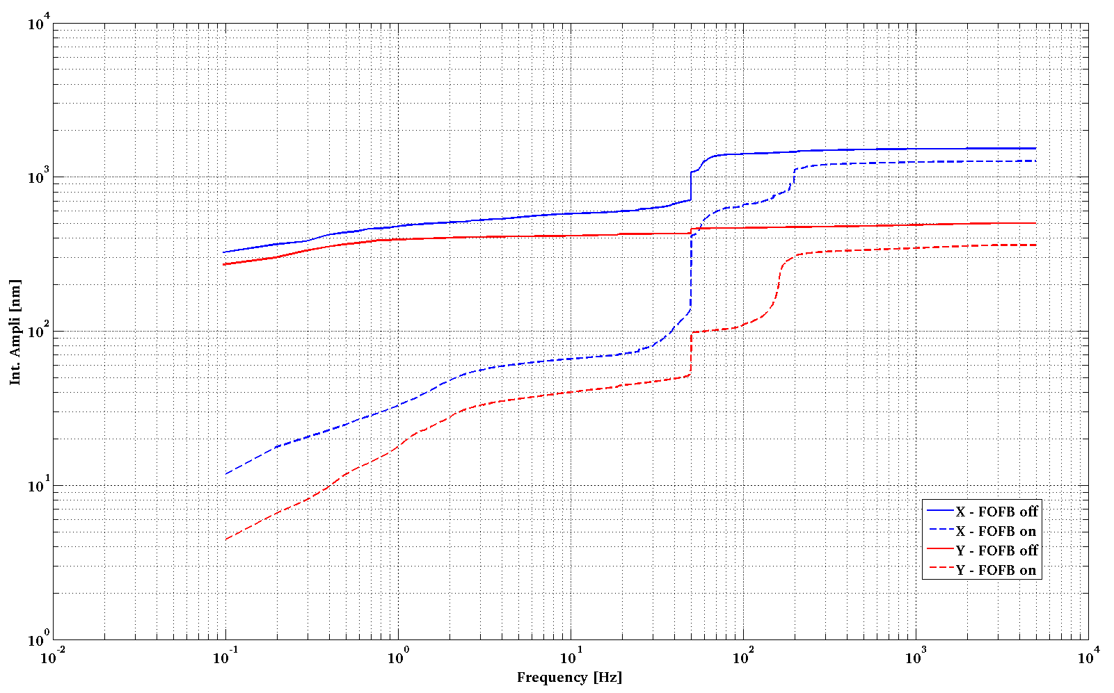
Orbit stability
Well below specs of 10% of beam size
600 nm < 1% of σ_{X} at ID (132 um)
Hor:
600 nm
Integrated amplitude [nm]
Ver:
100 nm
100 nm < 1.5 % of σ_{Y} at ID (7.5 um)
100Hz
Frequency [Hz]

Slide 14
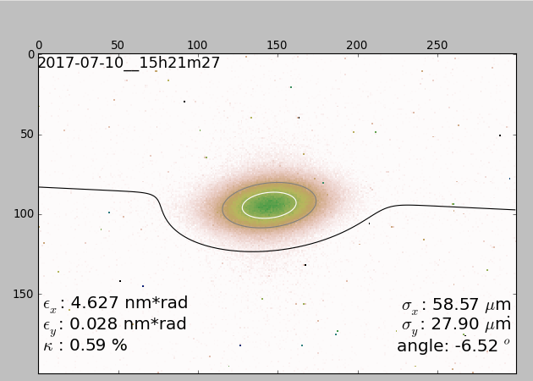
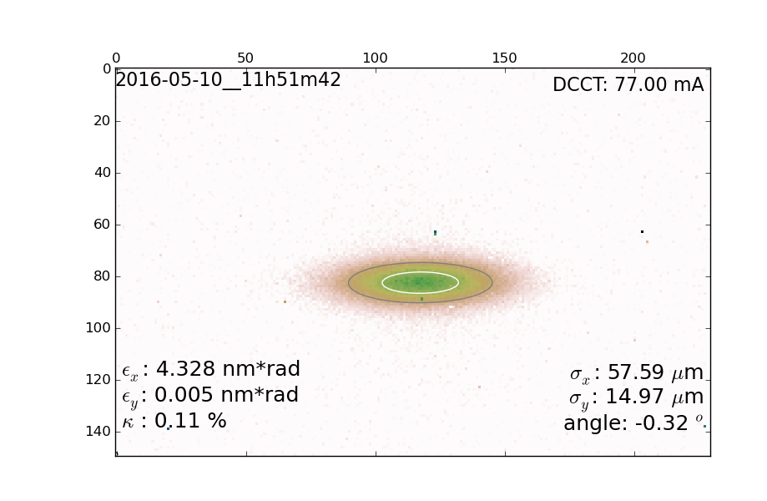
Vertical beam size
Coupling control using skew quadrupoles
Coupling of 0.59%
σ_{y} = 28 um
ε_{y} = 28 pm·rad
Coupling of 0.11%
σ_{y} = 15 um
ε_{y} = 5 pm·rad

Slide 15
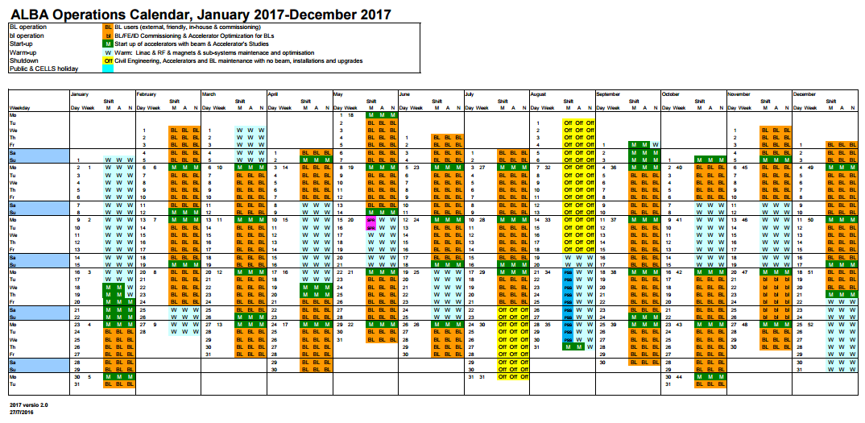
Operational performance
24/7
8 Runs
4 - 5 weeks / Run
5888 h Total (80% for BLs)

Slide 16
Operational performance
6000 h of operation:
consolidated

Slide 17
Operational performance
until 24/09/2018 BA: 98.0%
MTBF: 104 h
MTTR: 2.1 h

Slide 18
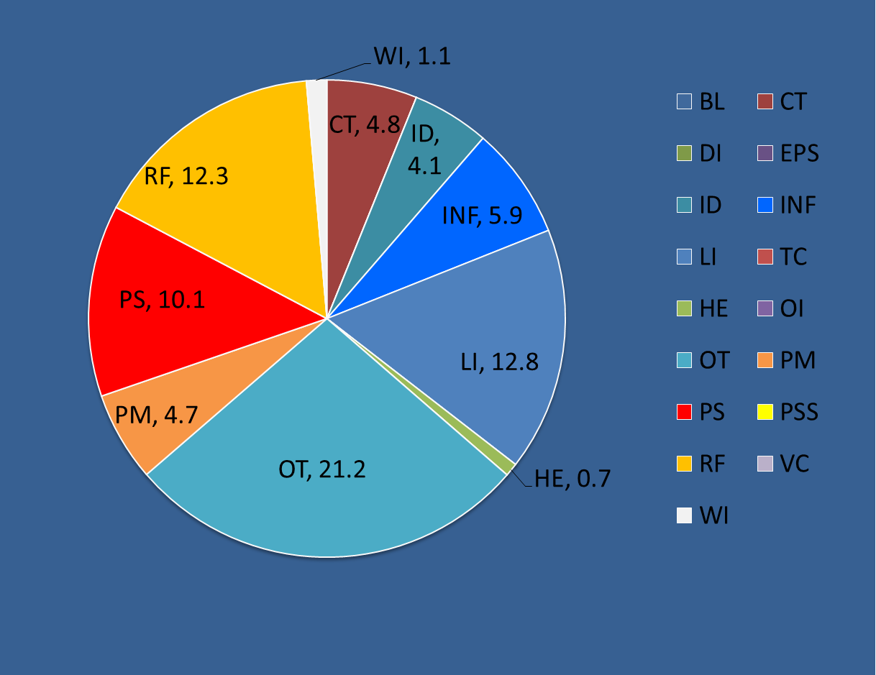
Operational performance
Down time analysis in 2017
  Systematic analysis of all events
  Including events not generating a beam dump

Slide 19
Operational performance
First fixed, patch, repair, and re-inject (“happy users”)
Then look for the root cause and fix it for the future
Operators and Floor coordinators ensure smooth operation
Readiness of tools for analysis: PM, FA, …
Importance of reducing MTTR:
    Keep adequate # spares.
    Spares well marked/located/ready
    Ensure training of operators and on-call staff
    Design for redundancy, modularity
    Deal with obsolescence

Slide 20
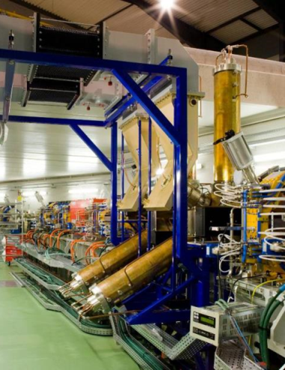
Maintenance from the CR

Slide 21
Maintenance
5888 hours of operation
Beam for Users
Accelerator Development and Maintenance
Shutdown - Basic systems OFF
Shutdown - Basic systems ON

Slide 22
Maintenance
5888 hours of operation
Accelerator Development and Maintenance 1 d/week
Shutdown - Basic systems ON 5 shut downs 1 w long
Shutdown - Basic systems OFF 2 long shut downs

Slide 23
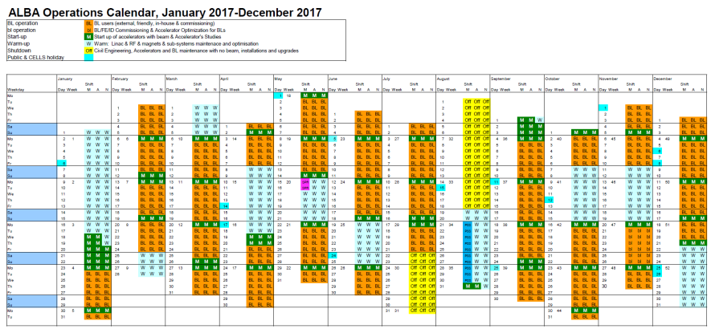
Maintenance
1 day/week is machine day
5 short shut downs
2 long shut downs
Organised on a week by week
Web based CTAR (request for interventions) prepared/approved
Operator in CR follows interventions, grants access, resolves interferences,..
Provides a window for short and urgent repairs
Modified at “extremely” short notice

Slide 24
Maintenance
1 day/week is machine day
5-6 short shut downs
2 long shut downs
Coordination starts 1 month before
Main access restrictions discussed at the Operations Meeting
Web based CTAR (request for interventions) prepared/approved
Operator in CR follows interventions, grants access, resolves interferences ...
Schedule distributed the week before

Slide 25
Maintenance
1 day/week is machine day
5 short shut downs
2 long shut downs
Coordination starts 3-4 months in advance through the Operations Meeting
Yearly maintenance of infrastructure
New installations/major interventions
No OP in control room. Machine is completely OFF
New in 2018: Controlled switch OFF/ON of all accelerator hardware

Slide 26
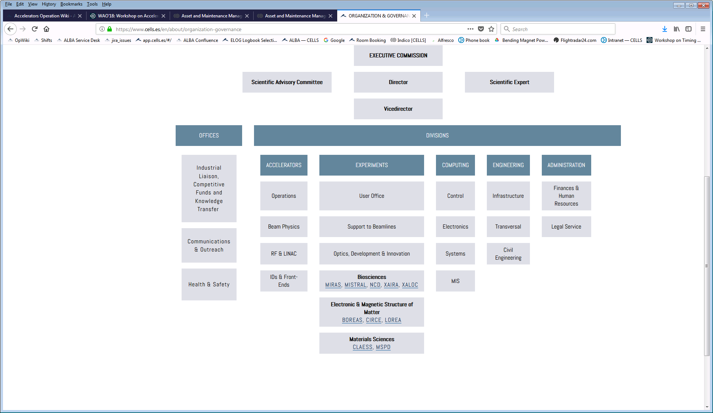
Maintenance
Division
Sections
Technical groups belong to different divisions/sections
No central maintenance programme
Missing general overview

Slide 27
Maintenance tools
Infrastructures:
Cooling,
Air conditioning
Electrical supply
Compressed air
Accelerators
RF
Magnets
Pulsed elements
Diagnostics
Computing:
Power supplies,
All electronics,
Controls
Preventive maintenance
using standard CMMS soft
More than 7000 equipment
700 different types of equipment
Largest series is 176
See contribution by J.Manotas, J.Iglesias
Develop our own programs and tools
See contribution by T.Camps

Slide 28
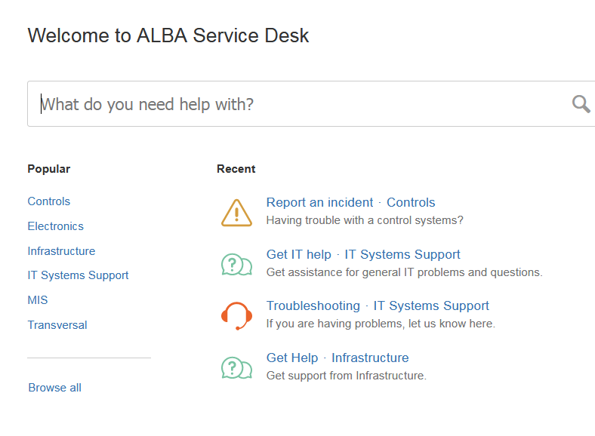
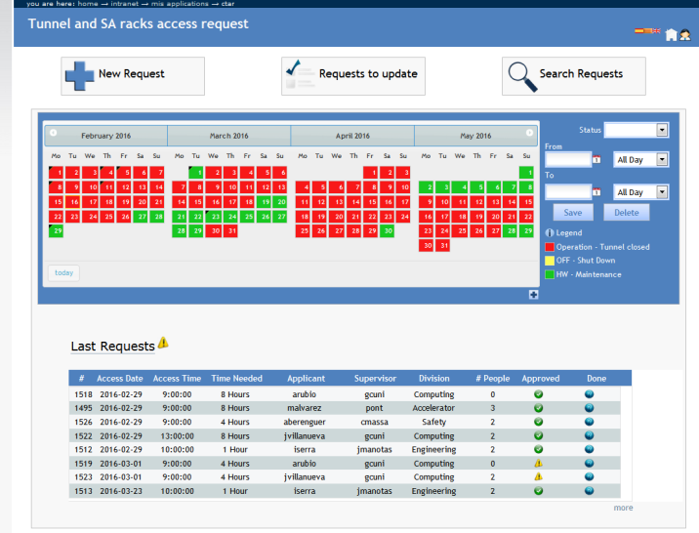
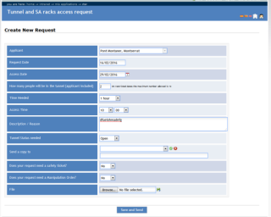
Maintenance tools
Operations Meeting: Weekly meeting to review operation and coordinate shut downs/major activities
Jira to handle service desk (service divisions). Can be used to request a maintenance task, but is not centrally managed
Web based CTAR (orders for interventions) prepared/approved

Slide 29
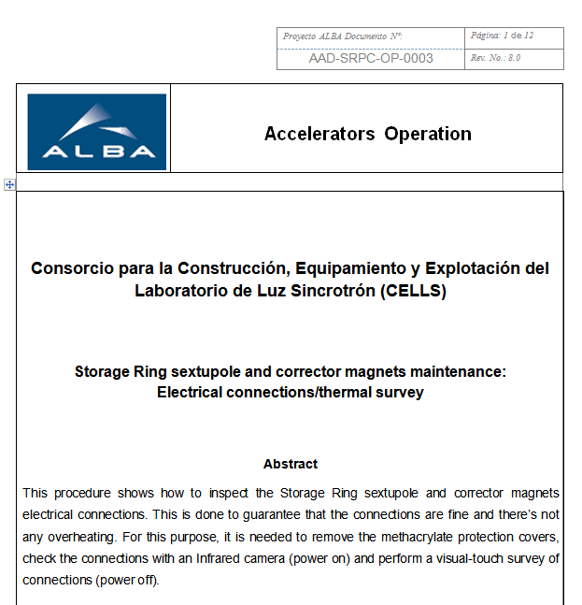
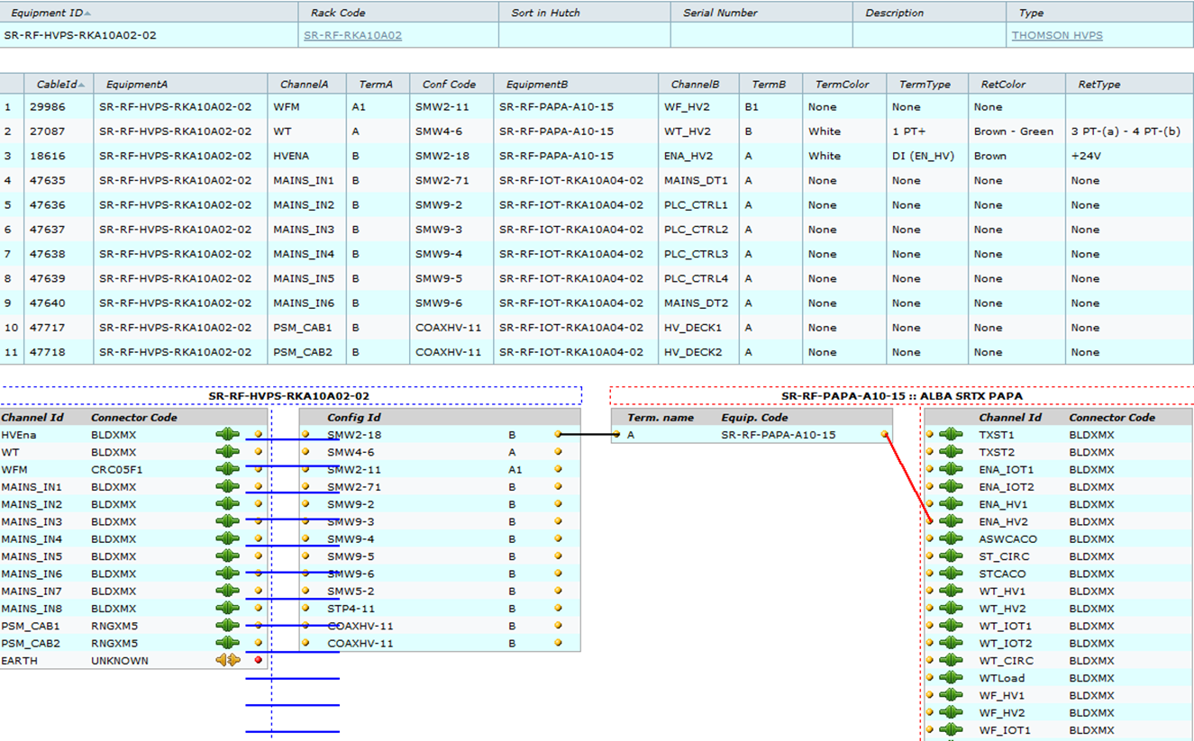
Maintenance tools
Equipment and Cable database
  Allows quick identification of components ant cables
Accelerators own maintenance programs:
  Magnets, pulsed elements, RF, LINAC

Slide 30
Summary
ALBA is operating since 2012
Achieving goal of BA = 98%
Maintenance management is not centrally organised
Maintenance is coordinated through the Operations Meeting
Developed own tools & programs to ensure adequate maintenance of accelerator equipment

