Slide 1
Maintenance at ALBA facility: Strategy for the conventional services

Slide 2
Contents:
2
1. Overall Layout
1.1 Electrical supplies
1.2 Water supplies
1.3 HVAC distribution
2. Strategy
2.1 Assets
2.2 Workers
2.3 Maintenance
2.3.1 Internal Orders
2.3.2 CMMS Software
3. Conclusions

Slide 3
1. Overall Layout
3
1.1 Electrical supplies
ALBA is directly connected to 220kV of the high voltage net,
Through a 20 MVA transformer the voltage is reduced to 220/25 kV and transmited to ALBA
ALBA has 25kV redundancy through the nearby congeneration plant.
Finally, the voltage is reduced from high to low voltage 25/0,4 KV.

Slide 4
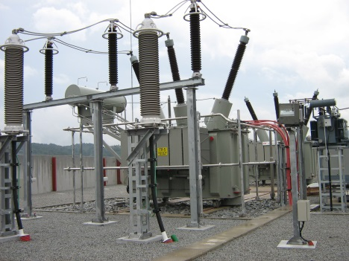
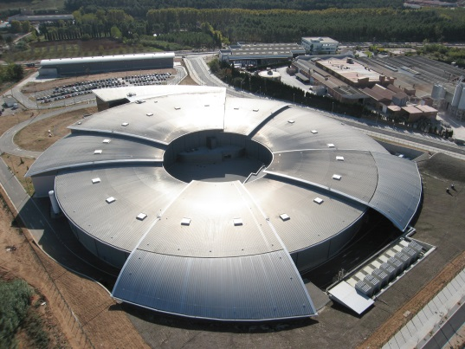
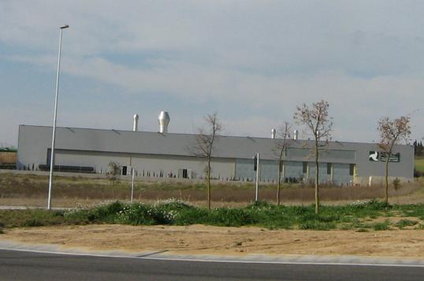
1. Overall Layout
4
S.E. CODONYERS
220/25 KV
1.1 Electrical supplies
2 X 25KV
2 X 25KV
ST4
COGENERATION PLANT
ALBA
1,8 Km
1,8 Km
25KV
0,7 Km

Slide 5
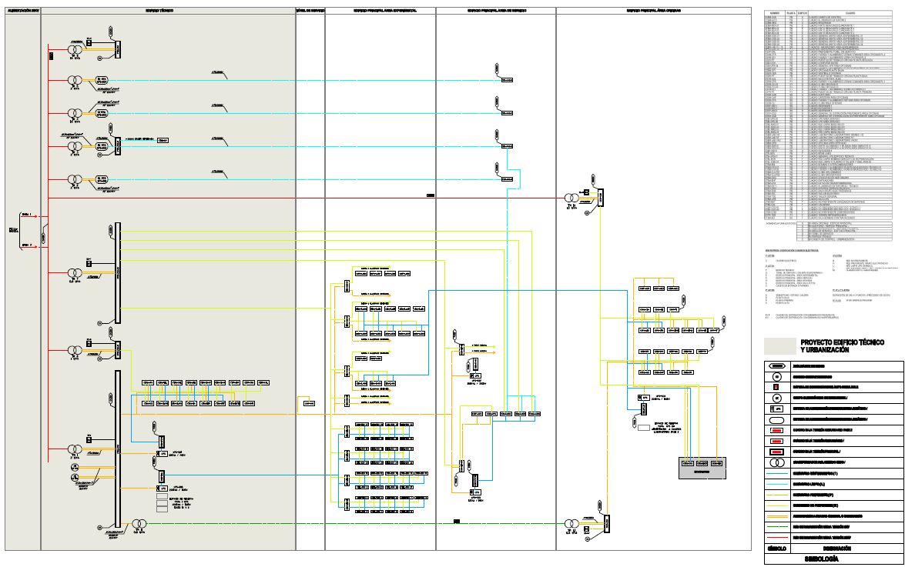
1. Overall Layout
5
1.1 Electrical supplies: ALBA Block Diagram and type of supplies
Non Preferential: lighting, air conditioning…(Network)
Preferential: lifts, hydraulic circuits, part of the lighting (Network + Diesel generators)
Critical: CPD, control room, Beam lines, etc (Network + UPS + Diesel generators)
Clean: magnets, RF plants or cooling inside tunnel(Network + Dynamic UPS)

Slide 6
1. Overall Layout
6
1.2 Water Supplies: in two ways
External: Cogeneration plant also supplies CW between 4 to 9ºC with about 4000 kW of cooling power for DW and CW (up to 6,2MW of cooling capacity), and HW up to 90ºC with 110 kW of heating power.
Internal: 4 chillers, 2 of 1,3MW and 2 o 2,9MW in different combination, depending on the loads; and two boilers of almost 700kW heating capacity.
From technical building using heat exchangers:
CW is supplied to HVAC at 7ºC and returns at 12ºC, 4 rings and distribution to the Workshop
HW is supplied to HVAC at 60ºC and returns at 45ºC, 2 rings and distribution to the Workshop
DW is supplied to magnets and other equipment at 23ºC and returns at 27ºC by using 4 rings: Service Area, Booster, Storage and Experimental Hall with a common return.

Slide 7
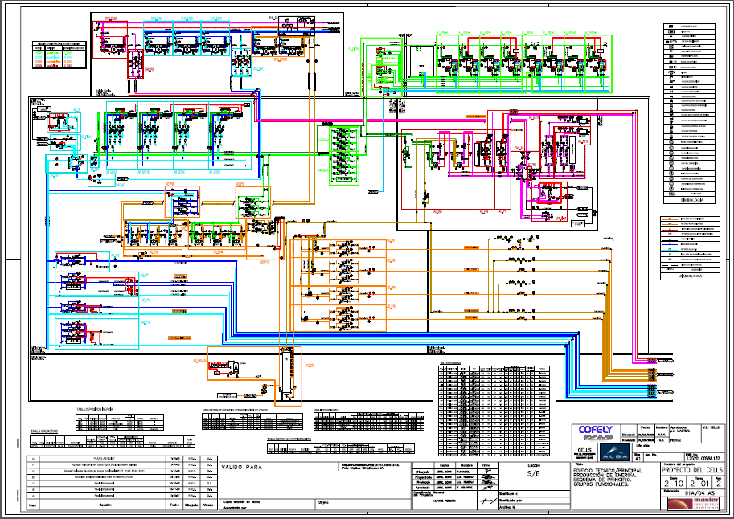
1. Overall Layout
7
1.2 Water Supplies:
Cold Water
Deionized Water
Hot Water
Cooling Tower

Slide 8
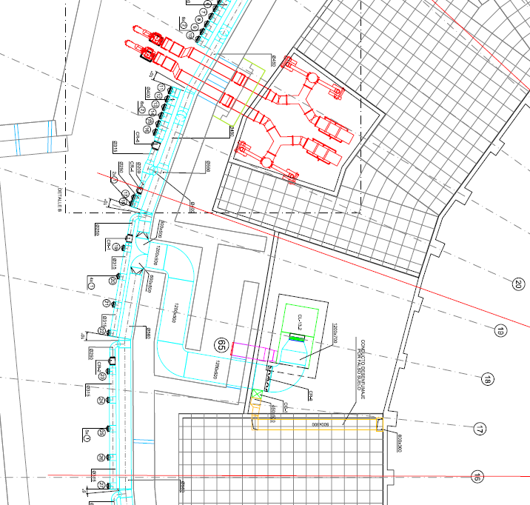
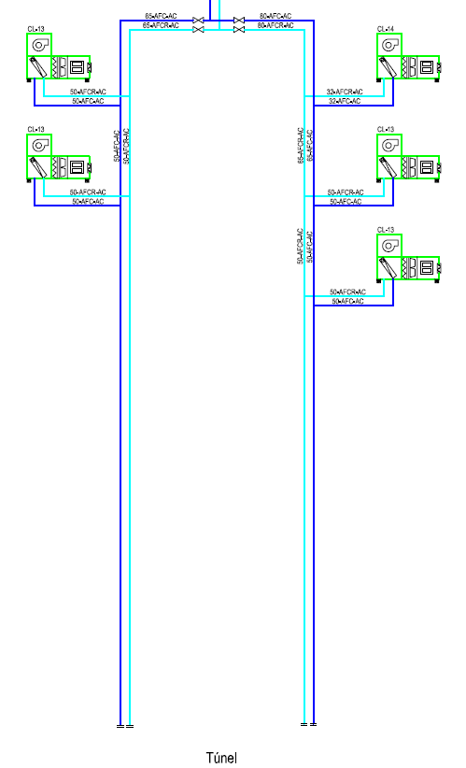
1. Overall Layout
8
1.3 HVAC distribution:
Tunel: Four units to keep 23ºC±0,2 for all the tunnel and one unit dedicated to the LINAC. Relative humidity at 49-50%
Tunnel: available power 45,5 kW each unit with an air flow of 15.500 m³/h
LINAC: available power 17,6 kW with an air flow of 6.000 m³/h.
Each quadrant has 7 temperature sensors to control the stability required inside the tunnel

Slide 9
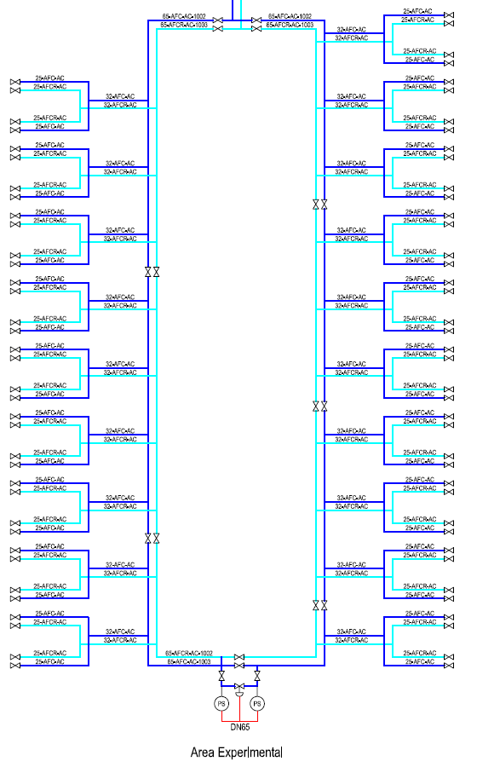
1. Overall Layout
9
1.3 HVAC distribution:
Beam Lines: each BL has the possibility to keep a comfortable temperature inside the Control Hutch by using a simple fan coil (old BL’s) or a dedicated unit (MIRAS)
The available power for each Beam Line is around 7 kW, only for the Control Hutch.
MIRAS has a maximum of 23,4 kW of power for all the line (Optical Hutch, Control hutch and a Meeting Room)

Slide 10
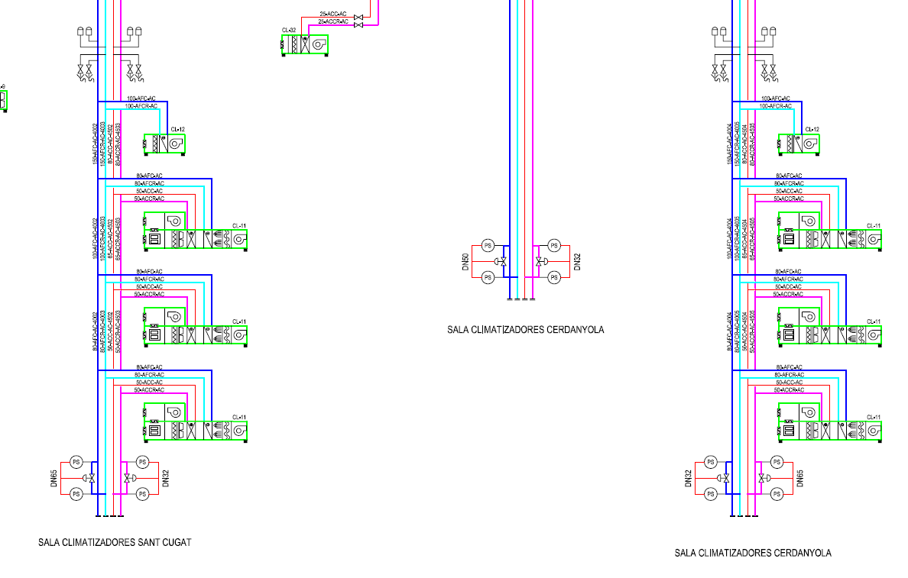
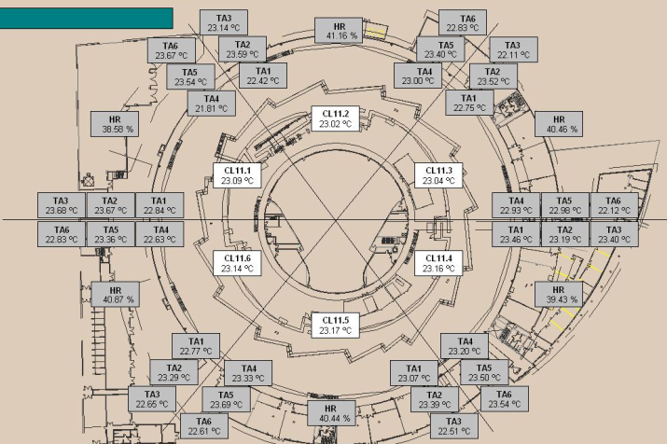
1. Overall Layout
10
1.3 HVAC distribution:
Experimental Hall: six units dedicated to the EH and two more only to cool down during the summer warm conditions.
EH is divided in six section, every section has six main temperature-humidity sensors and six extra contiguous sensors (three per side) to control the temperature.
Data for CL11:
Air flow: 40.000 m3/h
CW power 135 kW
HW power 94 kW
Data for CL12:
Air flow: 12.000 m3/h
CW power 175 kW

Slide 11
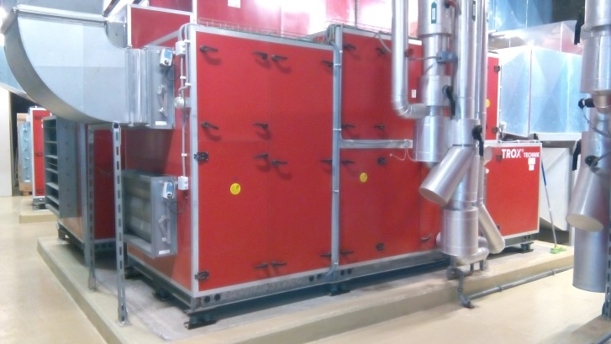
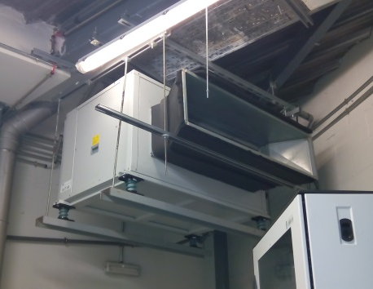
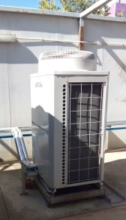
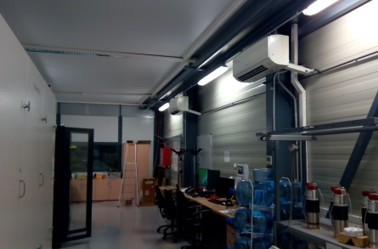
1. Overall Layout
11
1.3 HVAC distribution:
Offices and other uses: depending on the occupancy, the number of units has been increasing during the 10 years of operation.
In other spaces, like the RF lab, Electronic Lab or UPS rooms, a dedicated unit to control the temperature
Office Air conditioned unit
SA UPS room
RF Lab:

Slide 12
2. Strategy
12
Few years ago, in AMMW2013…
Objective, main target:
– Maximum reliability at minimum cost.
Strategy:
– Keep in-house all knowledge necessary to operate and maintain the facility.
– In-house management of the whole maintenance of the facility.
– Optimize the maintenance cost related to personnel, spares and reposition.

Slide 13
2. Strategy
13
2.1 Assets
Electrical assets: 3 electrical transformers rooms, 4 dinamic UPS, static UPS, 100 electrical cabinets…
Pumps: CW, HW and DW, almost 60 units
3 Air compressors
57 AHU’s
2 Boilers
7 chillers
14 Heat exchangers
2 Cranes
37 Toilets units
500 doors…
3 lift
Probes: temperature, pressure, conductivity, etc
Almost 3800 assets with some kind of maintenace, but not each asset has its work procedure

Slide 14







2. Strategy
14
2.2 Workers
Constantly
1 Electrical technician
1+3 mechanical technician
10 cleaning people
10 security people
Temporaly
Almost 70 external suppliers depending on their work

Slide 15
2. Strategy
15
2.3 Maintenance
2.3.1 Internal Orders between 2010 to 2011:
COFELY
CMMS Prisma
Planing to infrastructures
Internal order to workshop
Work done
Final report from COFELY

Slide 16
2. Strategy
16
2.3 Maintenance
2.3.2 CMMS Software from March 2012:
ALBA
CMMS Prisma
Planing executed by infrastructures engineers
Direct Work Order to technitians
Work done
Knowledge of the installtion, control of critical spare parts

Slide 17
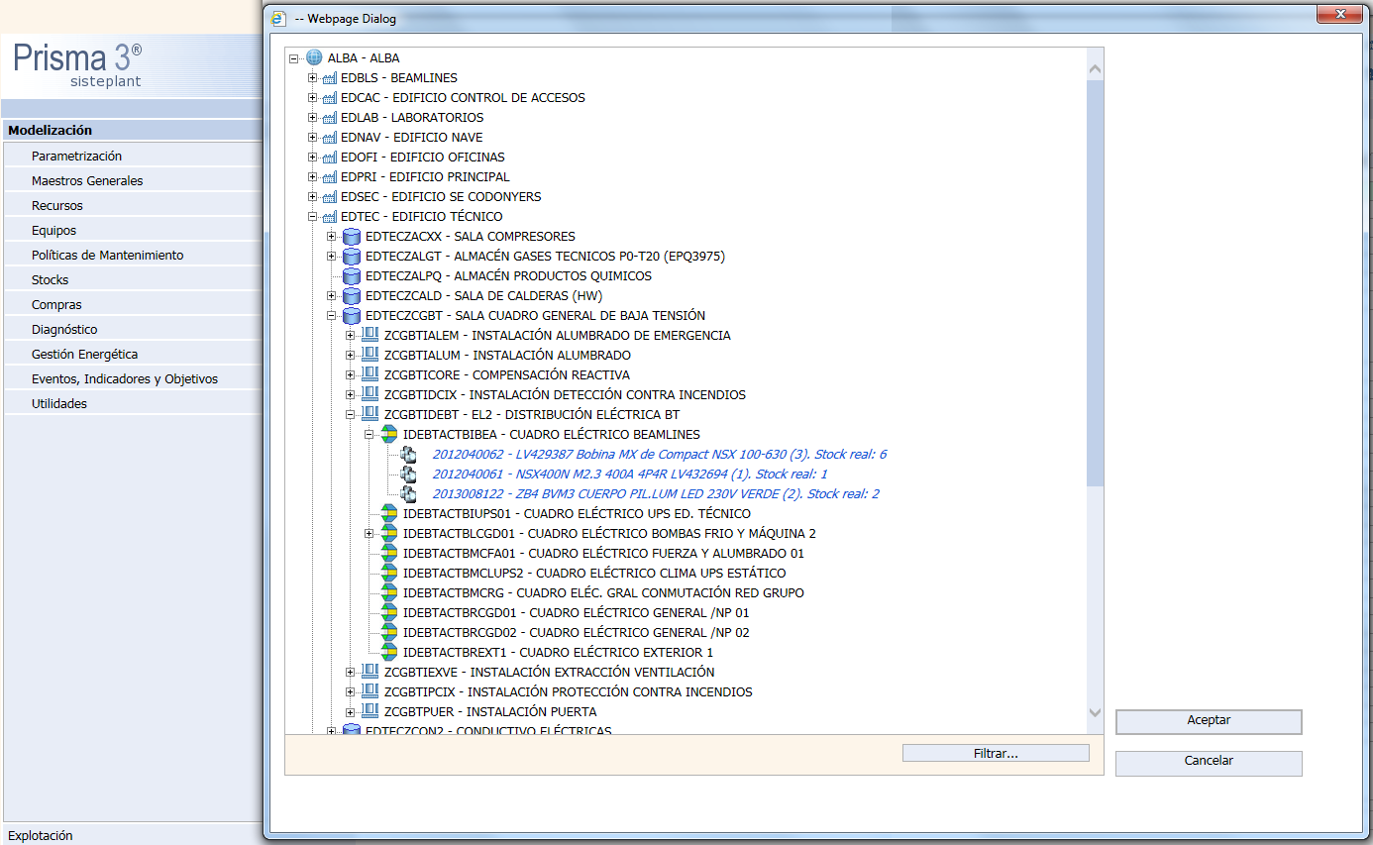
2. Strategy
17
2.3 Maintenance
Facility
2.3.2 CMMS Software
PRISMA3 (Sisteplant), use of excel to do the massive loads
Building
Zone
Prisma Users
Workers
Installation
Asset
Calendars
Planings
Element
Masurements
Analysis

Slide 18
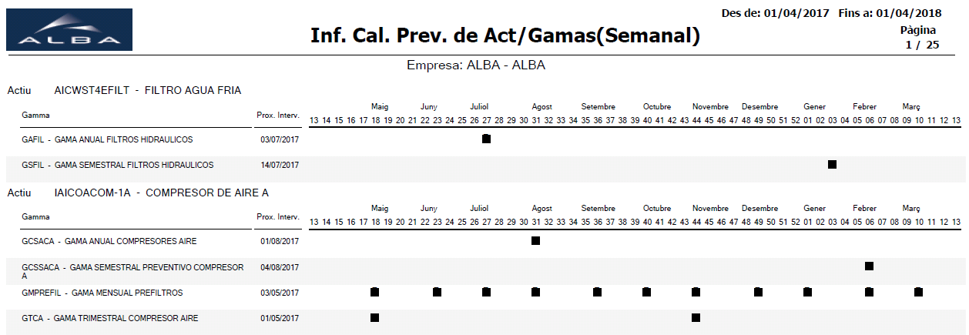
2. Strategy
18
2.3 Maintenance
Calendar
Asset
Work Procedure
Intervention date/week
Period

Slide 19
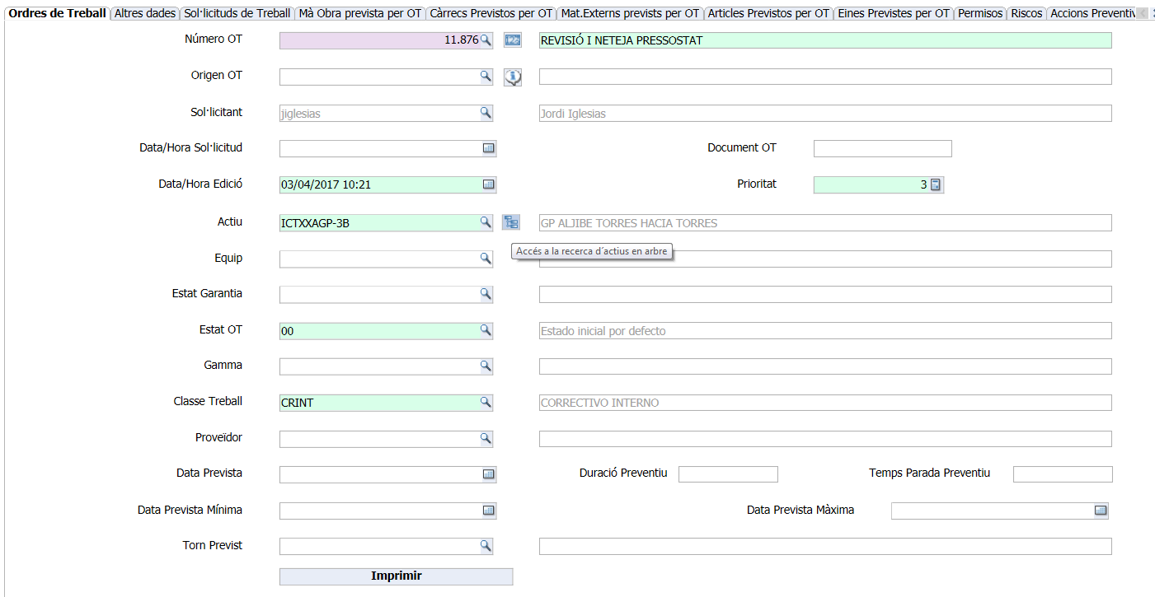
2. Strategy
19
2.3 Maintenance
Work Order
WO number
Applicant
Asset
Type of work

Slide 20
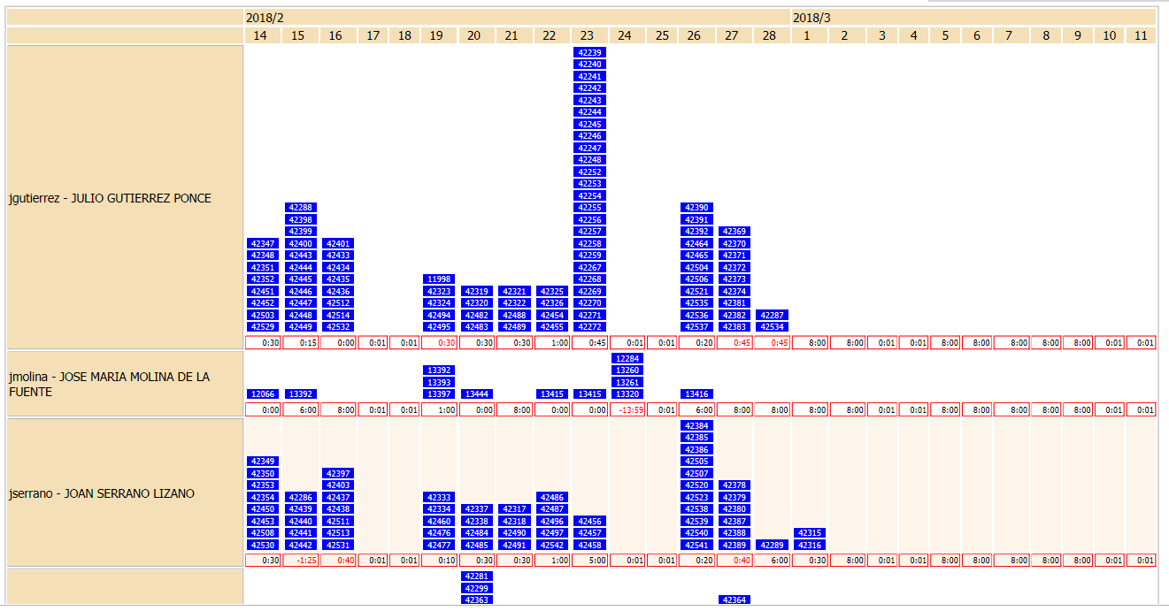
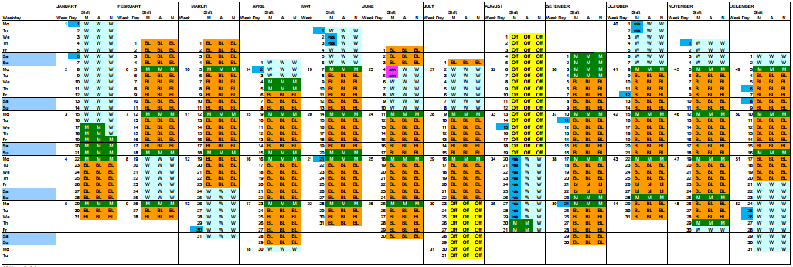
2. Strategy
20
2.3 Maintenance
Planing:
Internal workers
External Workers
External companies
Worker 1
Internal Calendar
Worker 1
Worker 3

Slide 21
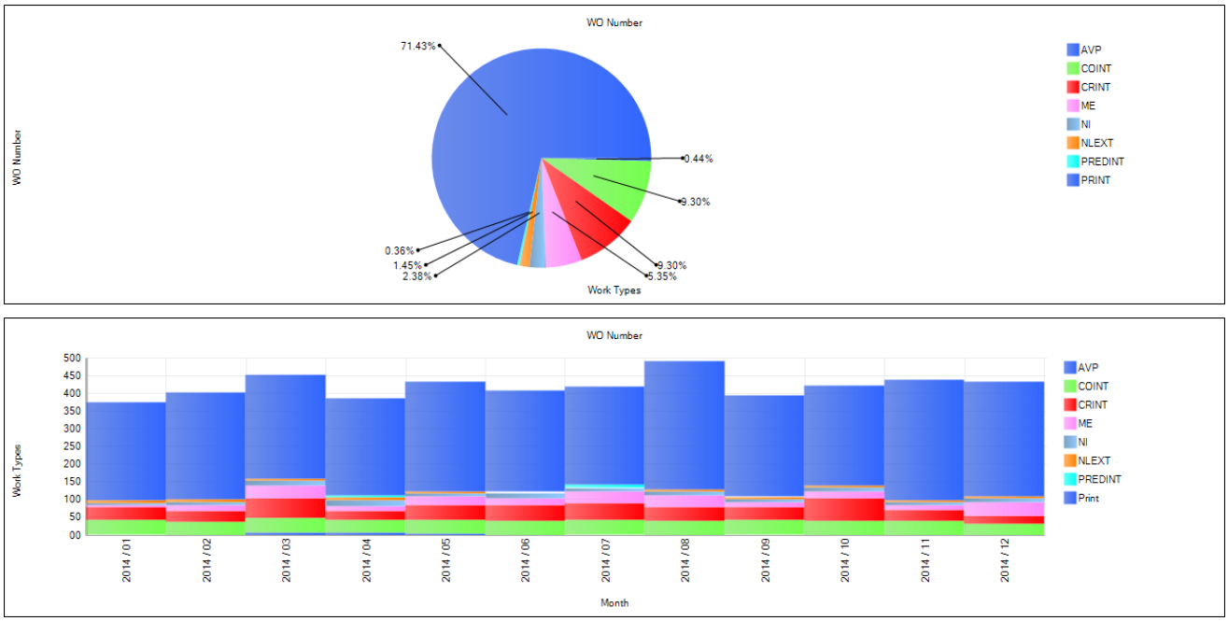
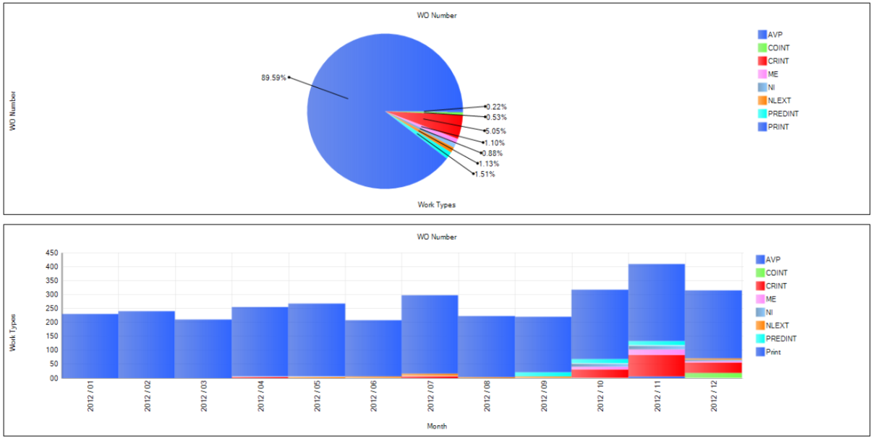
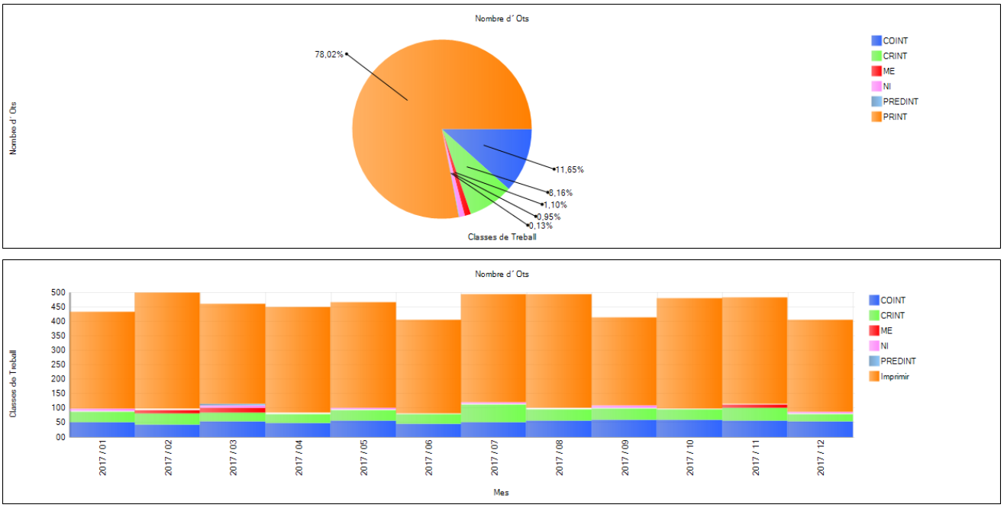
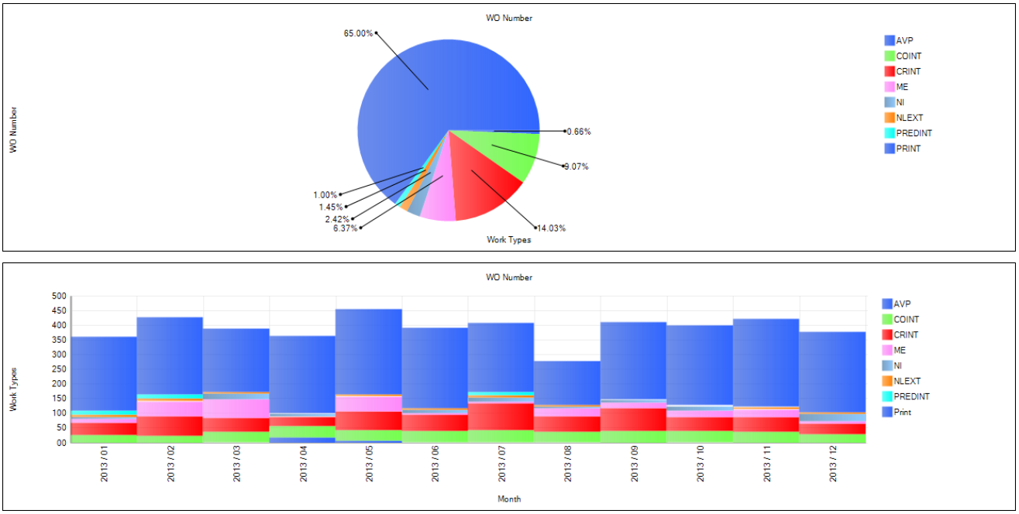
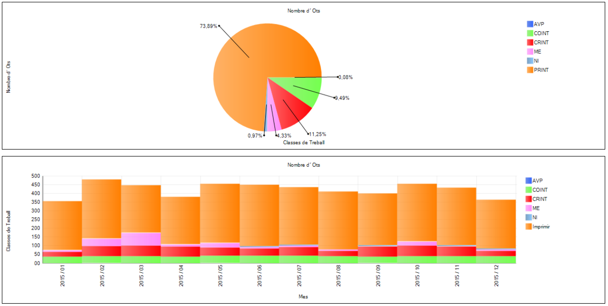
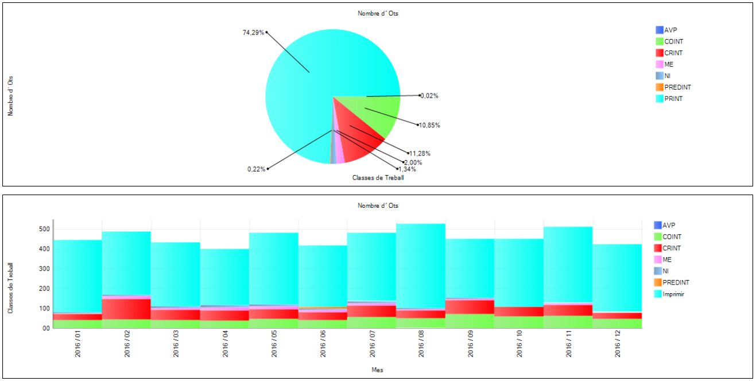
2. Strategy
21
2.3 Maintenance
Number of WO in Prisma3 during the years
 | 2012 | 2013 | 2014 | 2015 | 2016 | 2017
Preventive WO | 2857 | 3040 | 3602 | 3738 | 4095 | 4273
Corrective WO | 161 | 656 | 469 | 569 | 622 | 447

Slide 22
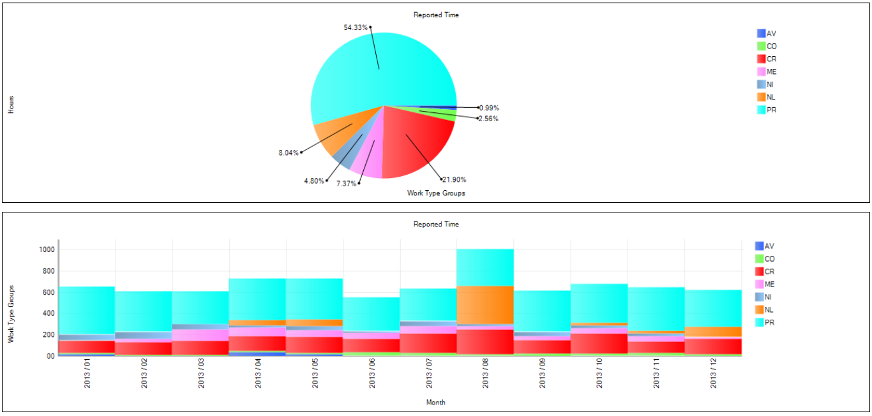
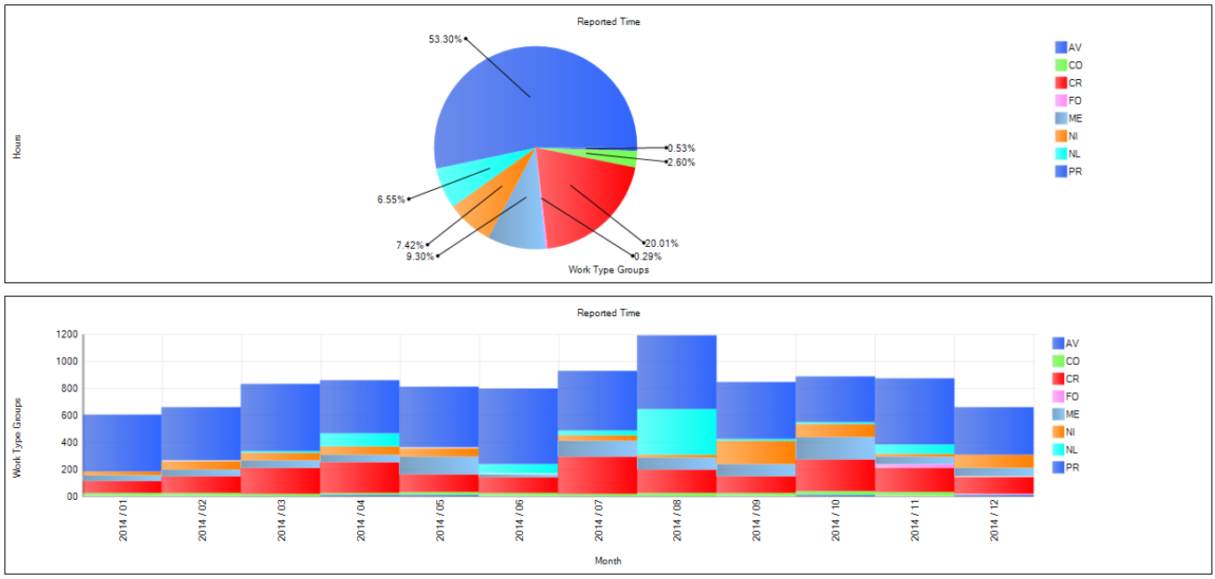
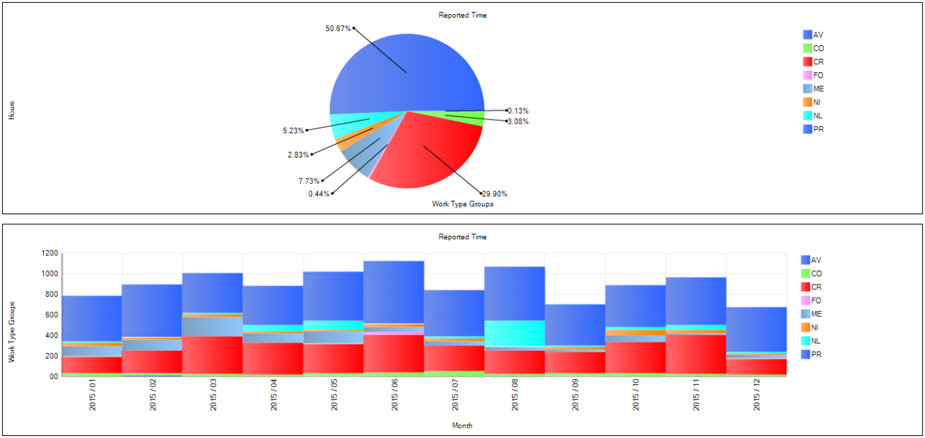
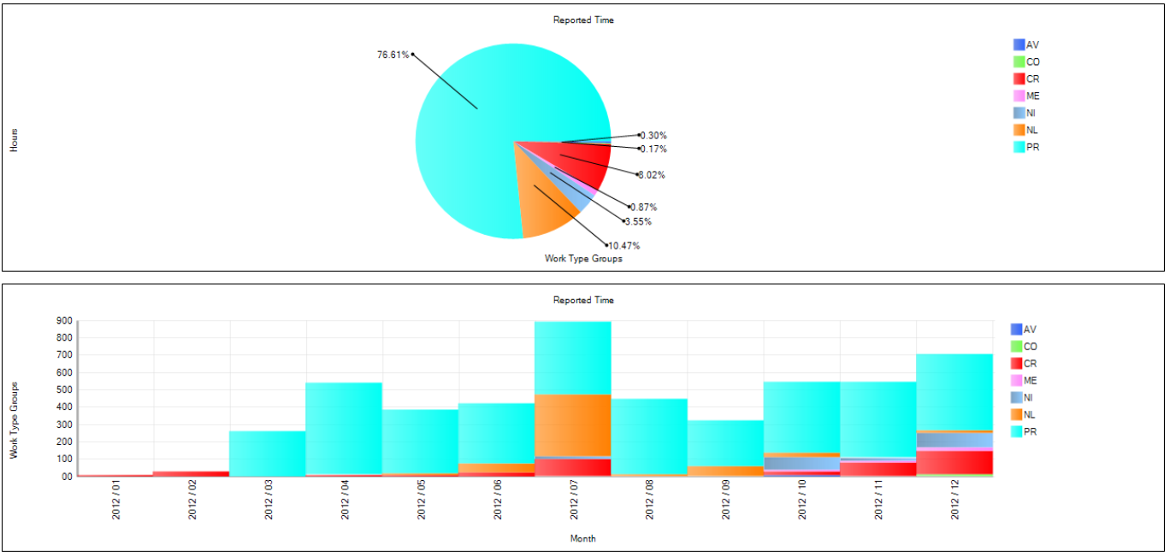
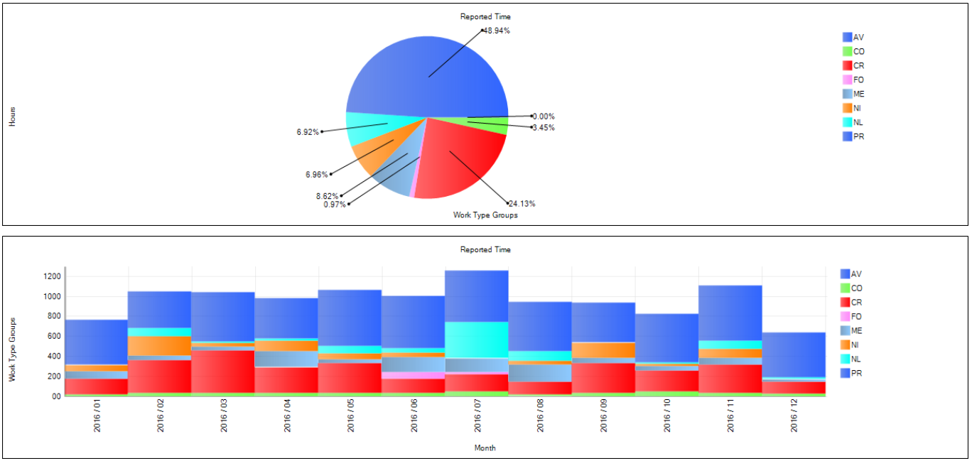
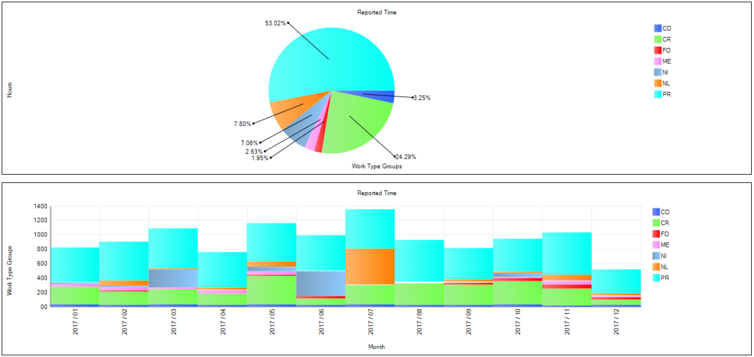
2. Strategy
22
2.3 Maintenance
Reported time in Prisma3 during the years
 | 2012 | 2013 | 2014 | 2015 | 2016 | 2017
Preventive hours | 3914 | 4406 | 5296 | 5483 | 5684 | 6009
Corrective hours | 409 | 1776 | 1988 | 3235 | 2802 | 2752

Slide 23
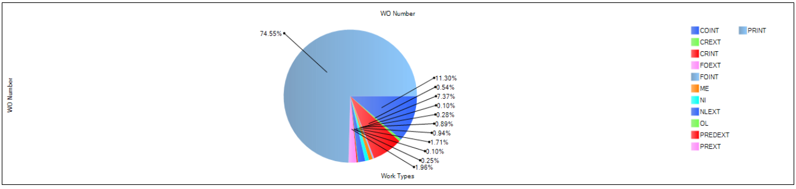
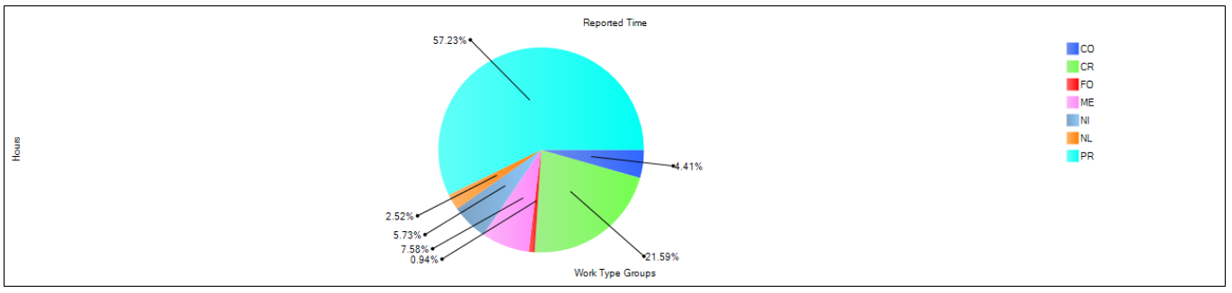
2. Strategy
23
2.3 Maintenance
WO numbers vs reported time for 2018

Slide 24
2. Strategy
24
2.3 Maintenance
WO numbers vs reported time for 2018
WO number vs hours | Number | Hours
Internal preventive | 3015 | 3829
External preventive | 77 | 167
Conductive | 443 | 295
Predictive | 10 | 22,5
New installation | 37 | 383
Improvements | 35 | 507
Corrective | 310 | 1444

Slide 25
3. Conclusions
25
Does the infrastructure section for the conventional equipment keep the knowledge in-house to maintain and operate the facility? Yes, they do. Just see the organization changes between 2011 and 2012.
Does the Infrastructure section have the management of the conventional equipment? Yes, and the number of assets with some kind of maintenance has raised during these years .
Is the cost related to personnel, spares and reposition optimized? Yes, the more preventive we plan, the less corrective should be done. But the preventive planed by date has to be moved to a preventive by parameter maintenance and increase the predictive maintenance.

Slide 26
3. Conclusions
26
Anual cost:
 | 2018 | 2019 (Prevision) | People
Mechanical | 164.533 € | 135.162 €
Mechanical | 166.433 € | 166.433 € | 3 external
Electrical | 262.153 € | 277.806 €
Facility Services | 696.765 € | 696.765 € | 20 external
Total | 1.289.884 € | 1.276.166 € | 23 external

Slide 27
27
Questions?
Jordi Iglesias: jiglesias@cells.es

