Slide 1
Maintenance program in the cooling circuit. DW case
Juan José Manotas
Engineering Division

Slide 2
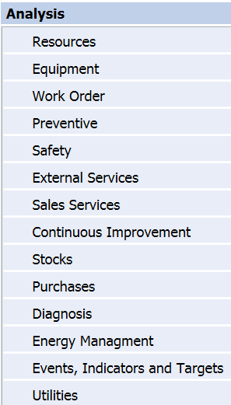
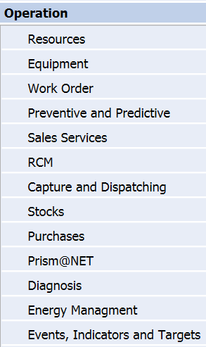
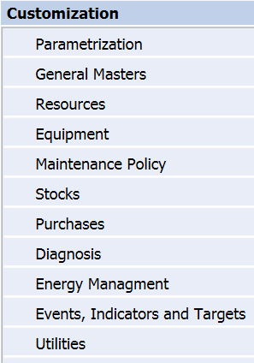
Computerized Maintenance Management Syst.
Software PRISMA 3
  For the maintenance management the commercial software PRISMA 3 has been selected as the adequate CMMS (Computerized Maintenance Management System). Functions:
  Installation description implemented in 6 levels: Facility, Building, Zone, Installation, Asset (main) and Element (part of Asset)
  3 Sections

Slide 3
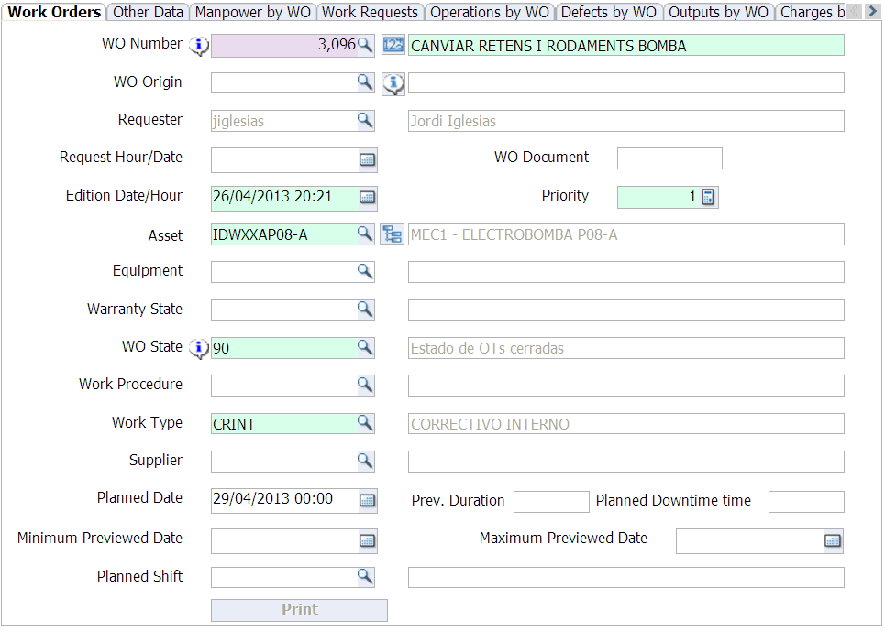
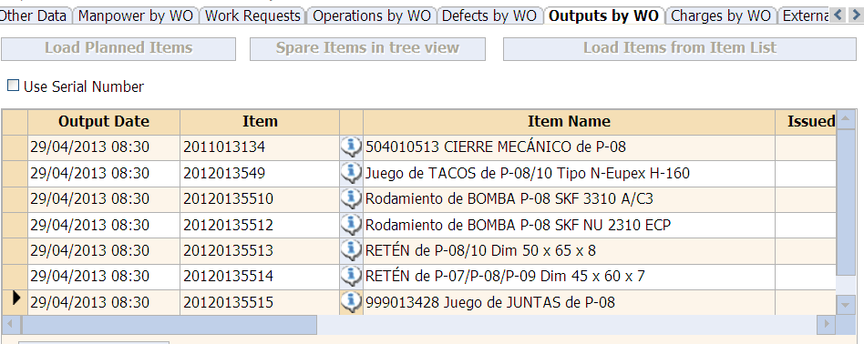
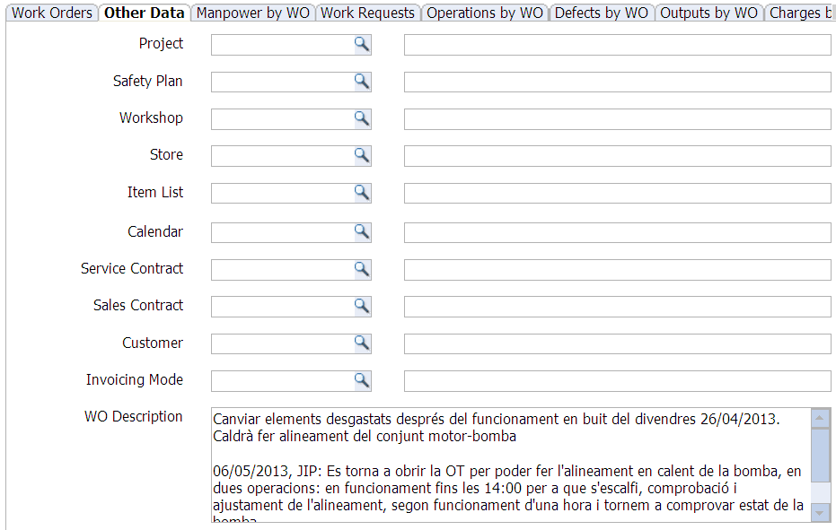
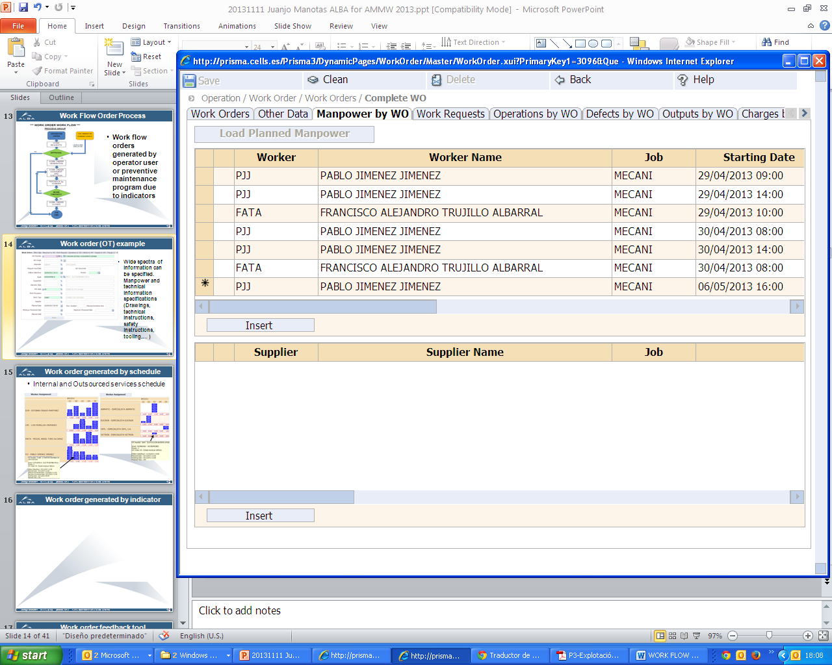
Work Order Example
WO number
Wide spectra of information can be specified. Manpower and technical information specifications (Drawings, technical instructions, safety instructions, tools,… )
Requester
Asset
Stock Items
Man Power

Slide 4
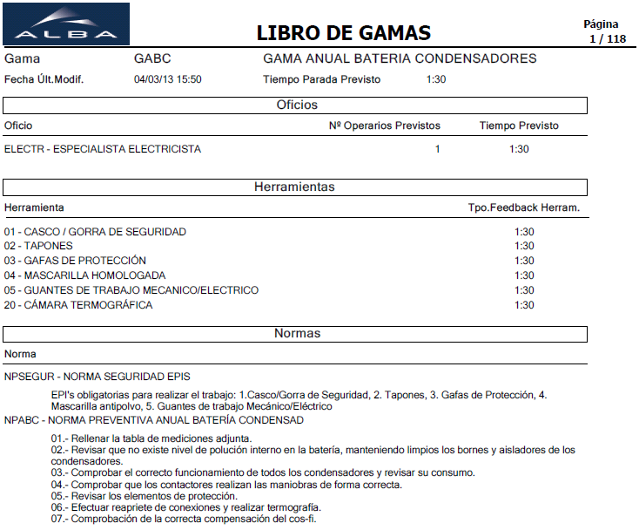
Work Procedure Example
Range Document: GABC example
Range code
Specialization
Tools
Regulation

Slide 5
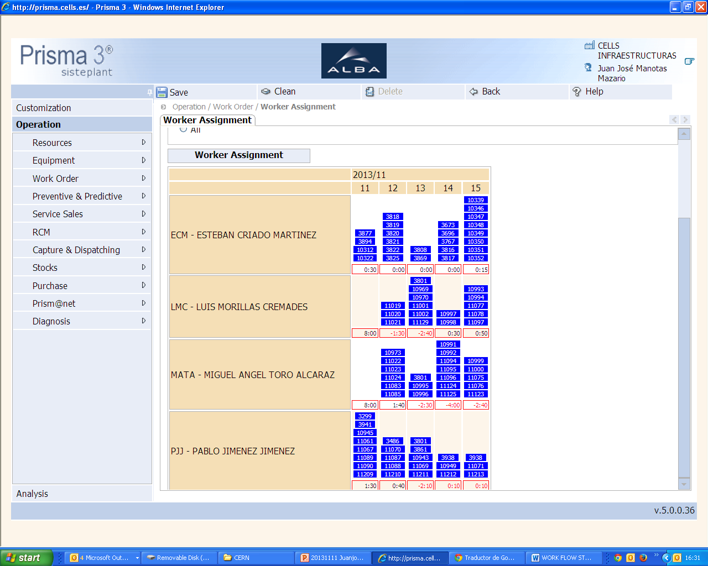
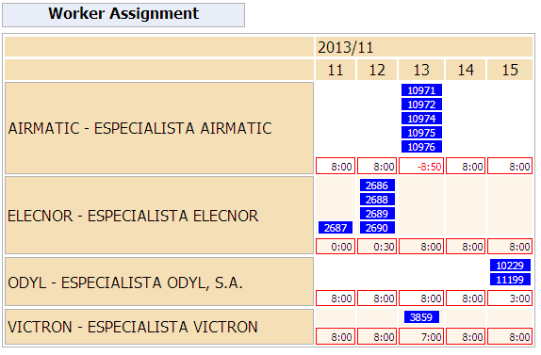
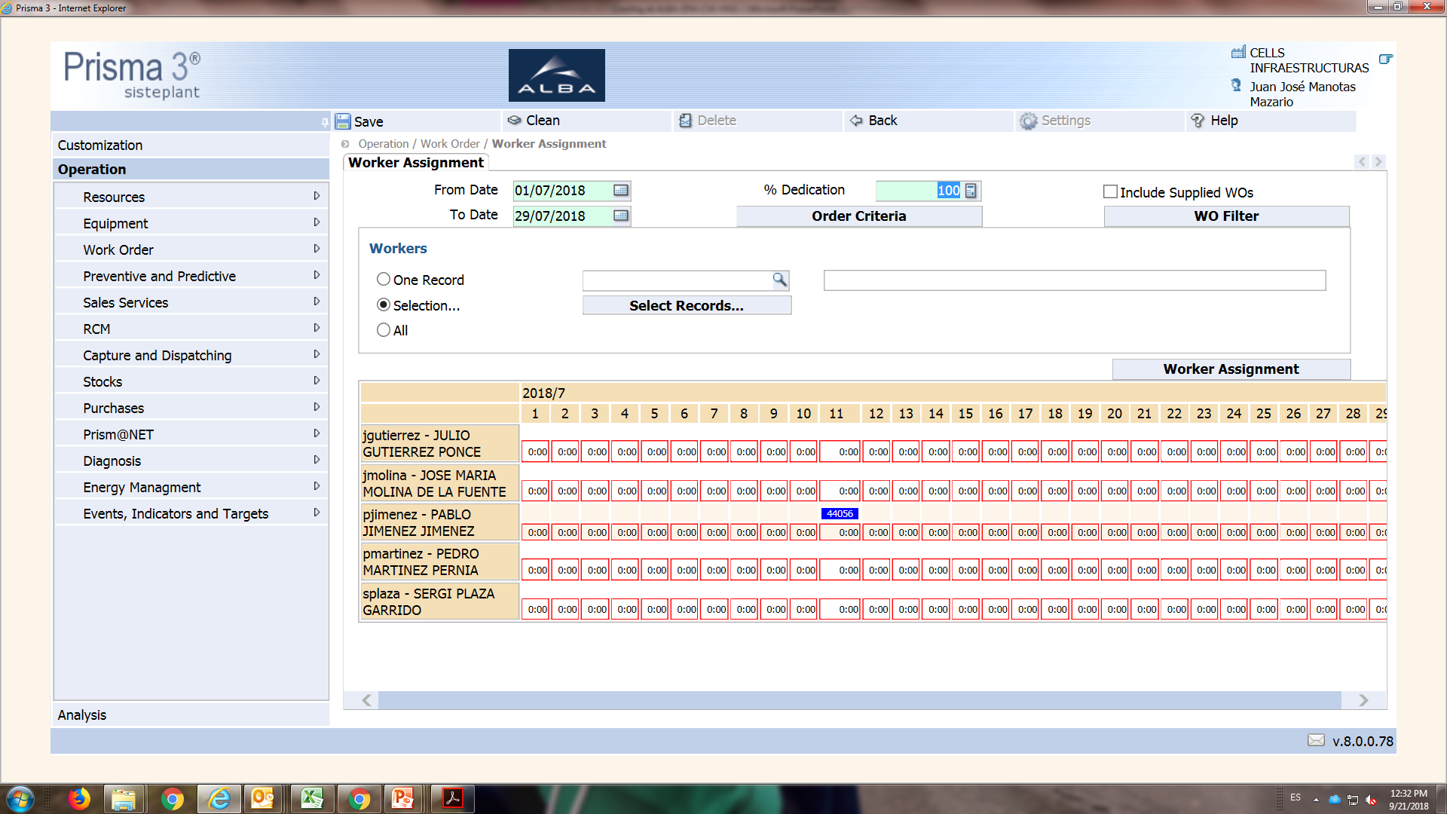
Work Order generated by schedule
(Preventive and Corrective Maintenance)
Internal and Outsourced services schedule
  Dates
Worker 1
Outsourced Service 1
Outsourced Service 2
Worker 2
Outsourced Service 3
Outsourced Service 4
Worker 3
  Work Load
  Available
  Outsourced Service assignment
Worker 4
  Worker assignment

Slide 6
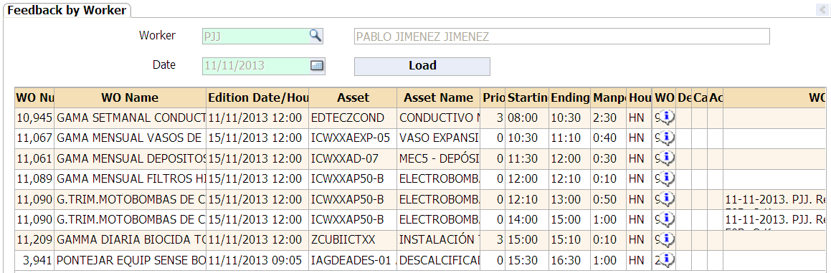
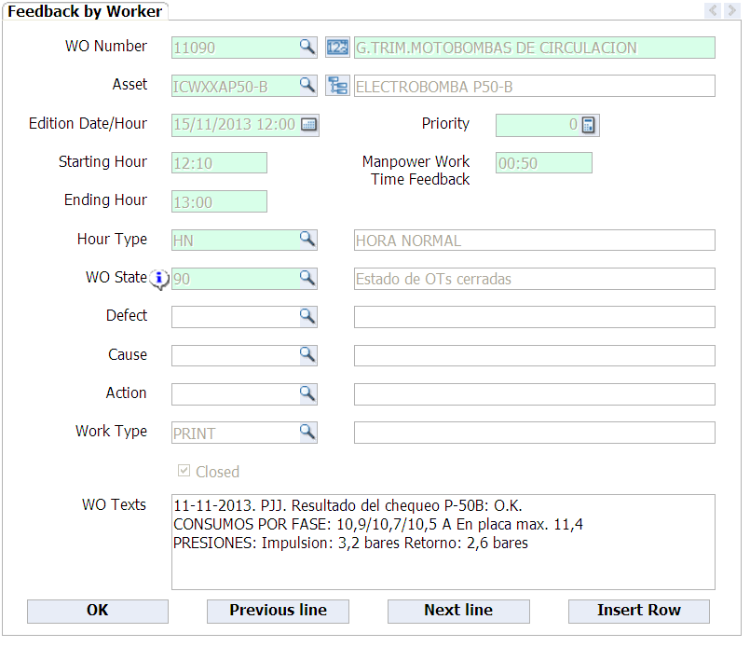
Work order feedback tool
  Workday loaded
  Few Fields to complete
Feedback by Worker:
Every day worker make report for every work order assigned.
Explain the main operations and change the type of work to finish (99) if is the case.
Manpower work time is filled with other many information.

Slide 7
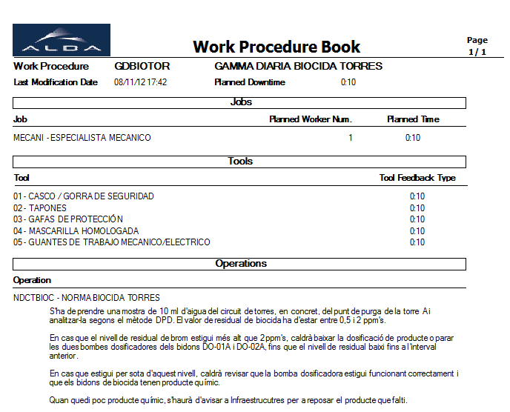
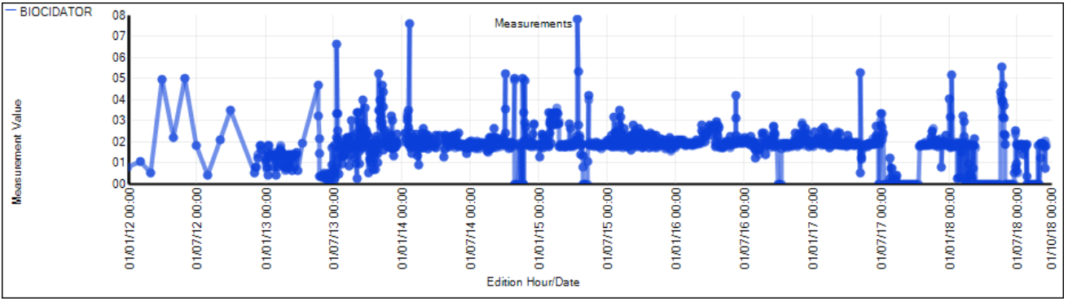
Work Order Measurement
Work order is generated to measure criticals points in the installation. That are not yet automated.
  Ex.: Operation to adquired the data.
More tha 8300 measures (with many meters) in differents equipments was done.
  7 years of measurements
  Meter

Slide 8
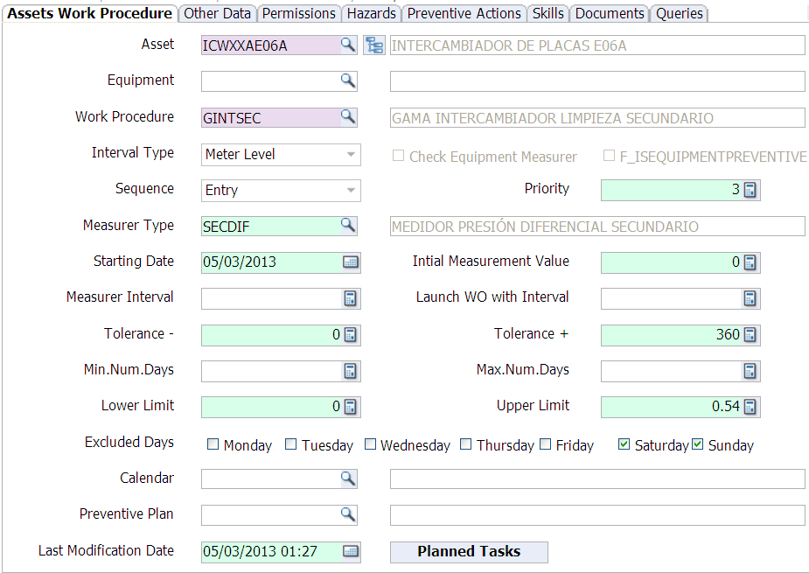
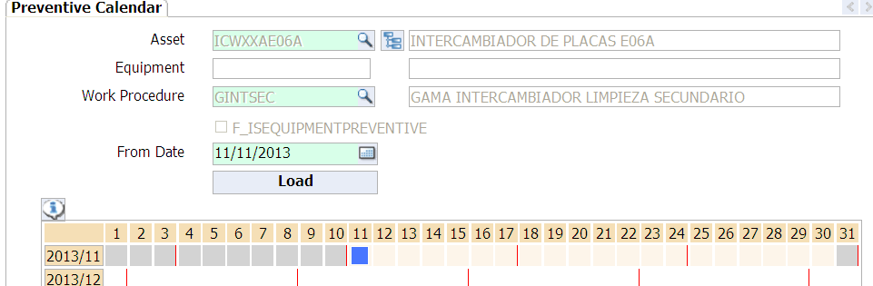
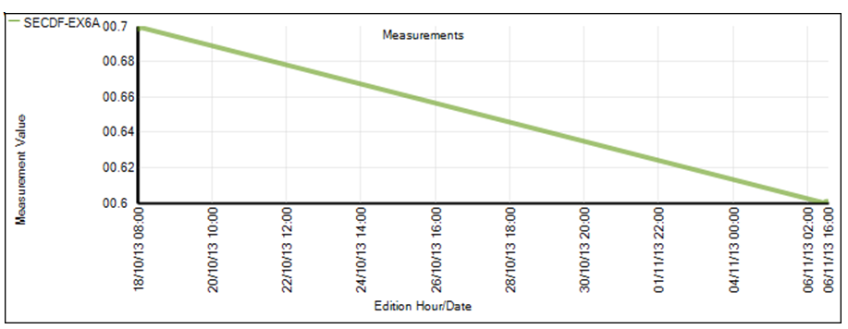
Work Order generated by indicator
Work order generated by indicator:
Planning launch work order to clean exchanger secondary side.
Differential pressure 0.60 bar > 0.54 bar, cleaning is required
  Measurer
  Inictial Value (if was necesary)
  Value to trigger Work Order
  Trend
  Predicted date

Slide 9
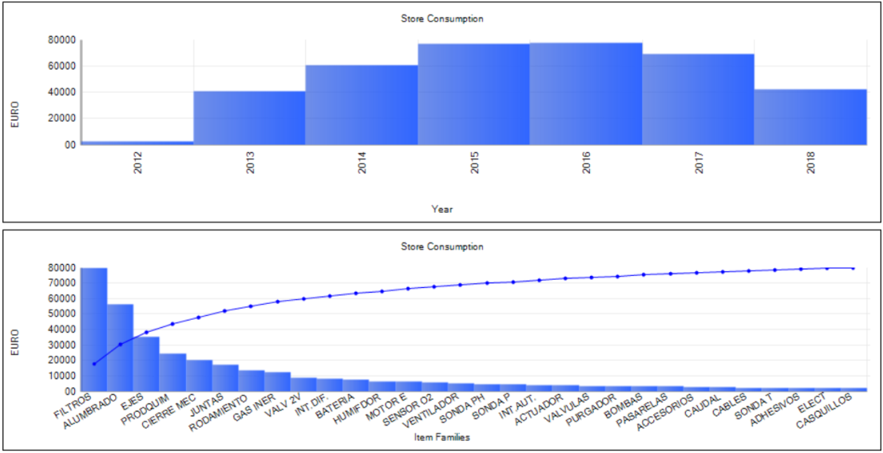
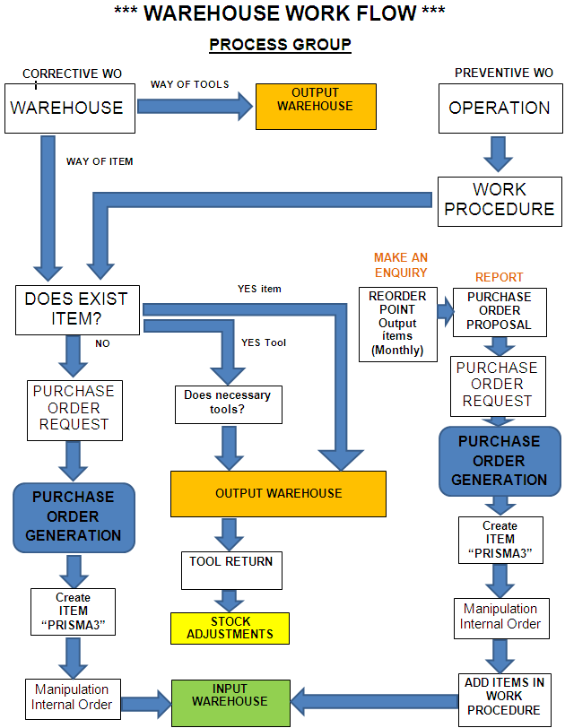
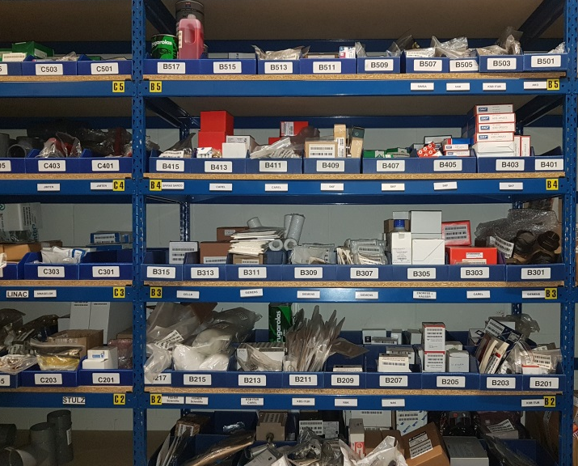
Spare parts
  Managed by Prisma3 (CMMS).
  Around 80.000 €/ last years
Spare parts Main Information
(2013-2018):
Different Families: 1.849 (bearings, filters, screw, seals, etc)
Quantity of items: 24.310
StoreShelf (positions): 3.666
StockMov: 15.920
  Take Item and WO register
  Stocks Work Flow

Slide 10
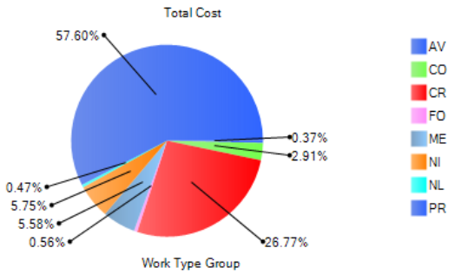
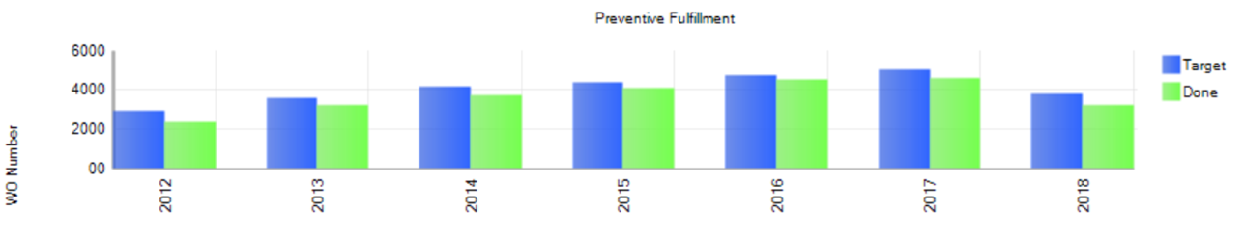
Maintenance Key figures
A total of 3830 Assets
  Since launched application, (2012)
Assets: 3800
Preventive Work Order: 49.909
Corrective Work Order: 13.885
Total Work Orders: 63.794
Planning Task simulated: 183.401
Number of Measurements performed: 8.321 (assets measure)
  Work Type Group
  Planning Task Target

Slide 11
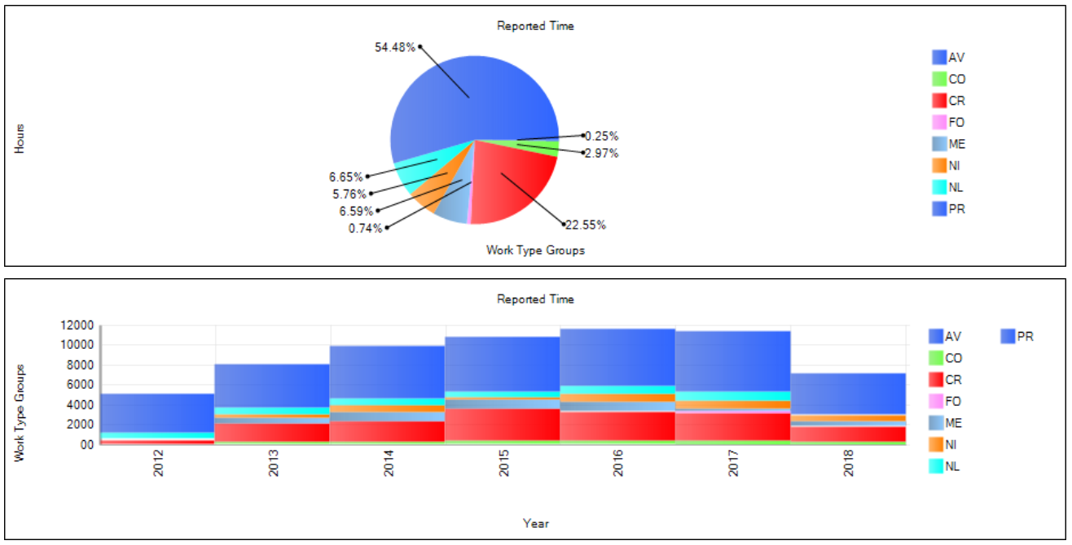
Work Type Reported Graphic (time)
All figures are since we launched application, (gen-2012)
Work Group types:
  PR: Preventive+Predictive
  CR: Corrective
  CO: Conductive
  NL: Legal Operations
  ME: Improvements
  NI: New Facilities
  FO: Training
  PR: Preventive, Predictive
  Maintenance
  NL: Legal Operations
  Maintenance
  (preventive also)
  CR: Corrective Maintenance
  11.000 hours/year = 6 technicians

Slide 12
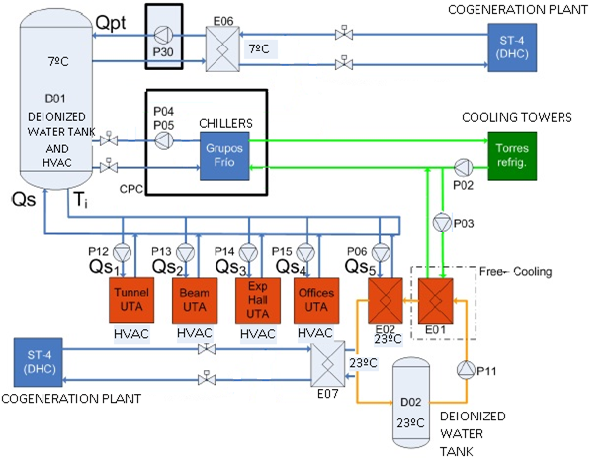
Water Cooling Systems Pumps
Water Cooling Systems and Distribution (4 circuits)
  Hot water at 50±0,5ºC used for comfort air conditioning.
  Cold Water at 7±0,5ºC, used mainly for HVAC (air conditioning) and cooling
  Deionized water at 23±0,2ºC, to refrigerate science equipment's and accelerator rings.
  Cooling towers for chillers and Free-Cooling.
CW and HVAC Storage Tank 19 m³
CW and HVAC Exchanger
DW Storage Tank 40 m³
DW Exchanger

Slide 13
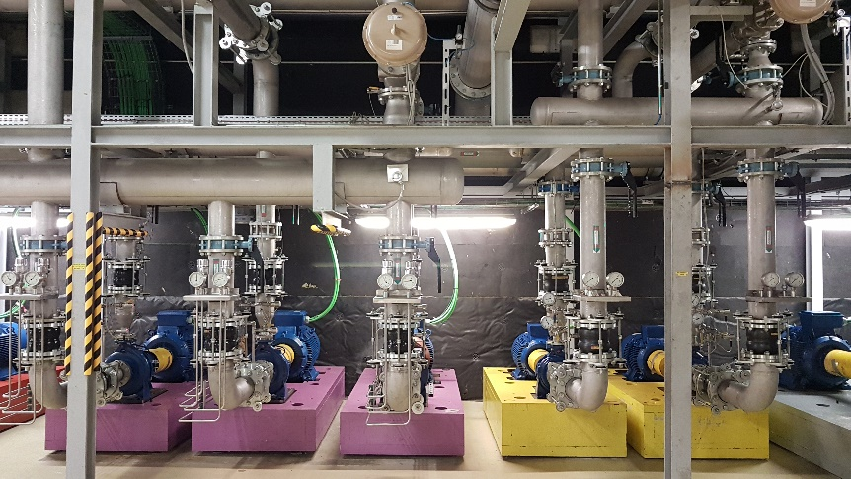
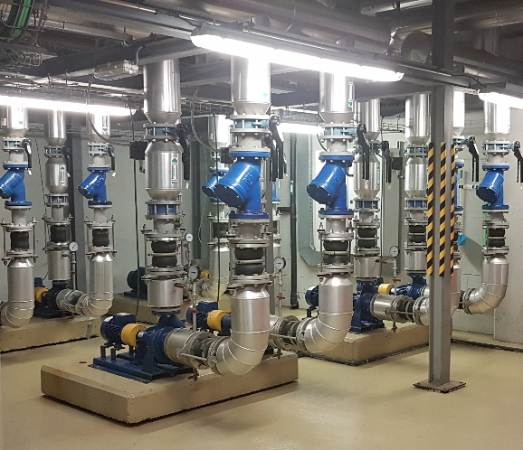
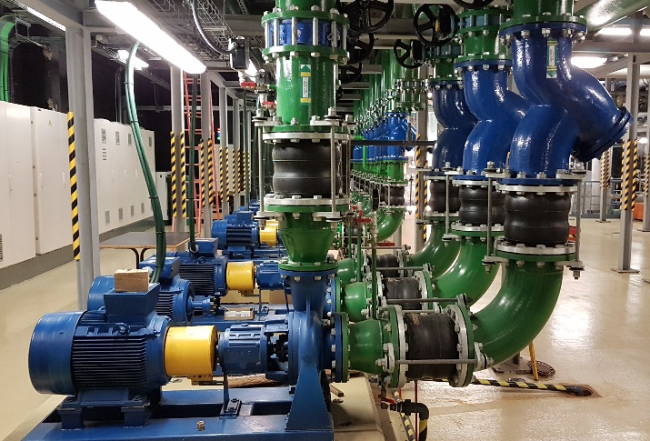
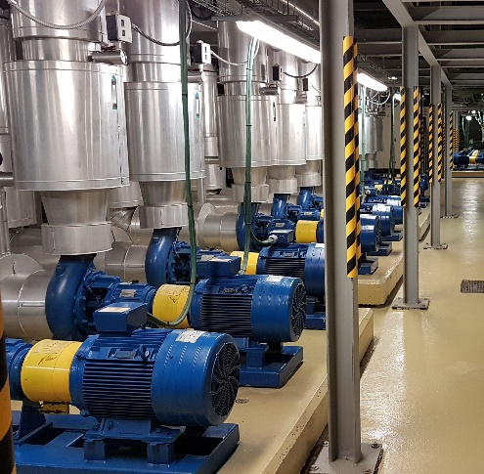
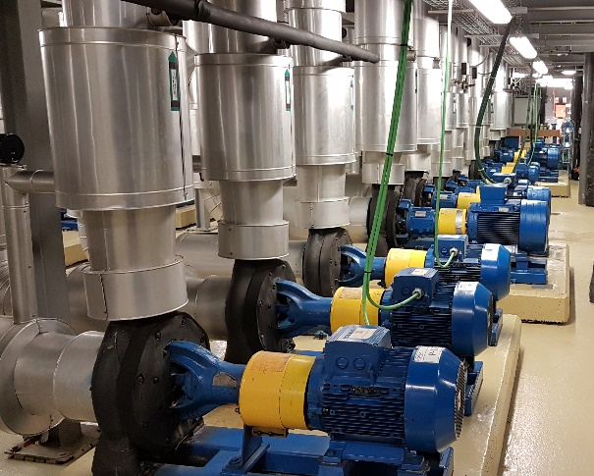
Water Pumps
Some pumps pictures from differents areas
64 Main Pumps of different sizes
  Deionized Water Pumps 23ºC
  Hot Water Pumps 50ºC
  Cooling Tower Water Pumps 25ºC
  Cooling Production
  Water Pumps 7ºC
  HVAC and Cooling Water Pumps 7ºC

Slide 14
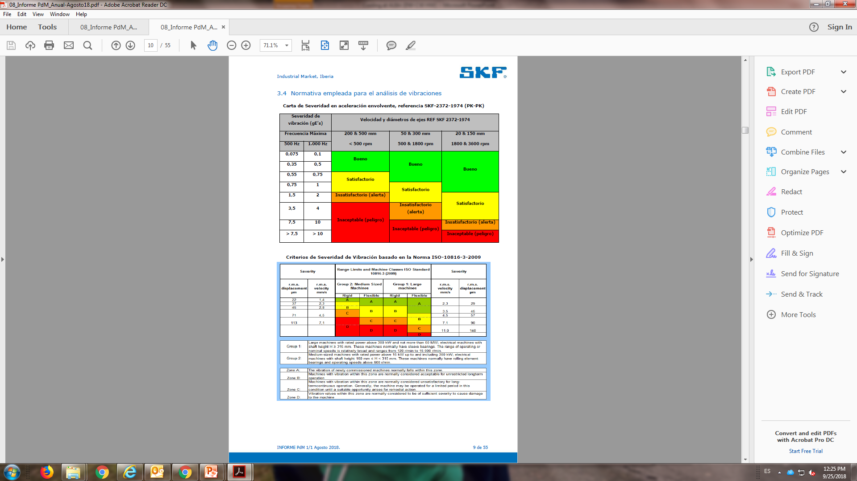
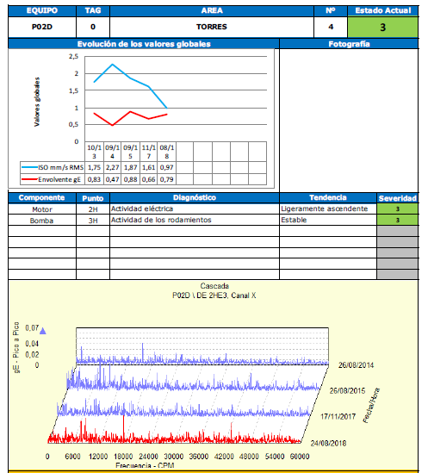
Pumps Predictive Maintenance
Reference Standard Severity ISO 10816
  Acceleration
  Displacement, Velocity
  Data collection at 10 Points of measure:
  Horizontal, Vertical and Axial in each pump
  Position of accelerometers
  Vibration Analysis Report

Slide 15
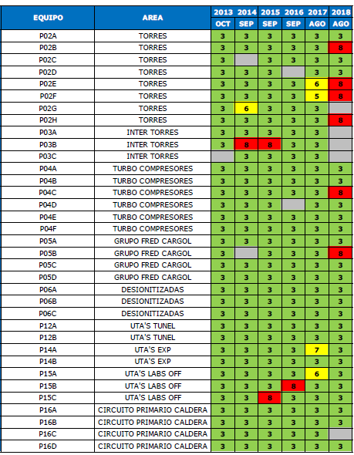
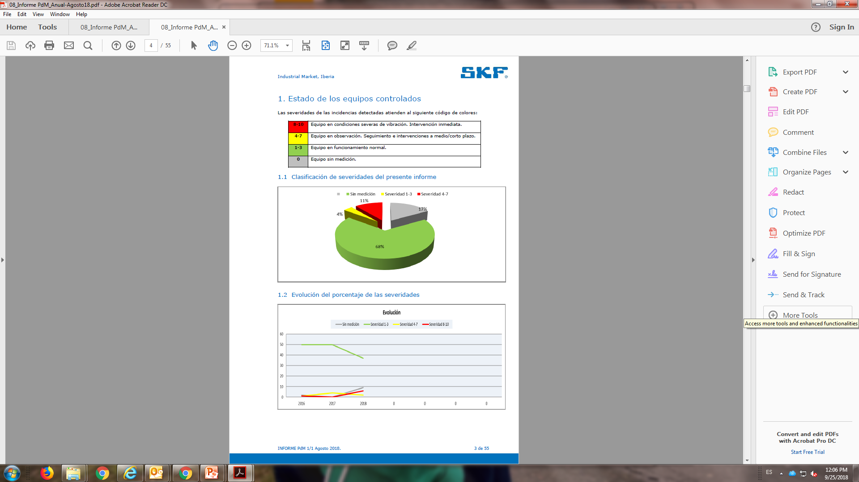
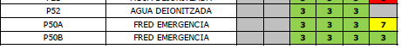
Pumps Predictive Maintenance
  Report of 6 years of measures
  Measurement on more than 60 Pumps
  Degree of Severity:
  Red: Bad
  Green: Good
  Number of measure Pumps
Results Pumps Vibration Analysis
  .
  .
  .

Slide 16
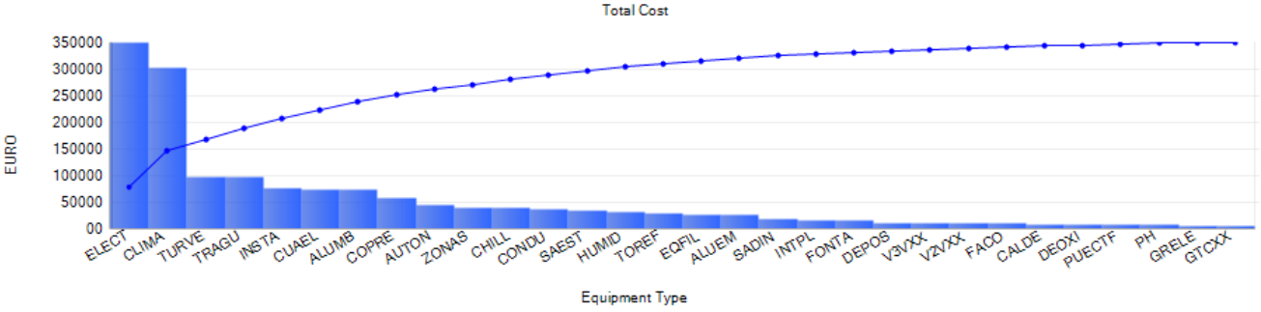
Equipment type cost
Major costs by type of equipment:
ELECT: Electric Motor and Pump
CLIMA: Heat, Ventilation and Air Conditioning, HVAC
TURVE: Turbine Extraction and Impulsion
TRAGU: Water treatments
etc…
  The higher cost: PUMPS

Slide 17
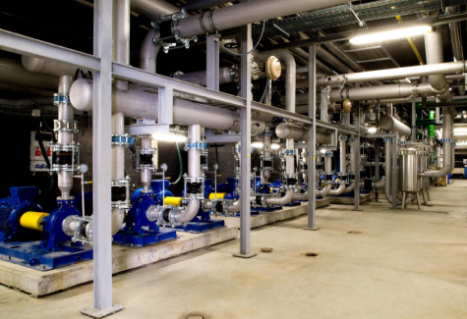
Deionized Water Pumps Case
12 Deionized water pumps
  Service Area: 3 Pumps (2 working + 1 backup)
  Booster Ring: 2 Pumps (1 working + 1 backup)
  Storage Ring: 3 Pumps (2 working + 1 backup)
  Experimental Hall: 2 Pumps (1 working + 1 backup)
  3 pumps in the same bench
  2 pumps in the same bench

Slide 18
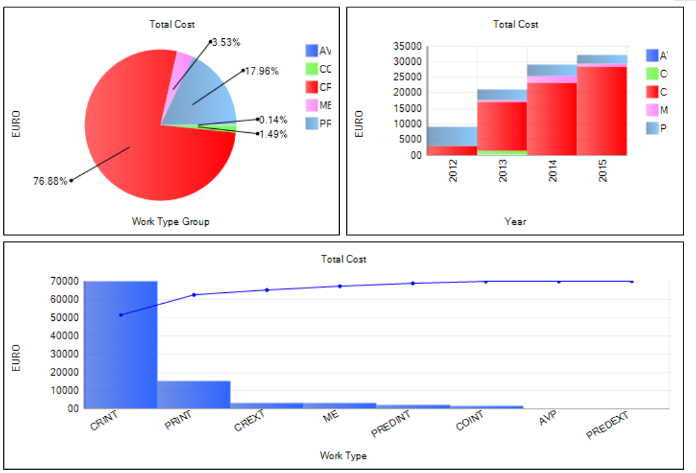
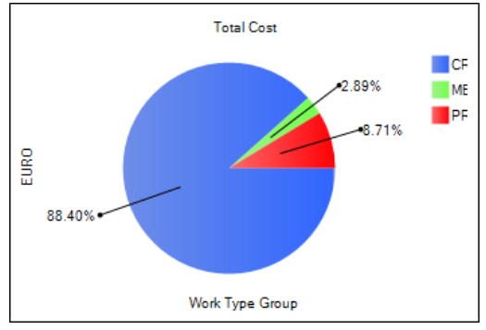
Deionized Water Pumps Case
Maintenance Cost (only in 12 Deionized Water Pumps)
  The maintenance costs were growing until 2015
  ¡We had a problem with DW Pumps!
  Only 2015
  Corrective
  Maintenance 2012-2018
  Corrective
  Maintenance 2015
  ¡Too much recurrent unexpected reparations!

Slide 19
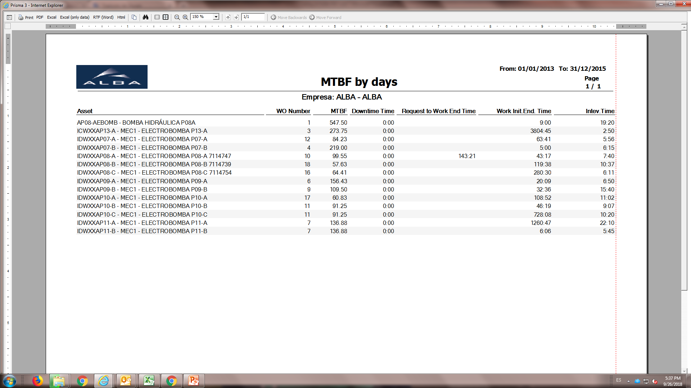
Deionized Water Pumps Case
Meanwhile the time between repairs was decreasing
  ¡Yes, we had a problem with DW Pumps!
  Only 2-3 months between big repairs!!!

Slide 20
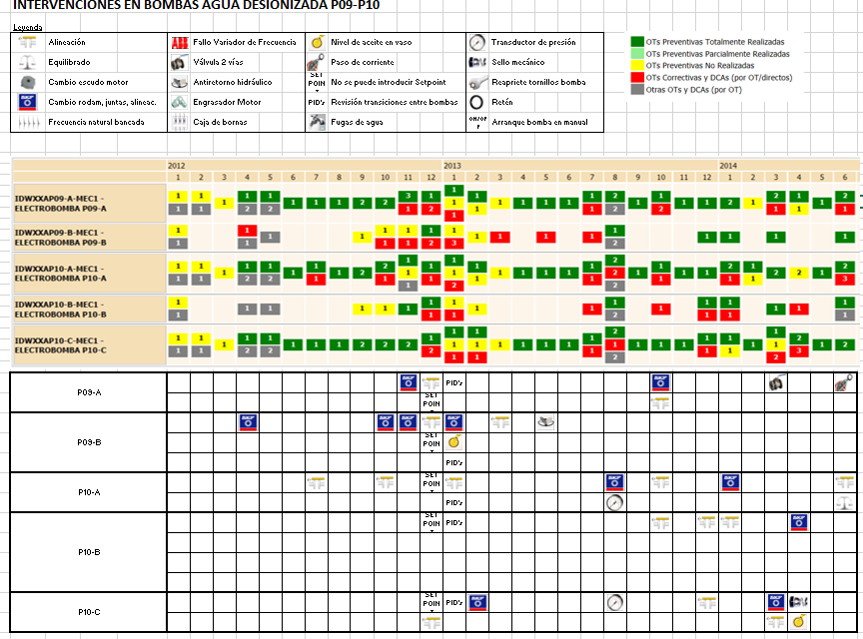
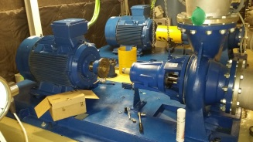
Deionized Water Pumps Case
Differents Problems:
  Many and repetitive problems
  Year
  CMMS: Prisma3, allowed us to analyze, identify and categorize the problems
  Bearing damage
  Misaligned
  Lost of oil
  Misaligned

Slide 21
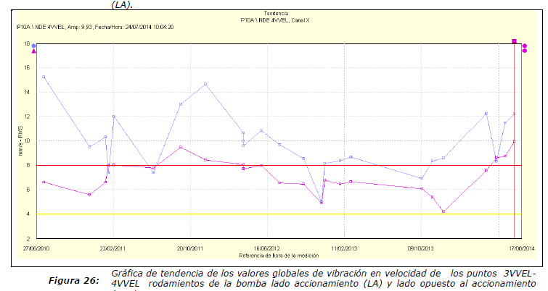
Deionized Water Pumps Case
The diagnosis and more questions:
  Predictive Analysis: Very high velocity values for pump size and type. Maintained in time.
  From P10A pump
  Usual values always higher than worse severity ISO
  High Severity value ISO
  Velocity: (8 mm/sg)
  Consequently, high values occur in acceleration also and finally damage.
  What about harmonic excitations?
  The design of the bench is the best to avoid them?
  What about of the rigidity of the bench (deformation amplitudes)?

Slide 22
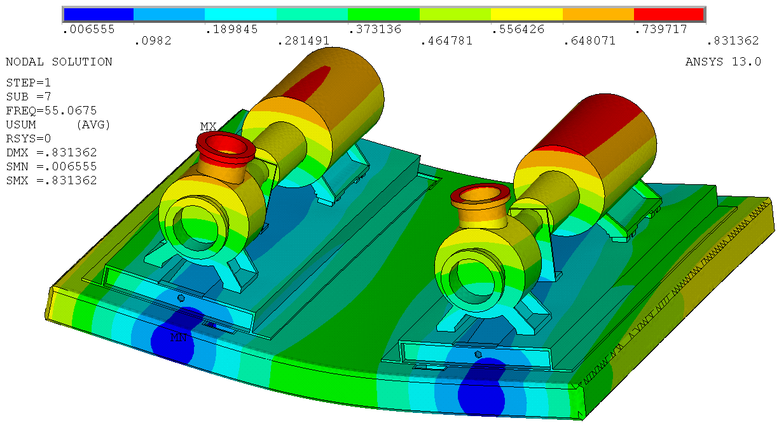
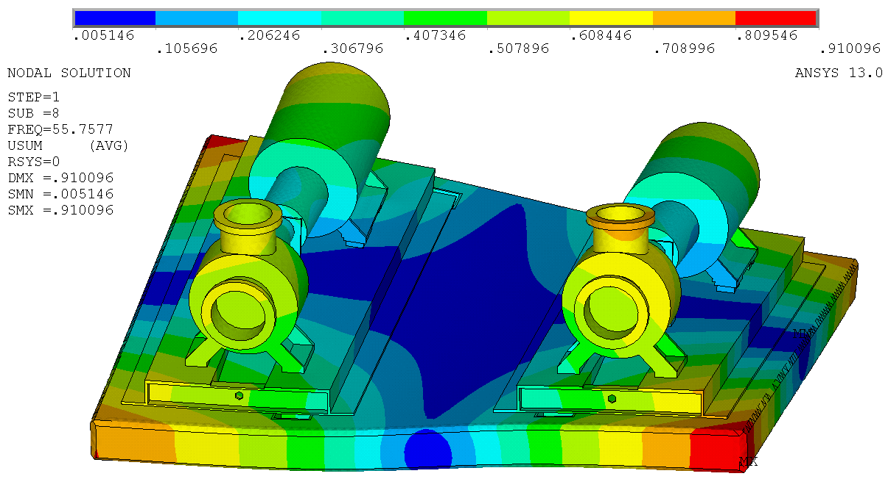
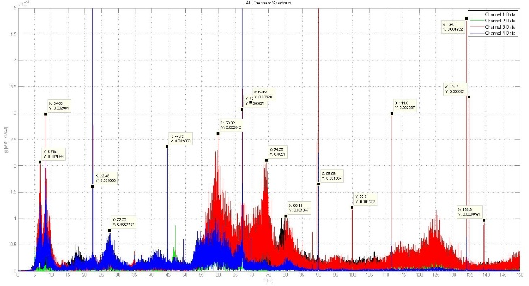
Deionized Water Pumps Case
Simulation, design, construction and test: New design of the bench
  We had the need to study the solution
  Bench simulation to discover natural frequencies in different vibration modes shapes.
  Modes shapes summary
Mode | Simulated [Hz] | Measured [Hz]
f₀ | 4 | 8,45
f₁ | 55,1 | 59,92
f₂ | 55,8 | 74,25
f ₃ | 127,5 | 125,1
f ₄ | 128,8 | 129,1
  Fundamental frequencies and harmonics

Slide 23


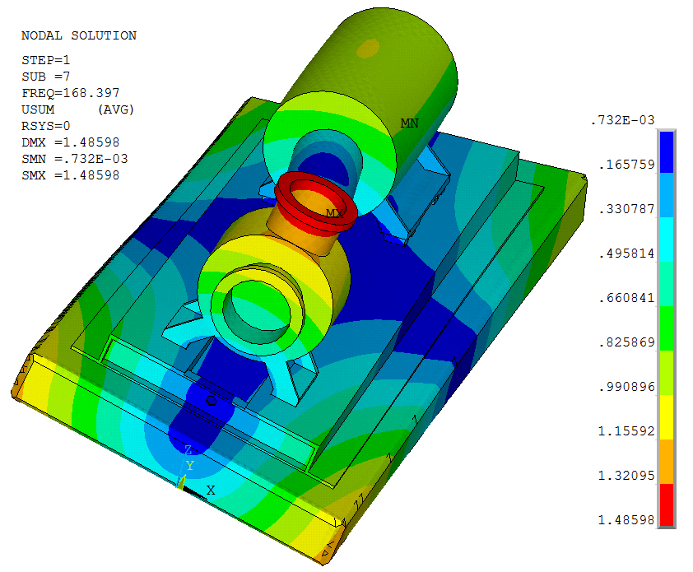
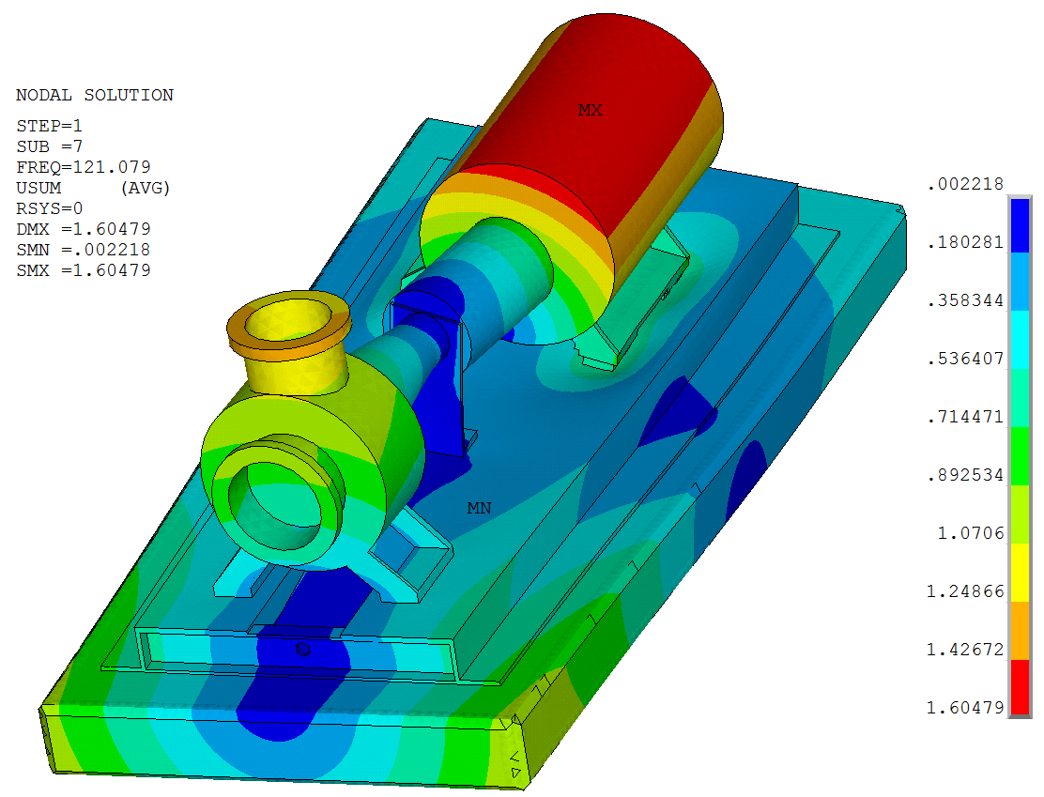
Deionized Water Pumps Case
Push the resonance modes to higher frequencies far away of the harmonic
  Dynamic Electro-pump loads coinciding with a natural frequency, can cause resonance, the design looking for push this frequencies far away the natural ones and his harmonics.
  Steel Base empty: f0=121 Hz
  Steel Base fill (steel): f0=168 Hz

Slide 24
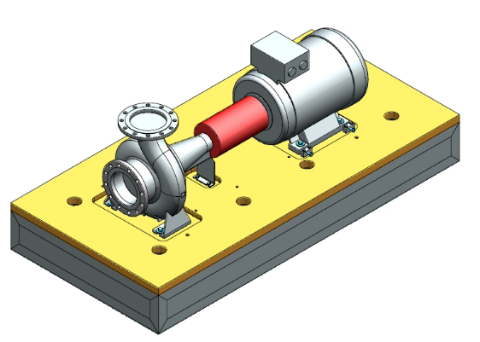
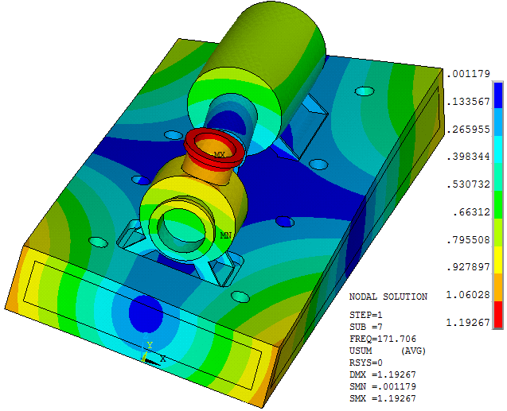

Deionized Water Pumps Case
Applied solutions
  Split the slab in two independent one for each pumping group.
  Concrete thick base
  Steel base plate
Isolation Pad
Steel plate
Concrete-steel gluing
Perimeter Steel
frame
Top/bottom steel frame
L steel profile
Concrete
  Proposed Design

Slide 25






Deionized Water Pumps Case
Construction and Test
  Frame
  Complete Frame ended
  Concrete Filling
  30 days of concrete setting
  Shaker final test

Slide 26





Deionized Water Pumps Case
Installation and commissioning
  Cutting the concrete
  Done
  Moving the slab

Slide 27




Deionized Water Pumps Case
Installation and commissioning
  Waiting the New slab
  New one
  Moving the slab
  Final position

Slide 28




Deionized Water Pumps Case
Installation and commissioning
  The next…
  12 Pumps moving….dozens of tons

Slide 29

Deionized Water Pumps Case
The results were as expected
  The corrective in the pumps has dropped between 50% - 60%
Impact of total cost of all maintenance
  - 3 %
  2015 New slabs installation
Corrective is going down

Slide 30
Deionized Water Pumps Case
Conclusions
This exercise it has been a very good example of how interact and work all together the multidisciplinary profiles of our engineers at CELLS Engineering Division.
Technician and Engineers from several fields such us Infrastructure, Workshop, Maintenance technicians, Civil Works, Survey&Alignment, Project Office, Draftsmen, Designers and Calculists.
  After 7 year in operation the Engineering Division is working on the upgrade of their Maintenance Program.
  According to our infrastructure growth the number of equipment pieces will increase.
  New installation will be included on the Maintenance Program: Radio Frequency (RF) Plants at Service Area, Beam Lines, and Helium Plant.

Slide 31


Thank you.

