Slide 2
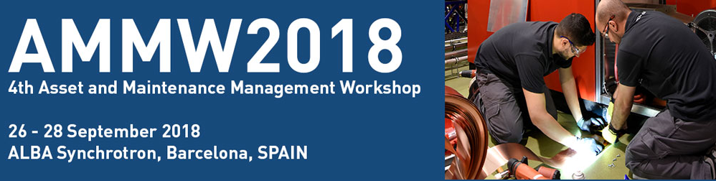
«From first to second Long ShutDown»
General cryogenic maintenance policy and recent update for CERN LHC assets
Presentation on behalf Cryogenics Group

Slide 3
Outline
INTRODUCTION
Lessons learned after LS1 in 2013-2014
2015-2018 Operational phase RUN 2
Evolution of the strategy for LS2 in 2019-2020
CONCLUSION

Slide 4
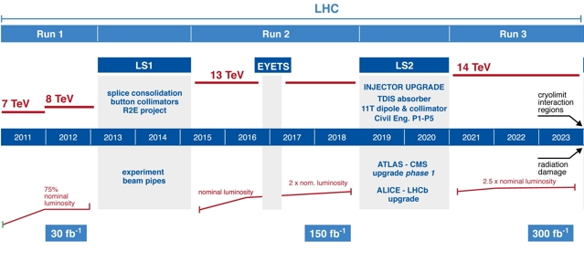
The context
Quick history
The LHC physics run 1 started in 2009 and the Cryo facilities. in 2008
  Change of sequence between operation and maintenance:
    LEP : 9 months of operation and 3 months of maintenance
    LHC : 3-4 years of continuous operation with 2-3 technical stops of a week and 1 stop of 8 weeks on Christmas, then 18 months of Long Shutdown
  Technical stop = no beams for physics, but Cryo. facilities have to work to ensure He inventory
INTRODUCTION

Slide 5

Mont Blanc
INTRODUCTION

Slide 6
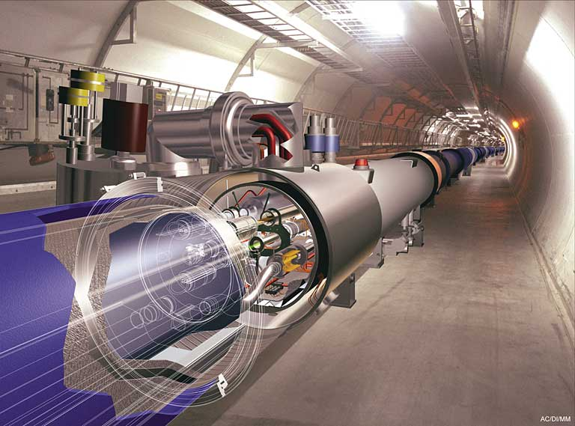
The LHC Accelerator
Technology
1800 Supraconducting Magnets
24 km @ 1.8 K
8 x 18kW @ 4.5 K
36 000 t He @ 1.9K
150 t He Inventory (LHC + strategy) = 7,5 MCHF
INTRODUCTION

Slide 7
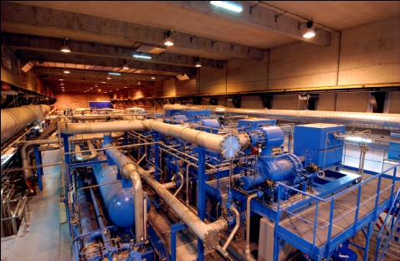
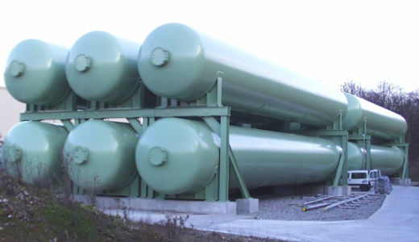
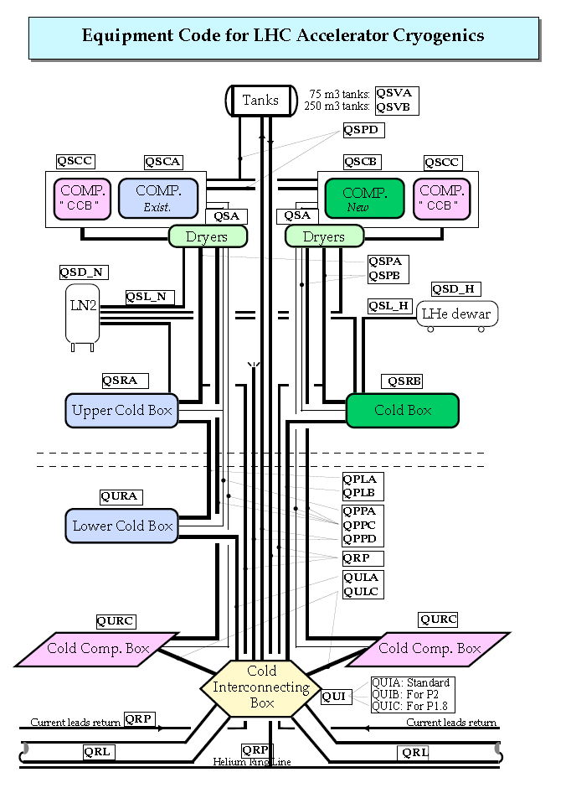
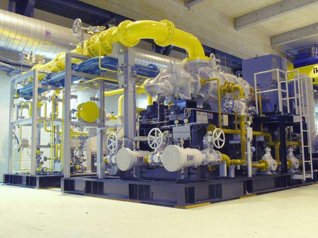
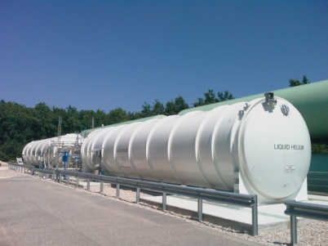
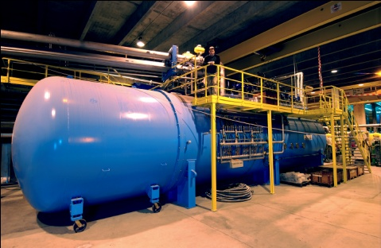
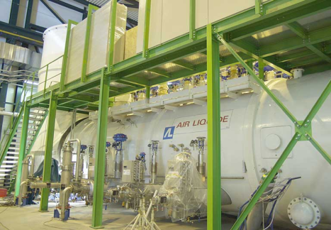
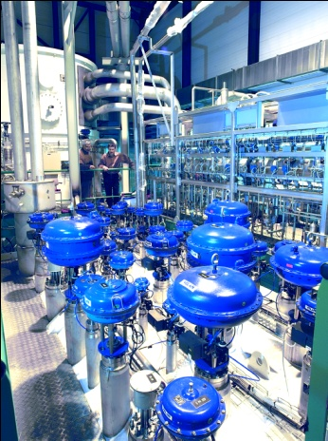
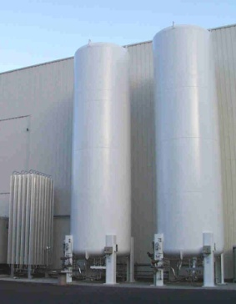

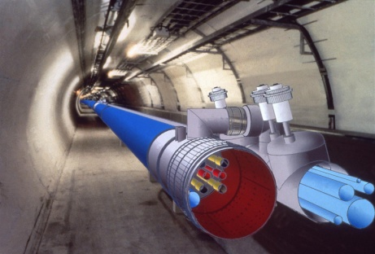
The refrigerators
helium storage
compressor
stations
liquid helium storage
cold boxes
helium transfer line
liquid nitrogen storage
INTRODUCTION
Notes:
Pour faire fonctionner le LHC, nous devons réfrigérer 24 km d’installations à une température de -271°C. Notre fluide réfrigérant est l’hélium qui est refroidi par huit grands réfrigérateurs.
Ces huit grand réfrigérateurs sont indiquées par des points rouges sur cette carte. A part ces installations nous avons encore une douzaine d’autres installations plus petites – représentés par les autres points colorés sur la carte. Les moyennes et petites installations alimentent plusieurs détecteurs et des stations de test.
Les tailles des systèmes sont très différentes, mais les principes de fonctionnement se ressemblent. Thermodynamiquement c’est toujours le même procès. Voici le schéma d’une des installations qui alimentent le tunnel avec du hélium refroidi.
Ces installations consistent en stockages d’hélium, en stations de compression, en réservoirs de stockages pour l’hélium et l’azote sous forme liquide, en boîtes froides qui contiennent tous les composants pour le procès cryogénique et la ligne de transfert isolée dans le tunnel qui alimente les aimants avec de l’hélium à -271 °C.
Ce sont donc les installations que nous devons maintenir.

Slide 8
Next chapter
INTRODUCTION
Lessons learned after LS1 in 2013-2014
2015-2018 Operational phase RUN 2
Evolution of the strategy for LS2 in 2019-2020
CONCLUSION

Slide 9
Introduction: les chiffres
LS1 in figure
Main revisions
57 Srew compressors
27 Oil pumps
50 Motors with sleeves bearings
11 Motors with ball bearings
20 Motors up to 1.8Mw
33 motors (<200kW) changed
75% LHC park
Vaccum
200 Pumps maintained
235 Gaujes maintained
29 Gate valves
METHODES/COORDINATION
5200 WO
GMAO,
Spares parts
PMs, Plannings, KPIs
MECHANICS
2000 Safety valves calibrated
~ 94 coalescers inspected,
et 613 cartouches changed
12 Adsorbers traited, 22 tonnes of active charcoal
28 chimical cleaning (Heat exchangers)
~ 6700 O-rings changed
ELEC - INSTRUMENTATION
250 Valves consolidated
38 Valves (Masoneilan) maintained
2000 Sensors / 3500 Transmiters
320 Relays changed
Source: SERCO
LS1 Feedback

Slide 10
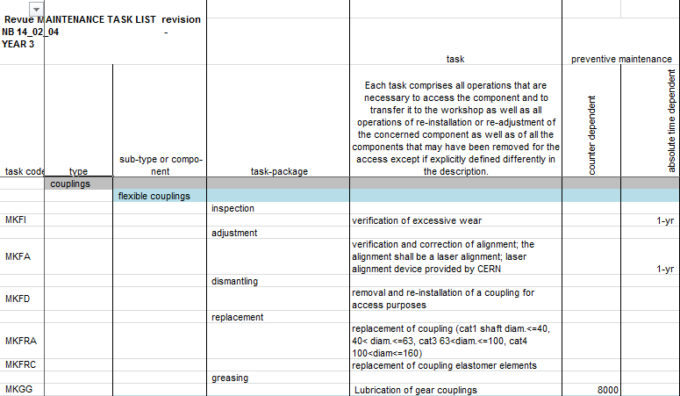
Maintenance plans
4400 maintenance plans, abundant generation of Workorders, but we knew that it was not completely exhaustive because nothing wanted to be ruled out:
References:
Defined Maintenance Task List
172 pre-established task codes
Defined Periodicities and meters
But a need to be updated before LS1
Be careful not to get lost in an abundant generation, which requires considerable processing time!
LS1 Feedback

Slide 11
Example with Oil Pumps
  Adjustment of the periodicities according to the elements of criticality :
    Redundancy
    Spares parts
    Detectability: Vibration measurement, oil analyses….
    Feed back of last overalls
Very useful !
LS1 Feedback

Slide 12
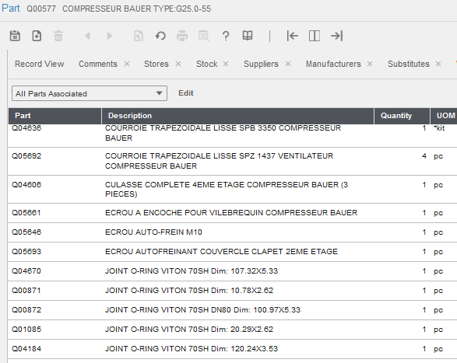
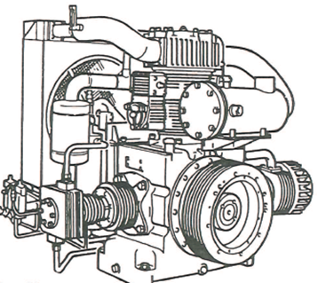
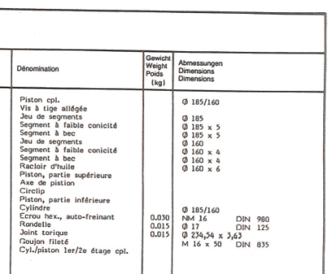
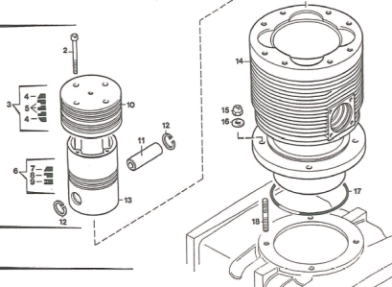

Spare parts management
Working basis = Preventive Maintenance Plans
Method of work adopted = Bills of Materials
Establishment of a nomenclature by equipment model
(Example for a piston compressor)
Very helpful !
LS1 Feedback

Slide 13
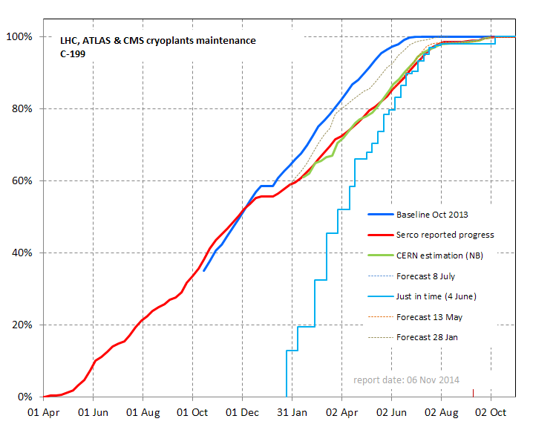
KPI(s)
No Baseline at the beginning
Provide comprehensive monitoring, to anticipate and ensure better reactivity
LS1 Feedback

Slide 14
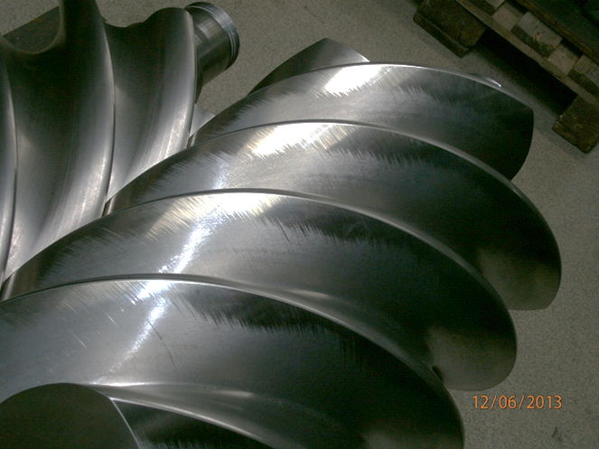
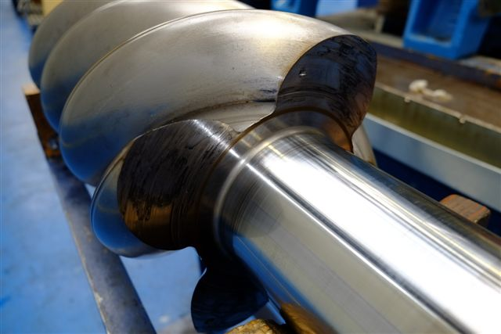
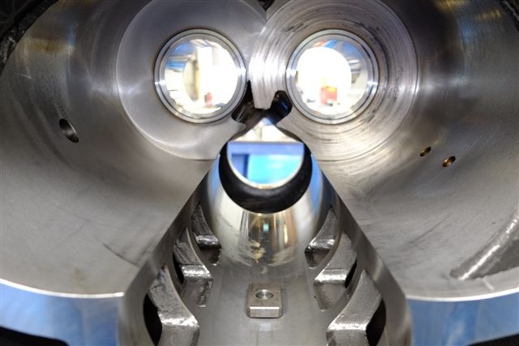
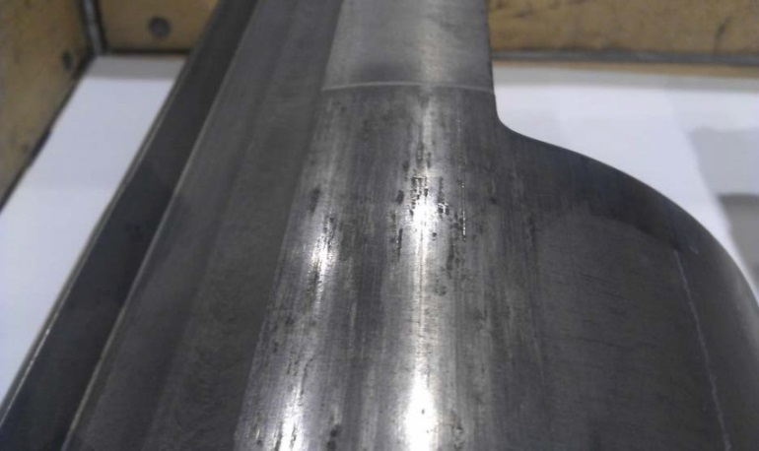
Compressors: examples of nonconformities
Kaeser
Howden
Scratches on rotors and stators
Stal
Slide valve
LS1 Feedback

Slide 15
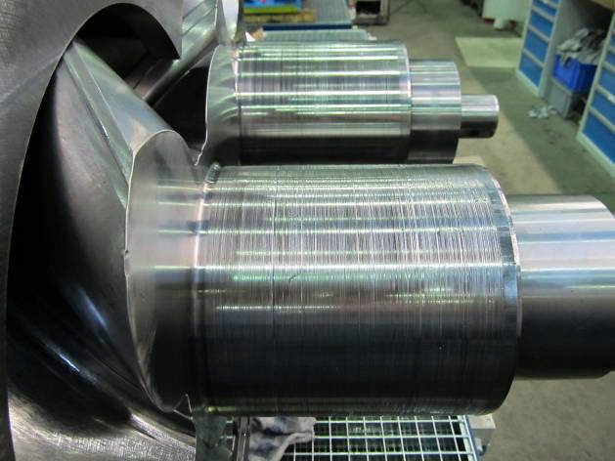
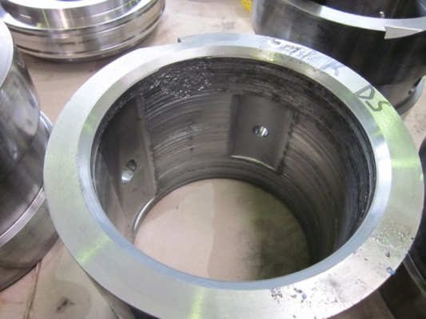
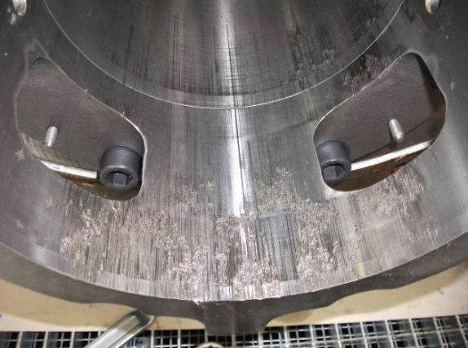
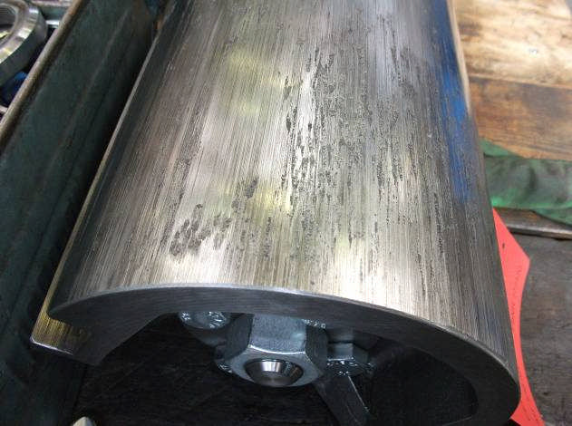
Compressors: examples of nonconformities
AERZEN
Rotors and sleeve bearings (VMY536aM)
Balancing piston
Slide valve
LS1 Feedback

Slide 16

Compressors: Costs by models and unit
The costs do not necessarily reflect the reliability!
LS1 Feedback

Slide 17
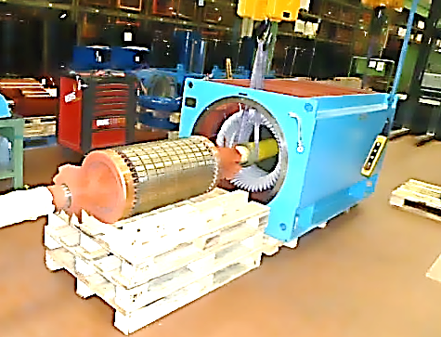
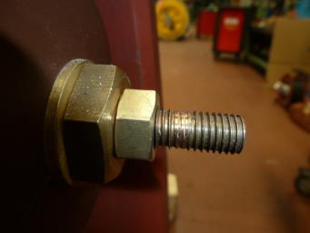
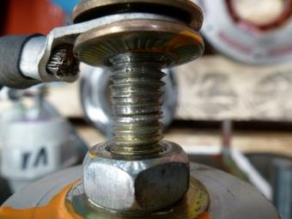
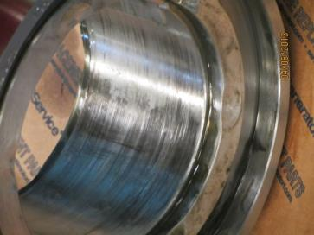
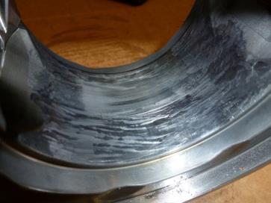
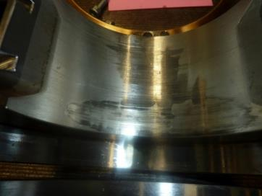
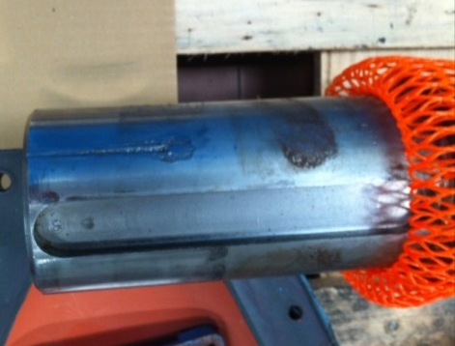
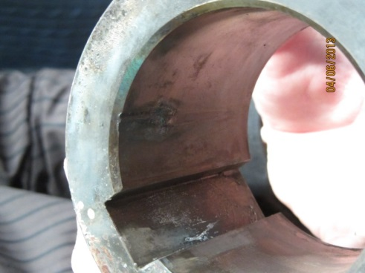
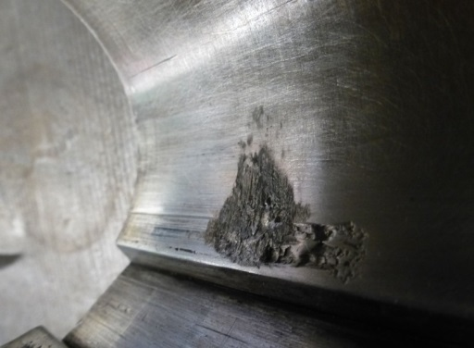
Motors: examples of nonconformities
Electrical connections
Sleeve bearings
But no major issues!
Shafts and couplings
LS1 Feedback

Slide 18
Next chapter
INTRODUCTION
Lessons learned after LS1 in 2013-2014
2015-2018 Operational phase RUN 2
Evolution of the strategy for LS2 in 2019-2020
CONCLUSION

Slide 19
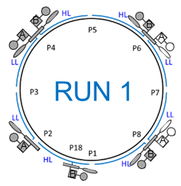
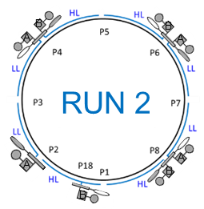
LHC Cryogenic System Configurations
RUN 2
Notes:
Idea: keep as many refrigerators as possible OFF, to minimize the number of running cryoplants and then maximize the global reliability and availability.
As well, increased beam-induced heat loads acts directly on the load seen by the 4.5 K refrigerators and not the 1.8 K ones. Remember that installed capacity can cover 160 W/hc, and we are no more at 10 W/hc but at 130 W/hc => less less margin!!!
BEWARE: at LHC Point 4, QURCB is running (and not QURCA), because of the sensitivity of RF cavities to pressure increase (around 1.4 bar). If we run QURCA, then there will be no temperature mixing between D return from QURCB (around 30 K) and D return from the cavity (around 12 K) => D return will be colder on that side (around 12 K instead 20 K).
On this “B side”, QSRB is at surface level => there is a 100 m hydrostatic column. At 12 K, gas is more dense, hence the raise in pressure in line D => as well in the RF cavity, which is very sensitive to that factor!
Instead of that, we run QURCB (to mix the “D returns” of the cavity and the QURC), because on the A side, there is no hydrostatic column, as QURA is in cavern.

Slide 20
Due operation days of one refrigerator
15 days allocated for maintenance
365 days
M
118 days
LHC sectors cold standby and beam commissioning
232 days
LHC physics production
LHC Cryogenic Availability statistics are refering to this period
Based on Run 2 average values
RUN 2

Slide 21
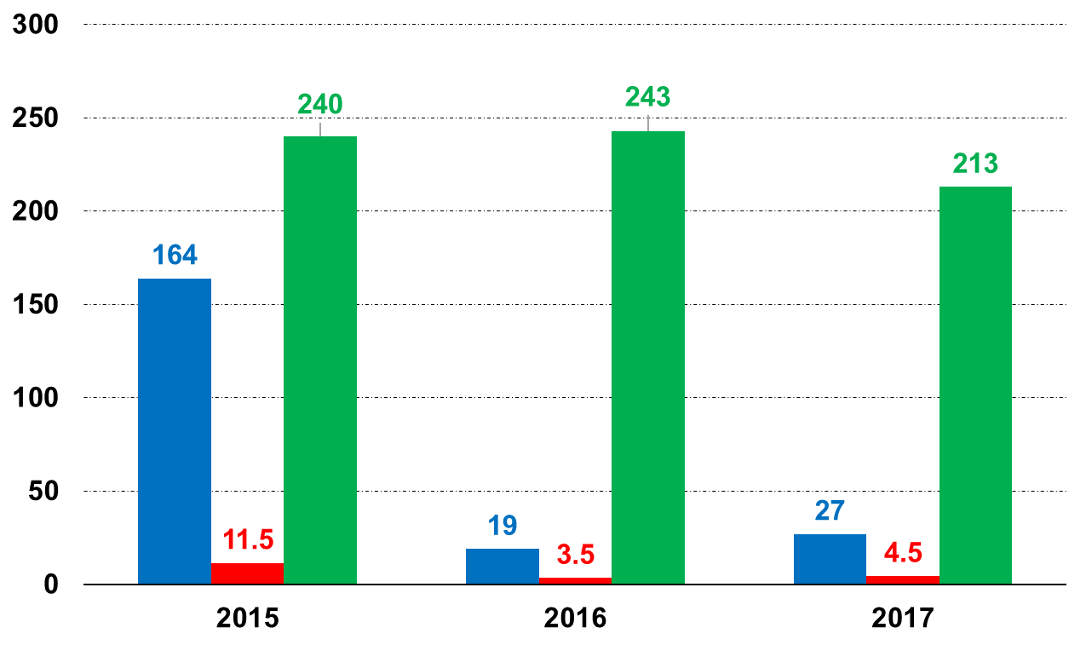
Run 2 CryoMaintain Downtime
Cryo losses duration (days)
Due operation time (days)
Cryo losses number
Average due operation time for Run 2:
5561 hours per year (⬄ 232 days)
RUN 2
Notes:
Comments: RUN 2 was dominated by increased beam energy and intensity. Electron cloud phenomenon pushed our refrigerators towards their limits, and for the first time the beam feedback had to be taken into account to operate LHC Cryogenics.
This is the very reason why 2015 served as learning curve, to allow for troubleshooting of CM losses related to increased beam-induced heat loads => let us see on next slide what were the main losses of RUN 2, by type and by duration.
One should also remember that LHC cryogenics deals with 64 CP, 74 TUs, 28 CCs, 1200 current leads, 60 000 I/O signals and 4000 PID loops!!!
Instrumentation – inventory for LHC tunnel : TTs ~10000, PTs ~700 PTs, LTs ~500, EHs ~2500 + different cryogenic valves (cold valves ~1400 + 1258 current leads warm valves)

Slide 22
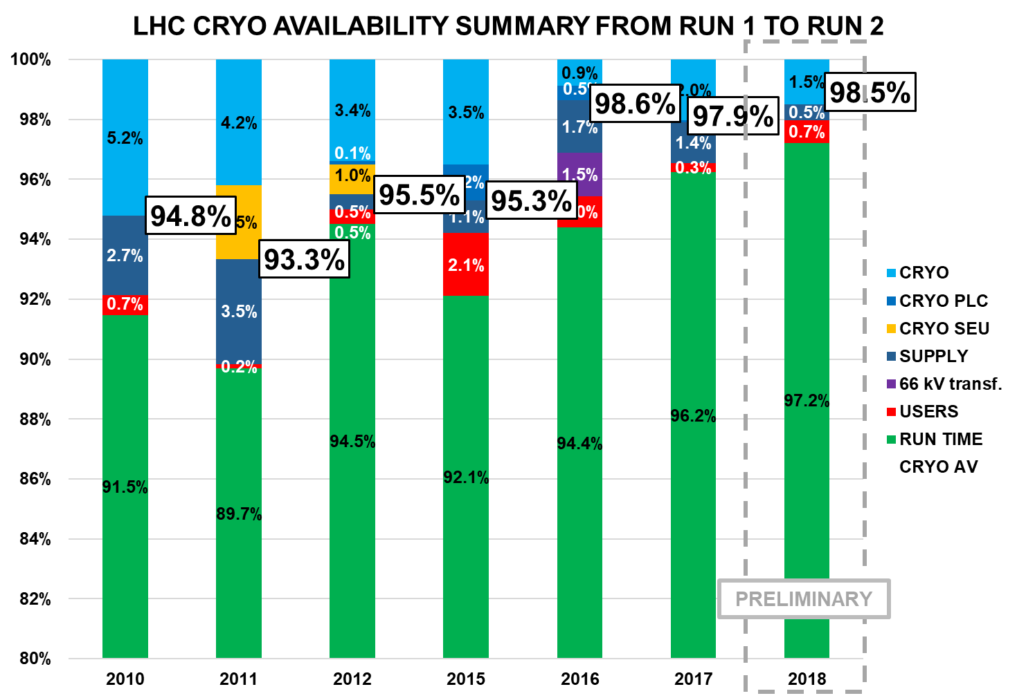
LHC Cryo availability summary
RUN 2

Slide 23
Next chapter
INTRODUCTION
Lessons learned after LS1 in 2013-2014
2015-2018 Operational phase RUN 2
Evolution of the strategy for LS2 in 2019-2020
CONCLUSION

Slide 24

New work organisation for LS2 (1/3)
Strong CERN Cryogenics group
involvement in Maintenance
Industrial Partnership
Cryogenics Group
Operation
Methods and Logistics
Cryolab and Instrumentation
Mechanical and Engineering support
Control and Electrical Support
Maintenance support Team
Mechanical Maintenance Experts
Instrumentation Maintenance Experts
Electrical Maintenance Experts
Operation
Operation support or fully delegated
Mechanical Maintenance Team
Maintenance support Team
Coordination
Planning
CMMS
Spare parts
Field Vaccum Team
Field E&I Team
LS2 Strategy

Slide 25
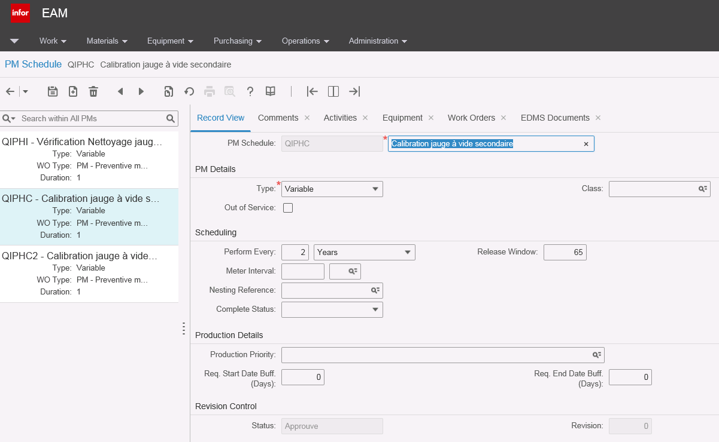
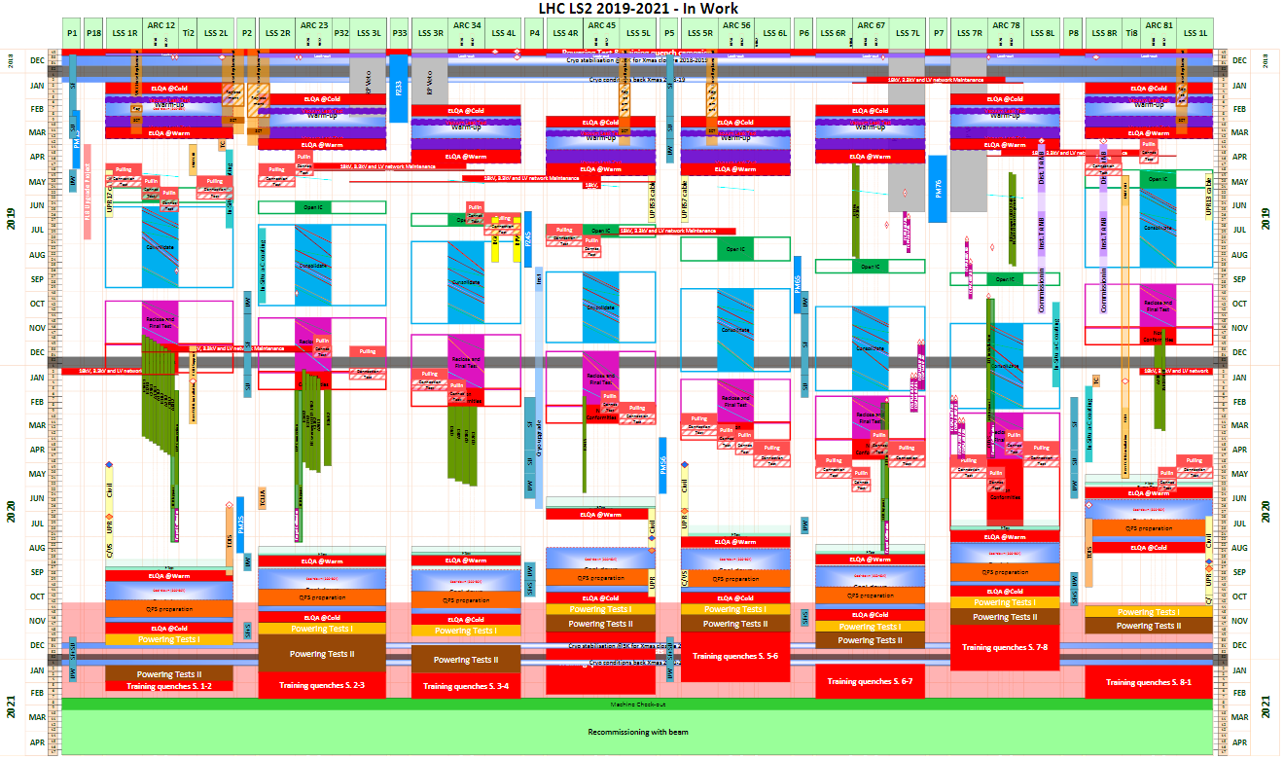
New work organisation for LS2 (2/3)
Computerized Maintenance Management System
All Maintenance Plans are review by:
  Maintenance experts by field
  Method & Logistic support section
  Contractor Maintenance Support team
Reference matrix is updated and shared with the contractor
Update of the of the CMMS is done by the contractor
Work Preparation and planning will following the coming months according to CERN requirement
LS2 Strategy

Slide 26

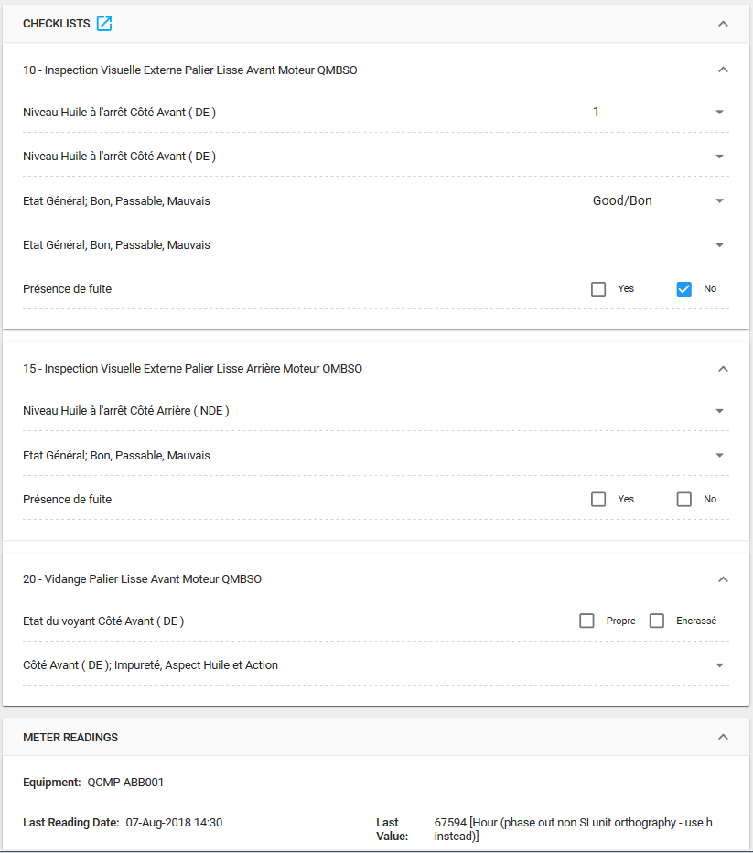

New work organisation for LS2 (3/3)
Work Instructions and Field Forms
All mechanical & electrical documents technical contents have been updated in the past year
We are testing electronic checklists
LS2 Strategy

Slide 27
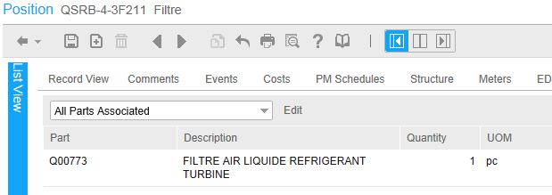
Implementation of spare parts management
Preparatory work has made the best use of the data with the integration of parts in the CMMS
=> Parts Associated and Material Lists for LS2, during LS1
The parts used on each device have been automatically integrated into the BOM, making it easier to operate the LS2
Implementation of a new integrated purchasing module to facilitate the workflow of restocking parts via CMMS
LS2 Strategy

Slide 28
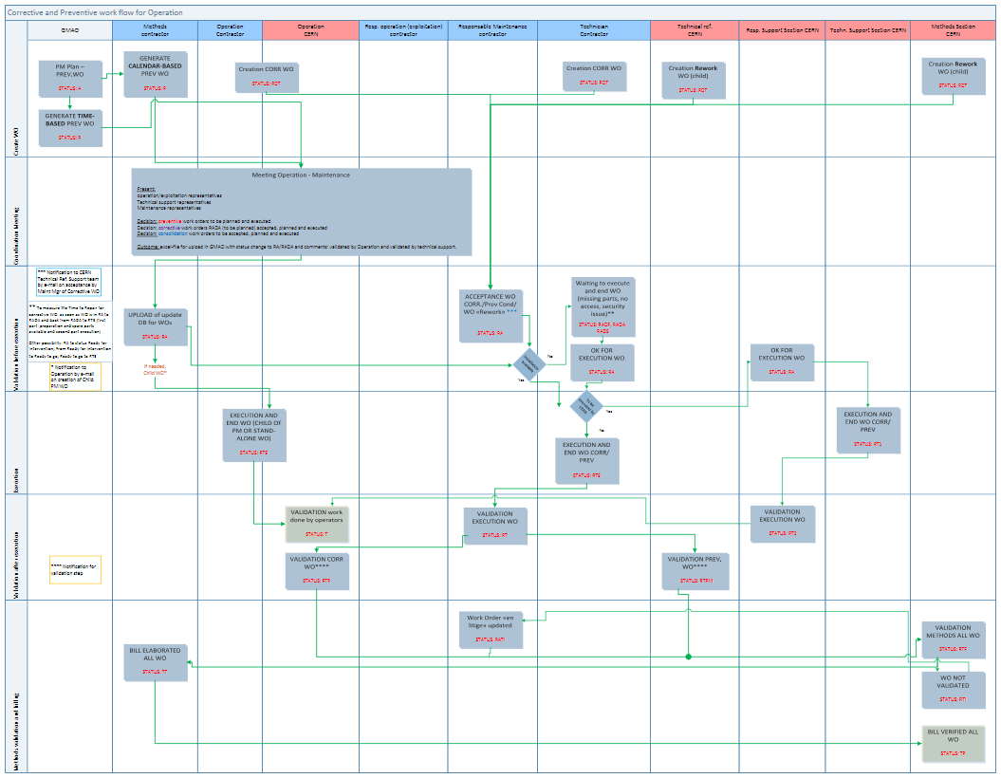
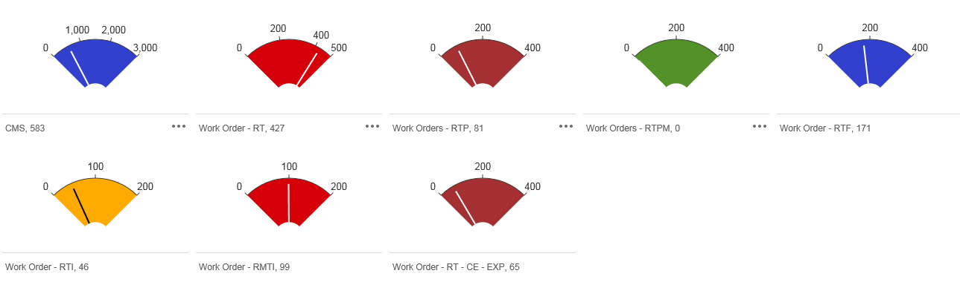
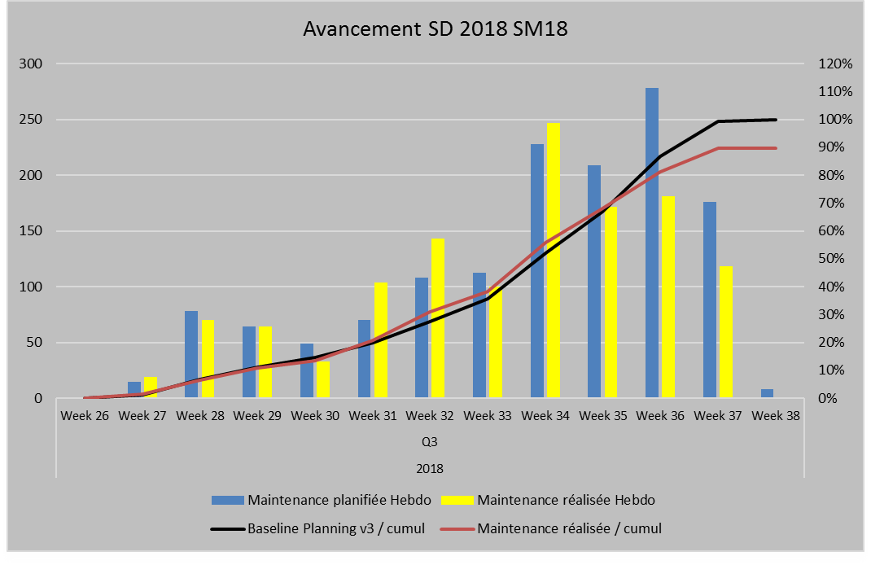
Implementation of workflow and KPIs
Optimization of the reporting quality in order to
get the best feedback from the field and manage teams
Improvement of workflow is in place and each check and validated by CERN technical expert in the field and WO is quality controller
LS2 Strategy

Slide 29
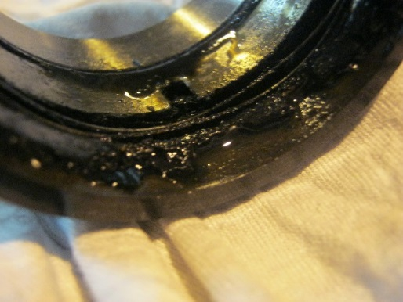
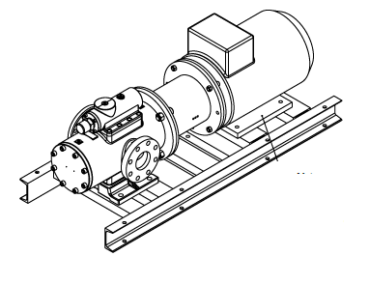
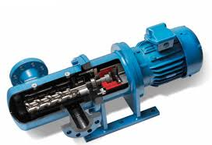

Typical consolidation on oil pumps
Shaft Seal Leaks
  Oil pump shaft seal failures caused by overheating due to dry running when the spare unit is switched on. Increase of shaft seal leaks after LHCB pump switch
  Failure by embrittlement of the secondary O-ring
  Destruction of the raceway surface by impurities
Integration of new oil pumps with magnetic coupling,
associated with a soft starter device
+
LS2 Strategy

Slide 30






Typical improvement of tools: Beamex MC6
New Integrated calibration system, to improve efficiency and quality
Calibrations are planned in Infor EAM. Work orders are transferred to CMX
Calibration planning and information from the work order are completed in CMX
work orders are transferred via the interface
Calibration is done in the field or at the workshop
The calibration summary is saved and the work order is closed in Infor EAM
a summary of the calibration is transferred via the interface
CMX saves calibration results, as found as left
LS2 Strategy

Slide 31
Next chapter
INTRODUCTION
Lessons learned after LS1 in 2013-2014
2015-2018 Operational phase RUN 2
Evolution of the strategy for LS2 in 2019-2020
CONCLUSION

Slide 32
Conclusion
Long Shutdown 1 has been a major challenge for us, but the results of availability obtained during the RUN 2 allow us today to prepare the LS2 on the same framework
Quantity of maintenance plans will be reduced as lesson learned showed us which tasks are the most valuable
Our new organization therefore aims to bring together the technical experts in each field of activity to provide the best answers for each equipment class
In order to provide the best methods of maintenance we are still working on further developments such as: purchase of new tools, transition to electronic checklists, device reliability analysis and improvement and spare parts stock optimization
CONCLUSION

Slide 33
Many thanks for your attention
Questions ?

