Slide 2
What’s new in AMM at CERN
Goran Perinić, Peter Jurcso, CERN

Slide 3
What’s new in AMM at CERN
Introduction
Recent developments
  Barcode printing
  Store kiosk
  New version of the radioactive waste management application
  New version of the end user interface EAM-Light
  New links with CERN’s ERP
Current developments
  Store management for the LS2 shut-down-storage location
  Open-sourcing of the web service hub and some of its applications
What is and what remains difficult in AMM

Slide 4
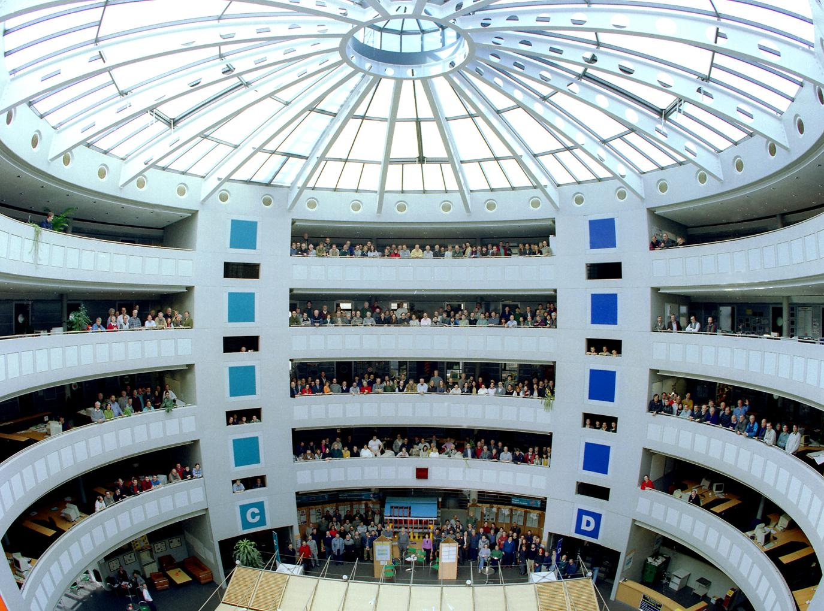
The CERN organisation in numbers
Funding: | 22 | member states
Staff: more than | 2600 750 13000 | staff fellows visiting scientists
Budget: | ~1.1 | billion CHF

Slide 5
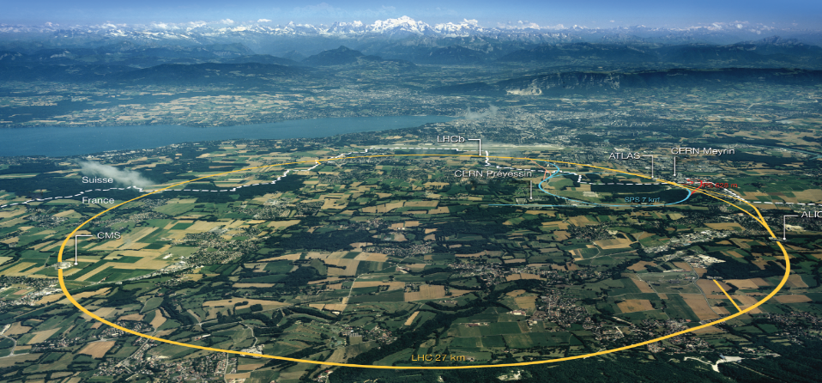
In terms of an operations engineer:

Slide 6
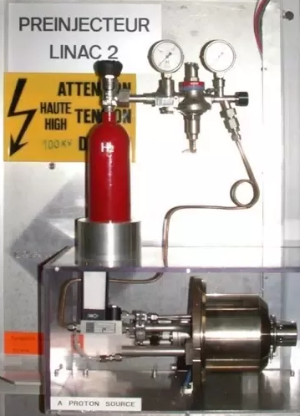
CERN is transforming a raw material (e.g. protons or heavy ions)

Slide 7
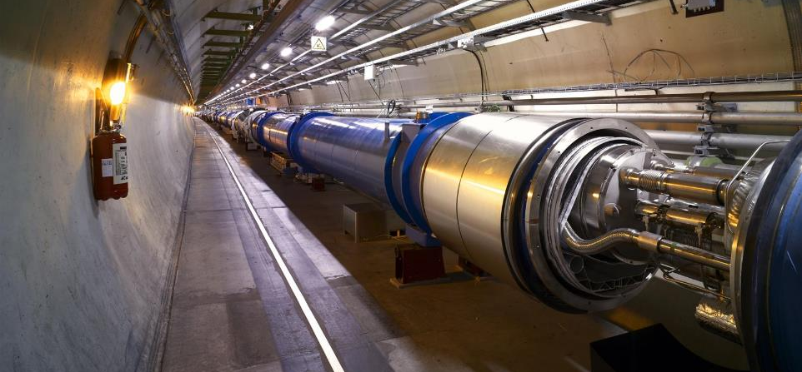
by acceleration in a series of highly complicated accelerators

Slide 8

and collision in the centre of ingenious detection systems

Slide 9
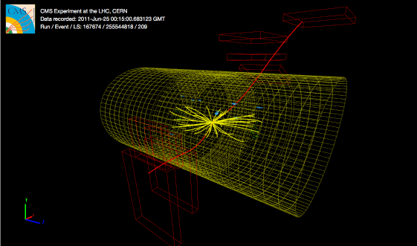
into data about particle collisions that is exploitable by the particle physics community.

Slide 10
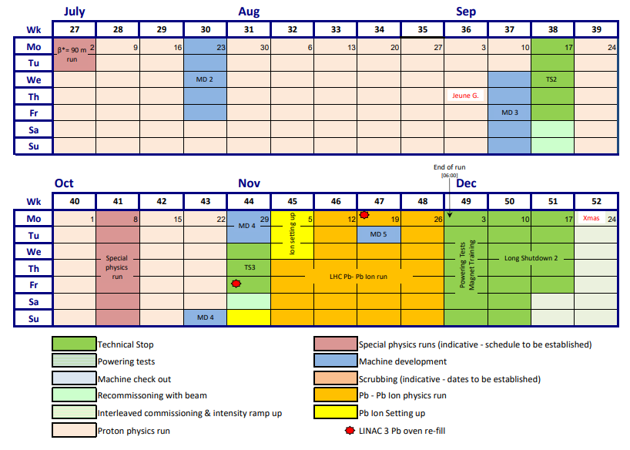
LHC Operation

Slide 11
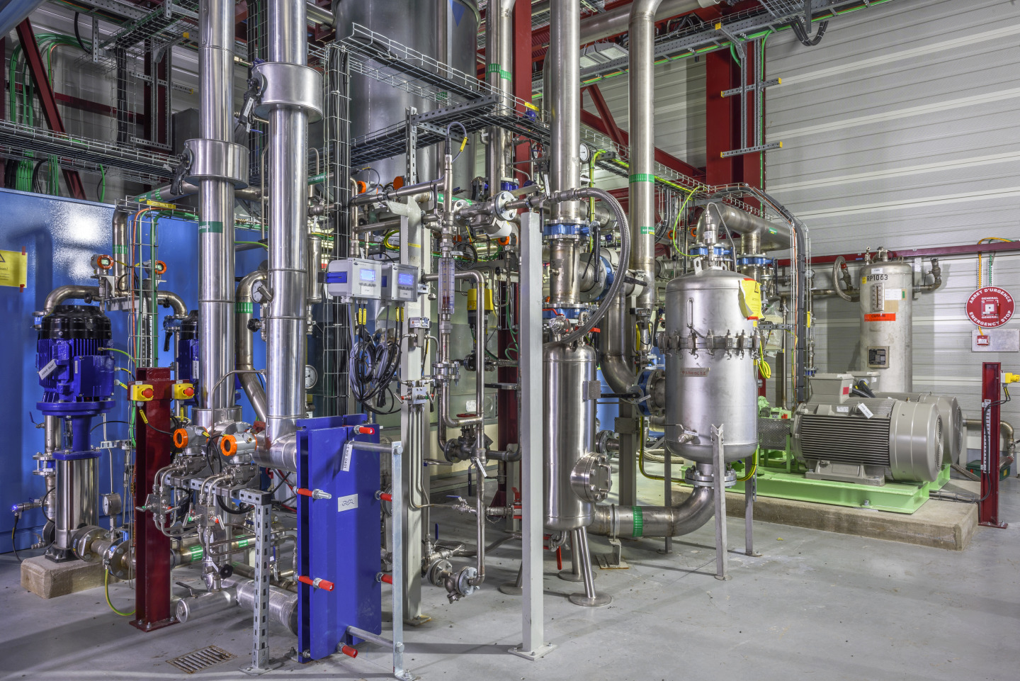
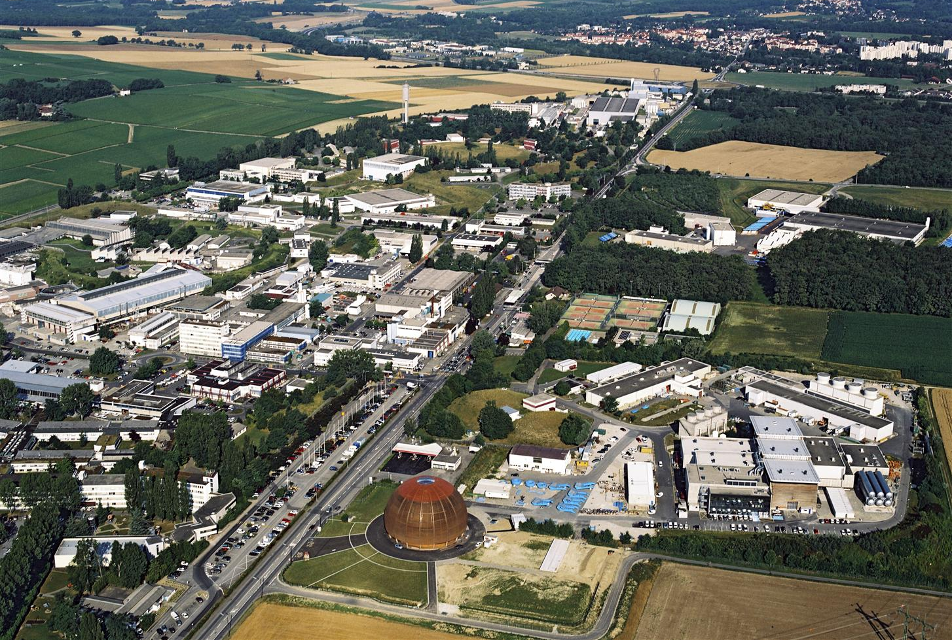
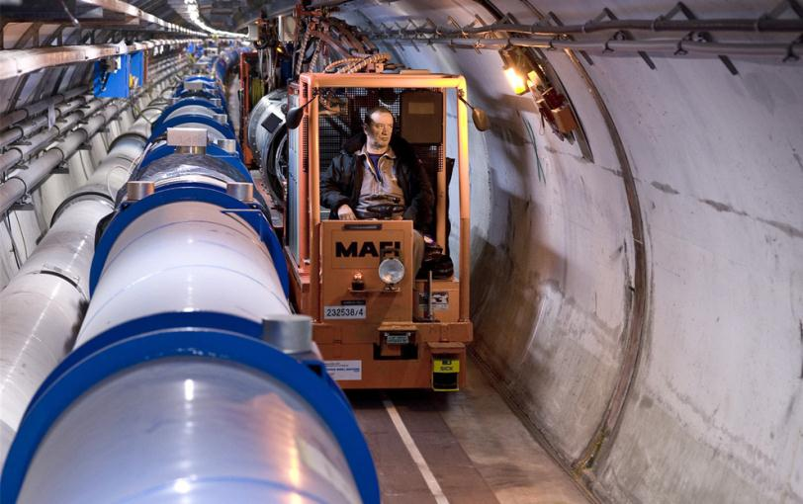
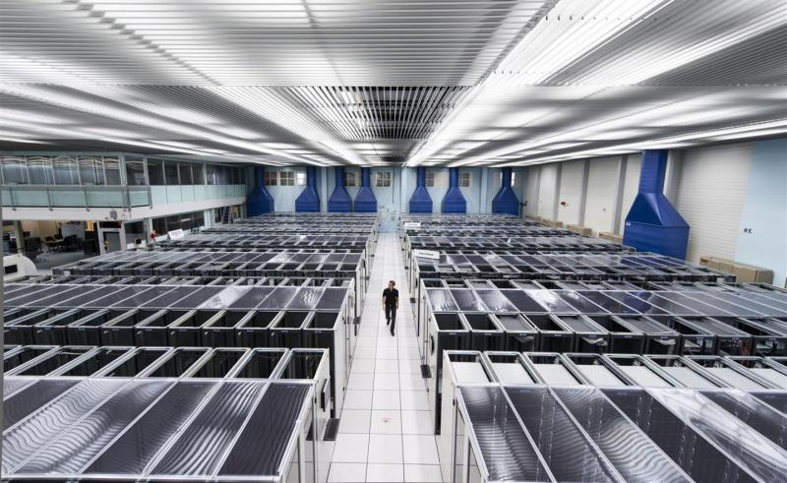
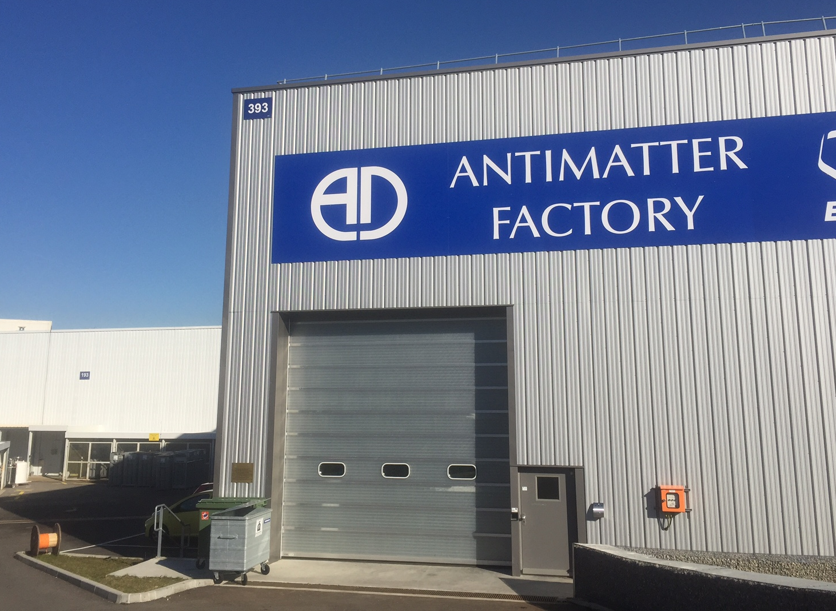
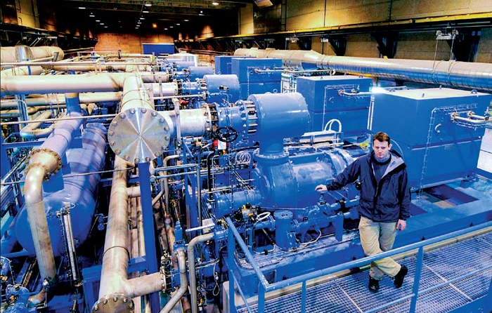
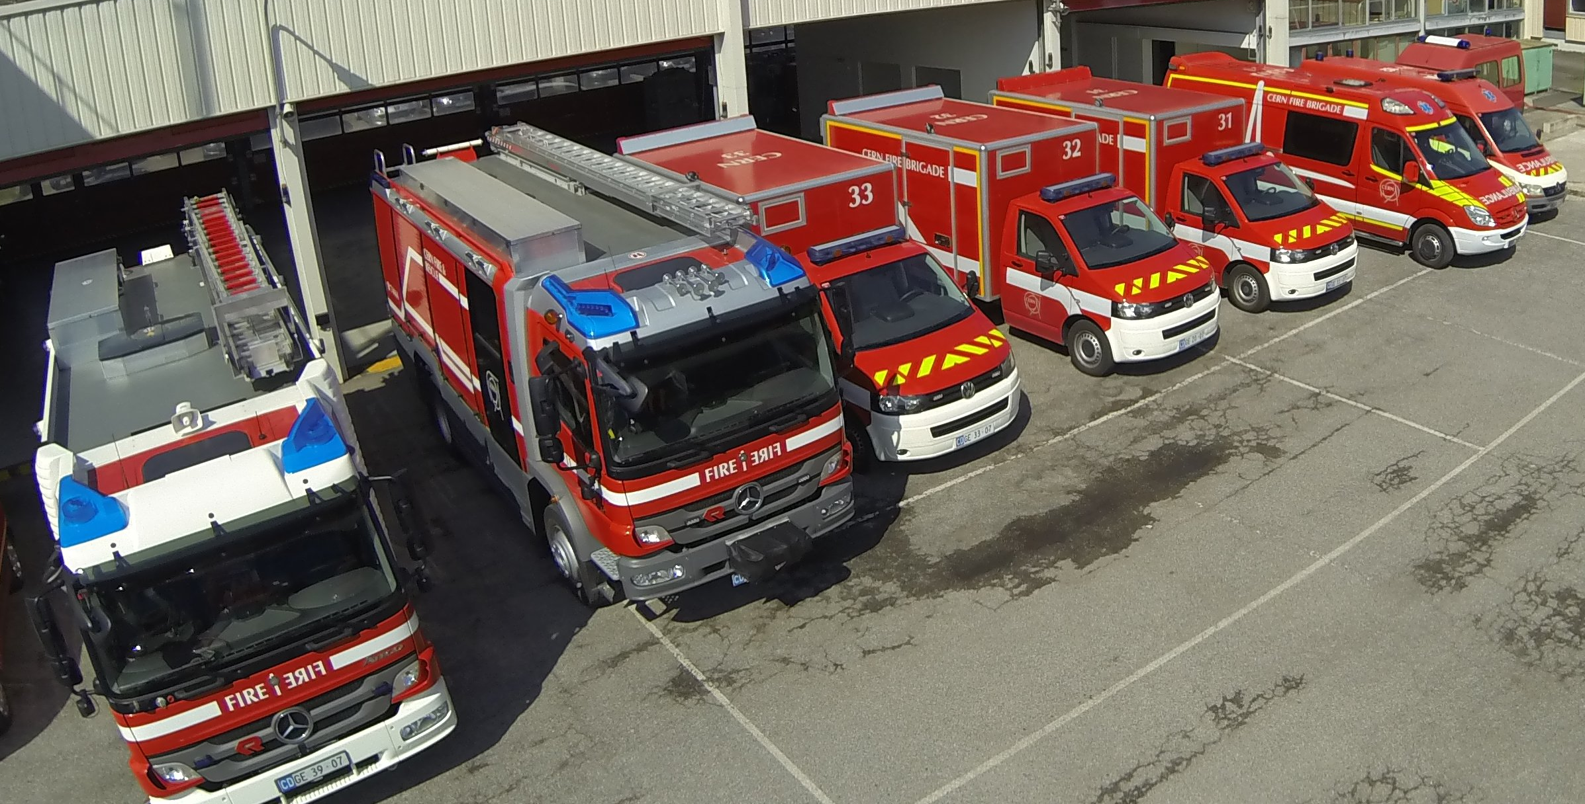


This requires numerous assets ranging from highly specialised to standard industrial:
that are all managed in the same asset management tool

Slide 12
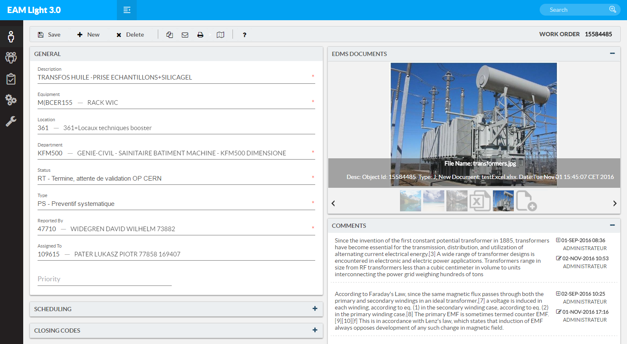
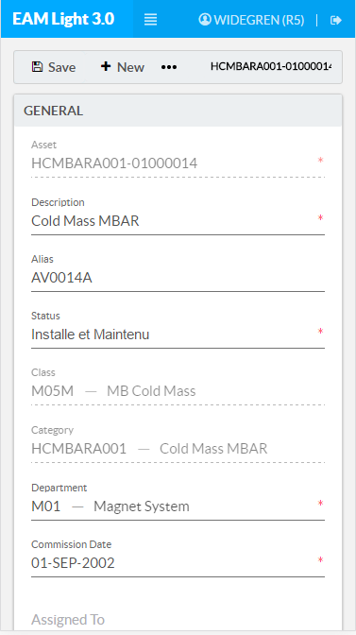
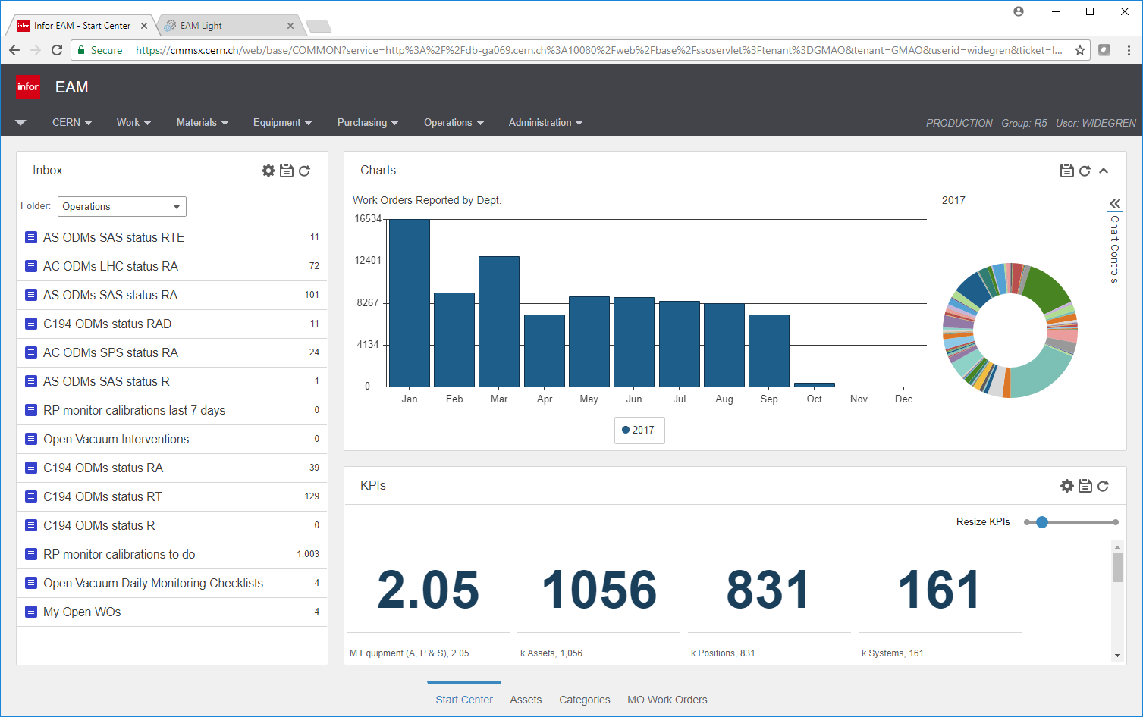

Key Points of CERN’s A&MM Tool Strategy
Manage all CERN assets in one EAM system
Use commercial software without customization
Implement links to external data sources, where the data is not owned by the EAM
Simplify interactions with the EAM by providing webservices
CERN AMM
interfaces
CERN third
party
interfaces
Infor
native interfaces
CERN’s WS hub
EAM webservices
Middleware
Database
Oracle

Slide 13
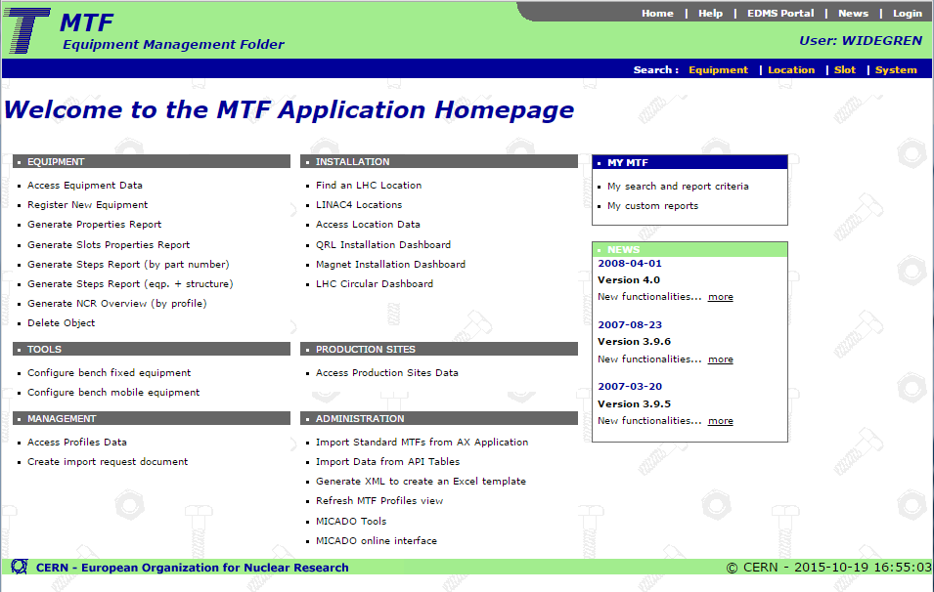


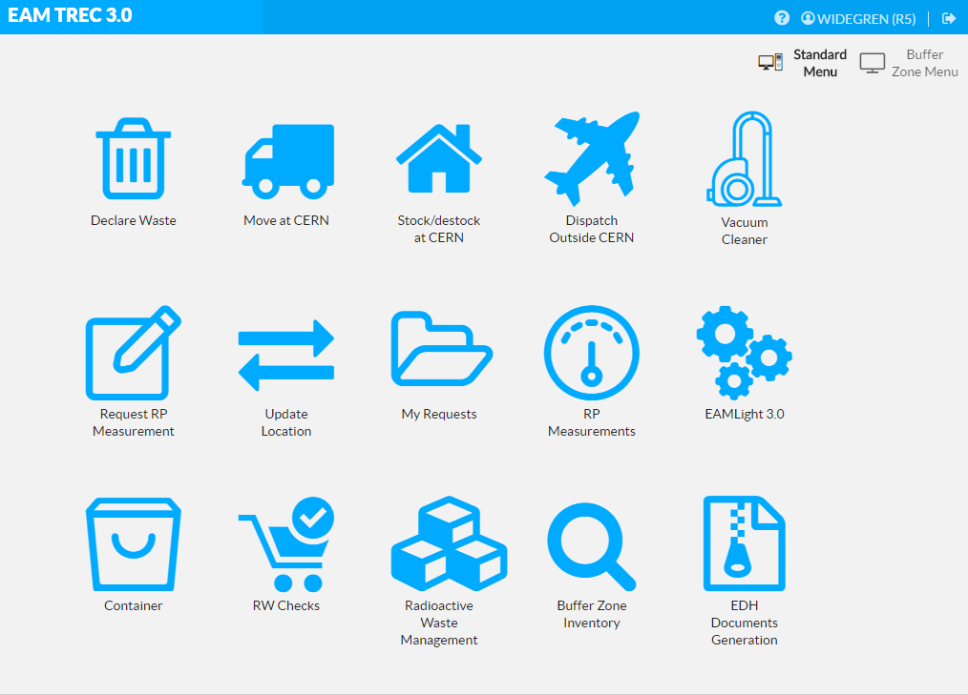

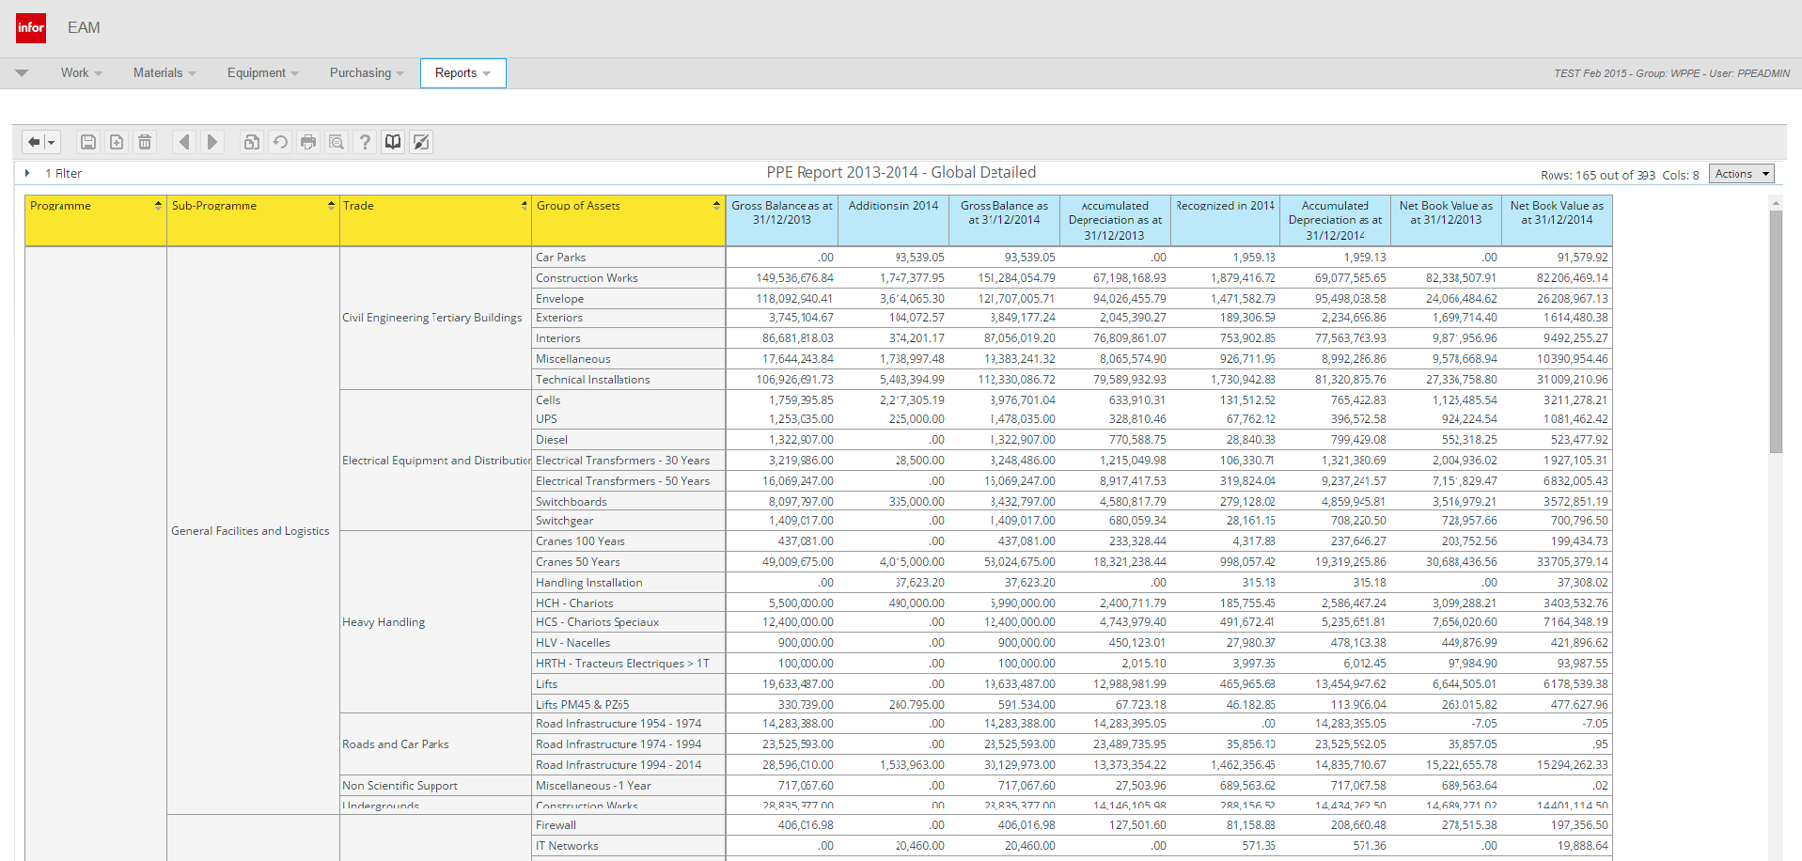
Our Asset Management Platform
Manufacturing &
Installation
Operation &
Maintenance
Disposal & Waste
Management
MTF
Manufacturing & Test Folder
Infor EAM
Enterprise Asset Management
TREC
Radioactive Traceability
Reporting & BI
Business Intelligence / Reports
Financial Depreciation
Plant, Property & Equipment

Slide 14
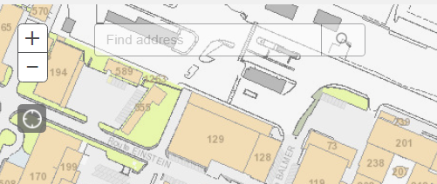
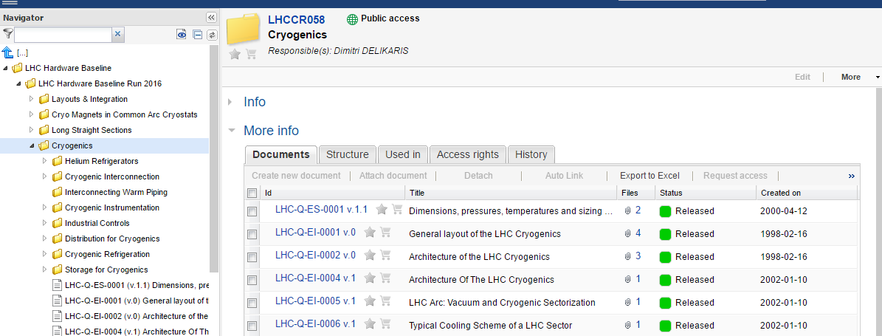

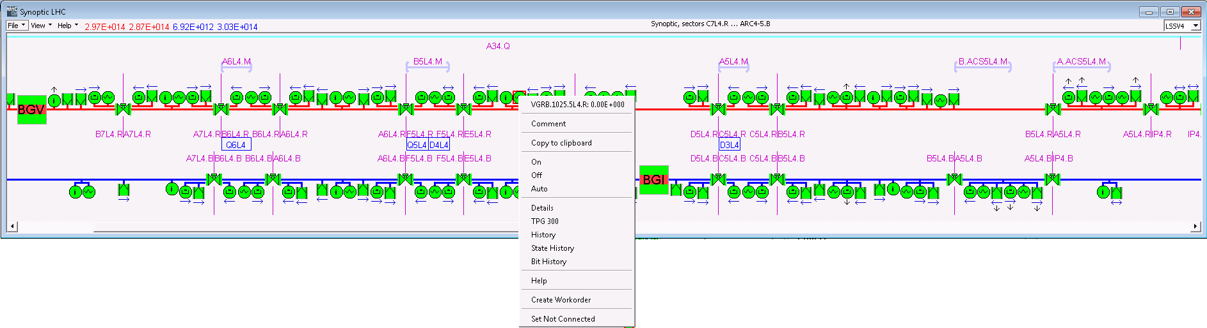

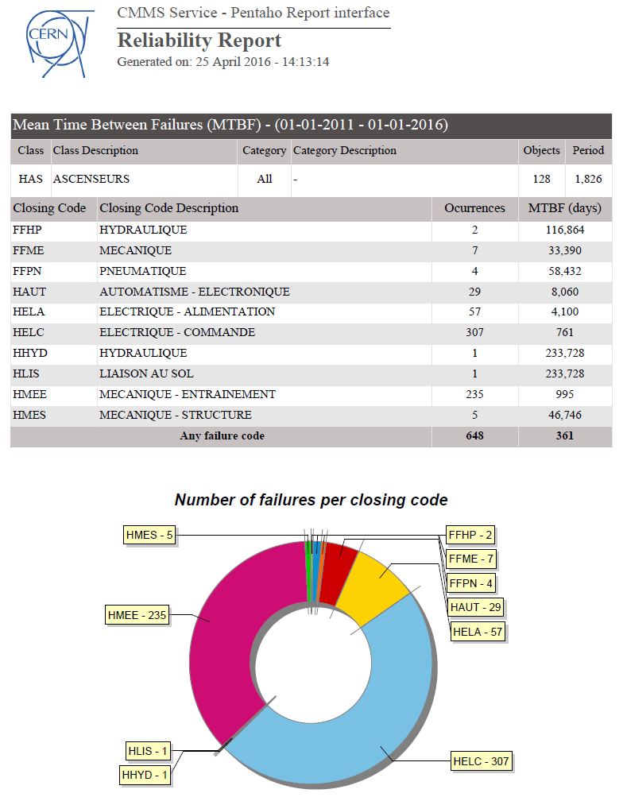
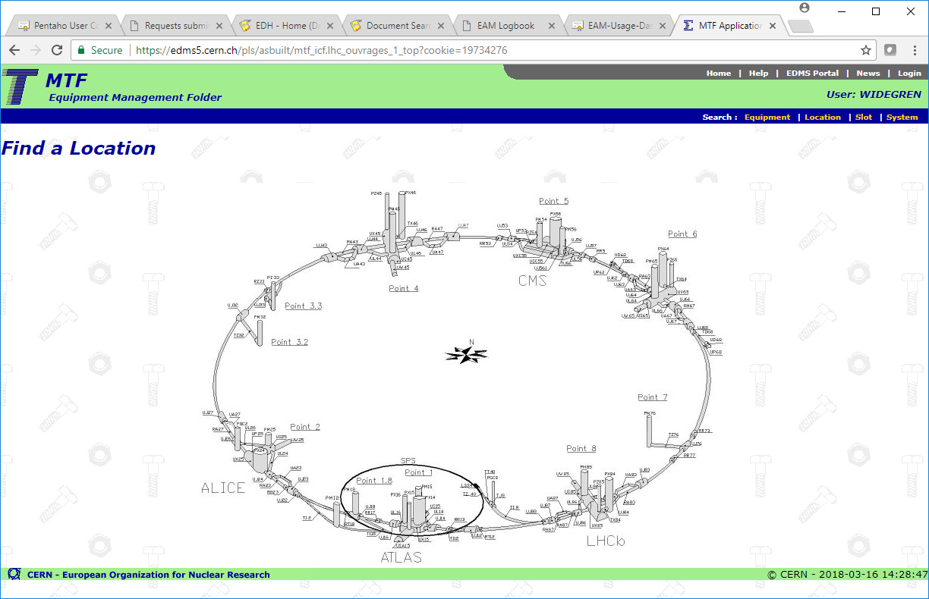

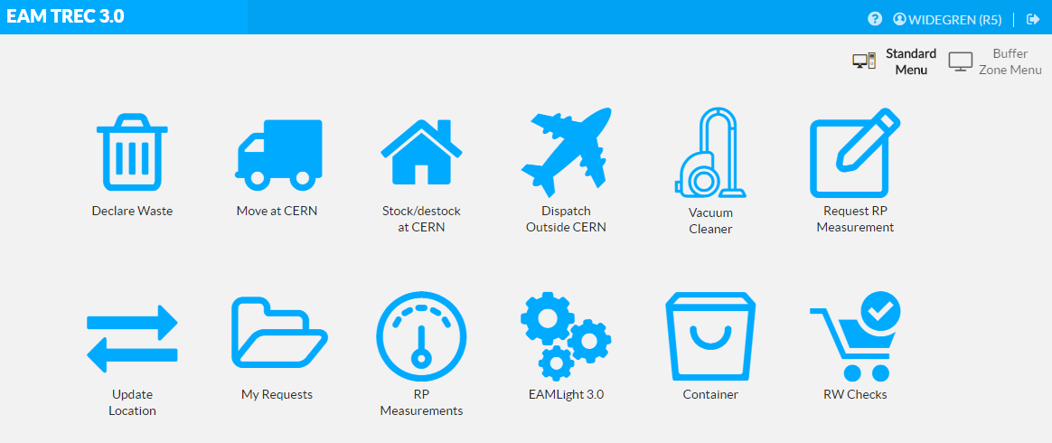
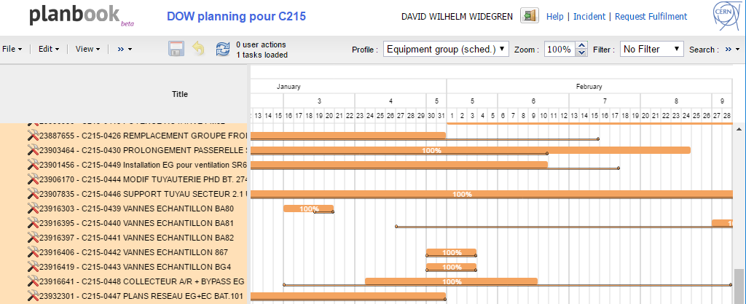

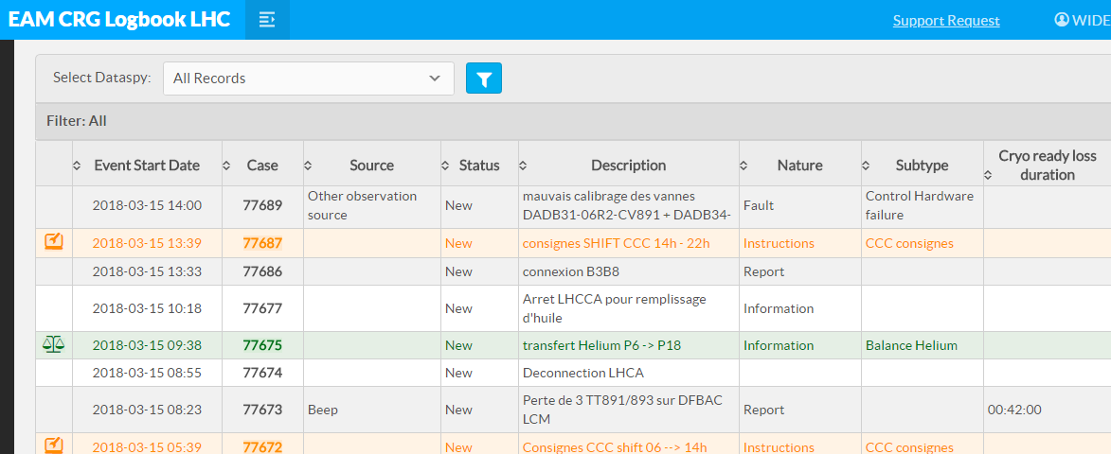
Asset management tool environment
Control Room & Service Desk
GIS
PLM
SCADA /IIoT
Manufacturing
Reporting / BI
Commissioning
Radioactive Waste
Planning
ERP(s)
Operation Logbooks
Contractor’s CMMS
Accelerator Layout /
Configuration Management
Access / Permit Management

Slide 15
Infor EAM at CERN: In numbers
2.1 M Equipment
2600 Equipment Classes
16 M Technical Parameters
900 k Documents
70 k Part References
150 k Work Orders / year

Slide 16
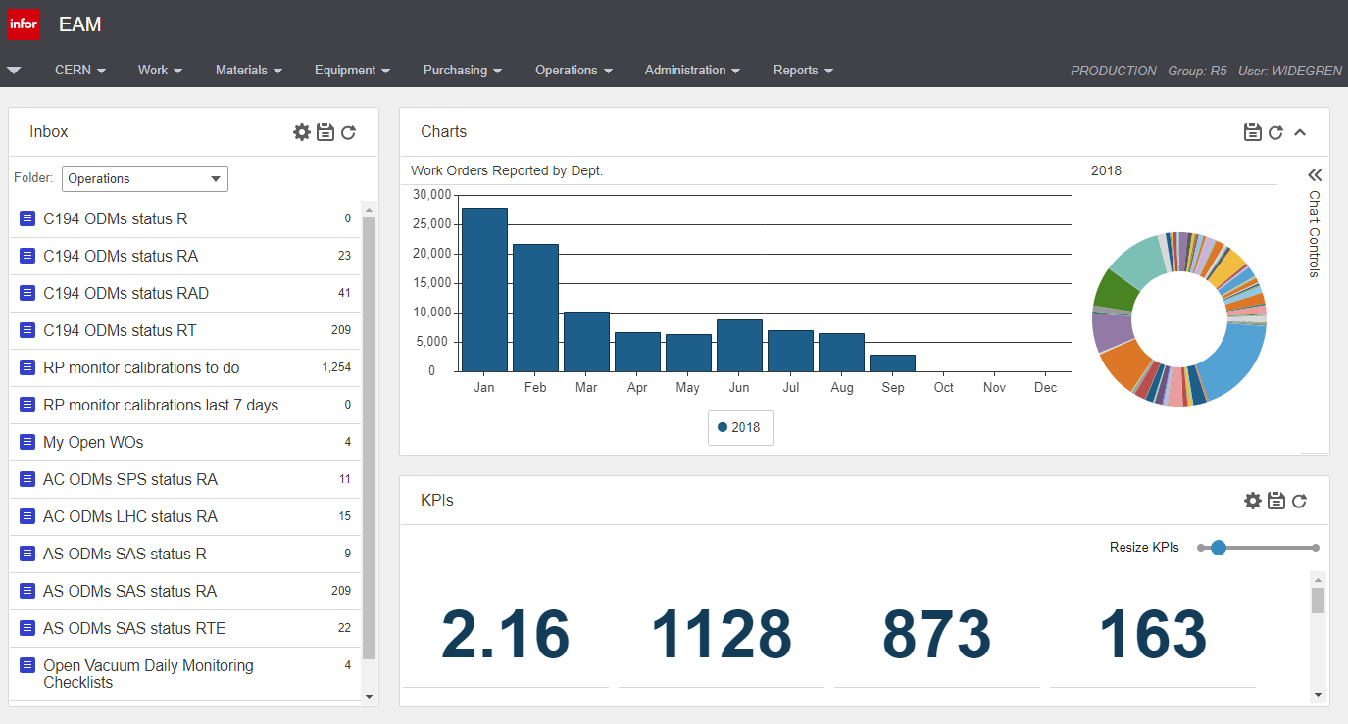
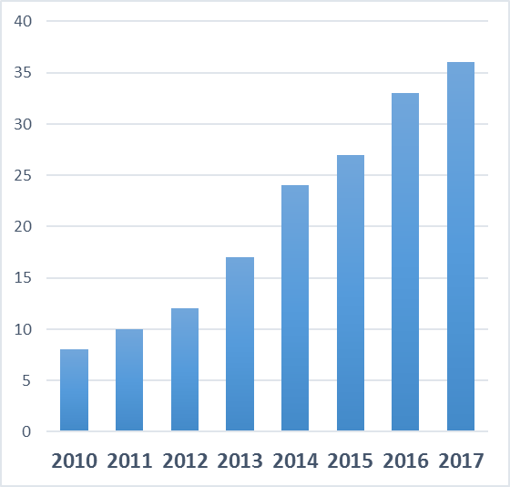
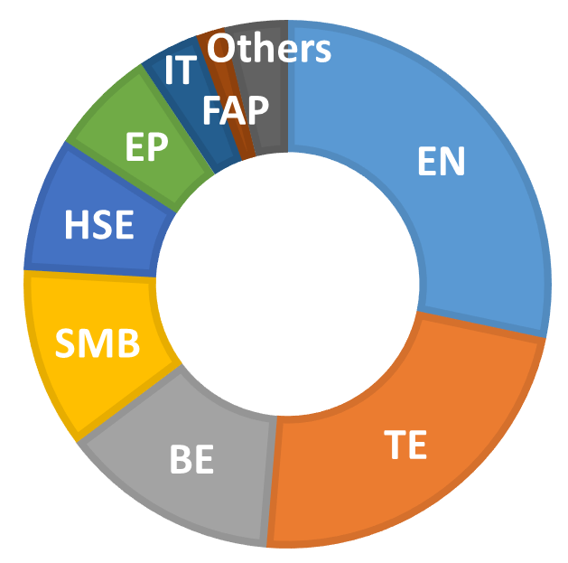
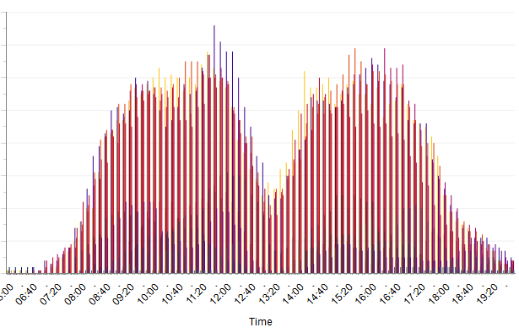
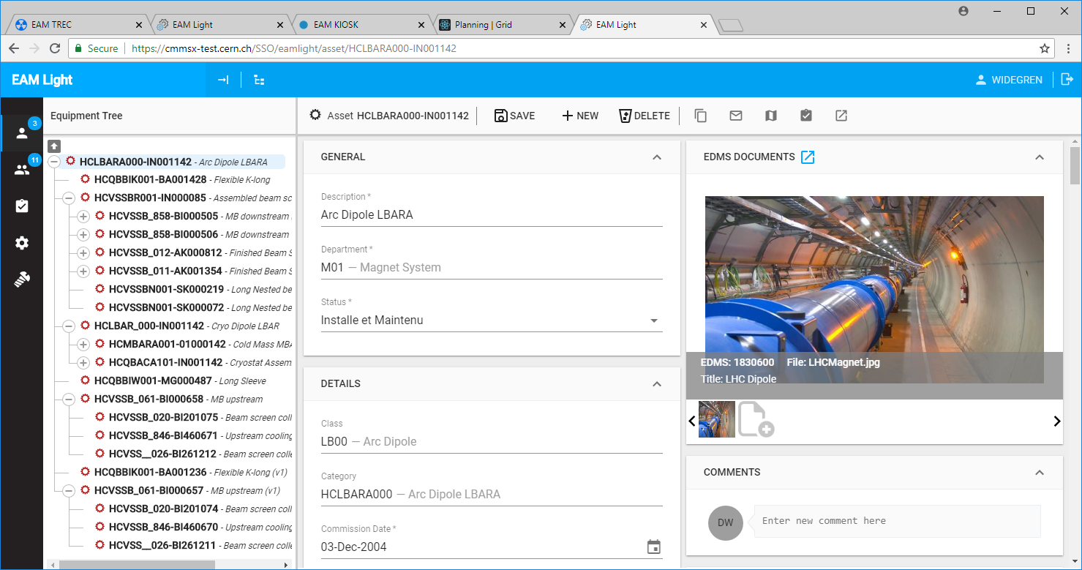
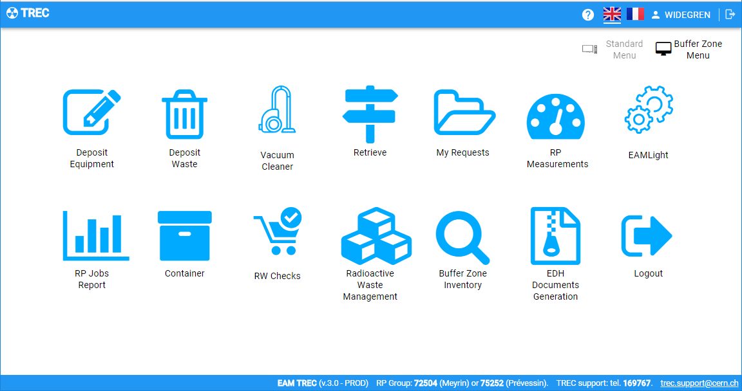
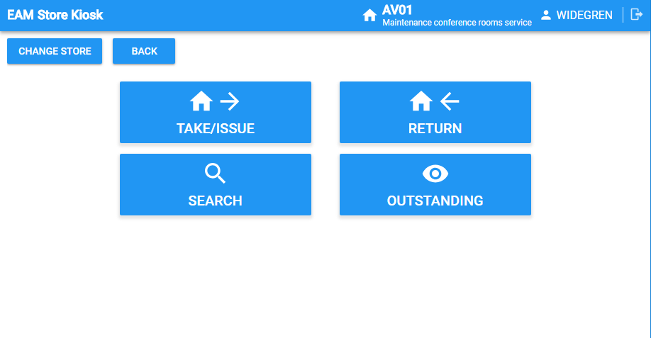

Infor EAM at CERN: In numbers
CERN groups using/
starting to use Infor EAM
Users in 2017
Daily usage profile
Users in 2018 - 1900+
1200 Extended
1100 EAM Light
1500
users
700 TREC
200 Store Kiosk
100 EAM Logbook

Slide 17

Users: Profiles and Needs
Roles | Tasks
Equipment operator | look up equipment information and request maintenance
Int. & ext. work executor | build, install, maintain or inspect
Scheduler | plan work and assign work to executors
Equipment owner | keep up to date equipment information, manage activities on equipment and need to report on equipment performance
Maintenance responsible | define and manage maintenance tasks and need to report on maintenance performance
Manager (maintenance, safety, accounts etc. | supervise specific equipment aspects and specific activity aspects
Storekeeper | perform store transactions
Store manager | manage parts and report on store performance
EAM Light
Simplified / Limited Web Interface
Infor EAM
Full / Expert Web Interface

Slide 18
Recent developments

Slide 19
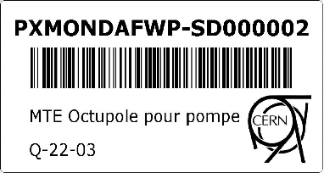


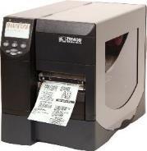
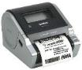
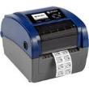
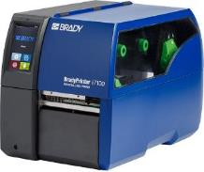
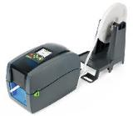

Equipment identification
User need
  Print reliably any equipment and part (article) barcodes
  “Omnia ubique omnibus”
The solution
  Printing server application
  to print standard size barcodes
  from Infor EAM to any network-barcode printer

Slide 20
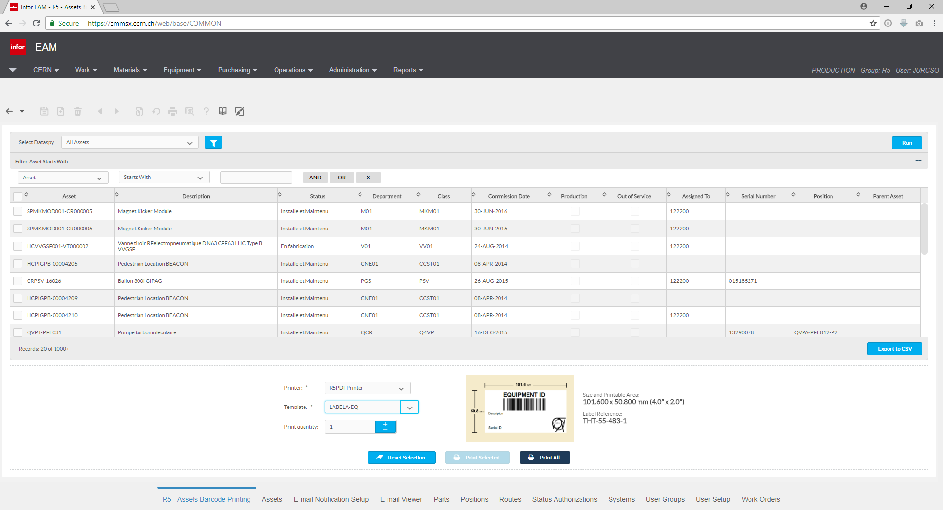

Slide 21
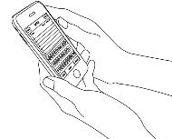
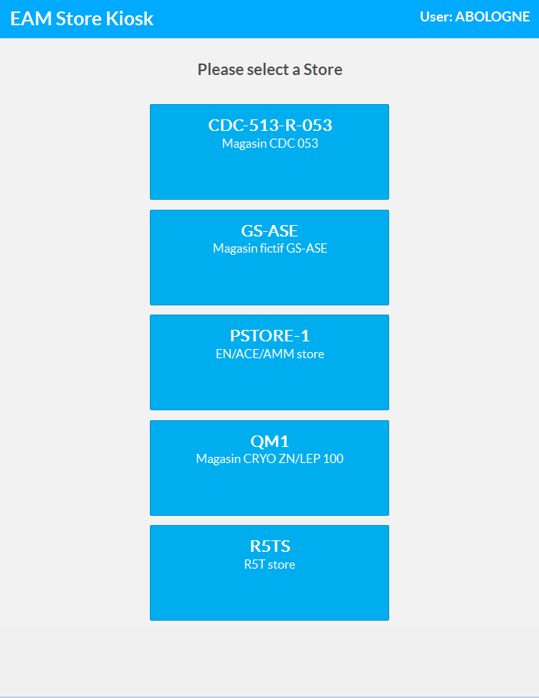
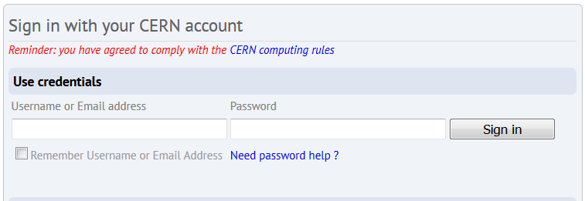

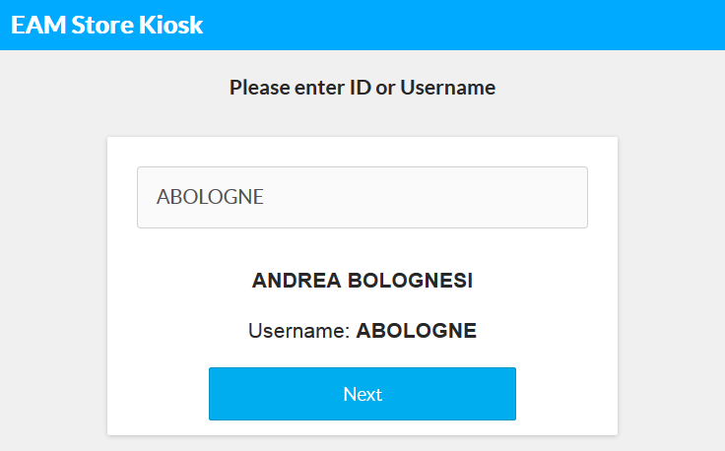
Store Management
User need
  Robust interface that allows users to register spare part transactions easily
The solution
  An SSO based store interface that adapts screens and functionalities to the platform and the function of the device.

Slide 22
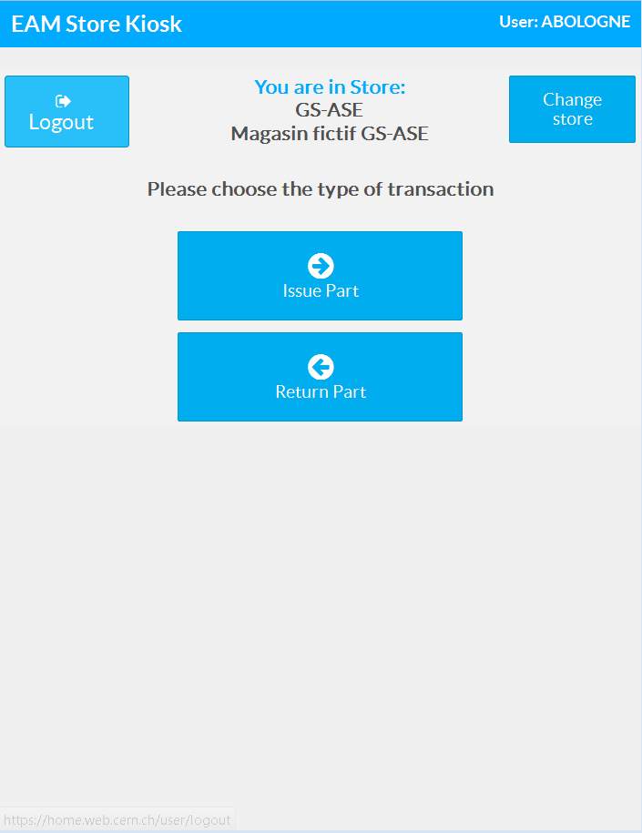
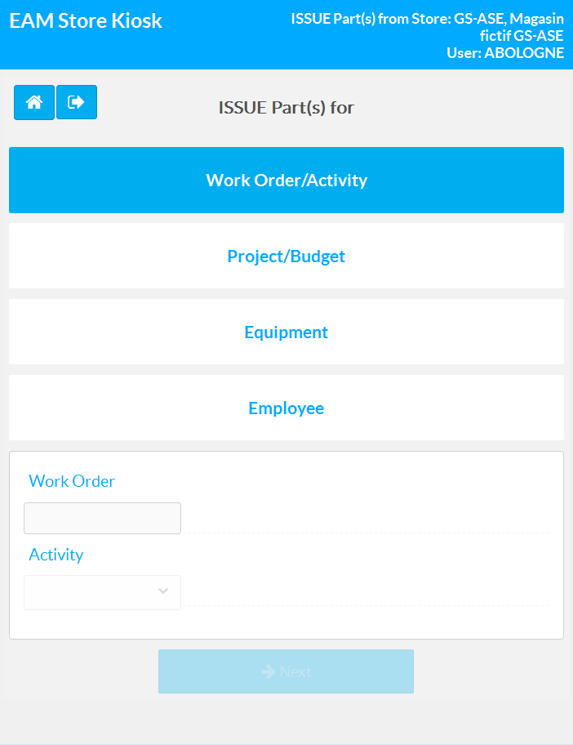
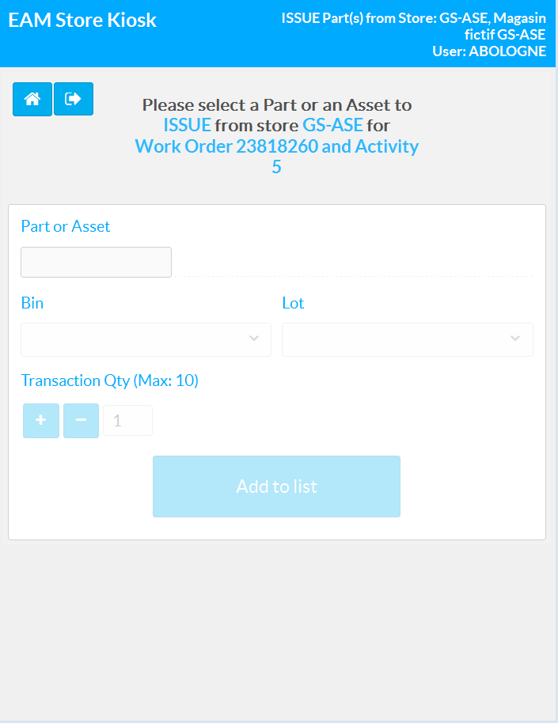



Why?
Which store
Take or Return?
What?

Slide 23
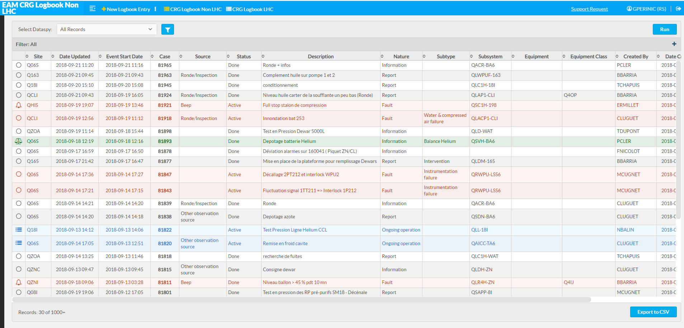
Logbook
User need
  Register operation related observations and information
The solution
  EAM based logbook application - will be presented by Sigrid Knoops

Slide 24
Waste management
User need
  Robust interface for
  registering and managing waste
The solution
  Integrating the EAM based
  waste management application
  into the WS based portfolio

Slide 25
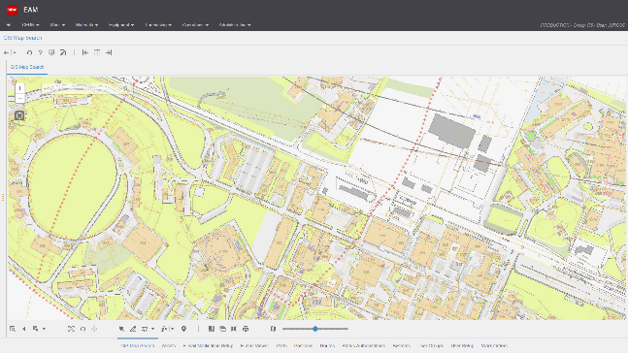

Geographical information
User need
  Provide better WHERE information (besides the WHAT)
The solution
  Porting the EAM based application to the technology used by the other A&MM applications

Slide 26


GIS information – equipment and environment

Slide 27
ERP bridge
EAM
ERP (EDH)
Work Order
Central stores order (MAG)
Parts
Purchase Order
External order (DAI)
My Stores
Labour
My Workforce
External service order (OSCV)
Services

Slide 28


EAM Light Improvements – Structure view

Slide 29
Current developments

Slide 30

CERN interfaces based on WS Hub

Slide 31




CERN Web Service Hub
A simplification layer for the native Infor EAM web services:
CERN
interfaces
Simplified
REST & SOAP
Web Services
CERN
Web Services
Hub
Infor EAM
SOAP
Web Services
complexity reduction
factor 50-100

Slide 32

CERN WS Hub: Simplified
Example:
Update of a Scheduled End Date for a Work Order in Infor EAM:
CERN WS Hub
<SchedEndDate>2-OCT-2017</SchedEndDate>
<ns2:SCHEDEND qualifier="OTHER"
xmlns:ns2="http://schemas.datastream.net/MP_fields">
<ns6:YEAR xmlns:ns6="http://www.openapplications.org/oagis_fields">2017</ns6:YEAR>
<ns6:MONTH xmlns:ns6="http://www.openapplications.org/oagis_fields">10</ns6:MONTH>
<ns6:DAY xmlns:ns6="http://www.openapplications.org/oagis_fields">2</ns6:DAY>
<ns6:HOUR xmlns:ns6="http://www.openapplications.org/oagis_fields">0</ns6:HOUR>
<ns6:MINUTE xmlns:ns6="http://www.openapplications.org/oagis_fields">0</ns6:MINUTE>
<ns6:SECOND xmlns:ns6="http://www.openapplications.org/oagis_fields">0</ns6:SECOND>
<ns6:SUBSECOND xmlns:ns6="http://www.openapplications.org/oagis_fields">0</ns6:SUBSECOND>
<ns6:TIMEZONE xmlns:ns6="http://www.openapplications.org/oagis_fields">UTC</ns6:TIMEZONE>
</ns2:SCHEDEND>
Infor EAM
Web Services

Slide 33

CERN Web Service Hub
A simplification layer for the native Infor EAM web services:
CERN
interfaces
Open source project
Simplified
REST & SOAP
Web Services
CERN
Web Services
Hub
Infor EAM
SOAP
Web Services

Slide 34

FLEX building
User need
  Manage the storage operations for the LS2 shut-down (mainly building 947)
The solution
  EAM and store kiosk based storage management application using
    EDH storage requests
    kits

Slide 35
What is and what remains difficult in A&MM

Slide 36
Is A&MM a cost centre or is it controlling cost
Well, it might depend on the investment policy …
If investment considerations are based on asset PRICE,
then any spending after the investment, i.e. especially operation and maintenance, is an expenditure.
If investment considerations are based on (lifetime) asset COST,
then A&MM might be considered as a tool to respect and optimise the overall COST.

Slide 37
Justify resources and training needs
No maintenance:
Replace when
broken
Maintain without
limits: Keep alive forever
What resources and what training are required to find the optimum operating point?

Slide 38
Finding the right training method
External trainer
PRO
Knows the principles and industrial tool(s)
May know industry practices and can provide an outside view
Can increase the organisation’s knowledge
CON
Does not know the organisation’s rules, habits, interfaces and problems
Internal trainer
PRO
Knows the organisation with all its constraints
Knows the organisation specific solutions
Can trigger internal knowledge transfer
CON
May be biased by local practice

Slide 39
Open discussion
surveymonkey.com/r/VMXSW27

