Slide 2
How to explain positions, parts and assets to dummies?
Goran Perinić, CERN

Slide 3

AMM concepts
Functional
Position
Part
Item
Location
Asset

Slide 4
Contents
Explanation attempt 1 – Our daily life
Explanation attempt 2 – Tell it the physicist
3 - My preferred official explanation

Slide 5
Explanation attempt 1 – Our daily life

Slide 6


Slide 7
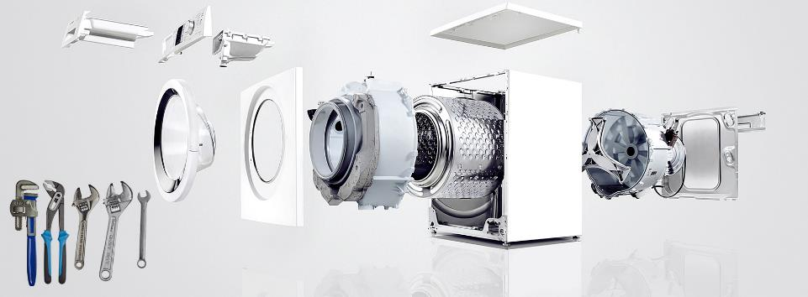

Slide 8


Slide 9
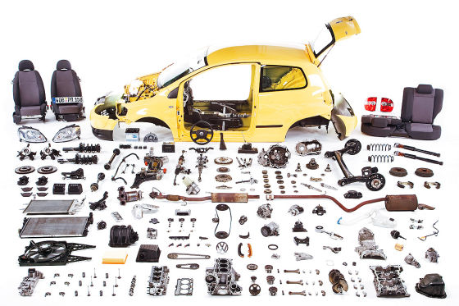
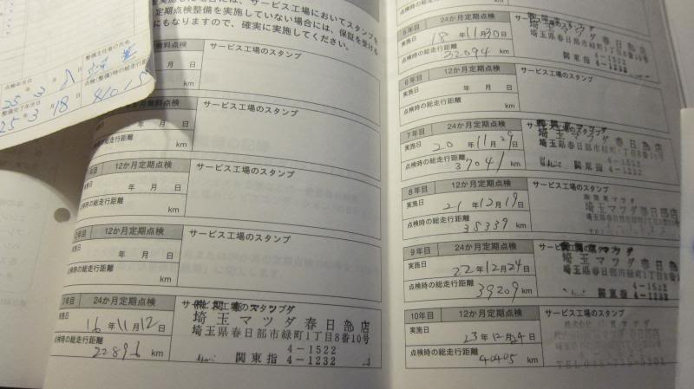

Slide 10





Explanation attempt 2 – Tell it the physicist
We need a new bunch compression
C4
C5
C3
C6
C7
C1
The C system
C2
CL controls
Describe
functional
requirements!
MB
magnet
RC
converter
ET
transformer
https://layout.web.cern.ch/

Slide 11
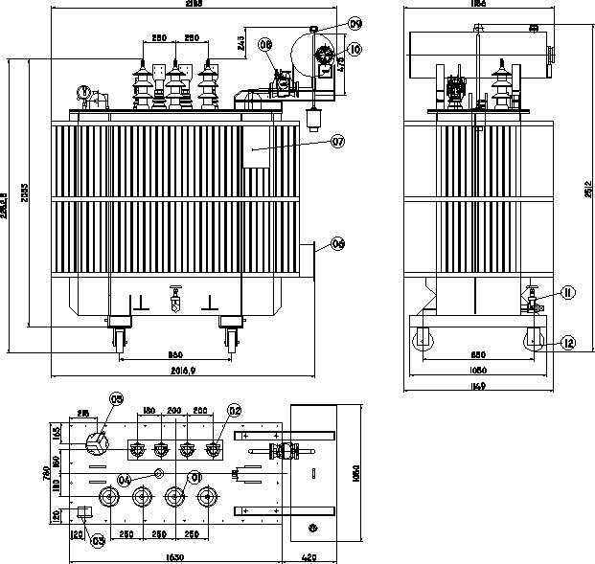


Items
What to build or to buy
Design of the EC transformers
Design or specify it!
https://edms.cern.ch/

Slide 12





Parts
Hey, both correspond to the spec.
Describe what we got!
https://cmmsx.cern.ch/

Slide 13
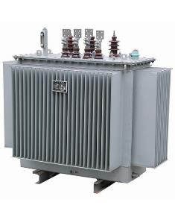

Assets
We need to change the oil on EC-013
https://cmmsx.cern.ch/

Slide 14
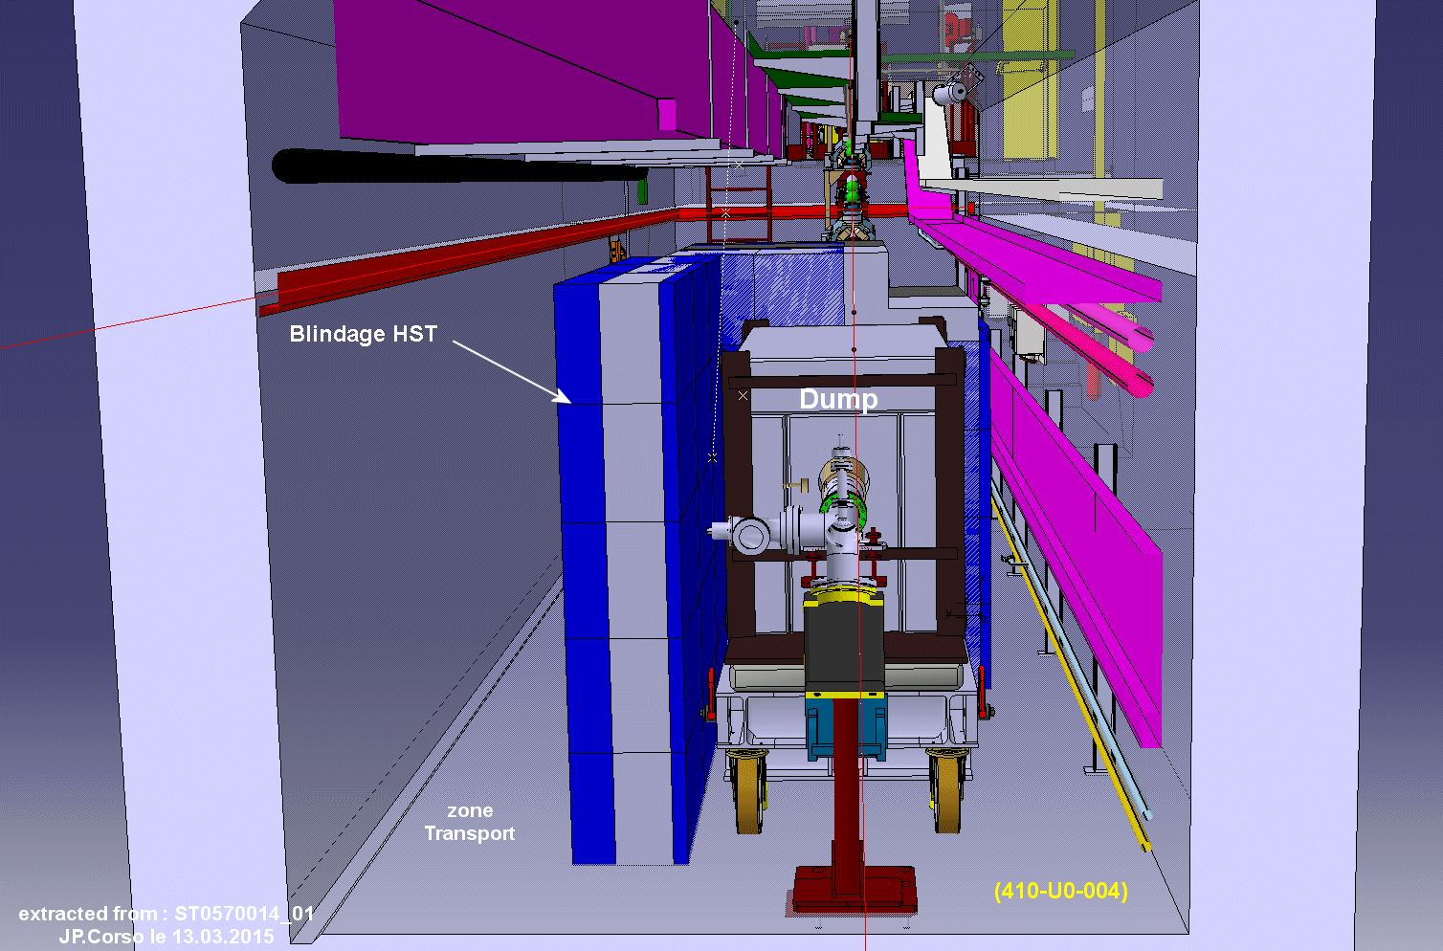


Locations
We need to reserve the space?
Where will it be located!
https://gis.cern.ch/

Slide 15
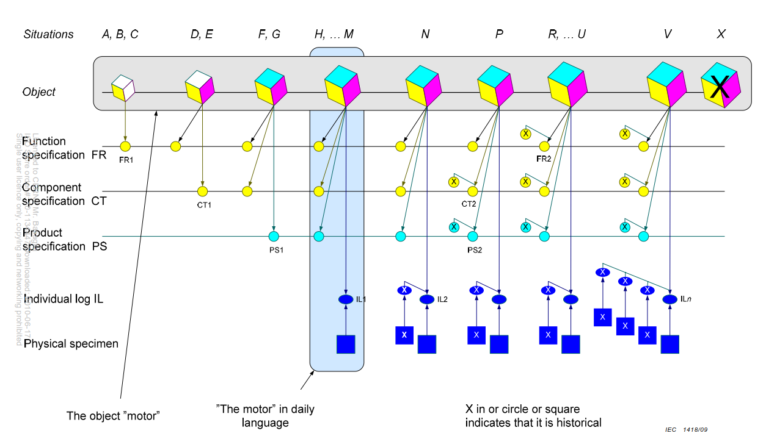
My preferred object lifecycle story – IEC-81346-1
Industrial systems, installations and equipment and industrial products
– Structuring principles and reference designations – Annex B
Function aspect (e.g. motor)
Functional requirement specification
(technical details)
Location aspect
(attribute a space)
Component type
specification
(standardize)
Function and
location list
Product
specification
Part list for
manufacturing
Transport specification
Installation
Commissioning
Acceptance and individual log
Operation and maintenance
Alternative specimen
Alternative type and supplier
Process modification
Location extension
Others
Closing down
Dismantling
Life cycle end

