Slide 1
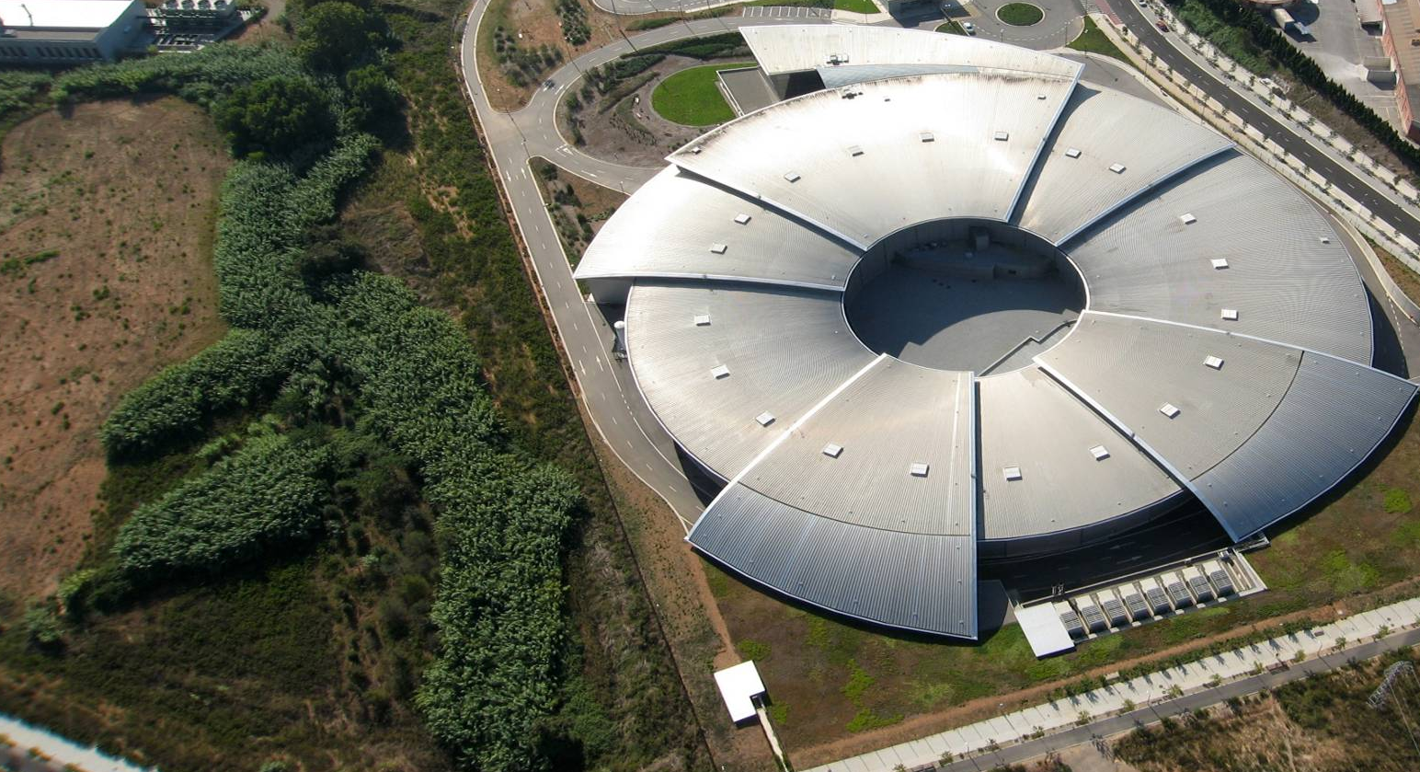
ALBA Synchrotron Light Source
C. Biscari

Slide 2
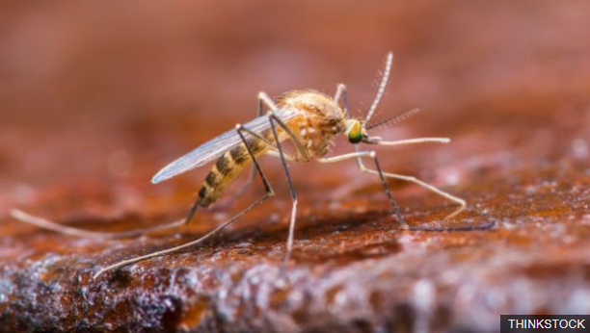
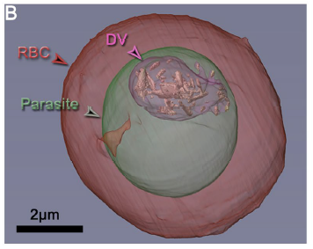
Understand diseases
How does the malaria parasites infection works?
An international team has unraveled details never described before about how the malaria parasite acts after invading the red blood cells. This discovery has been possible thanks to two advanced microscope techniques combination: X-ray fluorescence microscopy (at ESRF) and soft X-rays tomography, this one conducted at ALBA MISTRAL BL. Infected red blood cells image analysis offer new information that could yield new drugs design against malaria, an illness that claims over 400.000 lives each year.
Other examples
3D Map of Hepatitis C-infected cells ACS Nano (2016) 10 (7). DOI: 10.1021/acsnano.6b01374
Cholesterol crystals’ formation to understand atherosclerosis JAmChemSoc (2016) 138 (45). DOI: 10.1021/jacs.6b07584
Alzheimer’s mechanisms AnalyticalChemistry (2018) 90 (4). DOI: 10.1021/acs.analchem.7b04818
Solved a molecular recognition mechanism involved in protein recycling, involved in pathologies like Alzheimer or Parkinson. Cell (2016) DOI: 10.1016/j.cell.2016.10.056
Proving tolcapone as a powerful inhibitor of familial myloidosis Nature Communications (2016) 7, 10787.DOI: 10.1038/ncomms10787
Atomic resolution of enzyme MATα2, related to colon and liver cancers PNAS (2016) 8. DOI: 10.1073/pnas.1510959113
3D Structure of the fibre head of turkey adenovirus 3 PLOS One (2015) 29. DOI: 10.1371/journal.pone.0139339
Nature Scientific Reports (2017) 7, 802.DOI:10.1038/s41598-017-00921-2.
Nature Scientific Reports (2017) 7, 7610.DOI: 10.1038/s41598-017-06650-w

Slide 3
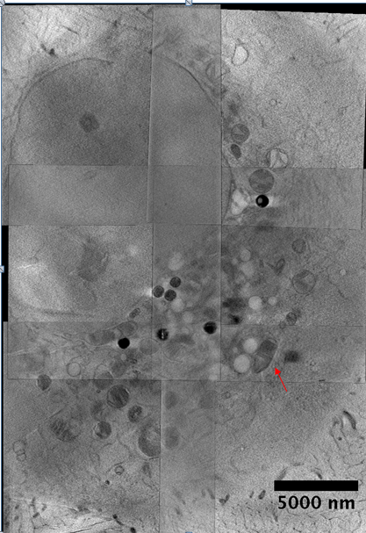
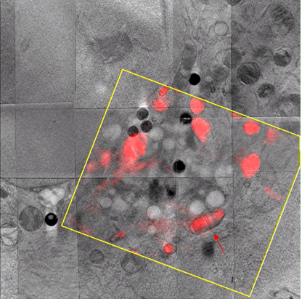
Design drugs
Cancer treatment: understanding the effect of metallic nanocomposites Javier Conesa et al, in preparation
Organomeallic molecules containing Ir are drugs for cancer treatment. Their localization inside the cancer cells was unknown.
A combination of X ray tomography (Mistral) and fluorescence imaging (ESRF) has revealed that the metallic Ir is localized at the mitochondria which generate ATP (chemical energy source)
Other examples
More stable and less toxic nanoparticles for medical applications Chemical Communications (2017) 60. DOI:10.1039/c7cc04945e
A new key target for prostate cancer treatment Nature Communications (2017) 8, 14388. DOI: 10.1038/ncomms14388
Proven efficacy of a protein with potential to inhibit HIV-1 PNAS (2014) 111 (51). DOI: 10.1073/pnas.1413592112
A new drug against malaria Acta Crystallographica Section D 70. DOI: 10.1107/S139900471400697X
Drugs for sleeping illness Nucleid Acids Research (2017) 45, 14. DOI: 10.1093/nar/gkx521
Iron Oxide Nanoparticles Stress the Cells Nanotoxicology, 1-11
Superposition of Ir fluorescence in red (ESRF) and tomography (black and white) MISTRAL:
Ir is in the mitochondria
mitochondria
Extended view (Mistral)

Slide 4
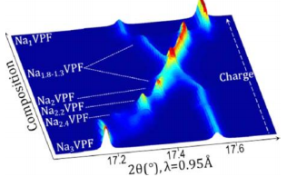
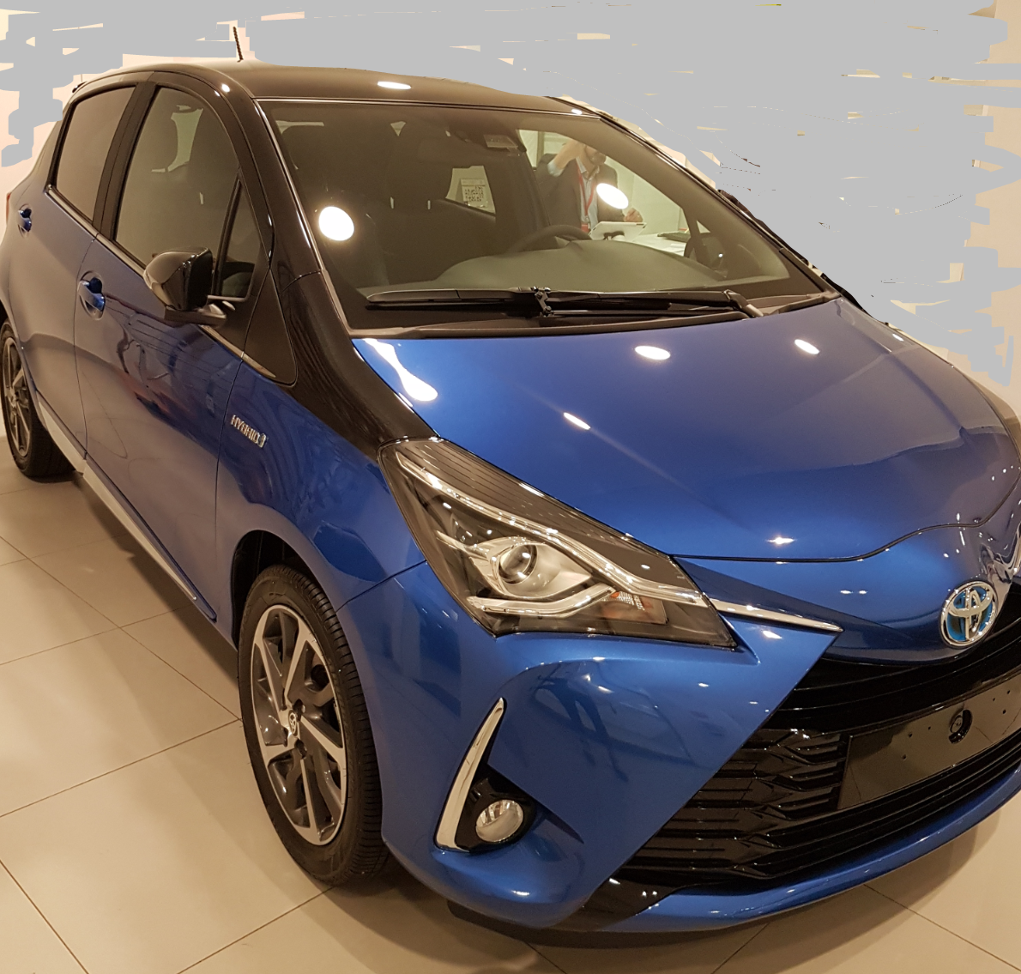
Develop energy materials
CA rechargeable batteries viability demonstrated
Calcium can be used as electrode in rechargeable batteries according to a study from CSIC in collaboration with Toyota Motor Europe (TME) supported by the measurements performed at ALBA.
This work proves that oxidation-reduction of calcium occurs in a reversible way in electrolytes that can operate at high potential.
Nature Materials (2016) 15. DOI: 10.1038/nmat4462
From Na₃ to Na₁
Other examples:
Visualising discharge products in lithium-oxigen batteries. Nanoletters (2015) 15. DOI: 10.1021/acs.nanolett.5b02862
Comparison of Electrospun and Conventional LiFePO4/C composite Cathodes for Li-ion Batteries, Mater. Sci. Eng. B-Adv. 10.1016/j.mseb.2016.04.006
Li is expensive and scarce. Research on batteries based on alternative electrodes are investigated at MSPD (diffraction) and CLAESS (absorption) beamlines.
Example: Na based batteries (Na, V, P, O and F) – Studying the charging capacity by understanding the crystalline structure of the cathode and its changes during charging

Slide 5
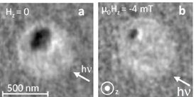
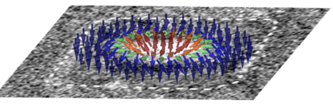
Advance in nanotechnology
Future computers will use the electron charge and magnetic moment for information processing. The science behind is nanomagnetism on which Alba performs top level research.
Skyrmions are structures that might be the future carriers of information. CIRCE, BOREAS and MISTRAL BLs are used to study their dynamical and structure properties.
Other examples
Unravelling the water condensation on photoactive nanotubes Langmuir (2017) 33 (26). DOI: 10.1021/acs.langmuir.7b00156
Nanometric magnetite with full properties Nanoscale (2018) 12. DOI: 10.1039/C7NR07143D
New method for fabricating high-quality ultrathin cobalt ferrite nanostructures Advanced Materials (2015). DOI: 10.1002/adma.201502799
How does cement hydration works? Scientific Reports (2018) 8. DOI: 10.1038/s41598-018-26943-y
IMAGING HOW MAGNETISM GOES SURFING, M. Foerster et al.Nature Communications 16-28724B
New magnetic mechanism in high temperature superconductor cuprates, proving the coexistence of magnetism and superconductivity, Advanced Science. DOI: 10.1002/advs.201500295
Skyrmion schematic
Images from CIRCE showing the contraction of the diameter from 230 to 50 nm under an applied field of 4 mT
Nature Nanotechnology (2016) O. Bulle ….L. Aballe, M. Foester, …G. Gaudin

Slide 6
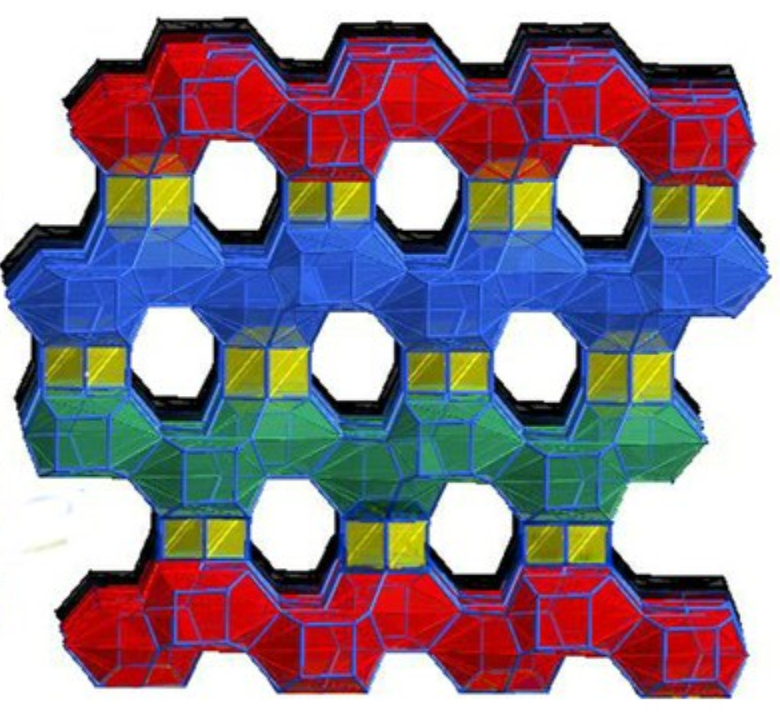
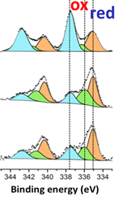
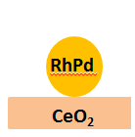

Improve catalysis processes
Catalysis: key technology for XXI century. Societal challenges including fertilizers, fuels from oil, air quality, pharmaceutical, agrochemical…and more recently photo-catalysis and electro-catalysis for energy research. Improving catalysts requires sophisticated tools to monitor the catalysts in operation.
Ambient pressure photoemission and absorption spectroscopies at CIRCE and CLAESS are steadily used
Other Examples:
Metal organic framework-mediated synthesis of highly active and stable Fischer-Tropsch catalysts, Nature Communications 6, 6451 (2015)
Water affinity and surface charging at the Z-cut and Y-cut LiNbO3 surfaces: An Ambient Pressure XPS Study, The Journal of Physical Chemistry C, 120 (4): 24048-24055 (2016) doi: 10.1021/acs. jpcc.6b05465
Strong Impact of the Oxygen Content in Na3 V2 (PO4 )2 F3-yO y (0 ≤ y ≤ 0.5) on their Structural and Electrochemical Properties, Chemistry of Materials, 28 7683-7692 (2016) doi: 10.1021/acs.chemmater.6b02659
First direct observation of the development of tailored mesoporosity within zeolites, Chemistry of Materials, 28 (24):8971 – 8979, (2016) doi: 10.1021/acs. chemmater.6b03688
Example: Ethanol hydrogenation reaction. Catalyst: PdRh metallic nanoparticles on a CeO2 support
Ambient photoemission reveals that the active catalyst is oxidized Pd and not metallic Pd
PdO

Slide 7
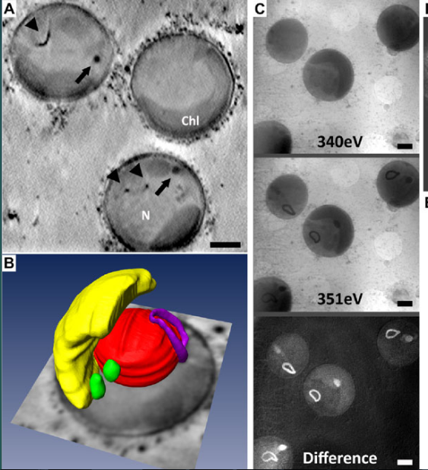
Care for environment and food
Spatial distribution of calcium in coccolithophores, widespread marine algae that may play an important role in the response of the oceanic ecosystem to predicted global climate change.
MISTRAL and Max-Planck Institute of Molecular Plant Physiology scientists
Other examples
A molecular mechanism that controls plant growth and development. Cell (2014) 156. DOI: 10.1016/j.cell.2013.12.027
THE INHIBITION OF RAP PHOSPHATASE BY SPECIFIC PHR PEPTIDES, PLoS Biology 2013 11(3):e1001511
Polymorphic study of alimentary triacyglycerols by SAXS/WAXS simultaneous measurements: from pure components to end food products
Distribution of Selenium speciation in Se-enriched wheat grain
HOW DO PLANTS RESIST SOIL MERCURY?
have discovered high amounts of calcium to be concentrated in membrane-bound compartments that are separate from the coccolith producing compartment
Coccolithophores may play an important role in the response of the oceanic ecosystem to predicted global climate change, and similar changes in the past were recorded in the chemical composition of coccoliths that accumulated in ocean-floor sediments.
Nature Communications (2016) 7, 11228. DOI: 10.1038/ncomms11228

Slide 8
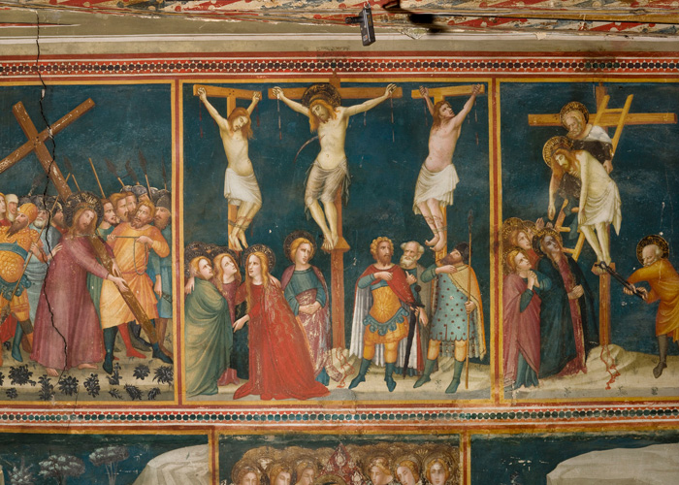
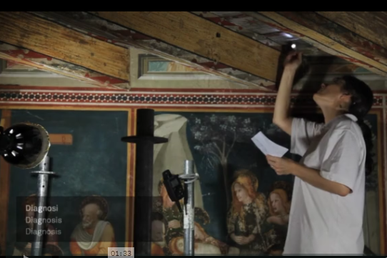
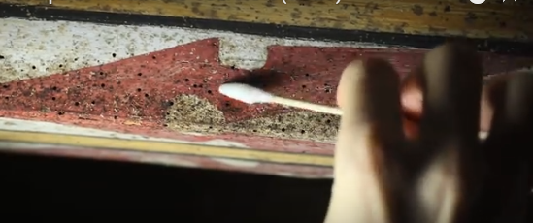
… and others as
Help cultural heritage conservation and knowledge
Investigating ancient skeletons
San Miguel de Pedralbes
Fungi in the paintings detected with Synchrotron Light at ALBA
Capilla de San Miguel del Monasterio de Pedralbes
Open to public after 10 years of restauration in 2016
Fungi in the paintings detected with Synchrotron Light at ALBA

Slide 9
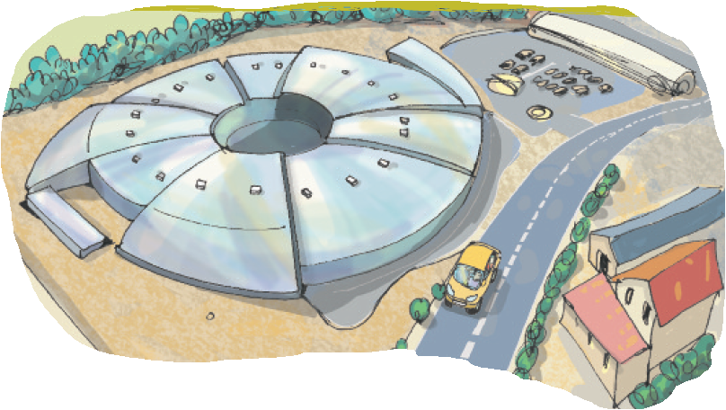
ALBA is a Research Infrastructure
National public consortium (CELLS)
50% national funding (Ministerio de Ciencia, Innovacion y Universidades )
50% regional funding (Departament d’Empresa i Coneixement)
National and international (21%) staff
National and international (35%) users
National and international collaborations
Participation to projects plus services providing extra 7- 8% of income and 10% of staff

Slide 10
ALBA history
2003
Project approval
2014
Phase II starts
2016
8th BL in operation
Phase III starts
2006
Construction start
2012
Operation start
Phase I: 7BLs
Prehistory linked to HEP community: a Tau-charm was the first proposal (‘90s) for building a large research infrastructure in Spain, later on evolved into a synchrotron light source, well suited to Spanish scientific community needs
2018
8 Operating BLs
4 BLs in construction
Design
Construction & commissioning
Operation consolidation
Expansion

Slide 11
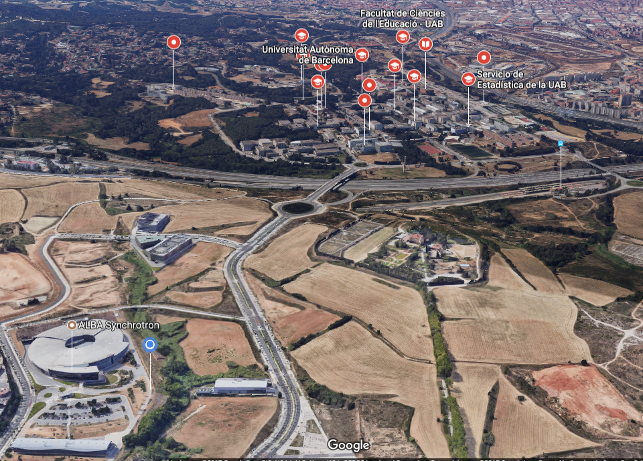
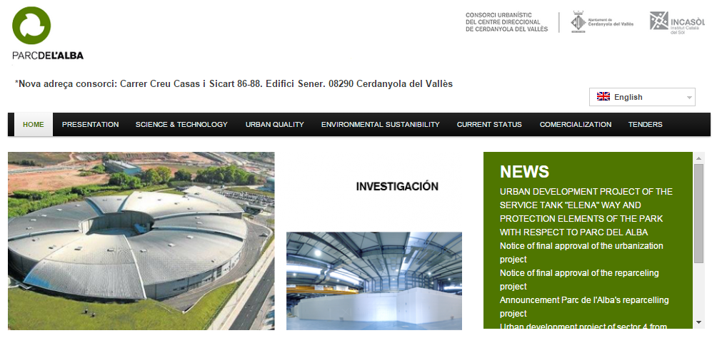
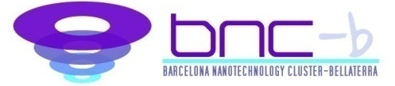
Inside Parc de l’ALBA
UAB
IFAE
4 Centres of Excellence “Severo Ochoa” and the 2 Units of Excellence “María de Maeztu” are located in the UAB campus
ICMAB
UAB
ICN2
ALBA
MATGAS
National Center Microelectronics
A cluster with nearly 750 scientists and technicians in the areas of Materials, Micro and Nanotechnologies

Slide 12
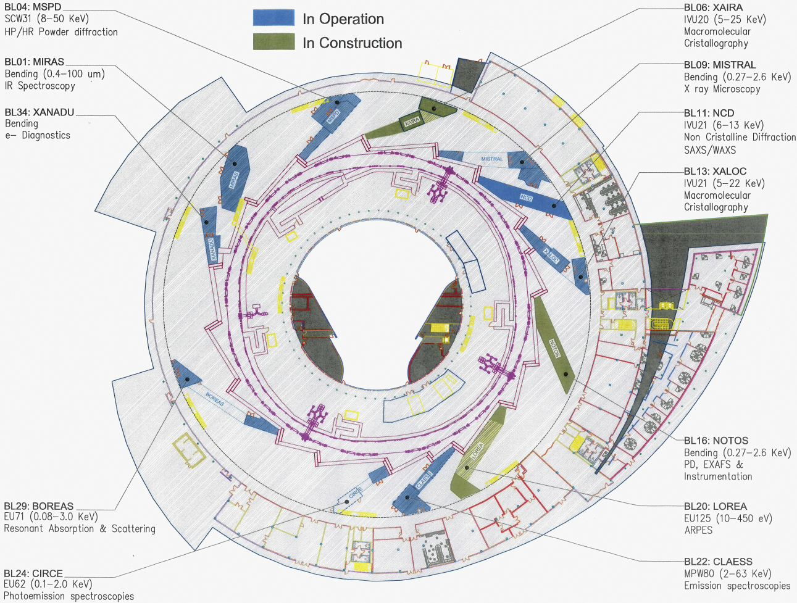
ALBA layout including accelerators and beamlines
FAXTOR
Hard X-ray Tomography

Slide 13
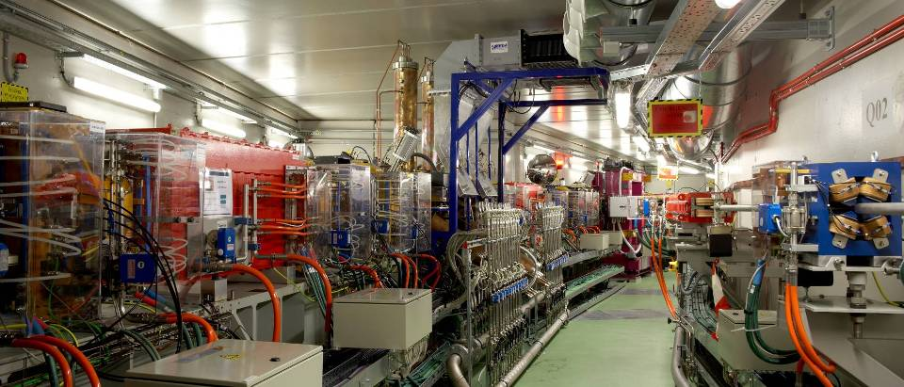
Large infrastructure based on e- accelerator
First (and up to now unique) large accelerator infrastructure in Spain
ALBA accelerator expertise in
Accelerator design / construction / operation at highest international standards
Magnet design / realization; magnetic measurement lab used also by other institutions and companies
RF systems – cavities, IOTs, Klystrons, LLRF; RF lab used also by other institutions and companies
Vacuum systems – vacuum chamber design and optimization; realization; mantainance; vacuum and diagnostic lab used also by other institutions and companies
e- beam diagnostics and instrumentations systems – BPMs, current monitors, SR monitors, streak cameras
Conventional infrastructure characteristics for high stability at mechanical and electromagnetic level
Bending
RF cavities
In vacuum undulator
Synchrotron Ring
3 GeV
Booster
0.1 – 3 GeV

Slide 14
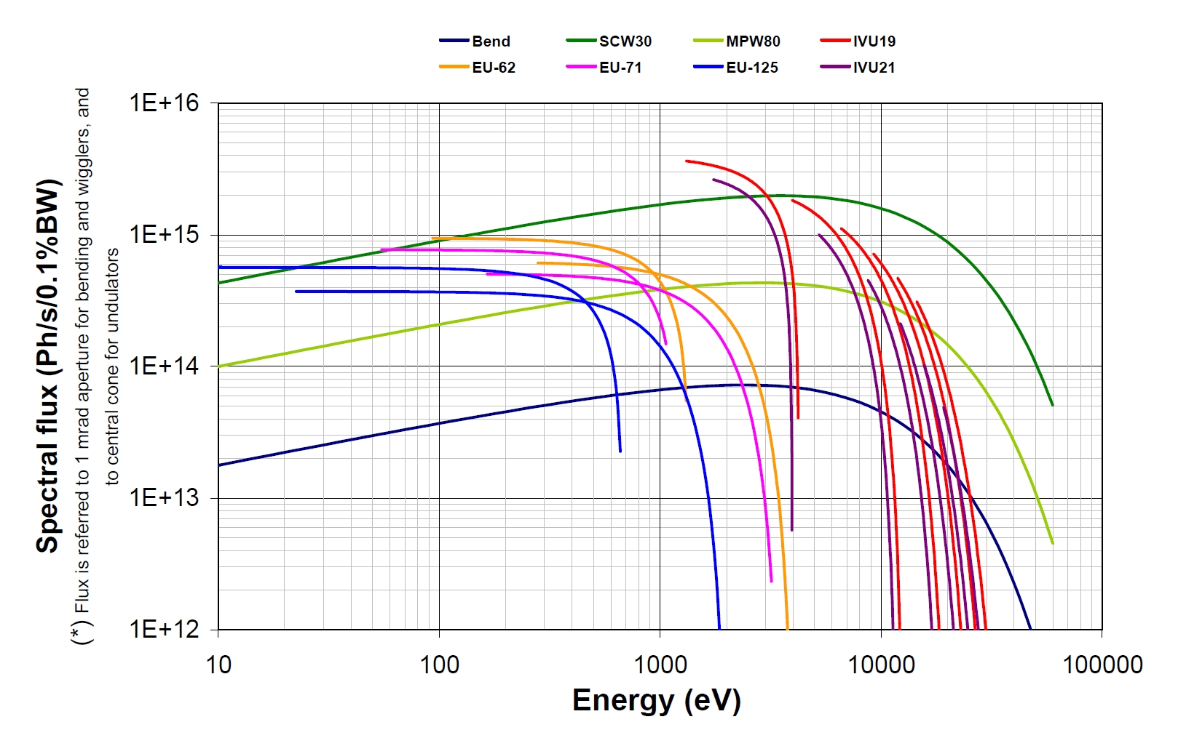
Photon sources: Insertion Devices and Bending Magnets
Bends (critical energy 8.6 keV)
1 SCW (2.1 T)
1 Multipole wiggler
Undulators
2 IV undulators
3 EU undulators
Covering from IR, through soft X-rays up to hard X-rays at 60 keV

Slide 15
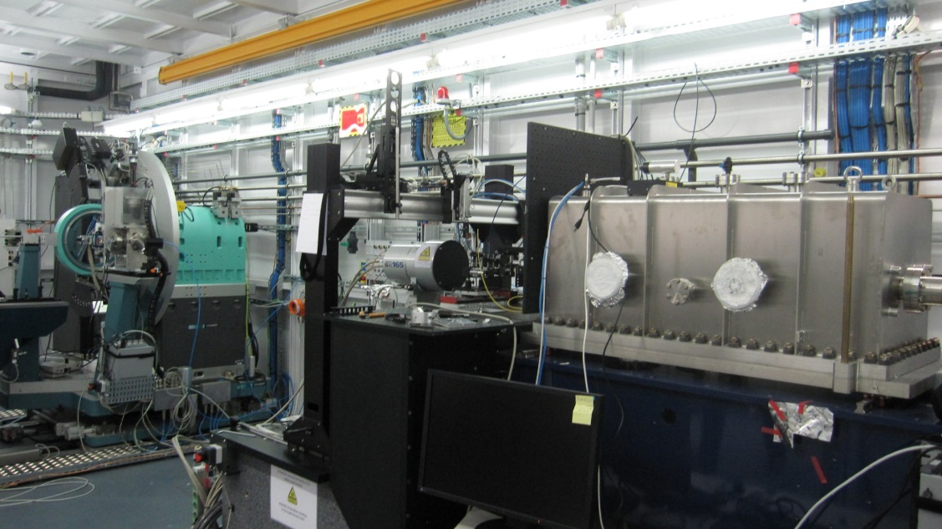
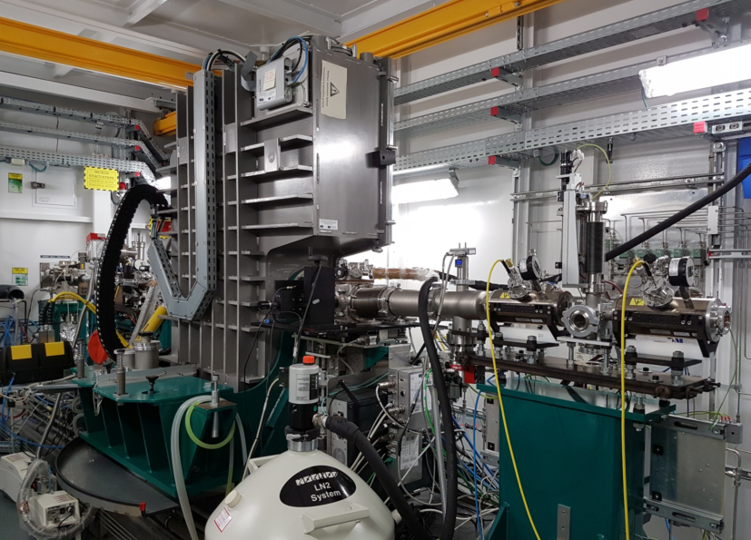
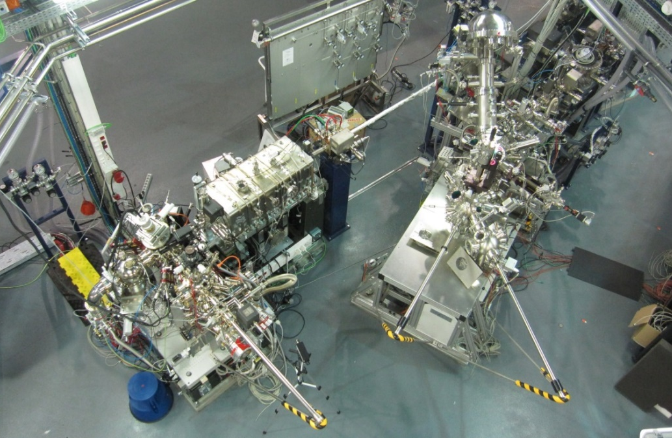
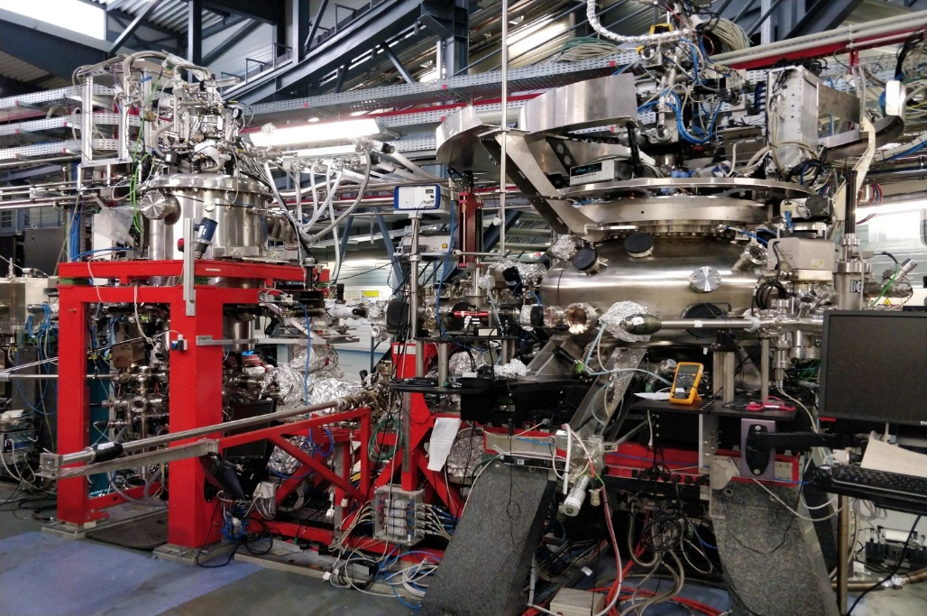
Four Beamlines mainly dedicated to Chemistry, Physics - Condensed Matter
Material science, Cultural heritage, 8 to 50 keV
Material science, Catalysis, Cultural heritage, 6 to 64 keV
MSPD: Material Science Powder Diffraction
HP & HR stations
CLAESS:
Absorption & Emission Spectroscopies
Nanomagnetism, Surface and materials science, Catalysis, 0.1 to 2 keV
Nanomagnetism, Surface and materials science, Catalysis, 0.1 to 2 keV
Nanomagnetism, Surface science, 0.08 to 4 keV
  CIRCE: PhotoEmission Electron Microscopy and
  Near Ambient Pressure Photoemission
BOREAS REsonant Absorption and Scattering
BOREAS

Slide 16
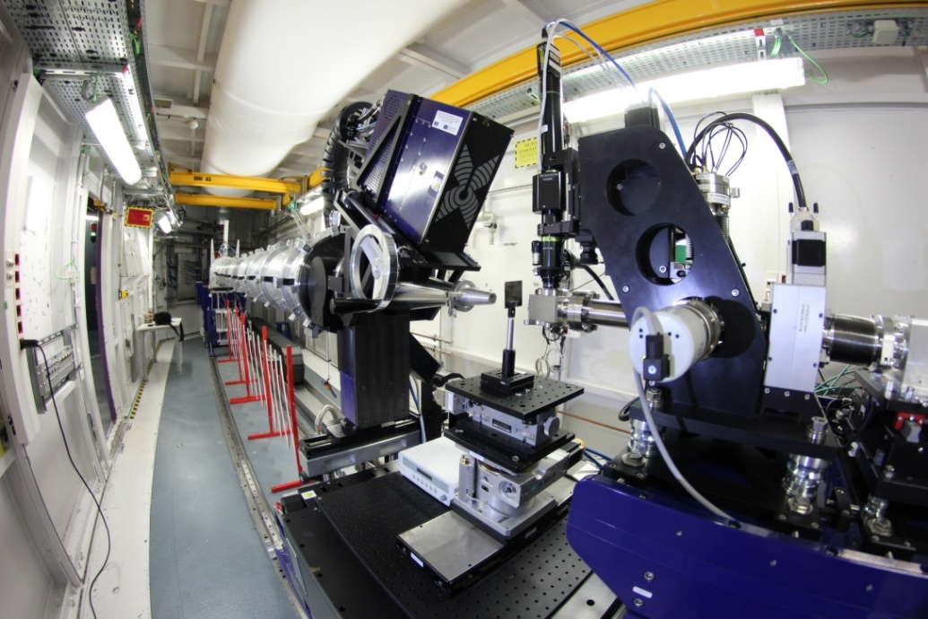
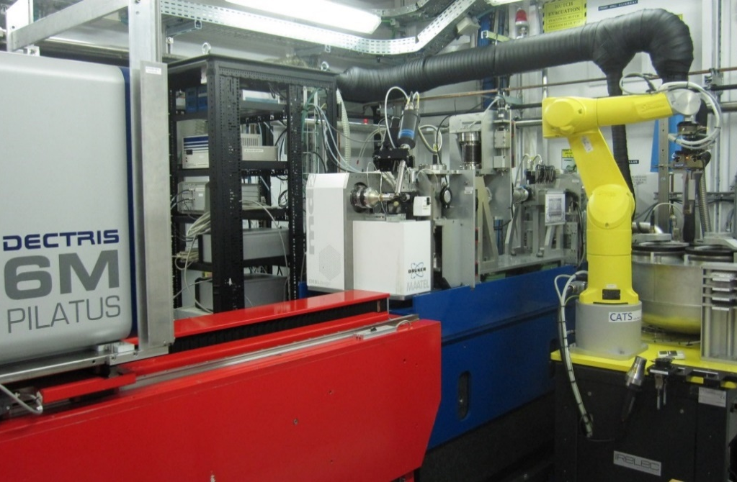
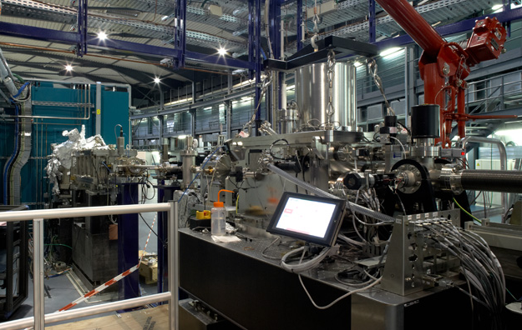
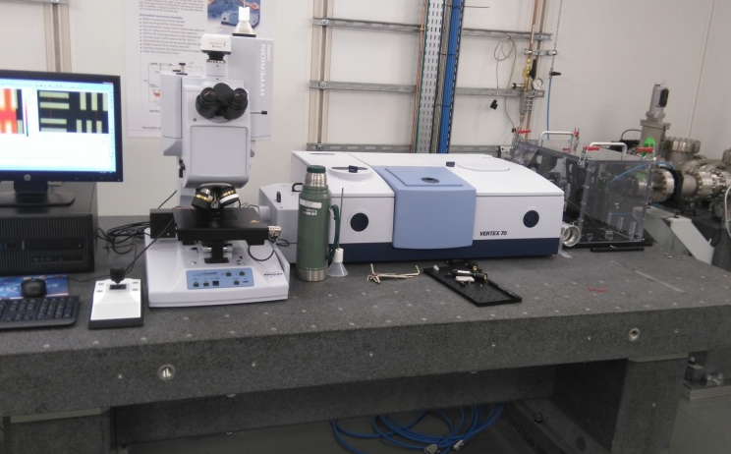
Four beamlines mainly dedicated to Life Sciences
Biosciences, Polymeres, Materials science, 6,5 to 13 keV
Biosciences, Polymers, Materials science, 6,5 to 13 keV
Biosciences, Proteins, drugs, 5 to 22 keV
NCD – SWEET, Non crystalline diffraction,
SAXS, WAXS and GISAXS
XALOC, Macromolecular Crystallography
Bioscience, Nanomagnetism, 0.27 to 1.2 keV
Bioscience, Material Science, Cultural Heritage, IR 10-100 um
MISTRAL, Cryo nano-tomography
MIRAS, IR spectroscopy

Slide 17
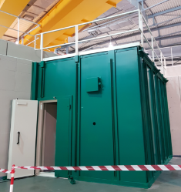
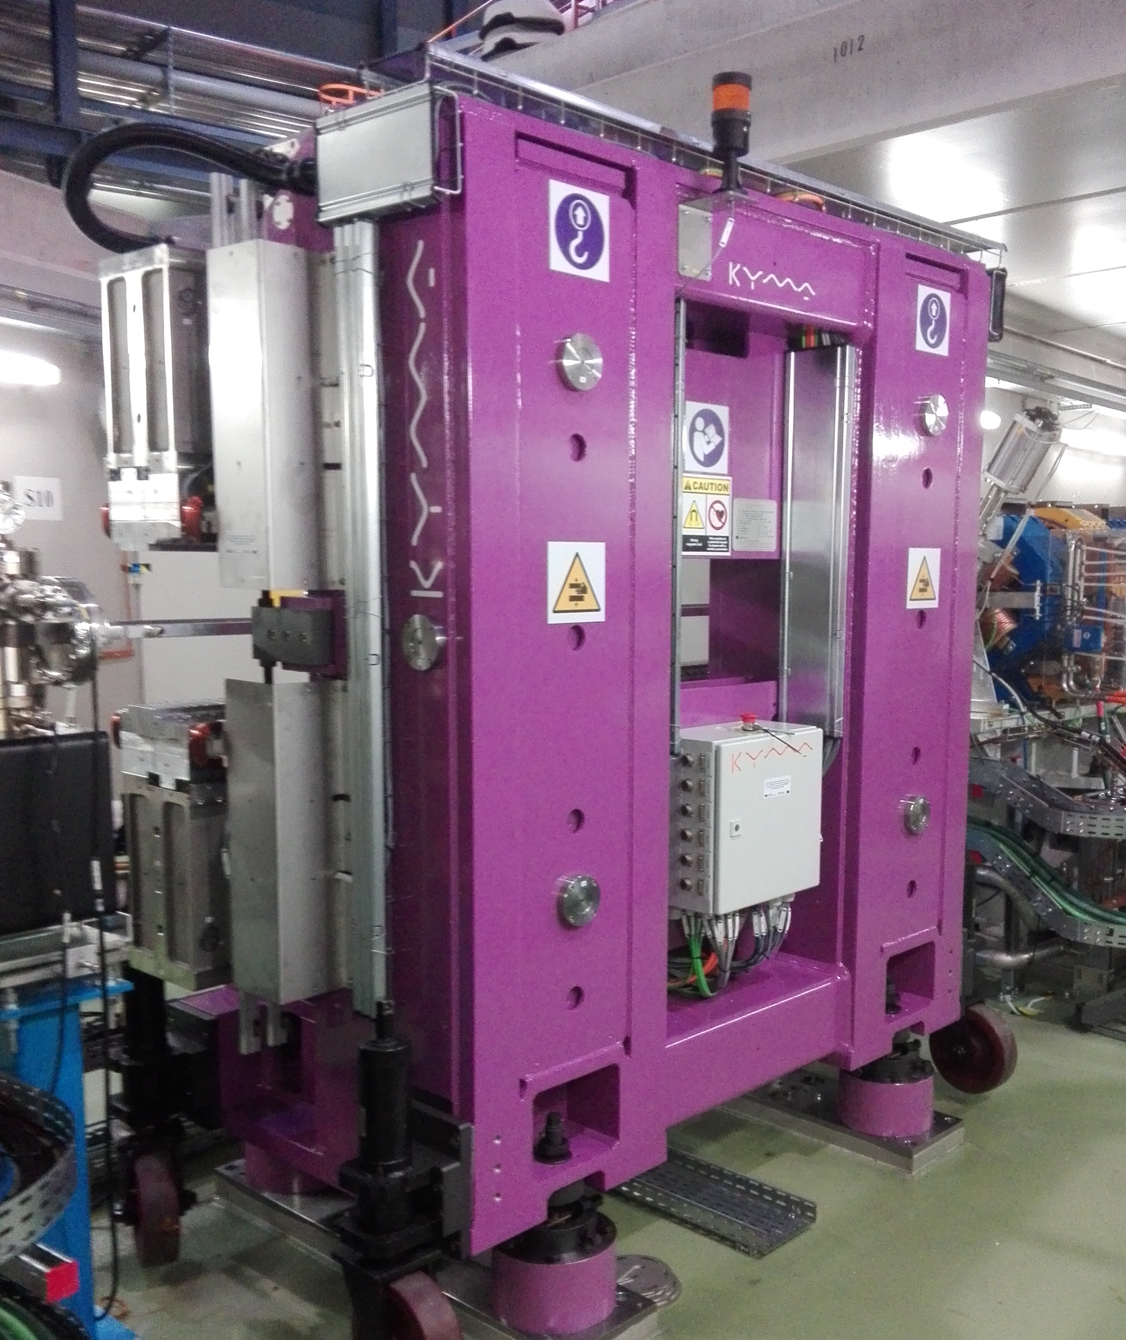
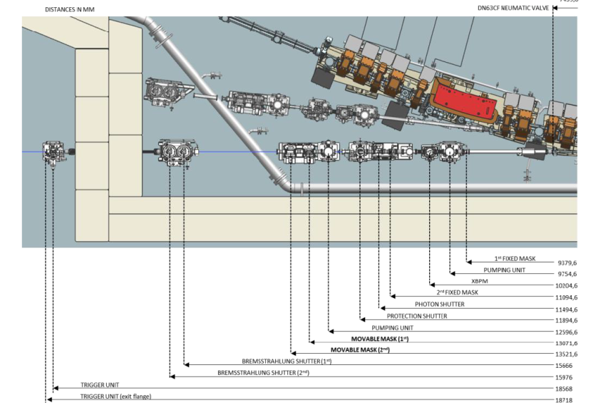
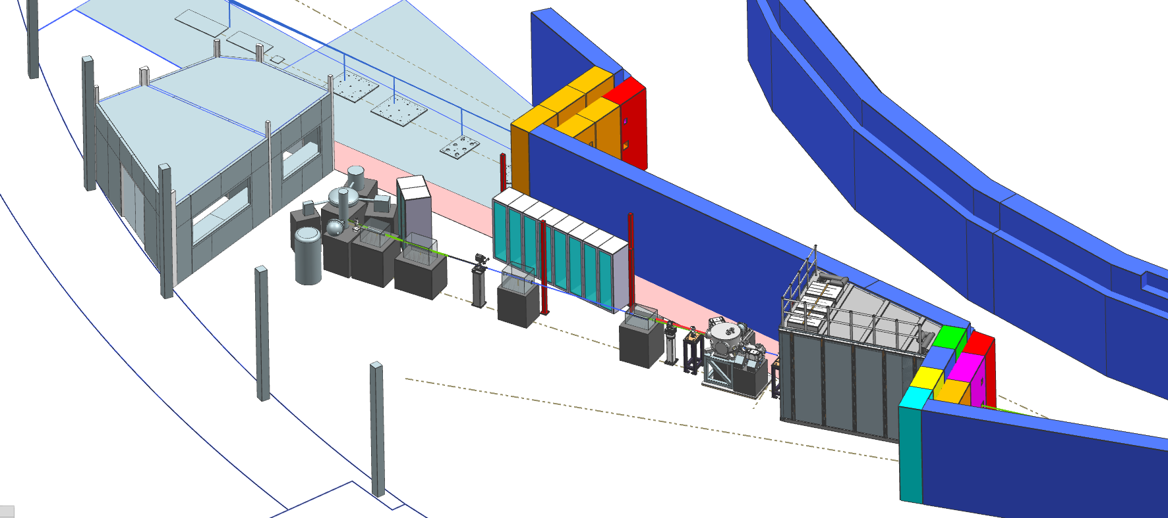
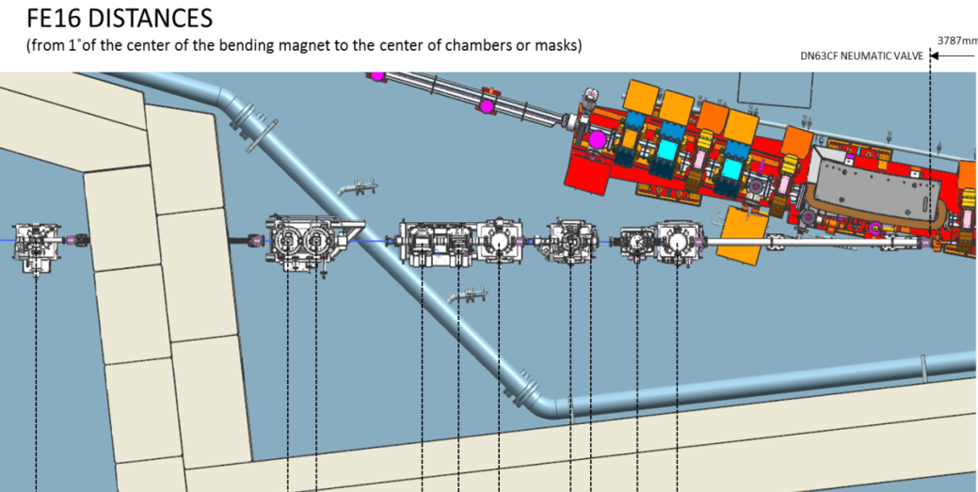

Four beamlines in construction at different stages
Electronic structures, Materials science, 0.01-1 keV
Biosciences, Proteins, drugs, 4 to 22 keV
LOREA, Angle resolved photoemission
XAIRA, Microfocus Macromolecular Crystallography
Material science, catalyisis, instrumentation, metrology,, 4.8 to 30 keV
Fast X‐ray radioscopy, real time tomography hard X-ray range
NOTOS, HP, Absorption and Instrumentation Development

Slide 18
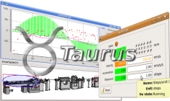

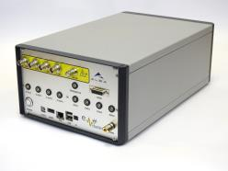




Control & IT Systems
Hardware and Software maintenance and Support to guarantee Availability > 99%
SUPPORT
>66000 h/year devoted to projects and operation
Data Handling
CONTROL SYSTEM
Software development
SARDANA & TAURUS
Instrumentation & Detectors Integration in Beamlines
300 MB/s data rates, Synchronization at nano-seconds and pico-seconds, Custom experimental Setups
International collaborations. Reference in the synchrotron community
Instrumentation development
Em# electrometer, High Voltage distribution, RF synchronization…

Slide 19
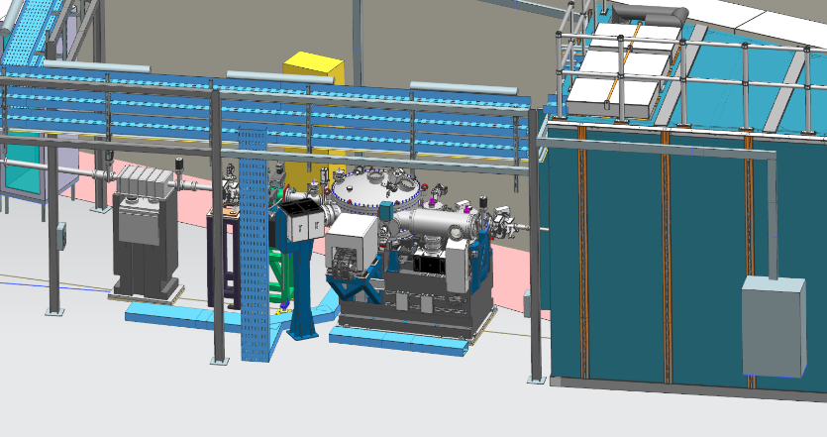
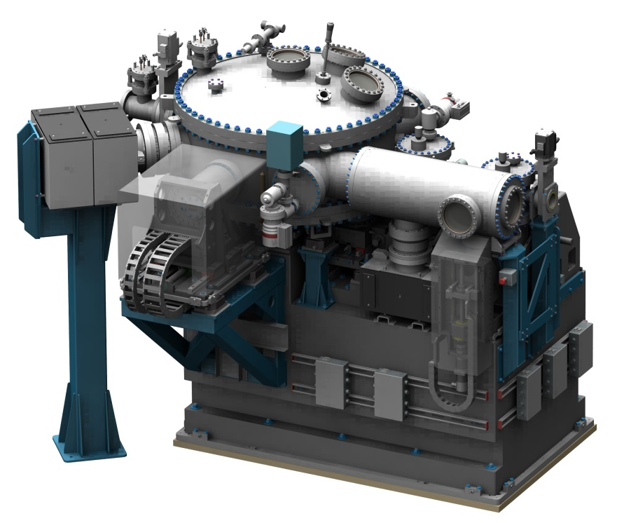
Cutting edge engineering processes & capabilities
Example: LOREA Monochromator new design
Novel grating cooling with thermoelectric modules. avoiding in-vacuum fittings, air guards and air encapsulations
Grating pitch mechanism with with 0.1 µrad resolution
ALBA engineering expertise in
Precision mechanics & mechatronics design of Synchrotron instrumentation.
Survey & Alignment, and metrology & vibrations test and analysis.
Vacuum systems design and operation (for third parties also).
Cryogenics engineering design at system level, and support to operation.
Workshop operation for high precision mechanical parts manufacturing and assembly.
Conventional infrastructure design, operation and maintenance (de-ionized water cooling, compressed air, liquid Nitrogen, liquid Helium, electrical systems, HVAC, civil engineering, control of technical installations).
Radiation protection hutches design following SPR’s team specification.
High stability
  First resonance at 65Hz
  The Fine mechanics and services are fully decoupled, structurally and with independent motorization
  Robust grating exchange mechanism
  Mirror movement with compact and rigid goniometers mechanics

Slide 20
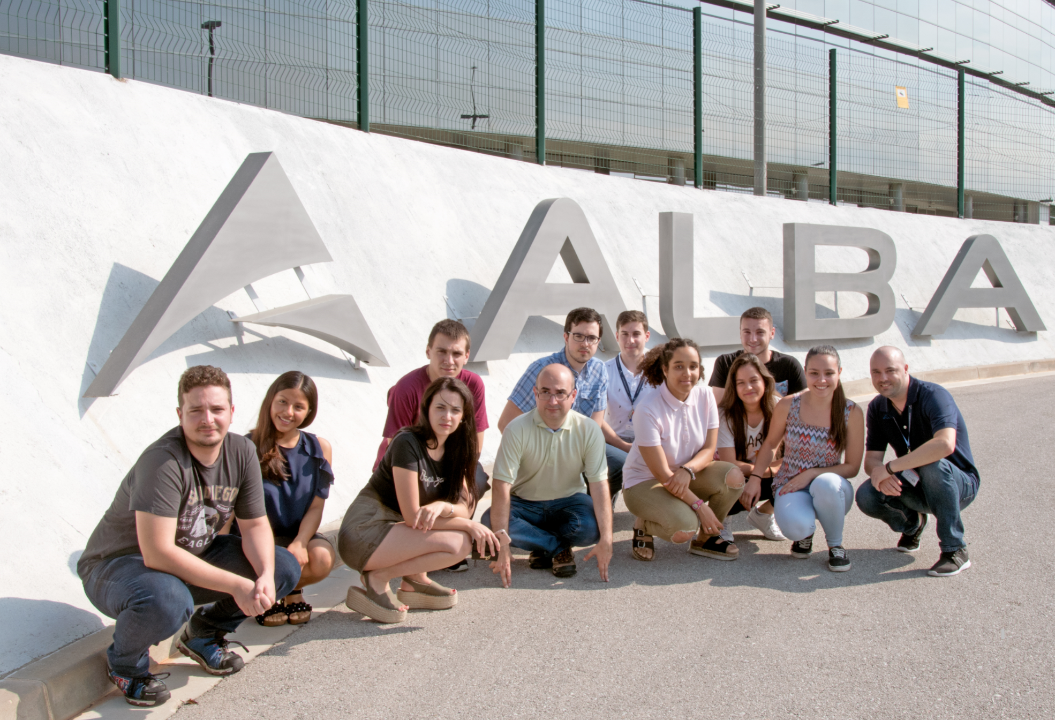
Training Center
Each year
~ 15-20 PhD students (ER), all with partial or full external funding
~ 20 university students (degrees/master)
10-15 FP (Professional Training) students have joined different areas, from accelerators, engineering, computer & control, beamlines, communication
2018 FP students

Slide 21
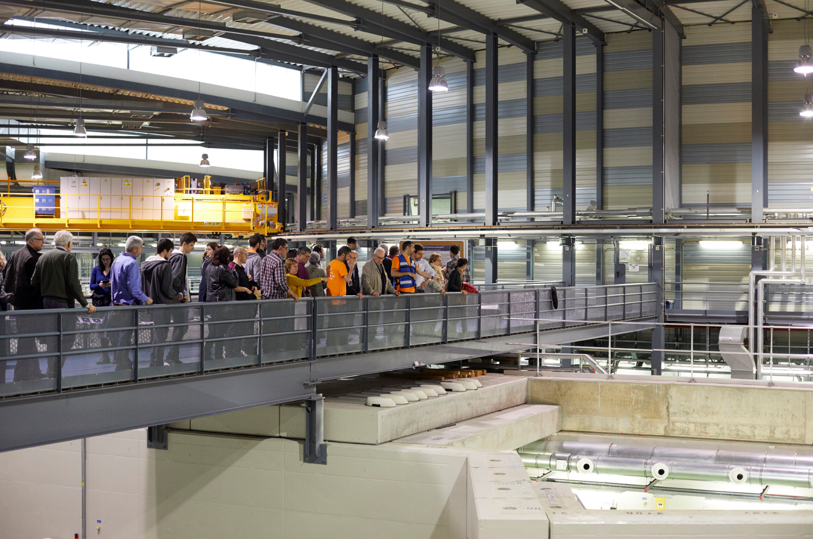
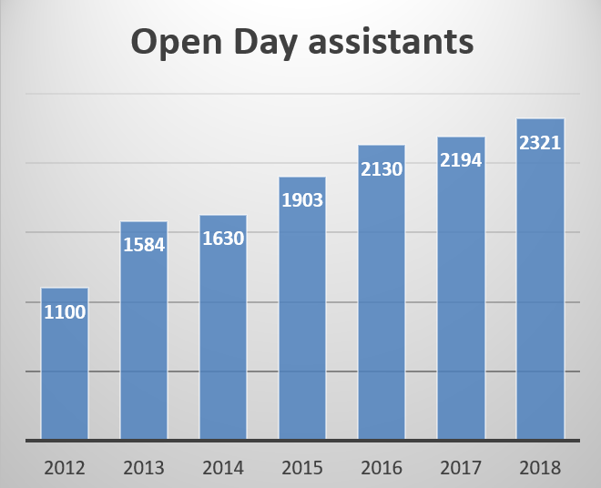




Outreach towards the society
More than 5000 visits/year
One yearly Open Day with high assistance
Participation of scientist in conferences and debates open to public
Mision ALBA: program to reach all Spanish schools
Open day celebrated on 5/5/18
Experiencia educativa. A través de una web común, los alumnos siguen 4 etapas donde realizan experimentos en clase.
Dirigido a
  Fomentar vocaciones científicas
  Proporcionar a los docentes recursos educativos
  Acercar a la comunidad educativa la labor científica

Slide 22

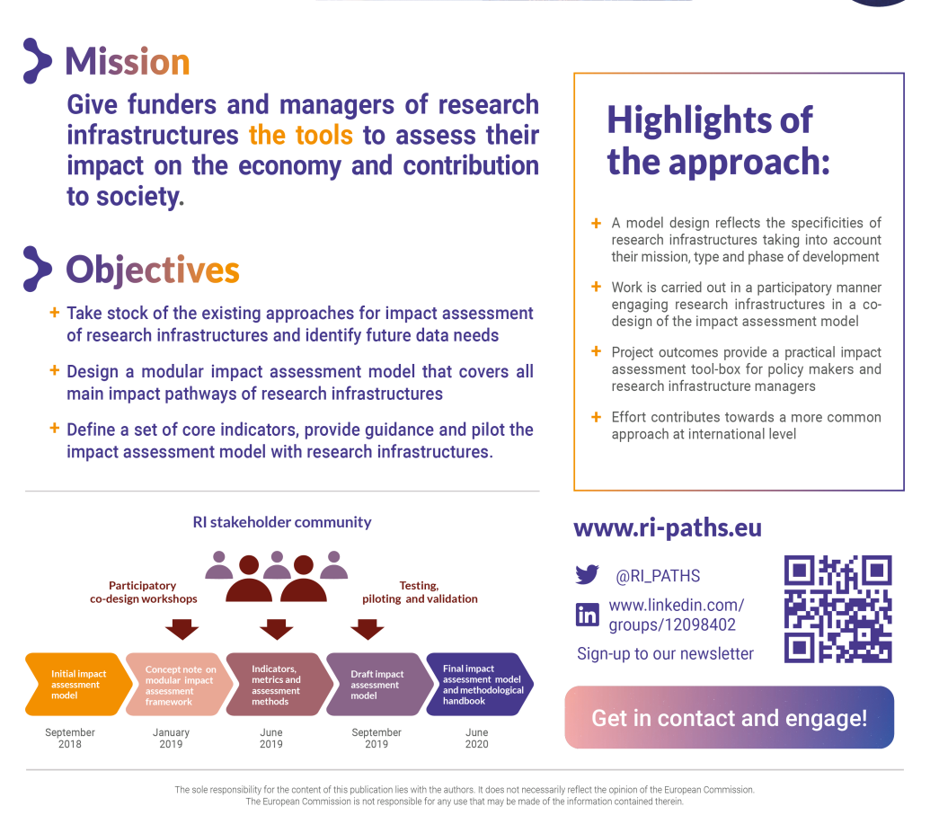
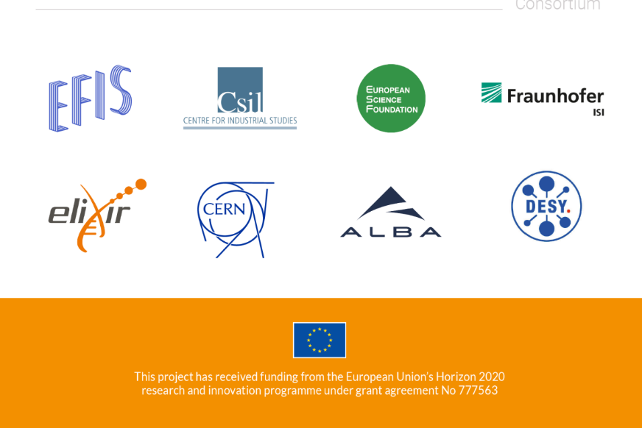
Assessing socio-economic impact through @RI_Paths

Slide 23
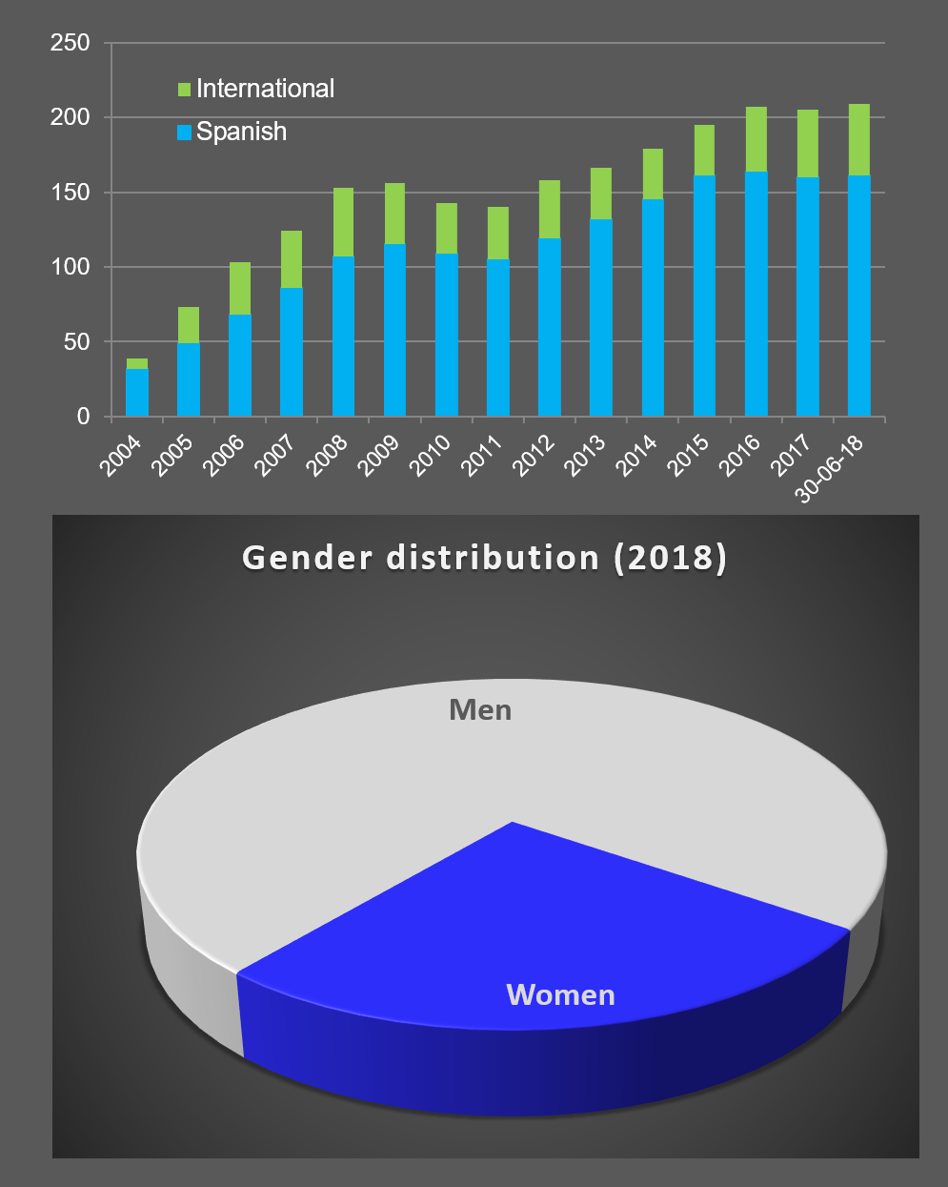
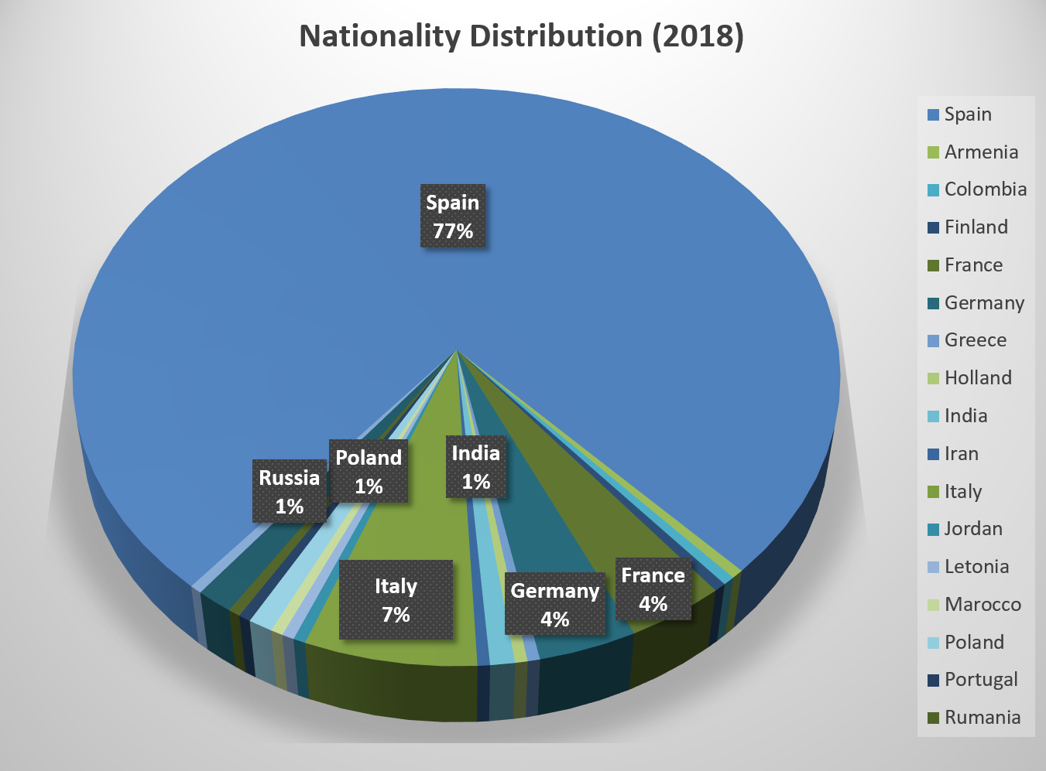
Staff

Slide 24
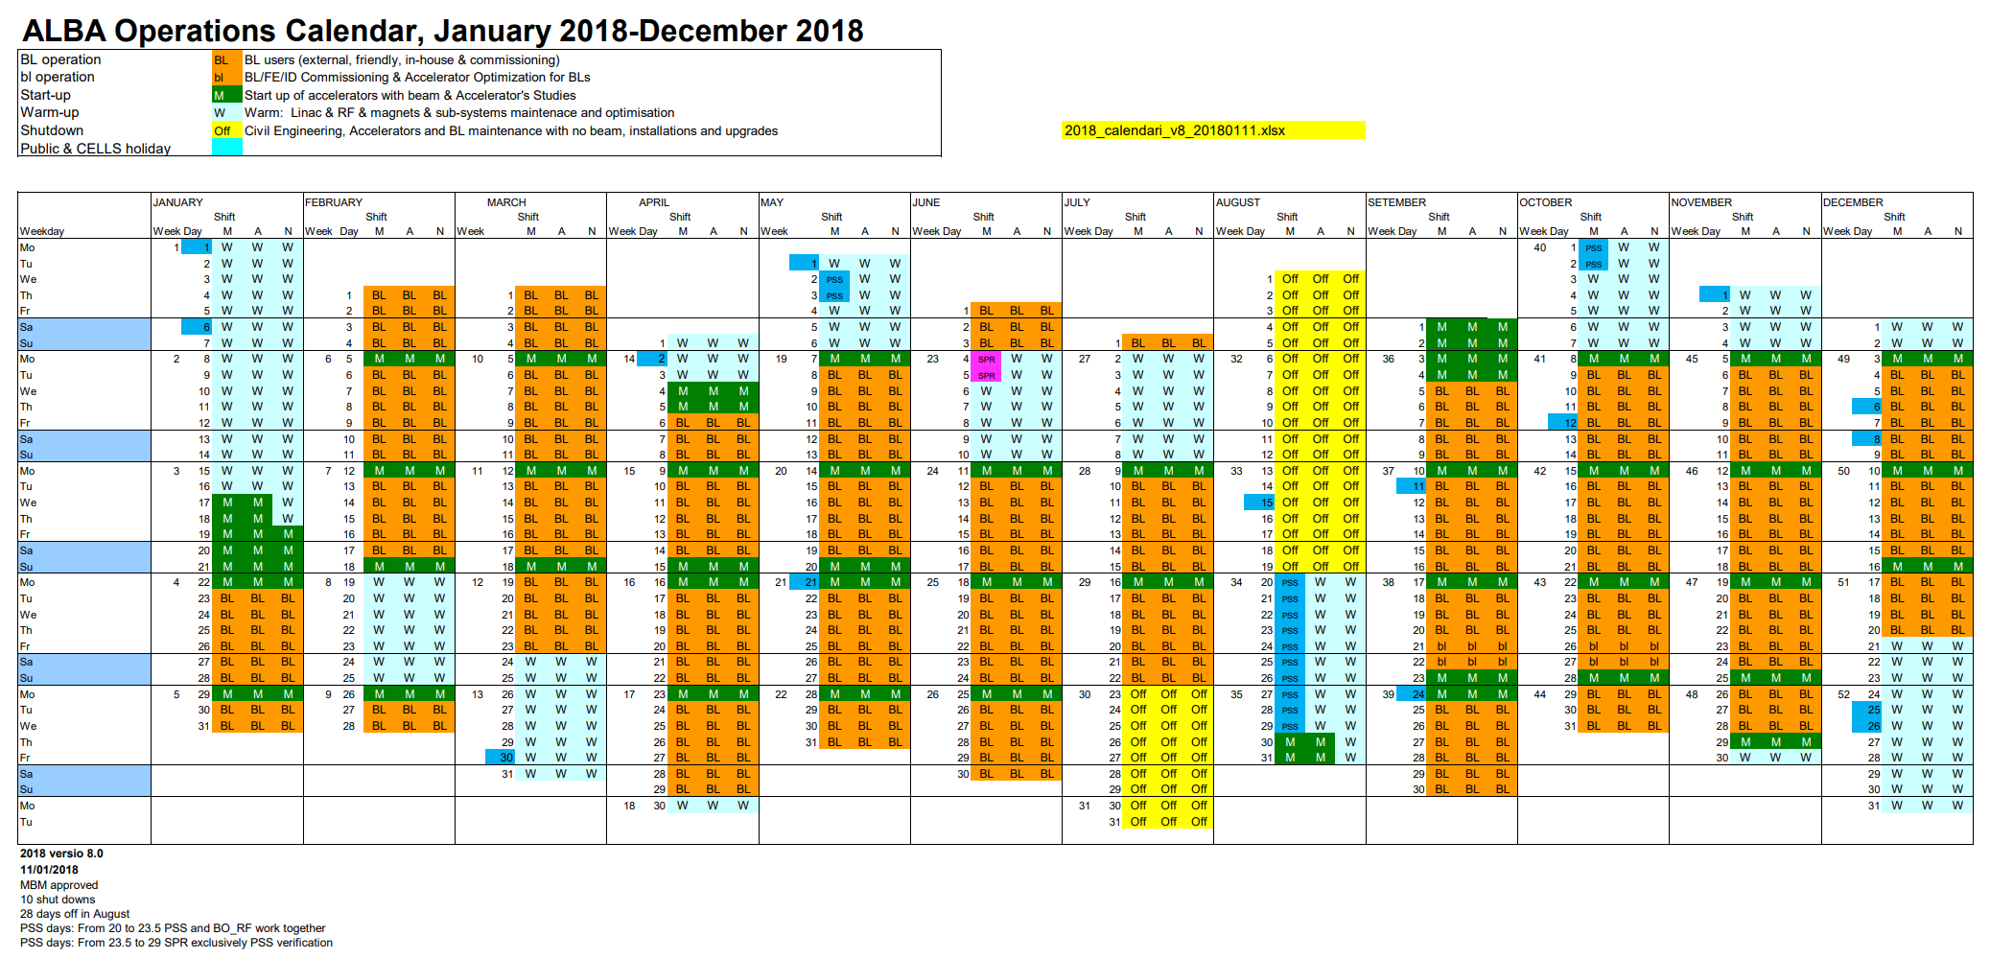
Operation – almost 6000h/year
Status Days
Shutdown (basic systems on) 91
Shutdown (all systems off) 28
Machine days 51
BEAMLINES operation 195

Slide 25
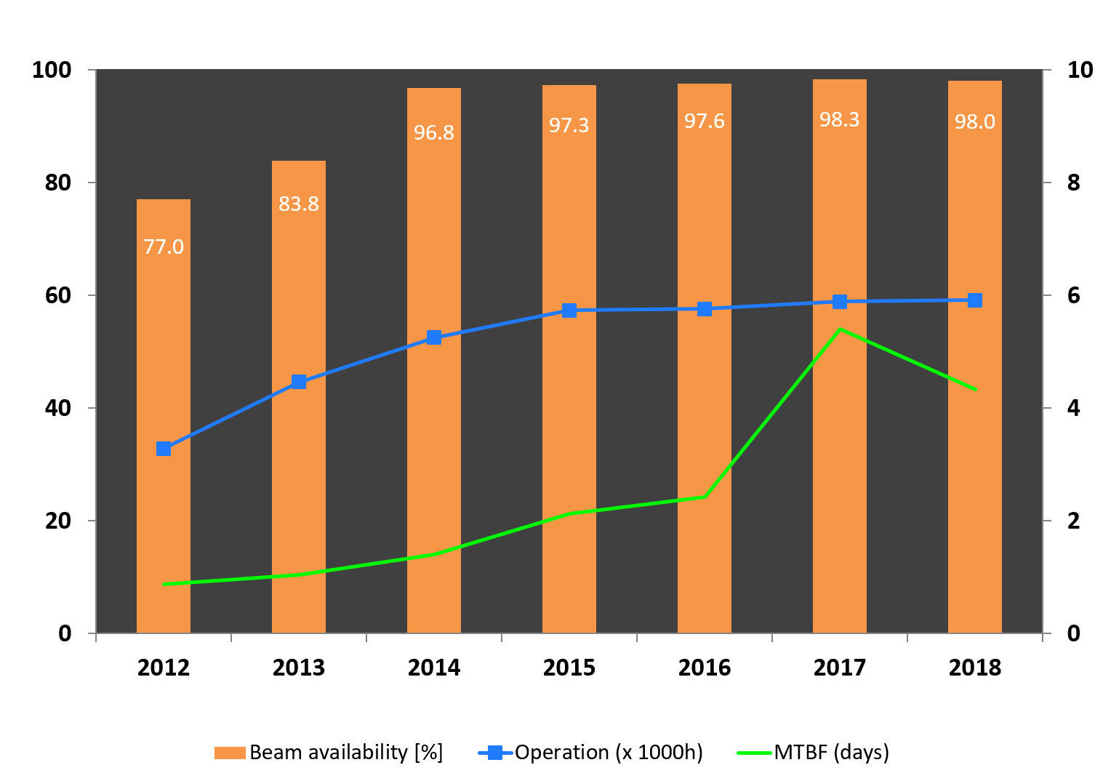
Availability since the start of the operation
Mean Time Between Failures above 4 days since 2017. Thanks to
Sound design and realization of the whole infrastructure and its systems, from the low-tech ones to the most advanced
Usage of preventive maintenance
Spare system availability optimized within budget constraints
Availability of maintenance teams 24/24 for all technical systems with quick reaction capacity based also on on-call organization
Until 24-09-18

Slide 26
USERS
Joint academic and industrial
Academic
Industrial
Direct access covering operational costs
Private results
Free access based
on competitive process
Open science

Slide 27






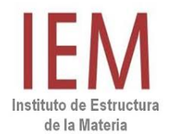












Life and Material Science
few examples of users from all Spain
(600 registered institutions in our user database)
+ Universities

Slide 28


















Few examples of users from the rest of the world (842 registered institutions in our user database)

Slide 29

Users evolution
2012-2016: Seven Operating Beamlines and progressive increase of beamtime hours per BL
2016 fall-today: Eight Operating BLs – beamtime hours/BL at maximum; beamline optimization and evolution allow to carry on experiments using shorter times, and hosting more users

Slide 30

International User Distribution – example of 2nd 2018 call
Summing up all calls, more than 40 different countries have participated to ALBA calls, about 30 countries have been granted beamtime

Slide 31

Historic of academic proposals
Call 2019-I closed few weeks ago and being evaluated
Record number of received proposals
National and specially international increased participation
(ESRF shutdown and visibility thanks to LEAPS)

Slide 32

Productivity
Peer reviewed publications per BL

Slide 33







Innovation Hub: Industrial users
The services include mail-in, pre and post experiment support, data treatment, experimental reports, advice on synchrotron techniques, etc

Slide 34




Technology Transfer
Innovative Designs
Industries
Production
Other scientific infrastructures, national and international

Slide 35


Examples of other activities
Collaboration with HEP community mainly on accelerator physics and technologies (see F. Perez talk on participation to FCC and CLIC studies)
Collaboration with SESAME
CESSAMAG program, directly working with CERN for synchrotron ring dipole measurements
OPEN SESAME program, ALBA work package leader for training

Slide 36




A new consortium of excellence in Europe devising a transformative level of coordination and integration
13 European Synchrotron Radiation and 6 FEL Facilities
are joining forces to master
the challenges of the next
decades

Slide 37


Strategy recently published
Available at https://www.leaps-initiative.eu/news/presentation_of_leaps_strategy_2030/

Slide 38
What LEAPS aims at:
Pushing X-Ray Science in Europe to the next level optimizing RI resources from now towards Horizon Europe and beyond
New Cooperation between European Facilities in close interaction with national authorities and the European Commission
Coordinated transformation of Europe´s facilities towards the next Gen facilities
Smart specialisation strategy among LEAPS facilities
LEAPS roadmaps for facility developments and new technologies
Most advanced technologies to academia and industry
New European training platform for nextGen scientists, industry and future managers
Development of LEAPS as a contact point of the future EOSC
Integration of emerging communities and strategic partners of Europe

Slide 39
ALBA future
2030
ALBA II
2020
11 Operating BLs
4 BLs in construction
2028
16-20 Operating BLs
Preparing ALBA II
Next decade fully exploiting the initial infrastructure by increasing number of BLs and add addional platforms (as Advanced Microscope Center)
2017-2020 Strategy Plan
In progress
Upgrade to more brilliant source

Slide 40

Thank you for the attention
And enjoy the workshop
Glasses of a Romanic chapel studied at ALBA

