Slide 1


DESIGNING AN EXPERIMENT FOR XAS
INTRODUCTORY COURSE:
Synchrotron EXAFS & XANES for Chemical Speciation on Environmental Systems
ALBA 6-9th October 2014
Part II
Marta Avila
CLÆSS - Core Level Absorption and Emission Spectroscopies

Slide 2

Outline
Part I
  What do we need to run a XAS experiment?
  Detection modes: Transmission and Fluorescence
  Sampling regions
  Scan repetitions
  Beam size
  Radiation damage
  Take away message
Part II
  Sample setups
  Sample preparation techniques
  Safety
  Bibliography

Slide 3

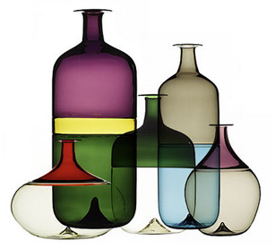
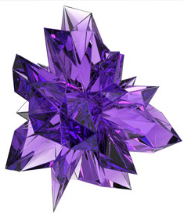
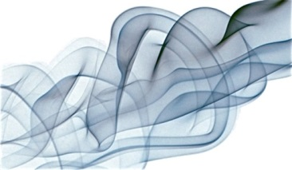
In previous episodes…
XAS can be applied to any kind of materials:
Crystals, glass, liquids, etc…
Transmission → Concentrated samples (> 10 wt. %)
Absorption jump between 0.1 and 1.5
Fluorescence → Diluted samples or not x-ray transparent samples
Very few restrictions on samples

Slide 4
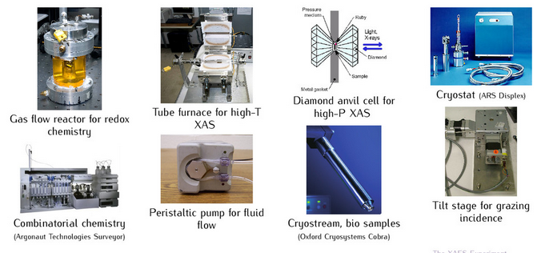
Sample environment
Almost anything can go on the sample stage
XAS is usually capable of measuring your sample very close to the “proper” state → in-situ
4
Notes:
- Pressure (pressure transmitting medium change as a function of the temperature investigated) – Reaction (time scan – to avoid uncontrolled reactions with the sample environment - ) - concentration – electrical current - …

Slide 5
Initial considerations
Ideally, the sample should be as homogeneous as possible to avoid spectra distortions
During synthesis of your sample, if possible, choose conditions to make small particles
If grinding of your sample is necessary: check that the chemical state of your sample does not change under heating or pressing and prevent aggregation back into larger particles
If you are going to measure your sample under special conditions (heat, pressure, chemical reaction with gases or liquids, etc.) check that the dilutant, tape or elements present in the sample (besides the sample) do not react
Good samples
Solutions and stable suspensions
Fine powders dispersed in a binder (BN, cellullose,etc.)
Foils
Uniform films
Glasses of appropriate thickness
5
Notes:
To dilute the samples : Dilutants: Alúmina y carburo de silicio absorven menos el agua que la cellullosa o el Boron nirtride. If you are doing a reaction with water, try to avoid a material that absorbs water.

Slide 6
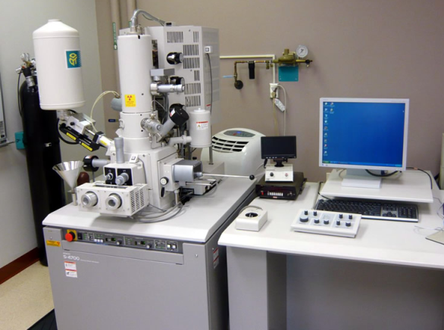
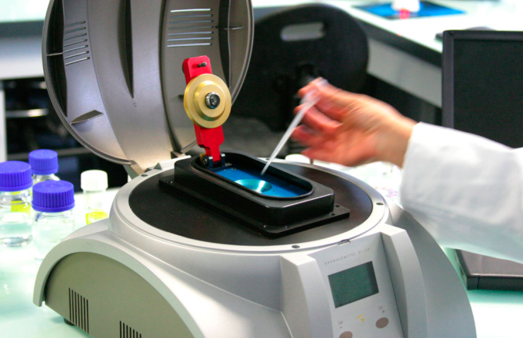
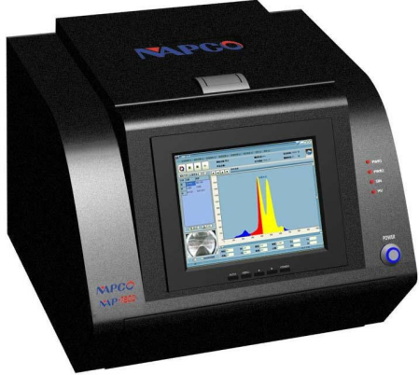

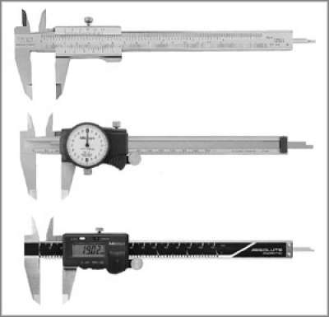
First step: Check your sample
Check composition by spectroscopy or diffraction
If you have nice instruments like a SEM or light scattering particle size analyzer, don’t hesitate to use them
Check for homogeneity with a digital microscope
Measure sample thickness
6
Notes:
Visually check for homogeneity

Slide 7
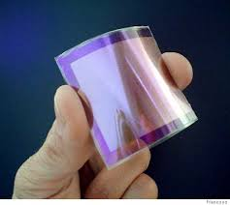
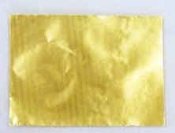
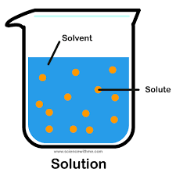
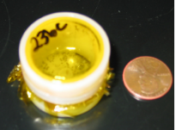
Some preparation techniques overview
FOILS, FILMS, GLASSES OR SINGLE CRYSTALS → MEASURED AS IT IS
Foils, self-supported films, thin single crystals → transmission
Thin supported films → fluorescence
Too thick single crystals → fluorescence
LIQUIDS → CELL, CAPILLARY CELL...
Transmission, if the concentration allow
Phase separation
Photolysis of water
Precipitation due to radiation damage (e.g. proteins)
Suspensions/pastes can be inhomogeneous
POWDER → Different methodologies: pellet, sedimentation, …
7
Notes:
Can make good transmission samples if concentrated
Usually make good fluorescence samples (∼ 1mM and 100 ppm are routine), lower concentrations feasible
They can become inhomogeneous during the experiment due to
Phase separation
Radiation damage can cause precipitation (e.g. protein solutions)
Photolysis of water makes holes in intense beams
Suspensions/pastes can be inhomogeneous

Slide 8
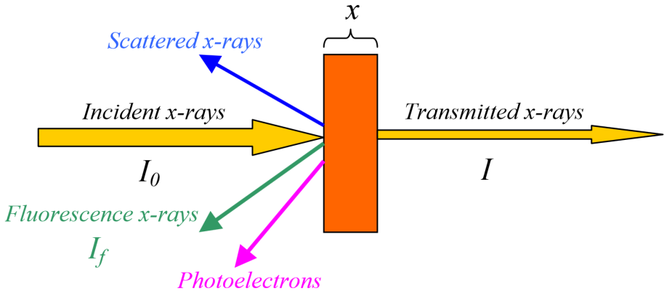
The jump, this unknown…
How to calculate it:
Powder sample preparation: Pellet
µ⁺
(µ⁺-µ⁻ ) x = J (Jump)
µ⁺ x < 2.5
(even better if µ⁺ x < 1.5 )
µ⁻

Slide 9
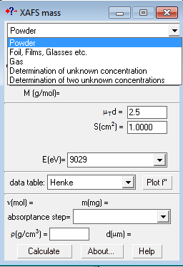
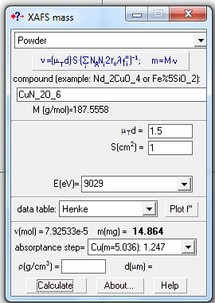
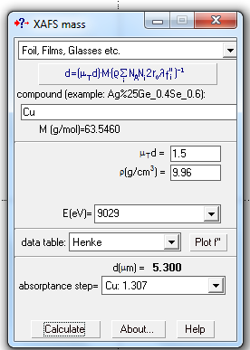
Powder sample preparation: Pellet
Optimal sample thickness can be calculated using several programs, i.e. XAFSmass (K. Klementiev)
Calculation of mass and absorption step for powders
Calculation of thickness and absorption step for samples with known density
1.5
Getting 0.1 < absorptance step < 1.5 is very important to avoid spectra distortions!!!
9
Notes:
We need a uniform sample of the required thickness and free of pinholes. This is not always easy!
Calculating absorption lengths:
Absorption cross-sections $σ(E)$ are tabulated in the McMaster tables (online of book form) in barns/atom (1barn=10⁻²⁴ cm²). From a material’s chemical formula and density $ρ$(in g/cm³), an absorption length (in cm) is given by:
$t=\frac{1}{μ}=\frac{1.66\sum_{i}{n_{i}M_{i}} }{ρ\sum_{i}{n_{i}σ_{i}(E)}}$
Sums are over the elements i in the chemical formula n, the elemental stoichiometry, M_{i} is the atomic mass (in amu), and 𝜎_{𝑖} (E) the crosss-section.
Getting both $t∆μ>0.1$ and $tμ<4$ are important!!!

Slide 10
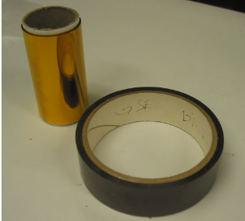
Powder sample preparation: Pellet
This does not require great laboratory skills, but does require: high precision balance, mortar and pestle, pellet maker, press, and sometimes a diluent.
DILUENTS: should be chemically non-reactive with the sample, depending from the experiment non-higroscopic and transparent to x-rays
Cellullose
Polyethylene
Boron nitride
Alumina
Sugar, loctite, etc.
burns at high temperature
highly higroscopic
Not compatible with low E
If compatible with the experimental condition, kapton is often used to fix the sample on the sample holder.
Kapton® is a polyimide film developed by DuPont that remains stable across a wide range of temperatures (−269 to +400 °C). Is strong and unusually radiation resistant. It comes in plain film (7 μm to 75 μ m or thicker) and tape form.
Be careful, at low T Kapton tape does not glue
Notes:
The sample and matrix are then ground together in a mortar and pestle and mixed thoroughly.
Usually the sample is uniformly mixed with with a filler/binder material with a low-Z material (cellullose, sugar, BN, alumina, duco cement, etc… - be carefull to the experimental conditions! Cellulose is burning at high temperature – BN can be warmed up but is highly higroscopic – alumina is not compatible with low energies - )

Slide 11
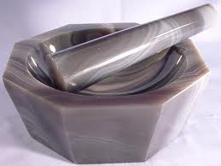
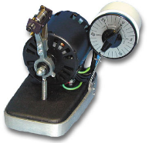
Powder sample preparation: Pellet
REMINDER: Each individual particle should be small enough (less than one absorption length) or the spectra will be distorted
Grind and mill your samples for at least 30 min
Mortar and pestle
(porcelain or agate)
Small volume ball mills
(MiniMill 2 Pananalytical, Gilson Micromill)
Be careful with the Grinding:
check that the chemical state of your sample does not change under temperature, pressure and prevent aggregation back into larger particles

Slide 12
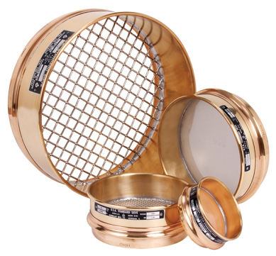
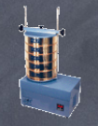
Powder sample preparation: Pellet
REMINDER: Each individual particle should be small enough (less than one absorption length) or the spectra will be distorted
Grind and mill your samples for at least 30 min
Mortar and pestle
(porcelain or agate)
Small volume ball mills
(MiniMill 2 Pananalytical, Gilson Micromill)
Sieve your samples
ASTM sieves
ASTM stack and shaker
Mix your sample with a non reactive liquid, stir it up and wait until the bigger particles have been sink. Decant the supernatant with a pipette and dry the particles

Slide 13
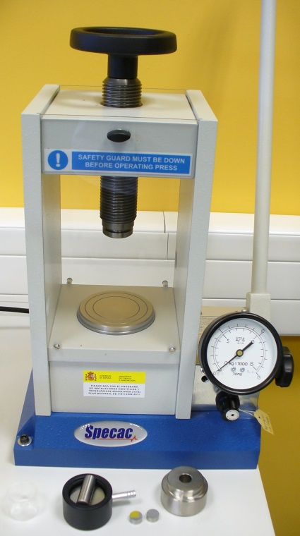
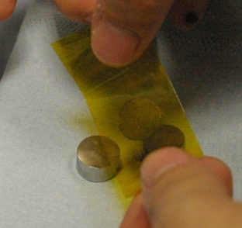
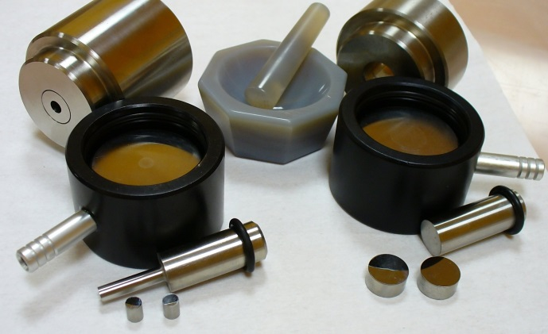
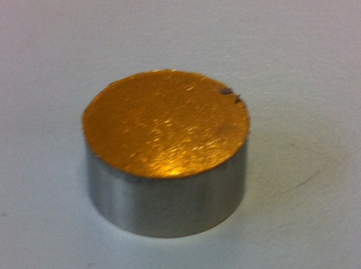
Powder sample preparation: Pellet
Pellet maker – different sizes
Do not put more than 0.5 ton! By pressing stronger you destroy the pellets rather than make them firmer.
Seal sample between Kapton tape
Hydraulic press
If your sample gets stacked to the dies of the pellet maker, one trick is to attach Kapton tape to it
Mix your sample with a non reactive liquid, stir it up and wait until the bigger particles have been sink. Decant the supernatant with a pipette and dry the particles

Slide 14
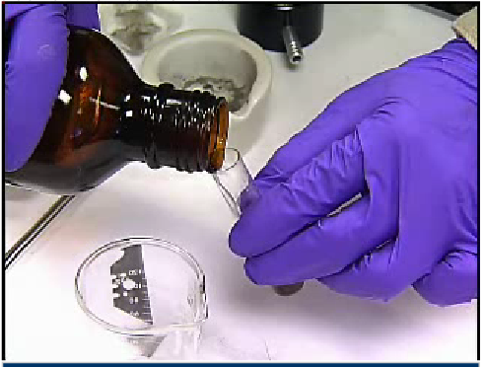
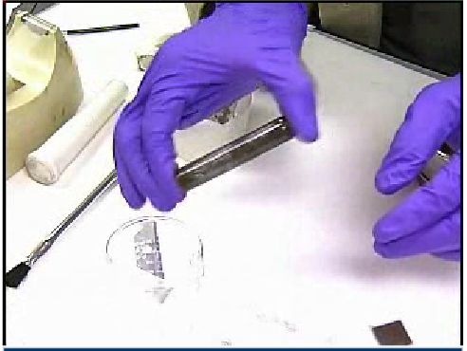
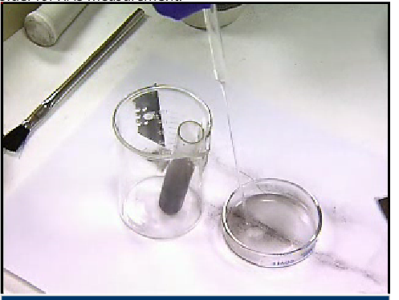
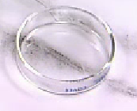
Powder samples: sedimentation
Is a very useful technique for low energy measurements in transmission mode
stir it up and wait until particles have been sink
Mix your sample with a non reactive liquid
Decant the supernatant with a pipette
dry the particles and on a thin kapton foil or similar.
14
http://xafstraining.ps.bnl.gov/XOO_Module3.swf
Notes:
This is also a good way to select finer particles from the bigger ones

Slide 15
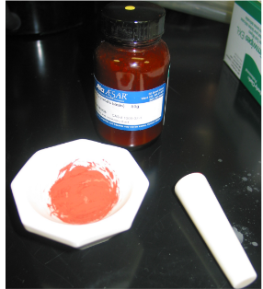
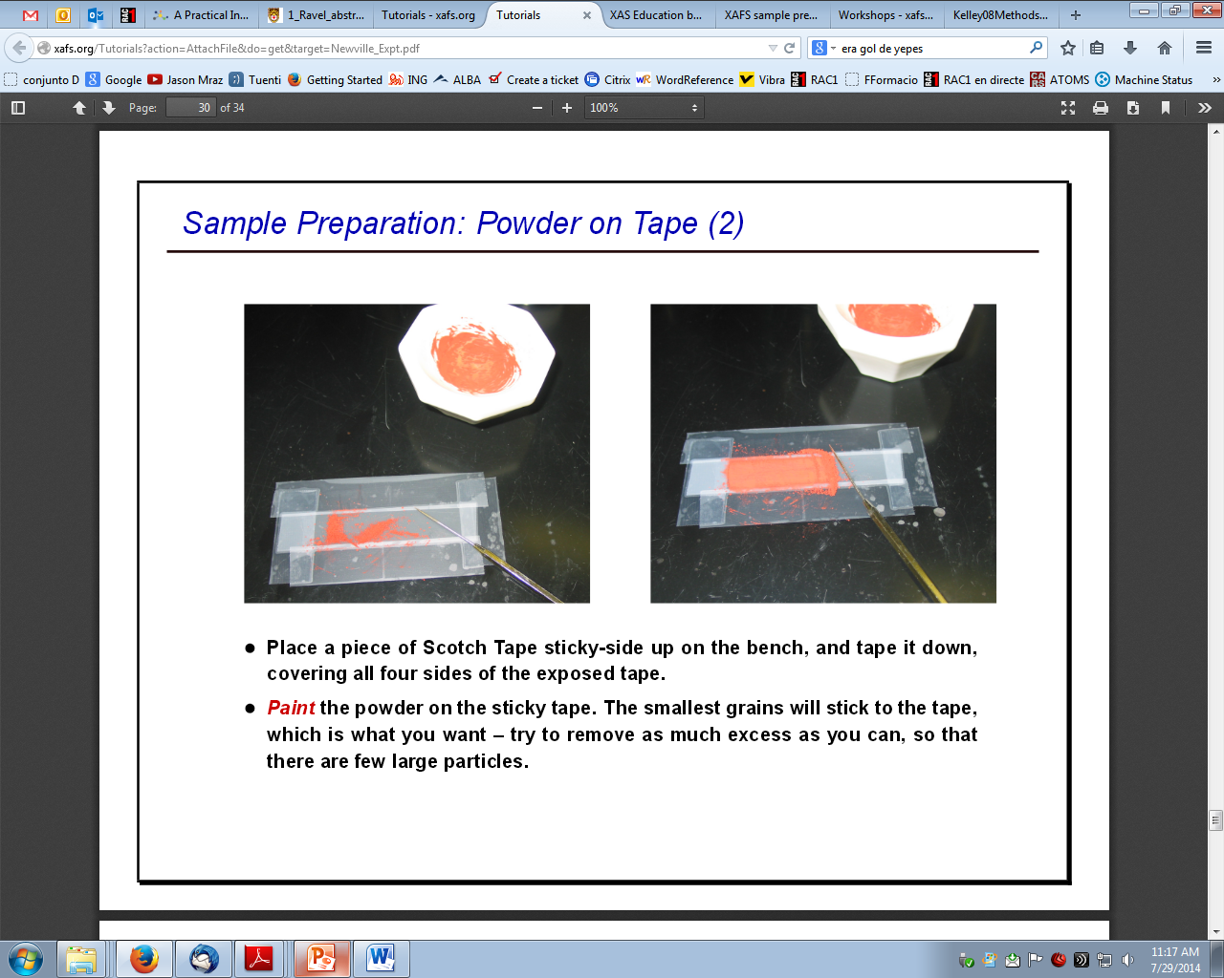
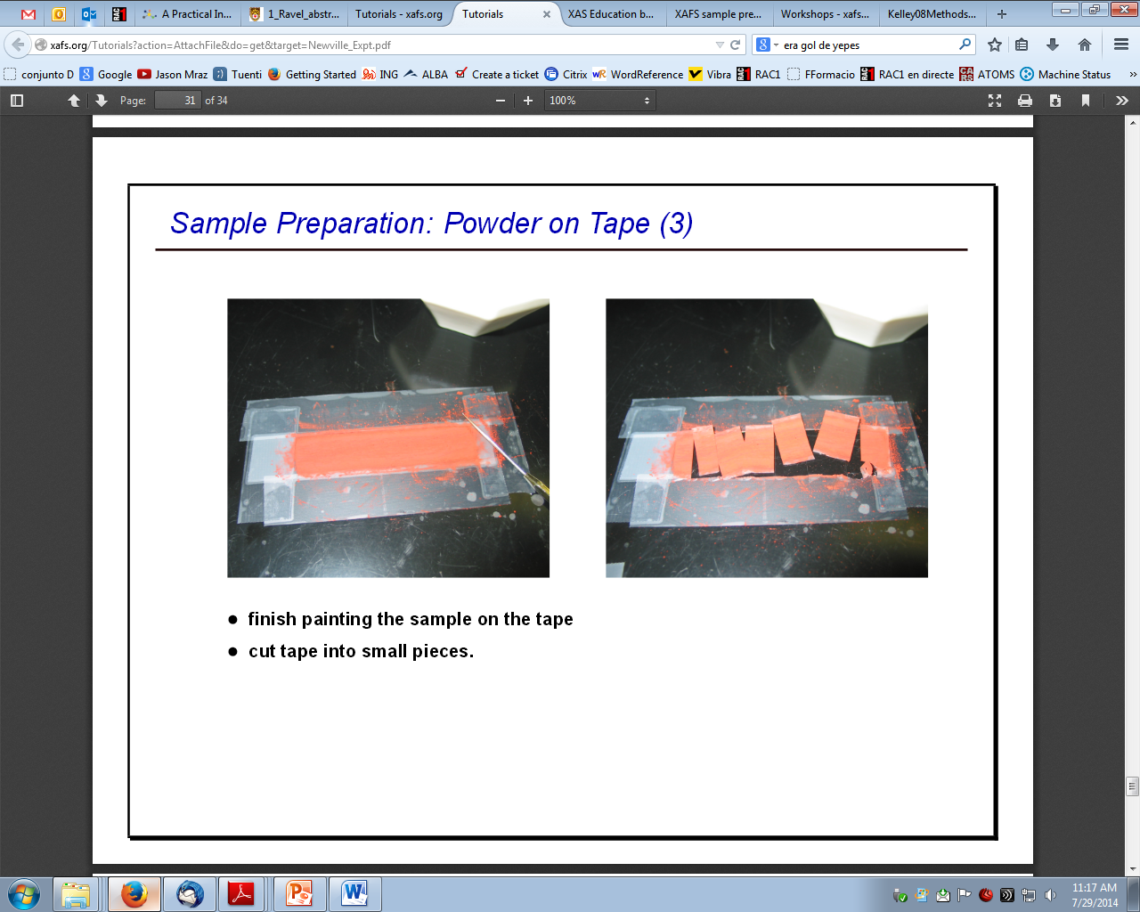
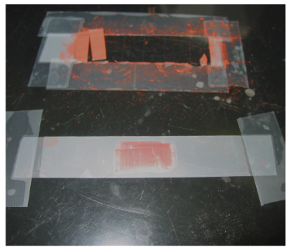
Sample preparation: Powder on tape
This method works well for XANES if the beamsize is large enough
Grind with a mortar and pestle for a few minutes
Place a piece of Scotch tape sticky-side up on the bench
Paint the powder on the sticky tape. The smallest grains will stick to the tape
Try to remove as much excess as you can
Cut tape into small pieces
stack 4-8 layers and cover with tape
Notes:
Don’t be afraid to try new sample preparation techniques

Slide 16
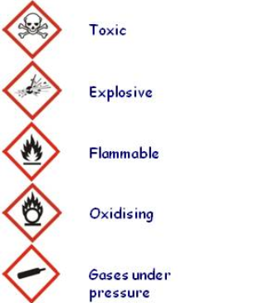
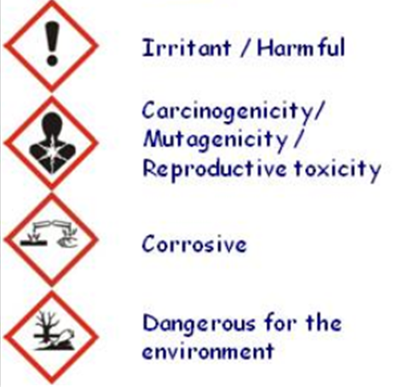

Safety : Identify the risks
Try to identify the risks associated to your sample or to the experimental conditions
In case of doubts contact Safety officer!
Biological hazard
Notes:
Don’t be afraid to try new sample preparation techniques

Slide 17

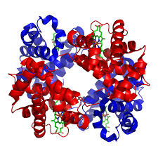
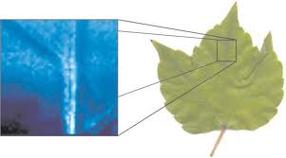
Safety : biological sample
Biological samples (like protein crystals, tissue, organic membranes… ) need a biosafety declaration, specifying the related hazards of the experiment.
Be careful in different institutions, legislations can be different!
Contact Safety officer!
Notes:
http://www.esrf.eu/Industry/applications/synchrotrontechniques

Slide 18
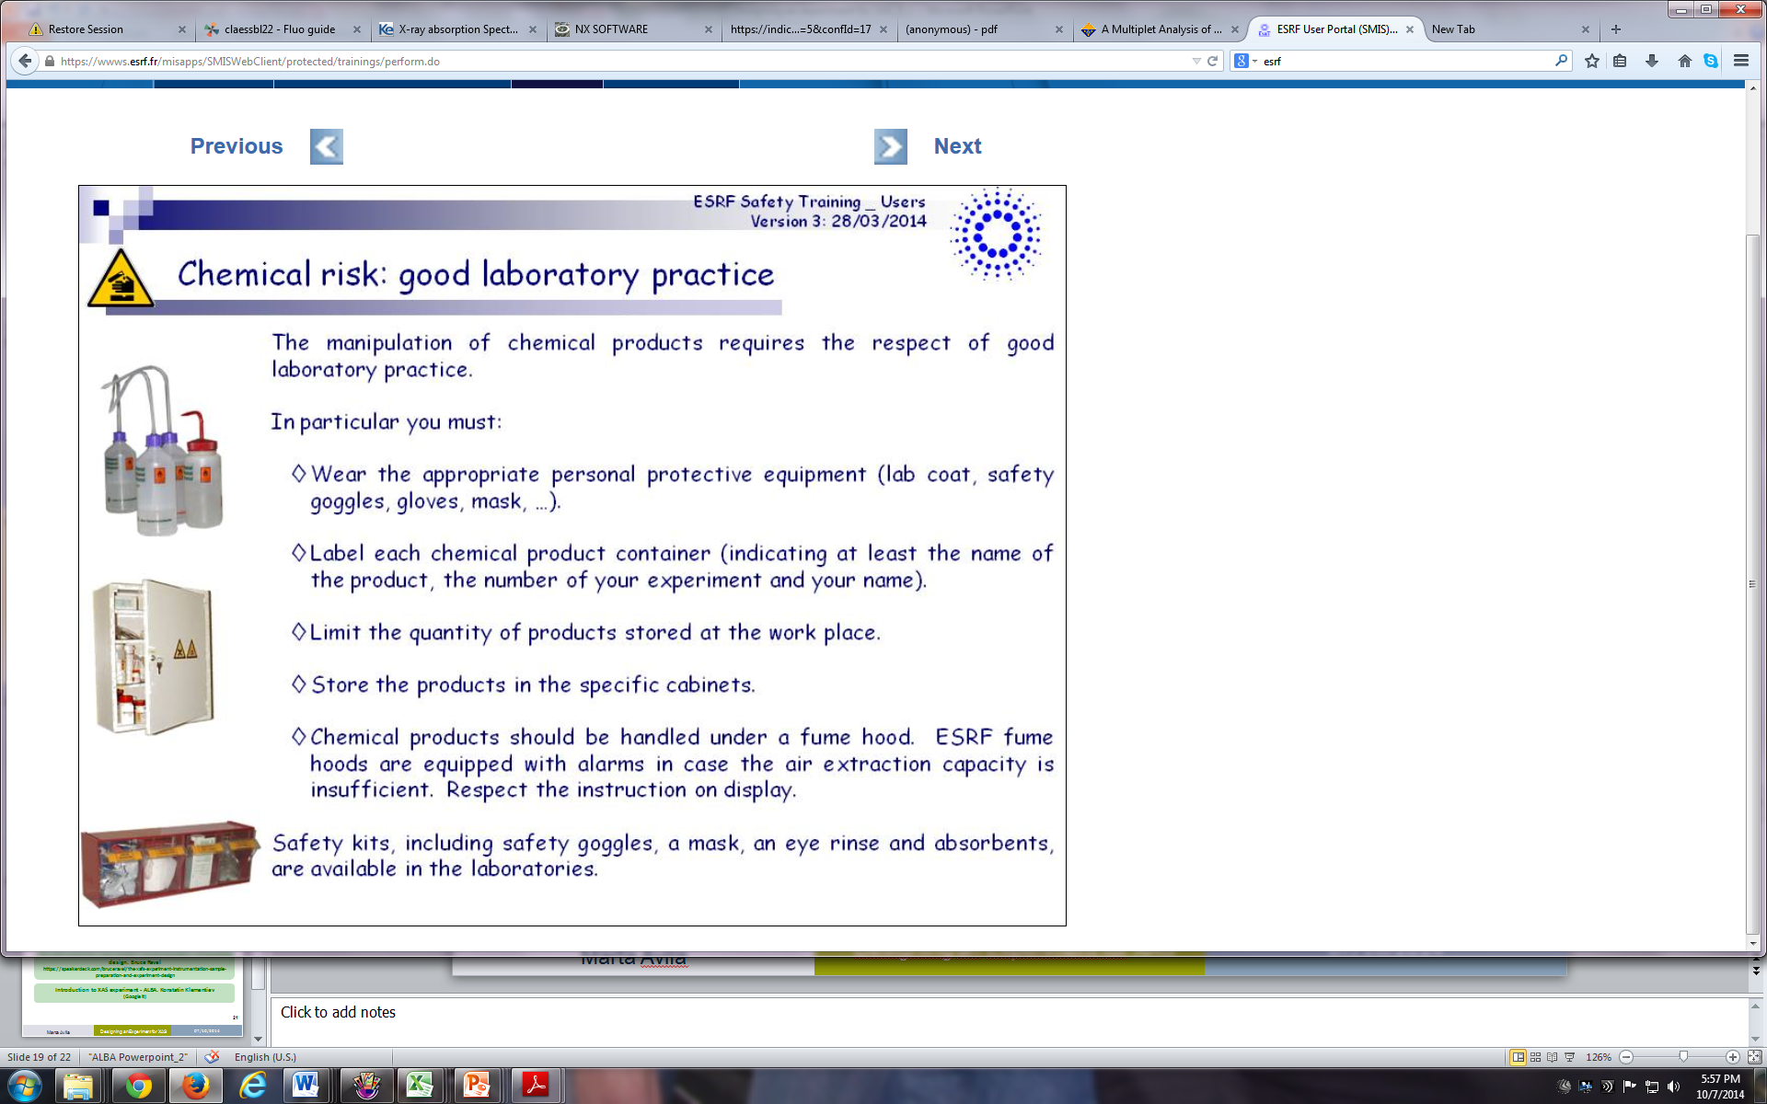

Safety : good laboratory practice
The manipulation of chemical products requires the respect of good laboratory practice.
Five basic rules
Wear the appropriate personal protective equipment (lab coat, safety goggles, gloves, mask ...)
Label each chemical product container
Limit the quantity of products stored at work place
Store the product in the specific cabinet
Chemical product should be handled under a fume hood.

Slide 19
Take away message
Think hard about how to measure your data
Prepare your samples well
Measure beautiful data
Facilisimo!!!
19

Slide 20
Reviews on XAS experiment design
XAFS Experimental Methods. Grant Bunker. http://www.bnl.gov/ps/nsls/workshops/2005/exafs/abstracts/Bunker.pdf
Sample Preparation for EXAFS Spectroscopy. Rob Scarrow
http://xafs.org/Workshops/NSLS2002?action=AttachFile&do=get&target=Scarrow.pdf
The XAFS experiment: instrumentation, sample preparation, and experiment design. Bruce Ravel
https://speakerdeck.com/bruceravel/the-xafs-experiment-instrumentation-sample-preparation-and-experiment-design
Introduction to XAS experiment - ALBA. Konstatin Klementiev
(Google it)
20

Slide 21
THANKS FOR YOUR ATTENTION!

