Slide 1
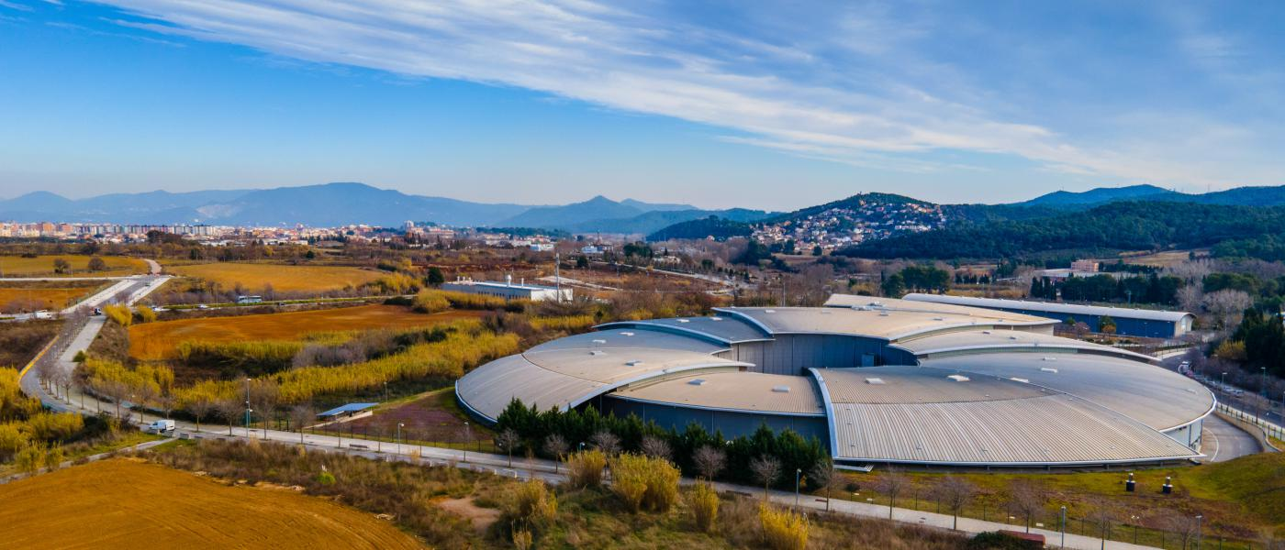




ALBA and its future, ALBA II
Caterina Biscari
24 October 2025

Slide 2
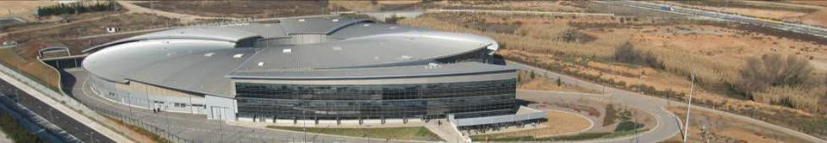

ALBA Synchrotron Radiation Facility
National public institution with 50% national + 50% regional funding: Consortium owned by Ministerio de Ciencia, Innovación y Universidades and Department de Recerca i Universitats
National and international (28%) staff
National and international (40%) users
National and international collaborations

Slide 3
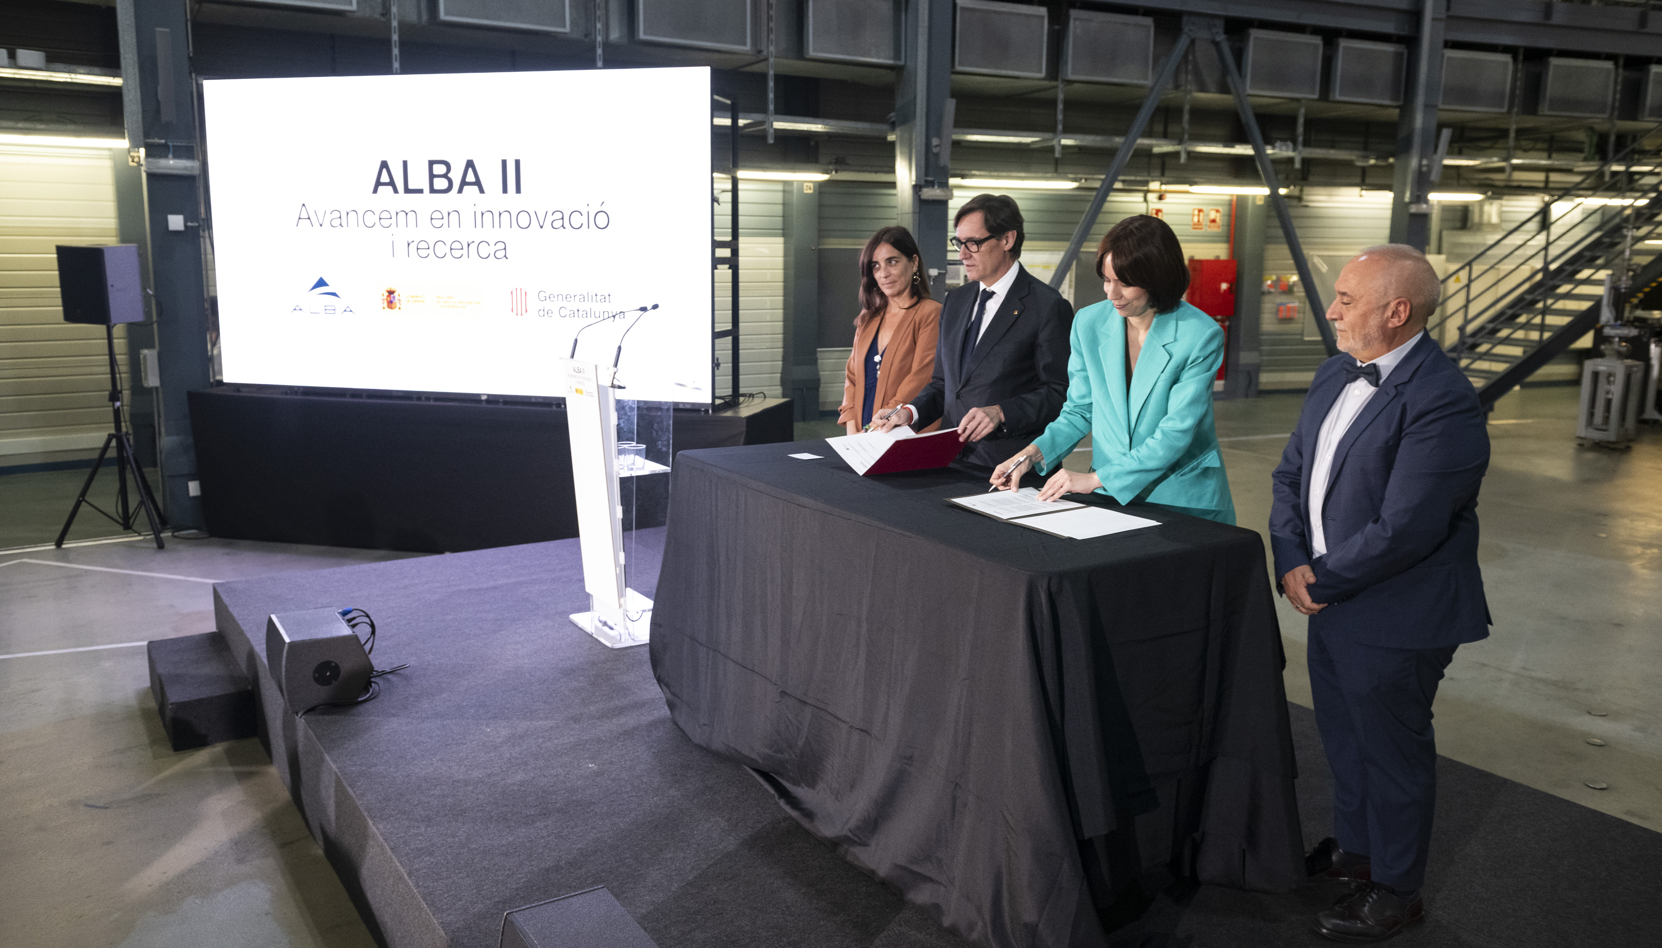
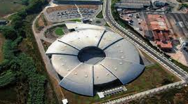
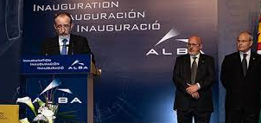
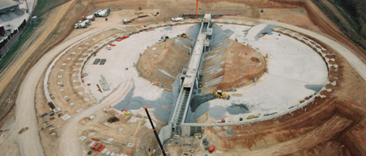
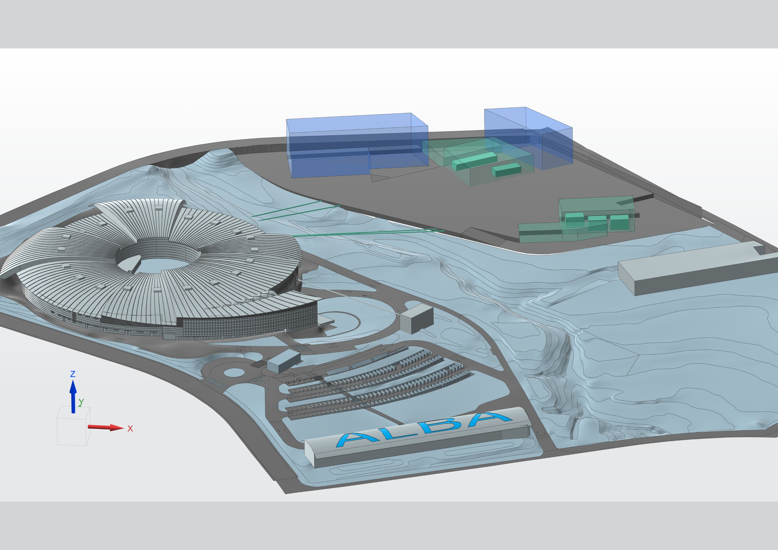
ALBA: past, present and future
2003 – Creation of CELLS Consortium (Spanish Government and regional Catalan Government), and agreement on facility funding for the period 2003 to 2022
2023-24 – Addenda for funding
2003 ALBA Approval
2012
Starting ALBA Operation
2020
Starting ALBA II design
2024
ALBA II Approval
2032
ALBA II Operation
2025
Approval of facility funding for 2025-2038
2006
Starting ALBA construction

Slide 4
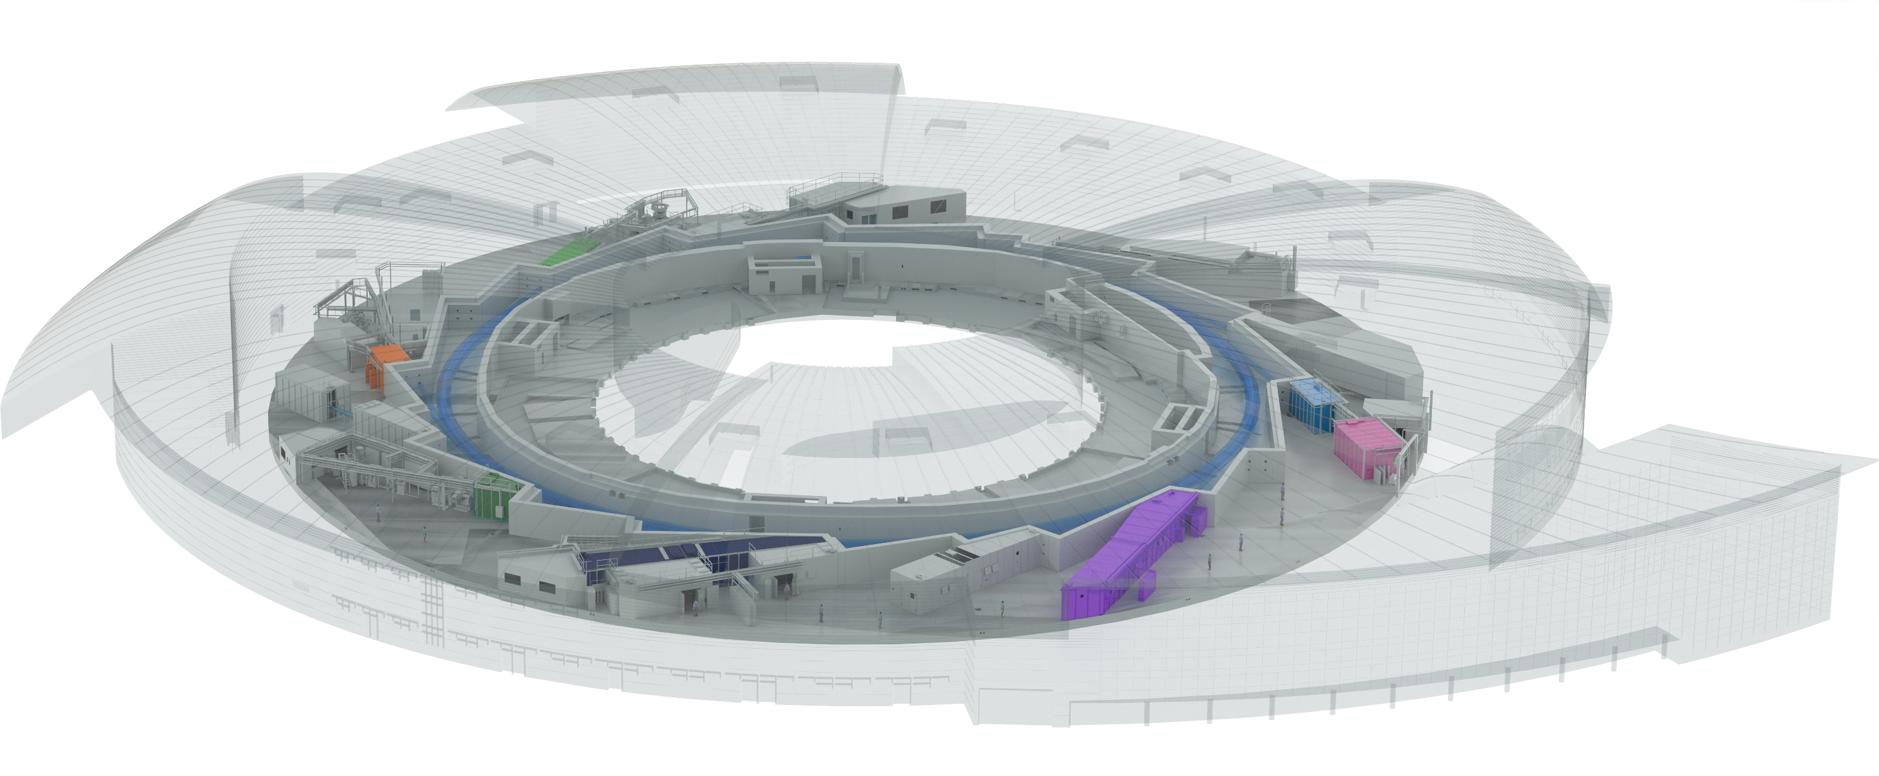

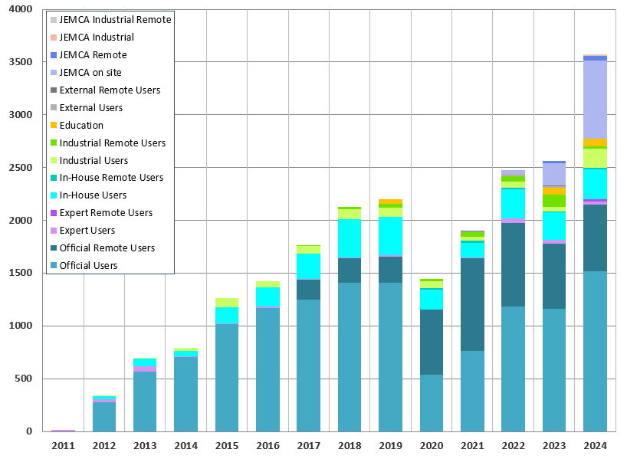
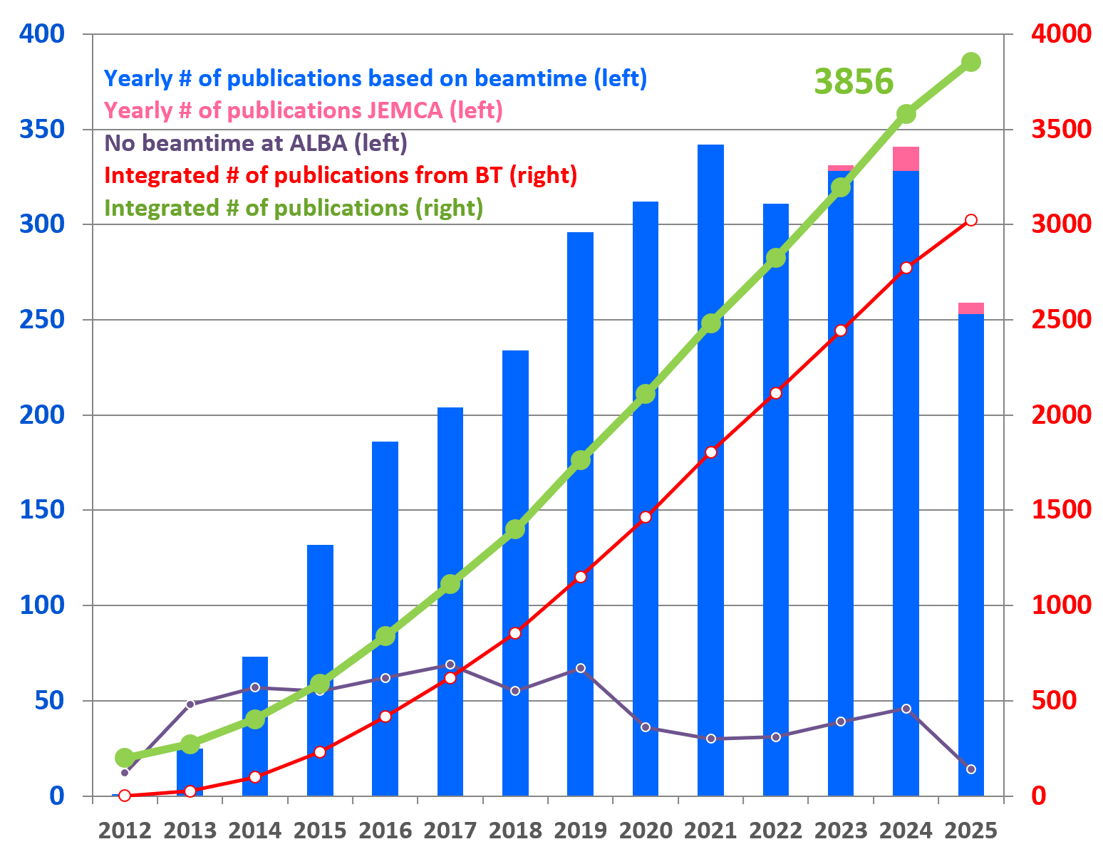
ALBA 2025
Instruments for life science
BOREAS
FAXTOR
Instruments for material science
MINERVA
MIRAS
Instruments for metrology
CIRCE
CLAESS
MSPD
LOREA
XAIRA
Cryo-EM
User visits
MISTRAL
TEM
InCAEM
NOTOS
Publications
3SBAR
XALOC
NCD-SWEET
13 operating beamlines + 1 in 2027
2 electron microscopes + 1 at end of 2025

Slide 5
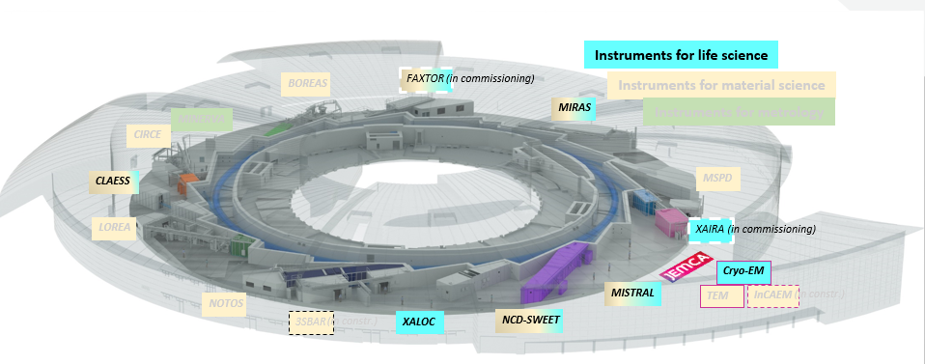
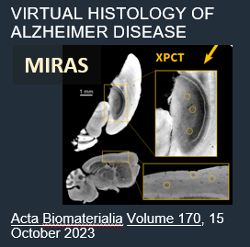
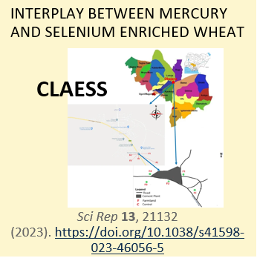
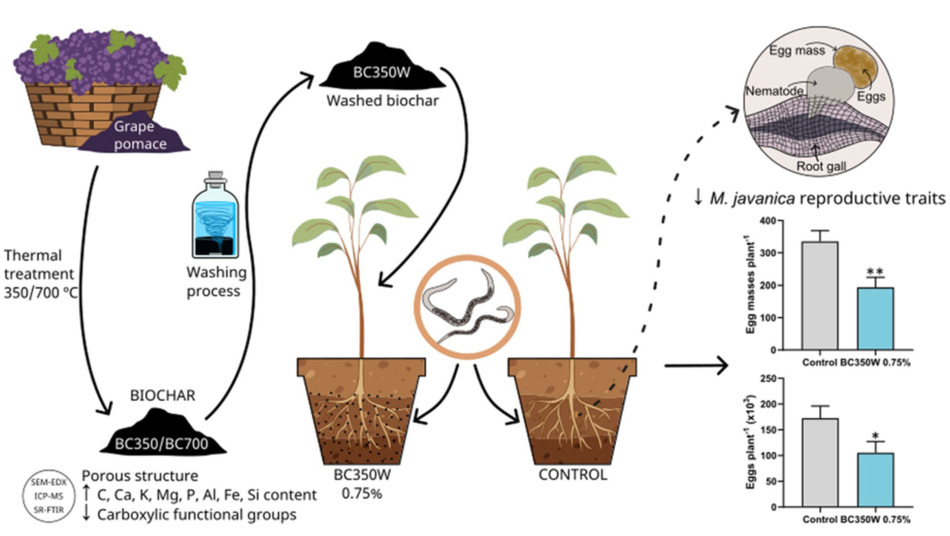

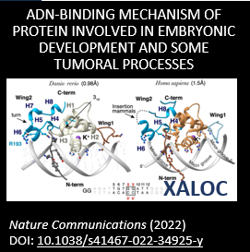
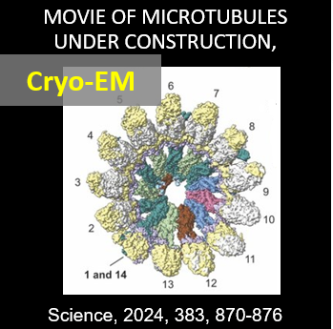

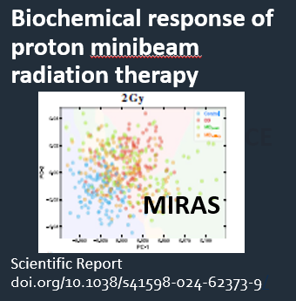
Life Science applications to increase life time and quality
Among many others:
Understanding diseases
Improving food quality and plant resilience
3D HOW SARS-COV-2 REPLICATES IN CELLS
ACS Nano. DOI: 10.1021/acsnano.3c07265
PEST CONTROL ON CROPS
BioChar doi.org/10.1007/s42773-023-00228-8
MISTRAL
MISTRAL
Understanding fundamental properties of life
Advancing in therapies and drug development

Slide 6
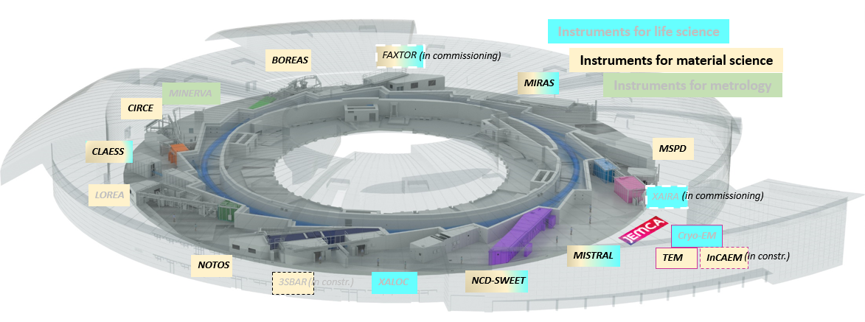
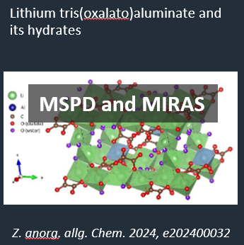
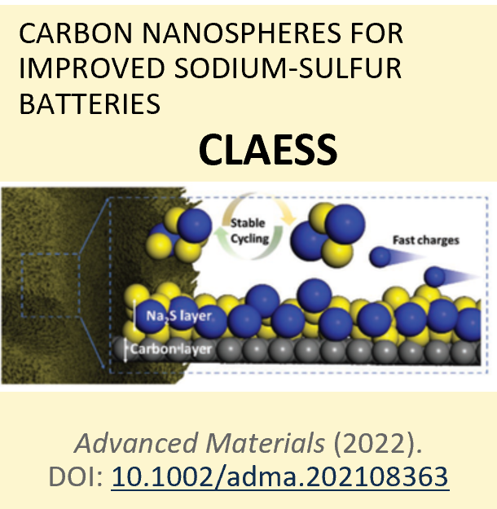

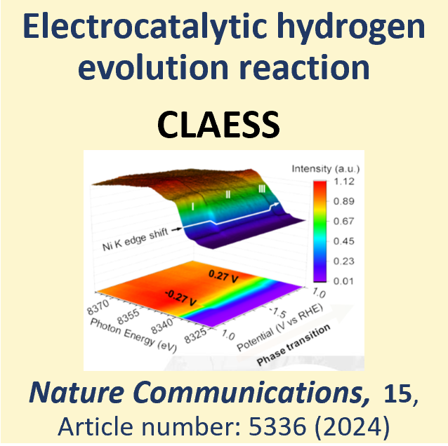
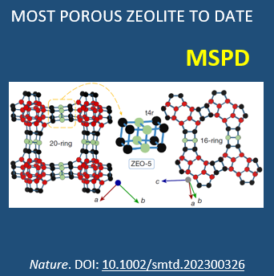
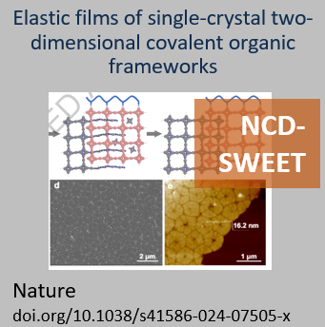
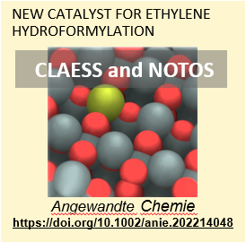
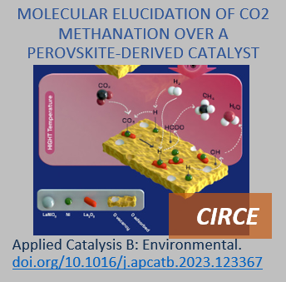
Chemistry and Materials Science for boosting decarbonization and decreasing material footprint
Among many others:
More performing and diverse batteries
Green energy technologies, solar and H
Low footprint materials
Catalysts for low footprint developments

Slide 7
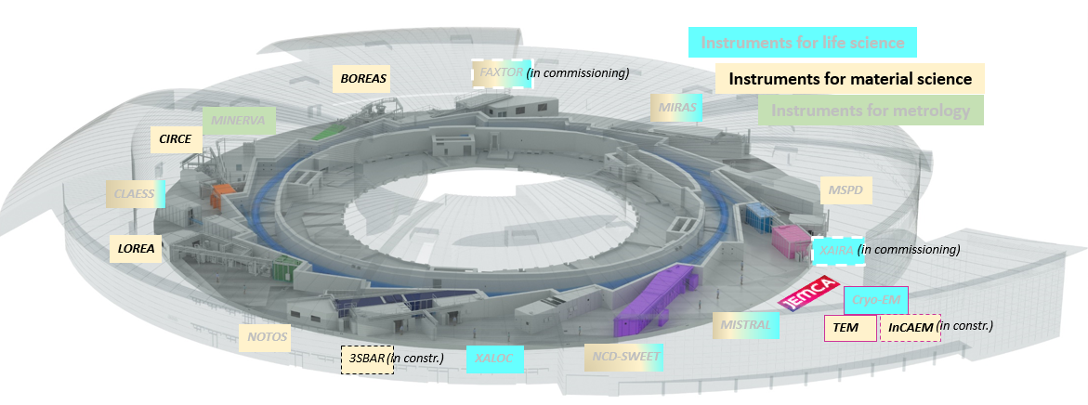
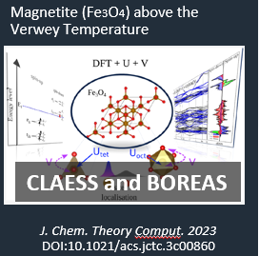
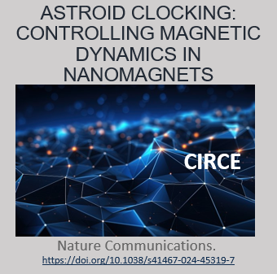
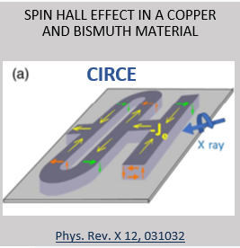
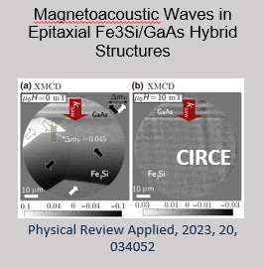
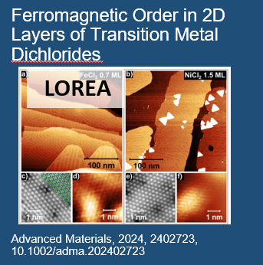
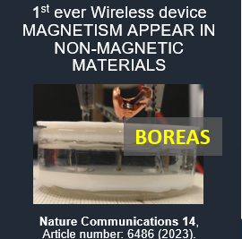
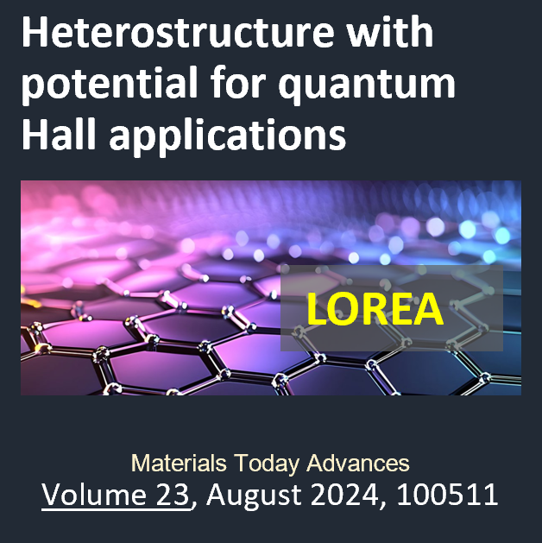
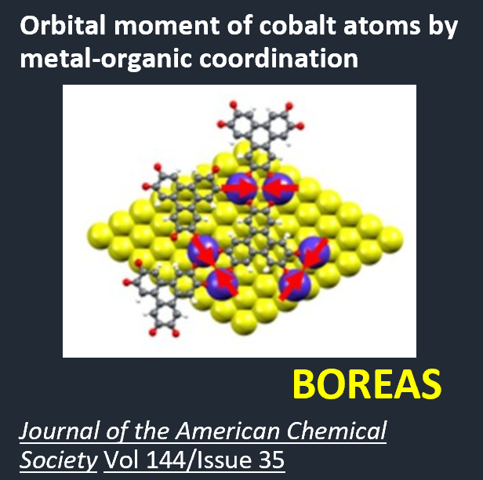
Electronic and Magnetic Structure of Matter for low-consumption new technologies, quantum, spintronics
Among many others:
Magnetism
Spintronic
2D materials
Quantum materials

Slide 8
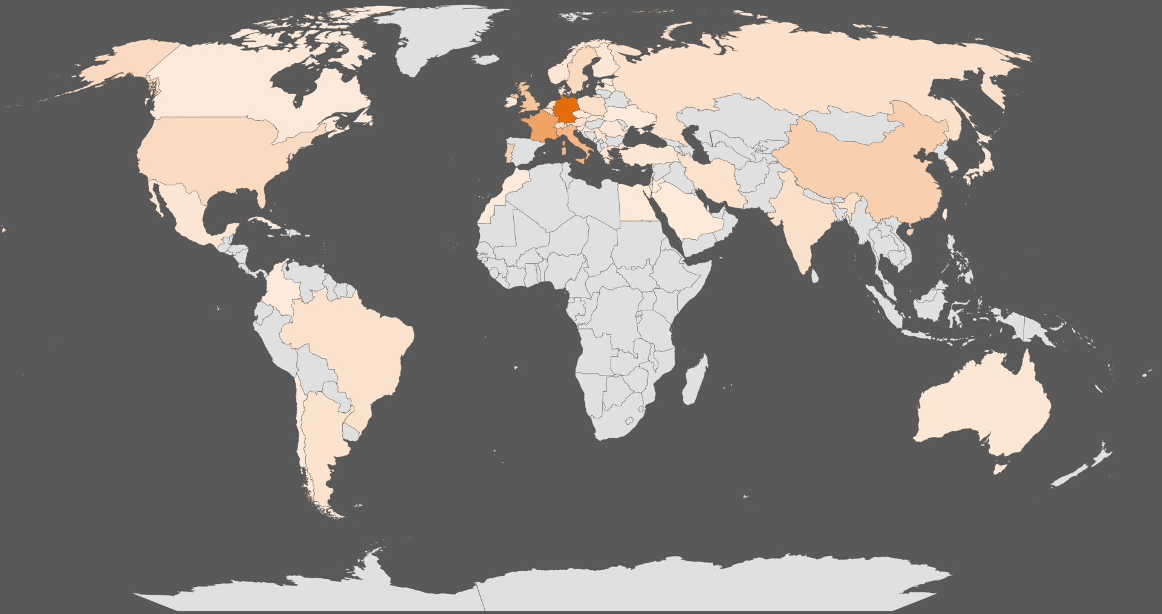
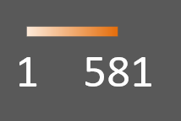
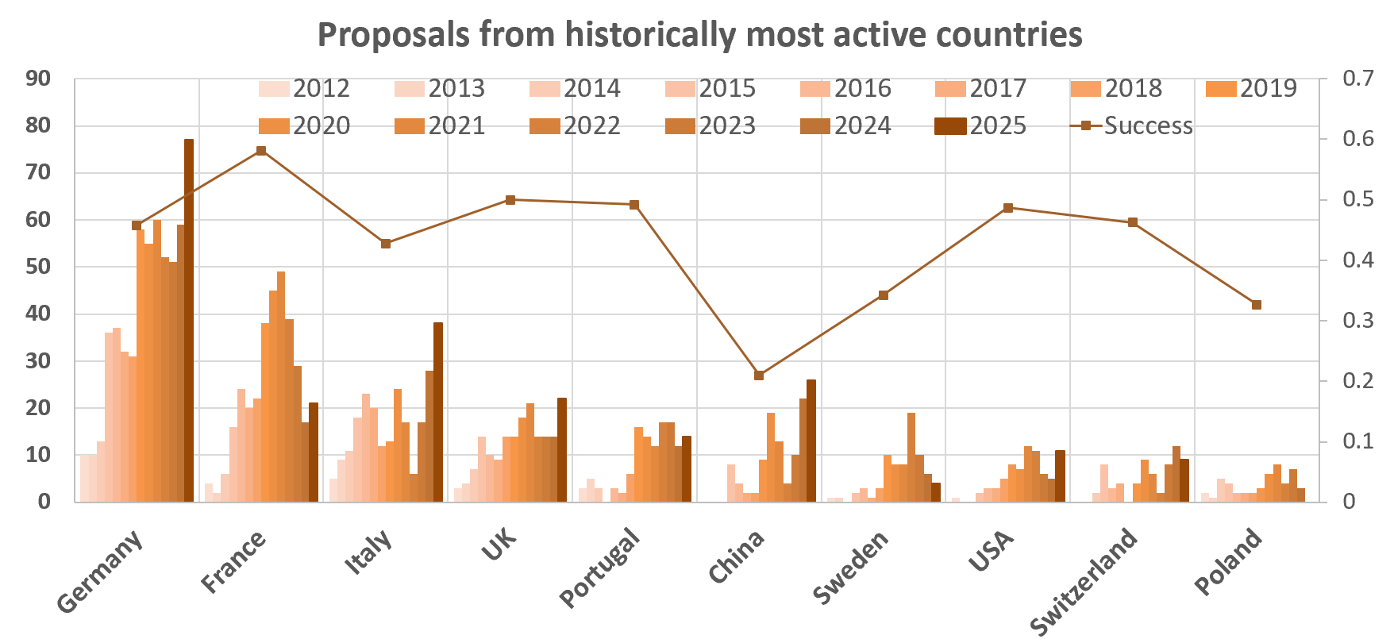
International users – proposals from 50 different countries
International | 2531 | 40%
National | 3745 | 60%
Total | 6276
1-2 Japan proposals per year

Slide 9
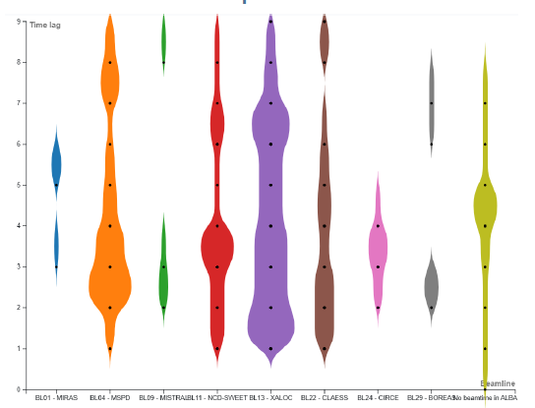
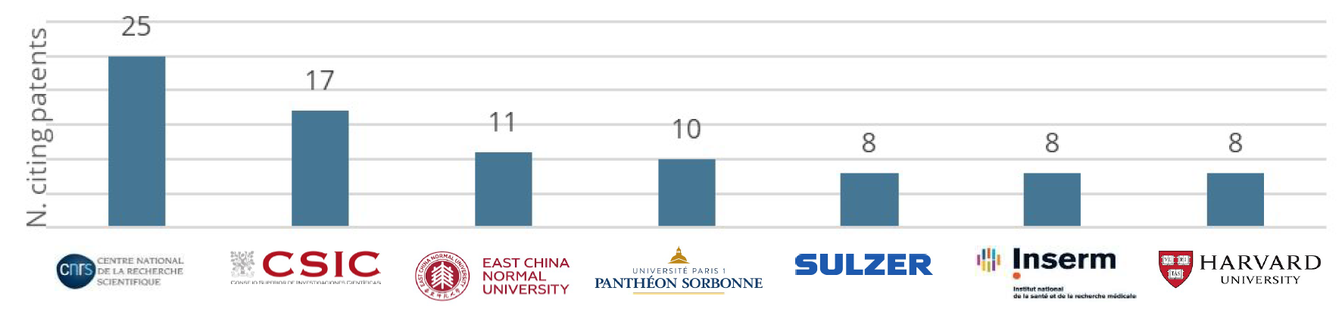
Impact of public competitive research on Innovation:
Patents citing ALBA publications
Fields of application
Time lag from publication to patent
142 ALBA publications out of 2,901 were cited in 290 patent documents (𝑃0)
2579 were cited by a total of 51,628 scholar works (𝑃1). 2214 of the 51,628 citing scholar works were in turn cited by 4283 patent documents (𝑃𝑎𝑡1)
Top patent applicants

Slide 10
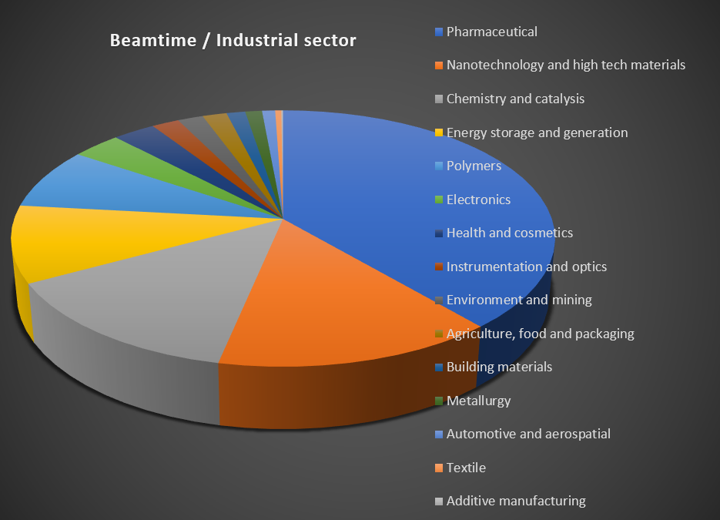
ALBA as Industrial instrument
Science and innovation programmes aligned to eliminate gaps between academic and industrial research
Special developments (i.e. on data analysis, automatization) for impact on industrial users
Harnessing a rich industrial networking (European and national projects and clusters)
Publicizing ALBA instruments towards national and international industry (outreach events)
Focusing on key industry sectors based on the strengths and opportunities of ALBA (Pharmaceutical, Steel, Energy)

Slide 11

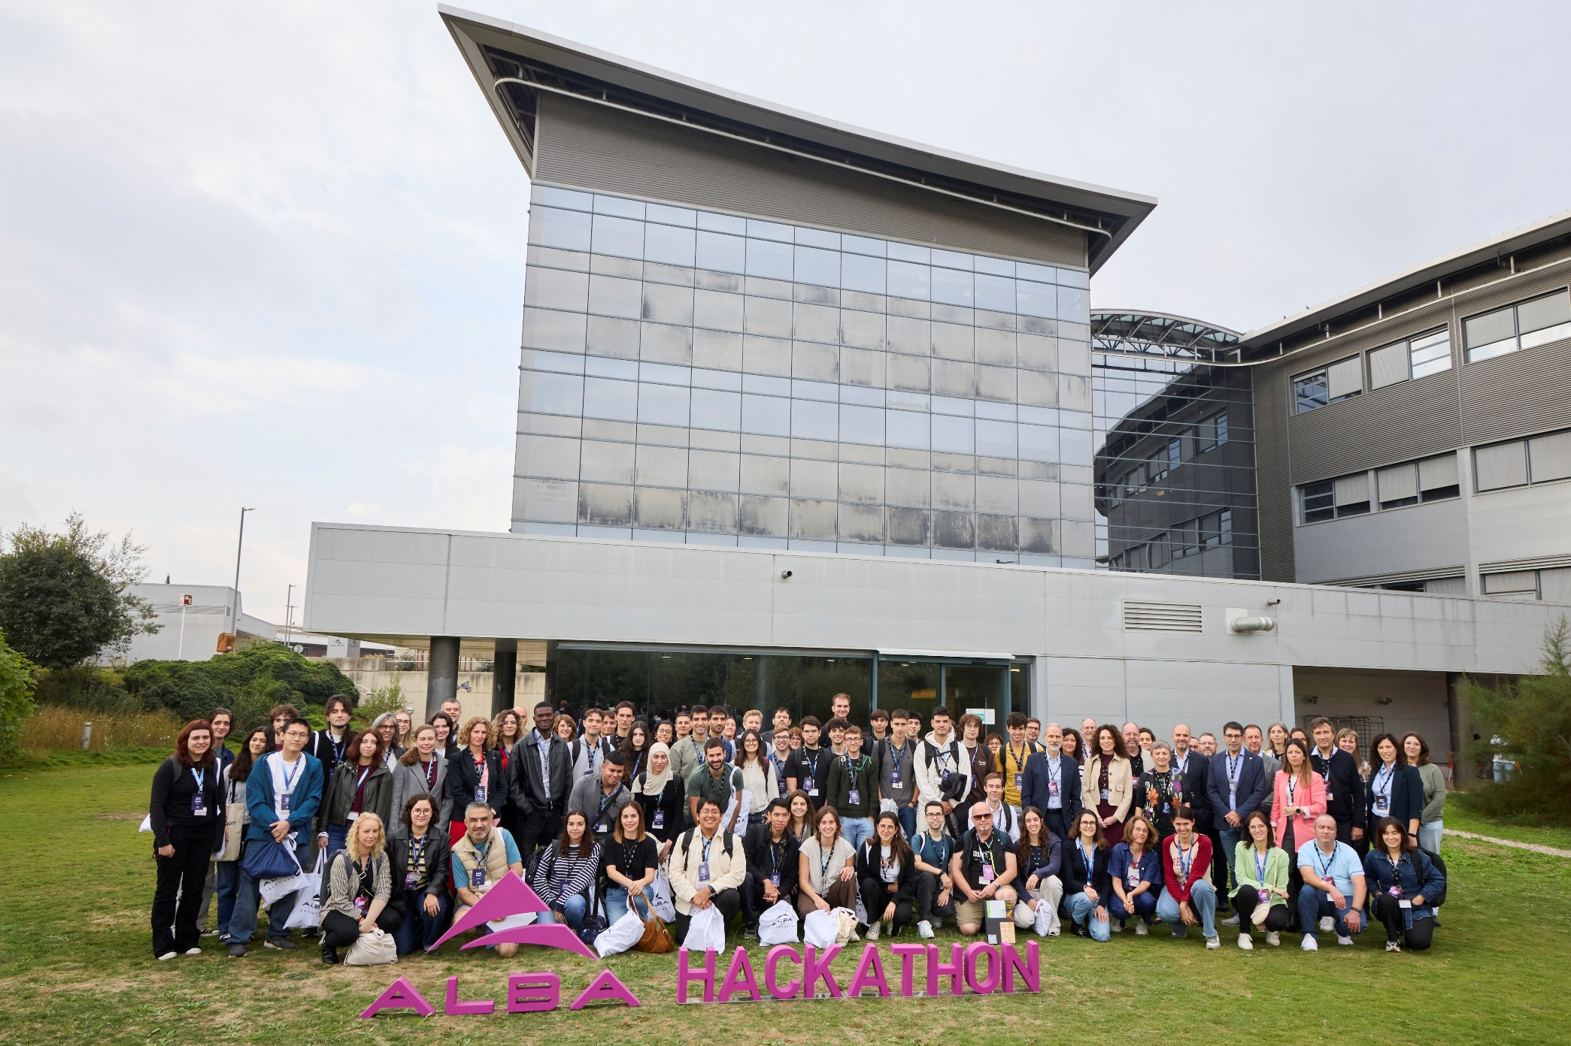
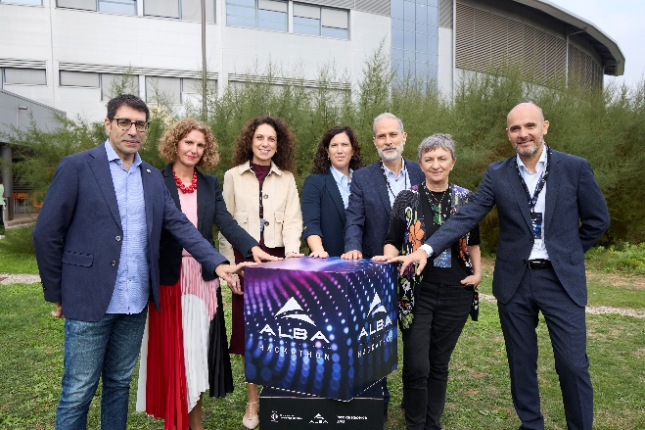
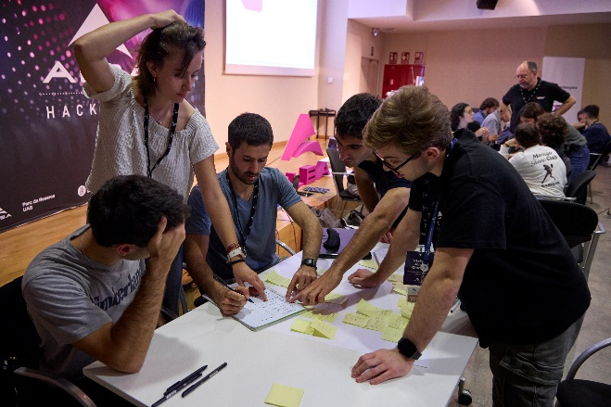
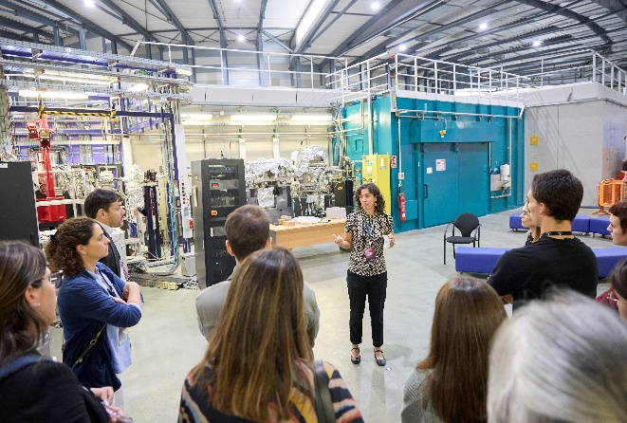

ALBA Hackathon 2025 A New Model for Industrial engagement 16-17 October 2025
📅 2 days 👩‍🔬 70+ participants
🏢 4 industrial challenges 🏆 4 winning teams
The first-ever ALBA Hackathon gathered 70+ students, researchers and professionals for two days of creativity and collaboration
Co-organized with UAB Research Park and Ajuntament de Cerdanyola, and backed by Acciona, Applus+ Laboratories, Dentaid and Ercros, to promote open innovation and knowledge transfer.
Teams developed solutions on water, plastics and energy with four winning projects to be tested through experiments at ALBA
Positioning ALBA as a catalyst for industrial and societal transformation, bridging frontier science with real industrial challenges.
Building connections with industry
Next generation of innovators
Talent meets ALBA Synchrotron

Slide 12
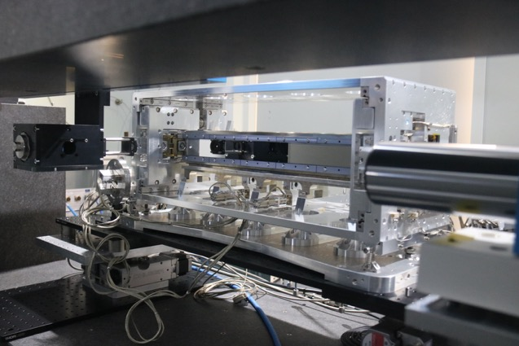
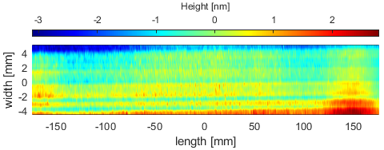
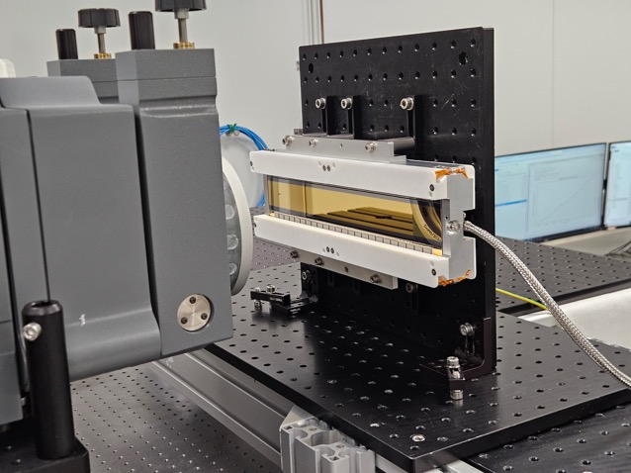
Optics and Metrology at ALBA
ALBA Bender at the NOM
Lab Instruments:
NOM (profilometer)
Stitching interferometer
Error removing algorithms:
Uncertainty < 0.1 nm
Differences about 0.026 nm
More than 75 benders measured for other labs.
Best results ever
JTEC mirrors on benders.
26 nrad on 400 mm. (Mechanical bender)
67 pm on 270 mm (JTEC bimorph)
Our own active optics mechanical bender.
Active correctors (< 1nm)
Strain free water cooling
Interferometer figure feedback
Stitching measurement of a JTEC mirror for ALBA 0.26 nm on 350 mm
JTEC bimorph at the ALBA-Stitching interferometry platform
Residual error of a JTEC bimorph after optimization at ALBA
67 pm / 23 nrad

Slide 13


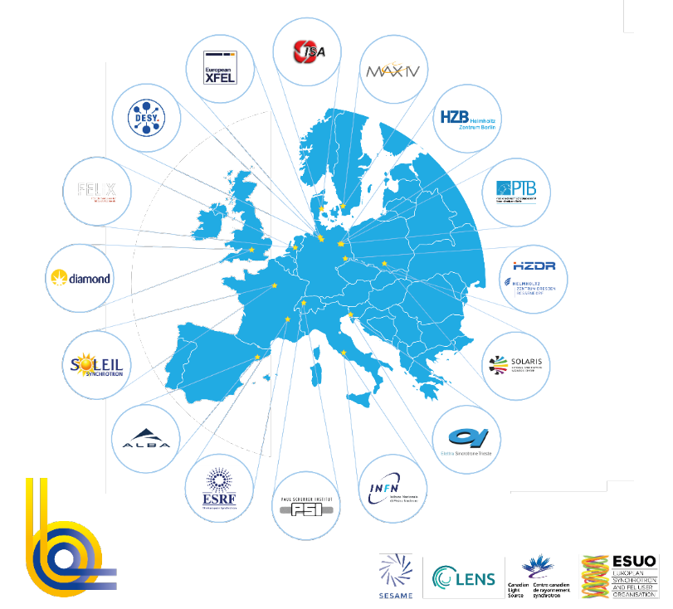
Europe as a key partner
+35000 users from all EU & beyond
+300 operating End Stations
19 facilities - 16 institutions - 10 countries
+25000 publications
In last 5 years
offering + 1Mh/year
2 international facilities
17 national facilities
Funded by national governments
Offering free access to ALL public researchers, based on competitive excellence
Offering advanced and cost effective instruments to ALL industrial world
Associate: SESAME
Partners: ESUO, LENS, CLS

Slide 14
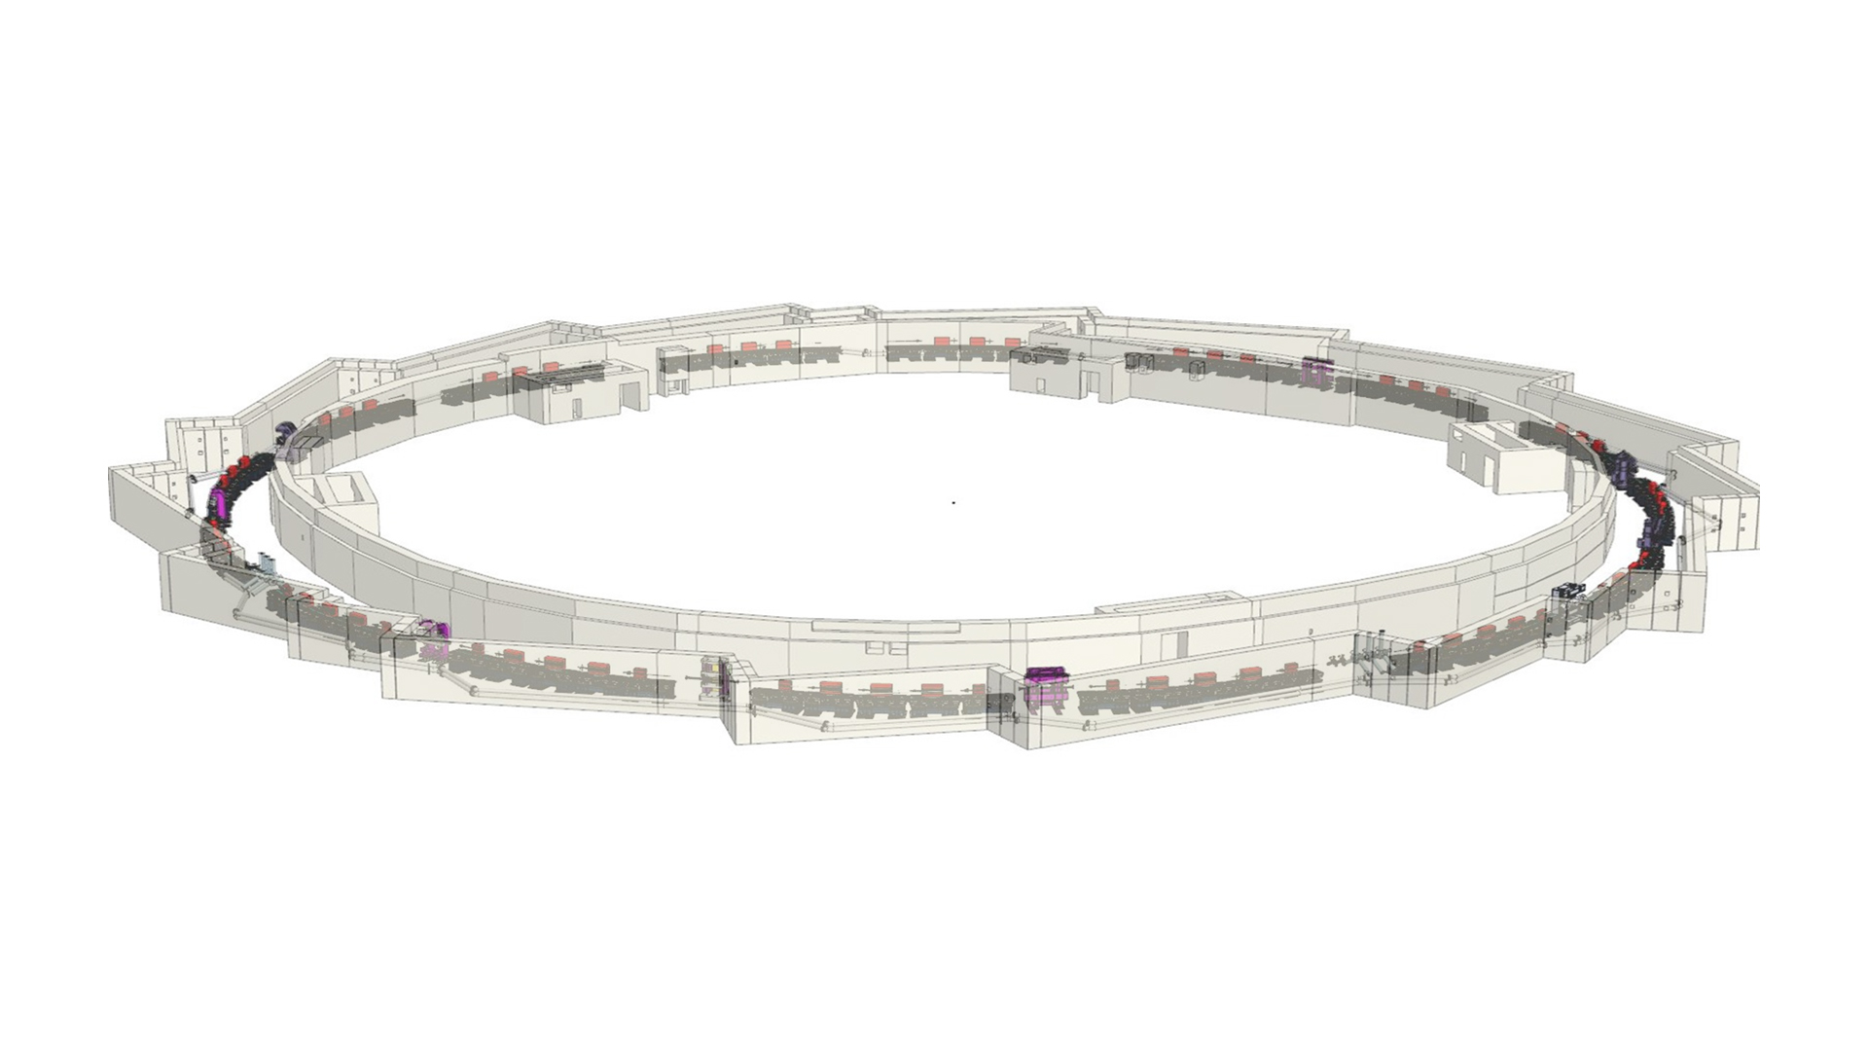
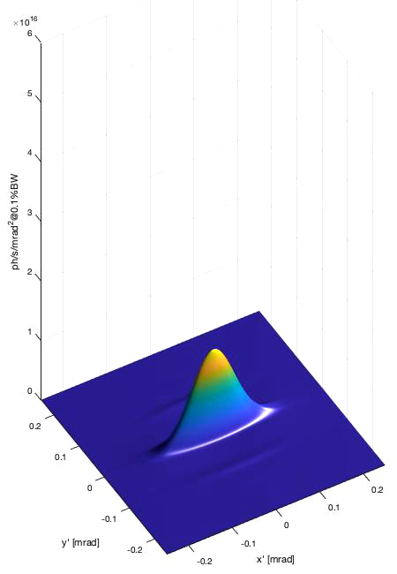
ALBA to ALBA II New accelerator
Much brighter synchrotron light

Slide 15

ALBA to ALBA II new beamlines, new methodologies, advanced data infrastructures, opening to new institutions
Long BLs
CORUS
Characterization of bio samples down to nanometric resolution
CODI: COherent DIffraction BL
For in-situ and operando experiments and characterization of large samples with nanometric resolution
Absorption and emission spectroscopy, Soft X-ray tomography, IR microscopy, Small and Wide Angle Scattering, HR and HP Powder Diffraction, Crystalline Diffraction, Photoemission, NAPP, ARPES, Resonant Absorption and Scattering, Metrology, Macromolecular crystalline diffraction, Hard X-ray tomography, Surface spectroscopy and ambient pressure photoemission, BioSAXS, Coherent Diffraction, Spectral Imaging and Tomography
In operation – in installation – in design phase

Slide 16
ALBA II - Day One - 2032
Instruments for life science
Instruments for material science
BOREAS
FAXTOR
MSPD2
Instruments for metrology
MIRAS
MINERVA
CIRCE
CODI
CLAESS
New Storage Ring
CORUS
LOREA
XAIRA
CALIMA
Cryo-EM
MISTRAL
TEM
InCAEM
Upgraded Beamlines
NOTOS
3SBAR
XALOC
NCD-SWEET

Slide 17

ALBA to ALBA II New space for enlarging the infrastructure
Long Beamlines
CORUS
Characterization of bio samples down to nanometric resolution
CODI: COherent DIffraction BL
For in-situ and operando experiments and characterization of large samples with nanometric resolution
Reach One Health
CODI
BL03
CORUS
CORUS
INNOFAB

Slide 18







ALBA to ALBA II Advancing in the cooperation with partners for proposals of new institutes
Resilience to Global Health challenges through the One Health approach – BSL3 connected to CORUS BL
Reach One Health
CODI
CODI
CORUS
INNOFAB
Lab to Fab clean room for microelectronics
for development of semiconductors technologies

Slide 19
Thank you for your attention

