Slide 1
Visa & Gpus
GPUs are used on VISA for :
Data processing
  Some processing workflows need GPUs, especially for tomography.
(new) Data visualisation
  CPU only rendering is too slow for some software ( paraview/dragonfly )
(new) IA
  Some people have found visa instances practical to experiment with IA.
Page <number>
C. Vinet TID - IT Services
26/07/2013

Slide 2
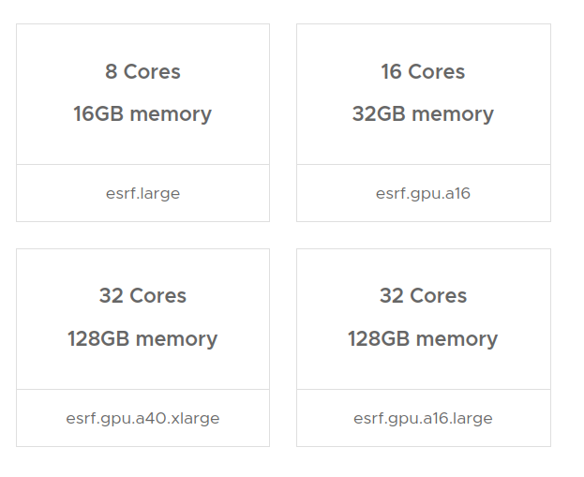
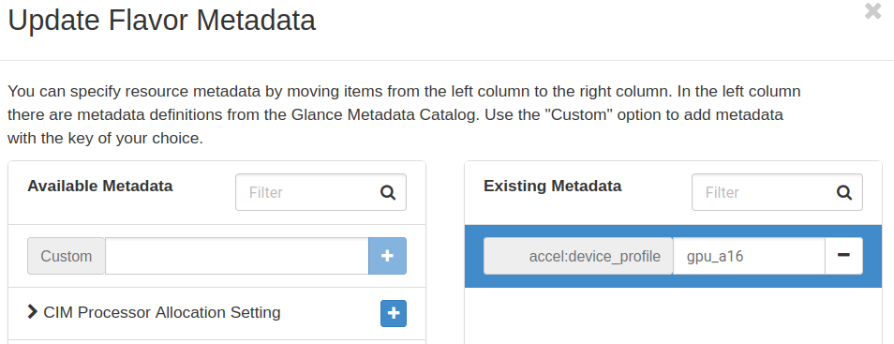
Visa & Gpus
Cyborg
We use the Cyborg openstack component to manage GPUs
Accelerators ( GPUs, FPGA, nvme disk… etc) can be scheduled and assigned to VMs.
Cyborg manages the discovery and the life cycle of these accelerators.
Cyborg is deployed with kolla-ansible.
Hardware requirements selection in visa
Add A16 to openstack flavor
Page <number>
C. Vinet TID - IT Services
26/07/2013

Slide 3
Visa & Gpus
HW Accelerated xrdp
Since March, NVIDIA Hardware acceleration support has been merged in xrdp.
We enabled it on our GPU instances:
We can now use visualization software like paraview or dragonfly to their full potential.
Remote Desktop becomes snappier, as window manager and other apps are accelerated too ( firefox, vscode, etc…).
Doesn’t need big GPUs, NVIDIA A16 is overkill in most cases.
Works with webX and Guacamole.
Page <number>
C. Vinet TID - IT Services
26/07/2013

Slide 4
Visa & Gpus
Remaining Issues
Remaining Issues :
GPUs are not integrated in VISA.
Choice of the GPU(s):
  Small (A16), big (A40/H100), vGPUs ? How to have an efficient use of the gpus ?
Find the right balance between the SLURM compute cluster and VISA for GPU compute.
GPUs usage makes openstack less versatile
  Migration of VMs with GPUs is not possible (yet).
  Need to carefully provision hypervisors with the right number of GPUs.
Cyborg component is not well documented and has some bugs.
Page <number>
C. Vinet TID - IT Services
26/07/2013

