Slide 1
VISA Workshop
6th June 2025 – ALBA
Cédric Vinet – Jean-François Perrin – ESRF IT Services

Slide 2
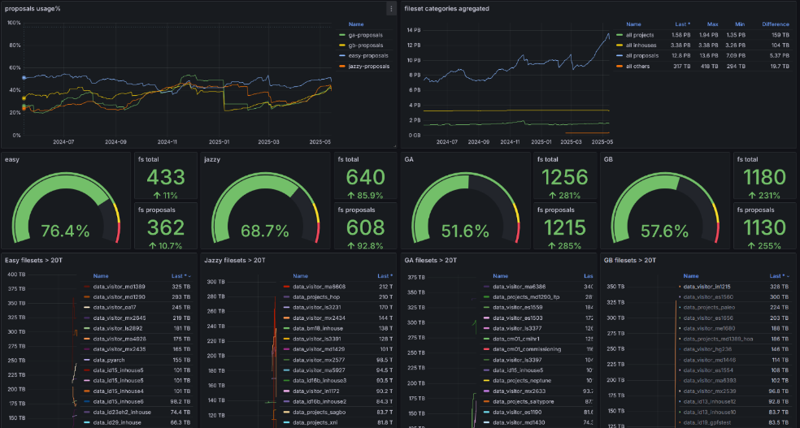
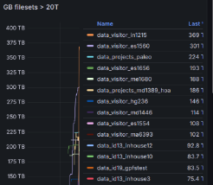
Evolution of proposal data – May 2025
18 PB occupied
400 TB single exp
35 Proposals on disks > 100TB

Slide 3
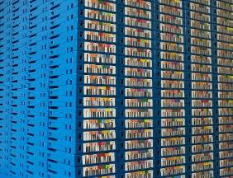
Evolution of Proposal data
    Standard process up to now:
      Data stays on disk 90 days before being archived on tape
    Spring 2025
      400 TB for a single experiment
      35 proposals > 100 TB (None, 2 years ago)
      18 PB of disk space is needed for BLs and users to operate in May 2025.
        Increase in data production
        More and more processing is done on ESRF infrastructure (+40 extension requests / month) – Less and less users being able to store/process data with their organization capacity
    Coming soon
      +32 new detectors

Slide 4
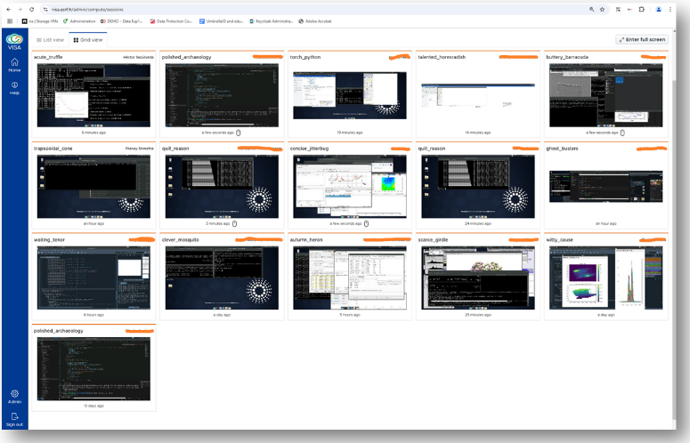
data Processing Offer
    HPC (Slurm):
      12 000 Cores
      140 GPUs
    VISA:
      Slurm Frontend
      12 TB RAM
      28 x A16
      4 x A40

Slide 5
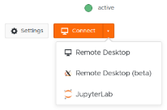
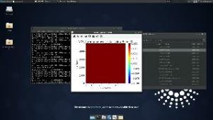
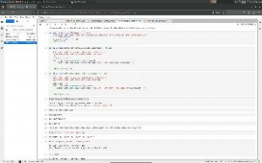
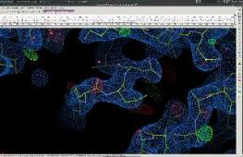
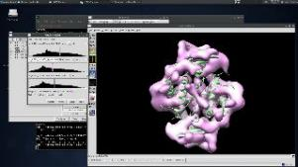
VISA At ESRF: Spring 2025
VM upgraded to Ubuntu 24.04 LTS
Graphical latency largely improved (U24.04 and WebX)
Use for 3D rendering
BL dedicated presentation/launch meeting (organisation jayesh.wagh@esrf.fr).
Usage by ESRF users is growing (ID16b, ID29, BM28, BM31, ID26, ID31, ID10 …)
1/3 of ESRF BLs have involved their users
  ID16B Documentation https://confluence.esrf.fr/display/ID16BKB/Connect+to+Visa

Slide 6
User requests
      Graphical latency
      Resolution scaling when changing display computer (typically from large screen to laptop)
      Ability to run MS Windows Software
      Better and more documentation

Slide 7
IT Side work and open questions
      Integration of Jupyter domain specific environment (Sepctro, tomo, …)
      Network upgrade (2x25Gb/s for Hypervisors)
      Monitoring + Logs
      Add more GPUs
      Deployment latest release (August – During shutdown)
      Refurbishment of our ETL
      Move WebX as default
    User support
      More and more users will request to process their data at ESRF
      Need to organize this support to limit the time spent on data processing at ESRF while ensure users could analyse data and exctract scientific knowledge.
      Ideas to optimize the use of High-end GPUs on VISA (current best option SLURM)?

