Slide 1



Exploring the Electronic and Magnetic Properties of Conventional 2D Materials and 2D MOFs: Insights from Photoelectron Emission Microscopy
🔬 PEEM ➡️ (X)PEEM ➡️ ef-peem ➡️ momentum peem 🔬
Vitaliy Feyer
Peter Grünberg InstitutE PGI-6 “Electronic Properties”
03/2025

Slide 2
outline
Scientific motivation
Immersion lens microscopy
Chemical selectivity
Energy and Spin filtering

Slide 3
outline
Scientific motivation
Immersion lens microscopy
Chemical selectivity
Energy and Spin filtering

Slide 4
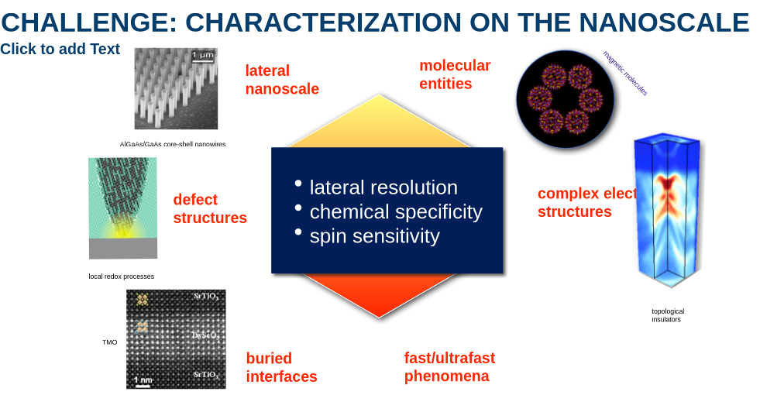
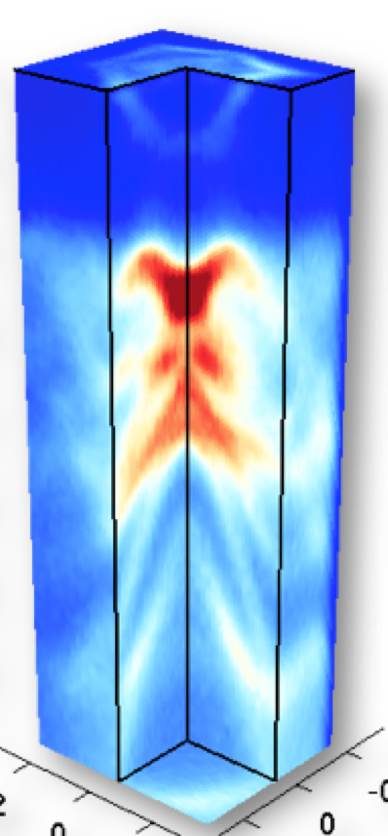
Challenge: characterization on the nanoscale
TMO

Slide 5
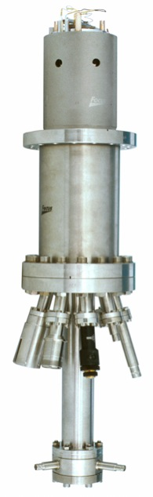
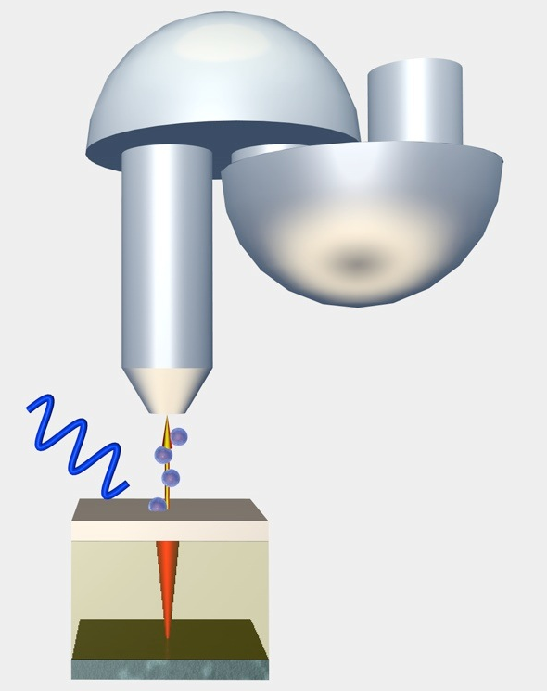
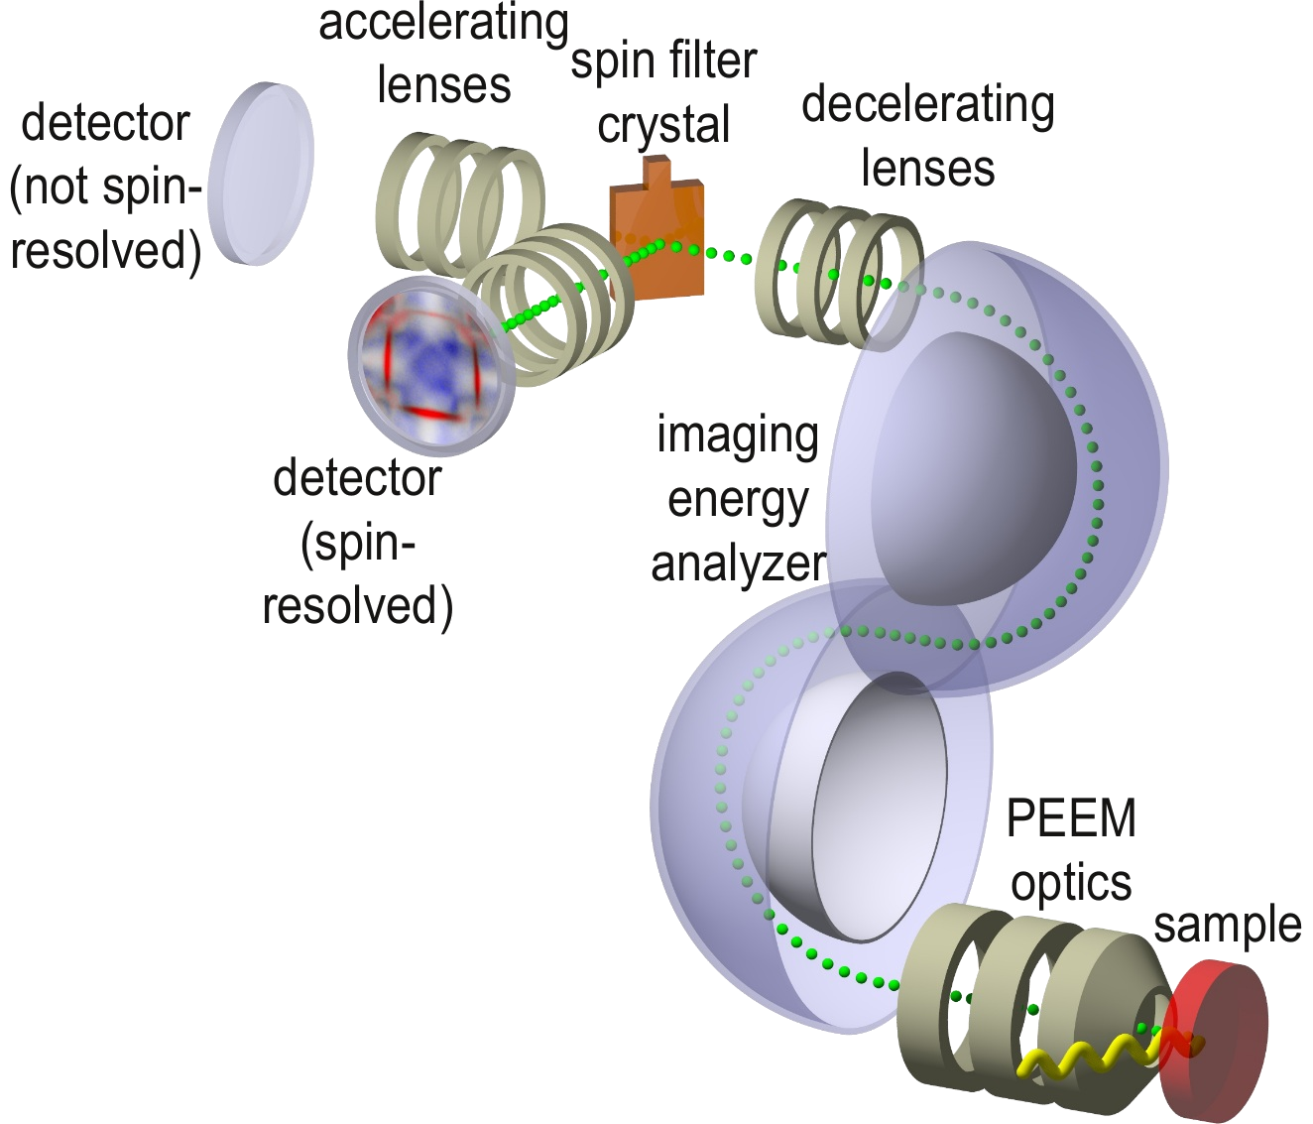
PEEM Evolution since 1970
50 years of PEEM: From UV light to synchrotron radiation
UV-PEEM
Balzers Methioskop
XPEEM
energy-filtered PEEM
momentum PEEM
~2000
~2015
~1970
~1990
  Hg discharge lamp (~5eV)
  surface imaging
  cryst. orient.
  work function
  narrow band exc.
  pol. synchrotron radiation
  elem. selectivity (XAS)
  magn. contrast (XMCD, XMLD)
  electron yield
  energy E selection (XPS)
  soft / hard X-rays
  information depth
  time resolution
  easy r - k switching
  momentum k selection (ARPES)
  real/momentum space imaging
  spin P selection
✚
✚
✚

Slide 6
outline
Scientific motivation
Immersion lens microscopy
Chemical selectivity
Energy and Spin filtering

Slide 7
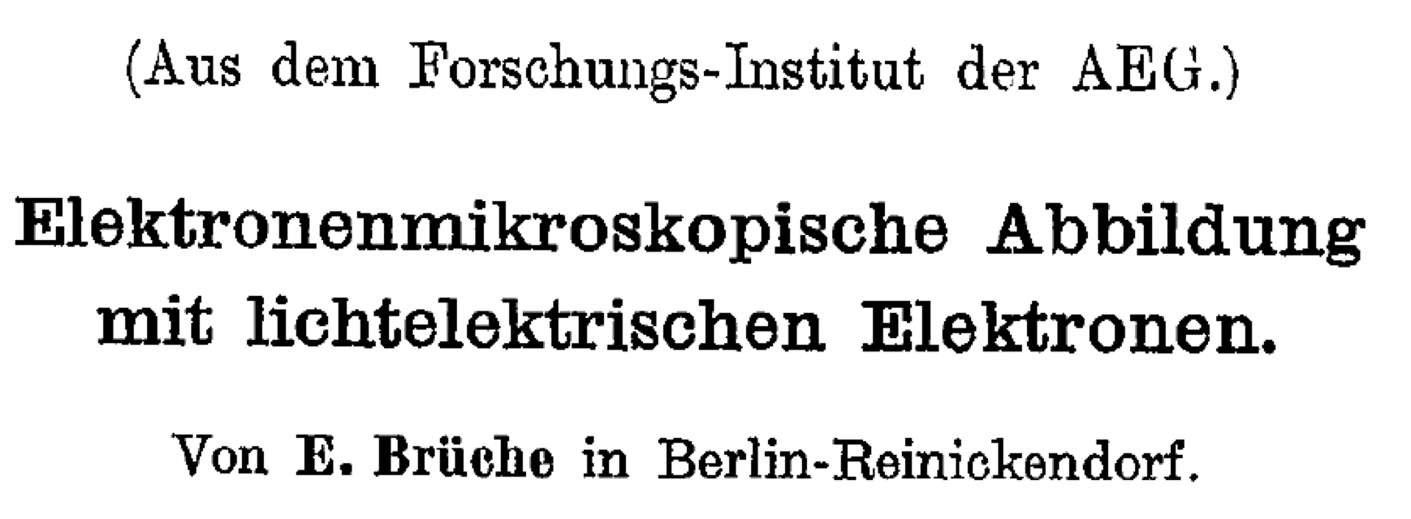
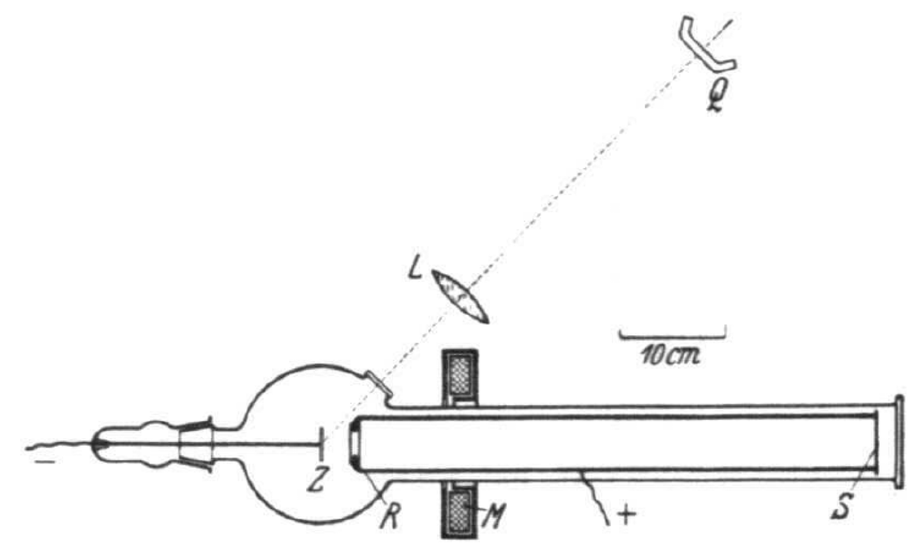
Ernst Brüche (1933)
holes in Zn metal plate

Slide 8
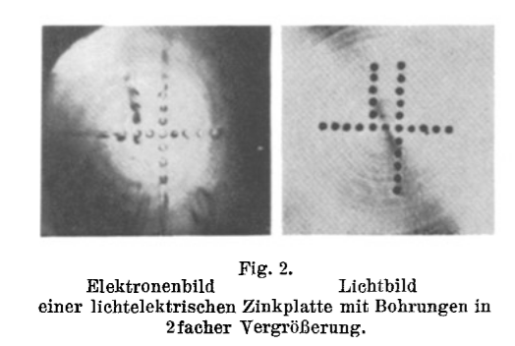
History
Same instrument, 1934!
Engel, 1970, group of Ruska
Polycrystalline Pt foil.
Magnification 2.5x
Magnification 10,000x

Slide 9
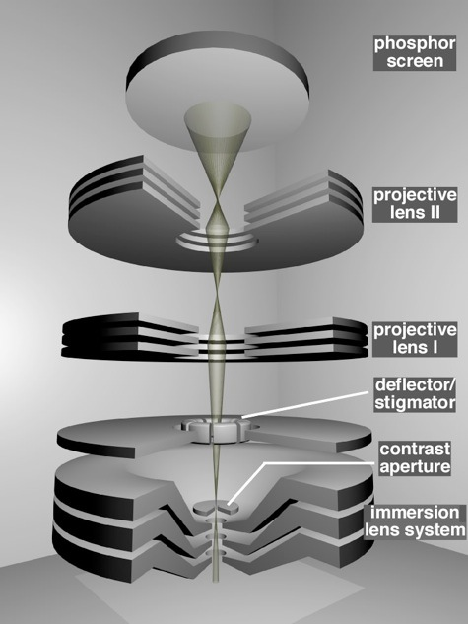
Immersion lens microscope (since 1990)

Slide 10
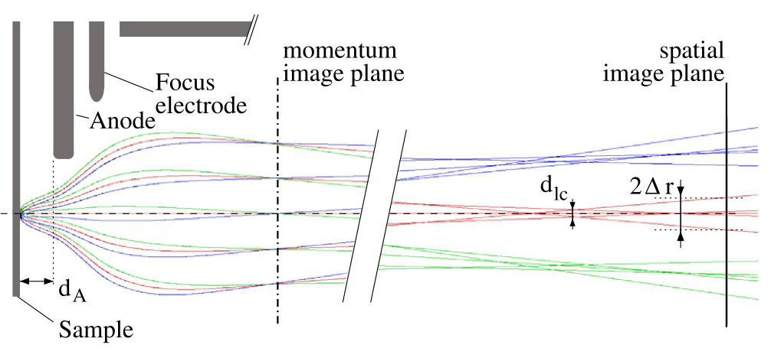
momentum microscope
Real space vs. reciprocal space: which image to project on the detector?
• same emission angles: focused in the momentum image plane
• different emission angles from the same spot: focused in the spatial image plane

Slide 11
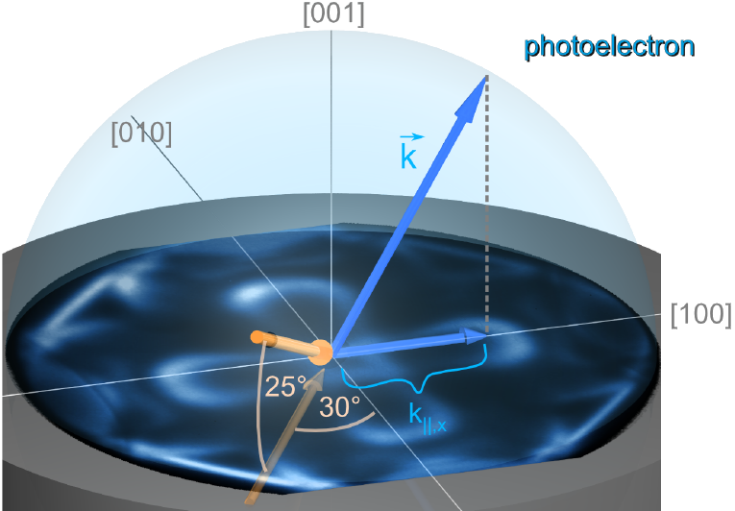
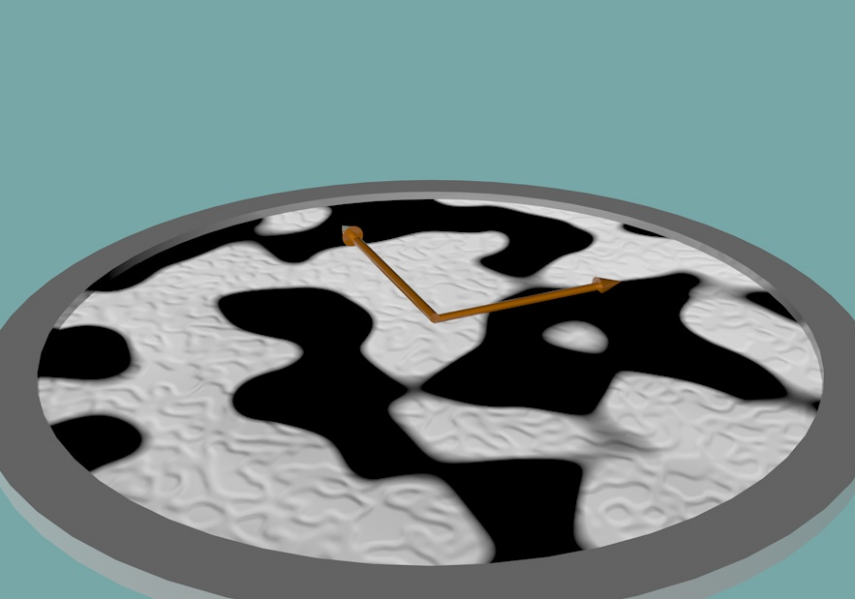
Principal imaging modes of an EEM
real space imaging
reciprocal space imaging
y
x
B
A
Secondary and photoelectrons
Only photoelectrons
  lateral distribution of emitted electrons from elements A and B
  angular distribution of photoelectrons
  switch between imaging modes by a single lens

Slide 12
Synchrotron Light Source
Simple source: Bending magnet
Better source: Wiggler/Undulator
flux
photon energy

Slide 13
outline
Scientific motivation
Immersion lens microscopy
Chemical selectivity
Energy and Spin filtering

Slide 14
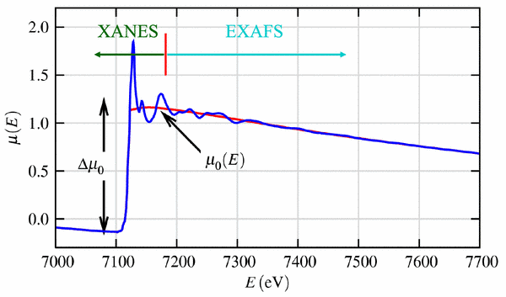
X-ray Absorption Spectroscopy (XAS)
Experimentally there are different ways to do XAS:
Typical XAS spectrum
inelastic scattering, fluorescence
incident beam
transmitted beam
drain current
total/partial electron yield
A
extended XAFS
atomic structure
near-edge
chemistry/magnetism
relevant to PEEM!

Slide 15
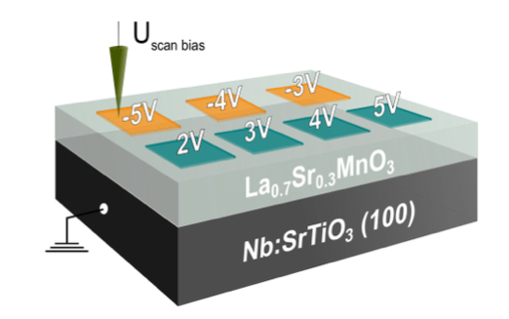
LSMO resistive switching (ex-situ)
RS in ferromagnetic La_{0,7}Sr_{0,3}MnO₃(LSMO)
☞ M. Wilhelm, at al., APL Materials 8, 111102 (2020)
  ReRAM (Resistive Random-Access Memory) is a type of non-volatile memory that stores data by changing the resistance of a material.
  It relies on the formation and dissolution of conductive filaments within an insulating layer when an electrical voltage is applied.

Slide 16
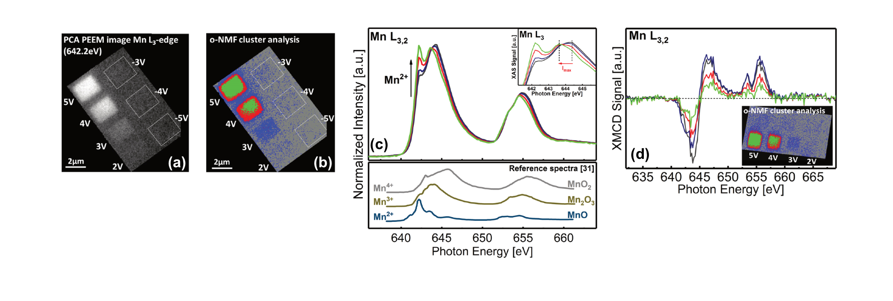
LSMO resistive switching (ex-situ)
RS in ferromagnetic La_{0,7}Sr_{0,3}MnO₃(LSMO)
☞ M. Wilhelm, at al., APL Materials 8, 111102 (2020)
  ex-situ switching at different voltages
  4 - 5V HRS state changes in region
  clear spectral signature of resistive switching Mn^{3+/4+} ⟹ Mn^{2+/3+}
  close link to magnetism (XMCD signature)

Slide 17
outline
Scientific motivation
Immersion lens microscopy
Chemical selectivity
Energy and Spin filtering

Slide 18
x-ray photoemission spectroscopy (XPS)
Need to determine the kinetic energy of photoelectrons
Kinetic
energy
Binding
energy
photon
hν ≈ B.E. + K.E.
(kinetic energy) = hν – (work function) – (binding energy)
vs the kinetic energy of the emitted electron

Slide 19
X-ray Photoemission Spectroscopy (XPS)
Typical XPS spectrum
(kinetic energy) = hν – (work function) – (binding energy)

Slide 20
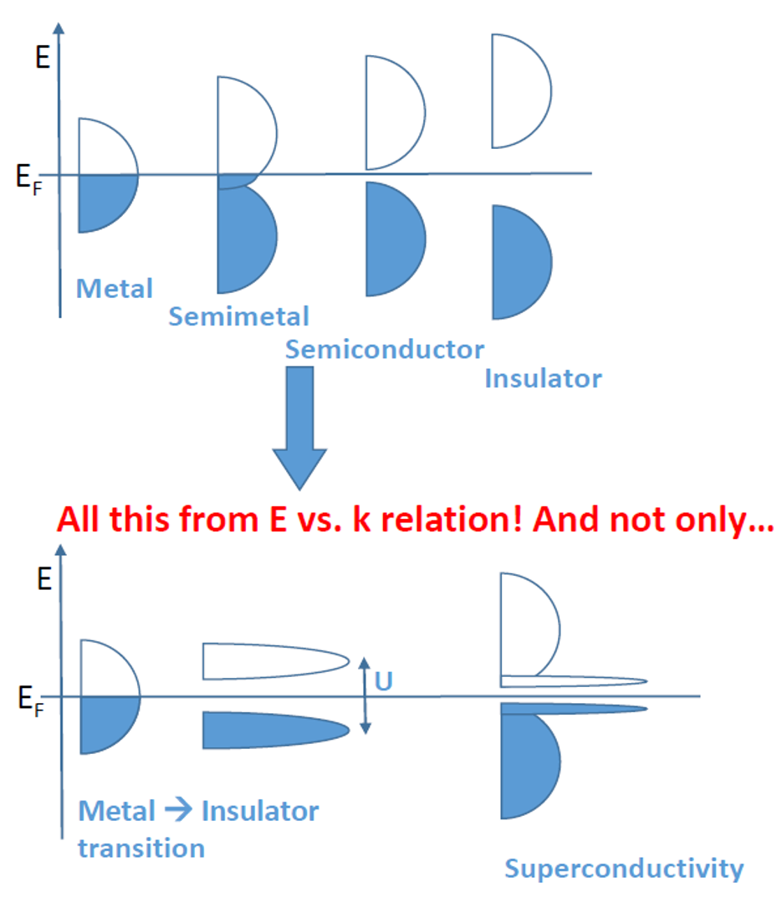
Valence electron photoemision
Periodic potential → electronic bands
and band gaps

Slide 21


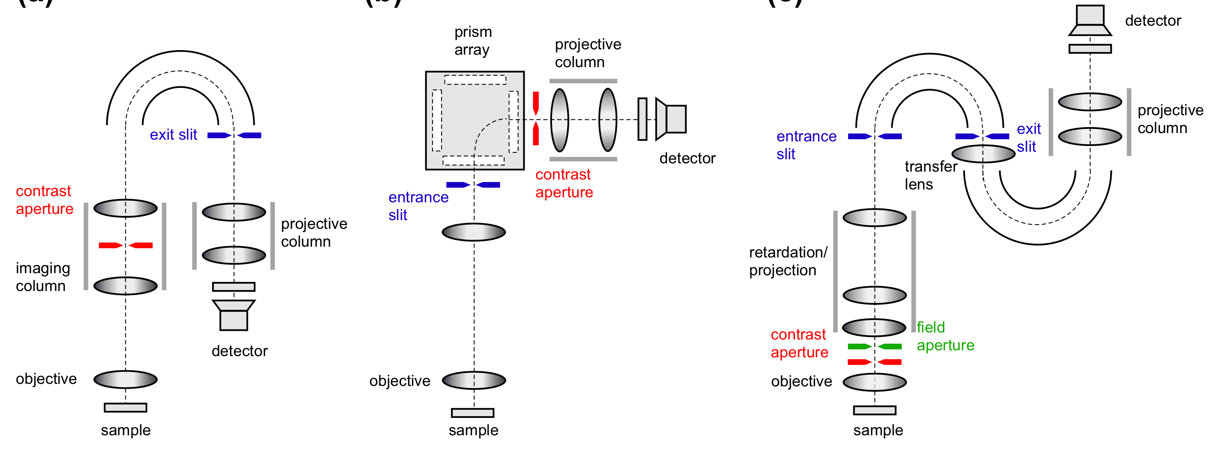
energy-filtered microscopes
US=–20 kV US=–20 kV US=0

Slide 22
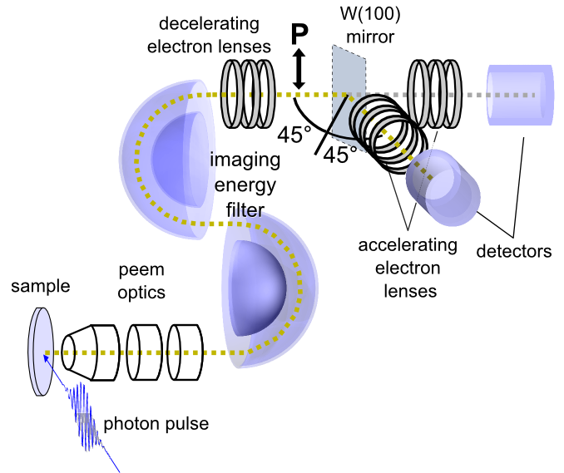
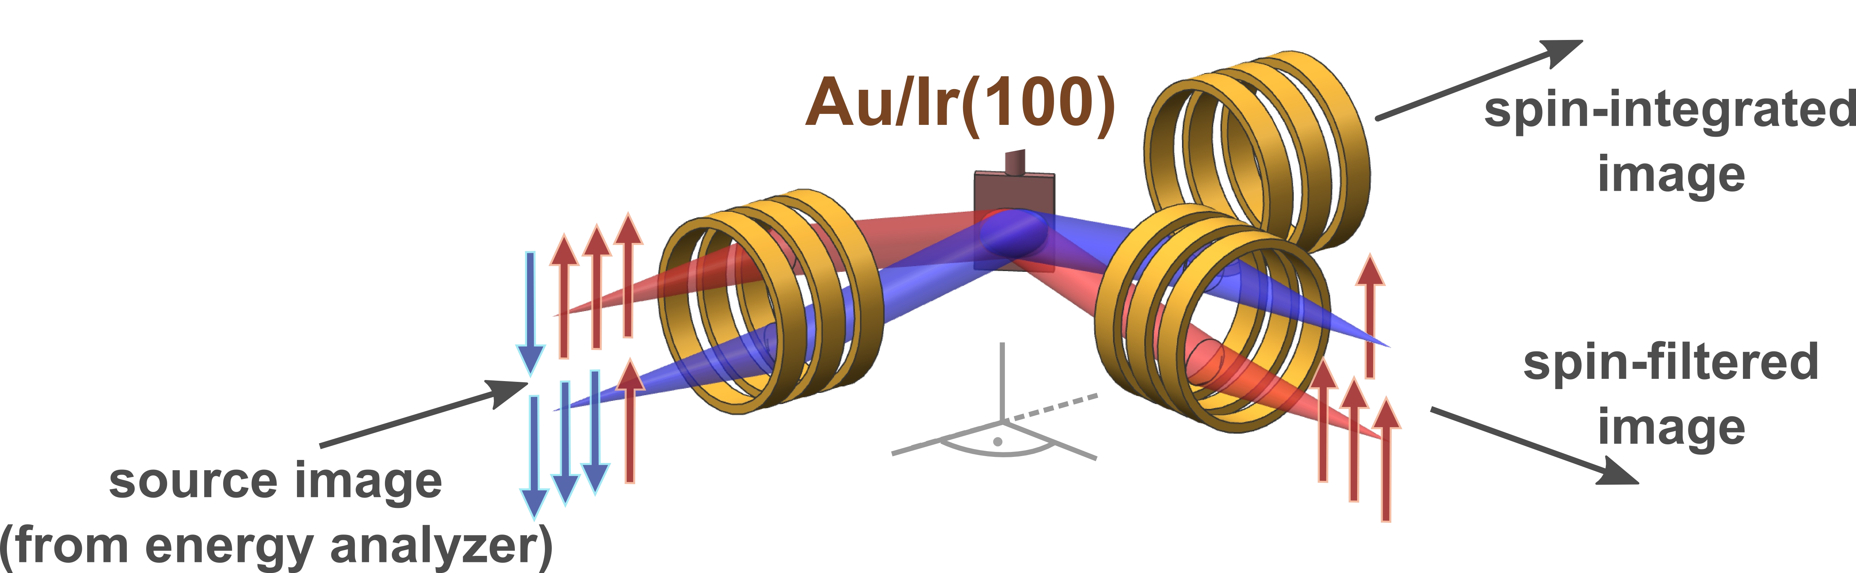
Spin filtered momentum microscope
  Spin filtering by reflection at W(100) mirror
  Alternative spin filter Au/Ir(001)
  Simultaneous detection of 10⁴ data points!
FoM2D =37@11.50eV
D. Vasilyev, C. Tusche, F. Giebels, H. Gollisch, R. Feder, J. Kirschner: J., Electron Spectrosc. Relat. Phenom. 199, p10-18 (2015)

Slide 23
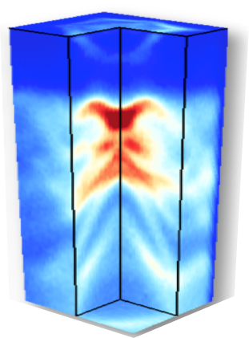
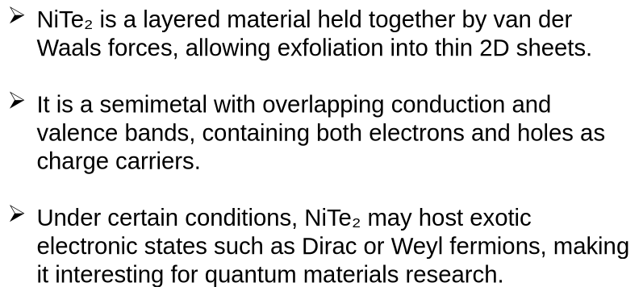
2D Materials: NiTe₂ layered semimetal

Slide 24
ENERGY- AND Spin-Resolved momentum space

Slide 25
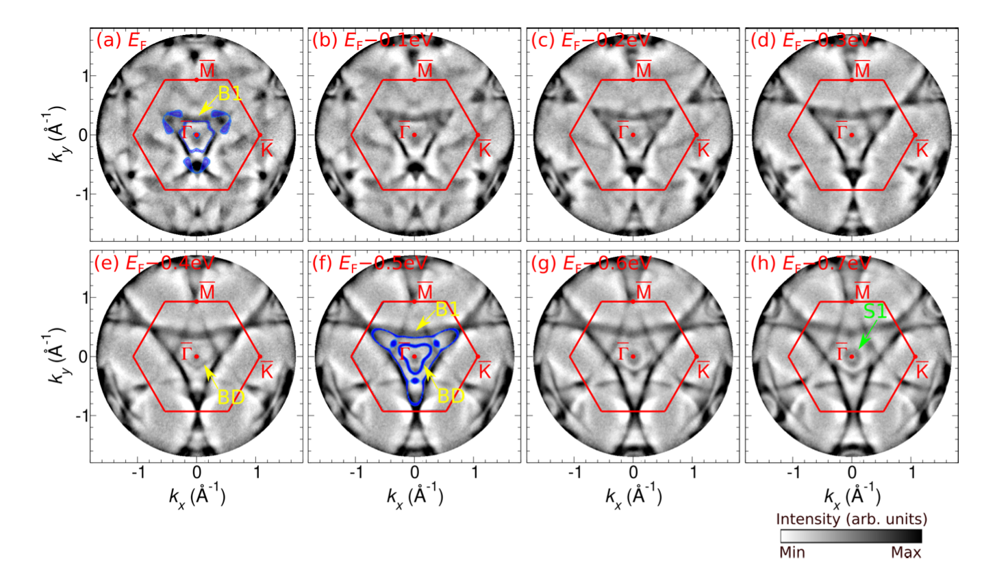
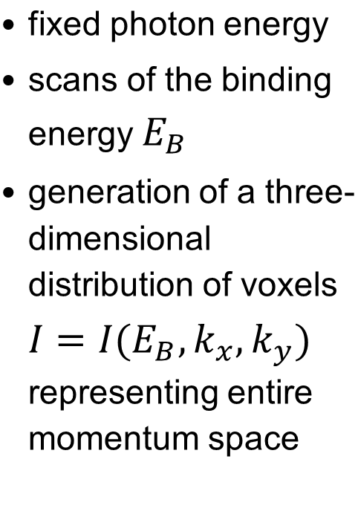
k-space imaging mode: momentum microscopy

Slide 26
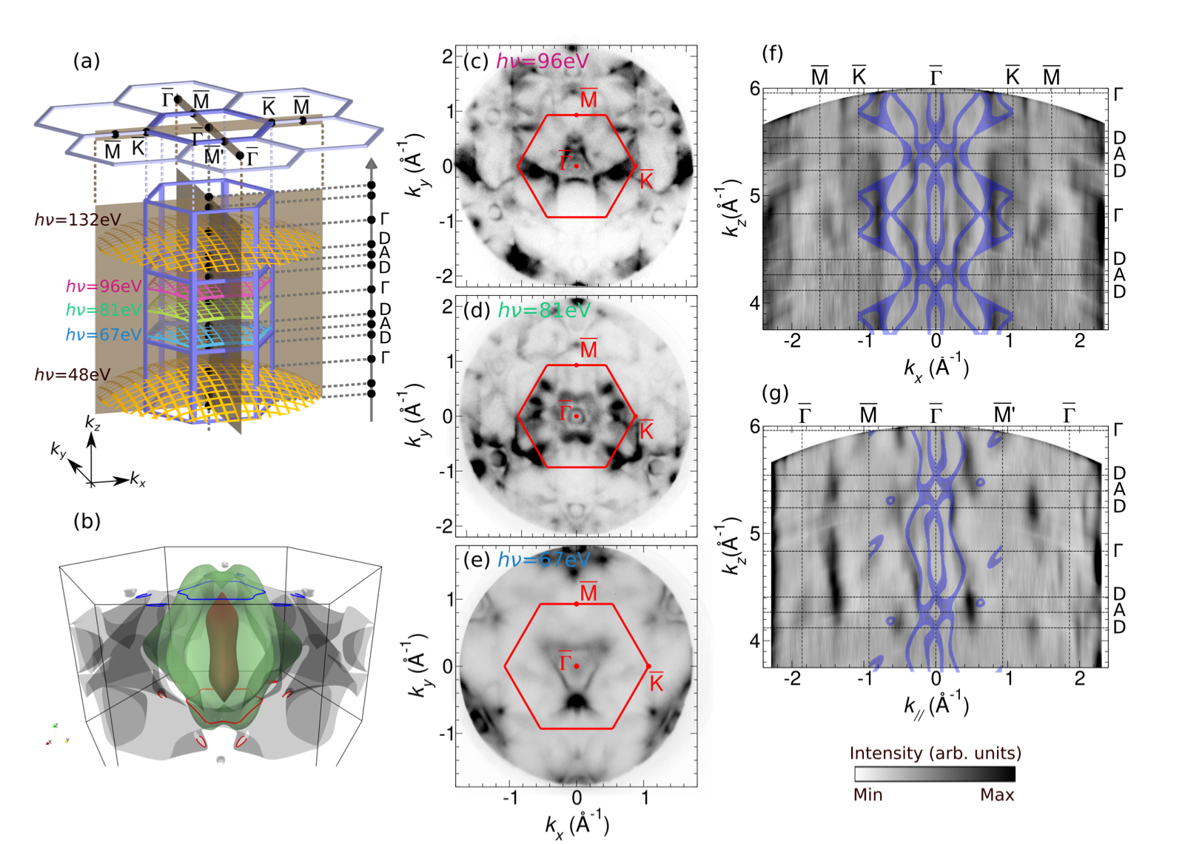
Type-II dirac semimetal
NiTe2: Fermi surface tomography
  Various cuts through the Fermi surface
  dispersion maps at different photon energy
  bulk bands (blue)

Slide 27
Spin texture of the surface Dirac cone
Above the surface Dirac point:
Characteristic spin-momentum locking is observed.
Below the surface Dirac point:
Reversed spin polarization emerges.

Slide 28
Spin texture of the bulk Dirac cone
Hidden spin polarization originates from broken inversion symmetry at the surface Te layer.
Observed Py spin texture is anti-symmetric with respect to kₓ = 0, consistent with mirror symmetry

Slide 29
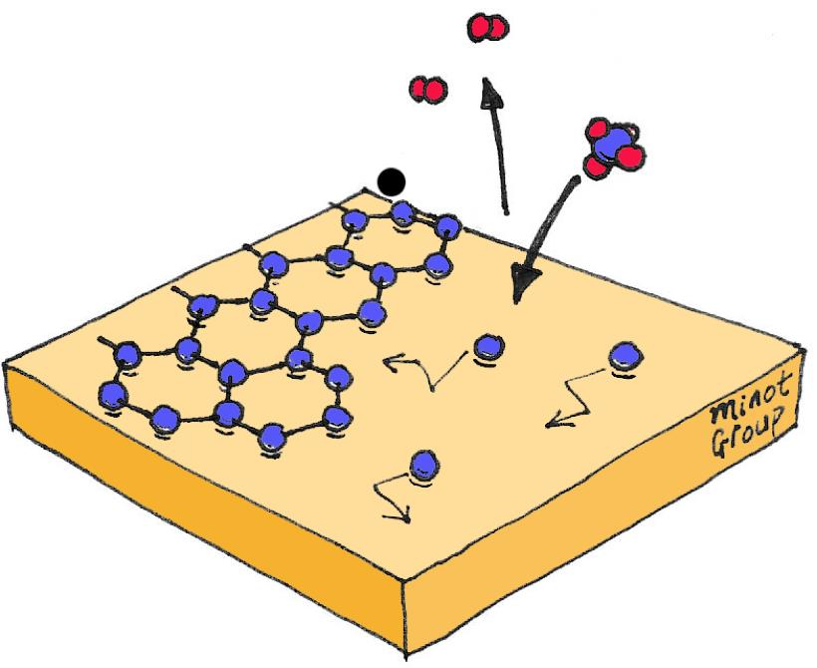
graphene

Slide 30
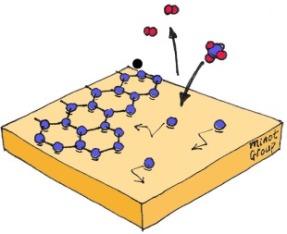
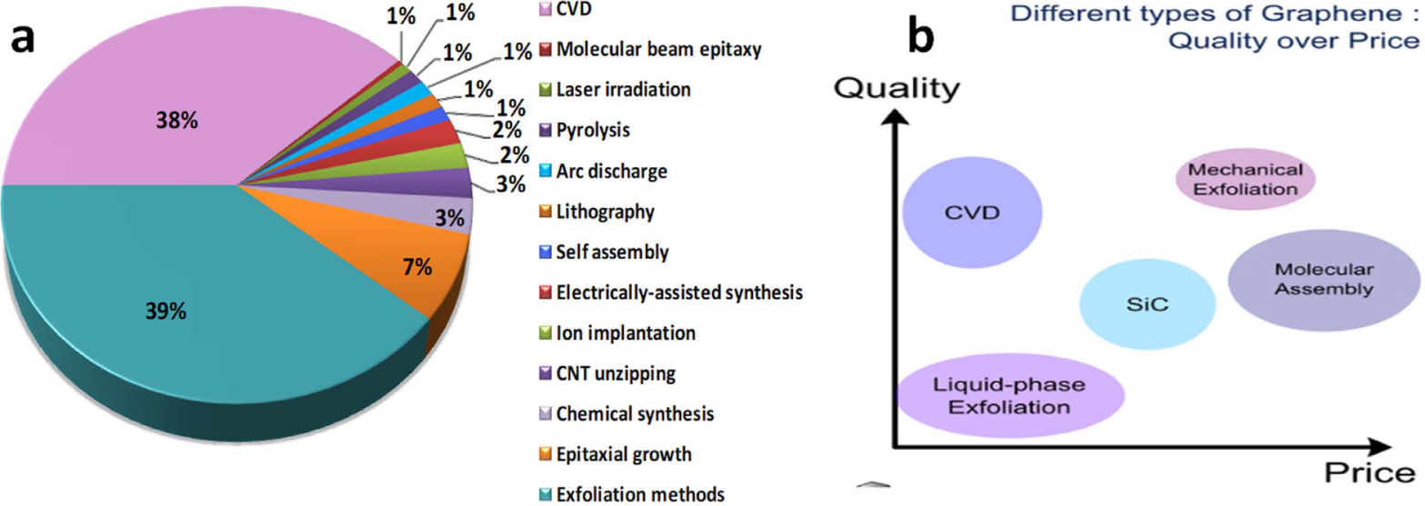
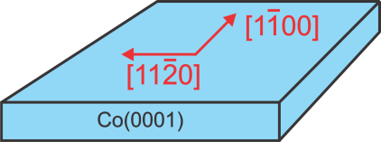
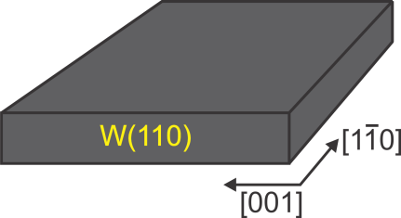
Growth method (CVD) and substrate
Chemical Vapor Deposition
catalytic decomposition of hydrocarbons
(methane, ethylene, propane, acetylene, …)
accumulation of C on the surface
CVD
substrate with hexagonal symmetry
lattice constant similar to the graphene one
(only 1.8 % mismatch)
easy magnetization axis
exfoliation

Slide 31
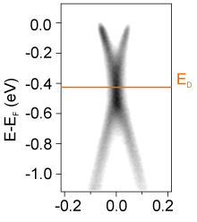
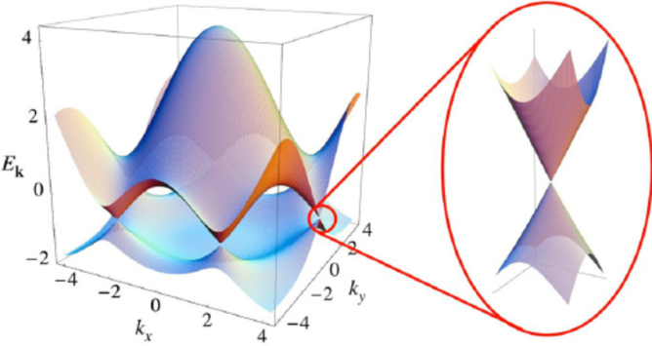
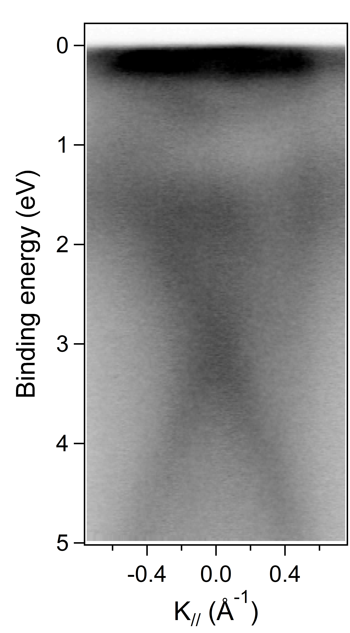
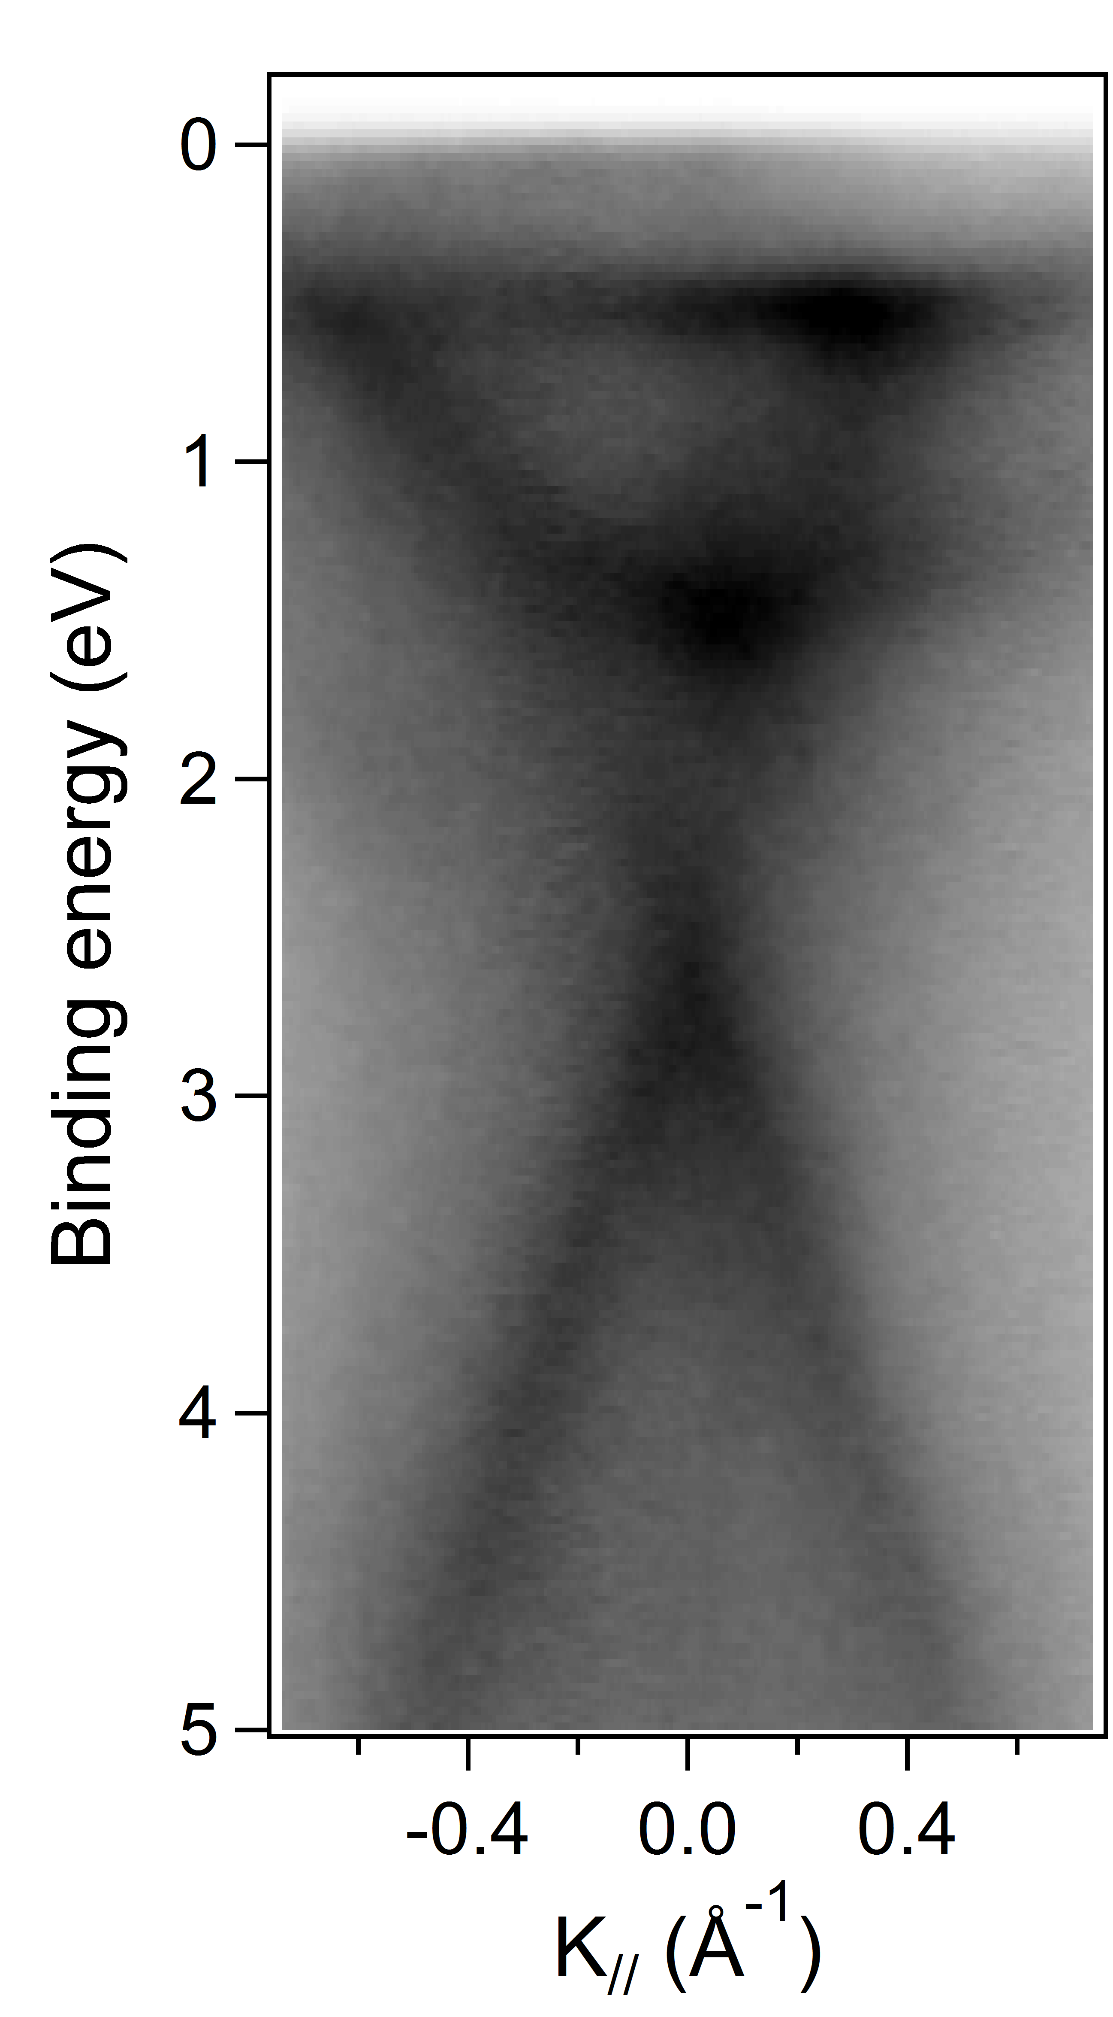
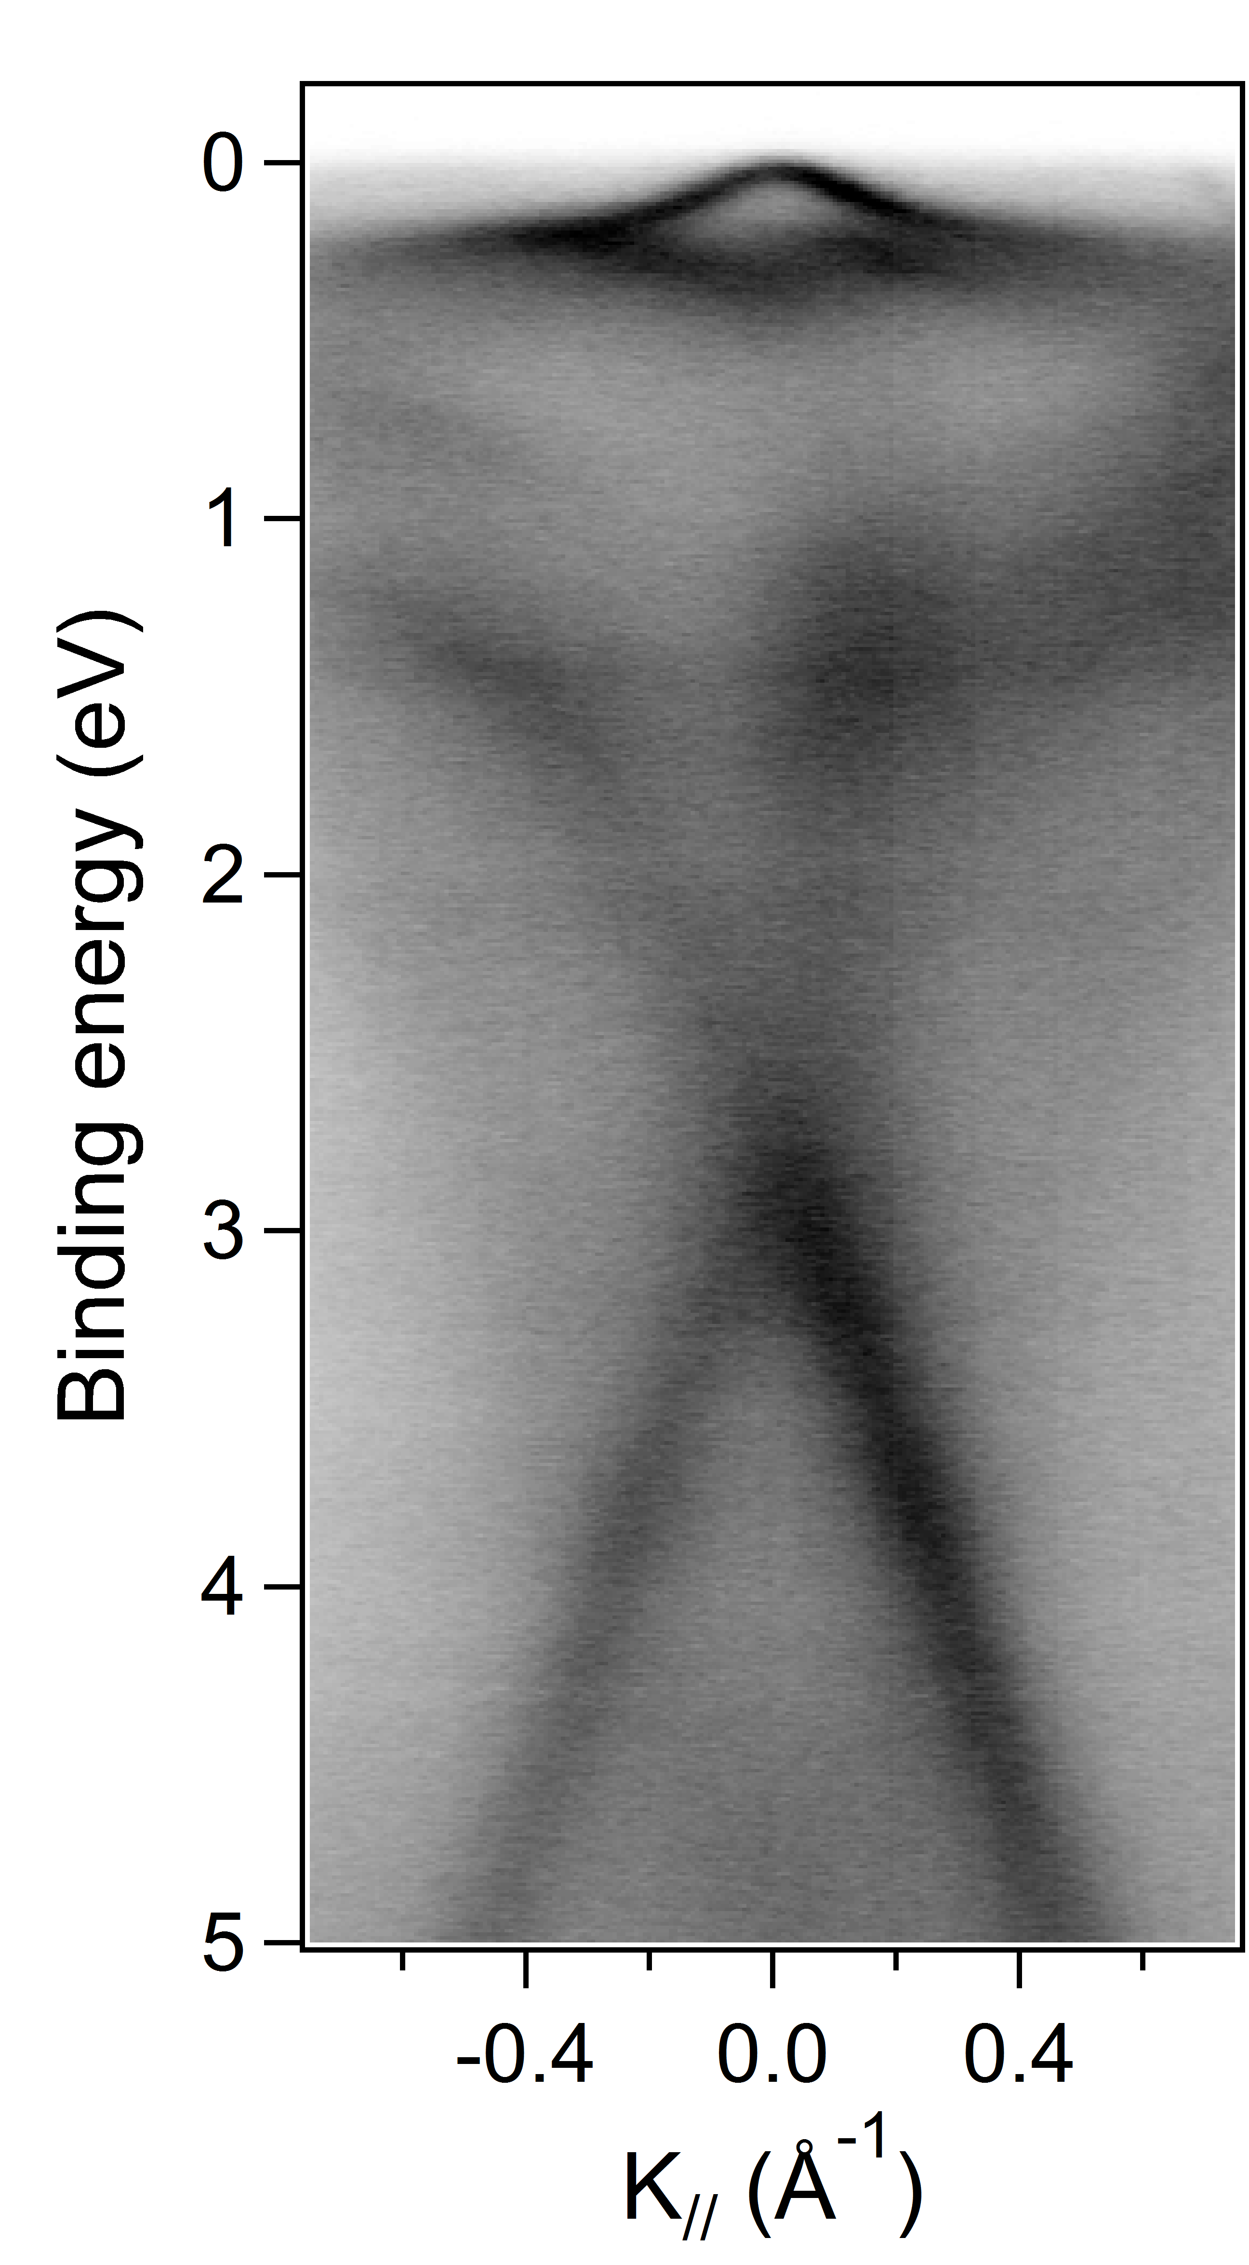
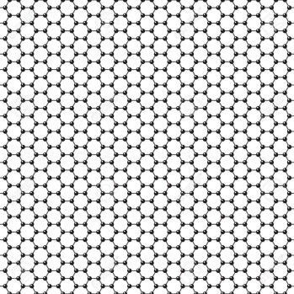
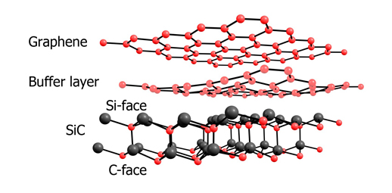
Effect of the substrate
Graphene on weakly
interacting substrates
Graphene on strongly
interacting substrates
Free-standing graphene
Gr/Ni(111)
Gr/Fe(110)
Gr/Co(0001)
E_{F}
C. Riedl et al., J. of Phys. D 43 (2010) 37
Notes:
Non interacting substrates → more interacting → magnetic next slide

Slide 32
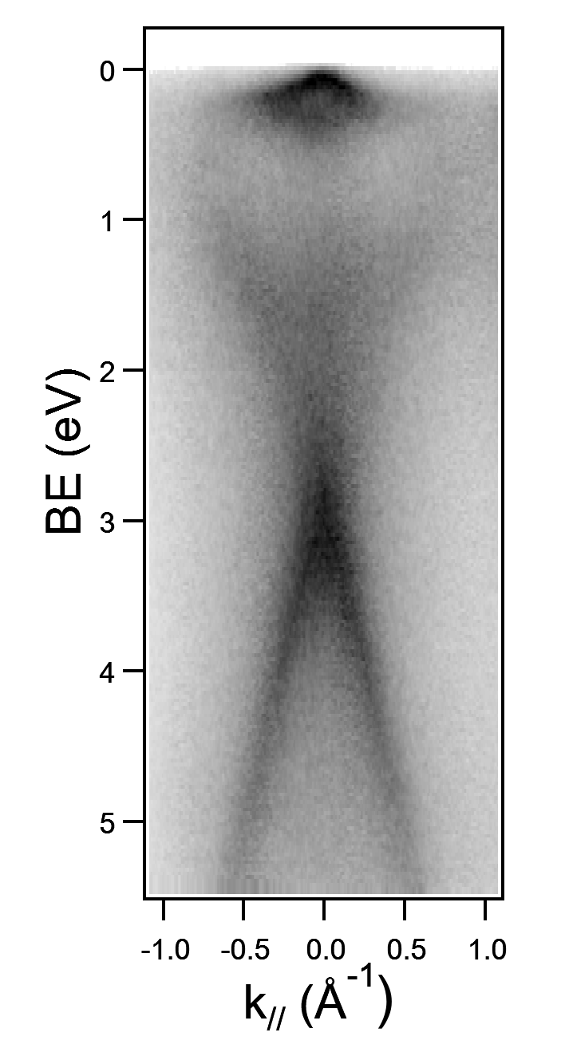
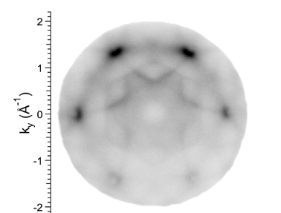
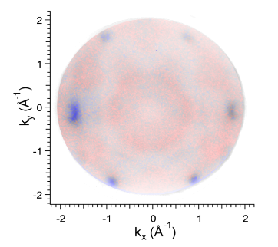
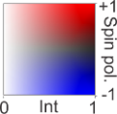
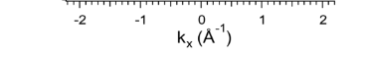
Spin-polarized feature in graphene
Spin-integrated
Spin-resolved
Intensity (arb. units)
M
Dirac-like features close to the Fermi level of Gr/Co/W(110) hybrid are spin polarized

Slide 33
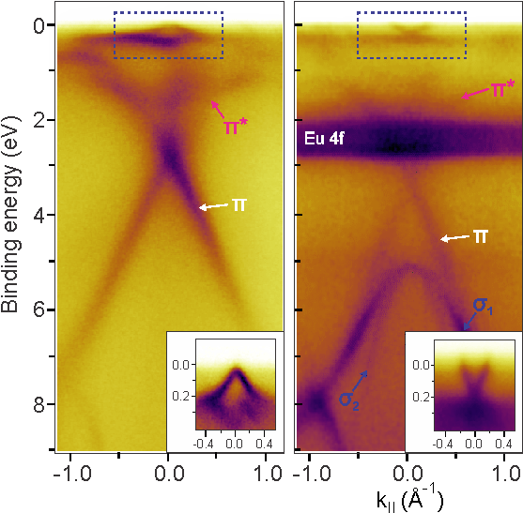
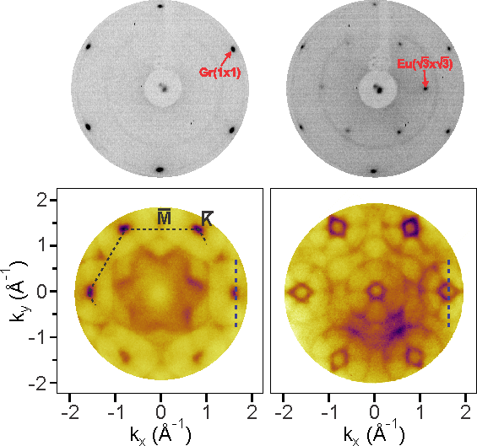
Eu doping of the Gr/Co interface
M. Jugovac et al., Advanced Materials (2023) 2301441.
Gr/Co
Eu/Gr/Co
Gr/Co
Eu/Gr/Co
Eu (1/3 ML) is ordered on top of graphene
Drastic change in the Fermi surface
Graphene is doped
Umklapp leads to band folding

Slide 34
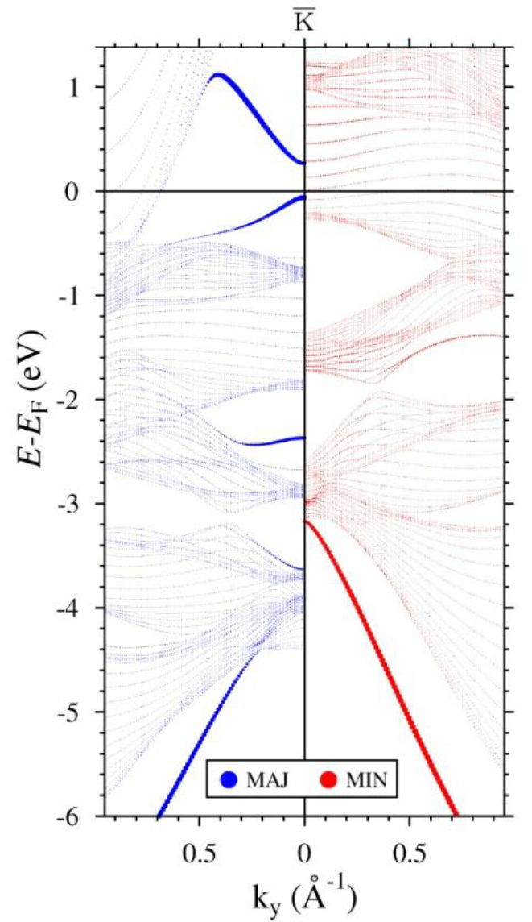
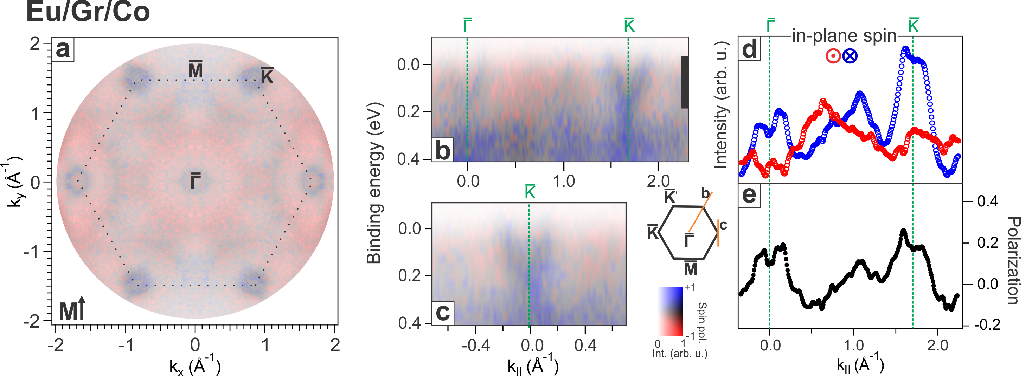
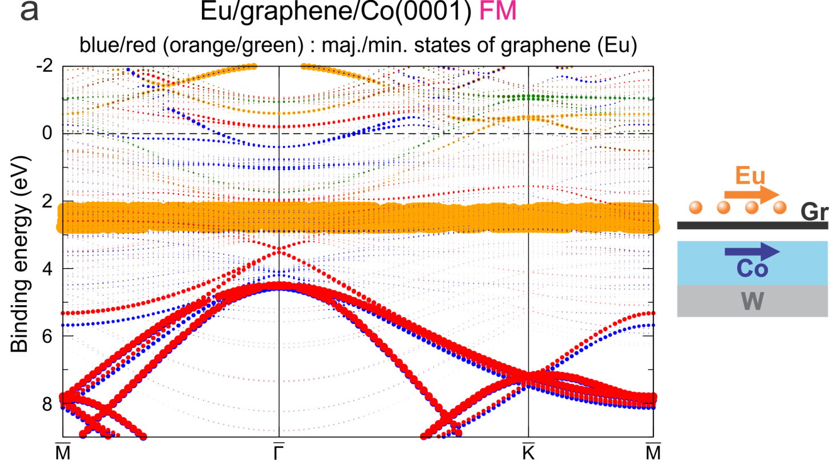
Eu doping of the Gr/Co interface – spin
Gr/Co
M. Jugovac et al., Advanced Materials (2023) 2301441.

Slide 35
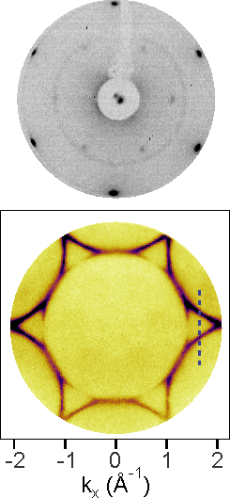
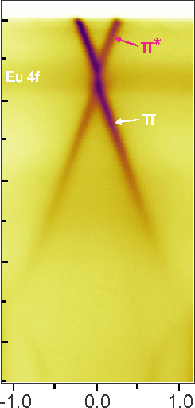
Eu intercalation at the Gr/Co interface
Gr/Co
Gr/Eu/Co
Gr/Co
Gr/Eu/Co
Eu (1/3 ML) is ordered upon intercalation
Drastic change in the Fermi surface
Graphene is doped
Bandgap at the Dirac point
M. Jugovac et al., Advanced Materials (2023) 2301441.

Slide 36

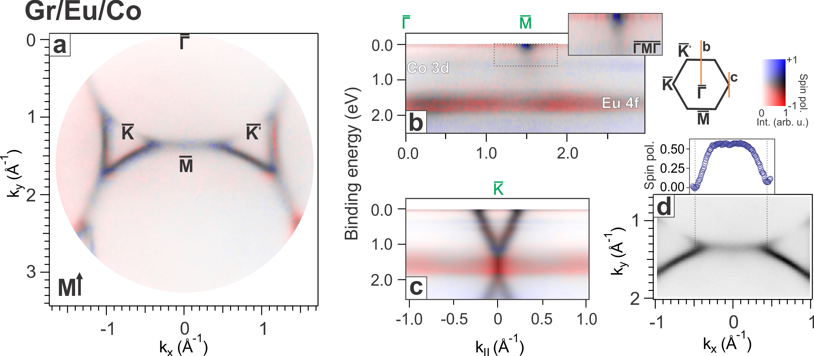
Eu intercalation at the Gr/Co interface - spin
M. Jugovac et al., Advanced Materials (2023) 2301441.
Single-spin polarized flat bands at the Fermi level!

Slide 37
Conclusions
…in Gr/Co(0001)
Eu deposition dopes the electronic bands of graphene
Eu intercalation decouples graphene and dopes it
formation of single spin flat bands at the Fermi level!

Slide 38
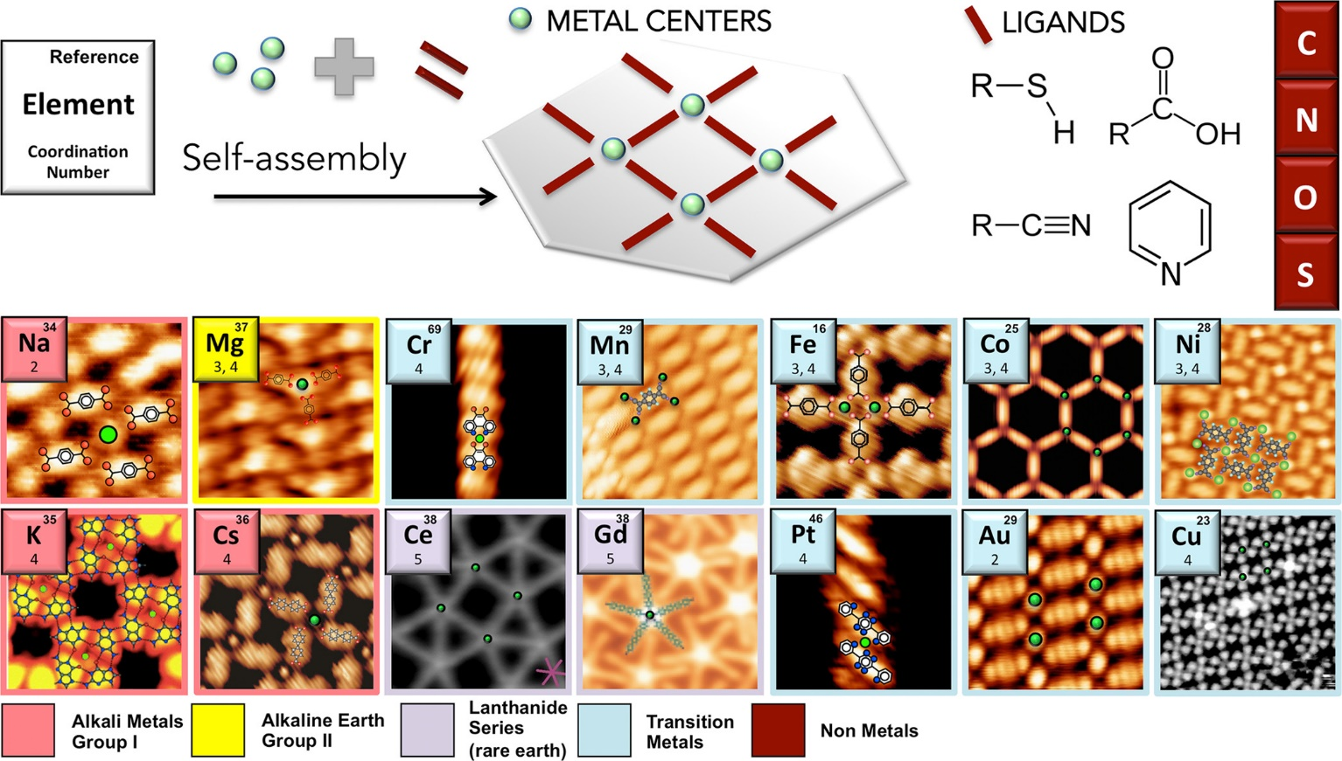
Metal-organic frameworks (2D-MOF)
DOI: 10.1021/acs.accounts.5b00172
Acc. Chem. Res. 2015, 48, 2132−2139

Slide 39





Experimental techniques
Near edge X-ray absorption fine structure (NEXAFS)
Molecular geometry
Electronic structure
Oxidation state
X-ray magnetic circular dichroism (XMCD)
Electronic and magnetic properties
Spin and oxidation states
Molecular geometry
Photoemission tomography (PT)
Electronic structure, energy level alignment
Charge transfer
Chemical modification
Band structure
3D tomographic imaging of MOs
P. Puschnig et al., Science, 2009, 326,702-706
J. Stöhr, Springer Tracts in Modern Physics, 2023, 288

Slide 40


Ni-(TCNQ)_{x}
Ni₁(TCNQ)₂
LC MOF
Ni₁(TCNQ)₁
HC MOF
Stable Ni(I) (d⁹) configuration observed in both 1:1 and 1:2 Ni-TCNQ phases.
Ni→TCNQ charge transfer fills ligand LUMO; extra charge comes from the Ag(100) substrate.
By tuning the surface concentration of Ni atoms, we achieve precise control over the formation of two distinct stoichiometric Ni:TCNQ phases.

Slide 41
coordination bonding
Energy level alignment is determined by analyzing the symmetry of ligand orbitals and their interaction with Ni d-states in a square planar field.
Covalent bonding revealed via orbital splitting into bonding/antibonding states.

Slide 42

Band structure of 2d ni-tcnq mofs
Hybrid bands show clear energy dispersion, proving extended 2D MOF formation.

Slide 43




Superexchange Coupling in Ni-Based MOFs
XMCD shows only Ni(I) is stabilized on Ag(100) and Au(111), due to strong MOF–metal interactions.
On Ag(100), a planar geometry leads to weak exchange coupling (J = 1.2 meV).
On Au(111), stronger coupling
(J = 3.2 meV) arises from altered charge transfer and Ni displacement.
Ni⁺, S=1/2 state
x²-y²
z²

Slide 44
an “All-In-One” Photoemission Experiment
Future Evolution
  From UV-PEEM to HAXPEEM
  From Statics to Dynamics
  Without / With Spin

Slide 45




Interaction of x-rays with matter: useful resources
https://xdb.lbl.gov/
https://vuo.elettra.trieste.it/services/elements/WebElements.html
https://srdata.nist.gov/xps/main_search_menu.aspx

Slide 46


Spin-Resolved momentum space
  Spin-resolved Fermi surface of Cobalt
C. Tusche, M. Ellguth, V. Feyer, A. Krasyuk, C. Wiemann, J. Henk, C. M. Schneider, and J. Kirschner, Nat. Comm. 9, 3727 (2018).

