Slide 1
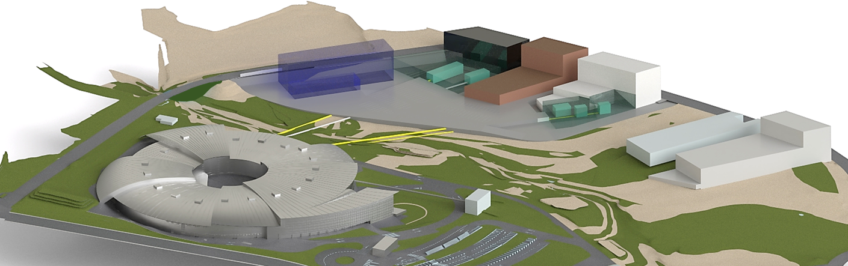
The beamlines of ALBA II
Josep Nicolas

Slide 2
ALBA II beamline program
UV
soft x-rays
hard x-rays
New!
Imaging
+ Tomography
New!
New!
Diffraction
New!
Spectroscopy
(Core level)
Imaging + Tomography
Spectroscopy (external atomic levels, core levels of light elements)
Spectroscopy
Diffraction
Tomography
To measure absorption (or photoemission, ionization, fluorescence, etc.) as a function of photon energy.
It gives information of the internal structure of electrons inside the atoms, and how they change during processes.
To measure the diffraction pattern of x-rays after crossing a sample.
Allows reconstructing the structure (geometry) in which atoms are laid out in a solid)
Take images (with or without focusing) of the sample from several perspectives and reconstruct its 3D volume.

Slide 3
ALBA II beamline program
A) Construction of 4 new beamlines
B) Upgrade of the 13 existing beamlines of ALBA
Main building
MSPD 2
Far Experimental Hall
Faxtor
Miras
BL02-CODI
Boreas
BL03
Minerva
Xaira
Circe
BL07-Calima
Claess
BL-04 CORUS
Mistral
3sbar
NCD-sweet
Notos
Xaloc
Stream course
(not usable)
BL15-3sbar
BL08

Slide 4
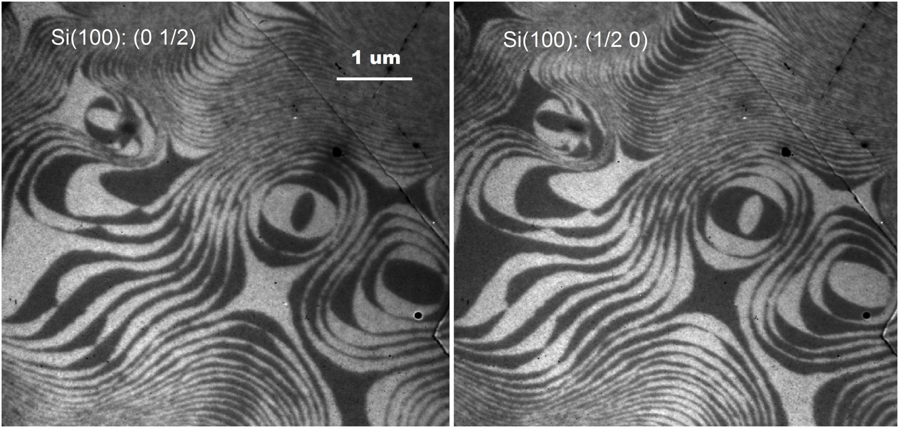
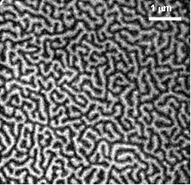
Soft x-ray spectro-microscopy (BL24-CIRCE)
Spectroscopy (combined with microscopy) allows imaging the atomic layers as they grow in a crystal, allowing understanding the processes at a fundamental level
We can also ‘image’ the magnetic domains, and study how small they can be and still b stable, and how fast we can change them.

Slide 5
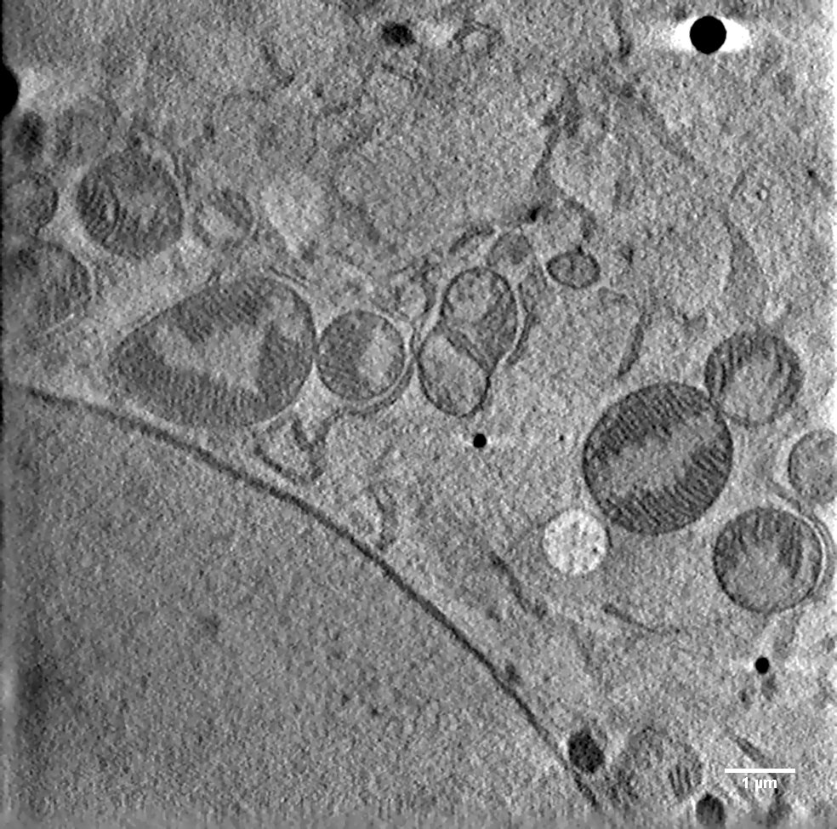
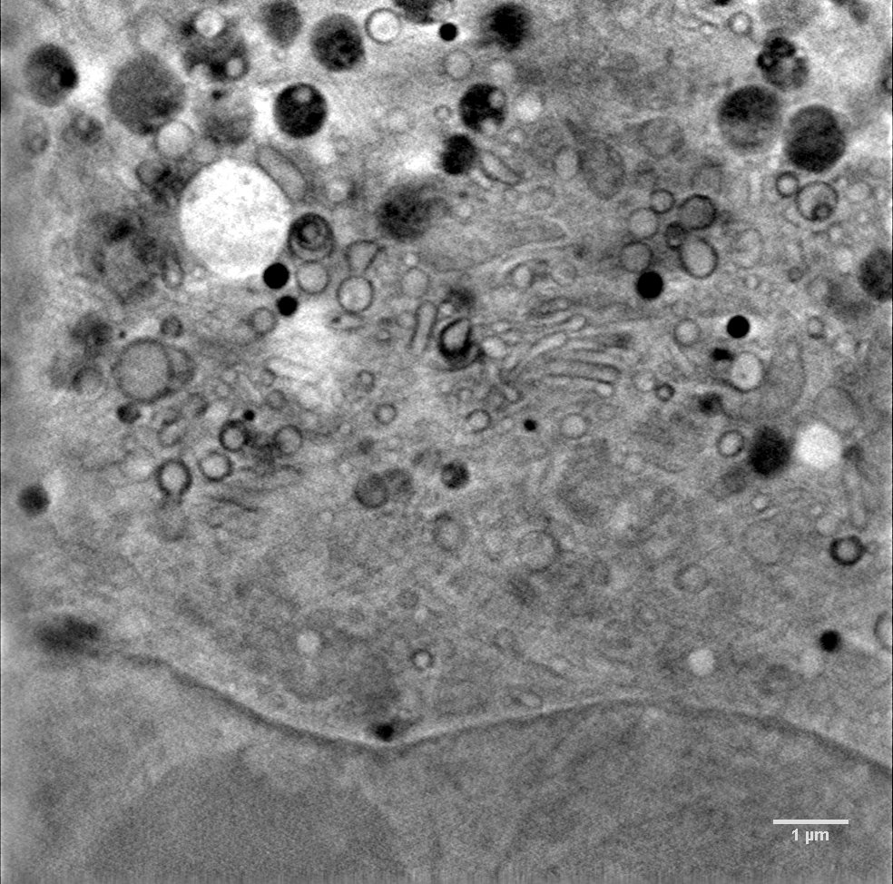
Soft x-ray micro-tomography (Mistral)
LV
M
M
ER
G
N: nucleus
NM: nuclear membrane
ER: endoplasmic reticulum
G: golgi
n: nucleoli
M: mitochondrion
LV: lipid vesicle
NM
M
NM
N
n

Slide 6

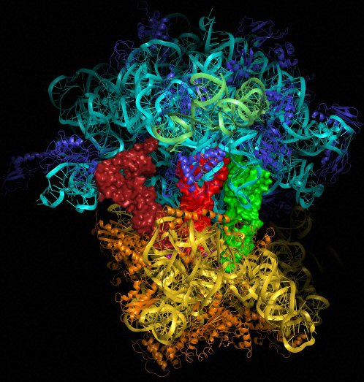
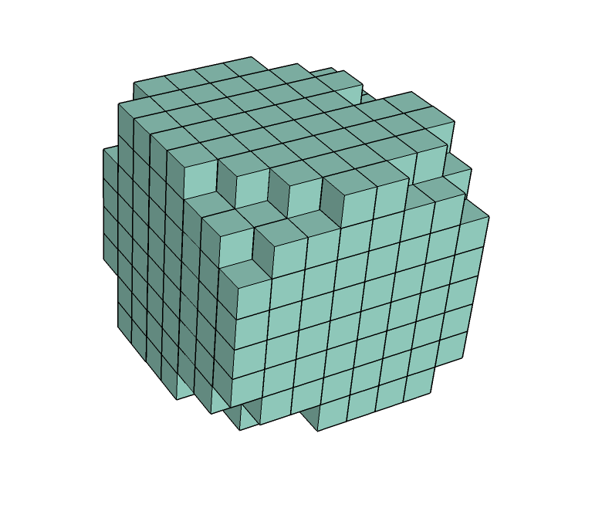
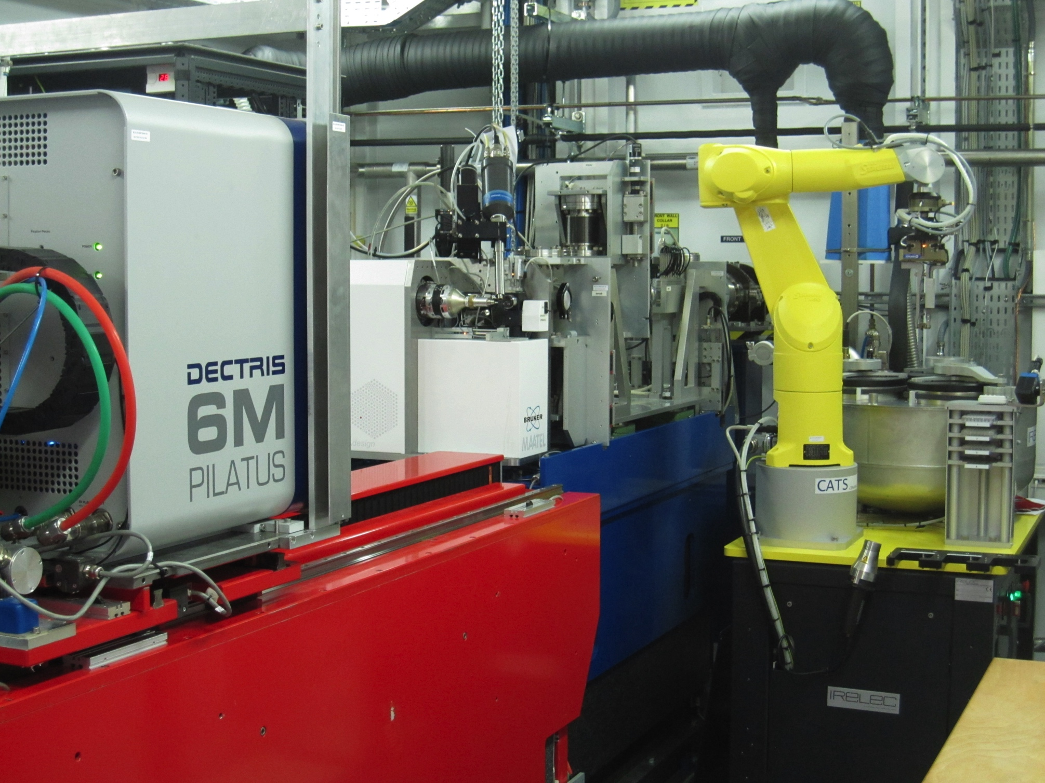
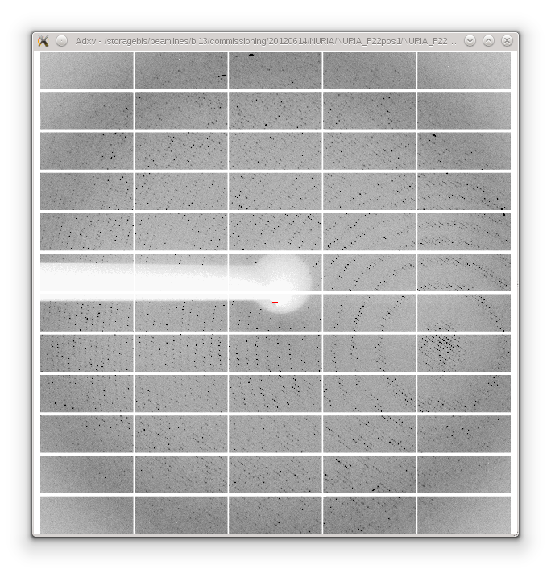
X-ray diffraction (MX)
Xrays
From the diffraction pattern we RECONSTRUCT the 3D STRUCTURE of the protein (or any large molecule)

Slide 7
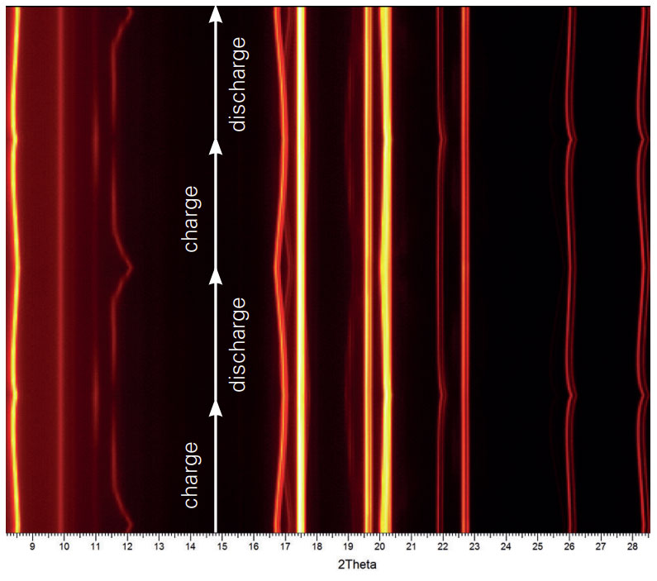
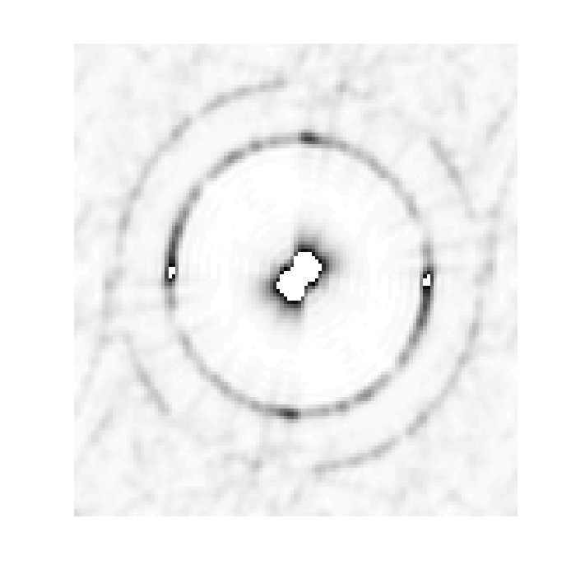
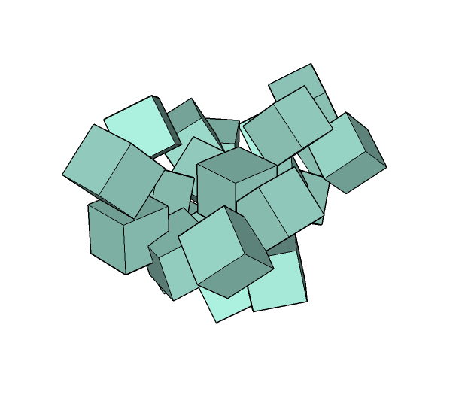
X-ray diffraction (Powder Diffraction)
X-rays
Powder diffraction allows studying the changes in the atomic structure while the sample is interacting with something. In this case, as a battery material is charged and discharged.

Slide 8
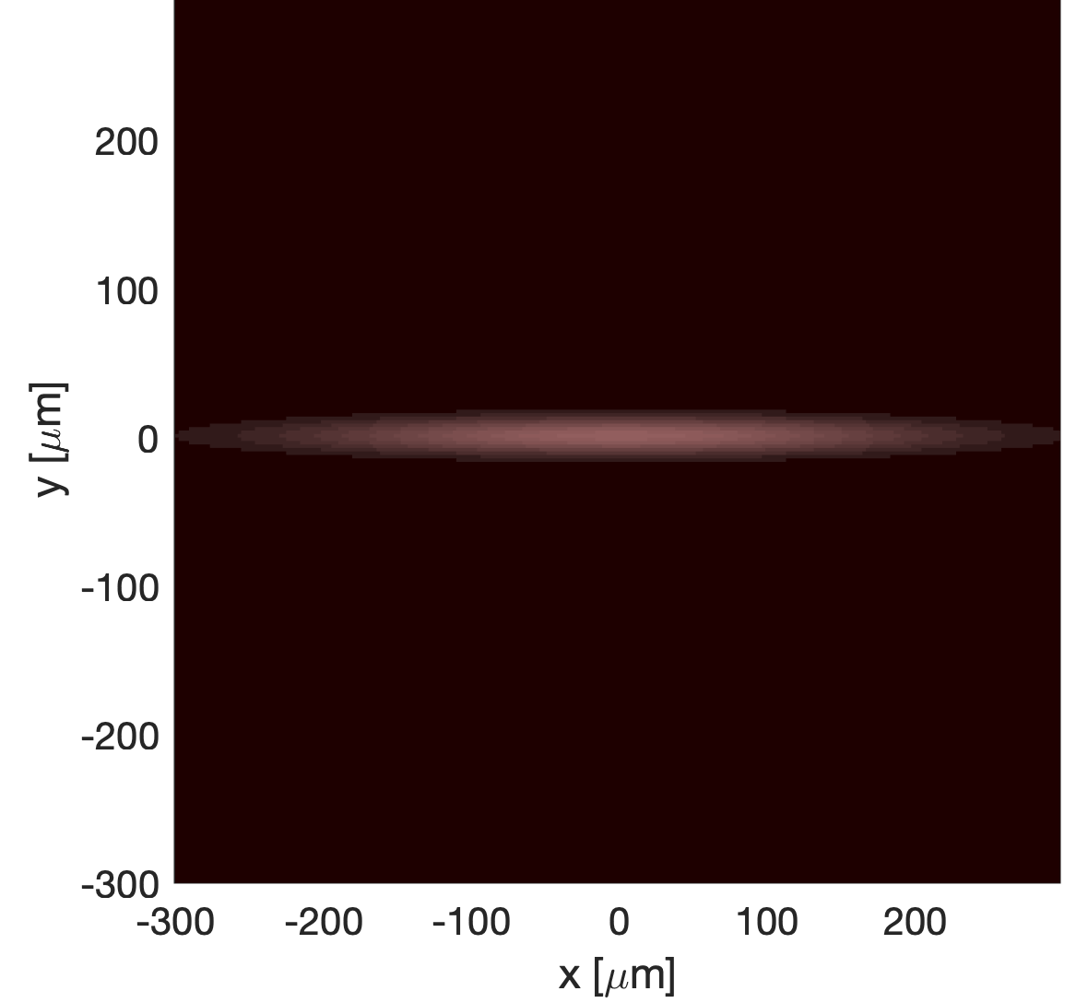
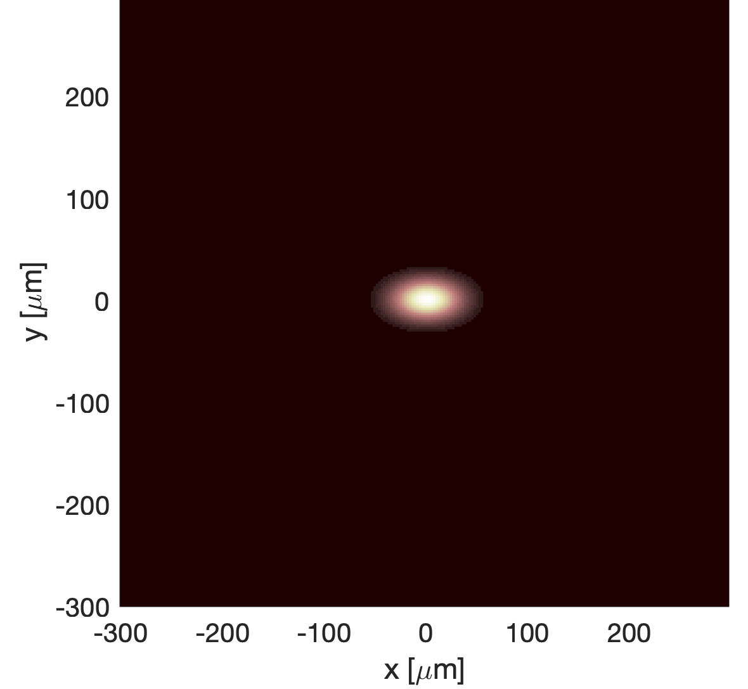
The ALBA II as a light source
The electron-beam will be
smaller
less divergent
Therefore more intense (more brilliant)
Brilliance is the flux of photons emitted
from the same point (Δx) (smaller)
in the same direction (Δα). (more collimated)
ALBA
ALBA II
ALBA
ALBA II
Difraction limit
x12
x8
Beam Size
x4
310 x 18 µm² fwhm
45 x 27 µm² fwhm
Δx Δα ≥ λ/2π
Wavelength is the limit on how much we can reduce the size and divergence of the source.
Near this limit, light behaves more as a wave and less as a geometric ray.
It shows diffraction and Interference effects (we say light is is coherent) .

Slide 9
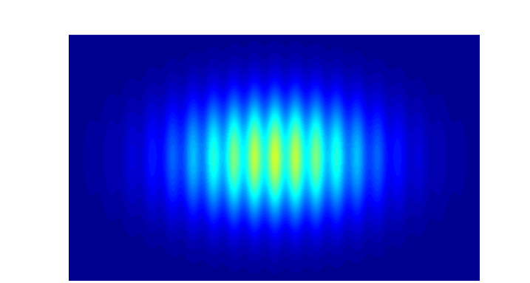
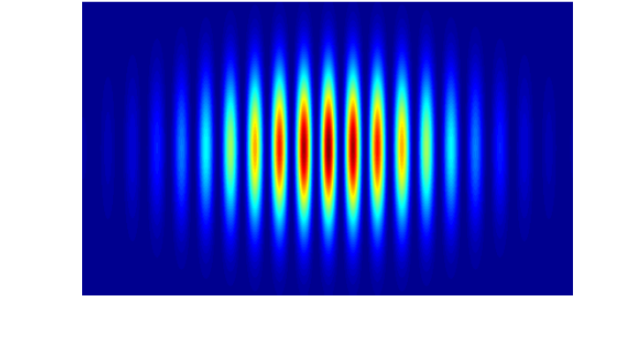
The features of ALBA 2
Brightness / coherence
Long beamlines
Superbends
More flux on diffraction beamlines.
Wave optics for x-rays.
Approach ultimate resolution limit.
Diffraction and imaging
Enable the use of BM beamlines for higher photon energies.
Spectroscopy and diffraction
Low coherence
40 m BL
230 m BL
High coherence
Better spatial resolution at large working distance.
Coherence at high photon energy.
Nanoprobes and imaging
x20

Slide 10
Benefits for photon science
ALBA-II
Super-BM
Low Emittance
New generation Optics
High Energy for BMs
Coherence (mainly SXR)
Brilliance
(mainly HXR)
New generation Mechanics
IDs
More ph/s on sample
Controls technology
“Wave” properties
smaller spot size
Optics
Optics
Fast scan
Fast detectors
Data handling
faster collection
Ptychography
Coherent diffractions
STXM
Dynamics
Stability
Data infr.
Imaging
Accuracy
Hi-throughput
Big-Data methods
Only a few examples of enabling technologies are indicated
Fast scan
nanoprobes
Higher coherence, smaller spot size and higher photon flux density drive the development of usual and new experimental techniques.
Beamlines need to include new technologies to enable such development.

Slide 11
ALBA II beamline program
A) Construction of 4 new beamlines
B) Upgrade of the 13 existing beamlines of ALBA
Main building
MSPD 2
Far Experimental Hall
Faxtor
Miras
BL02-CODI
Boreas
BL03
Minerva
Xaira
Circe
BL07-Calima
Claess
BL-04 CORUS
Mistral
3sbar
NCD-sweet
Notos
Xaloc
Stream course
(not usable)
BL15-3sbar
BL08

Slide 12
BL02-CoDi Optical layout
Side view
DCM
VXS
SLIT2
Sample
VFM
M1 (mcyl)
HFM
IVU19
M2 (scyl)
40.3
230.17
19.5
19.8
40.0
230
230.4
Top view
2.5 mrad
2.5 mrad
HXS
3.2 mrad
17.541
42.560
134
5.5 mrad
249
Tunel
Exp. Hall
Far Exp. Hall
Source
Focusing optics and monochromator
Secondary source
Refocusing optics and end-station

Slide 13
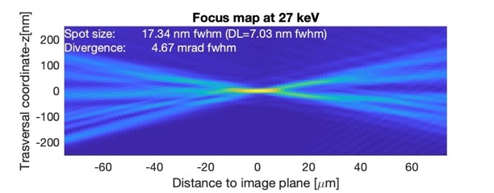
Nanofocusing optics
The intended nanoprobes represent a challenge, first in optics
HFM
VFM
202.5
122.5
80
Spot size <25 nm fwhm
Depth of focus < 10 µm
Distance to sample <40 mm
80
40
165
120
Plano-elliptic mirrors
Graded multilayer coating
R_{min} ~ 10 m
Length >80 mm
Figure Errors < 1 nm, < 50 nrad
Transversal acceptance < 1 mm²

Slide 14
Nanoprobes
Heat
Laser
Optics
Cryogenics
Reactive Gases
Sample
Strain
Electr.Field
Detector(s)
A nanoprobe allows obtaining spectra or diffraction data with spatial resolution over the sample.
It produces “images” in which each pixel is a complete spectrum or a complete diffractogram.
Its spatial resolution is given by the size of the focused beam (ca. 30x30 nm for ALBA II)
Long beamlines allow achieving this with sufficient space around the sample to set a “sample environment

Slide 15
BL02-CoDi
Hard X-ray nanoprobe beamline devoted to Coherent Diffraction Imaging techniques, for in-operando studies in material science.
 | CoDI
Source | In vacuum undulator (IVU19)
Energy Range | 10 - 30 keV (DCM + MLM)
Spot Size | 30-50 nm
Technique | nanoDiffraction, nanoFluorescence, CDI, Ptychography, Holography, Bragg-ptychography, Tele-ptychography
Features | 20 m flight tube Laser Heating, High Pressure, Gas dosing, Cryostream, Cryostat… (space around sample for versatile sample environment)
Sample | Micro reactors / Electro chemistry cells for in-situ and operando
Detector | One large area detector (6M type) One small detector mounted on robot arm Multielement SDD
3D reconstruction and Evolution of strain in a Pt nanoparticle as varying electrode potential. Useful for the design of strain-engineered nano-catalysts
From C. Atlan, et al. Nat. Mater. 23, (2023). https://doi.org/10.1038/s41563-023-01528-x

Slide 16
BL04-Corus
Hard X-ray nanoprobe beamline devoted to spectral Imaging and tomography for life sciences.
 | Corus
Source | In vacuum undulator (IVU19)
Energy Range | 10 - 27 keV (DCM + MLM)
Spot Size | 20-50 nm
Technique | 3D-nanoXRF, XANES (STXM) Holo-tomography (Full Field)
Features | LN2 cryogenics, 180º Rotation, XY mapping UHV, Visible microscope
Sample | Multi-sample shuttle system
Detector | Nanospec:: Two Multielement SDD, Diode NanoImag: Two Multielement SDD, sCMOS Area detector.
Determination of intra-cellular location of Ir in breast cancer cells. Imaging at nm-resolution with chemical sensitivity.
From Conesa et al. Angew Chem Int Ed Engl 2020, 59 (3), 1270-1278. DOI:10.1002/anie.201911510.

Slide 17
Impact of BL upgrades
Simulations of the beam on sample for XAIRA, assuming perfect alignment and stability
ALBA
ALBA-2
ALBA-2
+Superpolished mirrors
ALBA-2
+Superpolished mirrors
+Adaptive Optics
1
x14
x36
x48
 | AXO | Super Polished | Flux | Fluxdens | Size | Brilliance | Brilliance factor
ALBA |  |  | 4.5E+12 | 9.8E+11 | 2.9x1.4 | 2.3E+19 | 1
ALBA-2 |  |  | 1.5E+13 | 8.3E+12 | 0.8x1.1 | 3.3E+20 | 14
ALBA-2 |  | YES | 1.5E+13 | 2.1E+13 | 0.4x0.7 | 8.4E+20 | 36
ALBA-2 | YES | YES | 1.6E+13 | 2.7E+13 | 0.6x0.7 | 1.1E+21 | 48

Slide 18
The benefits of brilliance
Low brilliance: photon flux is distributed in a large/collimated or small/diverging beam
Source
Sample
Detector
Optics
High brilliance: The same photon flux is are distributed in a small and collimated
Source
Sample
Detector
Smaller spot
Higher flux density ( ~40 times)
More collimated
More intense
Smaller spot in detector (= Higher coherence distance on sample)
More beam accepted.
Lower aberrations
Optics

Slide 19
Thank you
jnicolas@cells.es

