Slide 1
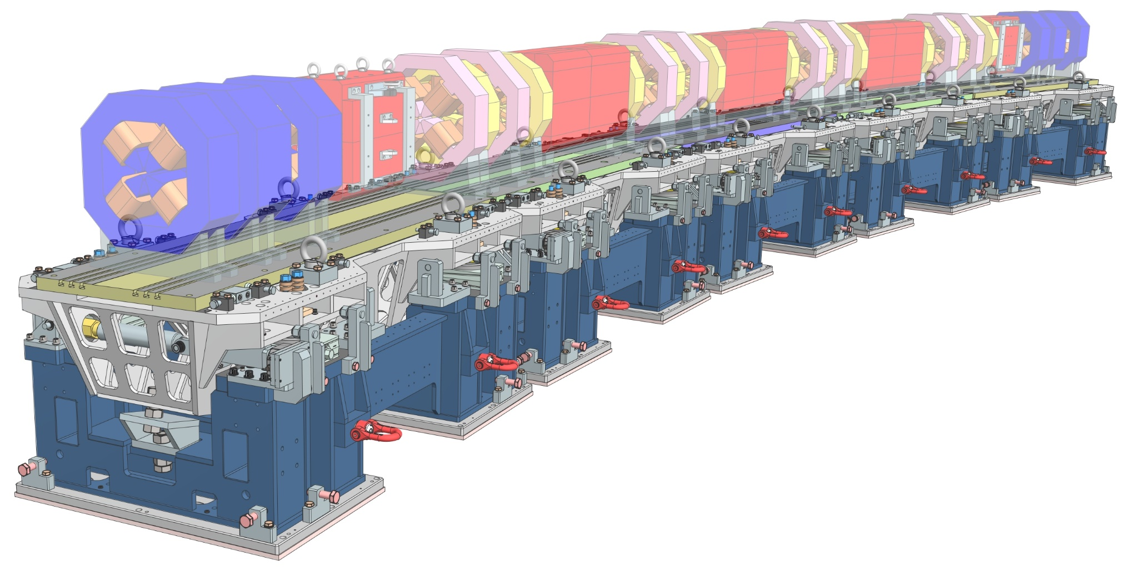
Sincrotrón ALBA: Proyecto ALBA II
AEC2 Visit – Dec 17th, 2024

Slide 2


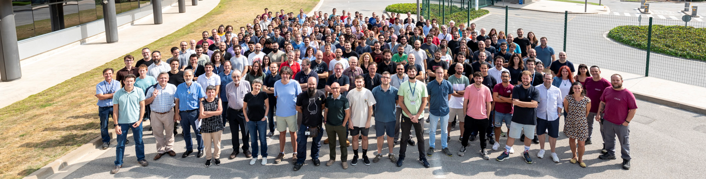
ALBA is the Spanish Synchrotron Radiation Facility
National Public institution with funding 50%/50% from the Spanish Ministerio de Ciencia e Innovacion and the Catalan Department de Recerca i Universitats
National and international (28%) staff
National and international (40%) users
National and international collaborations
The ALBA Team
We are today ≈250

Slide 3

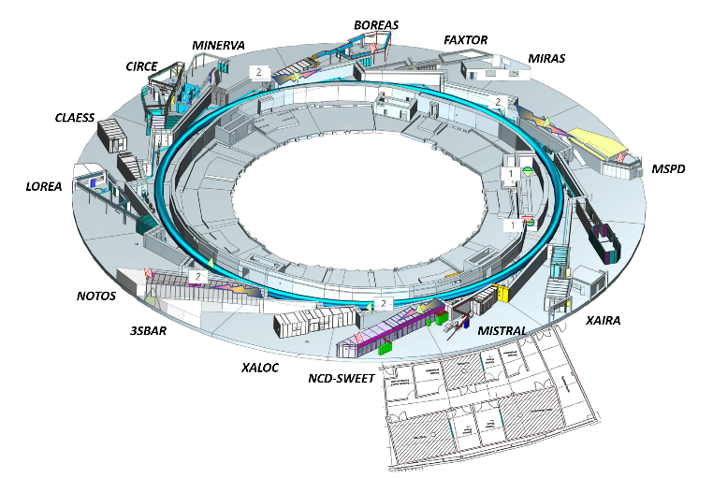
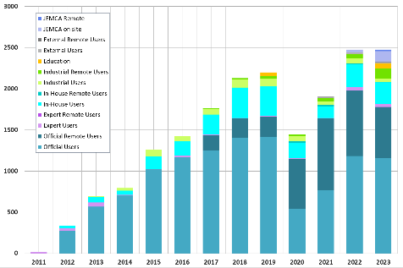
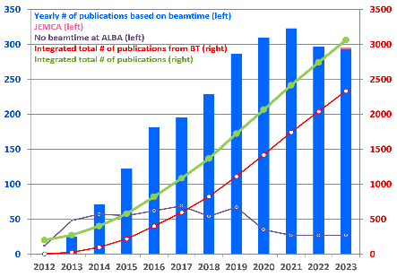
ALBA key parameters
e- Energy = 3 GeV
C = 270 m
Emittance = 4.4 nmrad
2500 User visits
11 operating BLs
2 in commissioning
1 in construction
2 for acc. diagnostics
3500 Publications
JEMCA
Joint Electron Microscope Center at ALBA
50% Funded through Catalan ERDF, and
50% co-funded by different partners

Slide 4


ALBA II upgrade Project
Evolution of ALBA to the 4th Generation ALBA II
2003 2012 2022 2031 2050
Design & construction
Exploitation
Design & construction
Exploitation
3rd Generation
4th Generation

Slide 5
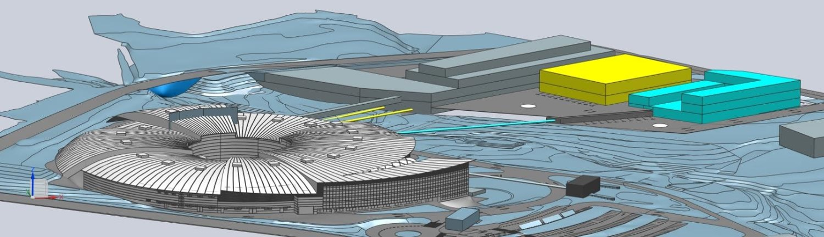
ALBA II upgrade Project
The adjacent land is already
secured for ALBA II
The upgrade ALBA II includes:
renovation of the storage ring
renovation of the existing beamlines.
expansion of the infrastructure.
construction of up to three new long beamlines.
synergy to create a scientific and technological pole in the area.

Slide 6
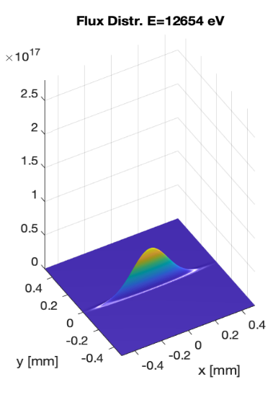
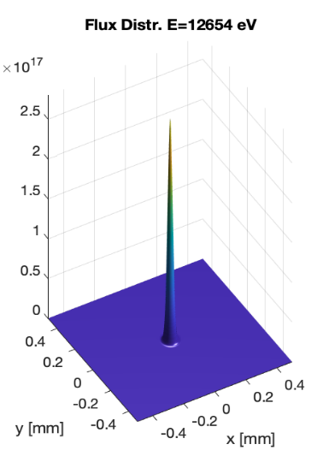
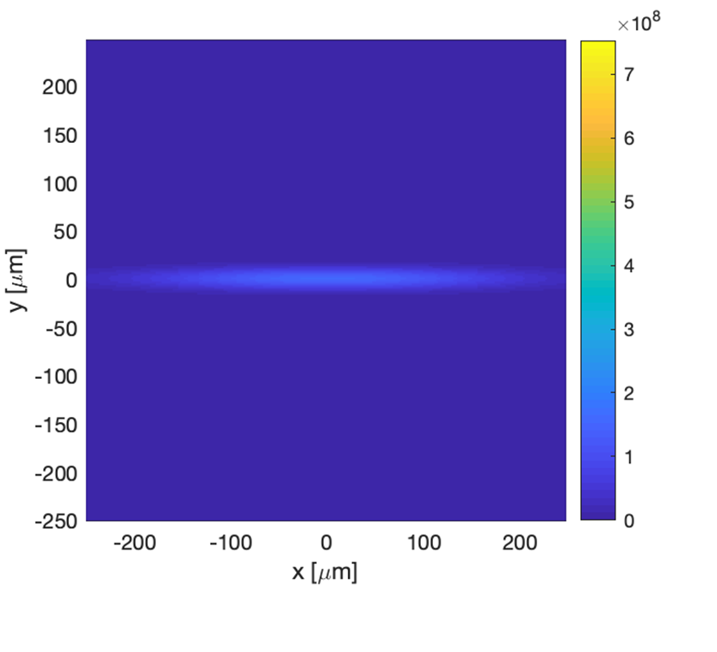
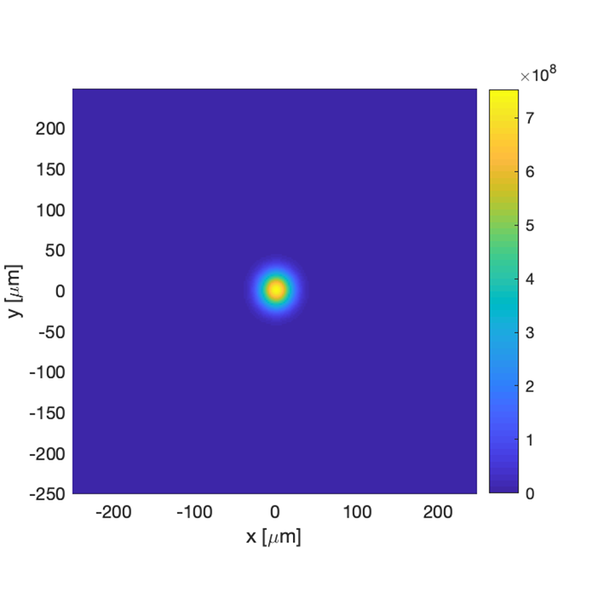
ALBA II Accelerator Upgrade
Upgrade the 3rd Generation ALBA Storage Ring
to a 4th Generation Ultra Low Emmittance Ring: ALBA II
with the aim of doing it as efficiently as posible,
in terms of cost and time.
ALBA
ALBA II
Simulation of the flux density emitted by IVU21 (XALOC)
2.5E17
ph/s/mrad²@0.1%BW
ph/s/mrad²@0.1%BW
0.5E17

Slide 7
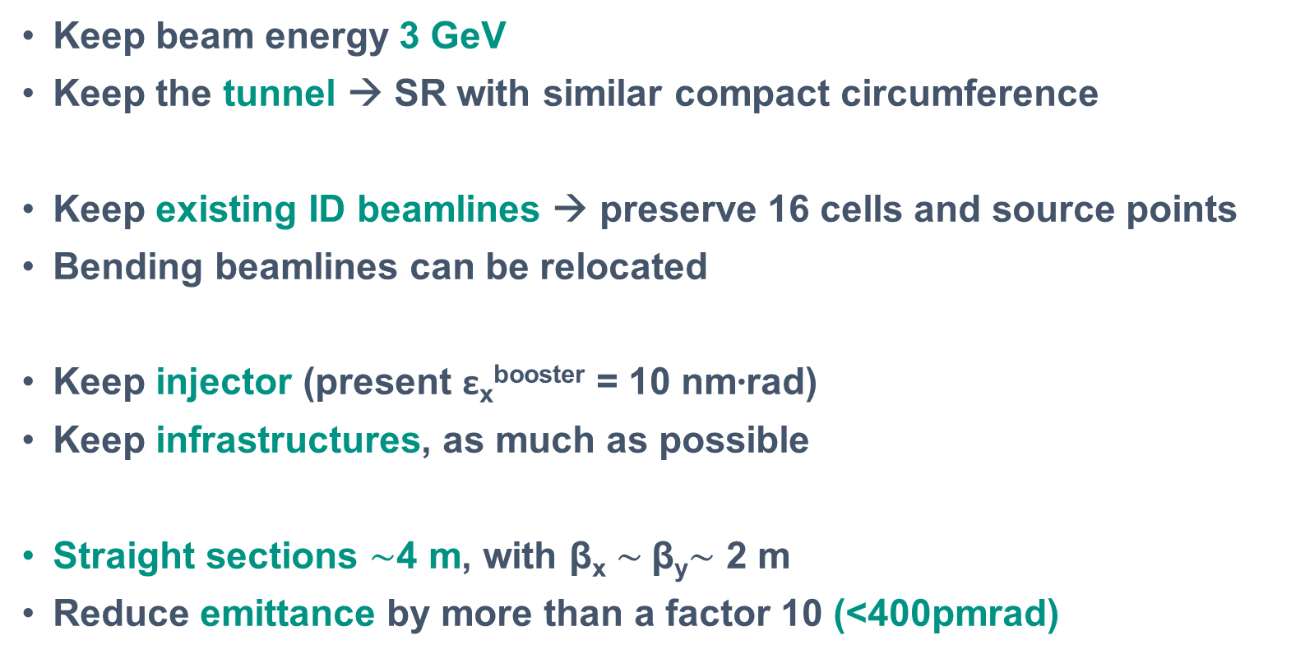
Accelerator’s design constrains
Keep beam energy 3 GeV
Keep the tunnel → SR with similar compact circumference
Keep existing ID beamlines → preserve 16 cells and source points
Bending beamlines can be relocated
Keep injector (present ε_{x}^{booster} = 10 nm∙rad)
Keep infrastructures, as much as possible
Straight sections $\sim$4 m, with β_{x} $\sim$β_{y}$\sim$ 2 m
Reduce emittance by more than a factor 10 (<400pmrad)

Slide 8




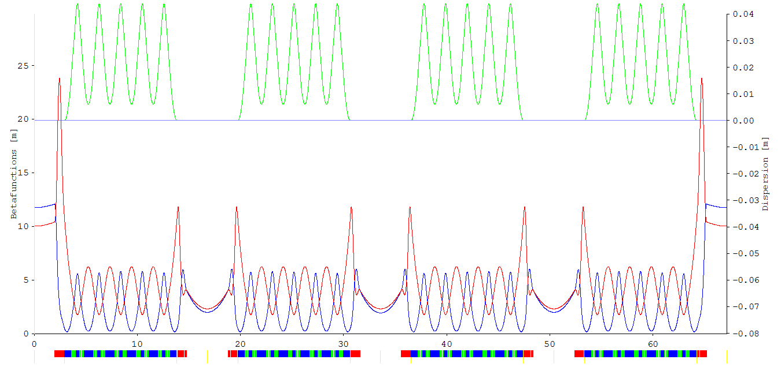
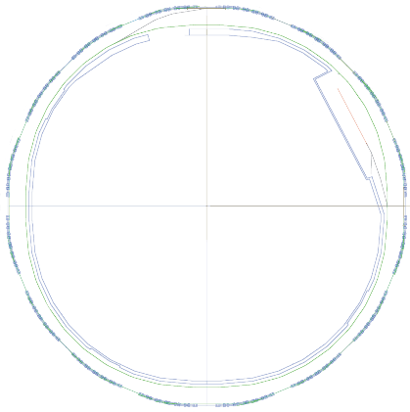
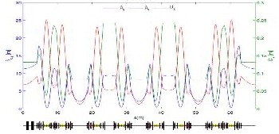
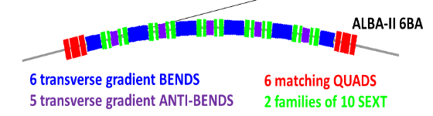
Accelerator’s upgrade
 | ALBA
Energy | 3 GeV
Circumference | 268.8 m
Symmetry | 4-fold
Lattice | 8×2 DBA cells
Emittance | 4.5 nm·rad
Nº of cells | 8+8
# of straights | 4 / 12 /8
Straight length | 7.8 / 4.0 / 2.3m
ALBA II
3 GeV
268.8 m
4-fold
16×MBA cells
~200 pm·rad
16
16
4.0 m

Slide 9

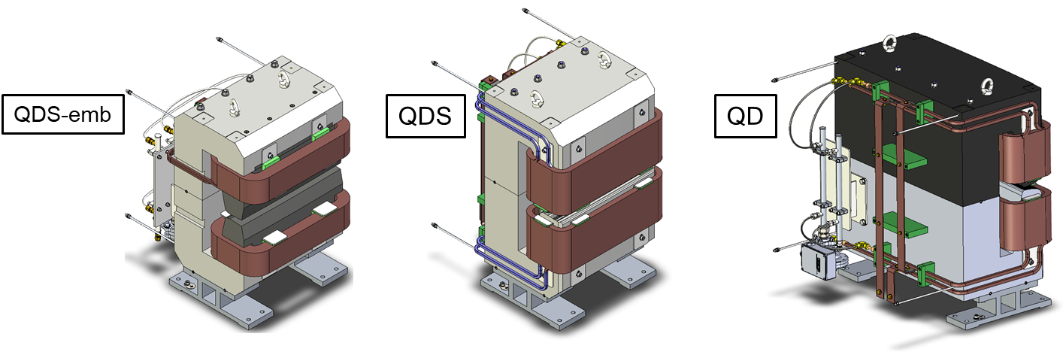
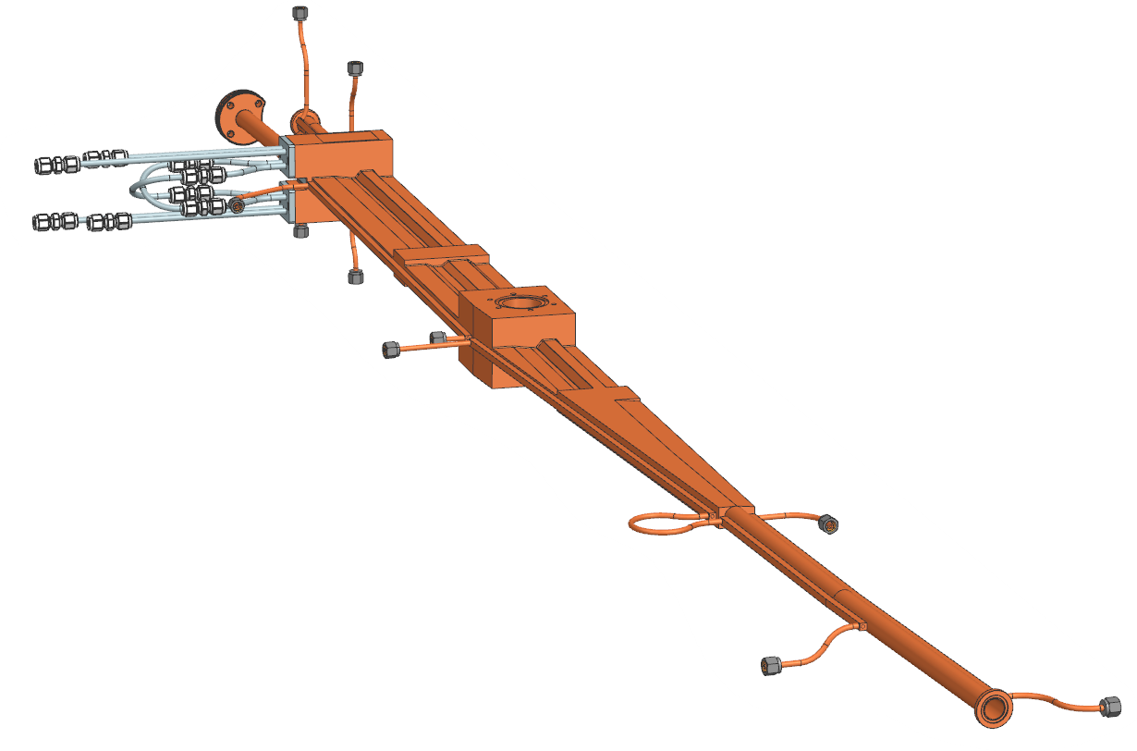
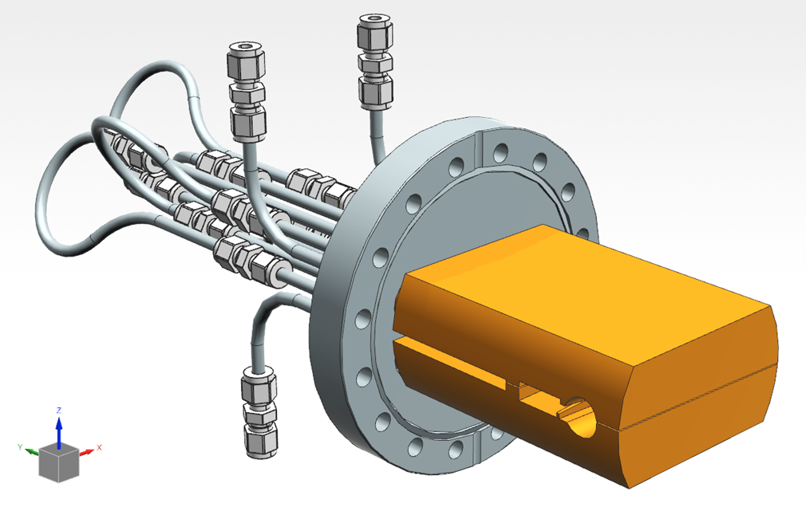
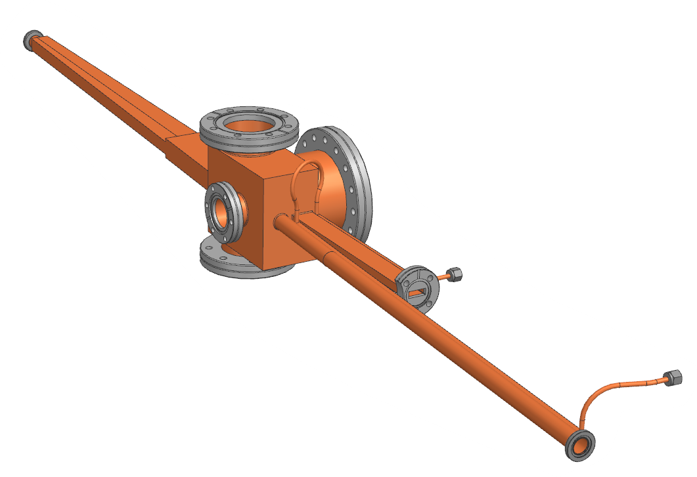
Prototypes
A series of prototypes are being produced to test the main components:
MAGNETS
VACUUM CHAMBERS
+ Permanent magnets version
Absorber
Vacuum chambers

Slide 10
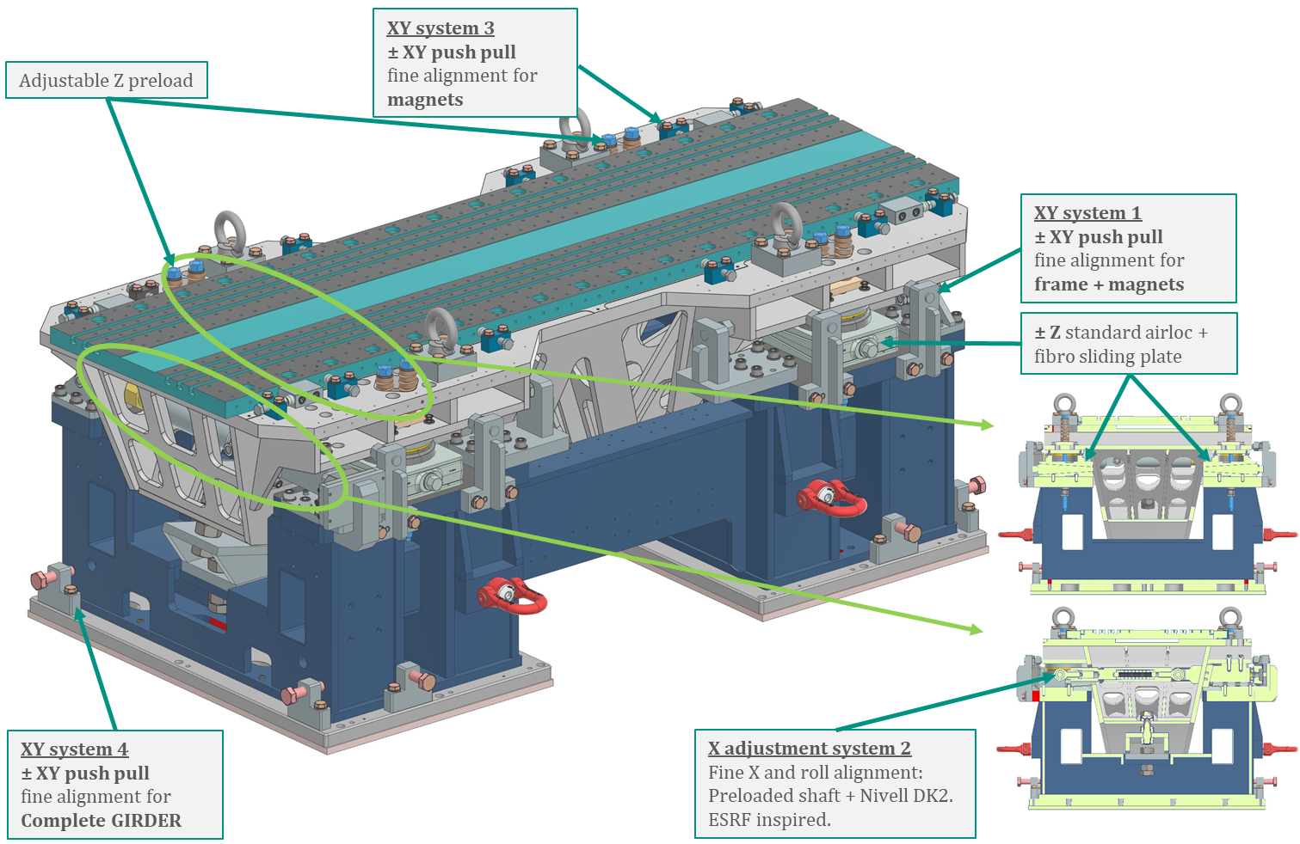
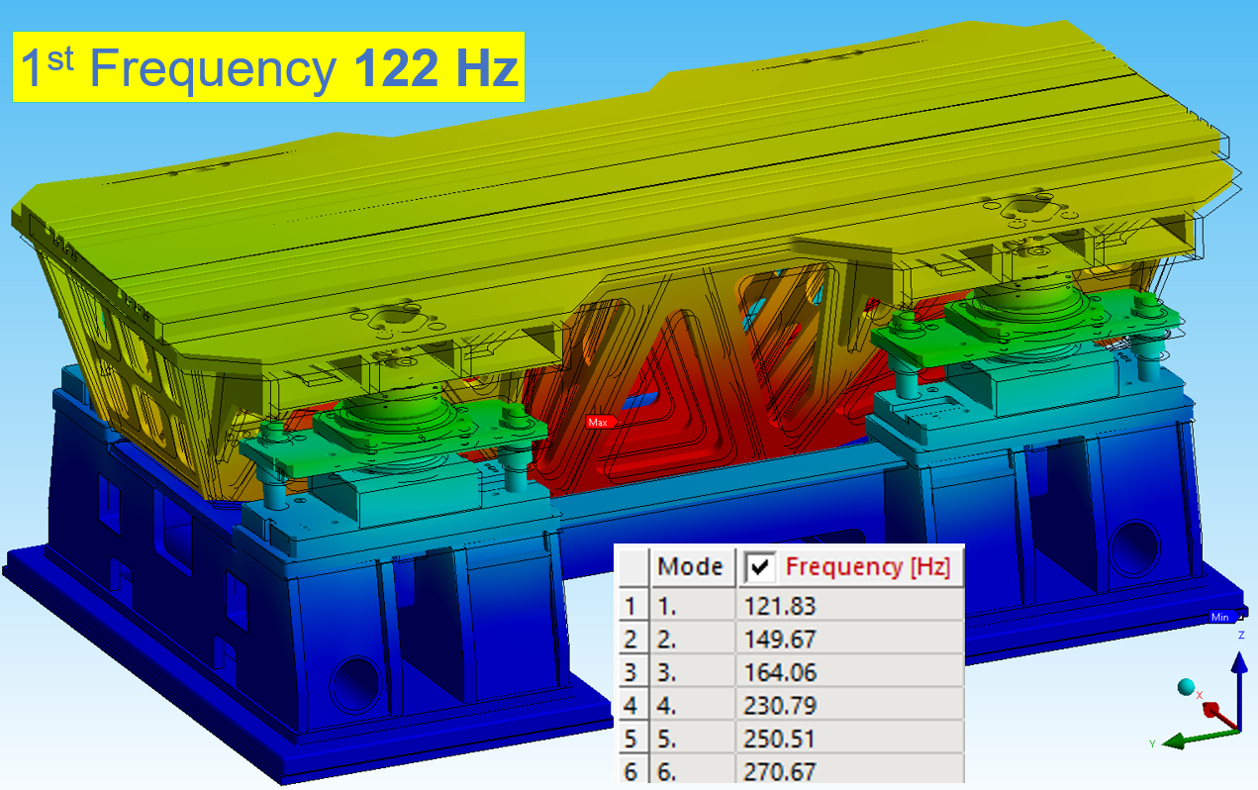
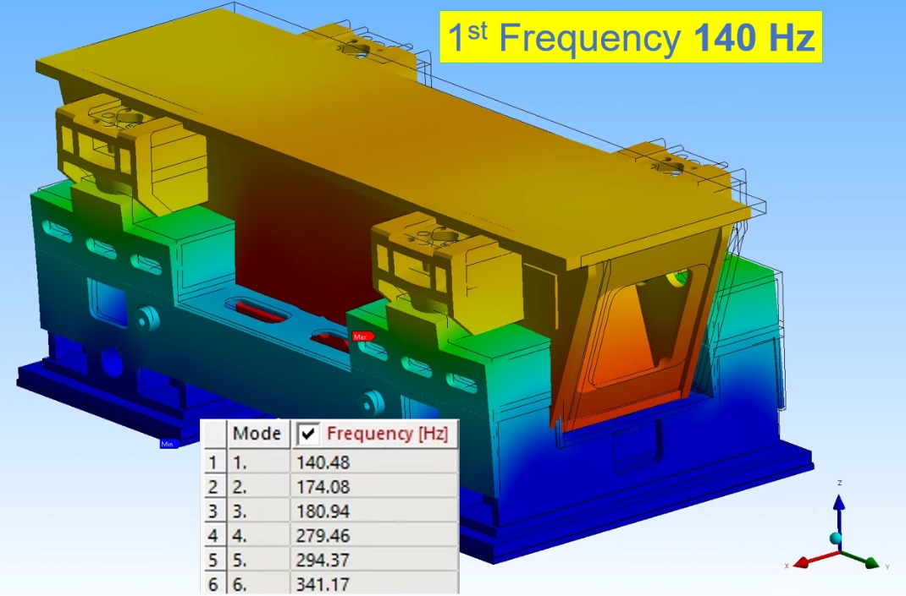
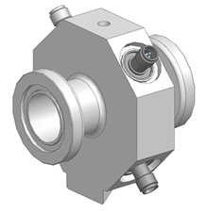
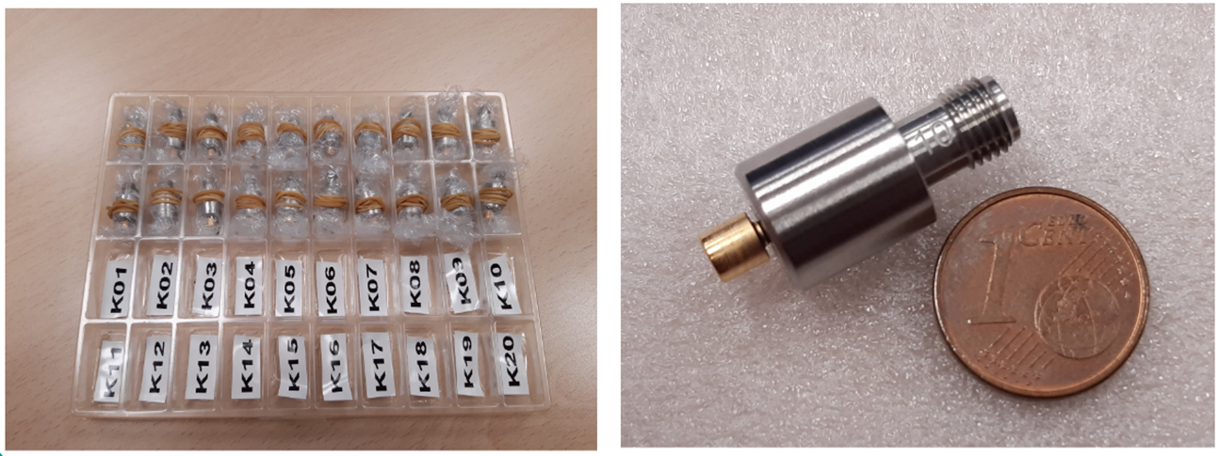
Prototypes
A serie of prototypes are being produced to test the main components:
GIRDERS
BPMs
Yaw
Y, X
Buttons BPMs

Slide 11

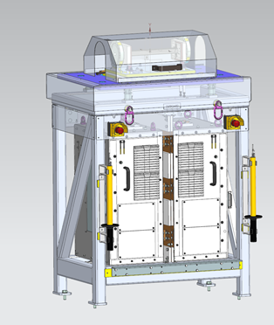
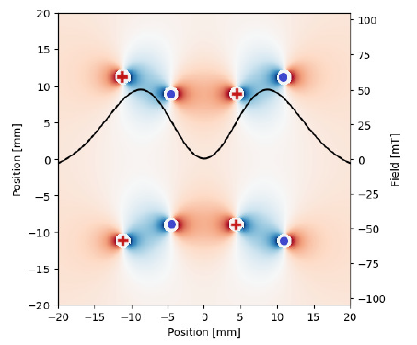
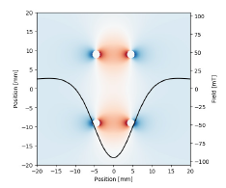
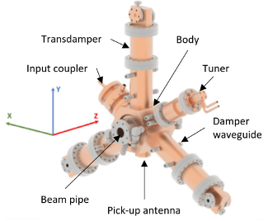
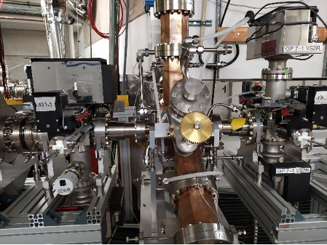
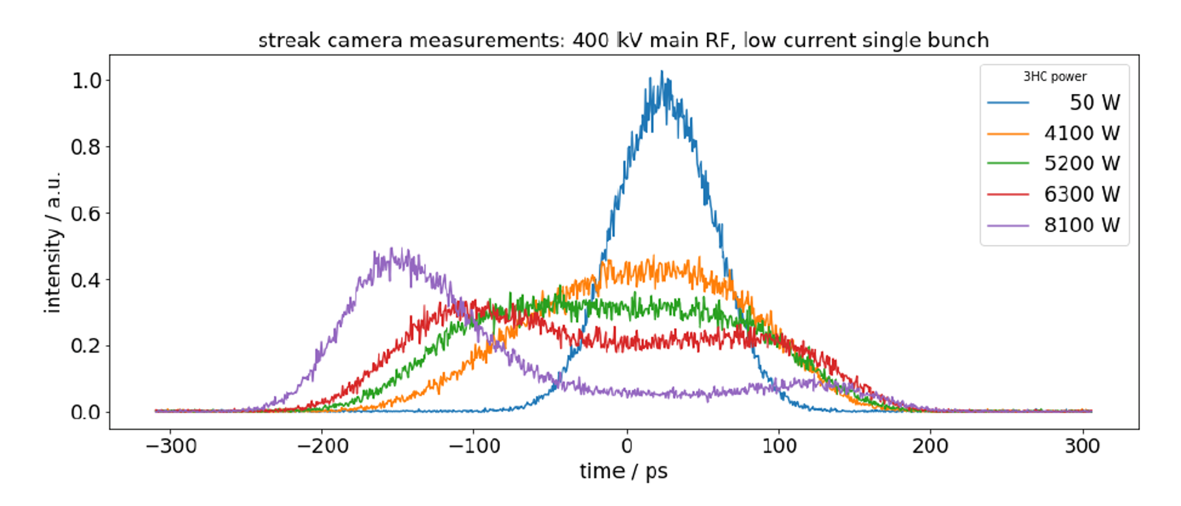
Prototypes
A serie of prototypes are being produced to test the main components:
PULSED Doble Dipole Kicker
3rd Harmonic Active RF system
Field profile for single kicker injection
Being tested at BESSY II Bunch lengthening of single bunch

Slide 12
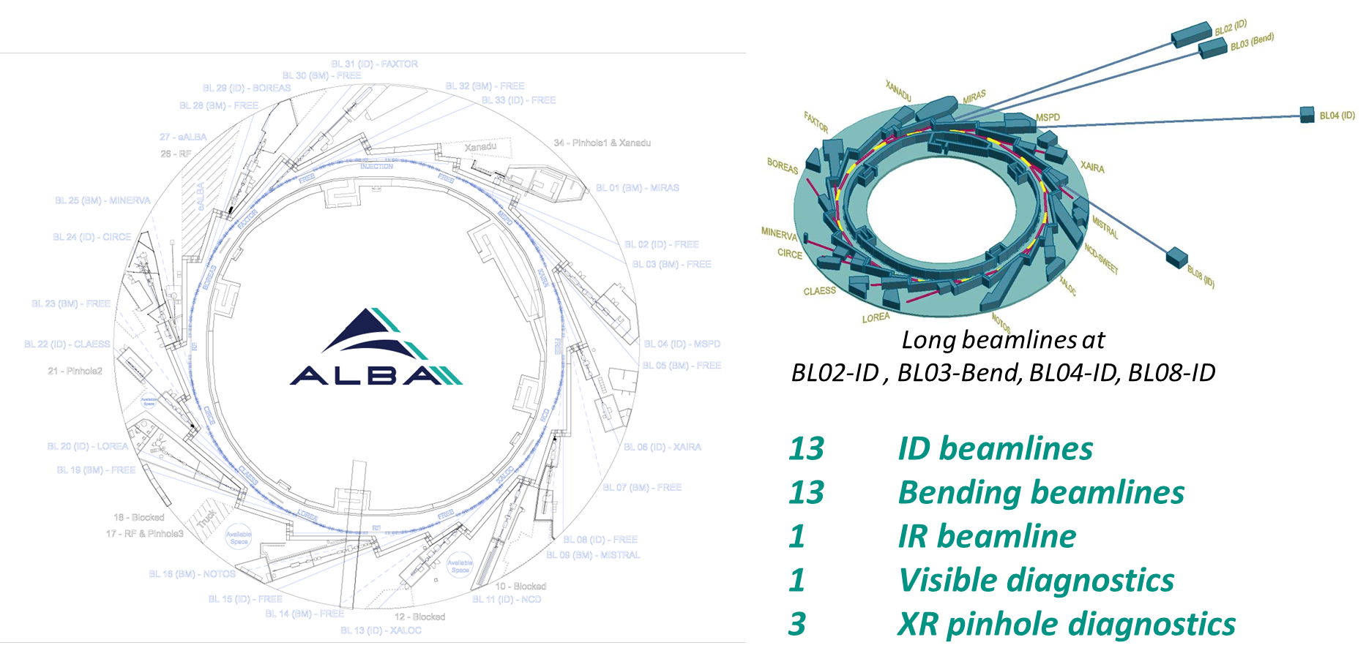
ALBA II implementation (2030-31)

Slide 13



Accelerator’s components
2026-2029
New magnets
  ∼ 600 electro-magnets
  ∼ 1000 power supplies
  ∼ 40 permanent magnets
New vacuum chambers
  ∼ 270 m vacuum chambers
  SS, Cu, NEG coated
New Girders
  High vibration modes
  High precision remote movement
Many others:
  Upgrade RF system with SSA and 3rd Harmonic Cavity
  New Diagnostics equipment
  New Insertion Devices
  Upgrade electronics
  …

