Slide 1
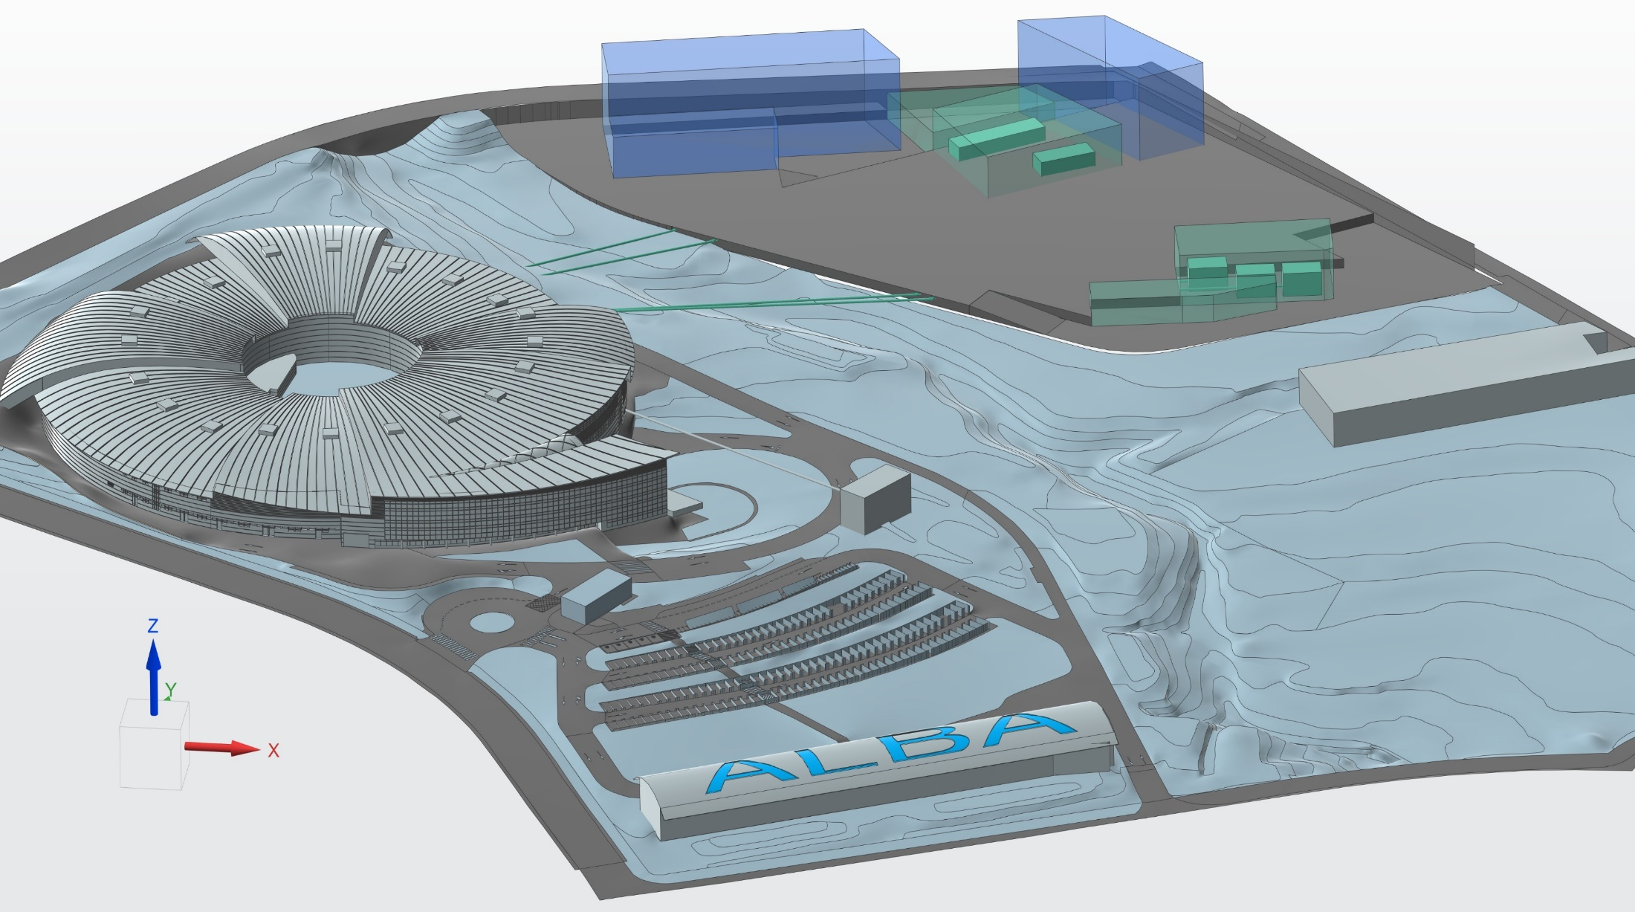


El sincrotró ALBA: una infraestructura de recerca al servei de la societat
Caterina Biscari
7 Novembre 2024
Dijous Innovadors - CSC

Slide 2

La radiación de sincrotrón emitida por las estrellas y los agujeros negros
M87 black hole
PHOTOGRAPH: EHT COLLABORATION

Slide 3
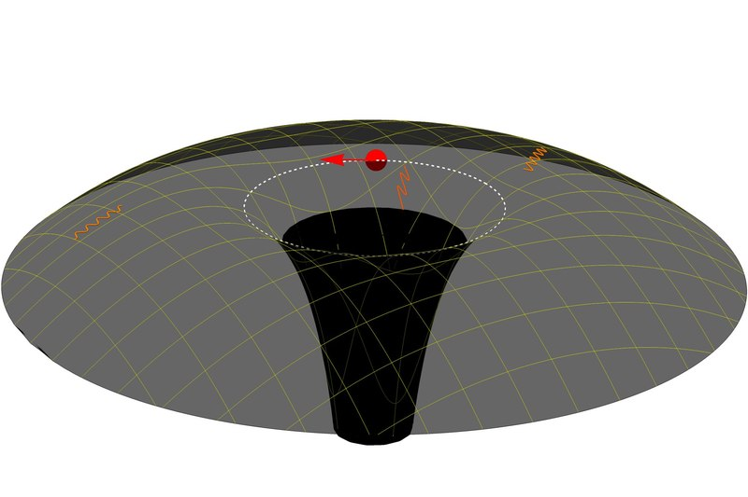
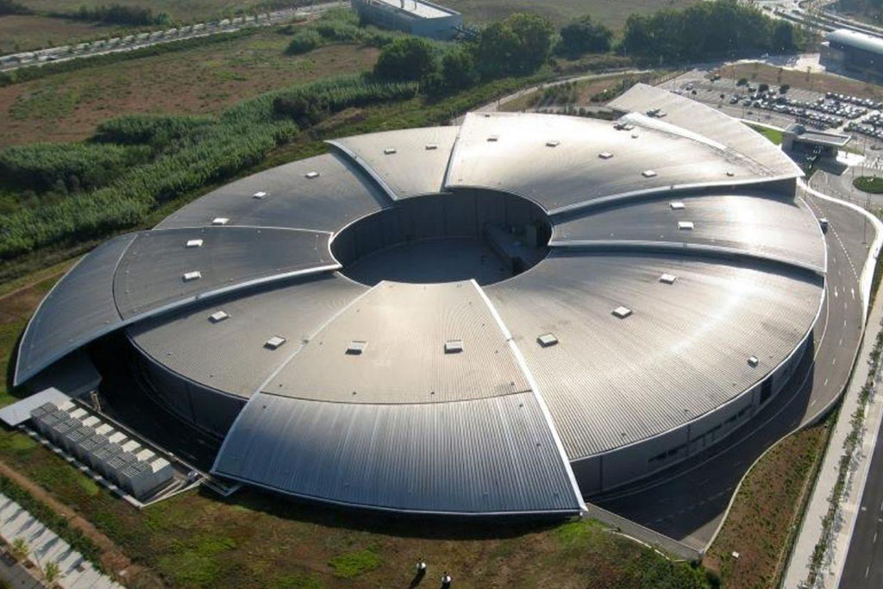
Radiación de Sincrotrón
En el universo y en nuestros aceleradores de particulas
Credit Wikipedia - Joao Paulo Bessa Brito
Representacion de agujero negro
ALBA Synchrotron

Slide 4
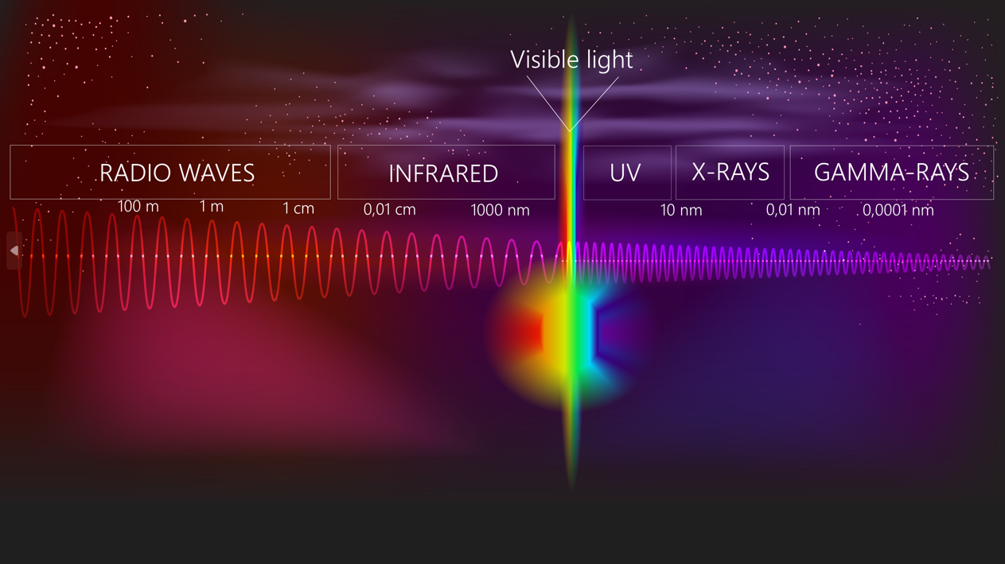
Synchrotron Light from ALBA
Used for understanding properties of matter with high resolution and chemical sensitivity under diverse conditions

Slide 5
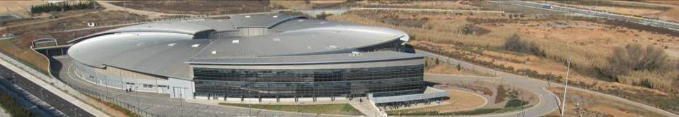
ALBA Synchrotron Radiation Facility
National public institution with 50% national + 50% regional funding (Ministerio de Ciencia e Innovación) and GenCat (Department de Recerca i Universitats)
National and international (28%) staff
National and international (40%) users
National and international collaborations

Slide 6
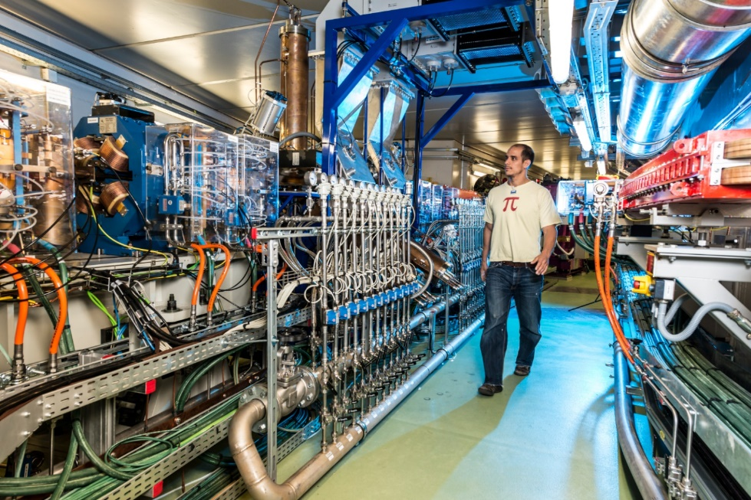
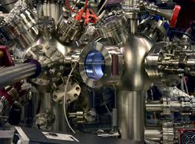
Main technological systems
Accelerator systems
Beamlines
Storage ring: 270 m circumference
3 GeV electrons producing the synchrotron light
Specialized laboratories, receiving the synchrotron light, with instrumentation to exploit its interaction with matter

Slide 7
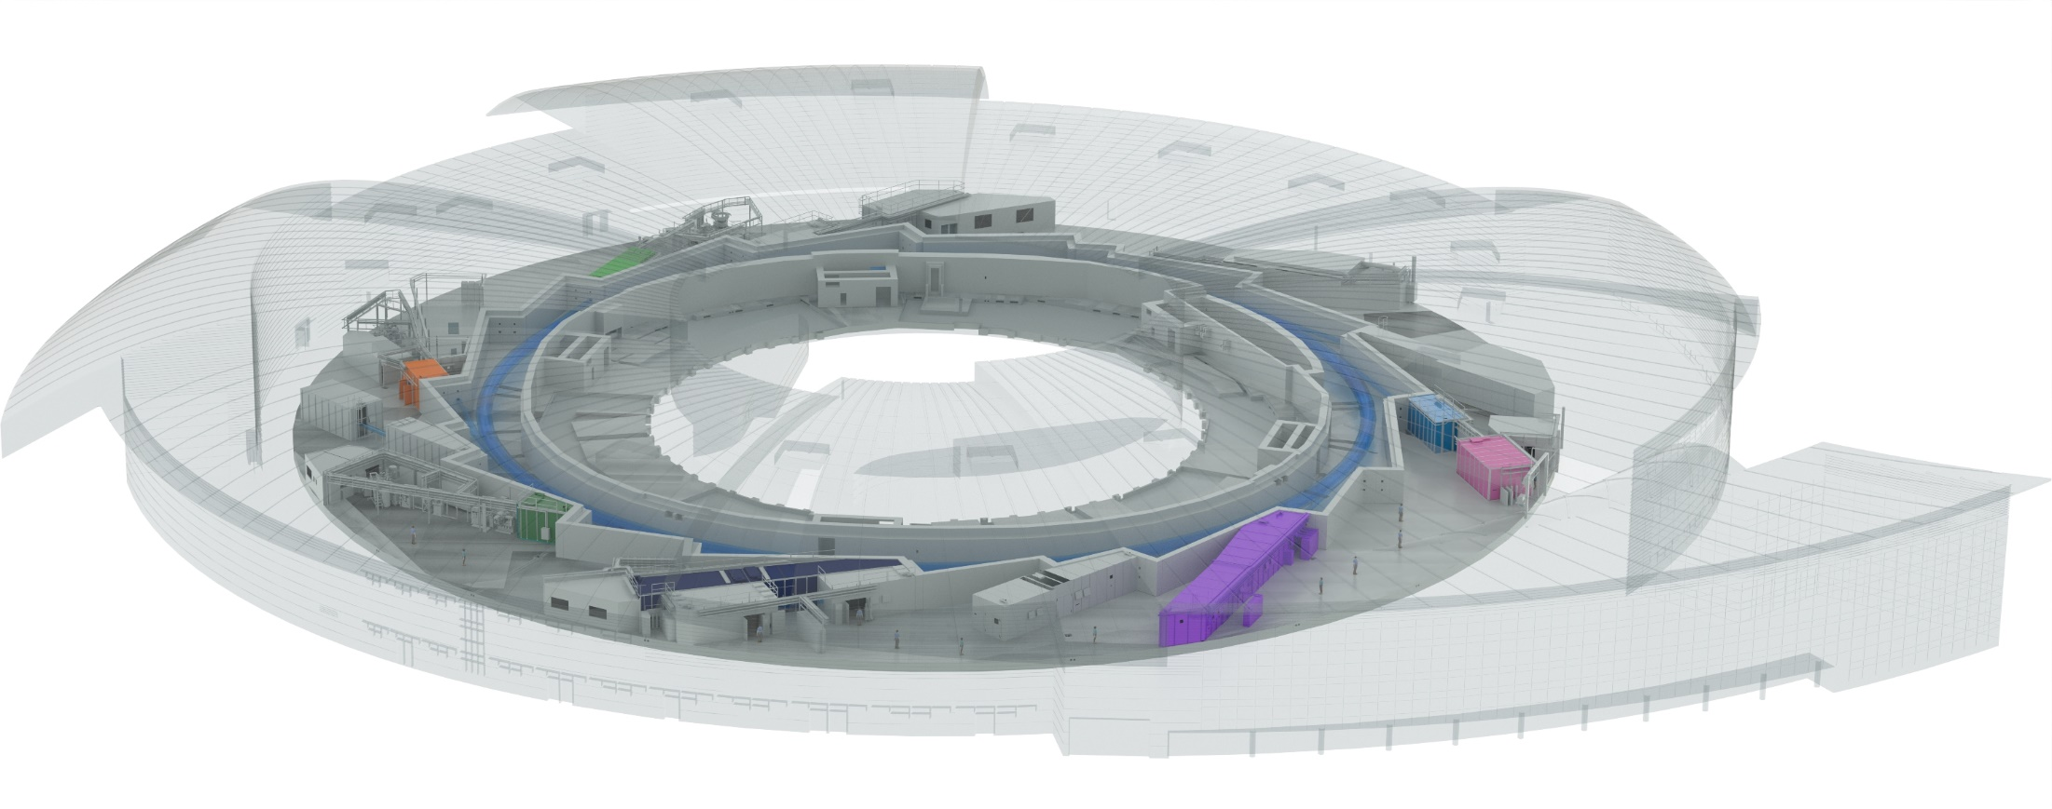



ALBA today
Instruments for life science
BOREAS
FAXTOR
(in commissioning)
Instruments for material science
MIRAS
Instruments for metrology
MINERVA
CIRCE
CLAESS
MSPD
LOREA
XAIRA
(in commissioning)
Cryo-EM
MISTRAL
TEM
InCAEM
(in constr.)
NOTOS
3SBAR
(in constr.)
XALOC
NCD-SWEET
11 BLs in operation, 2 in final commissioning stage, 1 in construction
2 cryo-EM in operation, 1 to be installed in 2025

Slide 8
In 2012 started the journey to develop ALBA as the instrument which addresses key questions for advancing in knowledge and innovation, as a service to society
Main players
With the permanent support from Spanish and Catalan governments
Integrated with some ERDF and NGEU funds
Users & partners
Staff
The journey is a balanced combination of
Scientific vision and creativity
Technical knowledge
Robustness and reliability in the RI
Spirit of service
Will and capacity of sharing
Enthusiasm for exploring new paths
Industry

Slide 9
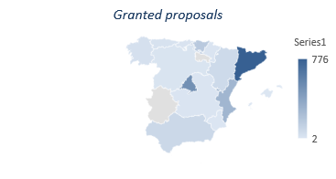
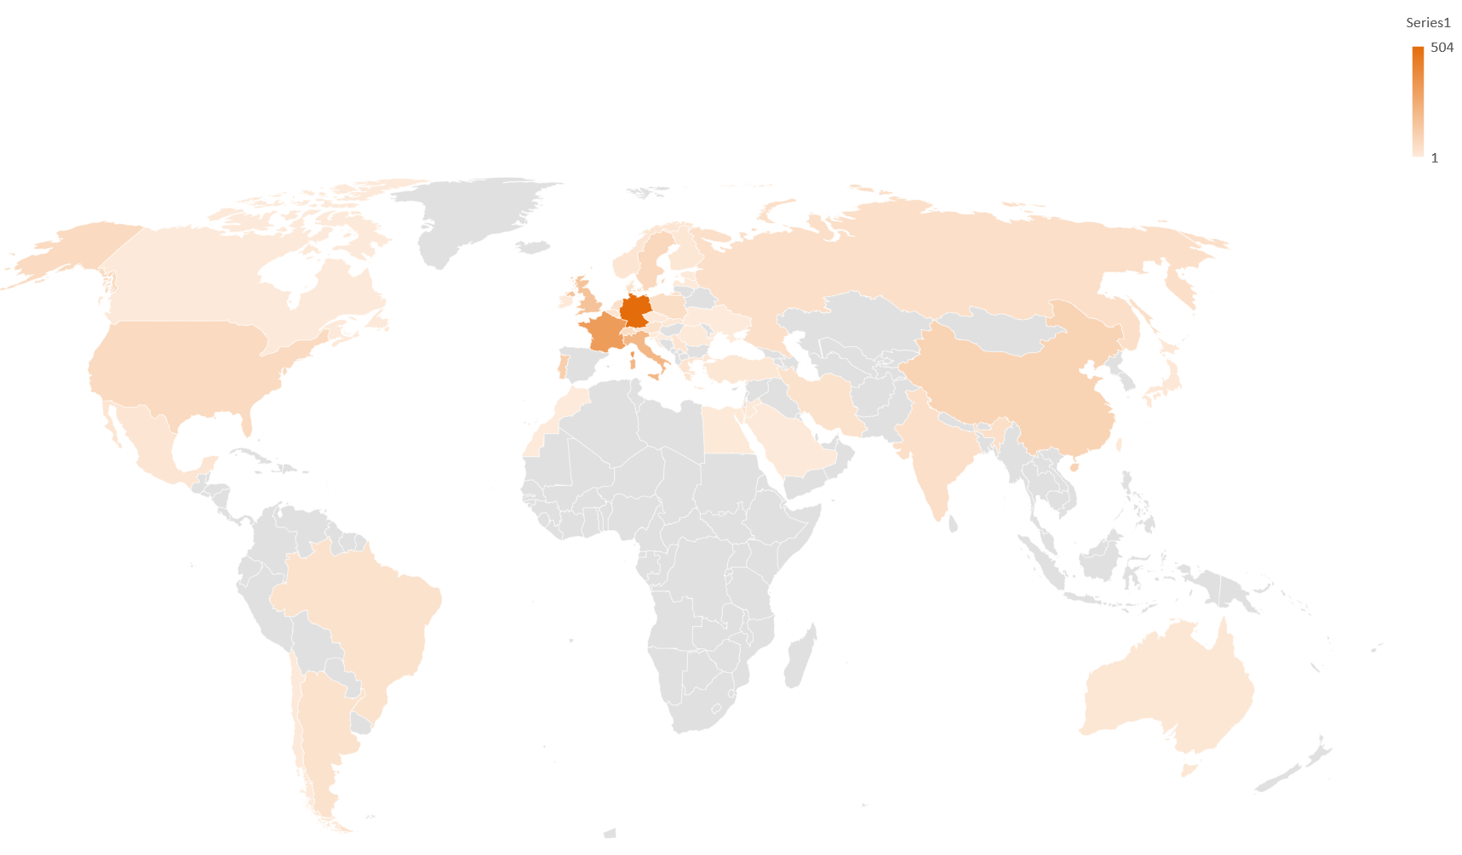

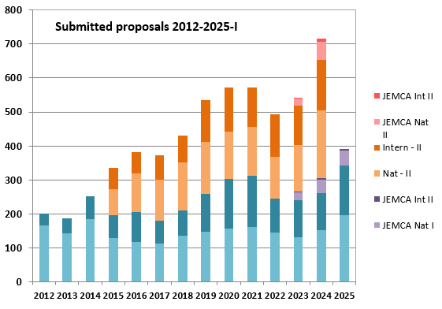
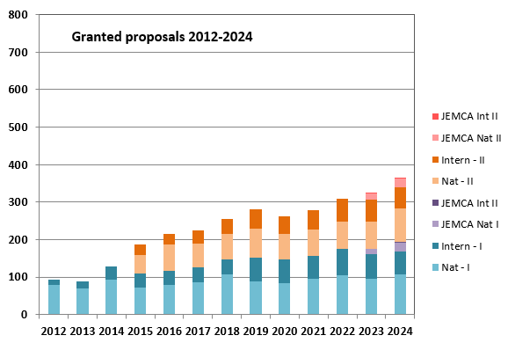
Our USERS
Academic proposals
(5777 submitted/2928 granted)
Joint academic and industrial
Private
Academic
+100 companies using our instruments
Competitive and free access
Public results
Direct access covering operational costs
Results can be confidential

Slide 10
The User Community has grown up to 8500 researchers 50% from Spain
More and more partner institutions participate to common proposals and projects

Slide 11

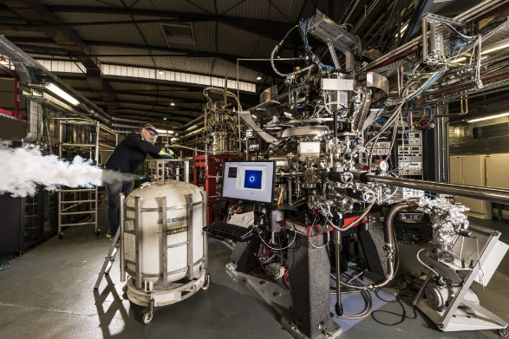
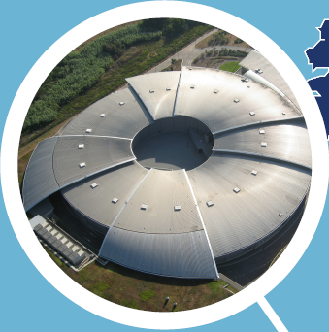
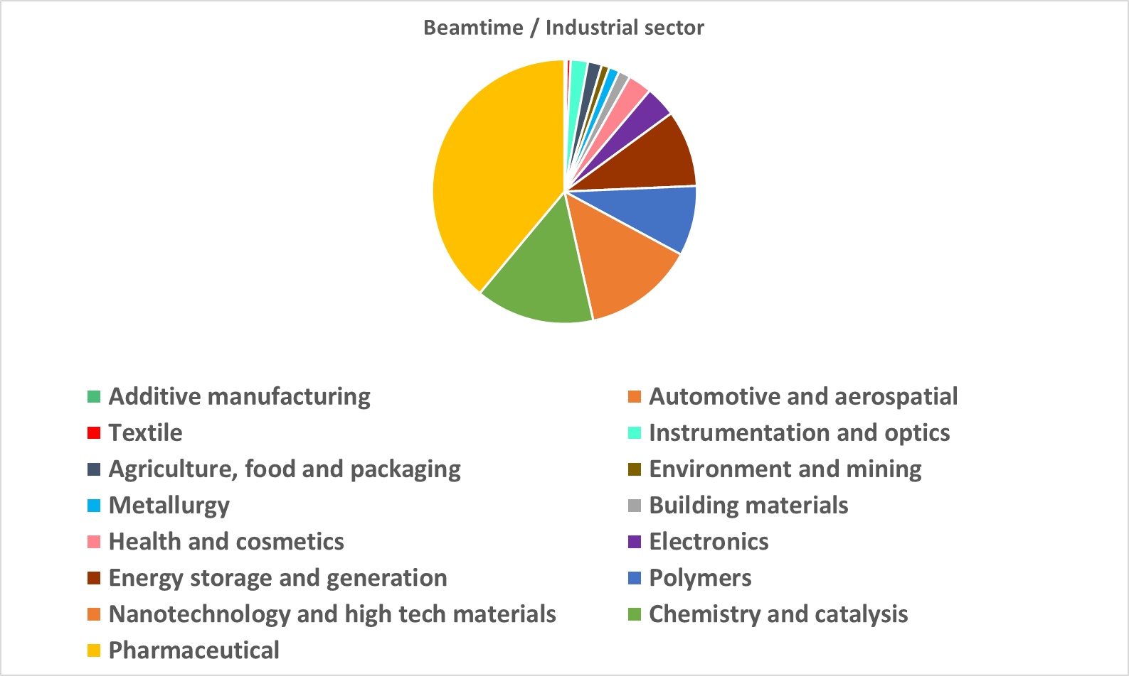
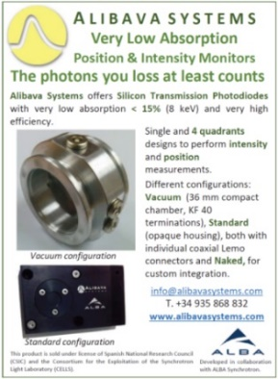
Industry: partner and user
Supplier
Industry of science
User and Innovation Partner
IP and
Technology Transfer
11

Slide 12



+ 2400 yearly user visits
+450 yearly experiments
+ 4500 national and + 4000 international users
+ 3500 publications
ALBA
key indicators
+3000 public experiments
Recent <IF> ~ 10
+700 industrial experiments
+1100
Proteins in PDB
+260 staff

Slide 13


ALBA Strategic Priorities
Being an instrument for Catalan, Spanish and European research and competitiveness
Being an instrument for Catalan, Spanish and European research and competitiveness
We follow the mainstream of national and autonomic strategies for science, technology and innovation
Catalan Research and Innovation Strategy for Smart Specialization (RIS3CAT)
Catalan Agreement on the Knowledge Society (PN@SC)
Spanish Strategy for Science, Technology and Innovation.
We map most of the Sustainable Development Goals 2030
As part of ICTS Map we update our strategy every 4 years
Now preparing the
SP 2025-2028
Health - Culture, creativity and inclusive society - Digital world, industry, space - Climate, energy and mobility - Food, bio-economy, natural resources and the environment.

Slide 14
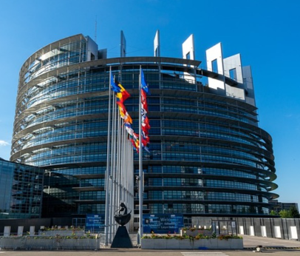
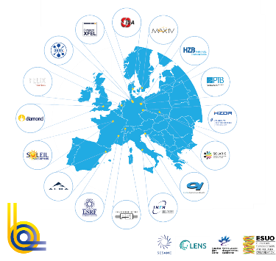

ALBA Strategic Priorities
Being an instrument for Catalan, Spanish and European research and competitiveness
c
c
Direct link with European Commission strategies and priorities through participation in LEAPS and European programs
We map Letta report
“Much more than a market”
5th Freedom for Research, Innovation and Education
Electronic Communications
Efficient Energy-Climate
Strengthening health resilience
Sustainable transportation
Letta report - April '24
We are aligned with European development plans, as shown
by Draghi report, “The future of European competitiveness”
Energy - Clean technologies - Transport – Pharma –
Digitalization and advanced technologies - Semiconductors
Draghi report – Sept 24

Slide 15


COVID research at BL09-MISTRAL
A549 cell (adenocarcinomic human alveolar basal epithelial cells) infected with SARS-CoV-2
Victoria Castro, Ana Joaquina Pérez-Berna, Gema Calvo, Eva Pereiro, and Pablo Gastaminza. Three-Dimensional Remodeling of SARS-2 CoV2-Infected Cells Revealed by Cryogenic 3 Soft X‑ray Tomography. ACS Nano. DOI: 10.1021/acsnano.3c07265

Slide 16

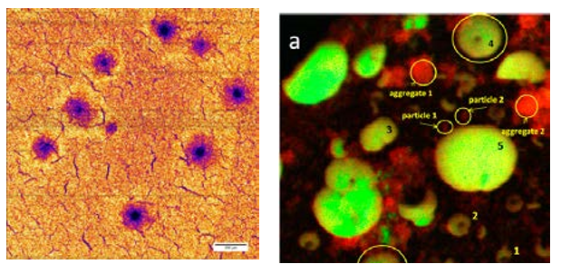
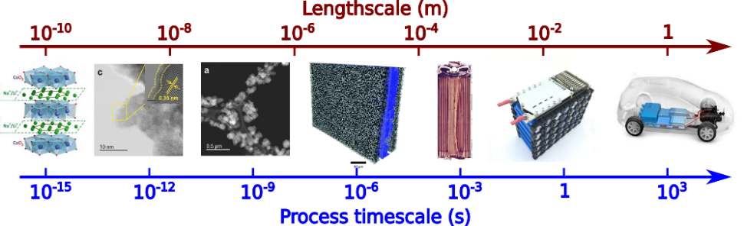
Materiales para generacion sostenible de energia, para su almacenamiento, transporte y conversion
Investigacion sobre baterias
Basadas no solo en litio sino en otros materiales, como sodio o calcio
Synchrotron X-ray studies of Li battery materials
(courtesy: ESRF)
Length scale challenge in battery research
Bridging spatial, temporal and chemical information

Slide 17
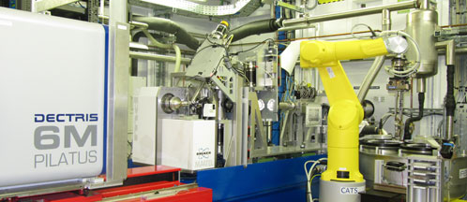
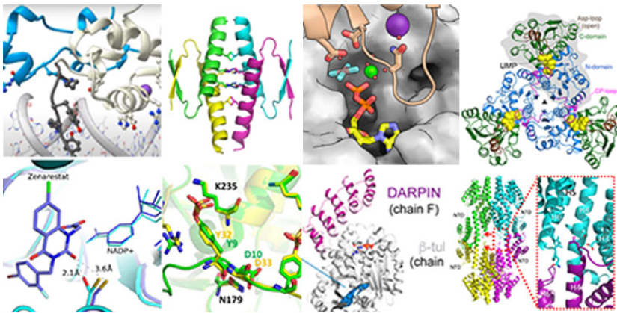




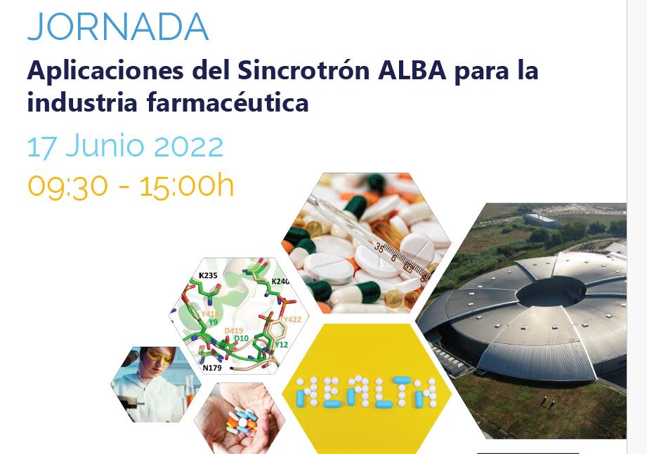


ALBA Industrial strategy (Pharmaceutics)
Drug development and discovery services, cryo-TEM and crystallization platform for Pharmaceutical applications
EXPLOITING CAPABILITIES
Industry Scientist focussed on pharmaceutic industry needs
ALBA in close contact with Biocat and Cataloniabio (i.e. Cataloniabio on 28 April 2023, Biocat Tech Transfer, 25 April 2024)
ALBA in contact with the Spanish Drug Discovery Network (i.e. 20 Nov 2023, 13-15 Nov 2024 at Valencia)
ALBA is contact with the Sociedad Española de Biotecnologia (i.e. 29 September 2023)
NETWORKING
PHARMA INDUSTRY INNOVATION
Pharma industry workshop, 17 June 2022, organised by ALBA
IDDST congress, 12-14 July 2023, Amsterdam
Cosmetorium, 23-24 October 2024 ALBA will participate with a talk
OUTREACH

Slide 18
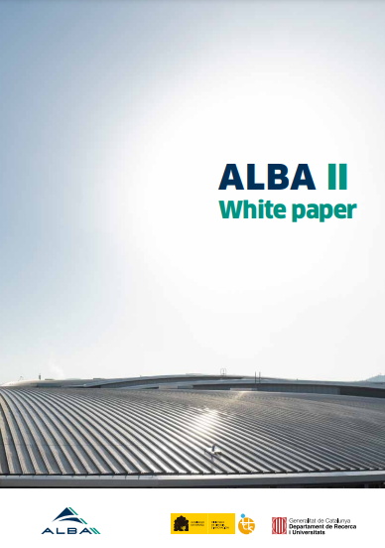
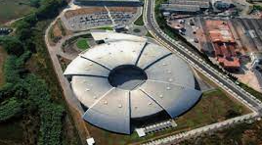
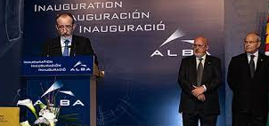
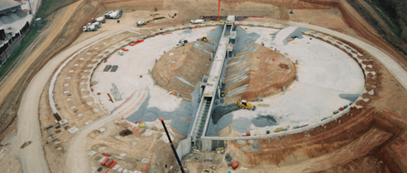

ALBA: past, present and future
2003 – Creation of CELLS Consortium (Spanish Government and regional Catalan Government), and agreement on facility funding for the period 2003 to 2022
2023 – Addendum for 2023 funding
Now: waiting for government approval of facility funding up to 2038
2003 ALBA Approval
2012
Starting ALBA Operation
2020
Starting ALBA II design
2024
ALBA II Approval CR38
2032
ALBA II Operation
2006
Starting ALBA construction

Slide 19

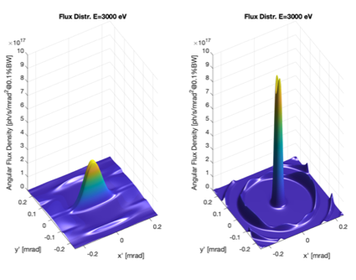
ALBA II: 4th generation light source
Full infrastructure to tackle the grand challenges of our time for the Spanish, European and international users
ALBA II combines the excellence and availability of the user program of ALBA with the development of full characterization suites for characterizing multi-lengthscale problems
ALBA II White Paper
Enhanced microscopy capabilities
Multimodal methodologies to address complex development tasks
High throughput capabilities and big-data connectivity for fast innovation
And optimized operando environments to optimize functional materials and devices

Slide 20

ALBA II - Day One
Instruments for life science
Instruments for material science
BOREAS
MSPD
FAXTOR
Instruments for metrology
MIRAS
MINERVA
CIRCE
CODI
CLAESS
New Storage Ring
CORUS
LOREA
XAIRA
CALIMA
Cryo-EM
MISTRAL
TEM
InCAEM
NOTOS
3SBAR
XALOC
NCD-SWEET
Upgraded Beamlines
17 BLs
3 cryo-EM

Slide 21
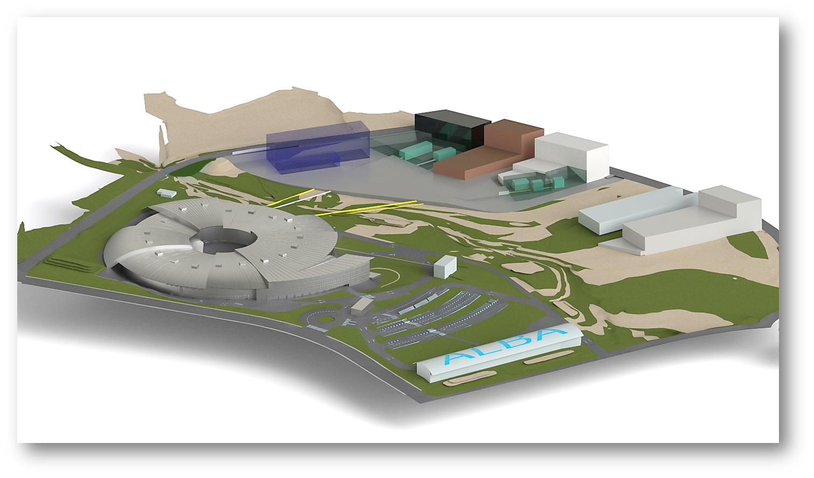







Advancing in the cooperation with partners for definition of new institutes
The potential of ALBA II is boosted by the availability of nearby green field
Resilience to Global Health challenges through the One Health approach – BSL3 connected to CORUS BL
Reach One Health
CODI
BL03
CORUS
CORUS
INNOFAB
Lab to Fab clean room for microelectronics
for development of semiconductors technologies,

Slide 22

ALBA II Roadmap
ALBA Operation
ALBA II Operation
Beamlines
Design Construction and installation commisss Operation
Accelerator
Design Construction and preinstallation Installation/comm Operation
Design Construction and preinstallation Installation/commiss
Buildings and infrastructures
Design Construction
20
21
22
23
24
25
26
27
28
29
30
31
32
33
34
35
2020
2024
2030 2032

Slide 23
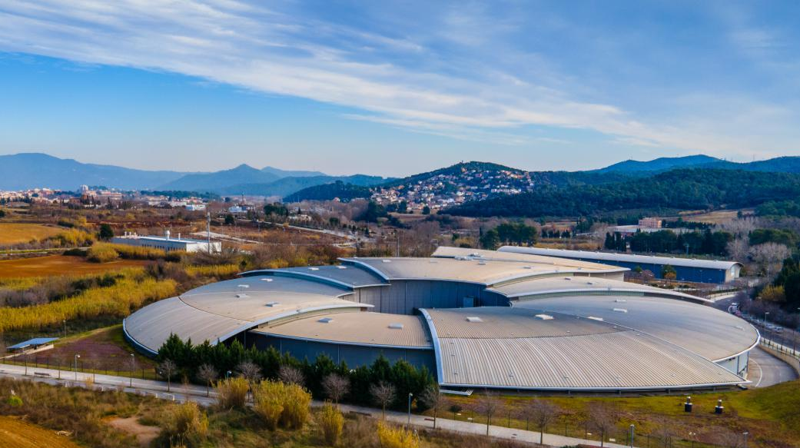
Enjoy the visit
Photo Credit Via Empresa

