Slide 1
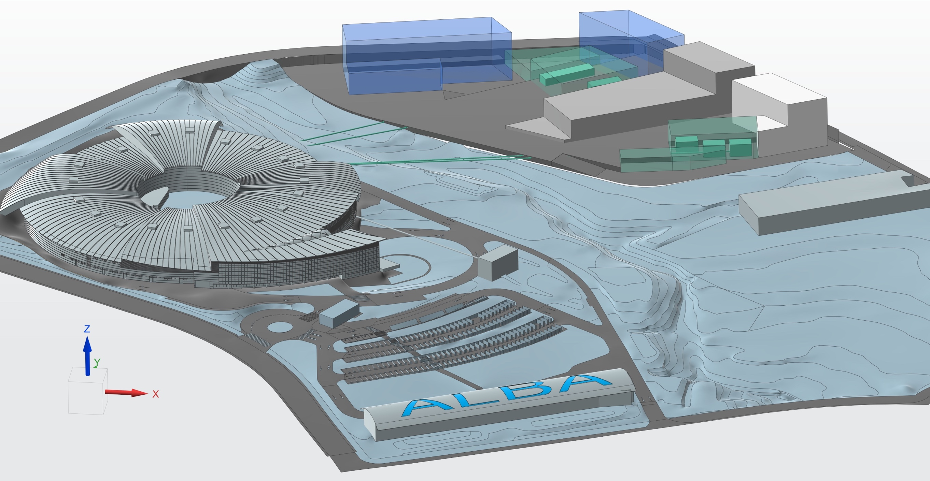
ALBA of the future:
My XAS story: CLAESS beamline
Oleg Usoltsev
06 November 2024 – Postdoc Day

Slide 2

The Scientific Background:
Educational Background:
  Thesis title and advisor: “Determination of the atomic structure of palladium nanoparticle by X-ray absorption spectroscopy” – Prof. A.V. Soldatov (Southern Federal University, Russia, 2021)
  Postdoc stay(s): PostDoc in Methodology group (2023)
          PostDoc at CLAESS beamline (from April 2024)
Scientific Interest:
  Fields: Big data analysis, Spectroscopy and Material science
  Previous key achievements: project management (software for big data correlation, theoretical and empirical databases); 3 students supervision; >20 conferences; >30 publications; 2 grants;
  ALBA key achievements: Users support (data treatment and experiment performance), collaborating to the pipeline of data analysis (InCAEM project, COOPHS project)
  Key publications:
Usoltsev O.A., Tereshchenko A. et al. Machine Learning for Quantitative Structural Information from Infrared Spectra: The Case of Palladium Hydride
Small Methods, 8 (7), pp. 2301397 (2024)
Usoltsev O.A., Bugaev A.L. et al. How Much Structural Information Could Be Extracted from XANES Spectra for Palladium Hydride and Carbide Nanoparticles
Journal of Physical Chemistry C, 126 (10), pp. 4921 (2022)
Usoltsev O.A., D. Stoian et al.
Restructuring of Palladium Nanoparticles during Oxidation by Molecular Oxygen
Small, 20 (42), pp. 2401184 (2024)
06. November 2024
Postdoc Day
Notes:
Select one work which you would to feature for your next job-application; It can be a project what you just started or some finished work from the past around which you want to build your next career steps.
Describe also in one slide how this work relates to your key achievement in case that it is another project.
This should take about 40% of the talk
Describe the scientific work you had done with
motivation why it is important
What exactly you have done and with whom
Are there any consequences from this work: you may have opened up a field, of there was a patent, any kind of IP……

Slide 3
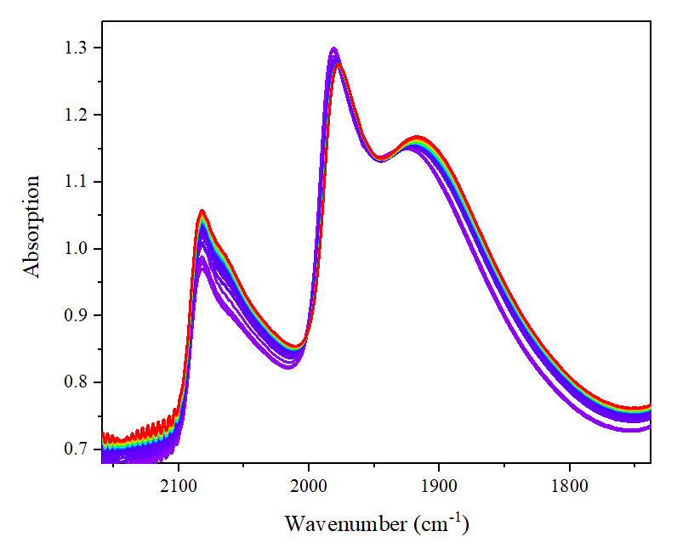
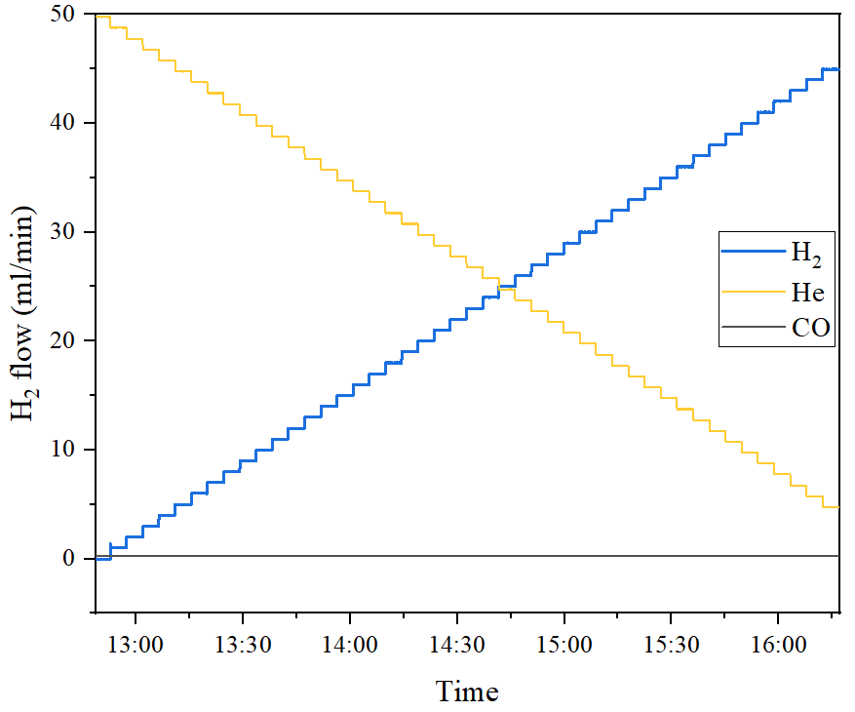
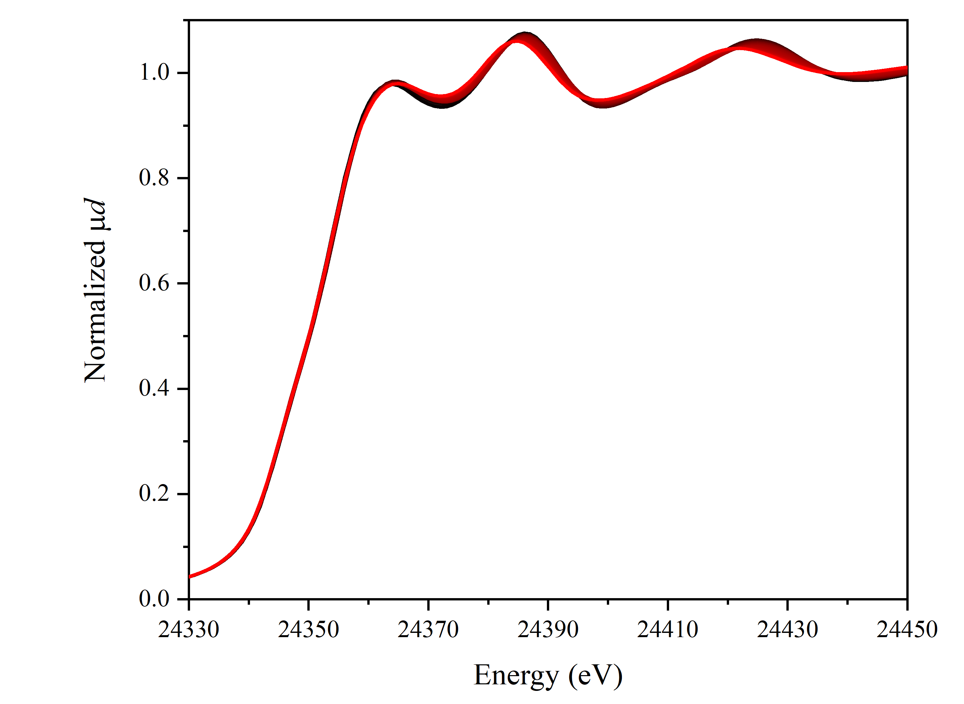
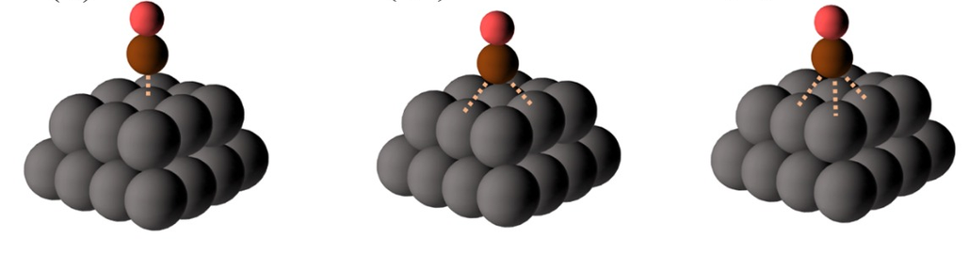
Key Work from the Past:
FTIR
XAS
H₂
He
CO
R_{Pd-Pd}
06. November 2024
Postdoc Day
Usoltsev O.A. et al. Small Methods, 8 (7), pp. 2301397 (2024)
Notes:
Select one work which you would to feature for your next job-application; It can be a project what you just started or some finished work from the past around which you want to build your next career steps.
Describe also in one slide how this work relates to your key achievement in case that it is another project.
This should take about 40% of the talk
Describe the scientific work you had done with
motivation why it is important
What exactly you have done and with whom
Are there any consequences from this work: you may have opened up a field, of there was a patent, any kind of IP……

Slide 4
Key Work from the Past:
06. November 2024
Postdoc Day
Usoltsev O.A. et al. Small Methods, 8 (7), pp. 2301397 (2024)
Notes:
Select one work which you would to feature for your next job-application; It can be a project what you just started or some finished work from the past around which you want to build your next career steps.
Describe also in one slide how this work relates to your key achievement in case that it is another project.
This should take about 40% of the talk
Describe the scientific work you had done with
motivation why it is important
What exactly you have done and with whom
Are there any consequences from this work: you may have opened up a field, of there was a patent, any kind of IP……

Slide 5
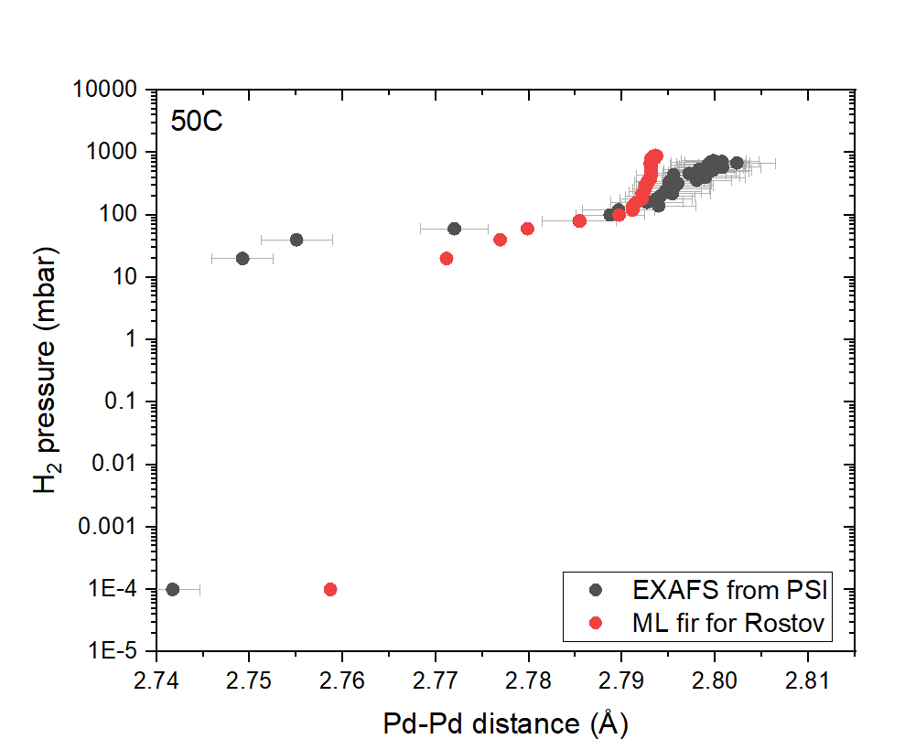

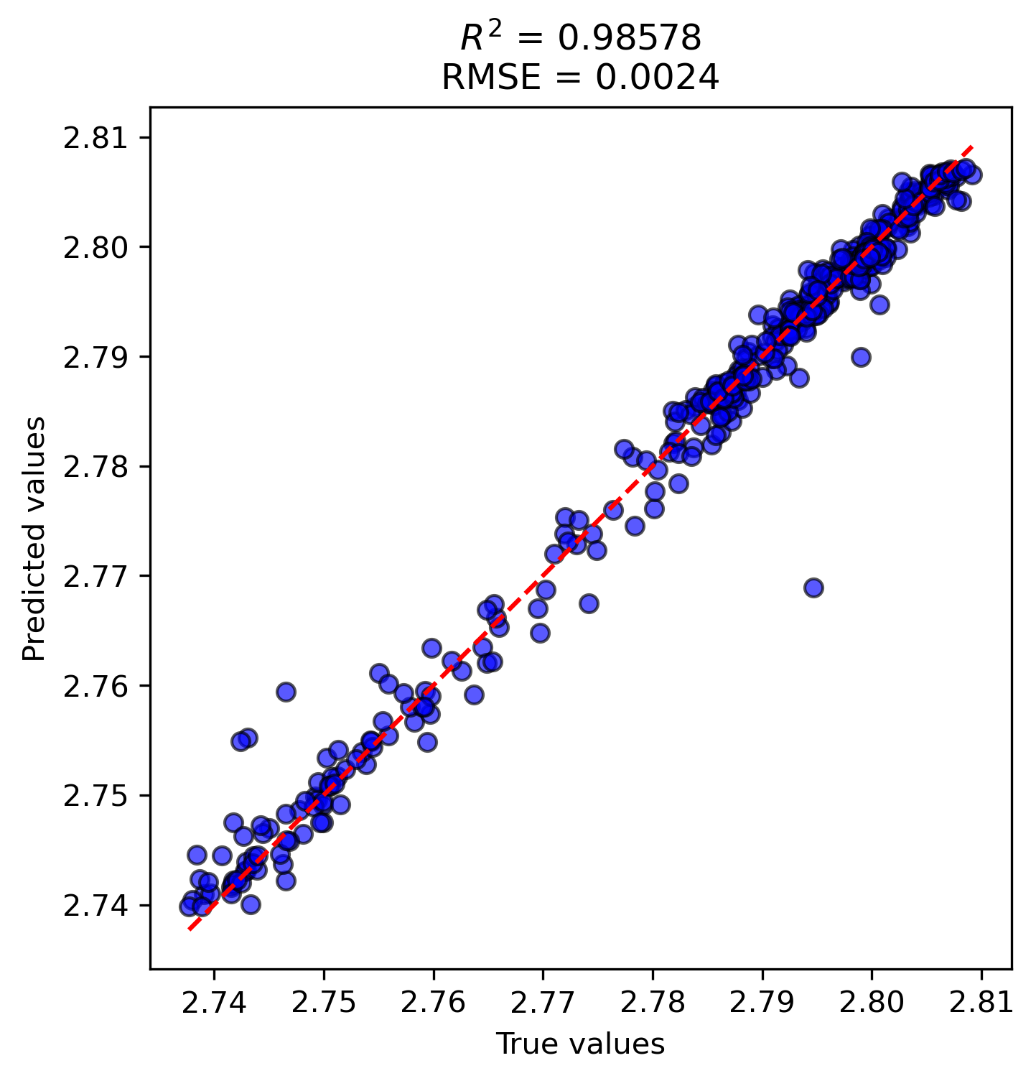
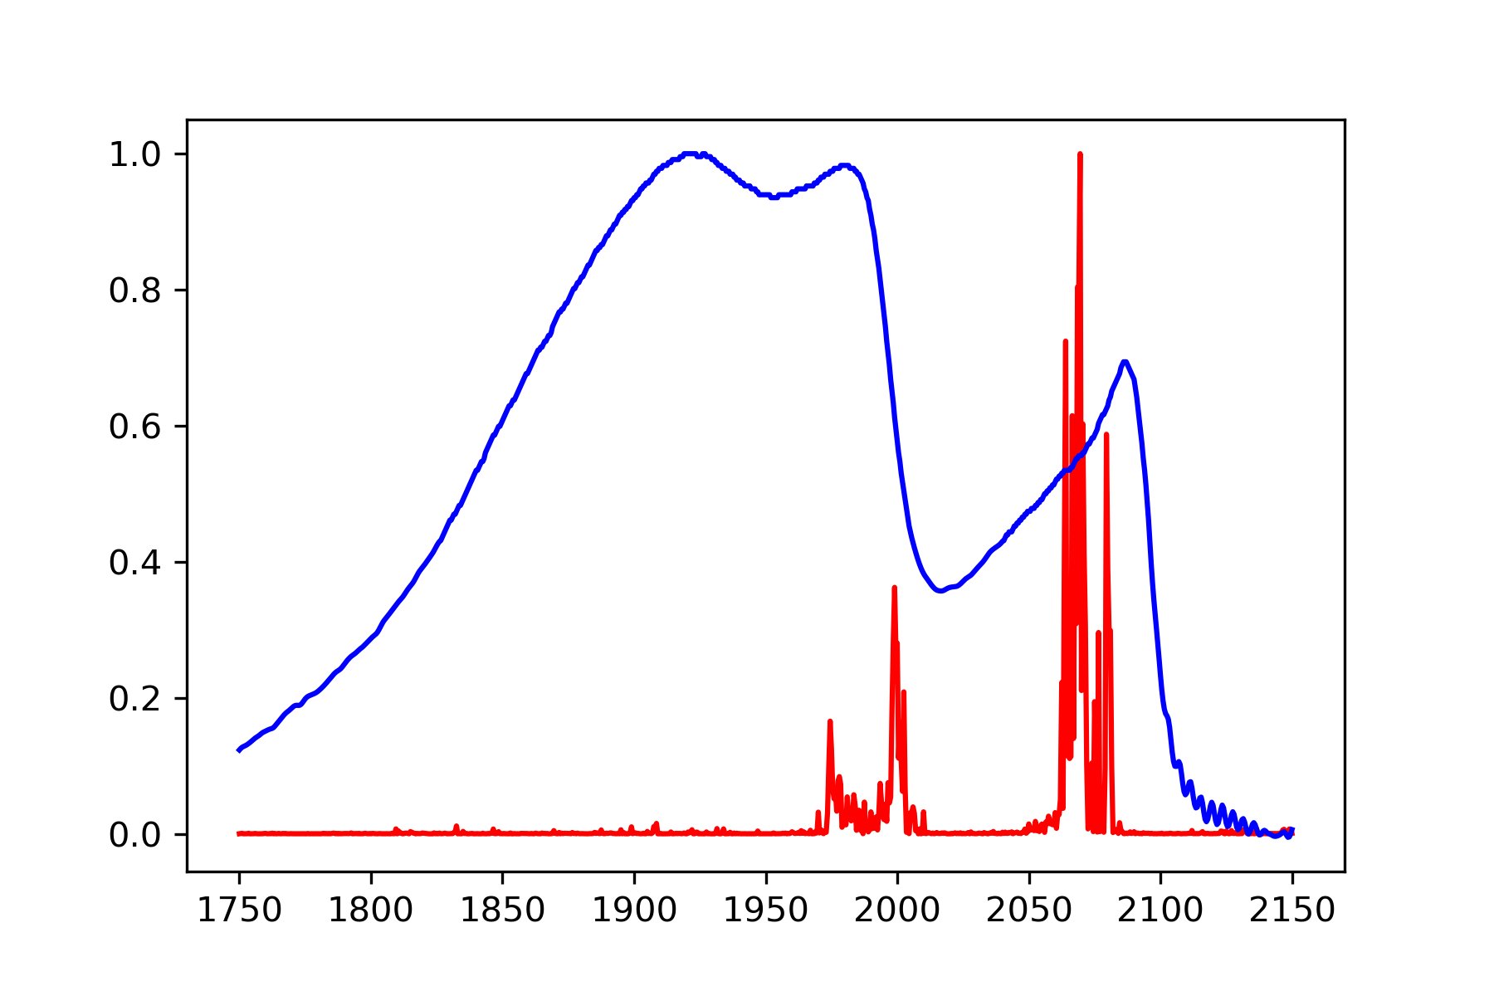
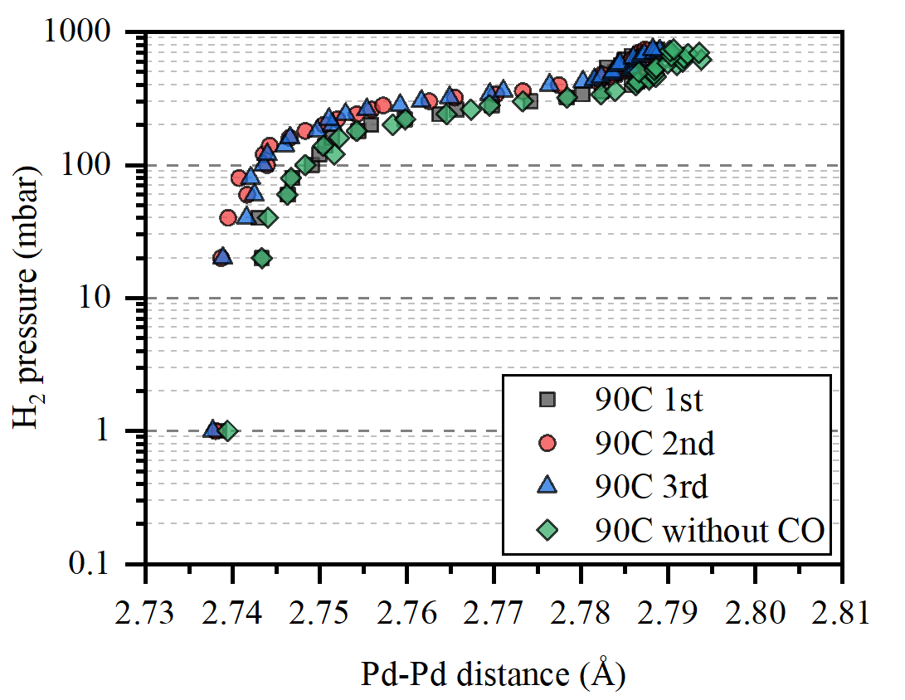
Key Work from the Past:
06. November 2024
Postdoc Day
Usoltsev O.A. et al. Small Methods, 8 (7), pp. 2301397 (2024)
Notes:
Select one work which you would to feature for your next job-application; It can be a project what you just started or some finished work from the past around which you want to build your next career steps.
Describe also in one slide how this work relates to your key achievement in case that it is another project.
This should take about 40% of the talk
Describe the scientific work you had done with
motivation why it is important
What exactly you have done and with whom
Are there any consequences from this work: you may have opened up a field, of there was a patent, any kind of IP……

Slide 6
Goal for the ALBA Stay:
Progress from previous PostDoc day
InCAEM: Big data treatment pipeline development for supporting the user community and ALBA beamlines
06. November 2024
Postdoc Day
Usoltsev O.A., Small, 20 (42), pp. 2401184 (2024)
Notes:
This will be the second 40%
Elaborate on changes if you had already participated on an ALBA postdoc day.

Slide 7
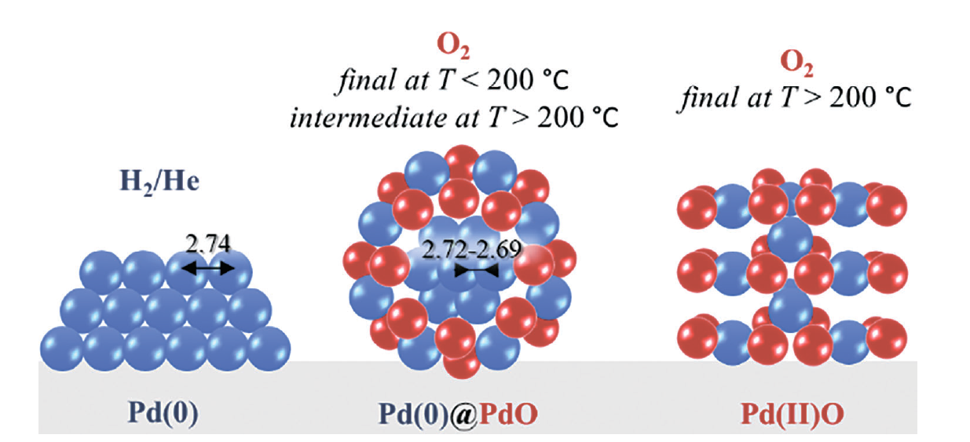
Goal for the ALBA Stay:
Progress from previous PostDoc day
PyFitit
A. Martini, S.A. Guda, A.A. Guda, G. Smolentsev, A. Algasov,
O. Usoltsev, M.A. Soldatov, A. Bugaev, Yu. Rusalev, C. Lamberti, A.V. Soldatov
Computer Physics Communications, 250, 107064 (2020)
https://doi.org/10.1016/j.cpc.2019.107064
Xraylarch
M. Newville.
Journal of Physics: Conference Series, 430, 012007 (2013) doi:10.1088/1742-6596/430/1/012007
06. November 2024
Postdoc Day
Usoltsev O.A., Small, 20 (42), pp. 2401184 (2024)
Notes:
This will be the second 40%
Elaborate on changes if you had already participated on an ALBA postdoc day.

Slide 8

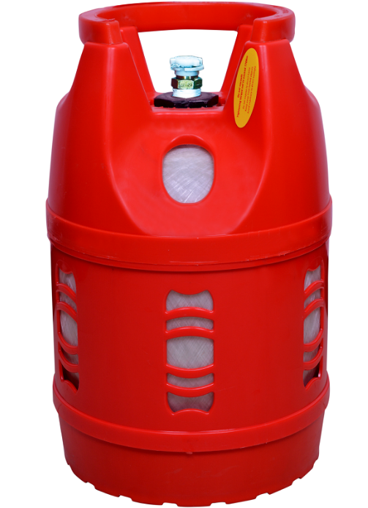


Goal for the ALBA Stay:
Beamlines and synchrotrons:
ALBA (CLAESS and NOTOS)
ESRF (BM31, BM23 and ID24)
SLS (SupreXAS)
DESY (P64)
Soleil (SAMBA)
Gas atmosphere
He
O₂, C₂H₂, C₂H₄, CH₄, CO, H₂
Different time of measurements and BL configurations:
2014 -2024
Temperature range
from -20С to 250С
Particle size
From 1 nm to 10 𝛍m
>3000 Pd K-edge spectra
06. November 2024
Postdoc Day
Notes:
This will be the second 40%
Elaborate on changes if you had already participated on an ALBA postdoc day.

Slide 9
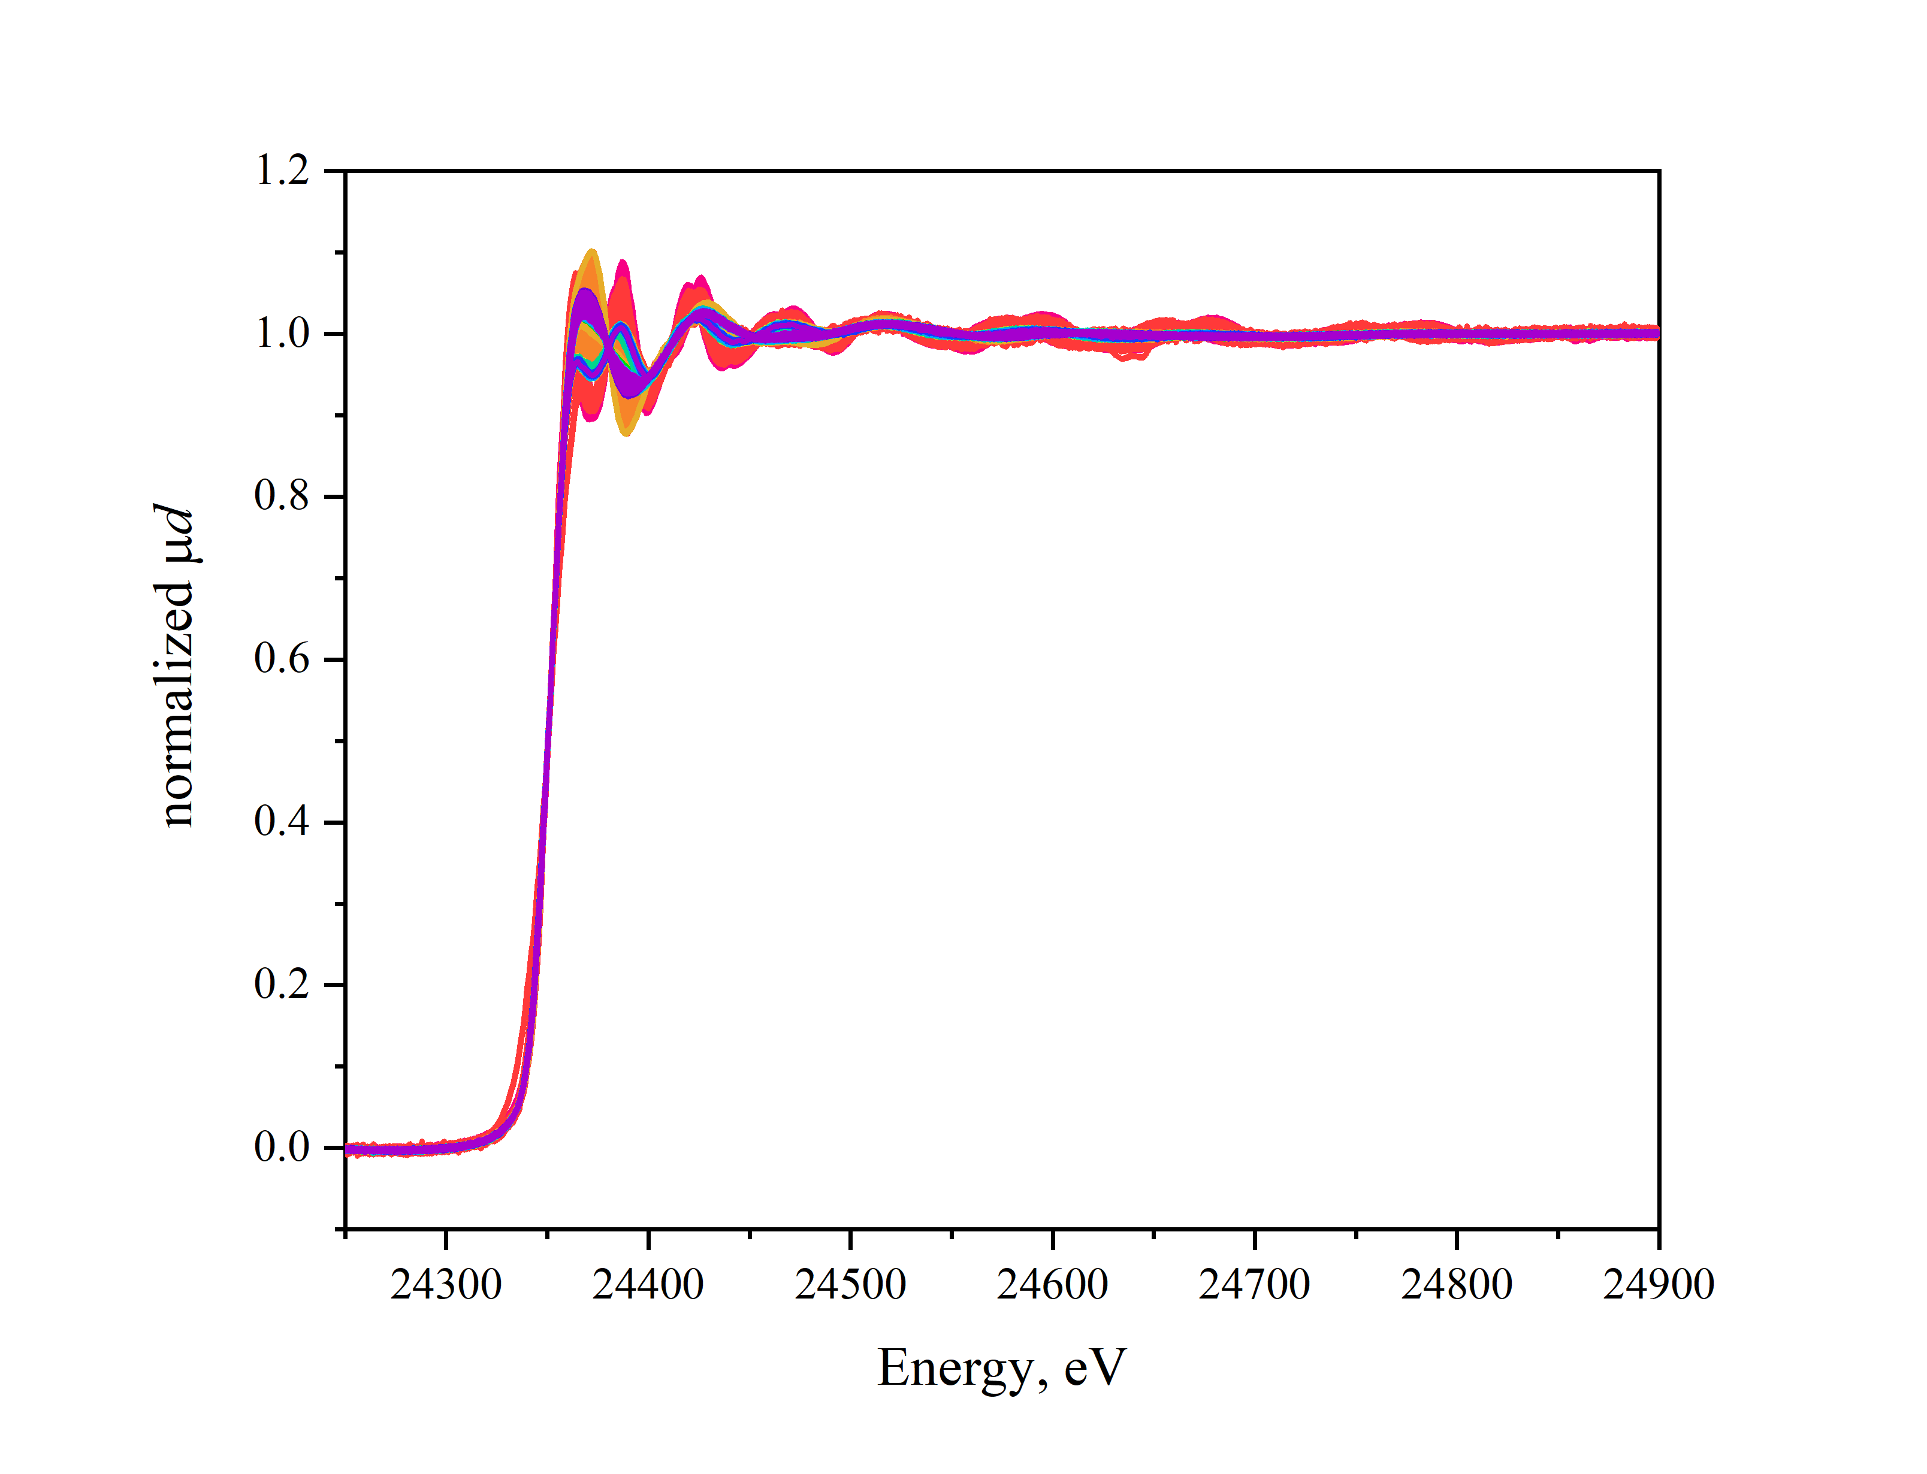
Goal for the ALBA Stay:
06. November 2024
Postdoc Day
Notes:
This will be the second 40%
Elaborate on changes if you had already participated on an ALBA postdoc day.

Slide 10
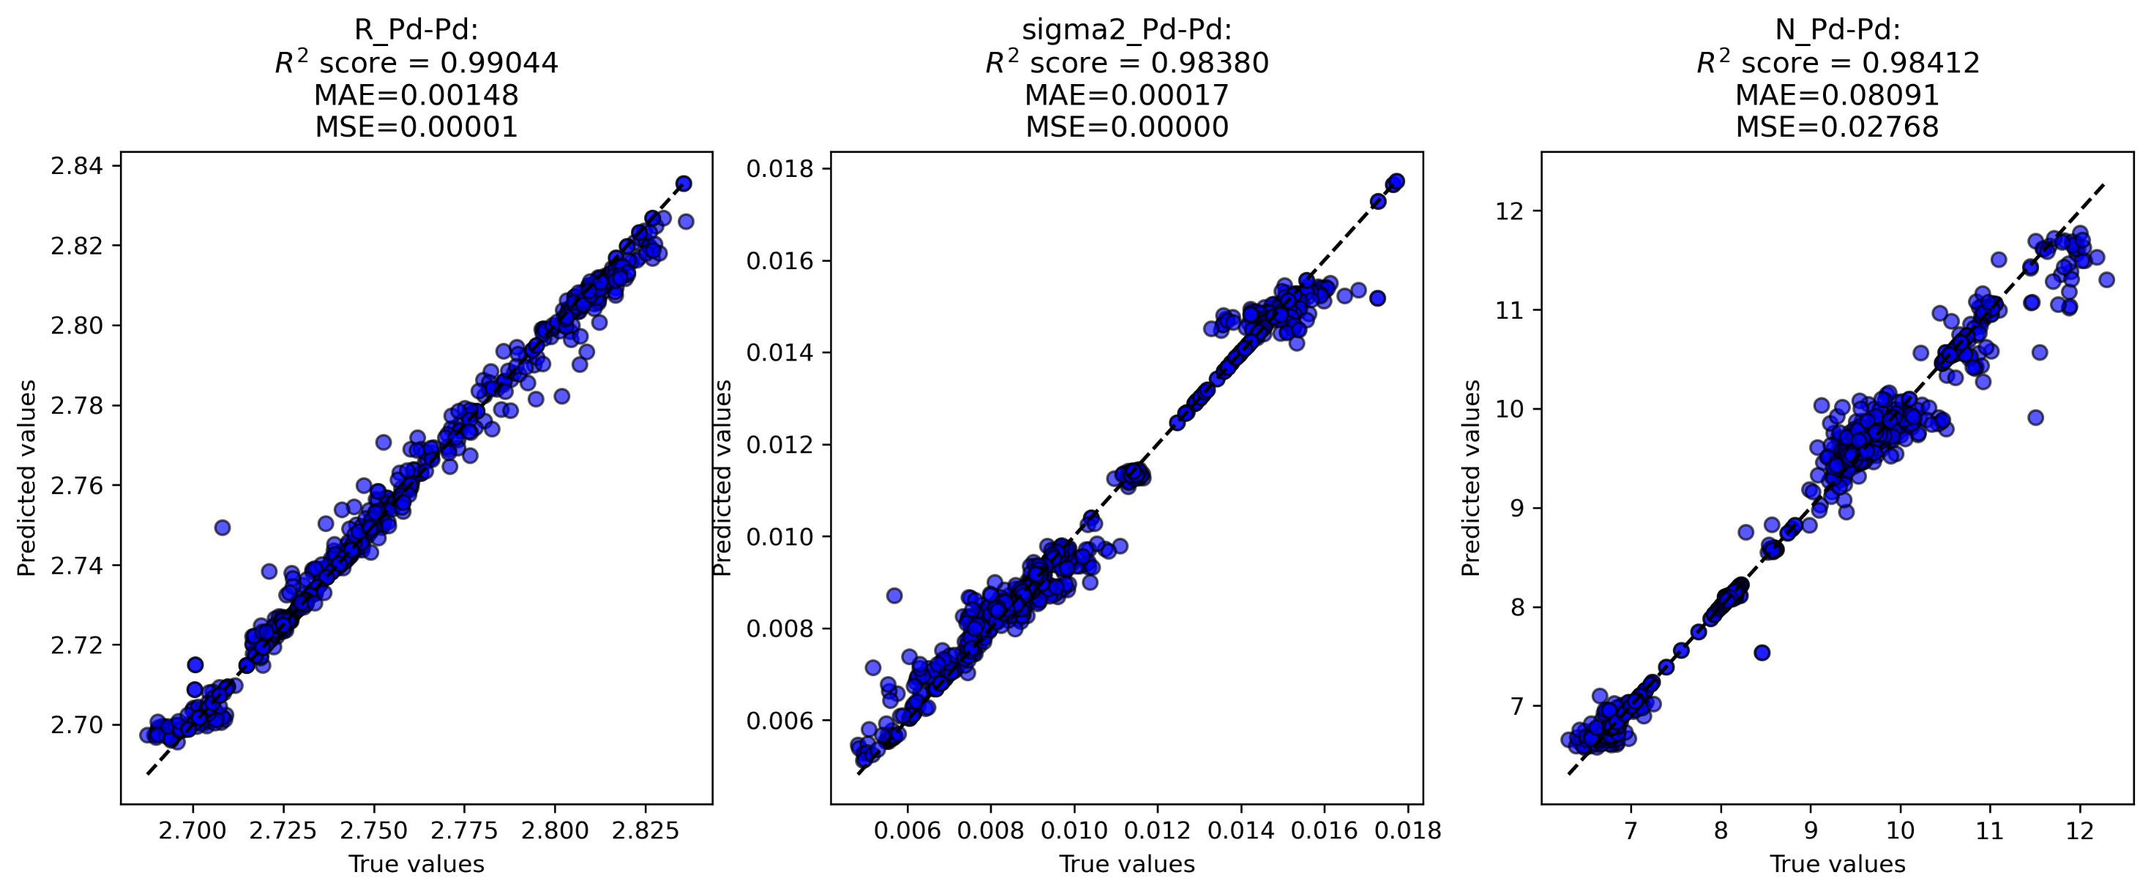
Goal for the ALBA Stay:
R_{Pd-Pd}
σ²
N_{Pd-Pd}
06. November 2024
Postdoc Day
Notes:
This will be the second 40%
Elaborate on changes if you had already participated on an ALBA postdoc day.

Slide 11
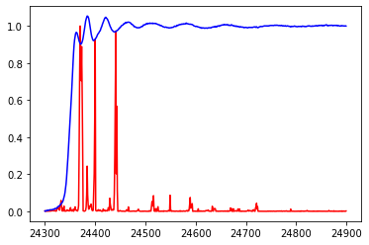
Goal for the ALBA Stay:
Normalized 𝛍d
Energy (eV)
06. November 2024
Postdoc Day
Notes:
This will be the second 40%
Elaborate on changes if you had already participated on an ALBA postdoc day.

Slide 12
Goal for the ALBA Stay:
Motivation: interest in big data processing and developing the skills both in data acquisition and analysis; be part of scientific international comunity
Measure for success:
  Development of advanced tools for users support including data analysis pipelines,
  Expanded XAS database creation
  High impact factor publications
  Participation and recognition on conferences
  Grant lead
  Salary
06. November 2024
Postdoc Day
Notes:
This will be the second 40%
Elaborate on changes if you had already participated on an ALBA postdoc day.

Slide 13
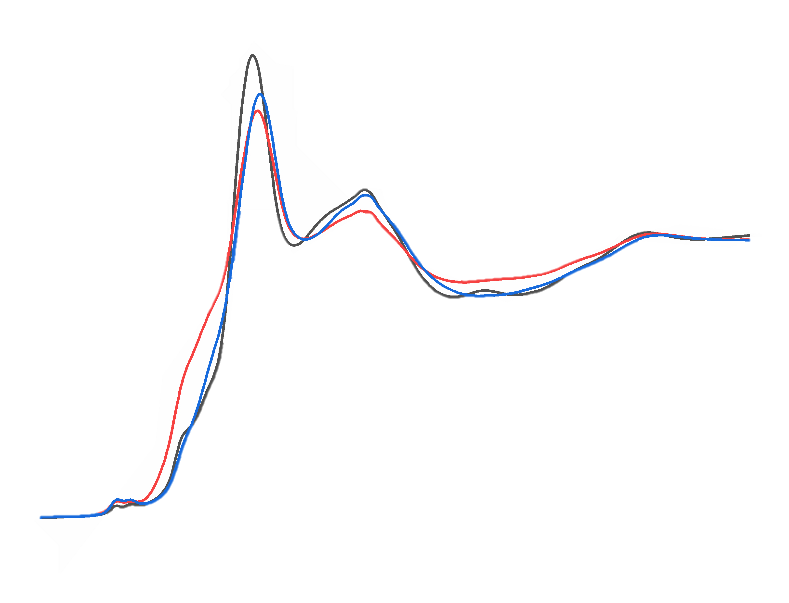
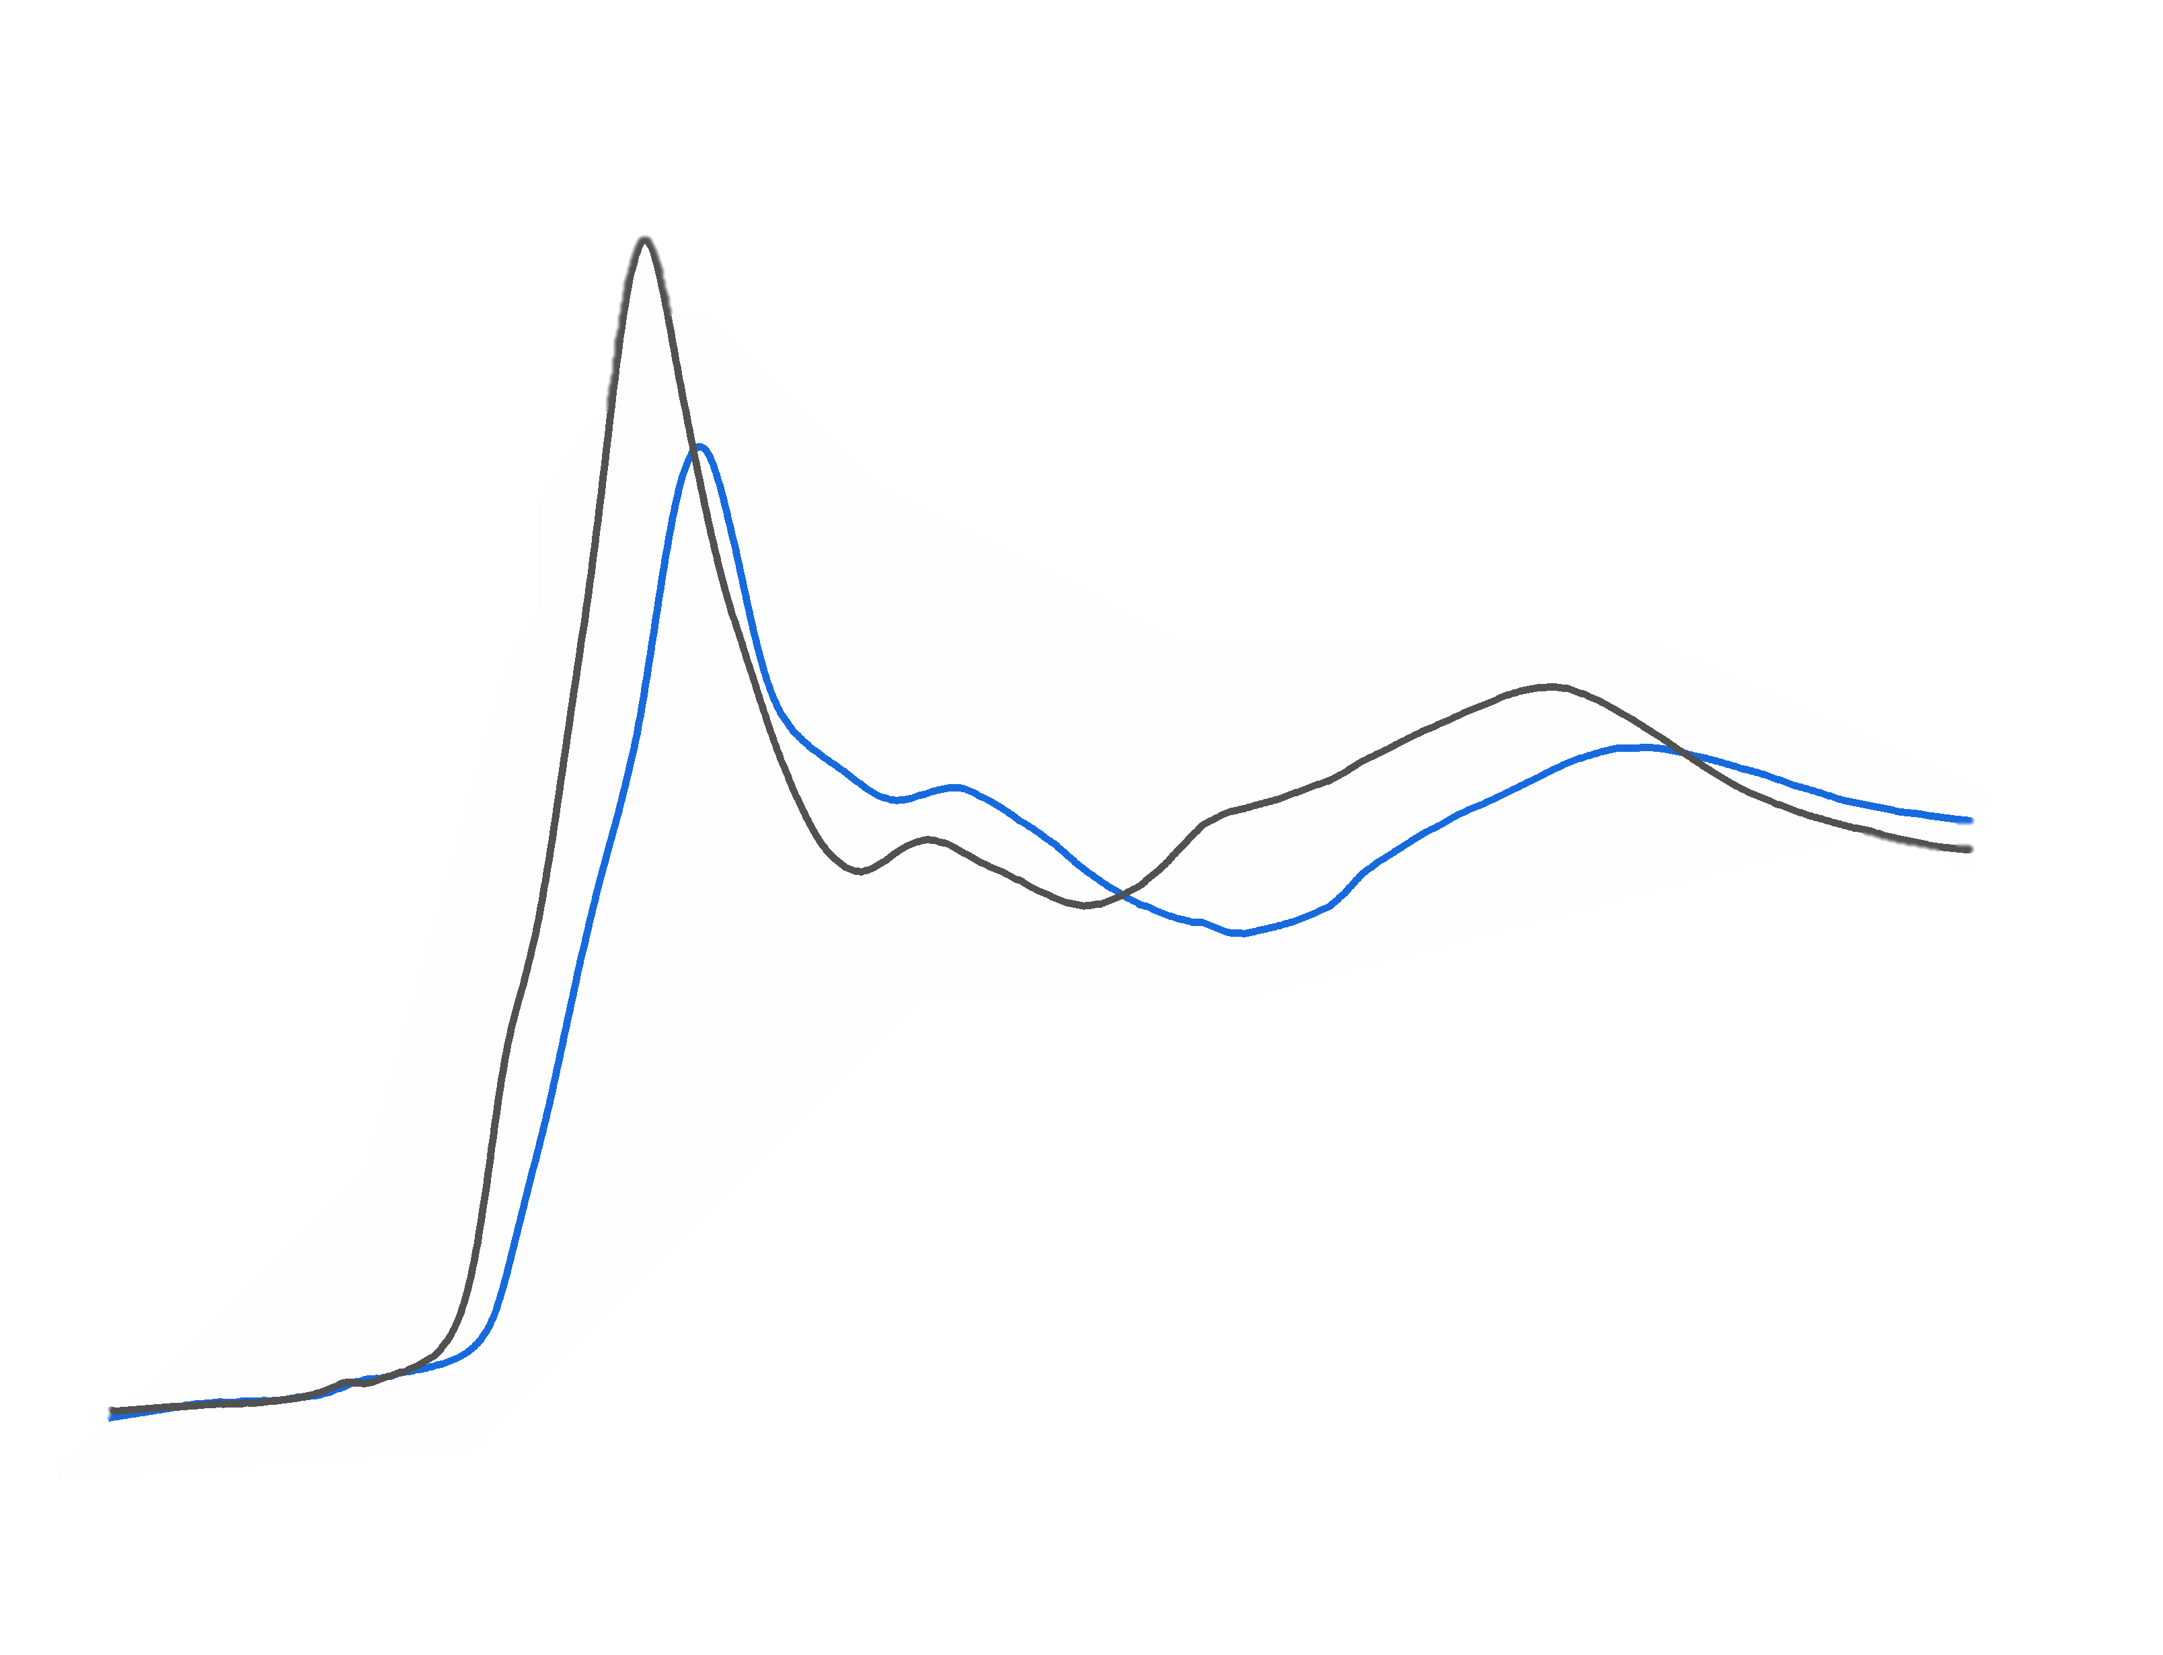
Applying approach
Li_{1.2}Mn_{0.60}Ni_{0.20}O₂
Li_{1.2}Mn_{0.56}Ni_{0.16}Co_{0.08}O₂
X-ray
06. November 2024
Postdoc Day
Usoltsev O.A. et al. ECS energy letters in process
Notes:
This will be the second 40%
Elaborate on changes if you had already participated on an ALBA postdoc day.

Slide 14
Applying approach
Li_{1.2}Mn_{0.60}Ni_{0.20}O₂
06. November 2024
Postdoc Day
Usoltsev O.A. et al. ECS energy letters in process
Notes:
This will be the second 40%
Elaborate on changes if you had already participated on an ALBA postdoc day.

Slide 15
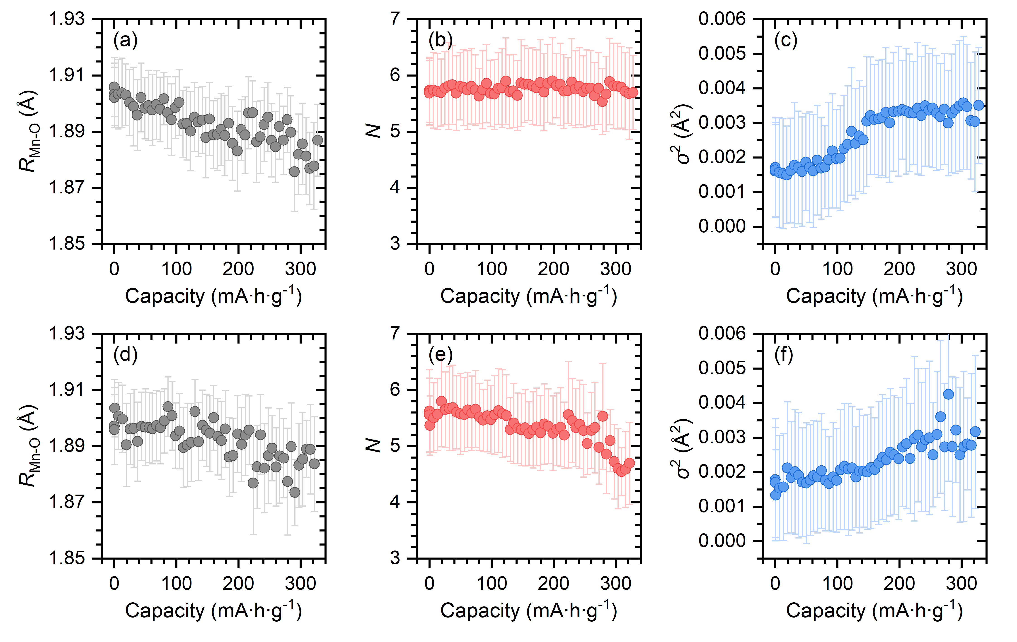
Applying approach Mn K-edge
Li_{1.2}Mn_{0.60}Ni_{0.20}O₂
Li_{1.2}Mn_{0.56}Ni_{0.16}Co_{0.08}O₂
06. November 2024
Postdoc Day
Usoltsev O.A. et al. ECS energy letters in process
Notes:
This will be the second 40%
Elaborate on changes if you had already participated on an ALBA postdoc day.

Slide 16
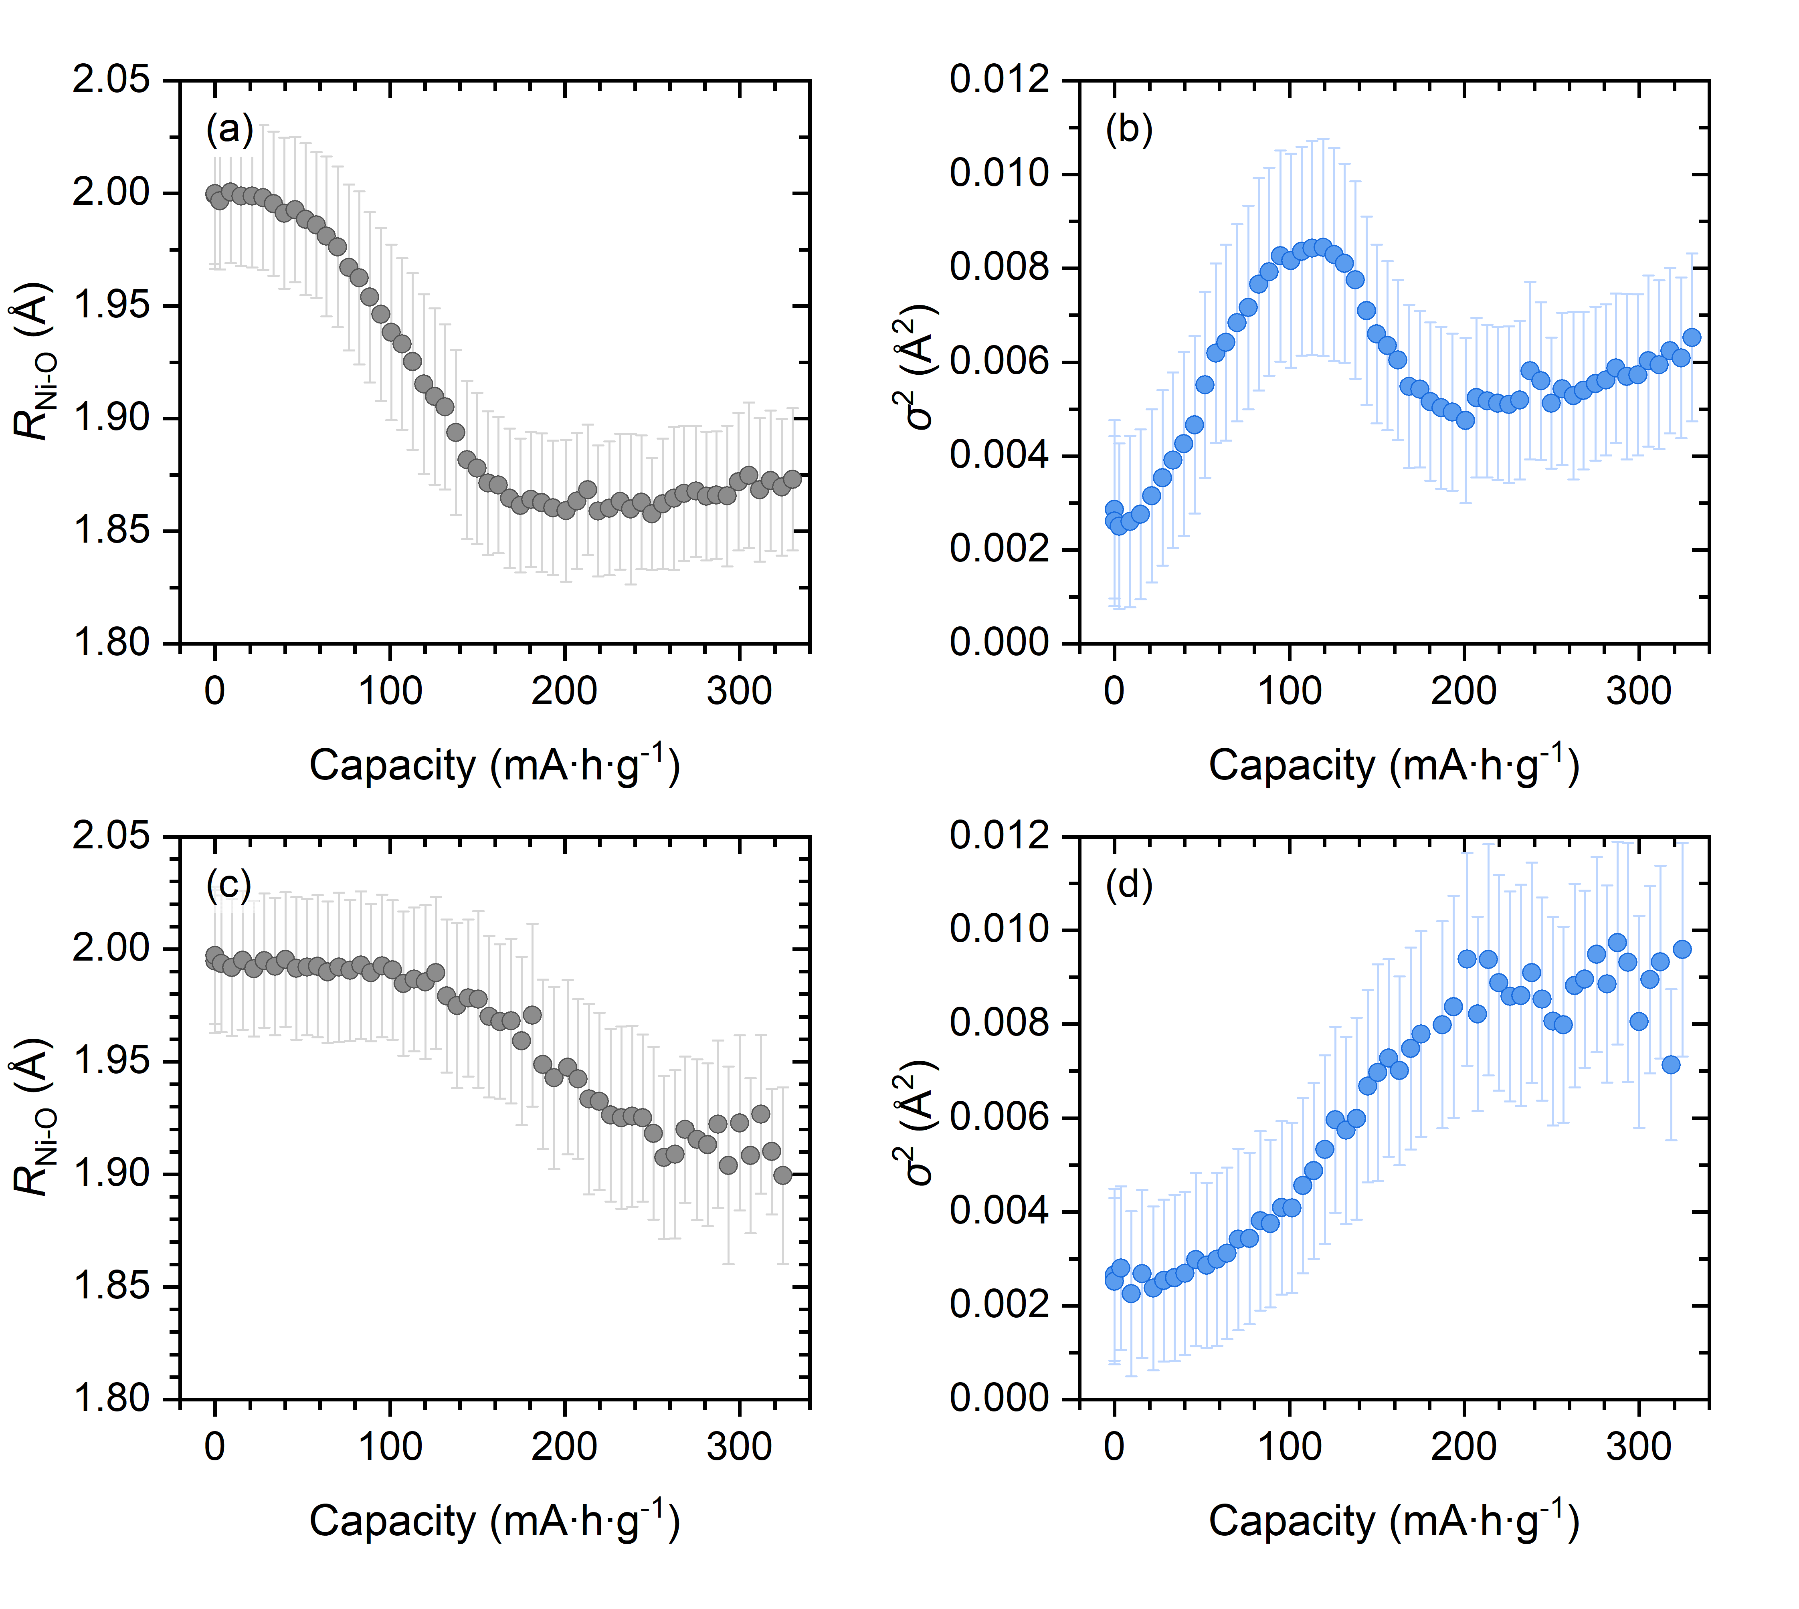
Applying approach Ni K-edge
Li_{1.2}Mn_{0.60}Ni_{0.20}O₂
Li_{1.2}Mn_{0.56}Ni_{0.16}Co_{0.08}O₂
06. November 2024
Postdoc Day
Usoltsev O.A. et al. ECS energy letters in process
Notes:
This will be the second 40%
Elaborate on changes if you had already participated on an ALBA postdoc day.

Slide 17
Summary:
Long term goals:
  - Creation of a tool for advanced XAS analysis utilizing ML and AI
  - Creation of advance XAS database
  - Application of EXAFS fit approach for the big data sets
  - Gain practical skills in experiment preparation and design
06. November 2024
Postdoc Day
Notes:
10% of the time
Try to summarize in a few bullet points; and try to be as precise in short as possible:
What are you good in; what you have already proven that you are good in?
What is your goal for the ALBA stay.
What networks you have built during your stay at ALBA?
Are there any issues which you have to overcome.

Slide 18


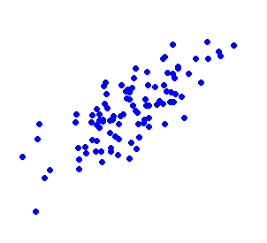






Acknowledgments
L. Simonelli, VMartin-Diaconescu, A. Skorynina
and so many people who help during experiments…
ALBA synchrotron , Spain
D. Tonti
ICMAB-CSIC, Spain
J. Otón, L. Aballe, K. Attenkofer, L. Panahi, M. Raventos
Methodology group, ALBA
J. Arbiol, J. Yu,
ICN2
Guda, S. Guda, A. Soldatov,
A. Pnevskaya, B. Protsenko
SFedU
D. De Vos, K. Janssens,
KU Leuven, Belgium
E. Kozyr, L Mino,
Torino University, Italy
Bugaev
Paul Scherer Institute, Switherland
21. July 2023
Postdoc Day

Slide 19
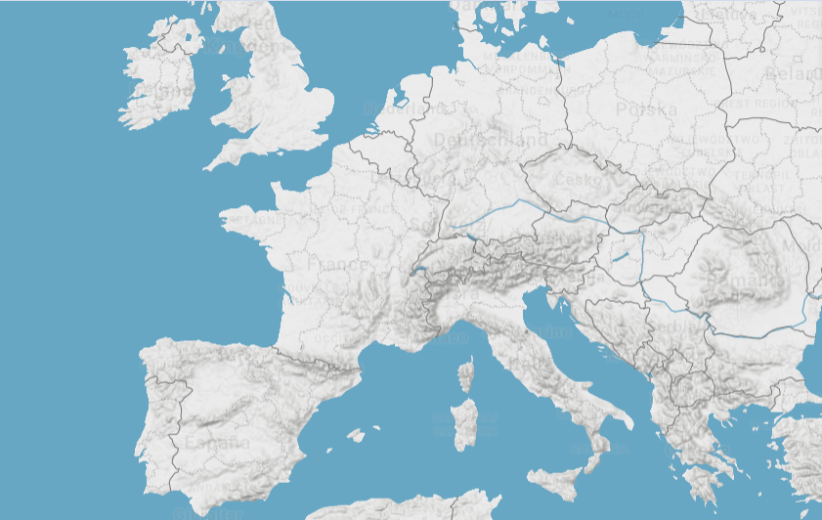
Thank you for your attention
KU Leuven
PSI (Villigen)
ESRF (Grenoble)
University of Torino (Torino)
INCAR-CSIC (Olviedo)
Univ. of Rome (Rome)
ICP (Madrid)
ICMAB
IREC
ICN2
PIC
Eurecat (Barcelona)
06. November 2024
Postdoc Day
Notes:
This will be the second 40%
Elaborate on changes if you had already participated on an ALBA postdoc day.

