Slide 1
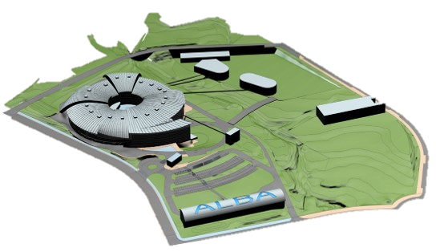
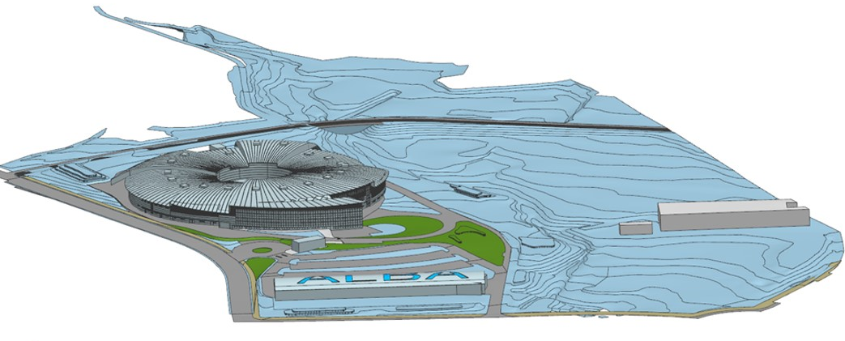
ALBA of the future:
ALBA today:
Application of optical metrology techniques
Albert Van Eeckhout Alsinet
6 November 2024 – Postdoc Day

Slide 2
The Scientific Background:
Educational Background:
  Ph.D. Thesis: Polarimetric methods for the image enhancement in biological applications ﻿
  (advisors: Juan Campos and Angel Lizana)(Awarded with Premio Justiniano Casas)
  Postdoc stays: Ecole Polytechnique (Paris, 2021),
  ALBA synchrotron (Cerdanyola del Vallès, since February 2022)
Scientific Interest:
  Fields: Optics, Metrology, Instrumentation, Polarimetry
  Key achievements: First use of light depolarization anisotropy to enhance biological tissue imaging
  New stitching procedure for surface metrology (LEEP)
  Key publications: Synthesis and characterization of depolarizing samples based on the indices of polarimetric purity (2017)
  Polarimetric imaging of biological tissues based on the indices of polarimetric purity (2018) Depolarization metric spaces for biological tissues classification (2020)
  Polarimetric imaging microscopy for advanced inspection of vegetal tissues (2021)
  The stitching interferometry system of ALBA (2023)
6 November 2024
Postdoc Day
Notes:
This should be 1 slide and take not more than 2 min.
Scientific interest: Please make sure that the three parts, field, key achievement, and publication should be coherent.
Field: typically 1 or maximal 2; point out the most important one in case that there are two
Key achievements: one or two; they should be easily described in a single phrase like: 1.) first measurement of XYZ; 2.) design of instrumentation to measure XYZ; organizing conference on XYZ
Key publications: if possible choose high impact publication and publications supporting your key achievements.

Slide 3
Key Work from the Past:
Introduction in light depolarization:
y
x
Biological Sample
Depolarization
Global observables (commonly used):
Depolarization index (P_{Δ})
Depolarization power (Δ)
Indices of Polarimetric Purity (IPP)
P₁, P₂, and P₃
Measure the overall depolarization
and the depolarization anisotropy
Measure the overall depolarization
But not the depolarization anisotropy
Albert Van Eeckhout et al. Synthesis and characterization of depolarizing samples based on the indices of polarimetric purity, Opt. Lett. 42, 4155-4158 (2017).
6 November 2024
Postdoc Day
Notes:
This should take about 40% of the talk
Describe the scientific work you had done with
motivation why it is important
What exactly you have done and with whom
Are there any consequences from this work: you may have opened up a field, of there was a patent, any kind of IP……

Slide 4
Key Work from the Past:
Depolarization in plant samples (microscopic scale):
Epipremnum aureum (pothos) leaf measured at 530 nm
Intensity Image
P_{Δ}
P₁
Depolarization images reveal raphides distributed over the leaf.
Depolarization anisotropy is now used for the early detection of plant diseases
Albert Van Eeckhout et al. Polarimetric imaging microscopy for advanced inspection of vegetal tissues, Sci Rep 11, 3913 (2021).
6 November 2024
Postdoc Day
Notes:
This should take about 40% of the talk
Describe the scientific work you had done with
motivation why it is important
What exactly you have done and with whom
Are there any consequences from this work: you may have opened up a field, of there was a patent, any kind of IP……

Slide 5
Goal for the ALBA Stay:
Motivation:
  Control high-precision instruments (with sub-nanometric resolution)
  Enhance my knowledge about optical metrology, x-ray optics and instrumentation
  Work in an interdisciplinary environment
  Meet new people from the synchrotron community for future collaborations
  Publish high impact articles
Long Term Goal:
  Consolidate and expand my knowledge in optics.
  Develop a scientific career as a scientist in the field of optical metrology.
6 November 2024
Postdoc Day
Notes:
This will be the second 40%

Slide 6
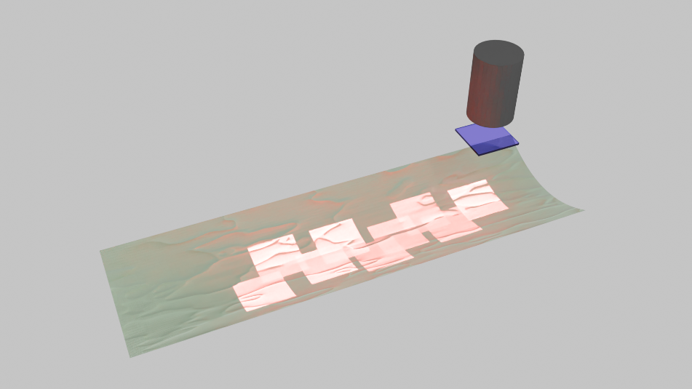
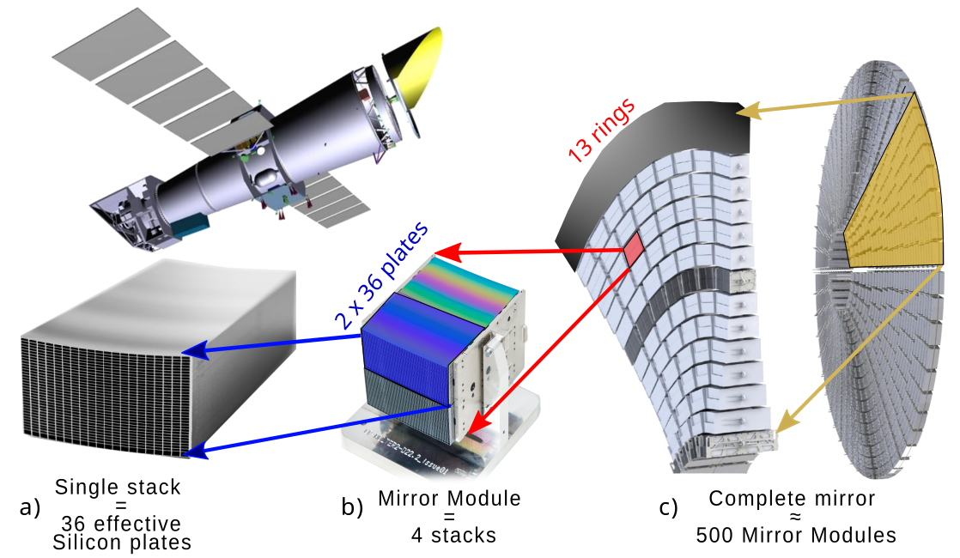
Work done at ALBA:
Optics Laboratory:
Improvement of the stitching interferometry system of ALBA for sub-nanometric surface metrology
Development of new techniques to measure strongly curved mirrors
Optics Laboratory:
Improvement of the stitching interferometry system of ALBA for sub-nanometric surface metrology
Development of new techniques to measure strongly curved mirrors
Minerva Beamline:
Commissioning of Minerva
Bayesian orientation control system
Laser tracker positioning
Minerva Beamline:
Commissioning of Minerva
Bayesian orientation control system
Laser tracker positioning
6 November 2024
Postdoc Day

Slide 7
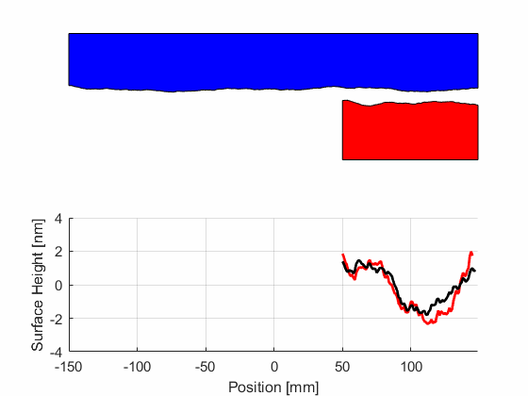
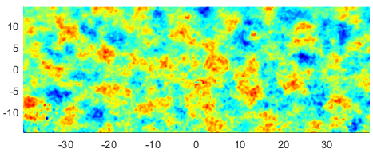
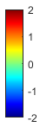
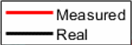
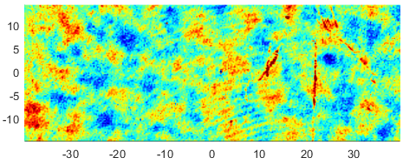
Previous work on stitching:
Linear Error Elimination Procedure (LEEP):
Surface under test (SUT)
Zygo Calibration
Measured
(Curvature removed)
nm
Reference
Surface reconstruction
LEEP-xy (0.04 nm rms repeatability)
nm
  LEEP calibrates and removes all systematic additive errors, including the defects of the Reference
6 November 2024
A. Van Eeckhout et al. SPIE proceeding (2023)
Postdoc Day

Slide 8
Work on stitching:
Influence of measurement errors in stitching:
Simulation
Contribution of 1 nm turbulence error on the SUT reconstruction
  We have simulated the effect of several measurement errors in stitching
  (uncorrelated noise, turbulence noise, sub-aperture positioning,…).
  The main contribution of error comes from air turbulences.
  Propagation of turbulence increases with the length of the mirror.
  The turbulence noise of our lab was of 0.6 nm rms.
*stitching of 200 sub-apertures
6 November 2024
Postdoc Day

Slide 9

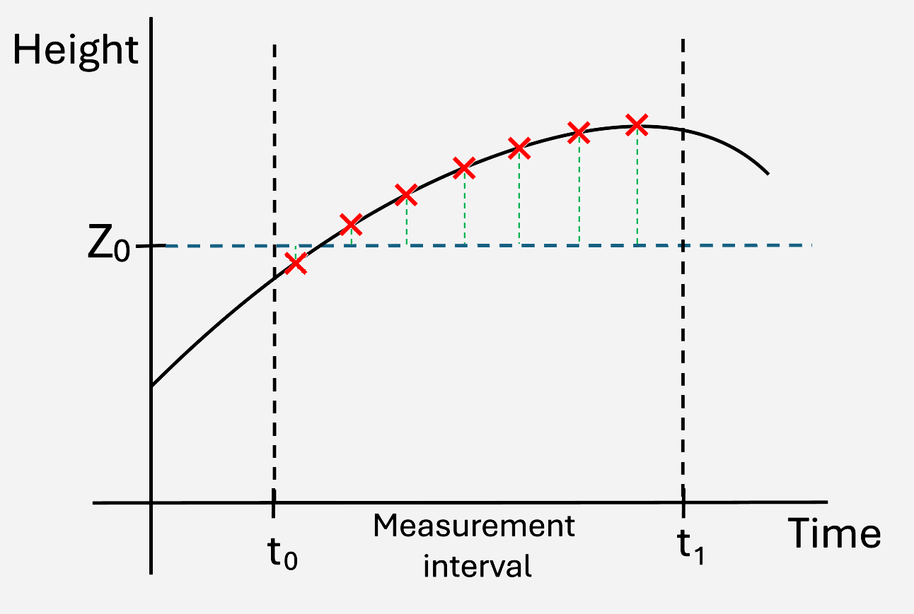
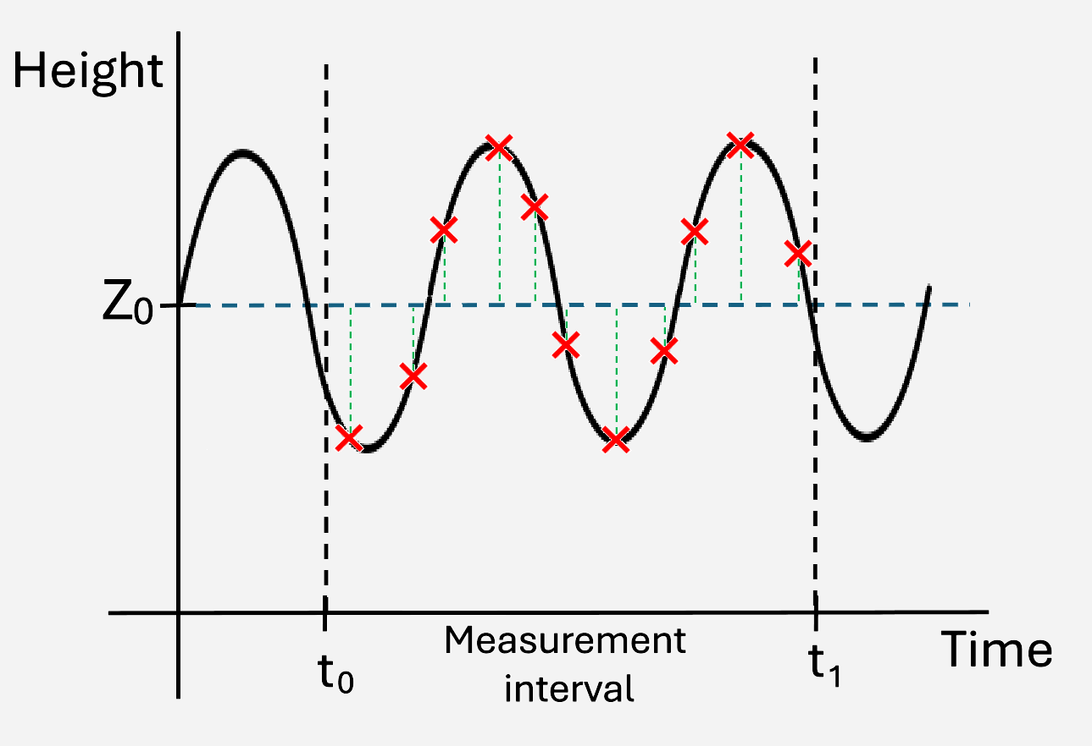
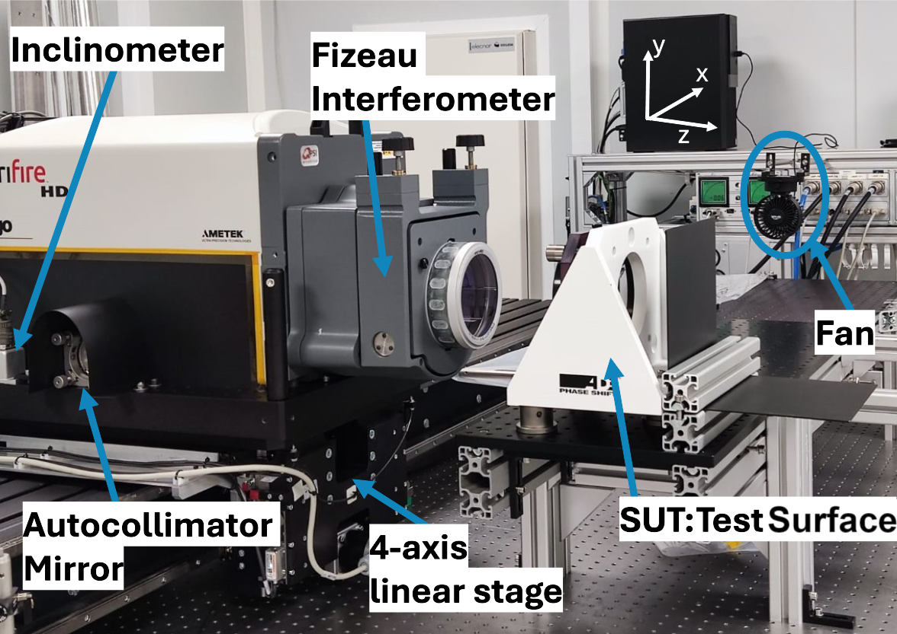
Work on stitching:
Reduction of turbulence error:
  Two approximations:
  Create an enclosure that reduces the fluctuations of the environment
  Create a controlled flux of zero mean high frequency air turbulences
  Fizeau interferometer heats the environment
6 November 2024
A. Vivio et al. SPIE proceeding (2017)
Postdoc Day

Slide 10
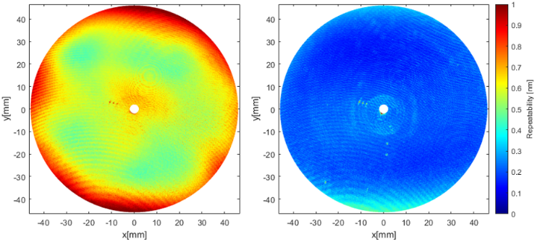
Work on stitching:
Reduction of turbulence error:
  A reflective surface is measured 100 times with the fan on and off.
  Repeatability with the fan on is three times better.
  The mean of the measurements are the same (2.5 picometers of difference).
Measured
Repeatability Fan off (0.62 nm)
Repeatability Fan on (0.21 nm)
6 November 2024
Postdoc Day
“Improving stitching interferometry measurements by a continuous air flow”, in preparation

Slide 11
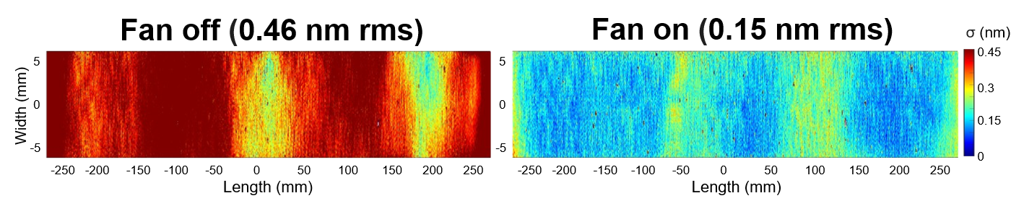
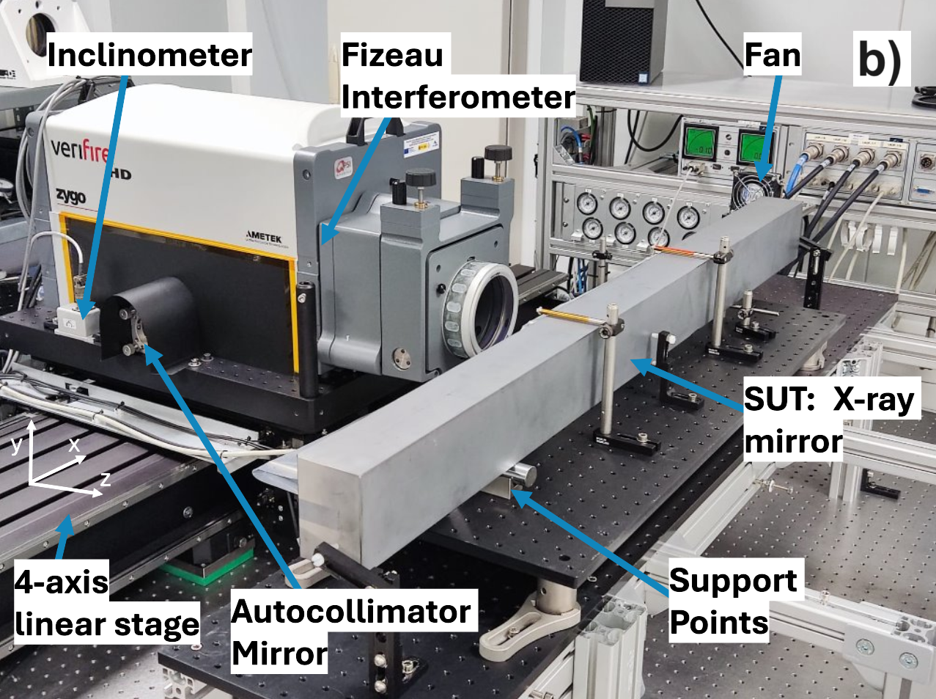
Work on stitching:
Reduction of turbulence error:
  A 550 mm section of the old MSPD mirror is measured 10 times with our standard stitching procedure and with the fan on and off.
  Repeatability with the fan on is three times better.
Measured
Repeatability Fan off (0.46 nm)
Repeatability Fan on (0.15 nm)
6 November 2024
Postdoc Day
“Improving stitching interferometry measurements by a continuous air flow”, in preparation

Slide 12
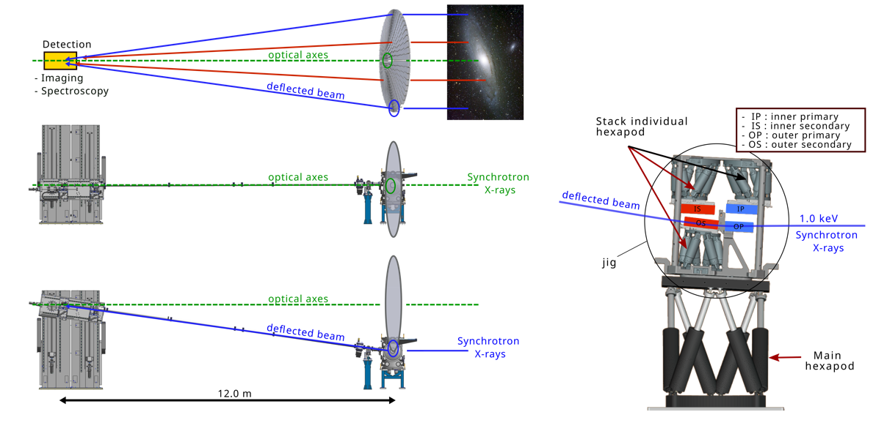
Work on MINERVA:
MINERVA beamline description:
  MINERVA is part of the NewATHENA mission.
  NewATHENA consist of building and launching an x-ray telescope build of 500 Mirror Modules.
  MINERVA role: align 4 stacks to produce a Mirror Module.
6 November 2024
D. Heinis et al. SPIE proceeding (2024)
Postdoc Day

Slide 13
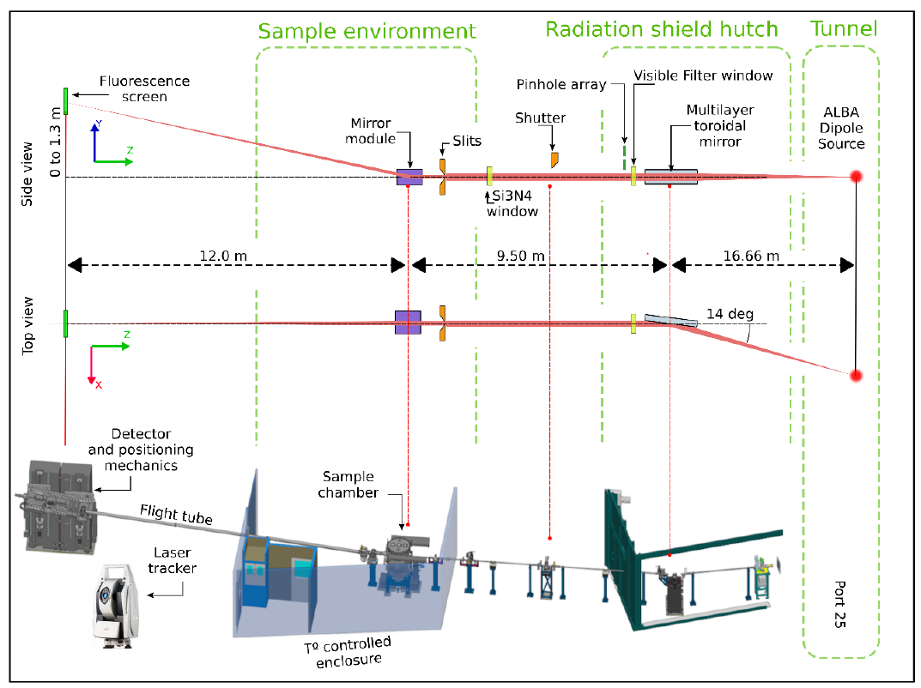
Work on MINERVA:
MINERVA beamline description:
  This beamline only has three optical elements:
    multilayer toroidal mirror
    mirror module
    detector
  The distance between the mirror module and the detector must be 12 ± 0.0001 meters, with a maximum error in the transversal direction of 50 μm.
  Constant orientation of the mirror module during the whole calibration. Maximum error of
  1 arcsecond (4.8 μrad).
6 November 2024
D. Heinis et al. SPIE proceeding (2024)
Postdoc Day

Slide 14
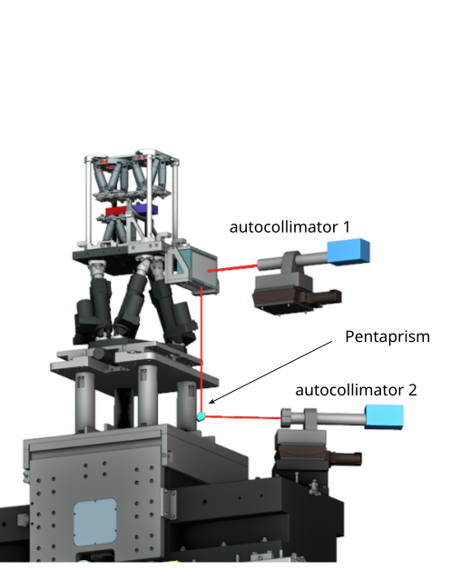
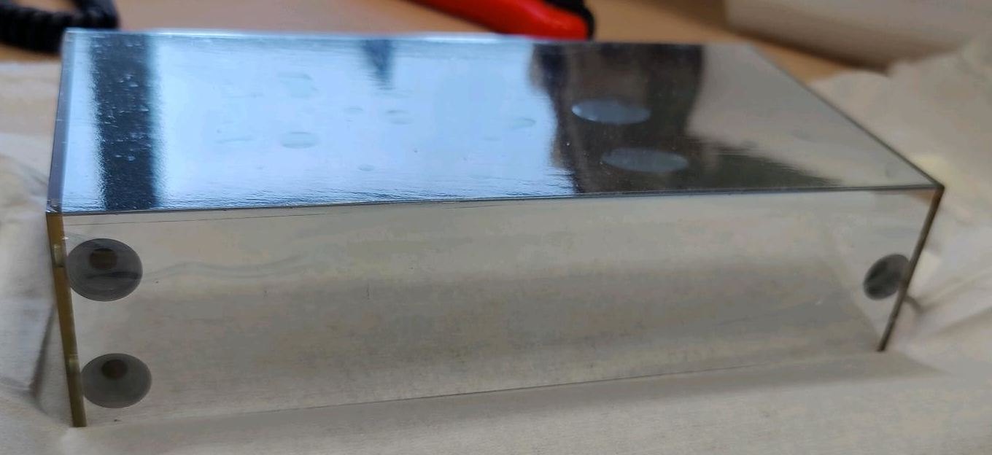
Work on MINERVA:
Bayesian orientation control system:
  Two autocollimators measure the orientation of the mirror with two reflective faces.
  The 3D orientation of the mirror is deduced from a Bayesian model.
  If the orientation of the mirror is deviated more than 0.5 arcsec, the hexapod corrects such orientation.
6 November 2024
D. Heinis et al. SPIE proceeding (2024)
Postdoc Day

Slide 15
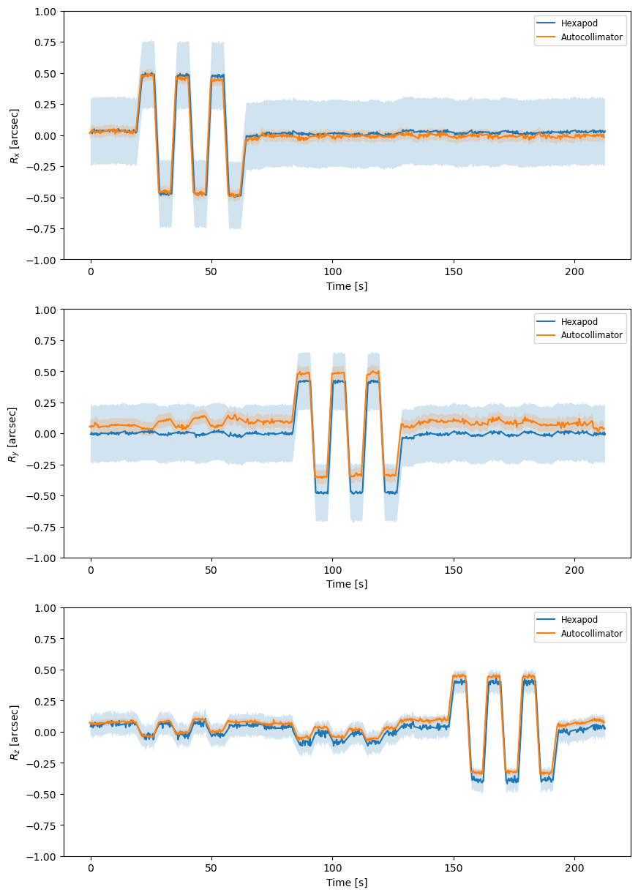
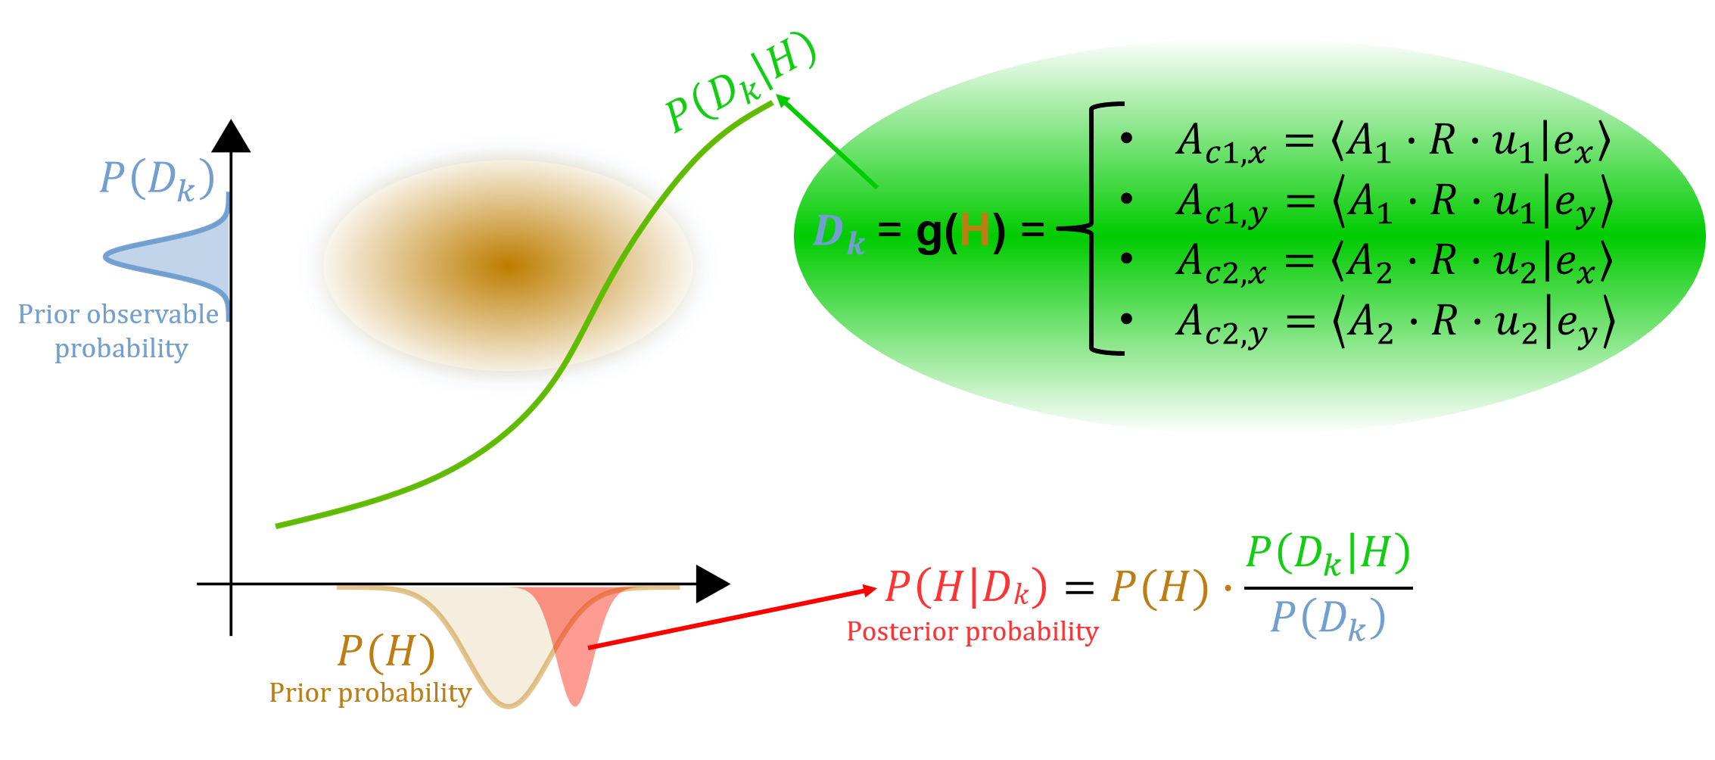
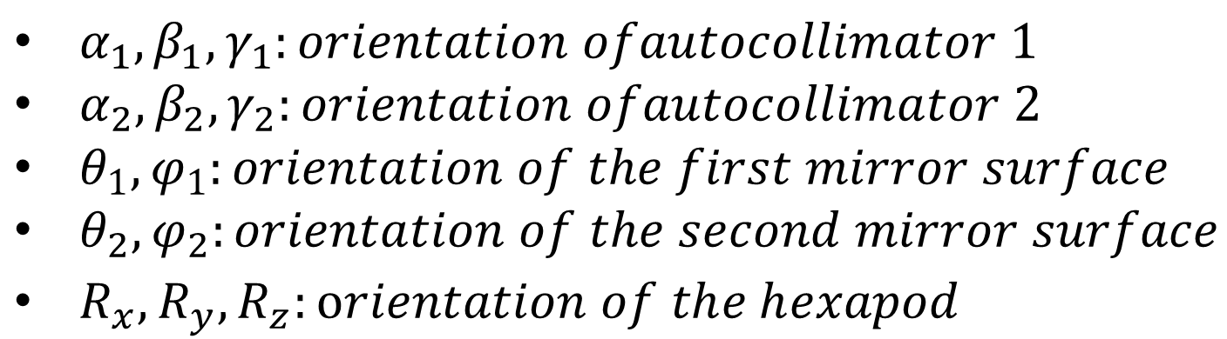
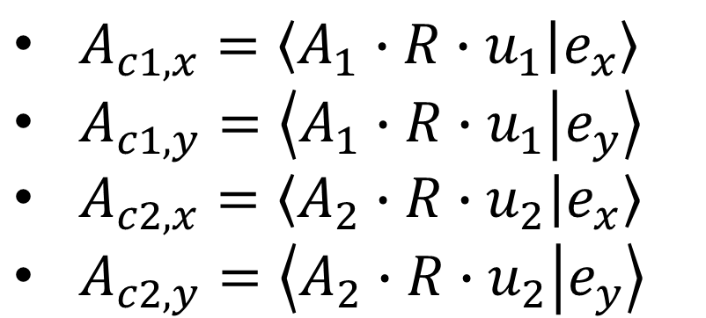
Work on MINERVA:
Measured
Bayesian model measurement:
  We first measure 50 known orientations with the autocollimators (calibration data).
  New unknown orientations are calculated by combining the new autocollimators measurements with the calibration data.
  The Bayesian model gives the most probable result with a given uncertainty.
6 November 2024
D. Heinis et al. SPIE proceeding (2024)
Postdoc Day
$α_{1},β_{1},γ_{1}:orientation ofautocollimator 1$
$α_{2},β_{2},γ_{2}:orientation ofautocollimator 2$
$θ_{1},φ_{1}:orientation of the first mirror surface$
$θ_{2},φ_{2}:orientation of the second mirror surface$
$R_{x},R_{y},R_{z}:orientation of the hexapod$
H: 13 unknowns
Forward problem (analytical solution)
Inverse Problem
$A_{c1,x}=\left\langle A_{1}∙R∙u_{1} | e_{x}\right\rangle$
$A_{c1,y}=\left\langle A_{1}∙R∙u_{1} | e_{y}\right\rangle$
$A_{c2,x}=\left\langle A_{2}∙R∙u_{2} | e_{x}\right\rangle$
$A_{c2,y}=\left\langle A_{2}∙R∙u_{2} | e_{y}\right\rangle$
H = g⁻¹(D) =?
D = g(H) =
D: 4 observations
Autocollimators measurements: $A{c_{1}}_{x}$, $A{c_{1}}_{y}$, $A{c_{2}}_{x}$, $A{c_{2}}_{y}$

Slide 16
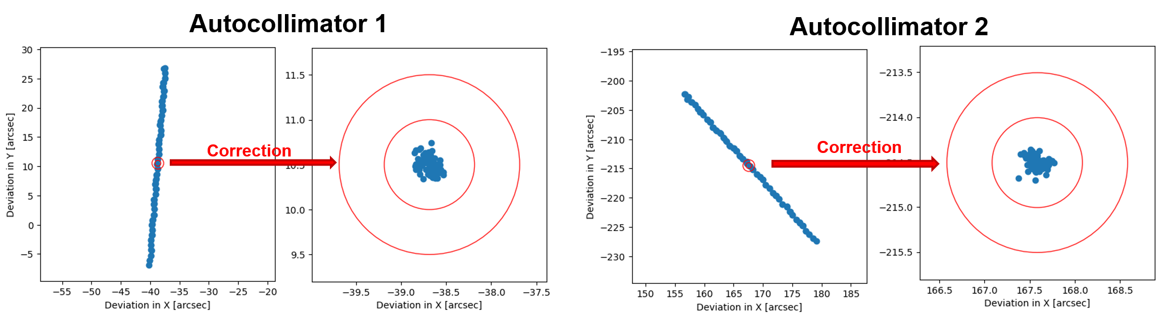
Work on MINERVA:
Bayesian orientation correction:
  Hexapod+mirror module block is moved with a vertical linear stage in a range of ±20 mm.
  Orientation with deviations higher than 0.5 arcseconds are corrected.
  Only 1 correction that takes from 1 to 2 seconds is needed.
Measured
6 November 2024
D. Heinis et al. SPIE proceeding (2024)
Postdoc Day

Slide 17
Networking:
  The work done in MINERVA made me meet colleagues from other areas
  I am in contact with colleagues from other Optical Laboratories of other Synchrotrons. For instance:
      Lei Huang (Brookhaven), Mourad Idir (Brookhaven)
      Amparo Vivo (ESRF), François Perrin (ESRF), Raymond Barret (ESRF)
      Simon Alcock (Diamond), Murilo Da Silva (Diamond)
      Other…
6 November 2024
Postdoc Day

Slide 18
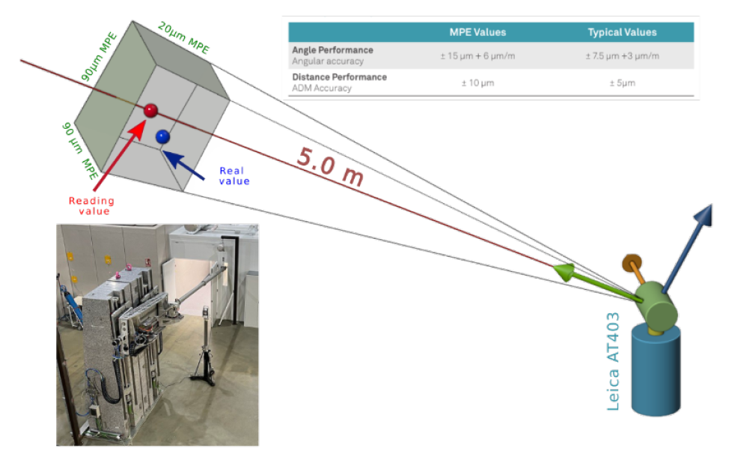
Future work at ALBA:
Optics Laboratory:
  Development of new techniques to measure strongly curved mirrors
  Evaluating the existing stitching errors for strongly curved mirrors
  Beamline diagnostics (at-wavelength metrology)
  Learn beamline design
Beamlines:
  MINERVA laser tracker positioning
U(x)
R(x)
Scanning direction
T_{p}
x_{p}
6 November 2024
Postdoc Day

Slide 19
Summary:
Working at the Optics Laboratory
Learning a lot of optical metrology, x-ray optics, and instrumentation
My research is based on optical metrology topics (e.g. stitching interferometry systems)
I am collaborating with people from ALBA and other synchrotrons
Challenging topics to face with in the near future (e.g. curved optics)
Interested in developing a career in the field of optical metrology
6 November 2024
Postdoc Day
Notes:
10% of the time
Try to summarize in a few bullet points; and try to be as precise in short as possible:
What are you good in; what you have already proven that you are good in? I am good
What is your goal for the ALBA stay.
What networks you have built during your stay at ALBA? I have met the people from the optical metrology laboratories of other synchrotrons.
Are there any issues which you have to overcome.

Slide 20
Acknowledgements:
Universitat Autonoma de Barcelona:
  Juan Campos
  Angel Lizana
Optics Laboratory Group:
  Dominique Heinis
  Igors Sicks
  Josep Nicolas*
  Guillem Alvarez (student)
Collaborators from other synchrotrons:
  Lei Huang (Brookhaven), Mourad Idir (Brookhaven)
  Amparo Vivo (ESRF), François Perrin (ESRF), Raymond Barret (ESRF)
  Simon Alcock (Diamond), Murilo Da Silva (Diamond)
Colleagues from ALBA
6 November 2024
Postdoc Day
Notes:
10% of the time
Try to summarize in a few bullet points; and try to be as precise in short as possible:
What are you good in; what you have already proven that you are good in? I am good
What is your goal for the ALBA stay.
What networks you have built during your stay at ALBA? I have met the people from the optical metrology laboratories of other synchrotrons.
Are there any issues which you have to overcome.

Slide 21
Thank you for your attention!
6 November 2024
Postdoc Day
Notes:
10% of the time
Try to summarize in a few bullet points; and try to be as precise in short as possible:
What are you good in; what you have already proven that you are good in? I am good
What is your goal for the ALBA stay.
What networks you have built during your stay at ALBA? I have met the people from the optical metrology laboratories of other synchrotrons.
Are there any issues which you have to overcome.

Slide 22
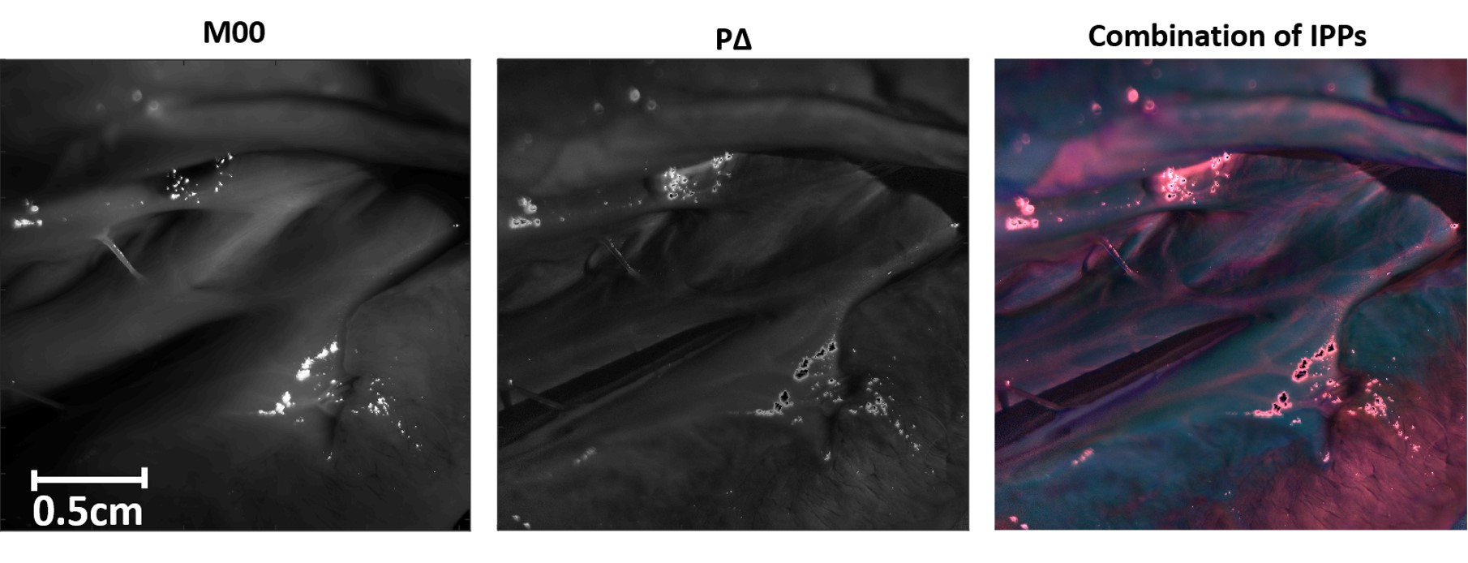
Key Work from the Past:
Depolarization in animal samples:
Dissected lamb heart measured at 625 nm
Intensity Image
Depolarization index (P∆)
Combination of IPPs
α₁ = 3; α₂ = 1, and α₃ = 1
Albert Van Eeckhout et al. Polarimetric imaging of biological tissues based on the indices of polarimetric purity, J. Biophotonics 11(4), e201700189 (2018).
6 November 2024
Postdoc Day
Notes:
This should take about 40% of the talk
Describe the scientific work you had done with
motivation why it is important
What exactly you have done and with whom
Are there any consequences from this work: you may have opened up a field, of there was a patent, any kind of IP……

Slide 23
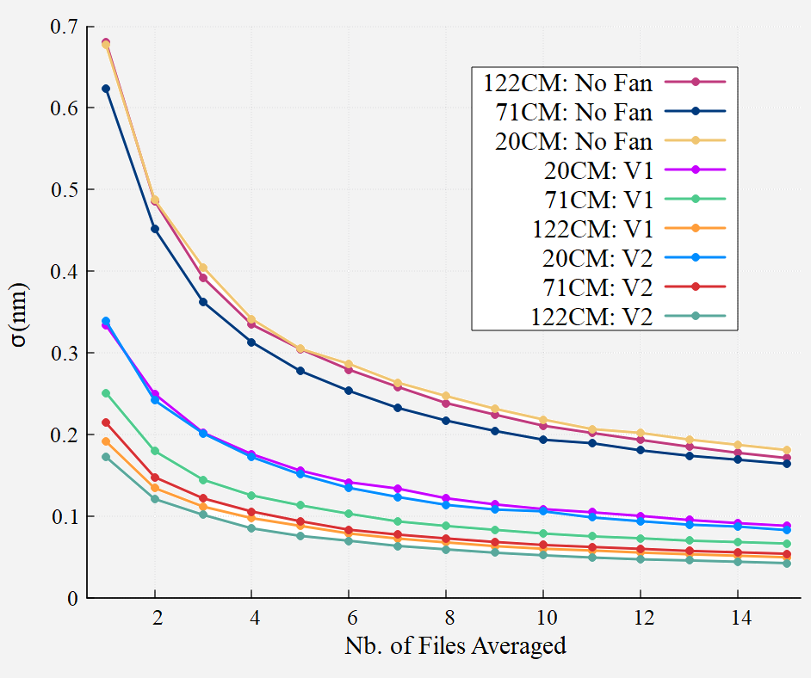
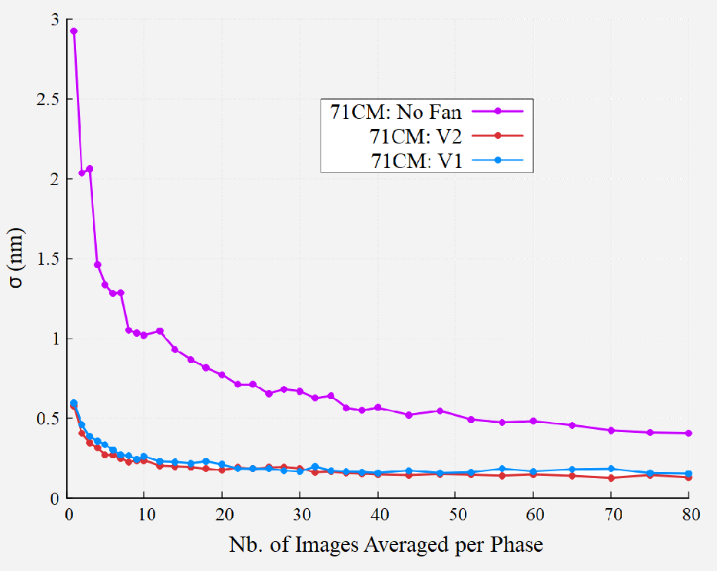
Work on stitching:
Repeatability as a function of averaged files:
(a)
(b)
6 November 2024
D. Heinis et al. SPIE proceeding (2024)
Postdoc Day

Slide 24
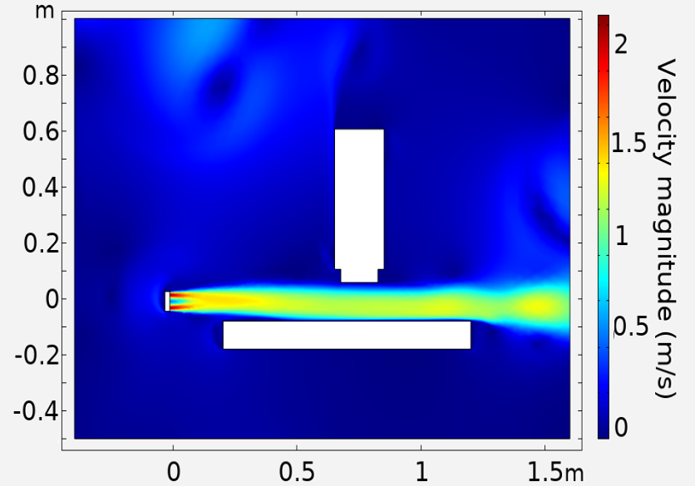
Work on stitching:
Why is the fan working?
(a)
(b)
6 November 2024
D. Heinis et al. SPIE proceeding (2024)
Postdoc Day

Slide 25
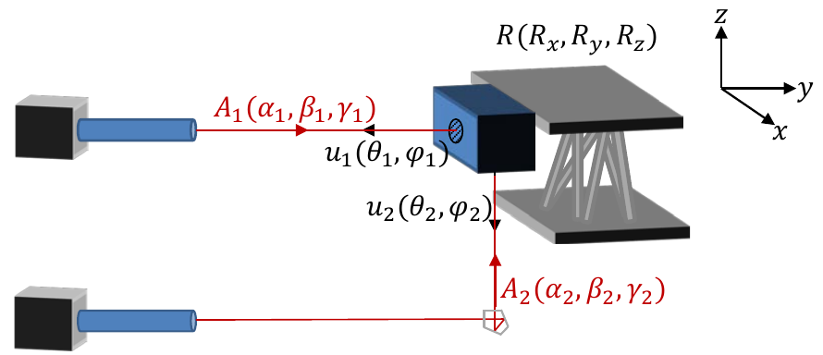
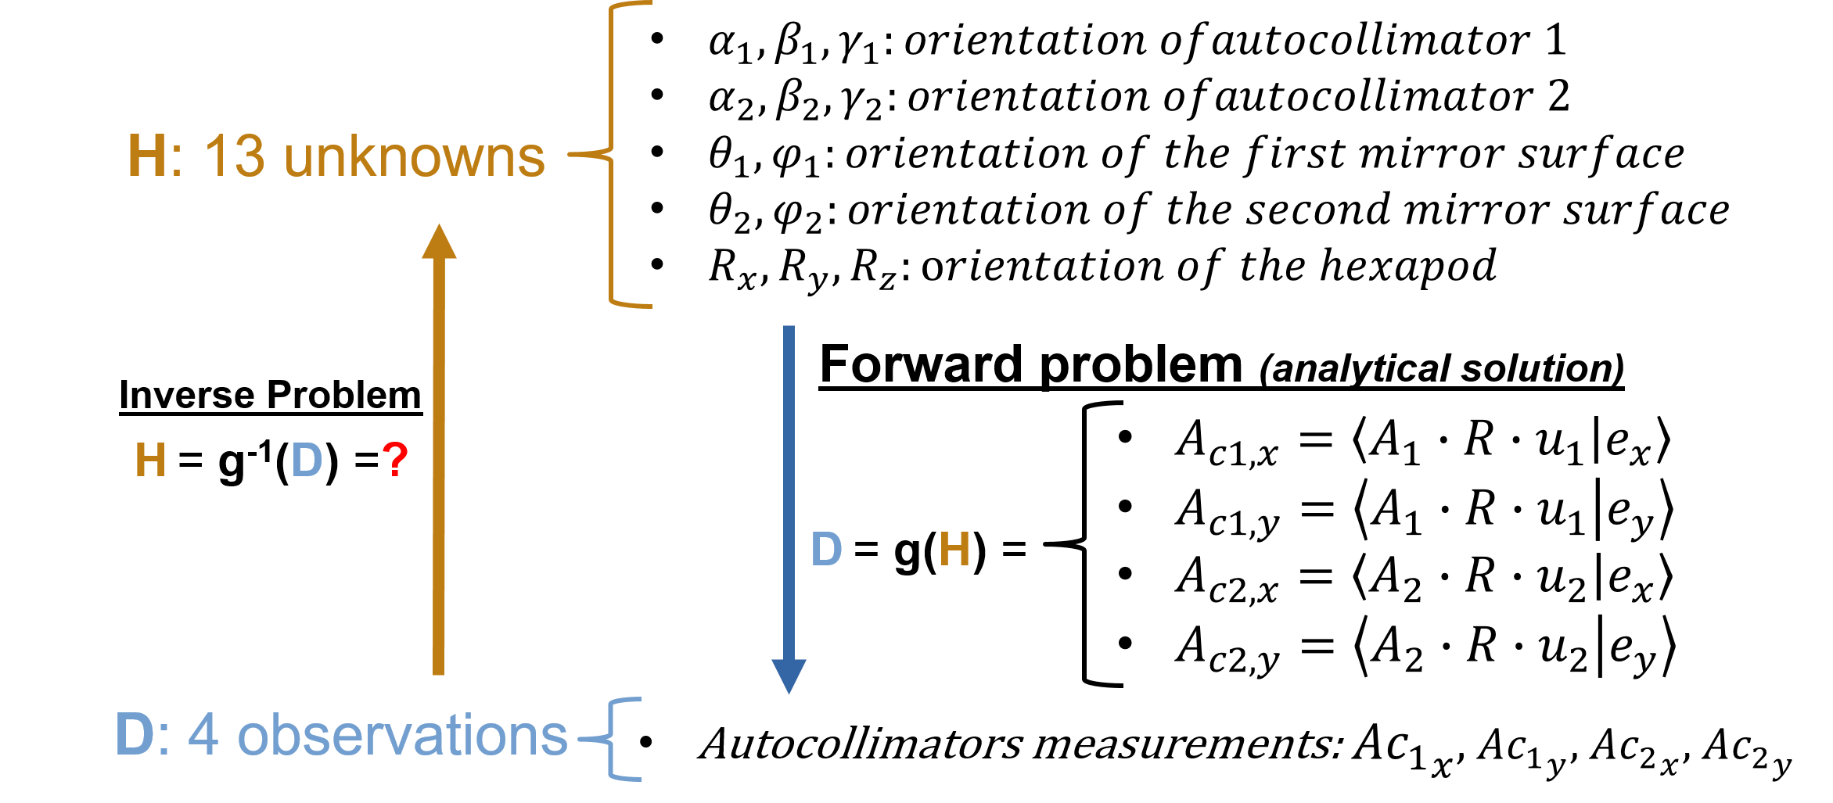
Work on MINERVA:
Bayesian model:
  We cannot model the Inverse problem.
  It forces a probabilistic approximation.
  Bayesian approach calculates the most probable result from the measurements with uncertainty (measurement errors).
6 November 2024
D. Heinis et al. SPIE proceeding (2024)
Postdoc Day

Slide 26
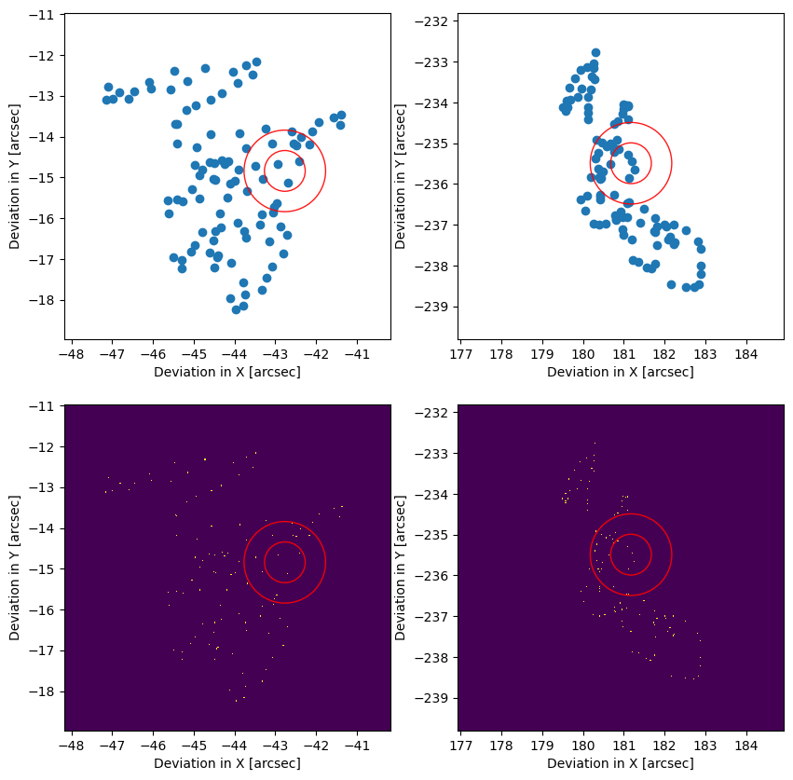
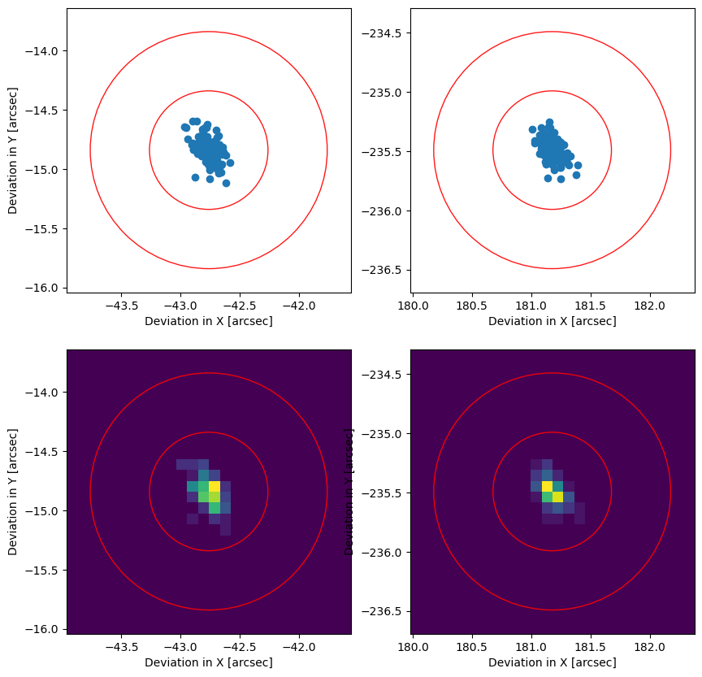
Work on MINERVA:
Bayesian orientation correction:
  Mirror module is vertically moved with the hexapod in a range of ±20 mm.
  Orientation with deviations higher than 0.5 arcseconds are corrected.
  Only 1 correction that takes from 1 to 2 seconds is needed.
Measured
Autocollimator 1
Autocollimator 2
Correction
Correction
6 November 2024
D. Heinis et al. SPIE proceeding (2024)
Postdoc Day

