Slide 1


2D BPM Simulation Codes: BEM and FEM fusion
BpmLab (FEM) developed in ALBA in 2017, and BEM developed in Diamond in 2004, both made for Matlab, have been extensively used across synchrotron labs and accelerator machines for the last 10 years. These codes precisely meet the needs of the Accelerator community, offering rapid and precise simulations of BPM sensitivity function and other related effects. Other alternatives are not as straightforward or accessible (like the expensive codes CST, HFSS), or are much older and limited (as Poisson, GdFidl, etc.).
This work summarizes the capabilities and potential of these 2D codes: arbitrary geometry layout, wall current and sensitivity function calculation, 2D response maps and various non-linearity correction methods, showing the benefits of a possible fusion between both FEM and BEM
This presentation summarizes the capabilities and potentials of two well known 2D BPM simulation codes for Matlab: BpmLab and BEM, developed in the last 2 decades and extensively used across synchrotron labs and accelerator machines all over the world.
Currently these codes are still powerful but outdated, there is a lot of potential to update them, and moreover - combine them. We show the benefits of a possible fusion between both FEM and BEM. The work will take place during 2025, and the first united code is anticipated to be released for public in early 2026.
Andriy Nosych (ALBA Synchrotron)
Guenther Rehm (Helmholtz-Zentrum Berlin)
BPM Button Workshop. ALBA, Dec 12, 2024

Slide 2
Our current options to model and study BPMs:
Electro-magnetic (3D)
CST Studio Wake/PIC ($$$)
HFSS ($$$ complex)
GdFidl ($$ complex)
Ace3P (complex)
Mafia (old)
Great for complicated geometries, TD & FD simulations, longitudinal dynamics, feed-through design, heating estimates.
All of them require external post-processing to access BPM-relevant parameters, and sometimes are overkill for the task.
Electrostatic (2D)
CST Studio ES ($$$)
Matlab PDE ($)
POISSON (old)
SuperFish (old)
Great for fast geometry/charge dependent calculations of relativistic BPMs.
BpmLab
Electrostatic FEM (2D)
for Matlab
BEM (1D/2D)
also TodoGUI
for Matlab
Free (only needs Matlab)
Fast
Flexible
Customizable
(Relatively) modern
All-in-one package
Community-made
Multitude of smaller-scale custom codes which exist in every lab
BUT…
Not flexible enough!
OUTDATED!

Slide 3

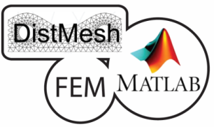


















2D finite element method-based (FEM) tool for Matlab that provides a fast and robust way to observe and treat the nonlinear distortion of a BPM.
ALBA
Soleil
ESRF
ILSF
CERN
ALS
Elettra
KEK
IHEP
BESSY
DESY
Sesame
CAS
INFN
Sirius
LNLS
HBNI
SLAC
DLS
KIT
…
Developed in 2016 in ALBA.
Later significantly extended under a collaboration with ESRF.
Used in a multitude of labs all over the world.
Contains an extensive editable real-life BPM library.

Slide 4
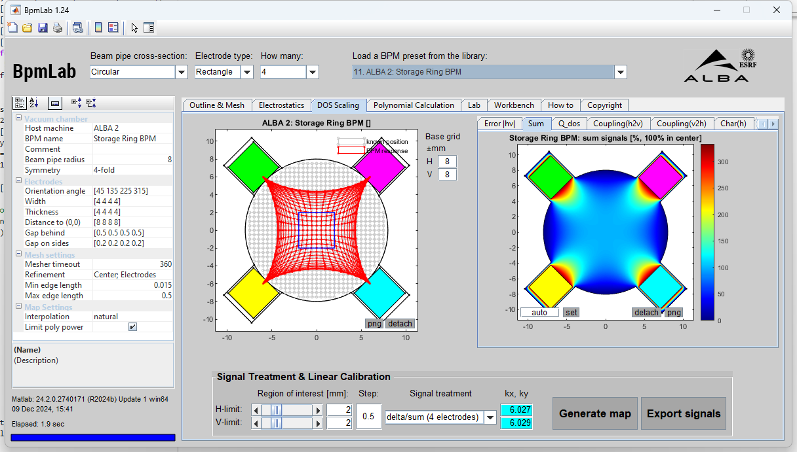
Main Features
OS/Matlab version-compatible (Win, Linux, Mac): tested for Matlabs v2013-2024
Arbitrary 2D geometry definition (analytic or polygonal): cross-sections of buttons, striplines, shoeboxes
Benchmarked VS. analytic wall-current method (WCM), BEM, CST (electrostatic, PS), ACE3P (T3P).
Tool-box free, using open-source libraries:
Tetrahedral mesh generator DistMesh,
Fast Laplace 2D FEM solver with linear basis functions and boundary electric potential excitation (ref1, ref2),
Green’s reciprocity theorem used to get all beam positions in x4 simulations
Geometrical nonlinearity correction with linear scaling factors, 1D/2D polynomials (polyfitn) or direct voltage-to-position inversion (minFunc).

Slide 5
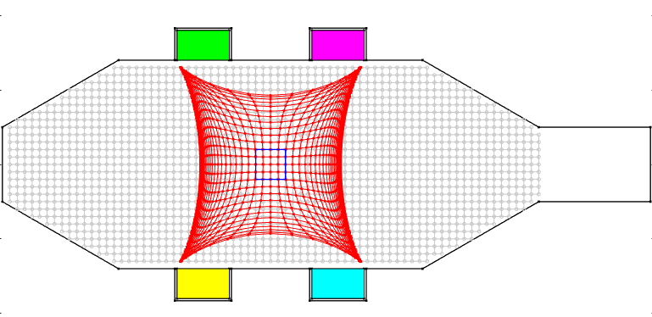
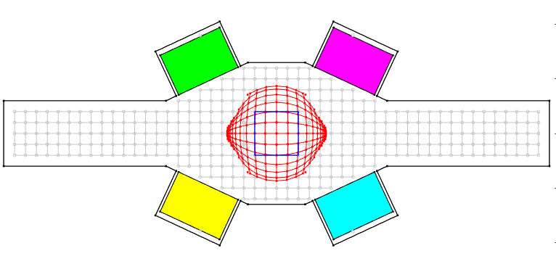
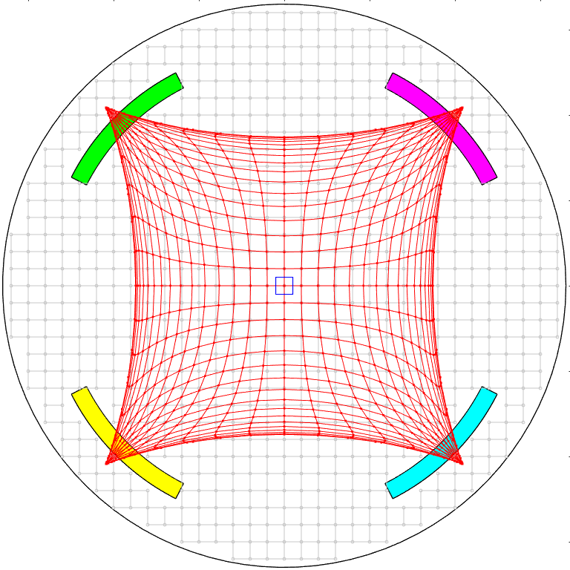
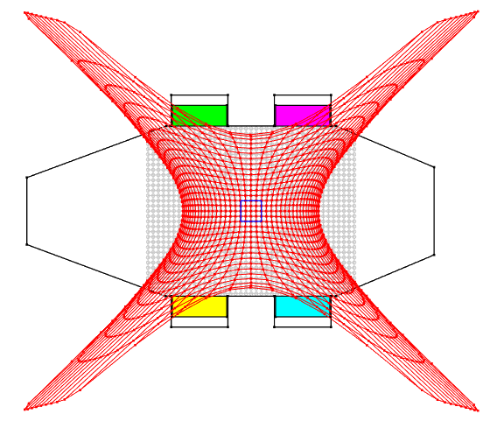
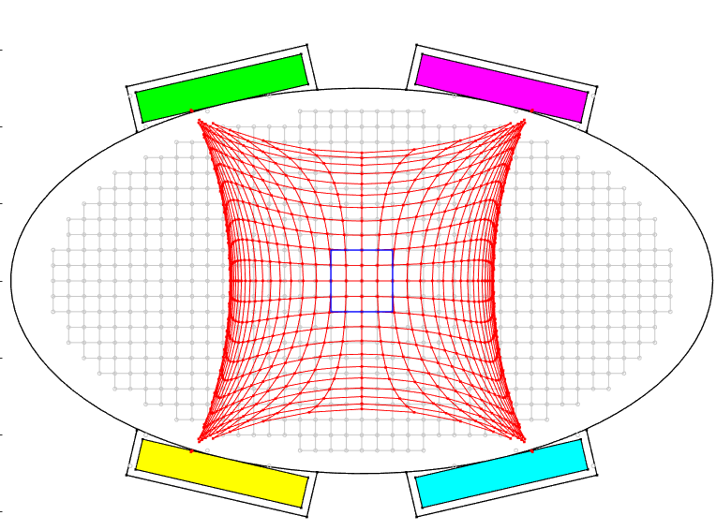
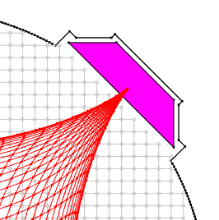
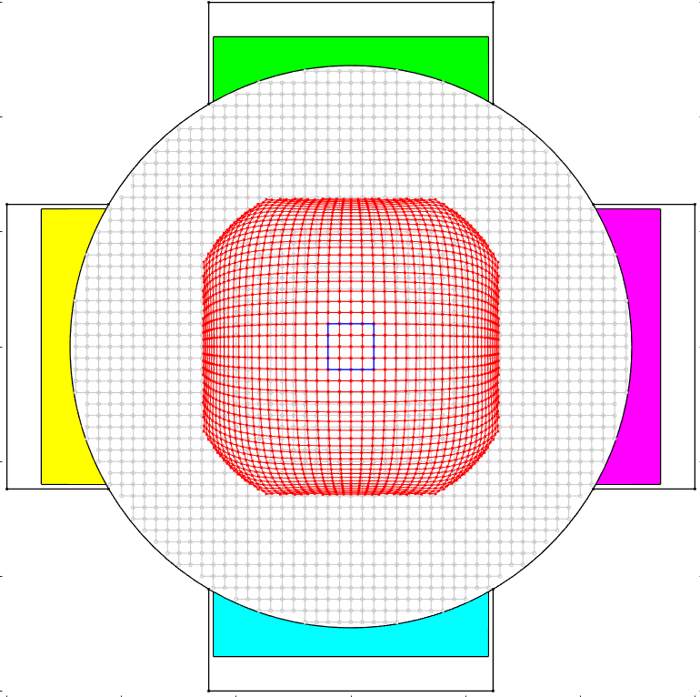
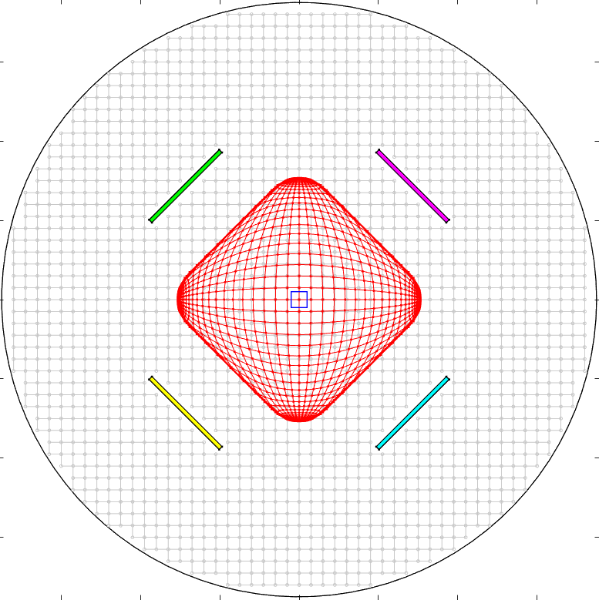
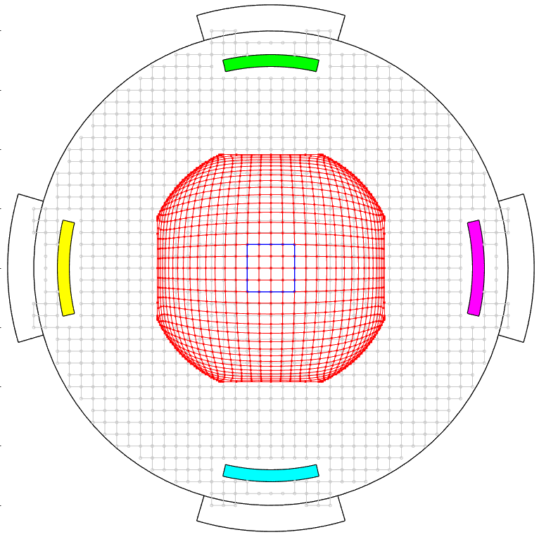
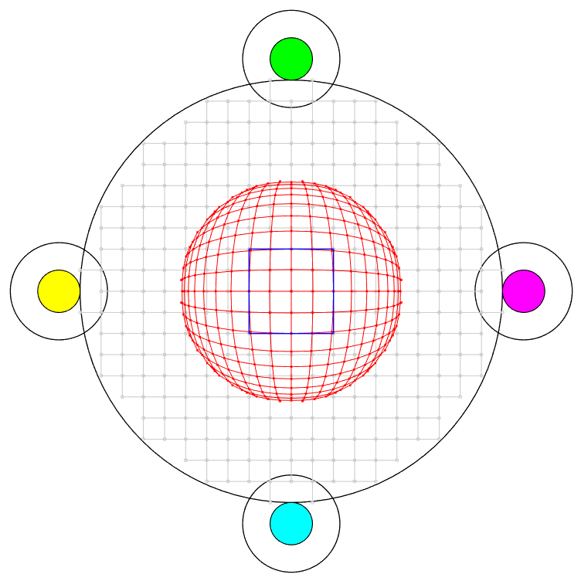
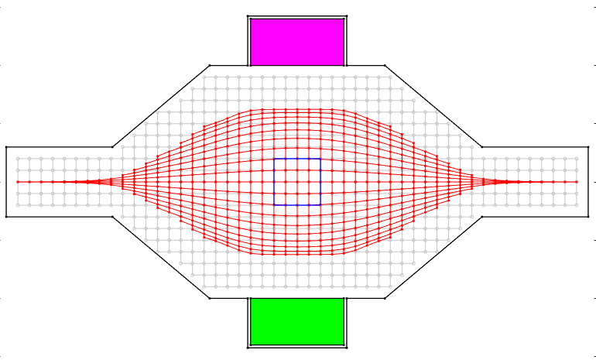
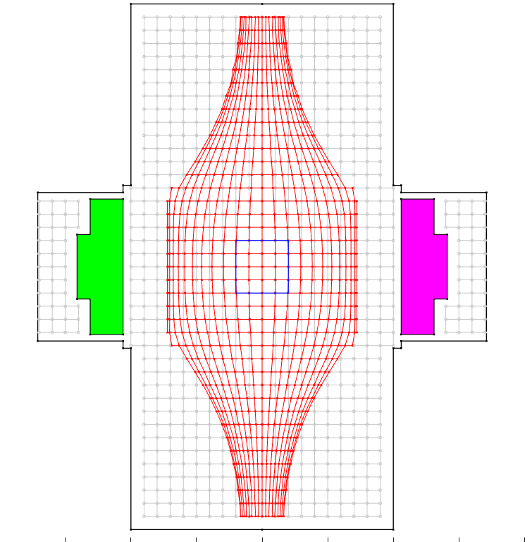
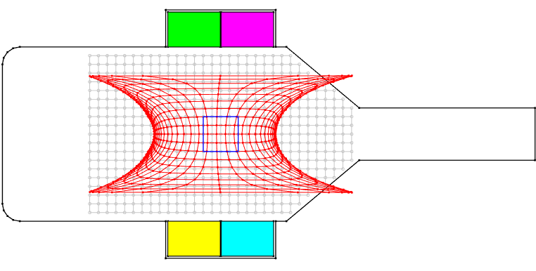
ALBA
EBS
LHC
ESRF
WHY BpmLab?
2 or 4 electrode BPMs.
Intuitive geometry definition: combinations of several analytical shapes and polygons, most common to BPM designs.
A big library of real-life BPMs are directly available as editable presets.
Estimates linear region and calculate scaling factors.
Study and compare performance of chosen nonlinearity correction methods: with scaling factors, 1D/2D low/high power polynomials, and voltage-to-position inversion.
Geometrical imperfections studies: their effect on BPM response and electrical center.
Import of real BPM voltages for post-processing.
Signal manipulation studies: channel distortion, attenuation, amplification and their effects on response map.
Petra3
Sirius
LHC
Tesla
SESAME
ELI
EBS
SPS

Slide 6
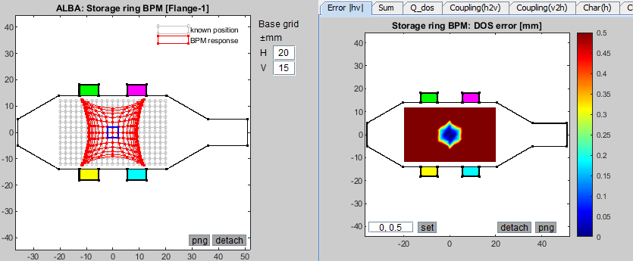
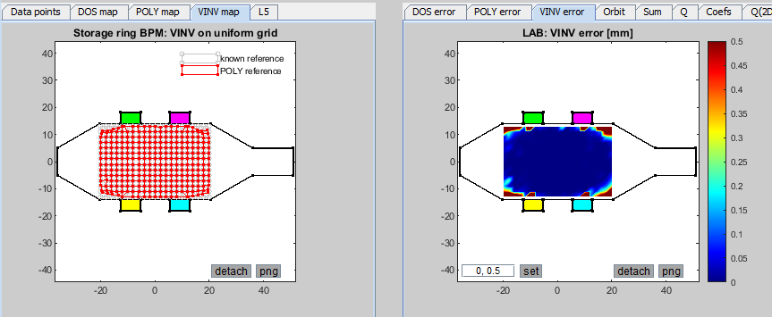
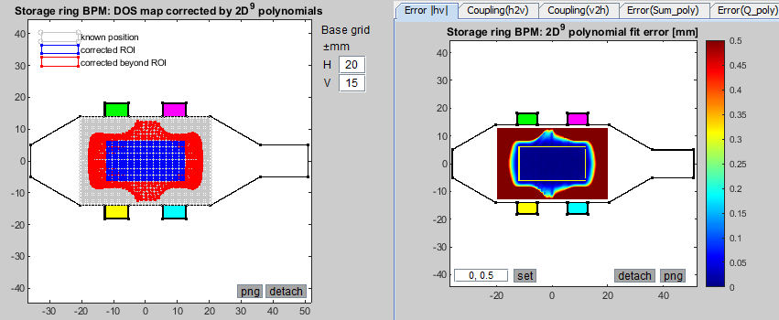
BPM response map corrections within BpmLab
Linear correction by scaling factors:
Voltage-to-position inversion:
2D Polynomial correction:

Slide 7
BEM
Boundary element method (BEM) tool for Matlab that provides a yet faster way to calculate BPM sensitivity and other characteristics.
Developed in 2004 in Diamond; later significantly extended with a GUI in ALBA in 2009.
Used across many labs, mainly customized versions.
Fast tool for Matlab with many useful calculations in one package.
(and many more)
Courtesy of G. Rehm, A. Olmos

Slide 8
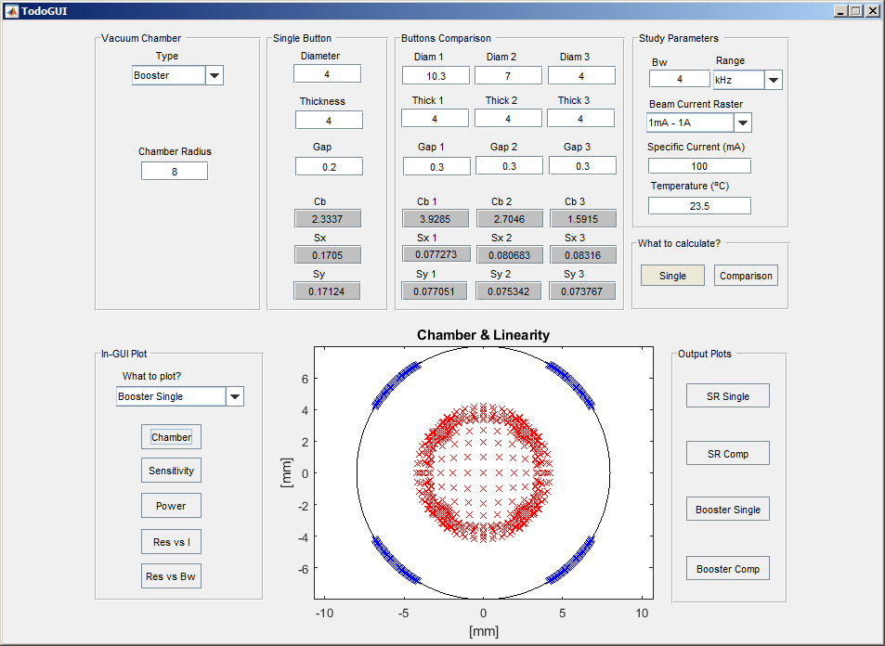
BEM is based on the PDE solution of the Poisson equation with Dirichlet boundary conditions.
Assuming flush electrodes, it has been reduced to deal with the boundary rather than the whole region, reducing the dimension of the problem to 1D.
BEM
MAIN FEATURES
OS/Matlab version-compatible (Win, Linux, Mac):
Tool-box free
BEM Solver: a simplified Electrostatic method to calculate wall charge from point charge excitation
Boundary contour discretization: few mesh nodes
Electrostatic problem dimension reduced to 1D: extremely fast calculation!
Courtesy of G. Rehm, A. Olmos

Slide 9
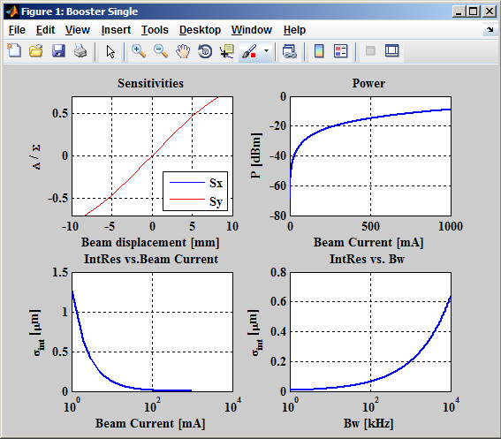
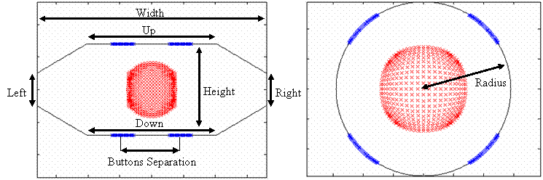
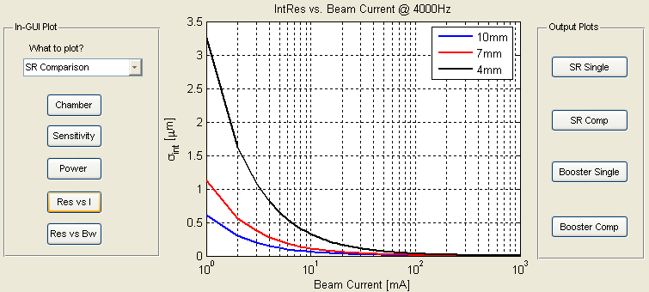
BEM
WHY BEM?
Point source excitation with a charge
Sensitivity calculation (DOS) for H and V axis
Power on electrodes for 50 Ohm load wrt. Beam current
Electrodes signal level wrt. Beam current
Capacitance calculation of electrodes
Intrinsic Resolution (Bw and temperature) vs. Beam current
Two scalable geometries available in the GUI version:
Courtesy of G. Rehm, A. Olmos

Slide 10
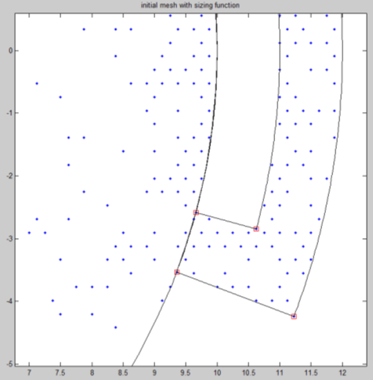
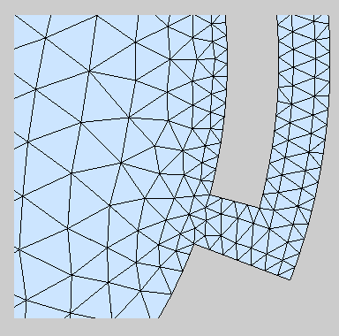
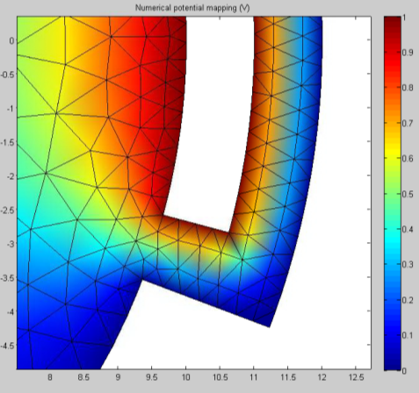
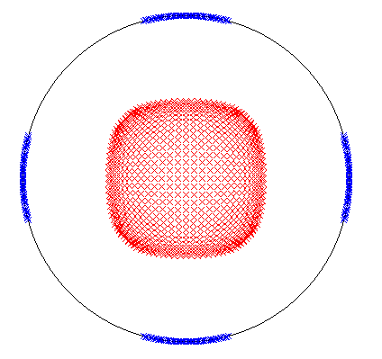
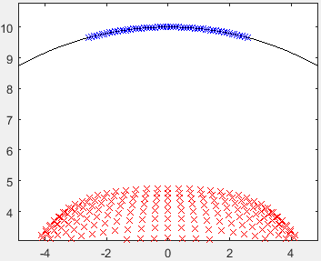
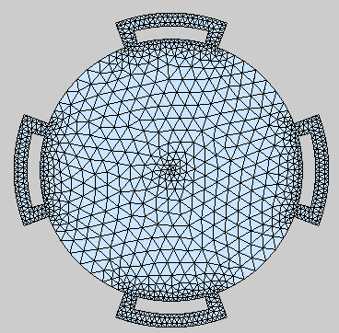
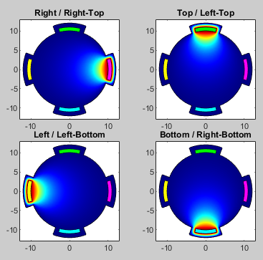
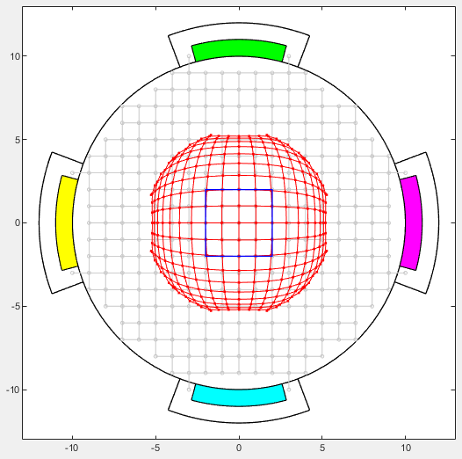
BpmLab
BEM
Solver differences
2D volume mesh generator -> 10x thousands of mesh nodes.
Electrostatic potential distribution in closed volume.
Use of Greens theorem: 4x calculations of Poisson’s equation.
Electrodes are isolated from chamber.
Beam charge independent.
BPM cross-section considered as closed contour.
1D Contour discretization -> Hundreds of mesh nodes.
Sections of contour considered as electrodes.
Wall charge is integrated over every section.
Electrodes are assumed flush with chamber.
Beam charge dependent.

Slide 11
BpmLab
Problems and disadvantages to date
BEM
Old Matlab syntax < 2014 → slow code execution.
Use of java functions → slow code execution → Matlab to drop support of java soon.
Geometry optimization very complicated due to re-meshing at every step.
Graphics errors on different modern OS/machines.
Command-line version is the only maintained one
Few geometries available.
Most model and simulation parameters are hardcoded → not scalable.
GUI made for old versions of Matlab < 2009.
Every lab has their own edition.
Only bug-fixing makes sense.
Updates or extensions are complicated because of old code.

Slide 12
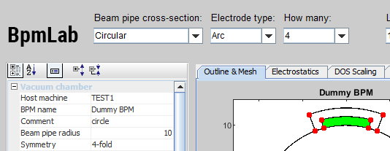
FEM
BEM
COMBINING THESE TWO BRINGS A LOT OF POTENTIAL!
Speed
Flexibility
Scalability
Optimization
Machine Learning
Education
Comparisons
Benchmark of two methods in one box
!
BEM works for hexagonal and round chambers with flush electrodes.
Hence, the only bottleneck could be complex geometries, e.g. striplines or asymmetrical chambers…
In the future edition of BpmLab: new tabs!
Solver selection:
Electrostatics (FEM)
Boundary-element (BEM)
Electrode characteristics
Power, capacitance, intrinsic res., etc.

Slide 13
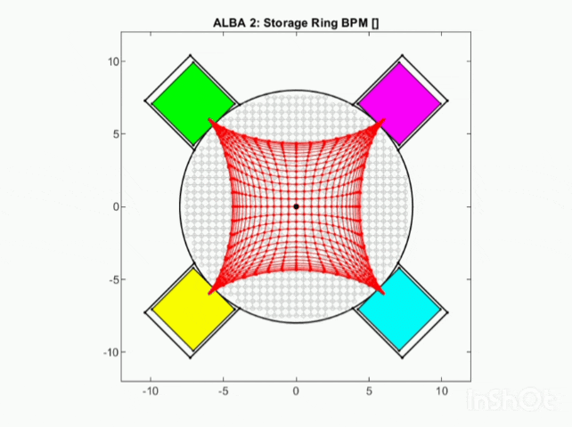
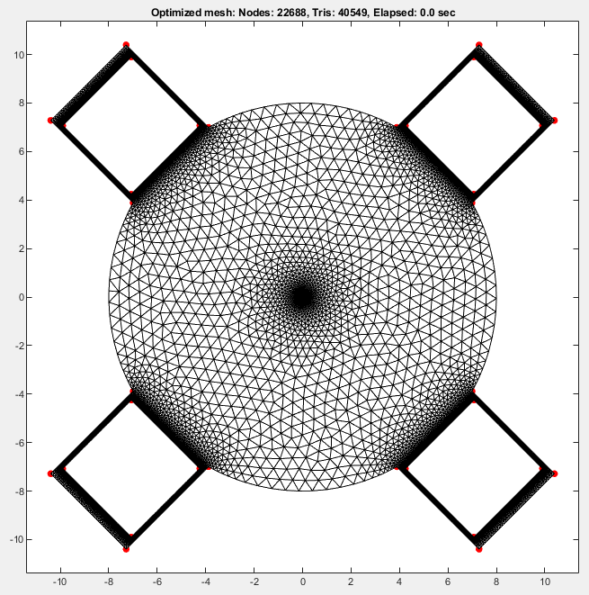
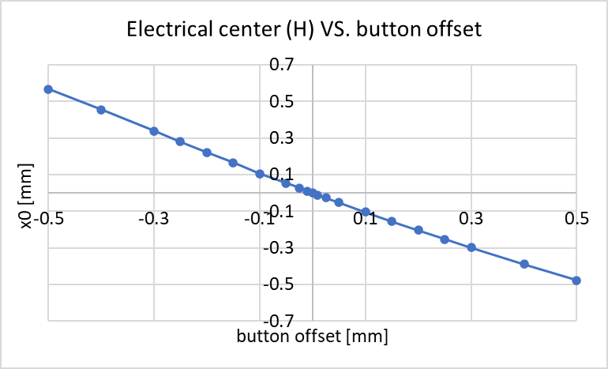
Fresh example where a fast 1D solver would be more beneficial than 2D:
button misalignments study of ALBA-2 BPM [±10 um to ±2mm]
Mesh requirements for FEM:
retraction
protrusion
Min mesh edge: 15 um
Max mesh edge: 50 um
We discover that hor. electrical center position is quite linear and inv prop to button displacement.
For every button offset BpmLab needs a new 2D mesh: 10-30 minutes to make a good mesh.
This gif took >6 hours of compute. With FEM this would take minutes!

Slide 14
Acknowledgements
Ubaldo Iriso (ALBA), Marek Gasior & Manfred Wendt (CERN BI), Guenter Rehm (DLS), Kees-Bertus Scheidt (ESRF).
Special thanks to Jan Olle for his valuable contribution to the project at its birth.
Download and contact
BpmLab v1.24 (2024) Andriy Nosych (ALBA), anosych@cells.es
BEM/TodoGUI (2014) Guenther Rehm (Helmholtz-Zentrum Berlin), guenther.rehm@helmholtz-berlin.de
Slides and code: https://indico.cells.es/event/1542/
References
A. Nosych, U. Iriso, J. Olle, "Electrostatic finite-element code to study geometrical nonlinear effects of BPMs in 2D", Proceedings of IBIC-2015, TUPB047 [PDF].
DIPAC07-MATLAB CODE FOR BPM BUTTON GEOMETRY COMPUTATION (Paper, A. Olmos)
Sensitivity calculation of beam position monitor using boundary element method, Tsumoru Shintake, Masaki Tejima, Hitoshi Ishii, Jun-ichi Kishiro. DOI: 10.1016/0168-9002(87)90496-7
http://www.lnf.infn.it/acceleratori/dafne/NOTEDAFNE/CD/CD-10.pdf
DAPHNE TECHNICAL NOTE CD-10, "ANALYSIS OF THE DA?NE BEAM POSITION MONITOR WITH A BOUNDARY ELEMENT METHOD“, A. Stella

Slide 15

Thank you for your attention!
ESRF, DEELS-2019
FEM!
BEM!

Slide 16
extras

Slide 17
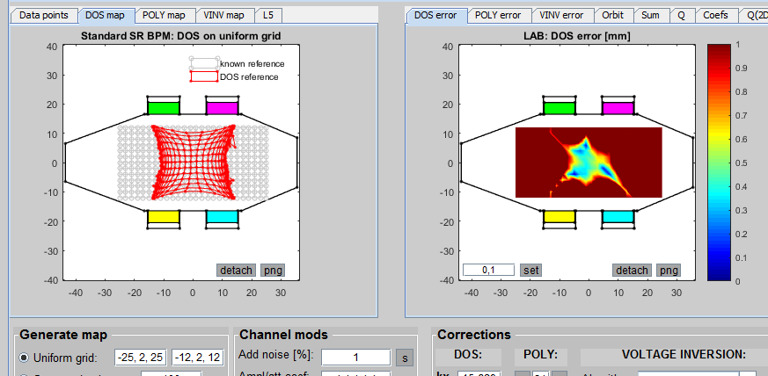
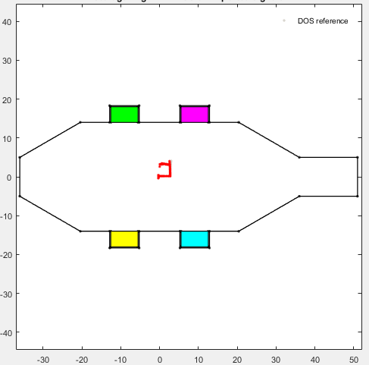
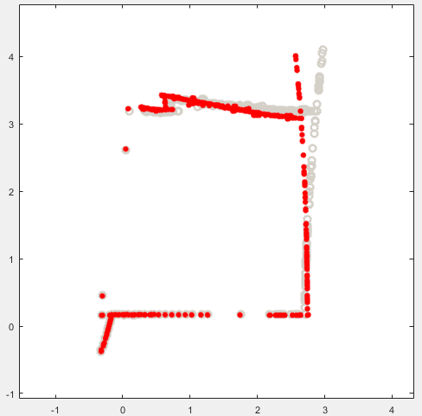
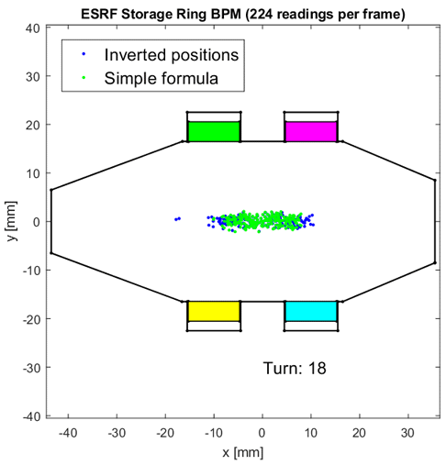
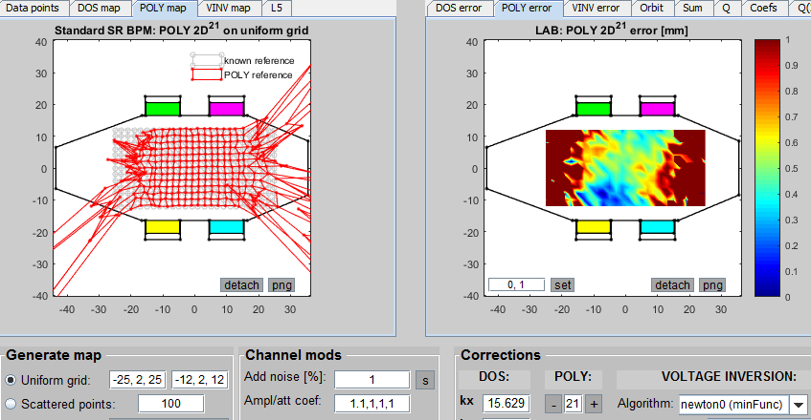
Beam tests
Add noise (1%) to all channels: after DOS treatment
ESRF, DEELS-2019
ALBA SR
Local bump, 4 orbit-correctors
Poly corrected
DOS
ESRF SR: injection with RF off
after Poly correction
Hor: 0 → 3 mm
Ver: 0 → 4 mm
Each dot:
position in one BPM (224 BPMs total)
Each image: turn

Slide 18
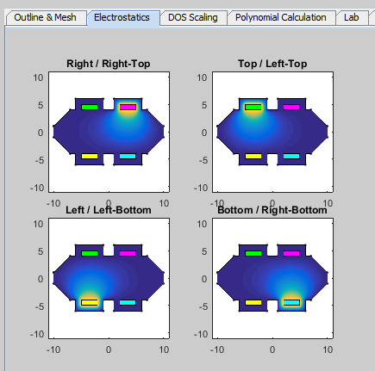
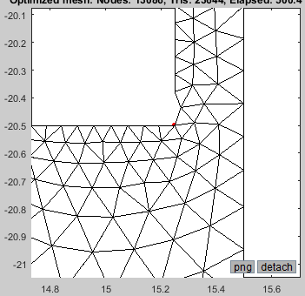
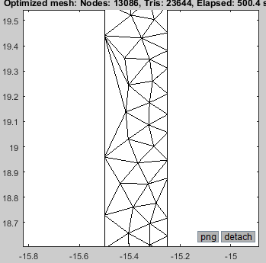
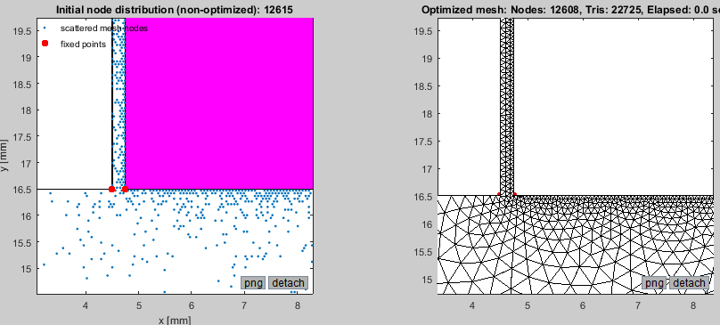
Meshing:
Open-source tetrahedral mesh generator
based on metric functions (DistMesh).
Uniform or non-uniform meshes
User-defined min/max mesh size
Extremely reliable inner mesh
Boundary mesh QA: by eye. Always check!
ESRF, DEELS-2019
FEM Solver:
2D electrostatic Poisson solver with linear basis functions and boundary electric potential excitation (Diriclet boundary conditions):
4 calculations for all beam positions
NOT OK
250 um
Examples of a badly converged mesh
OK
Green's reciprocity theorem: the surface charge induced on an electrode due to a test charge at (x,y) is proportional to the potential at that same position when the test charge is absent and the electrode is excited by a potential V.
Properly converged mesh

Slide 19
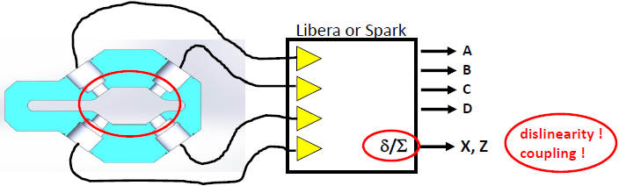
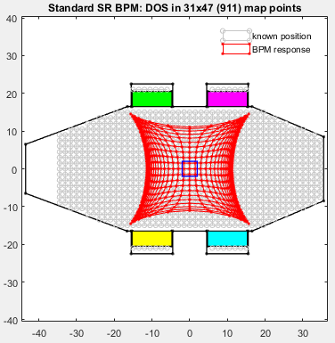
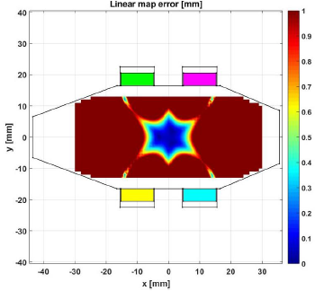
Perfect BPM & low noise stable electronics are still imperfect:
ESRF, DEELS-2019
Linearity error
How to correct?
Linear coefficient (real-time)
Polynomial families (real-time)
Specific formulae (real-time)
Lookup tables (post-process)
Voltage inversion (post-process)
At what level? (by DS/Libera? by end-user?)
How fast? (TbT 100x kHz, FA 10x kHz, SA 10x Hz)

Slide 20
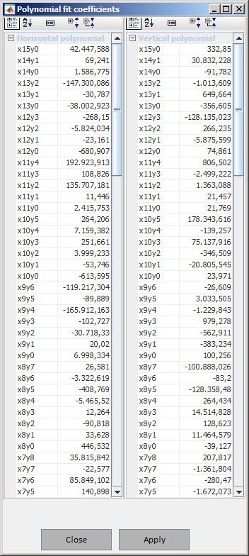
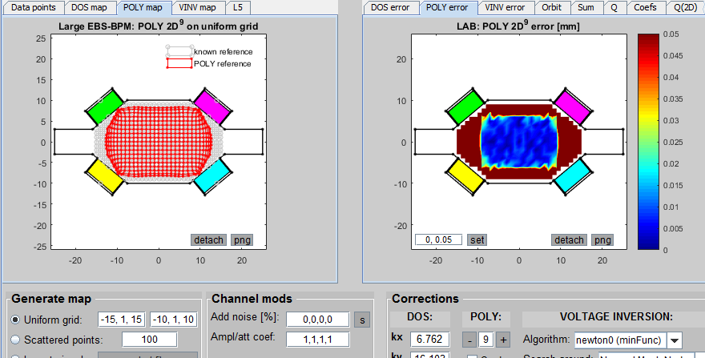
Polynomial correction seems to be the straight-forward solution if you want to have large beam drifts, and have fast real-time position nonlinearity suppression.
ESRF, DEELS-2019
2 polynomials need to be applied to each data sample:
A, B, C, D
δx/Σ
δy/Σ
Px(δx/Σ, δy/Σ)
Py(δx/Σ, δy/Σ)
Polynomials are coupled 2D type.
Higher power = more coefficients, e.g.:
Max pwr 7: 36 terms
Max pwr 13: 105 terms
etc.

