Slide 1
Design and manufacture and test experiences of the HEPS Button BPM
Jun He, Yanfeng Sui
Institute of High Energy Physics
2024-12-11

Slide 2
Contents
1
HEPS and BPM system
2
BPM design and manufacture
BPM test
3
Summary
4

Slide 3
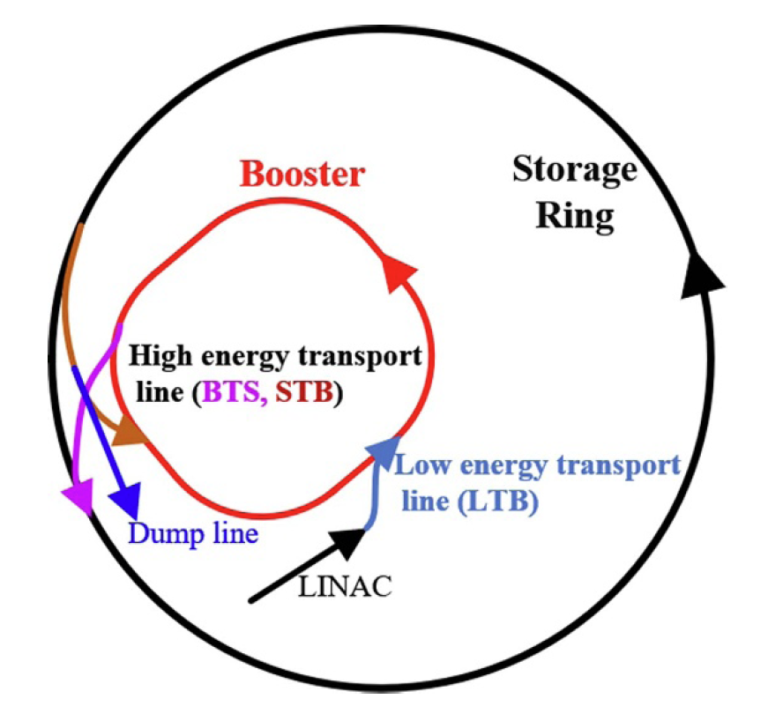
1. HEPS BPM system overview
Number and distribution of HEPS BPMs
 | Linac | LTB | BTS/STB | Booster | Dumpline | Ring
Button | 2 | - | - | 79 | 0 | 578
Strip | 6 | 8 | 22 | 1 | 2 | -
Characteristic:
1: Independent girder + shared girder
2: Self developed BPM read-out electronics
3: Water cooled constant temperature cabinet
4: Bundled cable （5-in-1, 4 for button 1 for PT）
5: With SO/FOFB system
6: With Bunch by Bunch FB system （Transverse and longitudinal ）
Schematic layout of the HEPS
HEPS：an energy of 6 GeV and a natural emittance of 34 pm rad, which includes a LINAC, a booster (454 m), a 1360 m SR, a lowe nergy transport line (LTB), two high-energy transport lines (BTS and STB ~100m), and a dump line.
Notes:
High Energy Photon Source with an energy of 6 GeV and a natural emittance of 34 pm rad. Figure 1 shows the schematic layout of the HEPS, which includes a linear accelerator (LINAC), a booster (Booster 454m), a 1360.4 m SR, a low energy transport line (LTB), two high-energy transport lines (BTS and STB 100 m), and a dump line. Table 1 summarizes the main physical parameters of the HEPS [2].

Slide 4
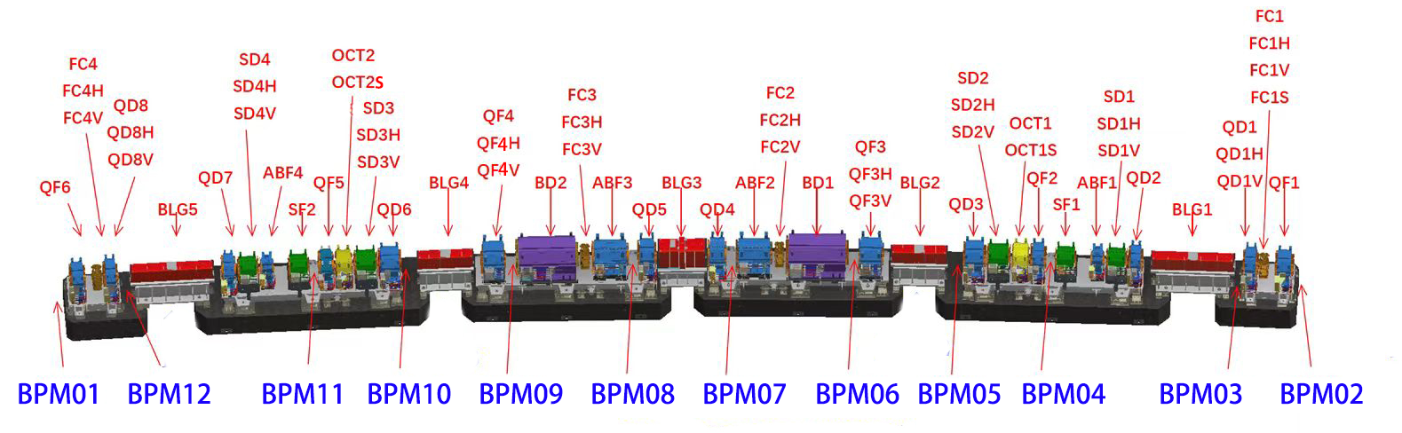
1. HEPS BPM system overview
Parameters | Requirement | Instruction
Resolution | <0.1 μm | Update rate 10 Hz, 200 mA （Slow orbit）
 | <0.3 μm | Update rate 22 kHz, 200 mA （Fast orbit feedback 10 turn）
 | <1 μm | Update rate 220 kHz, 200 mA （Turn by Turn）
First turn | <500 μm | 0.05 nC Bunch charge
BPM alignment accuracy | <±50 μm (x/y) | Related to the adjacent quadrupole
 | <±150 μm (z) | Related to the adjacent quadrupole
 | ±0.2 mrad | Pitch/yaw/roll
Hermeticity | <1 × 10⁻¹¹ Pa·m³ s⁻¹ | He
Specification of the BPMs.
48 × 7 BA, 12 BPMs, 4 fast, 8 slow correctors in one cell. BPM 01 &02 with independent girder

Slide 5
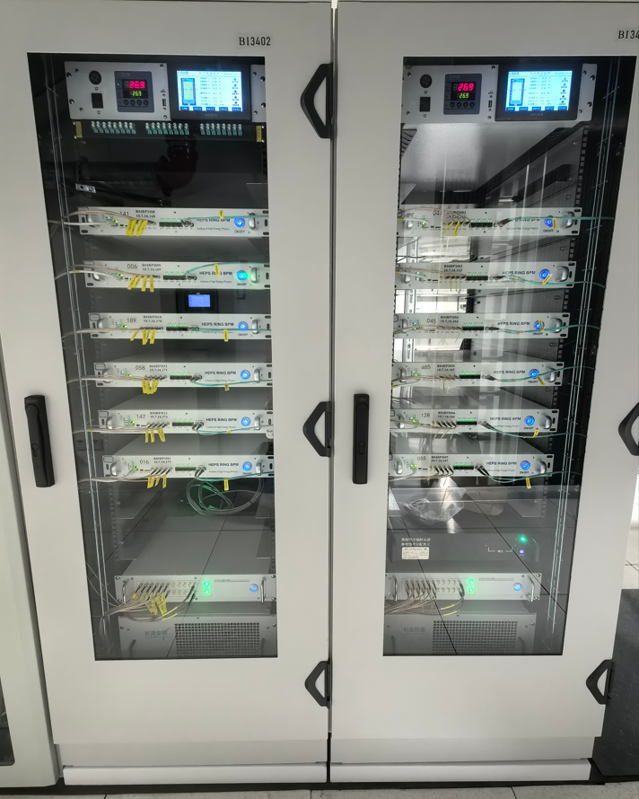
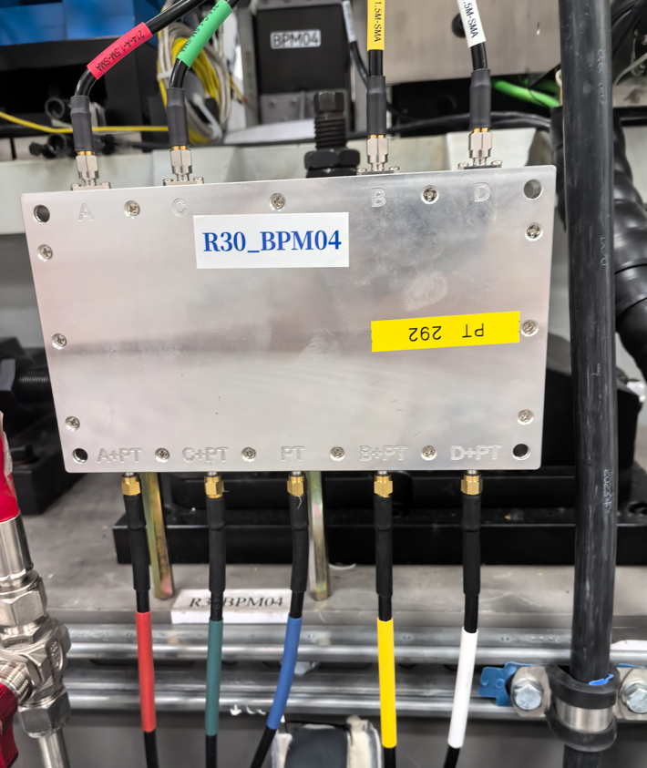
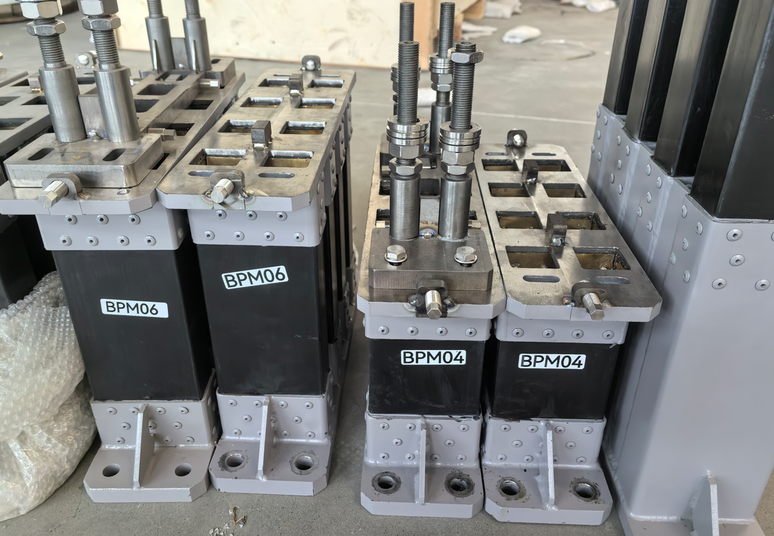
1. HEPS BPM system overview
Thermostatic cabinet: ±0.1℃
Home made reading-out electronics：Pilot tune box
Girder：Invar 4J32(lower) + Carbon fiber M40J(middle)+TZM(upper)
TZM
carbon fiber
Invar

Slide 6
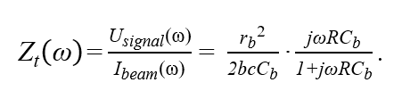
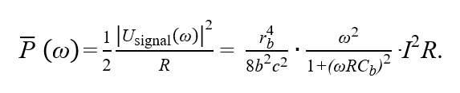
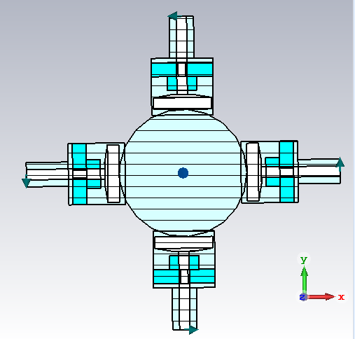
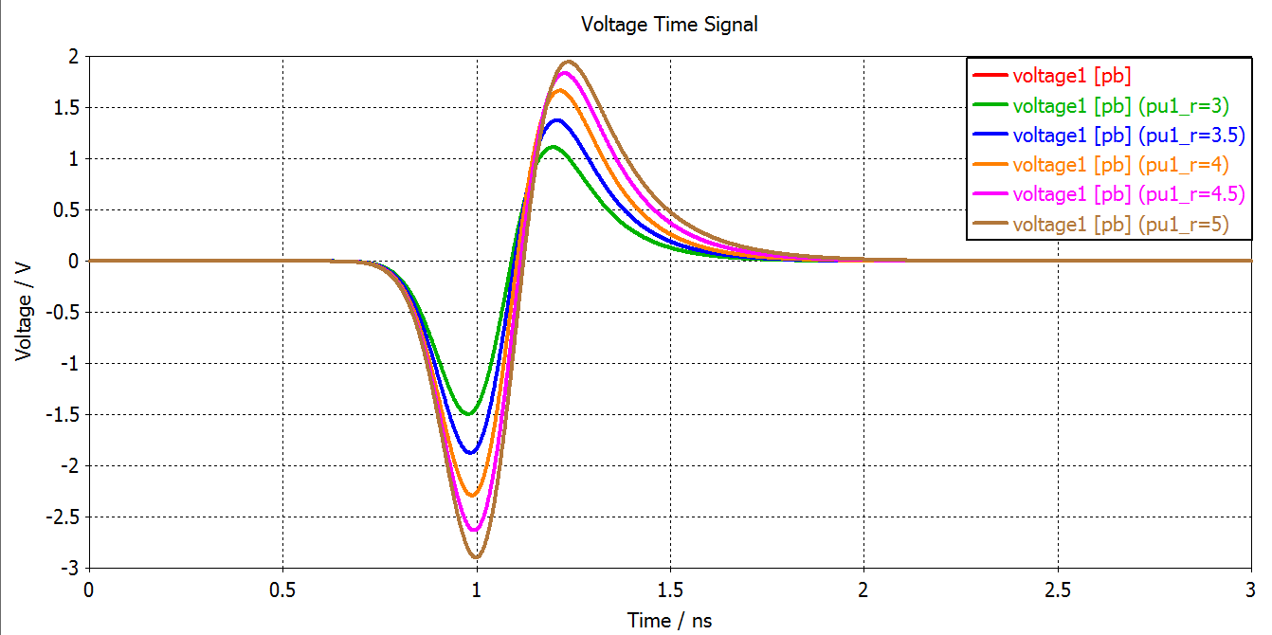
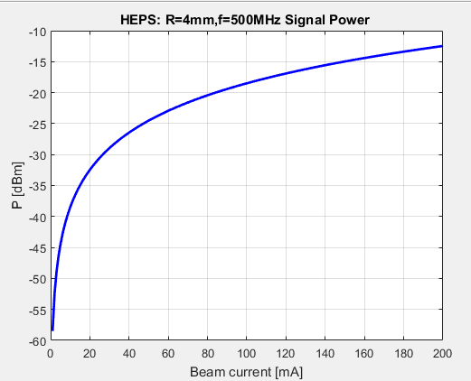
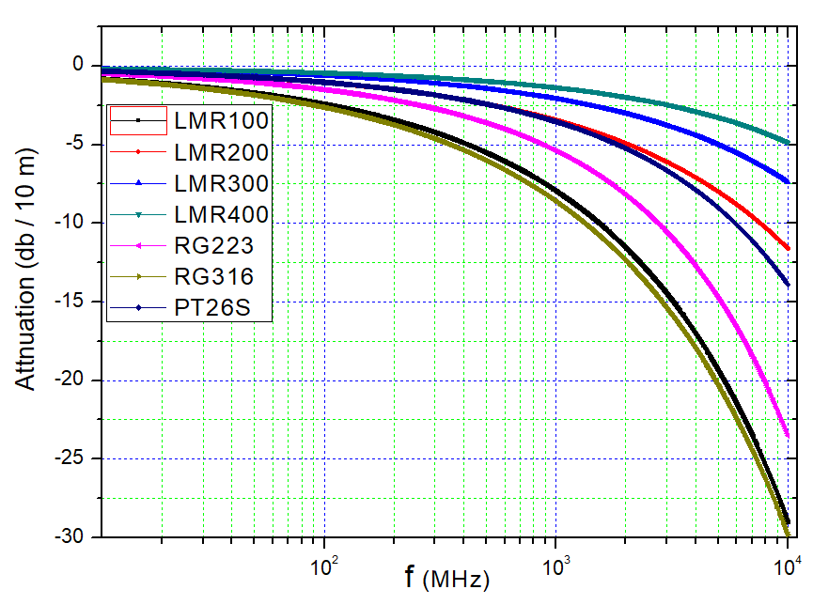
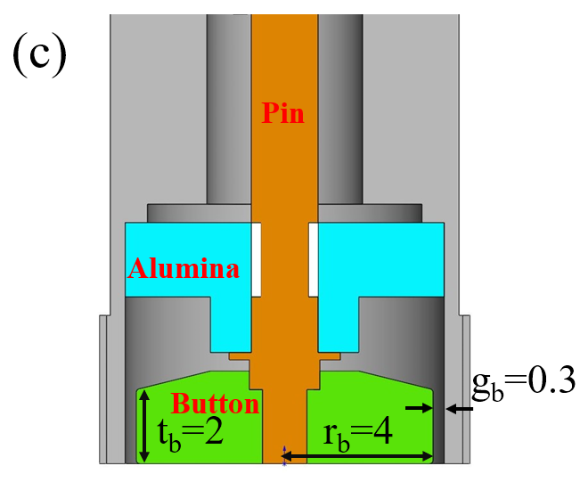

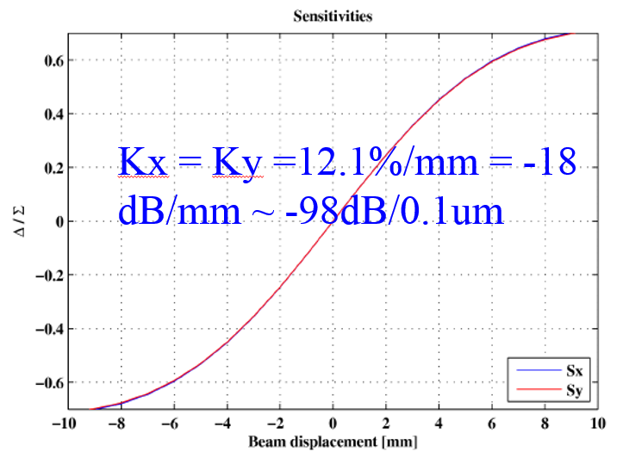
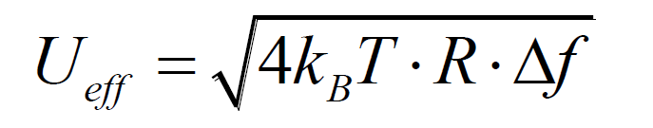



2. BPM design
Pipe
Radius-rb
Height-tb
Gap- gb
Mechanical design
Signal Vs Button
（Single bunch）
Signal Vs Current
（Multi-bunch）
Cable response
Thermal noise under different bandwidths + amplifier Noise Figure
Required Resolution
Evaluated SNR
Δ/Σ Vs position
Required SNR
Resolution

Slide 7
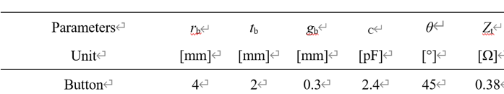
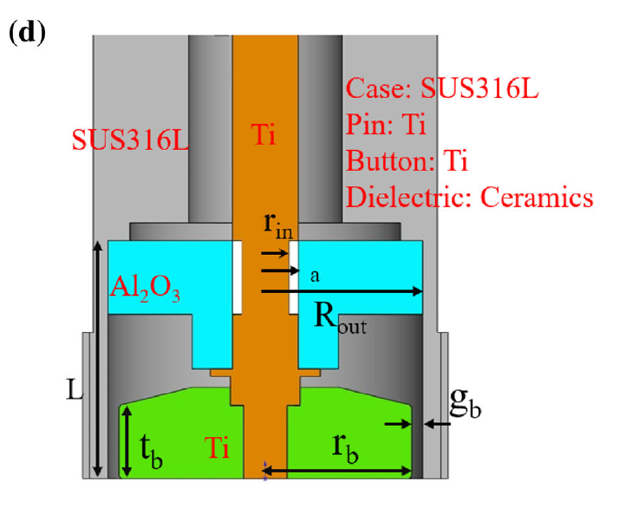
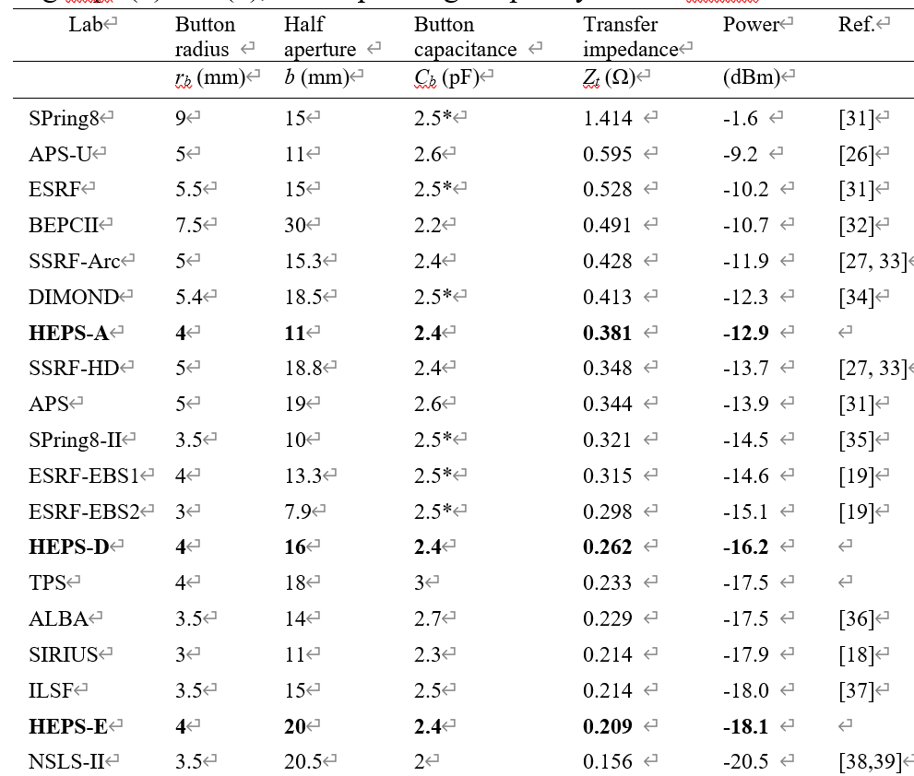
2. BPM and feedthrough design
Transfer impedance signal power (I = 200 mA) of light sources and colliders at an operating frequency of 500 MHz
Booster and Storage ring with the same button, different transfer impedance because of the pipe size

Slide 8
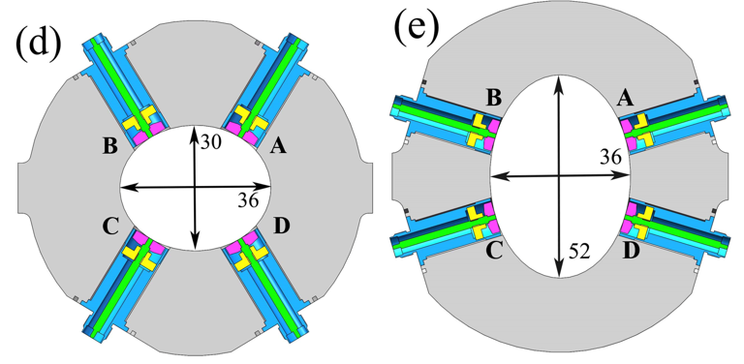
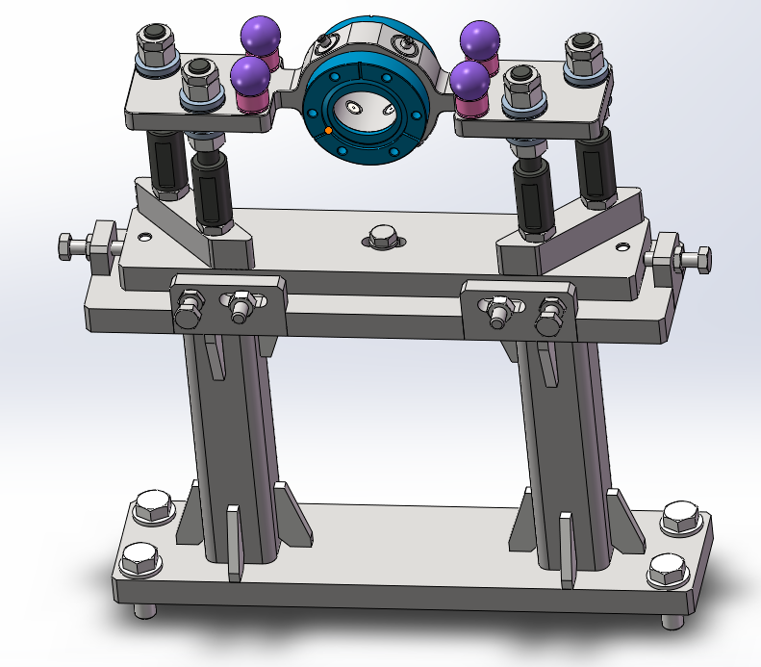
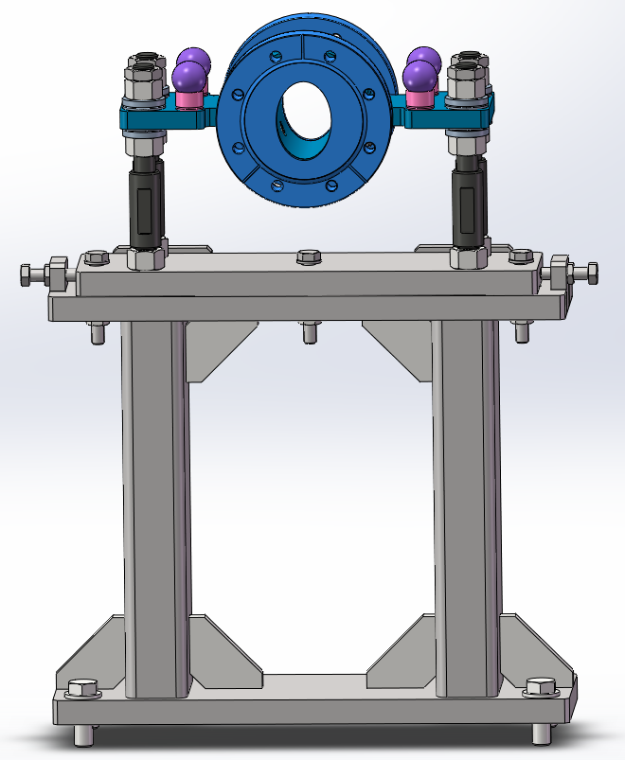
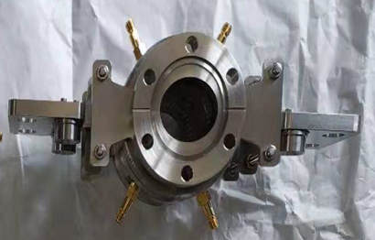
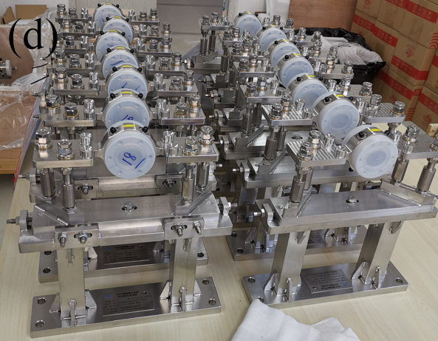
2. BPM design: Booster BPM
Booster BPM with 2 different cross-section with a transfer impedance of 0.26 and 0.21 Ω.

Slide 9
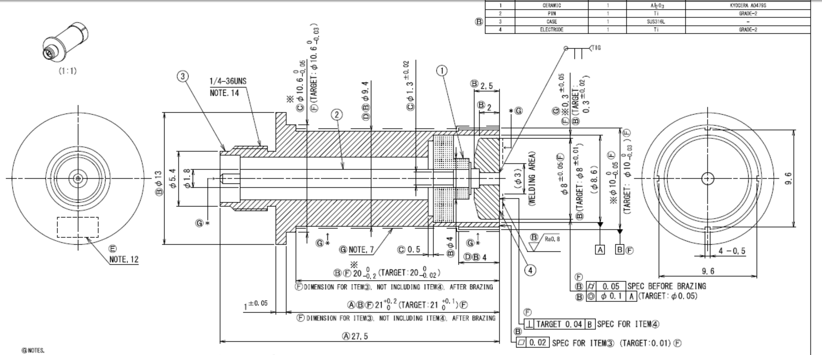
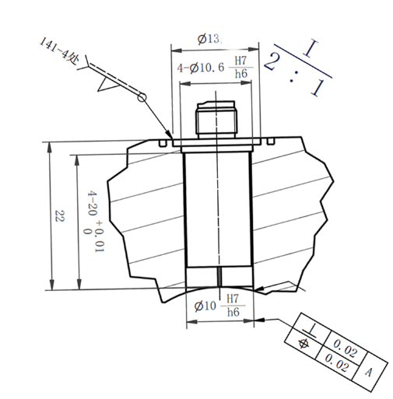

2. Feedthrough design detail
Reversed polarity SMA
Argon arc welding SUS to SUS
Tracking No
Vendor：Kyocera

Slide 10
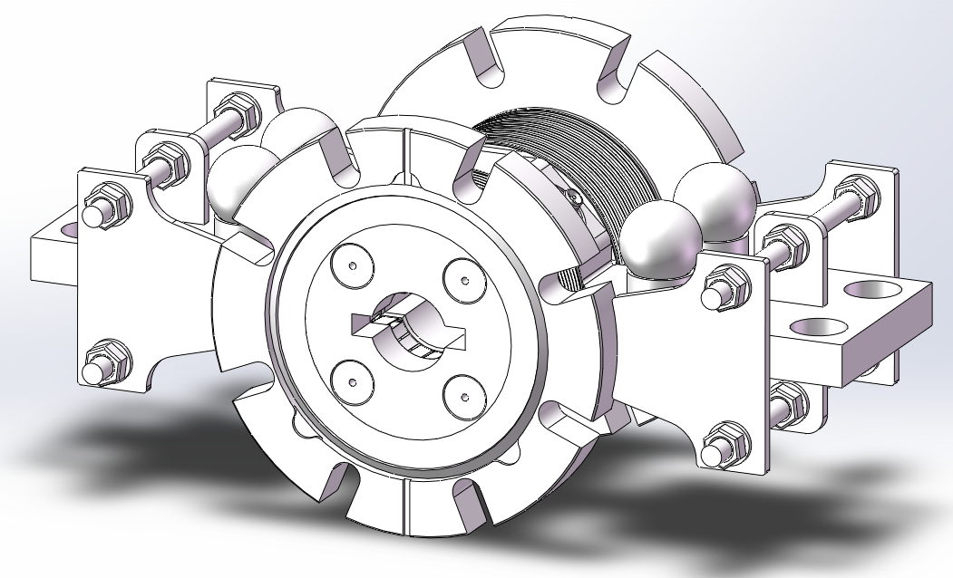
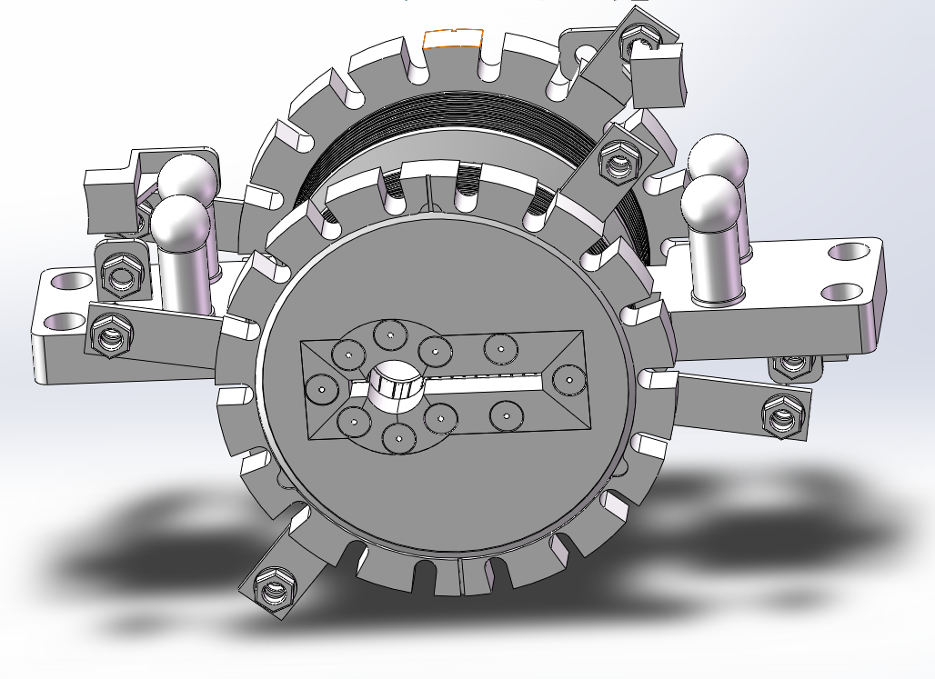
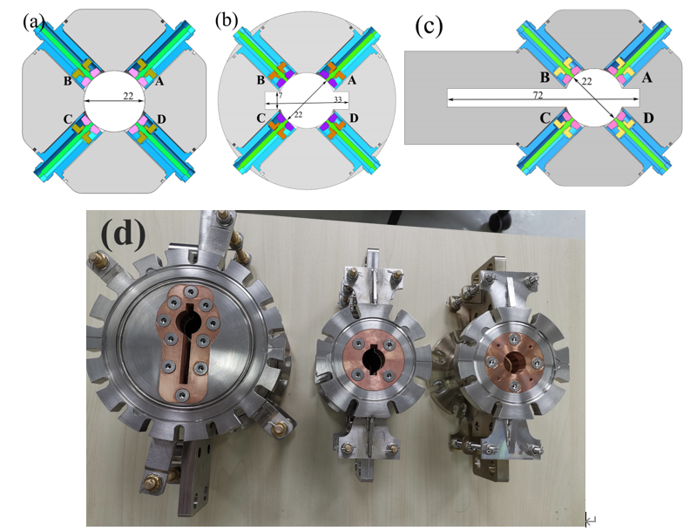
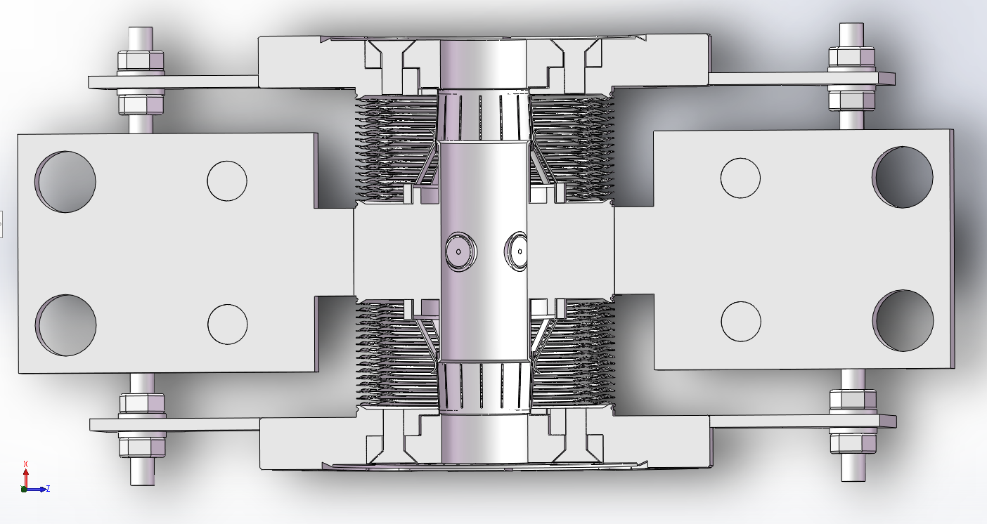
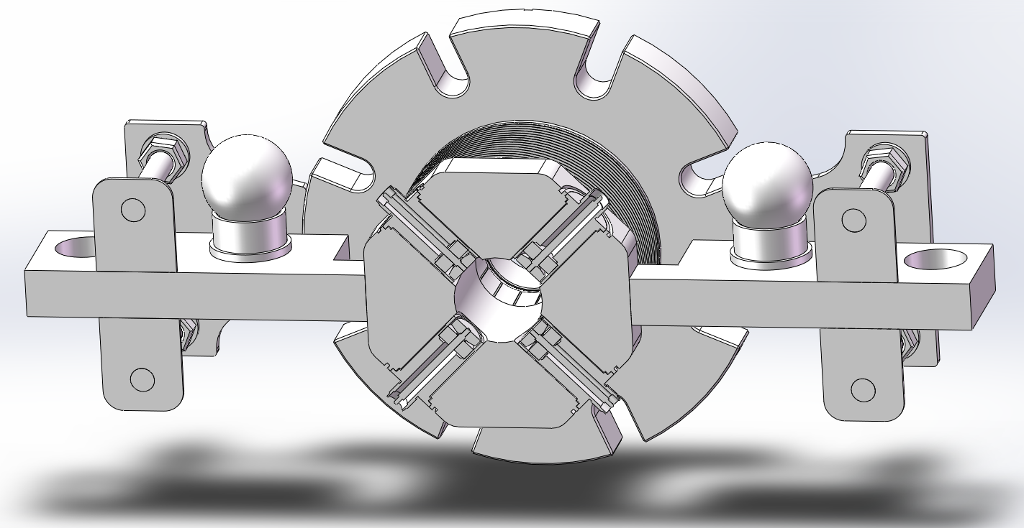
2. BPM manufacture : Storage ring BPM
A: BPM01-07, 09-12
B: BPM08
C: BPM09
xz plane view
xy plane view

Slide 11
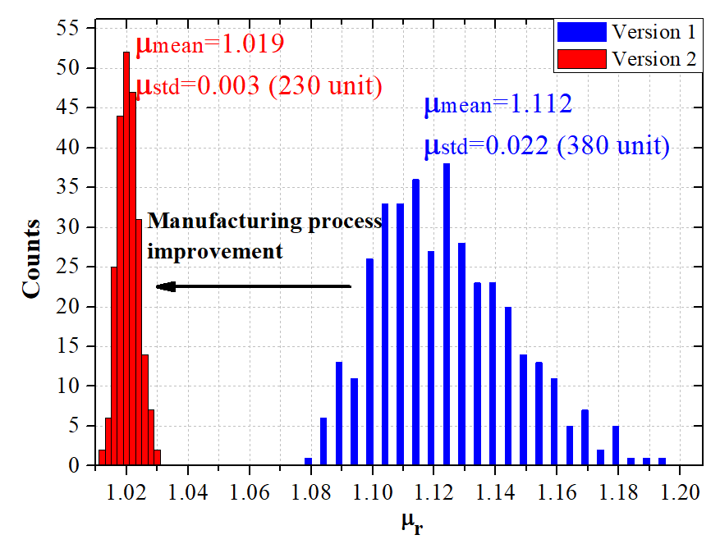
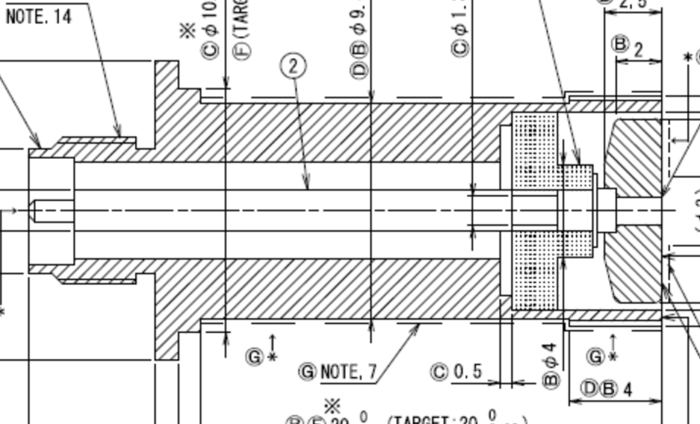
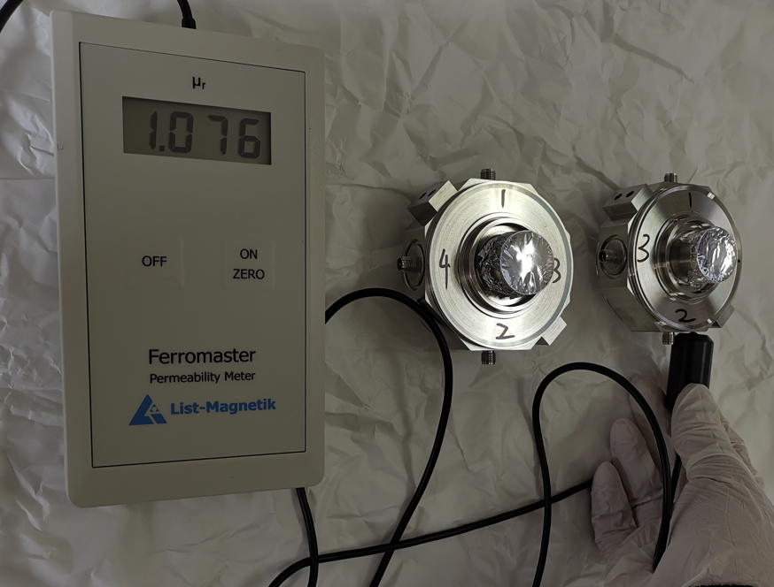
2. BPM manufacture : Permittivity minimize
Permittivity requirements of pipes μ_{r} <1.02 , <1.05 at few special points such as the welding spot.
Metallization: Mo-Mn + Ni Plating
With masking before Ni plating

Slide 12
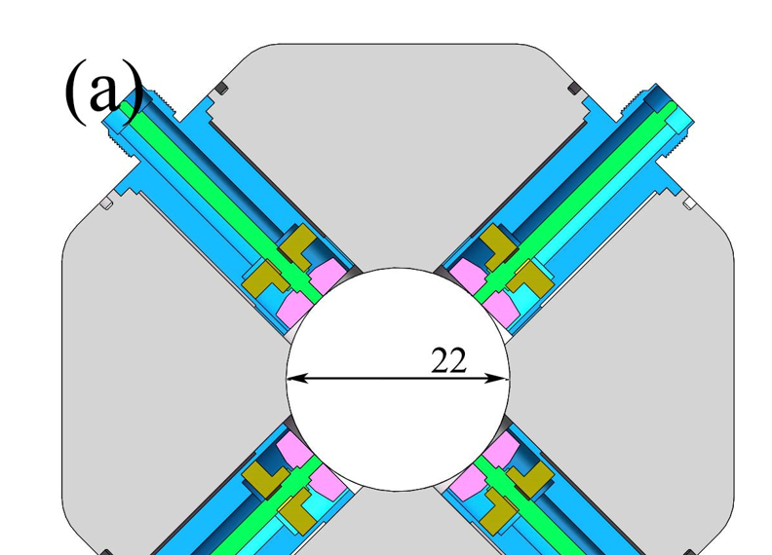
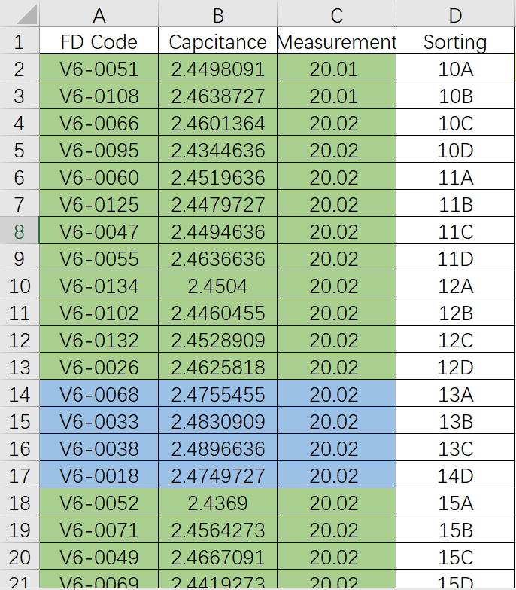
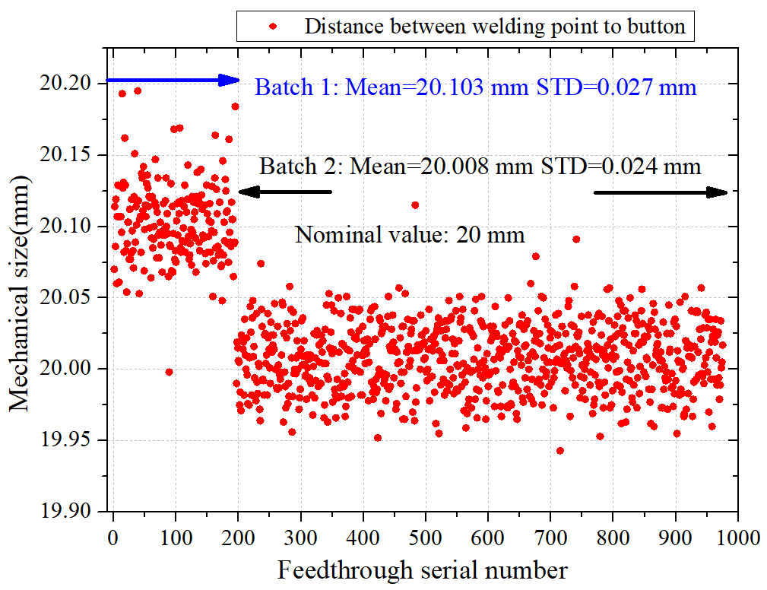
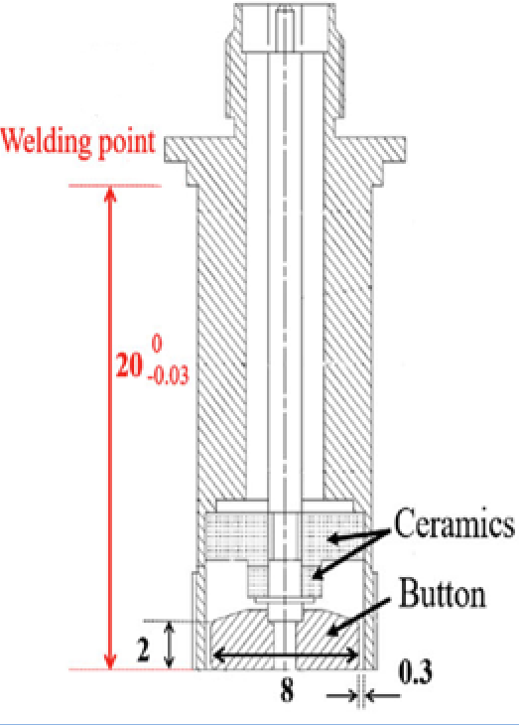
2. BPM manufacture : Sorting for reduce 4-channel inconsistency
Sorting sheet
The signal strength is mainly determined by position and capacitance.
Complementary BPM block and feedthrough

Slide 13
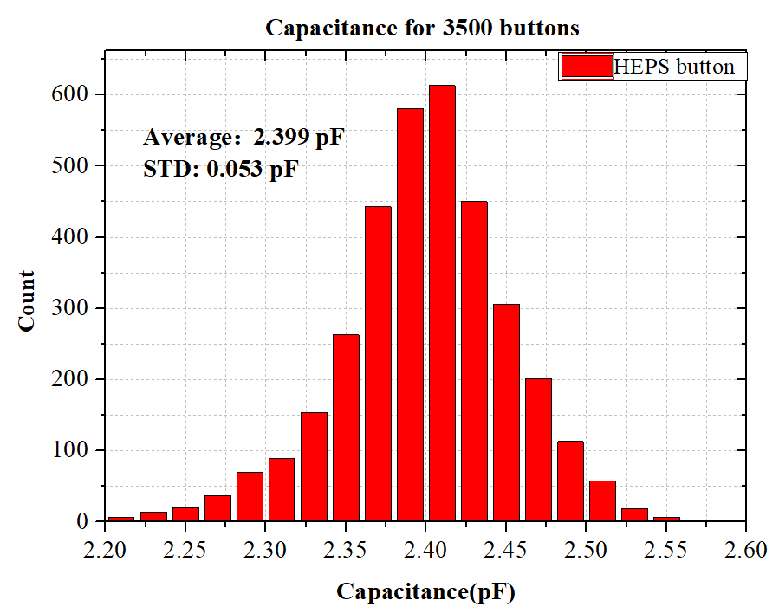
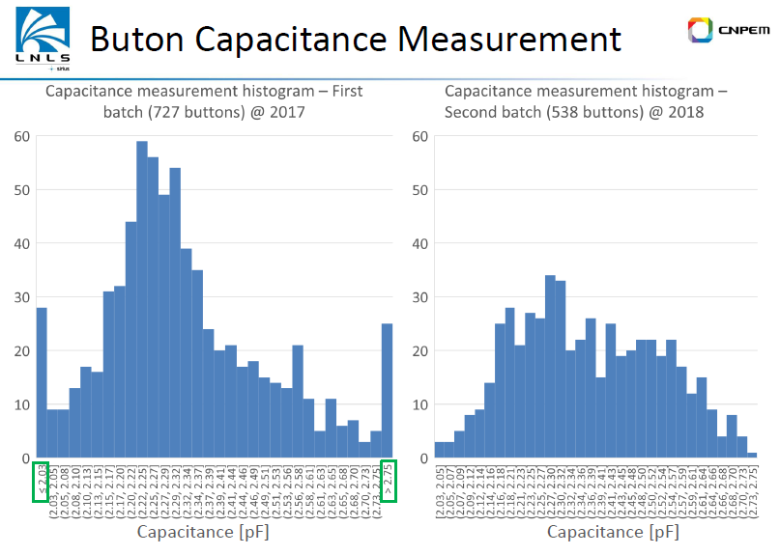
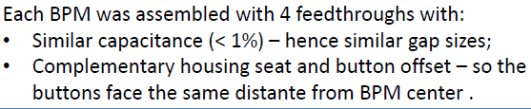
2. BPM manufacture: Acceptable differences in a BPM
Capacitance distribution of
SIRIUS bell-shaped button
Courtesy of Henrique O. C. Duarte
(Acceptable: 1% )
Capacitance: ±0.01pF (±0.02 pF)
Size: ±0.01 mm (±0.02 mm) in a BPM

Slide 14
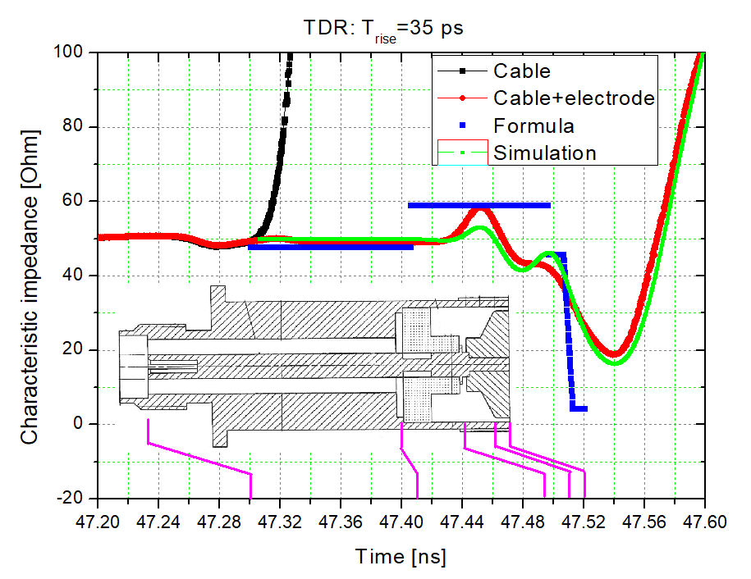
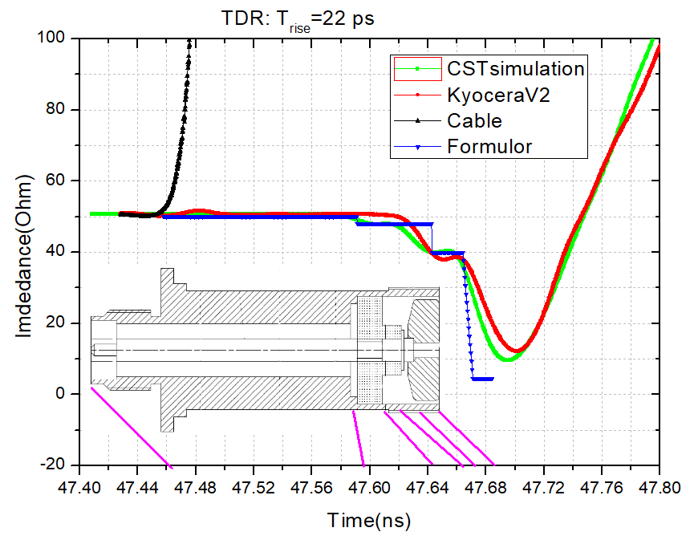
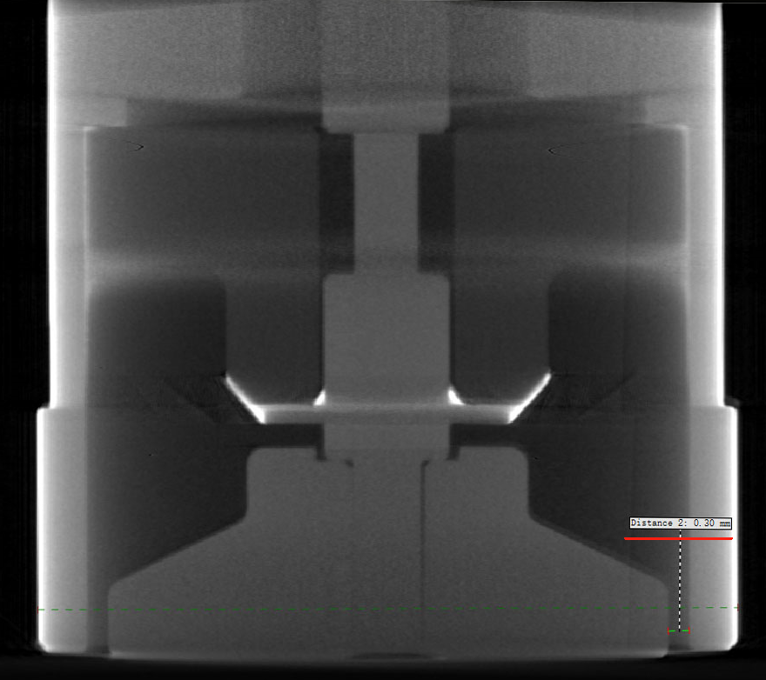
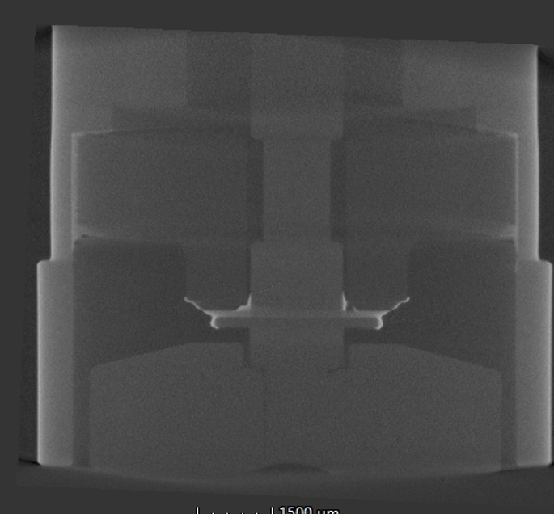
3. Feedthroughs characterization: TDR
TDR(time-domain reflectometry)
Capacitance: Cb =trise/2.2Z0
Optimization:
1. Smaller signal reflection by characteristic impedance optimized.
2. Smaller wakefield impedance by deduce the volume of the ceramics and hide it behind the button
X-ray Tomography

Slide 15
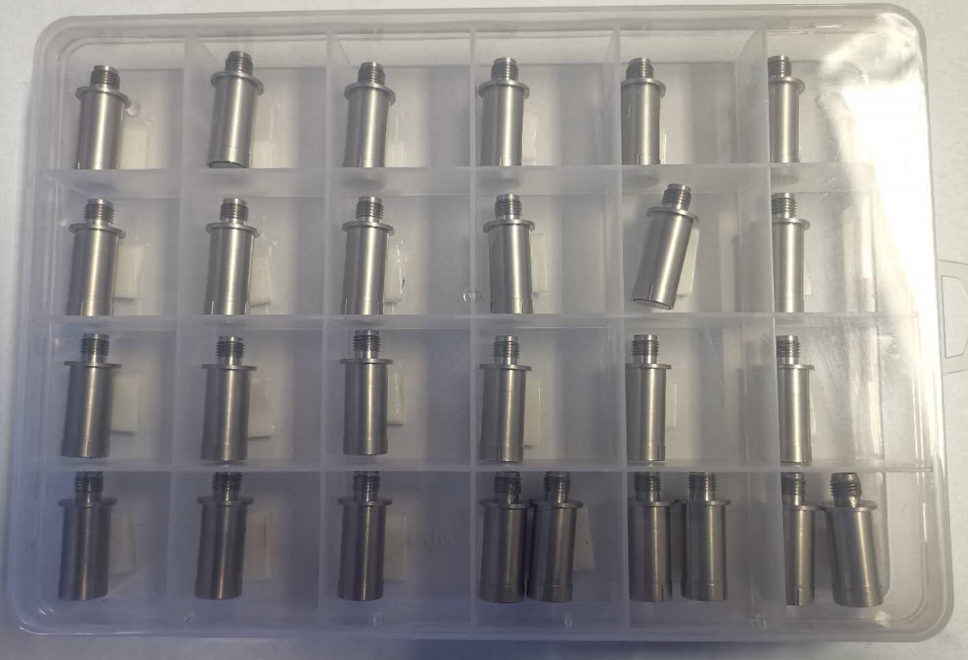
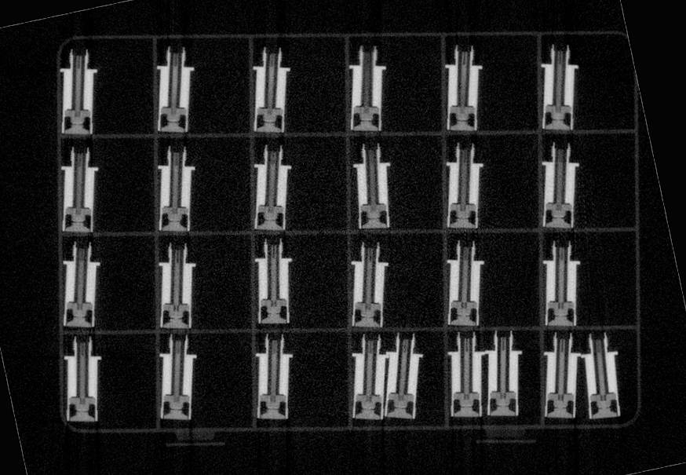
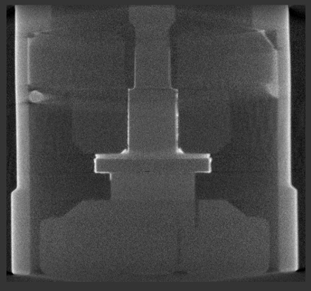
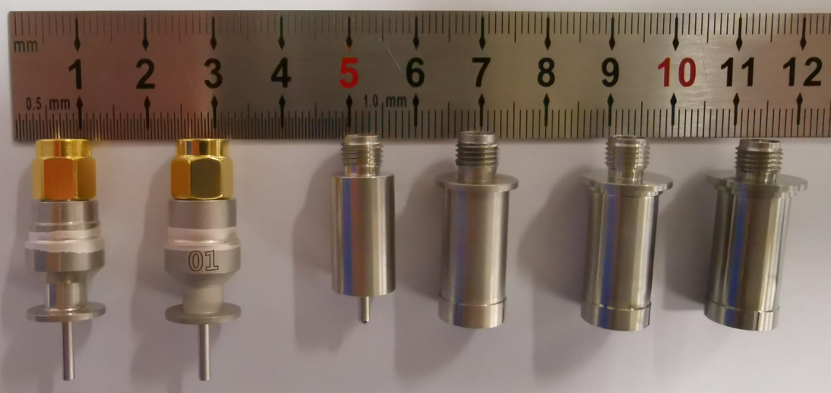
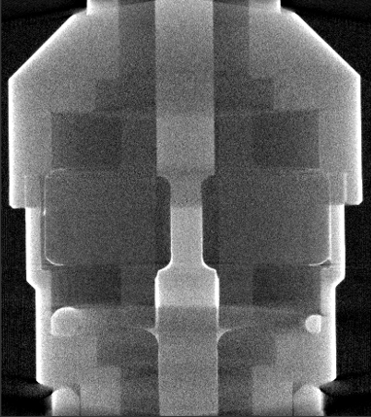
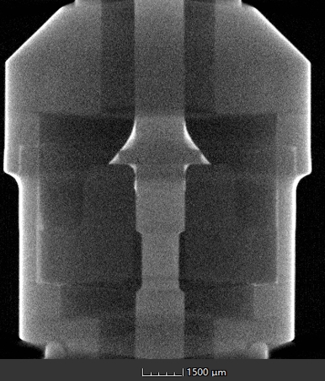
3. Characterization: X-ray Tomography
4
5
1
2
3
1
2
3
4
5

Slide 16
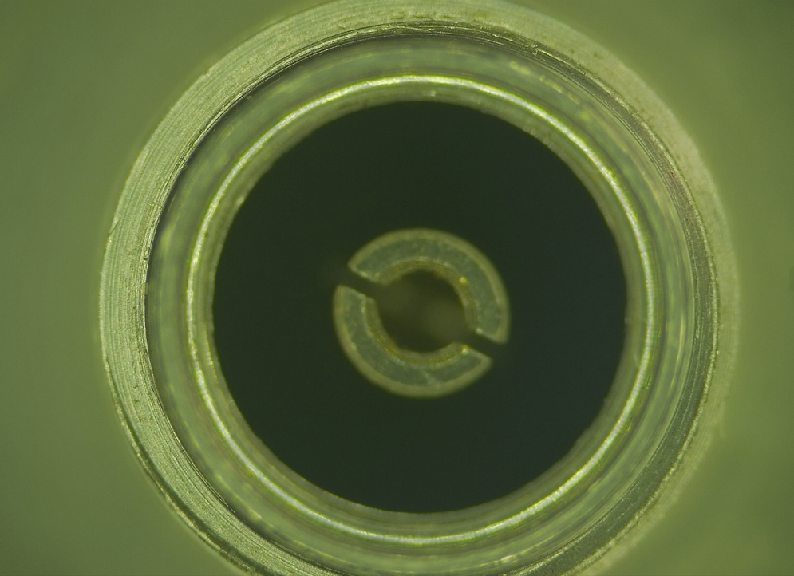




3. Characterization: Optical imaging
Magnification: 20~100X
Female
Male
Different vendors
Metal impurity because of chamfering

Slide 17




3. BPM test: Fiducials and button positon accuracy by the vendors

Slide 18


3. BPM test: Fiducials position accuracy by the alignment staff
Due to the HEPS project schedule, the alignment was not fully adjusted, many smooth operations were not completed, and the final positioning accuracy did not reach the predetermined target.

Slide 19



3. BPM test: a stretched wire calibration
x=A_{0,0} + A_{1,0}× Xraw + A_{0,1} × Yraw
Range: ±6 mm
Step size： 0.25mm
BBA
Gain calibration
The electrical center is easy to determine, but the mechanical center is not. The BPM are calibration by the electrical center where Va=Vb=Vc=Vd(x=y=0).

Slide 20





3. How accurate (trueness not reproduce) the k can be determined?
X=A_{0,0} + A_{1,0}× Xraw + A_{0,1} × Yraw
Y=B_{0,0} + B_{1,0}×Xraw + B_{0,1} ×Yraw
The calibration results show BPM with a difference (0.1%) of k if the Gain of each BPM can not be determined well because of the hardware limitations .

Slide 21




3. BPM test :
K(mm) got by the calibration was changed with different range and point density (advanced step size).
Step size induce a 0.1% change on k （0.1 mm →0.025mm for a range of ±1mm）
Range cause a 1% change on k (2mm →1 mm for a step of 0.05mm)
A light-guide slit induce a bigger k_{x} but the slit width have no impact on k.
Difference of k for strip-line is bigger than button type (Mechanical tolerances are difficult to control).

Slide 22



3. BPM characterization ：Electro-mechanical offset
Alignment goal: BPM mechanical center to adjacent magnet center ±50 μm.
Lambertson method (VNA)
Keysight E5080B + N4433D
Ecal Module

Slide 23

3. Electro-mechanical offset: Calculating the offsets on the VNA
S12
S13
S14
S23
S24
S34
G1
G2
G3
G4
Offset X
Offset Y
S21…
IF bandwidth: 500 Hz
Offset STD＜ 0.5 μm
Reconnection measurement ＜ 10 μm

Slide 24




Electro-mechanical offsets measured by Lambertson(VNA)
Courtesy of Angel Olmos
BIW10 TUPSM075

Slide 25





Lambertson method
S parameters is close to the lower detect limitation of VNA
S21 smaller than normal
S21 smaller than normal (several dB)
Channel A failure

Slide 26

4. Summary：
Progress chart of the HEPS commissioning.
The HEPS team (including the instrumentation group) made a good record（＞30 mA).
Beam can be stored without VNA offsets results.

Slide 27


4. Lessons learnt
Courtesy of Kees Scheidt ESRF
14.4 V with 10 capacitor of 2200 μF
Switch
The same problems with ESRF.
Always happen even during the commissioning.
Possible reasons：Dust ? Silver power on bellow ? NEG film on pipe?
Never be confirm but always can be cured.
Feedthrough

Slide 28
4. Lessons learnt/Summary：
1. Booster BPM signal strength is too small compared with SR if used a button with the same size.
2. Sorting is effective methods to reduce the inconsistency of the BPM also the electro-mechanical (geometry) offsets.
3. Lamberston (VNA) method is a effective methods not only to measure the offsets also check the failure of the BPM.
4. Optical imaging and X-ray Tomography are useful method to check the feedthroughs.
5. 2/3500 feedthroughs leak failure, 2/703 BPM welding failure (8 feedthroughs).
6. All the HEPS BPMs are working fine and played an important role in commissioning stage.

Slide 29


Thank you for your attention! ☺

Slide 30
Reference
1. Marcellini F, DAFNE broad-band button electrodes Nucl. Instrum. Methods Phys. Res. A 402 27-35
2. Chen Z-C, Leng Y B et al 2014 Beam position monitor design for a third-generation light source Phys. Rev. ST Accel. Beams 17, 112801.
3. Kees Scheidt, BPM workshop May2-3 DLS Didcot UK
3. Henrique O Duarte, Design development and manufacturing experiences for Sirius Button BPM.
4. A. Olmos, BPM Characterization for ALBA, BIW 10
5. Jun He*, Yan-Feng Sui, Jun-Hui Yue et al. Beam Position Monitor Characterization for the High Energy Photon Source Synchrotron, Symmetry 2023, 15, 660. https://doi.org/10.3390/sym15030660
6. Jun He*, Yanfeng Sui, Junhui Yue et al. Beam position monitor design for the High Energy Photon Source, Meas. Sci. Technol. 33 (2022) 115106
7. Jun He*, Yan-Feng Sui, Jun-Hui Yue et al. Design and fabrication of button-style beam position monitors for the HEPS synchrotron light facility，Nucl Sci Tech (2022) 33:141

Slide 31

Back up

Slide 32



Support
Fit tolerance

