Slide 1
Electron-Ion Collider BPM Button Design Progress
David Gassner
EIC Instrumentation Systems Group Leader
Not Light Sources Session
Button BPMs for Synchrotron Light Sources
ALBA Synchrotron
December 12, 2024

Slide 2
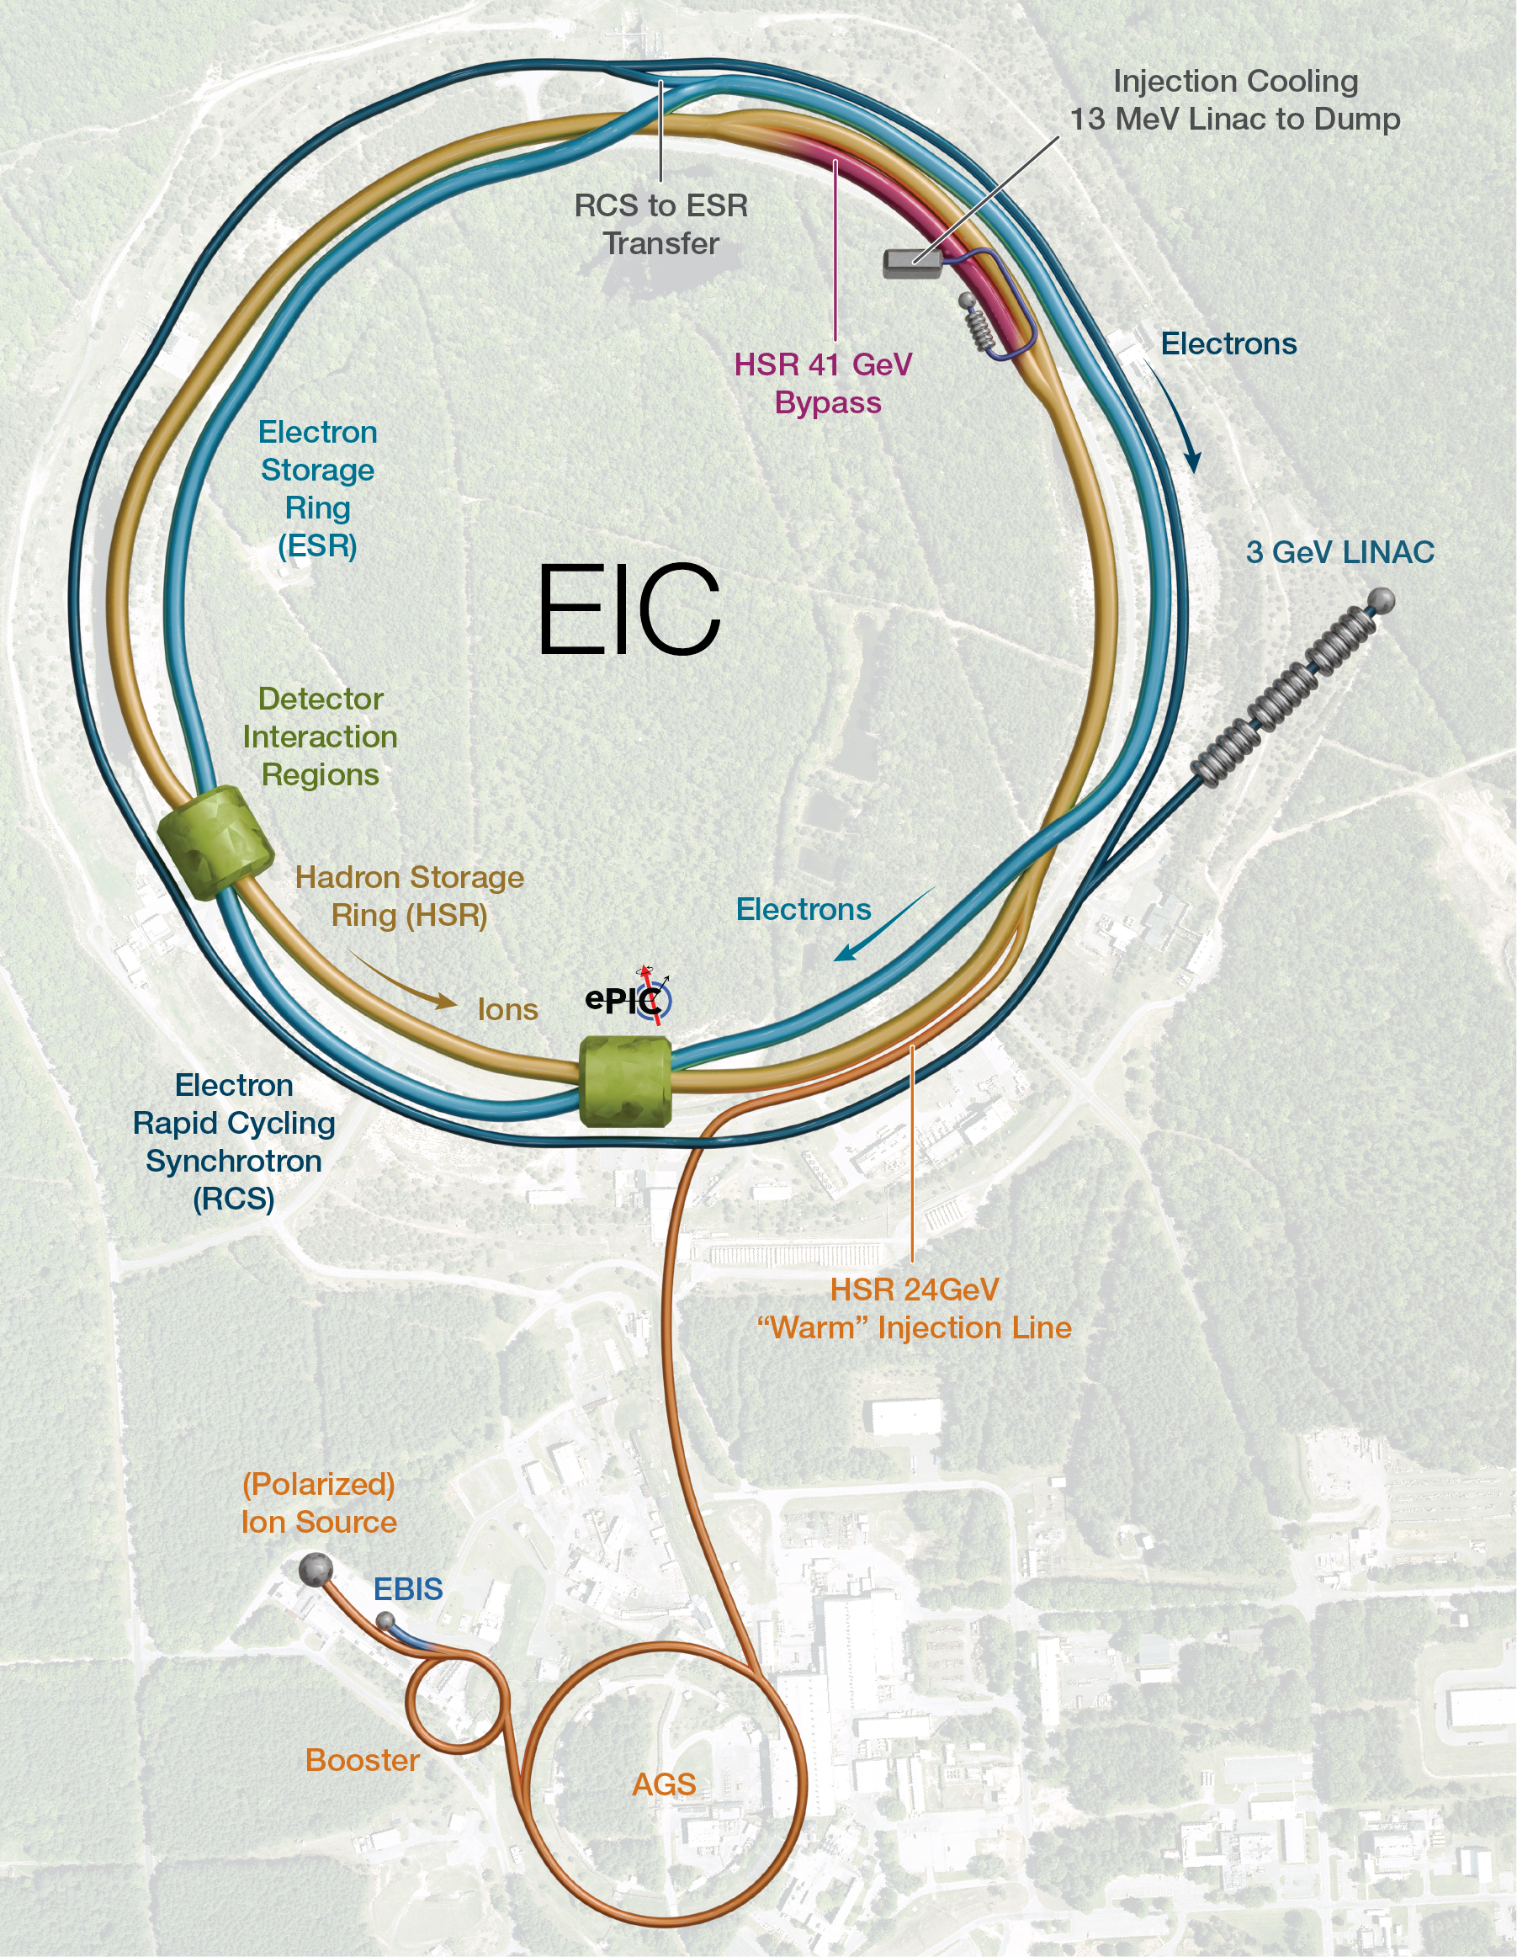
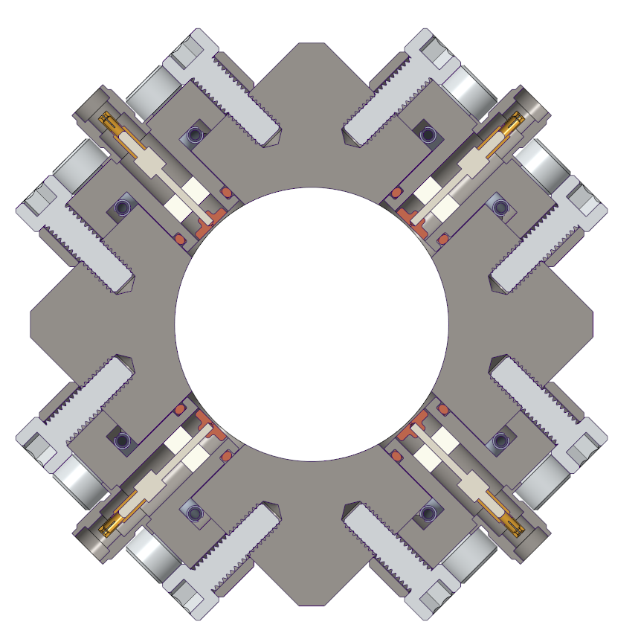
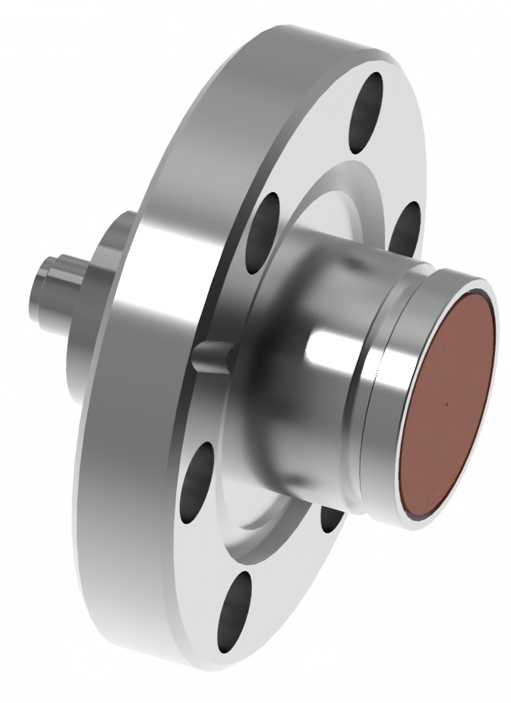
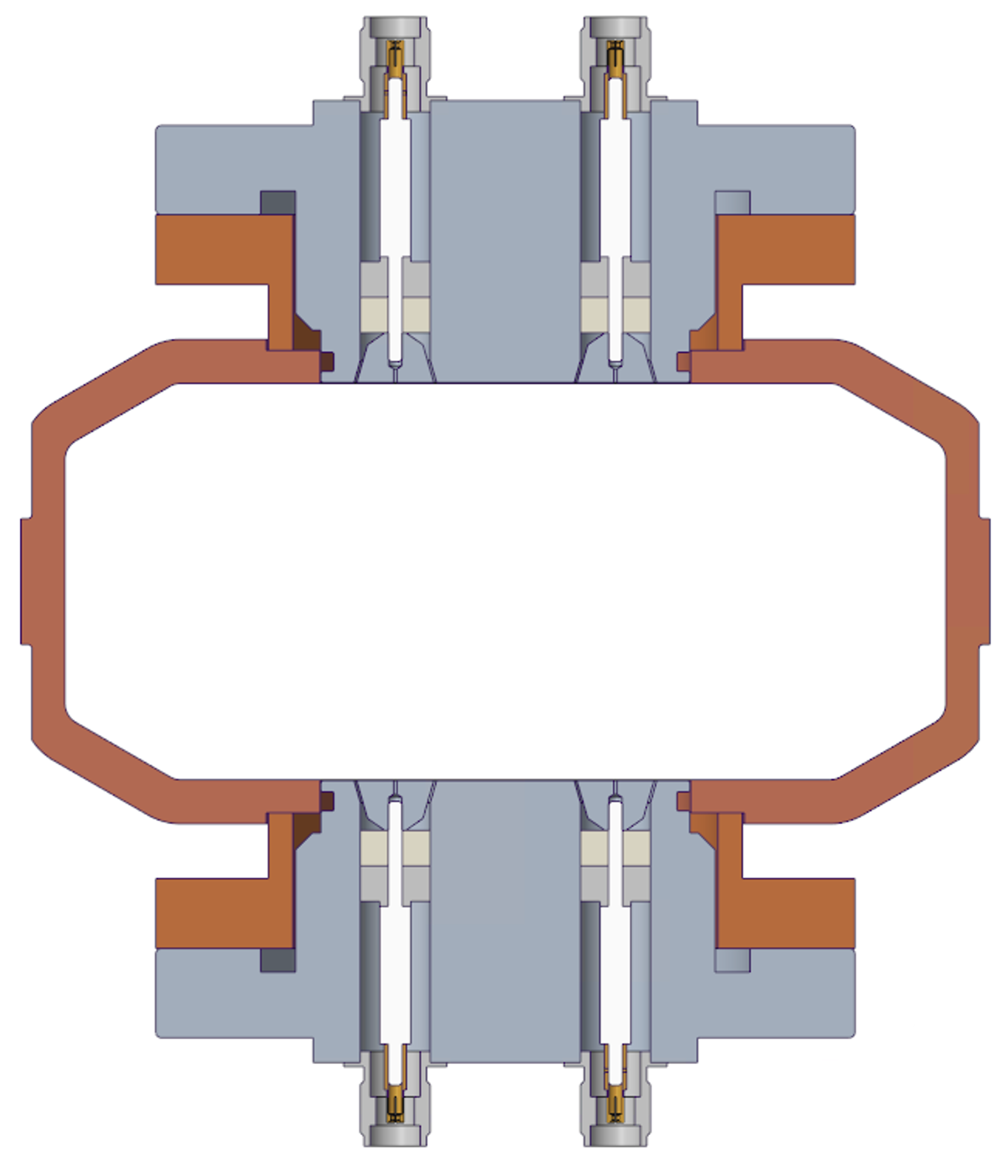
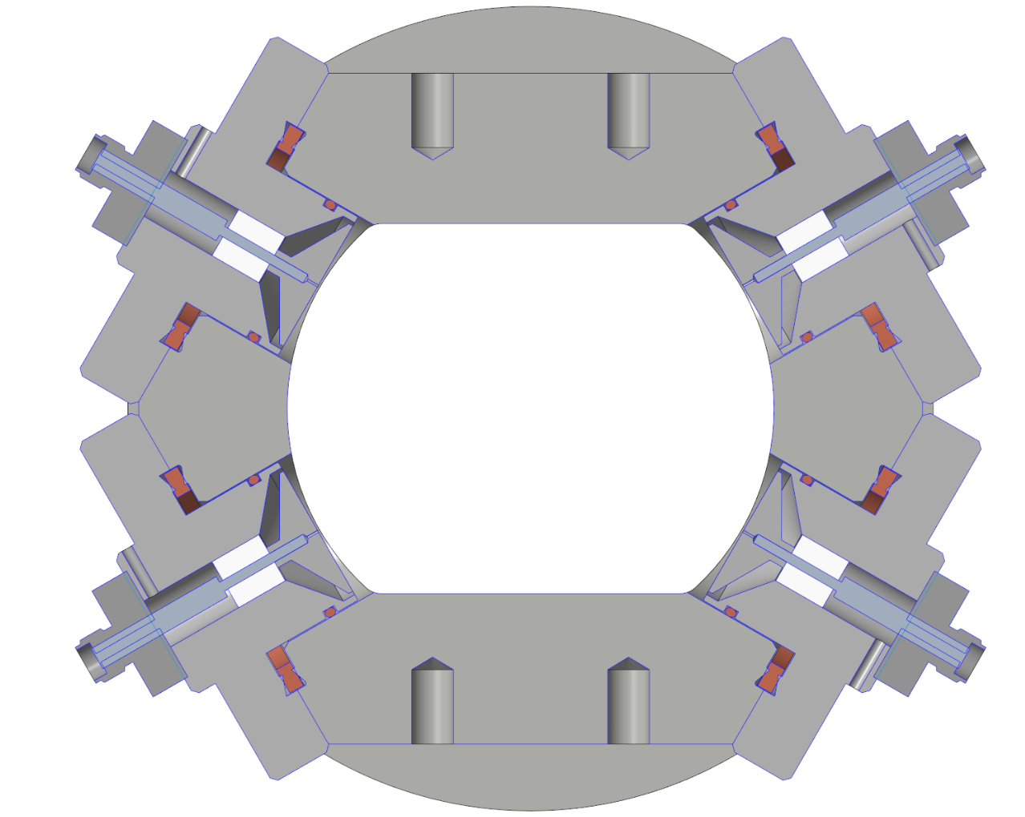
Outline
Introduction to the EIC
BPM Button Design Progress
  Electron Beams
    Rapid Cycling Synchrotron
    Electron Storage Ring
  Hadron Storage Ring
Summary
Rapid Cycling Synchrotron BPM
Electron Storage Ring BPM
Hadron Storage Ring BPM

Slide 3
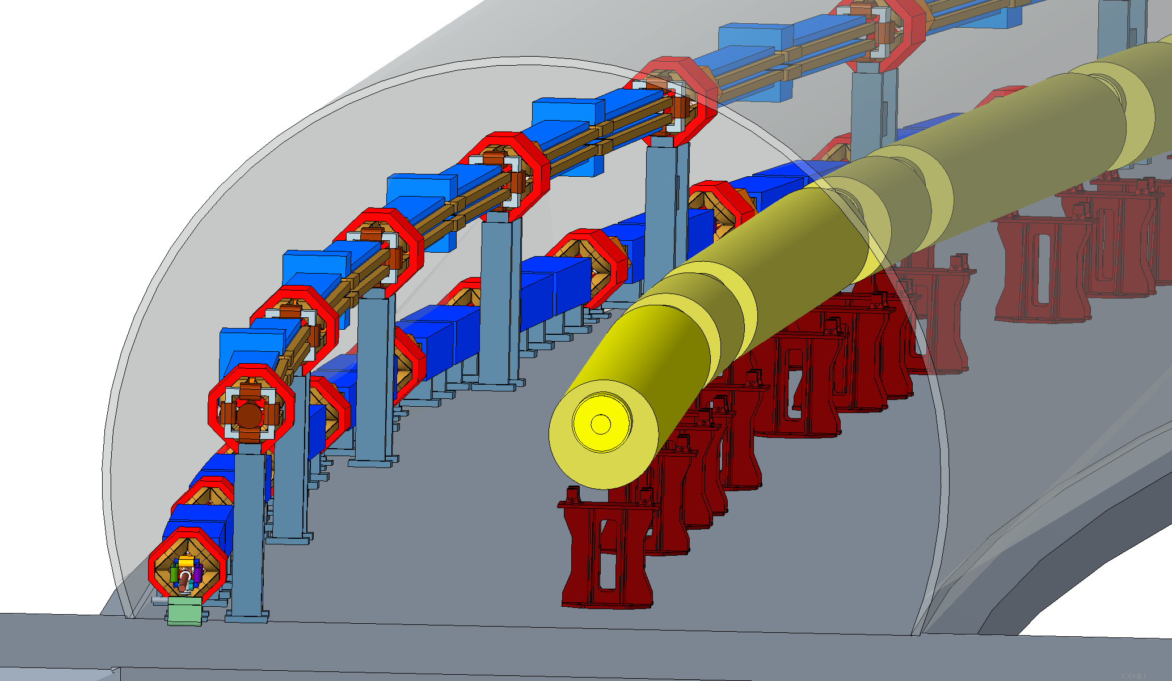
Electron-Ion Collider Overview
Hadron Storage Ring (HSR) 10-275 GeV
  3.8 km
  Superconducting magnets (existing)
  Up to 1,160 bunches, 1A beam current (3x RHIC)
  Variety of ions & polarized protons
Electron Storage Ring (ESR) 5–18 GeV
  3.8 km
  High beam current, 2.5 A ➔ 10 MW S.R. power
  Warm magnets, S.C. RF cavities
  Polarized e-bunches
Electron Rapid Cycling Synchrotron (RCS) 3 - 18GeV
  3.8 km (under redesign)
  1 Hz, ramp duration ~ 100 ms (7,800 turns)
Electron Pre-injector
  3 GeV superconducting Linac
EIC is a unique, high-energy, high-luminosity, polarized beam collider that will be one of the most challenging and exciting accelerator complexes ever built.
ESR
RCS
HSR

Slide 4
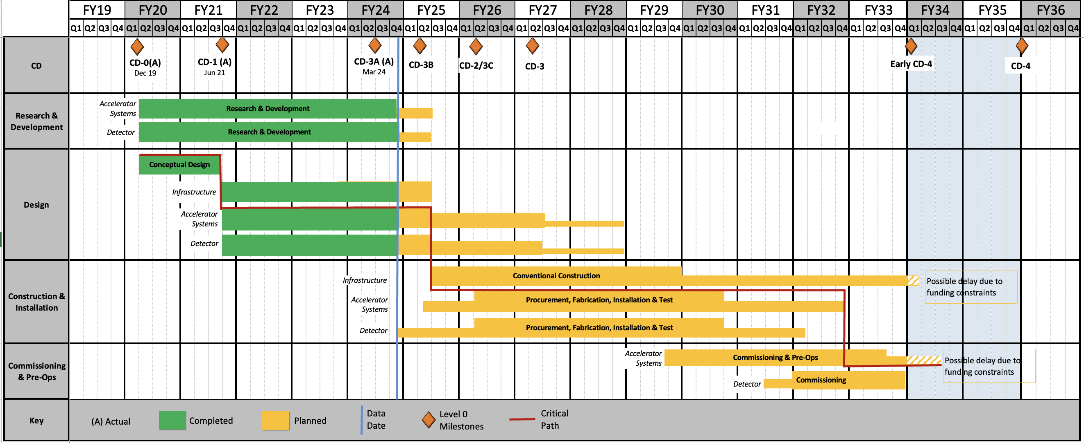
Electron-Ion Collider Schedule
HSR Buttons needed (Jun ’28)
Beam Commissioning completion schedule:
Pre-injector (Jan ’31)
RCS (Sep ’32)
ESR (Dec ’32)
HSR (Mar ’33)
RHIC Operations is planned for the end of CY2025
Today

Slide 5
Rapid Cycling Synchrotron BPM Buttons

Slide 6
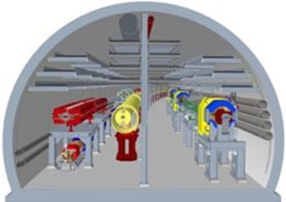
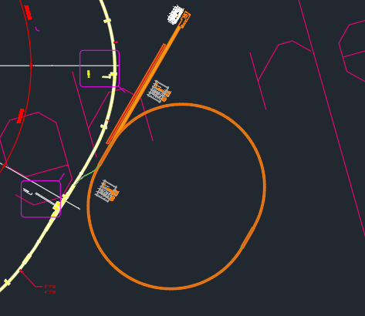
Rapid Cycling Synchrotron BPM button design status
Present design status
  Preliminary Design Review in June ’24. Design based on:
    400 MeV Linac pre-injector
    3.8 km RCS ring with 35.6 mm aperture, inside the RHIC tunnel
    Bunch length range: 40 to 23 ps
    Charge range: 1 to 28 nC
    1 to 4 bunches per cycle (max current a few mA)
  BPM button final design efforts delayed in July due to redesign of the electron Pre-injector and RCS
  Stray fields from other rings in tunnel can affect 400 MeV beams
  Space constraints in existing tunnel
  Pre-Injector and RCS redesign will continue for at least a few more months
  Pre-injector Linac energy increased to 3 GeV
  Alternate RCS ring designs under consideration
    Latest plan is for a ~1.4 km RCS adjacent to the RHC tunnel
  Will continue RCS button final design after receiving updated:
  Beam pipe aperture
  Beam parameters
  Performance requirements
Previous EIC (overcrowded) tunnel
HSR injection
Ø 16 ft
HSR
RCS
ESR
Proposed
3 GeV Pre-injector Linac
Proposed
1.4 km RCS
Existing
RHIC tunnel

Slide 7
RCS BPM System Performance Requirements
RCS functionally has similarities to a light source booster
RCS pilot bunch - 1 nC
  Single turn – 1 mm resolution
  Average over 100 turns – 100 microns resolution
RCS maximum bunch - 28 nC
  Single turn – 100 microns resolution
  Average 100 turns – 10 microns
Impedance budget (> 550 BPMs in RCS) - instability current threshold should exceed 28 mA
  ~ 10 times maximum expected beam current

Slide 8
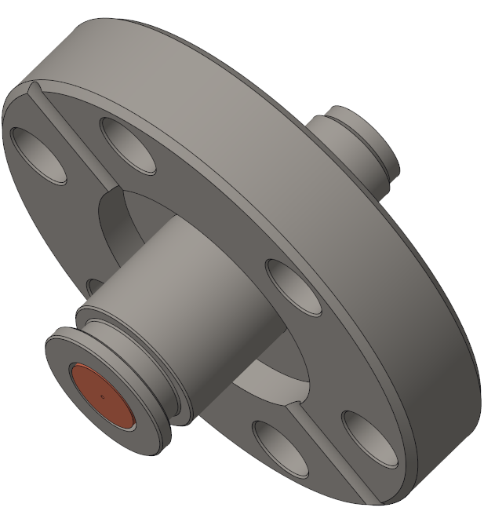
RCS BPM button Mechanical Design
Design based on:
  Requirements for RCS
  Successful designs for NSLS-II and APS
  Current experiences with other BPMs
Optimize design for:
  Reasonably low cost (~1,600 units)
  Ease of manufacturing (tolerances, fabrication methods, etc.)
  Mechanical robustness
  Minimal capacitance variation
Several design iterations evaluated by physics for performance

Slide 9
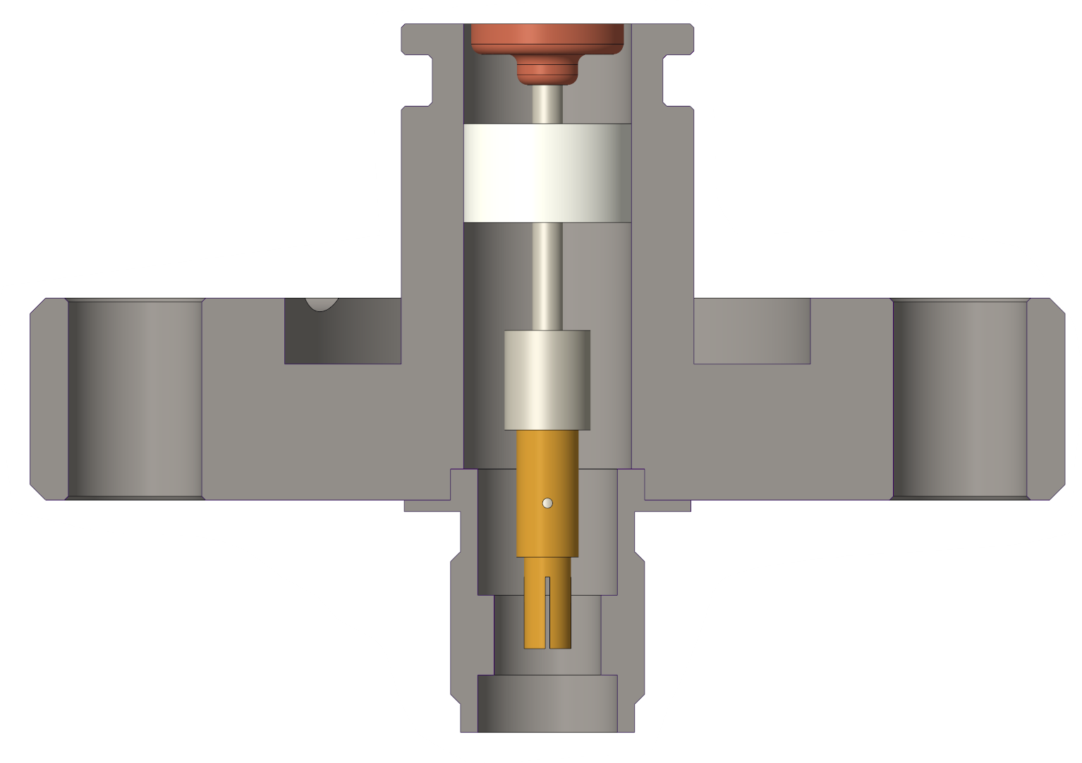
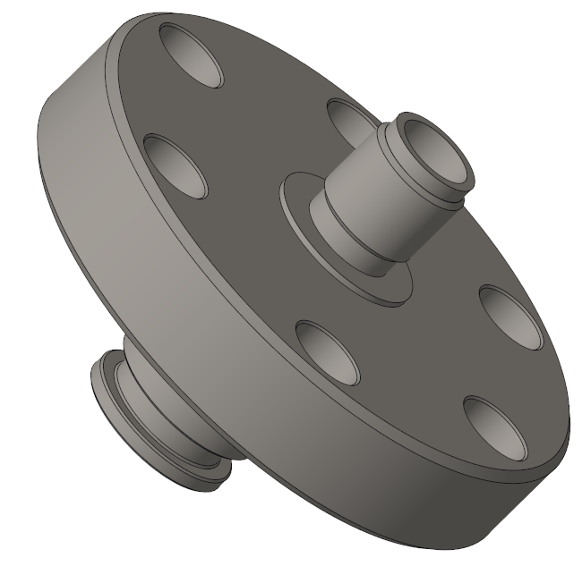
RCS BPM Button Cross Section
5 mm button
Protective collar
250-micron gap
Groove for RF spring
316L BPM body
Ceramic seal
Helicoflex groove
Stem
Integrated flange
SMA connector

Slide 10
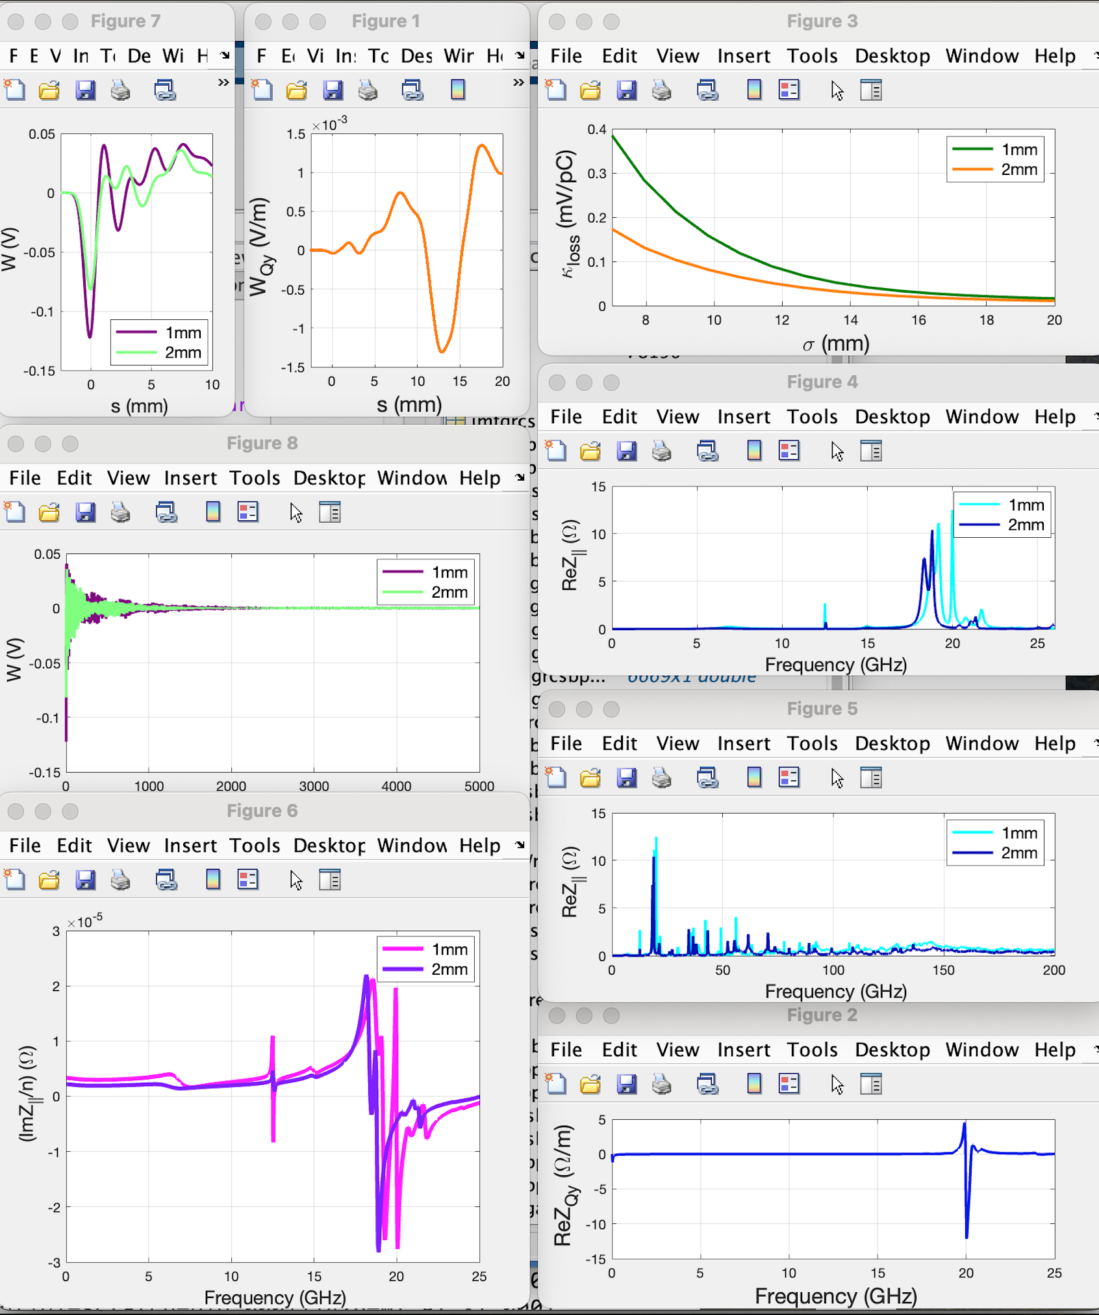
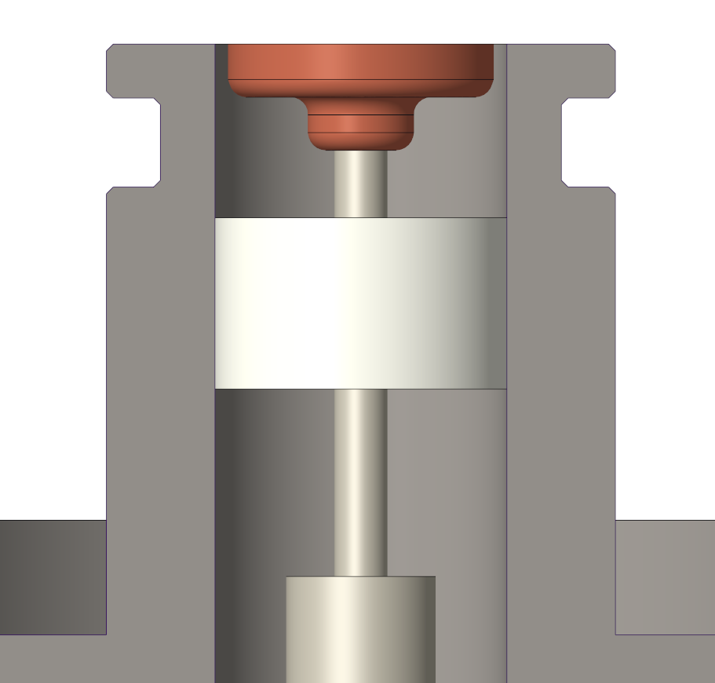
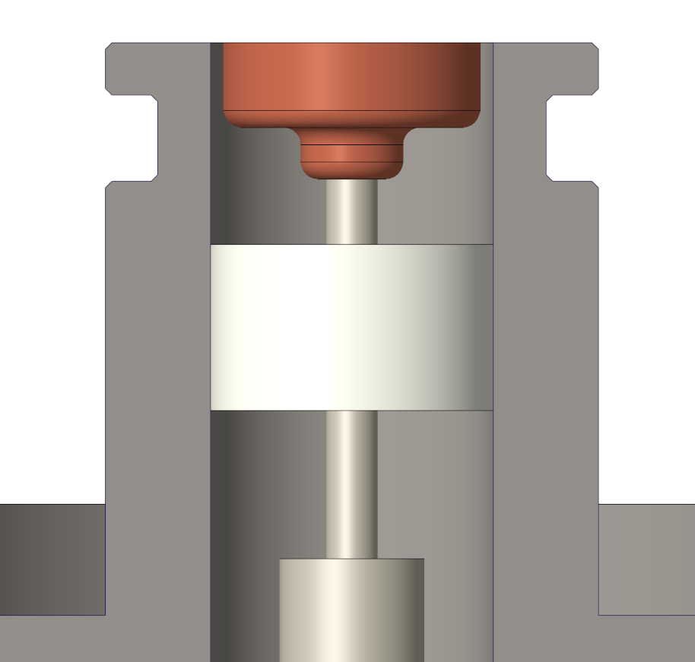
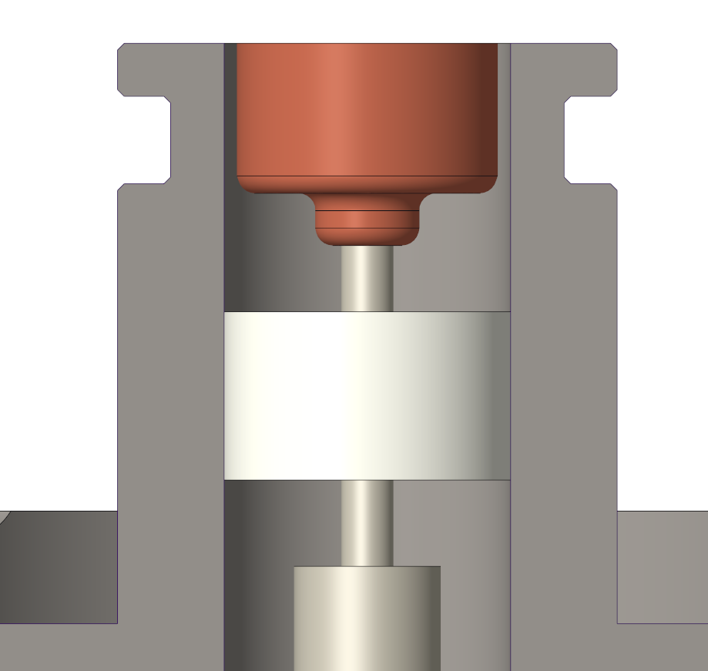
RCS BPM Button Geometry
Flat-faced design (in round chamber)
5 mm diameter button
Thickness: optimized at 2 mm
  Physics evaluations for variations in thickness (1 & 2 mm shown)
Geometry behind button
  Minimize capacitance variation
  Maximize ease of fabrication
  Various shapes undergoing physics evaluations
GdfidL simulation results for 1 & 2 mm thick buttons, no improvements with > 2 mm
Loss factor kloss provides thermal losses of 23 mW per assembly with nominal beam current. This value is acceptable.​ RCS 7mm bunch
Longitudinal
wake potentials look better with 2 mm thickness
1 mm thick
2 mm
4 mm
Resonance frequency around
20 GHz

Slide 11
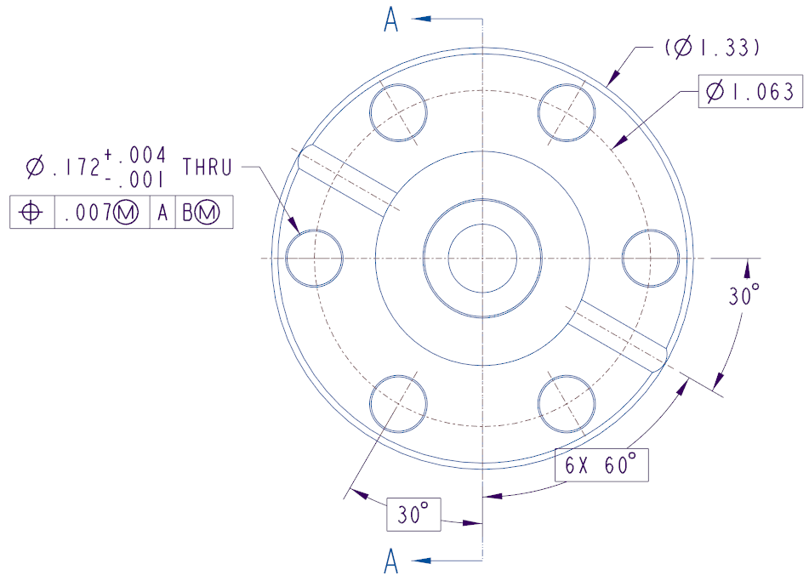
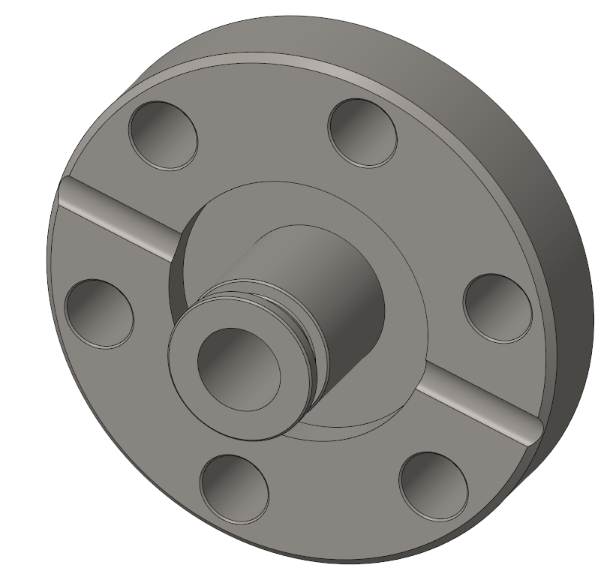
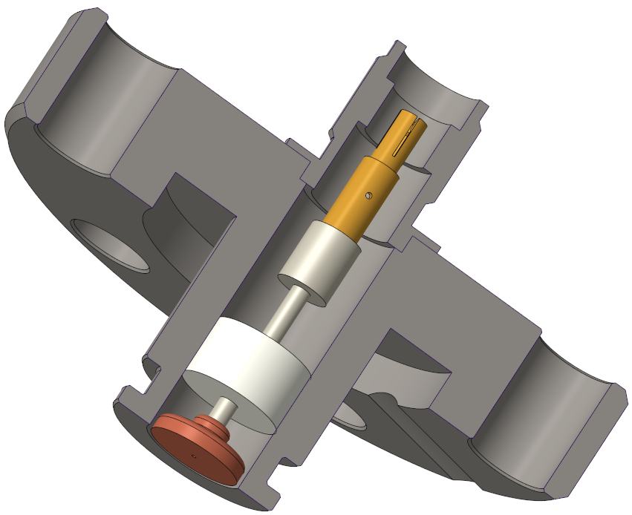
BPM Body Description
AISI 316L Stainless Steel
Single-piece design (no welds)
Standard 1 ⅓” Mini flange
  1” Micro dimensionally possible
    Major cost savings with 1 ⅓”
  Standard bolt size and circle
  6 bolt holes (standard) helps reliability
Helicoflex seal chosen over weld-in design due to:
  Quicker, easier installation
  Track record for reliability
  Easier to replace if needed

Slide 12
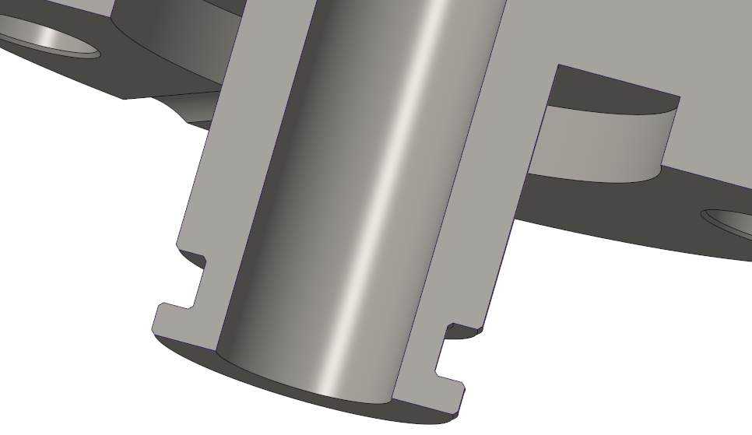
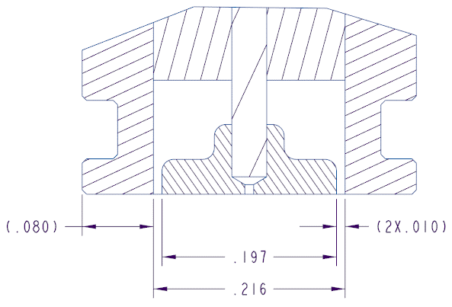
Collar and Button Gap
Collar featured in many past BPM designs
  Approximately 2 mm thickness
  End is flush with button face
  Protects button/stem from damage during handling
  Facilitates fabrication
    Provides a well-defined datum to align button with (depth, concentricity)
Built-in RF spring groove
Button Gap 250 microns
  Capacitance simulated to be 2.5~2.6 pF
collar
(250 um)

Slide 13
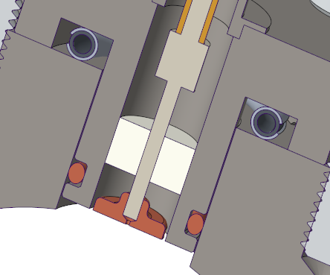
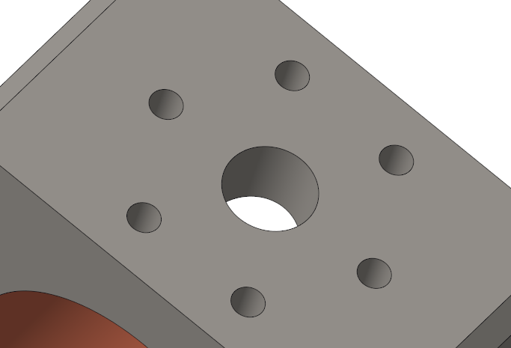
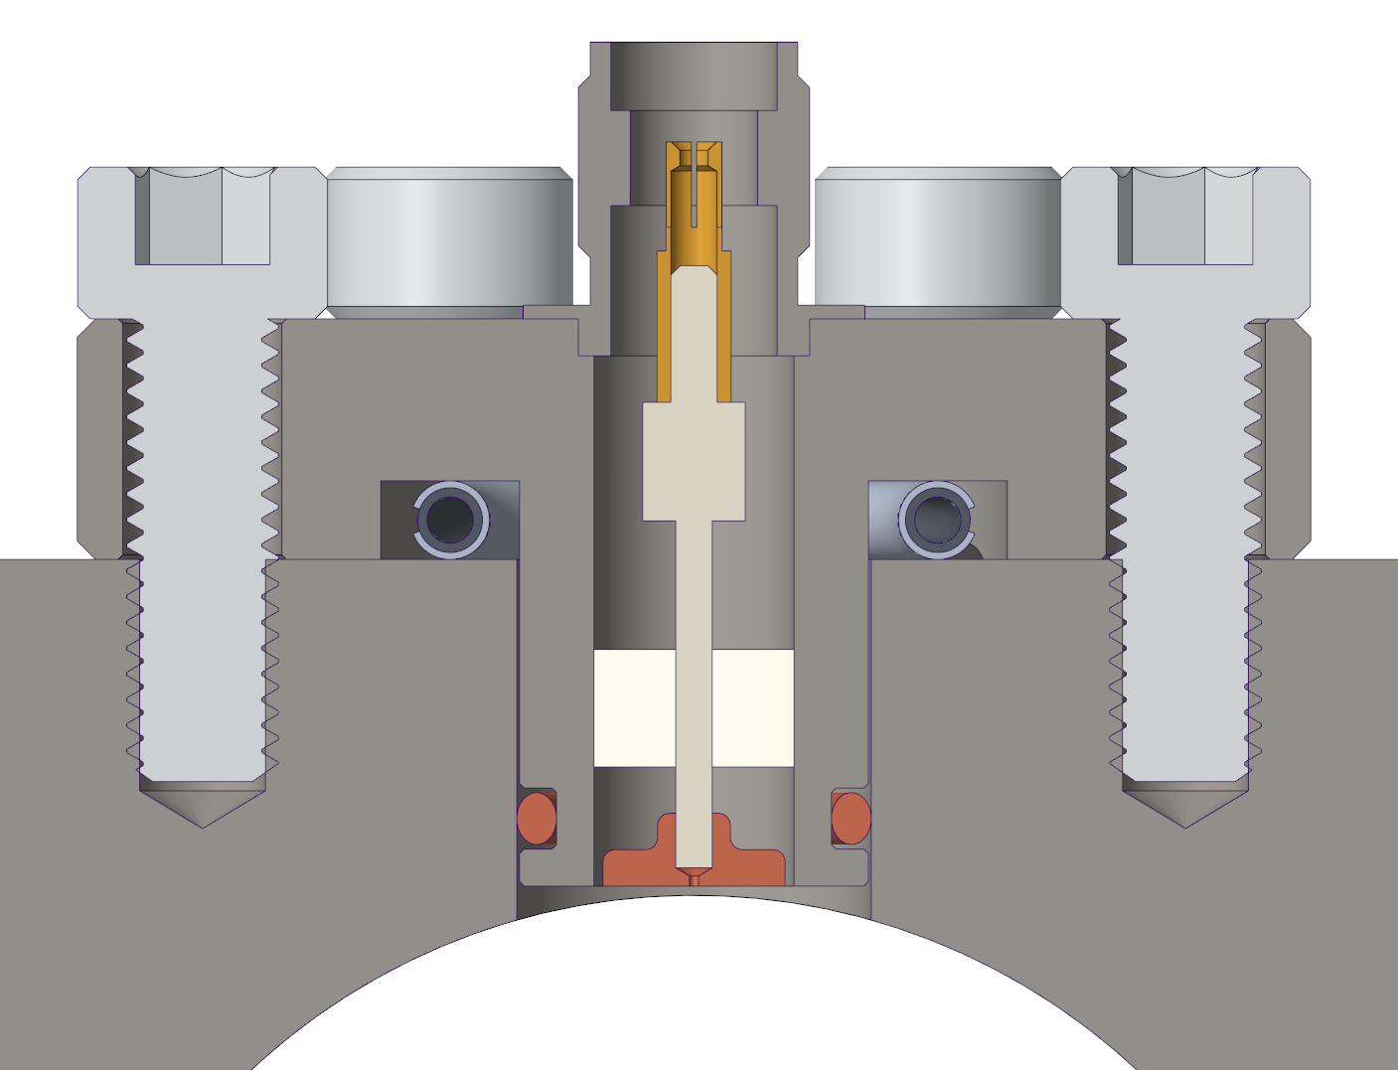
Housing Assembly + Mating Interface
Mating interface details:
  Helicoflex seal
  0.003” radial clearance between BPM and housing
    Used successfully on NSLS-II BPMs
    Minimum clearance without installation problems
  RF spring
Ø 35.6 mm beam aperture
Housing assembly will feature fiducials for survey

Slide 14
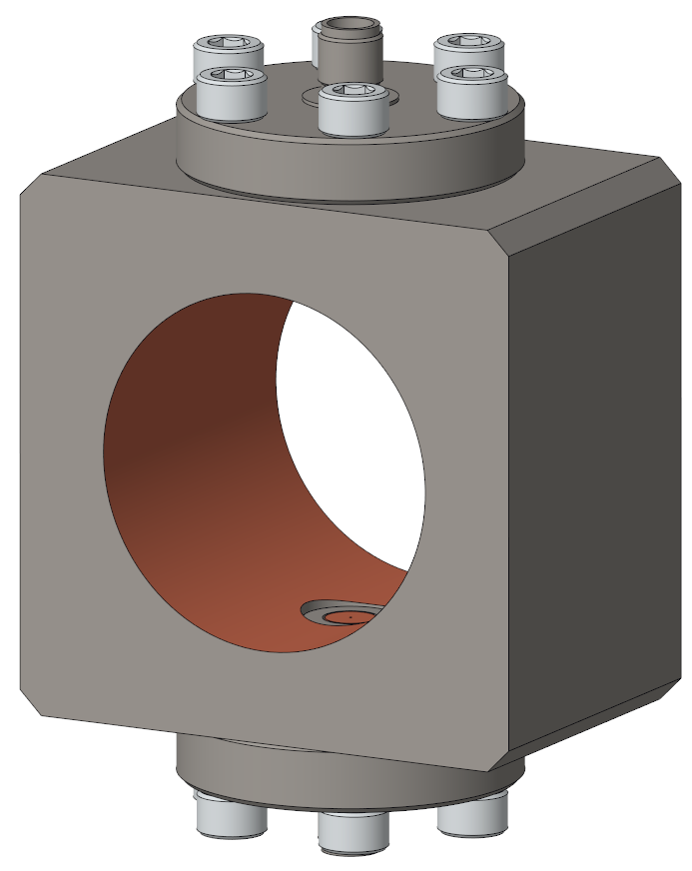
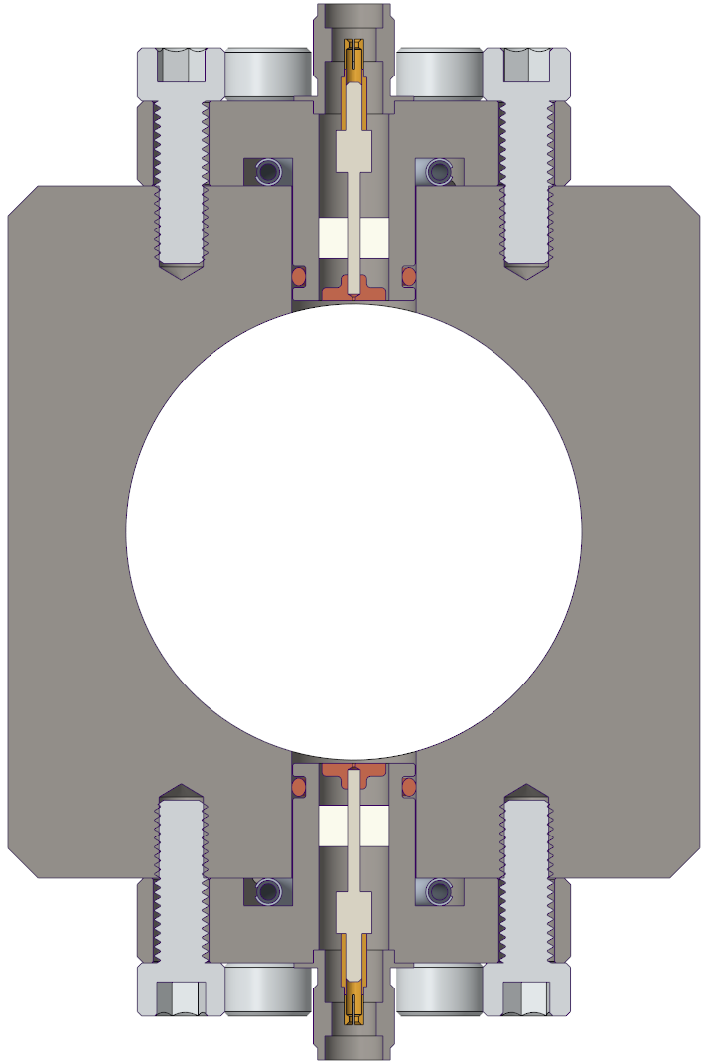
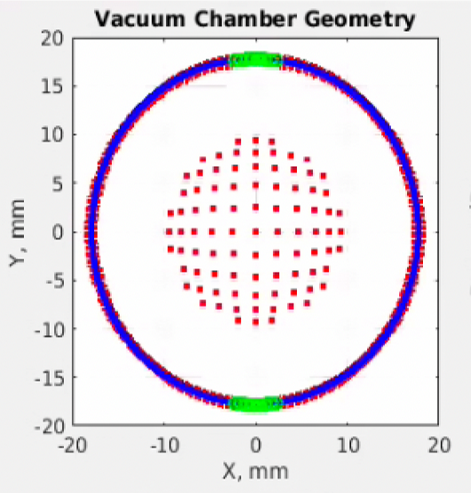
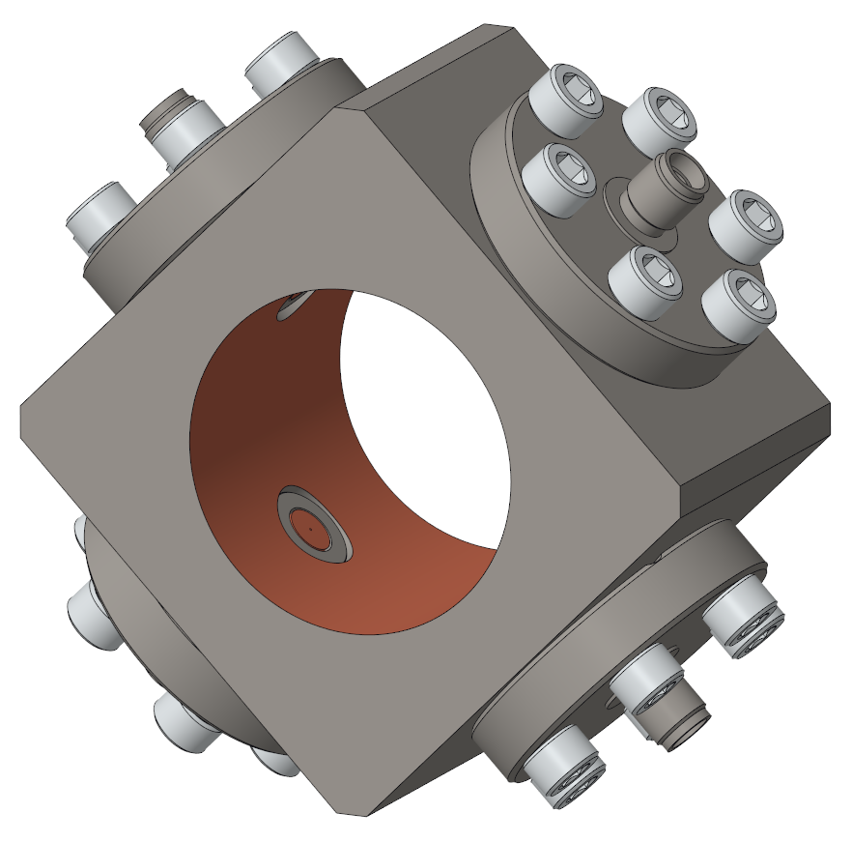
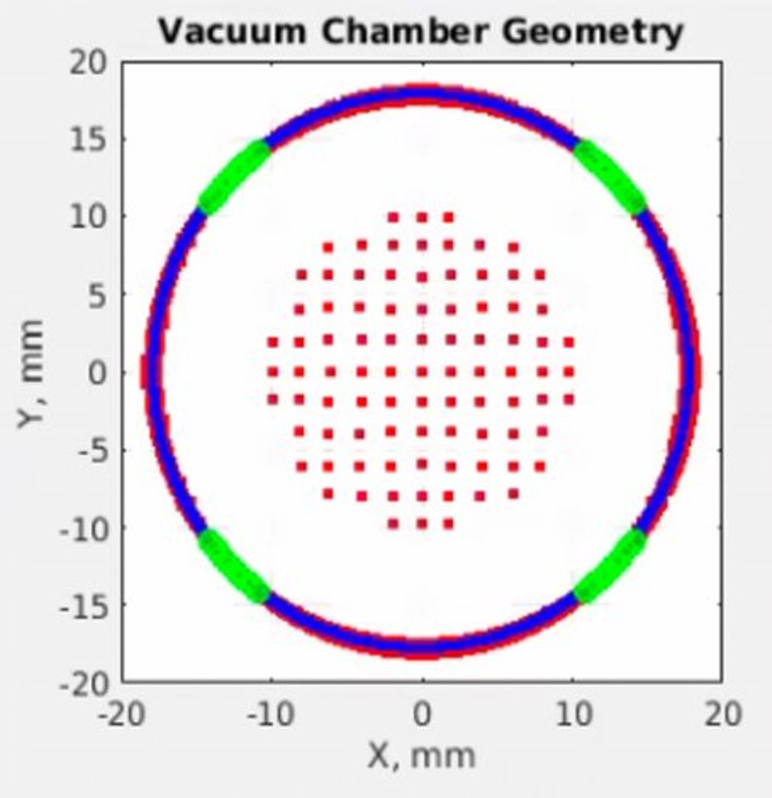
RCS - Single and Dual-Plane Types
Two different BPM configurations under consideration (35.6 mm aperture), one BPM per quad
  Single plane BPMs being evaluated for use at defocusing quads for cost savings
    Might be abandoned, and use dual plane everywhere
    With only top/bottom buttons, there is no horizontal measurement to contribute to the position calculation
  Dual-plane for x/y position (buttons rotated 45 degrees) at focusing quads
Same square housing can be used everywhere, with different orientation and number of BPM bores
Accuracy is adversely affected by pin-cushion distortion
10% error for 5 mm horizontal displacement
Third order polynomial fit provides correction for the pin-cushion distortion (needed for lattice measurements)

Slide 15
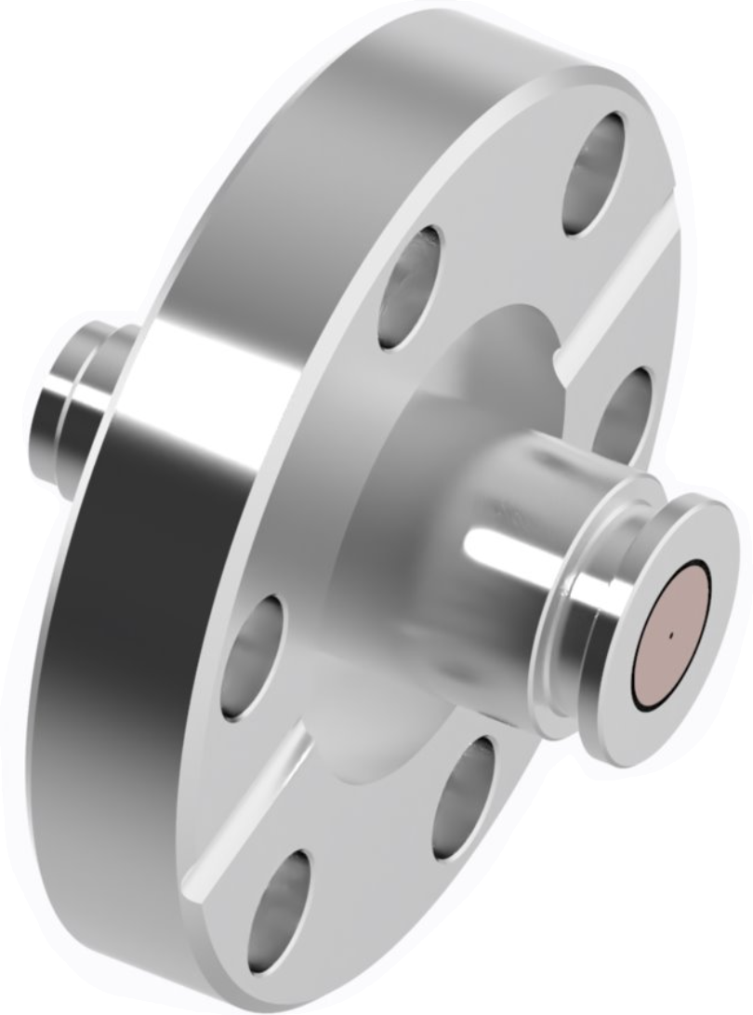
RCS BPM Button Summary
Preliminary design meets all existing beam measurement performance requirements
Considered a low-risk button design
Awaiting new RCS beam parameters, and performance requirements
Likely needs to be redesign

Slide 16
Electron Storage Ring BPM Buttons

Slide 17
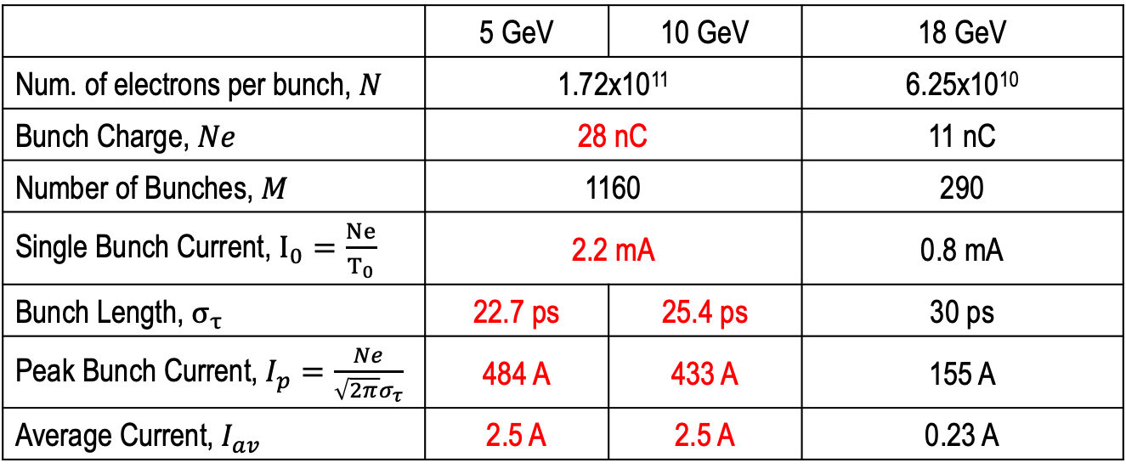
ESR Beam Parameters
 | 5 GeV | 10 GeV | 18 GeV
Num. of electrons per bunch, $N$ | 1.72x10¹¹ |  | 6.25x10¹⁰
Bunch Charge, $Ne$ | 28 nC |  | 11 nC
Number of Bunches, $M$ | 1160 | 1160 | 290
Single Bunch Current, $I_{0}=\frac{Ne}{T_{0}}$ | 2.2 mA |  | 0.8 mA
Bunch Length, $σ_{τ}$ | 22.7 ps | 25.4 ps | 30 ps
Peak Bunch Current, $I_{p}=\frac{Ne}{\sqrt{2π}σ_{τ}}$ | 484 A | 433 A | 155 A
Average Current, $I_{av}$ | 2.5 A | 2.5 A | 0.23 A
High intensity beams at 5 GeV and 10 GeV
Beam current reduced to 230 mA at 18 GeV to keep synch radiation below ~ 10 MW.
Comparable beam current was achieved at PEP-II LER in 2008; 3.2 Amps at 3 GeV.

Slide 18
ESR BPM Performance requirements
Measurement |  | Instrument | Requirements | Quantity
Position | Pilot bunch (2 nC) | Button BPM 7 mm button diameter 36 x 80 mm beam pipe aperture Range: (H): +/-10 mm (V): +/-5 mm | Resolution: 30 um | 494
 | Turn-by-turn (7 nC, 1,160 bunches) |  | Resolution: 10 um
 | Average, 1 second (7 nC, 1,160 bunches) |  | Resolution: 1 um
Injection trajectory – single bunch (7 nC) |  | BPMs downstream of injection with special electronics | Resolution H/V: 10/5 um | 20

Slide 19
ESR BPM Overview
ESR beam parameters
  2 - 28 nC bunches, 7 mm (~23 ps)
  Bunch spacing 10 or 40 ns
  Up to 1,160 bunches, 2.5 Amps
BPM Pick-up
  36 X 80 mm octagonal, copper cladded steel aperture
  Dual button planar arrangement
  Helicoflex vacuum seal
  304 or 316L housing, beam facing copper coated
  7 mm molybdenum* buttons, considering copper coating
  240 micron gap
  Buttons ~22 mm apart on center,
  Present button status – preliminary design phase
* Molybdenum has higher electrical conductivity than stainless steel, but less than copper. Despite its high thermal and electrical conductivity, copper is softer, has a lower melting point, and is more prone to deformation under thermal stress. Molybdenum’s superior thermal stability makes it less prone to softening or deformation under high temperatures.

Slide 20
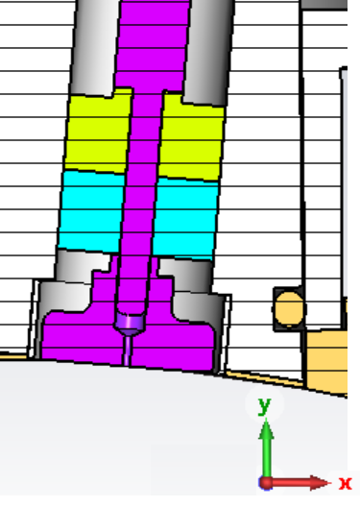
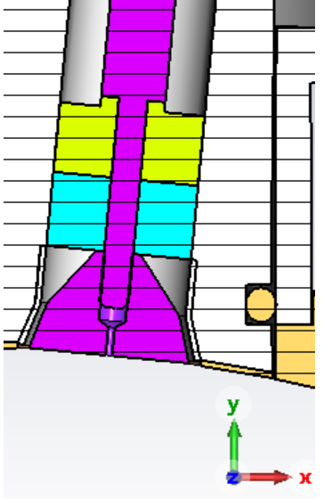
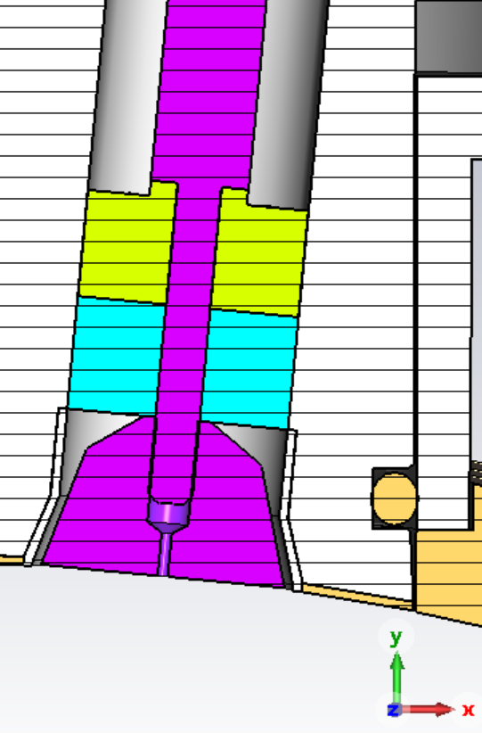
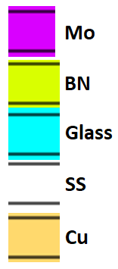
ESR BPM button shape development
Three BPM button shapes were studied with the Particle Studio simulations
NSLS2 Storage ring (Ref)
Design current 500 mA
Simulations show
  Max button temperature ~36 °C
Reference design based on NSLS2 storage ring BPM
EIC ESR Test 1
EIC ESR Test 2
Boron nitride disc installed on the ambient side of the glass seal to help sink heat into the stainless flange

Slide 21
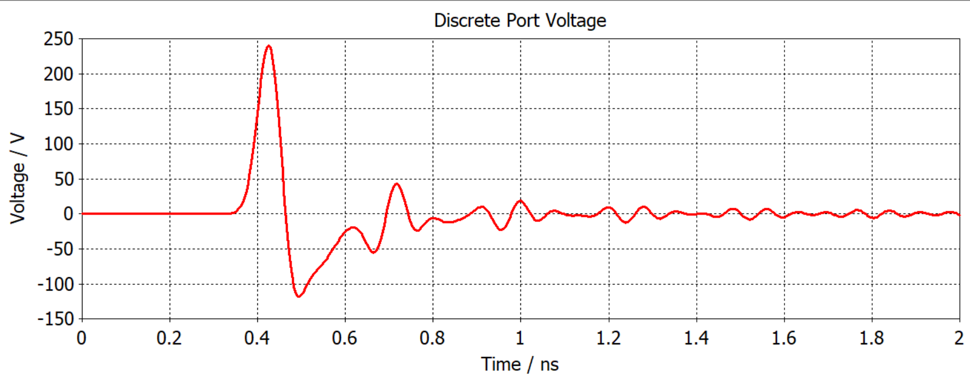
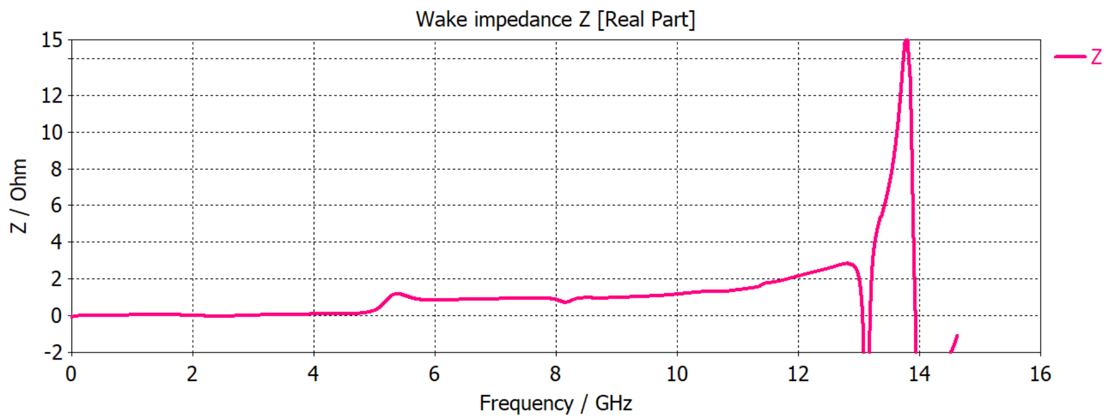
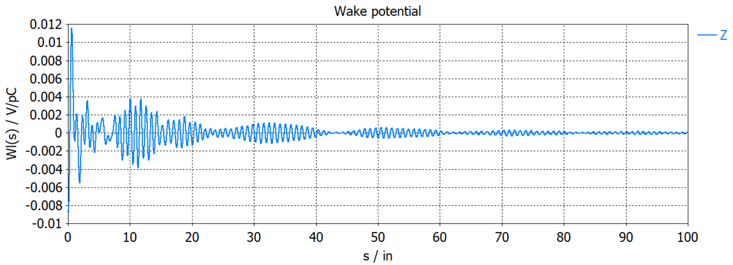
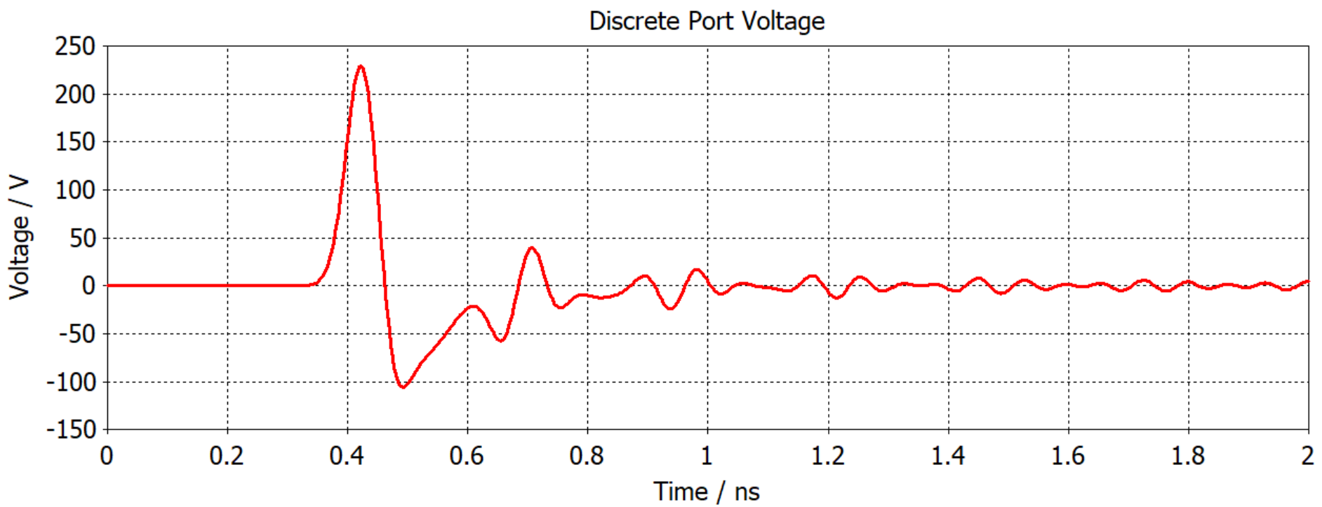
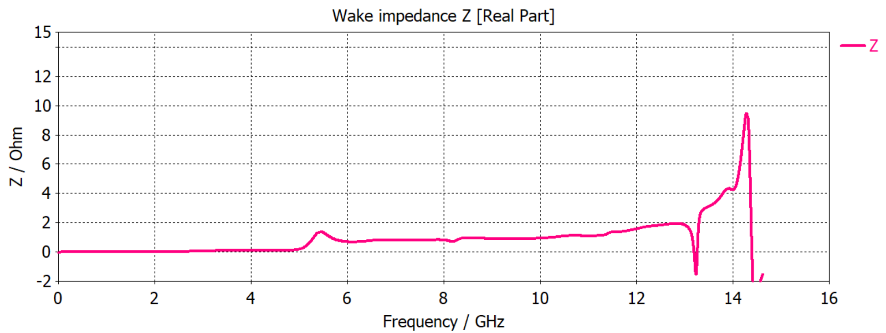
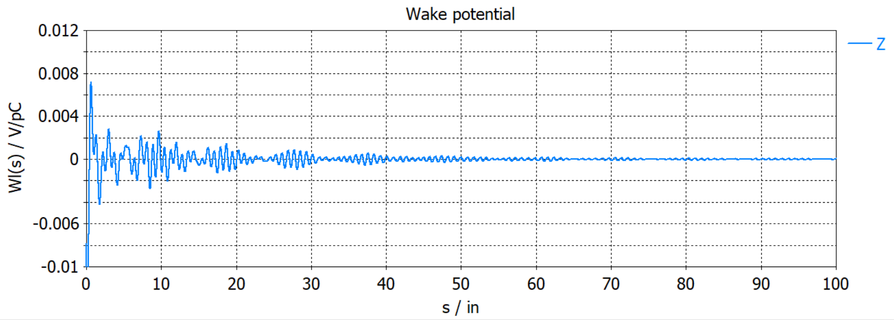
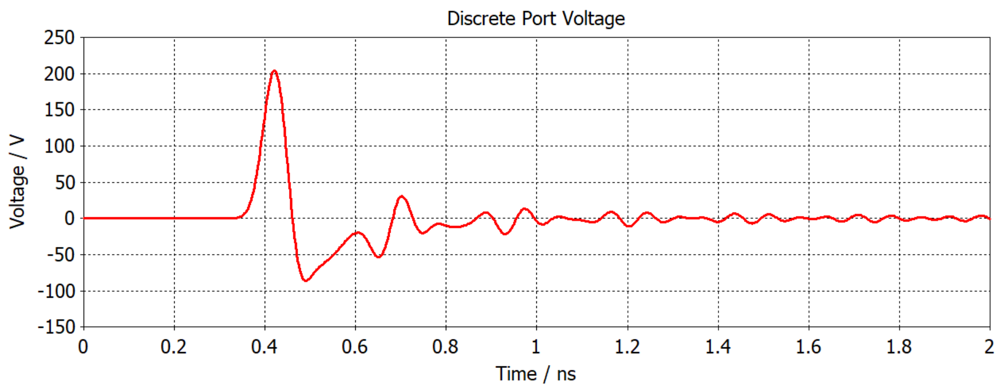
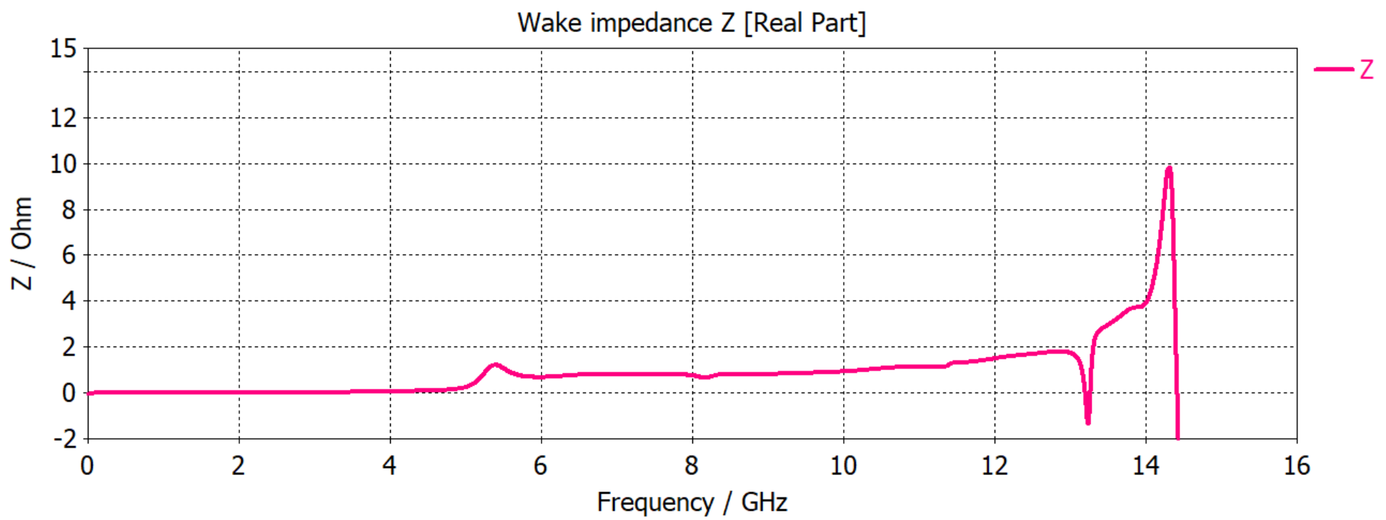
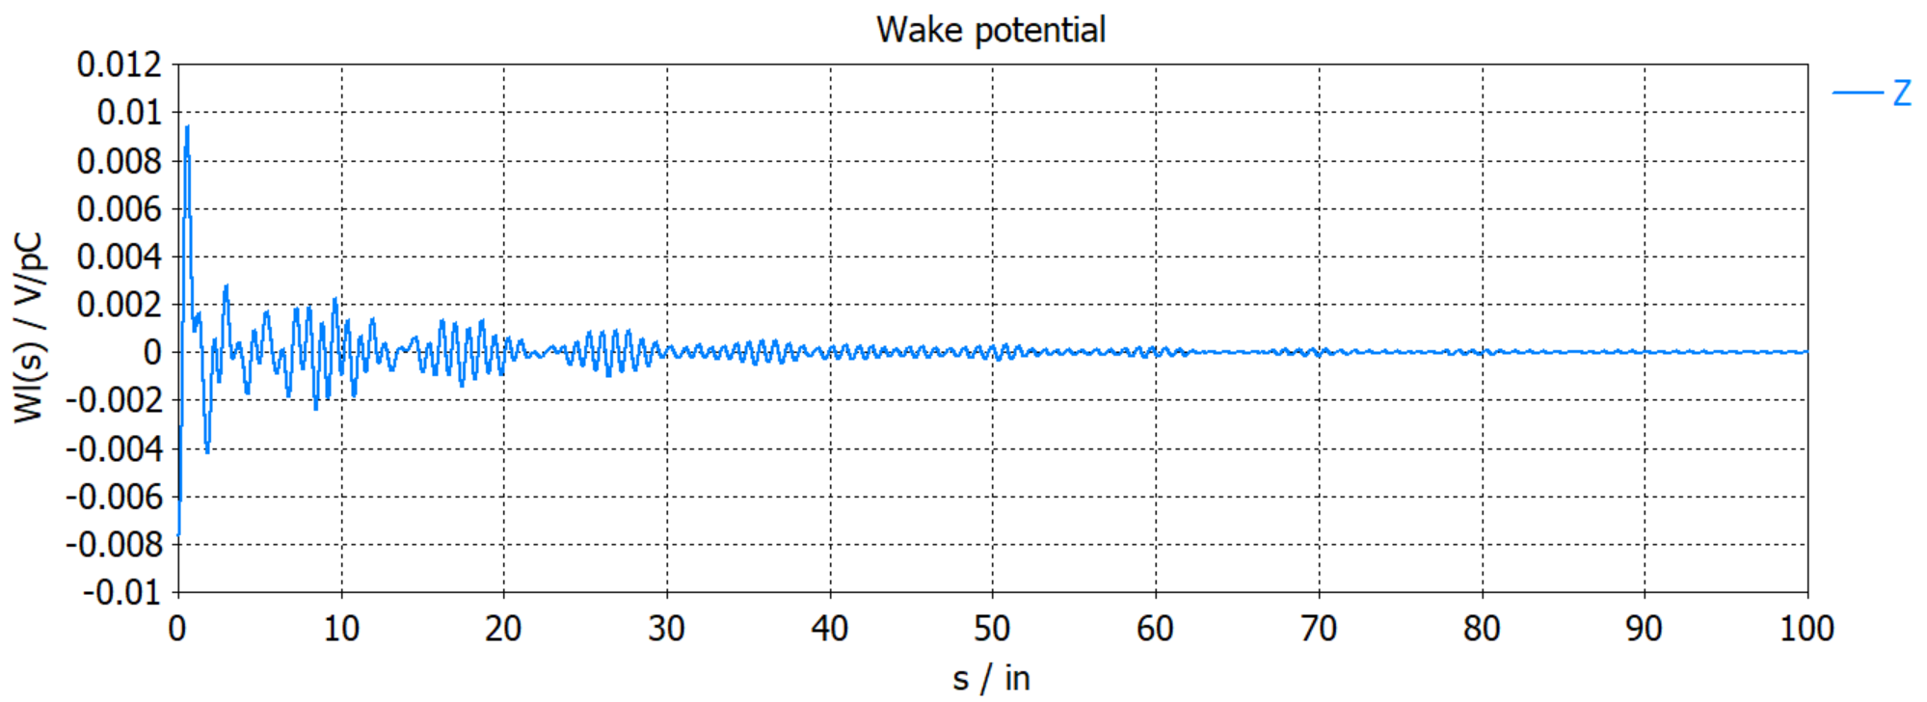
ESR BPM button shape comparison - CST
Signals from the three BPM models
The signals are similar as expected.
The slight amplitude reduction for ESR 1 and ESR 2 is probably due to the slightly increased capacitance.
Real part of the longitudinal wake impedance for the three models. Resonance peak ~ 14 GHz
The wake potentials for the three models with copper coating of the beam-facing housing surfaces.
Reference
ESR 1
ESR 2
8.5 ns

Slide 22
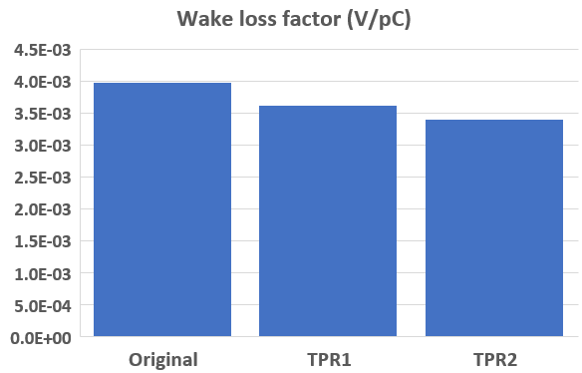
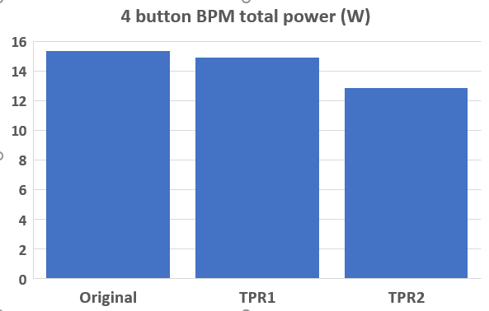
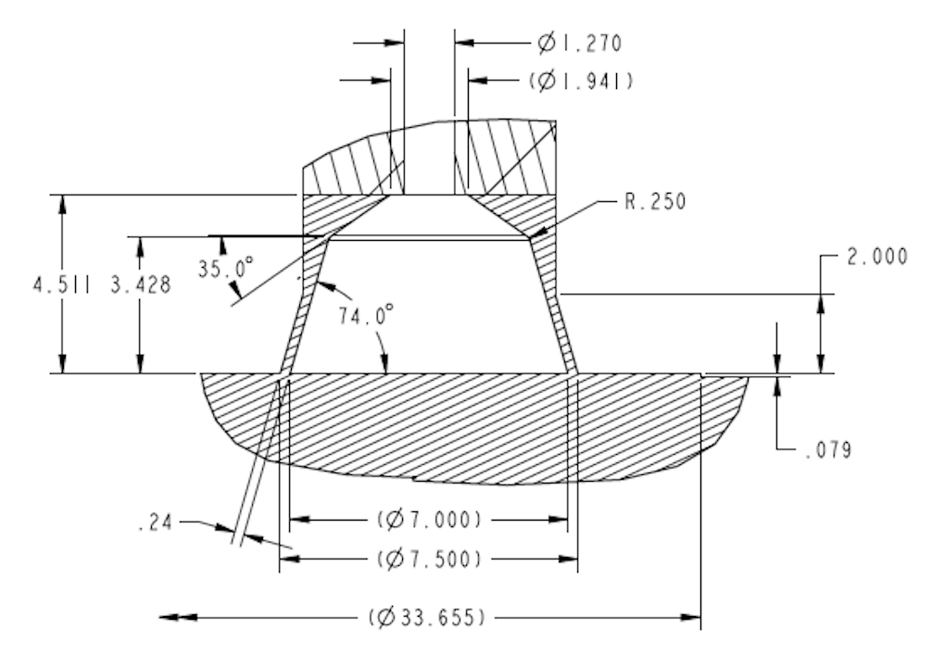
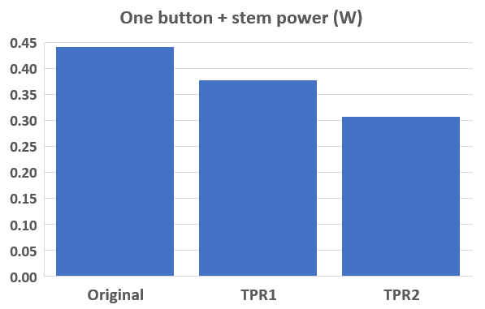
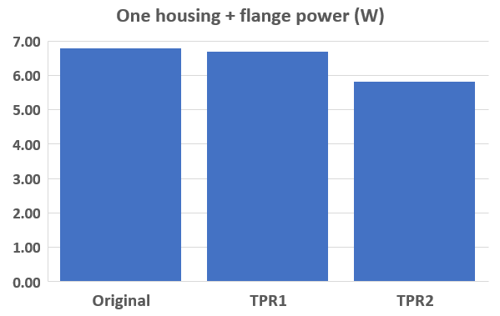
ESR BPM button shape comparison
Comparing the NSLS-II button with the two ESR BPM button shapes with copper coating on the surface of the housing
ESR 2 is ~ 15% less than Ref
2.5” long beam pipe section
Reference
ESR 1
ESR 2
Reference
ESR 1
ESR 2
ESR 2 button detail
Reference
ESR 1
ESR 2
Reference
ESR 1
ESR 2
Of the shapes studied, ESR 2 seems to be the best choice so far

Slide 23
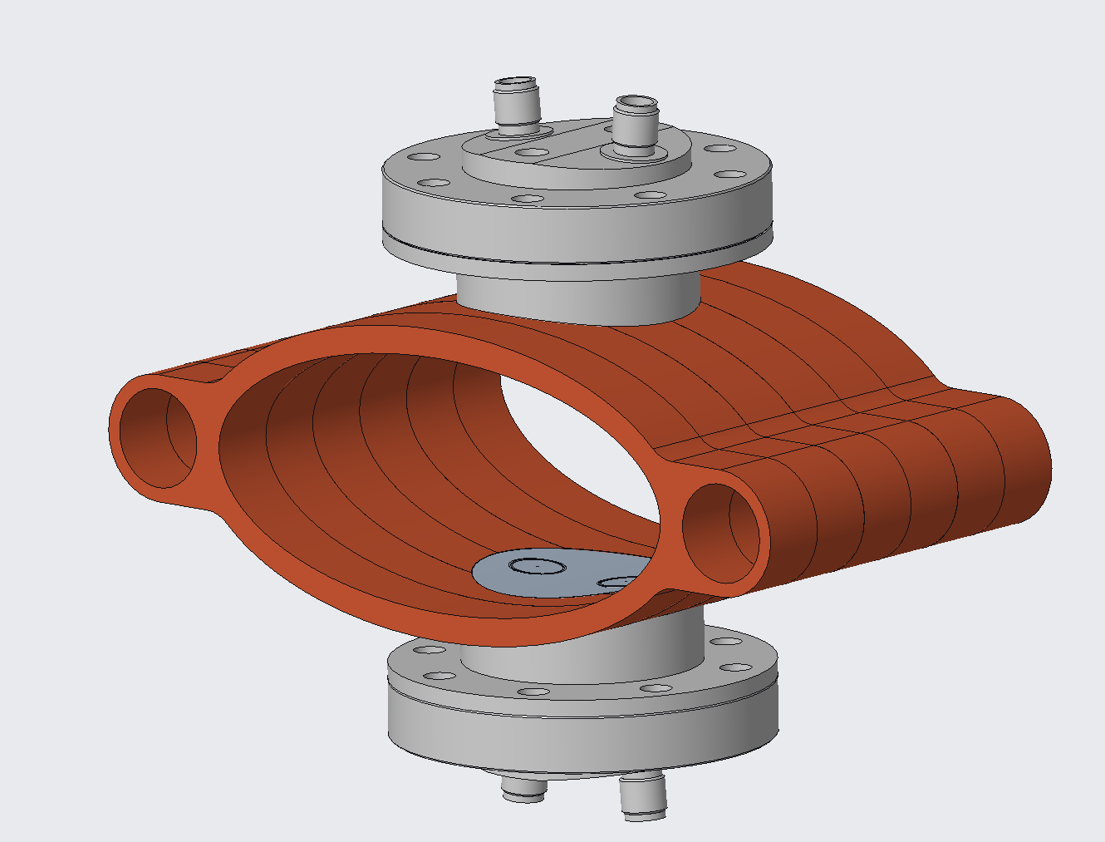

ESR BPM Thermal Analysis set up
This thermal analysis done before chamber was changed from oval to octagon
Heat loads are localized beam induced heating calculated in CST.
  Total heat load is 13W
Heat sinks (i.e. cooling) are:
  6 gpm of water flowing through each chamber water channel
  Static air convection on all exposed surfaces
    Film coefficient is 5 W/m²C
Conservative assumptions
  No heat flow through RF Gasket
  No heat flow away from Copper pins to cable
Heat Loads
Component | Material | Count | Heat Loads (W)
Button | Mo | 4 | 0.288
Stem | Mo | 4 | 0.017
Housing | SS | 1 | 2.231
Surface sheet | Cu | 2 | 1.033
Cavity liner | SS | 4 | 0.998
Flange | SS | 2 | 0.348
Beam pipe section 1 | Cu | 1 | 0.971
Beam pipe section 2 | Cu | 1 | 0.877
Beam pipe section 3 | Cu | 2 | 0.136
Beam pipe section 4 | Cu | 2 | 0.134
Beam pipe section 5 | Cu | 1 | 0.885
Beam pipe section 6 | Cu | 1 | 0.98
Beam Pipe
(sections 1-6)
Stainless Steel Connector
Copper Pin
Stainless Steel Body
Molybdenum Stem
Boron Nitride
(thermal conductor)
Stainless Steel Flange
7070 borosilicate glass
(vacuum seal)
RF Gasket
Surface sheet
(Cu coating)
Button

Slide 24

ESR BPM Thermal Analysis Results
Thermal results for worst case scenario:
1160 23 ps long, 28 nC bunches, 10 ns spacing, 484 Amps peak current, 2.5 Amps average current
Symmetric around the horizontal plane
Biggest impedance to thermal flow is the borosilicate glass (low thermal conductivity)
Max temp is button surface at 73 °C (desire to keep below 100 °C)
  Based on data collected from other machines and comments from manufacturer, these temperatures are not considered to be of concern.
Temperature values are conservatively high as analysis was conducted with cooling water flowing at 6 GPM and we plan to flow water at 8 GPM.
Temperatures may be further reduced by:
  BPM geometry changes
  Including RF gasket into thermal model
57°C
(connector)
65°C
(pin)
55°C
(body)
65°C
(boron nitride)
51°C
(flange)
68°C
(glass)
26°C
(chamber)
73°C
(button surface)

Slide 25



ESR Impedance Budget & BPMs
Impedance budget is being updated to reflect ongoing changes in the vacuum chamber profile.
• NEG coated vacuum chambers
• The list of vacuum components that need to be re-calculated is presented in the Table.
ESR Impedance budget simulations for 0.5 mm bunches are underway using GdfidL
Total BPM longitudinal wakefield is acceptable
0.5 mm
1
Bellows: 770
3
BPMs: 494
Beam line absorber 137 mm radius: 17
2
591 MHz RF cavities: 18
We simulated the pseudo-Green function for a 0.5 mm bunch length (15 times smaller than the circulated bunch length of 7 mm) to use it in particle tracking simulations.

Slide 26
Hadron Storage Ring Cryo BPM Buttons
Warm BPMs in the HSR will use the same buttons

Slide 27
HSR BPM performance requirements
Requirement | Resolution
The BPM electronics shall have the capability to provide a measurement of a single bunch when there is a single bunch in the machine, else bunch-by-bunch measurements are not required.
For 5 nC bunches at injection parameters, the BPM electronics resolution when measuring one turn orbit shall not be larger than 2 mm RMS. | < 2 mm
For 5 nC bunches at injection parameters, the BPM electronics resolution when measuring the averaged orbit over a 1 second period shall not be larger than 200 µm RMS. | < 200 microns
For bunch charge of 5 nC and above, during splitting and bunch compression at collision energies, the BPM electronics resolution when measuring the average orbit over a 1 second period shall not be larger than 100 µm RMS | < 100 microns
For bunch charge of 5 nC and above, post splitting and bunch compression at collision energies, the BPM electronics resolution when measuring the average orbit over a 1 second period shall not be larger than 20 µm RMS | < 20 microns
For a 44 nC bunch at injection parameters, the BPM electronics resolution when measuring one turn orbit shall not be larger than 200 microns RMS. | < 200 microns
For 44 nC bunch at acceleration ramp parameters, the BPM electronics resolution when measuring the averaged orbit over a 1 second period shall not be larger than 20 µm RMS. | < 20 microns

Slide 28
HSR BPM Button overview
Existing RHIC cryo stripline BPMs will be shielded, new button BPMs installed nearby
New cryo buttons will need to measure beams with
  large radial offsets (+/- 20 mm, in a 32 mm radius beam pipe)
  short bunches (6 cm)
  bunch spacing (40 ns & 10 ns)
  high average current (1 Amp) (3 x RHIC)
Design status
  Preparing for design verification procurements, contract award in a few months
    Plan to have 35 buttons fabricated by 3 vendors
    Acceptance test all buttons, and compare results
  Then select one vendor for the quantity (~ 1,200) fabrication, contract award in late 2025
Amorphous carbon coating of button face will be done at BNL
      For electron cloud suppression

Slide 29
HSR Energy Range and Radial Shift
Species | p | e | p | e | p | e | p | e | p | e
Energy (GeV) | 275 | 18 | 275 | 10 | 100 | 10 | 100 | 5 | 41 | 5
No. bunches | 290 |  | 1160 |  | 1160 |  | 1160 |  | 1160
Bunch spacing (ns) | 40.59 |  | 10.15 |  | 10.15 |  | 10.15 |  | 10.15
Bunch charge (E10) | 19.1 | 6.2 | 6.9 | 17.2 | 6.9 | 17.2 | 4.8 | 17.2 | 2.6 | 13.3
Bunch charge (nC) | 30.5 | 9.9 | 11.0 | 27.5 | 11.0 | 27.5 | 7.7 | 27.5 | 4.2 | 21.3
RMS bunch length (cm) | 6 | 0.9 | 6 | 0.7 | 7 | 0.7 | 7 | 0.7 | 7.5 | 0.7
CM Energy (GeV) | 140.7 |  | 104.9 |  | 63.2 |  | 44.7 |  | 28.6
Luminosity (E33) | 1.54 |  | 10 |  | 4.48 |  | 3.68 |  | 0.44
Large radial orbit offsets (up to 20mm)
In the arc must be accounted
in BPM button and electronics design
20 mm
100 GeV
138 GeV
275 GeV
50 mm
63.5 mm
Notes:
High ECM and High L beam scenarios will be the focus of this talk.

Slide 30




Hadron Storage Ring Cryo BPM Buttons
63.5 x 50 mm chamber
HSR Cryo Interconnect BPM & Bellows Module, 3D model
LHe Cooling tube
BPM buttons
Buttons rotated 30° above & below horizontal axis to reduce button heating at large radial beam displacements
18 mm button solid copper
450-micron gap, with option for smaller gap (250 microns if possible)
2” ConFlat flange
RP-SMA Female connector
HSR Cryo Interconnect Module, 3D model, cut-away
BPM buttons, amorphous carbon coated

Slide 31


HSR Impedance budget & BPMs
The list of HSR vacuum components that need to be
re-calculated is shown below.
Longitudinal wakefield GdfidL simulation
2
Beam screen 2880 m
4
Cold BPMs & bellows 250
Injection kickers 20
1
Flange Joint (steps) 1000
3
Warm bellows 200
gate valves 125 mm: 30
gate valves 88mm: 12
abort kickers: 5
Impedance simulations for all HSR devices is still underway
HSR BPM overall impedance is acceptable
We simulated the pseudo-Green function for a 4 mm bunch length (15 times smaller than the circulated bunch length of 6 cm) to use it in particle tracking simulations.

Slide 32
HSR BPM Buttons Summary
Design challenges/concerns for HSR cryogenic buttons
  Beam parameters
    Large radial offset (button heating, measurement resolution at large offset)
    Short bunches
    High bunch charge
    High average current
  Mechanical design concerns
    Solid copper button
    Fabrication
      All qualified button vendors have made BPM buttons previously
        Do they still have the capability?
        Only one has made cryo buttons (for FRIB)
      Will design verification buttons pass all acceptance testing?
        If not, there will be schedule delays
See next talk from Frédéric Micolon
  “Progress of the EIC HSR cryogenic BPM mechanical design”

Slide 33
Summary
EIC needs at least 3 different BPM button designs
Button designs are underway with various levels of maturity based on installation schedule
  The HSR design verification cryo-buttons are expected in July ’25.
    The cryo button acceptance test facility development is underway
This workshop is appreciated!
  Sharing BPM button design, fabrication and testing experience is valuable
Ring | Button size | Quantity | Maturity
Electron Storage Ring | 7 mm | 2,000 | Preliminary Design
Rapid Cycling Synchrotron | 5 mm | 1,600 | Final Design (stalled)
Hadron Storage ring | 18 mm | 1,200 | Procuring design verification units
Thank you for your attention!

Slide 34
Back-up slides

Slide 35









HSR BPM button signal analysis – button capacitance
Numerical (CST) TDR button analysis
  S11 $⇒ Γ\left(t\right) (DC−10 GHz)$
  Fit:
HSR pipe with HSR buttons – $±30°$ final arrangement
$$Γ\left(t\right)=1−2e^{−\frac{t−t_{D}}{τ}} \text{for} t>t_{D}$$
with: $τ=R_{load}C_{button}$
$$R_{load}=Z_{0}=50 Ω$$
$$d_{button}$$
bending
required
by CST
HSR pipe
with HSR buttons
($±30°$ arrangement)
$$D_{pipe}$$
$$h_{pipe}$$
Courtesy of Manfred

Slide 36

ESR BPM button - preliminary design

Slide 37

HSR BPM button

Slide 38




RCS "Button" Electrode
Button material:
  Solid molybdenum
    Conductivity 17 x 10⁶ S/m
Button shape inspired by NSLS-II transfer line BPM
  Dimensions will be optimized with physics feedback
Weephole on button face for outgassing
  Pin is brazed or laser-welded
Stem material is vendor-dependent

Slide 39


RCS BPM Body
Axisymmetric
  Easily machined
  Can hold very tight tolerances
Height dimensioned to prevent aperture intrusion
  BPM face nominally sits slightly recessed from bore
  Tolerances ensure it never “sticks out”
Groove fits standard RF spring
Shorter flange-to-face height helps perpendicularity for manufacturing
  Minimized while preserving bolt space
Minimize
"Flange"
"Face"

Slide 40


ESR BPM button spacing
The evaluation of the octagonal BPM geometry for the ESR vacuum chamber starts with studying of the scaling coefficients vs separation of the buttons. The dependence of scaling factors for horizontal and vertical planes vs. distance between button centers is shown below. The scaling factors are close to each other when the separation is about 20 mm.
Another analysis can be done using estimate in the position jitter. For equal signal-to-noise ratio in all channels the calculated position variation from actual beam location with delta over sum method is proportional to the square root of the sum of squares of scaling coefficients. This dependence is shown below.
Dependence of the scaling factors on
distance between button centers.
36 X 80 mm aperture
The minimum of the noise scaling factor is when separation is between 20 and 24 mm.
After simulating that the performance requirements can be met, the button spacing can be set at 22 mm

