Slide 1

Button Pickups for High
Bandwidth Applications
B. E. J. Scheible^{1,3}, S. Vilcins², A. Penirschke¹
¹Technische Hochschule Mittelhessen, Wilhelm-Leuschner-Str. 13, 61169 Friedberg
²Deutsches Elektronen-Synchrotron DESY, Notkestr. 85, 22607 Hamburg
³Technische Universität Darmstadt, Schlossgartenstr. 8, 64289 Darmstadt
This work is supported by the German Federal Ministry of Education and Research (BMBF) under contract no. 05K22RO2.

Slide 2
Acknowledgements
There are many contributors who pathed the way:
The project partners, e.g., M.K. Czwalinna, N. Nazer, H. Schlarb [DESY]; E. Bründermann, A. Kuzmin, A.-S. Müller, G. Niehues, A. Schwarzenberger [KIT]; W. Ackermann, H. De Gersem [TU Darmstadt] and B.E.J. Scheible, A. Penirschke [THM];
S. Vilcins, who gave a lot of valuable input for designing a vacuum-sealed demonstrator;
Measurements at HZDR, M. Freitag, M. Kuntzsch, U. Lehnert, K. Zenker (+many more);
In the prior projects, leading to the cone-shaped pickups: A. Angelovski, V. Arsov, S. Bou Habib, M. Bousonville,
M.K. Czwalinna, H. Dinter, M. Gensch, Ch. Gerth, M. Hansli, S. Hunziker, R. Jakoby, S. Korolczuk, A. Kuhl,
M. Kuntzsch, A. Penirschke, K. Przygoda, J. Rönsch-Schulenburg, J. Roßbach, R. Rybaniec, H. Schlarb,
V. Schlott, S. Schnepp, B. Steffen, C. Sydlo, J. Szewinski, S. Vilcins, M. Viti, T. Weiland (+many more);
We are grateful that Keysight made their Oscilloscope UXR1102A available to us & provided technical support through Thomas Kirchner, and that Neue Technologien GmbH & Co. KG (NTG) offered close cooperation during construction of the prototype even giving us the opportunity to carry out the final assembly on their premises.
This work is supported by the German Federal Ministry of Education and Research (BMBF)
under contract no. 05K22RO2.

Slide 3
Outline
Electro-Optical Bunch Arrival-Time Measurement
Pickups for Bunch Arrival-Time Monitors
  From button-pickups to 40-GHz cone-shaped pickups
Pickups on a Printed Circuit Board (PCB)
  Concept for a PCB-BAM
  Production of a first demonstrator
  Measurements
  Conclusion and Outlook
    Limitations for BPM in circular Machine

Slide 4
Outline
Electro-Optical Bunch Arrival-Time Measurement
Pickups for Bunch Arrival-Time Monitors
  From button-pickups to 40-GHz cone-shaped pickups
Pickups on a Printed Circuit Board (PCB)
  Concept for a PCB-BAM
  Production of a first demonstrator
  Measurements
  Conclusion and Outlook
    Limitations for BPM in circular Machine

Slide 5
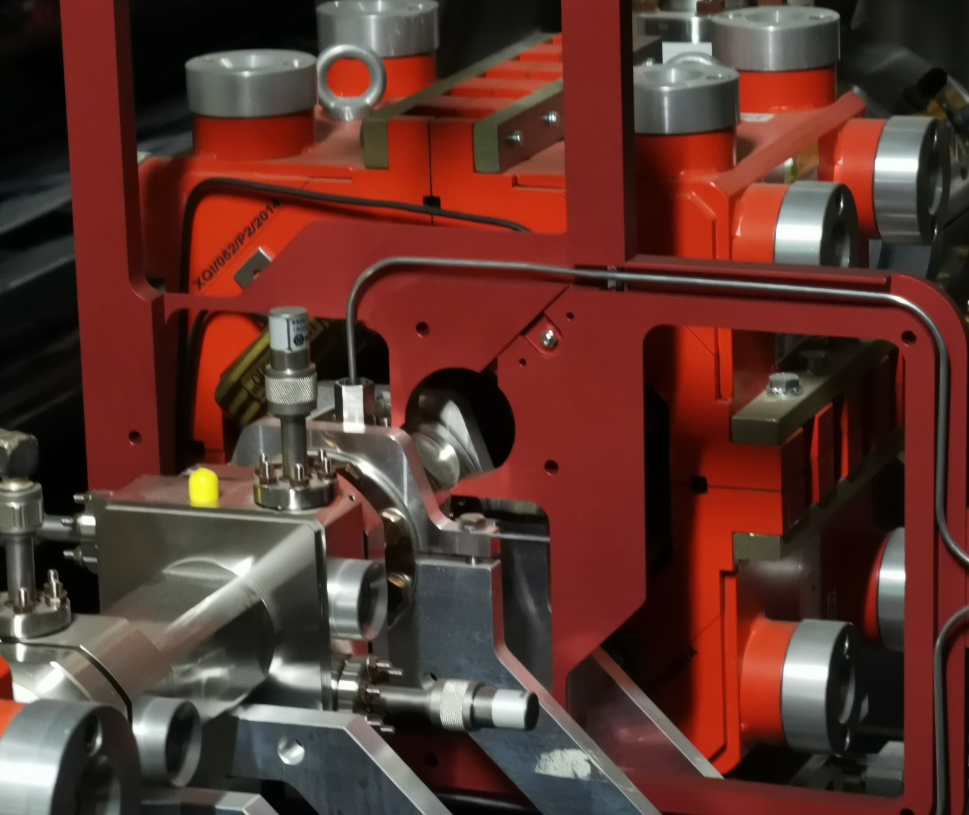
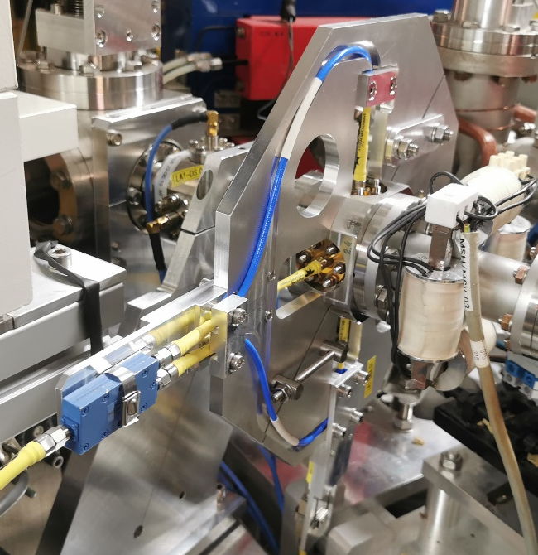
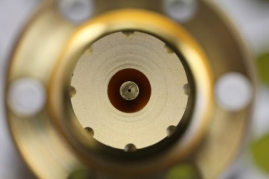
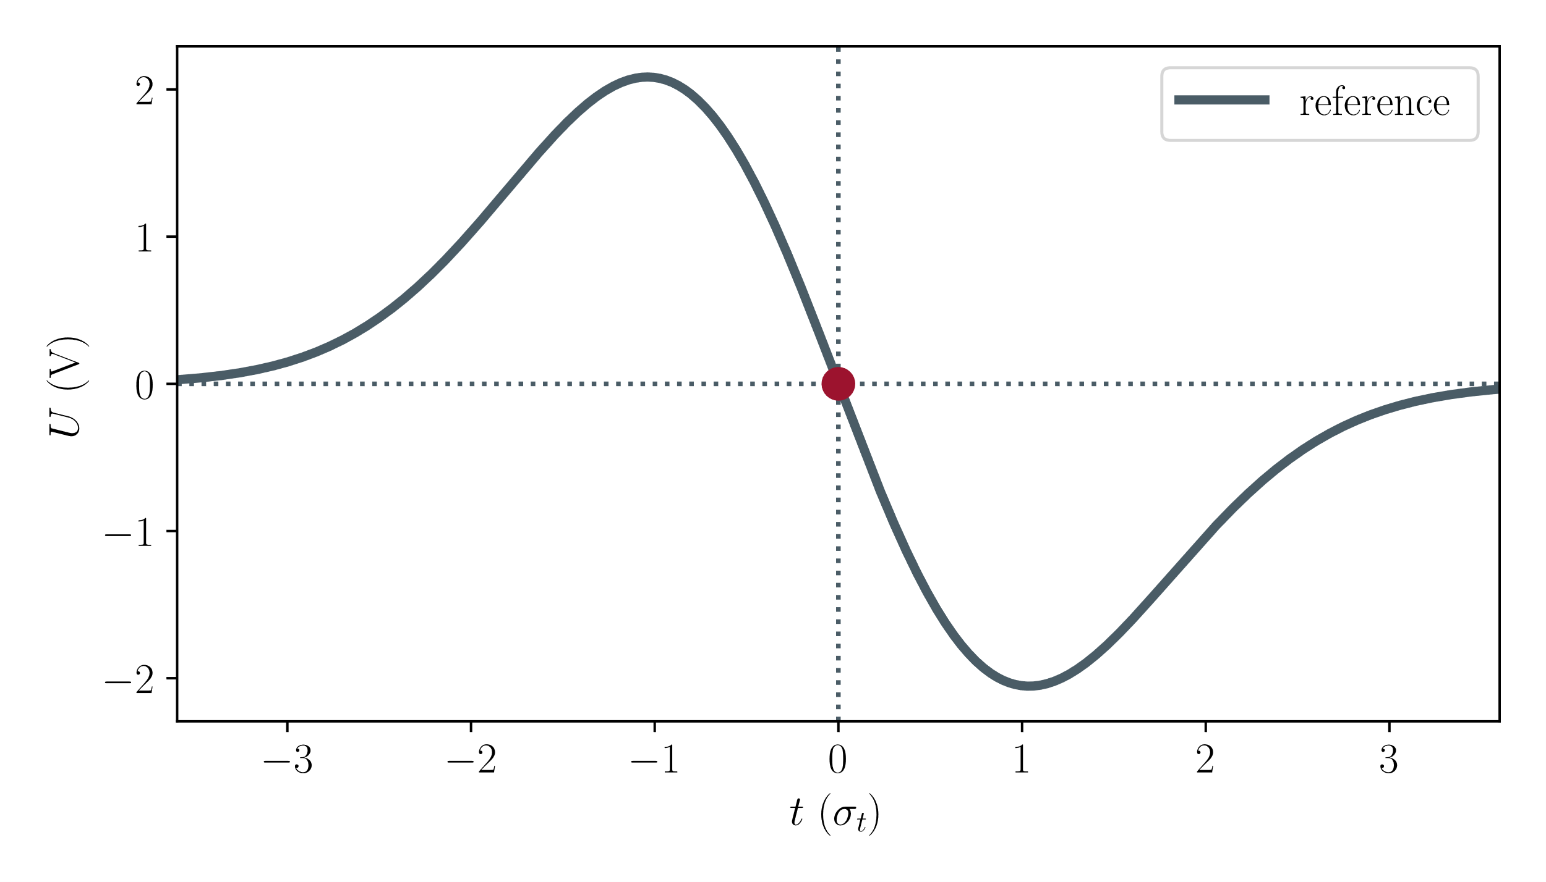
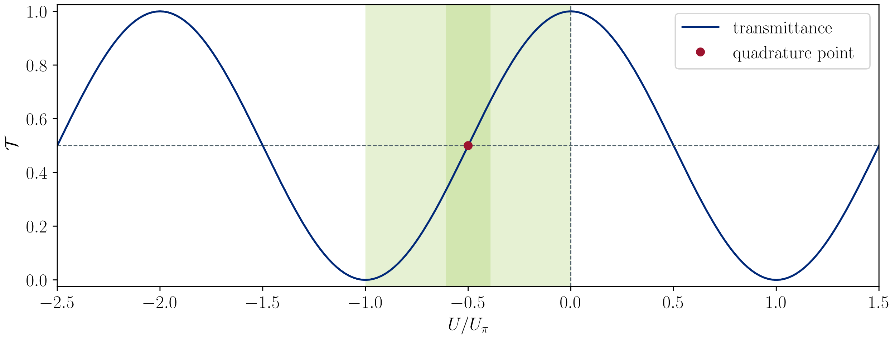
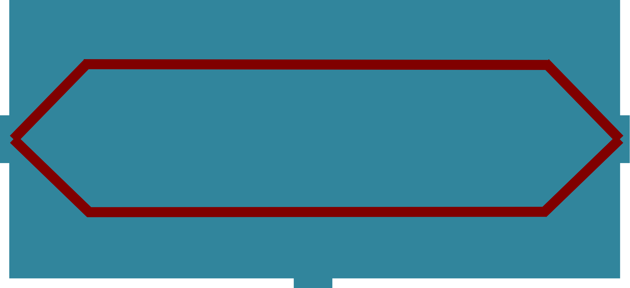



Electro-Optical Bunch Arrival-Time Measurement
Key Components:
$$U / V$$
RF-part
$$t / σ_{t}$$
Pickup-structure at EuXFEL (left) & ELBE (right)
Exemplary pickup signal
40-GHz cone-shaped pickup [Angelovski 2012]
fs pulsed
optical
reference
$$𝒯$$
EOM
Electronics
Diode
Electro-optical unit
Data acquisition
$$U / U_{π}$$
Transmittance of an idealized EOM vs signal voltage
Simplified EO-BAM layout with only one pickup and one EOM
A. Angelovski et al., Proc. IBIC’12. Paper: MOPA46

Slide 6
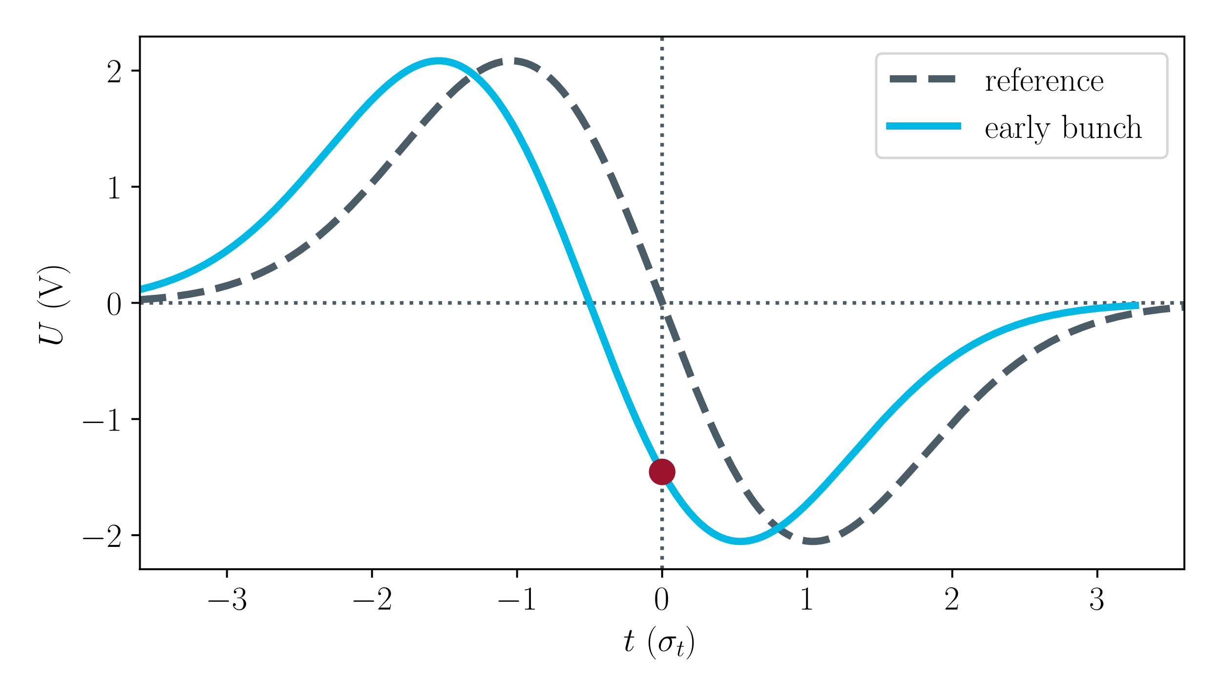
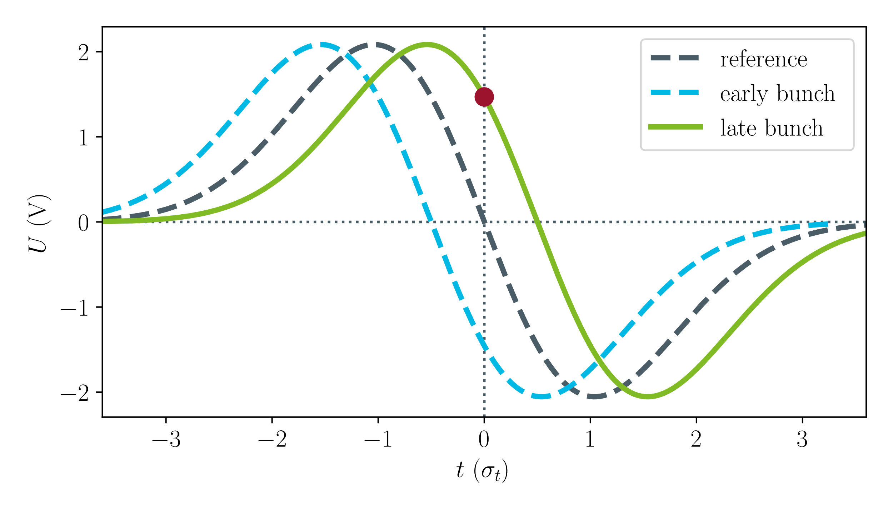
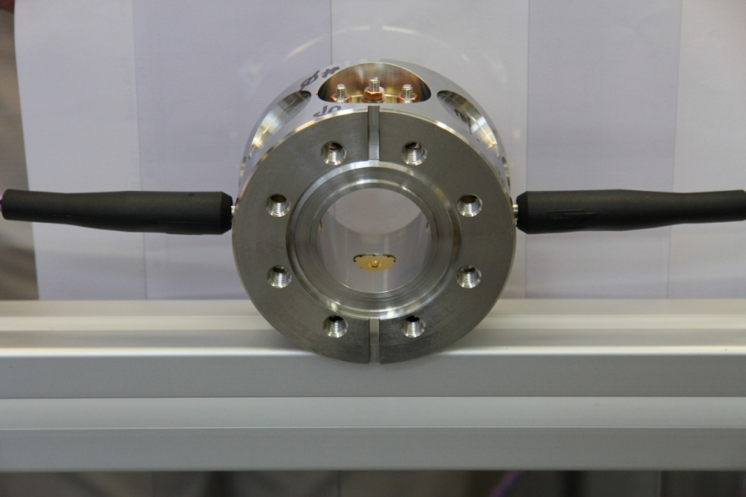
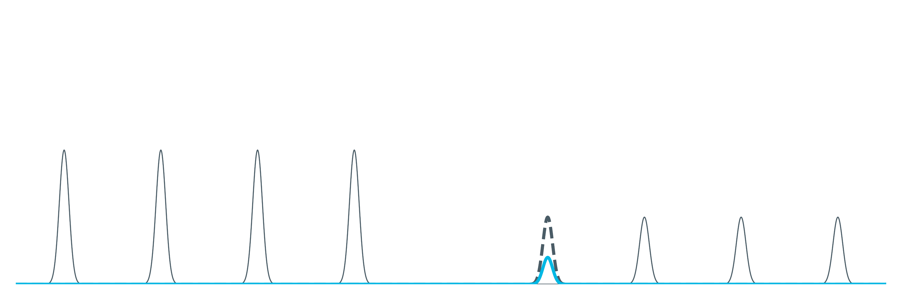
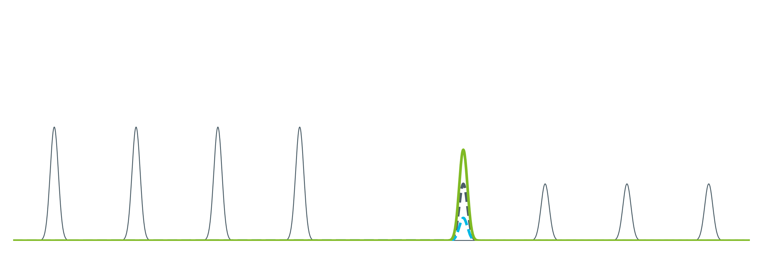
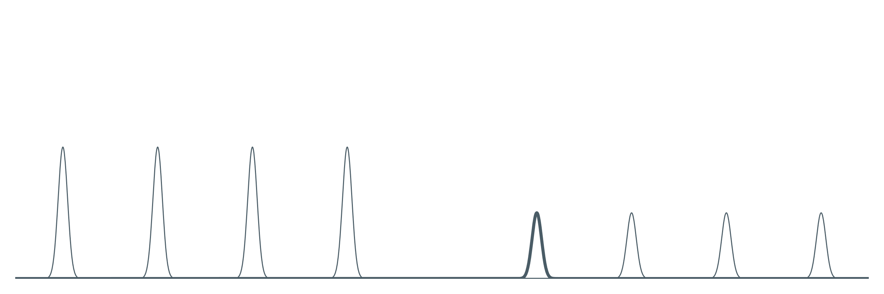
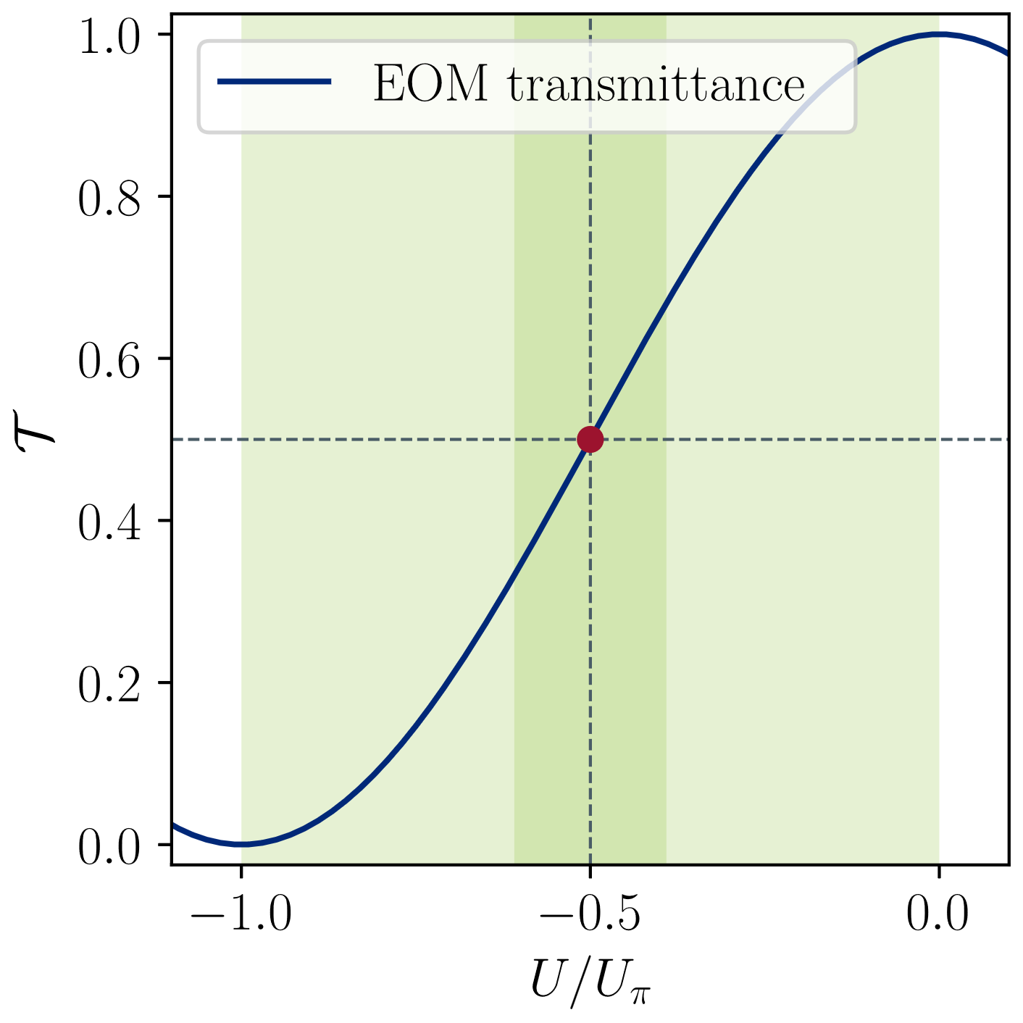
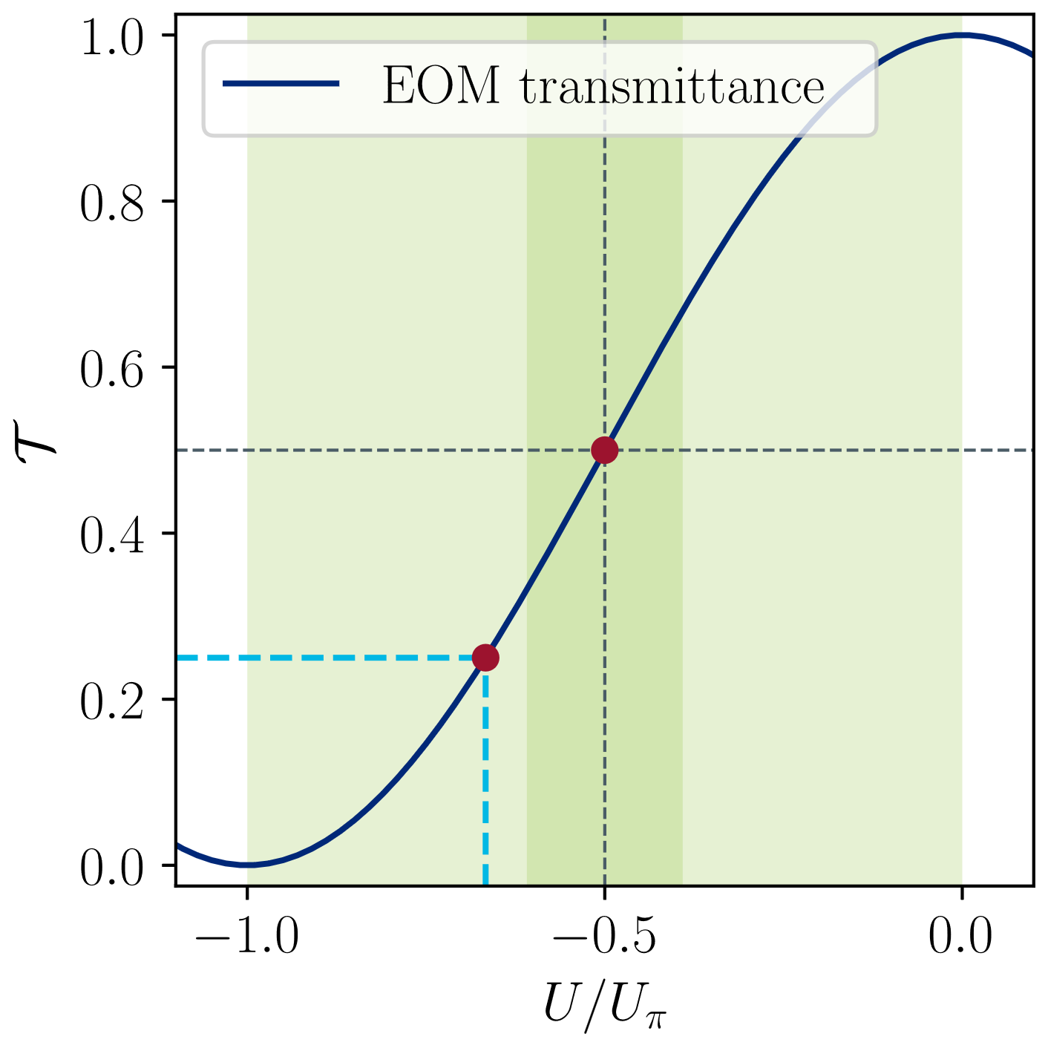
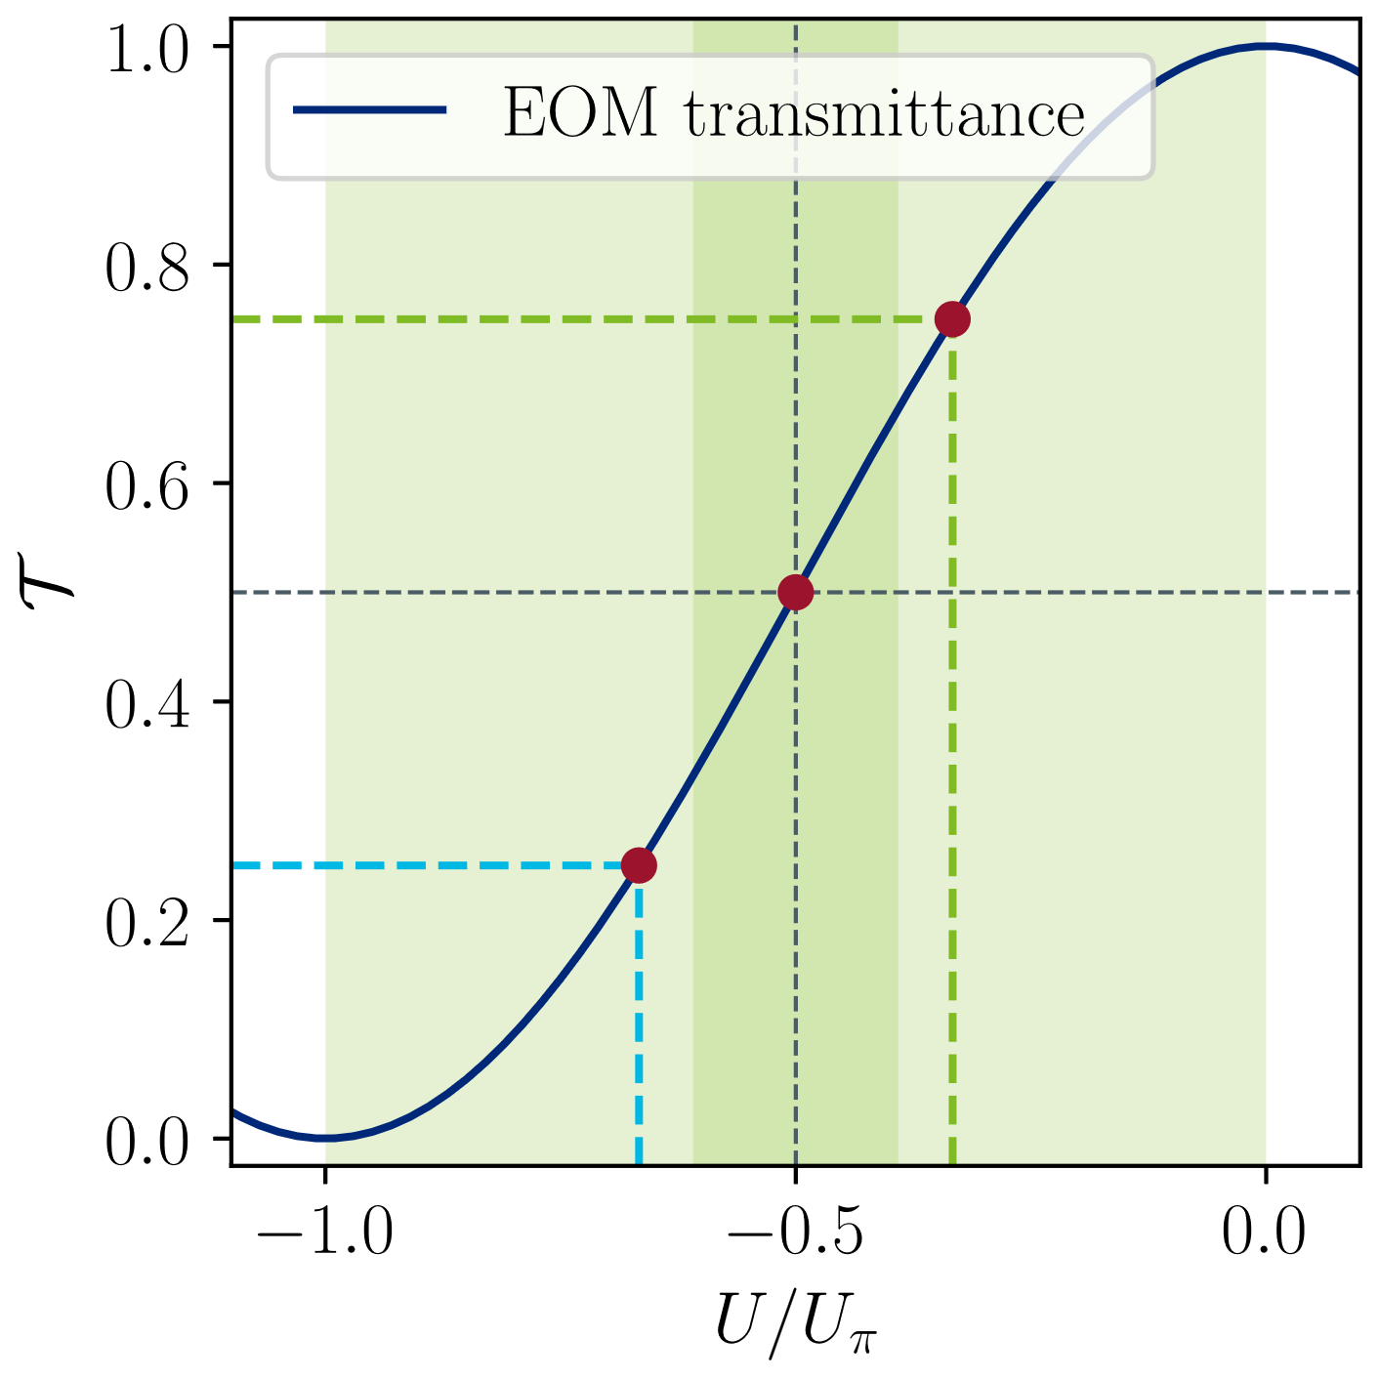


Electro-Optical Bunch Arrival-Time Measurement
EO-BAM – Detection scheme
Reference: Laser pulse samples signal @ zero crossing (ZC)
Ideal timing: Output amplitude same as the input amplitude
Early bunch: Lower output amplitude
Late bunch: Higher output amplitude
$Δt→U→ 𝒯→I$
Laser intensity $I$
proportional to $Δt$
All are linear for
small deviations
Pickup Voltage Signal
RF Input
EOM
Intensity
Output
fs pulsed optical reference
Diode
$$+$$
$$−$$
DC bias
Measurement Principle [based on Löhl, 2010]
Input Voltage
F. Löhl et al., Phys. Rev. Lett, 2010. DOI:10.1103/PhysRevLett.104.144801
Notes:
Sensititvity comes with reduced dynamic range

Slide 7
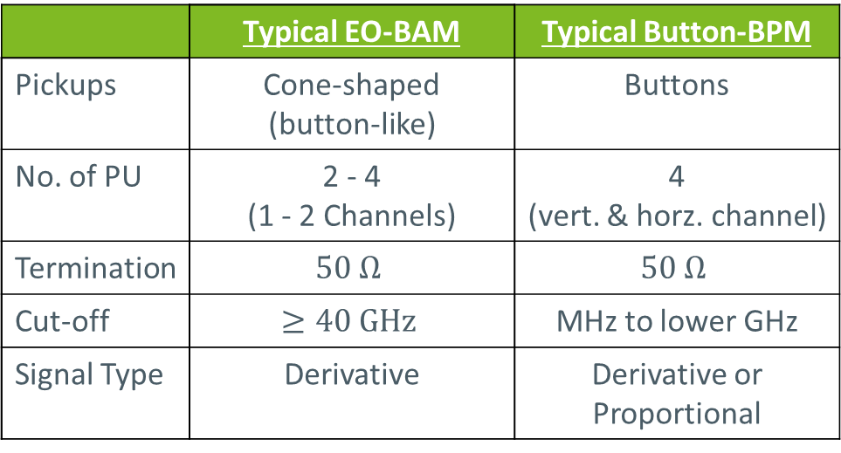
Electro-Optical Bunch Arrival-Time Measurement
Comparison to a Button-BPM
 | Typical EO-BAM | Typical Button-BPM
Pickups | Cone-shaped (button-like) | Buttons
No. of PU | 2 - 4 (1 - 2 Channels) | 4 (vert. & horz. channel)
Termination | $$50 Ω$$ | $$50 Ω$$
Cut-off | $$≥40 GHz$$ | MHz to lower GHz
Signal Type | Derivative | Derivative or Proportional

Slide 8




Electro-Optical Bunch Arrival-Time Measurement
Comparison to a Button-BPM
 | Typical EO-BAM | Typical Button-BPM
Pickups | Cone-shaped (button-like) | Buttons
No. of PU | 2 - 4 (1 - 2 Channels) | 4 (vert. & horz. channel)
Termination | $$50 Ω$$ | $$50 Ω$$
Cut-off | $$≥40 GHz$$ | MHz to lower GHz
Signal Type | Derivative | Derivative or Proportional
$$0°$$
$$0°$$
$$Δ$$
$$∑$$
sum
$$180°$$
$$0°$$
diff
hybrid
Angelovski, IBIC’12
Extract of an exemplary broadband signal processing scheme for a button-BPM [adapted from P. Forck, 2024].
Green parts are also common for the EO-BAM.
Two different problems, similar solutions!
A. Angelovski et al., Proc. IBIC’12. Paper: MOPA46
P. Forck, Proc. CAS 2024, Event:1356988, Contr.:5713247

Slide 9
Outline
Electro-Optical Bunch Arrival-Time Measurement
Pickups for Bunch Arrival-Time Monitors
  From button-pickups to 40-GHz cone-shaped pickups
Pickups on a Printed Circuit Board (PCB)
  Concept for a PCB-BAM
  Production of a first demonstrator
  Measurements
  Conclusion and Outlook
    Limitations for BPM in circular Machine

Slide 10
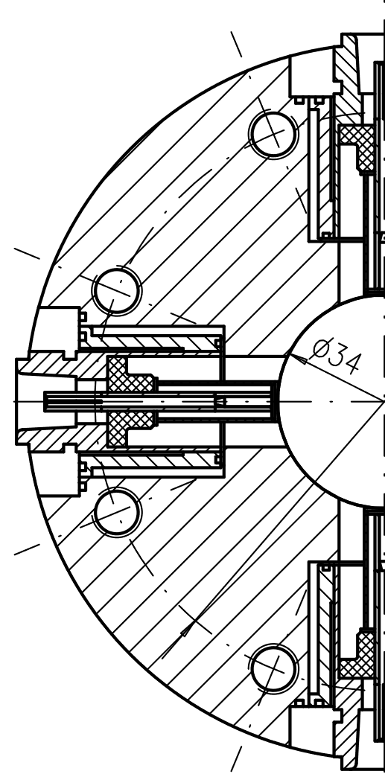
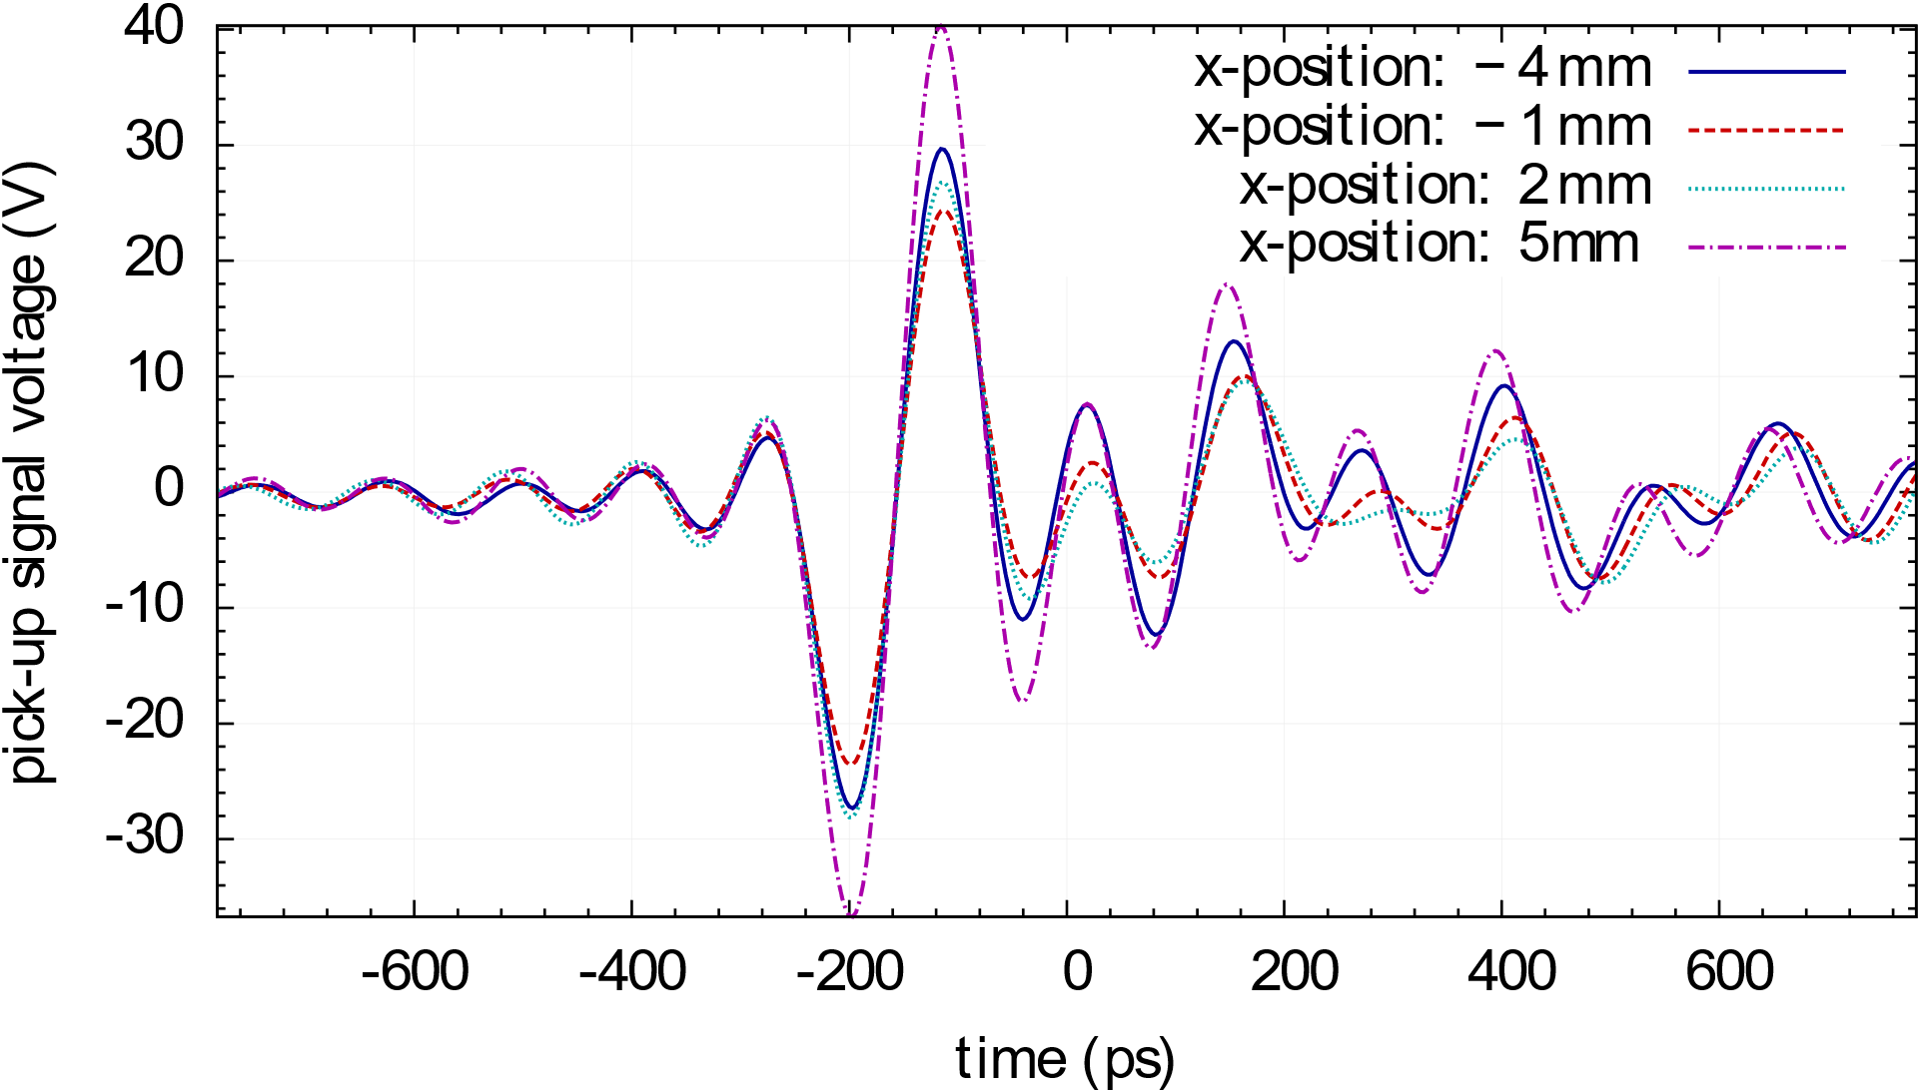

Pickups for Bunch Arrival-Time Monitors
2009
Button-type pickups:
Bandwidth: Pickup $>8 GHz$; EOM $≈20 GHz$
Bandwidth Showed viability of EO-BAM measurement:
$Δt<6 fs$
Strong ringing
F. Löhl & K. Hacker
3D model of the button-type beam pickup designed by Hacker and used for the EO-BAM by Löhl [Löhl 2009]
until
Measured signal of two combined pickups with an 8-GHz oscilloscope [Löhl 2009]
Technical drawing and 3D model of the button-type beam pickup de-signed by K. Hacker and used for the EO-BAM by F. Löhl [Löhl 2009].
F. Löhl , Thesis, 2009. DOI:10.3204/DESY-THESIS-2009-031

Slide 11
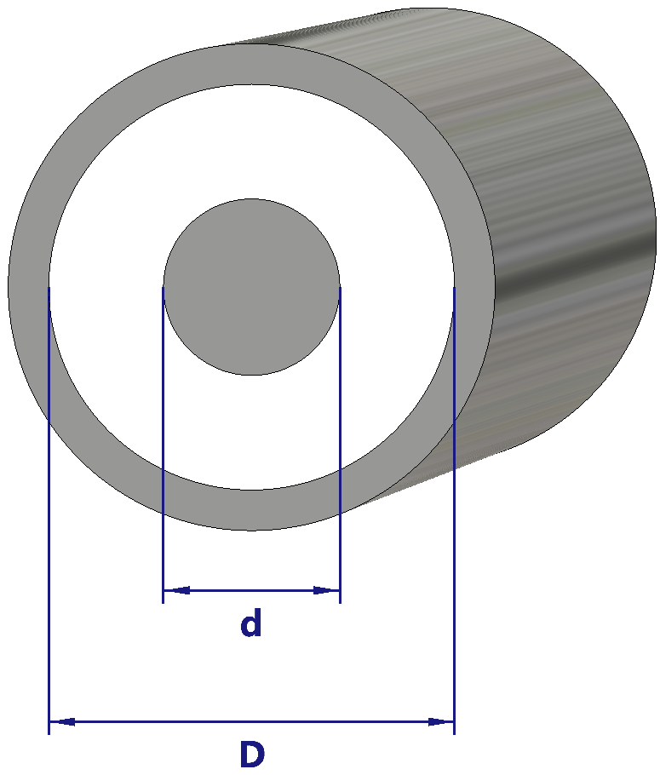
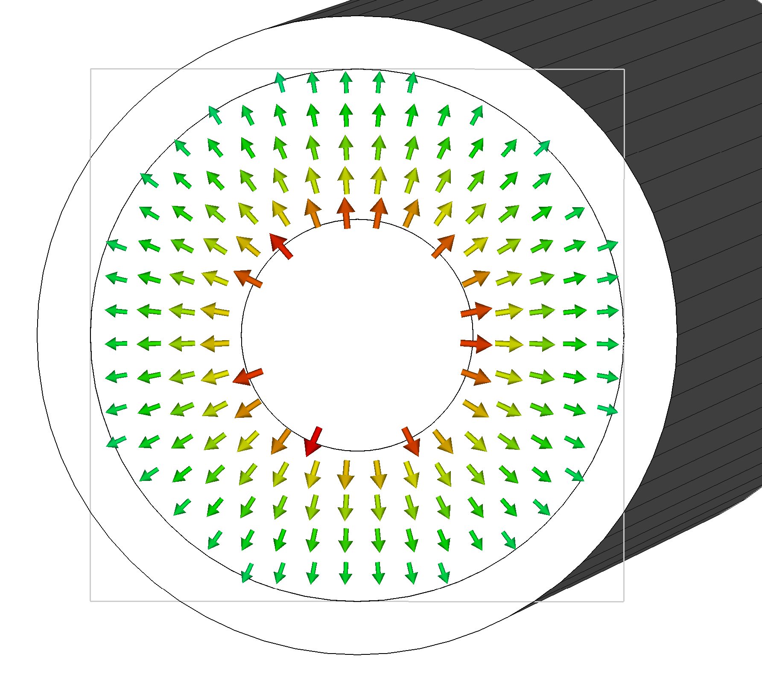
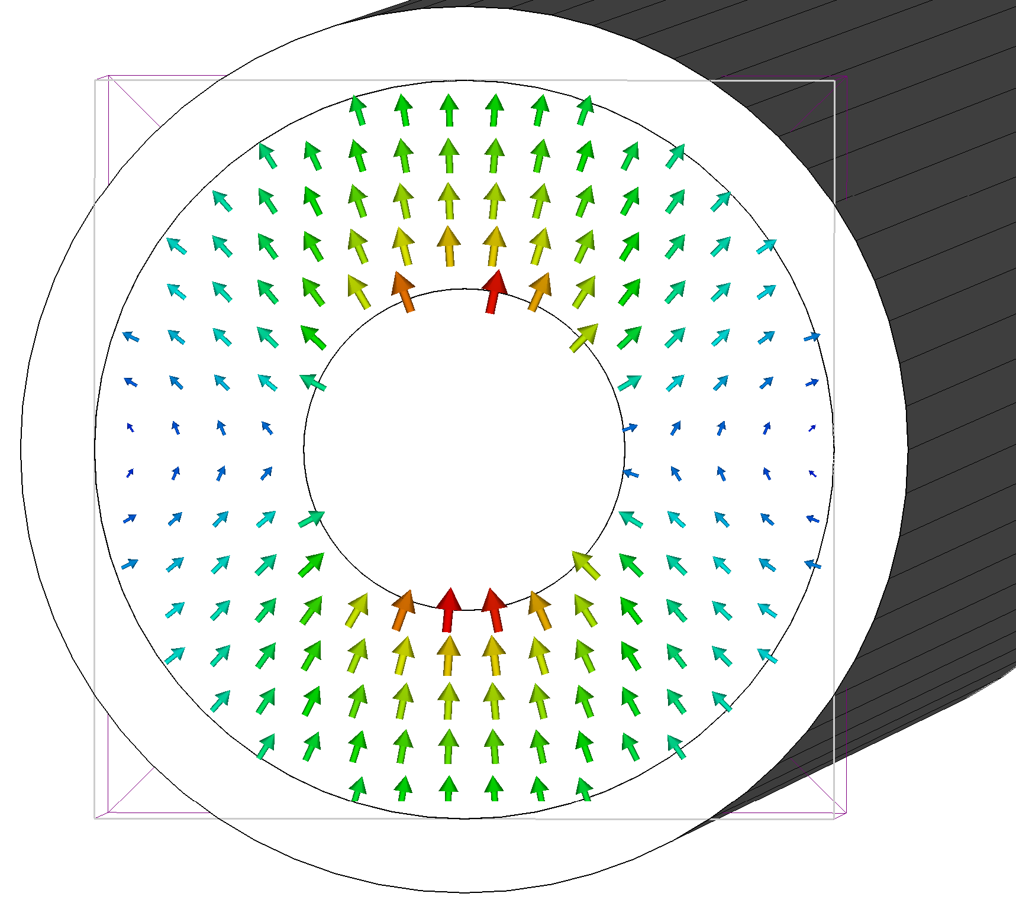


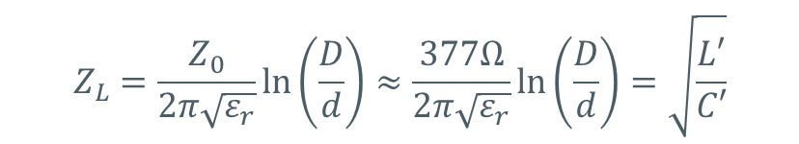
Pickups for Bunch Arrival-Time Monitors
Inner conductor
outer conductor
2009
Dielectric, e.g., air
Matching:
Goal: Reduction of ringing!
Using TEM wave model:
  only the TEM wave can propagate (at all frequencies)
  no other waves with axial components
  (TM_{mn} and TE_{mn} waves) should be propagating
  TE₁₁ lowest cut-off → Defines $f_{c}$ of a coaxial:
  $f<\frac{2c_{0}}{(D+d)π\sqrt{ε_{r}}}$
Line Impedance:
F. Löhl & K. Hacker
$$ε_{r}$$
3D model of the button-type beam pickup designed by Hacker and used for the EO-BAM by Löhl [Löhl 2009]
until
Cross section of a coaxial cable
$$Z_{L}=\frac{Z_{0}}{2π\sqrt{ε_{r}}}\text{ln}\left(\frac{D}{d}\right)≈\frac{377Ω}{2π\sqrt{ε_{r}}}\text{ln}\left(\frac{D}{d}\right)=\sqrt{\frac{L′}{C′}}$$
Field distribution of TEM (left) an unwanted TE₁₁ mode (right) in a coaxial cable
F. Löhl , Thesis, 2009. DOI:10.3204/DESY-THESIS-2009-031
Z₀: Free-Space wave impedance
Notes:
Epsilon_R = 10 → 13.95
Epsilon_R = 3 → 4.23

Slide 12
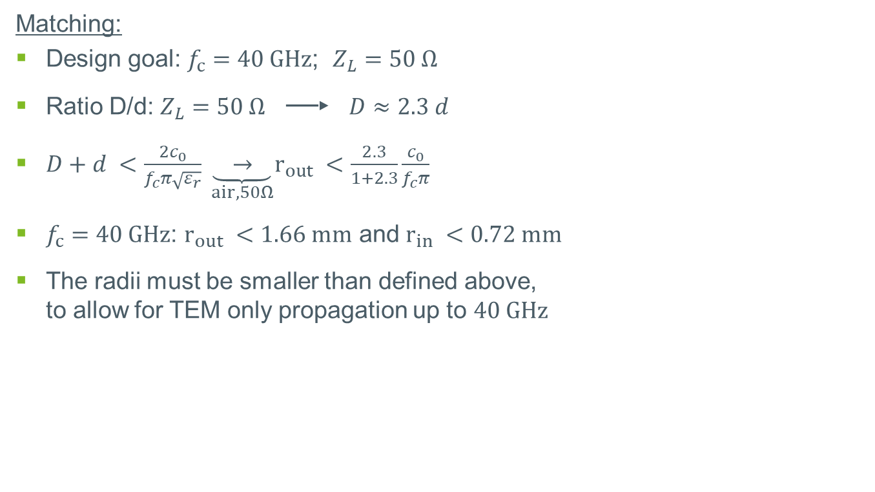
Pickups for Bunch Arrival-Time Monitors
Inner conductor
outer conductor
2009
Dielectric, e.g., air
Matching:
Design goal: $f_{c}=40 GHz$; $Z_{L}=50 Ω$
Ratio D/d: $Z_{L}=50 Ω$ ▬▬► $D≈2.3 d$
$D+d <\frac{2c_{0}}{f_{c}π\sqrt{ε_{r}}} \underset{air, 50Ω}{\underbrace{ → }}r_{out} <\frac{2.3}{1+2.3}\frac{c_{0}}{f_{c}π}$
$f_{c}=40 GHz$: $r_{out} <1.66 mm$ and $r_{in} <0.72 mm$
The radii must be smaller than defined above,
to allow for TEM only propagation up to $40 GHz$
F. Löhl & K. Hacker
$$ε_{r}$$
3D model of the button-type beam pickup designed by Hacker and used for the EO-BAM by Löhl [Löhl 2009]
until
(in air!)
Cross section of a coaxial cable
Field distribution of TEM (left) an unwanted TE₁₁ mode (right) in a coaxial cable
F. Löhl , Thesis, 2009. DOI:10.3204/DESY-THESIS-2009-031
Z₀: Free-Space wave impedance

Slide 13
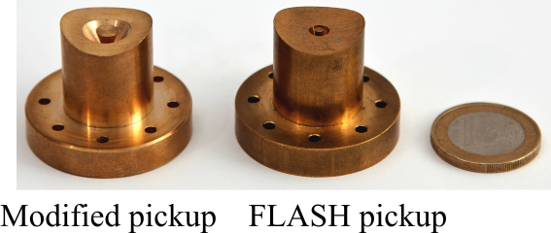
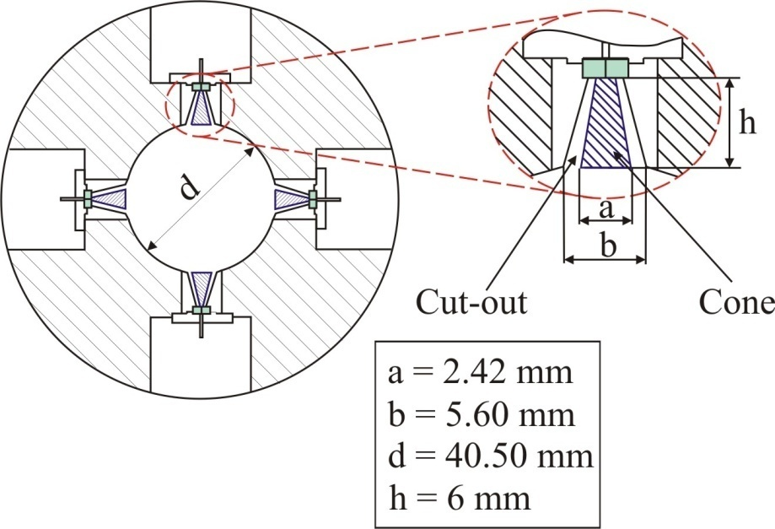
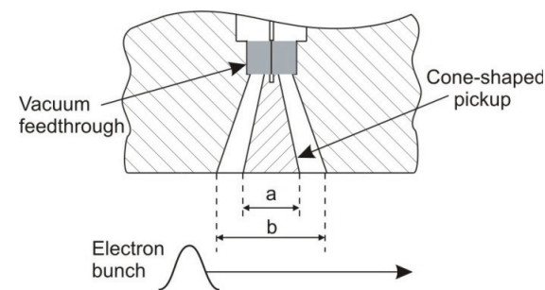
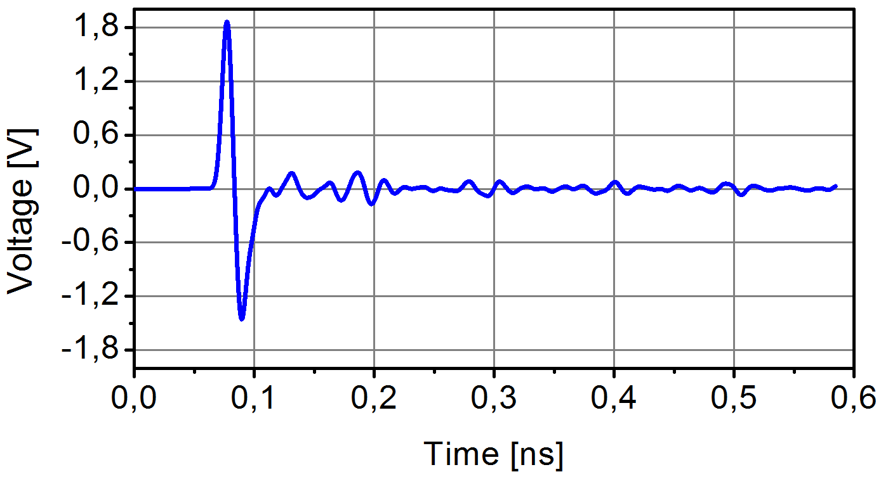
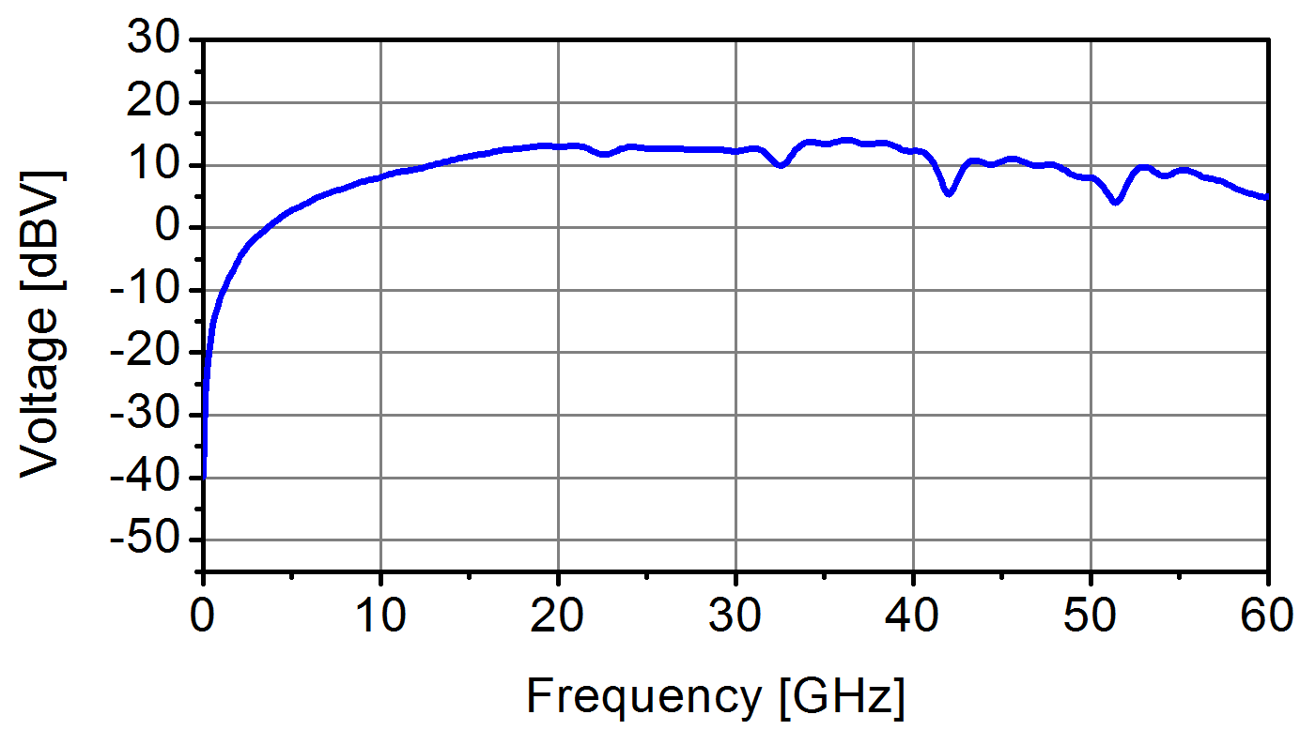

Pickups for Bunch Arrival-Time Monitors
2009
1st generation of cone-shaped pickups:
Increased rf bandwidth of all components ($>40 GHz$)
Avoids structural resonances by gaps, discontinuities & sharp edges
Avoids reflections by maintaining $50 Ω$
geometry at every cross-section
F. Löhl & K. Hacker
3D model of the button-type beam pickup designed by Hacker and used for the EO-BAM by Löhl [Löhl 2009]
until
2011
A. Angelovski
Cross-section of the cone-shaped pickup [Angelovski 2011]
Cross-section of the cone-shaped pickup [Angelovski 2011]
Signal output simulated with CST PS for a 1-mm 20-pC bunch [Angelovski 12]
F. Löhl , Thesis, 2009. DOI:10.3204/DESY-THESIS-2009-031
A. Angelovski et al., Proc. IPAC’11, Paper: TUPC076
A. Angelovski et al., Phys. Rev. ST Accel. Beams, 2012. DOI:10.1103/PhysRevSTAB.15.112803
Notes:
# Reduced capacitance (smaller time constant)
# Tapered cut-out with constant ratio b / a = 2.3 for 50 Ω
# (Nearly) Resonance-free up to 40 GHz

Slide 14
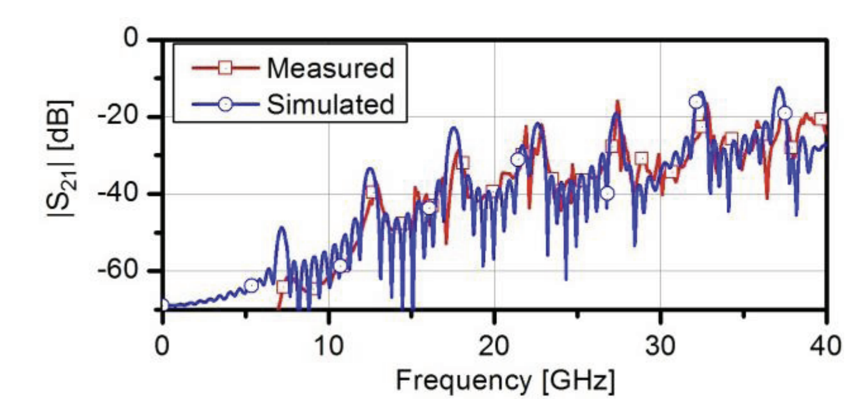
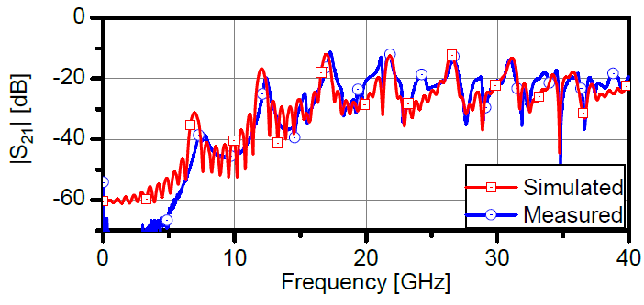
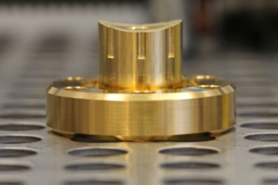
Pickups for Bunch Arrival-Time Monitors
2009
1st generation of cone-shaped pickups:
Vacuum sealed prototype successfully tested
But: Better agreement with simulation for non-hermetic demonstrator
F. Löhl & K. Hacker
3D model of the button-type beam pickup designed by Hacker and used for the EO-BAM by Löhl [Löhl 2009]
until
(Caused by step
in the beamline)
2011
A. Angelovski
Vacuum flange
Cross-section of the cone-shaped pickup [Angelovski 2011]
Pickup top view
Pickup side view
Hermetic demonstrator of the 1st generation cone-shaped pickup [Angelovski 12]
F. Löhl , Thesis, 2009. DOI:10.3204/DESY-THESIS-2009-031
A. Angelovski et al., Proc. IPAC’11, Paper: TUPC076
A. Angelovski et al, in Proc IBIC2012, Tsukuba, Japan, 2012
Notes:
# Reduced capacitance (smaller time constant)
# Tapered cut-out with constant ratio b / a = 2.3 for 50 Ω
# (Nearly) Resonance-free up to 40 GHz

Slide 15
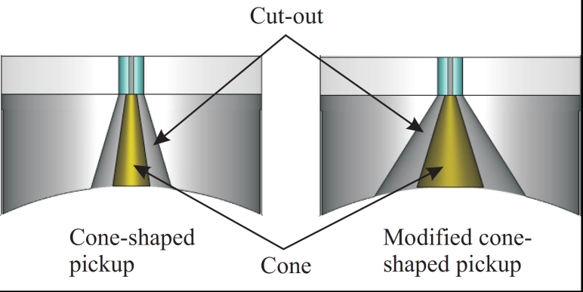
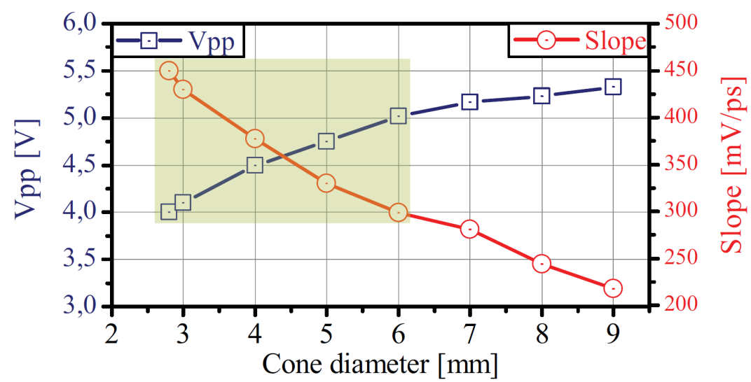
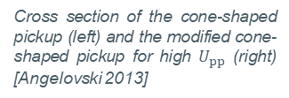


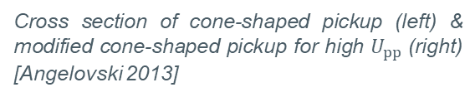

Pickups for Bunch Arrival-Time Monitors
2009
2nd generation of cone-shaped pickups:
1st generation did not reach sufficient voltages
Cone diameter: $U_{pp}$ vs. $SR$ trade-off
2nd gen. optimized for maximum voltage
maintaining a slope of at least $300 mV ps^{−1}$
F. Löhl & K. Hacker
3D model of the button-type beam pickup designed by Hacker and used for the EO-BAM by Löhl [Löhl 2009]
until
2011
A. Angelovski
Cross-section of the cone-shaped pickup [Angelovski 2011]
$$SR / \frac{mV}{ps}$$
$$U / V$$
Cross section of cone-shaped pickup (left) & modified cone-shaped pickup for high $U_{pp}$(right) [Angelovski 2013]
2013
A. Angelovski
Cross section of the cone-shaped pickup (left) and the modified cone-shaped pickup for high $U_{pp}$ (right) [Angelovski 2013]
Cone Diameter / mm
$V_{pp}$ and SR at ZC vs. cone diameter. The optimum area is shaded [Angelovski 13].
F. Löhl , Thesis, 2009. DOI:10.3204/DESY-THESIS-2009-031
A. Angelovski et al., Proc. IPAC’11, Paper: TUPC076
A. Angelovski et al., Proc. IBIC’13, Paper: WEPC40

Slide 16
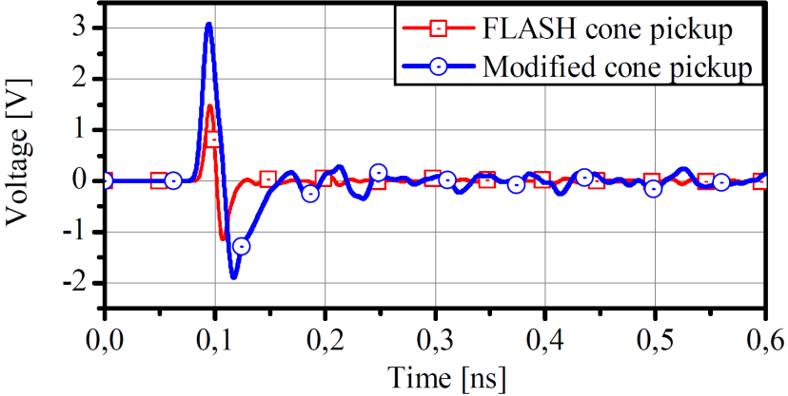
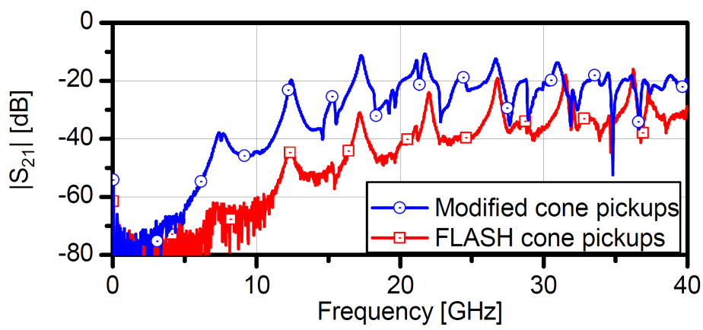
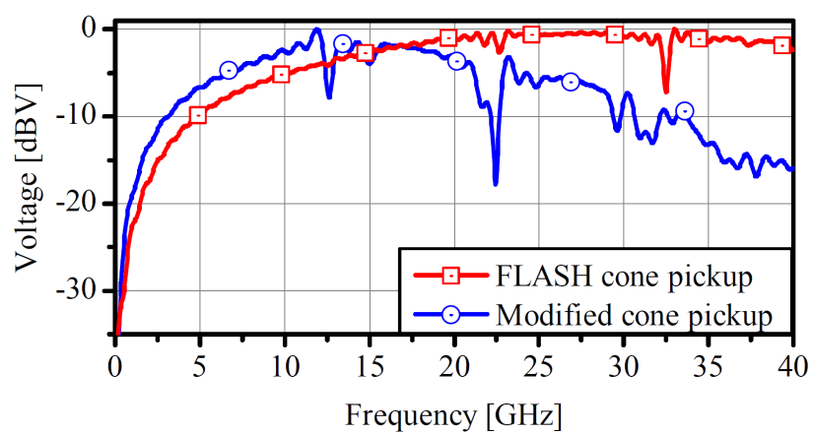

Pickups for Bunch Arrival-Time Monitors
2009
2nd generation of cone-shaped pickups:
1st generation did not reach sufficient voltages
Cone diameter: $U_{pp}$ vs. $SR$ trade-off
2nd gen. optimized for maximum voltage
maintaining a slope of at least $300 mV ps^{−1}$
$U_{pp}$ increased by a factor of 2
But:
Increased cross talk
F. Löhl & K. Hacker
3D model of the button-type beam pickup designed by Hacker and used for the EO-BAM by Löhl [Löhl 2009]
until
2011
A. Angelovski
Cross-section of the cone-shaped pickup [Angelovski 2011]
2013
A. Angelovski
Cross section of the cone-shaped pickup (left) and the modified cone-shaped pickup for high $U_{pp}$ (right) [Angelovski 2013]
Comparison of simulated signals & crosstalk (S₂₁) for 1st and 2nd gen. pickups [Angelovski 13].
F. Löhl , Thesis, 2009. DOI:10.3204/DESY-THESIS-2009-031
A. Angelovski et al., Proc. IPAC’11, Paper: TUPC076
A. Angelovski et al., Proc. IBIC’13, Paper: WEPC40

Slide 17




Pickups for Bunch Arrival-Time Monitors
2009
Broadband cone-shaped pickups:
Commercialized by DESY
Installed at:
F. Löhl & K. Hacker
3D model of the button-type beam pickup designed by Hacker and used for the EO-BAM by Löhl [Löhl 2009]
until
2011
A. Angelovski
Cross-section of the cone-shaped pickup [Angelovski 2011]
2013
A. Angelovski
Cross section of the cone-shaped pickup (left) and the modified cone-shaped pickup for high $U_{pp}$ (right) [Angelovski 2013]
F. Löhl , Thesis, 2009. DOI:10.3204/DESY-THESIS-2009-031
A. Angelovski et al., Proc. IPAC’11, Paper: TUPC076
A. Angelovski et al., Proc. IBIC’13, Paper: WEPC40

Slide 18
Outline
Electro-Optical Bunch Arrival-Time Measurement
Pickups for Bunch Arrival-Time Monitors
  From button-pickups to 40-GHz cone-shaped pickups
Pickups on a Printed Circuit Board (PCB)
  Concept for a PCB-BAM
  Production of a first demonstrator
  Measurements
  Conclusion and Outlook
    Limitations for BPM in circular Machine

Slide 19
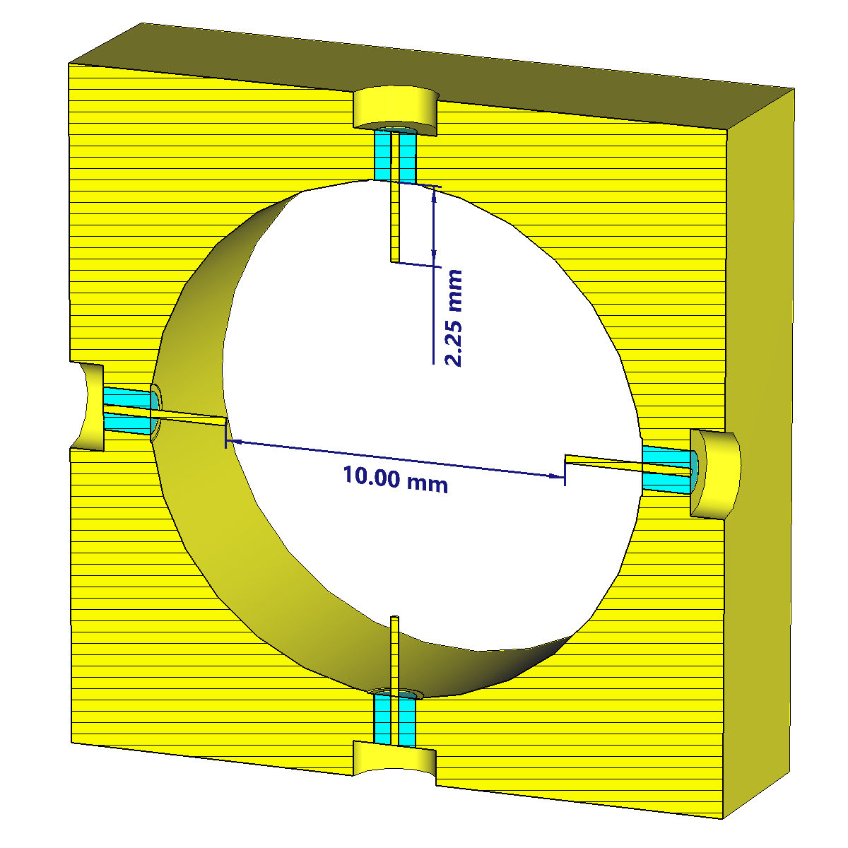
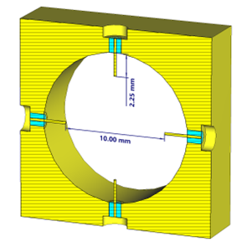
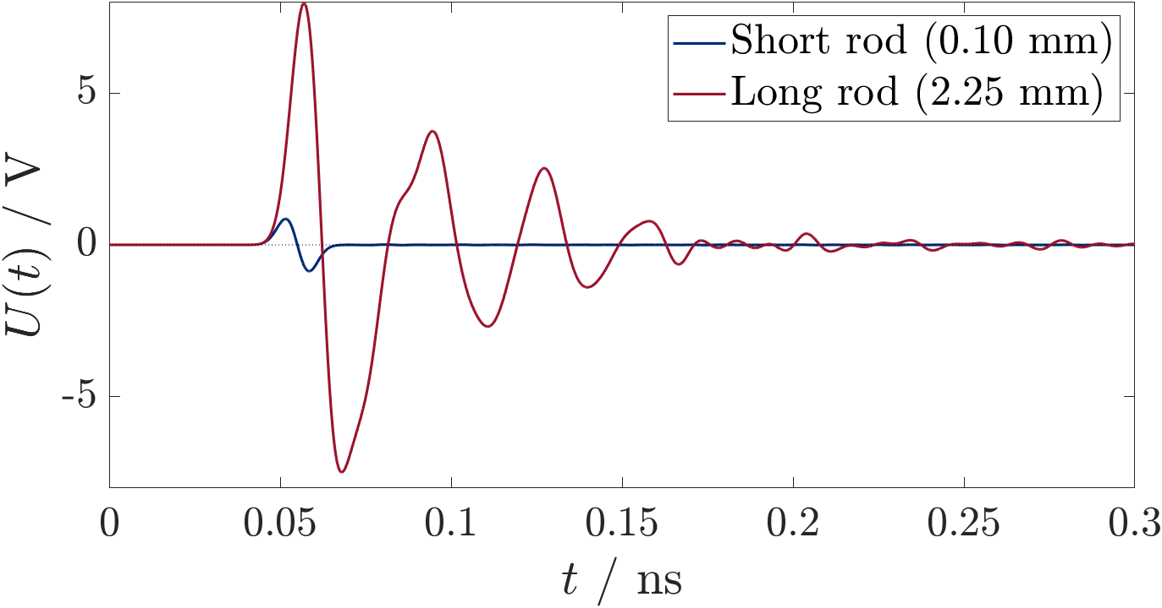
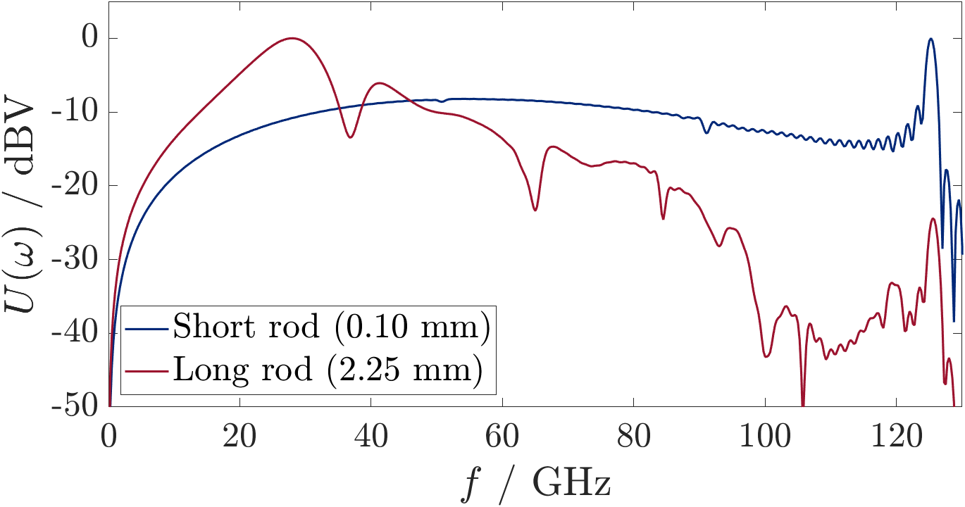


Pickups on a Printed Circuit Board
2021
Concept for a PCB-BAM:
First promising concept deviated from the
PCB idea
Reached 80 % of the project goal
Ringing and slew rate strongly depending
on protrusion length
B.E.J. Scheible
Open-coaxial pickups with elongated pins [Scheible 2021]
Open-coaxial pickups with elongated pins and a tip-to-tip distance of 10 mm [Scheible 2021]
$$U(f) / dBV$$
@ $Q_{B}=20 pC$, $σ_{B}=1 mm$
Pickup signal simulated by CST PS for a very short and a relatively long rod length [Scheible 2021]
B.E.J. Scheible et al., Proc. IBIC’21. 10.18429/JACoW-IBIC2021-WEPP19

Slide 20
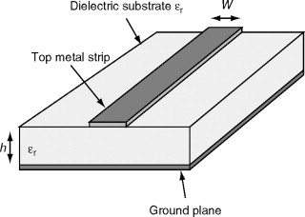
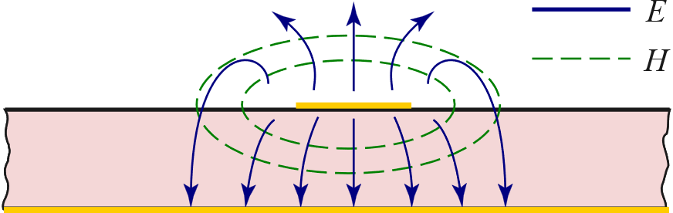

Pickups on a Printed Circuit Board
2021
Concept for a PCB-BAM:
Use printed circuit boards with planar transmission line
Easiest type: Microstrip line (quasi-TEM if sufficiently thin)
B.E.J. Scheible
Open-coaxial pickups with elongated pins [Scheible 2021]
Strip Conductor
Dielectric substrate
$$ε_{r}$$
Conductor (Ground plane)
Electric & magnetic fields on a microstrip [Pozar 2012]
Geometry of a microstrip line [De Flaviis 2005]
D. Pozar, “Microwave Engineering”, 4th Ed., 2012, 978-0-470-63155-3
F. De Flaviis, in The Electrical Engineering Handbook, 2005, downloaded from sciencedirect.com/topics/computer-science/microstrip at 09.12.2024
B.E.J. Scheible et al., Proc. IBIC’21. 10.18429/JACoW-IBIC2021-WEPP19

Slide 21



Pickups on a Printed Circuit Board
2021
Concept for a PCB-BAM:
Followed by a combination of former concepts
(PCB & open coax) with integrated signal
combination on the PCB
First to surpass project goal
But: Ringing and wake fields
B.E.J. Scheible
Open-coaxial pickups with elongated pins [Scheible 2021]
2021
B.E.J. Scheible
Open-“coax“ pickups on a PCB with Ø 10 mm opening [Scheible 2021]
@ $Q_{B}=20 pC$, $σ_{B}=1 mm$
Open-“coax“ pickups on a PCB with Ø 10 mm opening [Scheible 2021]
Pickup signal simulated by CST PS for a 4-rod on PCB pickup structure with combination network [Scheible 2021]
B.E.J. Scheible et al., Proc. IBIC’21. 10.18429/JACoW-IBIC2021-WEPP19

Slide 22




Pickups on a Printed Circuit Board
2021
Concept for a PCB-BAM:
Final concept: Planar elongated pickup on a
reduced PCB with integrated combination network
Reduced Wakefield effects
Easier to manufacture
B.E.J. Scheible
Open-coaxial pickups with elongated pins [Scheible 2021]
2021
B.E.J. Scheible
Open-“coax“ pickups on a PCB with Ø 10 mm opening [Scheible 2021]
2023
@ $Q_{B}=1 pC$, $σ_{B}=1 mm$
B.E.J. Scheible
Planar pickups on a printed circuit board [Scheible 2023]
Planar pickups on a printed circuit board [Scheible 2023]
Pickup signal simulated by CST PS for planar pickups on PCB with combination network [Scheible 2023]
B.E.J. Scheible et al., Proc. IBIC’21. 10.18429/JACoW-IBIC2021-WEPP19
B.E.J. Scheible et al., Proc. IPAC’23. 10.18429/JACoW-IPAC2023-THPL190

Slide 23
Outline
Electro-Optical Bunch Arrival-Time Measurement
Pickups for Bunch Arrival-Time Monitors
  From button-pickups to 40-GHz cone-shaped pickups
Pickups on a Printed Circuit Board (PCB)
  Concept for a PCB-BAM
  Production of a first demonstrator
  Measurements
  Conclusion and Outlook
    Limitations for BPM in circular Machine

Slide 24




Pickups on a Printed Circuit Board
2021
feedthrough module
B.E.J. Scheible
Production of a first demonstrator
Rapid prototyping at THM
Design of vacuum-sealed
demonstrator
dowel pin
Open-coaxial pickups with elongated pins [Scheible 2021]
DN25 CF
67-GHz connector
DN40 CF
PCB
2021
B.E.J. Scheible
3.6 cm
sheet pickups
Open-“coax“ pickups on a PCB with Ø 10 mm opening [Scheible 2021]
dowel pin
stopper
2023
B.E.J. Scheible
10 cm
Planar pickups on a printed circuit board [Scheible 2023]
Manufacturing model (in Inventor®) of the first vacuum-sealed prototype for ELBE and steel body built by NTG
B.E.J. Scheible et al., Proc. IBIC’21. 10.18429/JACoW-IBIC2021-WEPP19
B.E.J. Scheible et al., Proc. IPAC’23. 10.18429/JACoW-IPAC2023-THPL190

Slide 25


Pickups on a Printed Circuit Board
2021
Production of a first demonstrator
Rapid prototyping at THM
B.E.J. Scheible
Open-coaxial pickups with elongated pins [Scheible 2021]
2021
B.E.J. Scheible
Open-“coax“ pickups on a PCB with Ø 10 mm opening [Scheible 2021]
Broken spare PCB
made with TMM10i
2023
B.E.J. Scheible
RF PCB milling machine at THM
Sample PCB with 2 € coin for scale
Planar pickups on a printed circuit board [Scheible 2023]
B.E.J. Scheible et al., Proc. IBIC’21. 10.18429/JACoW-IBIC2021-WEPP19
B.E.J. Scheible et al., Proc. IPAC’23. 10.18429/JACoW-IPAC2023-THPL190

Slide 26





Pickups on a Printed Circuit Board
*HERMETIC TO 1X10-8 STD CC HE/SEC AT 1 ATM DIFFERENTIAL.
Production of a first demonstrator – Vacuum feedthroughs
Many connectors commercially available (even above 100 𝐺𝐻𝑧)
Typically, insufficient hermeticity and not well-suited for accelerators
Hermetic* and can be used as vacuum feedthrough !
Not suited as vacuum feedthrough !
Picture of an Anritsu $70 GHz$female sparkplug launcher connector and drawing from the instruction sheets
Picture of a Rosenberger $110 GHz$right angle jack for PCBs and drawing from the technical datasheet
rosenberger.com, Rosenberger No. 01K80A-40ML5, downloaded Nov. 28th, 2024
anritsu.com, Anritsu V1-102F Female Connector with V100 glass bead , downloaded Nov. 28th, 2024

Slide 27

Pickups on a Printed Circuit Board
Production of a first demonstrator – Vacuum feedthroughs
Many connectors commercially available (even above 100 𝐺𝐻𝑧)
Typically, insufficient hermeticity and not well-suited for accelerators
Some connectors can be used as a vacuum feedthrough!
Installation still is tricky!
Cross-section of the cone-shaped pickup [Angelovski 2011] and picture of an Anritsu $70 GHz$female sparkplug launcher connector and drawing from the instruction sheets
Vacuum feedthrough module
rosenberger.com, Rosenberger No. 01K80A-40ML5, downloaded Nov. 28th, 2024
anritsu.com, Anritsu V1-102F Female Connector with V100 glass bead , downloaded Nov. 28th, 2024
A. Angelovski et al., Proc. IPAC’11, Paper: TUPC076

Slide 28











Pickups on a Printed Circuit Board
Production of a first demonstrator – Vacuum feedthroughs (Non hermetic demonstrator)
No Undo-Button!

Slide 29










Pickups on a Printed Circuit Board
Production of a first demonstrator – Mounting of the PCB
Bead with sliding contact & sliding contact on a single wire
Rogers
TMM10i
Broken spare of the PCB
Backside of the PCB resting on the ledge
Sliding contact on the PCB
PCB through the DN25 CF (left) respectively DN40 CF flange (center) and front of the PCB before mounting the feedthrough and locking mechanism (opposite side).
One day of failed approaches…
Positioning with 3D stage (successful)

Slide 30
Outline
Electro-Optical Bunch Arrival-Time Measurement
Pickups for Bunch Arrival-Time Monitors
  From button-pickups to 40-GHz cone-shaped pickups
Pickups on a Printed Circuit Board (PCB)
  Concept for a PCB-BAM
  Production of a first demonstrator
  Measurements
  Conclusion and Outlook
    Limitations for BPM in circular Machine

Slide 31

Pickups on a Printed Circuit Board
Measurement with the first demonstrator
Proof-of-concept measurements at the ELBE accelerator
Signal similar to simulation
First pulse ever measured with the EO-PCB BAM (Acq002-CH1-Pulse0) with an expected charge of $3.45 pC$ at HZDR in 2023

Slide 32



Pickups on a Printed Circuit Board
Measurement with the first demonstrator
Proof-of-concept measurements at the ELBE accelerator
Signal similar to simulation
Slew-rate below project goal,
mostly due to choice of substrate
Decrease due to use of the TMM10i laminate
Sample of 0.2 mm fused-silica waver after laser-cutting at THM
Signal slew rate (SR) vs charge for the first demonstrator compared to different simulations and the current cone-shaped pickups.
A. Angelovski et al., Phys. Rev. ST Accel. Beams, 2015. DOI:10.1103/PhysRevSTAB.18.012801

Slide 33
Outline
Electro-Optical Bunch Arrival-Time Measurement
Pickups for Bunch Arrival-Time Monitors
  From button-pickups to 40-GHz cone-shaped pickups
Pickups on a Printed Circuit Board (PCB)
  Concept for a PCB-BAM
  Production of a first demonstrator
  Measurements
  Conclusion and Outlook
    Limitations for BPM in circular Machine

Slide 34



Pickups on a Printed Circuit Board
$$∑$$
Conclusion
Planar pickups on a printed circuit board give a strong signal
Well suited for short bunches and “low” repetition rates
Drawbacks:
  High wake effect due to discontinuity in beamline
  Strong ringing after main pulse
PCB is versatile:
  Subtraction of two signals should be possible,
  but ultra-wideband will be a challenge!
Additional
differential path?
$$Δ$$
Broken spare of the PCB
$$0°$$
$$0°$$
$$Δ$$
$$∑$$
$$180°$$
$$0°$$
hybrid
Angelovski, IBIC’12
Extract of an exemplary broadband signal processing scheme for a button-BPM [adapted from P. Forck, 2024]
P. Forck, Proc. CAS 2024, Event:1356988, Contr.:5713247

Slide 35

Further Questions?
This work is supported by the German Federal Ministry of Education and Research (BMBF) under contract no. 05K22RO2.
Bernhard E. J. Scheible
bernhard.scheible@iem.thm.de
Technische Hochschule Mittelhessen
Information Technology | Electrical Engineering | Mechatronics

Slide 36

APPENDIX: Achieved BAM resolution
European XFEL reached $σ_{BAM}≤3.5 fs$ at nominal $Q_{B}=150 pC$ [Czwalinna, 2021]
SwissFEL reached $σ_{BAM}≤1.0 fs$ at nominal $Q_{B}=160 pC$ due to smaller beampipe [Arsov, 2024]
Resolution depends on bunch charge and beampipe radius (etc.)
Single-bunch correlation for 1 min of data [Czwalinna 2021]
Charge dependence of the BAM resolution [Arsov 2024]
M. K. Czwalinna et al., Proc. IPAC’21. DOI:10.18429/JACoW-IPAC2021-THXB02
V. Arsov et al., Proc. IPAC’24 (pre press). DOI:10.18429/JACoW-IPAC2024-WEPG68
Notes:
They [BAM3 & BAM4] are separated by ca. 1.5 km straight section of the linac without any significant longitudinally dispersive element in between. [Czw.21]

Slide 37







APPENDIX: Expected Resolution
Estimated for a system with…
rod-shaped pickups on PCB with integrated combination (simulation)
silicon-organic hybrid MZM (measured demonstrator)
20 cm coaxial cable (model)
Different sources of jitter (typical, literature, …)
Theoretical jitter-charge product:
Dominated by relative laser intensity noise -> Balanced design
$$σ_{t}≈\frac{σ_{n}}{S_{eff}}$$
  $S=171.6\frac{mV}{ps pC}$ $S_{eff}=95\frac{mV}{ps pC}$
U (V)
$$σ_{n}$$
$$σ_{n}=\sqrt{σ_{RIN}^{2}+σ_{q}^{2}+σ_{pd}^{2}+σ_{adc}^{2}+ …}$$
$$σ_{t}$$
$$⇒σ_{t}×Q_{B}≈9 fs pC$$
t (ps)
Notes:
RIN Nois Laser, q Quantum shot noise, pd Photodiode, ADC ADC Digitizer

Slide 38


APPENDIX: Charge Estimation and Error
Example values:
$I_{Cathode}≈1.4 μA$,
$f_{CW}=0.41 MHz$
→ $Q_{B}≈3.45 pC$
Charge not known exactly (ICT below resolution limit), but
Approximation of bunch charge: $Q_{Bunch}≤\frac{I_{cathode}}{f_{Bunchtrain}}=I_{cathode}⋅T_{Bunch}$
Error estimation: $ΔQ_{Bunch}=\underset{Reading}{\underbrace{\left|I_{cathode}\right|}}⋅\underset{0.73 ps}{\underbrace{Δ^{rms}T_{Bunch}}}+\underset{0.1 μA}{\underbrace{Δ_{Disp}^{max}I_{cathode}}}\underset{2.46 μs}{\underbrace{\left|T_{Bunch}\right|}}$
Example: ${ I}_{cathode} =1.4 μA→Q_{Bunch}≈3.446(246) pC$
Error dominated by the resolution of the cathode current! Error of bunch spacing is negligible.
B.E.J. Scheible et al., Proc. IBIC’23. DOI:10.18429/JACoW-IBIC2023-TUP012
B.E.J. Scheible et al., Proc. IPAC’24. DOI:10.18429/JACoW-IPAC2024-WEPG82

Slide 39



APPENDIX: ELBE Parameter and Layout
Parameter
Thermionic gun
CW mode
Repetition rate:
$$=406.3 kHz$$
Current:
$$≈0.5…2.7 μA$$
Charge:
$$≈1…7 pC$$
Bunch length:
$$≈1.5…2.2 ps$$
PCB-BAM in Beamline
Position of the PCB-BAM Demonstrator
ELBE Facility Layout [Source: hzdr.de]

Slide 40

APPENDIX: Pre-Fields
Time travelling along transmission line

Slide 41


APPENDIX: Amplitude Jitter

Slide 42



APPENDIX: Optical Link Stabilization
Laser reference and stabilized distribution
MLO phase-locked to MO
Reference pulse split in free-space
Distribution in actively stabilized fiber links
  Links up to >3500 m
  Optical-cross correlator (OXC)
  Piezo fiber stretcher & optical delay line (ODL)
Link stabilization unit on optical the table in the European XFEL
MLO
OXC
piezo
mech. ODL
up to 3.5 km
partial reflection
sub-fs jitter
fs-pulsed optical
reference
detection
correction
long-haul-fiber link
link end
client system
Layout of one active-stabilized fiber link at the European XFEL [adapted from S. Schulz, ARD-ST3 Workshop 2023]
Optical table with MLO and OXC in the European XFEL
Notes:
Ref: Sydlo 2015
Optical tables made of Superinvar (low thermal expansion), thermal stability of < 0.1 K
Split for up to 24 links
Link length: 35 m to >3500 m
Delay-Line: 4 ns, slow
Fiber Stretcher: ~3.5 ps, fast correction
First P-Waves, later S-wave -> Very Sensitve system!

Slide 43









APPENDIX: Analytical Signal
Long Bunch Approximation:
$λ\left(z\right)$ is constant in any interval of length $ℓ_{p}$
$⇒λ\left(c_{0}t+1/2ℓ_{p}\right)≈λ\left(c_{0}t −1/2ℓ_{p}\right)≈λ\left(c_{0}t\right)$
$$Q_{im}\left(t\right)≈\frac{1}{2πr_{p}}\int_{−1/2ℓ_{p}}^{1/2ℓ_{p}}{λ\left(c_{0}t\right) \tilde{w} \left(z\right)dz}=\frac{A_{p}}{2πr_{p}}λ\left(c_{0}t\right)$$
$$⇒I_{im}\left(t\right)={\dot{Q}}_{im}\left(t\right)≈\frac{A_{p}}{2πr_{p}}\dot{λ}\left(c_{0}t\right)$$
$$Q_{W}\left(t\right)$$
$$I_{W}$$
$$Q_{im}\left(t\right)$$
$$\overset{⃑}{E}≈E_{r} {\hat{e}}_{r}$$
e⁻
$$I_{B}$$
$$λ\left(z,t\right)$$
$$Q_{im}\left(t\right)=\frac{1}{2πr_{p}}\int_{−∞}^{∞}{λ\left(z−c_{0}t\right)w\left(z\right) dz}$$
Independent of the pickup shape!

Slide 44

APPENDIX: Analytical Signal
Short Bunch Approximation:
For any $λ\left(z\right)$, which satisfies the requirements of a Dirac sequence: $λ\left(z\right)→Q_{b}δ\left(z\right)$
$$Q_{im}\left(t\right)=\frac{Q_{b}}{2πr_{p}}\int_{−∞}^{∞}{δ\left(z−c_{0}t\right)w\left(z\right) dz}=\frac{Q_{b}}{2πr_{p}}w\left(c_{0}t\right)$$
$$I_{im}\left(t\right)={\dot{Q}}_{im}\left(t\right)≈\frac{Q_{b}}{2πr_{p}}\dot{w}\left(c_{0}t\right)$$
$$Q_{W}\left(t\right)$$
$$I_{W}$$
$$Q_{im}\left(t\right)$$
$$\overset{⃑}{E}≈E_{r} {\hat{e}}_{r}$$
e⁻
$$I_{B}$$
$$λ\left(z,t\right)$$
$$Q_{im}\left(t\right)=\frac{1}{2πr_{p}}\int_{−∞}^{∞}{λ\left(z−c_{0}t\right)w\left(z\right) dz}$$
Independent of the bunch shape!

