Slide 1
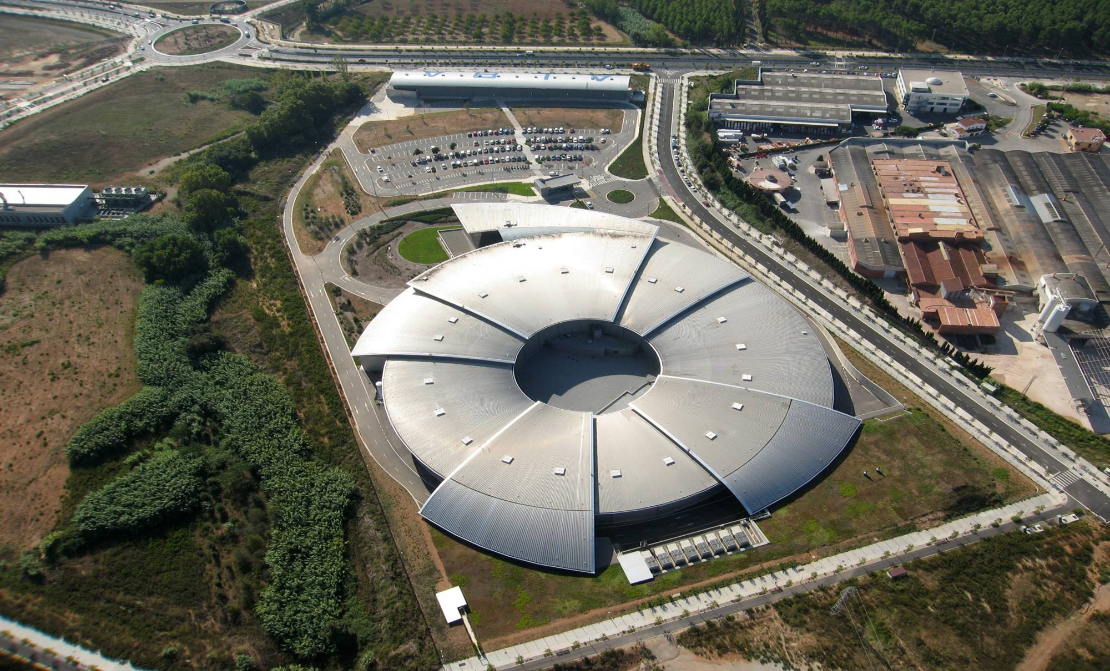
Particle Accelerators
(focusing on sync. light sources and ALBA)
Ubaldo Iriso
Accelerator Division
ALBA Synchrotron

Slide 2
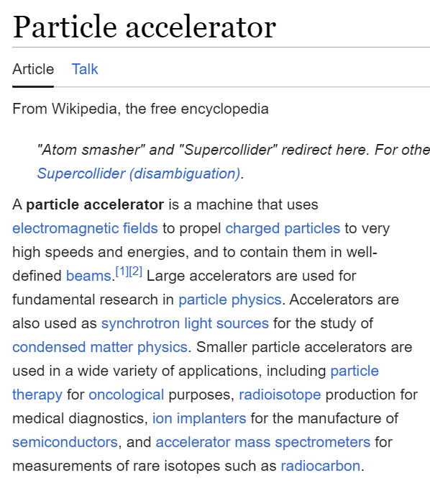
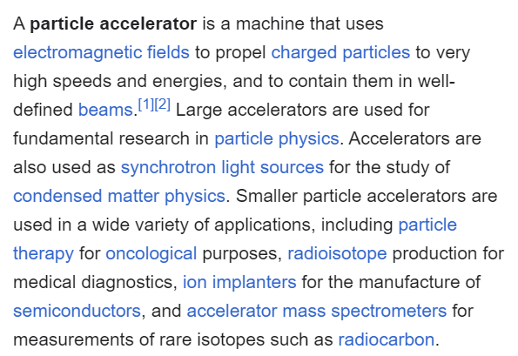
What is a Particle Accelerator?
…machine that uses electromagnetic fields to propel charged particles to very high speeds and energies, and contain them in well-defined beams.
…variety of accelerators…

Slide 3
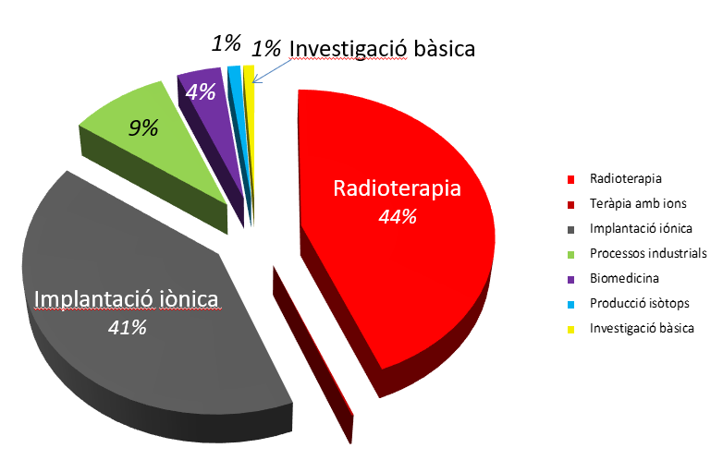
Types of Accelerators
~30000 accelerators worldwide
Notes:
The introduction of dopants in a semiconductor is the most common application of ion implantation.
Ion implantation is one of the fundamental processes used to make microchips. Raw silicon is neither a perfect insulator nor a perfect conductor. It’s somewhere in the middle. Inserting a smattering of boron or phosphorus atoms into the silicon crystal lattice allows us to control the flow of electricity through the silicon and make transistors – the building block from which we make chips

Slide 4
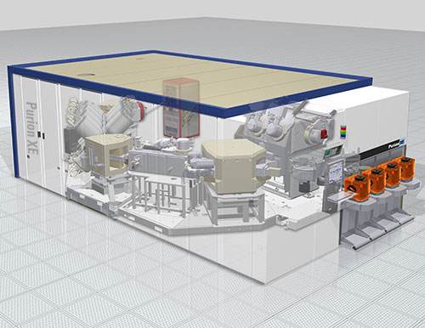
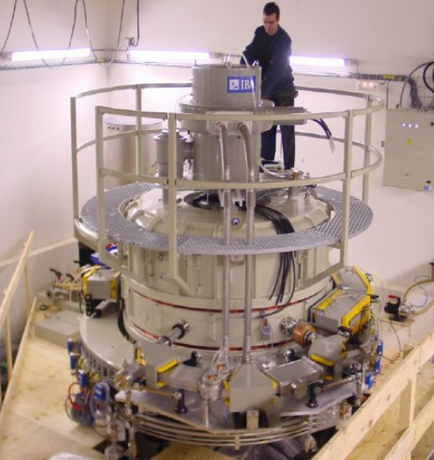
Types of Accelerators
1. Ion implantation
Modify material properties for industrial applications
2. Medical applications
Radio-therapy: Cancer/tumor treatments
Ion implantaion
~10m lenght
HZB (Alemanya)
Radio-isòtops
Circumference ~1m
IBA (Bèlgica)

Slide 5
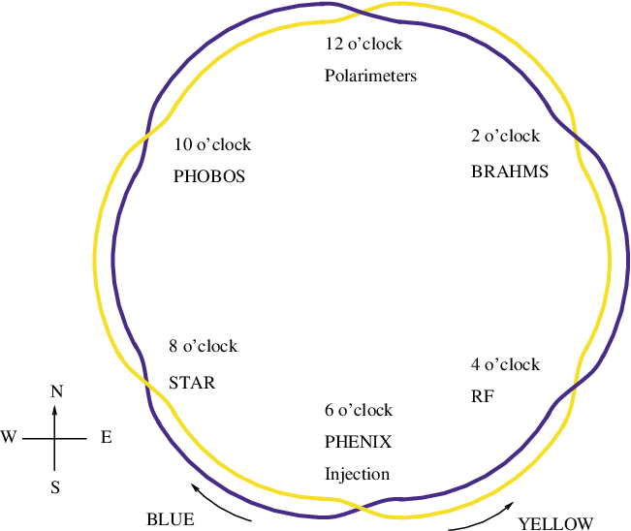
Types of Accelerators
3. Particle Colliders: Particle and Nuclear Physics
Colliders are actually TWO accelerators:
Two particle beams rotate in opposite directions
They cross at certain “collision points”, where massive detectors try to take a picture of the collision sub-products:
Particle discovery, quark-gluon plasma states…
RHIC Lay-out
New York (USA)

Slide 6
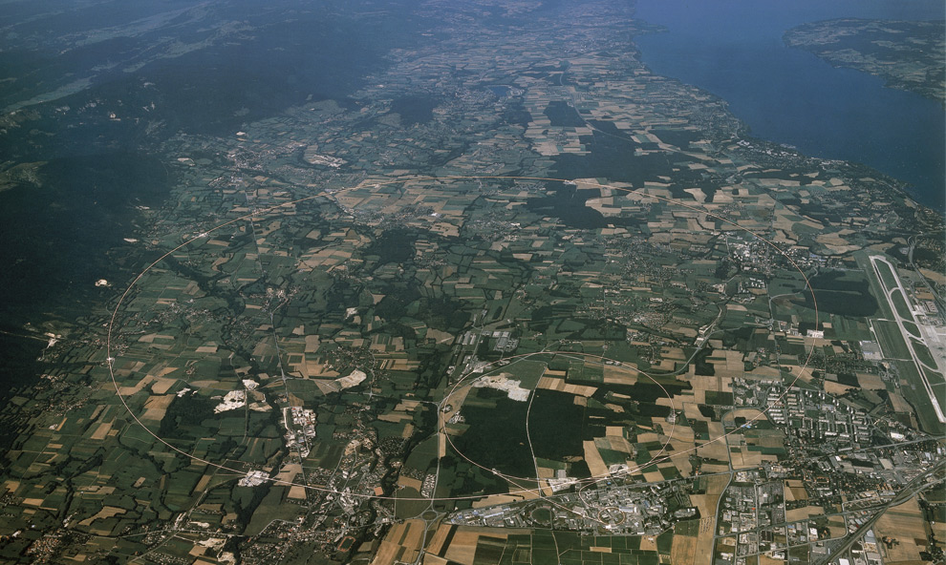
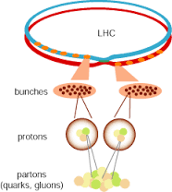
Types of Accelerators
3. Particle Colliders: Particle and Nuclear Physics
Large Hadron Collider - LHC
Circumference ~27km
Ginebra (Suïssa / França)

Slide 7
Types of Accelerators
3. Particle Colliders: Particle and Nuclear Physics
Name | Location | Circumf. | Particle | Energy
RHIC | New York (USA) | 3.8km | p / Au+ | 0.250 GeV
Tevatron | Chicago (USA) | 6.3km | p | 1 TeV
KEK | Tsukuba (Japó) | 1.5km | e- / e+ | 12 GeV
DESY | Hamburg (Alemanya) | 6.4km | e- / p | 27 GeV / 938 GeV
LHC | Ginebra (Suïssa) | 27km | p – p (Pb+) | 7 TeV

Slide 8
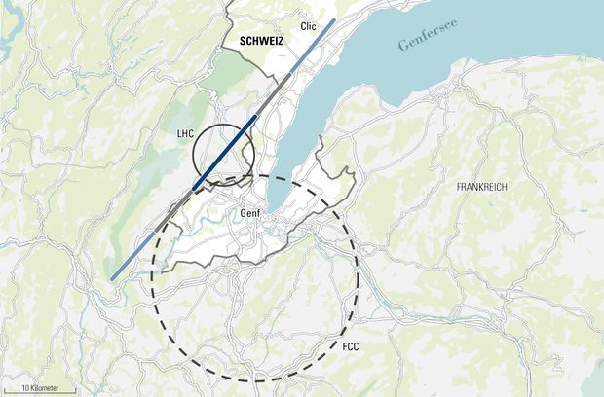
Types of Accelerator: future...
FCC (2035) – C ~[80 – 100] km, E=100 TeV
LHC
FCC

Slide 9
Types of Accelerators
4. Synchrotron Light Sources:
“see” material structures in molecular/atomic scales
interdisciplinar applications: biology, chemistry, nanotechnology…
ALBA Synchrotron
Circumference 270m
Cerdanyola (Barcelona)

Slide 10
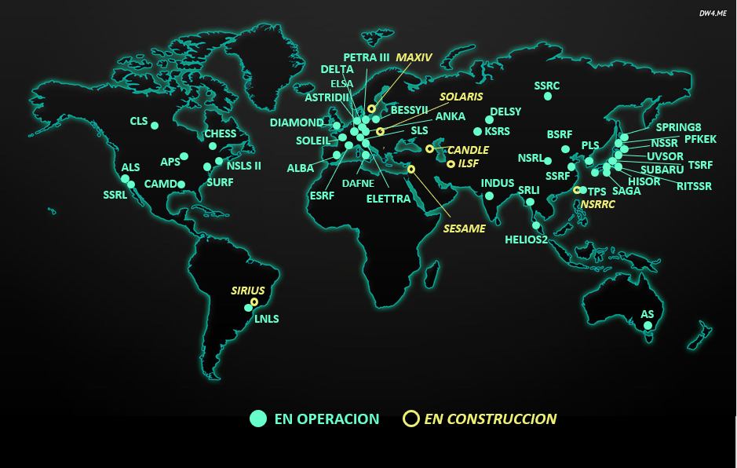
Types of Accelerators
4. Synchrotron Light Sources:
“see” material structures in molecular/atomic scales
interdisciplinar applications: biology, chemistry, nanotechnology…
Around 60 synchrotron light source in operation
(or construction)

Slide 11
Particle Acceleration:
electric fields

Slide 12
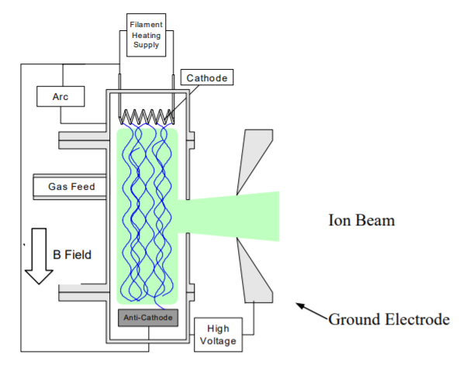
Particle’s Origin: protons
“Stripping” H atoms

Slide 13
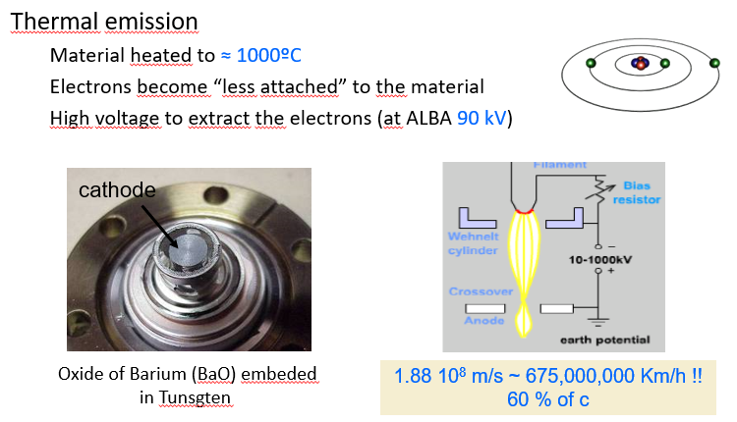
Particle’s Origin: electrons
Thermo-electric effect:
Heat metal to temperature ~1000ºC until electrons are released
High voltage to extract the electrons (90kV at ALBA)

Slide 14
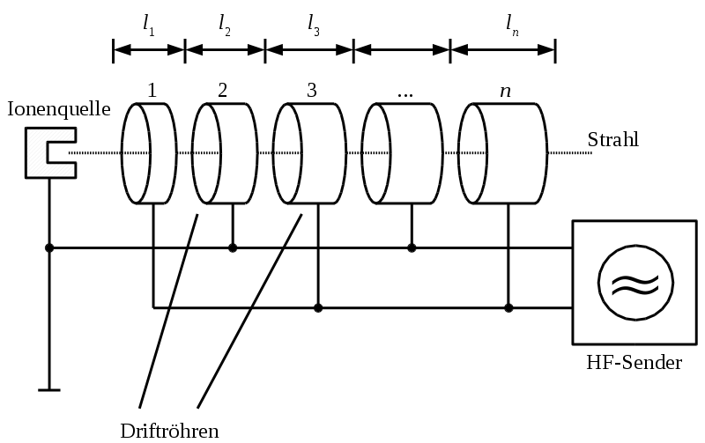
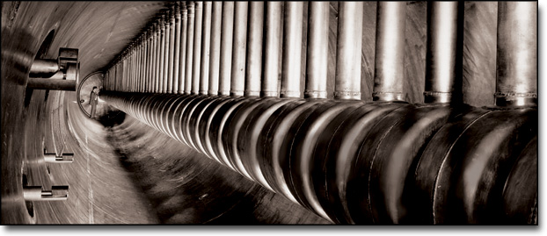
First Accelerators: LINACs
First Linacs (Wideroe, ~1930):
- e-gun followed by drift tubes with electrostatic potential between them
- Idea and first prototypes in the 1930s: drift tubes suspended in a non-conducting tubes.
e-Gun
Drift Tube Linacs (Alvarez, ~1950):
- Drift Tube Linacs (DTL) use conducting waveguides, which is still the typical structures of actual LINACS
LINAC, LBL, 1957

Slide 15
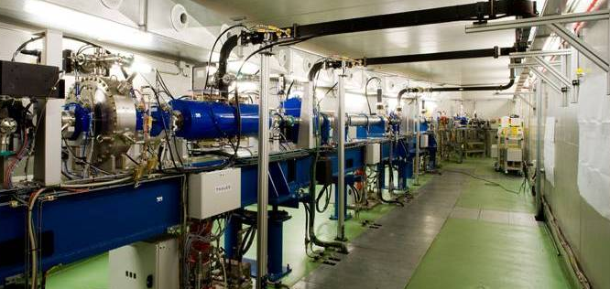
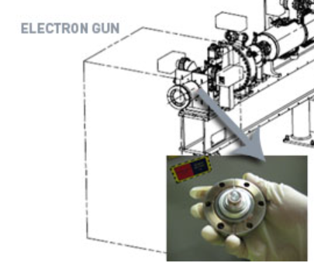
First Accelerators: LINACs
ALBA Linac (12 m):
  -first of ALBA Accelerator complex
  -creates e- and accelerates them from 90kV to 100MeV

Slide 16
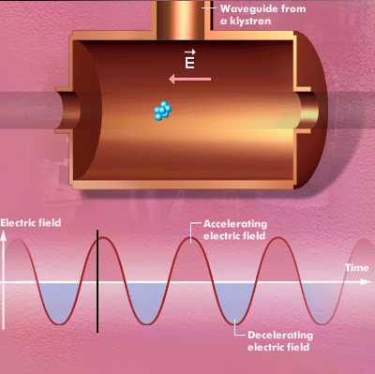
Particle Acceleration: rf systems
DC electric fields are limited to ~1MV/m due to dielectric breakdown
Instead, AC electric fields are used to reach high electric fields (~10MV/m)
These fields are produced in the so-called “radio-frequency ressonant cavities” , or just rf cavities
At ALBA:
E ≈ 10 MV/m @ 500 MHz
Notes:
A més, accelerar amb voltatges electrostàtics (DC) està limitat a V~1MV/m degut a la ruptura dielèctrica de l’aire

Slide 17
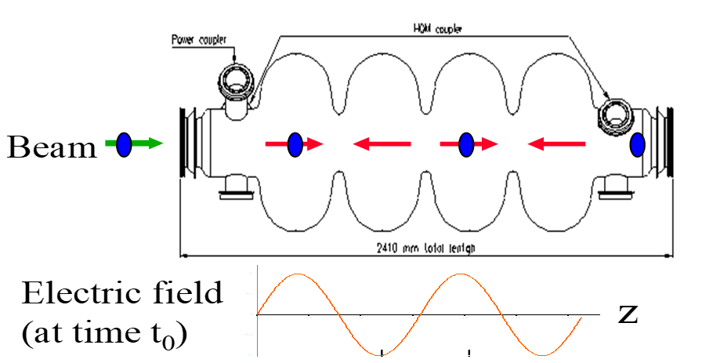
Particle Acceleration: rf systems
But passage of particles needs to be synchronized with the sinusoidal rf field in the cavities
The beam cannot be a continuous of particles, but travel in “bunches”:
  Bunch spacing = rf wavelength
  ALBA: f=500 MHz → λ_{rf}=60cm
λ_{rf}

Slide 18
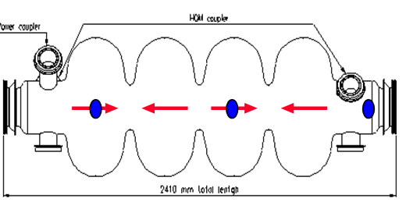

Particle Acceleration: rf systems
In circular accelerators, bunches need to pass again by the cavity in synchronism with the electric field:
So the bem orbit length “L” has to fulfill:
L = λ_{rf} ·h
  with h = Integer number (h_{ALBA} =448)
Since electrons travel at light speed:
λrf = c / f_{rf} → f_{rf} = c·h / L
→ tracking freq rf (f_{rf}) allows to track changes in the orbit length of the accelerator (L)
Rf cavity
$$\frac{{Δf}_{RF}}{f_{RF}}=−\frac{ΔL}{L}$$

Slide 19
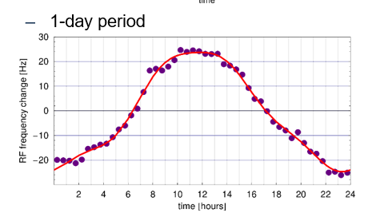
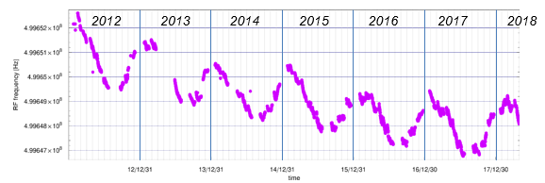
Particle Acceleration: rf systems
RF Frequency and Orbit Length (i.e. circumference)
frf = 499.644MHz +- 20Hz
Precision ~1e-7
Peak-to-peak orbit amplitude:
+/- 27um.
After the first 6 years o operation, the average RF frequency decreased by 3.1kHz, corresponding to an increase of the electron beam path of +1.7mm
ΔL (2012 – 2018) = 1.7mm

Slide 20
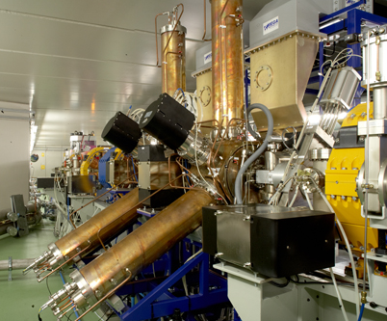
Particle Acceleration
ALBA RF Cavity
DAMPY Cavity:
european collaboration among several synchrotrons to avoid high order resonances
Precise design to control shape, constant monitoring of temperature…
Everything influences the cavity resonant frequency (so, the orbit lenght!)

Slide 21
Particle Guidance:
magnetic fields

Slide 22
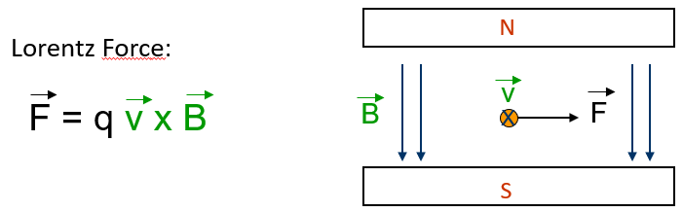
Particle Guidance: magnetic fields
Motion control is purely done with magnetic fields using the Lorentz Force
Magnetic field perpendicular to the electron velocity produces a transversal force and change trajectory

Slide 23
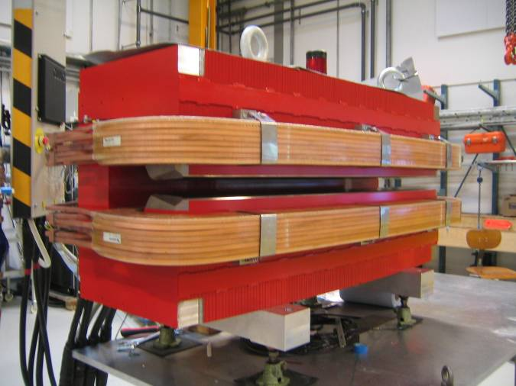
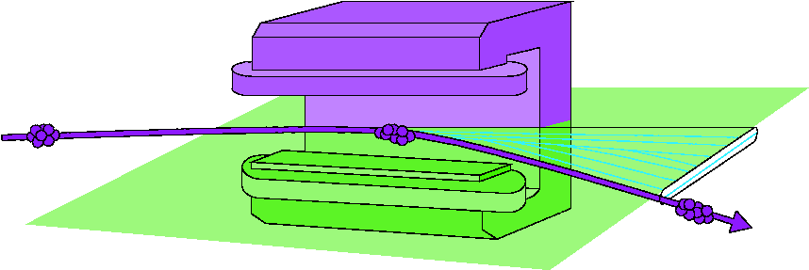
Particle Guidance: magnetic fields
Particle Curvature: dipolar magnets
N
S
Two coils with high current produce constant magnetic field between two poles (N/S)
By applying the Lorentz Force, particles bend and change their trajectory
Magnetic field at fridges: B~20 Gauss
Magnetic field at ALBA dipoles: B~14 000 Gauss
Electrical Current at coils: 600 A

Slide 24
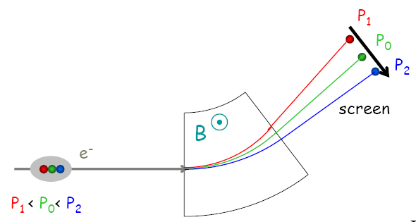
Particle Guidance: magnetic fields
Particle Curvature: dipolar magnets
But the energy of the beam is not a Dirac delta distribution, but has a Gaussian distribution ΔE~0.1%
Particles with different energies get dispersed transversely in space
Need something to group them again
➔ Quadrupole magnets

Slide 25
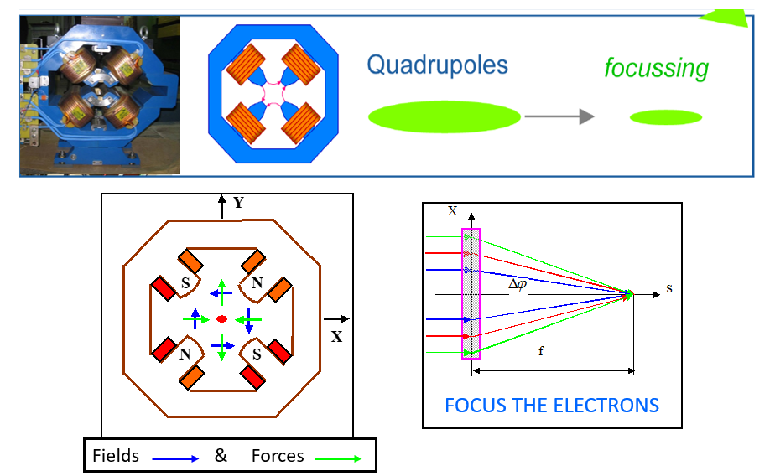
Particle Guidance: magnetic fields
Particle Focusing: quadrupolar magnets
Note: focus on hor plane → defocus on ver plane
Quadrupoles usually go in pairs or triplets

Slide 26
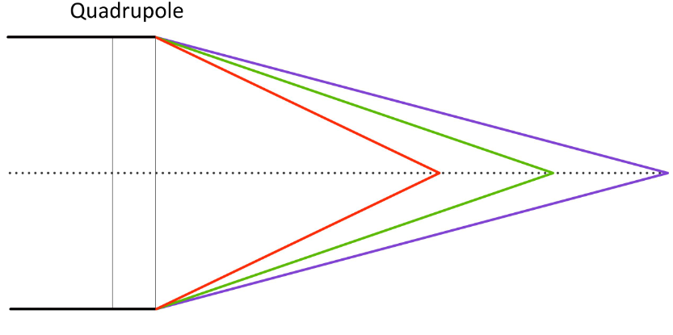
Particle Guidance: magnetic fields
Particle Focusing: quadrupolar magnets
But the energy of the beam is not a Dirac delta distribution, but has a Gaussian distribution ΔE~0.1%
Particles with different energies focused at different long locations
Need something to group them again
➔ Sextupole magnets

Slide 27
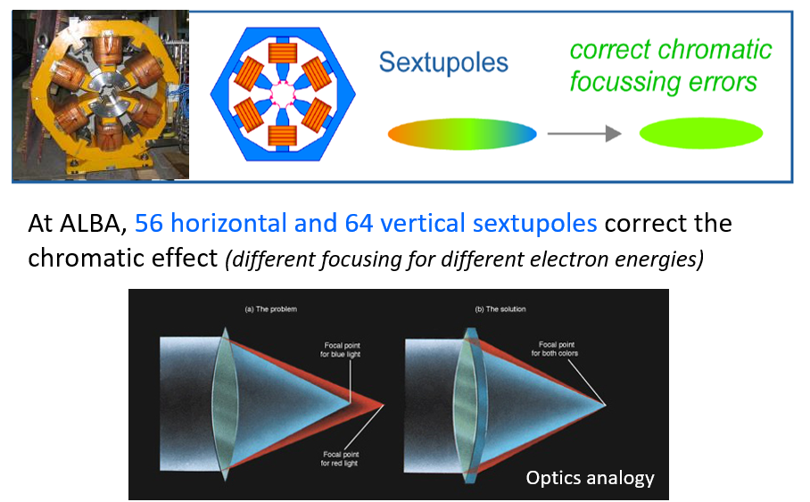
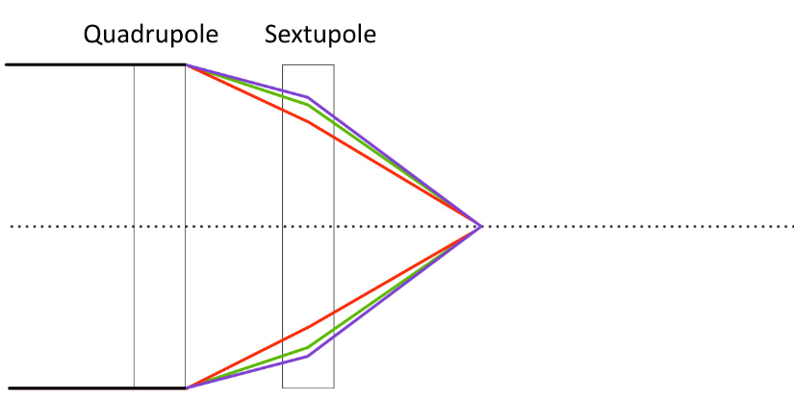
Particle Guidance: magnetic fields
Correct Chromatic effects: sextupole Magnets

Slide 28
Synchrotron Radiation

Slide 29
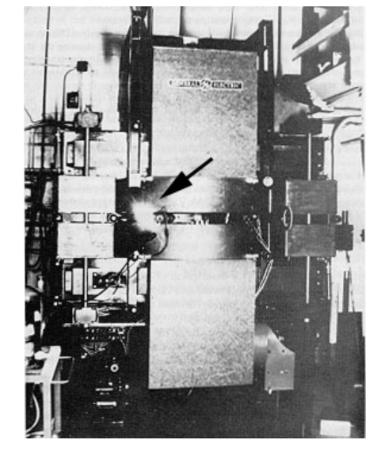
Synchrotron Radiation
Relativistic charged particles emet synchrotron radiation when they are bent in a dipole
The spectrum of this synchrotron radiation goes from near infrared to hard x-rays
N
Synchr. light
S
General Electrics (1947)

Slide 30
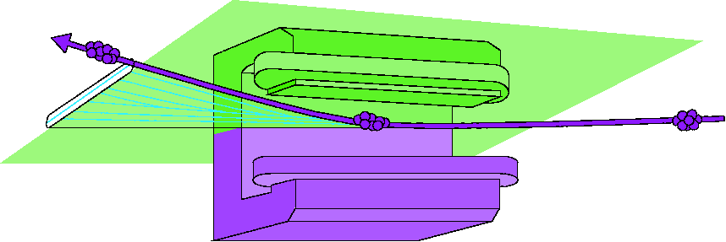
Synchrotron Radiation
First experiments with synchrotron light were “parasitic” experiments from particle colliders
They just use the radiation produced by dipoles when the particles were bent
Experiments were done in the experimental beamlines
beamline
beamline

Slide 31
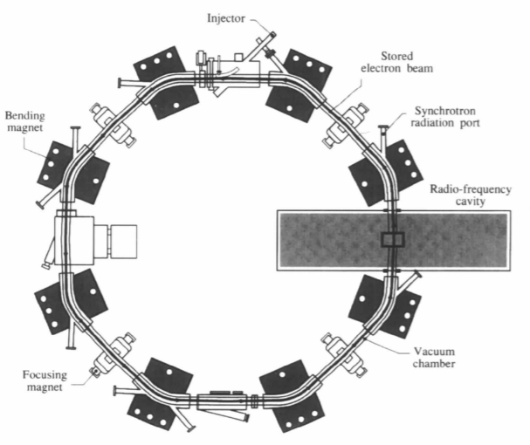
Synchrotron Radiation
Tantalus: first accelerator designed purely to produce synchrotron light
Wisconsin (USA), 1968 – 1987
C = 9m (octogonal shape!)
E=240 MeV
8 dipoles + 4 quads + 1 rf cavity
Two dipoles were used to extract synchrotron light
dipols
RF

Slide 32
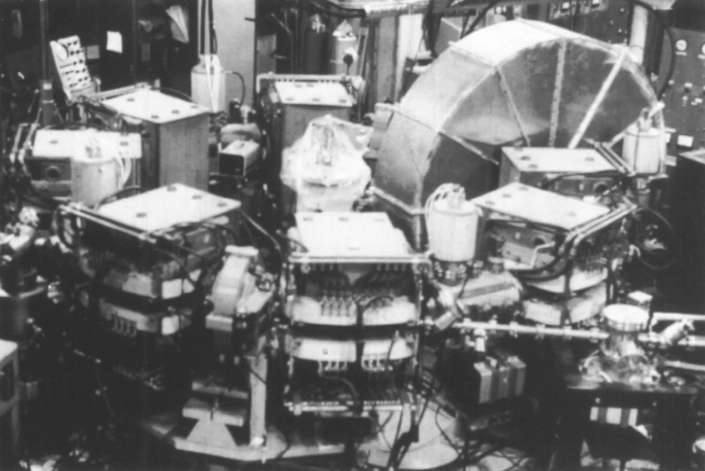
Synchrotron Radiation
Tantalus: first accelerator designed purely to produce synchrotron light
Wisconsin (USA), 1968 – 1987
C = 9m (octogonal shape!)
E=240 MeV
8 dipoles + 4 quads + 1 rf cavity
Two dipoles were used to extract synchrotron light

Slide 33
Synchrotron Light Sources (SLS)
After Tantalus, the scientific community started to exploit the synchrotron radiation
In the early 90s, the so-called “3rd Generation of SLS” were designed such that:
Maximize synchrotron light flux
Allow experiments in most stable conditions
Maximize space for Insertion Devices
beamline
injecció
beamline

Slide 34
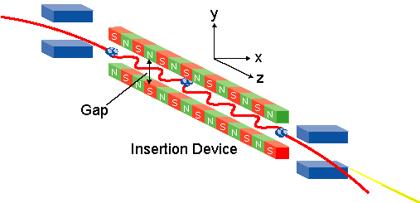
Insertion Devices
(see D. Heines presentation)
Small dipole arrangements
Electrons are forced to bend, producing strong emission of synchrotron radiation
Types of IDs:
  Unduladors: coherent light
  Wigglers: incoherent
Synchrotron Light

Slide 35
Accelerator Lattice

Slide 36
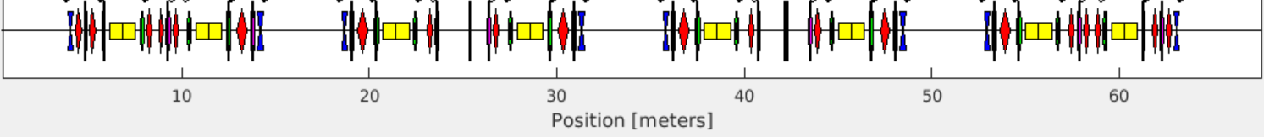
Accelerator Lattice
Magnets (dipoles, quadruples, sextupoles) are placed around circular accelerator in a periodic arrangement called “lattice”.
ALBA Lattice: 16 symmetrical cells
Synchrotron Light Sources: lattice design should leave space for Insertion Devices
Cell - 1
Cell - 2
Cell - 3
Cell - 4
¼ of the ALBA Ring

Slide 37
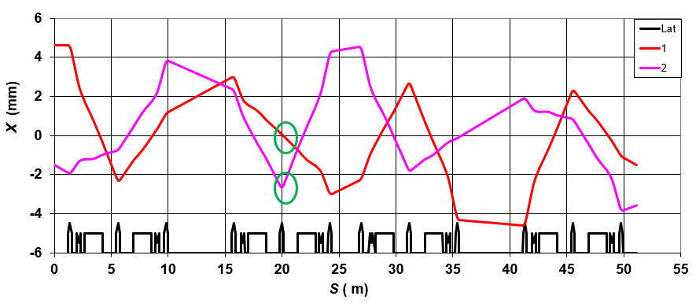
Accelerator Lattice
Particle Tracking ¼ of the ALBA ring

Slide 38
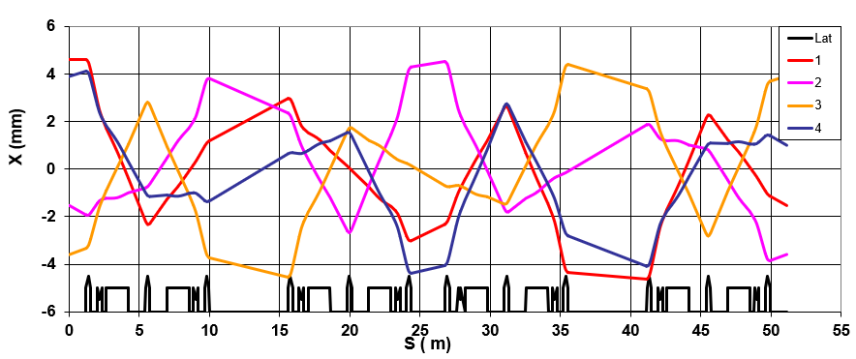
Accelerator Lattice
Particle Tracking ¼ of the ALBA ring

Slide 39
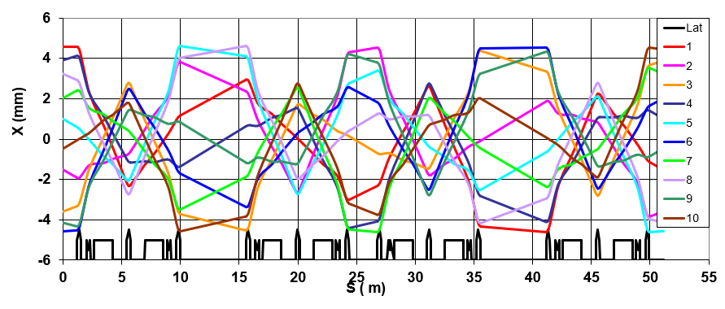
Accelerator Lattice
Particle Tracking ¼ of the ALBA ring

Slide 40
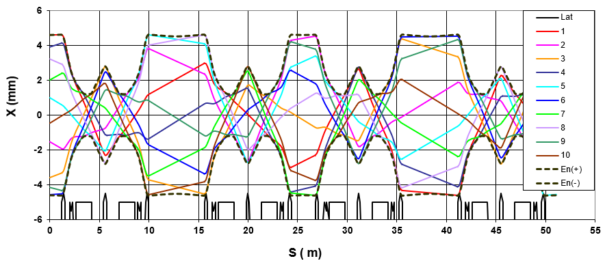
Accelerator Lattice
Particle Tracking ¼ of the ALBA ring

Slide 41
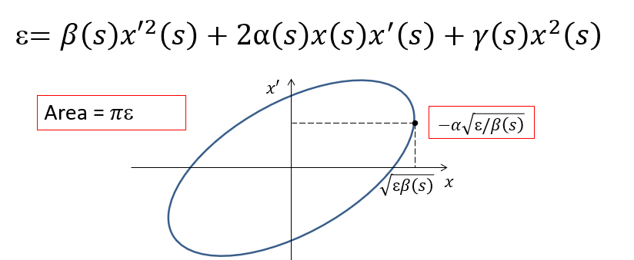
Accelerator Lattice
Particle Tracking around the ALBA ring
At each point of the accelerator circumference “s”, the distribution of position and angle (x, x’) describe and ellipse:
The shape of the ellipse changes with s, but the area is constant: ε is invariant.
This is what we call “emittance” , and it is the figure of merit of a synchrotron light source

Slide 42
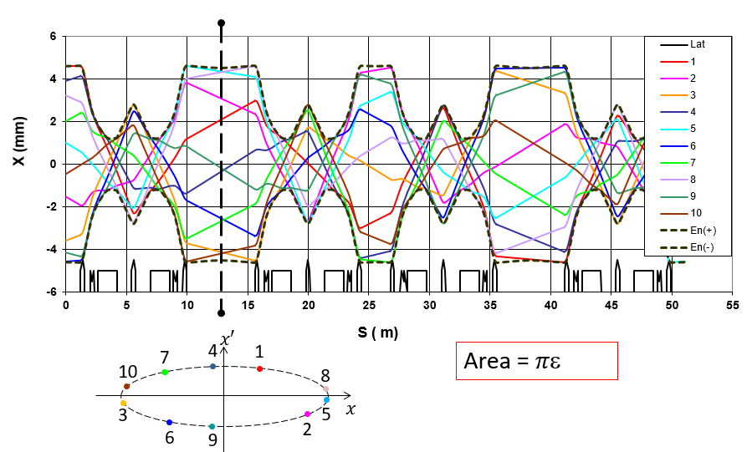
Accelerator Lattice
Particle Tracking around the ALBA ring

Slide 43
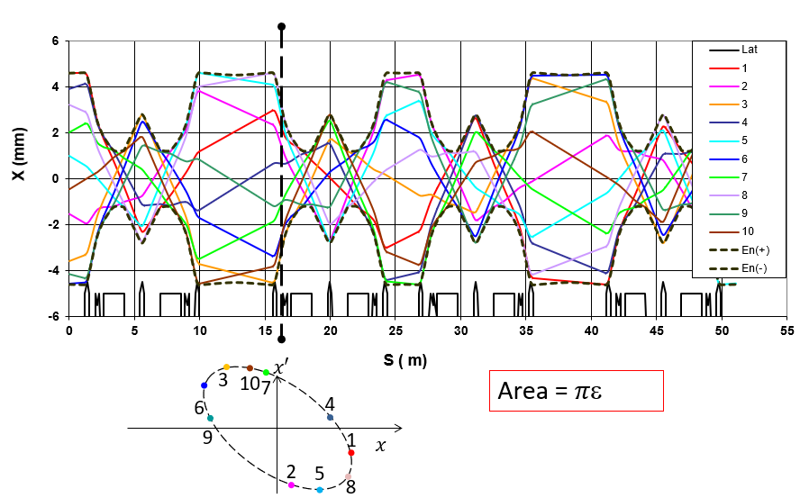
Accelerator Lattice
Particle Tracking around the ALBA ring

Slide 44
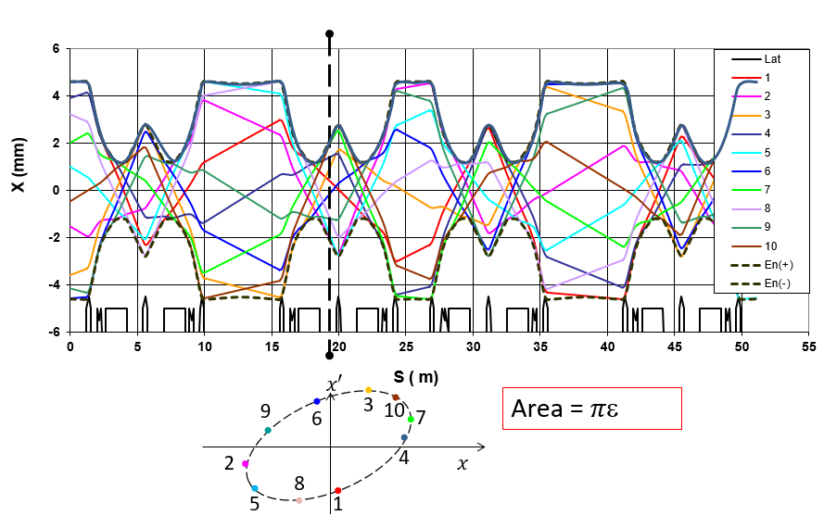
Accelerator Lattice
Particle Tracking around the ALBA ring

Slide 45
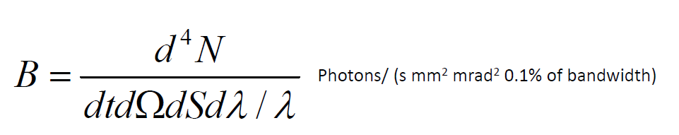
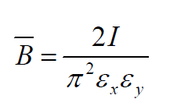
Accelerator Lattice: emittance
Synchrotron Light Sources are optimized to maximize photon flux.
This is computed by the Brilliance, or spectral brightness:
This can also be expressed as a function of the emittance:
The smaller the emittance →the highest the brlliance

Slide 46


ALBA Upgrade

Slide 47
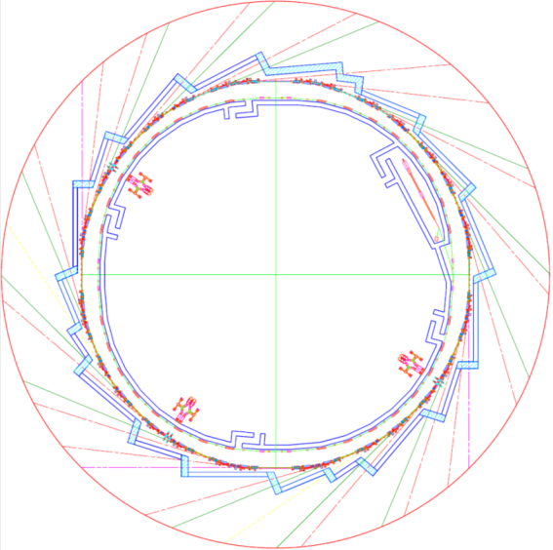
ALBA Upgrade
ALBA Accelerator Complex Today
LINAC:
100 MeV
BOOSTER:
100 MeV – 3 GeV
STORAGE RING:
100 MeV – 3 GeV

Slide 48
ALBA Upgrade
ALBA Accelerator Complex 2031(?):
LINAC:
100 MeV
BOOSTER:
100 MeV – 3 GeV
STORAGE RING:
3 GeV
Only change is the magnet lattice
The rest is kept: including beamlines

Slide 49
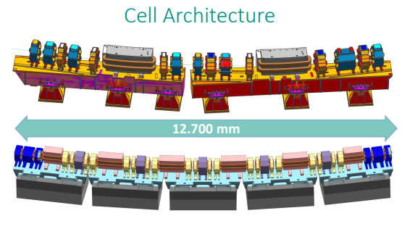
ALBA Upgrade
Take profit of the latest magnet technology progress
New design of the lattice to keep emittance around 20 times smaller
ALBA
ALBA-II

Slide 50
ALBA vs ALBA-II: the electron beam
ALBA
ε=4.6nm·rad
ALBA-II
ε=0.160 nm·rad
 | Size (σ) | Divergence (σ’)
Horizontal | 132 µm | 48.5 µrad
Vertical | 7.7 µm | 5.9 µrad
 | Size (σ) | Divergence (σ’)
Horizontal | 15 µm | 10 µrad
Vertical | 5 µm | 3.16 µrad

Slide 51

ALBA Upgrade
Notes:
suposaria una millora en les prestacions de les beamlines: experiments més ràpids, menys soroll al detectors…
More coherence , so different experiments, better resolution

Slide 52

ALBA Upgrade

Slide 53

ALBA Upgrade
2019: preliminar lattice design
07/2021: approval of ALBA-01, project to build magnets prototypes
2022: write CDR
2024 – 2028: Design and construction

Slide 54

ALBA Upgrade
2019: preliminar lattice design
07/2021: approval of ALBA-01, project to build magnets prototypes
2022: write CDR
2024 – 2028: Design and construction
(if finally approved)
2029 – 2030: black period to exchange magnets
2031: start of ALBA-II

Slide 55

Gràcies!

Slide 57

Acceleradors de Partícules
https://public.cells.es/machine-status/msGUI.html

Slide 58
Questions welcome

