Slide 1

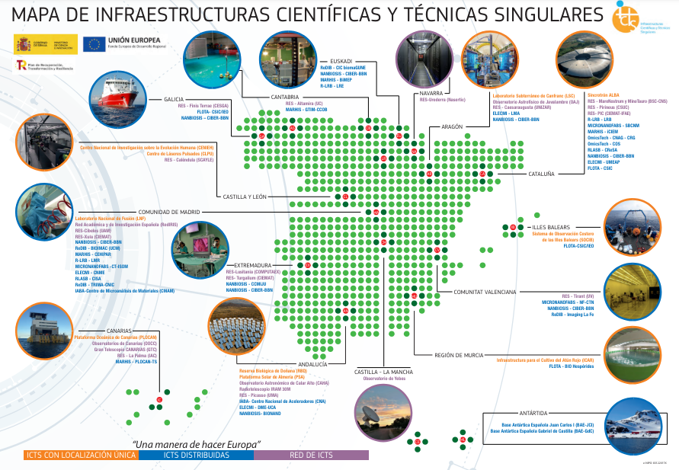
Mesa 2
Sumando capacidades de las ICTS para ofrecer soluciones a retos y problemas complejos
Mònica Bayés, CNAG - OMICSTECH
Caterina Biscari, Sincrotrón ALBA, moderadora
Luis Fonseca, CNM - MICRONANOFABS
Gastón García, CMAM - IABA
María Martinón, CENIEH
3er encuentro ICTS
Barcelona, 30 octubre 2024

Slide 2

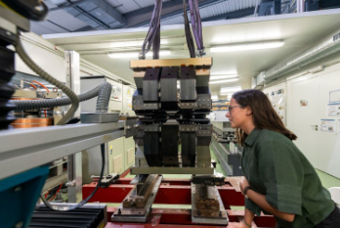
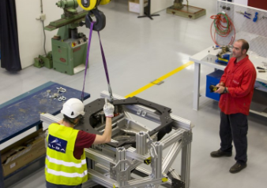
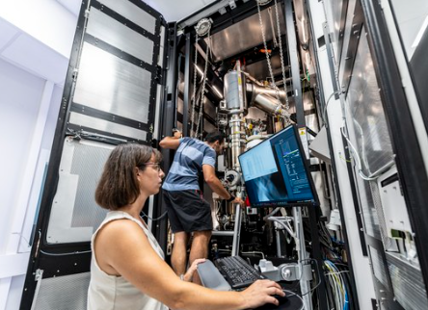
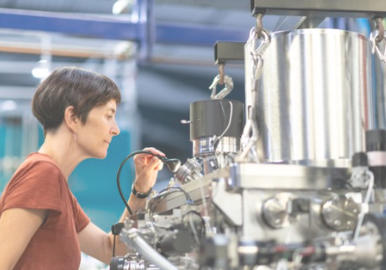
Spanish ICTS
Summing up analytical and technical capabilities
Technical capabilities
Analytical capabilities
Possibility of sharing test laboratories and workshops
Collaborating in development of accelerator technologies, detectors, laser technologies, diagnostics, control systems
Best practices for technology transfer and procurements
Use of analytical instruments of some ICTS for developing other ICTS technology (as for example magnetic materials for fusion, biotechnology, …)
Offering multimodal instruments to diverse user communities, as X-ray, Ions, Lasers, Electron Microscopes, NMR (see EU ARIE)
Management of experimental data

Slide 3
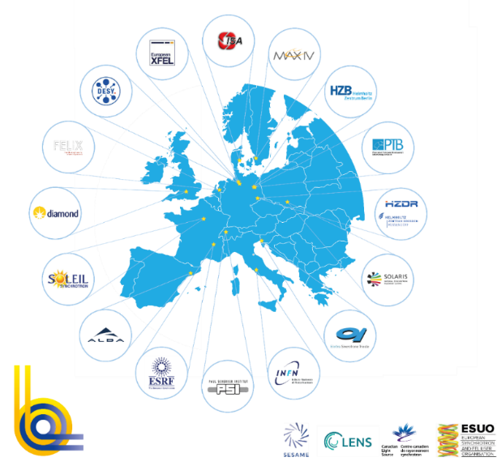
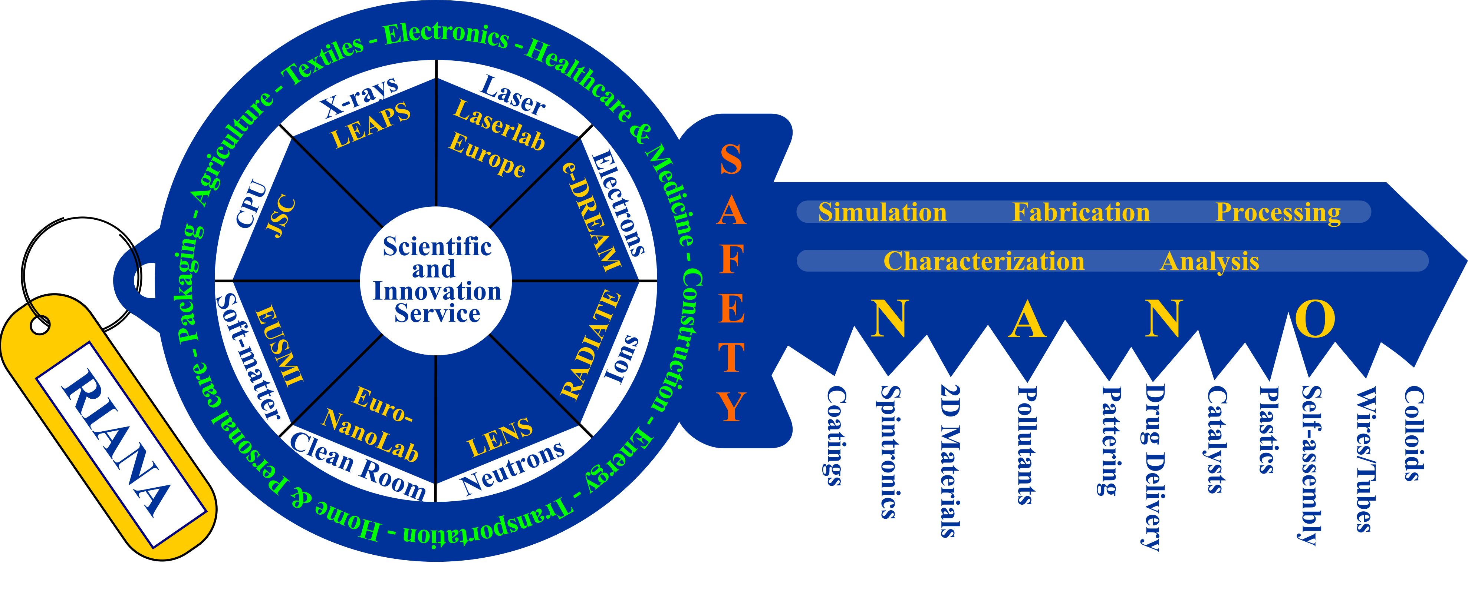
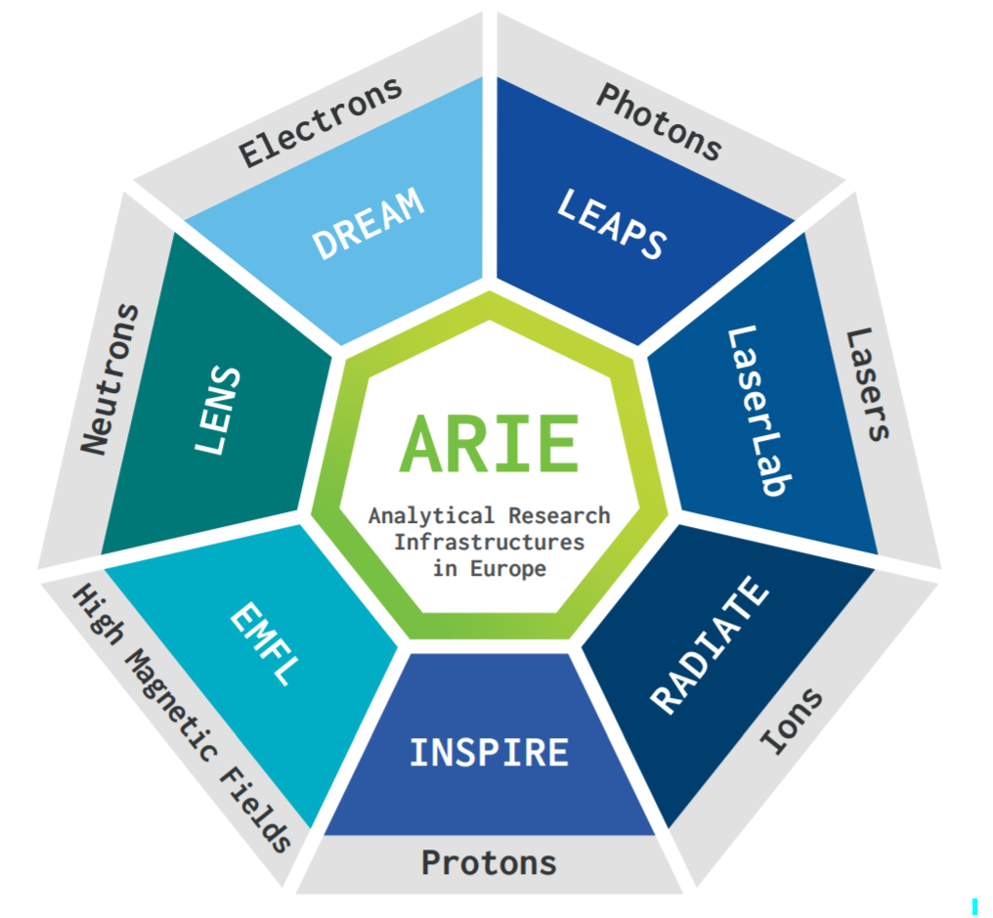





European Research Infrastructures
Summing up analytical and technical capabilities
IMPRESS
Sunstone
+35000 users from all EU & beyond
offering +1M h/year
+25000 publications in last 5 years
+300 operating End Stations
INFRA-2023-SERV-01-03
Neutrons and Photons Elevating Worldwide Science

Slide 4
Mesa 2
Sumando capacidades de las ICTS para ofrecer soluciones a retos y problemas complejos
Mònica Bayés, CNAG - OMICSTECH
Caterina Biscari, Sincrotrón ALBA, moderadora
Luis Fonseca, CNM - MICRONANOFABS
Gastón García, CMAM - IABA
María Martinón, CENIEH
3er encuentro ICTS
Barcelona, 30 octubre 2024

Slide 5




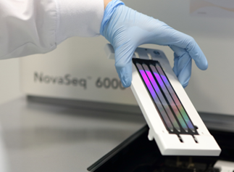
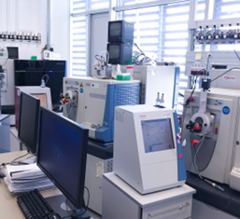
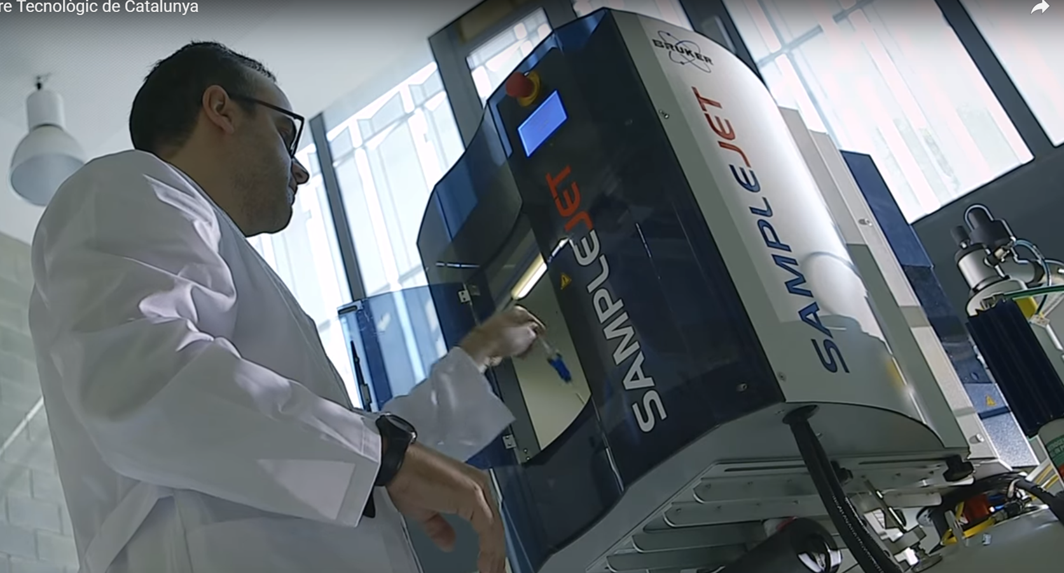

Genomics
Proteomics
Metabolomics
CNAG, COS
CRG, COS
COS
>1,500 accesses
> 400 users

Slide 6


WITHIN THE EUROPEAN RESEARCH INFRASTRUCTURE LANDSCAPE
EU INFRADEV
Development and Consolidation of RIs
ELIXIR Life Sciences Information (CNAG, through INB)
IBISBA Industrial Biotechnology/ Biomanufacturing (COS)
METROFOOD Metrology in Food and Nutrition (COS)
EASIGEN Advanced Genomics Technologies (CNAG)
EU INFRAIA
Transnational Access Provision
ESGI Genomic Technologies (CNAG)
EASI-GENOMICS Genomic Technologies (CNAG)
EPIC-X Proteomic Technologies (CRG)
US NIH
CGI: Centre for genome imaging (CNAG)

Slide 7
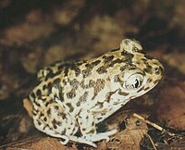
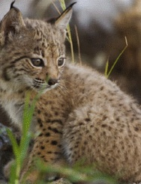
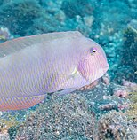
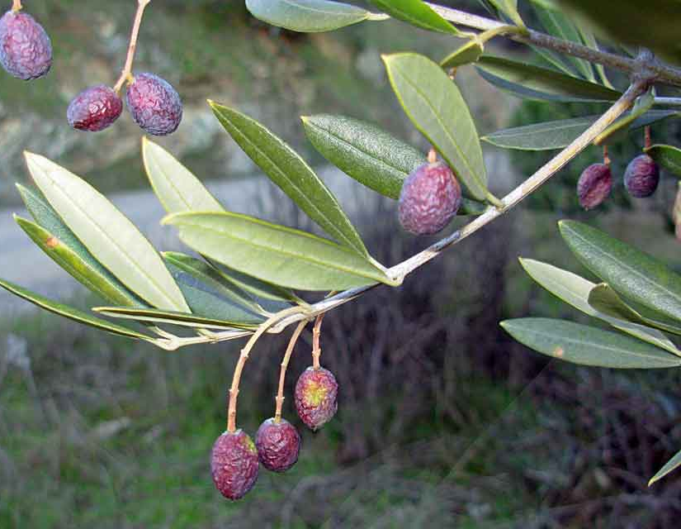
WITHIN THE SPANISH ICTS LANDSCAPE
OMICSTECH is a user of:
RedIRIS Red Académica y de Investigación Española
  Aspera service
  SSL certificates, etc
  OMICSTECH collaborations with:
  RES Red Española de Supercomputación y Datos
  BSC: GDI, VEIS, IMPaCT-DATOS, EASI-GENOMICS, EASIGEN, etc
  Nasertic: NAGEN
  CESGA: IMPaCT-Genómica
  And exploring more…
OMICSTECH users:
RDB Reserva Biológica de Doñana
  Pelobates cultripes
  Lynx pardinus
SOCIB/ IMEDEA Sistema de Observación Costero de las Illes Balears
  Xyrichtys novacula
  RES Red Española de Supercomputación y Datos
  Envirnomental samples
  Olea europaea

Slide 8

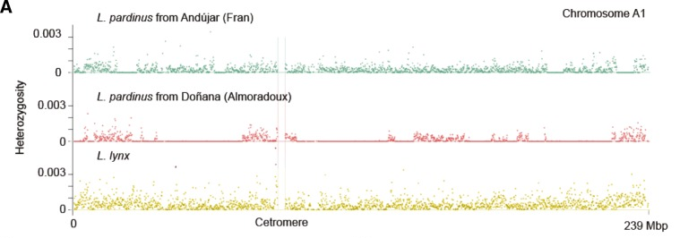
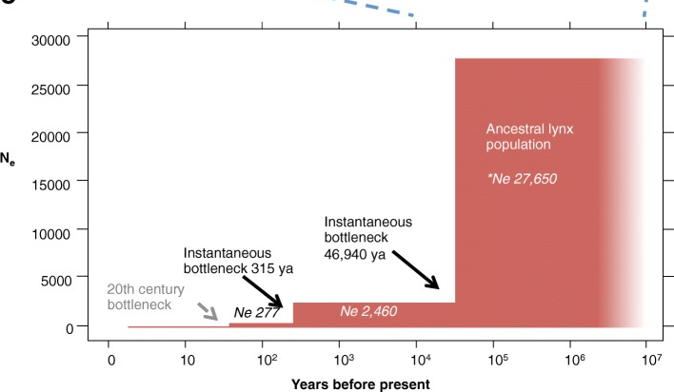
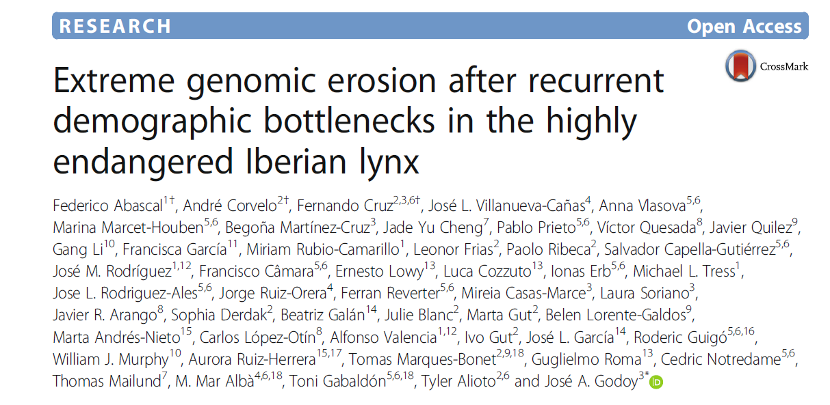
The Lynx Genomics project
RDB José Antonio Godoy (Coordinator)
RES-BSC Toni Gabaldon
OMICSTECH-CNAG Tyler Alioto

Slide 9
FUTURE COLLABORATION OPPORTUNITIES
Access provision, research projects, projects on transversal areas (training, etc)
OMICSTECH Complementary ICTSs
ReDIB Red Distribuida de Imagen Biomédica
NANBIOSIS Nanomateriales, biomateriales y sistemas en biomedicina
ALBA Sincrotrón
R-LRB Resonancia Magnética Nuclear de Biomoléculas
RedIRIS Red Académica y de Investigación
RES Red Española de Supercomputación y Datos
Potential OMICSTECH users
BAE Bases Antárticas Españolas
FLOTA Oceanográfica Española
ICAR Infraestructura de Cultivo del Atún Rojo
PLOCAN Plataforma Oceánica de Canarias
RBD Reserva Biológica de Doñana
SOCIB Sistema de Observación Costero de las Illes Balears
CENIEH Centro Nacional de Investigación sobre la Evolución Humana,

Slide 10
Mesa 2
Sumando capacidades de las ICTS para ofrecer soluciones a retos y problemas complejos
Mònica Bayés, CNAG - OMICSTECH
Caterina Biscari, Sincrotrón ALBA
Luis Fonseca, CNM - MICRONANOFABS
Gastón García, CMAM - IABA
María Martinón, CENIEH
3er encuentro ICTS
Barcelona, 30 octubre 2024

Slide 11
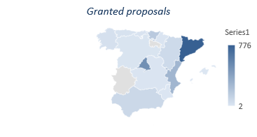
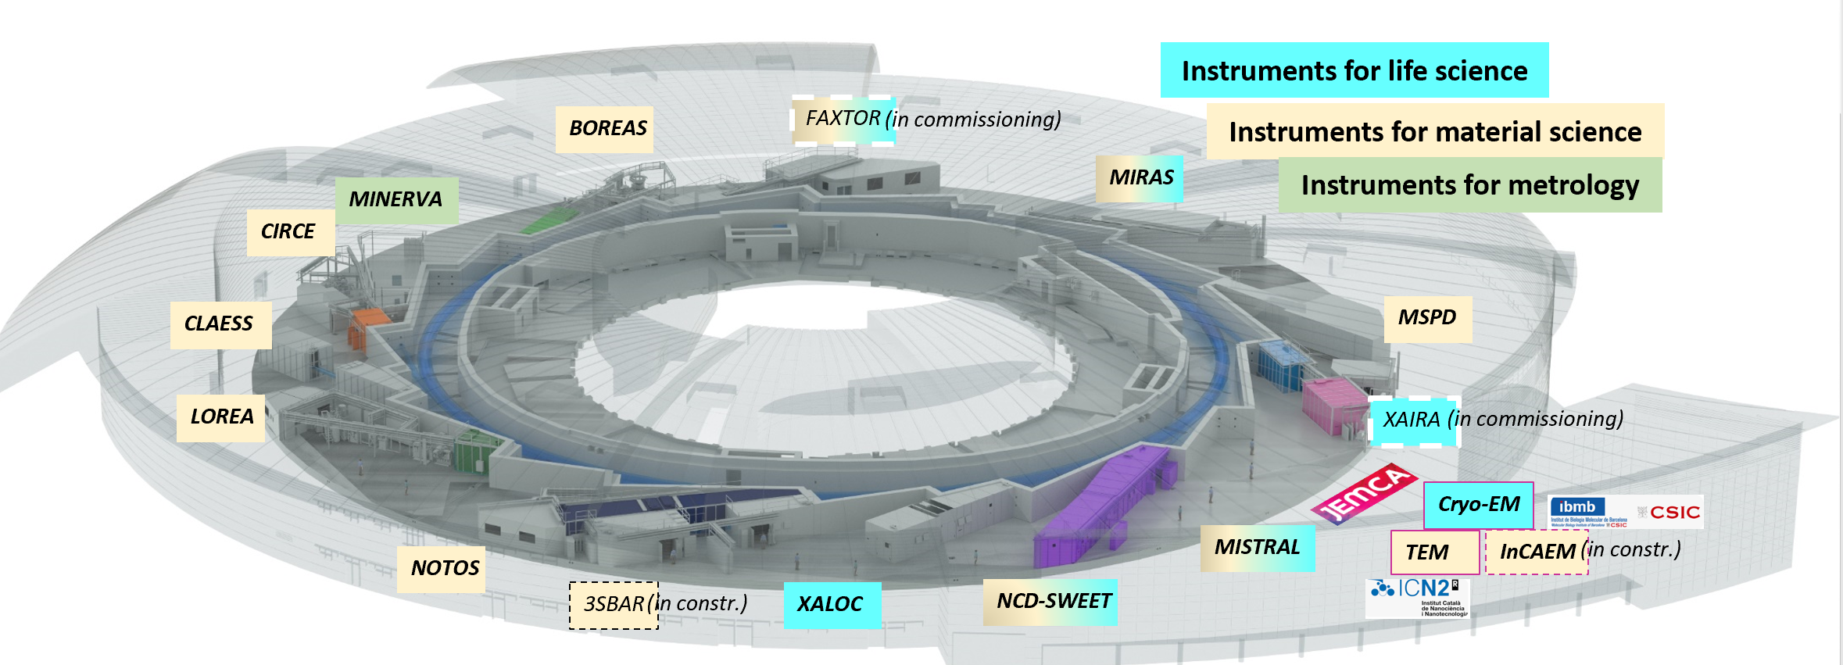
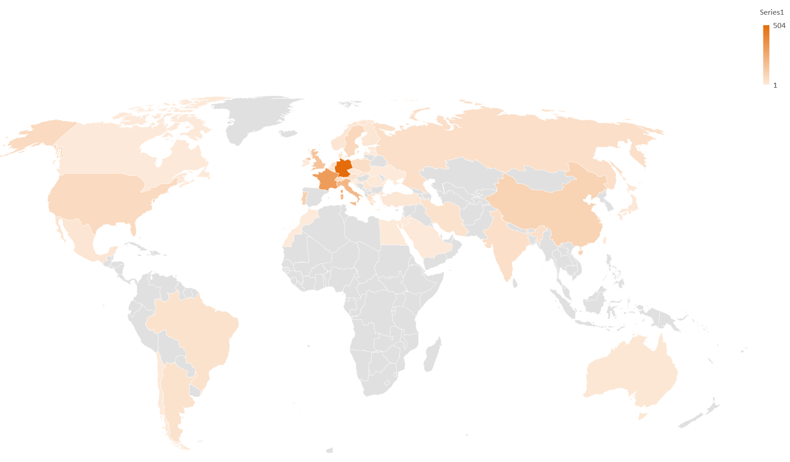
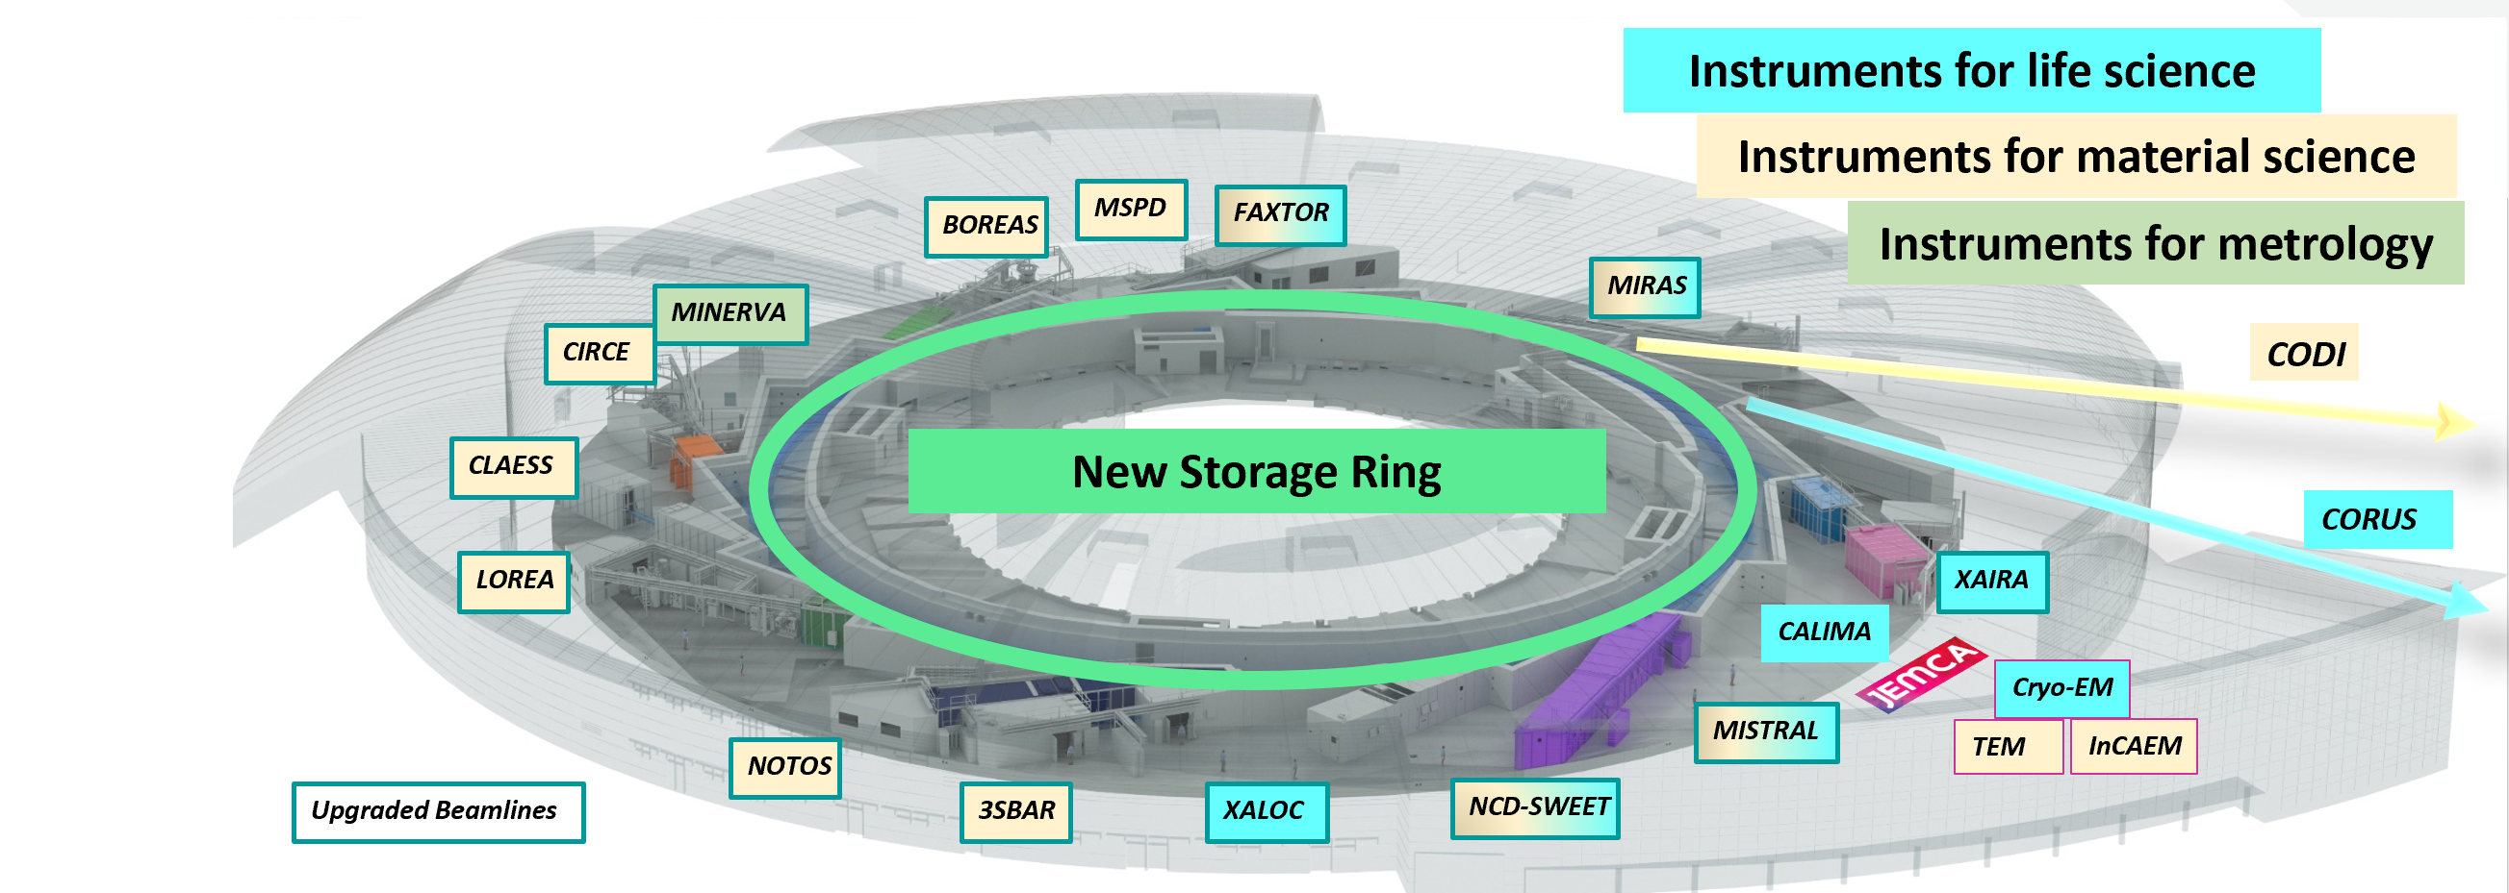


ALBA Synchrotron
+ 8500 users (51% from Spain)
+ 2400 users/year
2 user calls per year, OF ~ 2, 60% from Spain
+ 90 companies as users
+ 3400 publications, +300/year, <IF> = 10
261 staff members, 25% women
ALBA II, 4th generation light source, ready in 2032
Much brighter photon beam, improved resolution and photon coherence fraction, multimodal development, upgraded data infrastructure, three new beamlines, two of which nanoprobes with long paths
3 GeV electrons, 4500 h/year for users, 98% availability
11 BLs in operation, + 2 in 25, +1 in 2026
In partnership: 2 cryo-EM in operation + 1 in 2025 + SPM/AFM
Several ancillary labs for users
Scientific Sections: Life Science, Chemical and Material Science, Electronic Structure of Matter, Interdisciplinary MultiModal methods

Slide 12

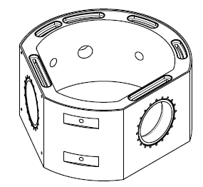
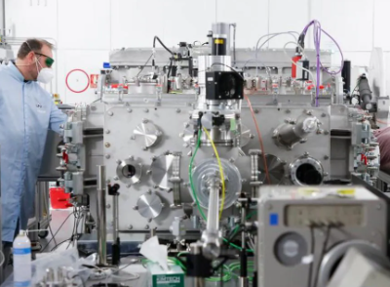


Past and present
Participation in European projects
Most through
Some of the collaborations inside ICTS map
TECHNOLOGY
CLPU : 1PW laser vacuum chamber design and fabrication
ESS- Bilbao – rf couplers designs
CMN – joint developments and patents (diagnostics, detectors, liquid cells)
CNA + CMAM – staff training for data (ICTS call)
LEAPS-INNOV
CoCid
SYLINDA
ReMade@ARI
RIANA
SUNSTONE
FUNLAYERS
NEPHEWS
COOPHS
Sup3rForm
H2FORM3G
NFFA-NEP
IMPRESS
DOCFAM
OPERA
RF2.0
CLEXM
SCIENCE
CENIEH, CRG, INIA, CNIC, CMAM, CNM, INTA, IRTA, ISOM, PIC among our users
Using REDIRIS
USER SERVICES
Collaborating with PIC inside Planes Complementarios for Advanced Materials
Collaborating with CMAM in European Projects

Slide 13
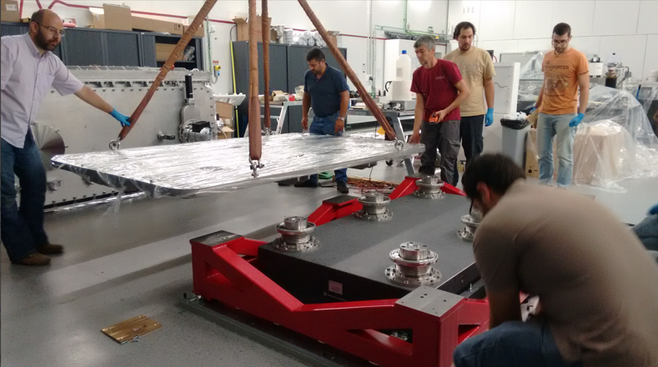
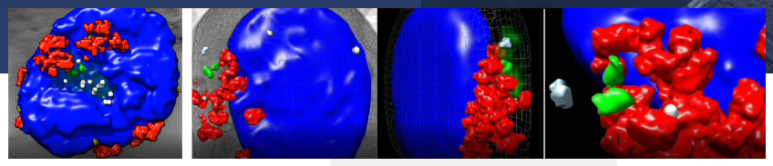
Two examples
The role of cct protein in the control of the immune synapse formation identified using Mistral BL.
CLPU and ALBA people working together in Salamanca mounting one of the Laser Vacuum Chamber
The CCT protein is a cytosolic chaperonin, in the reorganization of the cellular skeleton involved in the immune synapse. The interaction process between lymphocytes and antigen-presenting cells is necessary for the activation of lymphocytes and determines the immune response intensity.
Centro Nacional de Investigaciones Cardiovasculares (CNIC), the Instituto de Investigación Sanitaria del Hospital Universitario de La Princesa (IIS Princesa) and the National Centre for Biotechnology (CNB-CSIC)
Diseño y desarollo de la cámara del compressor de 200 TW: (size: W x L x H = 1,3 x 1,8 x 1,6 metres)
Diseño y desarollo de la cámara del compressor de 1 PW: (size: W x L x H = 1,8 x 3,8 x 1,6 x 2,5 metres)
Diseño y desarollo de la cámara experimental para el laser de 1 PW: (size: W x L x H = 1,8 x 3,2 x 1,6 x 1,9 metres)
The chaperonin CCT controls T cell receptor-driven 3D configuration of centrioles. Science Advances (6), 49. DOI: 10.1126/sciadv.abb7242

Slide 14
Future possibilities
TECHNOLOGY
Collaboration on accelerator systems with IFMIF-DONES, ESS-Bilbao, CMAM, CNA
Collaboration on detectors/diagnostics
Partnering with other ICTS for participation in EU calls, profiting of Block Grant concept
Common participation in
SCIENCE
Opening to wider user communities through dedicated actions
Collaboration ELECMI – JEMCA
Enlarging the reach of the new Scientific Section to other ICTS communities: IMM (Interdisciplinary and MultiModal)
USER SERVICES
Working on the preparation of a Pilot Project with RES: Macromolecular Crystallography (MX) Advanced Data Processing for Users
Extend the collaboration with RES

Slide 15
Mesa 2
Sumando capacidades de las ICTS para ofrecer soluciones a retos y problemas complejos
Mònica Bayés, CNAG - OMICSTECH
Caterina Biscari, Sincrotrón ALBA
Luis Fonseca, CNM - MICRONANOFABS
Gastón García, CMAM - IABA
María Martinón, CENIEH
3er encuentro ICTS
Barcelona, 30 octubre 2024

Slide 16


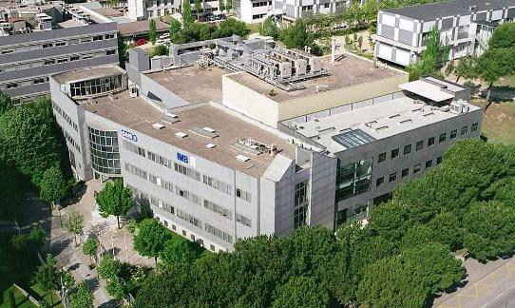


Red Española de Salas Blancas de Micro y Nanofabricación
Instituto de Microelectrónica de Barcelona (IMB)
Centro Nacional de Microelectrónica (CNM)
Public Research Center that belongs to the Spanish Council for Scientific Research (CSIC)
Located in Bellaterra, close to Barcelona (Spain) at Autonomous University of Barcelona (UAB) Campus
Scalable Nano and Micro technologies oriented to scalable electronics
ICTS: Micro-Nano Fabrication Facility (Clean Room) apt to R+D+I and small series
Clean Room virtual tour
https://www.imb-cnm.csic.es/en/micro-and-nanofabrication-clean-room
Notes:
Located in the UAB campus, belonging to CSIC, micronanoelectronics orientation, distinctive trait the clean room (unique), beyond R&D&I … small series

Slide 17




CLEAN ROOM
Clean Room facility at IMB-CNM is a Spanish Large Scale Facility since 1996
Since 2014 ⇒ Distributed ICTS: MICRONANOFABS
 | IMB-CNM | ISOM | NTC
Clean room (m²) | 1,500 | 400 | 500
Packaging (m²) | 75 | 200 | 200
Characterization labs (m²) | 60 | 300 | 200
Wafer diameter (mm) | 100 & 150 | 50 | 150 & 200
Building | 1991 | 2000 | 2009
Total ICTS staff | 45 | 19 | 21
Process staff | 23 | 3 | 6
Maintenance staff | 10 | 2 | 5
ICTS network formed by the clean rooms and labs of three nodes:
IMB-CNM
Institute of Microelectronics of Barcelona (CNM, CSIC)
Barcelona
ISOM
Institute of Optoelectronic Systems and Micro-technology (UPM)
Madrid
NTC
Nano-photonics Technology Center (UPV)
Valencia
https://micronanofabs.org/

Slide 18





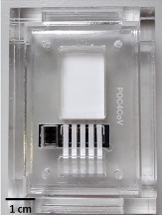

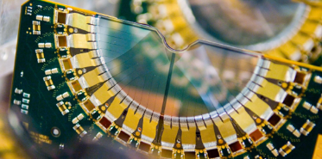
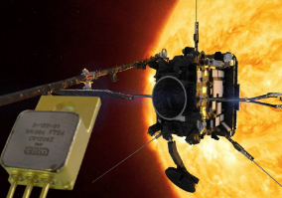
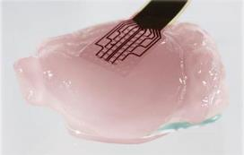
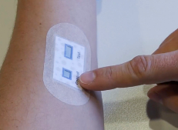
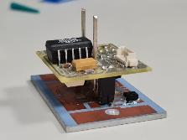
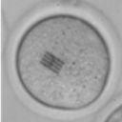
Red Española de Salas Blancas de Micro y Nanofabricación
Technologies & Advanced Processes for Micro & Nanosystems
Silicon (incl. photonics, quantum, neuromorphic)
Wide band gap semiconductors
2D materials (Graphene, …)
Polymers / Paper
Health and Environment Axis
Devices
Microfabrication
Design
Energy and Mobility Axis
Nanofabrication
Characterization
Systems
Physics Frontiers and Security Axis
Intracell Si chips
Graphene neural probes
Sweat patches
Covid test platforms
Smart power modules
Si radiation sensors
SiC diodes onboard space missions

Slide 19
Red Española de Salas Blancas de Micro y Nanofabricación
Relation with other ICTS:
Nanbiosis: antibodies / immunoreactions ↔ & electrochemical cells
Nanbiosis: graphene material ↔ graphene devices
CNA/CMAM: particle irradiation ↔ radiation detectors
ALBA: X-rays ↔ radiation detectors
ALBA: GISAXS ↔ polymers self-assembly
CPLU: laser ↔ neutron dosimeters
RES: Montecarlo simulations ↔ FLASH detectors
ALBA: assistance in X-ray holography developments
ALBA: membrane based liquid cells
ALBA: transmission monitors for beam diagnostic
User-pushed combination of capacities:
(beyond) Services
Joint papers & projects
ICTS-pushed combination of capacities:
Common developments
Joint patents
Relation with international partners:
NFFA (Nanofoundries & Fine Analysis): service offered through a INFRAIA project sponsored distributed infrastructure
EURONANOLAB: federation of EU cleanrooms
CERIC ERIC (through Sc & Tech advisory committee) → internal research projects, shared PhD

Slide 20

Red Española de Salas Blancas de Micro y Nanofabricación
Frente a los archivillanos complejos…
Liga de la JuICTSia

Slide 21
Mesa 2
Sumando capacidades de las ICTS para ofrecer soluciones a retos y problemas complejos
Mònica Bayés, CNAG - OMICSTECH
Caterina Biscari, Sincrotrón ALBA
Luis Fonseca, CNM - MICRONANOFABS
Gastón García, CMAM - IABA
María Martinón, CENIEH
3er encuentro ICTS
Barcelona, 30 octubre 2024

Slide 22
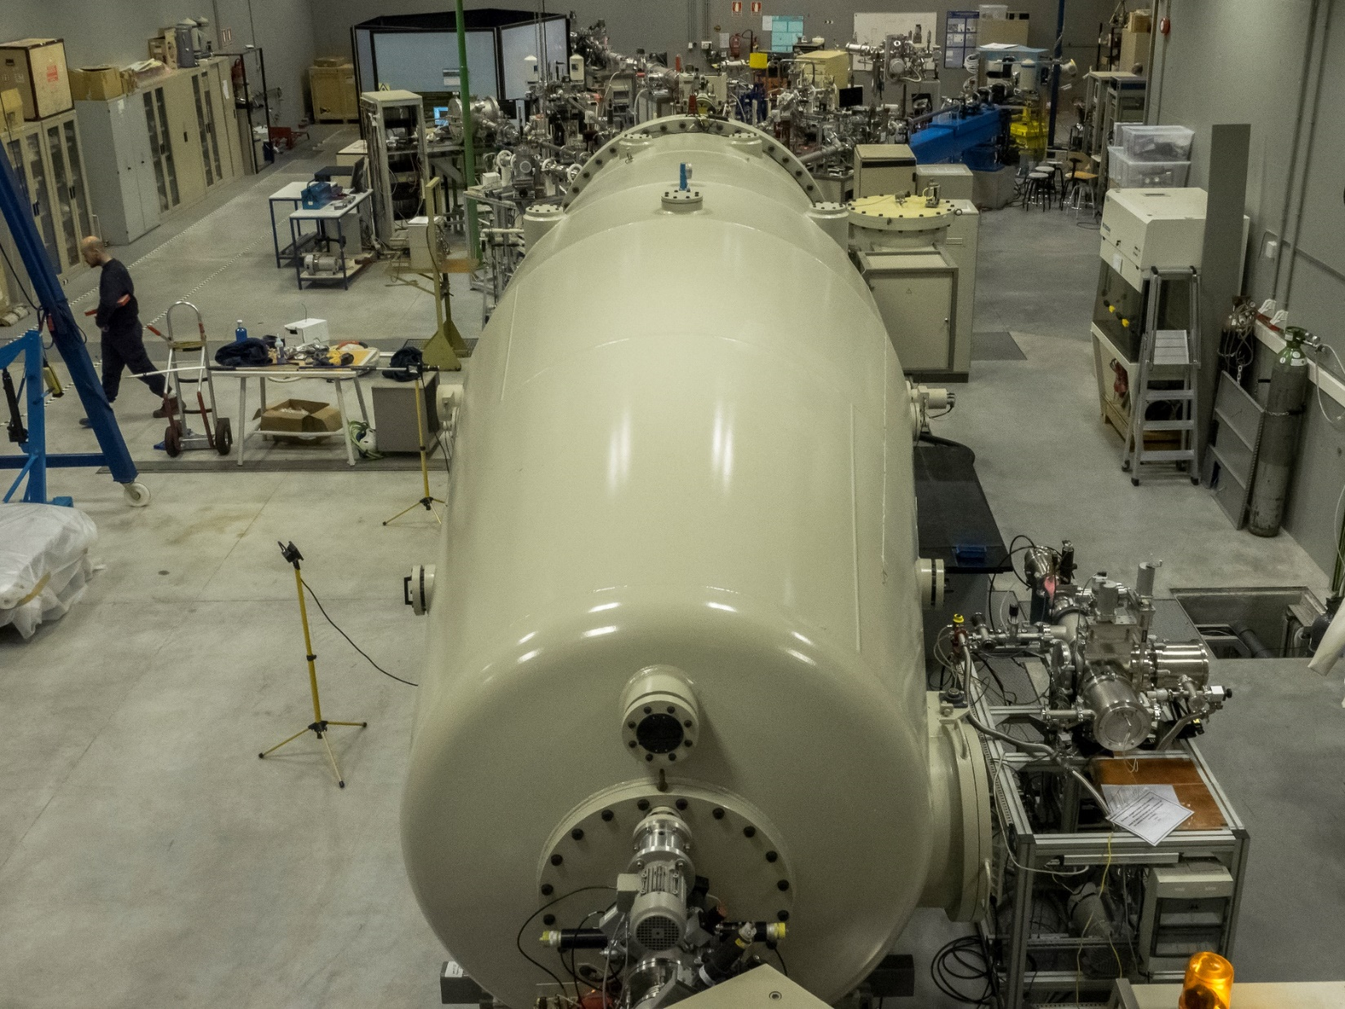
CMAM @ UAM
Ion Accelerator + BLs
ICTS IABA with two nodes: CNA and CMAM
Impact on materials science, energy, nuclear physics, radiobiology and other areas

Slide 23
Conexiones
Proyectos ReMade@ARI y RIANA:
Acceso transnacional en RIs complementarias
Presencia de varias ICTS
Con otras ICTS:
Proyecto red ICTS sobre datos con CNA y colaboración de ALBA
Proyecto solicitado red ICTS incluyendo reunión de usuarios CMAM/CNA/CLPU
Excelente relación con ALBA como ICTS de referencia en el campo de aceleradores
Estrecha colaboración con LNF (usuarios, validación de técnicas, proyectos científicos comunes)
Colaboraciones activas o planeadas a nivel de usuario con CLPU, LSC, CNM…

Slide 24
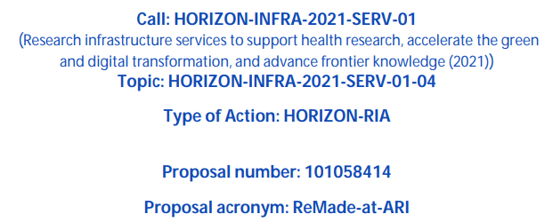
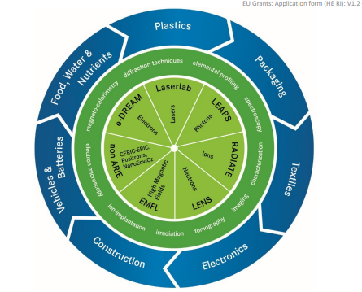
Proyecto 2022-26
Acceso trans-nacional red RI muy amplia
Foco en materiales para Economía Circular
Complementariedad de técnicas y apoyo a usuarios sin experiencia
CMAM-UAM lidera un WP (coordinación tiempo acceso)
CMAM-UAM participa con un postdoc y un doctor en gestion de proyecto

Slide 25
Perspectivas futuras
Consolidando ICTS IABA (CNA + CMAM)
Explotar la red ICTS como campo para extender la comunidad de usuarios
Planeando reuniones de usuarios, potencialmente con otras ICTS
Abiertos a iniciativas ICTS a-la-ReMade (acceso complementario con una sola propuesta)

Slide 26
Mesa 2
Sumando capacidades de las ICTS para ofrecer soluciones a retos y problemas complejos
Mònica Bayés, CNAG - OMICSTECH
Caterina Biscari, Sincrotrón ALBA
Luis Fonseca, CNM - MICRONANOFABS
Gastón García, CMAM - IABA
María Martinón, CENIEH
3er encuentro ICTS
Barcelona, 30 octubre 2024

Slide 27


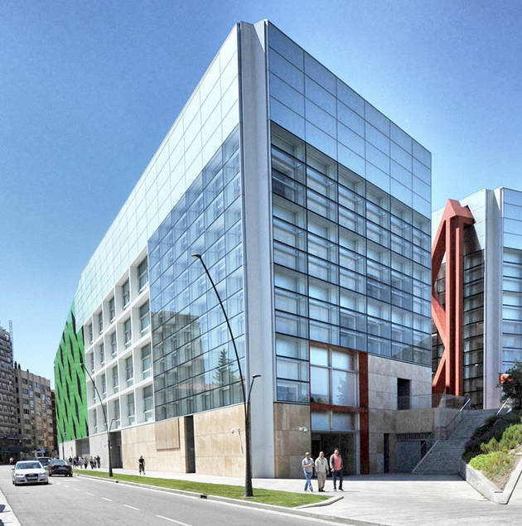
Social sciences and Humanities
CENIEH
Arqueología
Paleobiología
Geocronología y Geología
Laboratorios
-Biological and cultural evolution of human lineage
-Bidirectional impact of hominins and environmental interaction
-Climate and landscape change
-Conservation and heritage science (Atapuerca collections)
-Archaeological and paleontological excavations

Slide 28
Laboratories
Geology
Thin sections
Archaeometry
Microscopy
*Microcomputed Tomography
* Paleomagnetism
* Cosmogenic Nuclides
* Electron Spin Resonance
* Luminiscence
* Uranium Series
Material Characterization
Geochronology
Collections Conservation & Restoration
Palaeoproteomics and
ancient DNA
* Conservation and Restoration
Digital mapping and 3D Analysis
Experimental Archaeology and Taphonomy
2021-2024 7 outstanding facilities
600 solicitudes de acceso
210 proyectos
media de 200 usuarios anuales

Slide 29




EUROPEAN RESEARCH INFRASTRUCTURES LANDSCAPE

Slide 30

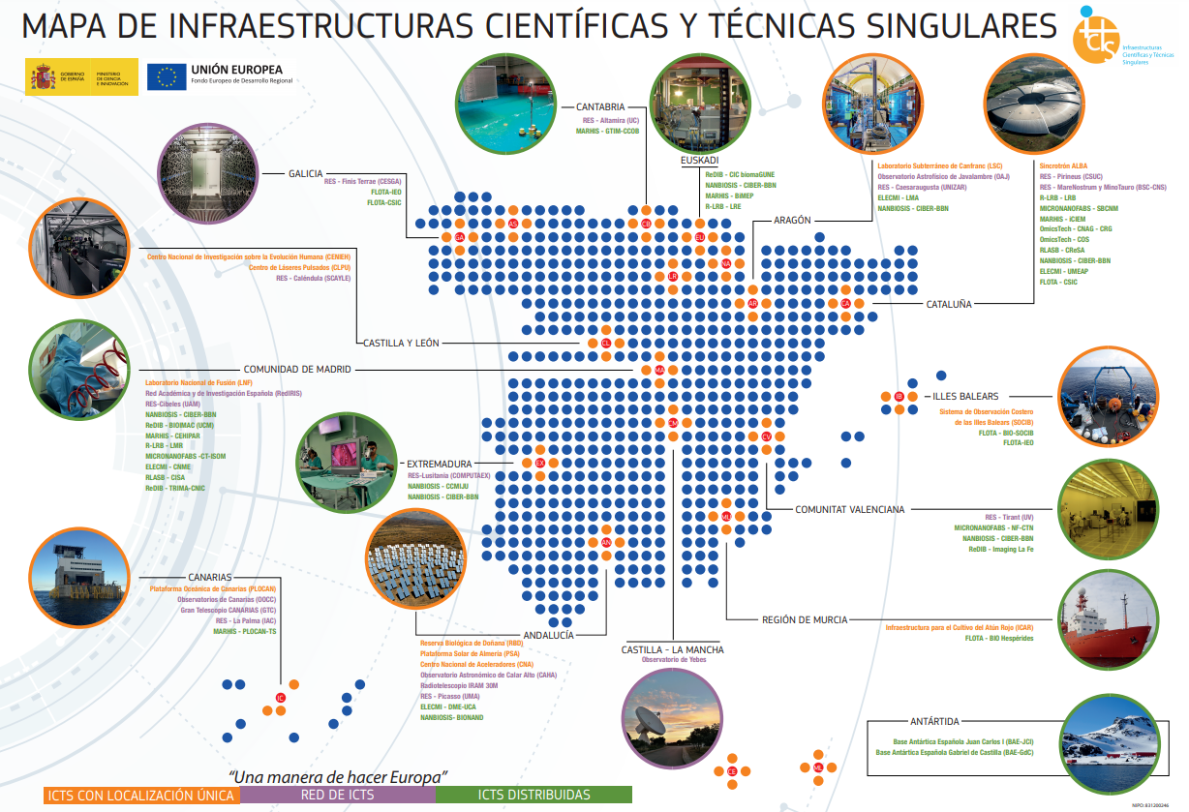









Collaborations with ICTS
Current
Possible/future

Slide 31
Spanish ICTS
Summing up analytical and technical capabilities
Technical capabilities
Analytical capabilities
Possibility of sharing test laboratories and workshops
Collaborating in development of accelerator technologies, detectors, laser technologies, diagnostics, control systems
Best practices for technology transfer and procurements
Use of analytical instruments of some ICTS for developing other ICTS technology (as for example magnetic materials for fusion, biotechnology, …)
Offering multimodal instruments to diverse user communities, as X-ray, Ions, Lasers, Electron Microscopes, NMR (see EU ARIE)
Management of experimental data
Proposals on possibilities to advance in the cooperation
Calls with funding that includes the possibility of financing staff (not just students) and technological developments (model INFRA-TECH, INFRA-SERV, etc.)
Mission oriented calls to tackle multidisciplinary challenges that require the interconnection of ICTs from different fields, similar to EC Mission calls
Thematic user meetings – example: sessions at some of the thematic conferences with support of ICTS organization
Webpage to share information on our engineering capabilities, existence of laboratories, test stands, etc.
Following the model of EU TNA, create programs of National Access for use of competitive instruments

