Slide 1
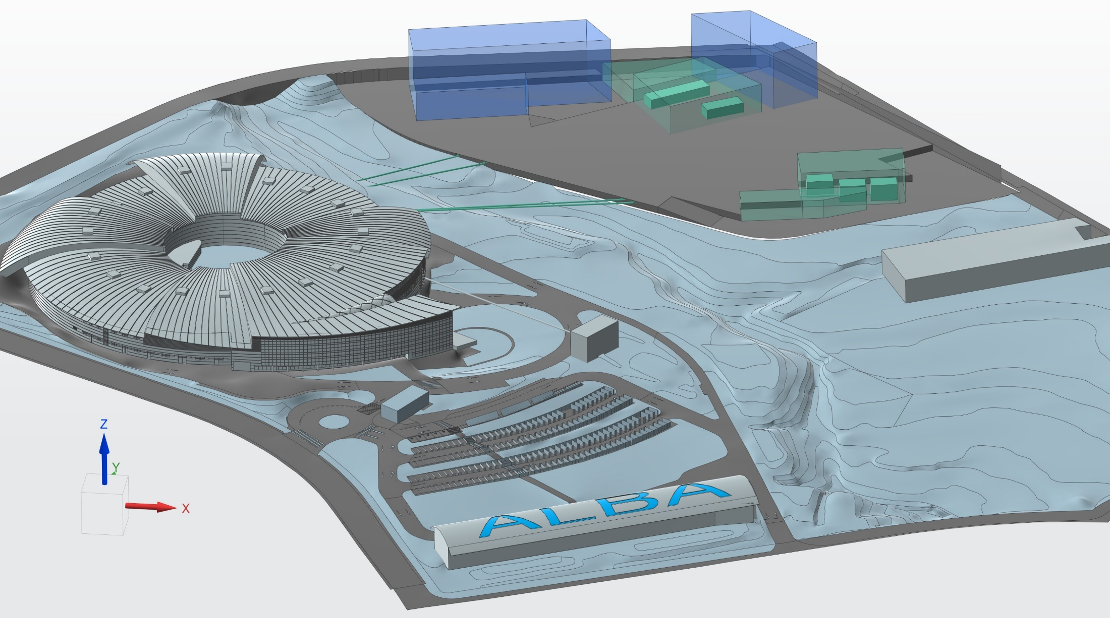
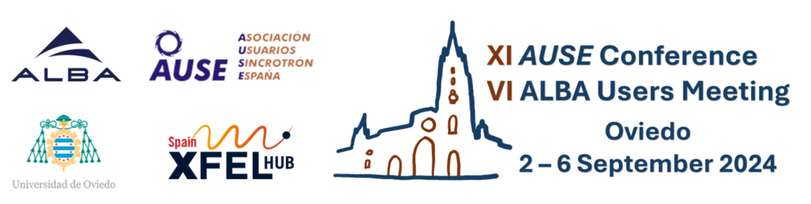
ALBA and its future, ALBA II
Caterina Biscari
4 September 2024
ALBA User Meeting - Oviedo

Slide 2
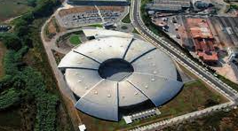
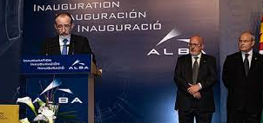
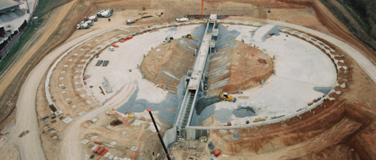

ALBA: past, present and future
2003 – Creation of CELLS Consortium (Spanish Government and regional Catalan Government), and agreement on facility funding for the period 2003 to 2022
2023 – Addendum for 2023 funding
Now: waiting for government approval of facility funding up to 2038
2003 ALBA Approval
2012
Starting ALBA Operation
2020
Starting ALBA II design
2024
ALBA II Approval
2032
ALBA II Operation
2006
Starting ALBA construction

Slide 3
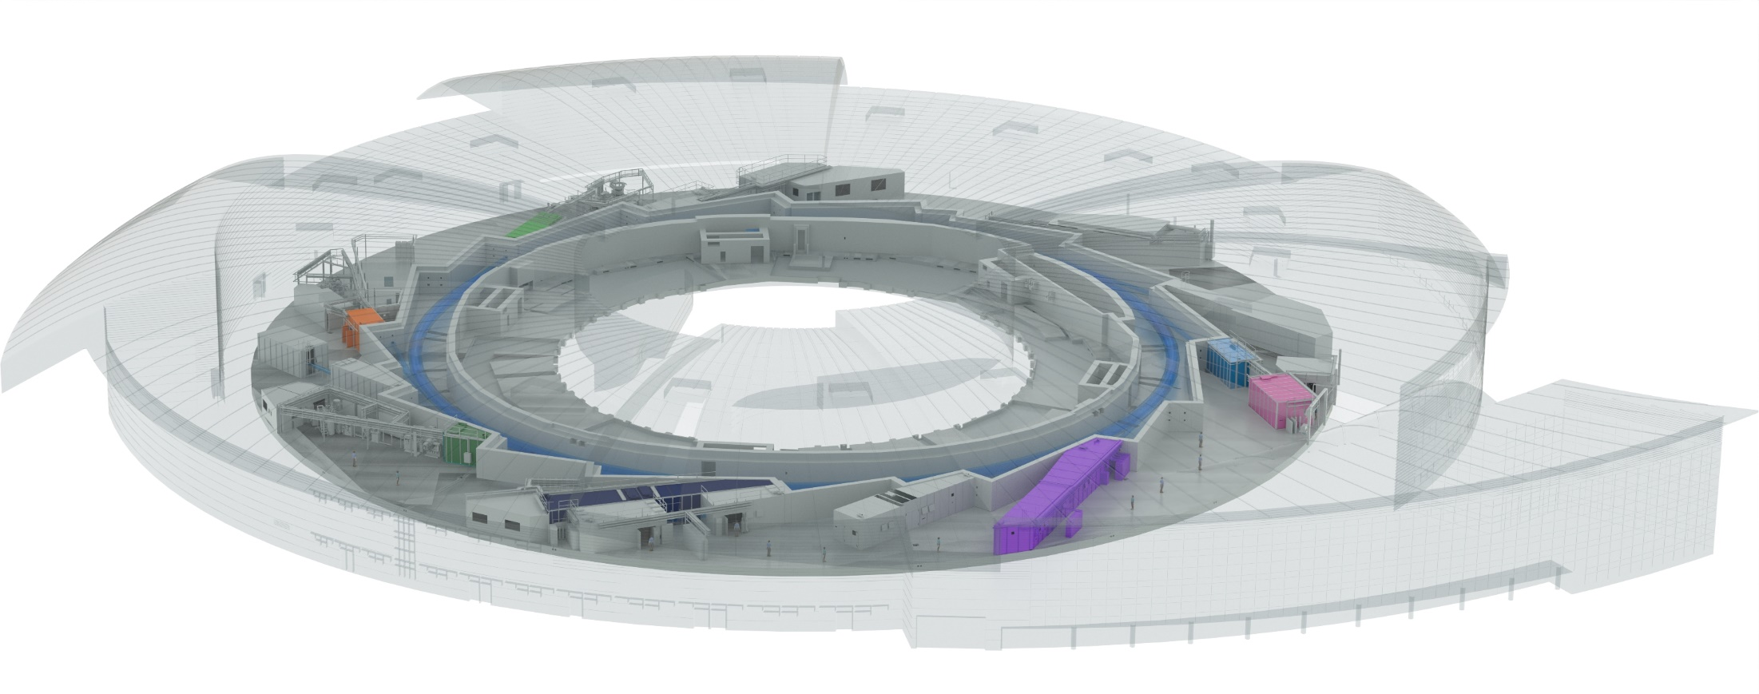

ALBA today
Instruments for life science
BOREAS
FAXTOR
(in commissioning)
Instruments for material science
MIRAS
Instruments for metrology
MINERVA
CIRCE
CLAESS
MSPD
LOREA
XAIRA
(in commissioning)
Cryo-EM
MISTRAL
TEM
InCAEM
(in constr.)
NOTOS
3SBAR
(in constr.)
XALOC
NCD-SWEET
11 BLs in operation, 2 in final commissioning stage, 1 in construction
2 cryo-EM in operation, 1 to be installed in 2025

Slide 4

ALBA II - Day One
Instruments for life science
Instruments for material science
BOREAS
MSPD
FAXTOR
Instruments for metrology
MIRAS
MINERVA
CIRCE
CODI
CLAESS
New Storage Ring
CORUS
LOREA
XAIRA
CALIMA
Cryo-EM
MISTRAL
TEM
InCAEM
NOTOS
3SBAR
XALOC
NCD-SWEET
Upgraded Beamlines
17 BLs
3 cryo-EM

Slide 5
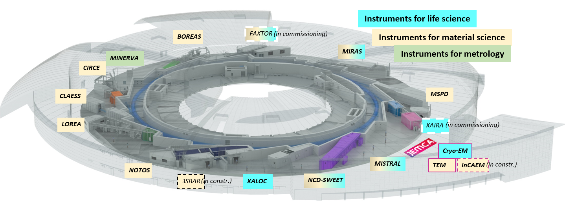
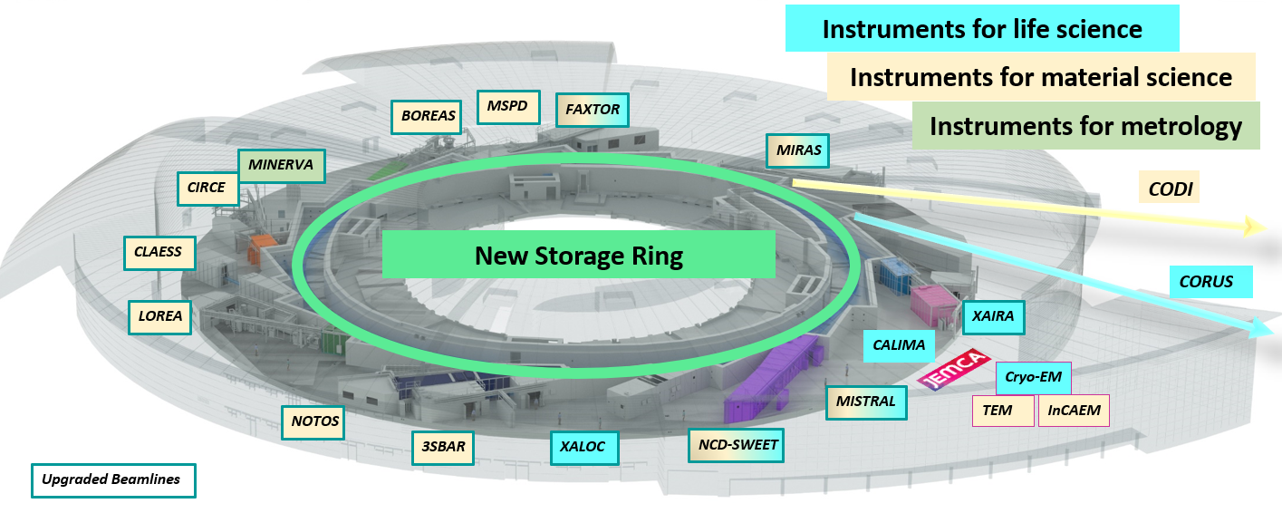
Strategy to go from …
… to

Slide 6
The process takes one decade
ALBA II project main dates so far
2020 2021 2022 2023 2024 2025 2026 2027 2028 2029 2030 2031 2032 2033
Starting the design
Presenting to funding agencies the ‘pre-White Paper’
ALBA II included in 2021-2024 ALBA Strategy Plan
First funding for prototyping (ALBA01) – 7.5 M€
Funding for 1st ALBA II BL (ALBA05) – 10 M€
New plots assigned for Long BLs extension - 16 M€
White Paper published
Decision on long BLs
Council approval of long-term budget (2034-2038) (08/05/24)
Next step: Government approval (national and regional) – date tbd
Design and Construction .
Preinstallation .
Installation
Commissioning.
Operation .

Slide 7
ALBA Priorities today
Design and build ALBA II
Develop methodologies and services bridging ALBA to ALBA II
Maintain excellence in operation

Slide 8
ALBA Priorities today
Maintain excellence in operation

Slide 9
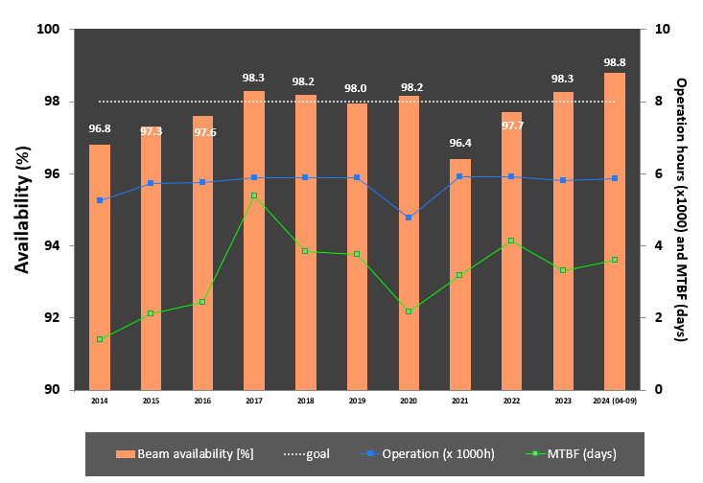
Accelerator operation
98.8%
2025 Operation Calendar
to be published mid September
same number of shifts of 2024

Slide 10
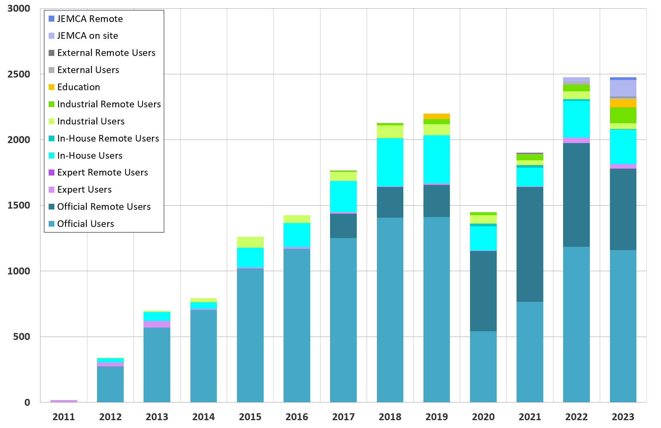
USERS
2023: has the same number of visits of 2022 (1st normal year after the pandemic), increasing the JEMCA on-site ones, decreasing the remote users
BLs
TEMs
7 8 9 10
1 2

Slide 11
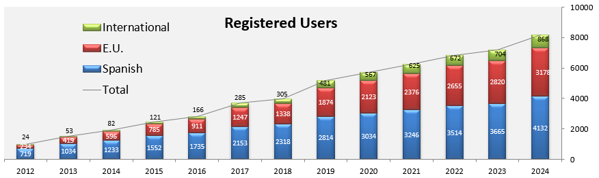
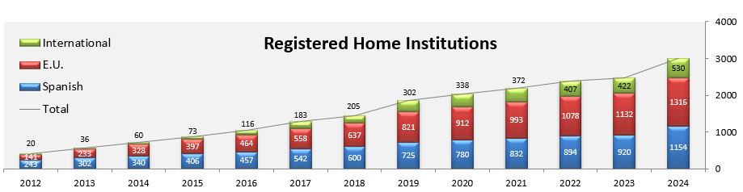
Users and institutions in our database
2024 has seen a relevant increase with respect to the usual one
More than 8000 users and 3000 institutions

Slide 12
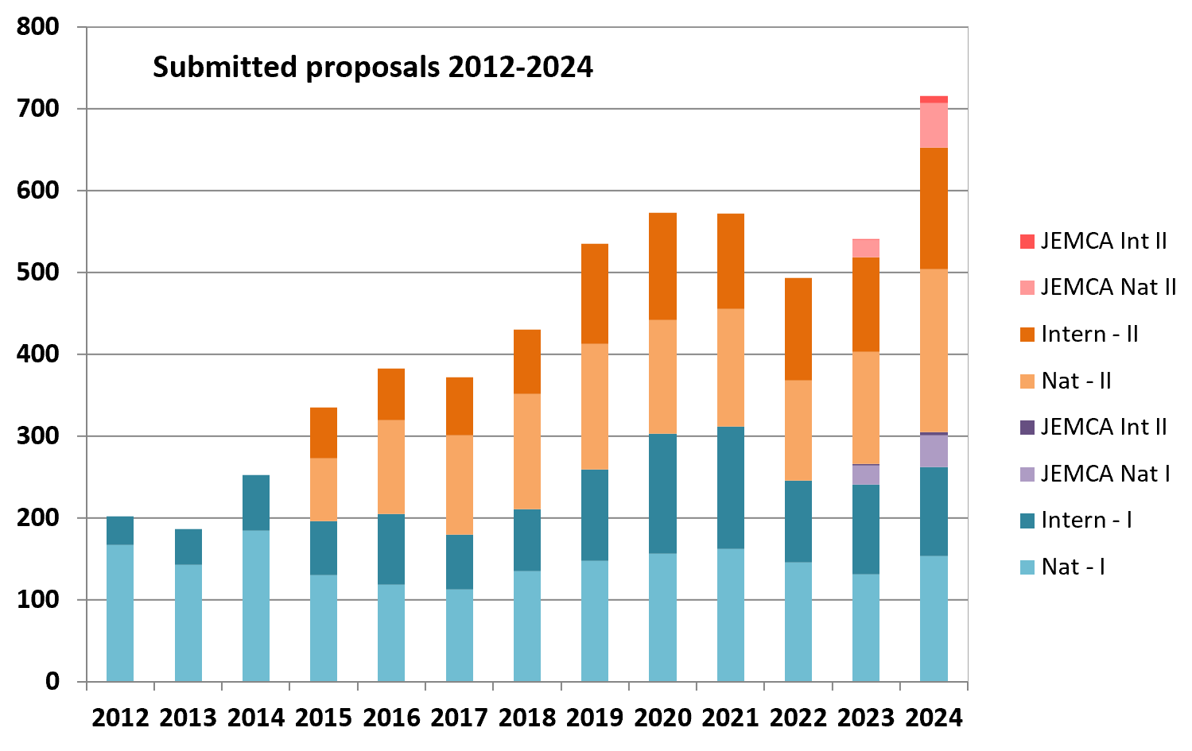
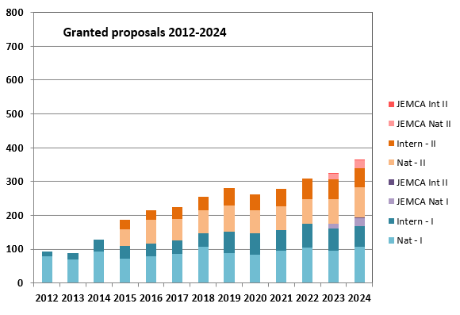

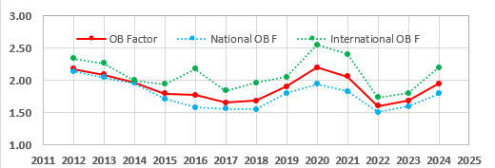
Academic user proposals
Call 2025-I is open until 09/09
BLs only

Slide 13
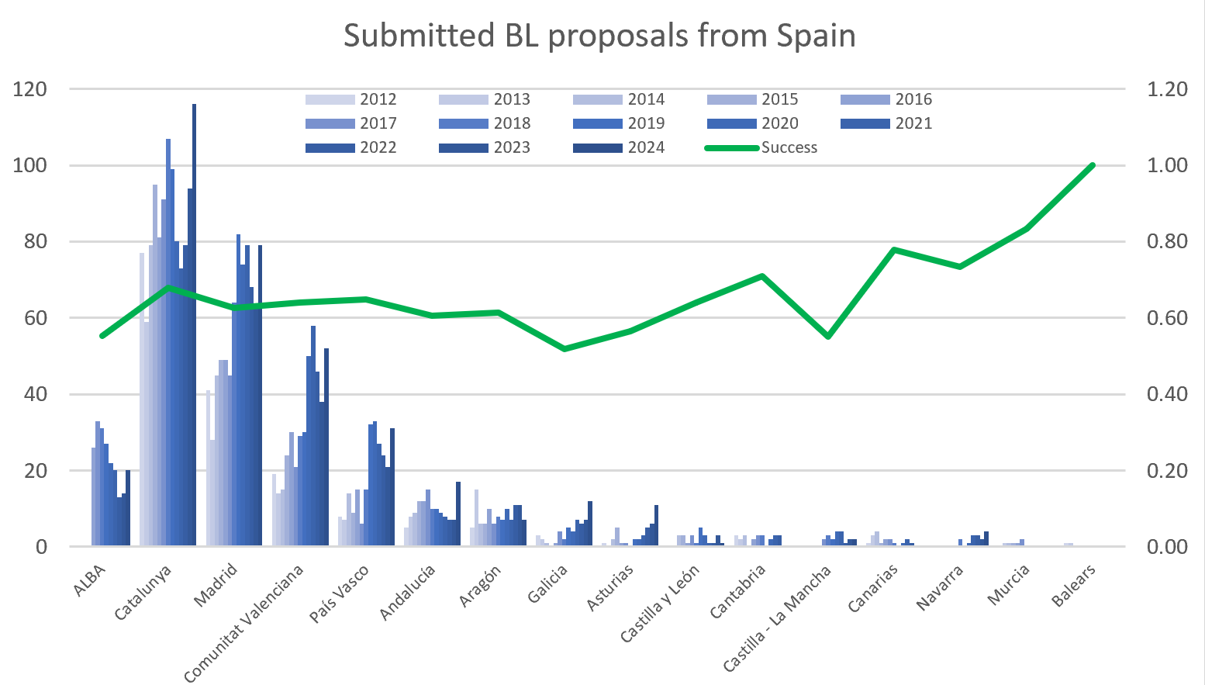
National academic proposals
3231 submitted, 1865 granted

Slide 14
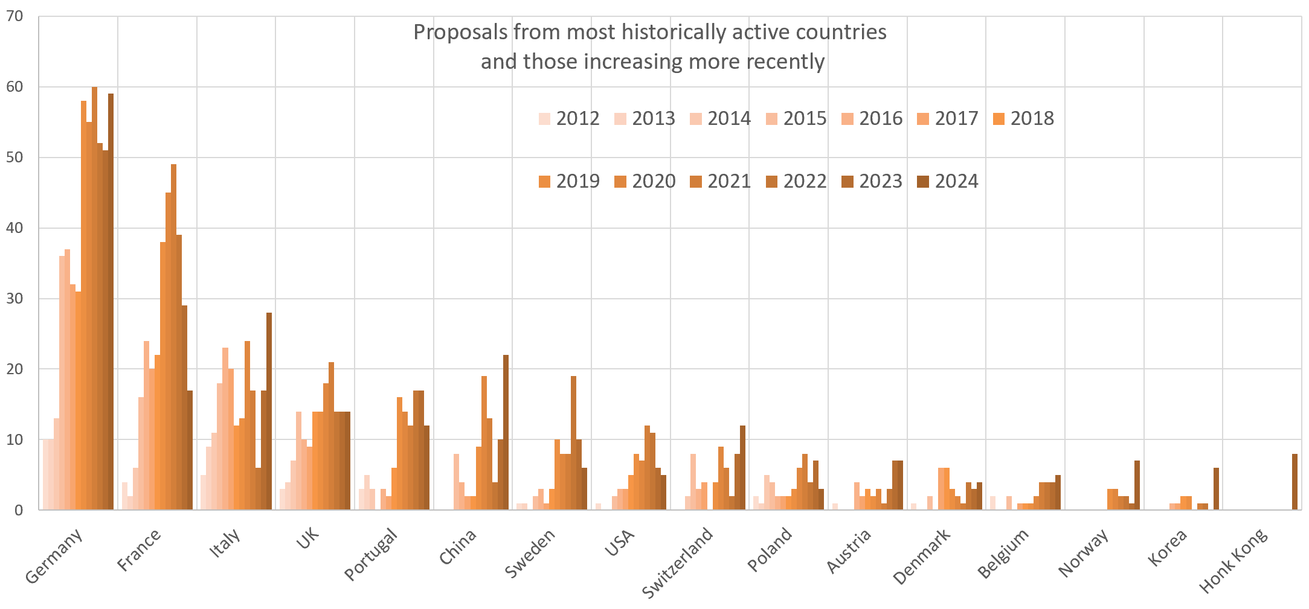
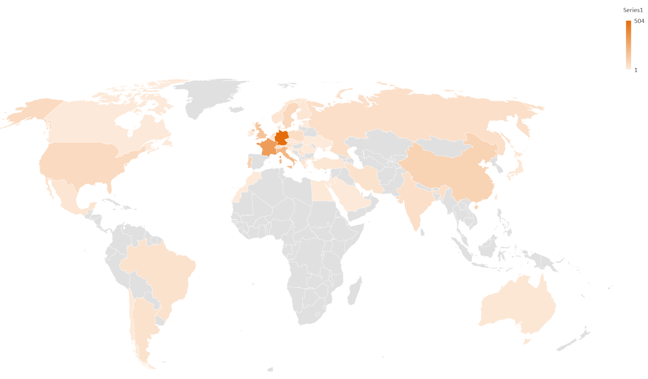
International academic proposals
2203 submitted, 1063 granted

Slide 15
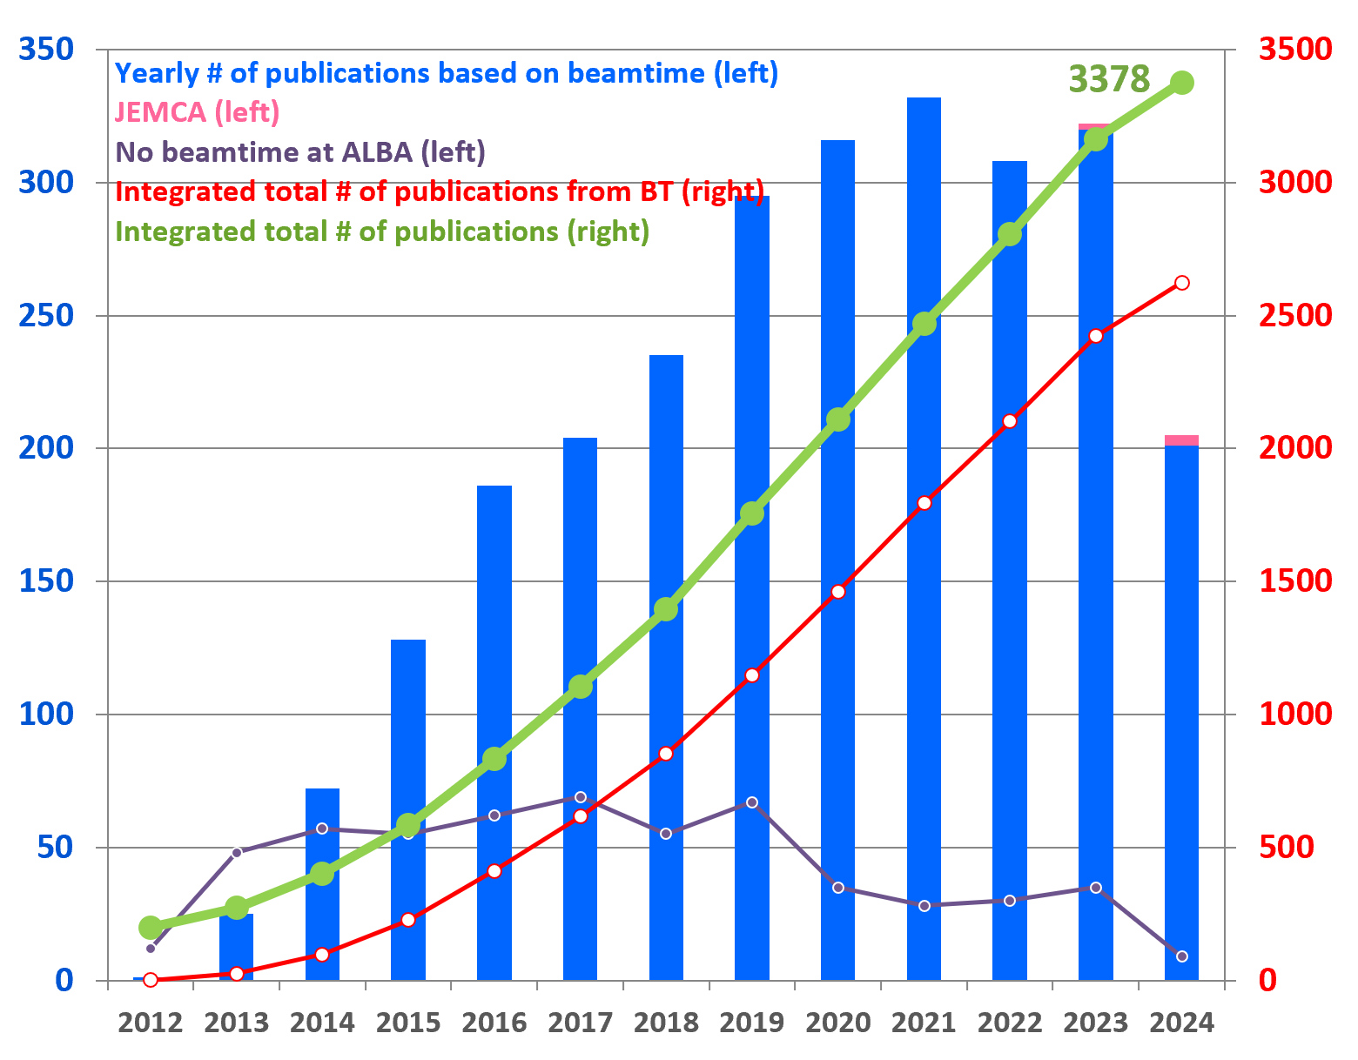
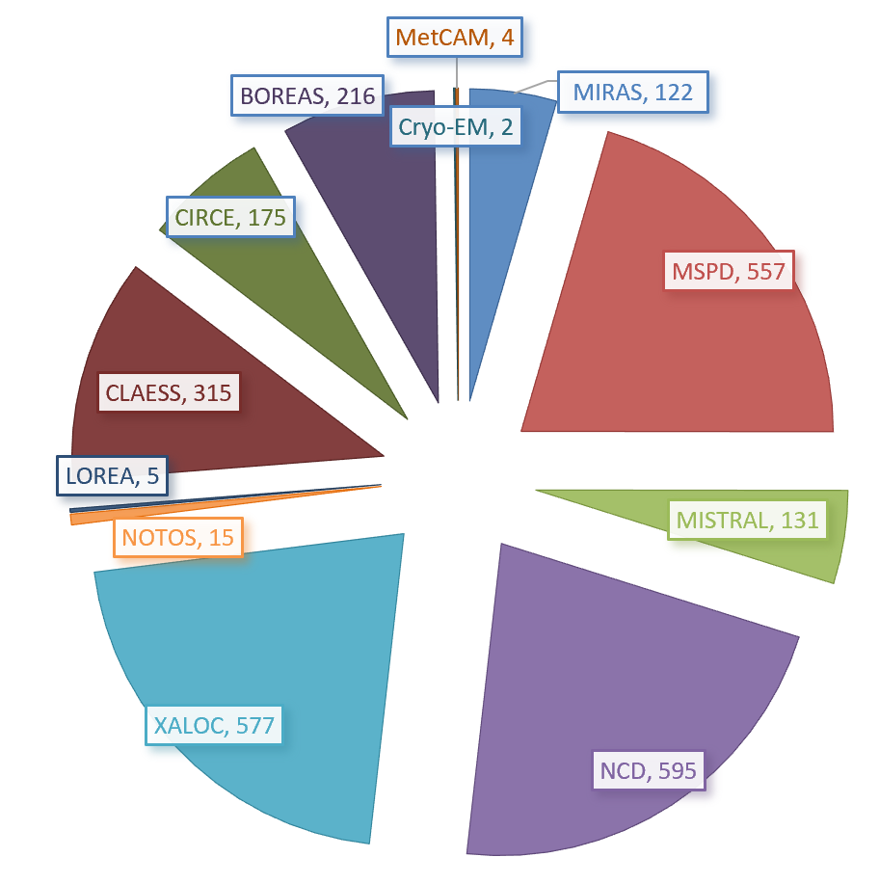
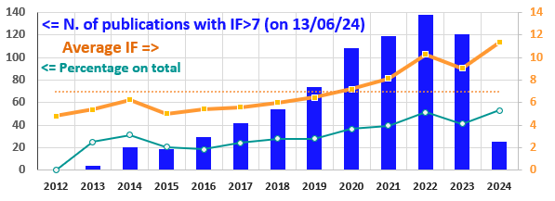
Scientific productivity
Publications based on beamtime
2022: <IF> = 10.3; 51% of publications with IF>7
2023: <IF> = 9.1; 41% of publications with IF>7
2024: <IF> = 10.6; 43% of publications with IF>7

Slide 16
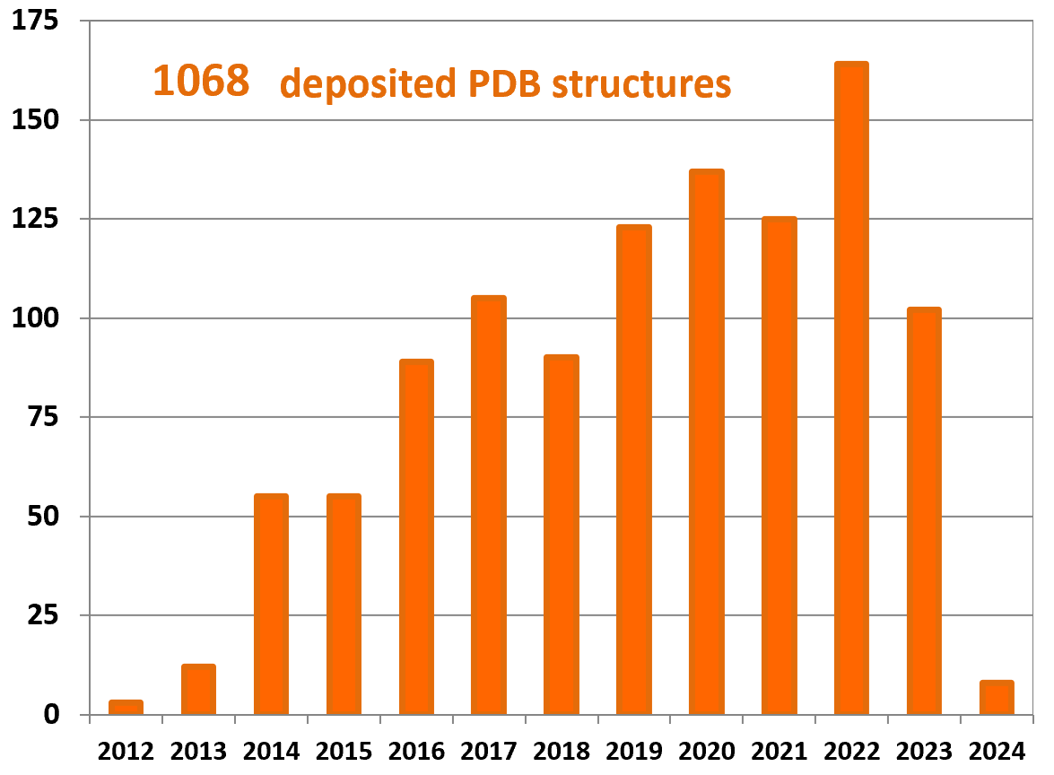
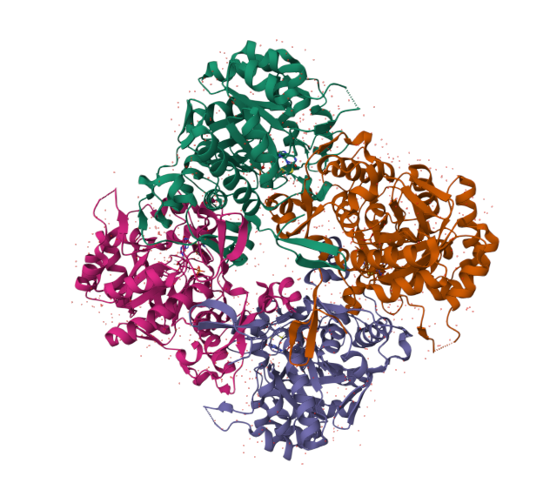
Protein Data Base
reached the 1000 resolved proteins at XALOC
(see PDB from Synchrotrons)
After a decade of operation, the macromolecular crystallography (MX) beamline XALOC has determined +1000 structures, and made them public in the Protein Data Bank (PDB). The macromolecules and macromolecular complexes are involved in a myriad of relevant biological processes and research topics such as drug discovery, diseases or living organisms' functions
PDB DOI: https://doi.org/10.2210/pdb8P4Q/pdb
Classification: BIOSYNTHETIC PROTEIN
Organism(s): Synechocystis sp. PCC 6803
Expression System: Escherichia coli BL21(DE3)

Slide 17
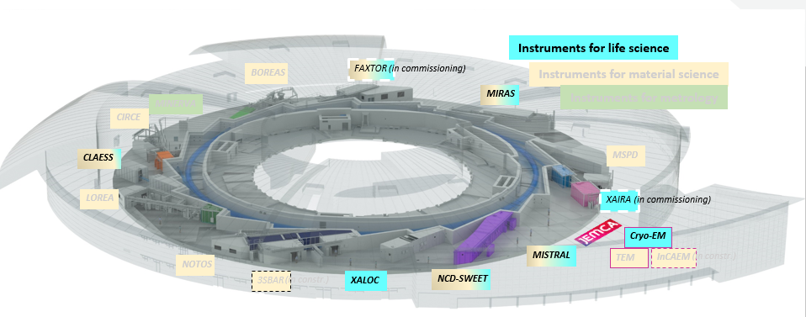

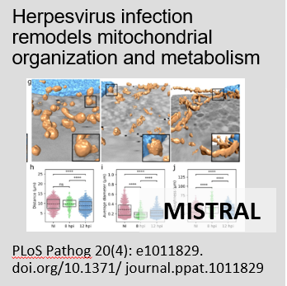
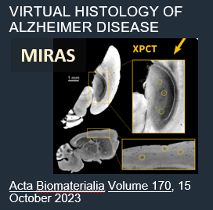
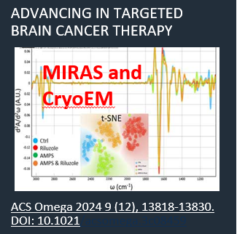
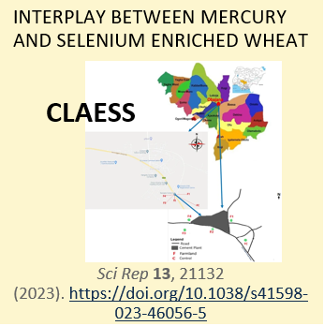
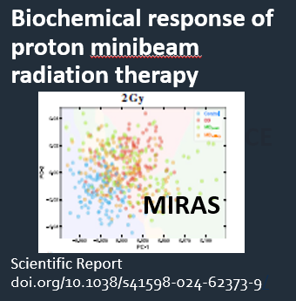
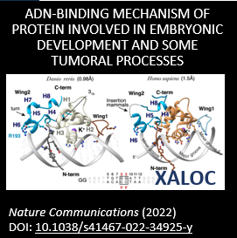
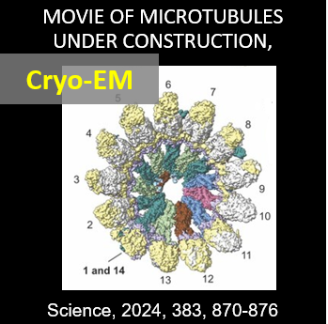
Life Science Section

Slide 18
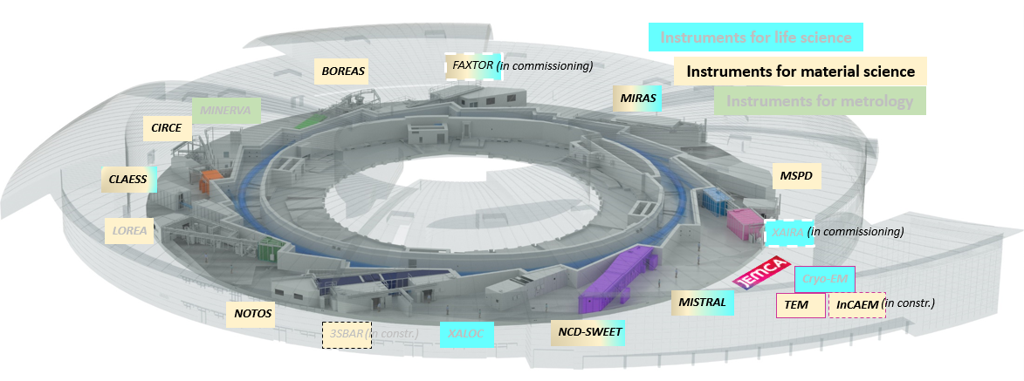

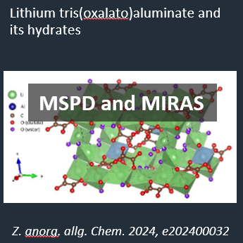
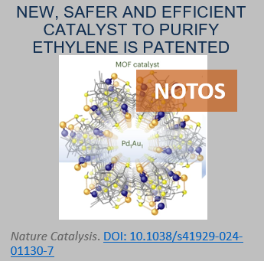
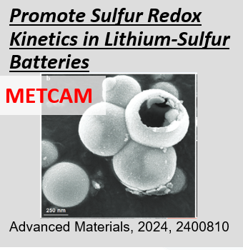
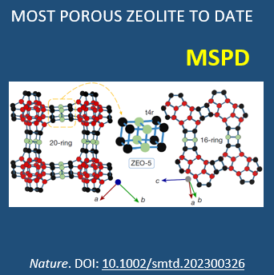
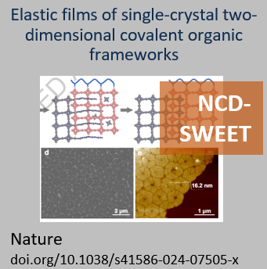
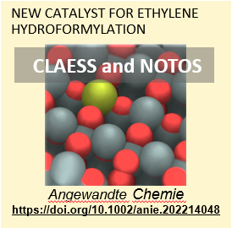
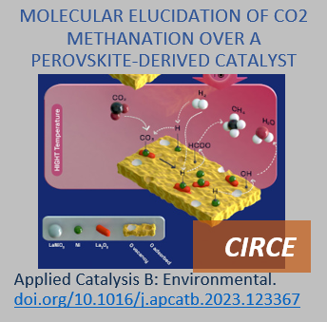
Chemistry and Materials Science Section

Slide 19
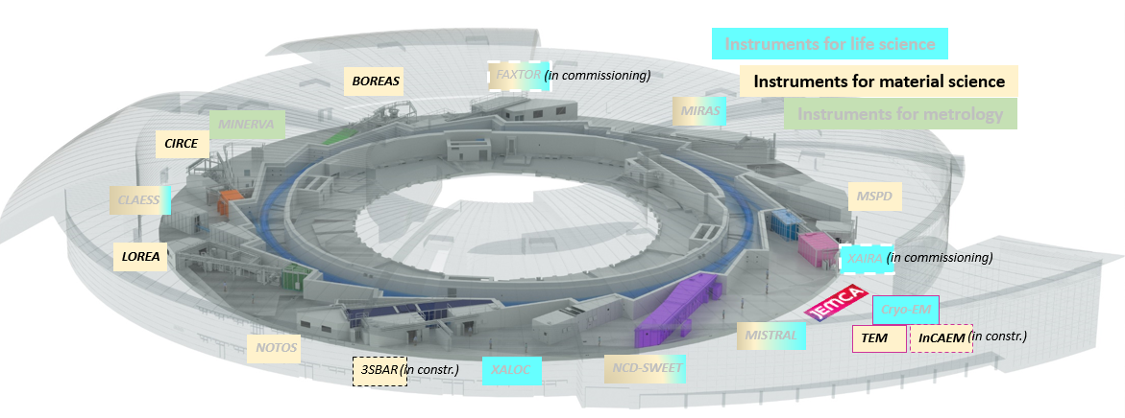
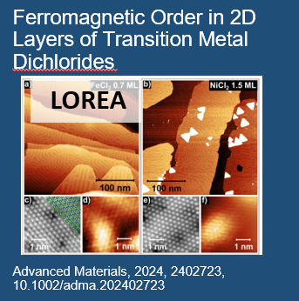

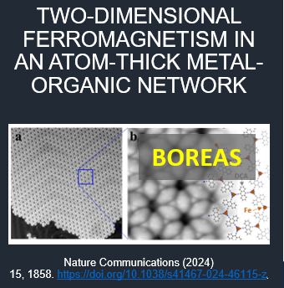
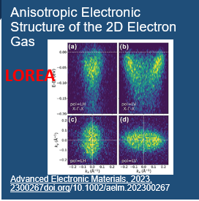
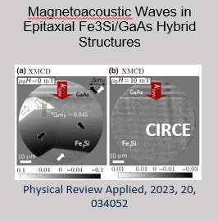
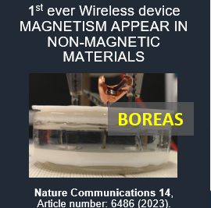
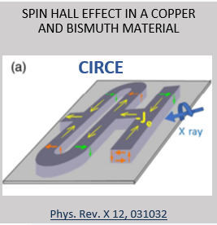
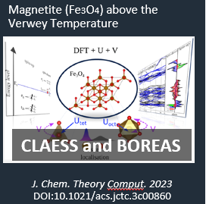
Electronic and Magnetic Structure of Matter Section

Slide 20
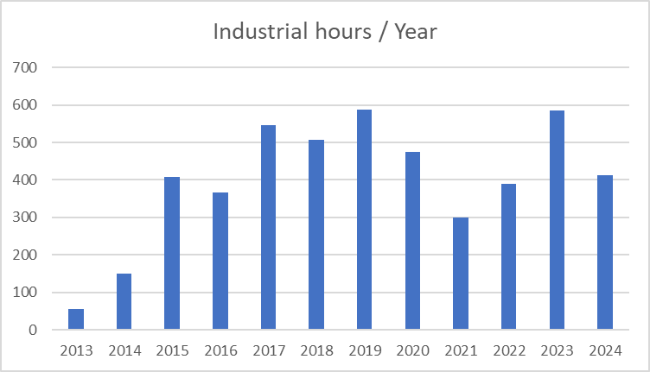
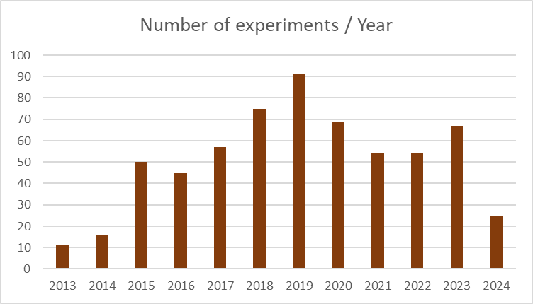
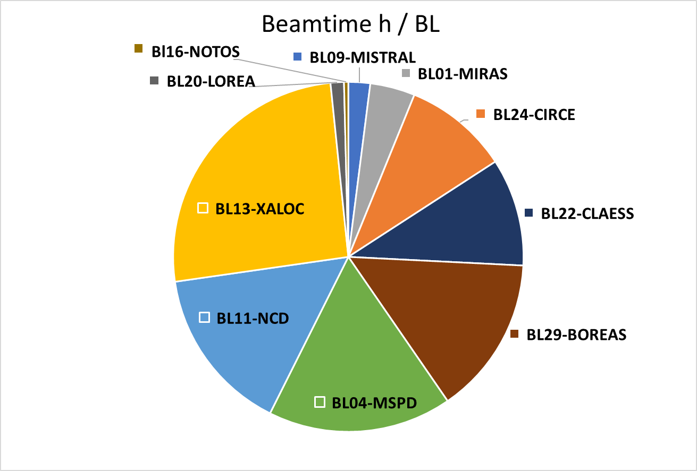

INDUSTRIAL BEAMTIME EVOLUTION
92 different clients

Slide 21
ALBA Priorities today
Develop methodologies and services bridging ALBA to ALBA II
Maintain excellence in operation

Slide 22

Interdisciplinary and MultiModal Section
Just established – see Lucia Aballe talk
How
• Development of new instrumentation, pipelines, workflows
• Foster multimodal & multilength scale projects with ALBA & external scientists
• Develop pilot projects, aligning research and industrial programs, make strategic alliances
• Research & implement new technologies, acquire new partners
What
• Advance techniques and methods to be put at the service of the community
• Act as cross-link between beamlines, EM and SPM platforms, advanced data analysis, collaborating institutions, and user community
• Establish ALBA as leading facility in target areas
• Bridge towards ALBAII and partner institutions

Slide 23



    Further develop user support
Further develop own research capabilities
Data Management evolution - see Oscar Matilla talk tomorrow
New Access modes (i.e., implementation of Resident User, allowing the development of strategic research areas between the public user and ALBA, enhancing collaboration in the research and service capabilities)
Better integration of user labs into routine access, as the battery lab (with ICMAB), catalysis lab (with ICQ), cellular bio-safety 2 lab, 2D material lab,…
Multimodal instrumentation (see Lucia Aballe talk)

Slide 24

See Oscar Matilla talk
www.cells.es/en/public/news/a-new-data-portal-is-available-for-users

Slide 25









ALBA Industrial strategy (Pharmaceutics example)
Drug development and discovery services, cryo-TEM and crystallization platform for Pharmaceutical applications
EXPLOITING CAPABILITIES
Industry Scientist focussed on pharmaceutic industry needs
ALBA in close contact with Biocat and Cataloniabio (i.e. Cataloniabio on 28 April 2023, Biocat Tech Transfer, 25 April 2024)
ALBA in contact with the Spanish Drug Discovery Network (i.e. 20 Nov 2023, 13-15 Nov 2024 at Valencia)
ALBA is contact with the Sociedad Española de Biotecnologia (i.e. 29 September 2023)
NETWORKING
PHARMA INDUSTRY INNOVATION
Pharma industry workshop, 17 June 2022, organised by ALBA
IDDST congress, 12-14 July 2023, Amsterdam
Cosmetorium, 23-24 October 2024 ALBA will participate with a talk
OUTREACH
see Barbara Machado talk tomorrow

Slide 26


Guest house in September 2025
Student Residence in construction at walking distance from ALBA (500 m now, will be 200 m with new ALBA II buildings)
Includes rooms for ALBA users
and several facilities for shared use
Can be used for stages of several months
Guest House
Future entrance
Present entrance

Slide 27

ALBA as Spanish Research Infrastructure (ICTS)
1st Map of ICTS agreed at the III Conference of Presidents, held on 11th January 2007.
The "Spanish Strategic of Science, Technology and Innovation 2013-2020", approved by the Council of Ministers in February 2013, establishes that the ICTS Map is their long-term planning and development tool in coordination with the CCAA.
The ICTS Map is updated every four years, based on Strategy Plans (SPs), being the Scientific, Technological and Innovation Policy Council (CPCTI) the competent body for its approval. Updates done in 2014, 2018, 2021
4th update expected at the end of 2024.
3rd ICTS Meeting at ALBA
30 October 24
Organized by Ministry of Science and Innovation
https://www.ciencia.gob.es/InfoGeneralPortal/documento/0acdb51b-2425-4460-9b97-c620367344d2

Slide 28
Strategy Plan 2025-2028 => ALBA II Strategy
Provide the Spanish research and innovation community with state-of-the-art X-ray and microscopy instrumentation, networks and workflows to enhance the Spanish community’s capabilities for solving societal challenges of the health, environment, energy and communication sector.
Integrate ALBA beamlines and its microscopy platform with research partners and structures to maximize ALBA national and European impact.
Execute the first phase of the ALBA II project.

Slide 29



ALBA as a window to European Research centers and RIs
19 facilities - 16 institutions - 10 countries
+35000 users from all EU & beyond
+300 operating End Stations
+25000 publications
In last 5 years
offering
+1M h/year
Associate: SESAME (Jordan)
Partners: ESUO, LENS, CLS

Slide 30

Video de Britta?
Message from LEAPS chair
Britta Redlich, FELIX

Slide 31

LEAPS is becoming a legal entity, by the end of 2024: LEAPS-AISBL
LEAPS is teaming-up with other communities for complex multimodal approach
LEAPS is proposing the BLOCK-GRANT model for an optimum seed funding from the EC for long-term programs, both technological developments and full solutions for scientific challenges, in collaboration with research institutes and industrial world
LEAPS is the forum for collaborating in facing the data deluge and the sustainability of the data management
LEAPS is an instrument for the European sovereignity
New LEAPS ERA Strategy Group (European Research Area) – strengthening links with EC and LEAPS voice in Europe – Chair: C. Biscari
LEAPS acts as inclusive institution for less advanced countries and communities

Slide 32







Participation in European projects
LEAPS-INNOV
CoCid
SYLINDA
ReMade@ARI
RIANA
SUNSTONE
FUNLAYERS
NEPHEWS
COOPHS
Sup3rForm
H2FORM3G
NFFA-NEP
IMPRESS
DOCFAM
OPERA
RF2.0
CLEXM
Sunstone
INFRA-2023-SERV-01-03
Neutrons and Photons Elevating Worldwide Science
COOPHS
H2FORM3G
Sup3rForm
32

Slide 33
ALBA Priorities today
Design and build ALBA II
Develop methodologies and services bridging ALBA to ALBA II
Maintain excellence in operation

Slide 34

Synchrotron
Radiation
Facilities
PETRA III
MAXIV
SSRC
ASTRIDII
SOLARIS
BESSYII
ANKA
DELSY
SPRING8
CLS
DIAMOND
SLS
KSRS
HEPS
CHESS
SOLEIL
BSRF
PFKEK
APS
HALF
PLS
Nanoterasu
NSLS II
NSRL
UVSOR
TSRF
ALS
CAMD
ALBA
SSRF
SUBARU
SSRL
SURF
DAFNE
INDUS
SRLI
PALX
HISOR
RITSSR
ESRF
ELETTRA
TPS
SAGA
NSRRC
SESAME
HELIOS2
SIRIUS
AS
4th Generation IN OPERATION
4th Generation in construction
Upgrading or planning upgrade from 3rd to 4th generation
3rd generation
Approved upgrade projects in Europe:
SLS2 (in execution; op: 2025)
Elettra2 (in execution; op: 2026)
Diamond2 (in execution; op: 2027)
Soleil2 (in execution; op: 2028)
Recent news:
APS starting the commissioning with the smallest emittance in the world (40 pm)

Slide 35

ALBA II White Paper
Published in 2023
Design strategy
Scientific case
Preliminary design of new storage ring and related accelerator systems
Preliminary considerations for new beamlines
ALBA II White Paper

Slide 36

ALBA II design as today
4th generation light source
Emittance 240 pm (20 times smaller than ALBA)
Current 300 mA (+ 20% with respect to ALBA)
Increase of brilliance by orders of magnitude
Increase of coherence
Advanced properties for imaging, spectroscopy, diffraction
Accelerator design in progress

Slide 37




ALBA II Storage ring design
Being optimized while defining all technical details: 5BA lattice
MSPD will be repositioned
The 9 existing ID BLs need no repositioning
The 4 existing bending BLs need repositioning

Slide 38

Storage ring design
5BA Dynamic aperture

Slide 39



Prototyping all systems of the storage ring
Magnets
Girders
Vacuum

Slide 40





Prototyping all systems of the storage ring
and testing 3rd HC at BESSY
Diagnostics Super Bend
control gap
130.1 mm
554.96 mm
376 mm
Al
spacer
NdFeB blocks
FeNi strips
Injection Pulsed magnets
Installation of the 3rd HC in the SR foreseen for Summer 2026

Slide 41



Construction of a nanoposition laboratory
Research, development and commissioning of high performance motion and positioning instrumentation, with requirements of stability, accuracy and/or resolution in the nanometer-nanoradian ranges.
Lab spaces currently in construction, available in Nov’24
Clean room ISO4
Temp stability ±0.1ºC and ±0.01ºC
Space for up to 5 work stations.
Instrumentation being purchased
DMI interferometers,
Capacitive sensors
Several Motion controllers
Pool of non-standard stages
Vibration and modal analysis tools
HW response simulation tools
First Pilot
Goniometer setup. Feedback, speed, metrology, correction, etc.
Example: Feed-forward correction of XAIRA’s runout (<50 nm 5-360 deg/s)
Metrology frame for LEAPS-INNOV collab

Slide 42

ALBA II science defined with the user community
2021 (https://www.cells.es/en/science-at-alba/alba-ii-upgrade/alba-ii-colloquium)
- 17 on line colloquia from key note speakers
7 on line workshop with extended discussion time
30/06/21: 1st ALBA II Day – on line event, with presentation of preliminary project and scientific discussion
Call for first ideas for ALBA II Beamlines
2022
Call for proposals for first short Beamlines – 3SBar (in construction) and CALIMA chosen
2023
Call for proposals for long short – CODI and CORUS chosen
2024
18-19 January – ALBA II Symposium in Madrid (UAM) – 120 participants
3 scientific sessions: Multi length scale imaging, Multimodal and Big data, Operando, in situ, in vivo
Participation of partners, CSIC and Ministry of Science and Innovation representatives

Slide 43







BL15 - 3Sbar
Environmental surface diffraction and surface spectroscopy at high pressure beamline
Simultanous SXRD/APXPS collection at high pressure ~3 bar
Energy range: 3-17 keV
Grazing incidence: total external reflection (~1 µm x ~1 µm beam spot size)
CFT | Awared | PDR | DDR | FAT | Delivery | SAT
ID | KYMA |  |  | May 2025 | May 2025
FE | TEES |  |  | Dec. 2024 | January 2025
Mirrors | Bertin Tech. |  |  |  | May 2025
Slits | FMB |  |  | Sept. 2024 | Oct 2024
DCM | AXILON |  |  |  | May 2025
VCM | IRELEC |  |  | January 2025 | Feb. 2025
Vacuum | In adminis.
XPS detec. | SPECS |  |  | 01/01/2025 | April 2025
HPCD detec. | DECTRIS |  |  |  | April 2025
Hex.+Gonio. | Symetrie |  |  | 24/10/2024 | 04/11/2024
PSS | Published
Cryocooler | AXILON
Op. Hutch | INNOSPEC |  |  |  | July 2024
BL in constructionction
Important dates
Optics element comisioning: Fourth quarter 2025
Endstation comisioning: First quarter 2026
Expert users: Second half 2026
Endstation
EH
EH
OH
CH
CH
OH

Slide 44


BL07 - CALIMA
Techniques
BIO SAXS
Batch mode SAXS
SAXS + chromatography
Time-resolved SAXS
Fiber diffraction
3D scanning SAXS
nLC/MS SAXS
WAXS
Allosteric biomolecules modulation
Intrinsically Disordered Proteins
Membrane proteins
Amyloid proteins
Domain swapping in diseases
Complex biological assemblies
RNA folding
Microtubules GTPase cycle
Bone arrangement
Brain connectivity
Skin damage
Polymers
Bending magnet beamline (ALBA) and Superbend (ALBA II)
Gains in ALBA-II: better q resolution (standard mode), gain x7 H size
2 optical setups:
  Large (standard): ~200-500 μm beam size
  Microfocus: ~10 μm beam size
Experimental Hutch
Optical Hutch
44

Slide 45




The longest the distance between the photon source and the sample, the better the resolution and the highest the coherent fraction
Opportunity with new plots for long BLs
assigned to ALBA in Dec. 2022
Beam spot size on sample
$$Δx_{Geom}=\frac{q}{p}Δx_{Source}$$
Coherent fraction
$$A_{C}\left(p\right)=\frac{{\left(λp\right)}^{2}}{A_{S}}$$

Slide 46

BL33 - MSPD2
Present schedule:
Transfer of recovered components from BL04 to BL33: summer shutdown 2027
First experiment at MSPD2: before the end of 2027

Slide 47
BL02-CoDI
Hard X-ray nanoprobe beamline devoted to Coherent Diffraction Imaging techniques, for in-operando studies in material science
Satellite workshop in Oviedo
6 October 2024
 | CoDI
Source | In vacuum undulator (IVU19)
Energy Range | 10 - 30 keV (DCM + MLM)
Spot Size | 30-50 nm
Technique | nanoDiffraction, nanoFluorescence, CDI, Ptychography, Holo-tomography, Bragg-ptychography, Tele-ptychography
Features | 20 m flight tube Laser Heating, High Pressure, Gas dosing, Cryostream, Cryostat… (space around sample for versatile sample environment)
Sample | Micro reactors / Electro chemistry cells for in-situ and operando
Detector | One large area detector (6M type) One small detector mounted on robot arm Multielement SDD
3D reconstruction and Evolution of strain in a Pt nanoparticle as varying electrode potential. Useful for the design of strain-engineered nano-catalysts
From C. Atlan, et al. Nat. Mater. 23, (2023). https://doi.org/10.1038/s41563-023-01528-x

Slide 48



CODI and BL03
Decision on BLs length taken – the longest available, keeping a distance (~30 m) from nearby road
Optics design report for CODI – work in progress
  Source selection (IVU16), including phase errors and energy spread effects
  Studying the dependence of performances on the total length of the BL
  Starting the design of Wolter arrangements for improved stability of the spot on sample.
Measured from the source
CODI needs high coherence and small spot size (large flux density)
Below 180 m it cannot reach 90% y-coherence at 30 keV
For shorter BLs, acceptance is higher, but the secondary source slit needs to be very closed to achieve high coherence, wasting flux, but also being more sensitive to vibrations
CODI & BL03 hutches

Slide 49
BL04-Corus
Workshop will be organized along 2025 - Stay tuned
Hard X-ray nanoprobe beamline devoted to spectral Imaging and tomography for life sciences
 | Corus
Source | In vacuum undulator (IVU19)
Energy Range | 10 - 27 keV (DCM + MLM)
Spot Size | 20-50 nm
Technique | 3D-nanoXRF, XANES (STXM) Holo-tomography (Full Field)
Features | LN2 cryogenics, 180º Rotation, XY mapping UHV, Visible microscope
Sample | Multi-sample shuttle system
Detector | Nanospec:: Two Multielement SDD, Diode NanoImag: Two Multielement SDD, sCMOS Area detector.
Determination of intra-cellular location of Ir in breast cancer cells. Imaging at nm-resolution with chemical sensitivity.
From Conesa et al. Angew Chem Int Ed Engl 2020, 59 (3), 1270-1278. DOI:10.1002/anie.201911510.

Slide 50

CORUS layout
Decision on BLs length taken – the longest available, keeping a distance (~30 m) from nearby road
Optics design report for CORUS – work in progress – together with CODI
For CORUS coherence is not so important, while it is aiming at the smallest possible spot size, for which the contributions are:
Slope error (will improve in the future)
Numerical aperture, can only improve by making a longer mirror.
Source size (hard to change, except by changing the length)
All values here are based in the optimization done for the proposal, actual slope error, machine parameters and source aperture are not yet final
Measured from the source
CORUS hutches, including a 3rd one for ReachOH

Slide 51

Upgrades of existing BL
The beamlines under ALBA and ALBA II conditions
The upgrade-package
ALBA essential
ALBA enabling
ALBA II essential
ALBA II enabling
During 2021:
Workshop programs combined with colloquium brings user community with other experts together and condenses needs.
During 2022:
Sections present resulting strategy in Section Reviews
During 2023-24:
Working out technical realization with focus on impact on existing program
Internal discussion at ALBA
July 24: First presentation to SAC
Sept 24: First presentation to users
Fall 24: Review document to be shared with users, asking for their input
Fall 24: Including the preliminary plans in the 2025-2028 Strategy Plan
Start-up of priority projects
During 2025:
Early 2025: one-day workshops with users to wrap-up conclusions
Follow-up of priority projects
Flexibility to account for urgent interventions
Presented in next session:
Judith Juanhuix – Life Science
Carlo Marini – Chemistry and Material Science
Manuel Valvidares – Electronic and Magnetic Structure of Matter

Slide 52


Infrastructures
New buildings and related Infrastructures being defined – Sustainability and green energy
DAY 1 – ALBA II Beamlines Experimental Halls
GF _ total 2.575 m2
E1 CODI -> 1.700 m2
Buildings for CODI, CORUS and BL3
E2 CORUS -> 875 m2

Slide 53

Infrastructures
New buildings – after DAY 1 – ALBA II
GF + 3 _ total 3.000 m2
E3 ALBA II -> 750 m2
Buildings for CODI, CORUS and BL3
Building for offices and labs

Slide 54

Infrastructures
After DAY 1 – ALBA II
GF+3 / GF+1 _ total 6.000 m2
E4 ALBA II -> 1.750 m2
Buildings for CODI, CORUS and BL3
Building for offices and labs
Building for other services (auditorium, cafeteria..)

Slide 55




Working on the design of the long BLs across the two plots
New buildings
BL02
BL03
BL02
BL04
BL03
BL04

Slide 56

Other initiatives in the ALBA hub
External – Innofab & R1H
E5 Innofab -> 4000 m2
GF+3/GF+1 _ total 6.600 m2
Buildings for CODI, CORUS and BL3
Building for offices and labs
Building for other services (auditorium, cafeteria..)
4) Buildings for INNOFAB and R²OH
E6 R1H -> 1.250 m2
GF+3/GF+1 _ total 3.275 m2
E5 Innofab

Slide 57

Proposal
Preparation of proposals on- going, together with negotiations with funding agencies
2.000 m2 clean room infrastructure for development of semiconductors technologies, offering a solution to the current gap between research and commercial development of innovative prototypes:
Research Lab
Fab-in-Fab space for start-ups.
An R&D Pilot Line equipped with 200 mm high-volume manufacturing equipment.
A national network for long-term collaborative R&D programmes.
Dedicated access to advanced characterization offered by a unique integration with ALBA Synchrotron

Slide 58


REACH - One Health center Proposal
REsilience Against global Changes through One Health approach
Key center to secure biopreparedness in structural and chemical analyses.
Response to biosafety, food and climate emergencies with 4 focuses:
  Zoonotic infections and antibiotic resistance
  Food safety and enviromental surveillance
  Neurodegenerative diseases and their relation with environment
  Impact of emerging climates and contaminants in public health
Equipped with state-of-the-art instruments based on rayos X, electrons, superresolution microscopy in BSL3
Complementary with existing centers focusingon biomedicine, genetics and cell and molecular biology
Establishment of protocols (e.g. sample transport) and programs (use of new techniques) between research centers and REACH
Contención BSL3
Centro
Biomedicina
Centro
Bio molecular
Centro
microbiología
cultivos
células
REACH
(preparación)
Análisis
Proteínas, fármacos
tejidos
Centro
Seguridad alimentaria
Centro
Salud animal
cultivos
secciones
biopsias
Centro
Medio ambiente
Hospital

Slide 59


Socio-economic Impact of ALBA II for the period 2023-2050
(Raya and Montalvo)
After studies done for ALBA in 2003 (ex-ante) and 2010 (after the construction)
2023-2030: ALBA cost (operation + staff + investments) 310 M€
2023-2030: ALBA II cost (staff + Investments) 120 M€
As a whole, economic analysis in the basic scenario provides a net updated value of 460 M€ and an internal rate of profitability of 18.4%. That is, every euro of investment has a social return of 1.18 euros per year.

Slide 60

Long term Agreement (2024-2038) to be signed and
requested budget committed
Operation of ALBA, including related main maintenance
Staff cost
Continuous upgrade + inhouse
Plots
Construction and installation of ALBA II storage ring and related infrastructures (82 M€ )
Construction of CODI, CORUS, CALIMA, MSPD2 (56 M€)
New buildings (32 M€)
Upgrade of BLs, data infrastructure, other infrastructures (80 M€)
On going: ALBA01 (7.5M€), 3Sbar (10M€), plots (16.5M€)

Slide 61

ALBA II Roadmap
ALBA Operation
ALBA II Operation
Beamlines
Design Construction and installation commisss Operation
Accelerator
Design Construction and preinstallation Installation/comm Operation
Design Construction and preinstallation Installation/commiss
Buildings and infrastructures
Design Construction
20
21
22
23
24
25
26
27
28
29
30
31
32
33
34
35
2020
2024
2030 2032

Slide 62
ALBA II - Future developments
ALBA II total capacity: 26 beamlines
New resources (investments and staff) not yet planned
Aiming at including other institutions with partnerships (JEMCA model)
Instruments for life science
Instruments for material science
BOREAS
MSPD
FAXTOR
Instruments for metrology
MIRAS
MINERVA
CIRCE
CODI
CLAESS
New Storage Ring
BL03
CORUS
LOREA
XAIRA
CALIMA
Cryo-EM
Upgraded Beamlines
MISTRAL
TEM
InCAEM
NOTOS
3SBAR
XALOC
NCD-SWEET
BL03 – Long BL on superbend
BL08 – Medium BL on ID
Other 7 dipole or superbend ports available
BL08

Slide 63

Thank you for your attention

