Slide 1

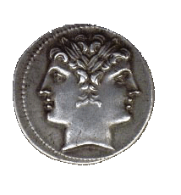
BL22-CLÆSS
Core Level Absorption & Emission Spectroscopies
Laura Simonelli
XAS
XES

Slide 2

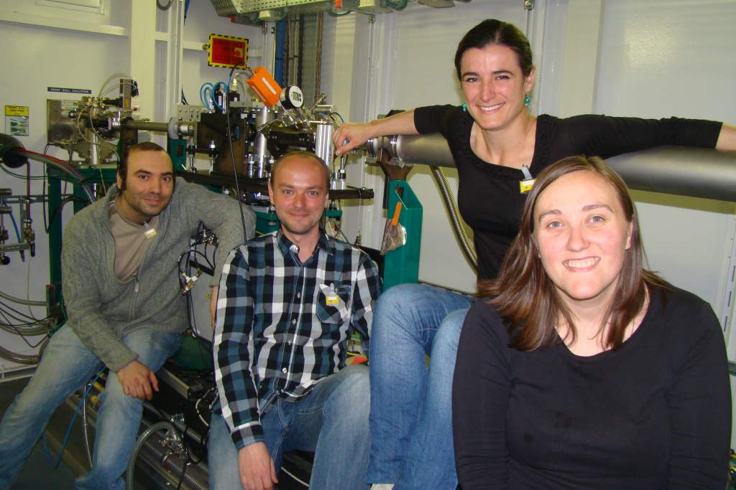
BL22-CLÆSS
Core Level Absorption & Emission Spectroscopies
The completed CLÆSS team
Laura Simonelli
Carlo Marini
Wojciech Olszewski
Marta Avila

Slide 3
OUTLINE
    Beam time allocation
    Users feedback
    Users/IH research
    BL22 status
    Future and perspective
Laura Simonelli
Carlo Marini
Wojciech Olszewski
Marta Avila

Slide 4
    Beam time allocation

Slide 5
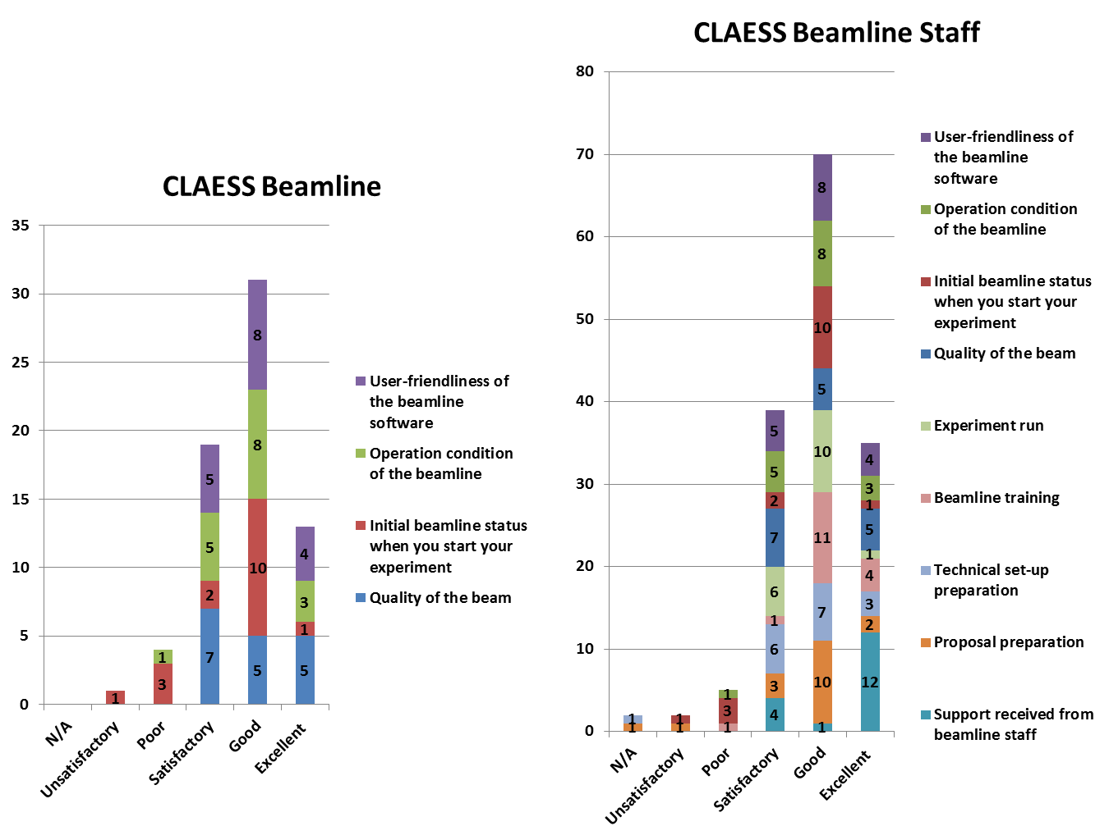
    Users feedback received during 2013

Slide 6
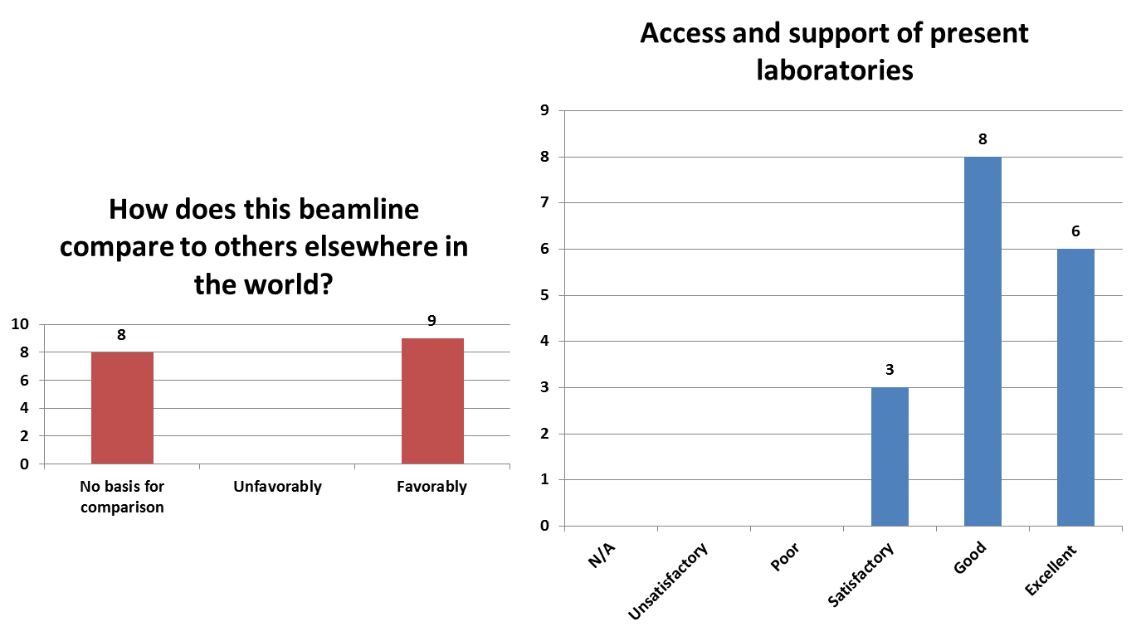
    Users feedback received during 2013

Slide 7
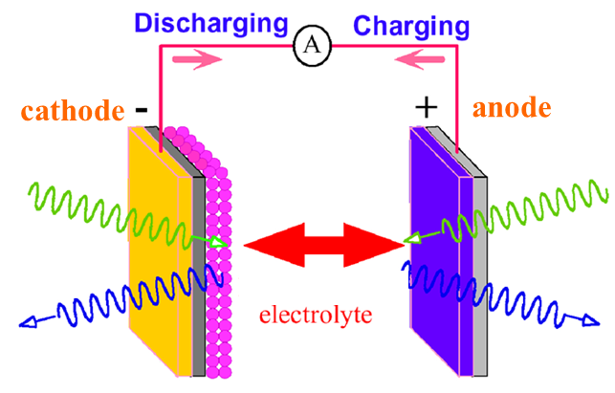
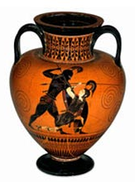
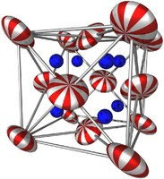
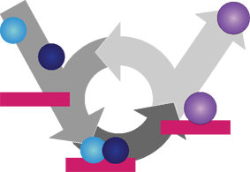

    Users/IHR production
Batteries
Artificial Photosynthesis
Cultural Heritages
Catalysis
Solid State Physics
Environmental Science

Slide 8
    publications
Exceptional oxidation activity with size-controlled supported gold clusters of low atomicity
Avelino Corma et al., NATURE CHEMISTRY 5,775 (2013)
Low-Temperature Oxidation of Carbon Monoxide with Gold(III) Ions Supported on Titanium Oxide
Wolfgang Grünert et al., Angew. Chem. Int. Ed. 2014, 53, 3245 (2014)
Isomerization of -pinene oxide using Fe-supported catalysts: Selective synthesis of campholenic aldehyde
Martina Stekrova et al., Applied Catalysis A: General 470, 162 (2014)
Strong local lattice instability in hexagonal ferrites RFe₂O₄ (R = Lu,Y,Yb) revealed by x-ray absorption spectroscopy
Sara Lafuerza et al., PHYSICAL REVIEW B 89, 045129 (2014).
Catalysis
Solid State Physics

Slide 9
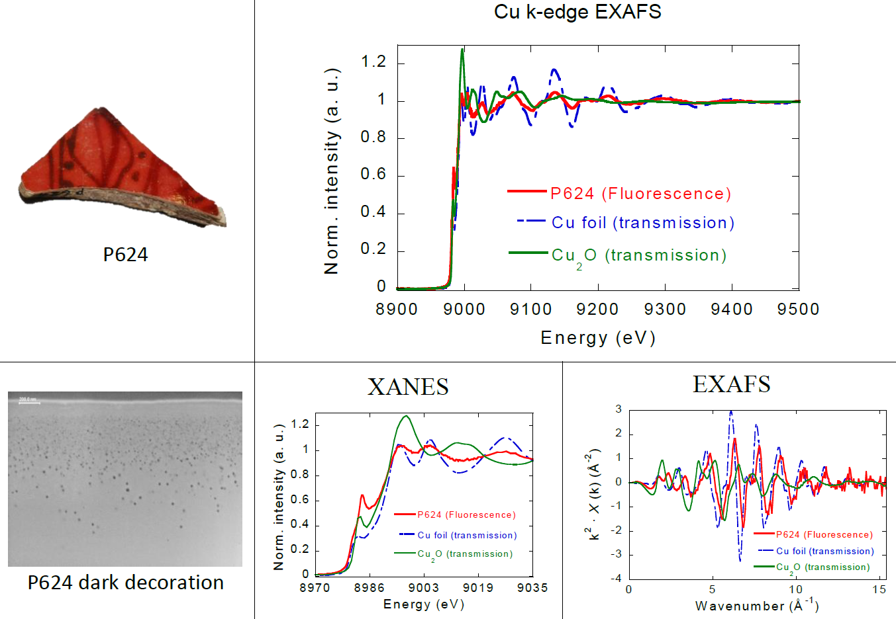
    Users research
Cultural Heritages
(first fluorescence scans Dec. 2013)
Courtesy of T. Pradell

Slide 10
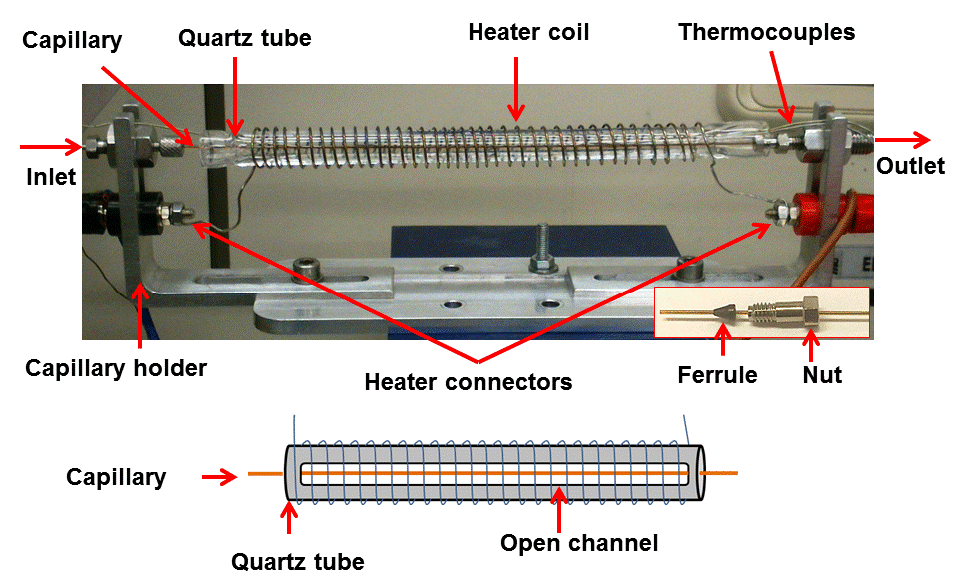
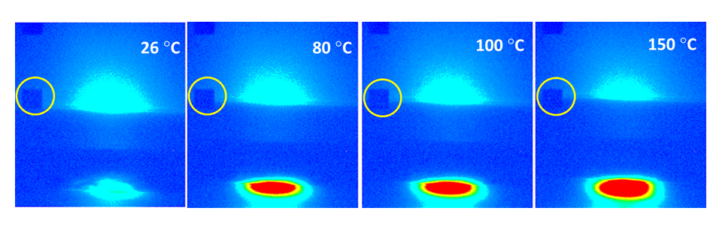
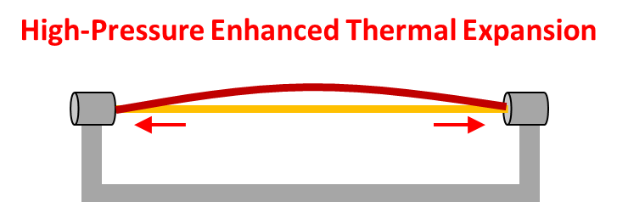
    Users research
Rev Sci Instrum.
Catalysis
(high pressure reactor – up to 200 bar)
A. Bansode, G. Guilera, V. Cuartero, L. Simonelli, M. Avila and A. Urakawa, Submitted to Rev. Sci. Instrum.
XANES spectra at the Cu K-edge of Cu/ZnO/Al₂O₃ catalyst during the pre-reduction at 70 bar under the flow of 5% H₂ in He
XANES spectra collected at three reaction temperatures over Cu/ZnO/Al₂O₃ catalyst at CO₂:H₂ = 1:3 and 200 bar.
Reaction

Slide 11
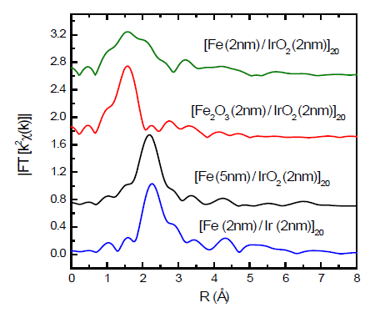
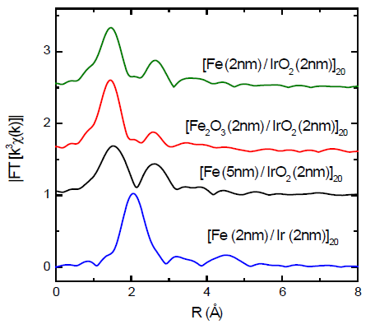
    Users research
Courtesy of Maria Ángeles Laguna Marco
XAS study on the crystal and electronic structures of Fe(FeO_{x})/Ir(IrO₂) multilayers.
Solid State Physics
FT of the Ir L₃ edge EXAFS
FT of the Ir L₃ edge EXAFS
The results indicate a fully oxidized Fe layer with a very similar crystal structure in all the samples. The Ir shell, on the other hand, evolves from pure metallic to a mixture of metal and oxide phases and finally to pure IrO₂.
Differences in the M(H) behavior can be associated to the state of the Ir layer.

Slide 12
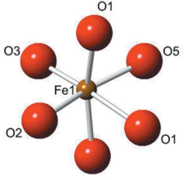
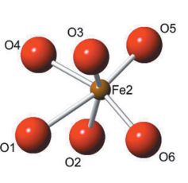
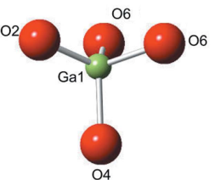
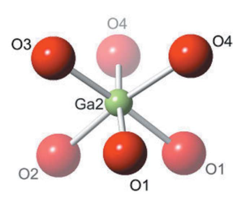
    IHR
GaFeO₃
Combined analysis of Fe and Ga local environment
Local structure determination
Solid State Physics
W. Olszewski et al., in preparation
GaFeO₃ hex
|FT(k²χ(k))|
k²χ(k)
Fe-Ga local force constant
k(Å⁻¹)
R(Å)

Slide 13
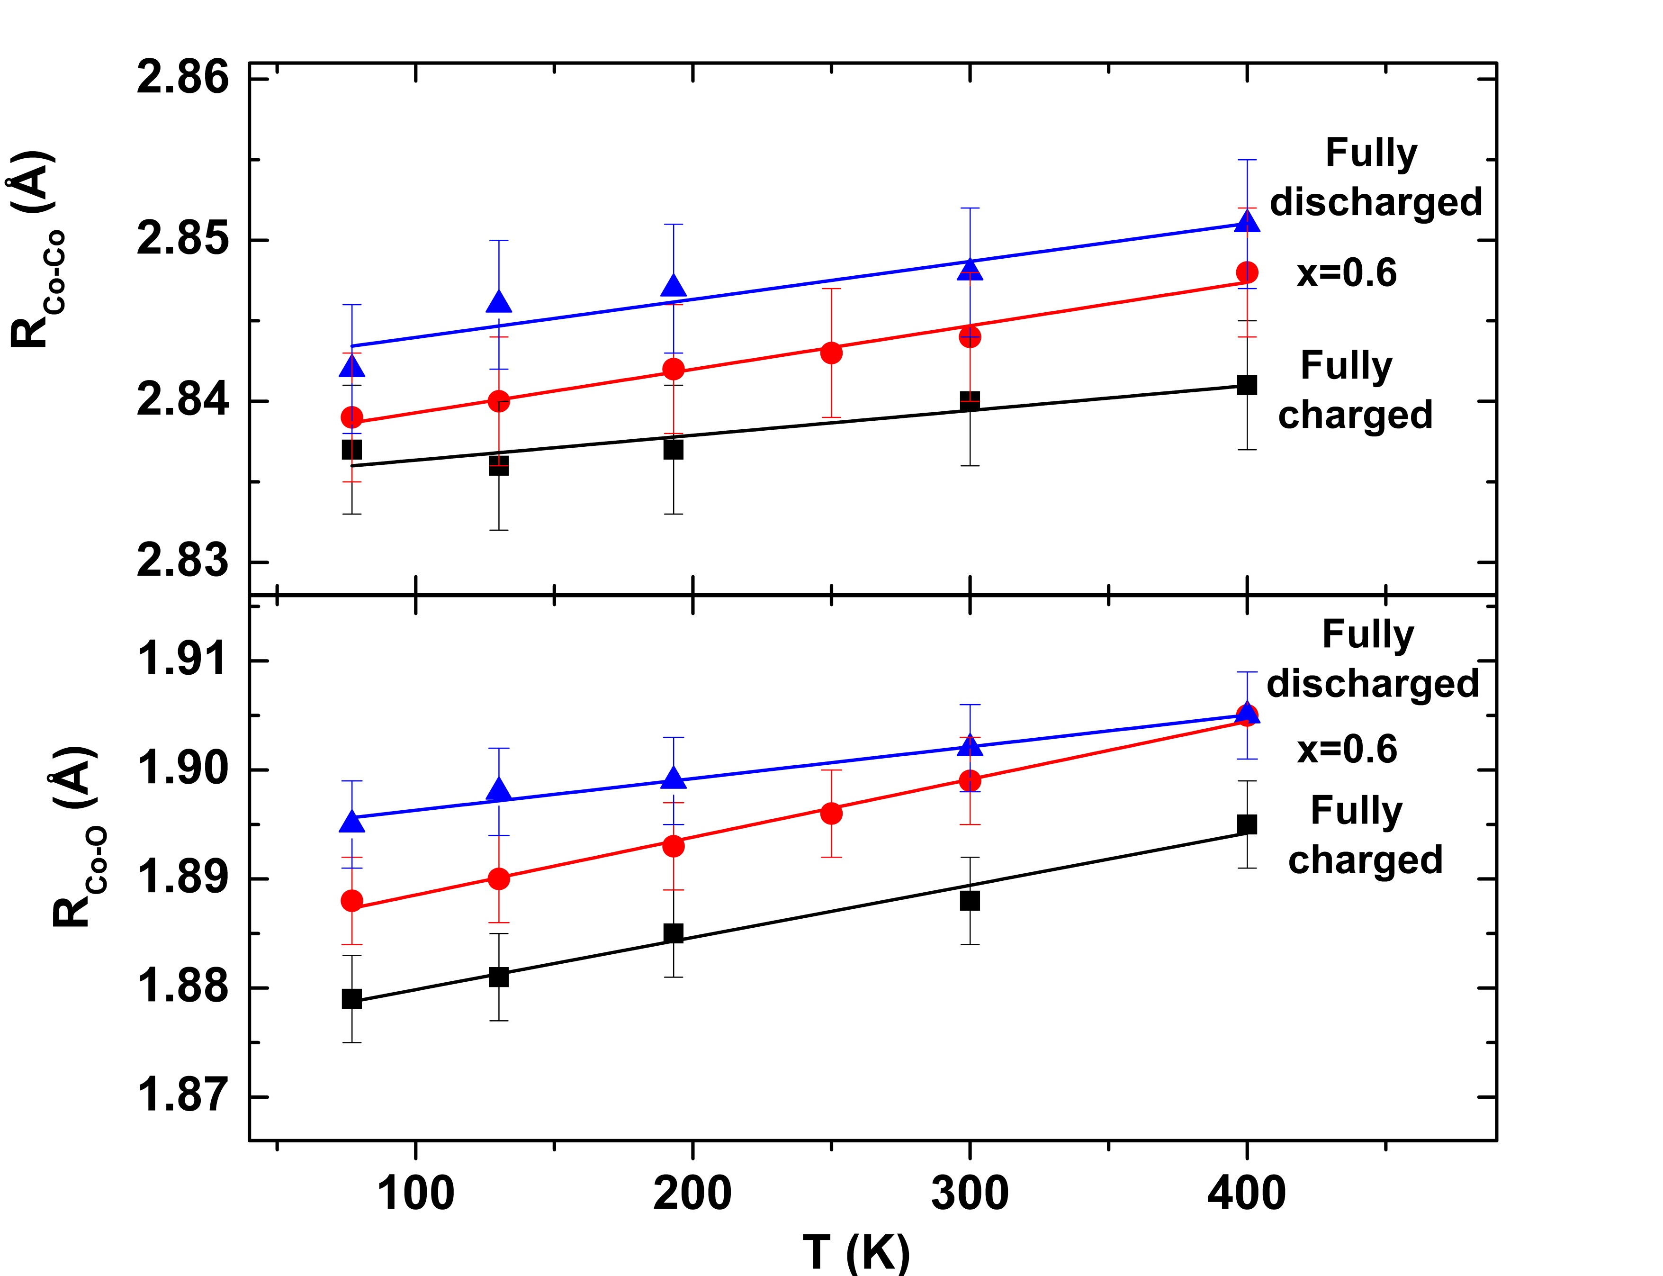
    IHR
M. Avila et al., in preparation
Batteries
Study of the Co-O / Co-Co local force strength as a function of sodiation/desodiation

Slide 14
BL22 Status
    Flux and stability
    (≈ 10¹² ph/s – beam displacement in ±10-15 µm)
    Energy range
    (2.4 – 70 keV)
    Safety
    (external gas cabinet – integrated gas detectors)
    Experimental setups
    (remotely controlled temperature: 80-700 °C
    Solid-gas reactor: 80-700°C / A.P.-8 bar)
    Scan mode
    (Continuous scan in transmission and fluorescence mode)
    CLEAR
    (under commissioning)

Slide 15
Beam flux and energy range
Flux at the sample from 2.4 to 70 keV
≈ 10¹² ph/s
(Front end slits 1x10 (VXH) mm²)
Pt
Rh L₃
Energy range accessible up to 2013

Slide 16
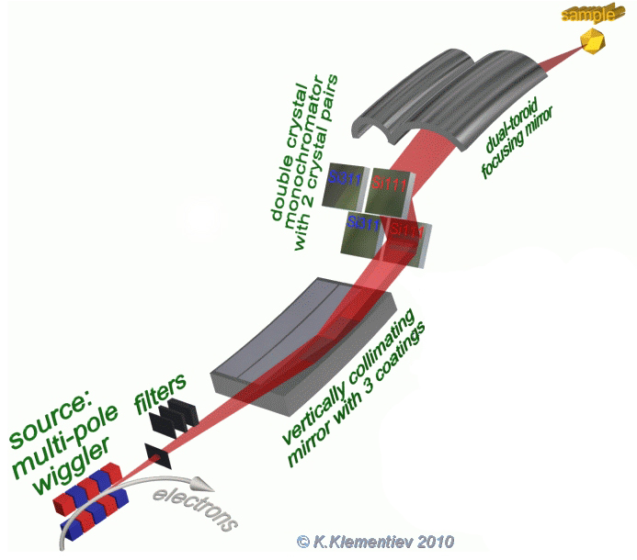
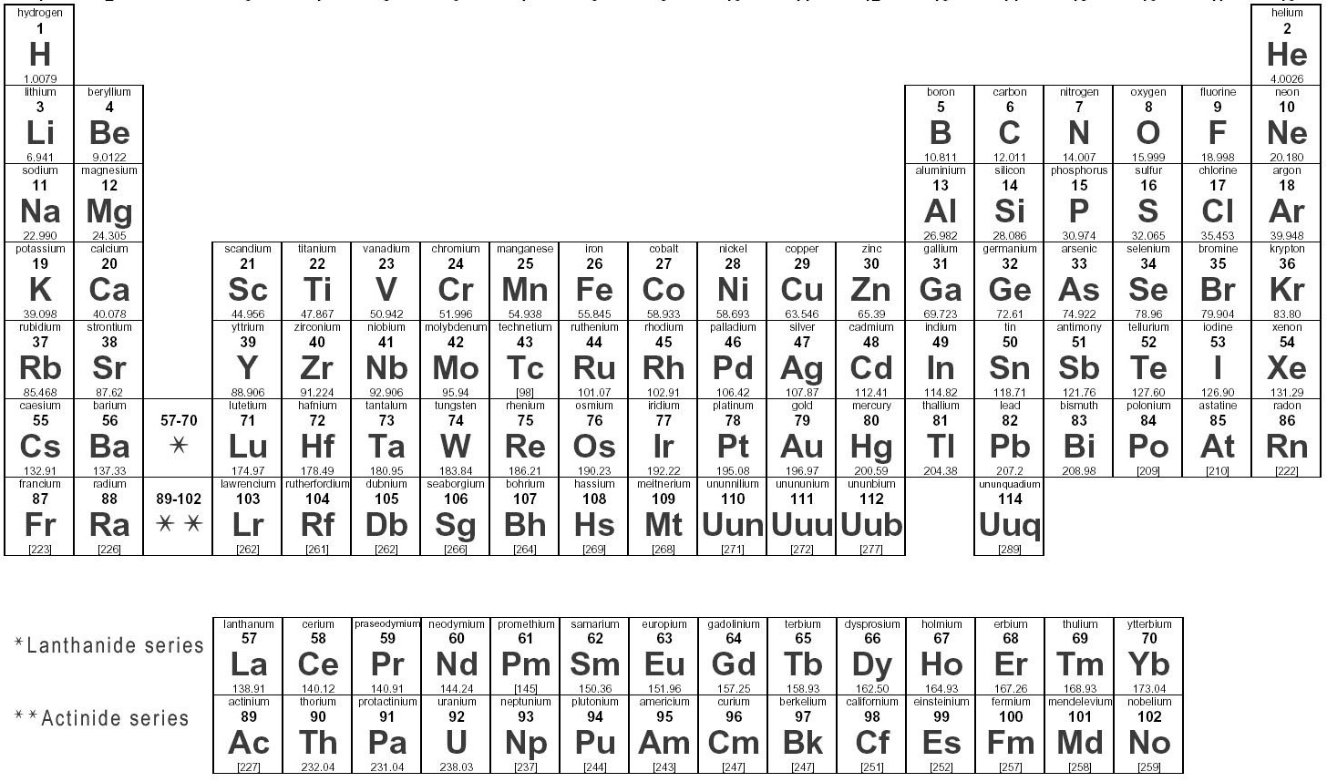
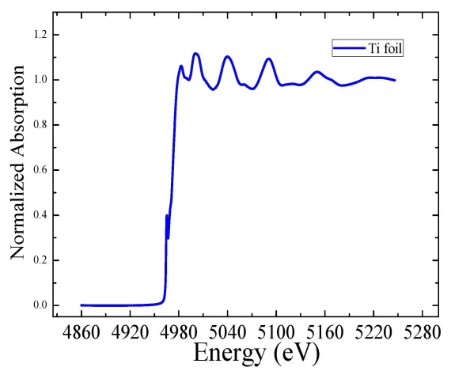
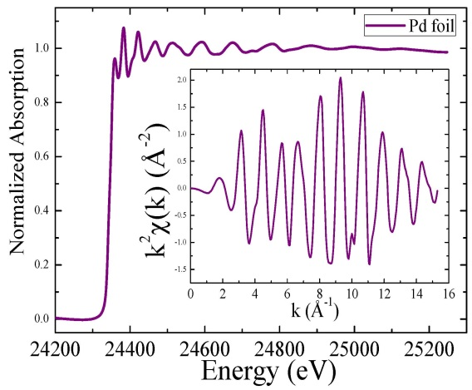
Beam flux and energy range
k-edges (low photon flux)
k-edges
L-edges
Low Energies | Middle Range | High Energies
Ti K edge (4966 eV) | Pd K edge (24.350 eV)
Ta K edge (67.416 eV)
SAC 16. 06/17/2013

Slide 17
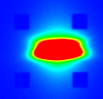
BL22 Status
    Beam displacement during a 1.1 keV scan (up to ±7 µm)
    (investigated at different energies and with both Si(111) and Si(311) monochromator)
    MOCO in position mode
Si(311) Si(111) MOCO
Mn 25±5 µm 20±5 µm ON
Mn 360±10 µm 270±10 µm OFF
Co 20±5 µm 60±5 µm ON
Co 440±10 µm 220±10 µm OFF
Ni 15±5 µm 35±5 µm ON
Ni 310±10 µm 200±10 µm OFF
Fe 30±5 µm 25±5 µm ON
Fe 330±10 µm 360±10 µm OFF
Cu 20±5 µm 35±5 µm ON
Cu 310±10 µm 200±10 µm OFF
≈ 100 x 220 µm² (V x H)

Slide 18
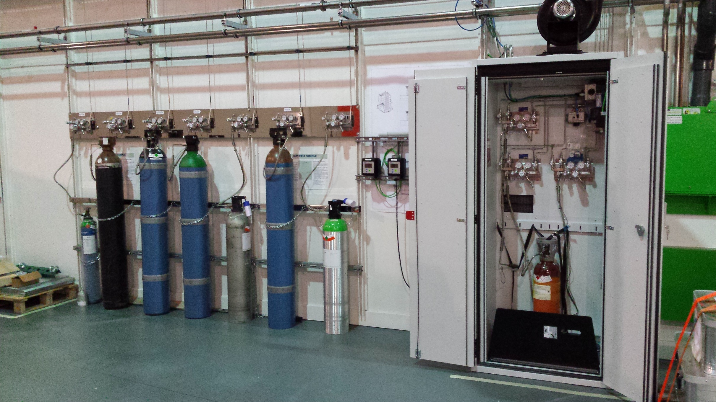
BL22 Status
    Safety
    New gases cabinet, CO and flammable dedicated detectors installed outside and inside the experimental hutch

Slide 19
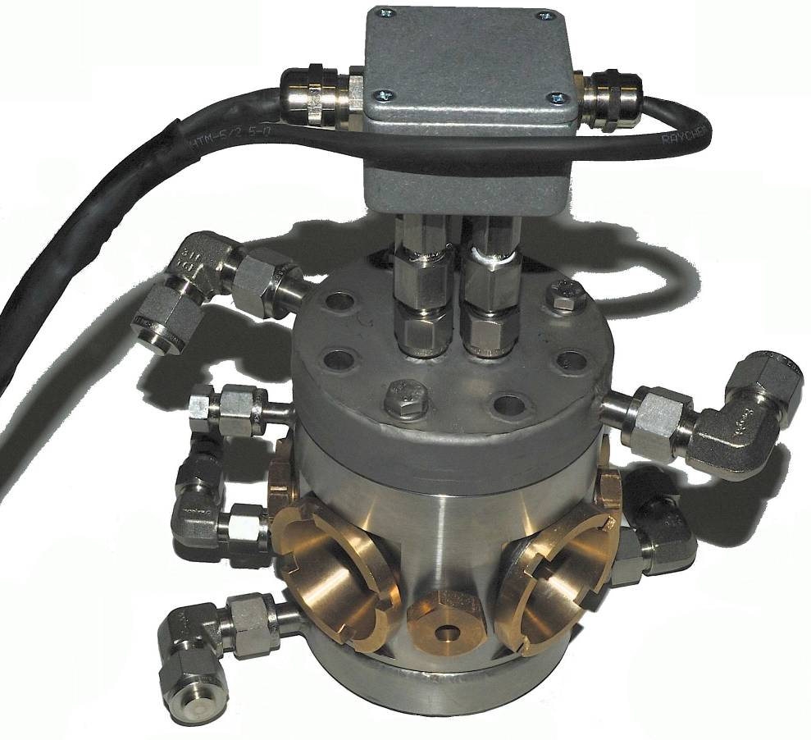
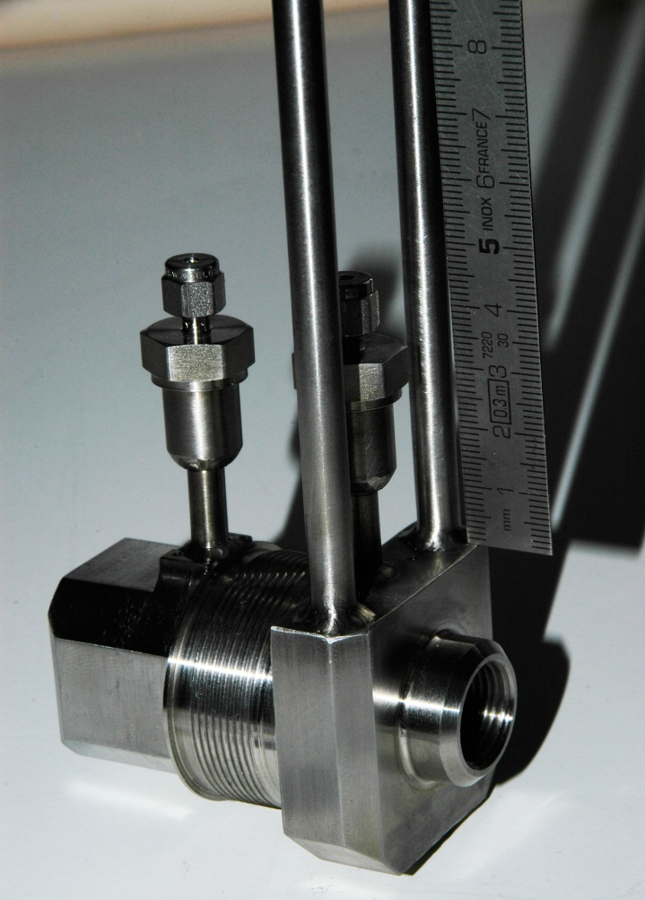
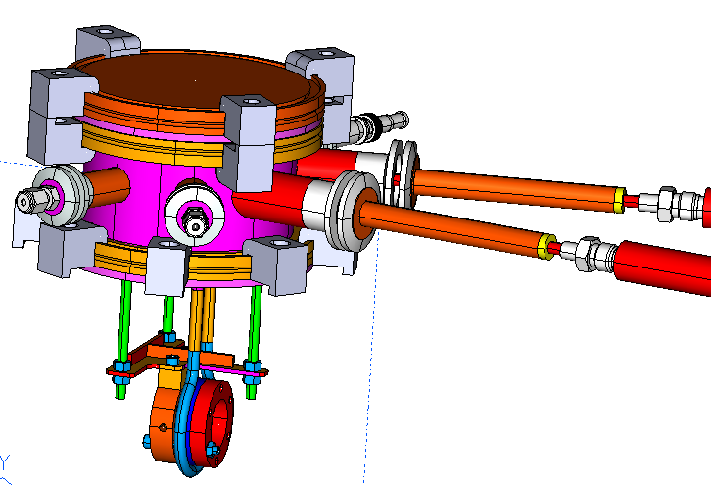
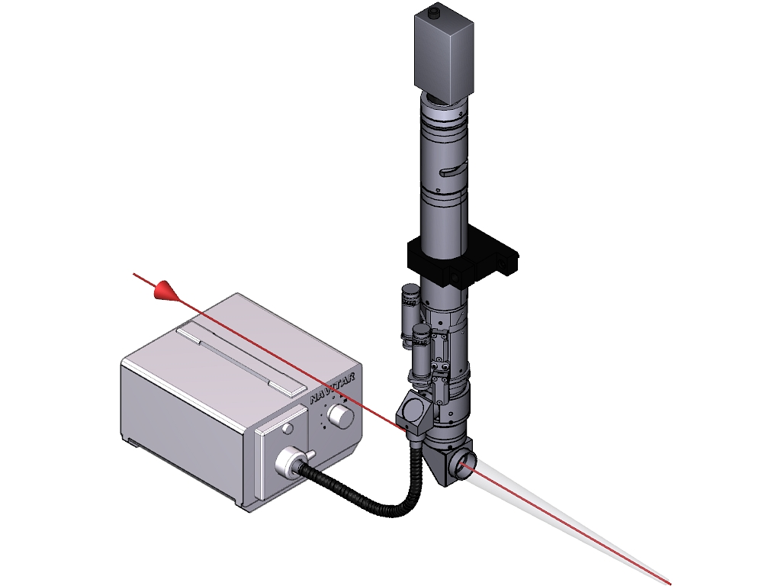
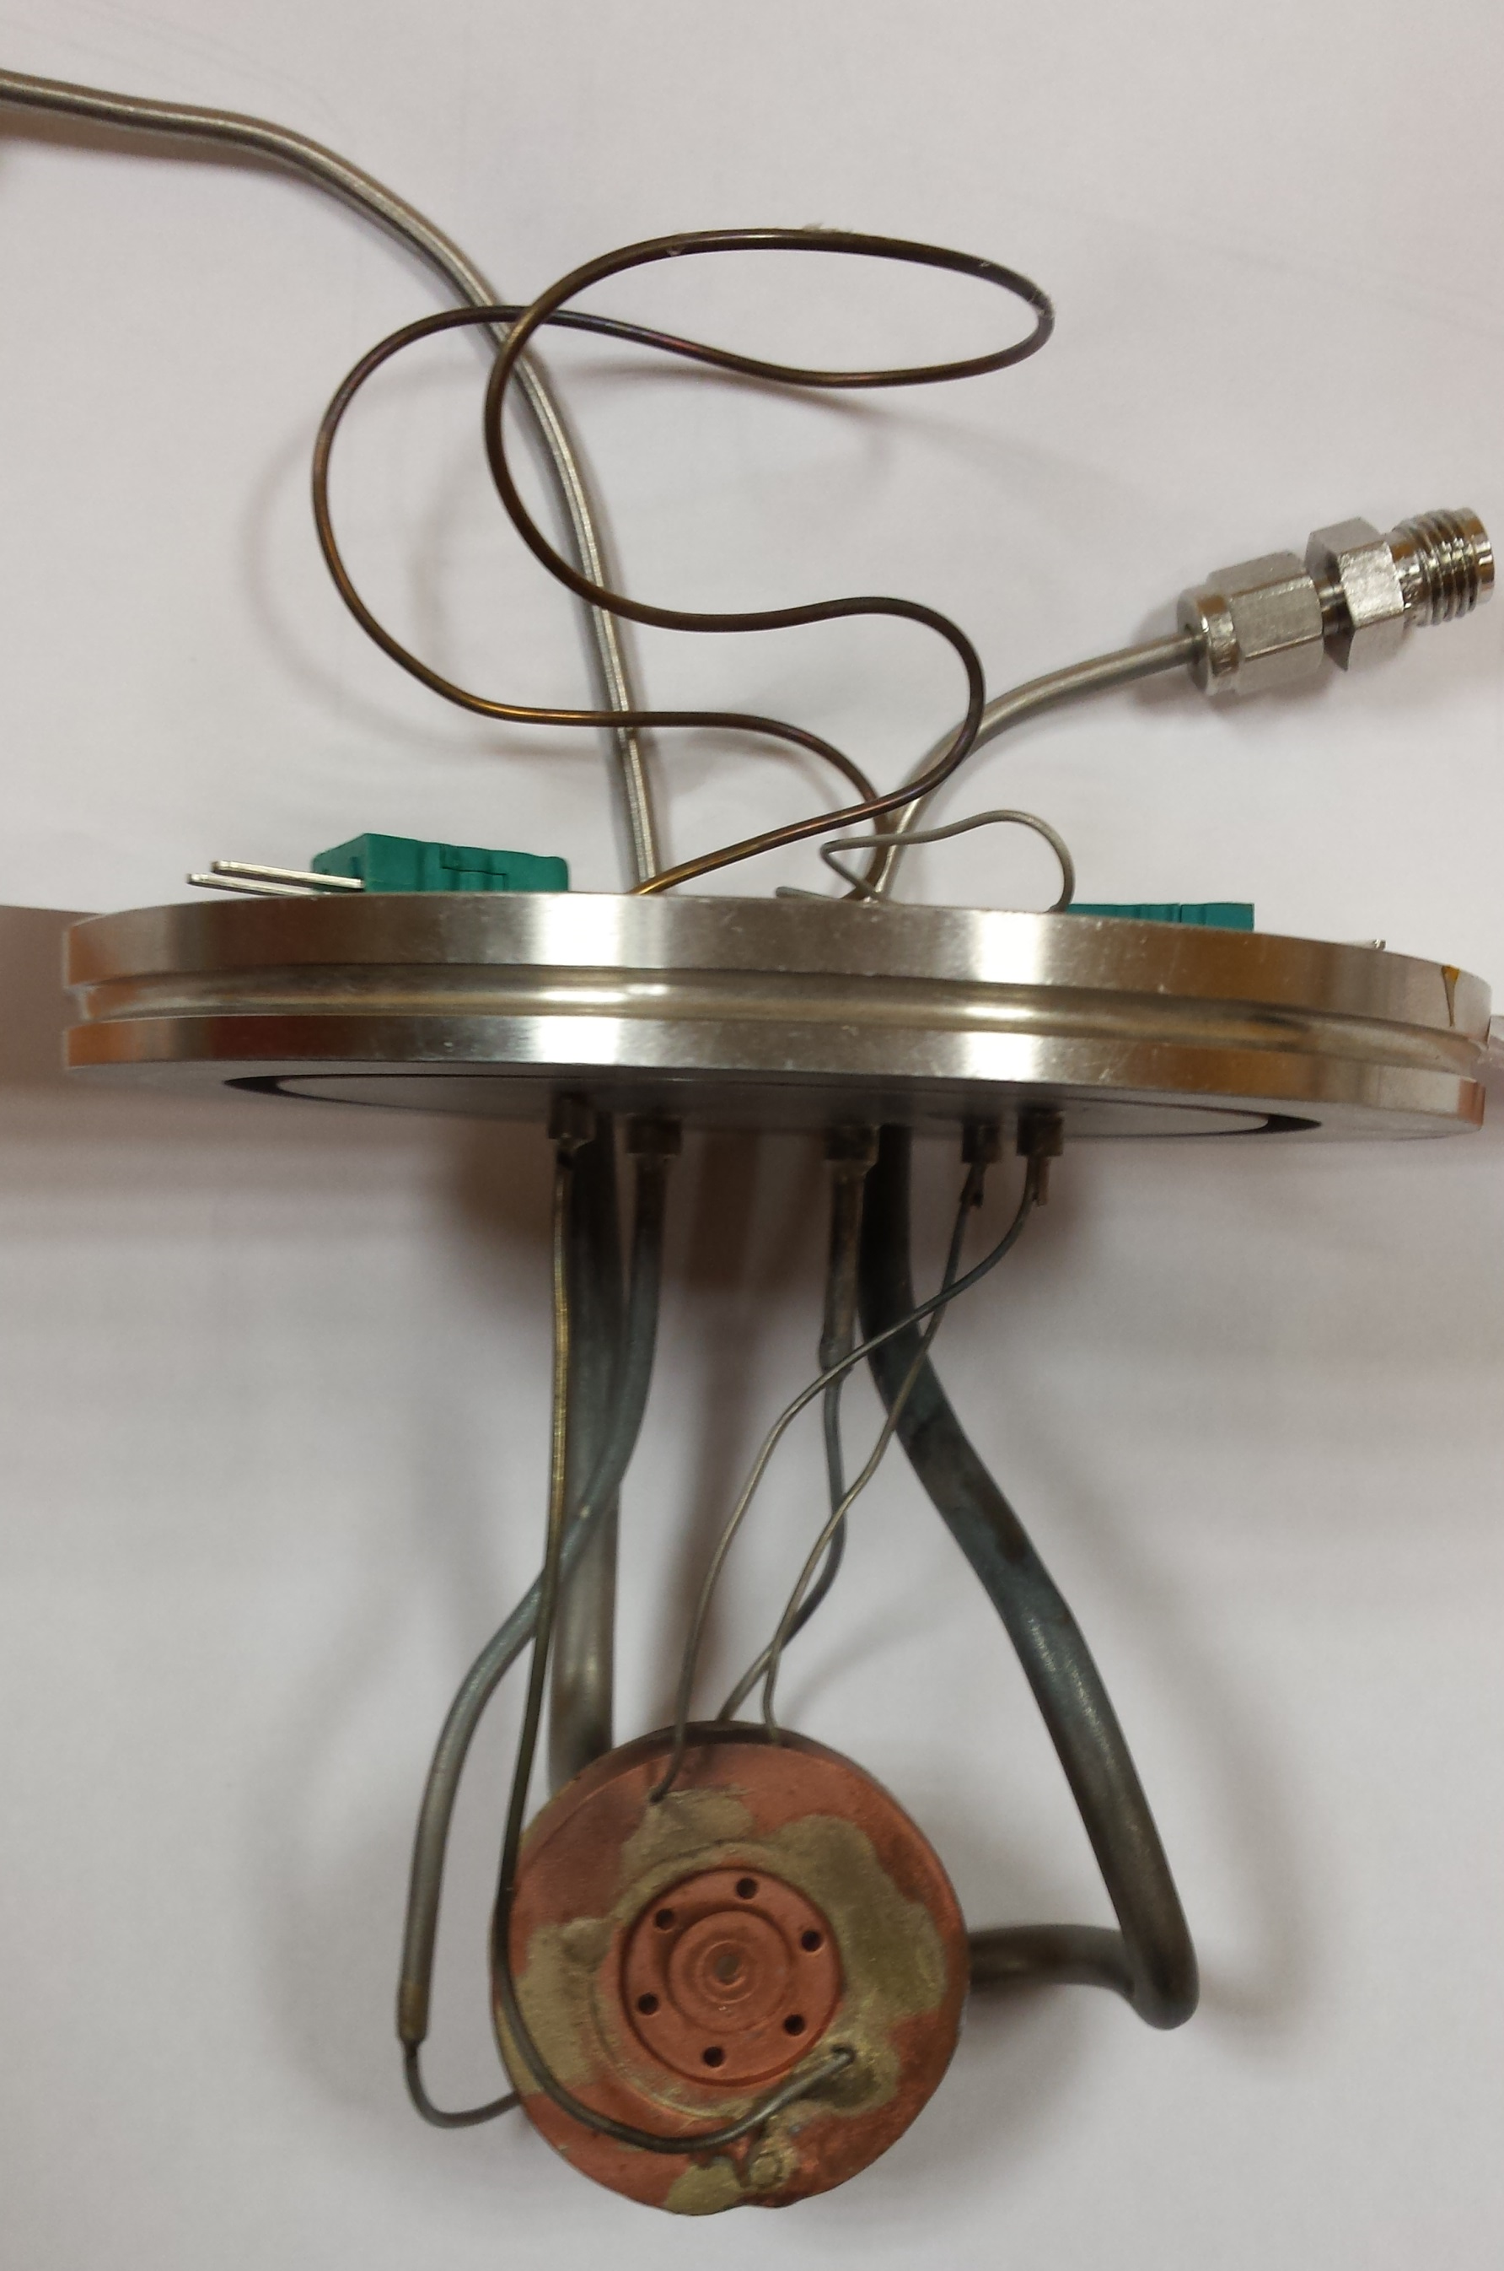
BL22 Status
    Experimental setups
In-situ cell for catalysis
LN2/furnace system
In line NAVITAR camera (I. Sics)
High spatial resolution
NAVITAR 6000 lens
X-ray
T = 80 – 1000 K
Coaxial illumination
T = 300 – 1000 K
P_{max} = 8 bar
Fluo. & transm.
WD = 55mm
T = 80 – 1000 K
P_{max} = 4 bar
Transmission
New prototype of in-situ cell for catalysis:
Transmission and fluorescence geometry
T = 80 - 1000 K
In vacuum (low energy accessible)
Expected pressure range below 20 bar
Iulian Preda et. al, working in progress

Slide 20
BL22 Status
    XAS scan mode
    Continuous scan in transmission mode
    E < 30 keV
    ≈ 5 (10) min per scan XANES (EXAFS)
    Up to 4000 points
    Step scan in transmission and fluorescence mode
    2.4 < E < 70 keV
    ≈ 10 (60) min per scan XANES (EXAFS)
    Continuous scan in fluorescence mode
    E < 30 keV
    In commissioning since June 2014

Slide 21
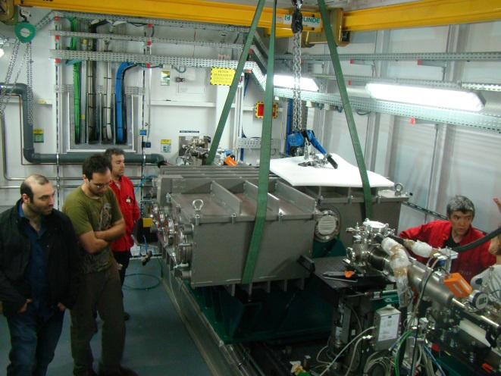
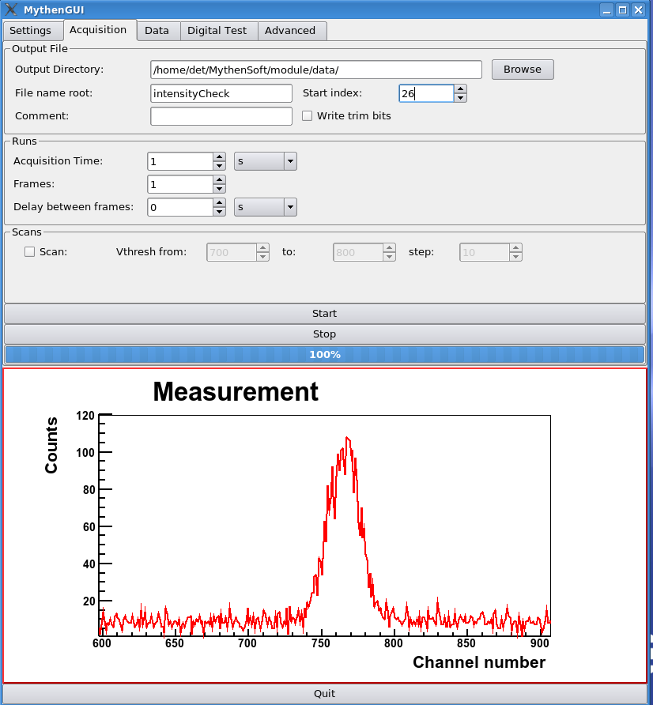
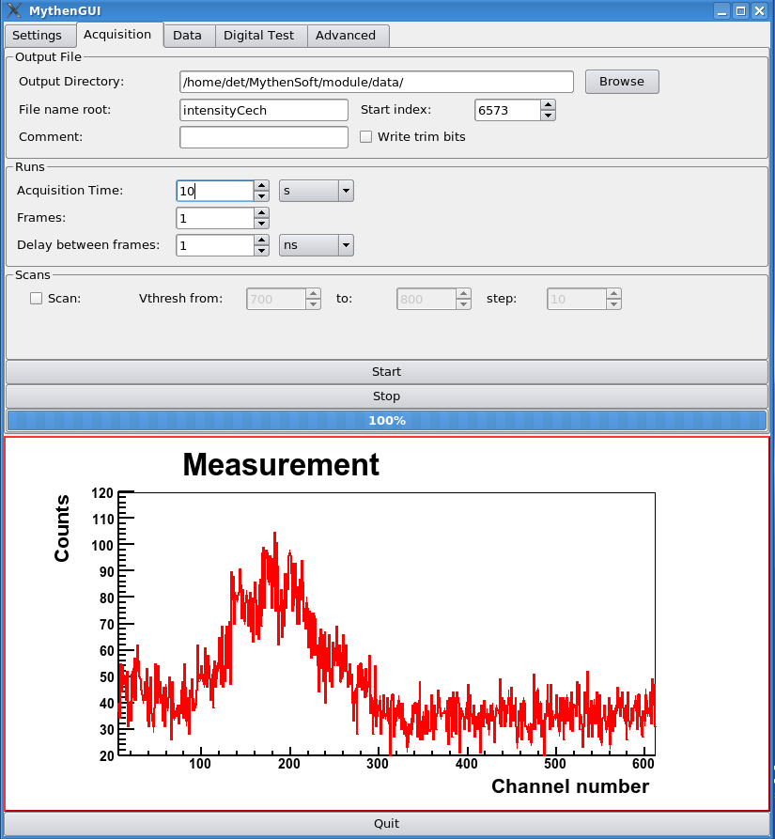
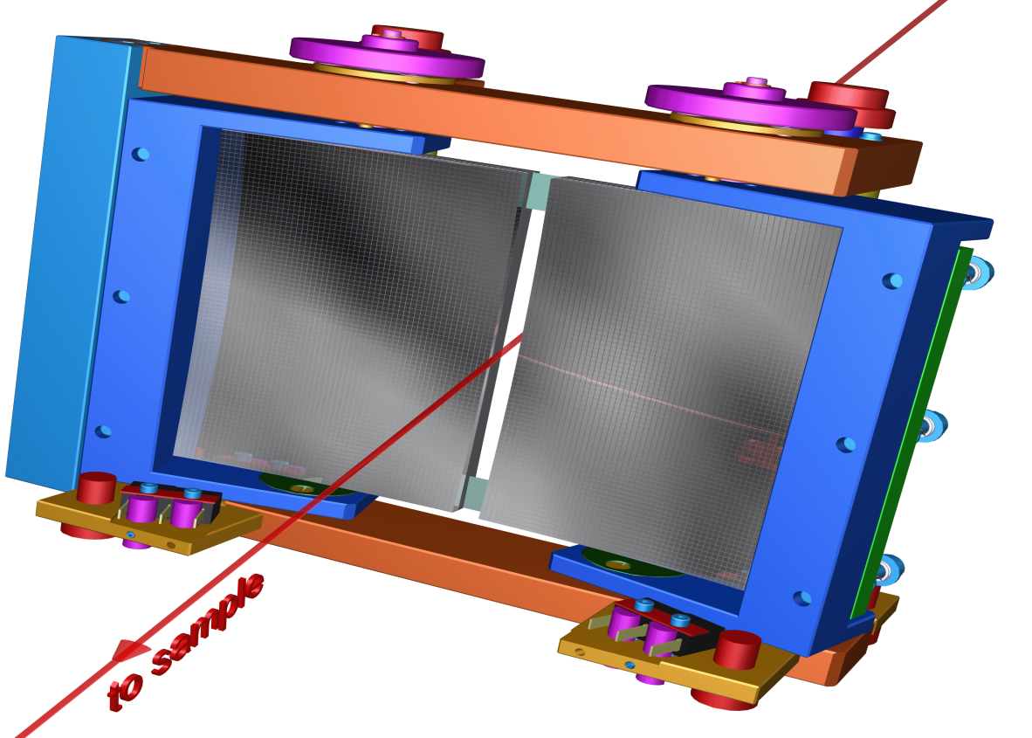
BL22 Status
    CLEAR
x-ray emission spectrometer (2-22 keV)
In commissioning from May 2014
CLEAR installation on CLÆSS
April 2014
Si(555) reflection on Mythen
x 1 sec
x 10 sec
First fixed radius analyzer prototype in commissioning –first users on Dec. 2014
Final analyzer bender project ready for Feb. 2015
Verbeni’s Si(555) diced 3·10³ cps
5 Si(555) diced stripes
660 cps → 4·10³ cps for a full Verbeni diced analyser

Slide 22
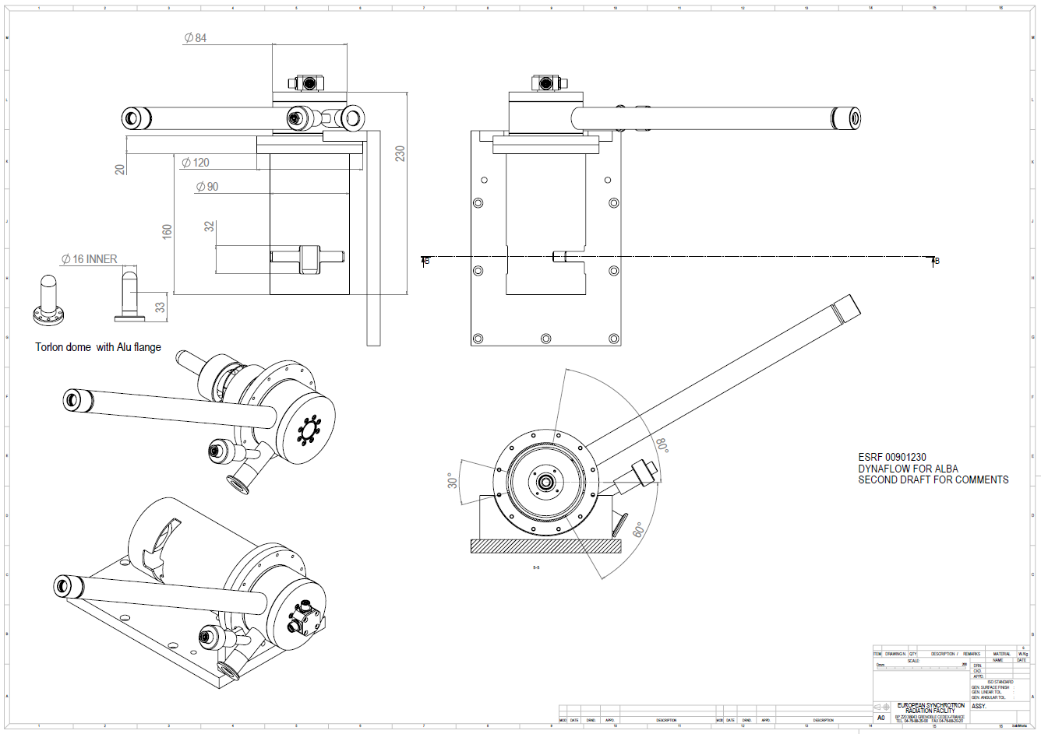
    Future and perspective
    Liquid He cryostat
    4 K < T < 300 K
  Developed in ESRF (Peter Van Der Linden)
  In collaboration with MSPD
  Expected operational from 2015

Slide 23
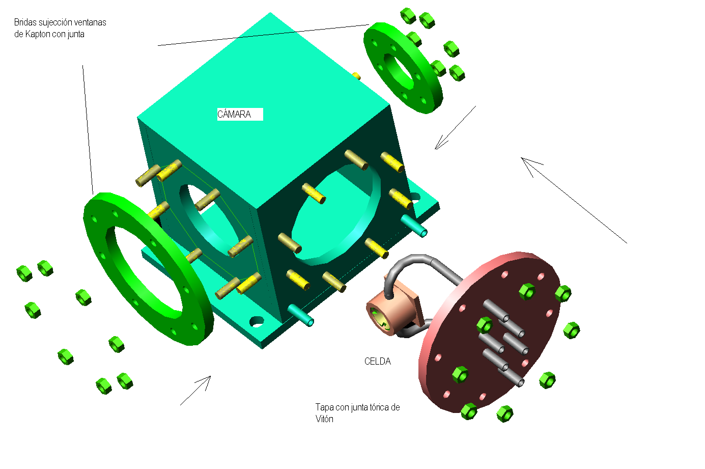
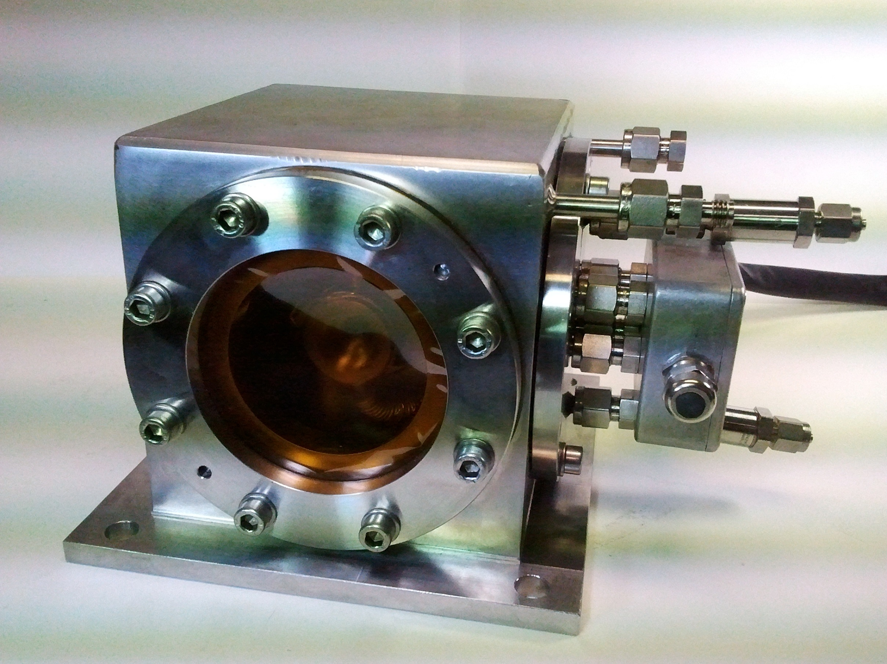
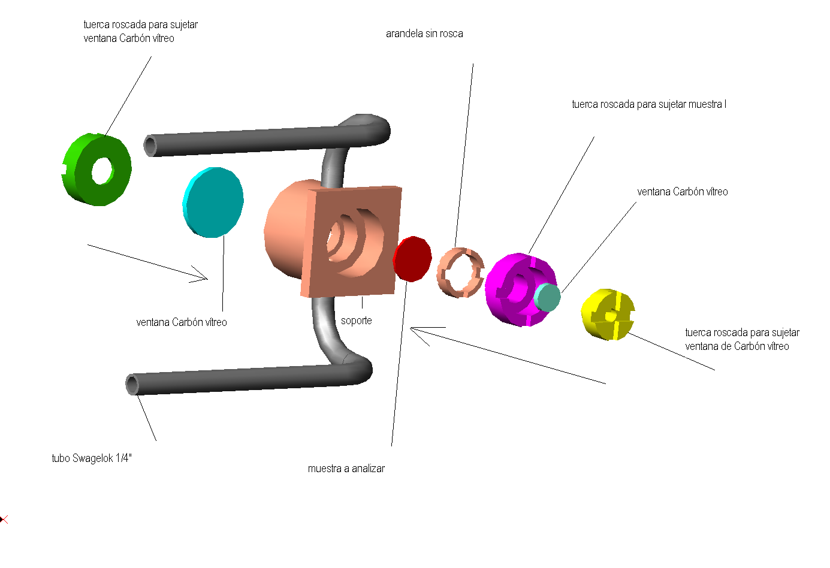
    Future and perspective
    New liquid-solid-gas reactor cell
    300 K < T < 1000 K
    P < 20 bar
  Developed in the ITQ in collaboration with MSPD
  Expected operational from 2015

Slide 24
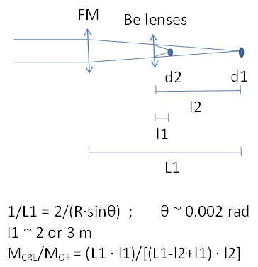
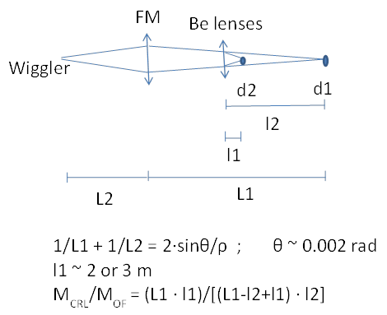
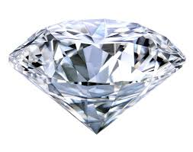
    Future and perspective
    Beam size reduction – Be lenses ?
VERTICAL PLANE
HORIZONTAL PLANE
IMAGING ?
High-PRESSURE ?

Slide 25
BL22-CLÆSS: XAS & XES
XAS Chemical, electronic, and structural information (2.4 - 70 keV)
XES electronic, magnetic, and structural information (2 - 22 keV)
  Beamline performance:
    Continuous scan in transmission mode (5-10 min scan)
    XAS in transmission and fluorescence detection mode
    XES – first analyser prototype expected operational from 2015
    Stable beam-position (±10 μm) and beam-size (200-500 μm) for 2.4 < E < 70 keV
  Experimental set-ups:
    Remote temperature controller from 80 K to 800 K
    In-situ cell for solid-gas reactions (80 K – 700 K)
  3. Low temperature cryostat (4 K – 300 K) - Expected operational from 2015

Slide 26
Thanks to:
Old and new CLÆSS team:
Konstantin Klementiev, Gemma Guilera, Vera Cuartero,
Laura Simonelli, Carlo Marini, Marta Avila, Wojciech Olszewski
Controls Engineers: Roberto Homs
Electronic Engineers: José Ávila
Mechanical Engineers: Llibert Ribó
Technicians: José Prieto, Edmundo Fraga
Special thanks to: Josep Nicolás, Igors Sics, Salvador Ferrer, Iulian Preda, Yury Nikitin, Zbigniew Reszela, Ricardo Valcárcel, Daniel Roldán, Marc Rosanes, Robert Oliete, Rafael Montaño, Jerzy Jamroz, Jordi Navarro, Francesc Farré, David Fernández, Óscar Matilla, Guifré Cuní, Alejandro Crisol, Fabien Rey, Marta Llonch, Carles Colldelram, José Ferrer, Carme Mármol, Xavier Queralt…
Collaborators: Olivier Mathon (ESRF-Grenoble), Atsushi Urakawa’s group (ICIQ-Tarragona), Fernando Rey’s group (ITQ-Valencia), Joaquín García’s group (ICMA-Zaragoza).
SAC 16. 06/17/2013

