Slide 1
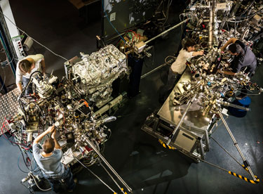
Report on BL24- CIRCE
1
Lucia Aballe
Michael Foerster
Virginia Perez
Carlos Escudero
Support:
Jose Prieto (Technician, with CLAESS)
Nahikari Gonzalez (Mechanical engineer, with XALOC)
Abel Fontsere, Toni Camps (Electronics engineer, with NCD)
Fulvio Becheri (Controls, with ID)
Josep Nicolas (Optics, transversal section)
Eric Pellegrin (Section Head)

Slide 2
BL24- CIRCE: Photoemission Spectroscopy and Microscopy
2
Status and progress: technical aspects
  Beamline (soft X-ray PGM with helical undulator)
  Photoemission electron microscope (PEEM)
  Near ambient pressure photoemission (NAPP)
Productivity: User Statistics, Output

Slide 3
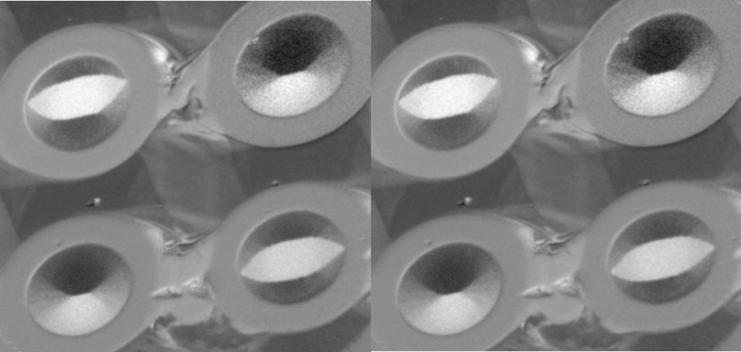
3
Beamline

Slide 4
KB motor exchange (1/2014)
4
“Problems with KB optics need solution! Risk of loosing the station for ca. 8 weeks.”
Three linear actuators for HFM x, HFM pitch and VFM pitch were replaced during Christmas’13 shutdown.
Irelec provided and installed a new-designed actuator, UHV compatible and capable of standing larger loads (up to 200 N).
All motions are functional, friction effects still present but largely reduced.
Intervention:
Nahikari González
José Prieto / Francesc Ferrer
Marta Llonch / Jon Ladrera
Josep Nicolas
Oscar Borrego
Lluís Gines
Resolution test obtained during intervention

Slide 5
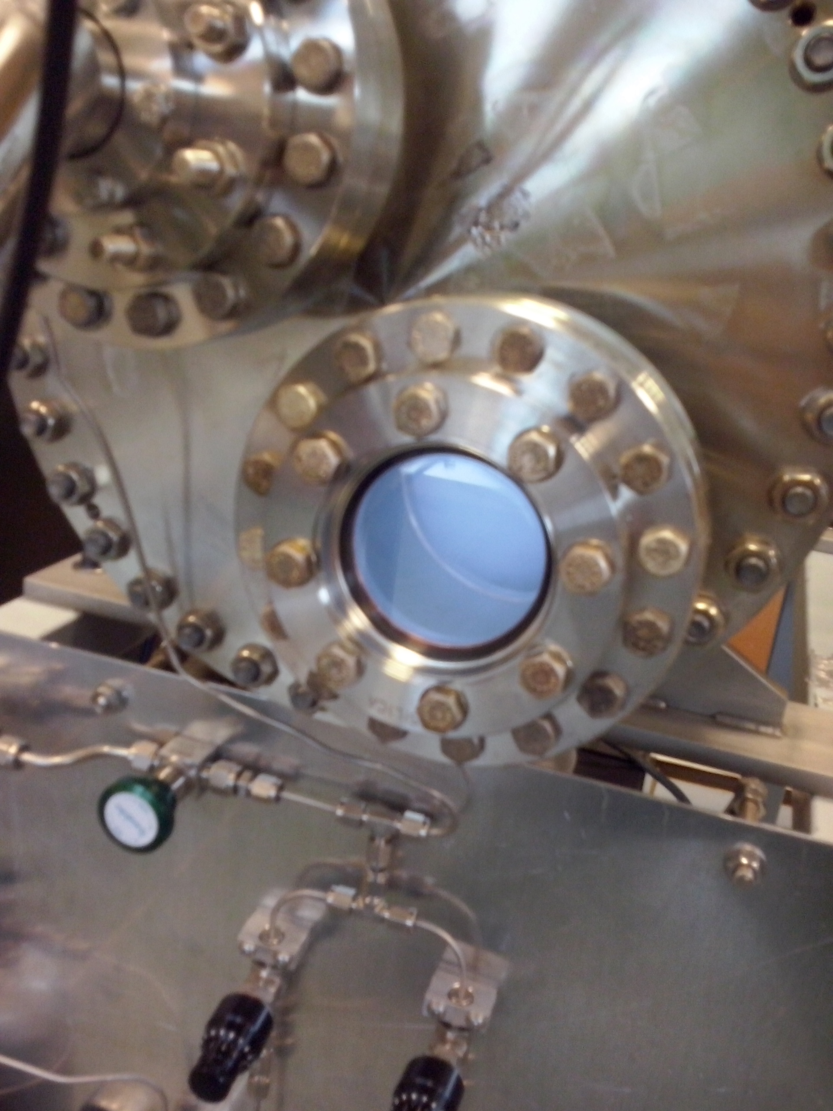
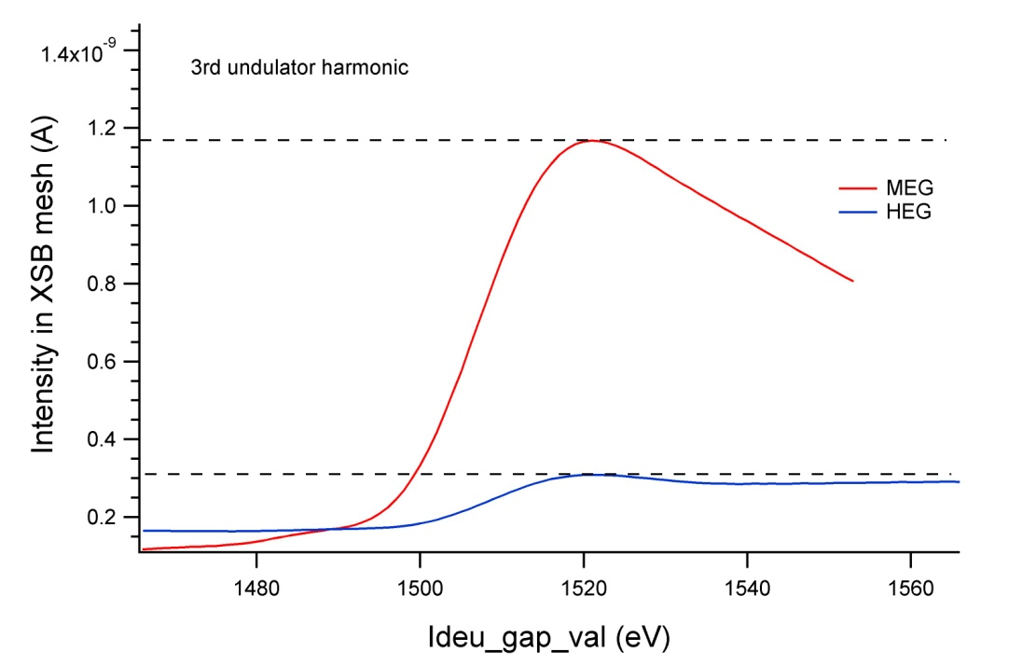
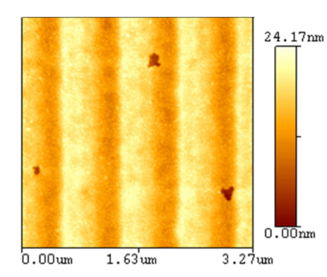

HEG cleaning (in progress)
5
HEG flux= MEG flux/4: Carbon contamination?
- Ex-situ characterization by AFM
- HEG ex-situ cleanning with oxygen plasma: in progress
- Post-cleaning characterization and reinstalling in PGM
darkest area
cleanest area
Notes:
Au coated Si, no binding layer
Cleanning tests in Au coated Si mirror samples.

Slide 6
Top up tests – mirror drain current @ 10Hz
6

Slide 7
Top up tests – beam spot on sample
7
Spot on sample (PEEM): no major change on size or position, but strong effect on intensity
10% dip, 3Hz, no difference with/out FOFB
vertical beam profile at sample

Slide 8
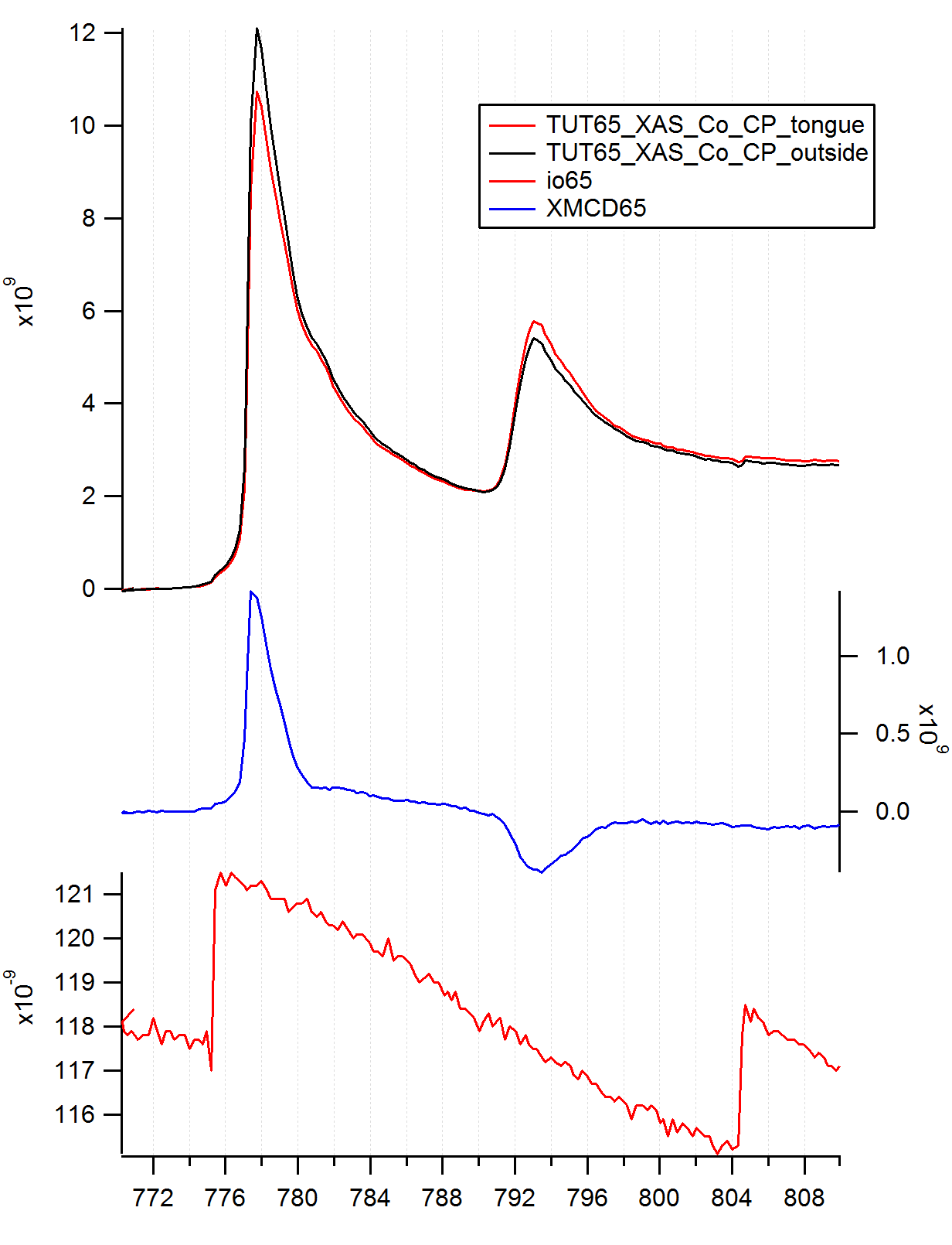
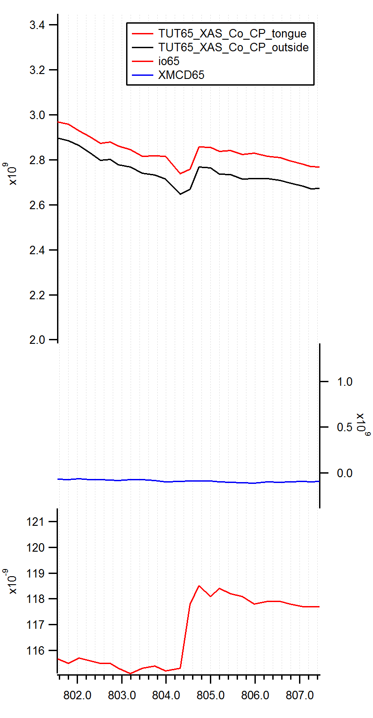
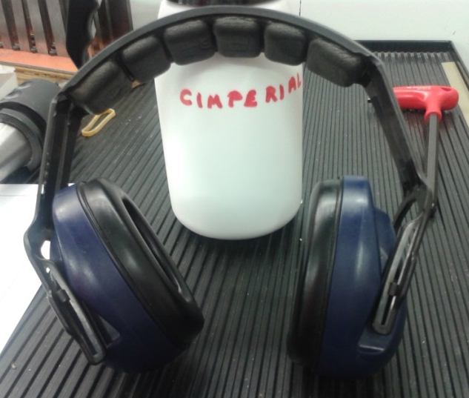
Top up tests – spectra in PEEM
8
Normalization does not work exactly
So far, no I₀ signal synchronized with NAPP analyzer software
Not yet solved: acoustic noise, mainly affecting PEEM

Slide 9
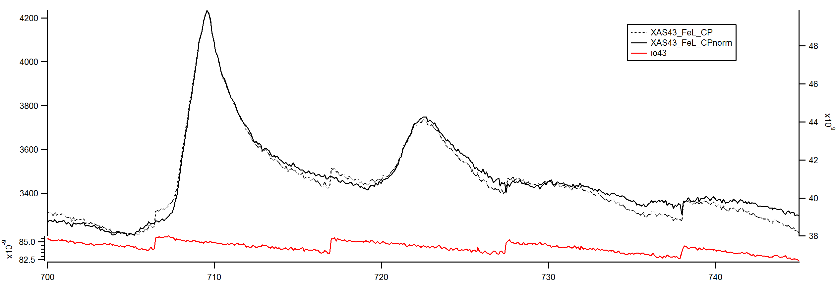
Top up tests – XAS spectra in PEEM
9
Normalization seems to depend on timing/synchronization → faster aquistion needed

Slide 10
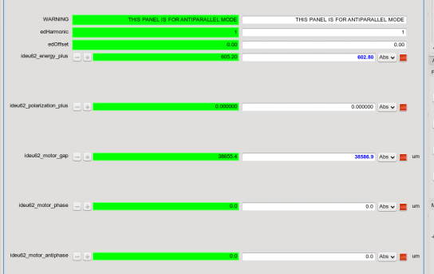
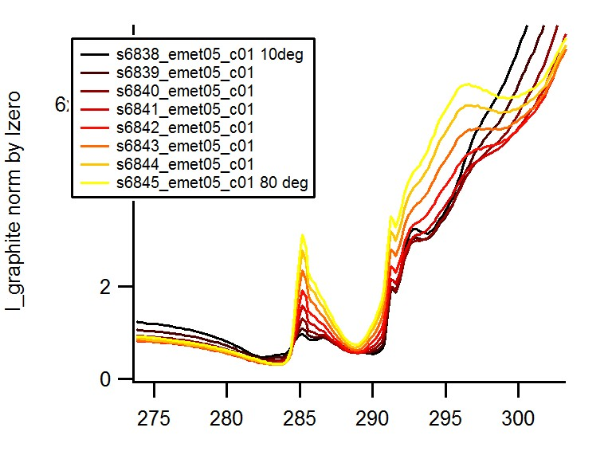
Linear polarization using AP
(Controls)
10
Changed by user
For information/expert user
Cross-implemented from Boreas (Fulvio Becheri)
Change parallel/antiparallel mode via macro (sets phase=antiphase=0, changes ID correction coils settings and pseudomotors (equations))
Future: single pseudomotors set (and panel)

Slide 11
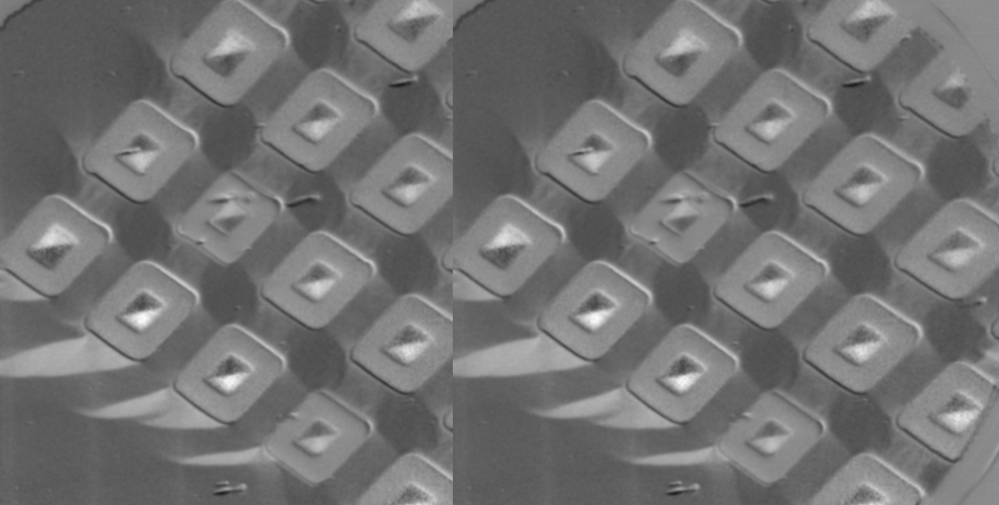
11
PEEM

Slide 12
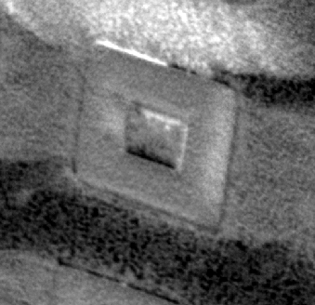
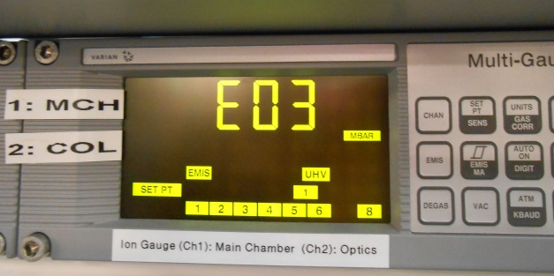
PEEM advances
12
Microscope:
  (Preliminary) Alignement and operation at 15kV
  Vacuum: Installation of Ti sublimators
Sample environment:
  (moderate) magnetic field cooling
  Electrical poling
Controls:
  XAS and XMCD previews available
  (much faster operation)
  Continous Camera readout in XMCD macro
  (saving 25-50% time, used in regular beamtime)
1 um
XMCD image taken at 15 kV
(showing film grain structure)

Slide 13
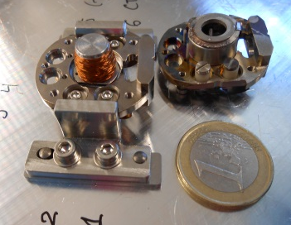
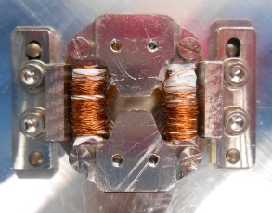
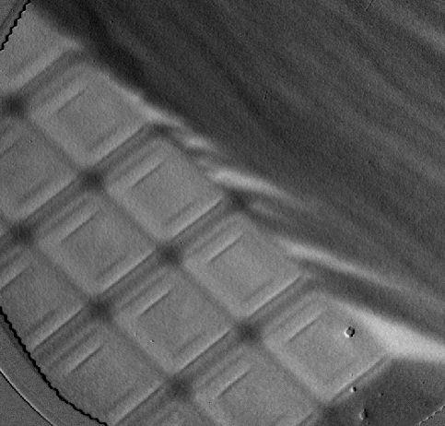
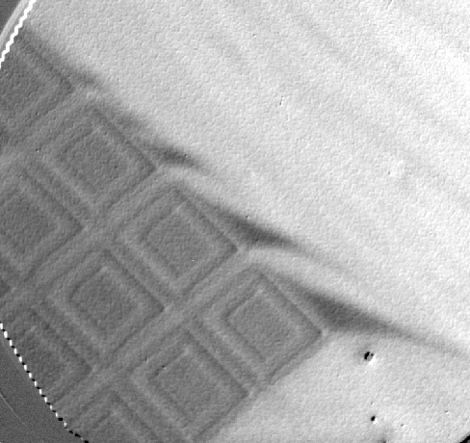
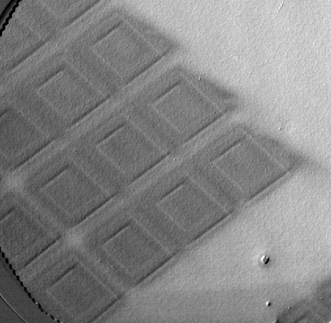
PEEM magnetic sample holders
13
  New sample holders with electro-
  magnets in use (IP and OOP fields)
  (engineering: N. Gonzalez, J. Ferrer,
  intern student Pol Alonso)
  Added polarity switch, debug
  current source and sample mount
Based on design from BESSY (F. Kronast)
XMCD images (FOV 50 um) showing in-situ switching
(opposite remanent states) and image taken at 9mT

Slide 14
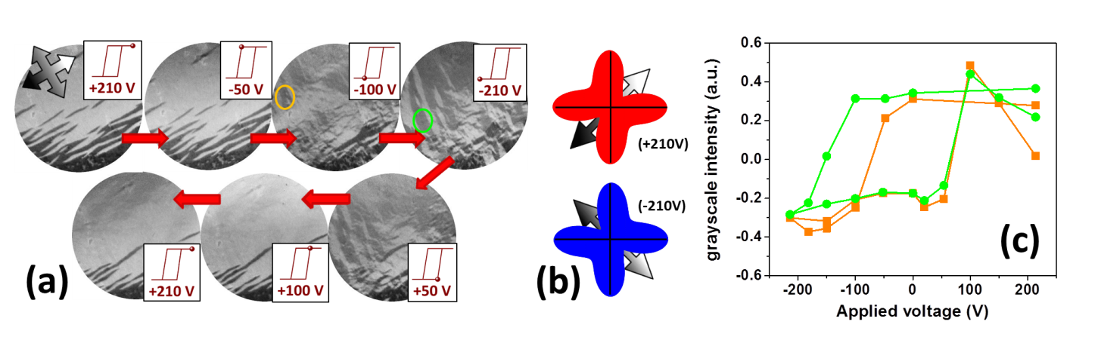
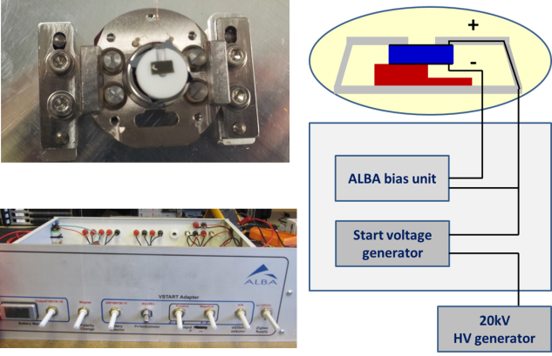
Imaging eletric field induced magnetic switching at RT
14
La_{2/3}Sr_{1/3}MnO₃//PMN-PT (100)
with OOP electrical poling
(A. Fontsere & Electronics)
D. Pesquera, B. Casals, G. Herranz, J. Fontcuberta (Institut de Ciencia de Materials ICMAB-CSIC)

Slide 15
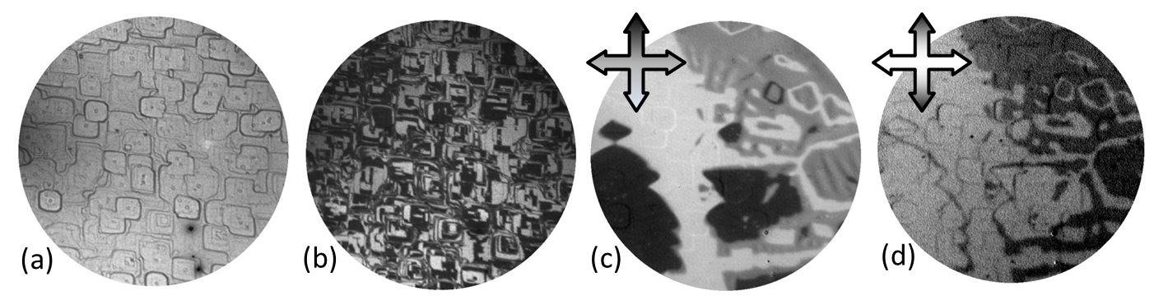
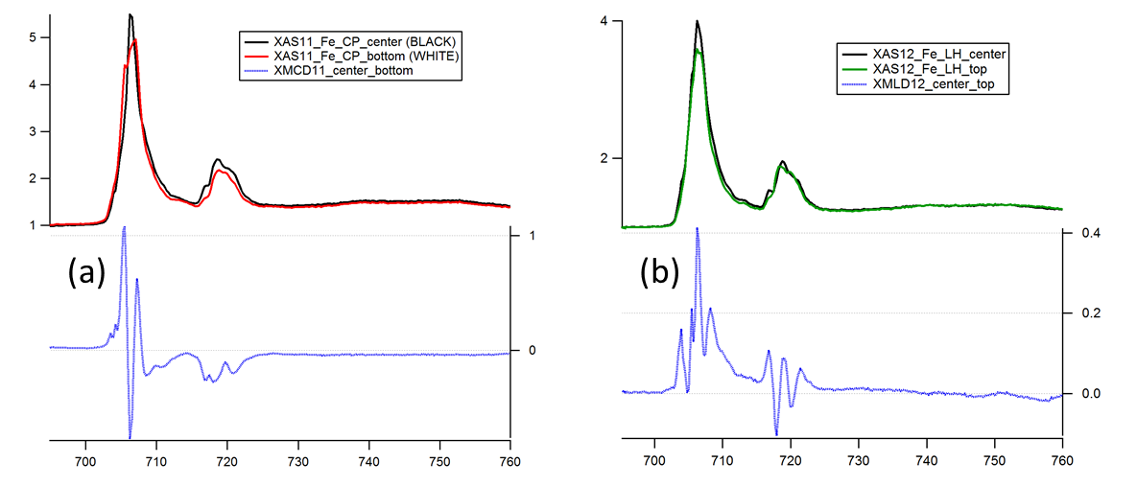
Spectromicroscopy of the Fe₃O₄ (100) surface
15
Top: LEEM,
DF-LEEM,
XMCD-PEEM, XMLD-PEEM (FOV 20 um)
Bottom: XMCD and XMLD spectra extracted from opposite domains
L. Martin, M. Monti, J. Marco, J. Figuera (IQFR-CSIC, Instituto de Química Física "Rocasolano")

Slide 16
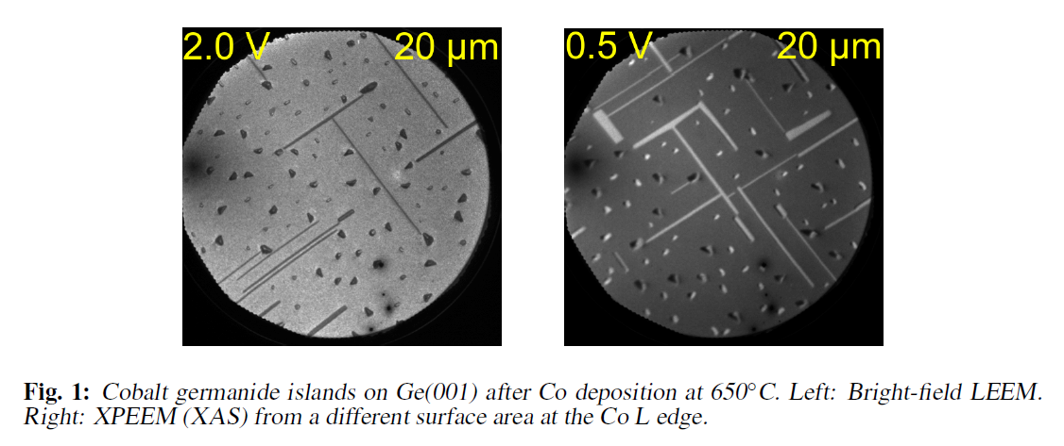
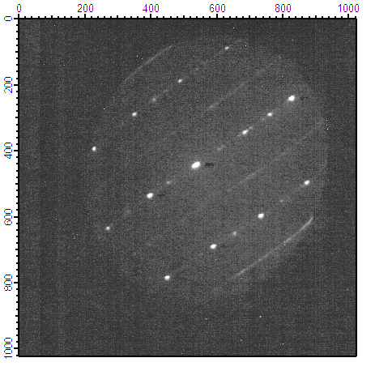
Reactive growth of cobalt germanide islands on Ge (001)
16
µ-LEED on one needle (27 V)
T. Schmidt, I. Heidmann, M. Ewert, J.I. Flege, T. Grzela, T. Schroeder and J. Falta (Institute of Solid State Physics, University of Bremen, & IHP Microelectronics GmbH, Frankfurt (Oder), Germany)

Slide 17
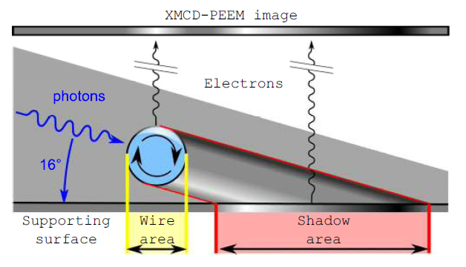
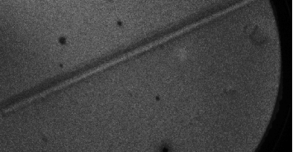

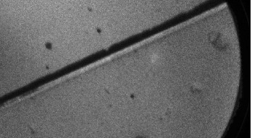
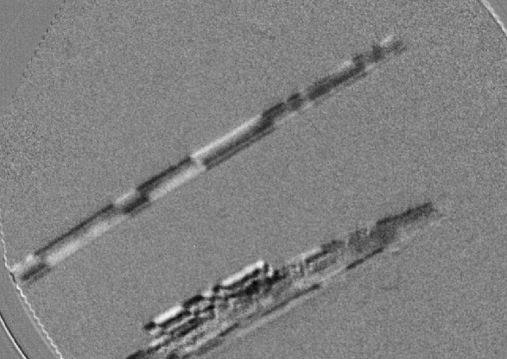
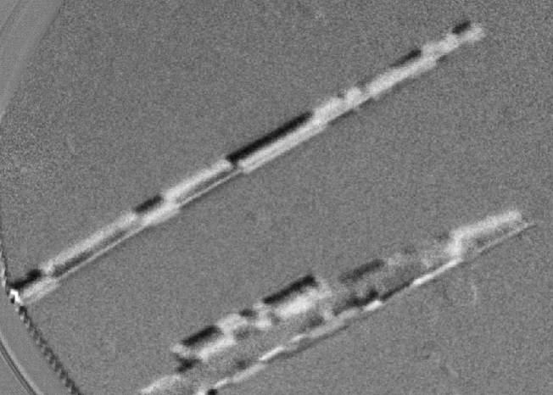
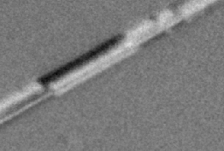
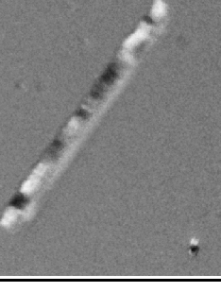
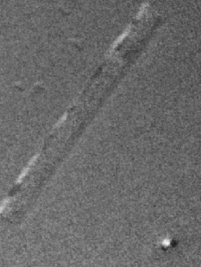
Magnetic depth profiling of nanowires
17
PEEM direct images with photon energy around Co L3
S. da Col et al., Phys. Rev B 89, 180405(R) (2014)
1 um
C. Bran, A. Asenjo, R. Perez, E. Palmero, M. Vazquez (ICMM-CSIC) and A. Fraile (UB)
Co L3
Co L2
Co L3
„preedge“

Slide 18
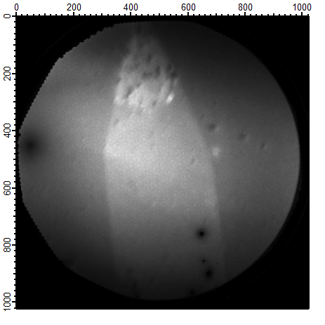
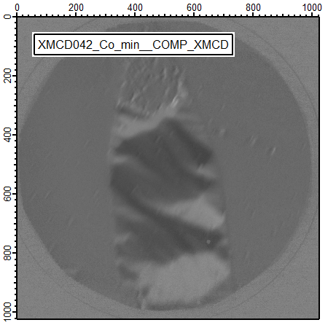
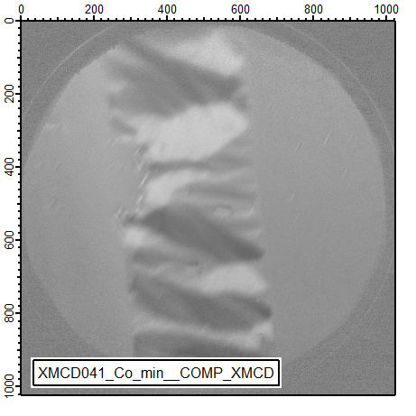
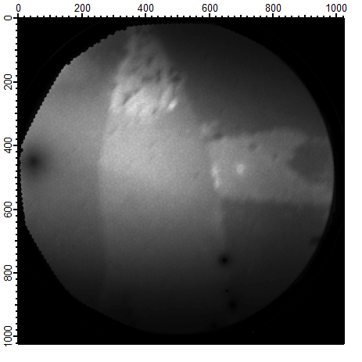
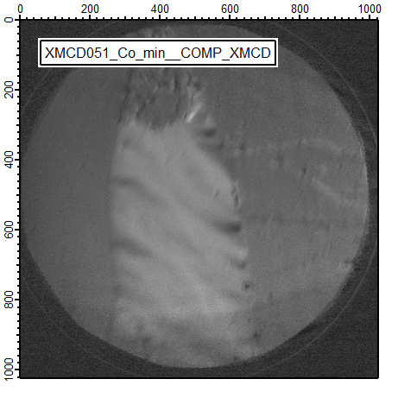
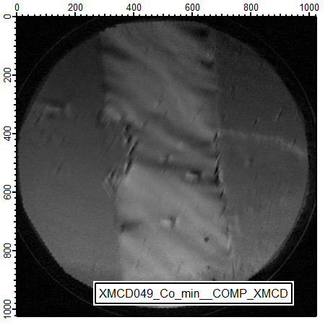
For the future: using in-plane electrodes
18
With I. Fina (MPI Halle, ICMAB-CSIC)

Slide 19
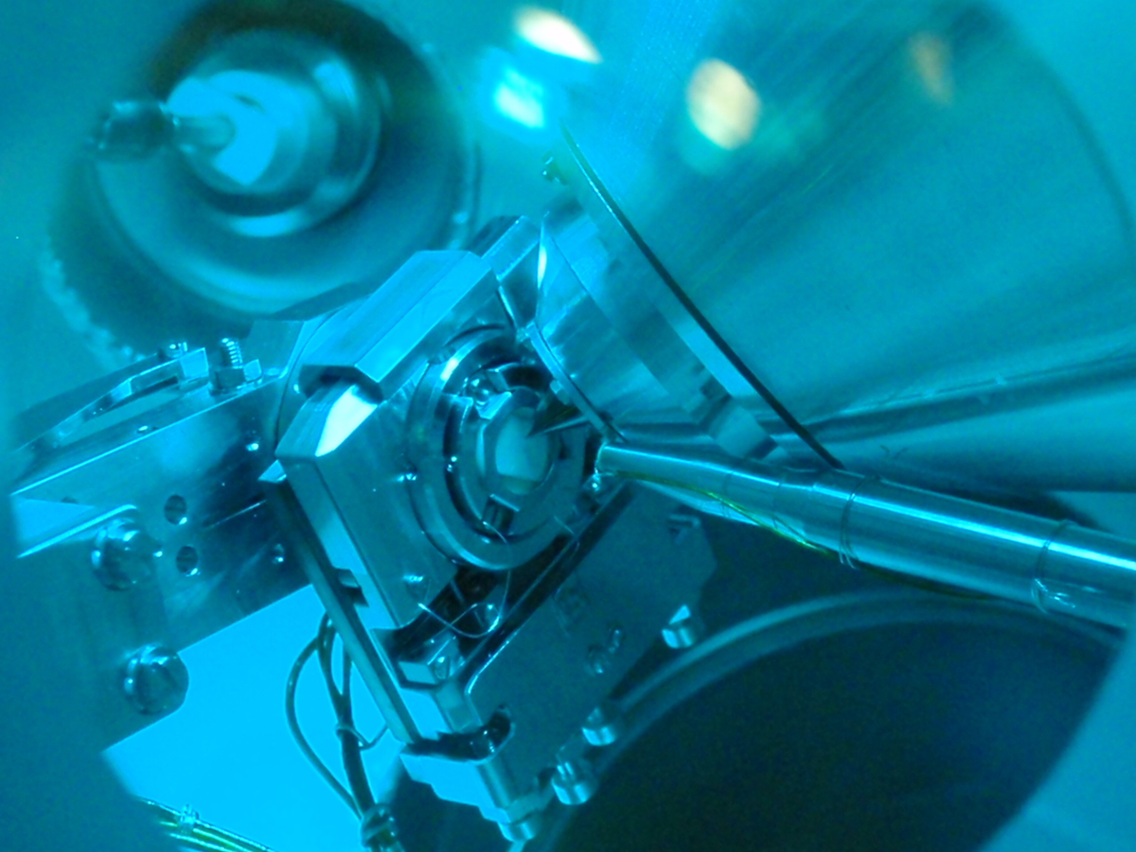
19
NAPP

Slide 20
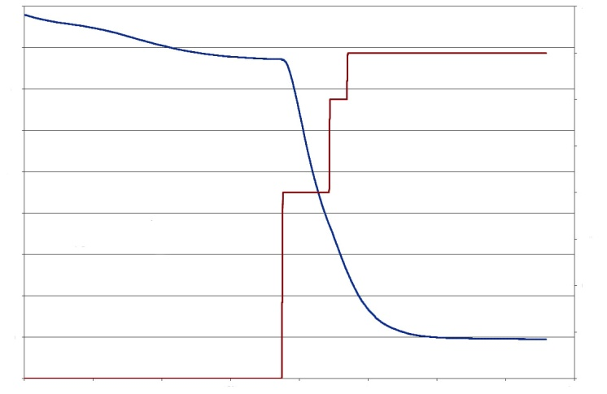
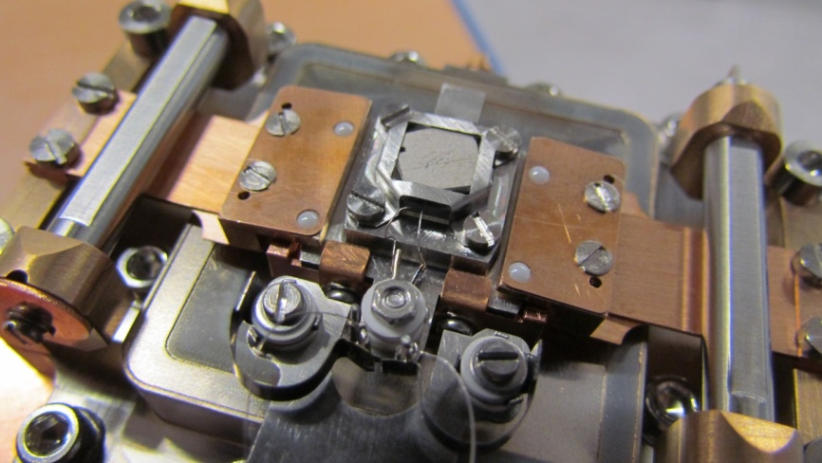
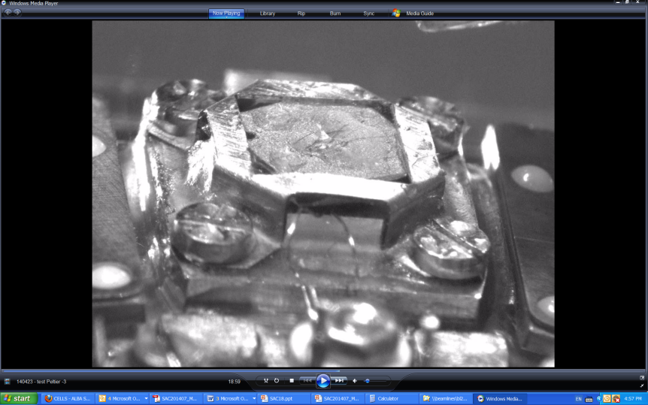
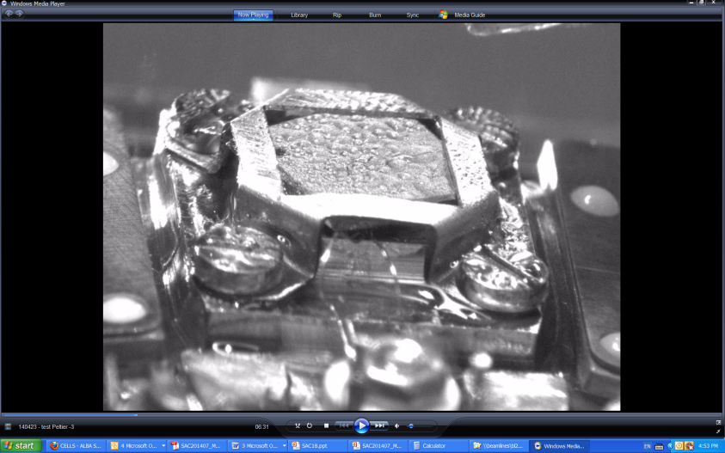
Peltier cooling manipulator delivered
20
FAT Dec 2013
In UHV
290
285
1.75
280
1.50
275
Sample T(K)
1.25
T (K)
270
1.00
I (A)
265
260
0.75
255
Peltier Current (A)
0.50
250
0.25
245
3000
0
1000
2000
4000
Time (s)
SAT April 2014
Lowest T in UHV: -22.3 ºC in 10 min
Lowest T at P=1 mbar : -13 ºC in 10 min

Slide 21
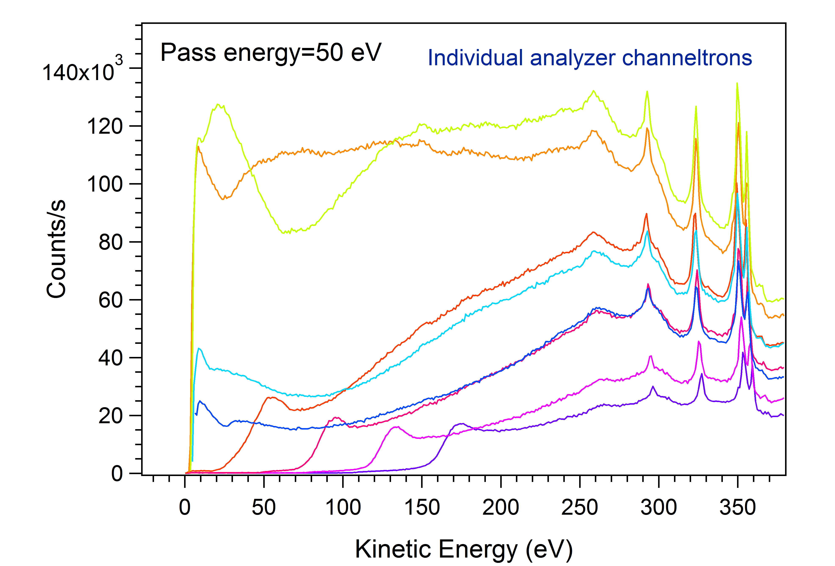
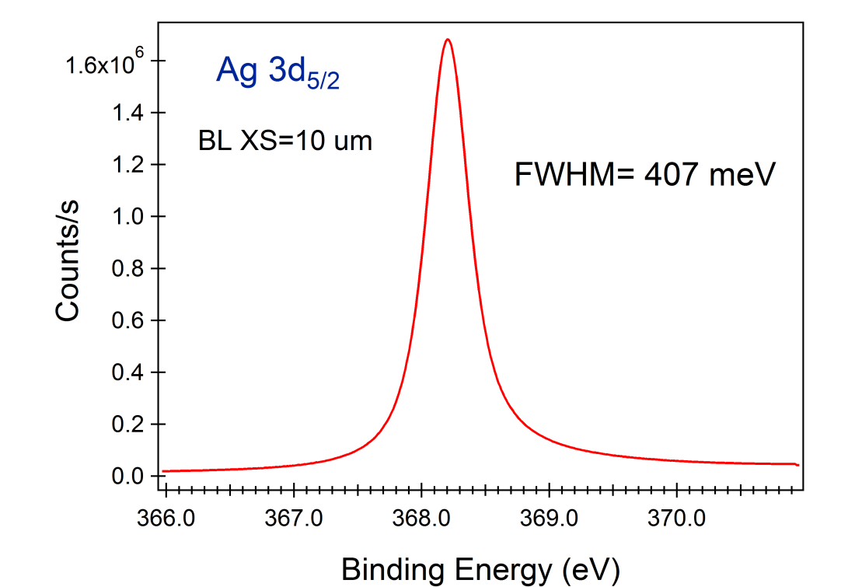
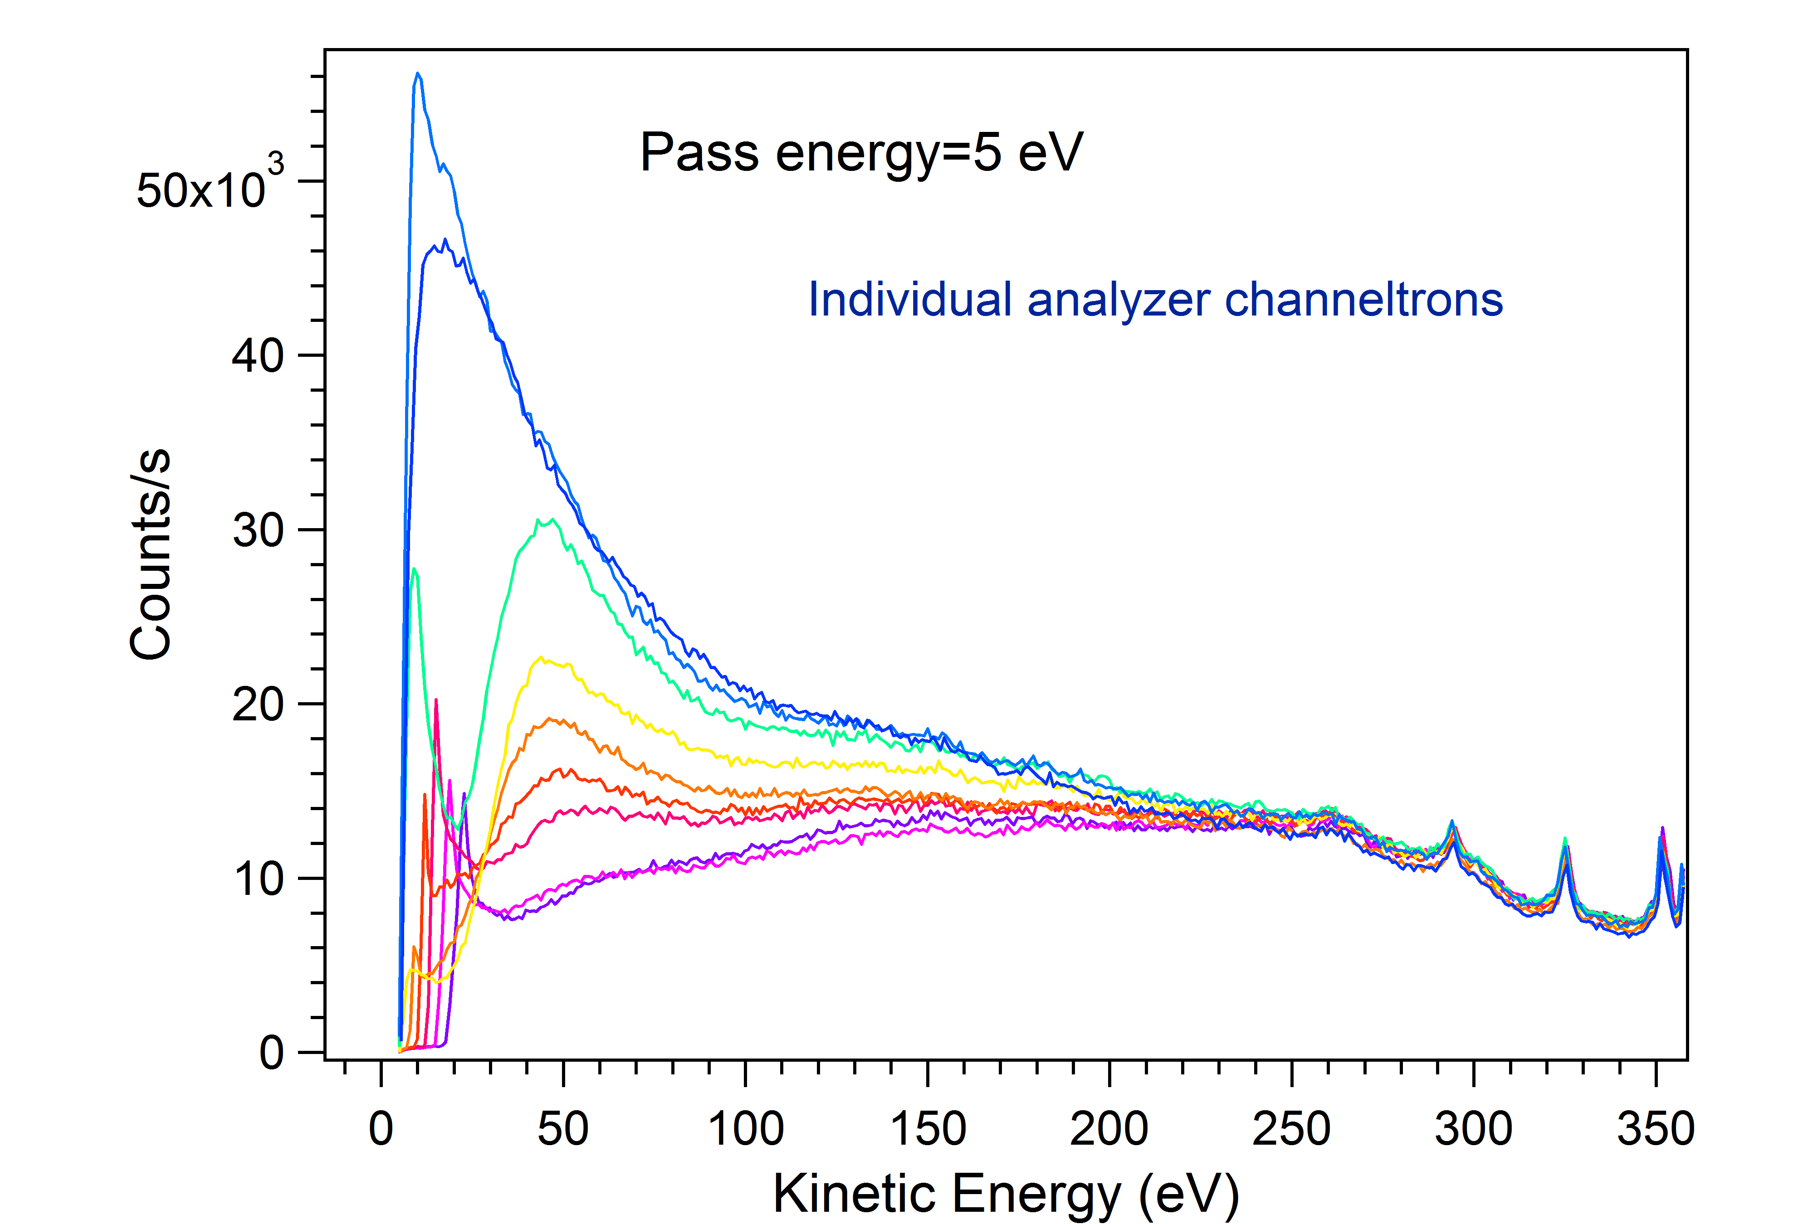
Analyzer commissioning
21
Remarkable count rate increase:
issue with slits solved/nozzle exchanged
- NAPP Prelens very sensitive to low retarding ratios

Slide 22
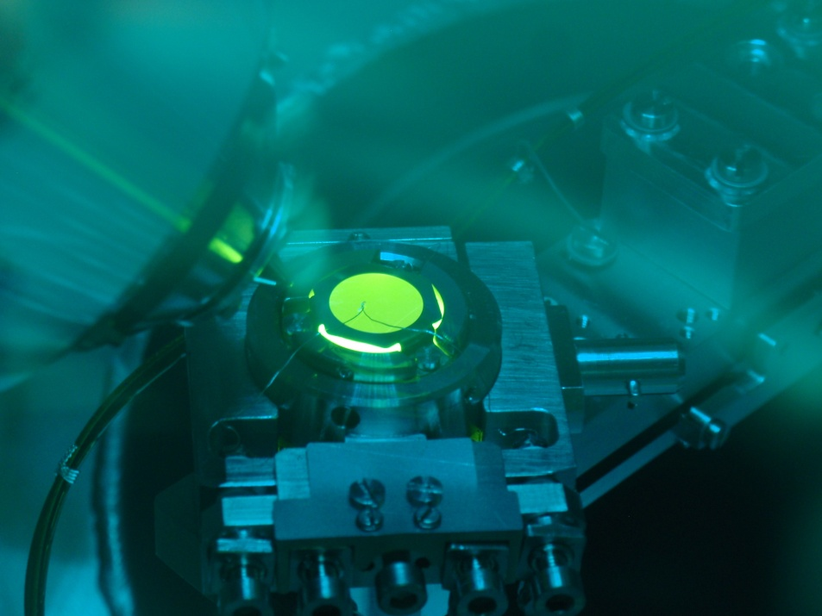
C&C and Electronics Highlights
Heating remote control with button heater. With laser heater, in
progress (A. Fontsere)
Implementing NEXAFS scans with NAPP analyzer in Auger mode
(F. Becheri and R. Homs)
Safety vacuum interlock system and vacuum tank system
(Electronics, Engineering)

Slide 23

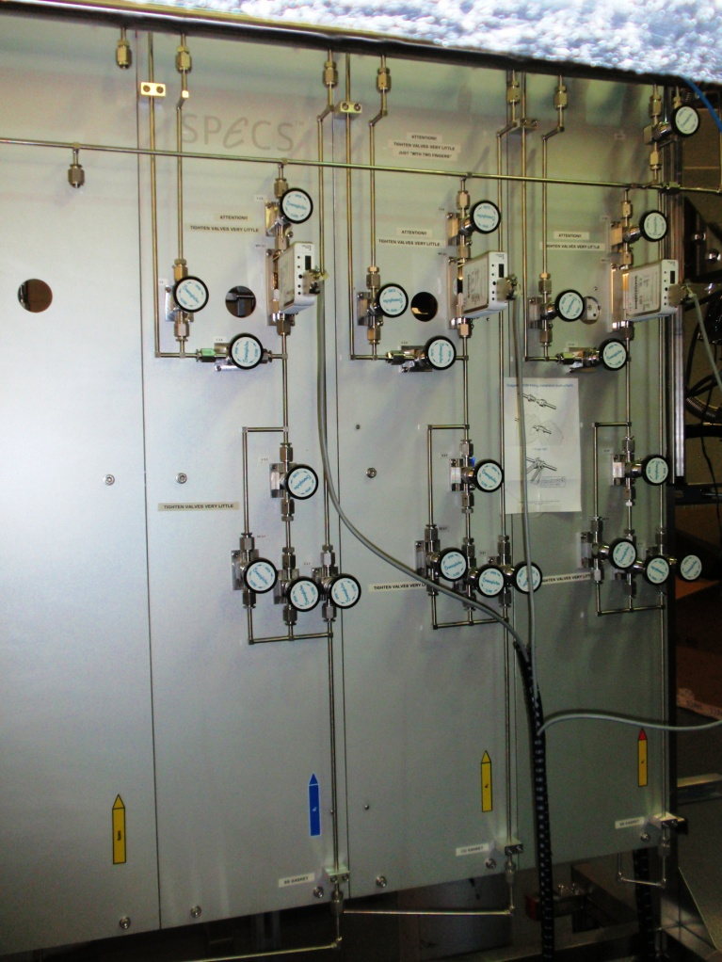
Puregas system
23
  Work under dynamic conditions with up to three different gases simultaneously (flow control from 0 to 30 mL/min for each gas)
  Gas lines for specific gases:
1) H₂ and hydrocarbons
2) inert gases
3) O₂/CO₂
Electro-polished pipe with the possibility to insert additional purifiers: low contamination level, down to ppb’s
In comissioning

Slide 24
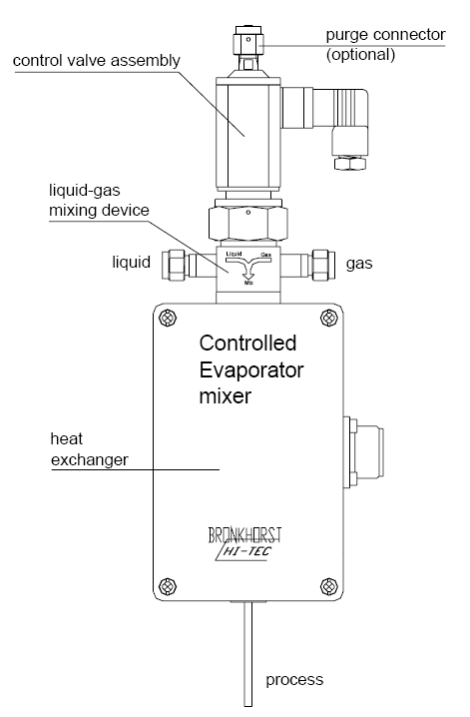


CEM system
(Controlled Evaporator and Mixer)
24
In comissioning
(Support by Francisco Trujillo)
  It enables to mix liquid flows of 0,25-5 g/h resulting in saturated vapour flows of up to 60 ml/min.
This system replace bubblers allowing more control

Slide 25



Liquid microjet system
25
Ordered
  Segregation phenomena of ions in solutions
  Adsorption of gas molecules on liquid films
  Electronic structure of biomolecules in water and other organic molecules in different solvents minimizing the potential beam damage
  Synergy with project for XFEL

Slide 26

RhPd-based catalysts for hydrogen production (UPC Barcelona)
26
Ethanol steam reforming
for H₂ generation
C₂H₅OH + 3 H₂O è 6 H₂ + 2 CO₂
Rearrangement of metals in NP´s
during catalytic reaction?
N. J. Divins, I. Angurell, C. Escudero, V. Perez-Dieste and J. Llorca (Submitted)
Pd and Rh 3d levels during reaction at different probe depth

Slide 27


27
Breathing chemistry
By courtesy of Dr. Celia Rogero (CSIC-UPV/EHU)
1 x 10^{–9} mbar
1 x 10^{–2} mbar (O₂)
7 x 10^{–10} mbar

Slide 28
Next steps/goals:
28
BL: Beam chopper and normalization at Carbon edge
BL: Continous energy scan (adapt from BOREAS)
NAPP: Commissioning of CEM and liquid microjet system
NAPP: Installation of a conventional X-ray source
NAPP: Integration of I₀ signal with SPECS software (NEXAFS & Top-up)
PEEM: reduce camera deadtime for single image (XAS/XPS)
PEEM: in-plane electrodes and current injection
PEEM: HF cable connections and electronics
Maintain oversupscription & develop user communities (e.g. workshops)
Solve contractual situation of BL staff (2 of 4)
BL- Scientists: Find more time for „scientific“ work (demanding experiments)
BL- Users: output in form of papers

Slide 29

29
Productivity and Output

Slide 30


User statistics – Call 2014
30
  Total 47 Proposals submitted: 810 shifts
  We foresee to be able to give 225 shifts to users only during the call period (5-12/2014)
  (NAPP and PEEM together)
  High oversubscription can cause frustation/pressure
(from 2014 Call Statistics provided by User Office)

Slide 31
User statistics: 2014 and before
31
 | PEEM – 2014 (May-December) | NAPP – 2014 (May-December) | PEEM – since 11/2012 | NAPP – since 9/2013
Beamtime (d) | 38 | 37 | 51 | 12
Proposals (Groups) | 8(7) | 7(7) | 8(4) | 2(2)
Friendly (d) | 0 | 0 | 30 | 18
Follow-up proposals | 3 | 3 | - | -
User feedback
  Receiving LEEM users and in-House collaborators
Countless days of experiment preparation & in-situ sample preparation

Slide 32
User feedback
32
2013 Statistics kindly provided by User Office

Slide 33
User feedback
33
- “do not allow to do absorption measurements on C K-edge”
- “The beamline status needs to be improved and optimized.”
- I have to emphasize the excellent support from the Circe beamline scientist and beamline staff
- The support of the beam team was excellent.
2013 Statistics kindly provided by User Office

Slide 34
Publications and Confs.
34
Publications in 2013 & 2014:
  One paper about NAPP endstation (J. Phy. Conf. Ser.): (1)
  Other publications by BL staff (still without ALBA data): (14)
2014 Conference contributions and Talks with ALBA data: (13)
Current paper drafts with ALBA data in progress/submitted: (4)
Workshops are organized on annual basis

Slide 35


1000th ALBA user
35
From: OkDork by Noah Gordon
Keep in mind: Continued, strong efforts are needed for further improvements.
Reaching maturity as an infrastructure, indicated by small „coincidences“:
  damaged ICs (discharge) were exchanged in 2 hours
  Fully functional but slow software was discarded for new one
  User comments: „Your crane drivers are more respectful to the experiments than in other synchrotrons“
  User support over telephone

Slide 37
Detailed publication list 2013/2014 – CIRCE BL Staff
(With and without ALBA affiliation)
S. Finzio, M. Foerster, et al., Phys. Rev. App. 1, 021001 (2014)
M. Foerster, et al., Appl. Phys. Lett. 104, 072410 (2014)
T. O. Mentes, A. Locatelli, L. Aballe, L.; et al. Ultramicroscopy 130, 82 (2013)
V. Pérez-Dieste, L. Aballe, S. Ferrer, J. Nicolàs, C. Escudero, A. Milán, E. Pellegrin , J. Phys.: Conf. Series 425, 072023 (2013)
S. Finizio, M. Foerster et al., SPIN 03, 1340008 (2013)
C. Escudero et al., Journal of Synchrotron Radiation , 20, 504 -- 508 (2013)
Z. El-Hachemi, C. Escudero et al, Journal of Materials Chemistry C 1, 3337 -- 3346 (2013)
S. Carenco, A. Tuxen, M. Chintapalli, E. Pach, C. Escudero, The Journal of Physical Chemistry C 117, 6259 -- 6266 (2013) .
J. M. Rebled, M. Foerster, et al., Phys. Chem. Chem. Phys., 2013,15, 18274-18280
C. Escudero, M. Salmeron, Surface Science 607, 2 -- 9 (2013)
T. Miyawaki, M. Foerster, et al., J. Appl. Phys. 114, 073905 (2013)
R.M. Reeve, C. Mix, M. König, M. Foerster, G. Jakob, and M. Kläui, Appl. Phys. Lett. 102, 122407 (2013)
Wohlhüter, J. Rhensius, C.A.F. Vaz, J. Heidler, H.S. Körner, A. Bisig, M. Foerster, L. Mechin, F. Gaucher, A. Locatelli, M.A. Nino, A. El Moussaoui, E. Goering, L.J. Heyderman, and M. Kläui, J. Phys.: Condens. Matter 25, 176004 (2013)
A. Tuxen, S. Carenco, M. Chintapalli, C.-H. Chuang, C. Escudero, et al., Journal of the American Chemical Society 135, 2273 -- 2278 (2013)
(Conferences Contributions 2014)
ORAL PRESENTATION Tailor 2014 workshop: N.J. Divins, C. Escudero, V. Pérez-­-Dieste, J. Llorca.
INVITED PRESENATION ICCC-41: J. Veciana, I. Ratera, Souto, M., Morales, D., Pérez-Dieste, V., Escudero, C., et al. .
Abstract IPS-20, V. A. de la Peña O'Shea , L. Collado, J. Fermoso, V. Perez-Dieste, C. Escudero, J. M. Coronado, D. P. Serrano.
6 abstracts for LEEM/PEEM 2014 with ALBA data (L. Martin, T. Schmidt, J. Figuera, L. Aballe, M. Foerster, CIRCE)
Abstract TMRC 2014 (J. Figuera)
Abstract GEFES 2014 (L. Martin)
Talk at FyT 2014 (L. Aballe, CIRCE)
Invited talk at Nanoselect-Consolider meeting 2014 (L. Aballe, CIRCE)

